Slide 1
Welcome to
Unit 10 Part 20
MATH366 Probability and Statistics
https://online.stanford.edu/sites/default/files/styles/figure_default/public/2018-04/theory-of-probability_stats116.jpg?itok=ms4fRMO-

Slide 2
What’s Up?
Today we will be going over:
Review of “t” and “p” Confidence Intervals
New: Quality/process control

Slide 3
What’s Up?
Outcome 5) Calculate the parameters of continuous random variable distributions and compute the probability of events in a typical continuous event application
Outcome 6) Computation of calculus of these parameters will be assisted with math software

Slide 4

Review
https://www.istockphoto.com/photo/silhouette-of-lonely-businessman-standing-by-boardroom-table-in-office-gm157640817-13923812

Slide 5
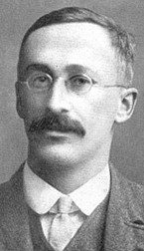
t Confidence Intervals
Mr. Gossett invented a new continuous probability distribution for small samples from close-to-normal populations
https://upload.wikimedia.org/wikipedia/commons/thumb/4/42/William_Sealy_Gosset.jpg/800px-William_Sealy_Gosset.jpg
W.S. Gosset 1908

Slide 6
t Confidence Intervals
He called this the “t” (always small letter) distribution because he was using it to compare two groups (“t” for two)
This distribution is called
“Student’s t-Distribution”

Slide 7
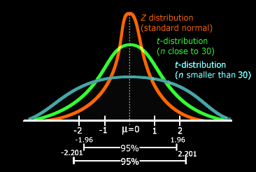
t Confidence Intervals
The thick tails of the “t” ensure that the confidence intervals are wider than those using a standard normal distribution (and are
better at including
the population
mean)
https://towardsdatascience.com/everything-you-need-to-know-about-hypothesis-testing-part-i-4de9abebbc8a

Slide 8
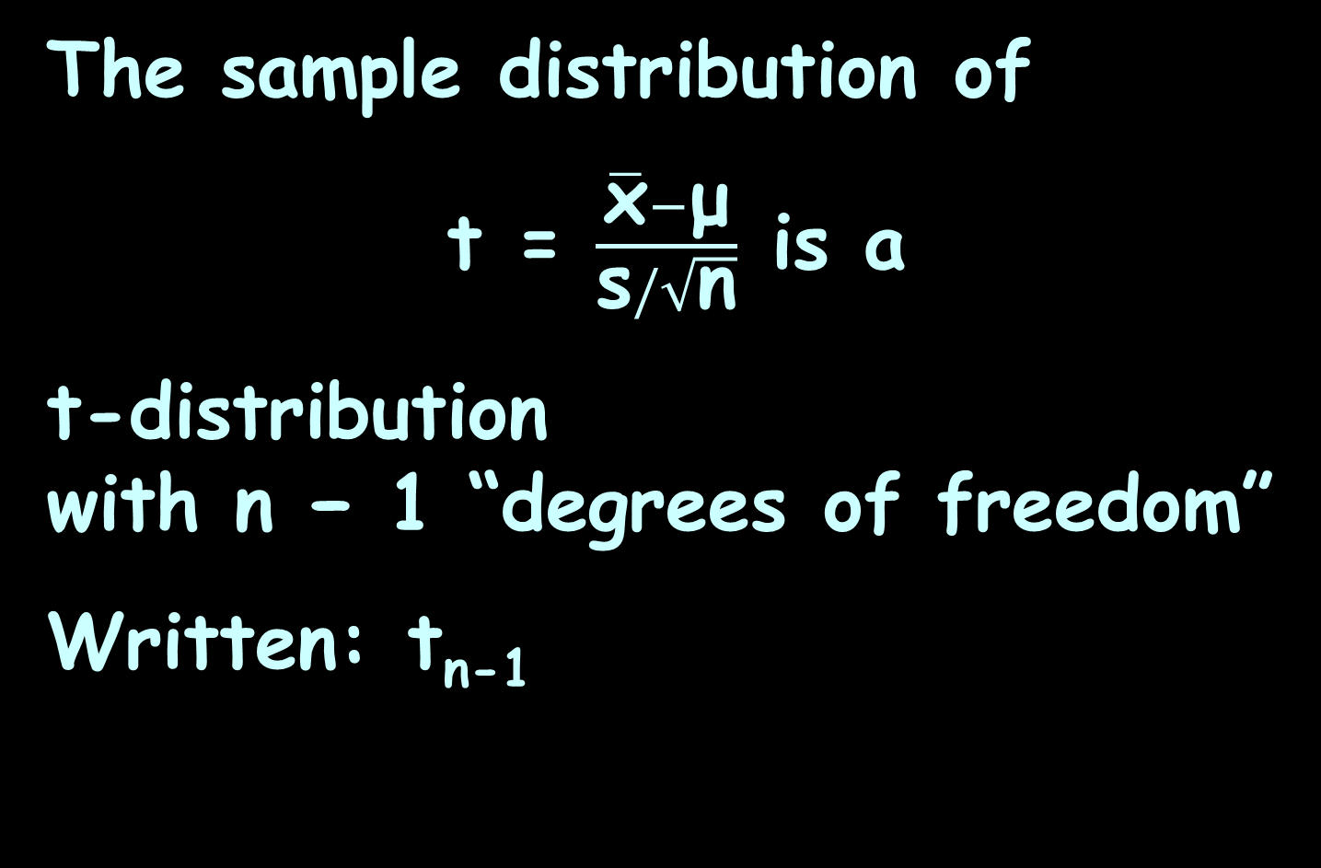
t Confidence Intervals
The sample distribution of
t = $\frac{\overline{\text{x}}−\text{μ}}{\text{s}/\sqrt{\text{n}}}$ is a
t-distribution
with n − 1 “degrees of freedom”
Written: t_{n-1}

Slide 9
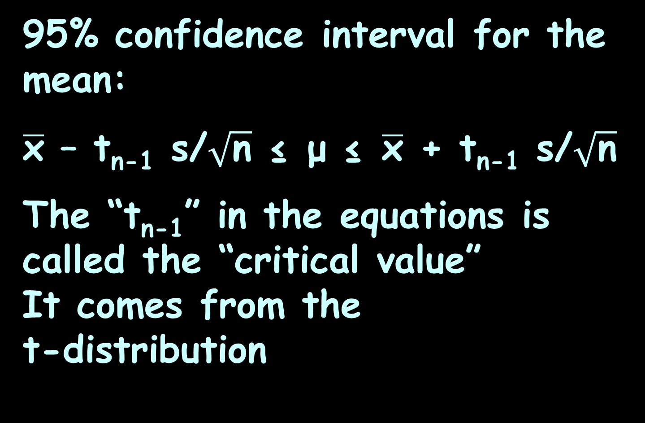
t Confidence Intervals
95% confidence interval for the mean:
$\overline{\text{x}}$ – t_{n-1} s/$\sqrt{\text{n}}$ ≤ μ ≤ $\overline{\text{x}}$ + t_{n-1} s/$\sqrt{\text{n}}$
The “t_{n-1}” in the equations is called the “critical value”
It comes from the
t-distribution
https://towardsdatascience.com/everything-you-need-to-know-about-hypothesis-testing-part-i-4de9abebbc8a

Slide 10
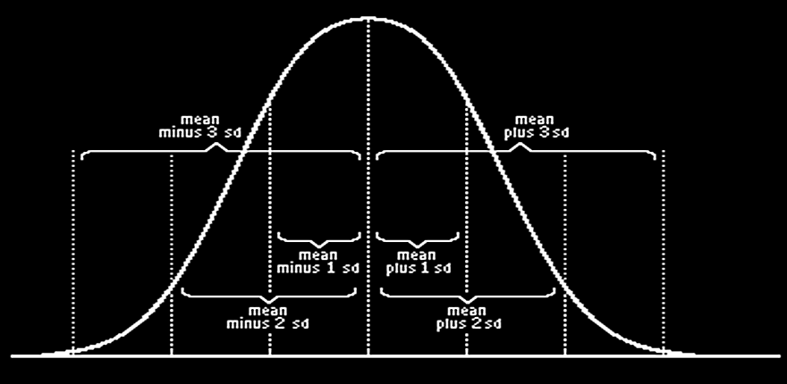
CI for Proportions
For proportions we’ll use the normal curve for proportions:
$\hat{\text{p}}$-3$\sqrt{\frac{\text{p}\text{q} }{\text{n} }}$ $\hat{\text{p}}$-2$\sqrt{\frac{\text{p}\text{q} }{\text{n} }}$ $\hat{\text{p}}$-$\sqrt{\frac{\text{p}\text{q} }{\text{n} }} \hat{\text{p}} \hat{\text{p}}+\sqrt{\frac{\text{p}\text{q} }{\text{n} }}$ $\hat{\text{p}}$+2$\sqrt{\frac{\text{p}\text{q} }{\text{n} }}$ $\hat{\text{p}}$+3$\sqrt{\frac{\text{p}\text{q} }{\text{n} }}$
VFrench, 2017

Slide 11
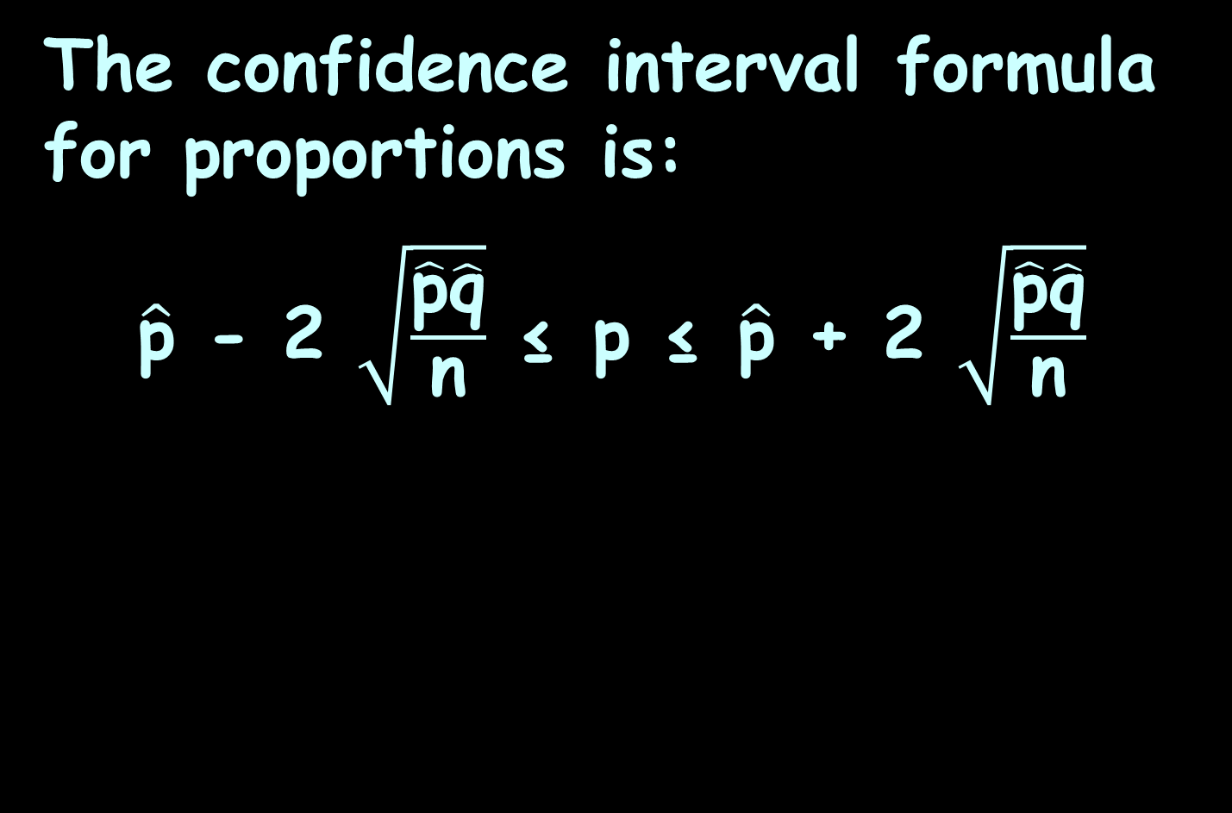
CI for Proportions
The confidence interval formula for proportions is:
$\hat{\text{p}}$ - 2 $\sqrt{\frac{\hat{\text{p}}\hat{\text{q}}}{\text{n}}}$ ≤ p ≤ $\hat{\text{p}}$ + 2 $\sqrt{\frac{\hat{\text{p}}\hat{\text{q}}}{\text{n}}}$

Slide 12
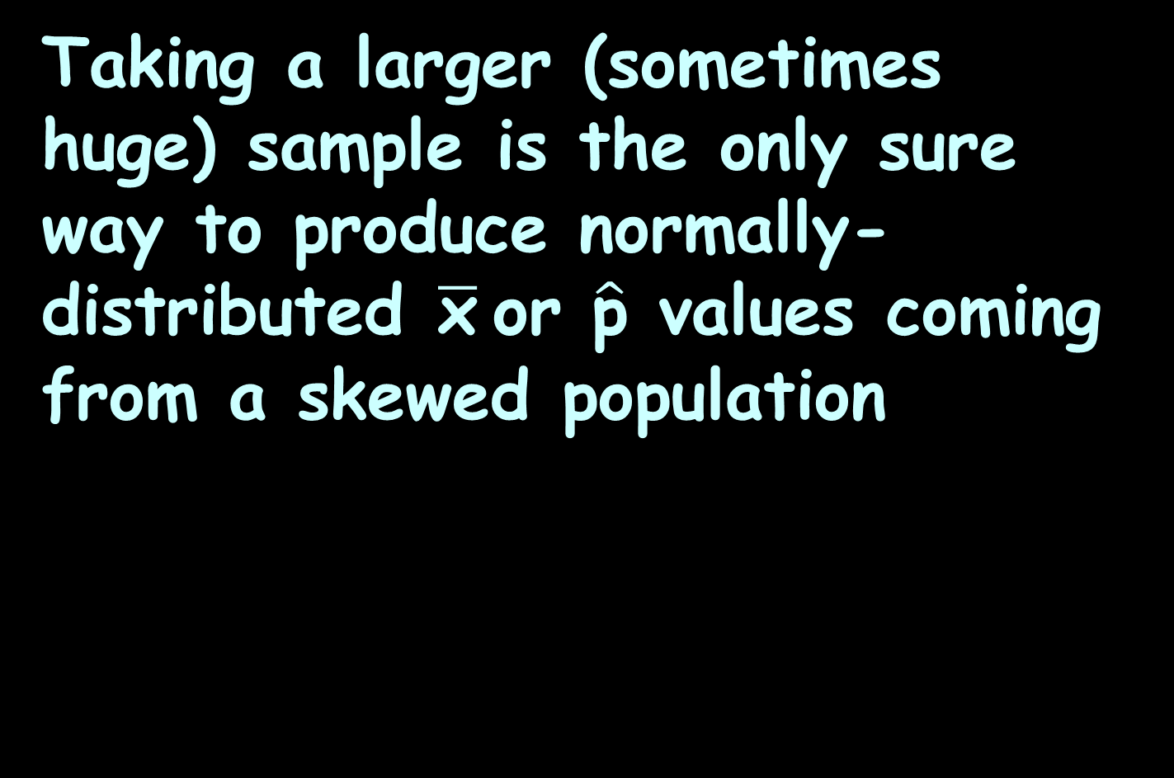
Confidence Intervals for Skewed Data
Taking a larger (sometimes huge) sample is the only sure way to produce normally-distributed $\overline{\text{x}}$or $\hat{\text{p}}$ values coming from a skewed population

Slide 13
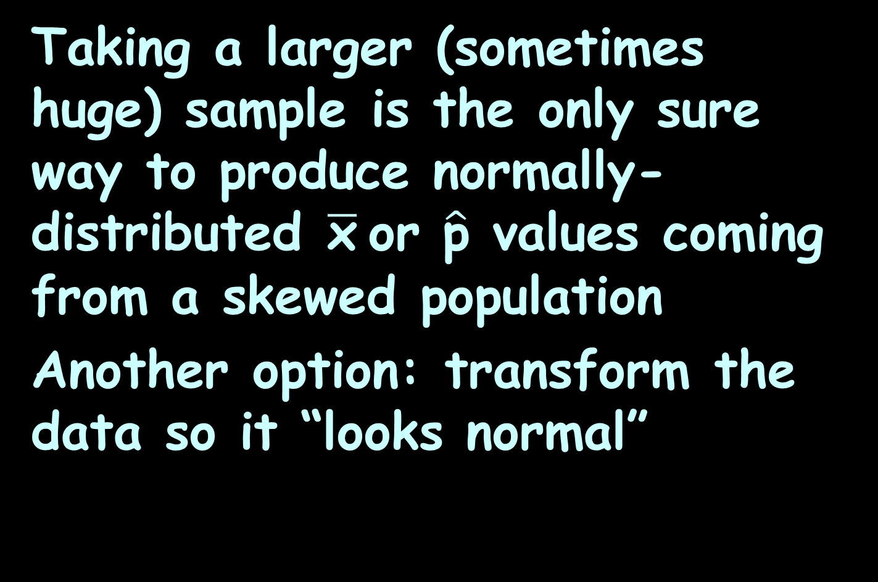
Confidence Intervals for Skewed Data
Taking a larger (sometimes huge) sample is the only sure way to produce normally-distributed $\overline{\text{x}}$or $\hat{\text{p}}$ values coming from a skewed population
Another option: transform the data so it “looks normal”

Slide 14
Confidence Intervals for Skewed Data
One popular transformation is to take the natural logarithm (ln) of the data

Slide 15
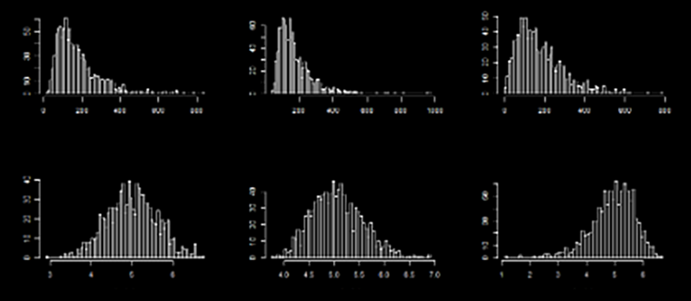
Confidence Intervals for Skewed Data
Sorry – really horrible pic…
pretty close to normal
not quite enough
too much!
https://stats.stackexchange.com/questions/107610/what-is-the-reason-the-log-transformation-is-used-with-right-skewed-distribution

Slide 16

Questions?
http://i.imgur.com/aliTlT3.jpg

Slide 17
Process Control
Process control is the ability to monitor and adjust a process to give a desired output

Slide 18
Process Control
Process control is the ability to monitor and adjust a process to give a desired output
It is also called “quality engineering”

Slide 19
Process Control
It is used in industry to maintain quality and improve performance

Slide 20
Process Control
An example of a simple process that is controlled is keeping the temperature of a room at a certain temperature using a heater, air conditioner, and a thermostat

Slide 21
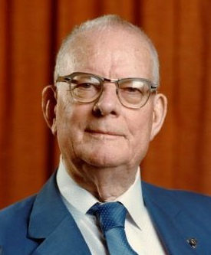
Process Control
W. Edwards Deming brought process control to Japanese factories during the US occupation after WWII
https://www.strategyandcomplexity.guide/wp-content/uploads/2019/09/
Deming.jpg

Slide 22
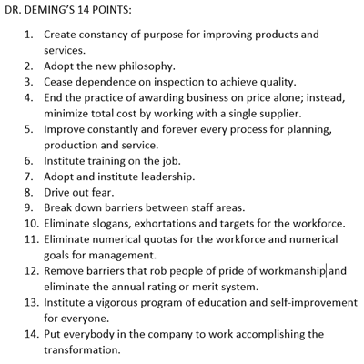
Process Control
https://www.infinityqs.com/blog/deming-14-points-part-one

Slide 23
Process Control
A central pillar of his managerial philosophy is that the problem is not the people… it’s the process

Slide 24
Process Control
Deming tried to get his ideas adopted in America, but they fell largely on deaf ears with post-war American industrialists

Slide 25
Process Control
It wasn’t until Japanese industry became a threat to US industry in the 1980s that Deming’s ideas came to America

Slide 26
Process Control
An interesting feature is that many of the QC instructors visiting US plants emphasize the problem is the workers, not the process!

Slide 27
Process Control
Deming quotes:
You cannot inspect quality into a product.
Eliminate the need for inspection on a mass basis by building quality into the product in the first place.

Slide 28
Process Control
In a factory or other system, there is a process that creates products

Slide 29
Process Control
Data taken over time at different parts of the process can be used to detect problems, inefficiencies, and deteriorations

Slide 30
Process Control
Data taken over time at different parts of the process can be used to detect problems, inefficiencies, and deteriorations
These are called process data

Slide 31
Process Control
Process data typically change over time and are arranged according to time sequence

Slide 32
Process Control
They measure characteristics of goods or services resulting from equipment, people, materials, methods, and other business conditions

Slide 33
Process Control
To build quality into the products, control charts are used to monitor changing process data characteristics over time

Slide 34
Process Control
These charts allow us to determine whether some process is statistically stable (or within statistical control)

Slide 35
Process Control
A control chart is a sequential plot of individual process data values over time
The vertical axis is used for the data values
The horizontal axis is used for the time sequence

Slide 36
Process Control
A process is statistically stable (or within statistical control) if it has natural variation, with no patterns, cycles, or any unusual points

Slide 37
Process Control
Only when a process is statistically stable can we assume the population has a constant mean, standard deviation, distribution, and other characteristics

Slide 38
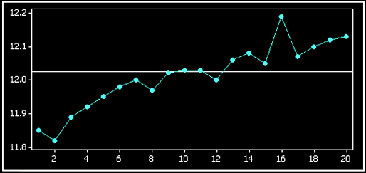
PROCESS CONTROL
PROJECT QUESTION 1a
Processes That Are Not Statistically Stable
How is this not stable?
VFrench, 2016

Slide 39
PROCESS CONTROL
PROJECT QUESTION 1a
There is an upward trend
VFrench, 2016

Slide 40
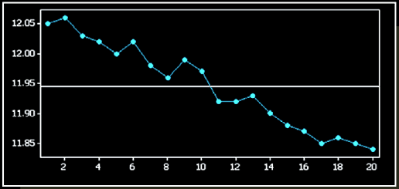
PROCESS CONTROL
PROJECT QUESTION 1b
Processes That Are Not Statistically Stable
How is this not stable?
VFrench, 2016

Slide 41
PROCESS CONTROL
PROJECT QUESTION 1b
There is a downward trend
VFrench, 2016

Slide 42
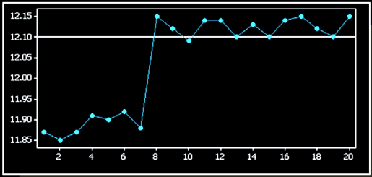
PROCESS CONTROL
PROJECT QUESTION 1c
Processes That Are Not Statistically Stable
How is this not stable?
VFrench, 2016

Slide 43
PROCESS CONTROL
PROJECT QUESTION 1c
There is an upward shift
VFrench, 2016

Slide 44
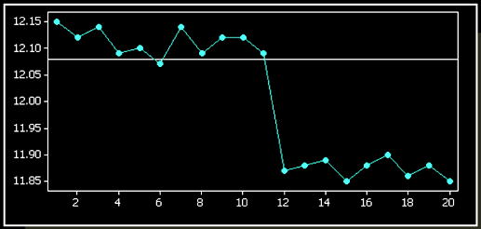
PROCESS CONTROL
PROJECT QUESTION 1d
Processes That Are Not Statistically Stable
How is this not stable?
VFrench, 2016

Slide 45
PROCESS CONTROL
PROJECT QUESTION 1d
There is a downward shift
VFrench, 2016

Slide 46
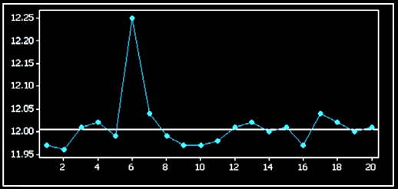
PROCESS CONTROL
PROJECT QUESTION 1e
Processes That Are Not Statistically Stable
How is this not stable?
VFrench, 2016

Slide 47
PROCESS CONTROL
PROJECT QUESTION 1e
The process is stable except for one exceptionally high value
VFrench, 2016

Slide 48
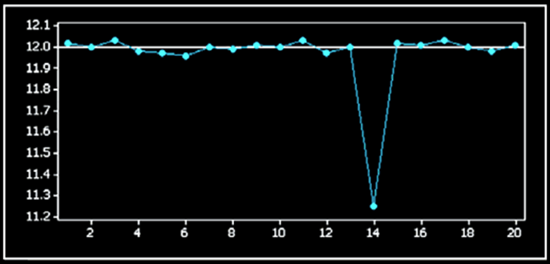
PROCESS CONTROL
PROJECT QUESTION 1f
Processes That Are Not Statistically Stable
How is this not stable?
VFrench, 2016

Slide 49
PROCESS CONTROL
PROJECT QUESTION 1f
There is one exceptionally low value
VFrench, 2016

Slide 50
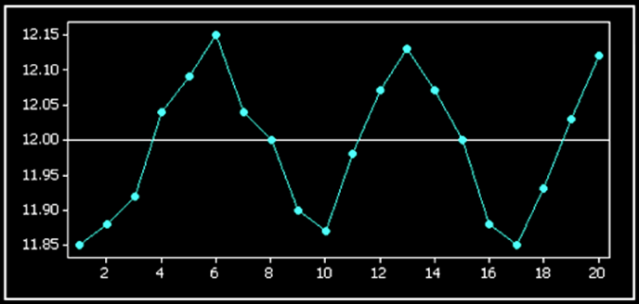
PROCESS CONTROL
PROJECT QUESTION 1g
Processes That Are Not Statistically Stable
How is this not stable?
VFrench, 2016

Slide 51
PROCESS CONTROL
PROJECT QUESTION 1g
There is a cyclical pattern (repeating cycle)
VFrench, 2016

Slide 52
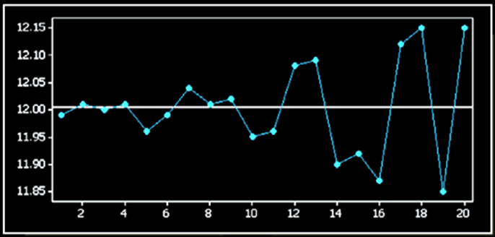
PROCESS CONTROL
PROJECT QUESTION 1h
Processes That Are Not Statistically Stable
How is this not stable?
VFrench, 2016

Slide 53
PROCESS CONTROL
PROJECT QUESTION 1h
The variation is increasing over time
VFrench, 2016

Slide 54
Questions?
http://i.imgur.com/aliTlT3.jpg

Slide 55
Process Control
Anybody do this at work?

Slide 56
Questions?
http://i.imgur.com/aliTlT3.jpg

Slide 57
Process Control
The goal of quality control
is to:
reduce variation in a product or a service

Slide 58
Process Control
Random variation is due to chance; it is inherent in any process – it would be impossible to produce every good or service exactly the same way every time

Slide 59
Process Control
Assignable variation results from causes that can be identified (such as defective machinery, untrained employees, and so on)

Slide 60
Process Control
A control chart of a process characteristic consists of values plotted sequentially over time

Slide 61
Process Control
An X-Bar and R-Chart is a type of statistical process control chart for use with continuous data collected in subgroups at set time intervals - usually between 3 to 5 pieces per subgroup

Slide 62
Process Control
The Mean (X-Bar) of each subgroup is charted on the top graph and the Range (R) of the subgroup is charted on the bottom graph

Slide 63
Process Control
Out of Control points or patterns can occur on either the X-bar or R chart

Slide 64
Process Control
An X-Bar and R-Chart is used to answer the questions:
• Is the process stable over time?
• What is the effect of a process change on the output characteristics?

Slide 65
Process Control
An X-Bar and R-Chart is used to answer the questions:
• How will I know if the process becomes unstable, or the performance changes over time?

Slide 66
Process Control
When is it used?
• Constructed throughout the
process, particularly in the Measure, Analyze and Control phases of the cycle
• Used to understand process
behavior, evaluate different
treatments or methods, and to
control a process

Slide 67
Process Control
It is recommended for subgroup sizes of 10 or less
If the subgroup size exceeds 10, the range chart is replaced by a chart of the subgroup standard deviation, or S chart

Slide 68
Process Control
A control chart of a process plots values sequentially over time, and it includes a center line as well as a lower control limit (LCL) and an upper control limit (UCL)

Slide 69
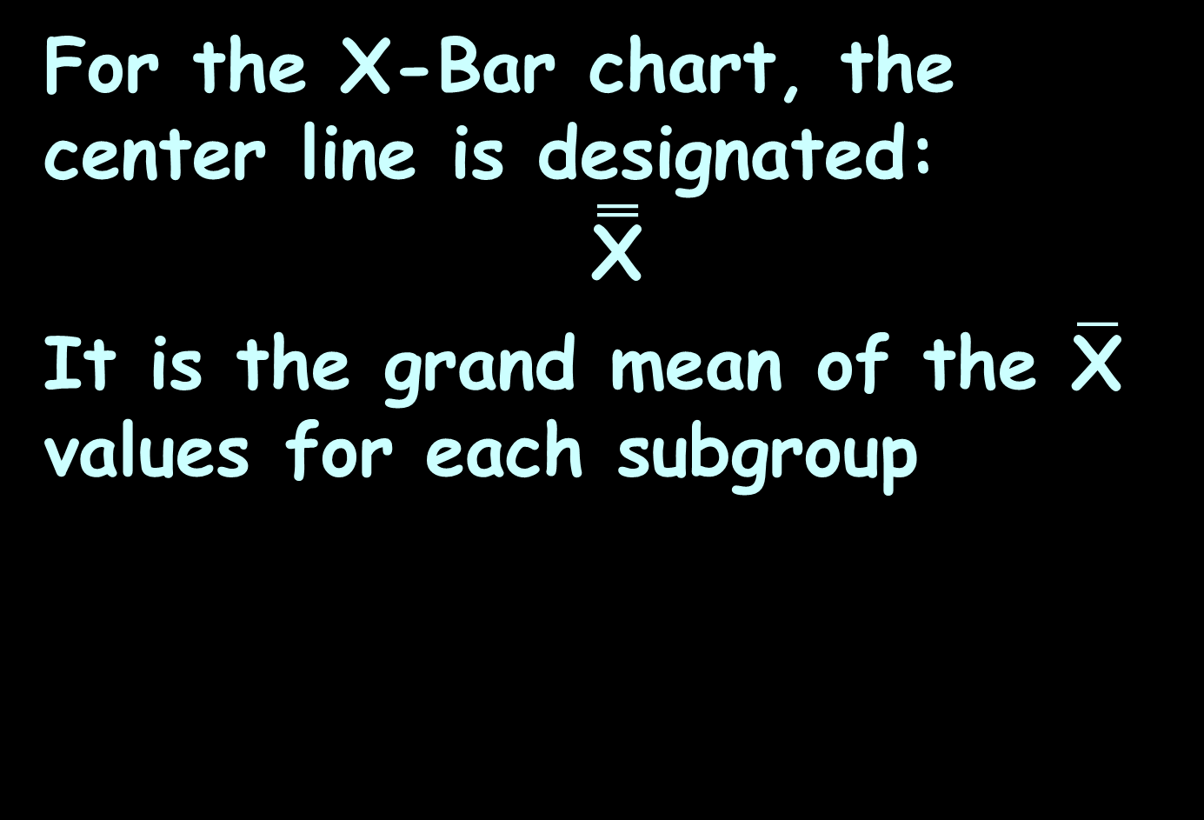
Process Control
For the X-Bar chart, the center line is designated:
$$\overset{̿}{\text{X}}$$
It is the grand mean of the $\overline{\text{X}}$ values for each subgroup

Slide 70
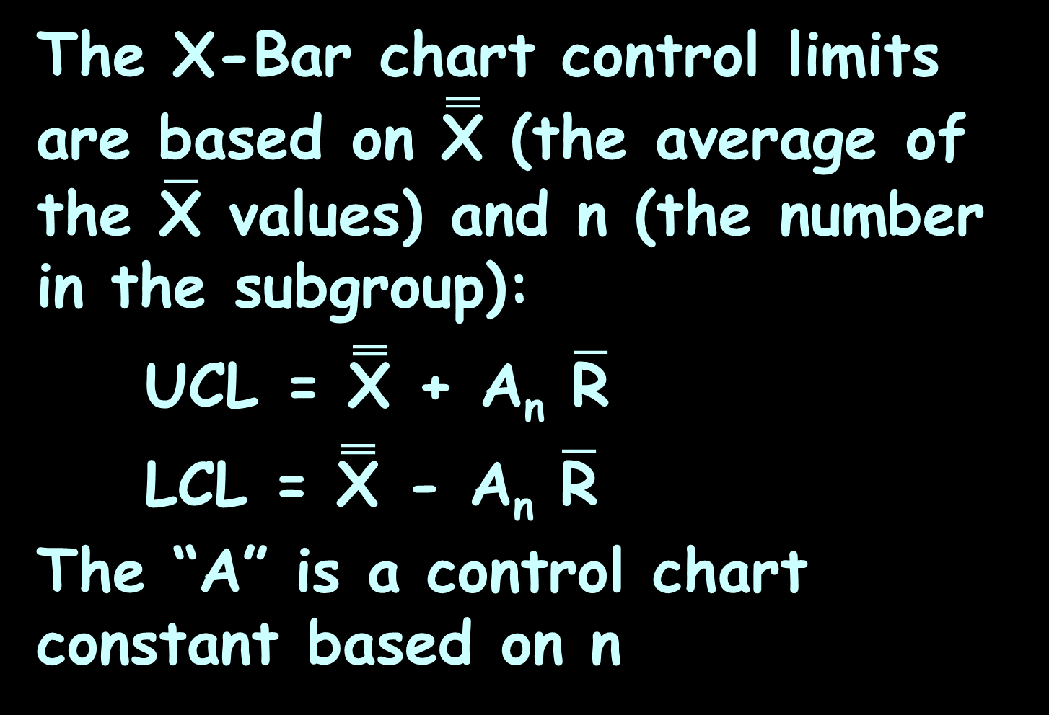
Process Control
The X-Bar chart control limits are based on $\overset{̿}{\text{X}}$ (the average of the $\overline{\text{X}}$ values) and n (the number in the subgroup):
UCL = $\overset{̿}{\text{X}}$ + A_{n} $\overline{\text{R}}$
LCL = $\overset{̿}{\text{X}}$ - A_{n} $\overline{\text{R}}$
The “A” is a control chart constant based on n

Slide 71
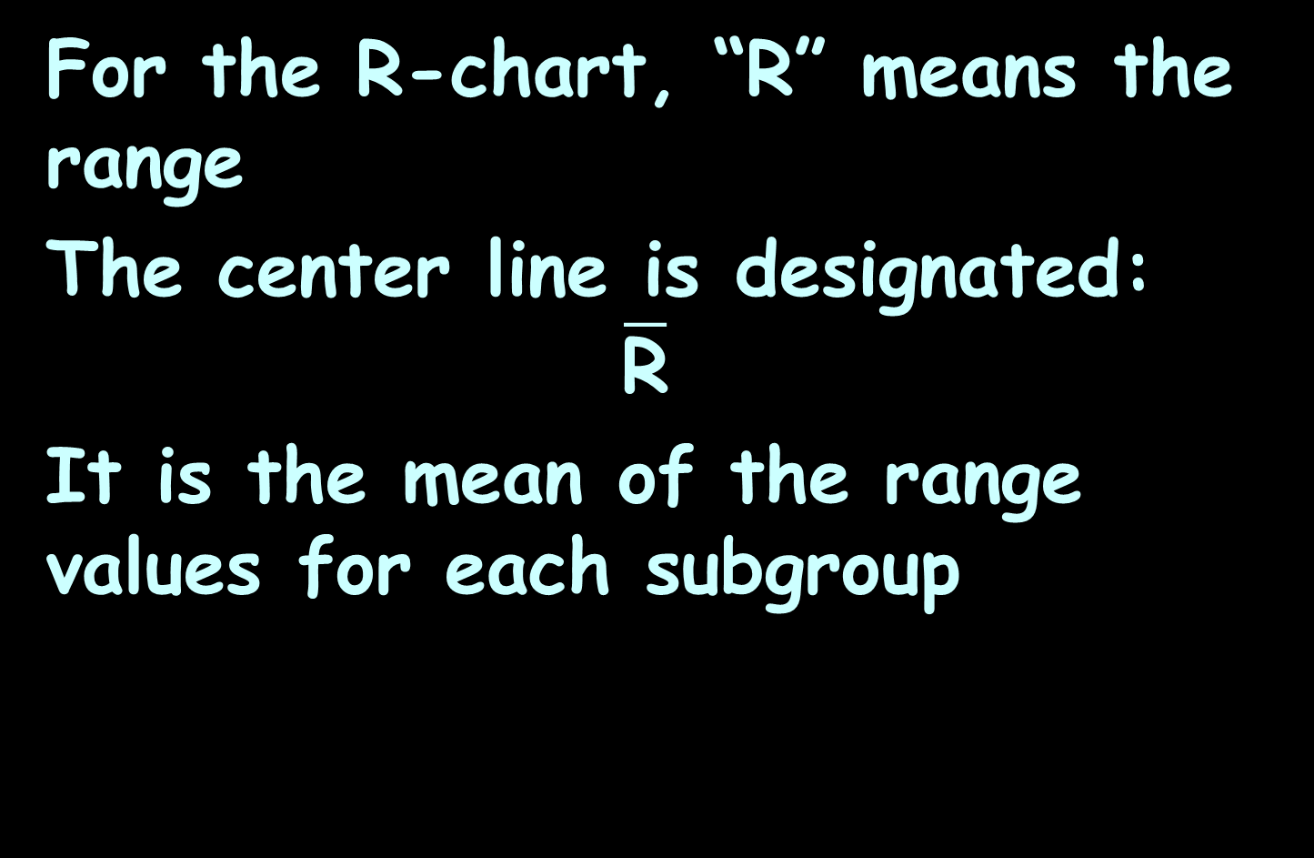
Process Control
For the R-chart, “R” means the range
The center line is designated:
$$\overline{\text{R}}$$
It is the mean of the range values for each subgroup

Slide 72
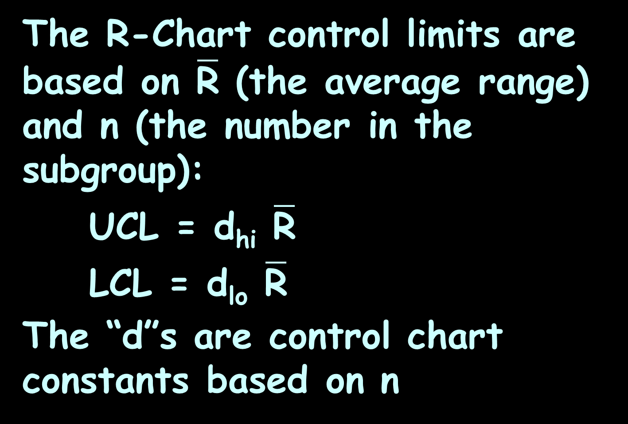
Process Control
The R-Chart control limits are based on $\overline{\text{R}}$ (the average range) and n (the number in the subgroup):
UCL = d_{hi} $\overline{\text{R}}$
LCL = d_{lo} $\overline{\text{R}}$
The “d”s are control chart constants based on n

Slide 73
Process Control
n | A_{n} | d_{lo} | d_{hi}
2 | 1.880 |  | 3.267
3 | 1.023 |  | 2.574
4 | 0.729 |  | 2.282
5 | 0.577 |  | 2.114
6 | 0.483 |  | 2.004
7 | 0.419 | 0.076 | 1.924
8 | 0.373 | 0.136 | 1.864
9 | 0.337 | 0.184 | 1.816
10 | 0.308 | 0.223 | 1.777
https://www.moresteam.com/university/workbook/wb_spcxbarandrintro.pdf

Slide 74
Process Control
Note: A_{n} is usually designated “A₂”
d_{lo} is usually designated “d₃”
d_{hi} is usually designated “d₄”

Slide 75
Questions?
http://i.imgur.com/aliTlT3.jpg

Slide 76
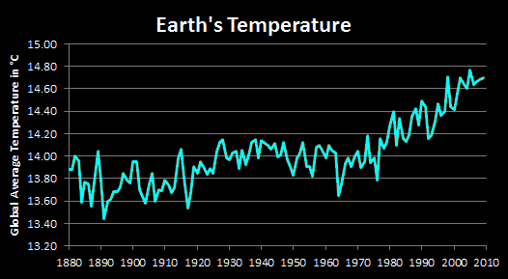
Process Control
Is it stable?
VFrench, 2016

Slide 77

PROCESS CONTROL
PROJECT QUESTION 2a,b
For the temperature of the Earth data, calculate the “$\overline{\text{X}}$”s and “R”s for each decade:
Decade | 0 | 1 | 2 | 3 | 4 | 5 | 6 | 7 | 8 | 9
1880s | 13.88 | 13.88 | 14.00 | 13.96 | 13.59 | 13.77 | 13.75 | 13.55 | 13.77 | 14.04
1890s | 13.78 | 13.44 | 13.60 | 13.61 | 13.68 | 13.68 | 13.73 | 13.85 | 13.79 | 13.76
1900s | 13.95 | 13.95 | 13.70 | 13.64 | 13.58 | 13.75 | 13.85 | 13.60 | 13.70 | 13.69
1910s | 13.79 | 13.74 | 13.67 | 13.72 | 13.98 | 14.06 | 13.80 | 13.54 | 13.67 | 13.91
1920s | 13.85 | 13.95 | 13.91 | 13.84 | 13.89 | 13.85 | 14.04 | 14.12 | 14.15 | 13.98
1930s | 13.97 | 14.03 | 14.04 | 13.89 | 14.05 | 13.92 | 14.01 | 14.12 | 14.15 | 13.98
1940s | 14.14 | 14.11 | 14.10 | 14.06 | 14.11 | 13.99 | 14.01 | 14.12 | 13.97 | 13.91
1950s | 13.83 | 13.98 | 14.03 | 14.12 | 13.91 | 13.91 | 13.82 | 14.08 | 14.10 | 14.05
1960s | 13.98 | 14.10 | 14.05 | 14.03 | 13.65 | 13.75 | 13.93 | 13.98 | 13.91 | 14.00
1970s | 14.04 | 13.90 | 13.95 | 14.18 | 13.94 | 13.98 | 13.79 | 14.16 | 14.07 | 14.13
1980s | 14.27 | 14.40 | 14.10 | 14.34 | 14.16 | 14.13 | 14.19 | 14.35 | 14.42 | 14.28
1990s | 14.49 | 14.44 | 14.16 | 14.18 | 14.31 | 14.47 | 14.36 | 14.40 | 14.71 | 14.44
2000s | 14.41 | 14.56 | 14.70 | 14.64 | 14.60 | 14.77 | 14.64 | 14.66 | 14.68 | 14.70

Slide 78


PROCESS CONTROL
PROJECT QUESTION 2c,d,e
Calculate $\overset{̿}{\text{X}}$, $\overline{\text{R}}$ and n
Calculate the upper and lower control limits
UCL = $\overset{̿}{\text{X}}$ + A_{n} $\overline{\text{R}}$
LCL = $\overset{̿}{\text{X}}$ - A_{n} $\overline{\text{R}}$

Slide 79

PROCESS CONTROL
PROJECT QUESTION 2f,g
Include an $\overset{̿}{\text{X}}$ column in the table
Include an $\overline{\text{R}}$ column in the table

Slide 80
PROCESS CONTROL
PROJECT QUESTION 2h,I,j,k
Calculate the UCL, LCL, RUCL, and RLCL columns in the table using the appropriate A_{n} d_{lo} and d_{hi} values

Slide 81
PROCESS CONTROL
PROJECT QUESTION 2l
Make an X-bar process control graph of this process

Slide 82
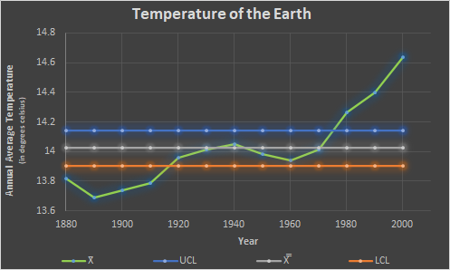
PROCESS CONTROL
PROJECT QUESTION 2l
X-Bar process control graph of the temperature of the Earth:
VFrench, 2022

Slide 83
PROCESS CONTROL
PROJECT QUESTION 2m
Make a process control R-Chart of this process

Slide 84
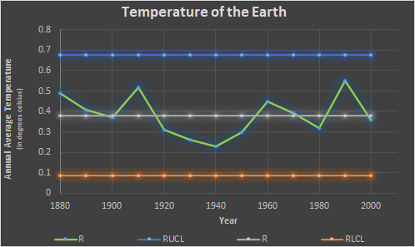
PROCESS CONTROL
PROJECT QUESTION 2m
Process control R-Chart of the temperature of the Earth:
VFrench, 2022

Slide 85
Questions?
http://i.imgur.com/aliTlT3.jpg

Slide 86
Process Control
When IS a Process Out of Statistical Control?
1. There is a pattern, trend, or cycle that is obviously not random

Slide 87
Process Control
When IS a Process Out of Statistical Control?
2. Run of 8 Rule: There are eight consecutive points all above or all below the center line

Slide 88
Process Control
When IS a Process Out of Statistical Control?
3. There is a point lying beyond the upper or lower control limits

Slide 89
PROCESS CONTROL
PROJECT QUESTION 2n
Is there is a pattern, trend, or cycle that is obviously not random?
VFrench, 2022

Slide 90
PROCESS CONTROL
PROJECT QUESTION 2n
Run of 8 Rule: Are there eight consecutive points all above or all below the center line?
VFrench, 2022

Slide 91
PROCESS CONTROL
PROJECT QUESTION 2n
Is there is a point lying beyond the upper or lower control limits?
VFrench, 2022

Slide 92
PROCESS CONTROL
PROJECT QUESTION 2n
Is this process in control?
VFrench, 2022

Slide 93
PROCESS CONTROL
PROJECT QUESTION 2n
Applying the three criteria:
There IS an obvious trend
There are not eight consecutive points all above or all below the centerline (yet)
Points lie outside of the region between the upper and lower control limits

Slide 94
PROCESS CONTROL
PROJECT QUESTION 2n
We conclude that this process is not within statistical control

Slide 95
PROCESS CONTROL
PROJECT QUESTION 2o
How about the R-Chart?
VFrench, 2022

Slide 96
PROCESS CONTROL
PROJECT QUESTION 2o
The variability is under control
VFrench, 2022

Slide 97
PROCESS CONTROL
PROJECT QUESTION 2o
Even though it looks volatile, it’s not TOO volatile!
VFrench, 2016

Slide 98
Questions?
http://i.imgur.com/aliTlT3.jpg

Slide 99
Process Control
OK… but where did these mysterious “A” and “d” values come from?

Slide 100
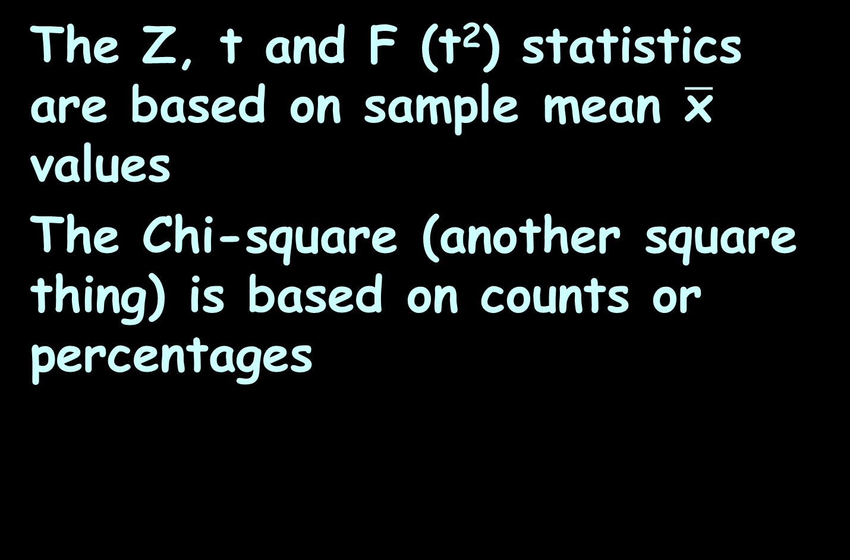
Process Control
The Z, t and F (t²) statistics are based on sample mean $\overline{\text{x}}$ values
The Chi-square (another square thing) is based on counts or percentages

Slide 101
Process Control
The A and d statistics are based on sample range values

Slide 102
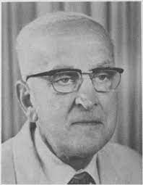
Process Control
They were derived by Leonard Henry Caleb Tippett, British statistician, in 1925
https://encrypted-tbn0.gstatic.com/images?q=tbn:ANd9GcQyD2UtfVvzI2Pli_
BLRMQpG50G9guTpFEyXhqrWtgVGvuCyu-I6cEwchh399aFsuouAx0&usqp=CAU

Slide 103
Process Control
We owe a debt of gratitude to Tippett and other pioneers who put ‘engineering’ into quality engineering.
Anthony Chirico
https://www.qualitydigest.com/inside/lean-article/d2-more-just-control-chart-constant-110718.html

Slide 104
Process Control
Tippett used calculus and hand calculations to integrate and determine the first (mean), second (variance), third (skewness), and fourth (kurtosis) moments of the range for samples drawn from a standard normal distribution for sample sizes of size two through 1,000 by hand

Slide 105
Process Control
The control limits LOOK a lot like confidence intervals, but are they?

Slide 106
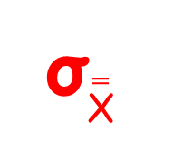
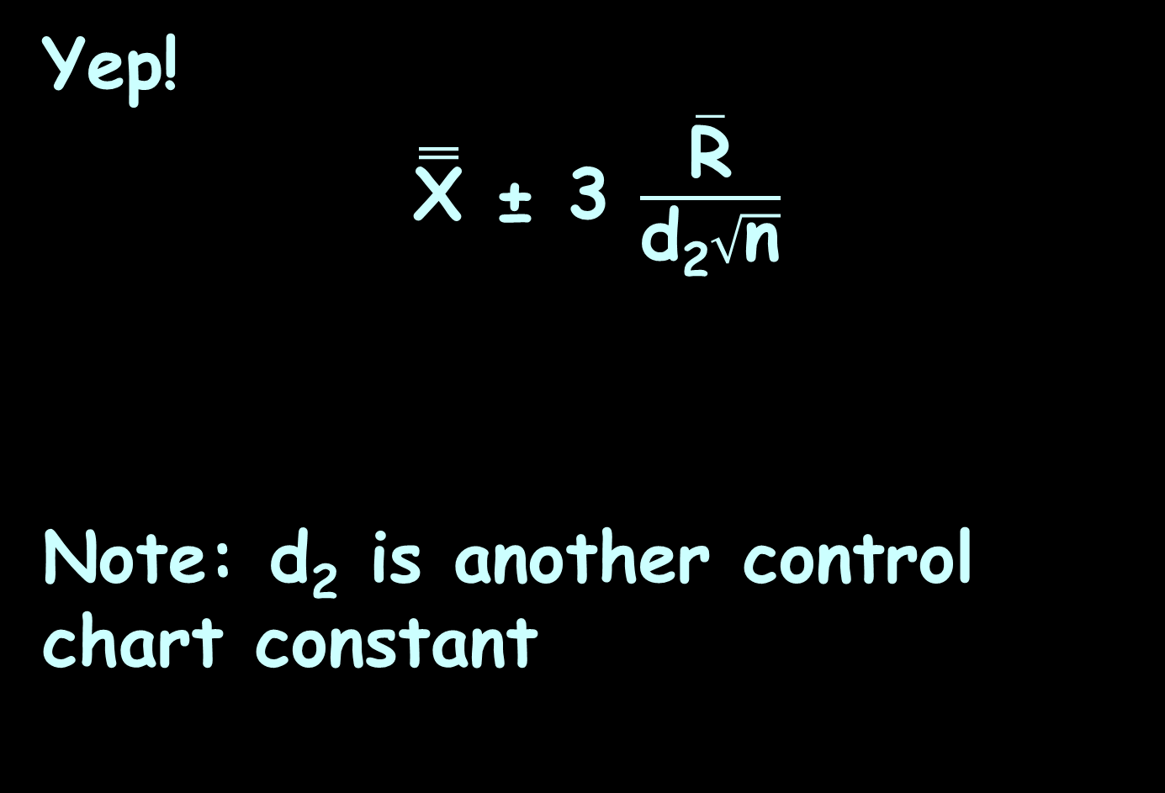
Process Control
Yep!
$\overset{̿}{\text{X}}$ ± 3 $\frac{\overline{\text{R}}}{\text{d}\text{2}\sqrt{\text{n}}}$
Note: d₂ is another control chart constant
σ$\overset{̿}{\text{X}}$

Slide 107
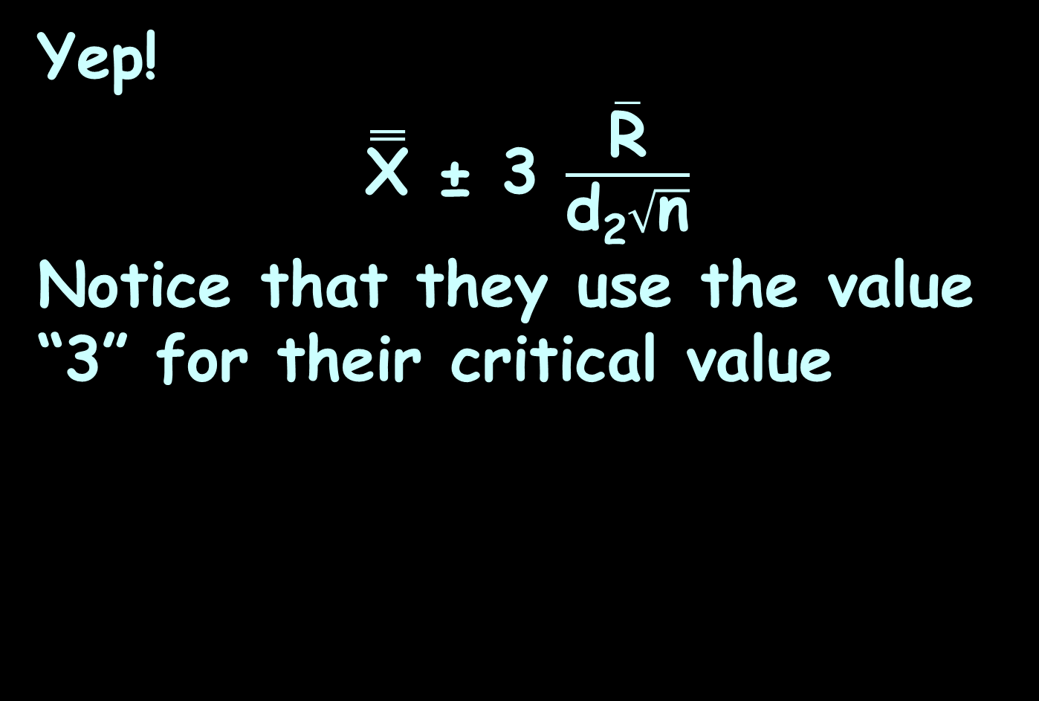
Process Control
Yep!
$\overset{̿}{\text{X}}$ ± 3 $\frac{\overline{\text{R}}}{\text{d}\text{2}\sqrt{\text{n}}}$
Notice that they use the value “3” for their critical value

Slide 108
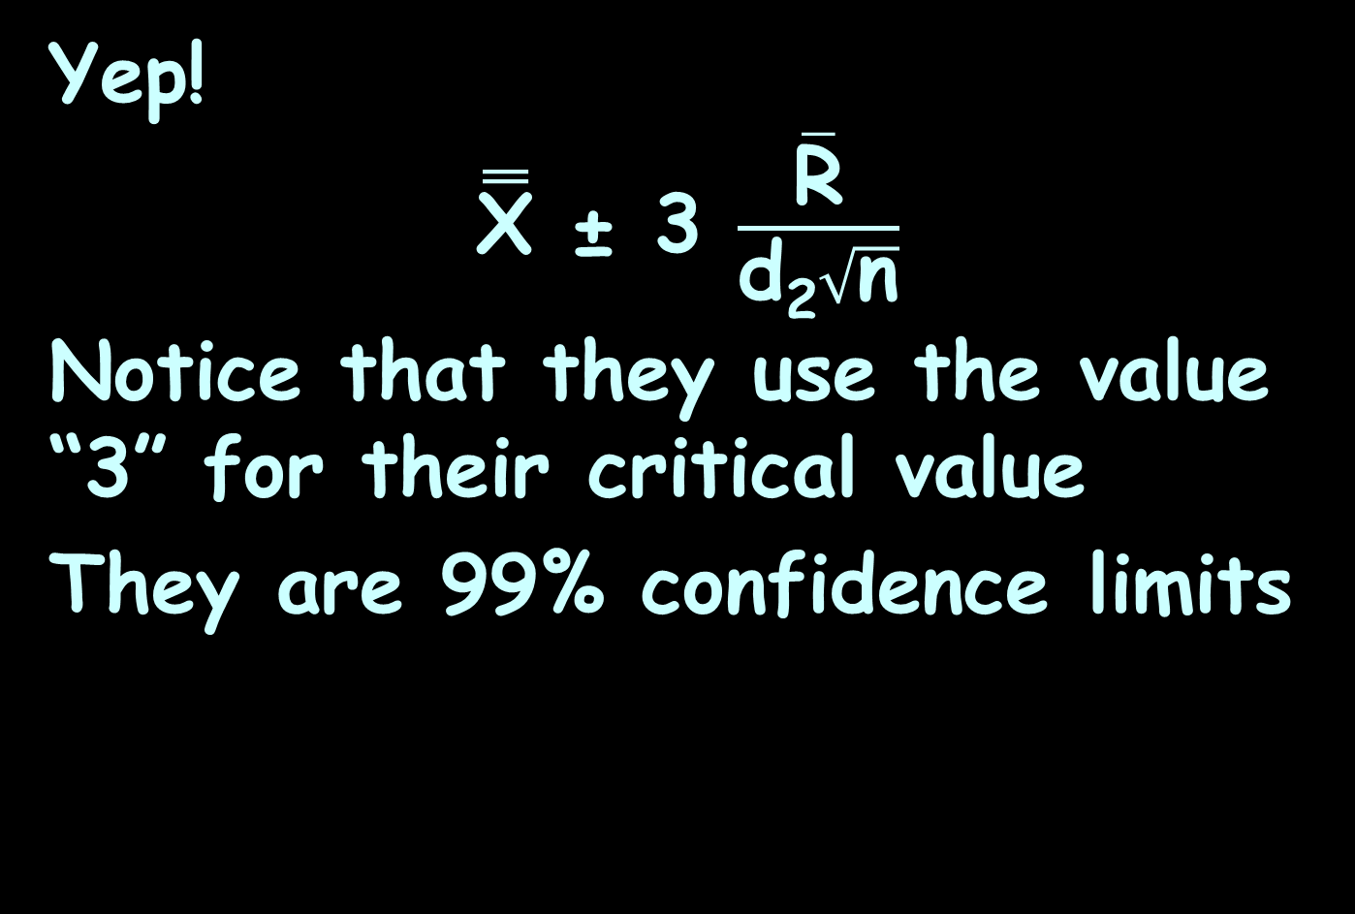
Process Control
Yep!
$\overset{̿}{\text{X}}$ ± 3 $\frac{\overline{\text{R}}}{\text{d}\text{2}\sqrt{\text{n}}}$
Notice that they use the value “3” for their critical value
They are 99% confidence limits

Slide 109
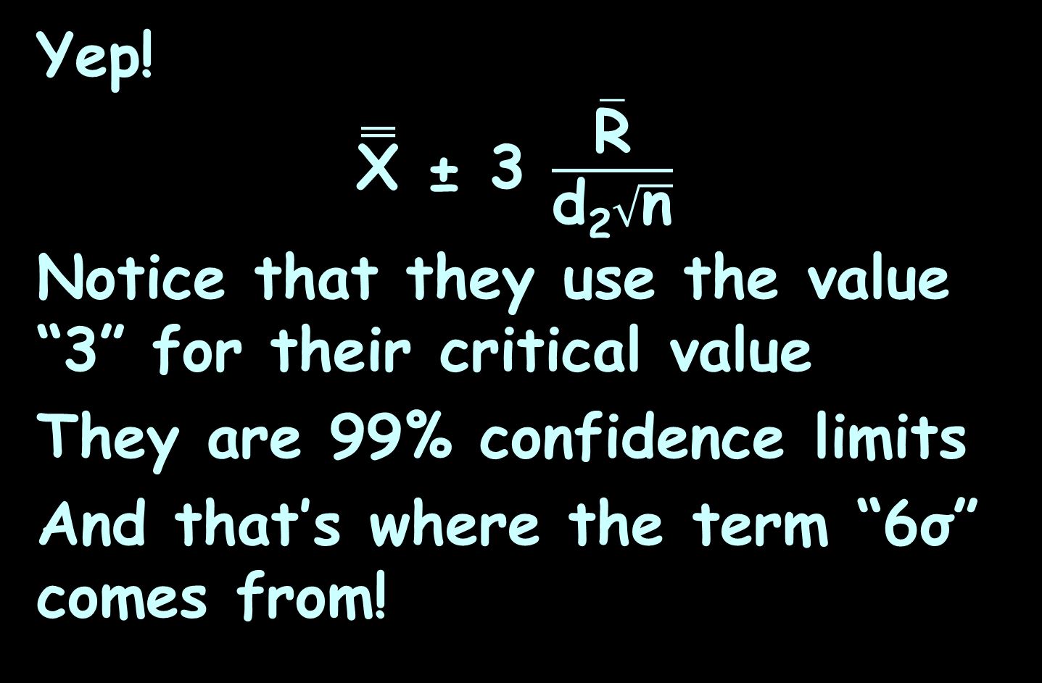
Process Control
Yep!
$\overset{̿}{\text{X}}$ ± 3 $\frac{\overline{\text{R}}}{\text{d}\text{2}\sqrt{\text{n}}}$
Notice that they use the value “3” for their critical value
They are 99% confidence limits
And that’s where the term “6σ” comes from!

Slide 110
Questions?
http://i.imgur.com/aliTlT3.jpg

Slide 111
Summary
Today we studied:
Review of “t” and “p” Confidence Intervals
New: Quality/process control

Slide 112

You Survived!

