Slide 1
Welcome to
Unit 10 Part 19
MATH366 Probability and Statistics
https://online.stanford.edu/sites/default/files/styles/figure_default/public/2018-04/theory-of-probability_stats116.jpg?itok=ms4fRMO-

Slide 2
What’s Up?
Today we will be going over:
Review of sampling, the distribution of
the mean, confidence
intervals, and a new MCG
Today: “t” confidence intervals for
samples that might not be normally-distributed and confidence intervals for “p”

Slide 3
What’s Up?
Outcome 5) Calculate the parameters of continuous random variable distributions and compute the probability of events in a typical continuous event application
Outcome 6) Computation of calculus of these parameters will be assisted with math software

Slide 4

Review

Slide 5
Sampling
A census is a “sampling” of “all” the members of a population

Slide 6
Sampling
Random Sampling
Each member of the population has an equal chance of being included in the sample

Slide 7
Sampling
Stratified Sampling
Divide the population into non-overlapping groups (strata)
Each member of a strata has an equal chance of being included in the sample

Slide 8
Sampling
Systematic Sampling
Selects every “kth” member from the population (from a random starting point)

Slide 9
Sampling
Cluster Sampling
Randomly select a group of members from the population

Slide 10
Sampling
If your sample is not representative of the population, the sample is
biased

Slide 11
Sampling
Sources of bias:
sampling bias
(bad-luck sample)
nonresponse bias
(Reps respond, Dems don’t)
response bias
(crummy survey questions)
inaccurate data entry

Slide 12
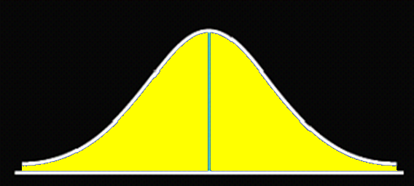
Normal Distribution
The most popular continuous graph in statistics is the
NORMAL DISTRIBUTION
VFrench 2019

Slide 13
Normal Distribution
We use normal distributions a lot in statistics because lots of things have graphs this shape!
        heights
        weights
        IQ test scores
        bull’s eyes

Slide 14
Normal Distributions
If you plotted the frequency of the gazillion sample mean values, it is called a
SAMPLING DISTRIBUTION

Slide 15
Sampling Distributions
The shape of the plot of a gazillion sample means would have a normal-ish distribution
NO MATTER WHAT THE ORIGINAL DATA LOOKED LIKE

Slide 16
Sampling Distributions
We usually say the sample mean will be normally distributed if n is ≥ 20or30
(the “good-enuff” value)

Slide 17
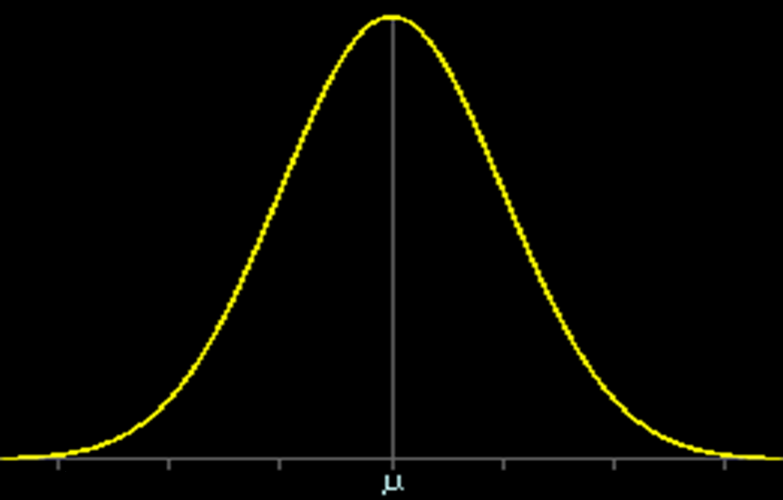


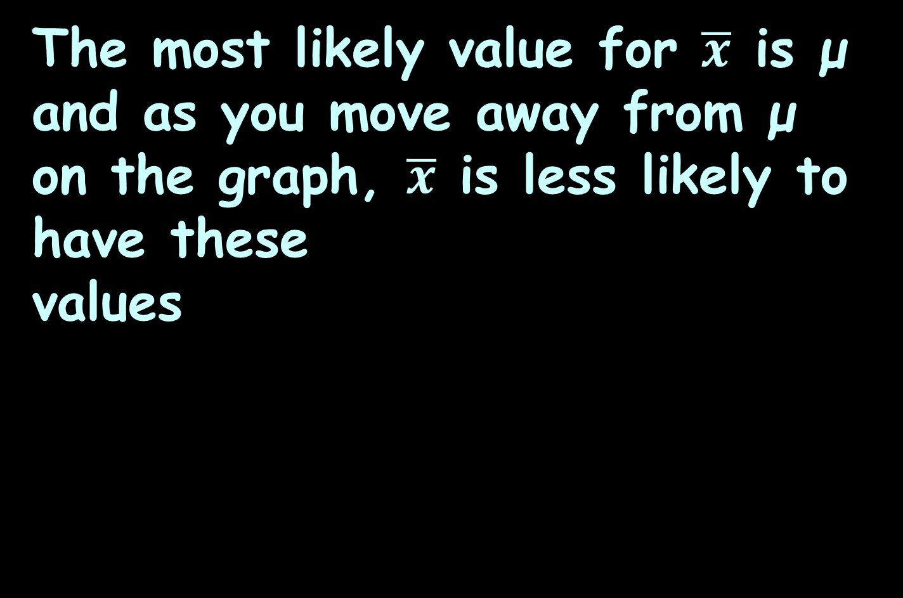
Graphs of $\overline{x}$
The most likely value for $\overline{x}$ is μ and as you move away from μ on the graph, $\overline{x}$ is less likely to have these
values
Graph of $\overline{x}$ values
mathbitsnotebook.com

Slide 18
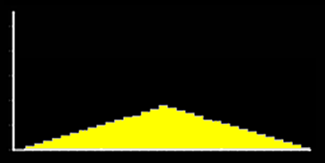
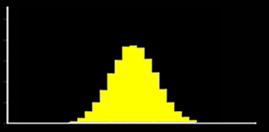
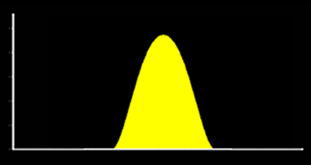
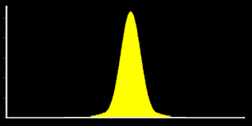
Sampling Distributions
as “n” increases,
variability (spread) also decreases
distribution of means of samples of size n = 2
distribution of means of samples of size n = 10
distribution of means of samples of size n = 20
distribution of means of samples of size n = 30
VFrench 2019
https://onlinestatbook.com/2/sampling_distributions/graphics/clt_sim2.gif

Slide 19
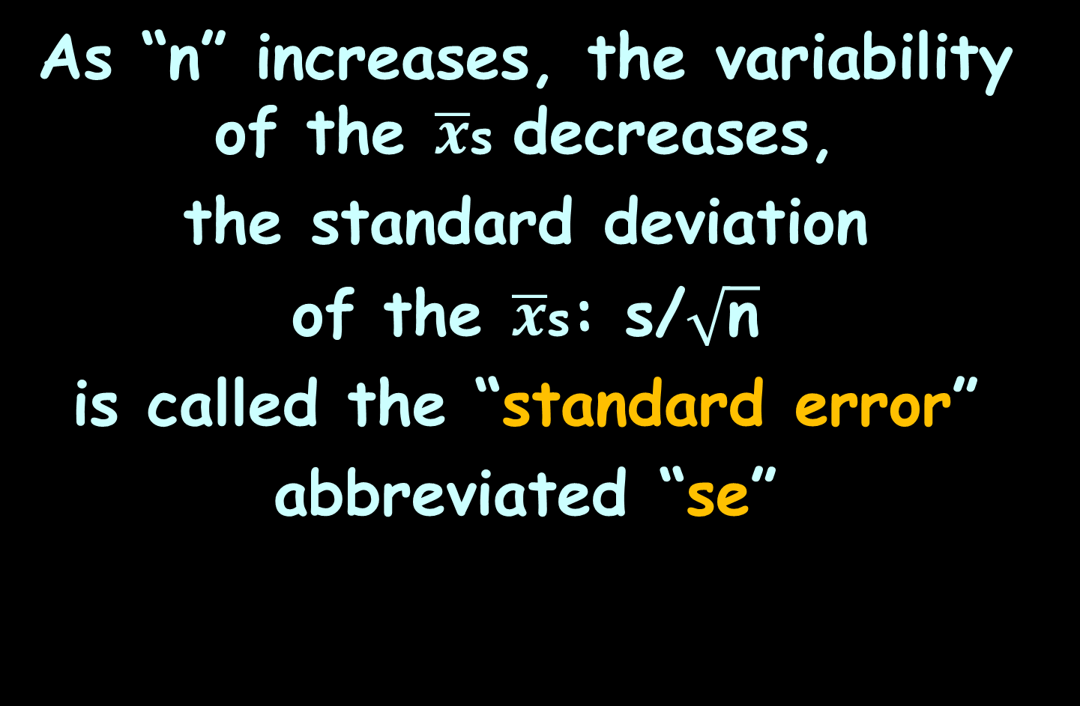
Estimation
As “n” increases, the variability of the $\overline{x}$s decreases,
the standard deviation
of the $\overline{x}$s: s/$\sqrt{\text{n}}$
is called the “standard error”
abbreviated “se”

Slide 20
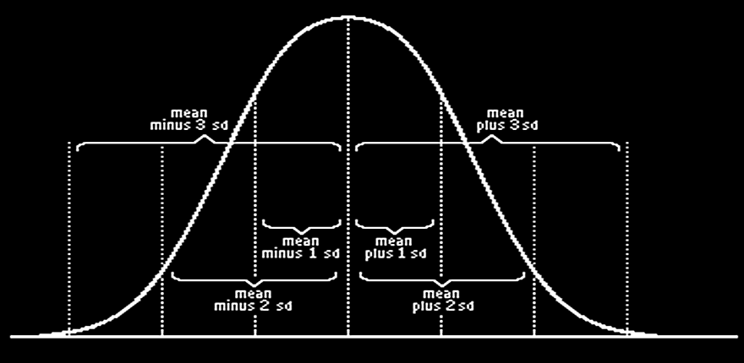







Estimation
Because as “n” increases, the variability decreases:
$\overline{x}$-3s/$\sqrt{\text{n}}$
$\overline{x}$-2s$/\sqrt{\text{n}}$
$\overline{x}$-s$/\sqrt{\text{n}}$
$\overline{x}$+s/$\sqrt{\text{n}}$
$\overline{x}$+2s/$\sqrt{\text{n}}$
$\overline{x}$+3s/$\sqrt{\text{n}}$
$$\overline{x}$$
mathbitsnotebook.com

Slide 21
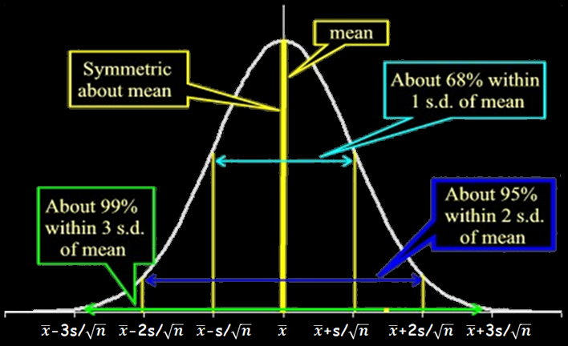

Inferences About μ
About 95% of the possible values for μ will be within 2se
of $\overline{x}$
se
se
se
mathbitsnotebook.com

Slide 22
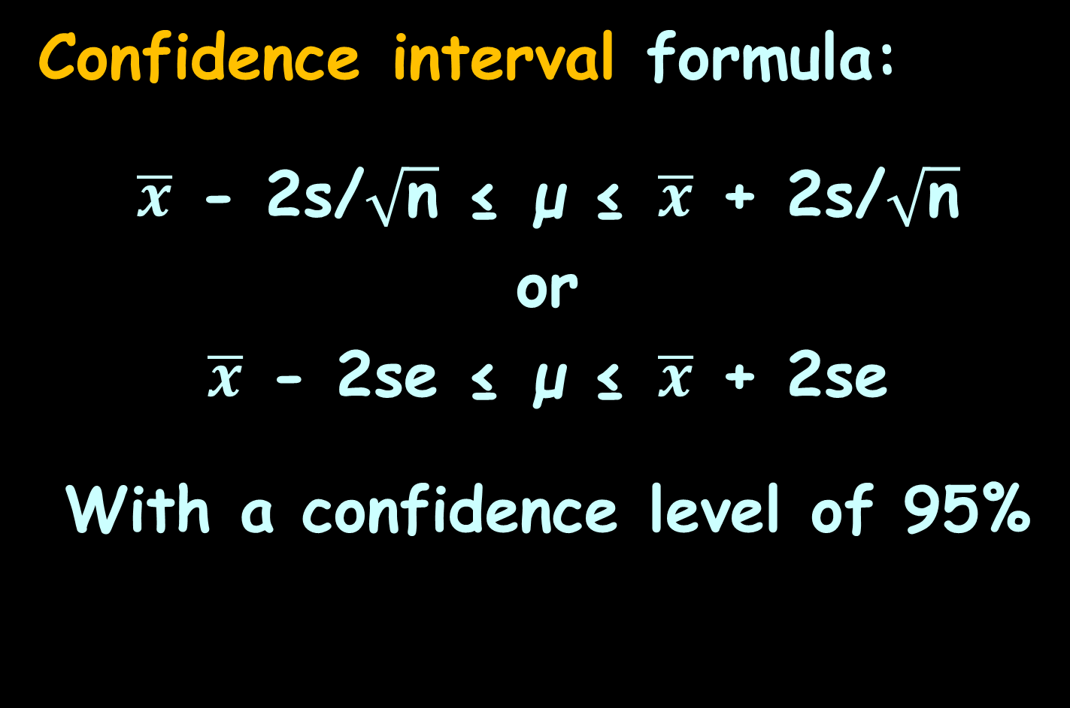
Confidence Intervals
Confidence interval formula:
$\overline{x}$ - 2s/$\sqrt{\text{n}}$ ≤ μ ≤ $\overline{x}$ + 2s/$\sqrt{\text{n}}$
or
$\overline{x}$ - 2se ≤ μ ≤ $\overline{x}$ + 2se
With a confidence level of 95%

Slide 23
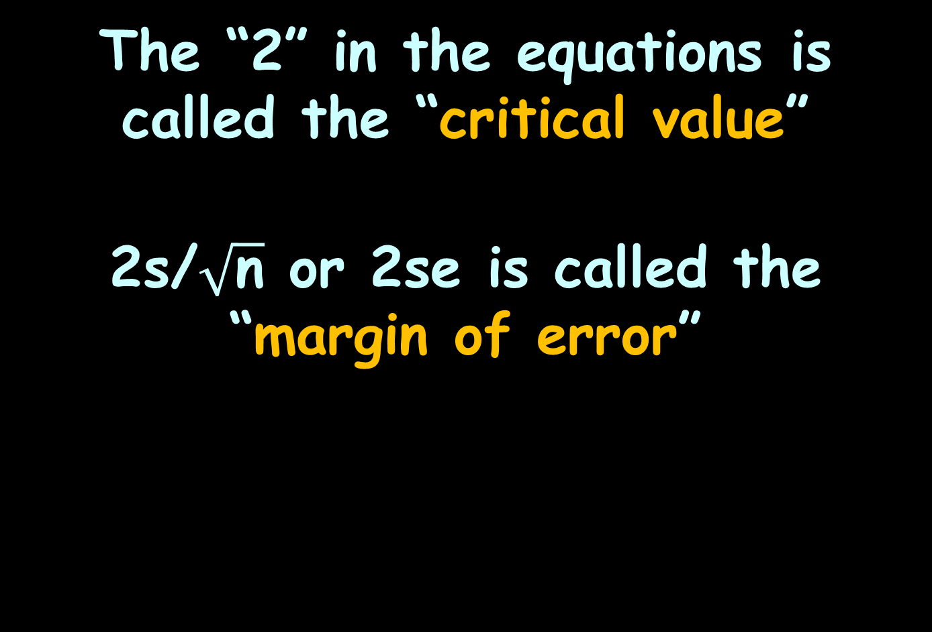
Confidence Intervals
The “2” in the equations is called the “critical value”
2s/$\sqrt{\text{n}}$ or 2se is called the
“margin of error”

Slide 24

Confidence Intervals
For a 95% confidence interval, 95% of the values of μ will be within 2se of $\overline{x}$

Slide 25

Confidence Intervals
For a 95% confidence interval, we will be
WRONG
5% of the time
https://janeymackenstreet.files.wordpress.com/2015/02/fingers-crossed.jpg

Slide 26
Confidence Intervals
The percent of time we are willing to be wrong is called
“α”
(“alpha”)
or “the α-level”

Slide 27
Confidence Interval MCG
We’ve been doing Multiple Comparison Graphs using the upper and lower confidence limits (without even knowing we were doing that)

Slide 28
Confidence Interval MCG
We have a narrower comparison range (because the confidence limits are always narrower than the max and min)
AND
We can state the certainty probability that two groups are different

Slide 29

Questions?
http://i.imgur.com/aliTlT3.jpg

Slide 30
Confidence Intervals
We usually say the sample mean will be normally distributed if n is ≥ 20or30
(the “good-enuff” value)

Slide 31
Confidence Intervals
What if you have a sample size smaller than 20???

Slide 32
Confidence Intervals
What if you have a sample size smaller than 20???
If it’s from a normal distribution – NO PROBLEM!

Slide 33
Confidence Intervals
What if you have a sample size smaller than 20???
But, what if we’re not sure about that…?

Slide 34
Confidence Intervals
What if you have a sample size smaller than 20???
But, what if we’re not sure about that…?
The graph kinda looks normal-ish… but…

Slide 35
Confidence Intervals
You must use a different (bigger) critical value

Slide 36
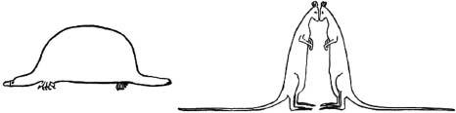
Difference Between Means
Remember the guy who drew the “leptokurtic/platykurtic” pics?
https://twitter.com/davidcnorrismd/status/839566103177121792

Slide 37

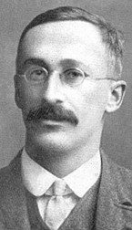
Difference Between Means
William Sealy Gossett
https://en.wikipedia.org/wiki/William_Sealy_Gosset#/media/File:William_Sealy_Gosset.jpg
https://lancasteronline.com/features/an-irish-pub-favorite-at-home-cooking-with-guinness-goodness/article_b110c4f6-4507-11e9-b5fc-f7b6015bf155.html

Slide 38
t Confidence Intervals
W.S. Gossett (who worked for the Guinness brewery) was working with sensory testing
(flavor) of the vats of
stout
https://upload.wikimedia.org/wikipedia/commons/thumb/4/42/William_Sealy_Gosset.jpg/800px-William_Sealy_Gosset.jpg
W.S. Gosset 1908

Slide 39
t Confidence Intervals
Only a limited number of trained testers were available (about 5-7)
It seemed unlikely that flavor characteristics would follow a normal distribution (but
might be close)

Slide 40
t Confidence Intervals
Mr. Gossett invented a new continuous probability distribution for small samples from close-to-normal populations

Slide 41
t Confidence Intervals
He called this the “t” (always small letter) distribution because he was using it to compare two groups (“t” for two): the standard flavor and the flavor for a particular vat

Slide 42
t Confidence Intervals
Because he worked for a company (and companies don’t like their employees publishing things) he published his ideas under the pseudonym “A Student”
So this distribution is called
“Student’s t-Distribution”

Slide 43
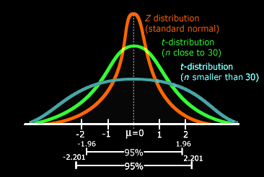
t Confidence Intervals
The t distributions is wide (has thicker tails) than a standard normal distribution
https://towardsdatascience.com/everything-you-need-to-know-about-hypothesis-testing-part-i-4de9abebbc8a

Slide 44
t Confidence Intervals
The thick tails ensure that the confidence intervals are wider than those using a standard normal distribution (and are better at including the population mean)
https://towardsdatascience.com/everything-you-need-to-know-about-hypothesis-testing-part-i-4de9abebbc8a

Slide 45
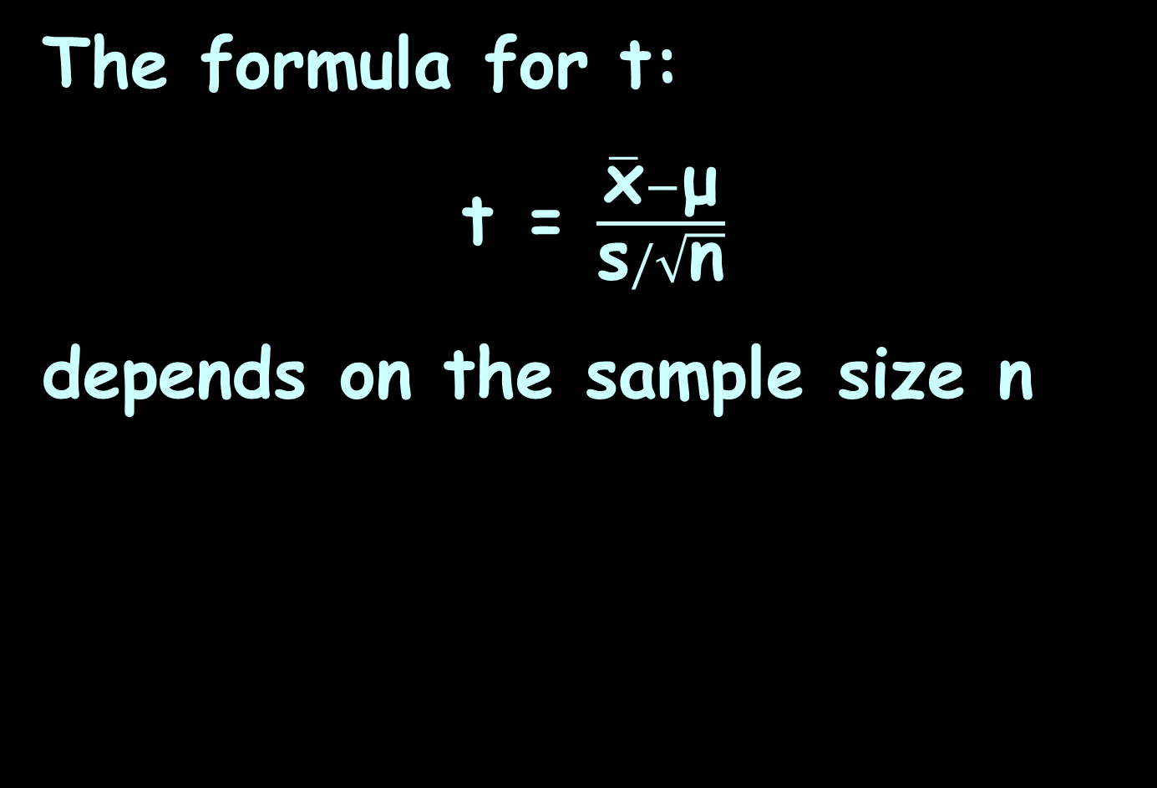
t Confidence Intervals
The formula for t:
t = $\frac{\overline{\text{x}}−\text{μ}}{\text{s}/\sqrt{\text{n}}}$
depends on the sample size n

Slide 46
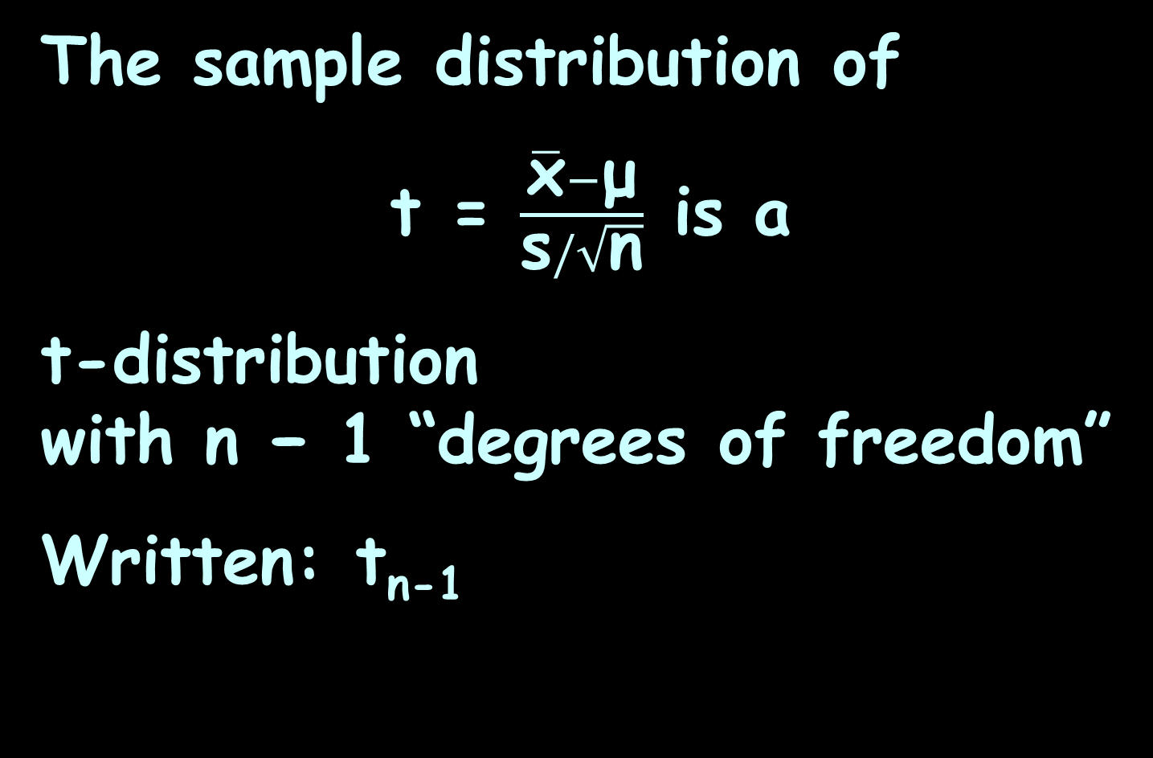
t Confidence Intervals
The sample distribution of
t = $\frac{\overline{\text{x}}−\text{μ}}{\text{s}/\sqrt{\text{n}}}$ is a
t-distribution
with n − 1 “degrees of freedom”
Written: t_{n-1}

Slide 47
t Confidence Intervals
The degrees of freedom (df) is a measure of how well s estimates σ
The larger the degrees of freedom, the better σ is estimated

Slide 48
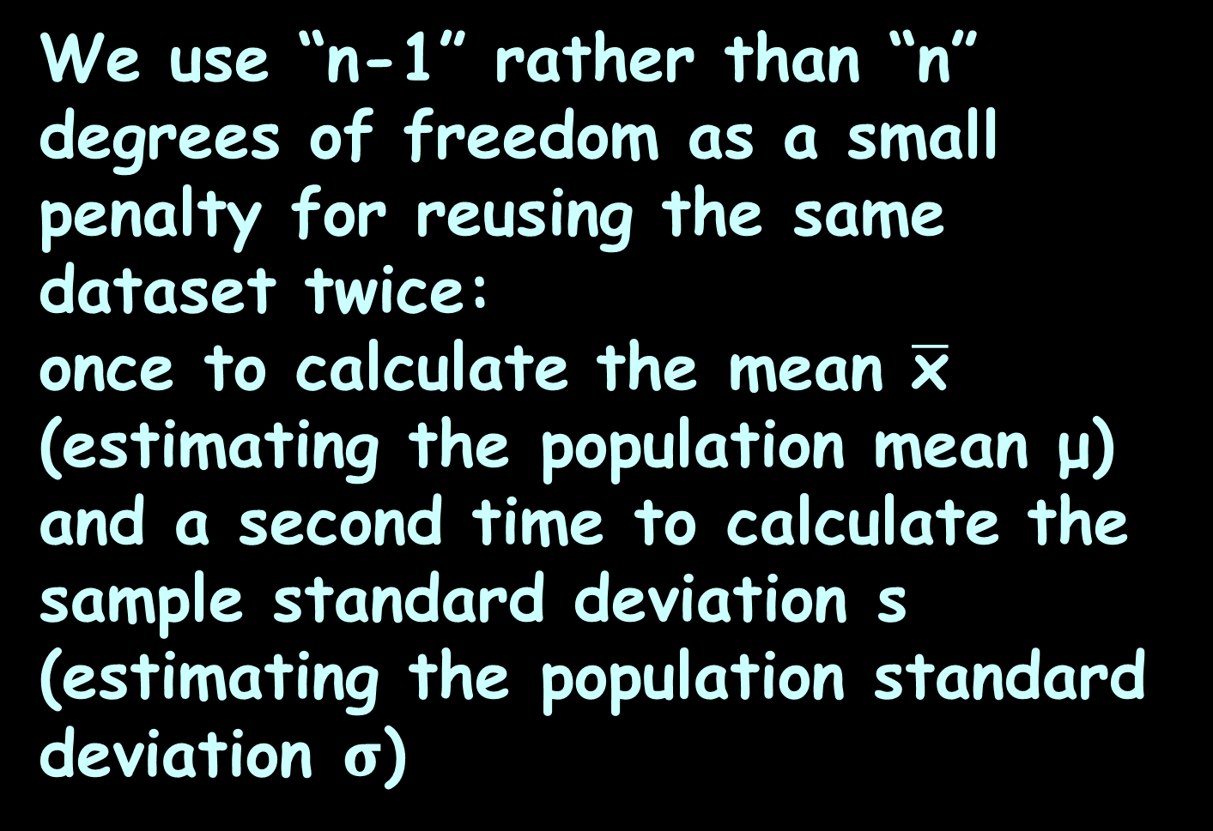
t Confidence Intervals
We use “n-1” rather than “n” degrees of freedom as a small penalty for reusing the same dataset twice:
once to calculate the mean $\overline{\text{x}}$ (estimating the population mean μ) and a second time to calculate the sample standard deviation s (estimating the population standard deviation 𝛔)

Slide 49
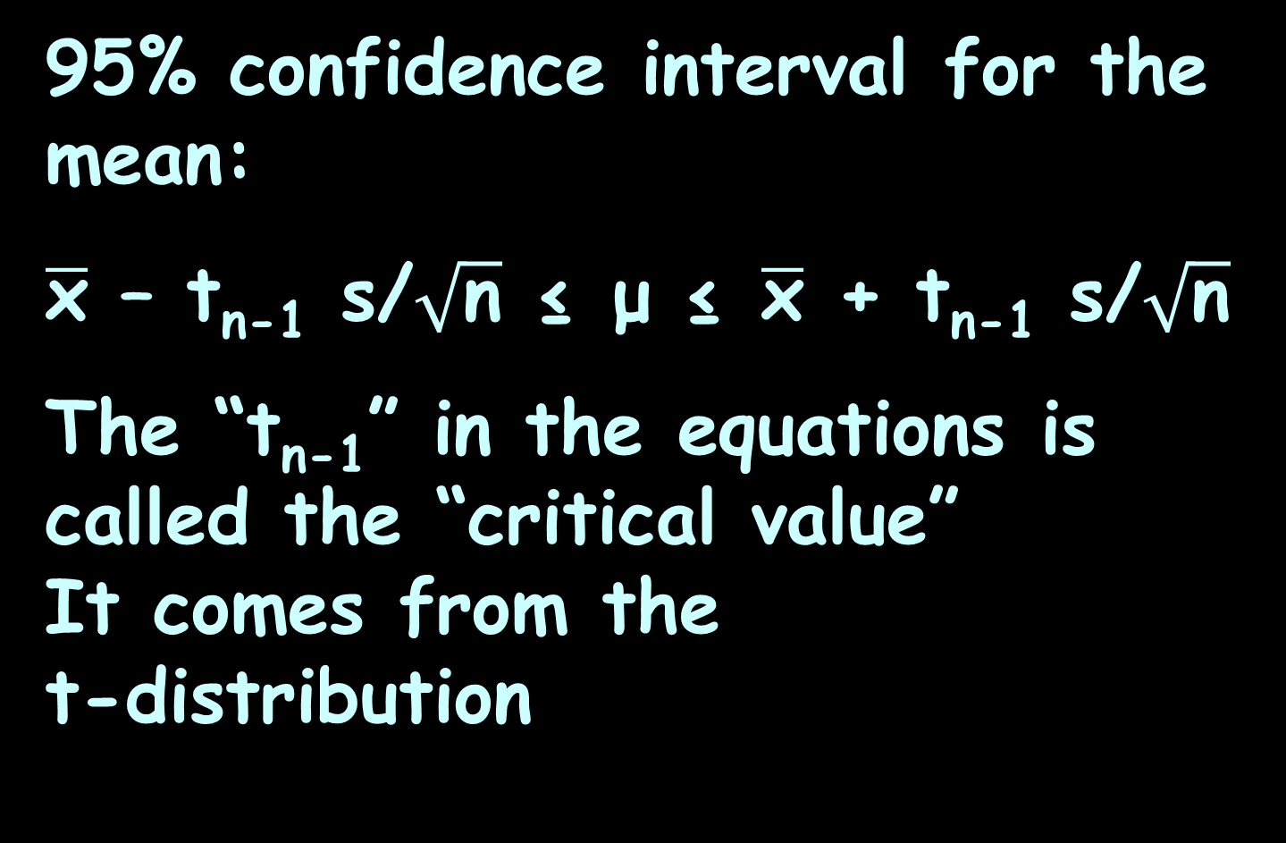
t Confidence Intervals
95% confidence interval for the mean:
$\overline{\text{x}}$ – t_{n-1} s/$\sqrt{\text{n}}$ ≤ μ ≤ $\overline{\text{x}}$ + t_{n-1} s/$\sqrt{\text{n}}$
The “t_{n-1}” in the equations is called the “critical value”
It comes from the
t-distribution
https://towardsdatascience.com/everything-you-need-to-know-about-hypothesis-testing-part-i-4de9abebbc8a

Slide 50
t Confidence Intervals
Traditionally, people had to use tables of these t-values
You looked up the “n – 1” value and the % confidence you needed to find the t-value

Slide 51
t Confidence Intervals
Nowadays, we use Excel or a variety of other on-line software systems

Slide 52
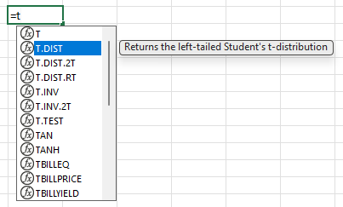
t Confidence Intervals
There are several “flavors” of
“t” in Excel
For confidence intervals, use:
t.inv.2t
the two-tail (we’re using “minus” the value,
and “plus” the value,
so it’s two tails)

Slide 53
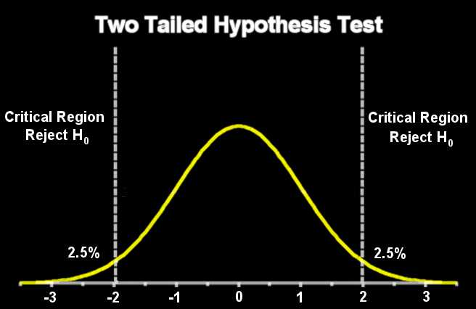
“Tailed” Tests
A two-tailed test will reject H₀ either if the experimental values we get are too high or too low
https://towardsdatascience.com/everything-you-need-to-know-about-hypothesis-testing-part-i-4de9abebbc8a

Slide 54
“Tailed” Tests
α is split between the upper and lower tails
https://towardsdatascience.com/everything-you-need-to-know-about-hypothesis-testing-part-i-4de9abebbc8a

Slide 55
t Confidence Intervals
Excel will want to know α (usually 5%) and the degrees of freedom (n-1):
t.inv.2t(α,n-1)

Slide 56
t CONFIDENCE INTERVAL
PROJECT QUESTION 1
Suppose you have taken a sample of size 10 from a population that you suspect is hill-shaped (but you are not sure it is normal)

Slide 57

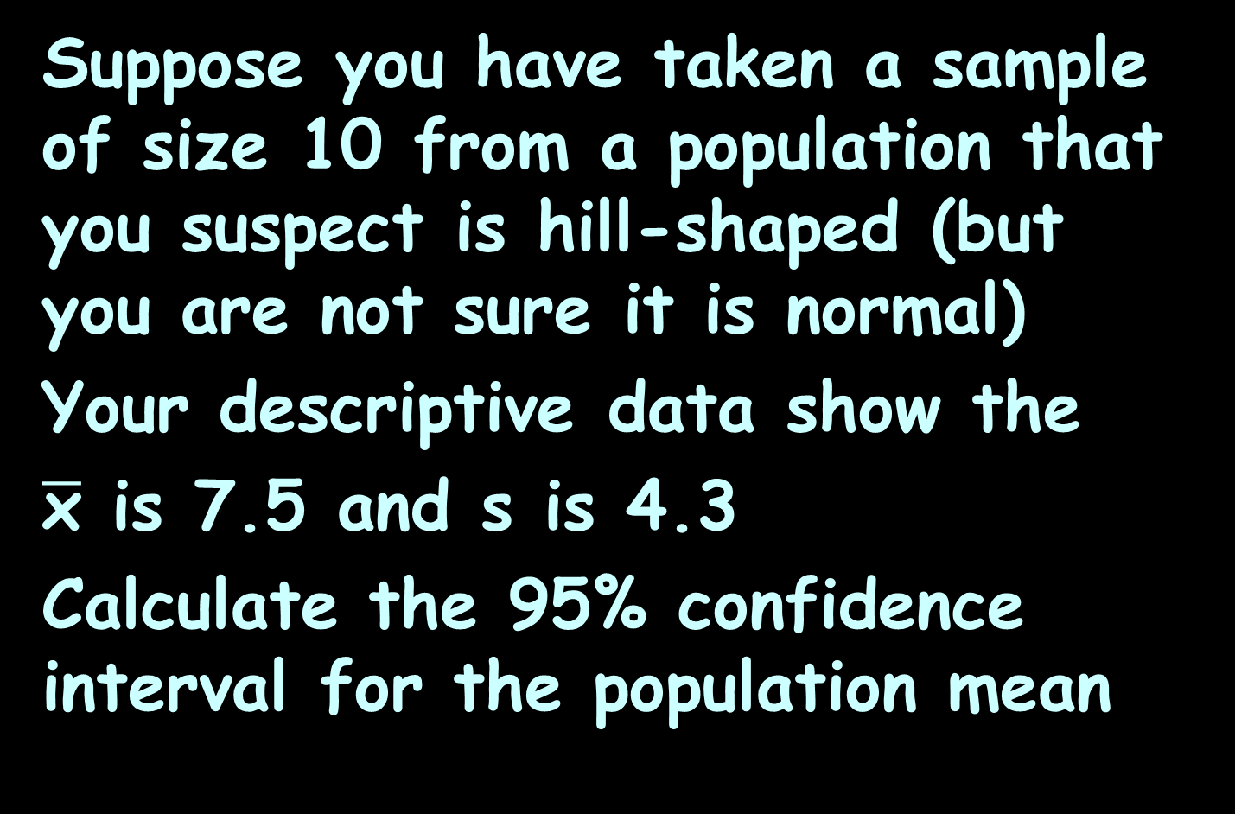
t CONFIDENCE INTERVAL
PROJECT QUESTION 1
Suppose you have taken a sample of size 10 from a population that you suspect is hill-shaped (but you are not sure it is normal)
Your descriptive data show the
$\overline{\text{x}}$ is 7.5 and s is 4.3
Calculate the 95% confidence interval for the population mean
t_{n-1 =} t.inv.2t(α,n-1)
$\overline{\text{x}}$ – t_{n-1} s/$\sqrt{\text{n}}$ ≤ μ ≤ $\overline{\text{x}}$ + t_{n-1} s/$\sqrt{\text{n}}$

Slide 58
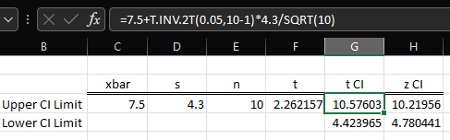
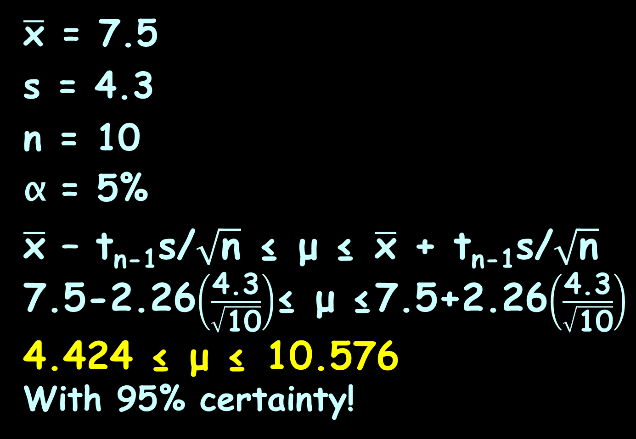
t CONFIDENCE INTERVAL
PROJECT QUESTION 1
$\overline{\text{x}}$ = 7.5
s = 4.3
n = 10
α = 5%
$\overline{\text{x}}$ – t_{n-1}s/$\sqrt{\text{n}}$ ≤ μ ≤ $\overline{\text{x}}$ + t_{n-1}s/$\sqrt{\text{n}}$
7.5-2.26$\left(\frac{\text{4.3}}{\sqrt{\text{10}}}\right)$≤ μ ≤7.5+2.26$\left(\frac{\text{4.3}}{\sqrt{\text{10}}}\right)$
4.424 ≤ μ ≤ 10.576
With 95% certainty!
t_{n-1 =} t.inv.2t(α,n-1)
$\overline{\text{x}}$ – t_{n-1} s/$\sqrt{\text{n}}$ ≤ μ ≤ $\overline{\text{x}}$ + t_{n-1} s/$\sqrt{\text{n}}$

Slide 59
t CONFIDENCE INTERVAL
PROJECT QUESTION 1
4.424 ≤ μ ≤ 10.576
With 95% certainty!
Is it likely the true population mean is 10.6?
t_{n-1 =} t.inv.2t(α,n-1)
$\overline{\text{x}}$ – t_{n-1} s/$\sqrt{\text{n}}$ ≤ μ ≤ $\overline{\text{x}}$ + t_{n-1} s/$\sqrt{\text{n}}$

Slide 60
t CONFIDENCE INTERVAL
PROJECT QUESTION 1
4.424 ≤ μ ≤ 10.576
With 95% certainty!
Is it likely the true population mean is 10.6?
We are 95% sure it is NOT!
t_{n-1 =} t.inv.2t(α,n-1)
$\overline{\text{x}}$ – t_{n-1} s/$\sqrt{\text{n}}$ ≤ μ ≤ $\overline{\text{x}}$ + t_{n-1} s/$\sqrt{\text{n}}$

Slide 61
Questions?
http://i.imgur.com/aliTlT3.jpg

Slide 62
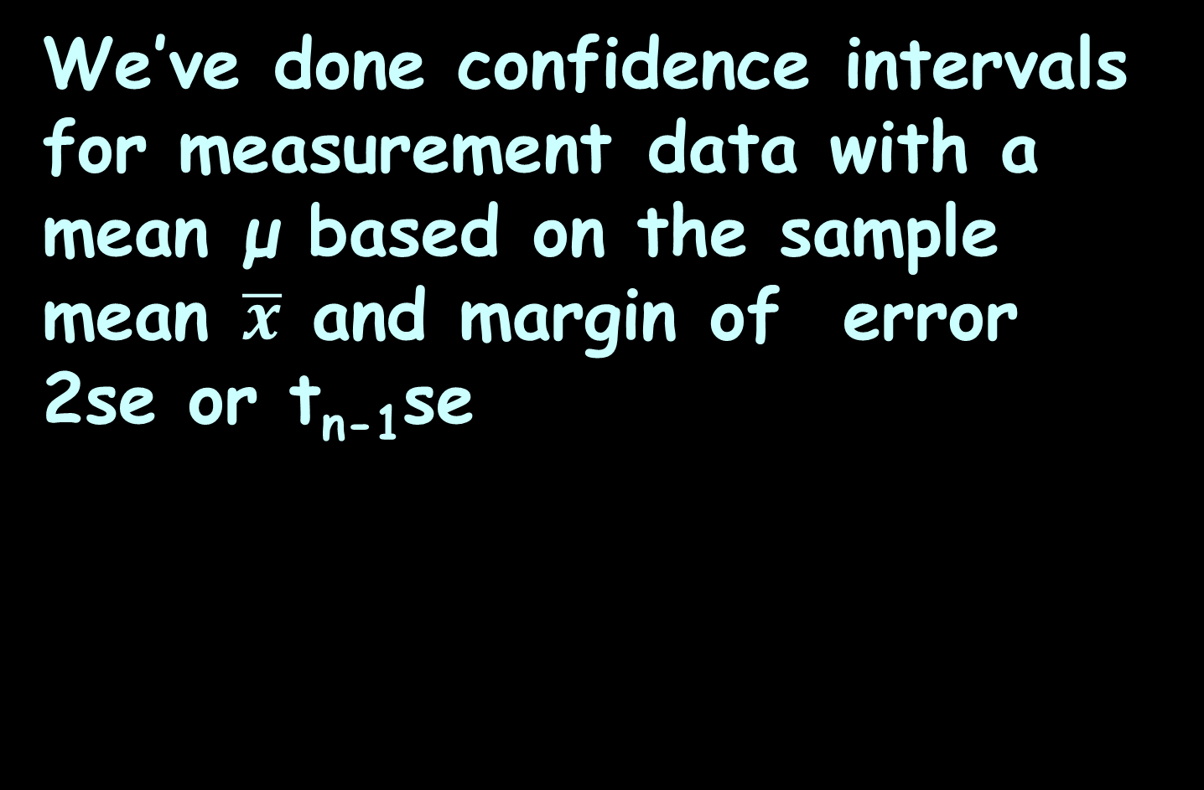
Confidence Intervals
We’ve done confidence intervals for measurement data with a mean μ based on the sample mean $\overline{x}$ and margin of error 2se or t_{n-1}se

Slide 63
CI for Proportions
What about count data and proportions?

Slide 64
CI for Proportions
We’ll use the normal curve for proportions:
$\hat{\text{p}}$-3$\sqrt{\frac{\text{p}\text{q} }{\text{n} }}$ $\hat{\text{p}}$-2$\sqrt{\frac{\text{p}\text{q} }{\text{n} }}$ $\hat{\text{p}}$-$\sqrt{\frac{\text{p}\text{q} }{\text{n} }} \hat{\text{p}} \hat{\text{p}}+\sqrt{\frac{\text{p}\text{q} }{\text{n} }}$ $\hat{\text{p}}$+2$\sqrt{\frac{\text{p}\text{q} }{\text{n} }}$ $\hat{\text{p}}$+3$\sqrt{\frac{\text{p}\text{q} }{\text{n} }}$
VFrench, 2017

Slide 65

CI FOR PROPORTIONS
PROJECT QUESTION 2
If $\hat{\text{p}}$ = .4 and n = 30
find the 95% CI for p

Slide 66

CI FOR PROPORTIONS
PROJECT QUESTION 2
If $\hat{\text{p}}$ = .4 and n = 30
find the 95% CI for p
se =

Slide 67

CI FOR PROPORTIONS
PROJECT QUESTION 2
If $\hat{\text{p}}$ = .4 and n = 30
find the 95% CI for p
se =$\sqrt{\frac{\hat{\text{p}}\hat{\text{q}}}{\text{n}}}$ = $\sqrt{\frac{\text{.4}×\text{.6}}{\text{30}}}$ ≈ .089

Slide 68
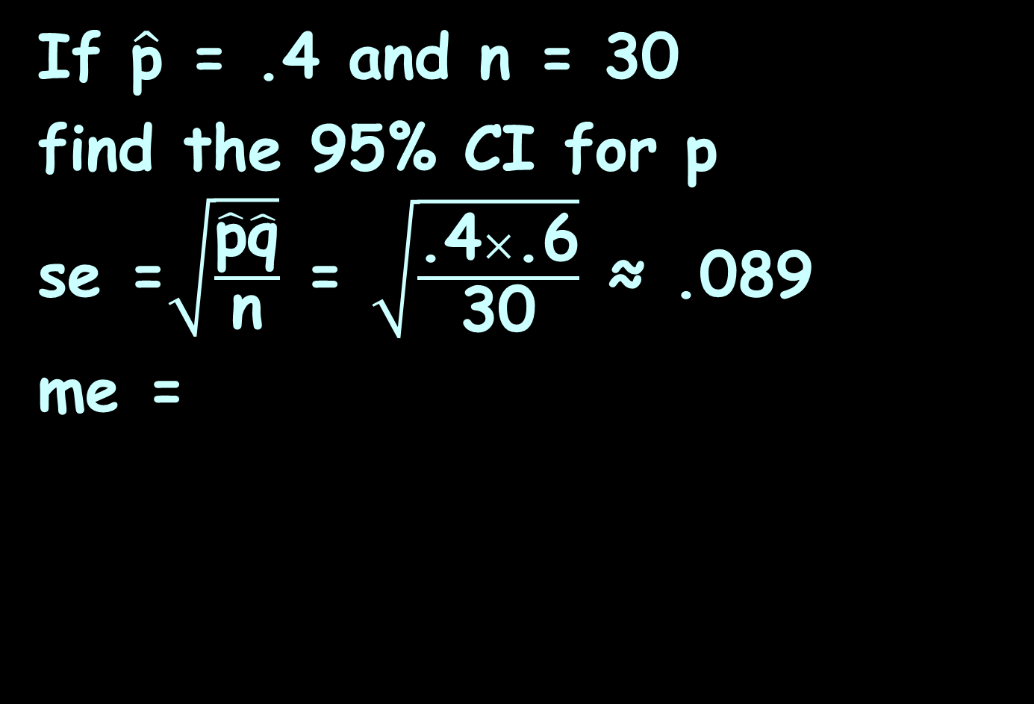
CI FOR PROPORTIONS
PROJECT QUESTION 2
If $\hat{\text{p}}$ = .4 and n = 30
find the 95% CI for p
se =$\sqrt{\frac{\hat{\text{p}}\hat{\text{q}}}{\text{n}}}$ = $\sqrt{\frac{\text{.4}×\text{.6}}{\text{30}}}$ ≈ .089
me =

Slide 69
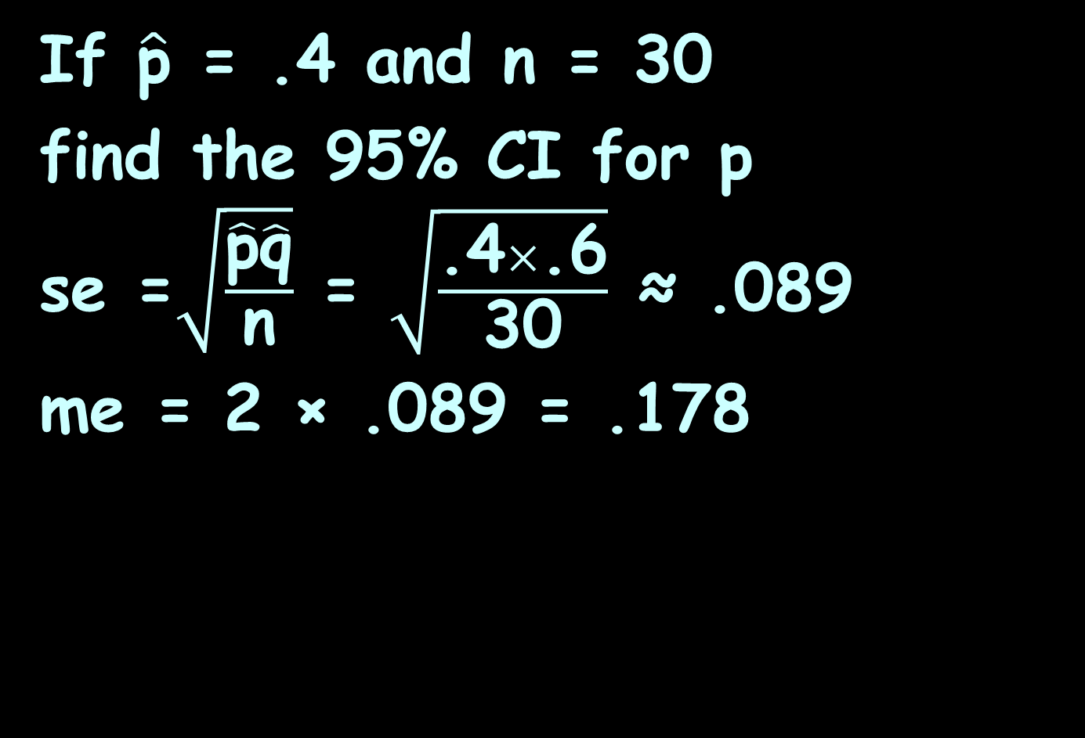
CI FOR PROPORTIONS
PROJECT QUESTION 2
If $\hat{\text{p}}$ = .4 and n = 30
find the 95% CI for p
se =$\sqrt{\frac{\hat{\text{p}}\hat{\text{q}}}{\text{n}}}$ = $\sqrt{\frac{\text{.4}×\text{.6}}{\text{30}}}$ ≈ .089
me = 2 × .089 = .178

Slide 70

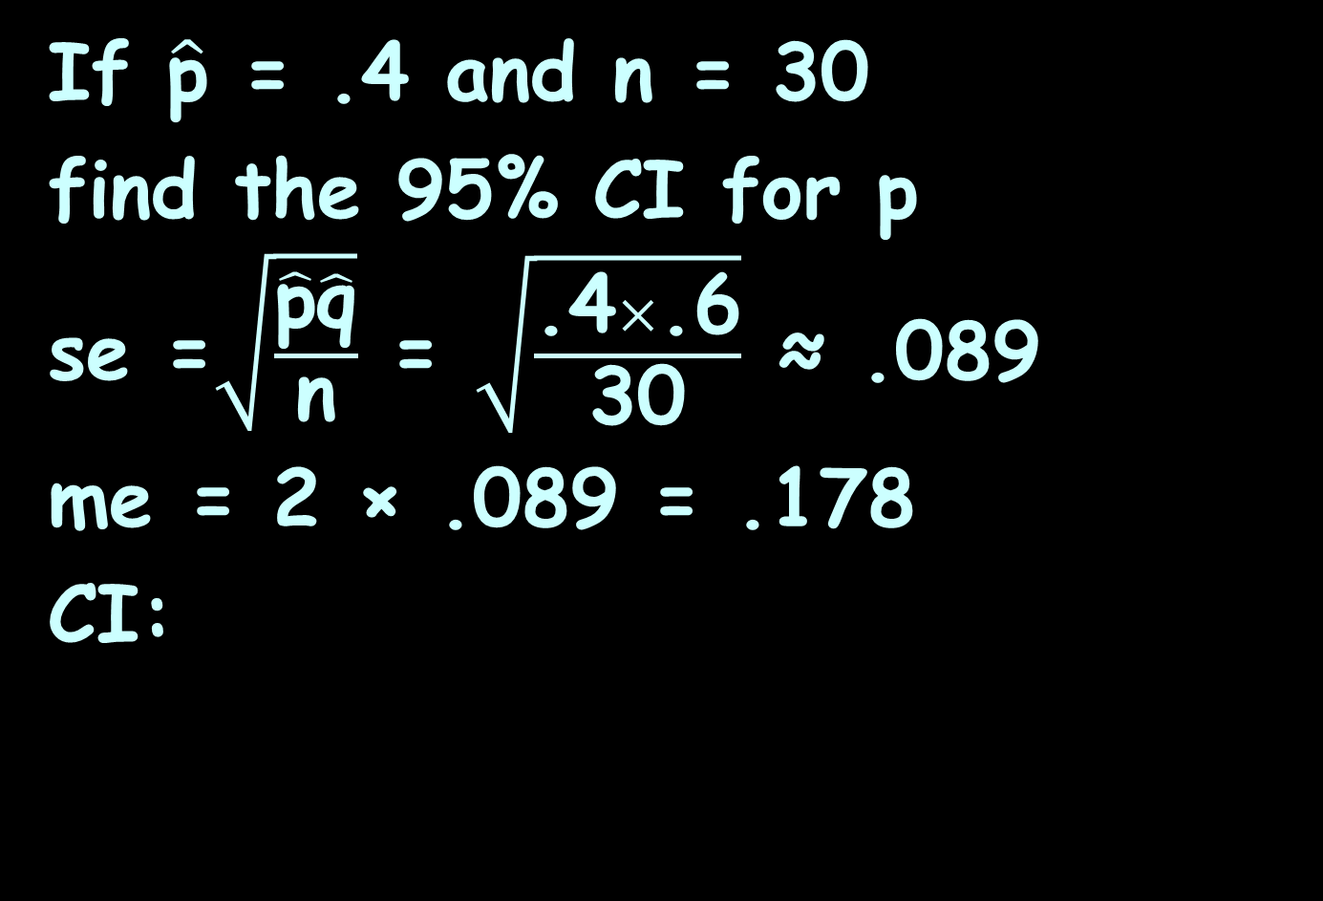
CI FOR PROPORTIONS
PROJECT QUESTION 2
If $\hat{\text{p}}$ = .4 and n = 30
find the 95% CI for p
se =$\sqrt{\frac{\hat{\text{p}}\hat{\text{q}}}{\text{n}}}$ = $\sqrt{\frac{\text{.4}×\text{.6}}{\text{30}}}$ ≈ .089
me = 2 × .089 = .178
CI:
$\hat{\text{p}}$ - 2 $\sqrt{\frac{\hat{\text{p}}\hat{\text{q}}}{\text{n}}}$ ≤ p ≤ $\hat{\text{p}}$ + 2 $\sqrt{\frac{\hat{\text{p}}\hat{\text{q}}}{\text{n}}}$

Slide 71
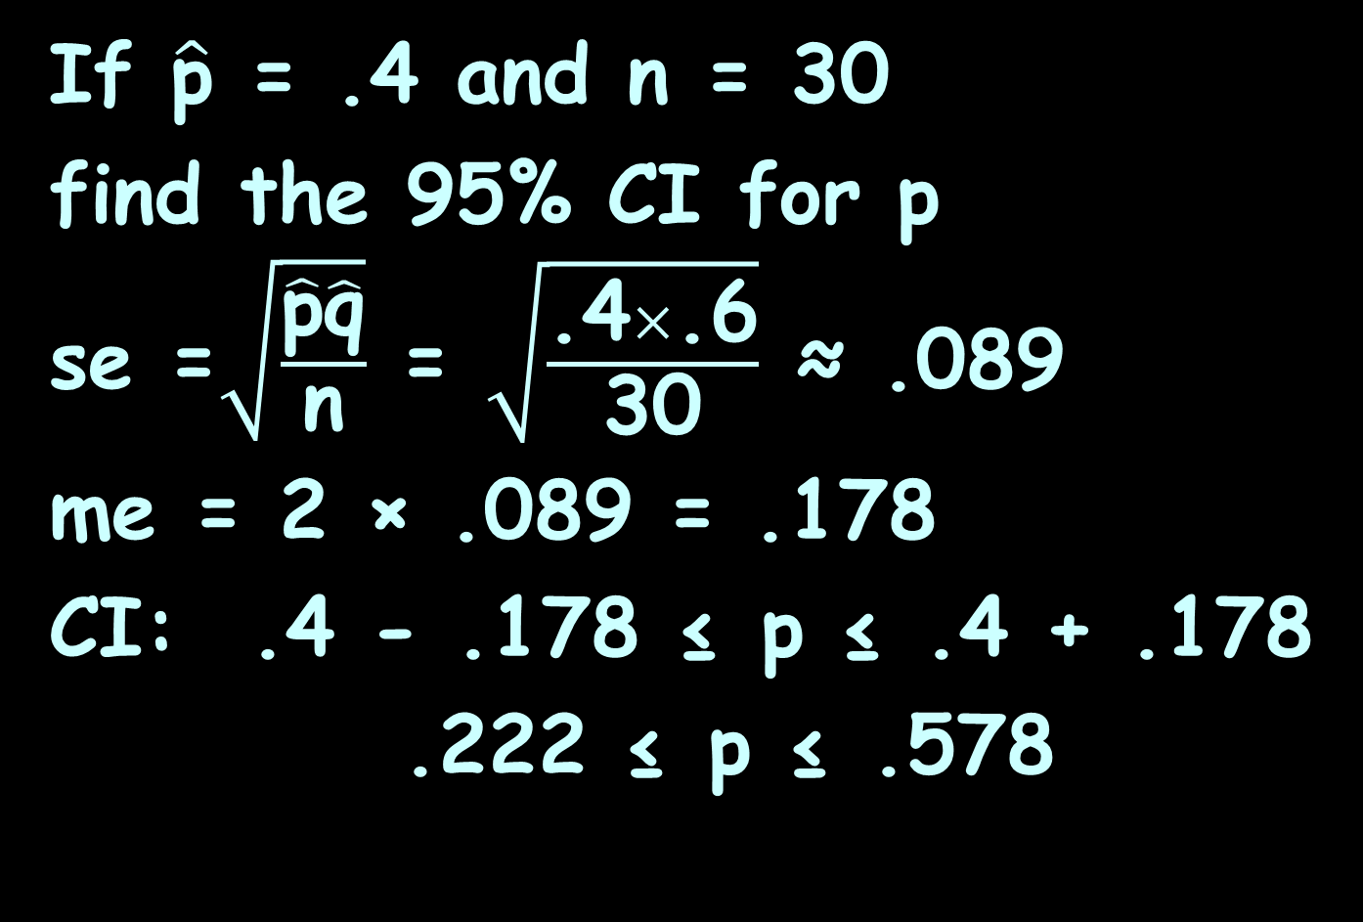
CI FOR PROPORTIONS
PROJECT QUESTION 2
If $\hat{\text{p}}$ = .4 and n = 30
find the 95% CI for p
se =$\sqrt{\frac{\hat{\text{p}}\hat{\text{q}}}{\text{n}}}$ = $\sqrt{\frac{\text{.4}×\text{.6}}{\text{30}}}$ ≈ .089
me = 2 × .089 = .178
CI: .4 - .178 ≤ p ≤ .4 + .178
.222 ≤ p ≤ .578
$\hat{\text{p}}$ - 2 $\sqrt{\frac{\hat{\text{p}}\hat{\text{q}}}{\text{n}}}$ ≤ p ≤ $\hat{\text{p}}$ + 2 $\sqrt{\frac{\hat{\text{p}}\hat{\text{q}}}{\text{n}}}$

Slide 72
Questions?
http://i.imgur.com/aliTlT3.jpg

Slide 73
CI for Proportions
What if we had a small sample size?

Slide 74
CI for Proportions
What if we had a small sample size?
Use “t”

Slide 75

CI for Proportions
What if we had $\hat{\text{p}}$ = .1?

Slide 76

CI for Proportions
What if we had $\hat{\text{p}}$ = .1?
You have to have a very large sample!

Slide 77
CI for Proportions
https://shiny.rit.albany.edu/
stat/binomial/

Slide 78
Questions?
http://i.imgur.com/aliTlT3.jpg

Slide 79
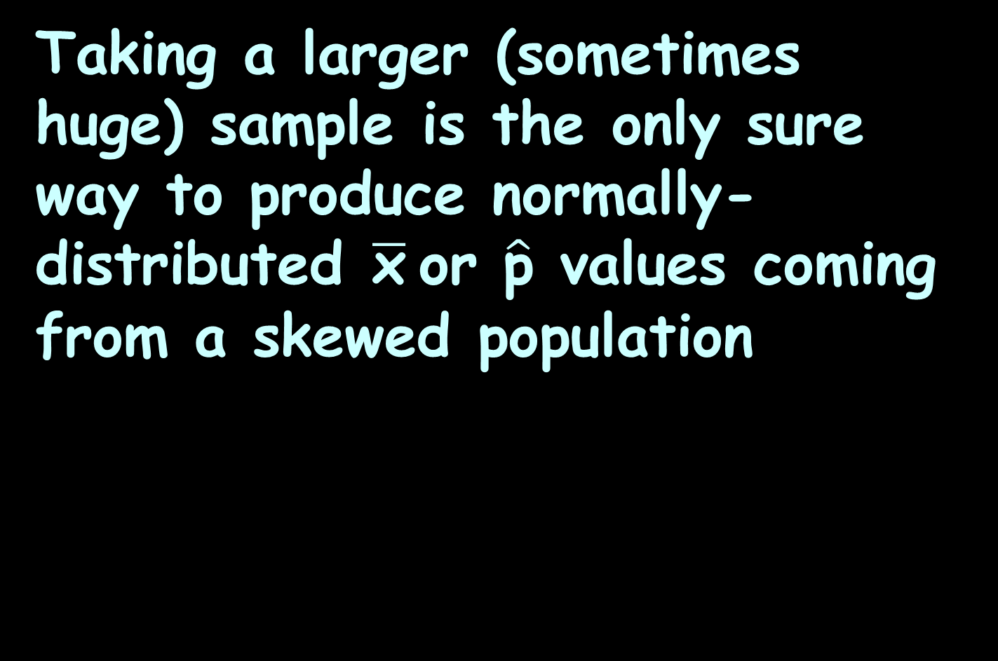
Confidence Intervals for Skewed Data
Taking a larger (sometimes huge) sample is the only sure way to produce normally-distributed $\overline{\text{x}}$or $\hat{\text{p}}$ values coming from a skewed population

Slide 80
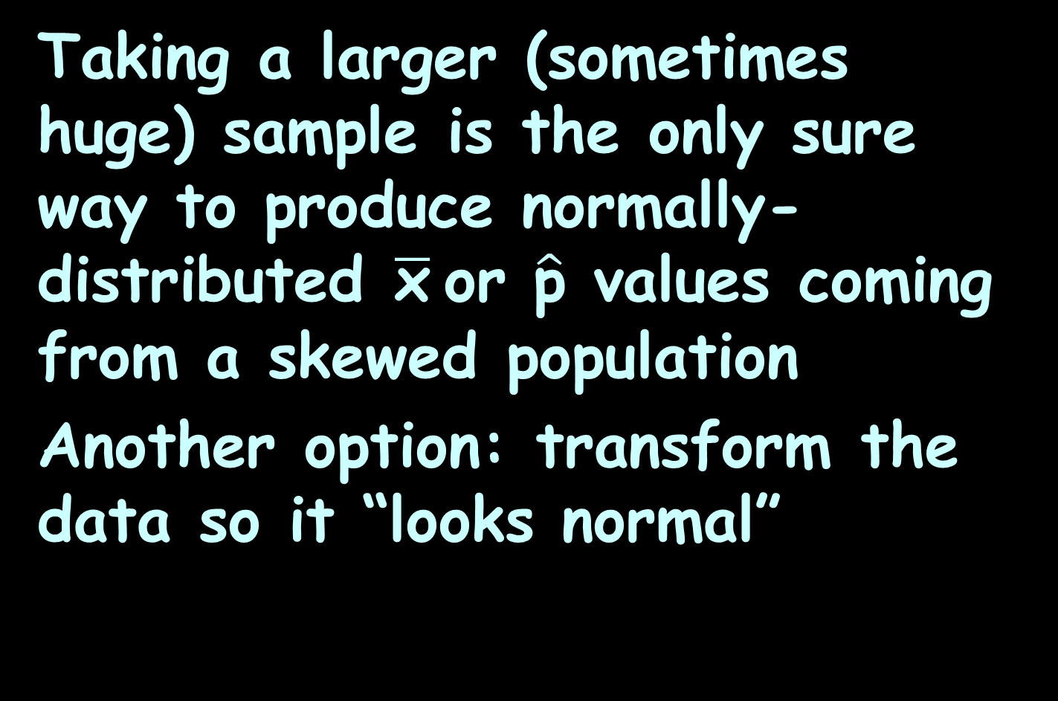
Confidence Intervals for Skewed Data
Taking a larger (sometimes huge) sample is the only sure way to produce normally-distributed $\overline{\text{x}}$or $\hat{\text{p}}$ values coming from a skewed population
Another option: transform the data so it “looks normal”

Slide 81
Confidence Intervals for Skewed Data
A log transformation (change all your data into the log of the data values) is the first thing you should try to remove right-skewness

Slide 82
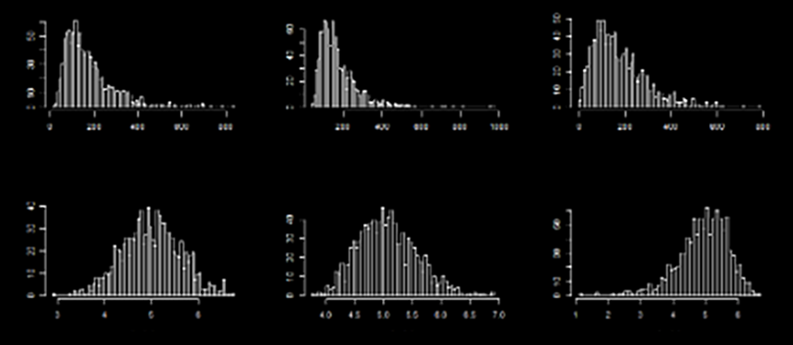
Confidence Intervals for Skewed Data
Sorry – really horrible pic…
https://stats.stackexchange.com/questions/107610/what-is-the-reason-the-log-transformation-is-used-with-right-skewed-distribution

Slide 83
Confidence Intervals for Skewed Data
Sorry – really horrible pic…
pretty close to normal
not quite enough
too much!
https://stats.stackexchange.com/questions/107610/what-is-the-reason-the-log-transformation-is-used-with-right-skewed-distribution

Slide 84

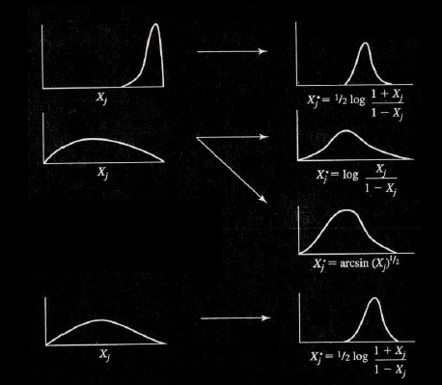
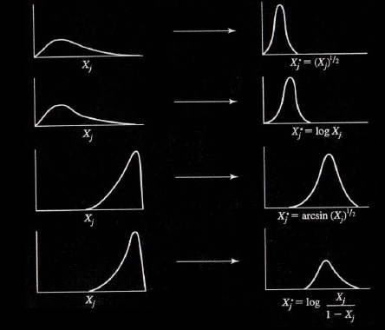
Confidence Intervals for Skewed Data
Some other transformations
to normalize data:
https://unaettie.com/img/b2.webp

Slide 85
Confidence Intervals for Skewed Data
BTW: all right-thinking readers of reports with transformed data immediately think:
“hmm… I wonder why they did that? Are they possibly lying with statistics???”

Slide 86
Questions?
http://i.imgur.com/aliTlT3.jpg

Slide 87
Summary
Today we studied:
Review of sampling, sampling
distributions, confidence
intervals, new MCG
New: “t” confidence interval,
confidence interval for p

Slide 88

You Survived!
www.playbuzz.com

