Slide 1
Welcome to
Unit 8 Part 16
MATH366 Probability and Statistics
https://online.stanford.edu/sites/default/files/styles/figure_default/public/2018-04/theory-of-probability_stats116.jpg?itok=ms4fRMO-

Slide 2
What’s Up?
Today we will be going over:
Review: Project Management Charts
New: Decision Trees

Slide 3
What’s Up?
Outcome 3) Modeling will be assisted by Monte Carlo simulations run with mathematical software
Outcome 4) Calculate the parameters of several discrete random variable distributions and compute the probability of events in a typical discrete event application

Slide 4

Review

Slide 5
Project Management
… is planning, organizing, motivating, and controlling resources to achieve specific goals

Slide 6
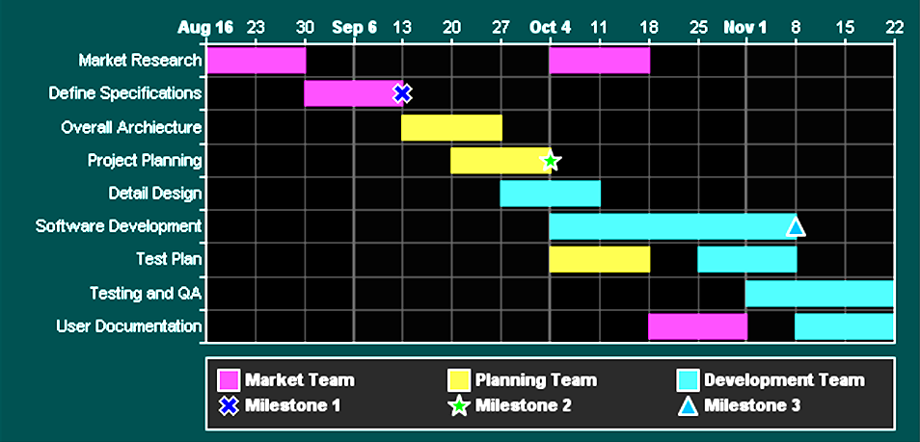
Project Management
Gannt charts show the viewer when parts of the project are to be done and how long each will take

Slide 7
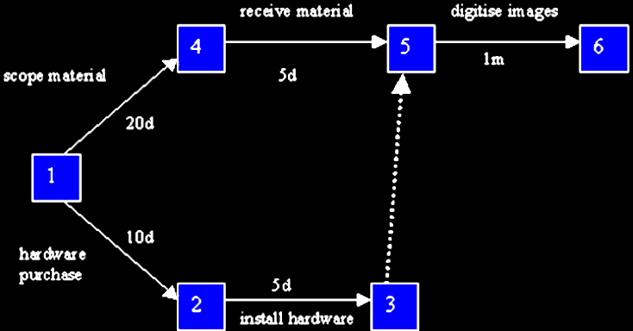
Project Management
CPM includes paths showing which activities must be done before the next activity can start

Slide 8
Project Management
Times are shown using numbers, not lengths of bars

Slide 9
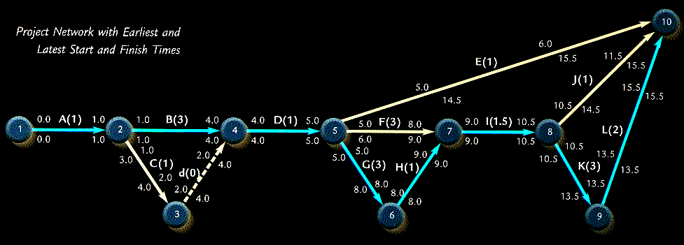
Project Management
The “Program Evaluation and Review Technique” (PERT) can show three estimates of the duration of each activity

Slide 10
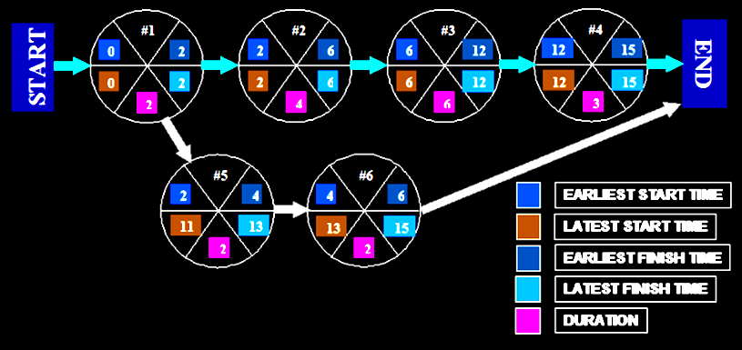
Project Management
The Activity on Node (AON) chart can show any number of timing estimates

Slide 11
Project Management
Most of the charts you will do for your boss are Gannt charts
They are easy to do in Microsoft Project but can also be done in Excel

Slide 12

Questions?

Slide 13
Project Part 2
Treasure Hunt 3
Find a real-world example of an Assignment Problem, Gannt chart or other type of Project Management chart
Don’t forget your url
Explain what was the intended use

Slide 14
Questions?

Slide 15
Decision Trees
These graphical tools help show possible outcomes to aid decision making

Slide 16
Decision Trees
Mathematically, trees must have connected branches
And they must not form a circuit

Slide 17
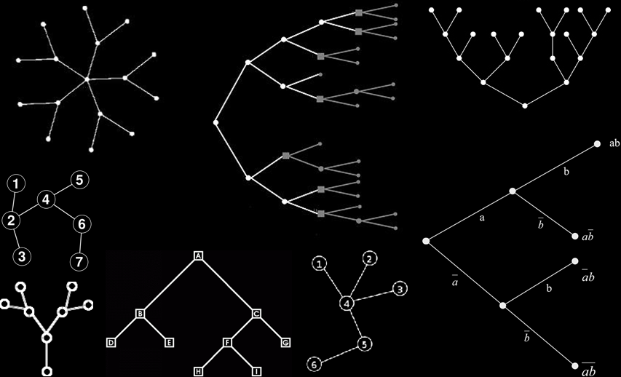
Decision Trees
Trees

Slide 18
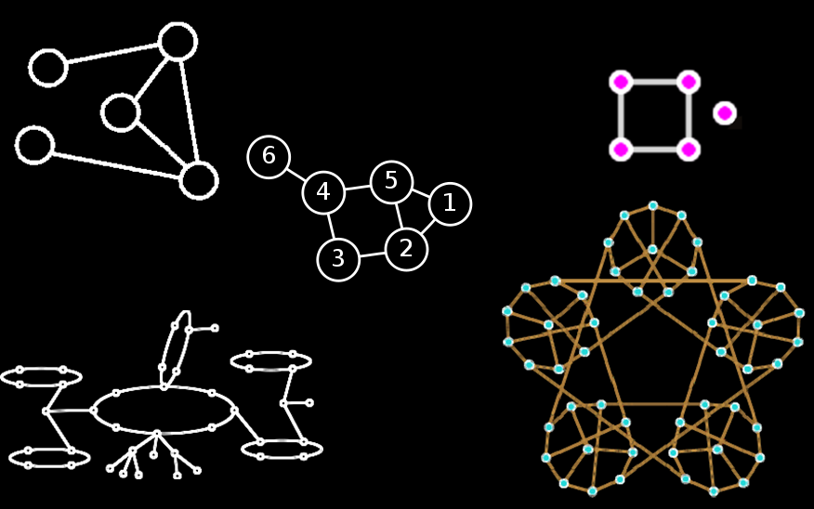
Decision Trees
Not Trees

Slide 19
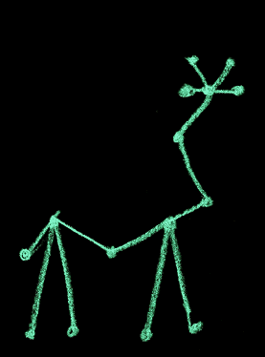
Decision Trees
Tree or not a tree?

Slide 20
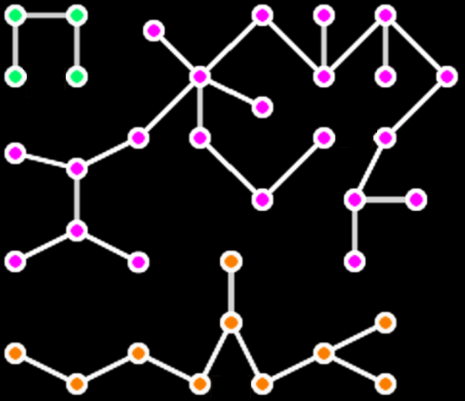
Decision Trees
Tree or not a tree?

Slide 21
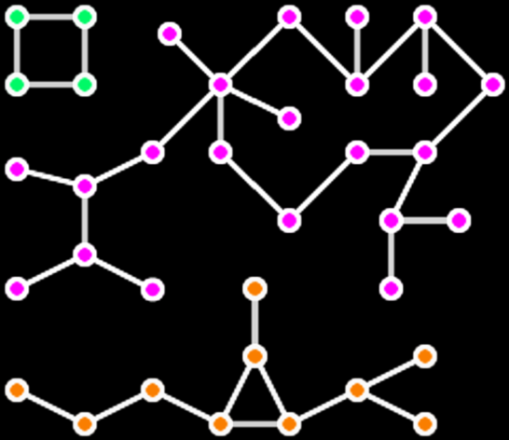
Decision Trees
Tree or not a tree?

Slide 22
Decision Trees
Clearly define the problem
List all possible alternatives
Identify outcomes for each alternative
Identify the cost or payout for each alternative and outcome

Slide 23
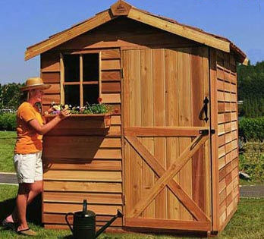
Decision Trees
Thompson Lumber Company needs to know whether to manufacture a new product: backyard
storage sheds

Slide 24
Decision Trees
What is the problem?

Slide 25
Decision Trees
To manufacture backyard storage sheds or not

Slide 26
Decision Trees
Generate a complete list of decision alternatives

Slide 27
Decision Trees
Suppose these were the alternatives the owner came up with:
Build a large plant to manufacture storage sheds
Build a small plant to manufacture storage sheds
Don’t do it

Slide 28
Decision Trees
Determine the cost of each alternative:
Alternative | Cost
Build large plant | $148,000
Build small plant | $46,000
Don’t do it | $0

Slide 29
Decision Trees
Identify all possible future outcomes

Slide 30
Decision Trees
Suppose these were the outcomes the owner came up with:
Demand is high
Demand is moderate
Demand is low
(They don’t have to be the same for all alternatives)

Slide 31
Decision Trees
What are the payouts for each outcome?
Consider payouts:
 | Demand is high | Demand is moderate | Demand is low
Payout | $200,000 | $100,000 | $20,000

Slide 32
Decision Trees
Define a measurable result from each combination of alternatives and outcomes

Slide 33
Decision Trees
What are all the combinations?

Slide 34
Decision Trees
All the combinations:
 | Demand is high | Demand is moderate | Demand is low
Build large plant
Build small plant
Don’t do it

Slide 35
Decision Trees
What are the results?
Consider profits:
 | Demand is high | Demand is moderate | Demand is low
Build large plant | $200,000 - $148,000 = $52,000 | $100,000 - $148,000 = -$48,000 | $20,000 - $148,000 = -$128,000
Build small plant | $200,000 - $46,000 = $154,000 | $100,000 - $46,000 = $54,000 | $20,000 - $46,000 = -$26,000
Don’t do it | $0 | $0 | $0

Slide 36
Decision Trees
The table may be all you need to make a decision!
 | Demand is high | Demand is moderate | Demand is low
Build large plant | $200,000 - $148,000 = $52,000 | $100,000 - $148,000 = -$48,000 | $20,000 - $148,000 = -$128,000
Build small plant | $200,000 - $46,000 = $154,000 | $100,000 - $46,000 = $54,000 | $20,000 - $46,000 = -$26,000
Don’t do it | $0 | $0 | $0

Slide 37

Decision Trees
Your boss may have trouble with it…
https://previews.123rf.com/images/thirteenfifty/thirteenfifty1201/thirteenfifty120100085/12091333-devil-boss-cartoon-Stock-Vector.jpg

Slide 38
Decision Trees
Another graphical way:
Build a tree!

Slide 39
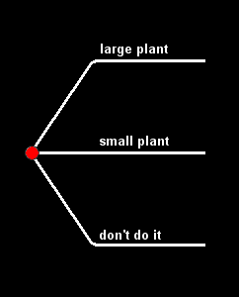
Decision Trees
Each branch of the tree is an alternative decision

Slide 40
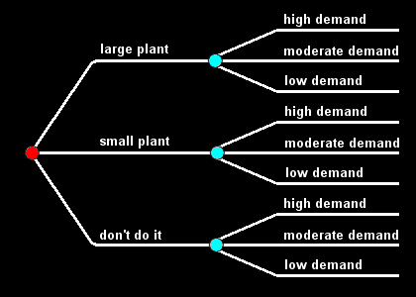
Decision Trees
Each sub-branch of the tree is a possible scenario

Slide 41
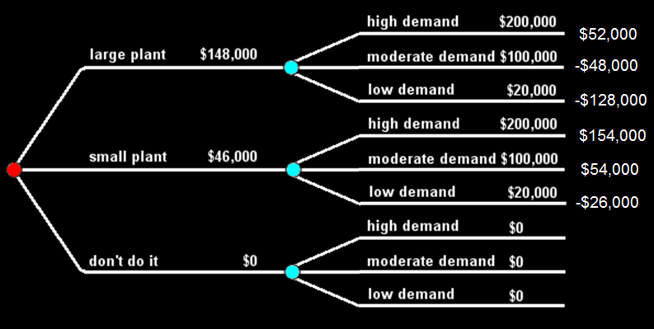
Decision Trees
The “leaves” are the possible outcomes

Slide 42
Decision Trees
Of all the decision support tools available, decision trees have several advantages

Slide 43
Decision Trees
Are simple to understand and interpret
People are able to understand decision tree models after a brief explanation

Slide 44
Decision Trees
Have value even with little hard data
Important insights can be generated based on experts describing a situation (its alternatives, probabilities, and costs) and their preferences for outcomes

Slide 45
Decision Trees
Possible scenarios can be added
Worst, best and expected values can be determined for different scenarios

Slide 46
Decision Trees
Disadvantages of decision trees:
Decision trees are biased in favor of those attributes with more levels

Slide 47
Decision Trees
Disadvantages of decision trees:
Calculations can get very complex particularly if many values are uncertain and/or if many outcomes are linked

Slide 48
Questions?

Slide 49
Decision Trees
Building a tree in Excel is nice because you always have to move stuff around (which is relatively easy in Excel)

Slide 50
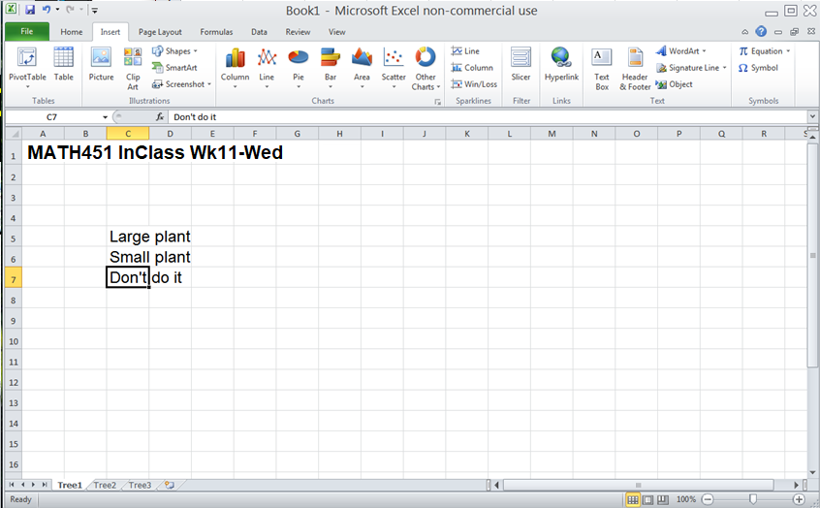
Decision Trees
Enter your first decisions:

Slide 51
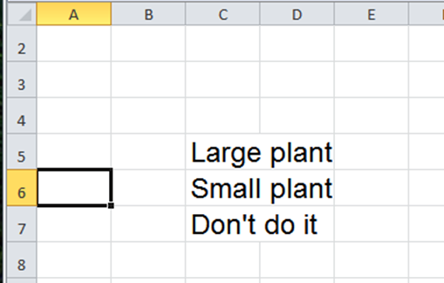
Decision Trees
To make it pretty, we add a starting point
Go to a good place for a starting point

Slide 52
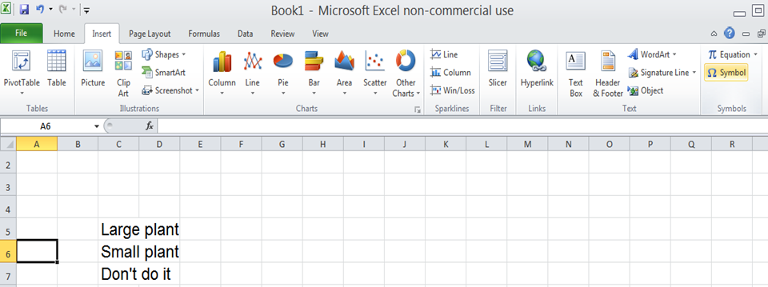
Decision Trees
Click on the “Insert” tab the click “Symbol”

Slide 53
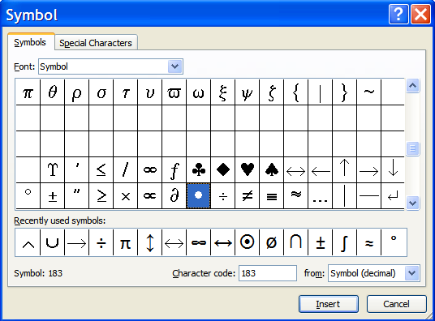
Decision Trees
Scroll down until you find a good starting point symbol
Click it
and hit
“Insert”
“Close”

Slide 54
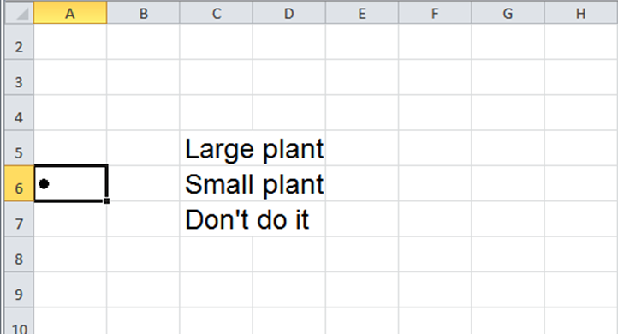
Decision Trees
Hit “Enter” on your keyboard

Slide 55
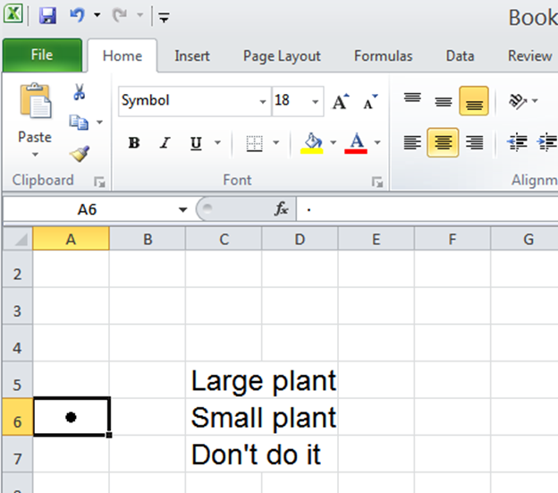
Decision Trees
Click on
the “Home”
tab and
click the
centered
text icon

Slide 56
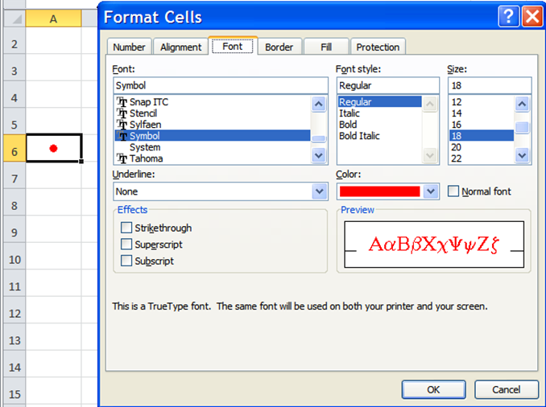
Decision Trees
You can
change
the
color

Slide 57
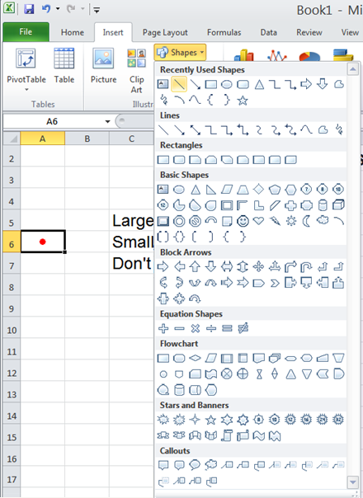
Decision Trees
To add lines
click “Insert”
“Shapes” and
select the line

Slide 58
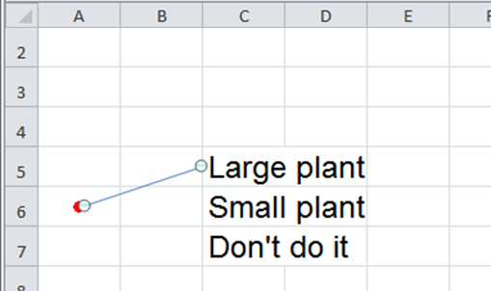
Decision Trees
Draw the line from the point to the first decision text

Slide 59
Decision Trees
You can change the width or color of the line at this point

Slide 60
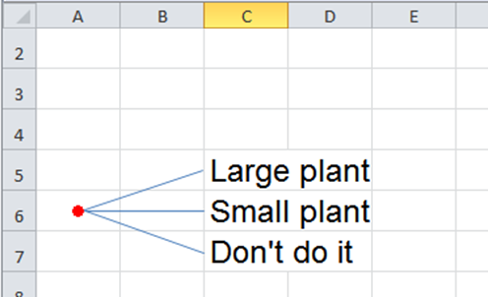
Decision Trees
Copy, paste and realign for all the initial branches of the tree

Slide 61
Decision Trees
Hand-drawn tree vs Excel tree

Slide 62
Decision Trees
Now, for the next decision point:

Slide 63
Decision Trees
Oops… we need more room on our tree

Slide 64
Decision Trees
We’ll need at least three lines for each or our initial decisions”
1
2
3
1
2
3
1
2
3

Slide 65
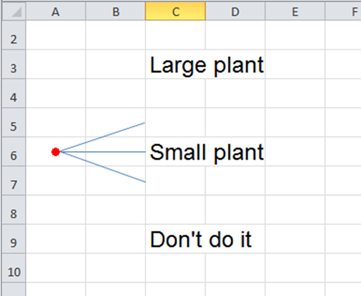
Decision Trees
Move your text

Slide 66
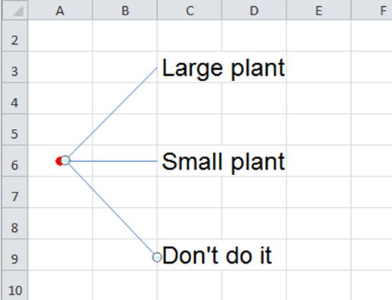
Decision Trees
And realign your lines

Slide 67
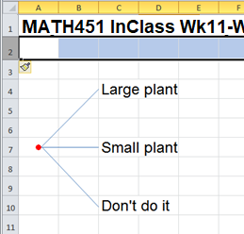
Decision Trees
I think I want to add another line under the
title

Slide 68
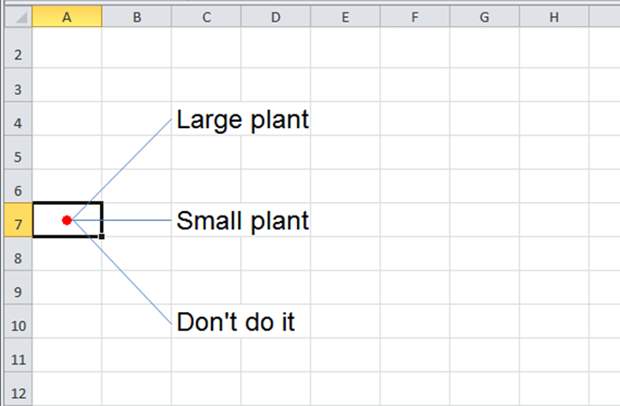
Decision Trees
Copy your starting point and line

Slide 69
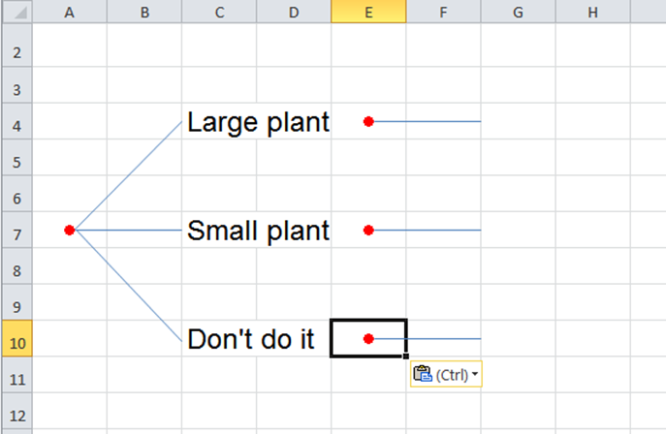
Decision Trees
Paste for the new decision points
(I got
a free
line,
too!)

Slide 70
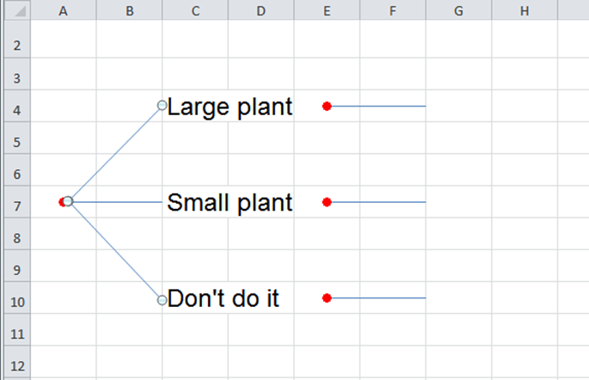
Decision Trees
Copy your diagonal lines

Slide 71
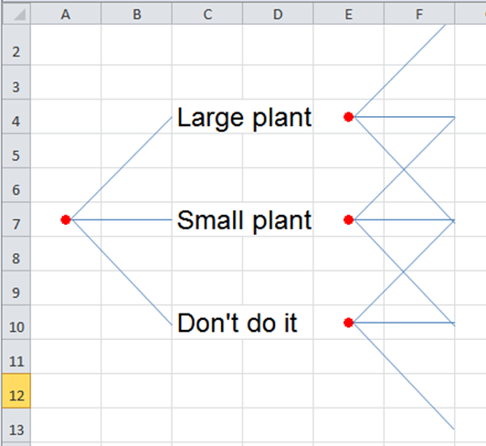
Decision Trees
Paste them and move them to the new
points
(don’t
worry,
we’ll fix
them in
a bit)

Slide 72
Decision Trees
Add the next decision text

Slide 73
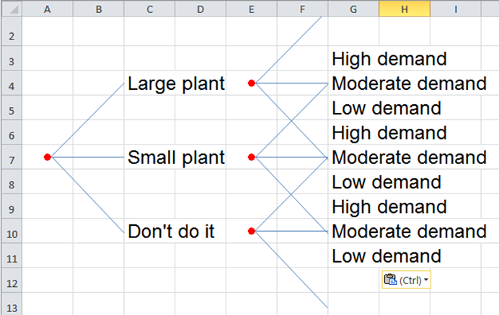
Decision Trees
Hmm… I think I want to add more lines to make it prettier…

Slide 74
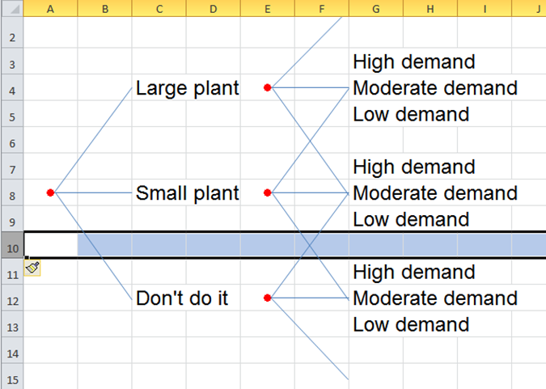
Decision Trees
Better!

Slide 75
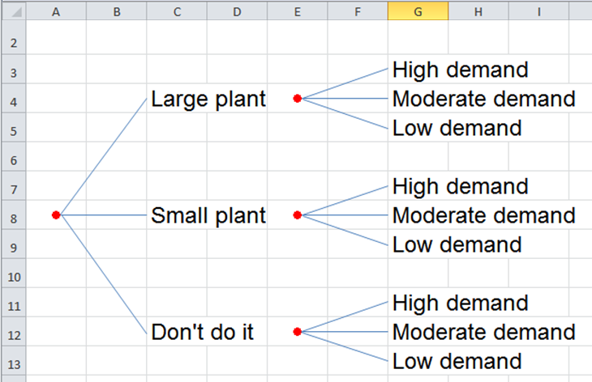
Decision Trees
Now realign the lines

Slide 76
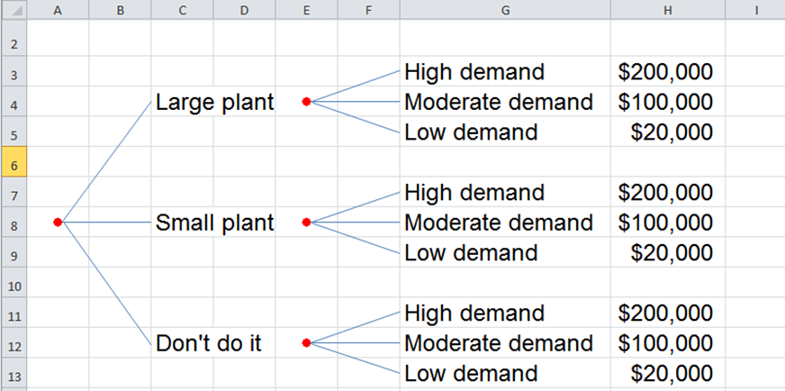
Decision Trees
Add the income values in “H” (I adjusted the width of column “G”)

Slide 77
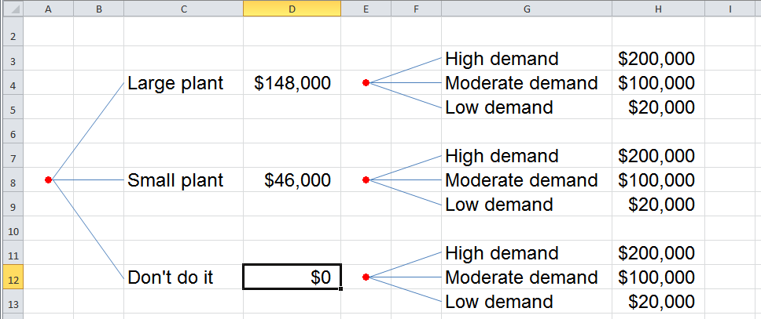
Decision Trees
Add the cost values in “D” (I adjusted the width of column “C”)

Slide 78
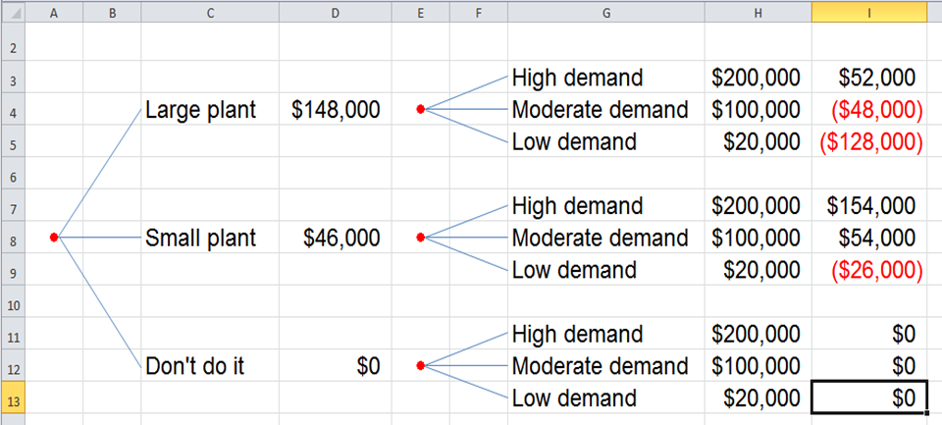
Decision Trees
And add the “leaves” – the profit projections

Slide 79
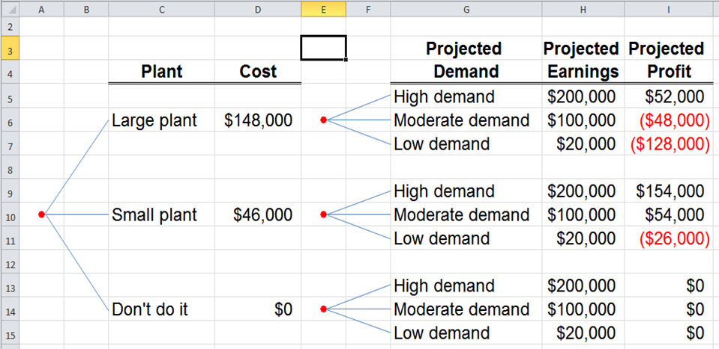
Decision Trees
You can label the columns:

Slide 80
Decision Trees
Once it’s in Excel, you can tweak and move things all you want!

Slide 81

Decision Trees
Bosses like trees!
https://previews.123rf.com/images/thirteenfifty/thirteenfifty1201/thirteenfifty120100085/12091333-devil-boss-cartoon-Stock-Vector.jpg

Slide 82
Questions?

Slide 83
Decision Trees + Prob
Thompson Lumber Company needs to know whether to manufacture a new product: backyard
storage sheds

Slide 84
Decision Trees + Prob
You’ve identified the decisions, the results and the profits…
 | Demand is high | Demand is moderate | Demand is low
Build large plant | $200,000 - $148,000 = $52,000 | $100,000 - $148,000 = -$48,000 | $20,000 - $148,000 = -$128,000
Build small plant | $200,000 - $46,000 = $154,000 | $100,000 - $46,000 = $54,000 | $20,000 - $46,000 = -$26,000
Don’t do it | $0 | $0 | $0

Slide 85
Decision Trees + Prob
You’ve built a tree!
Plant Cost Proj Proj Proj
Demand Earnings Profit

Slide 86
Decision Trees + Prob
What if you think you know the probabilities of the different outcomes?
You can add that, too!

Slide 87

Decision Trees + Prob
But… it’s not the same as the probability we used for Assignments

Slide 88
Decision Trees + Prob
Mutually exclusive events:
If event A occurs then
event B cannot occur

Slide 89
Decision Trees + Prob
Mutually exclusive events:
Event A: I am 5’ 2” tall today
Event B: I am 5’ 6” tall today

Slide 90
Decision Trees + Prob
What is the probability an Internet subscriber uses 61-80 minutes?
Minutes Internet Usage | Probability
1-20 | 17%
21-40 | 35%
41-60 | 29%
61-80 | 15%
81-100 | 2%
101-120 | 0%
121+ | 2%

Slide 91
Decision Trees + Prob
P(61-80 minutes) = 15%
Minutes Internet Usage | Probability
1-20 | 17%
21-40 | 35%
41-60 | 29%
61-80 | 15%
81-100 | 2%
101-120 | 0%
121+ | 2%

Slide 92
Decision Trees + Prob
What is the probability an Internet subscriber uses 1-20 minutes?
Minutes Internet Usage | Probability
1-20 | 17%
21-40 | 35%
41-60 | 29%
61-80 | 15%
81-100 | 2%
101-120 | 0%
121+ | 2%

Slide 93
Decision Trees + Prob
P(1-20 minutes) = 17%
Minutes Internet Usage | Probability
1-20 | 17%
21-40 | 35%
41-60 | 29%
61-80 | 15%
81-100 | 2%
101-120 | 0%
121+ | 2%

Slide 94
Decision Trees + Prob
What is the probability an Internet subscriber uses 1-20 OR 61-80 minutes?
Minutes Internet Usage | Probability
1-20 | 17%
21-40 | 35%
41-60 | 29%
61-80 | 15%
81-100 | 2%
101-120 | 0%
121+ | 2%

Slide 95
Decision Trees + Prob
P(1-20 min OR 61-80 min)
= P(1-20 min) + P(61-80 min)
= 17% + 15%
= 32%
Minutes Internet Usage | Probability
1-20 | 17%
21-40 | 35%
41-60 | 29%
61-80 | 15%
81-100 | 2%
101-120 | 0%
121+ | 2%

Slide 96
Decision Trees + Prob
This is called the
Addition Rule

Slide 97
Decision Trees + Prob
If two categories are
“mutually exclusive”
(can’t happen at the same time)
you add their probabilities to get the probability of one
OR
the other

Slide 98
Decision Trees + Prob
How to tell when to use the Addition Rule and when to use the Multiplication Rule

Slide 99
Decision Trees + Prob
If it’s “A and B and C and D”
use the Multiplication Rule
If it’s “A or B or C or D” use the Addition Rule

Slide 100
Decision Trees + Prob
Suppose we believe:
the probability of high demand is 30%
the probability of moderate demand is 50%
the probability of low demand is 20%

Slide 101
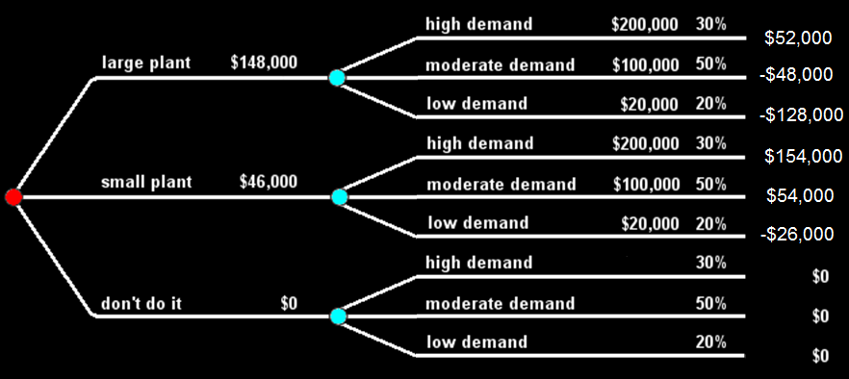
Decision Trees + Prob
Which will give incomes higher than the cost of operation?
Plant Cost Proj Proj Prob Proj
Demand Earnings Profit

Slide 102
Decision Trees + Prob
Plant Cost Proj Proj Prob Proj
Demand Earnings Profit

Slide 103
Decision Trees + Prob
What is the probability a large plant will bring a profit?
Plant Cost Proj Proj Prob Proj
Demand Earnings Profit

Slide 104
Decision Trees + Prob
30%
Plant Cost Proj Proj Prob Proj
Demand Earnings Profit

Slide 105
Decision Trees + Prob
What is the probability a small plant will bring a profit?
Plant Cost Proj Proj Prob Proj
Demand Earnings Profit

Slide 106
Decision Trees + Prob
50% + 30% = 80%
Plant Cost Proj Proj Prob Proj
Demand Earnings Profit

Slide 107
Decision Trees + Prob
What would you do?
Plant Cost Proj Proj Prob Proj
Demand Earnings Profit

Slide 108
Decision Trees + Prob
You can calculate “Expected Monetary Value” (EMV) using the profit and probability values

Slide 109
Decision Trees + Prob
Multiply each profit by its probability to calculate the EMV
Plant Cost Proj Proj Prob Proj
Demand Earnings Profit

Slide 110
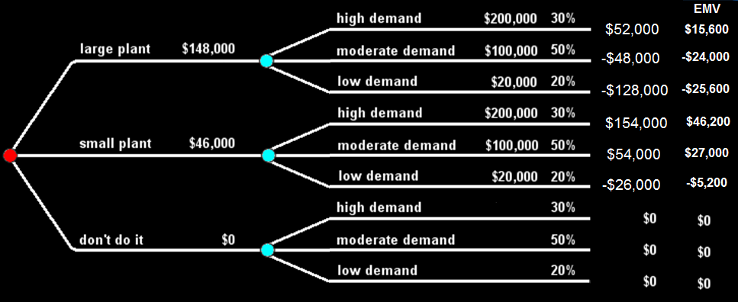
Decision Trees + Prob
You add the EMVs if you want to find the EMV for a branch
Plant Cost Proj Proj Prob Proj EMV
Demand Earnings Profit

Slide 111
Decision Trees + Prob
What is the EMV for a large plant?
Plant Cost Proj Proj Prob Proj EMV
Demand Earnings Profit

Slide 112
Decision Trees + Prob
What is the EMV for a small plant?
Plant Cost Proj Proj Prob Proj EMV
Demand Earnings Profit

Slide 113
Decision Trees + Prob
What is the EMV for “don’t do it”?
Plant Cost Proj Proj Prob Proj EMV
Demand Earnings Profit

Slide 114
Decision Trees + Prob
Compare the EMVs:
Large plant = -$34,000
Small plant = $68,000
Don’t do it = $0

Slide 115
Decision Trees + Prob
Bosses hate
tables
https://previews.123rf.com/images/thirteenfifty/thirteenfifty1201/thirteenfifty120100085/12091333-devil-boss-cartoon-Stock-Vector.jpg

Slide 116

Decision Trees + Prob
They don’t want to
have to figure
stuff out
https://previews.123rf.com/images/thirteenfifty/thirteenfifty1201/thirteenfifty120100085/12091333-devil-boss-cartoon-Stock-Vector.jpg

Slide 117

Decision Trees + Prob
They prefer
graphics
https://previews.123rf.com/images/thirteenfifty/thirteenfifty1201/thirteenfifty120100085/12091333-devil-boss-cartoon-Stock-Vector.jpg

Slide 118

Decision Trees + Prob
They like trees
https://previews.123rf.com/images/thirteenfifty/thirteenfifty1201/thirteenfifty120100085/12091333-devil-boss-cartoon-Stock-Vector.jpg

Slide 119
Decision Trees + Prob
…and EMVs are easy
for bosses to
understand
https://previews.123rf.com/images/thirteenfifty/thirteenfifty1201/thirteenfifty120100085/12091333-devil-boss-cartoon-Stock-Vector.jpg

Slide 120
Decision Trees + Prob
Try the other problems in the Project

Slide 121
Questions?

Slide 122
Summary
Today we studied:
Review of Project Management Charts
Decision Trees

Slide 123

You Survived!
www.playbuzz.com

