Slide 1
Welcome to
Unit 7 Part 14
MATH366 Probability and Statistics
https://online.stanford.edu/sites/default/files/styles/figure_default/public/2018-04/theory-of-probability_stats116.jpg?itok=ms4fRMO-

Slide 2
What’s Up?
Today we will be going over:
Review: Types of discrete probabilities New: Uses for discrete probabilities

Slide 3
What’s Up?
Outcome 3) Modeling will be assisted by Monte Carlo simulations run with mathematical software
Outcome 4) Calculate the parameters of several discrete random variable distributions and compute the probability of events in a typical discrete event application

Slide 4

Review
http://995642590.r.lightningbase-cdn.com/wp-content/uploads/2010/12/looking-back-hrexaminer-v144-cover425px.jpg

Slide 5
Random Variables
A random variable
“varies”
(not always the same)
is “random”

Slide 6
Random Variables
A random variable…
Is a way to quantify outcomes
of unforecastable processes
This allows us to do arithmetic with the outcomes

Slide 7
Random Variables
There are two types of random variables:
discrete - has countable
values
continuous - can take on
any value in an interval
- can have an
infinite number of
outcomes

Slide 8
Binomial Probability
Variables that can have only two values are called:
“binomial”
The values are mutually exclusive events

Slide 9
Binomial Probability
A binomial experiment:
trials are done a fixed number
of times
the trials are independent
each has two mutually exclusive
outcomes: success or failure
the probability of success is
the same for each trial

Slide 10
Binomial Probability
Notation:
“n” trials
“p” is the probability of
success
“q” or “1-p” is the
probability of failure
“X” is the number of
successes in the “n” trials

Slide 11
Binomial Probability
The probability of getting exactly X success in n trials, with the probability of success on a single trial being p is:
P(X) = _{n}C_{x} × p^{x} × q^{n-x}
In Excel:
P(X)=BINOM.DIST(X,n,p,FALSE)

Slide 12
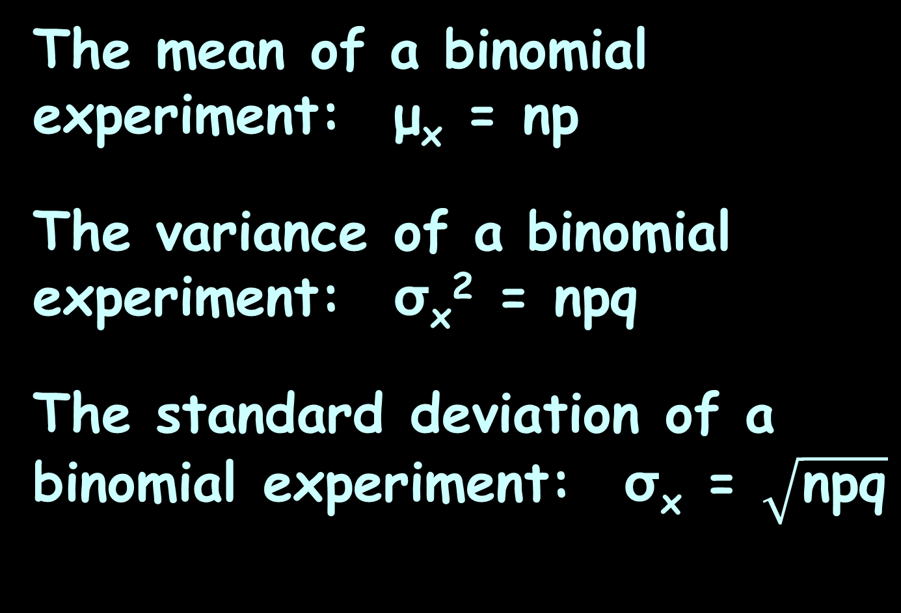
Binomial Probability
The mean of a binomial experiment: μ_{x} = np
The variance of a binomial experiment: σ_{x}² = npq
The standard deviation of a binomial experiment: σ_{x} = $\sqrt{\text{npq}}$

Slide 13
Hypergeometric
Describes the probability of k successes in n draws, without replacement, from a finite population of size N that contains exactly K objects with a desired feature, where each draw is either a success or a failure

Slide 14
Hypergeometric
In contrast, the binomial distribution describes the probability of k successes in n draws with replacement

Slide 15
Poisson
Is a discrete probability distribution for the probability of a given number of events occurring in a fixed interval of time (or space) when the events happen with a known constant rate and independently of the time since the last event

Slide 16

Questions?
http://i.imgur.com/aliTlT3.jpg

Slide 17
Assignment
Open the spreadsheet in the Portal

Slide 18
Assignment
Sometimes you need to make decisions about assigning people to jobs, tasks to machines, etc.

Slide 19
Assignment
These are called “Assignment Problems”

Slide 20
Assignment
In addition, you want to minimize or maximize something: cost, hours, maintenance, etc.

Slide 21
Assignment
…and…
you can’t assign half a person to a task or 0.93 of a machine, so you may have to tweak the problem to find the optimal whole number

Slide 22
Assignment
Assignment problems are complicated, but we can set them up in Excel

Slide 23
Assignment
Suppose your company has three employees:
Ayesha, Brad and Carlos

Slide 24
Assignment
Suppose you have three projects you want to assign these employees to with the goal of minimizing labor costs
(it doesn’t have to be the same number of projects as employees)

Slide 25
Assignment
You could just flip a coin or roll dice to determine who is assigned to each project

Slide 26
Assignment
But, suppose you know the projects and your employees well enough to know that some assignments would work better than others

Slide 27
Assignment
Suppose past experience has given you this information on how much it would cost for each employee to do each project:
Employee | Project 1 | Project 2 | Project 3
Ayesha | $11 | $14 | $6
Brad | $8 | $10 | $11
Carlos | $9 | $12 | $7
VFrench, 2022

Slide 28
Assignment
Who would you probably have do project 1?
How about project 2?
Project 3?
Employee | Project 1 | Project 2 | Project 3
Ayesha | $11 | $14 | $6
Brad | $8 | $10 | $11
Carlos | $9 | $12 | $7
VFrench, 2022

Slide 29
Assignment
But you don’t want to assign Brad to two projects and Carlos to none – you want one employee for each project!

Slide 30
Assignment
Sometimes you need a little help seeing what is the best solution!

Slide 31
Assignment
How many ways can you assign the projects to the employees?

Slide 32
Assignment
Project 1 could be any of your three employees

Slide 33
Assignment
Once Project 1 has been assigned, there are only two employees left for project 2

Slide 34
Assignment
Once Projects 1 and 2 have been assigned, there is only one employee left for project 3

Slide 35
Assignment
So, there are
3 x 2 x 1 = 6
ways you can assign the projects

Slide 36
Assignment
The formula for how many ways you can assign “k” tasks to “n” employees (with no double assignments) is:
n! / (n-k)!

Slide 37
Assignment
The symbol ! means:
n! = n*(n-1)*(n-2)*(n-3)*... *3*2*1
So: n!/(n-k)! = 3!/(3-3)!
and 0! is defined to be 1

Slide 38
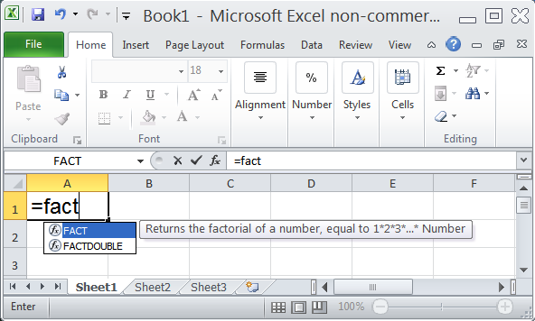
Assignment
In Excel, the ! function is “FACT” for “factorial”
VFrench, 2022

Slide 39
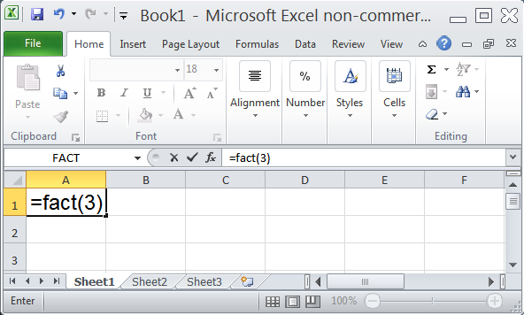
Assignment
VFrench, 2022

Slide 40
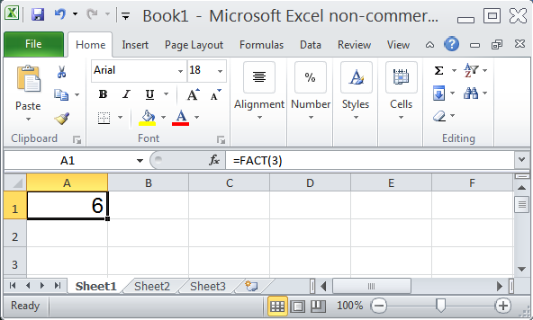
Assignment
VFrench, 2022

Slide 41
Assignment
Now that we know there are six possible ways to make the assignment, we need to list what those possibilities are

Slide 42
Assignment
New table!
Project Assignment
1 | 2 | 3
Ayesha | Brad | Carlos
Ayesha | Carlos | Brad
Brad | Ayesha | Carlos
Brad | Carlos | Ayesha
Carlos | Ayesha | Brad
Carlos | Brad | Ayesha
VFrench, 2022

Slide 43
Assignment
What would the labor costs be for each assignment?
Employee | Project 1 | Project 2 | Project 3
Ayesha | $11 | $14 | $6
Brad | $8 | $10 | $11
Carlos | $9 | $12 | $7
Project Assignment
1 | 2 | 3 | Labor Costs
Ayesha | Brad | Carlos | $11 + $10 + $7
Ayesha | Carlos | Brad | $11 + $12 + $11
Brad | Ayesha | Carlos | $8 + $14 + $7
Brad | Carlos | Ayesha | $8 + $12 + $6
Carlos | Ayesha | Brad | $9 + $14 + $11
Carlos | Brad | Ayesha | $9 + $10 + $6
VFrench, 2022

Slide 44
Assignment
So, which is the most cost-effective assignment?
Project Assignment
1 | 2 | 3 | Labor Costs |  | Total Costs
Ayesha | Brad | Carlos | $11 + $10 + $7 | = | $28
Ayesha | Carlos | Brad | $11 + $12 + $11 | = | $34
Brad | Ayesha | Carlos | $8 + $14 + $7 | = | $29
Brad | Carlos | Ayesha | $8 + $12 + $6 | = | $26
Carlos | Ayesha | Brad | $9 + $14 + $11 | = | $34
Carlos | Brad | Ayesha | $9 + $10 + $6 | = | $25
VFrench, 2022

Slide 45
Assignment
So, which is the most cost-effective assignment?
Project Assignment
1 | 2 | 3 | Labor Costs |  | Total Costs
Ayesha | Brad | Carlos | $11 + $10 + $7 | = | $28
Ayesha | Carlos | Brad | $11 + $12 + $11 | = | $34
Brad | Ayesha | Carlos | $8 + $14 + $7 | = | $29
Brad | Carlos | Ayesha | $8 + $12 + $6 | = | $26
Carlos | Ayesha | Brad | $9 + $14 + $11 | = | $34
Carlos | Brad | Ayesha | $9 + $10 + $6 | = | $25
VFrench, 2022

Slide 46
Questions?
http://i.imgur.com/aliTlT3.jpg

Slide 47
Assignment
Go to the “Minimum-Time Assignment” problem
Suppose you have 4 employees:
Alice, Bob, Carmen and Dewan

Slide 48
Assignment
Suppose you need to assign them to 2 tasks

Slide 49
Assignment
Suppose you want to minimize the time it takes to complete the two tasks

Slide 50
Assignment
Suppose you know from past experience that the time in hours needed for each employee to complete each task would be:
 | Task1 | Task2
Alice | 1.50 | 2.00
Bob | 1.25 | 3.25
Carmen | 2.00 | 2.25
Dewan | 1.75 | 2.50
VFrench, 2022

Slide 51
Assignment
How many ways can you assign the tasks?

Slide 52
Assignment
Task1: 4 possible employees
Task2: 3 possible employees
(You will end up with 2 employees unassigned)

Slide 53
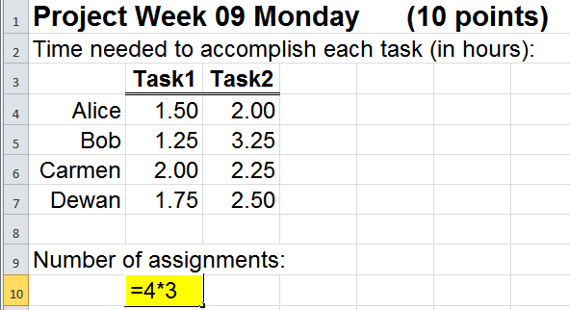
Assignment
Number of assignments:
= n!/(n-k)! = 4!/(4-2)! = 12
VFrench, 2022

Slide 54
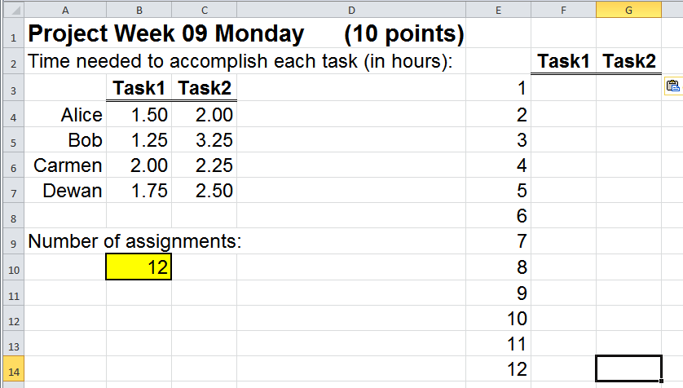
Assignment
Set up a table to list all 12 of the assignments:
VFrench, 2022

Slide 55
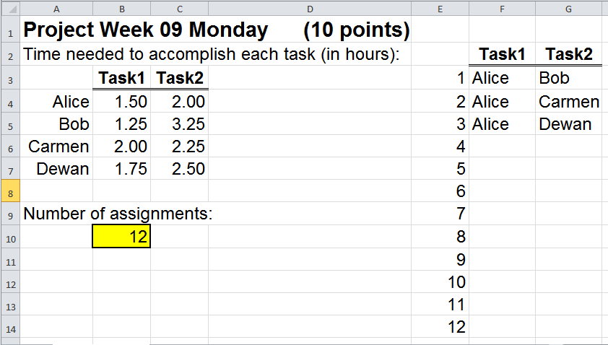
Assignment
First: Alice
VFrench, 2022

Slide 56
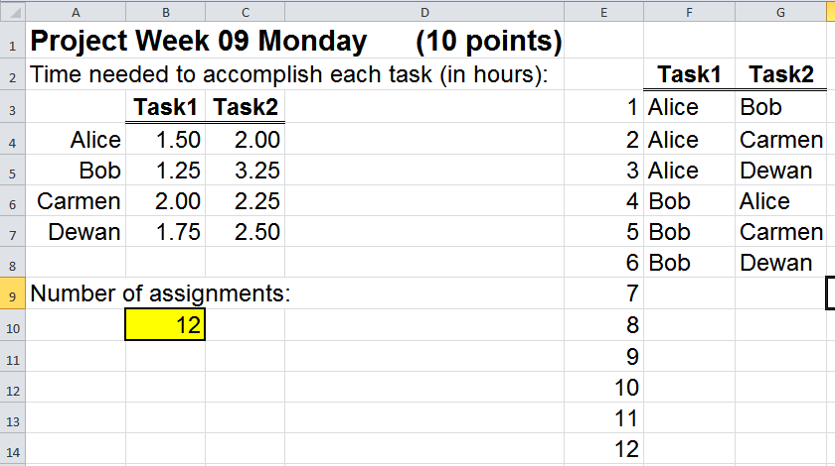
Assignment
Next add: Bob
VFrench, 2022

Slide 57
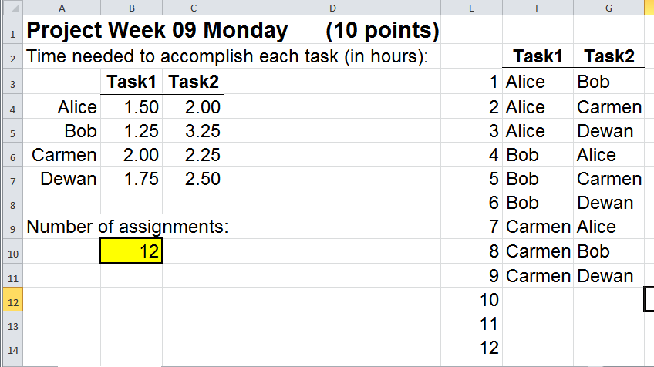
Assignment
Next: Carmen
VFrench, 2022

Slide 58
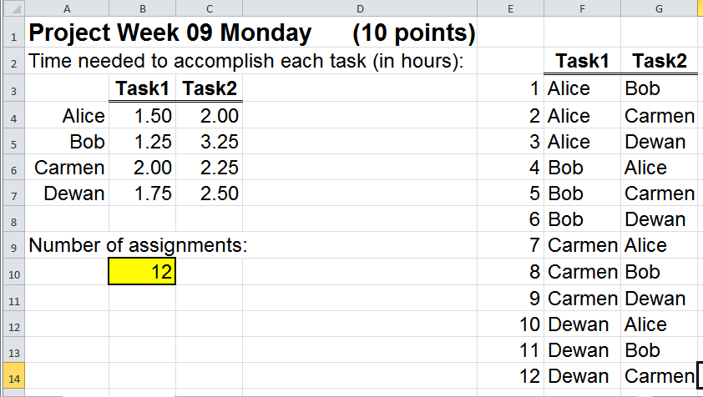
Assignment
Last: Dewan
VFrench, 2022

Slide 59
Assignment
This is why we calculate how many assignments first – it is SO easy to leave one out or duplicate one!

Slide 60
Assignment
OK, now we’re set up…
how do we do the calculation?

Slide 61
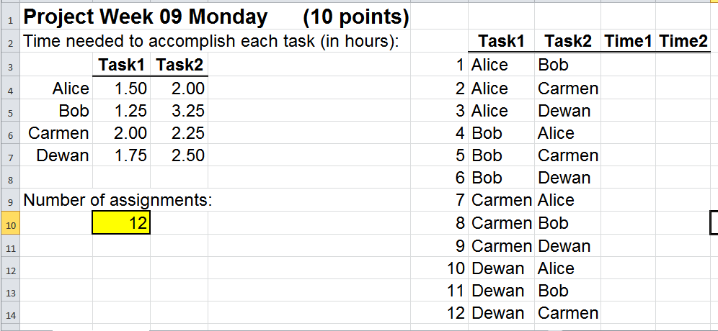
Assignment
Create a couple of columns to get the time values for each assignment:
VFrench, 2022

Slide 62
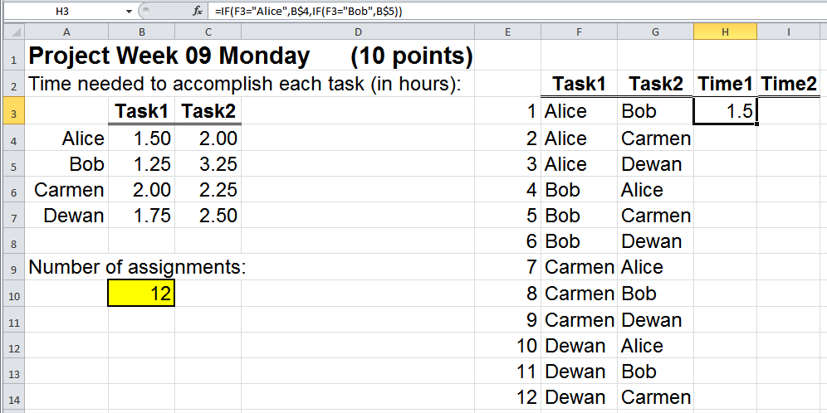
Assignment
Enter the amount of time it would take Alice to do Task1
VFrench, 2022

Slide 63
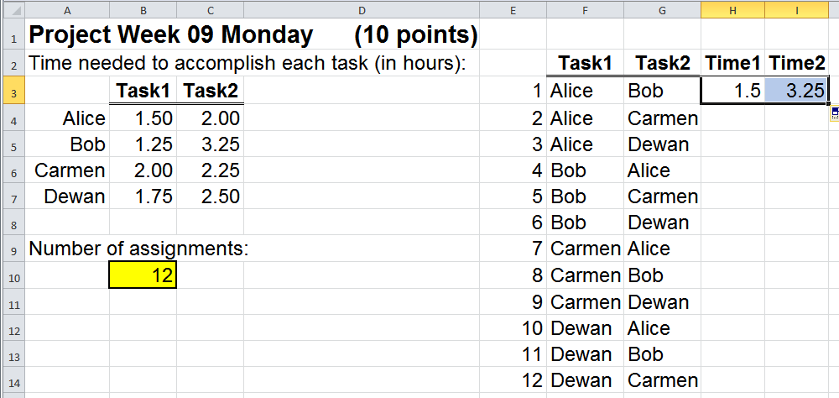
Assignment
Enter the amount of time it would take Bob to do Task2
VFrench, 2022

Slide 64
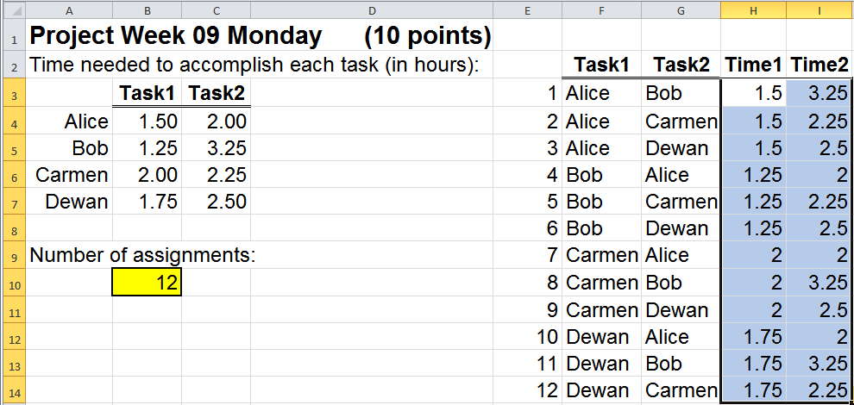
Assignment
Keep going!
VFrench, 2022

Slide 65
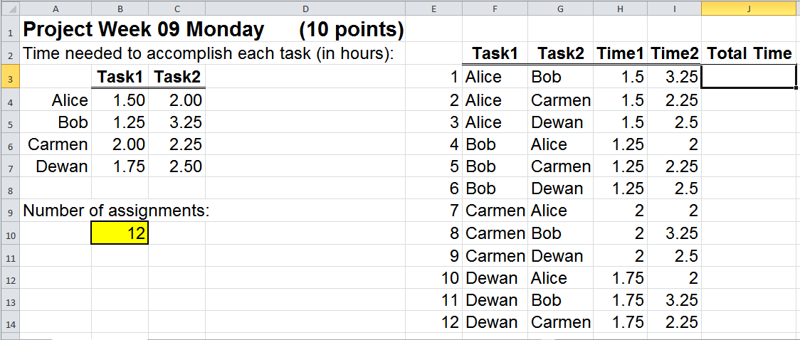
Assignment
Now we can calculate how much time each assignment will take
VFrench, 2022

Slide 66
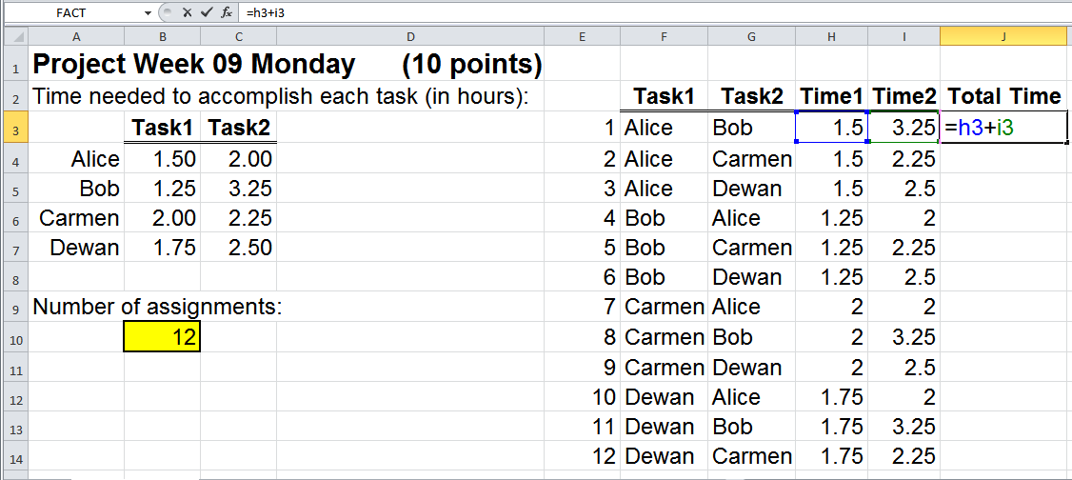
Assignment
The total time will be:
=h3+i3
VFrench, 2022

Slide 67
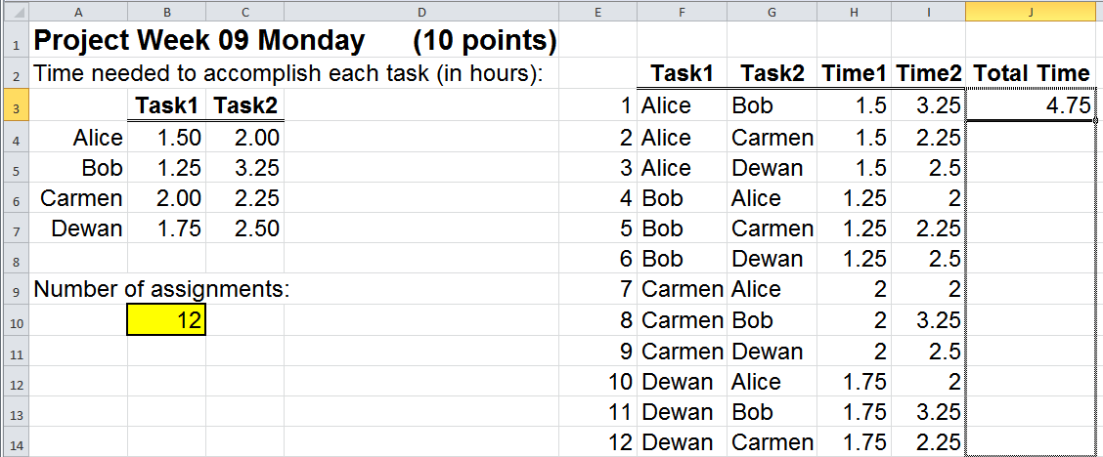
Assignment
Can we copy that down?
VFrench, 2022

Slide 68
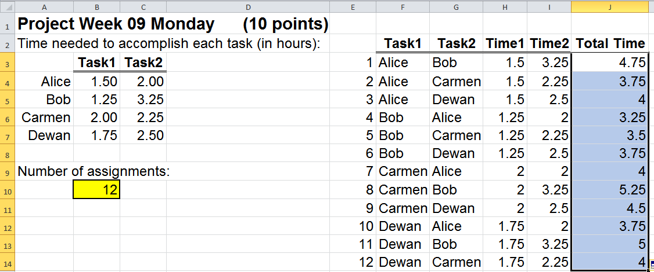
Assignment
Now we have the time values for each assignment:
VFrench, 2022

Slide 69
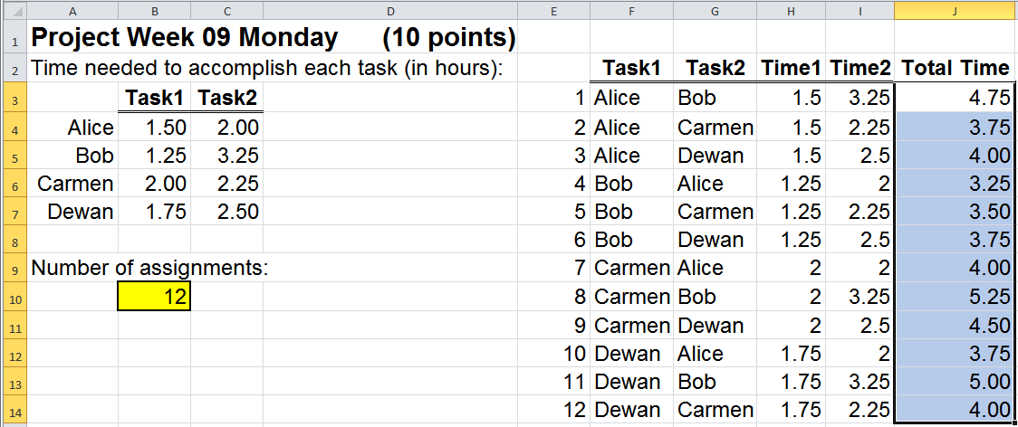
Assignment
So, what is the minimum?
VFrench, 2022

Slide 70
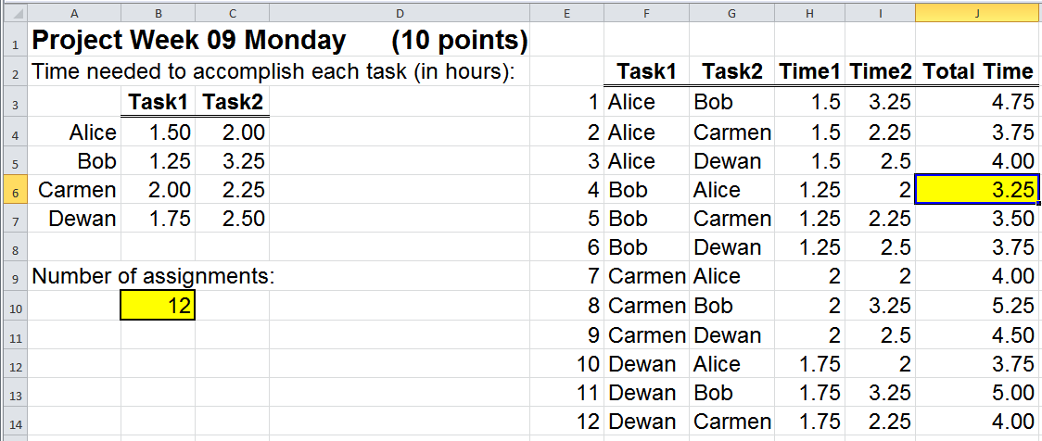
Assignment
Bob should be assigned to task1 and Alice to task2
VFrench, 2022

Slide 71
Questions?
http://i.imgur.com/aliTlT3.jpg

Slide 72
Probability Assignment
Some Assignment problems are about minimizing time spent
Some are about minimizing cost or maximizing profit
Some are about minimizing the number of errors

Slide 73
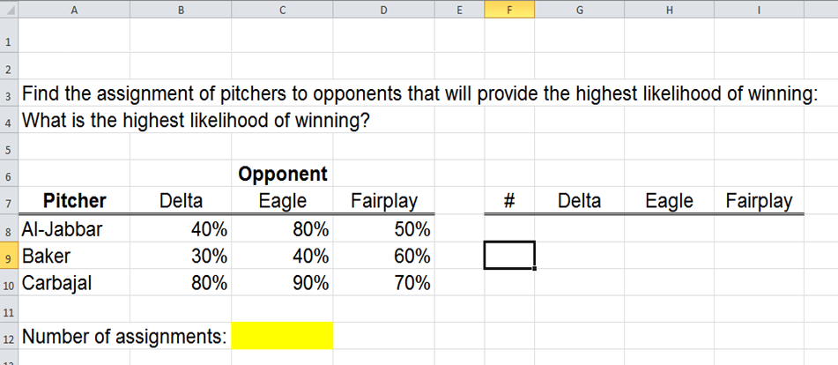
Probability Assignment
Some are about probabilities:
VFrench, 2022

Slide 74
Probability Assignment
When we had assignments problems trying to minimize time or cost we had to add the values to get the total time or cost

Slide 75
Probability Assignment
When we have a problem with probabilities, we will have to multiply the probabilities to get the total probability

Slide 76
Probability Assignment
The spreadsheet on the Portal:
VFrench, 2022

Slide 77
Probability Assignment
How many assignments are possible?

Slide 78
Probability Assignment
Delta: 3
Eagle: 3
Fairplay: 3

Slide 79
Probability Assignment
Hmm???

Slide 80
Probability Assignment
For this problem, you may want to reuse the pitcher at different locations

Slide 81
Probability Assignment
If the n employees can be assigned to multiple tasks, the formula for how many ways you can assign “k” tasks to “n” employees is:
n^{k}

Slide 82
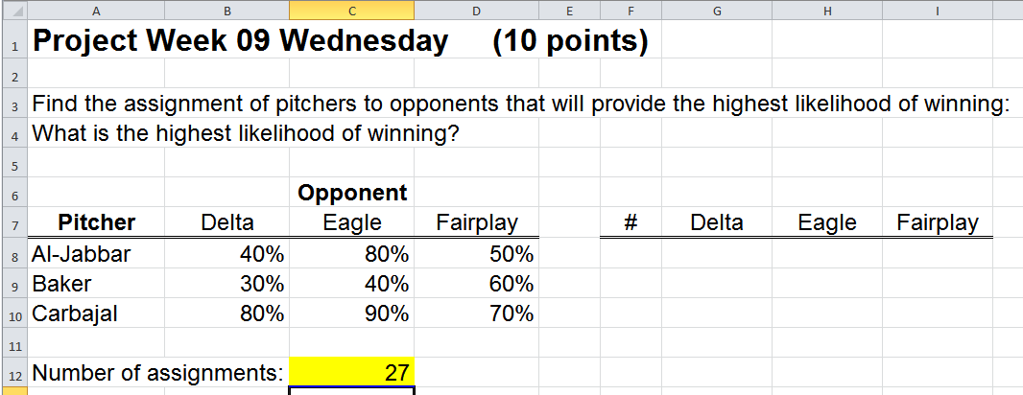
Probability Assignment
So the number of assignments is: 3³ = 27
VFrench, 2022

Slide 83
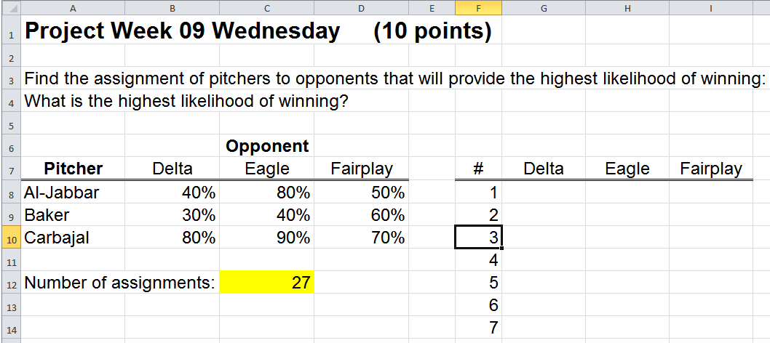
Probability Assignment
Set up the assignment list down to 27 possibilities (line 34):
VFrench, 2022

Slide 84
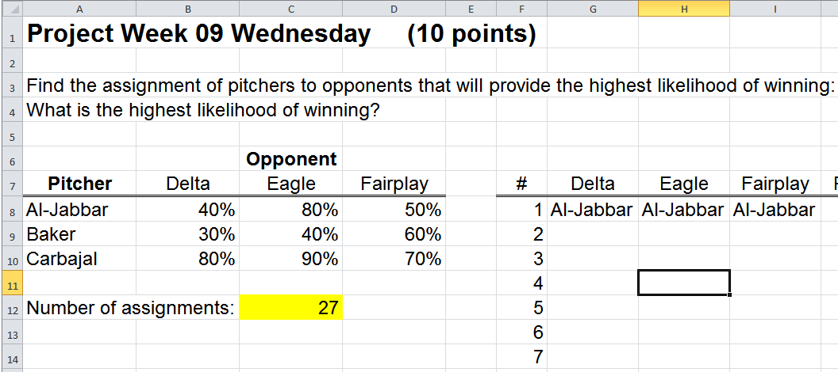
Probability Assignment
Fill in the possible assignments
Al-Jabbar gets three games:
VFrench, 2022

Slide 85
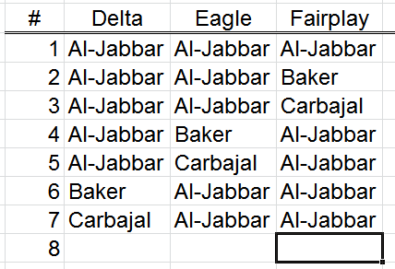
Probability Assignment
Al-Jabbar gets two games:
VFrench, 2022

Slide 86
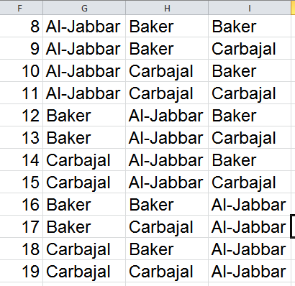
Probability Assignment
Al-Jabbar gets one game:
VFrench, 2022

Slide 87
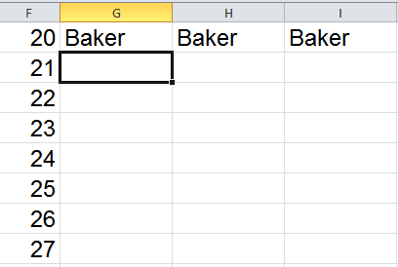
Probability Assignment
Baker could also get three games:
VFrench, 2022

Slide 88
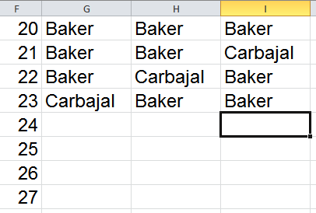
Probability Assignment
Or two games (without Al-Jabbar being one of the pitchers):
VFrench, 2022

Slide 89
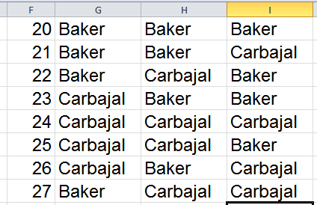
Probability Assignment
And the same for Carbajal:
VFrench, 2022

Slide 90
Probability Assignment
NOW DO YOU SEE WHY IT IS ABSOLUTELY CRITICAL THAT YOU CALCULATE THE NUMBER OF ASSIGNMENTS FIRST??

Slide 91
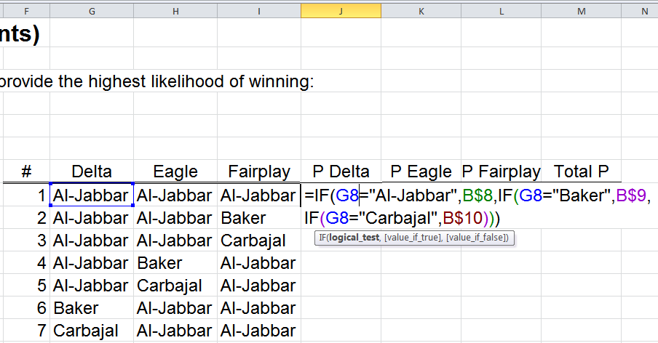
Probability Assignment
Now for our probability calculations:
VFrench, 2022

Slide 92
Probability Assignment
=IF(G8="Al-Jabbar",B$8,IF(G8=
"Baker",B$9,IF(G8="Carbajal",B$10)))
VFrench, 2022

Slide 93
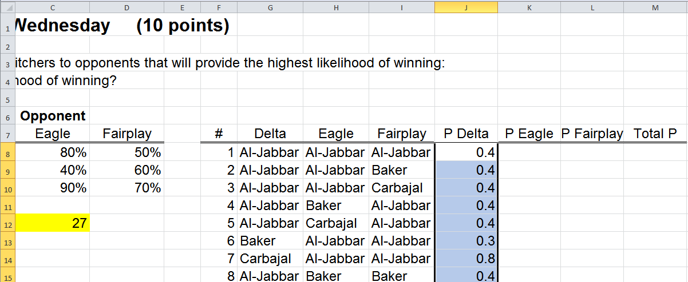
Probability Assignment
Copy down
VFrench, 2022

Slide 94
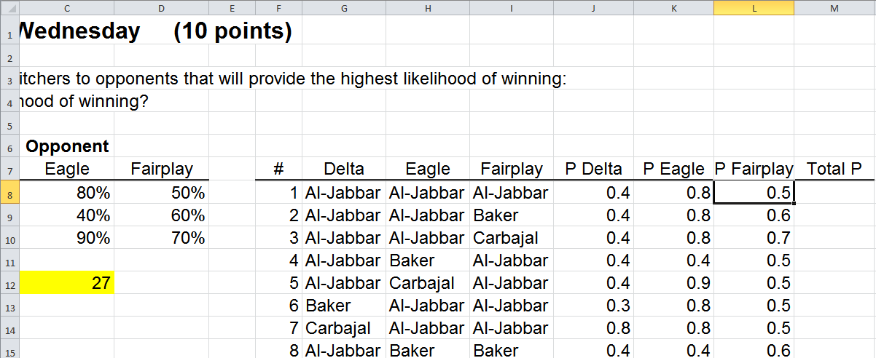
Probability Assignment
Copy right
VFrench, 2022

Slide 95
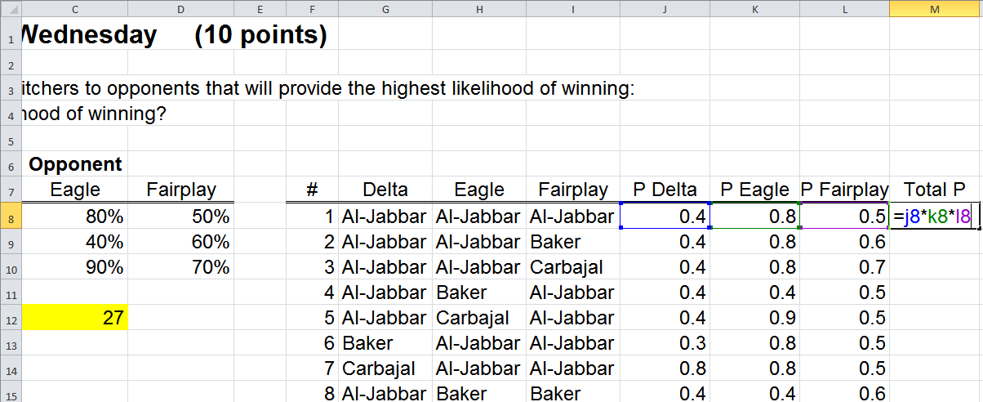
Probability Assignment
Calculate the total probability:
=j8*k8*l8
VFrench, 2022

Slide 96
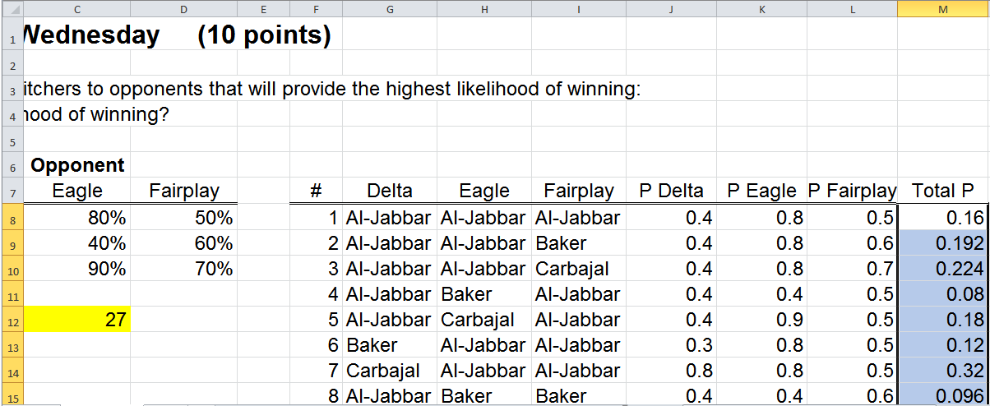
Probability Assignment
Copy down
VFrench, 2022

Slide 97
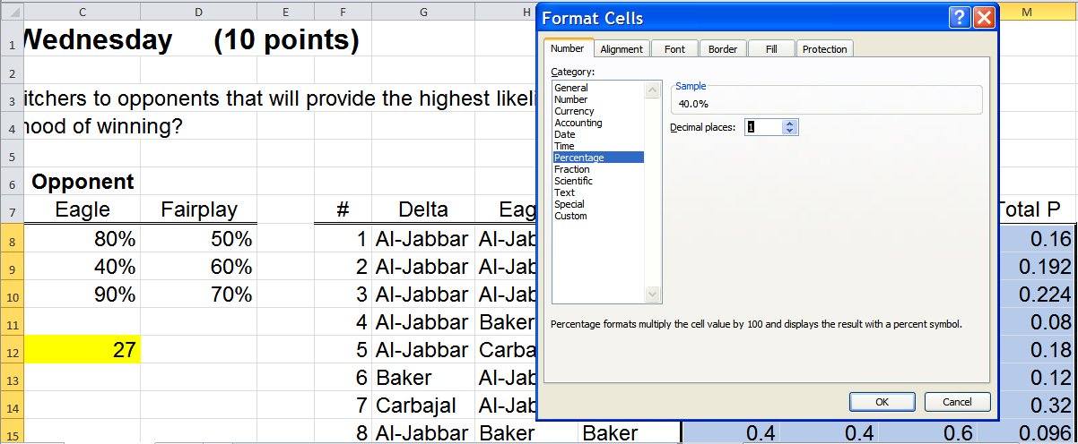
Probability Assignment
Change everything to % so it’s easier to understand
VFrench, 2022

Slide 98
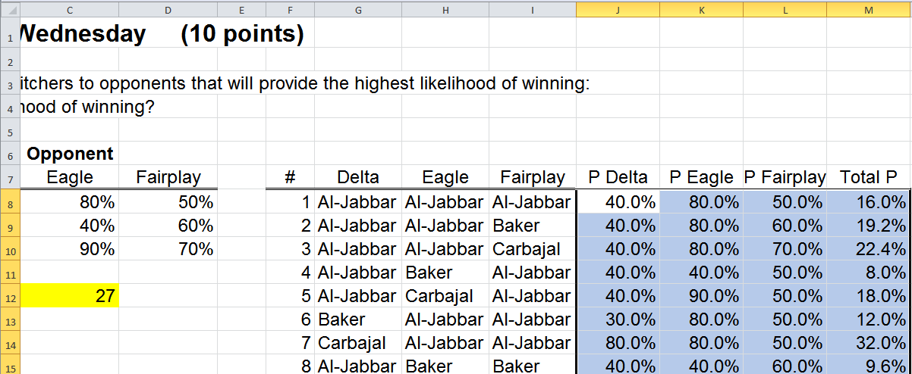
Probability Assignment
What is the pitching assignment that will give the highest probability of winning all the games?
VFrench, 2022

Slide 99
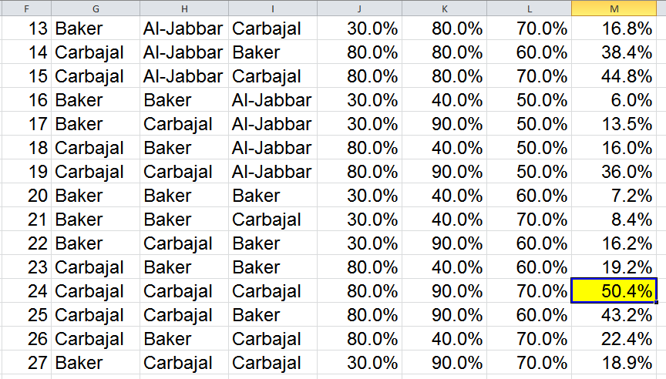
Probability Assignment
Best chance:
VFrench, 2022

Slide 100
Probability Assignment
So, the highest probability of winning all games (50.4%) is to have Carbajal pitch all three games

Slide 101
Probability Assignment
Try the other problems in the Project

Slide 102
Questions?
http://i.imgur.com/aliTlT3.jpg

Slide 103
Summary
Today we studied:
Review of types of discrete probabilities
New: Discrete probabilities in assignment problems

Slide 104

You Survived!
www.playbuzz.com

