Slide 1
Welcome to
Unit 5 Part 09
MATH366 Probability and Statistics
https://online.stanford.edu/sites/default/files/styles/figure_default/public/2018-04/theory-of-probability_stats116.jpg?itok=ms4fRMO-

Slide 2
What’s Up?
Today we will be going over:
Review of Discrete Probability
New: Counting Principles
Combinatorics

Slide 3
What’s Up?
Outcome 2) Formulate models for the probability of simple events and then apply the properties of probabilities to calculate the probabilities of complex events

Slide 4

Review
http://995642590.r.lightningbase-cdn.com/wp-content/uploads/2010/12/looking-back-hrexaminer-v144-cover425px.jpg

Slide 5
Probability
Probability is defined to be:
# favorable outcomes
total # of outcomes
P =

Slide 6
Probability
Because the # favorable outcomes is always less than or equal to the total # of outcomes and cannot be less than zero:
0 ≤ P ≤ 1
or
0% ≤ P ≤ 100%

Slide 7
Probability
A probability cannot be bigger than 1.00 (100%)
A probability cannot be negative

Slide 8
Probability
And
P(all possible outcomes) = 100%

Slide 9
Probability
Probability calculations assume each outcome is equally likely to occur –
RANDOM

Slide 10
Probability
The complement of an outcome is all outcomes that are not favorable
Called P′ (pronounced “P prime")
P′ = 1 – P
or
P′ = 100% – P

Slide 11
Probability
Mutually exclusive outcomes:
If event A occurs then
event B cannot occur
Ex: if you have a “H” then you can’t have a “T”

Slide 12
Probability
If two categories are “mutually exclusive”
you add their probabilities to get the probability of one OR the other
This is called the
Addition Rule

Slide 13
Probability
If two categories are “mutually exclusive”
you add their probabilities to get the probability of one OR the other
P(either) = P(one) + P(other)

Slide 14
Probability
If they are not mutually exclusive, you can add them together but then must subtract any overlap

Slide 15
Probability
Sequential outcomes – one after the other
first toss: H
second toss: T
third toss: T . . .

Slide 16
Probability
If one outcome in the sequence does not affect the outcome of the next event in the sequence we can call them “independent outcomes”

Slide 17
Probability
Multiplication rule - if you have independent outcomes:
P(one and another) =
P(one) * P(another)

Slide 18
Conditional Probability
In the universe we live in, one event often changes the likelihood of another event happening

Slide 19
Conditional Probability
Notation:
P(A|B)
means:
the probability of A given B is true or has already happened

Slide 20
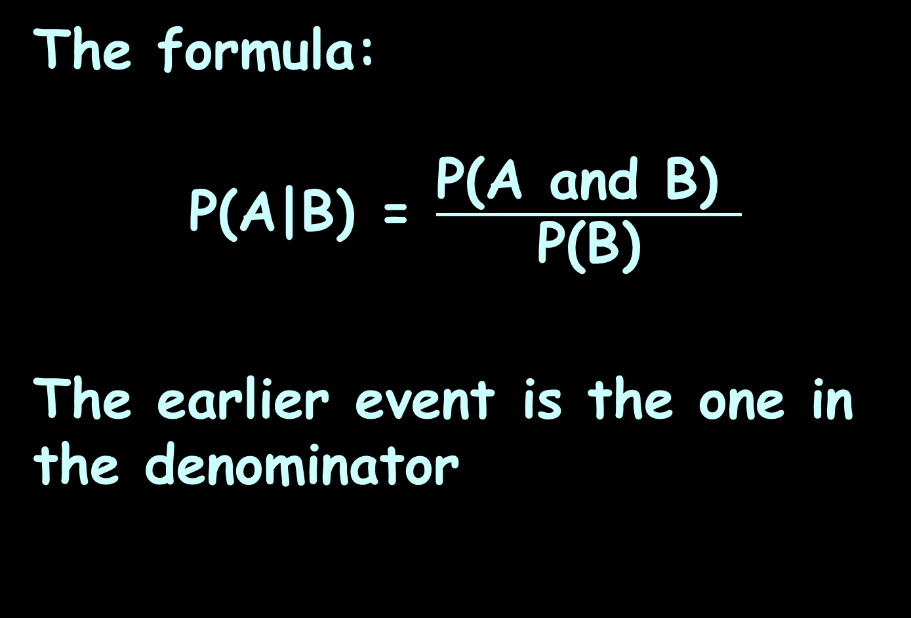
Conditional Probability
The formula:
P(A|B) = $\frac{\text{P}\text{(}\text{A} \text{and} \text{B}\text{) }}{\text{P}\text{(}\text{B}\text{)}}$
The earlier event is the one in the denominator

Slide 21

Questions?
http://i.imgur.com/aliTlT3.jpg

Slide 22
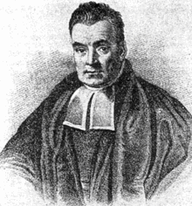

Conditional Probability
Bayes’ Theorem:
P(A|B) = $\frac{\text{P}\text{(}\text{B}\text{|}\text{A}\text{)} \text{P}\text{(}\text{A}\text{)} }{\text{P}\text{(}\text{B}\text{)}}$
https://upload.wikimedia.org/wikipedia/commons/thumb/d/d4/Thomas_Bayes.gif/220px-Thomas_ Bayes.gif

Slide 23
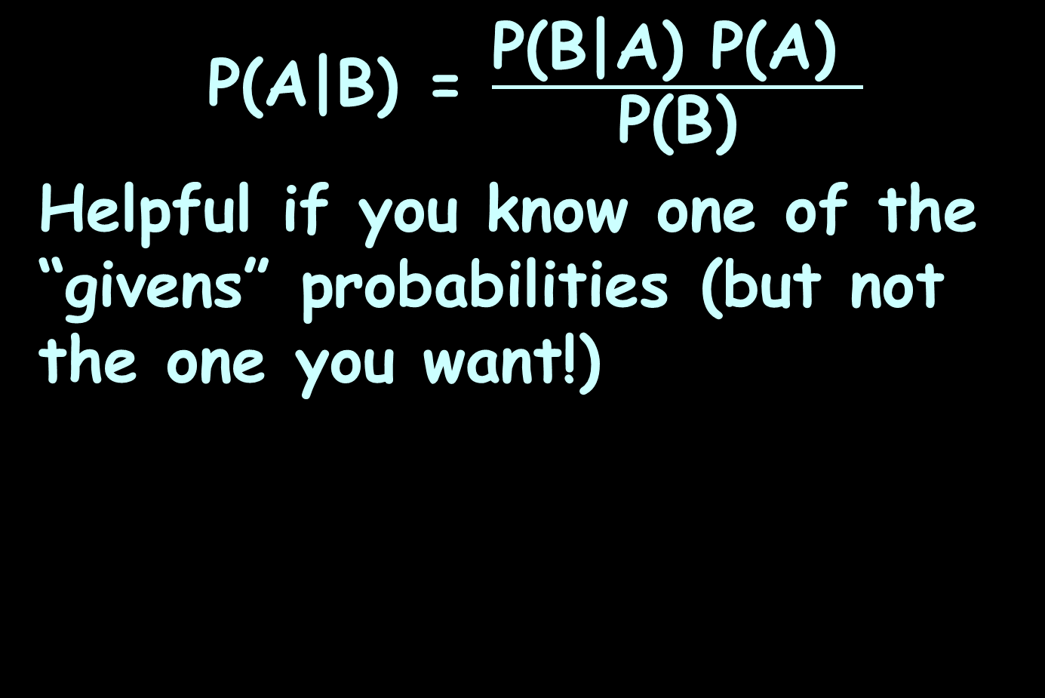
Conditional Probability
P(A|B) = $\frac{\text{P}\text{(}\text{B}\text{|}\text{A}\text{)} \text{P}\text{(}\text{A}\text{)} }{\text{P}\text{(}\text{B}\text{)}}$
Helpful if you know one of the “givens” probabilities (but not the one you want!)

Slide 24

CONDITIONAL PROBABILITY
IN-CLASS PROBLEM 1a
What is the probability of a patient’s having liver disease if the patient is an alcoholic?
Let “A” be “patient has liver disease”
Let “B” be “patient is an alcoholic”
P(A|B) = $\frac{\text{P}\text{(}\text{B}\text{|}\text{A}\text{)} \text{P}\text{(}\text{A}\text{)} }{\text{P}\text{(}\text{B}\text{)}}$

Slide 25
CONDITIONAL PROBABILITY
IN-CLASS PROBLEM 1a
If you know that at your clinic:
10% of your patients have liver disease: P(A) = 0.10
5% of your patients are alcoholics: P(B) = 0.05
of your patients with liver disease, 7% are alcoholics:
P(B|A) = 0.07
P(A|B) = $\frac{\text{P}\text{(}\text{B}\text{|}\text{A}\text{)} \text{P}\text{(}\text{A}\text{)} }{\text{P}\text{(}\text{B}\text{)}}$

Slide 26
CONDITIONAL PROBABILITY
IN-CLASS PROBLEM 1a
What is the probability of a patients having liver disease if the patient is an alcoholic (P(A|B)?
P(A ) = 0.10
P(B ) = 0.05
P(B |A ) = 0.07
So, what is P(A |B ) ?
liver disease
alcoholic
liver disease
alcoholic
liver disease
alcoholic
P(A|B) = $\frac{\text{P}\text{(}\text{B}\text{|}\text{A}\text{)} \text{P}\text{(}\text{A}\text{)} }{\text{P}\text{(}\text{B}\text{)}}$

Slide 27
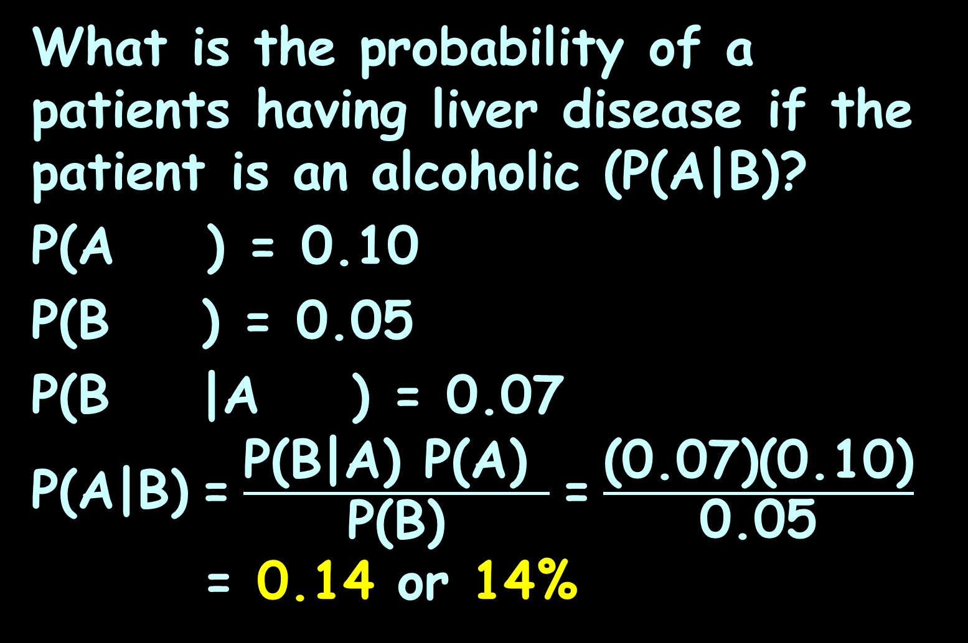
CONDITIONAL PROBABILITY
IN-CLASS PROBLEM 1a
What is the probability of a patients having liver disease if the patient is an alcoholic (P(A|B)?
P(A ) = 0.10
P(B ) = 0.05
P(B |A ) = 0.07
P(A|B) = $\frac{\text{P}\text{(}\text{B}\text{|}\text{A}\text{)} \text{P}\text{(}\text{A}\text{)} }{\text{P}\text{(}\text{B}\text{)}}$ = $\frac{\text{(0.07)(0.10)}}{\text{0.05}}$
= 0.14 or 14%
liver disease
alcoholic
liver disease
alcoholic

Slide 28
Questions?
http://i.imgur.com/aliTlT3.jpg

Slide 29

CONDITIONAL PROBABILITY
IN-CLASS PROBLEM 1b
The Monty Hall Problem…
https://m.media-amazon.com/images/M/MV5BNjUxNjMyZmUtYWE4Yi00Mzg2LWJkZmYtY2
YyNjQ4ZmIyMGQwL2ltYWdlXkEyXkFqcGdeQXVyMTIxMDUyOTI@._V1_.jpg

Slide 30
CONDITIONAL PROBABILITY
IN-CLASS PROBLEM 1b
In the TV show “Let’s Make A Deal” (hosted by Monty Hall) contestants would be given the choice of one of three doors (you would get the prize behind that door – maybe a great prize (like a car or dream vacation), but maybe not!)

Slide 31
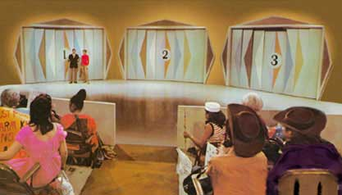
CONDITIONAL PROBABILITY
IN-CLASS PROBLEM 1b
Suppose you pick door #1
What is the probability you have won the glamor prize?
https://thiswastv.files.wordpress.com/2013/05/70s-doors.jpg

Slide 32
CONDITIONAL PROBABILITY
IN-CLASS PROBLEM 1b
Suppose you pick door #1
What is the probability you have won the glamor prize? 1/3
https://thiswastv.files.wordpress.com/2013/05/70s-doors.jpg

Slide 33
CONDITIONAL PROBABILITY
IN-CLASS PROBLEM 1b
Monty has a new deal for you:
Keep your door or change it for another!
https://thiswastv.files.wordpress.com/2013/05/70s-doors.jpg

Slide 34
CONDITIONAL PROBABILITY
IN-CLASS PROBLEM 1b
And he’s going to show you what’s behind one of the doors you didn’t pick… maybe 3…
https://thiswastv.files.wordpress.com/2013/05/70s-doors.jpg

Slide 35

CONDITIONAL PROBABILITY
IN-CLASS PROBLEM 1b
And he’s going to show you what’s behind one of the doors you didn’t pick… maybe 3…
It won’t be the glamor prize…
https://thiswastv.files.wordpress.com/2013/05/70s-doors.jpg

Slide 36
CONDITIONAL PROBABILITY
IN-CLASS PROBLEM 1b
Should you change doors?
What’s the probability of winning if you keep your door?
https://thiswastv.files.wordpress.com/2013/05/70s-doors.jpg

Slide 37
CONDITIONAL PROBABILITY
IN-CLASS PROBLEM 1b
Initially, when you picked door #1, there was a 1/3 chance the glamor prize was there.
What was the probability it was someplace else?
1/3
https://thiswastv.files.wordpress.com/2013/05/70s-doors.jpg

Slide 38
CONDITIONAL PROBABILITY
IN-CLASS PROBLEM 1b
Initially, when you picked door #1, there was a 1/3 chance the glamor prize was there.
What was the probability it was someplace else? 2/3
1/3
2/3
https://thiswastv.files.wordpress.com/2013/05/70s-doors.jpg

Slide 39
CONDITIONAL PROBABILITY
IN-CLASS PROBLEM 1b
But, we already know door 3 ain’t it…
1/3
2/3
https://thiswastv.files.wordpress.com/2013/05/70s-doors.jpg

Slide 40
CONDITIONAL PROBABILITY
IN-CLASS PROBLEM 1b
But, we already know door 3 ain’t it…
So the full 2/3 probability is about door 2…
1/3
2/3
https://thiswastv.files.wordpress.com/2013/05/70s-doors.jpg

Slide 41
CONDITIONAL PROBABILITY
IN-CLASS PROBLEM 1b
But, we already know door 3 ain’t it…
So the full 2/3 probability is about door 2…
Should you change doors?
1/3
2/3
https://thiswastv.files.wordpress.com/2013/05/70s-doors.jpg

Slide 42
CONDITIONAL PROBABILITY
IN-CLASS PROBLEM 1b
But, we already know door 3 ain’t it…
So the full 2/3 probability is about door 2…
Should you change doors?
Yep! You’ll win
twice as often!
1/3
2/3
https://thiswastv.files.wordpress.com/2013/05/70s-doors.jpg

Slide 43
Questions?
http://i.imgur.com/aliTlT3.jpg

Slide 44
Probability
# favorable outcomes
total # of outcomes
you’ll need to know the total
# of outcomes!
If P =

Slide 45
Fundamental Counting Principle
the number of ways things can occur

Slide 46
COUNTING
IN-CLASS PROBLEM 2a
Male/Female and Tall/Short
How many ways can these characteristics combine?

Slide 47
COUNTING
IN-CLASS PROBLEM 2a
Male/Female and Tall/Short
I try to build a tree:

Slide 48
COUNTING
IN-CLASS PROBLEM 2a
Male/Female and Tall/Short
Male Female
/ \ / \
Tall Short Tall Short

Slide 49
COUNTING
IN-CLASS PROBLEM 2a
Male Female
/ \ / \
Tall Short Tall Short
4 possible ways to combine the characteristics:
MT MS FT FS

Slide 50
COUNTING
IN-CLASS PROBLEM 2b
How about: Blonde/Brunette/Redhead and Blue eyes/Green eyes/Brown eyes
Build a tree!

Slide 51
COUNTING
IN-CLASS PROBLEM 2b
Blonde Brunette Red
/ | \ / | \ / | \
Bl Br Gr Bl Br Gr Bl Br Gr
How many ways to combine these characteristics?

Slide 52
COUNTING
IN-CLASS PROBLEM 2b
Blonde Brunette Red
/ | \ / | \ / | \
Bl Br Gr Bl Br Gr Bl Br Gr
How many ways to combine these characteristics? 9:
BdBl BdBr BdGr BtBl BtBr BtGr
RdBl RdBr RdGr

Slide 53
Questions?
http://i.imgur.com/aliTlT3.jpg

Slide 54
Fundamental Counting Principle
The number of ways in which characteristics can be combined is found by multiplying the possibilities of each characteristic together

Slide 55
COUNTING
IN-CLASS PROBLEM 3a
Two pairs of jeans: black blue Three shirts: white yellow blue Two pairs of shoes: black brown
How many different ways can you get dressed?

Slide 56
COUNTING
IN-CLASS PROBLEM 3a
Two pairs of jeans: black blue Three shirts: white yellow blue Two pairs of shoes: black brown
How many jeans?
How many shirts?
How many shoes?

Slide 57
COUNTING
IN-CLASS PROBLEM 3a
Two pairs of jeans: black blue Three shirts: white yellow blue Two pairs of shoes: black brown
How many jeans? 2
How many shirts? 3
How many shoes? 2
So how many outfits?

Slide 58
COUNTING
IN-CLASS PROBLEM 3a
Two pairs of jeans: black blue Three shirts: white yellow blue Two pairs of shoes: black brown
How many different ways can you get dressed?
2 ∗ 3 ∗ 2 = 12

Slide 59
COUNTING
IN-CLASS PROBLEM 3a
Black Blue
W Y B W Y B
bk bn bk bn bk bn bk bn bk bn bk bn

Slide 60
COUNTING
IN-CLASS PROBLEM 3b
Multiple choice quiz
10 questions
4 choices on each
How many ways are there to answer the questions on the test?

Slide 61
COUNTING
IN-CLASS PROBLEM 3b
Multiple choice quiz
10 questions
4 choices on each
How many answers on the first question?

Slide 62
COUNTING
IN-CLASS PROBLEM 3b
Multiple choice quiz
10 questions
4 choices on each
How many answers on the first question? 4
The second?

Slide 63
COUNTING
IN-CLASS PROBLEM 3b
Multiple choice quiz
10 questions
4 choices on each
How many answers on the first question? 4
The second? 4
How many questions?

Slide 64
COUNTING
IN-CLASS PROBLEM 3b
Multiple choice quiz
10 questions
4 choices on each
How many answers on the first question? 4
The second? 4
How many questions? 10

Slide 65
COUNTING
IN-CLASS PROBLEM 3b
Multiple choice quiz
10 questions
4 choices on each
4 ∗ 4 ∗ 4 ∗… (10 of them)

Slide 66
COUNTING
IN-CLASS PROBLEM 3b
Multiple choice quiz
10 questions
4 choices on each
4 ∗ 4 ∗ 4 ∗… (10 of them)
Otherwise known as 4¹⁰
= 1,048,576

Slide 67
COUNTING
IN-CLASS PROBLEM 3b
Multiple choice quiz
10 questions
4 choices on each
How many ways out of the 1,048,576 can you get a 100?

Slide 68
COUNTING
IN-CLASS PROBLEM 3b
Multiple choice quiz
10 questions
4 choices on each
1/1,048,576 chance of getting 100% if you guess on all questions

Slide 69
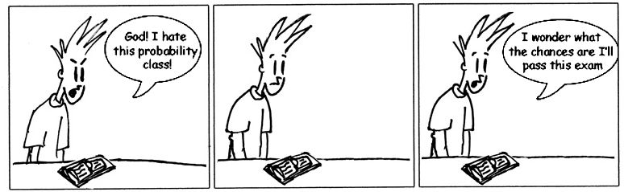

Slide 70
COUNTING
IN-CLASS PROBLEM 3c
How many zip codes?
5 slots

Slide 71
COUNTING
IN-CLASS PROBLEM 3c
How many zip codes?
___ ___ ___ ___ ___

Slide 72
COUNTING
IN-CLASS PROBLEM 3c
How many zip codes?
10 0

Slide 73
COUNTING
IN-CLASS PROBLEM 3c
How many zip codes?
10 10 10 10 10

Slide 74
COUNTING
IN-CLASS PROBLEM 3c
How many zip codes?
10 10 10 10 10
10⁵ = 100,000

Slide 75
COUNTING
IN-CLASS PROBLEM 3d
In Canada, they alternate Letter Number Letter
Number Letter Number
How many postal codes can they have?

Slide 76
COUNTING
IN-CLASS PROBLEM 3d
In Canada, they alternate Letter Number Letter
Number Letter Number
26∗10∗26 ∗ 10∗26∗10
= 26³ ∗ 10³ = 17,576,000
(A whole lot more than 100,000!)

Slide 77
Questions?
http://i.imgur.com/aliTlT3.jpg

Slide 78
Combinatorics
The number of ways in which characteristics can be combined is found by multiplying the possibilities of each characteristic together

Slide 79
Combinatorics
Combinatorics expands on this idea – from a complete group, how many subgroups can you select?

Slide 80
COMBINATORICS
IN-CLASS PROBLEM 4a
An office has 5 employees that want to go to a conference:
Amy Bob Carlos Dawn Ed
There is money in the budget for only 3 to go

Slide 81
COMBINATORICS
IN-CLASS PROBLEM 4a
An office has 5 employees that want to go to a conference:
Amy Bob Carlos Dawn Ed
There is money in the budget for only 3 to go
The order in which they are selected is not important

Slide 82
COMBINATORICS
IN-CLASS PROBLEM 4a
The possibilities are:
ABC ABD ABE ACD ACE ADE
BCD BCE BDE CDE
What is the probability that Bob will be going to the conference?

Slide 83
COMBINATORICS
IN-CLASS PROBLEM 4a
ABC ABD ABE ACD ACE ADE
BCD BCE BDE CDE
How many outcomes total?
How many outcomes favorable?

Slide 84
COMBINATORICS
IN-CLASS PROBLEM 4a
ABC ABD ABE ACD ACE ADE
BCD BCE BDE
CDE
How many outcomes total? 10
How many outcomes favorable?
6 have a “B” in them

Slide 85
COMBINATORICS
IN-CLASS PROBLEM 4a
ABC ABD ABE ACD ACE ADE
BCD BCE BDE
CDE
So there is a 6/10 or 60% probability Bob will be going to the conference

Slide 86
Questions?
http://i.imgur.com/aliTlT3.jpg

Slide 87
Combinatorics
For our possibilities, we made a list:
ABC ABD ABE ACD ACE ADE
BCD BCE BDE
CDE

Slide 88

Combinatorics
Even for a small list,
it’s a lot of work
And… how do you
know you’ve got
them all?

Slide 89
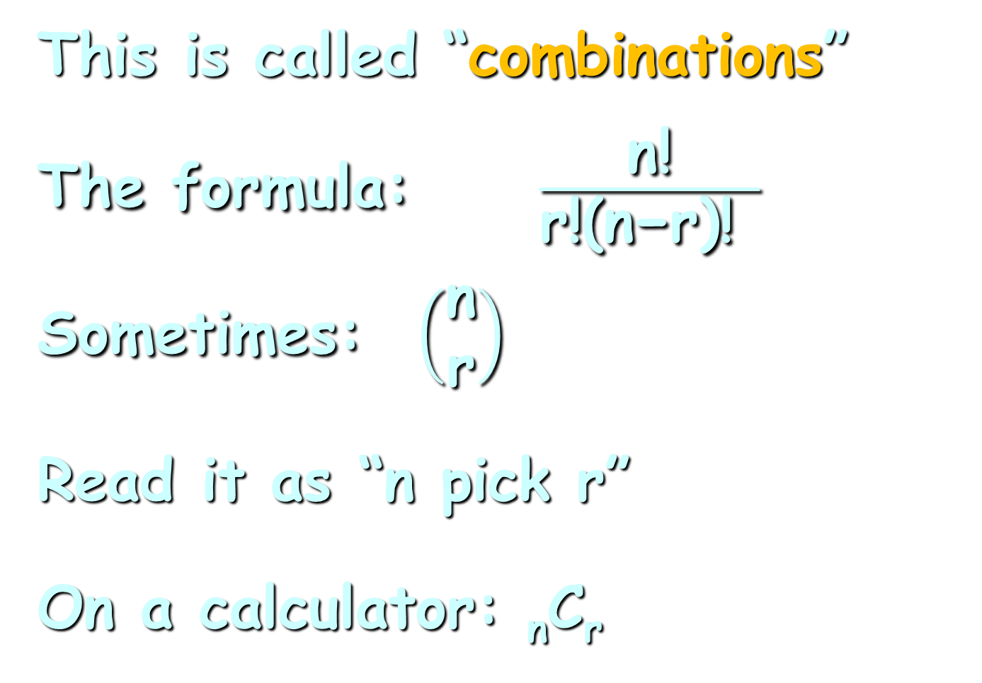
Combinatorics
This is called “combinations”
The formula: $\frac{\text{n}\text{!}}{\text{r}\text{!(}\text{n}\text{−}\text{r}\text{)! }}$
Sometimes: $\left(\begin{matrix}\text{n} \\ \text{r}\end{matrix}\right)$
Read it as “n pick r”
On a calculator: _{n}C_{r}

Slide 90
Combinatorics
What’s the “!” ?

Slide 91
Combinatorics
What’s the “!” ?
A mathy-symbol
n! is read as “n factorial”
It is defined to be:
n × (n-1) × (n-2) × … × 2 × 1

Slide 92
Combinatorics
Combinations
an arrangement of items such that:
the items are selected from
the same group
no item is used more than once
the order makes no difference

Slide 93
Combinatorics
For _{n}C_{r} or n!/r!(n-r)!
“n” is the total number in the group
“r” is the number you are selecting

Slide 94
COMBINATORICS
IN-CLASS PROBLEM 4b
If you have 5 office members, how many ways can you pick 3 of them to go to a conference?
Amy Bob Carlos Dawn Ed
What is “n”?
What is “r”?

Slide 95
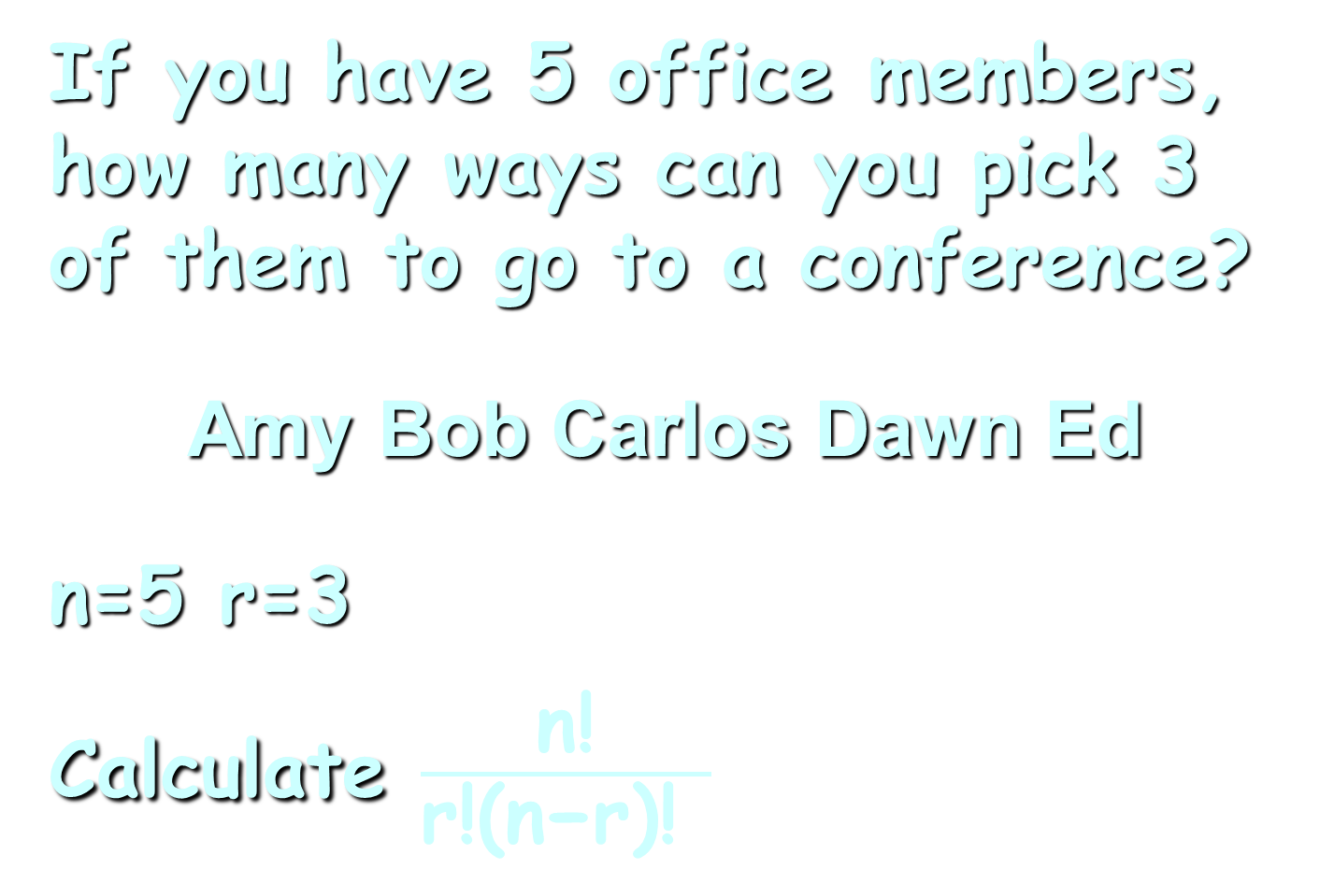
COMBINATORICS
IN-CLASS PROBLEM 4b
If you have 5 office members, how many ways can you pick 3 of them to go to a conference?
Amy Bob Carlos Dawn Ed
n=5 r=3
Calculate $\frac{\text{n}\text{!}}{\text{r}\text{!(}\text{n}\text{−}\text{r}\text{)! }}$

Slide 96
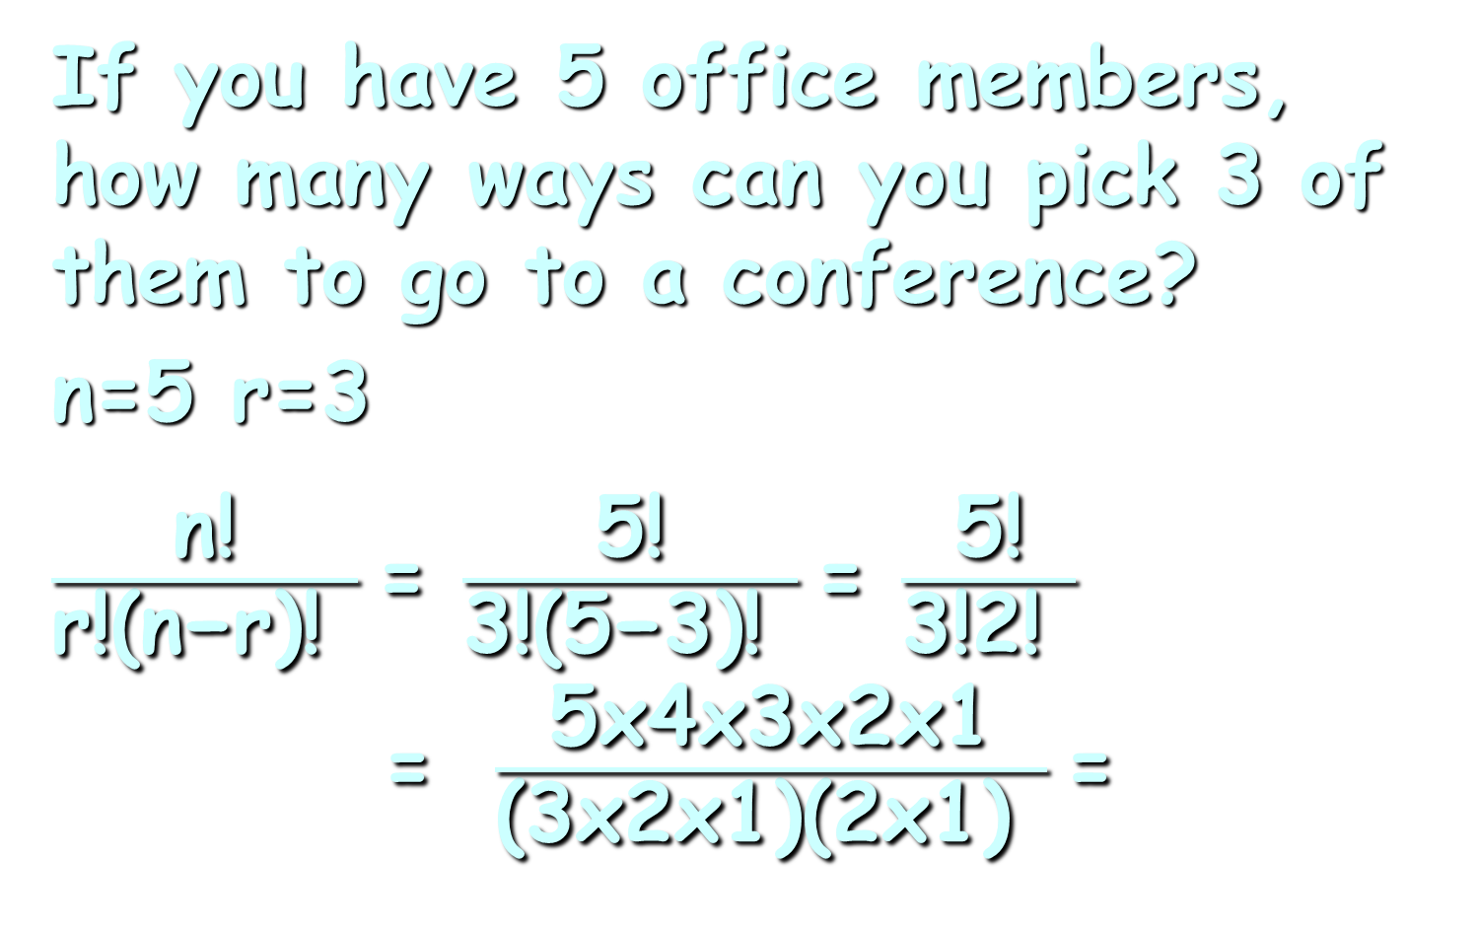
COMBINATORICS
IN-CLASS PROBLEM 4b
If you have 5 office members,
how many ways can you pick 3 of them to go to a conference?
n=5 r=3
$\frac{\text{n}\text{!}}{\text{r}\text{!(}\text{n}\text{−}\text{r}\text{)! }}$= $\frac{\text{5}\text{!}}{\text{3}\text{!(}\text{5}\text{−}\text{3}\text{)! }}$= $\frac{\text{5}\text{!}}{\text{3}\text{!}\text{2}\text{! }}$ = $\frac{\text{5}\text{x}\text{4}\text{x}\text{3}\text{x}\text{2}\text{x}\text{1}}{\text{(3}\text{x}\text{2}\text{x}\text{1)(2}\text{x}\text{1)} }$=

Slide 97
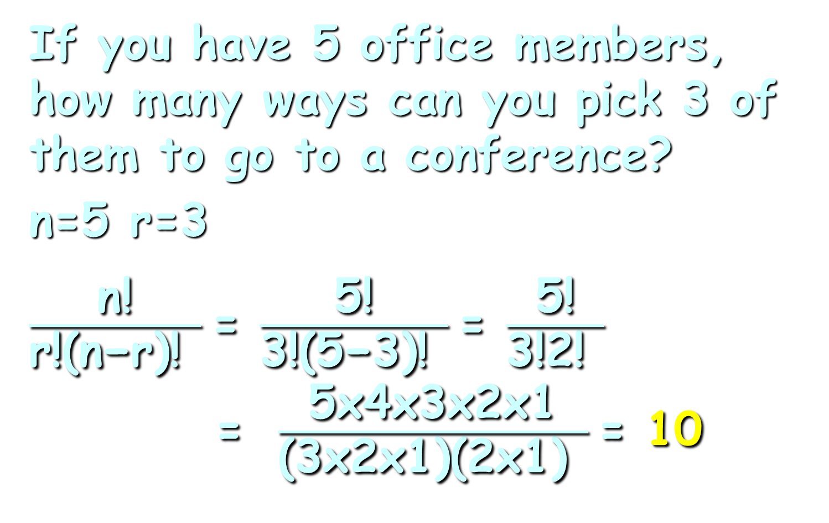
COMBINATORICS
IN-CLASS PROBLEM 4b
If you have 5 office members,
how many ways can you pick 3 of them to go to a conference?
n=5 r=3
$\frac{\text{n}\text{!}}{\text{r}\text{!(}\text{n}\text{−}\text{r}\text{)! }}$= $\frac{\text{5}\text{!}}{\text{3}\text{!(}\text{5}\text{−}\text{3}\text{)! }}$= $\frac{\text{5}\text{!}}{\text{3}\text{!}\text{2}\text{! }}$ = $\frac{\text{5}\text{x}\text{4}\text{x}\text{3}\text{x}\text{2}\text{x}\text{1}}{\text{(3}\text{x}\text{2}\text{x}\text{1)(2}\text{x}\text{1)} }$= 10

Slide 98
COMBINATORICS
IN-CLASS PROBLEM 4b
Did we have 10 listed before?
ABC ABD ABE ACD ACE ADE
BCD BCE BDE
CDE

Slide 99
COMBINATORICS
IN-CLASS PROBLEM 4b
Try this in Excel!
_{n}C_{r} is:
=combin(n,r)
Do you get 10?

Slide 100
For TI Calculators:
ncr(5,3)

Slide 101
WolframAlpha
combination(5,3)
Or
ncr(5,3)

Slide 102
Symbolab
5 ncr 3

Slide 103
COMBINATORICS
IN-CLASS PROBLEM 4c
Try: ₈C₅ ₄C₀ ₁₂C₁₀

Slide 104
COMBINATORICS
IN-CLASS PROBLEM 4c
Try: ₈C₅ ₄C₀ ₁₂C₁₀
56

Slide 105
COMBINATORICS
IN-CLASS PROBLEM 4c
Try: ₈C₅ ₄C₀ ₁₂C₁₀
56 1

Slide 106
COMBINATORICS
IN-CLASS PROBLEM 4c
Try: ₈C₅ ₄C₀ ₁₂C₁₀
56 1 66

Slide 107
Questions?
http://i.imgur.com/aliTlT3.jpg

Slide 108
Combinatorics
What happens if order IS important in selecting your subgroup?

Slide 109
Combinatorics
If you have 5 club members, how many ways can you pick a President, VP and Treasurer?
Amy Bob Carlos Dawn Ed

Slide 110
Combinatorics
Example:
P: A
VP: B or C or D or E
T: whichever you didn’t pick
for VP

Slide 111

Combinatorics
This is going to be a REALLY hard one to do by making a list!

Slide 112
Pres | VP | Treas
A | B | C
A | C | B
A | B | D
A | D | B
A | B | E
A | E | B
A | C | D
A | D | C
A | C | E
A | E | C
A | D | E
A | E | D
And that’s just with Amy as president!

Slide 113
Combinatorics
We call this “permutations”
an arrangement of items such that:
no item is used more than
once
the order DOES make a
difference

Slide 114

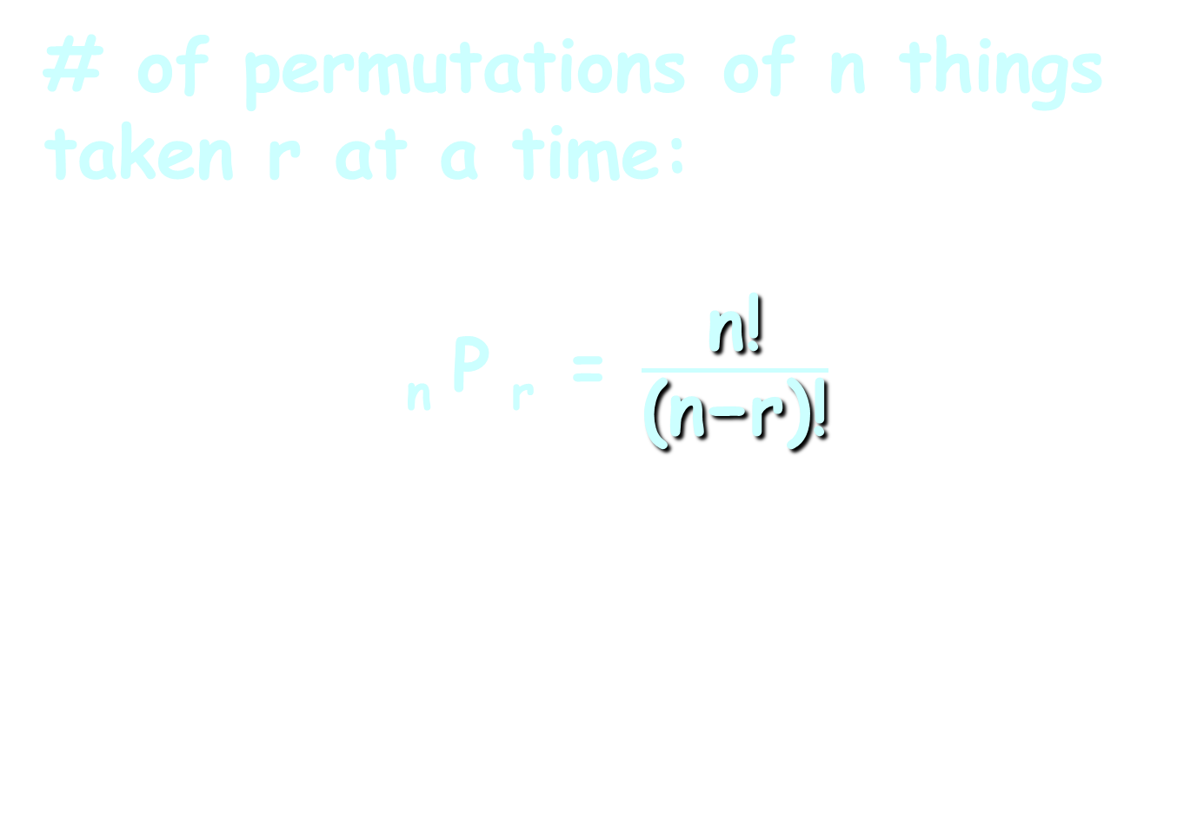
Combinatorics
# of permutations of n things taken r at a time:
_{n} P _{r} = $\frac{\text{n}\text{!}}{\text{(}\text{n}\text{−}\text{r}\text{)!}}$
_{n} C _{r} = $\frac{\text{n}\text{!}}{\text{r}\text{!(}\text{n}\text{−}\text{r}\text{)!}}$

Slide 115

COMBINATORICS
IN-CLASS PROBLEM 5a
For our club members:
₅P₃ = $\frac{\text{5}\text{!}}{\text{(}\text{5}\text{−}\text{3}\text{)!}}$ = $\frac{\text{5}\text{x}\text{4}\text{x}\text{3}\text{x}\text{2}\text{x}\text{1}}{\text{2}\text{x}\text{1}}$ =

Slide 116

COMBINATORICS
IN-CLASS PROBLEM 5a
For our club members:
₅P₃ = $\frac{\text{5}\text{!}}{\text{(}\text{5}\text{−}\text{3}\text{)!}}$ = $\frac{\text{5}\text{x}\text{4}\text{x}\text{3}\text{x}\text{2}\text{x}\text{1}}{\text{2}\text{x}\text{1}}$ = 60

Slide 117
COMBINATORICS
IN-CLASS PROBLEM 5a
Try this in Excel!
_{n}P_{r} is:
=permut(n,r)
Do you get 60?

Slide 118
COMBINATORICS
IN-CLASS PROBLEM 5b
Try:
₈P₅ ₄P₀ ₁₂P₁₀

Slide 119
COMBINATORICS
IN-CLASS PROBLEM 5b
Try:
₈P₅ ₄P₀ ₁₂P₁₀
6720 1 239,500,800

Slide 120
Combinatorics
Word problems:
Try to figure out if order is important or not
Usually, it’s not, so it’s combinations
If it is, it’s permutations

Slide 121
Questions?
http://i.imgur.com/aliTlT3.jpg

Slide 122
Combinatorics
In Colorado Powerball, you choose 5 from 69 numbers and then 1 from 26 for the Powerball

Slide 123
Combinatorics
Because you are selecting 5 out of 69 and 1 out of 26, it is combinatorics!

Slide 124
COMBINATORICS
IN-CLASS PROBLEM 6
What is the probability of winning the top prize
(5 + Powerball)?

Slide 125
COMBINATORICS
IN-CLASS PROBLEM 6
What is the probability of winning the top prize
(5 + Powerball)?
To do this, you have to pick all five numbers correctly and you also have to pick the Powerball number correctly

Slide 126
COMBINATORICS
IN-CLASS PROBLEM 6
What is the probability of winning the top prize
(5 + Powerball)?
Is order important?

Slide 127
COMBINATORICS
IN-CLASS PROBLEM 6
What is the probability of winning the top prize
(5 + Powerball)?
Is order important? Nope
so we will use

Slide 128
COMBINATORICS
IN-CLASS PROBLEM 6
What is the probability of winning the top prize
(5 + Powerball)?
Is order important? Nope
so we will use combinations

Slide 129
COMBINATORICS
IN-CLASS PROBLEM 6
What is the probability of winning the top prize
(5 + Powerball)?
What is the number of possible outcomes (the denominator)?
In Colorado Powerball, you choose 5 from 69 numbers and then 1 from 26 for the Powerball

Slide 130
COMBINATORICS
IN-CLASS PROBLEM 6
What is the probability of winning the top prize
(5 + Powerball)?
How many ways are there to pick the five numbers?
In Colorado Powerball, you choose 5 from 69 numbers and then 1 from 26 for the Powerball

Slide 131
COMBINATORICS
IN-CLASS PROBLEM 6
What is the probability of winning the top prize
(5 + Powerball)?
How many ways are there to pick the five numbers?
₆₉C₅ = 69!/(5! * (69-5)!) = 11,238,513
In Colorado Powerball, you choose 5 from 69 numbers and then 1 from 26 for the Powerball

Slide 132
COMBINATORICS
IN-CLASS PROBLEM 6
What is the probability of winning the top prize
(5 + Powerball)?
How many ways are there to pick the Powerball?
In Colorado Powerball, you choose 5 from 69 numbers and then 1 from 26 for the Powerball

Slide 133
COMBINATORICS
IN-CLASS PROBLEM 6
What is the probability of winning the top prize
(5 + Powerball)?
How many ways are there to pick the Powerball?
₂₆C₁ = 26
In Colorado Powerball, you choose 5 from 69 numbers and then 1 from 26 for the Powerball

Slide 134
COMBINATORICS
IN-CLASS PROBLEM 6
What is the probability of winning the top prize
(5 + Powerball)?
What is the number of possible outcomes (the denominator)?

Slide 135
COMBINATORICS
IN-CLASS PROBLEM 6
What is the probability of winning the top prize
(5 + Powerball)?
What is the number of possible outcomes (the denominator)?
11,238,513 * 26 = 292,201,338

Slide 136
COMBINATORICS
IN-CLASS PROBLEM 6
What is the probability of winning the top prize
(5 + Powerball)?
Now for the numerator!
How many ways can you win?

Slide 137
COMBINATORICS
IN-CLASS PROBLEM 6
What is the probability of winning the top prize
(5 + Powerball)?
Now for the numerator!
How many ways can you win? 1

Slide 138
COMBINATORICS
IN-CLASS PROBLEM 6
What is the probability of winning the top prize
(5 + Powerball)?
So the probability of winning the top prize is:

Slide 139
COMBINATORICS
IN-CLASS PROBLEM 6
What is the probability of winning the top prize
(5 + Powerball)?
So the probability of winning the top prize is:
1/292,201,338

Slide 140
COMBINATORICS
IN-CLASS PROBLEM 6
To make it easier to calculate the other prizes, let’s specify more exactly how the “1” way of winning happened

Slide 141
COMBINATORICS
IN-CLASS PROBLEM 6
Among the 69 numbers, 5 are "winners" and 64 are "losers"
Similarly, among the 26 Powerball numbers, 1 is a "winner" and 25 are "losers"

Slide 142
COMBINATORICS
IN-CLASS PROBLEM 6
To pick all five numbers and the Powerball correctly, you must pick 5 out of the 5 winners and 0 out of the 64 losers, and you must pick 1 out of 1 Powerball winners and 0 out of 25 Powerball losers

Slide 143
COMBINATORICS
IN-CLASS PROBLEM 6
Or:
₅C₅ * ₆₄C₀ * ₁C₁ * ₂₅C₀
= 1 * 1 * 1 * 1
= 1

Slide 144
COMBINATORICS
IN-CLASS PROBLEM 6
Now we can calculate the probabilities of all of the prizes!

Slide 145
COMBINATORICS
IN-CLASS PROBLEM 6
What is the probability of winning a prize (any prize?)

Slide 146
COMBINATORICS
IN-CLASS PROBLEM 6
What is the probability of winning a prize (any prize?)
a tad over 4%

Slide 147
Questions?
http://i.imgur.com/aliTlT3.jpg

Slide 148
Summary
Today we studied:
Review of Discrete Probability
and Conditional Probability
New: Counting Principles, Combinatorics

Slide 149

You Survived!
www.playbuzz.com

