Slide 1
Welcome to
Unit 3 Part 06
MATH366 Probability and Statistics
https://online.stanford.edu/sites/default/files/styles/figure_default/public/2018-04/theory-of-probability_stats116.jpg?itok=ms4fRMO-

Slide 2
What’s Up?
Today we will be going over:
Review of descriptive statistics:
  averages, variability, MCG
New: Relationships between variables:
Covariance
Correlation
RSQ
Regression
Time Series

Slide 3
What’s Up?
Outcome 1) Calculate statistical measures of central tendency and dispersion used in describing and summarizing collected samples. Both by hand calculation methods supported by calculators and programmed software procedures will be used to make these computations

Slide 4

Review
http://995642590.r.lightningbase-cdn.com/wp-content/uploads/2010/12/looking-back-hrexaminer-v144-cover425px.jpg

Slide 5
Descriptive Statistics
Averages tell where the data pile up

Slide 6
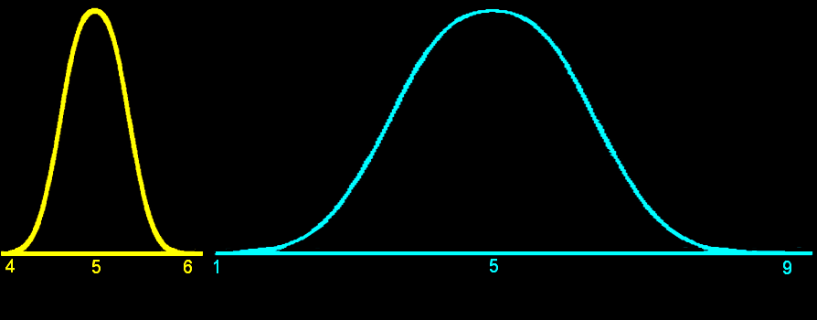
Descriptive Statistics
Variability measures describe how spread out the data are
VFrench, 2012

Slide 7
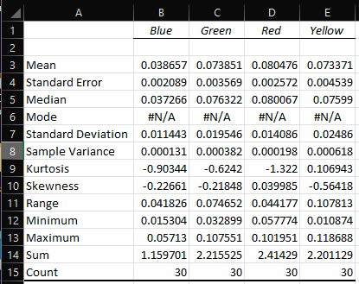
Descriptive Statistics
Excel provides a nice (messy) Summary Table:
(make it
purty!)
VFrench, 2022

Slide 8
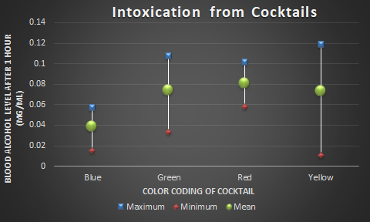
Descriptive Statistics
To show both average and variability on one graph, use the Multiple Comparison Graph (high-low-close
Excel graph)
VFrench, 2022

Slide 9
Descriptive Statistics
One problem with this version of the MCG: using the range means that fewer differences can be
detected

Slide 10
Descriptive Statistics
Newer, better MCG: instead of the max use mean + 2se and use mean – 2se instead of the min
Trust me for now,
you’ll see why later!

Slide 11
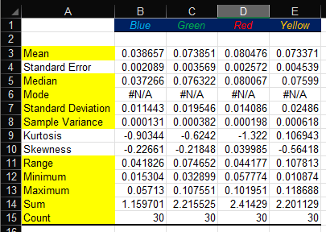
Descriptive Statistics
Newer, better MCG: instead of the max use mean + 2se and use mean – 2se instead of the min
se
Trust me for now,
you’ll see why later!

Slide 12
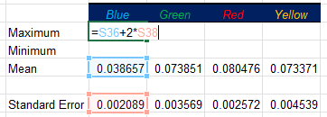
Descriptive Statistics
Newer, better MCG: instead of the max use mean + 2se and use mean – 2se instead of the min
se
Trust me for now,
you’ll see why later!

Slide 13
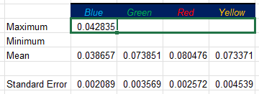
Descriptive Statistics
Newer, better MCG: instead of the max use mean + 2se and use mean – 2se instead of the min
se
Copy it over…
Trust me for now,
you’ll see why later!

Slide 14
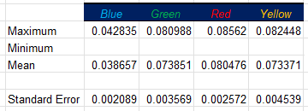
Descriptive Statistics
Newer, better MCG: instead of the max use mean + 2se and use mean – 2se instead of the min
Tah-Dah!
se
Trust me for now,
you’ll see why later!

Slide 15
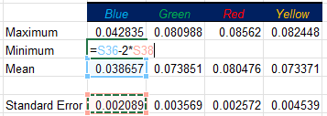
Descriptive Statistics
Newer, better MCG: instead of the max use mean + 2se and use mean – 2se instead of the min
se
Trust me for now,
you’ll see why later!

Slide 16
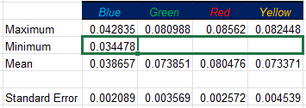
Descriptive Statistics
Newer, better MCG: instead of the max use mean + 2se and use mean – 2se instead of the min
se
Copy it over…
Trust me for now,
you’ll see why later!

Slide 17
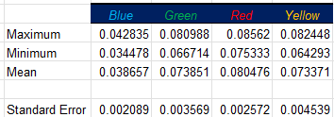
Descriptive Statistics
Newer, better MCG: instead of the max use mean + 2se and use mean – 2se instead of the min
Tah-Dah!
se
But… it’s not the max and min anymore!
Trust me for now,
you’ll see why later!

Slide 18
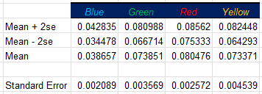
Descriptive Statistics
Newer, better MCG: instead of the max use mean + 2se and use mean – 2se instead of the min
Now you can make the new and improved MCG!
se

Slide 19
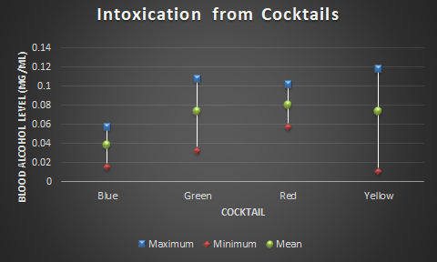
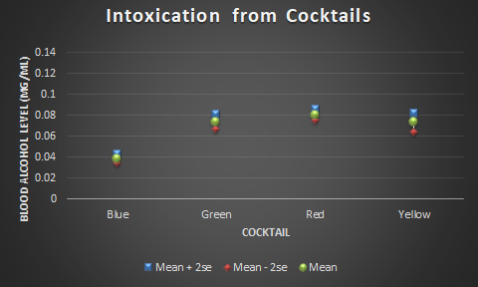
Descriptive Statistics
Notice how much BETTER the new MCG is vs the old one

Slide 20
Descriptive Statistics
Notice how much BETTER the new MCG is vs the old one
Please use this new version on your Problems!

Slide 21

Questions?
http://i.imgur.com/aliTlT3.jpg

Slide 22
Computers and Statistics
During the time when you had to do all calculations by hand, most statistical calculations had “calculator” formulas which were designed to make calculations easier

Slide 23
Computers and Statistics
Definition formula for a sample variance:
n
s² = ∑ (x_{i} – ͞x)²/(n-1)
i=1
Calculator formula:
n n
s² = (∑(x_{i}²) - (∑x_{i})²/n)/(n-1)
i=1 i=1

Slide 24
Computers and Statistics
It seemed obvious to early PC statistical software developers that the calculator formulas were no longer needed – PCs were fast enough they could easily calculate the definition formulas quickly!

Slide 25
Computers and Statistics
But…
n
s² = ∑ (x_{i} – ͞x)²/(n-1)
i=1
this formula accumulates any rounding errors

Slide 26
Computers and Statistics
But…
n
s² = ∑ (x_{i} – ͞x)²/(n-1)
i=1
this formula accumulates any rounding errors
… and arrived at noticeably wrong answers!

Slide 27
Computers and Statistics
Huge scandal in the mid-90s to about 2005!

Slide 28
Computers and Statistics
So, now Excel and others use the calculator formulas!
n n
s² = (∑(x_{i}²) - (∑x_{i})²/n)/(n-1)
i=1 i=1

Slide 29
Computers and Statistics
But… many people remain skeptical about using Excel and other PC software for statistical analyses!

Slide 30
Computers and Statistics
But… many people remain skeptical about using Excel and other PC software for statistical analyses!
(Like CTU’s doctoral program…)

Slide 31
Questions?
http://i.imgur.com/aliTlT3.jpg

Slide 32
Two Variables
So far we have used only one variable measured on each of our sample subjects
What if we had more than one?

Slide 33
Two Variables
Subject | Height | Weight
1 5’8’’ 170
2 5’3’’ 120
3 6’ 200
4 5’7’’ 250
5 6’2’’ 195

Slide 34
Two Variables
With two variables measured on each subject, the measurements are “paired” – linked to each other

Slide 35
Two Variables
If you calculate means or standard deviations for one variable then the other, the pairing is lost, and you
lose information
(a bad thing…)

Slide 36
Relationships
Using the pairing, you can determine if there is a
relationship
between the two variables

Slide 37
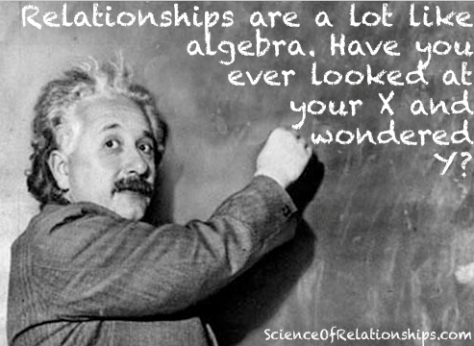

Slide 38
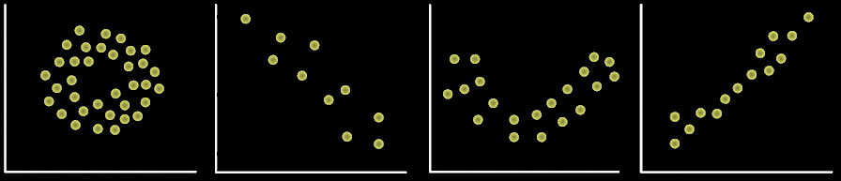
Relationships
The relationship can be seen by graphing the variables in a scatter graph
Our brains are programmed to see visual relationships
VFrench, 2016

Slide 39
Relationships
“Covariance”
Cov(x,y) = Σ(x-͞x)(y-͞y)/(n-1)
a measure of "linear dependence" between the two variables x and y
(again, for samples – note the “n-1”)

Slide 40
Relationships
It is also symbolized:
s_{xy} = Σ(x-͞x)(y-͞y)/(n-1)
a measure of "linear dependence" between the two variables x and y
(again, for samples – note the “n-1”)

Slide 41
Relationships
Calculator formula for covariance:
Cov(x,y) = Σ(xy)/(n-1) - ͞͞x ͞y

Slide 42
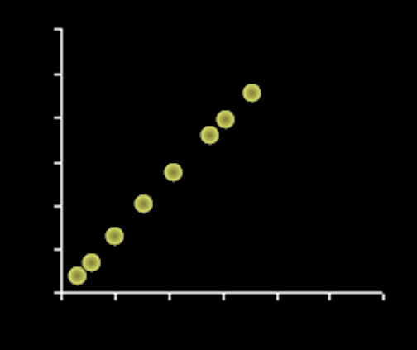
Relationships
There are all sorts of relationships, but we define a covariance to be a linear relationship
𝒚
𝒙
VFrench, 2016

Slide 43
Correlation
Another linear relationship between two variables (x,y) is called a “correlation”

Slide 44
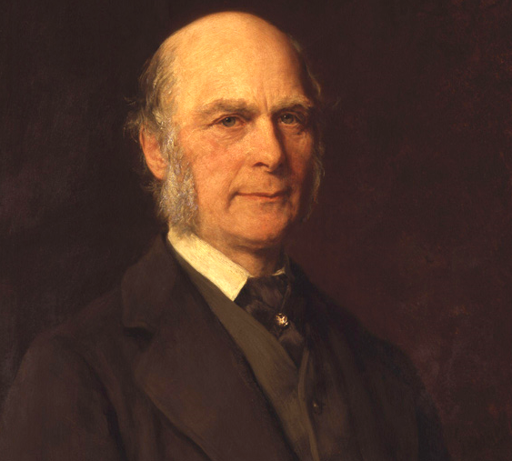
Correlation
Francis Galton
https://galton.org/

Slide 45
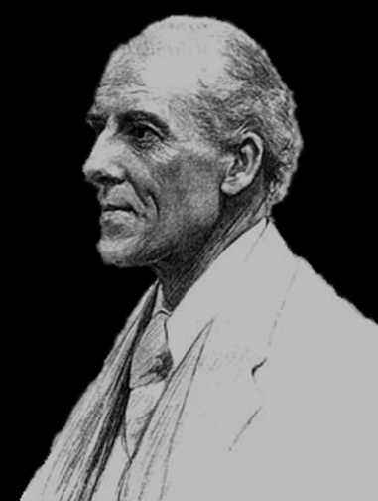
Correlation
Karl Pearson’s
Correlation
Coefficient:
r
Karl Pearson (1857 - 1936) - Biography - MacTutor History of Mathematics (st-andrews.ac.uk)

Slide 46
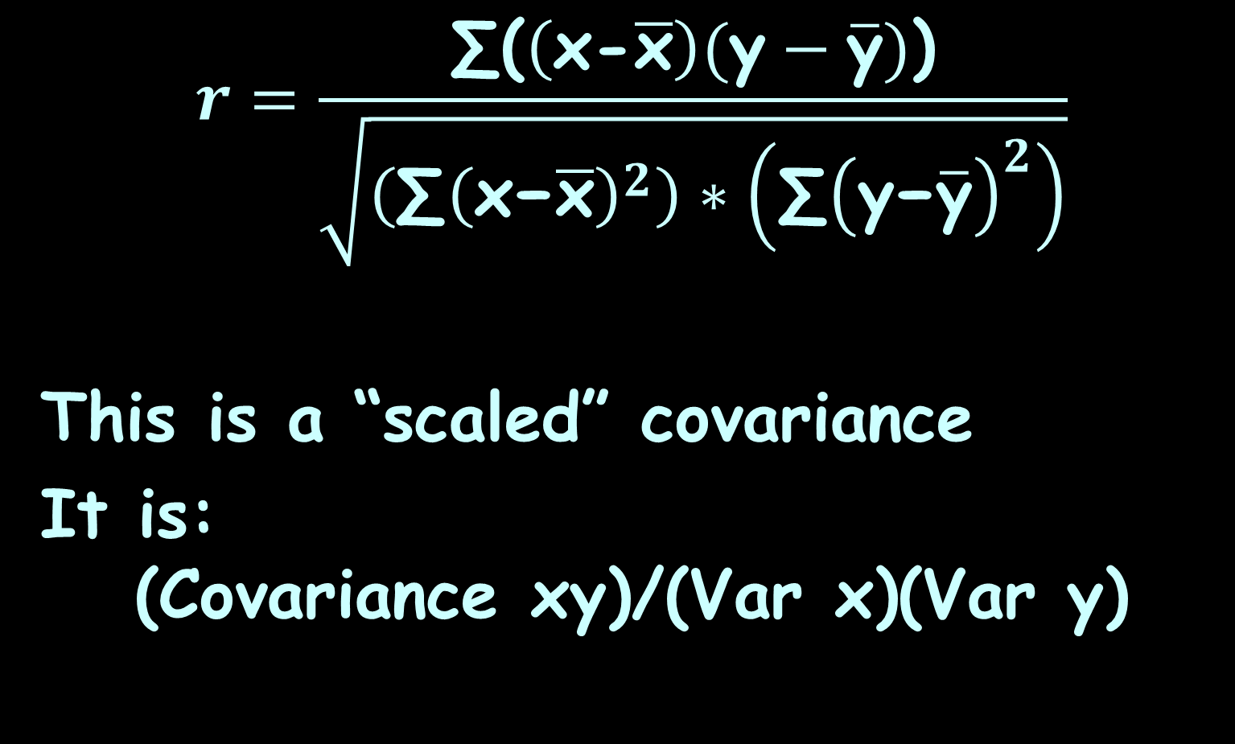
Correlation
$$r=\frac{\text{∑}\text{(}\left(\text{x}\text{−}\overline{\text{x}}\right)(\text{y}−\overline{\text{y}})\text{)}}{\sqrt{\left(\text{∑}{\left(\text{x}\text{−}\overline{\text{x}}\right)}^{2}\right)∗\left(\text{∑}{\left(\text{y}\text{−}\overline{\text{y}}\right)}^{2}\right)}}$$
This is a “scaled” covariance
It is:
(Covariance xy)/(Var x)(Var y)

Slide 47
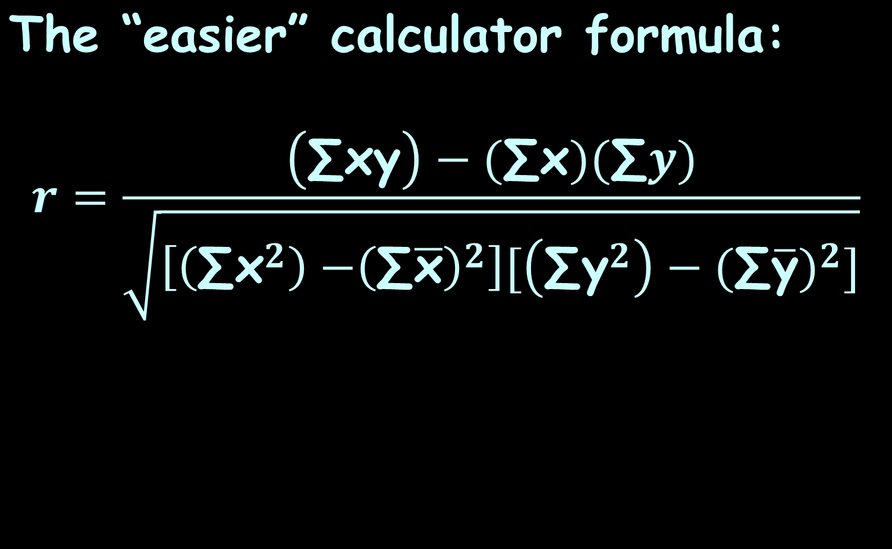
Correlation
$$\text{The} \text{“}\text{easier}\text{” }\text{calculator} \text{formula}\text{:}$$
$$r=\frac{\left(\text{∑}\text{xy}\right)−(\text{∑}\text{x})(\text{∑}y)}{\sqrt{\left[\left(\text{∑}{\text{x}}^{2}\right){−\left(\text{∑}\overline{\text{x}}\right)}^{2}\right][\left(\text{∑}{\text{y}}^{2}\right)−(\text{∑}{\overline{\text{y}})}^{2}]}}$$

Slide 48


Correlation
$$r=\frac{\left(Σxy\right)−(Σx)(Σy)}{\sqrt{\left[\left(Σx^{2}\right){−\left(Σx\right)}^{2}\right][\left(Σy^{2}\right)−(Σ{x)}^{2}]}}$$
EEK!
dreamstime.com

Slide 49

Correlation
Excel does this calculation for you…
http://www.shutterstock.com/s/whew/search.html

Slide 50
Correlation
Correlation coefficient “r”:
Measures the strength of the linear relationship between two variables (x,y)

Slide 51
Correlation
Correlation coefficient “r”:
Measured by the closeness of the data to a straight line of “best fit”

Slide 52
Correlation
In real life, you practically never get all of your data points on the line of best fit
How close is close enough?

Slide 53
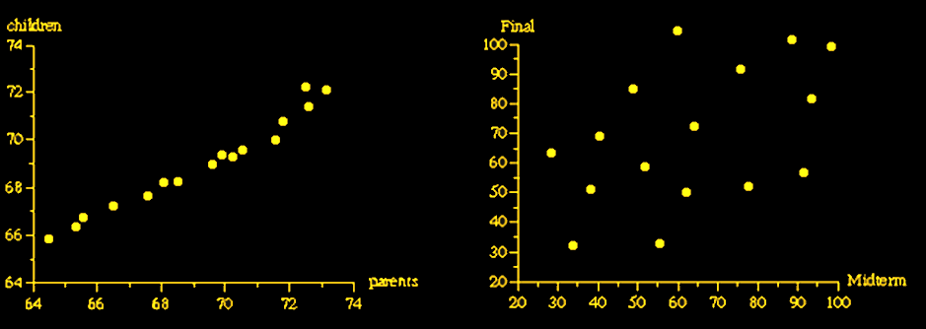
Correlation
Strong Weak
relationship relationship
VFrench, 2016

Slide 54
Correlation
So… a correlation is actually a measure of
VFrench, 2016

Slide 55
Correlation
So… a correlation is actually a measure of VARIABILITY!
VFrench, 2016

Slide 56
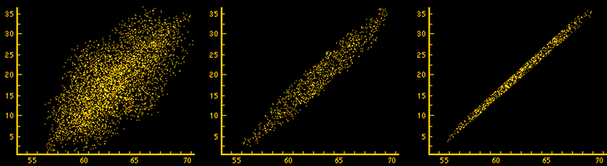
CORRELATION
IN-CLASS PROBLEM 1a
Which has the strongest linear relationship?
VFrench, 2016

Slide 57
CORRELATION
IN-CLASS PROBLEM 1a
Which has the strongest linear relationship?
VFrench, 2016

Slide 58

Relationships
Can be positive…
https://images.sciencedaily.com/2015/05/150513135011_1_900x600.jpg

Slide 59

Relationships
http://cdn2.momjunction.com/wp-content/uploads/2016/01/Relationship-With-Kids-After-Divorce.jpg

Slide 60
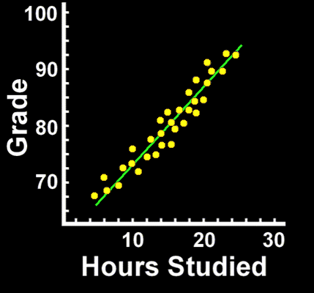
Correlation
Positive Correlation:
as one variable increases, the other also increases
VFrench, 2016

Slide 61
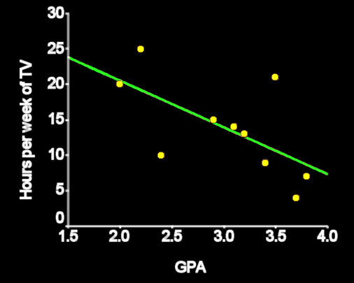
Correlation
Negative correlation:
as one variable increases, the other decreases
VFrench, 2016

Slide 62
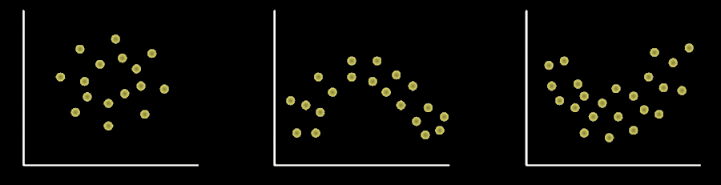
Correlation
Zero correlation:
no LINEAR relationship
VFrench, 2016

Slide 63
Correlation
Zero correlation:
there may be a strong nonlinear relationship
VFrench, 2016

Slide 64
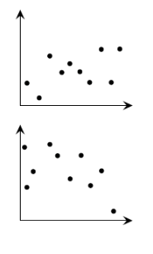
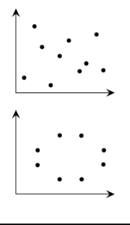
Correlation
A horizontal line fit is defined to be “zero correlation”
low correlation zero correlation
VFrench, 2016

Slide 65
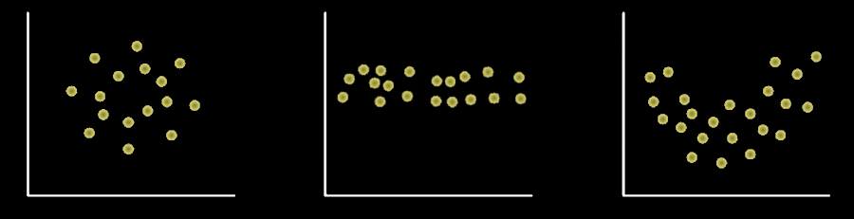
Correlation
Zero correlation:
If it is a horizontal line
VFrench, 2016

Slide 66
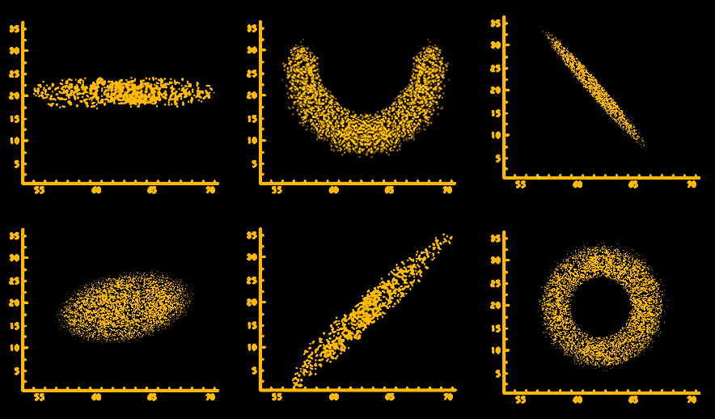
CORRELATION
IN-CLASS PROBLEM 1b
Positive, negative, or zero?
VFrench, 2016

Slide 67
CORRELATION
IN-CLASS PROBLEM 1b
Positive, negative, or zero?
Zero
Zero
Negative
Slightly positive
Positive
Zero
VFrench, 2016

Slide 68
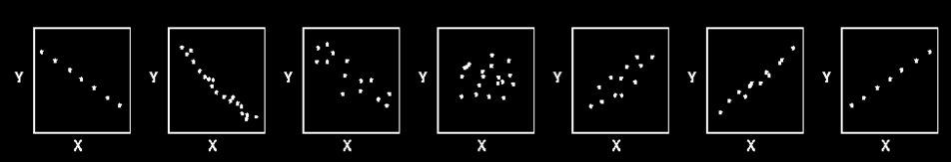
Correlation
Correlation coefficients range from -1.0 to +1.0
r=-1.0 r=-0.9 r=-0.5 r=0.0 r=0.5 r=0.9 r=1.0
VFrench, 2016

Slide 69
Correlation
Traditional descriptors for the strength of correlation:
–1.0 perfect negative relationship
–0.7 strong negative relationship
–0.5 moderate negative relationship
–0.3 weak negative relationship
0.0 no linear relationship
+0.3 weak positive relationship
+0.5 moderate positive relationship
+0.7 strong positive relationship
+1.0 perfect positive relationship

Slide 70
Correlation
Correlation coefficients can’t be bigger than 1 or less than -1
-1 ≤ corr ≤ 1

Slide 71
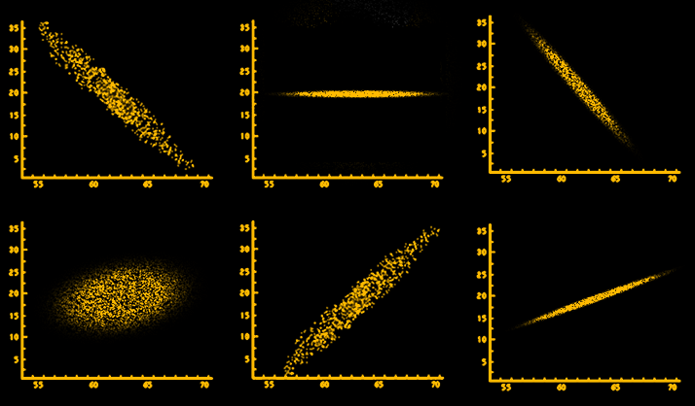
CORRELATION
IN-CLASS PROBLEM 1c,d
Which has the highest positive correlation value? The highest negative correlation value?
VFrench, 2016

Slide 72
CORRELATION
IN-CLASS PROBLEM 1c,d
Which has the highest positive correlation value? The highest negative correlation value?
Highest negative
Highest positive
VFrench, 2016

Slide 73

Greeky Stuff
The sample correlation coefficient is called “r”
The population coefficient is called “ρ ”
Pronounced “rho”
http://transinformation.net/wp-content/uploads/2015/09/zeus-greek-mythology-687267_1024_768.jpeg

Slide 74
Correlation
If you square the correlation coefficient (R² or RSQ)
the coefficient tells how well the (x,y) values are “fitted” by the line of best fit

Slide 75
Correlation
R² tells you
in %
how well the trend line fits the data

Slide 76
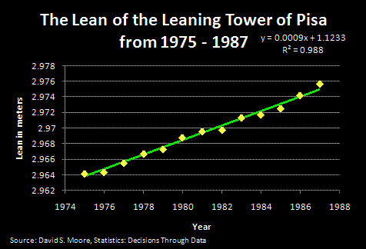
CORRELATION
IN-CLASS PROBLEM 2
Is it a good fit?

Slide 77
Correlation
R² = 0.988 means 98.8% of the variability in the data is “explained” by the fit line

Slide 78
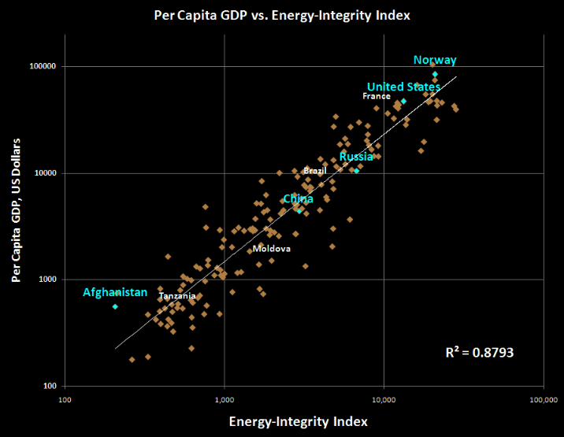
CORRELATION
IN-CLASS PROBLEM 2
Is it a good fit?
VFrench, 2016

Slide 79
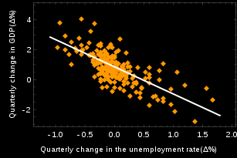
CORRELATION
IN-CLASS PROBLEM 2
Is it a good fit?
VFrench, 2016

Slide 80
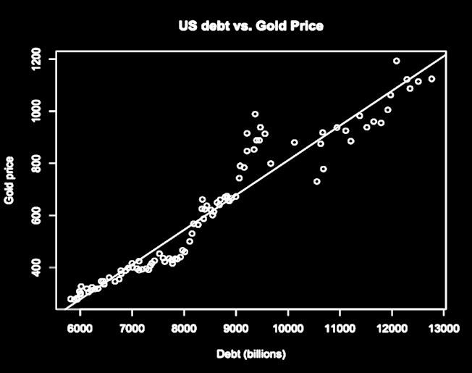
CORRELATION
IN-CLASS PROBLEM 2
Is it a good fit?
VFrench, 2016

Slide 81
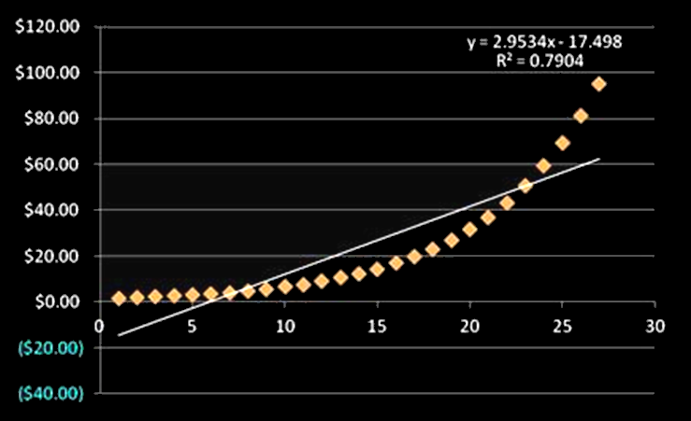
CORRELATION
IN-CLASS PROBLEM 2
Is it a good fit?
VFrench, 2016

Slide 82
Questions?
http://i.imgur.com/aliTlT3.jpg

Slide 83
How to Lie with Statistics
Just because two variables have a high correlation coefficient doesn’t mean one causes the other

Slide 84
How to Lie with Statistics
They could both be caused by a third variable
Or… it could just be a coincidence

Slide 85
correlation does not imply causation

Slide 86

How to Lie with Statistics
Sleep studies
http://clipart-library.com/cartoon-man-sleeping.html

Slide 87
How to Lie with Statistics
How would you “prove” that getting a certain amount of sleep causes you to live longer?

Slide 88
Correlation vs Causation
Causation is hard to prove
In research, causation can only be shown by a carefully controlled experiment

Slide 89
Correlation vs Causation
So you can’t show causation by observation or by using a survey

Slide 90
Correlation vs Causation
The research must be carefully designed so that the suspected cause can be the only cause of the result

Slide 91
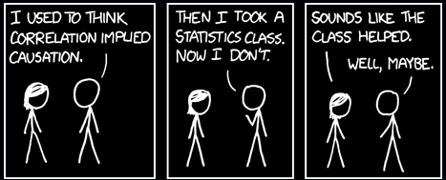
Correlation vs Causation
http://imgs.xkcd.com/comics/correlation.png

Slide 92
Causation
If you know that one variable DOES cause the other, put the variable that is the “causal” or “explanatory” variable on the horizontal “x” axis

Slide 93
Causation
The causal or explanatory or predictor variable is called the “independent” variable
Changing its value changes the value of the y variable

Slide 94
Causation
The variable affected by the causal variable (the response variable) is called the “dependent” variable
Its value depends on the value of x

Slide 95
CAUSATION
IN-CLASS PROBLEM 3
Which graph has the correct placement for the causative variable?
VFrench, 2016

Slide 96
CAUSATION
IN-CLASS PROBLEM 3
Which graph has the correct placement for the causative variable?
VFrench, 2016

Slide 97
Questions?
http://i.imgur.com/aliTlT3.jpg

Slide 98
Inputs and Outputs
In formulas, some variables are “input” variables
The thing you are calculating with the formula is the “output”

Slide 99
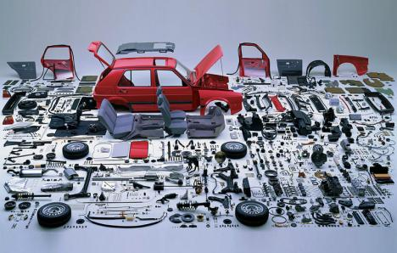
Inputs and Outputs
In a factory, the inputs are the components
https://3.bp.blogspot.com/-DEIw6og908M/VuLU19CgaII/AAAAAAAACgg/
IcW5UTOy7MY4O9ZdcCeqPyV_NI63Ou-6Q/s1600/Screen%2BShot%2B2016-03-07%2Bat%2B11.23.54%2BAM.png

Slide 100
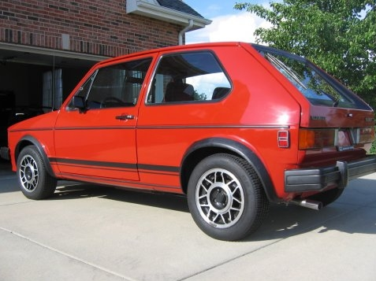
Inputs and Outputs
The output is the final product
https://i89.photobucket.com/albums/k230/echassin/GTI008.jpg

Slide 101
Inputs and Outputs
The input variable is ALWAYS put on the x-axis (horizontal axis)
No reason – it’s a TRADITION!

Slide 102
Inputs and Outputs
It can sometimes be hard to figure out which is the input variable and which the output variable

Slide 103
Inputs and Outputs
Input variables sometimes CAUSE the result

Slide 104
Inputs and Outputs
Sometimes input variables occur before the out variables

Slide 105
Inputs and Outputs
Frequently the input variables cannot be controlled by us (time, for example)
For this reason, input variables are frequently called “independent” variables

Slide 106
Inputs and Outputs
And, the output variables (which depend on the values of the independent input variables) are called “dependent” variables

Slide 107
Questions?
http://i.imgur.com/aliTlT3.jpg

Slide 108
Correlation
When we calculated a correlation coefficient, we said it was a measure of the closeness to a linear relationship between the two variables

Slide 109
Line of Best Fit
That means, we could find the formula for a line that would be the best fit for the two variables

Slide 110
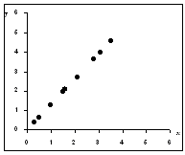
Line of Best Fit
We “fit” a line to the data
VFrench, 2016

Slide 111
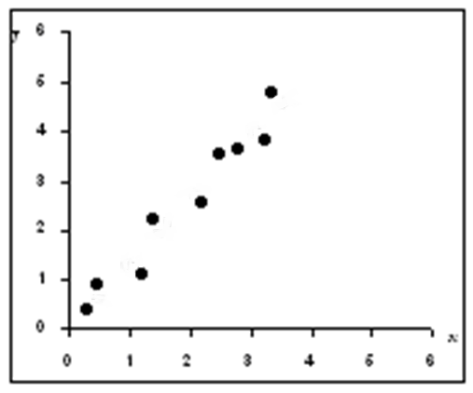
Line of Best Fit
Real-world data rarely lands exactly on a straight line
VFrench, 2016

Slide 112
Line of Best Fit
But we fit the “best” line to the data
VFrench, 2016

Slide 113
Line of Best Fit
When you graph two variables on an x-y plot, you can fit a line through the data called a “trend line”

Slide 114
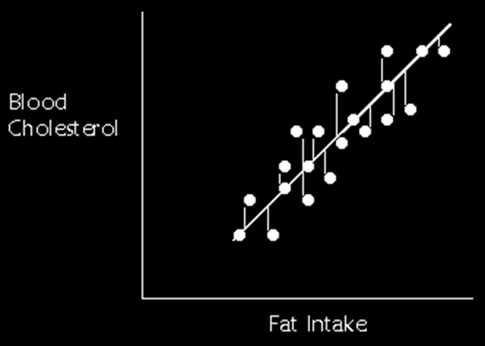
Line of Best Fit
This trend line is a “line of best fit” to the data
VFrench, 2016

Slide 115
Regression
The “line of best fit” is created by minimizing the total
distance of
all the
points to
the line
(deviations)
VFrench, 2016

Slide 116

Regression
The line of best fit is called the “regression” line
VFrench, 2016

Slide 117
Regression
Because it is a line, it has an equation:
y = b + mx
m = slope
b = y-intercept
VFrench, 2016

Slide 118
Regression
The slope “m” and the correlation coefficient “r” will both have the same sign

Slide 119
Regression
Note: some people use the symbol “ŷ” for the trend data corresponding to the “y” observation data

Slide 120
Regression
R² tells how closely the regression line “fits” the data –
“goodness of fit”

Slide 121

Regression
As you can imagine, the calculations for correlation and
the regression
line are scary
scared-pic.jpg

Slide 122

Regression
Hooray for Excel!
hooray.jpg

Slide 123
Regression
Francis Galton
https://galton.org/

Slide 124
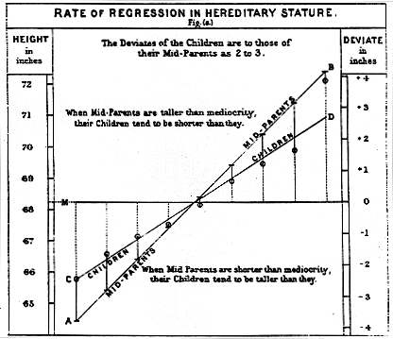
https://galton.org/

Slide 125
Questions?
http://i.imgur.com/aliTlT3.jpg

Slide 126
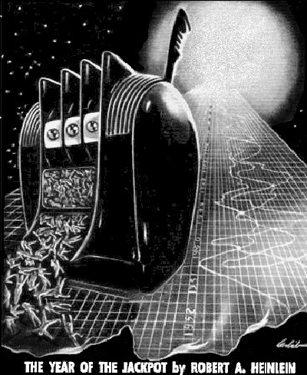

Slide 127
Time Series
A lot of things happen over time

Slide 128
Time Series
Another variable we are interested in happens over time… changes over time…
DEPENDS on what time is is…

Slide 129
Time Series
This variable that depends on time we call the “dependent” variable

Slide 130
Time Series
Time is called the “independent” variable – we can’t control it!

Slide 131
Time Series
Data that change over time are called “time series” data

Slide 132
Time Series
Time is the “input” variable that we put on the horizontal ↔ x-axis
The other “output” variable goes on the vertical ↕ y-axis

Slide 133
TIME SERIES
IN-CLASS PROBLEM 4a
Time series or not?
Federal debt 1950-2017

Slide 134
TIME SERIES
IN-CLASS PROBLEM 4a
Time series or not?
Federal debt 1950-2017

Slide 135
TIME SERIES
IN-CLASS PROBLEM 4b
Time series or not?
Taxes paid by income level

Slide 136
TIME SERIES
IN-CLASS PROBLEM 4b
Time series or not?
Taxes paid by income level

Slide 137
TIME SERIES
IN-CLASS PROBLEM 4c
Time series or not?
Global atmospheric temperature 1880-2021

Slide 138
TIME SERIES
IN-CLASS PROBLEM 4c
Time series or not?
Global atmospheric temperature 1880-2022

Slide 139
TIME SERIES
IN-CLASS PROBLEM 4d
Time series or not?
Average salary by education level

Slide 140
TIME SERIES
IN-CLASS PROBLEM 4d
Time series or not?
Average salary by education level

Slide 141
TIME SERIES
IN-CLASS PROBLEM 4e
Time series or not?
Average annual salary of US workers 1950-2017

Slide 142
TIME SERIES
IN-CLASS PROBLEM 4e
Time series or not?
Average annual salary of US workers 1950-2017

Slide 143
Time Series
Most engineering problems involve changes over time
Much of the regression analysis practiced by engineers is time series analysis

Slide 144
Questions?
http://i.imgur.com/aliTlT3.jpg

Slide 145
Time Series Forecasting
“Forecasts are expectations. The future can fail to meet expectations.”
Stephanie Black, 2022
Thanks, Stephanie!

Slide 146
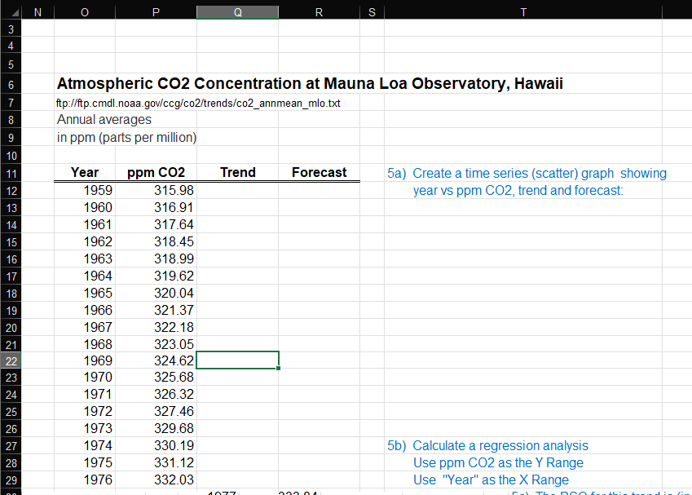
Time Series Forecasting
Go to the Atmospheric CO2 data

Slide 147
Time Series Forecasting
For time series forecasts, the spreadsheet setup is critical:
“x” is in the left column
“y” is at the right
Further right include a “Trend” column
And furthest right include a
“Forecast” column

Slide 148
Time Series Forecasting
To make a forecast out to 2025, you would add the year rows (they are already there…)

Slide 149
TIME SERIES FORECASTING
IN-CLASS PROBLEM 5a
Make a Graph!
Hint1: Include all columns from
Year to Forecast clear to
the bottom 2025
Hint2: Go back to the top
before you hit “Insert”

Slide 150
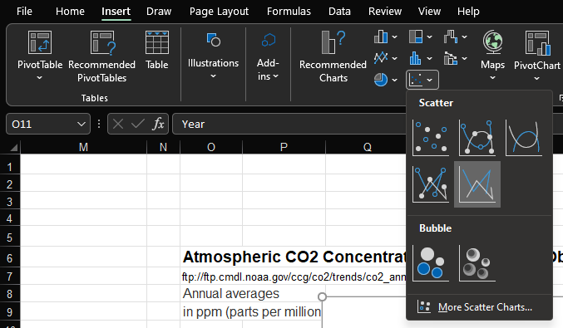
TIME SERIES FORECASTING
IN-CLASS PROBLEM 5a
Use the scatter lines graph

Slide 151
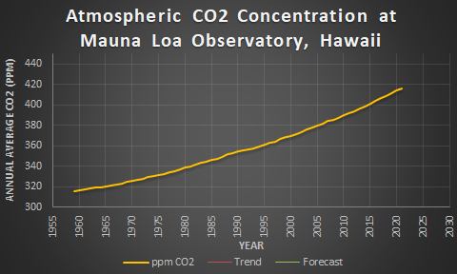
TIME SERIES FORECASTING
IN-CLASS PROBLEM 5a
Make it “purty”
VFrench, 2022

Slide 152
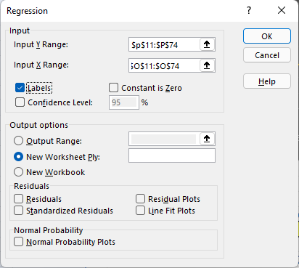
TIME SERIES FORECASTING
IN-CLASS PROBLEM 5b
Next, do your regression calculations:
Data
Data Analysis
Regression
Start with “y”
Only go down to
2021

Slide 153
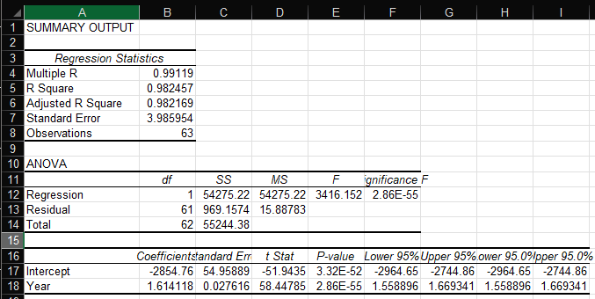
TIME SERIES FORECASTING
IN-CLASS PROBLEM 5b
Again on a new page:
EEEK! What’s all this?

Slide 154
TIME SERIES FORECASTING
IN-CLASS PROBLEM 5b
Good news: we only want a couple of things!

Slide 155

TIME SERIES FORECASTING
IN-CLASS PROBLEM 5c
Change the RSQ into a % with 2 decimals

Slide 156

TIME SERIES FORECASTING
IN-CLASS PROBLEM 5c
Copy/paste it over to your Zoomwork sheet

Slide 157

TIME SERIES FORECASTING
IN-CLASS PROBLEM 5d
Next copy the
coefficients…

Slide 158

TIME SERIES FORECASTING
IN-CLASS PROBLEM 5d
To the Zoomwork sheet Q8

Slide 159

TIME SERIES FORECASTING
IN-CLASS PROBLEM 5d
Input your trend equation

Slide 160

TIME SERIES FORECASTING
IN-CLASS PROBLEM 5d
Copy to the bottom (2025)
Oops… what’s wrong?

Slide 161
TIME SERIES FORECASTING
IN-CLASS PROBLEM 5d
Excel is adjusting the formula “down one” for each row

Slide 162
TIME SERIES FORECASTING
IN-CLASS PROBLEM 5d
We want that for “Year” but not for the coefficients!

Slide 163

TIME SERIES FORECASTING
IN-CLASS PROBLEM 5d
Insert a “$” into your formula before the number for each coefficient

Slide 164

TIME SERIES FORECASTING
IN-CLASS PROBLEM 5d
Copy this one down to 2025…
Much better!

Slide 165
TIME SERIES FORECASTING
IN-CLASS PROBLEM 5d
Notice: We don’t have to redo the graph!

Slide 166

TIME SERIES FORECASTING
IN-CLASS PROBLEM 5e
To emphasize the forecasts
go to the bottom of the data
Move the forecasts to the next
column

Slide 167

TIME SERIES FORECASTING
IN-CLASS PROBLEM 5e
To make the forecasts “attach”
to the trend line, copy the
TEXT
of the last
trend value
to the next
column

Slide 168

TIME SERIES FORECASTING
IN-CLASS PROBLEM 5e
Yay! Now we have a visible forecast on the graph!
VFrench, 2022

Slide 169
TIME SERIES FORECASTING
IN-CLASS PROBLEM 5f
Is it a good forecast?
Remember the RSQ was 98.25%
VFrench, 2022

Slide 170
TIME SERIES FORECASTING
IN-CLASS PROBLEM 5f
Even thought the RSQ is large, the forecast is crummy
VFrench, 2022

Slide 171
TIME SERIES FORECASTING
IN-CLASS PROBLEM 5f
The data are really curved, not a straight line!
VFrench, 2022

Slide 172
Time Series Forecasting
Even though a time series may have a VERY high correlation, this does not guarantee an accurate forecast

Slide 173
Time Series Forecasting
Time series data are often curved, not straight lines!

Slide 174
Time Series Forecasting
We’ll see how to fix that next class…

Slide 175
Questions?
http://i.imgur.com/aliTlT3.jpg

Slide 176
Summary
Today we studied:
Review of Average,
Variability, MCG
Correlation
Regression
Time Series

Slide 177

You Survived!
www.playbuzz.com

