Slide 1
Welcome to
Unit 2 Part 04
MATH366 Probability and Statistics
https://online.stanford.edu/sites/default/files/styles/figure_default/public/2018-04/theory-of-probability_stats116.jpg?itok=ms4fRMO-

Slide 2
What’s Up?
Today we will be going over:
  Review of frequencies
New: Descriptive statistics

Slide 3
What’s Up?
Outcome 1) Calculate statistical measures of central tendency and dispersion used in describing and summarizing collected samples. Both by hand calculation methods supported by calculators and programmed software procedures will be used to make these computations

Slide 4

Review
http://995642590.r.lightningbase-cdn.com/wp-content/uploads/2010/12/looking-back-hrexaminer-v144-cover425px.jpg

Slide 5
Fractiles
Another way of describing frequency data
A measure of position
Based on the ogive (cumulative frequency) or ordered data
Quartile - four pieces
Percentile - 100 pieces

Slide 6
Fractiles
The median is the 50th percentile or 2nd quartile

Slide 7
Fractiles
Interquartile range (IQR):
IQR = 3rd quartile – 1st quartile

Slide 8
Fractiles
We are using descriptive statistics to summarize our sample (and, hopefully, our population) in just a few numbers

Slide 9
Fractiles
The “five-number summary” is:
the min
Q1
the median
Q3
the max

Slide 10
Fractiles
The 5-number summary for our Internet Usage data is:
Min = 5
Q1 = 28.5
Median = 39.5
Q3 = 56
Max = 123

Slide 11
Fractiles
While Excel can accurately calculate the median for a dataset either using the formula or the Add-In, the quartile formulas for Excel ARE NOT the formulas for quartiles
DO NOT USE THEM!

Slide 12

Questions?
http://i.imgur.com/aliTlT3.jpg

Slide 13
Boxplots
There is a graph statisticians use to show the 5-number summary:
the boxplot

Slide 14
Boxplots
The boxplot (a.k.a. box and whisker diagram) is a standardized way of displaying the distribution of data based on the five number summary: minimum, first quartile, median, third quartile, and maximum

Slide 15
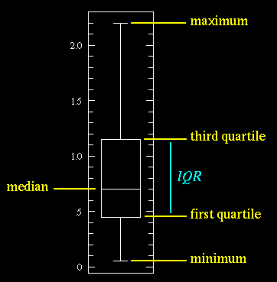
Boxplots
VFrench, 2017

Slide 16
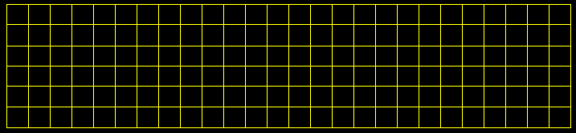
BOXPLOTS
IN-CLASS PROBLEM 4a
Min = 5 Now let’s create Q1 = 28.5 the box!
Median = 39.5
Q3 = 56
Max = 123
0 10 20 30 40 50 60 70 80 90 100 110 120
VFrench, 2022

Slide 17
BOXPLOTS
IN-CLASS PROBLEM 4a
Min = 5
Q1 = 28.5
Median = 39.5
Q3 = 56
Max = 123
Median!
0 10 20 30 40 50 60 70 80 90 100 110 120
VFrench, 2022

Slide 18
BOXPLOTS
IN-CLASS PROBLEM 4a
Min = 5
Q1 = 28.5
Median = 39.5
Q3 = 56
Max = 123
Q1!
0 10 20 30 40 50 60 70 80 90 100 110 120
VFrench, 2022

Slide 19
BOXPLOTS
IN-CLASS PROBLEM 4a
Min = 5
Q1 = 28.5
Median = 39.5
Q3 = 56
Max = 123
Q3!
0 10 20 30 40 50 60 70 80 90 100 110 120
VFrench, 2022

Slide 20
BOXPLOTS
IN-CLASS PROBLEM 4a
Min = 5
Q1 = 28.5
Median = 39.5
Q3 = 56
Max = 123
Box!
0 10 20 30 40 50 60 70 80 90 100 110 120
VFrench, 2022

Slide 21
BOXPLOTS
IN-CLASS PROBLEM 4a
Min = 5
Q1 = 28.5
Median = 39.5
Q3 = 56
Max = 123
Min!
0 10 20 30 40 50 60 70 80 90 100 110 120
VFrench, 2022

Slide 22
BOXPLOTS
IN-CLASS PROBLEM 4a
Min = 5
Q1 = 28.5
Median = 39.5
Q3 = 56
Max = 123
Max!
0 10 20 30 40 50 60 70 80 90 100 110 120
VFrench, 2022

Slide 23
BOXPLOTS
IN-CLASS PROBLEM 4a
Min = 5
Q1 = 28.5
Median = 39.5
Q3 = 56
Max = 123
Whiskers!
0 10 20 30 40 50 60 70 80 90 100 110 120
VFrench, 2022

Slide 24
Questions?
http://i.imgur.com/aliTlT3.jpg

Slide 25
Outliers
Because the min and max may be outliers, a variation on the boxplot includes “fences” to show where most of the data occurs

Slide 26
Outliers
Lower fence:
Q1 - 1.5 * IQR
Upper fence:
Q3 + 1.5 * IQR

Slide 27
OUTLIERS
IN-CLASS PROBLEM 4b
Min=5
Q1=28.5
Median=39.5
Q3=56 Max=123
What is the IQR?
0 10 20 30 40 50 60 70 80 90 100 110 120
VFrench, 2022

Slide 28
OUTLIERS
IN-CLASS PROBLEM 4b
Min=5
Q1=28.5
Median=39.5
Q3=56 Max=123
IQR=27.5
What is the lower fence?
0 10 20 30 40 50 60 70 80 90 100 110 120
VFrench, 2022
Q1 - 1.5*IQR

Slide 29
OUTLIERS
IN-CLASS PROBLEM 4b
Min=5
Q1=28.5
Median=39.5
Q3=56 Max=123
IQR=27.5
Lower fence =
28.5-1.5*27.5
= -12.75
0 10 20 30 40 50 60 70 80 90 100 110 120
VFrench, 2022
Q1 - 1.5*IQR

Slide 30
OUTLIERS
IN-CLASS PROBLEM 4b
Min=5
Q1=28.5
Median=39.5
Q3=56 Max=123
IQR=27.5
Lower fence=-12.75
What is the upper
fence?
0 10 20 30 40 50 60 70 80 90 100 110 120
VFrench, 2022
Q3 + 1.5*IQR

Slide 31
OUTLIERS
IN-CLASS PROBLEM 4b
Min=5
Q1=28.5
Median=39.5
Q3=56 Max=123
IQR=27.5
Lower fence=-12.75
Upper fence=
56+1.5*27.5
=97.25
0 10 20 30 40 50 60 70 80 90 100 110 120
VFrench, 2022
Q3 + 1.5*IQR

Slide 32
OUTLIERS
IN-CLASS PROBLEM 4b
Min=5
Q1=28.5
Median=39.5
Q3=56 Max=123
IQR=27.5
Lower fence=-12.75
Upper fence=97.25
So, do we have any outliers?
0 10 20 30 40 50 60 70 80 90 100 110 120
VFrench, 2022
Q3 + 1.5*IQR

Slide 33
OUTLIERS
IN-CLASS PROBLEM 4b
Min=5
Q1=28.5
Median=39.5
Q3=56 Max=123
The max value (123) is outside the upper fence and is an outlier!
0 10 20 30 40 50 60 70 80 90 100 110 120
VFrench, 2022

Slide 34
OUTLIERS
IN-CLASS PROBLEM 4b
Min=5
Q1=28.5
Median=39.5
Q3=56 Max=123
The min value (5) is inside the lower fence and is not an outlier
0 10 20 30 40 50 60 70 80 90 100 110 120
VFrench, 2022

Slide 35
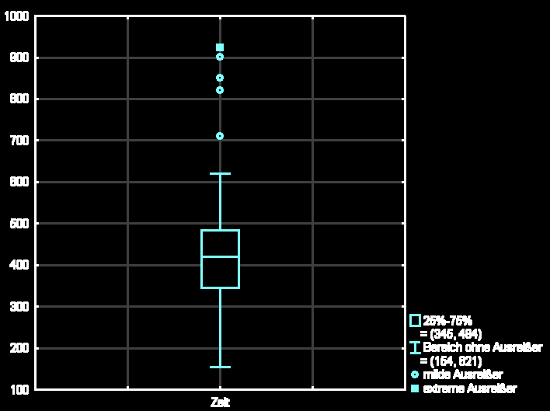
Outliers
How outliers are shown in a boxplot

Slide 36
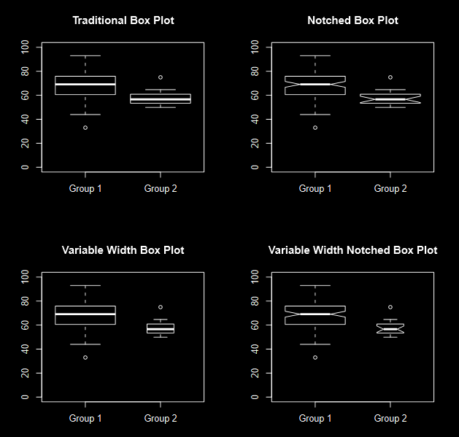
Types of Boxplots
https://upload.wikimedia.org/wikipedia/commons/thumb/2/2b/Fourboxplots.svg/220px-Fourboxplots.svg.png

Slide 37
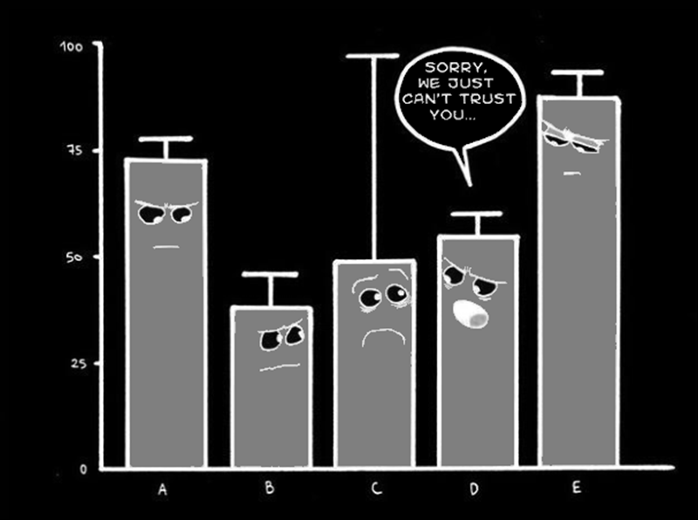
Multiple Comparisons
Explain the comic:
https://scontent.cdninstagram.com/hphotos-xfa1/t51.2885-15/e15/11418992_1449926035311275_671189903_n.jpg

Slide 38
Questions?
http://i.imgur.com/aliTlT3.jpg

Slide 39
Boxplots
Boxplots are typically used to compare different groups

Slide 40
Boxplots
Data Summary Table from a Ball-bouncing Experiment
 | Super Ball | Wiffle Ball | Golf Ball | Splash Ball | SpongyBall
Minimum | 66 | 38 | 70 | 7 | 44
Q1 | 71 | 45 | 75 | 14 | 58
Median | 76 | 48 | 78 | 16.5 | 60
Q3 | 78 | 50 | 80 | 23 | 62
Maximum | 91 | 58 | 90 | 28 | 67
VFrench, 2012

Slide 41
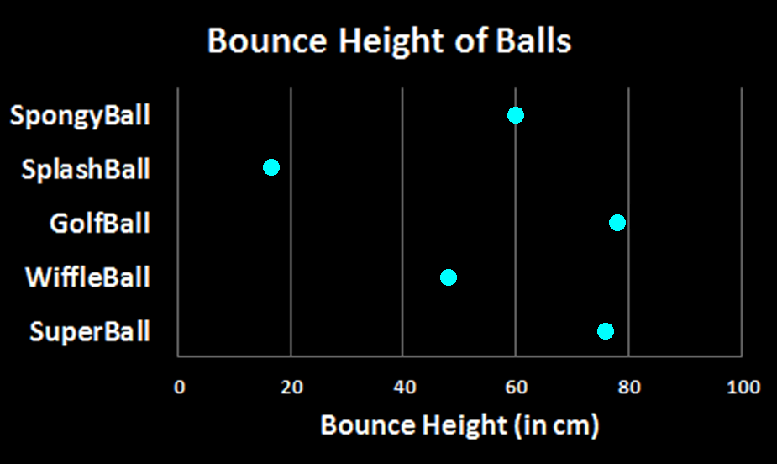
Boxplots
VFrench, 2012

Slide 42
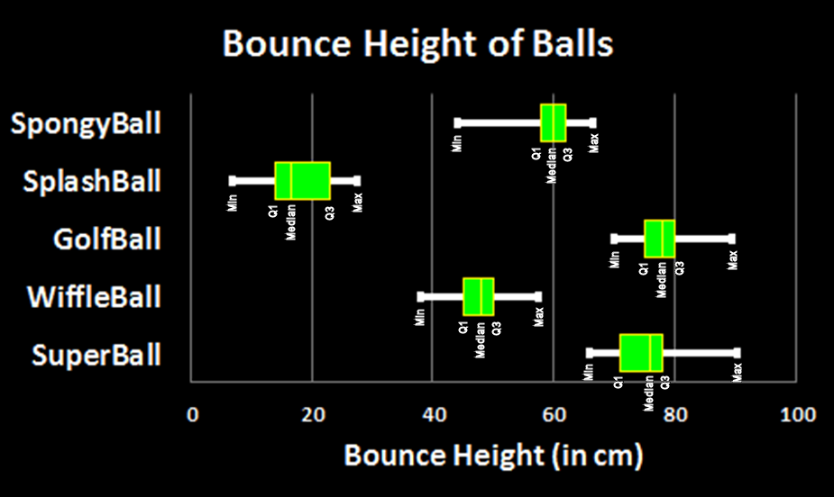
Boxplots
VFrench, 2012

Slide 43
Boxplots
It is customary to conclude that if two boxplots’ boxes overlap, they are not different
If the boxes do not overlap, even if the whiskers do, they are different

Slide 44
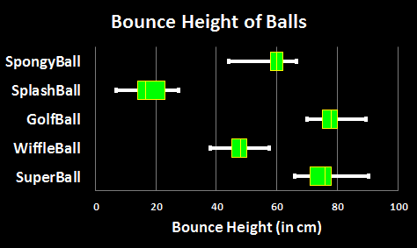
BOXPLOTS
IN-CLASS PROBLEM 4c
What differences?
VFrench, 2012

Slide 45
BOXPLOTS
IN-CLASS PROBLEM 4c
What differences?
C
A
A is different from all the rest
(no overlaps)
E
B
D
VFrench, 2012

Slide 46
BOXPLOTS
IN-CLASS PROBLEM 4c
What differences?
B is different from all others
(no overlaps)
C
A
Different
Different
E
Different
B
Different
D
VFrench, 2012

Slide 47
BOXPLOTS
IN-CLASS PROBLEM 4c
What differences?
C
Different
A
Different
Different
Different
E
C is different from A, and E but not different from
C and D
B
D
VFrench, 2012

Slide 48
BOXPLOTS
IN-CLASS PROBLEM 4c
What differences?
D is different from A, and B but not different from
C and D
C
A
Different
E
B
Not different
Different
Different
D
VFrench, 2012

Slide 49
BOXPLOTS
IN-CLASS PROBLEM 4c
What differences?
E is different from A, B and C but not different from
D
C
A
Different
Different
Different
E
B
Not different
D
VFrench, 2012

Slide 50
Boxplots
Unfortunately it is almost impossible to get a true boxplot using Excel

Slide 51
Boxplots
Unfortunately it is almost impossible to get a true boxplot using Excel
(there are several YouTube videos showing how to get one…

Slide 52
Boxplots
Unfortunately it is almost impossible to get a true boxplot using Excel
(there are several YouTube videos showing how to get one… but they are all wrong…)

Slide 53
Questions?
http://i.imgur.com/aliTlT3.jpg

Slide 54
Summary
Today we studied:
Review of frequencies
Descriptive statistics:
Measures of central tendency:
mean, median, mode, midrange
Measures of variability:
IQR, range, variance,
standard deviation
Multiple Comparison Graphs

Slide 55

You Survived!
www.playbuzz.com

