Slide 1
Welcome to
Unit 2 Part 03
MATH366 Probability and Statistics
https://online.stanford.edu/sites/default/files/styles/figure_default/public/2018-04/theory-of-probability_stats116.jpg?itok=ms4fRMO-

Slide 2
What’s Up?
Today we will be going over:
  Review of graphs
New: Frequencies!

Slide 3
What’s Up?
Outcome 1) Calculate statistical measures of central tendency and dispersion used in describing and summarizing collected samples. Both by hand calculation methods supported by calculators and programmed software procedures will be used to make these computations

Slide 4

Review
http://995642590.r.lightningbase-cdn.com/wp-content/uploads/2010/12/looking-back-hrexaminer-v144-cover425px.jpg

Slide 5
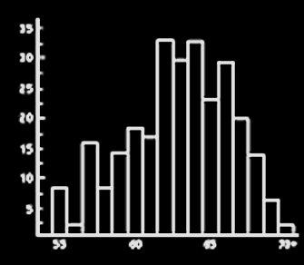

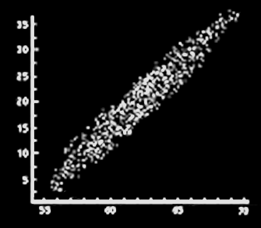
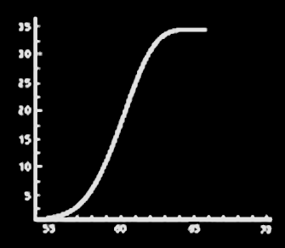
Graphs
The best way to understand any data set is to GRAPH IT!
VFrench, 2016

Slide 6
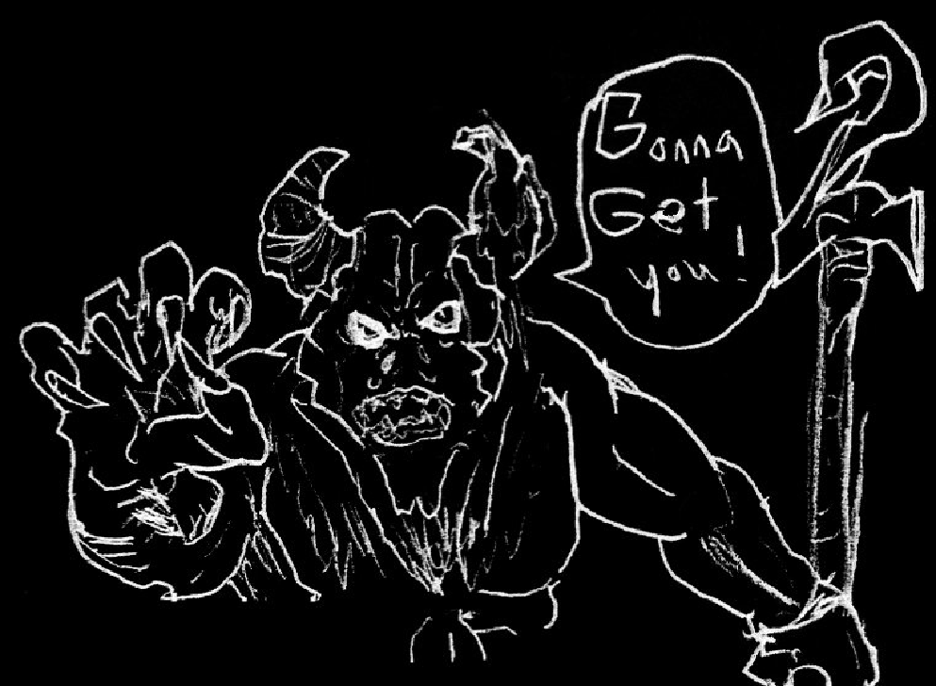
Graphs
If you don’t graph your data, the Stat Demons will get ya!
Thanks to Jonathan
Bellamy for the stupendous Stat Demon drawing !

Slide 7
Graphs
Graphs are easier for most people to understand than a table of numbers or text

Slide 8
Graphs
Graphs are pictures of something mathematical
- counts
- measurements
- a mathematical relationship

Slide 9
Graphs
Graphs=Charts=Plots=Diagrams

Slide 10
Excel Graphs
Graphs need to be a complete story in themselves
By looking at the graph, the viewer should understand the question and its answer

Slide 11
Excel Graphs
Graphs need:
      Titles
      Axis labels
      Legends
If you don’t have these…
you get points taken off!

Slide 12
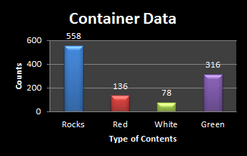
Excel Graphs
The perfect beautiful and informative graph!
Vfrench, 2016

Slide 13
Graphs
Graphs have a psychological component that CANNOT be ignored

Slide 14
Frequencies
Many bar/column charts display count data
The counts shown in each category are called “frequencies”

Slide 15
Frequencies
There are a lot of graphs that specialize in showing frequencies
These are called “histograms”

Slide 16
Measurement Frequencies
We can change measured data to categories by splitting the continuum into named categories

Slide 17
Measurement Frequencies
It is less confusing to viewers to keep the numerical categories the same width

Slide 18
Measurement Frequencies
Numerical categories should not overlap
Numerical categories should not leave any blank spaces in the continuum

Slide 19
Measurement Frequencies
Numerical categories are also called “classes”

Slide 20
Measurement Frequencies
For numerical categories, the maximum and minimum values in each category are called the “class limits”

Slide 21
Measurement Frequencies
So you should aim for 5-8 classes with “kinda-nice” class limit values

Slide 22
Measurement Frequencies
You can have a first class limit that is “a value or lower” and a last class limit that is “a value or higher” for rare classes

Slide 23
Histograms
There are several popular types of histograms:
Dot plots
Stem and leaf plots

Slide 24

Questions?
http://i.imgur.com/aliTlT3.jpg

Slide 25
FREQUENCIES
IN-CLASS PROBLEM 1
You are doing research on traffic offenses in CoS
Your first research objective is to find out if Garden of the Gods Road’s speed limit is being ignored
You start by sampling 30 speeding tickets from this street and recording the speed

Slide 26
FREQUENCIES
IN-CLASS PROBLEMS 1a,b,c
What is the population?
What is the variable?
Is the variable qualitative
or quantitative?

Slide 27
FREQUENCIES
IN-CLASS PROBLEM 1d
58 | 62 | 51 | 59 | 50 | 103 | 53 | 68 | 59 | 52
71 | 54 | 57 | 52 | 66 | 83 | 55 | 70 | 52 | 58
55 | 61 | 53 | 65 | 52 | 56 | 80 | 56 | 63 | 98
Create a dot plot for the data:
?
46-50 51-55 56-60 61-65 66-70 71-75 76-80 81+
mph mph mph mph mph mph mph mph

Slide 28
FREQUENCIES
IN-CLASS PROBLEM 1d
58 | 62 | 51 | 59 | 50 | 103 | 53 | 68 | 59 | 52
71 | 54 | 57 | 52 | 66 | 83 | 55 | 70 | 52 | 58
55 | 61 | 53 | 65 | 52 | 56 | 80 | 56 | 63 | 98
Create a dot plot for the data:
?
46-50 51-55 56-60 61-65 66-70 71-75 76-80 81+
mph mph mph mph mph mph mph mph

Slide 29
FREQUENCIES
IN-CLASS PROBLEM 1d
58 | 62 | 51 | 59 | 50 | 103 | 53 | 68 | 59 | 52
71 | 54 | 57 | 52 | 66 | 83 | 55 | 70 | 52 | 58
55 | 61 | 53 | 65 | 52 | 56 | 80 | 56 | 63 | 98
Is the speed limit being ignored?
?
46-50 51-55 56-60 61-65 66-70 71-75 76-80 81+
mph mph mph mph mph mph mph mph
X
X
X
X
X
X
X
X
X
X
X
X
X
X
X
X
X
X
X
X
X
X
X
X
X
X
X
X
X
X

Slide 30
FREQUENCIES
IN-CLASS PROBLEM 1e
58 | 62 | 51 | 59 | 50 | 103 | 53 | 68 | 59 | 52
71 | 54 | 57 | 52 | 66 | 83 | 55 | 70 | 52 | 58
55 | 61 | 53 | 65 | 52 | 56 | 80 | 56 | 63 | 98
Create a Stem and Leaf for the raw data:
(adjourn to the tablet!)

Slide 31
Questions?
http://i.imgur.com/aliTlT3.jpg

Slide 32
Measurement Frequencies
You need to have a question you are trying to answer with the data
Please open up the Excel spreadsheet in the Learning Materials

Slide 33
Measurement Frequencies
What you might want to show is:
“Do our customers spend a lot of time on the Internet?
How much?”

Slide 34
Measurement Frequencies
To show this, it would make sense to create categories from this quantitative data!

Slide 35
Measurement Frequencies
How many minutes is “not many”? 5? 10? 15?
Let’s say “10 or fewer”
That becomes our first category:
“1-10”

Slide 36
Measurement Frequencies
Type in:
‘1-10
or Excel will change it into a date

Slide 37
Measurement Frequencies
Start a “Summary Table” of categories and how many observations fall into each one:
Minutes Internet Usage | Number of Users
1-10

Slide 38
Measurement Frequencies
What would be the next category?
It could be anything you decide… but…

Slide 39
Measurement Frequencies
…remember, it is less confusing to viewers to keep the categories the same width

Slide 40
Measurement Frequencies
Your previous category was
“1-10 minutes”
Its width is: 10-1 +1 = 10

Slide 41
Measurement Frequencies
SO, the next category should be right next to “1-10”, not overlap with “1-10” and be 10 wide:
“ ”

Slide 42
Measurement Frequencies
Continuing, our categories will be:
Minutes Internet Usage | Number of Users
1-10 | 3
11-20
21-30
31-40
41-50
51-60
etc...

Slide 43
Measurement Frequencies
But… that’s still A LOT of categories!
Our data goes up to 123 minutes!!
The graph will be better than the original, but still cluttered!

Slide 44
Measurement Frequencies
Remember… the human brain can compare only 7-8 things before becoming overloaded

Slide 45
Measurement Frequencies
We need to redo our categories to have only about 7 or 8 of them

Slide 46
Measurement Frequencies
Our data goes from a minimum of 5 to a maximum of 123
If we had only one category, it would have a width:
123-5 +1 = 119

Slide 47
Measurement Frequencies
If we split the 119 into 7 equal pieces: 119/7 = 17
17 is not a very “nice” number for category splits
15 or 20 would be “evener”

Slide 48
FREQUENCIES
IN-CLASS PROBLEM 2a
Which would be better?
Minutes Internet Usage | Number of Users
1-15
16-30
31-45
46-60
61-75
76-90
91-105
106-120
121+
Minutes Internet Usage | Number of Users
1-20
21-40
41-60
61-80
81-100
101-120
121+

Slide 49
FREQUENCIES
IN-CLASS PROBLEM 2b
Now we have to get the number of users for each category:
Minutes Internet Usage | Number of Users
1-20
21-40
41-60
61-80
81-100
101-120
121+

Slide 50
Measurement Frequencies
Let’s sort the data!
In Excel, first highlight just the numbers
Then click on the “Data” tab

Slide 51
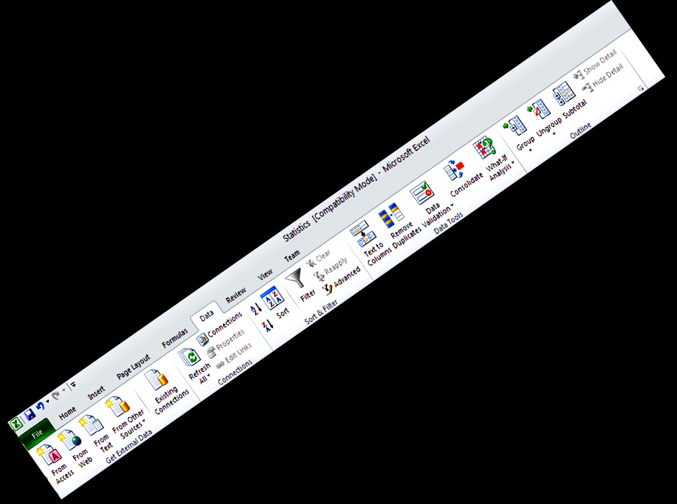
Measurement Frequencies
Click on “Sort”
Use the “A->Z”
sort to go
from lo
to hi

Slide 52
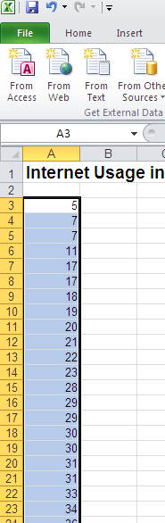
Measurement Frequencies
Poof!
Little numbers on top,
big numbers on the
bottom

Slide 53
Measurement Frequencies
How many observations fall in this first category?
Highlight the observations that are 20 or less

Slide 54
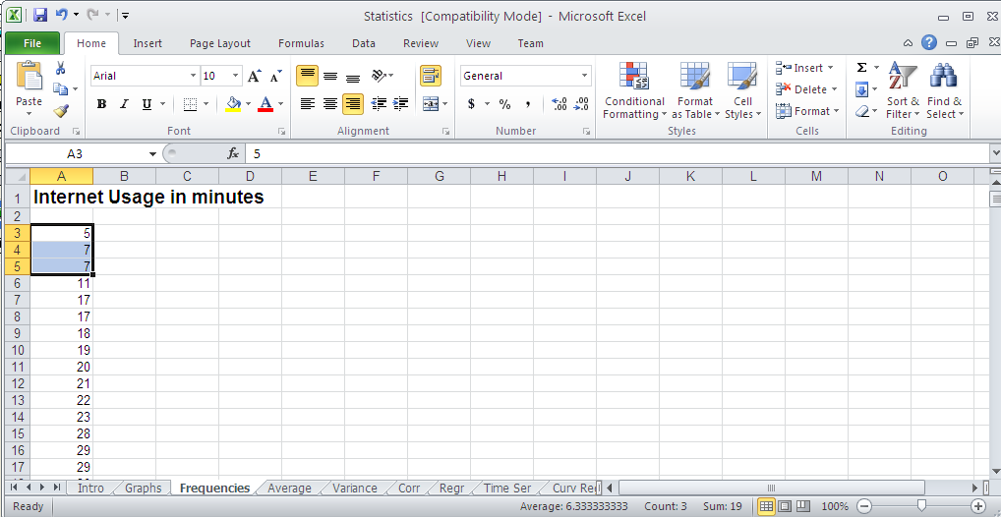
Measurement Frequencies
The number of observations is

Slide 55
Measurement Frequencies
The number of observations in that category is the frequency

Slide 56
FREQUENCIES
IN-CLASS PROBLEM 2b
Here is the data summary table:
Minutes Internet Usage | Number of Users
1-20 | 9
21-40 | 18
41-60 | 15
61-80 | 8
81-100 | 1
101-120 | 0
121+ | 1

Slide 57
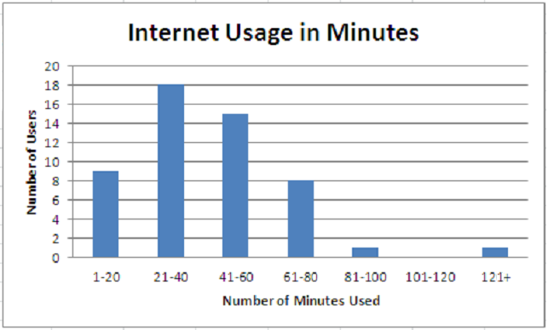
Measurement Frequencies
The graph now tells a story
VFrench, 2017

Slide 58
Measurement Frequencies
You can also now see that the value “123” is an “outlier”
VFrench, 2017

Slide 59
Measurement Frequencies
Outliers have one or more empty (zero count) categories between their category and the others
VFrench, 2017

Slide 60
Measurement Frequencies
Outliers can be a problem in statistical analysis
You have to decide whether the value is truly an outlier and should be eliminated or a valid extension of the data

Slide 61
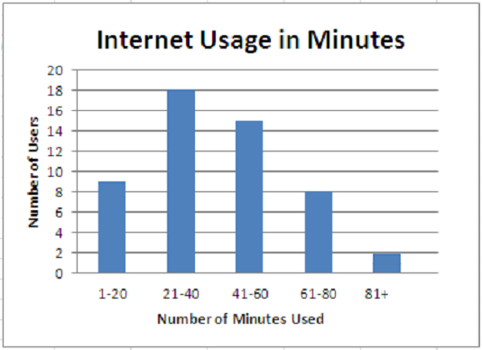
Measurement Frequencies
Another option:
VFrench, 2017

Slide 62
Questions?
http://i.imgur.com/aliTlT3.jpg

Slide 63
Frequencies
Types of frequencies:
A relative frequency is the fraction or percent of observations that fall in each category

Slide 64
Frequencies
You first find the total sample size (n) by adding up all of the counts in each category

Slide 65
Frequencies
Then divide each category count by n

Slide 66
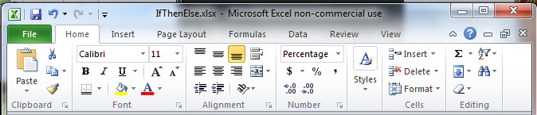
Frequencies
You can make these percentages by multiplying by 100 (or just clicking the % sign on the Excel ribbon)

Slide 67
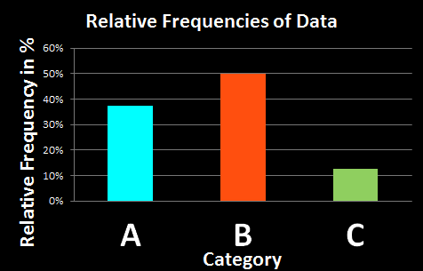
Frequencies
Data table: n = 8
A B A B A C B B
Rel Freq Histogram:
distribution:
A: 3/8
B: 4/8
C: 1/8
VFrench, 2016

Slide 68
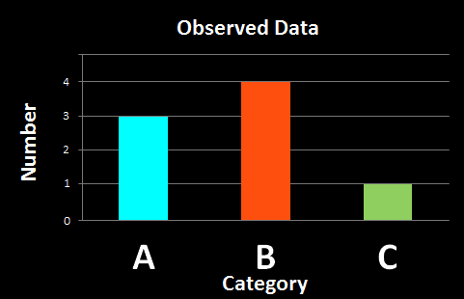
Frequencies
Notice the shapes of the absolute frequency and relative frequency graphs are the same
VFrench, 2016

Slide 69
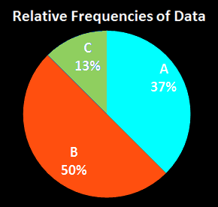
Frequencies
Because we see % more easily in a pie chart, relative frequencies should be shown in this format
VFrench, 2016

Slide 70
FREQUENCIES
IN-CLASS PROBLEM 2c
Create relative frequency data for the Internet Usage data

Slide 71
Questions?
http://i.imgur.com/aliTlT3.jpg

Slide 72
Cumulative Frequencies
Types of frequencies:
Cumulative frequency – the number of observations that fall in that category or a previous category
This can only be done if the categories can be ordered

Slide 73
Cumulative Frequencies
How many observations occur in a given
category
and any
previous:
Minutes Internet Usage | Number of Users | Cumulative Number of Users
1-20 | 9 | 9
21-40 | 18 | 27
41-60 | 15 | 42
61-80 | 8 | 50
81-100 | 1 | 51
101-120 | 0 | 51
121+ | 1 | 52

Slide 74
Cumulative Frequencies
The last value is always “n”
the sample size
Minutes Internet Usage | Number of Users | Cumulative Number of Users
1-20 | 9 | 9
21-40 | 18 | 27
41-60 | 15 | 42
61-80 | 8 | 50
81-100 | 1 | 51
101-120 | 0 | 51
121+ | 1 | 52

Slide 75
Cumulative Frequencies
The histogram for a cumulative frequency distribution is called an
“ogive”

Slide 76
Cumulative Frequencies
The histogram for a cumulative frequency distribution is called an
“ogive”
“oh jive!”

Slide 77
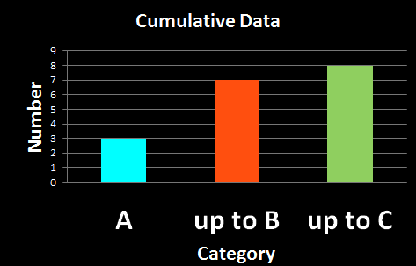
Cumulative Frequencies
Data table: n = 8
A B A B A C B B
Cum Freq Histogram:
distribution:
A: 3
A or B: 3+4=7
A,B or C: 8
VFrench, 2016

Slide 78
Cumulative Frequencies
Note that the last category in a cumulative frequency ALWAYS has the value n

Slide 79
Cumulative Frequencies
Note also a cumulative frequency cannot get smaller as you move up the categories

Slide 80
Cumulative Frequencies
Note also a cumulative frequency cannot get smaller as you move up the categories
It can stay the same (if the category count is 0)

Slide 81
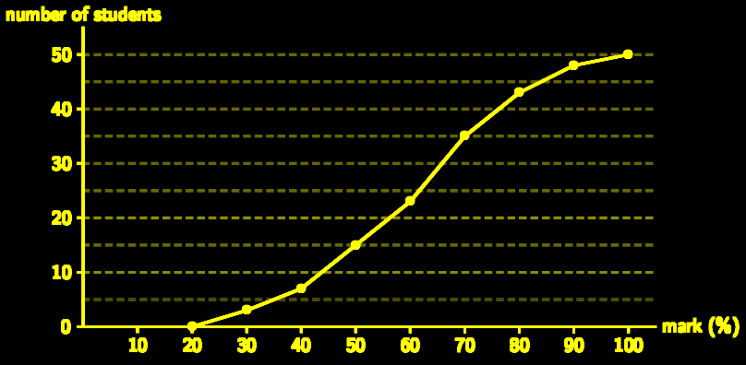
Cumulative Frequencies
An ogive typically forms an “s” shape
http://everythingmaths.co.za/maths/grade-11/11-statistics/tikzpictures/4d8229e8dd2b71fe85520a97acdab63a.png

Slide 82
FREQUENCIES
IN-CLASS PROBLEM 2d
Create cumulative frequency data for the Internet Usage data

Slide 83
Questions?
http://i.imgur.com/aliTlT3.jpg

Slide 84
Measurement Frequencies
Numerical categories are called “classes”

Slide 85
Measurement Frequencies
For numerical categories, the maximum and minimum values in each category are called the “class limits”

Slide 86
FREQUENCIES
IN-CLASS PROBLEM 2e
What are the class limits for the second class in the Internet Usage data?

Slide 87
Measurement Frequencies
For numerical categories, the range of values included in each category is called the “width”

Slide 88
FREQUENCIES
IN-CLASS PROBLEM 2f
What is the category width for the Internet Usage data?

Slide 89
Measurement Frequencies
The middle of each numerical category is called the “midpoint”
Add the maximum and minimum (class limits) and divide by 2

Slide 90
FREQUENCIES
IN-CLASS PROBLEM 2g
What is the midpoint for the first class in the Internet Usage data?

Slide 91
FREQUENCIES
IN-CLASS PROBLEM 2h
Create a column graph for the Internet Usage data

Slide 92
FREQUENCIES
IN-CLASS PROBLEM 2i
Create a pie chart for the Internet Usage data

Slide 93
Questions?
http://i.imgur.com/aliTlT3.jpg

Slide 94
Fractiles
Another way of describing frequency data
A measure of position
Based on the ogive (cumulative frequency) or ordered data

Slide 95
Fractiles
How to do it:
find n
order the data
divide the data into the # of pieces you want, each with an equal # of members

Slide 96
Fractiles
quartile - four pieces
percentile - 100 pieces

Slide 97
FRACTILES
IN-CLASS PROBLEM 3a
Step 1: Find n

Slide 98
FRACTILES
IN-CLASS PROBLEM 3a
n = 52
What’s next?

Slide 99
FRACTILES
IN-CLASS PROBLEM 3b
Order the data!
What if you split it into equal halves?
How many observations would be in each half?

Slide 100
FRACTILES
IN-CLASS PROBLEM 3b
What if you split it into equal halves?
How many observations would be in each half? 26
Where would the splits be?

Slide 101
FRACTILES
IN-CLASS PROBLEM 3b
Poof!
26 observations in each half!
What is the median?
…
36
37
39
39
39
40
41
41
42
44
…

Slide 102
FRACTILES
IN-CLASS PROBLEM 3b
The 50th percentile
or the “median”
39+40
2
Note: the median often will not be an actual observation in your data but something between two observed values
…
36
37
39
39
39
40
41
41
42
44
= 39.5
…

Slide 103
FRACTILES
IN-CLASS PROBLEM 3c
What if you wanted quartiles?
How many observations would be in each quartile?

Slide 104
FRACTILES
IN-CLASS PROBLEM 3c
What if you wanted quartiles?
How many observations would be in each quartile? 13
Where would the splits be?

Slide 105
FRACTILES
IN-CLASS PROBLEM 3c
…
Poof!
13 observations in each quartile!
What are the quartiles?
20
21
22
23
28
29
29
30
30
31
…
…
51
53
54
54
56
56
56
59
62
67
…

Slide 106
FRACTILES
IN-CLASS PROBLEM 3c
…
1st quartile = = 28.5
3rd quartile = = 56
20
21
22
23
28
29
29
30
30
31
28+29
2
56+56
2
…
…
51
53
54
54
56
56
56
59
62
67
…

Slide 107
Fractiles
Quartiles and percentiles are common, others not so much
The median is also common, but it is called “the median” rather than “the 50th percentile” or “2nd quartile”

Slide 108
Questions?
http://i.imgur.com/aliTlT3.jpg

Slide 109
Variability
How close are the data to the median?
0 1 1 5 9 9 10
vs
4 4.5 4.9 5 5.1 5.2 5.3

Slide 110
Variability
Interquartile range (IQR):
IQR = 3rd quartile – 1st quartile

Slide 111
Variability
The interquartile range is in the same units as the original data (like the range and standard deviation “s”)

Slide 112
FRACTILES
IN-CLASS PROBLEM 3c
…
1st quartile = 28.5
3rd quartile = 56
What is the IQR?
20
21
22
23
28
29
29
30
30
31
…
…
51
53
54
54
56
56
56
59
62
67
…
IQR = 3rd quartile – 1st quartile

Slide 113
FRACTILES
IN-CLASS PROBLEM 3c
…
1st quartile = 28.5
3rd quartile = 56
IQR = 56 – 28.5 = 27.5
20
21
22
23
28
29
29
30
30
31
…
…
51
53
54
54
56
56
56
59
62
67
…
IQR = 3rd quartile – 1st quartile

Slide 114
Descriptive Statistics in Excel
How to add “Add-Ins” to Excel
Click on the 'File' button at the top left of the screen
At the bottom of the drop down menu, click on the
'Excel Options' button
The Excel Options window will open
In the column on the left, click on the 'Add-Ins’ heading
Click the 'Go' Button - an 'Add-Ins' window will open.
Click in the checkbox next to 'Analysis ToolPak'
Click the 'OK' button
When it is finished, click on the 'Data' tab
The Analysis group will be on the right side of the ribbon
If “Data Analysis” is not there, your installation of the
ToolPack didn’t work

Slide 115
FRACTILES
IN-CLASS PROBLEM 3d
Use the Excel Add-In to calculate the Summary Statistics for the Internet Usage dataset

Slide 116
Questions?
http://i.imgur.com/aliTlT3.jpg

Slide 117
Fractiles
Excel thinks it has formulas in the software to calculate Q1 and Q2 and the median
=quartile. (data range, )
=median(data range)
exc
inc
Q1
Q2

Slide 118
FRACTILES
IN-CLASS PROBLEM 3e
Use the Excel formulas to calculate Q1, the median and Q3 for the Internet Usage dataset

Slide 119


FRACTILES
IN-CLASS PROBLEM 3e
Use the Excel formulas to calculate Q1, the median and Q3 for the Internet Usage dataset
Hmm… not the same values…

Slide 120
Fractiles
While Excel can accurately calculate the median for a dataset either using the formula or the Add-In, the quartile formulas for Excel ARE NOT the formulas for quartiles
DO NOT USE THEM!

Slide 121
Questions?
http://i.imgur.com/aliTlT3.jpg

Slide 122
Exploring Data
We are using descriptive statistics to summarize our sample (and, hopefully, our population) in just a few numbers

Slide 123
Exploring Data
The “five-number summary” is:
the min
Q1
the median
Q3
the max

Slide 124
FRACTILES
IN-CLASS PROBLEM 3f
Calculate the five-number summary for the Internet Usage data
Min = ?
Q1 =
Median =
Q3 =
Max =

Slide 125
FRACTILES
IN-CLASS PROBLEM 3f
Calculate the five-number summary for the Internet Usage data
Min = 5
Q1 = ?
Median =
Q3 =
Max =

Slide 126
FRACTILES
IN-CLASS PROBLEM 3f
Calculate the five-number summary for the Internet Usage data
Min = 5
Q1 = 28.5
Median = ?
Q3 =
Max =

Slide 127
FRACTILES
IN-CLASS PROBLEM 3f
Calculate the five-number summary for the Internet Usage data
Min = 5
Q1 = 28.5
Median = 39.5
Q3 = ?
Max =

Slide 128
FRACTILES
IN-CLASS PROBLEM 3f
Calculate the five-number summary for the Internet Usage data
Min = 5
Q1 = 28.5
Median = 39.5
Q3 = 56
Max = ?

Slide 129
FRACTILES
IN-CLASS PROBLEM 3f
Calculate the five-number summary for the Internet Usage data
Min = 5
Q1 = 28.5
Median = 39.5
Q3 = 56
Max = 123

Slide 130
Questions?
http://i.imgur.com/aliTlT3.jpg

Slide 131
Summary
Today we studied:
Review of graphs
Frequencies

Slide 132

You Survived!
www.playbuzz.com

