Slide 1
Welcome to
Unit 1 Part 02
MATH366 Probability and Statistics
https://online.stanford.edu/sites/default/files/styles/figure_default/public/2018-04/theory-of-probability_stats116.jpg?itok=ms4fRMO-

Slide 2
What’s Up?
Today we will be going over:
  Review of population, sample, and
  types of data
New: Graphs!
(and how to lie with them…)

Slide 3
What’s Up?
Outcome 1) Calculate statistical measures of central tendency and dispersion used in describing and summarizing collected samples. Both by hand calculation methods supported by calculators and programmed software procedures will be used to make these computations

Slide 4

Review
http://995642590.r.lightningbase-cdn.com/wp-content/uploads/2010/12/looking-back-hrexaminer-v144-cover425px.jpg

Slide 5

Statistics!!
Statistics is the mathematics
of uncertainty
so, in our uncertain world
statistics is the
mathematics of
making decisions
http://www.webdesignerdepot.com/wp-content/uploads/designer_pet_peeves/confused.jpg

Slide 6
How It Works
The BIG thing we want to answer a question about is called our
POPULATION
The small piece of it we actually take is called our
SAMPLE

Slide 7
How It Works
The count or measurement we need to answer our question about the population is called a
PARAMETER
The count or measurement we actually take to answer our question using a sample is called a STATISTIC

Slide 8
Sampling
You want to have a sample that closely resembles your population – a representative sample

Slide 9
Sampling
How do you make sure your sample statistic is close to your population parameter?
Make sure that every element/subject in the population has an equal chance of being in the sample
a RANDOM sample

Slide 10
Sampling
How do you make sure your sample statistic is close to your population parameter?
Take the BIGGEST sample you can
the LAW OF LARGE NUMBERS

Slide 11
Sampling
The number in your sample is called the “sample size”
It is usually called “n”

Slide 12
Sampling
The population also has a size (probably really REALLY huge, and also probably unknown)
called: “N”

Slide 13
Types of Data
We count qualitative data (how many fall into each category)
We measure quantitative data

Slide 14
Types of Data
  Other types of data:
  Qualitative/quantitative
  Observation/experiment
  Deterministic/nondeterministic
  Periodic/nonperiodic
  Continuous/discrete
  Stationary/nonstationary

Slide 15

Questions?
http://i.imgur.com/aliTlT3.jpg

Slide 16

Organizing Data
The population is huge
We can’t handle it
So we take a sample
We take counts or measurements
on the sample
These are messy and
hard to understand
NOW WHAT???
http://www.un-s.ru/images/question.jpg

Slide 17

Organizing Data
Step 1: Put your data into Excel
Step 2: Graph it!
excel.gif

Slide 18
Organizing Data
Once in Excel we have a variety of organizing tools we can use for our data

Slide 19
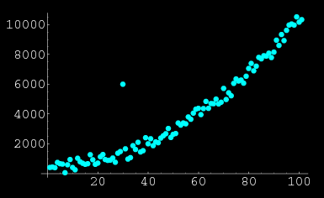
Organizing Data
Always do a quick graph of your data table to identify problems
http://mathworld.wolfram.com/images/eps-gif/OutlierScatterplot_1000.gif

Slide 20
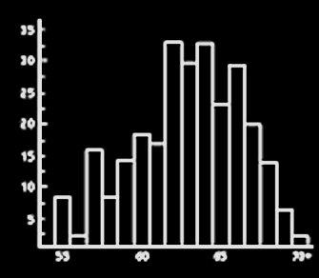

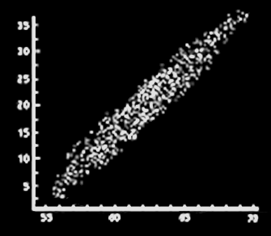
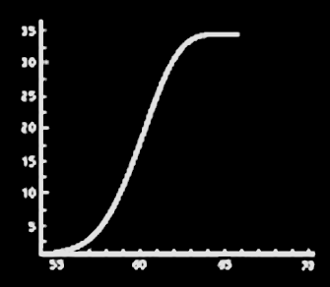
Graphs
The best way to understand any data set is to GRAPH IT!
VFrench, 2016

Slide 21

Graphs
If you don’t graph your data, the Stat Demons will get ya!
Thanks to Jonathan
Bellamy for the stupendous Stat Demon drawing !

Slide 22
Graphs
Graphs are easier for most people to understand than a table of numbers or text

Slide 23
Graphs
Graphs are pictures of something mathematical
- counts
- measurements
- a mathematical relationship

Slide 24
Graphs
Graphs=Charts=Plots=Diagrams

Slide 25
Excel Graphs
Graphs are easy-peasy in Excel!

Slide 26
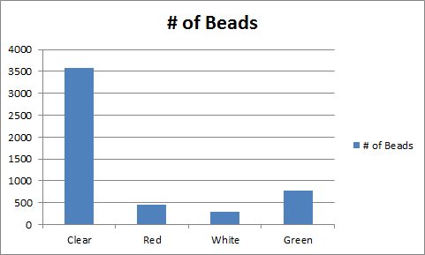
Excel Graphs
TAH-DAH!
A (kinda ugly) graph!
VFrench, 2016

Slide 27

Excel Graphs
But… you aren’t done yet!
(You were hoping… right?)
http://cdn3.sbnation.com/imported_assets/1930587/cross-fingers-100712-02.jpg

Slide 28
Excel Graphs
Graphs need to be a complete story in themselves
By looking at the graph, the viewer should understand the question and its answer

Slide 29
Excel Graphs
Graphs need:
      Titles
      Axis labels
      Legends
If you don’t have these…
you get points taken off!

Slide 30
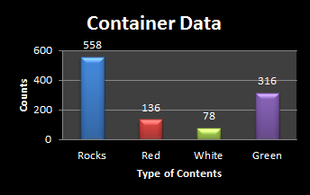
Excel Graphs
The perfect beautiful and informative graph!
VFrench, 2016

Slide 31
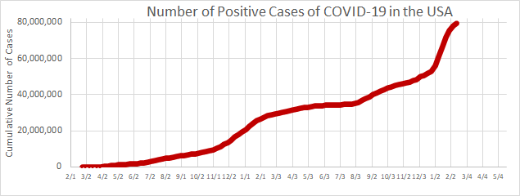
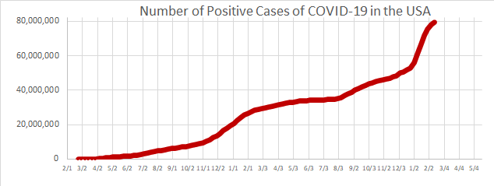
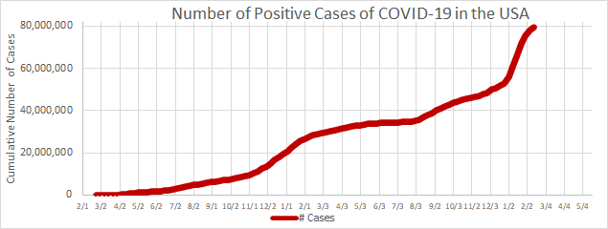

TYPES OF GRAPHS
IN-CLASS PROBLEM 1
Which is the complete graph:
a
b
c
d

Slide 32
Questions?
http://i.imgur.com/aliTlT3.jpg

Slide 33

What About the Other Types of Graphs?
VFrench, 2016

Slide 34
Types of Graphs
Bar and column charts should be used to highlight differences in the actual number
Pie charts are super for highlighting percentages

Slide 35
Types of Graphs
Here’s some salary data for the Chicago Bulls in 1998:
http://www.basketball-reference.com/teams/CHI/1998.html
Player | Salary
Michael Jordan | $33,140,000
Ron Harper | $4,560,000
Toni Kukoc | $4,560,000
Dennis Rodman | $4,500,000
Luc Longley | $3,184,900
Scottie Pippen | $2,775,000
Bill Wennington | $1,800,000

Slide 36
Types of Graphs
How can we show that Michael Jordan is paid a lot more than everyone else on the team?
Player | Salary
Michael Jordan | $33,140,000
Ron Harper | $4,560,000
Toni Kukoc | $4,560,000
Dennis Rodman | $4,500,000
Luc Longley | $3,184,900
Scottie Pippen | $2,775,000
Bill Wennington | $1,800,000

Slide 37
Types of Graphs
Graphs!!!
Player | Salary
Michael Jordan | $33,140,000
Ron Harper | $4,560,000
Toni Kukoc | $4,560,000
Dennis Rodman | $4,500,000
Luc Longley | $3,184,900
Scottie Pippen | $2,775,000
Bill Wennington | $1,800,000

Slide 38
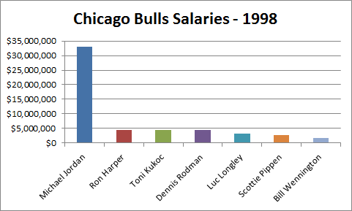
TYPES OF GRAPHS
IN-CLASS PROBLEM 2a
What does the bar chart tell you?
VFrench, 2016

Slide 39
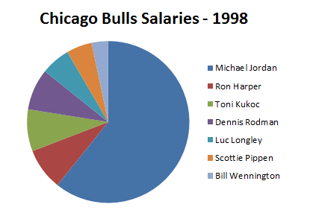
TYPES OF GRAPHS
IN-CLASS PROBLEM 2b
What does the pie chart tell you?
VFrench, 2016

Slide 40
Questions?
http://i.imgur.com/aliTlT3.jpg

Slide 41
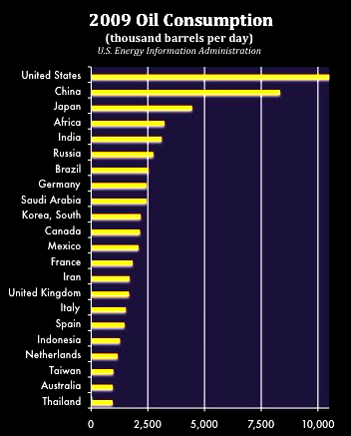
Types of Graphs
Pareto plot
An ordered
bar chart
http://burnanenergyjournal.com/wp-content/uploads/2011/05/Oil-consumption-by-country-2009.jpg

Slide 42
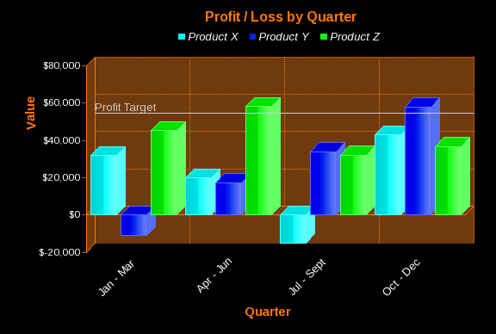
Types of Graphs
Bars that are not based on counts
can be positive or negative
http://www.jpowered.com/graphs-and-charts/gallery/images/3d-vertical-bar-graph-multi-600x400.png

Slide 43
Types of Graphs
We used bar/column graphs to display measurement data (salaries, profit/loss, etc.)
There are other ways to show measurement data also

Slide 44
Types of Graphs
Scatter plot
aka: x-y plot
requires paired data
you don't split the data into classes or categories

Slide 45
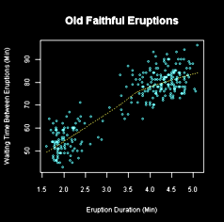
Types of Graphs
Scatter plot
https://commons.wikimedia.org/wiki/File:Oldfaithful3.png

Slide 46
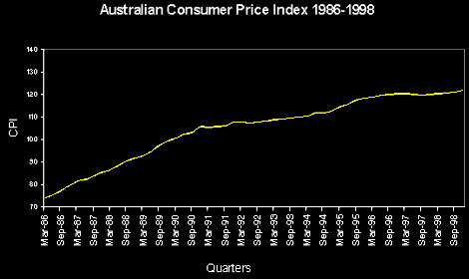
Types of Graphs
Time series plot
the x-axis variable is "time"
VFrench, 2016

Slide 47
Types of Graphs
More exotic types of graphs

Slide 48
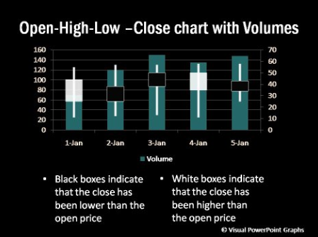
Types of Graphs
Open/Hi/Low/Close plot
box-plot-ppgr.html/box-plots-005.jpg

Slide 49
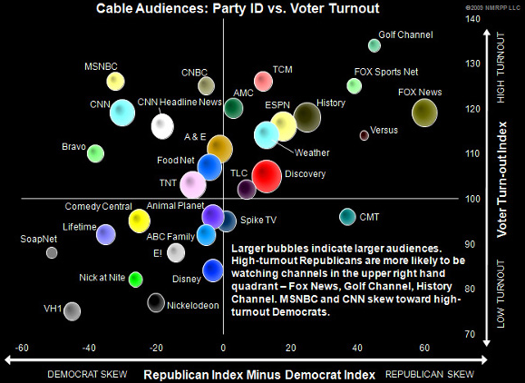
Types of Graphs
Bubble chart
http://www.unzcloud.com/wp-content/uploads/2010/04/research-graph-target.jpg

Slide 50
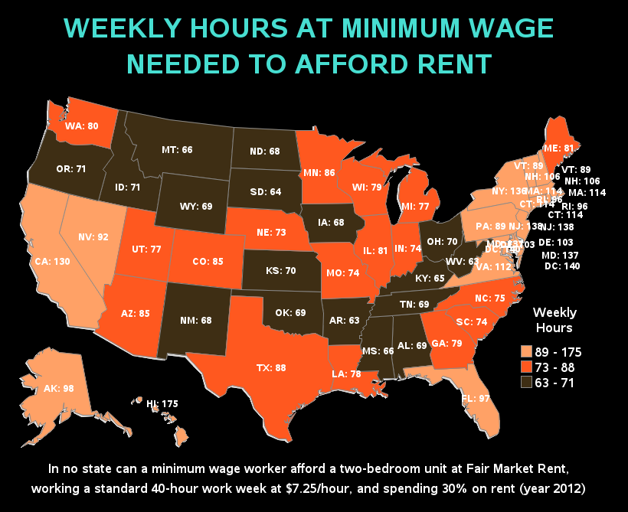
Types of Graphs
Map graph
https://tse2.mm.bing.net/th?id=OIP.CIeOrtCE2W1a58te3cv6AgHaGB

Slide 51
Rule of Thumb:
Use column, bar and pie charts for categorical count data
Use scatter and area charts for quantitative measurement data
VFrench, 2016

Slide 52
WARNING
CEOs have a higher probability of being color blind than the general public

Slide 53
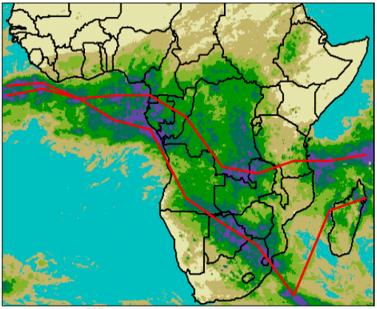
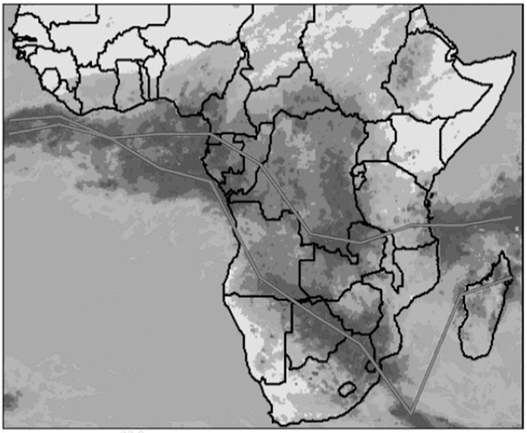
WARNING
Use colors with a dark-to-light
component
VFrench, 2000

Slide 54
Questions?
http://i.imgur.com/aliTlT3.jpg

Slide 55
Graphs
Graphs have a psychological component that CANNOT be ignored

Slide 56
How to Lie with Statistics
How to lie with graphs

Slide 57
Lying with graphs
Where’s the zero?

Slide 58
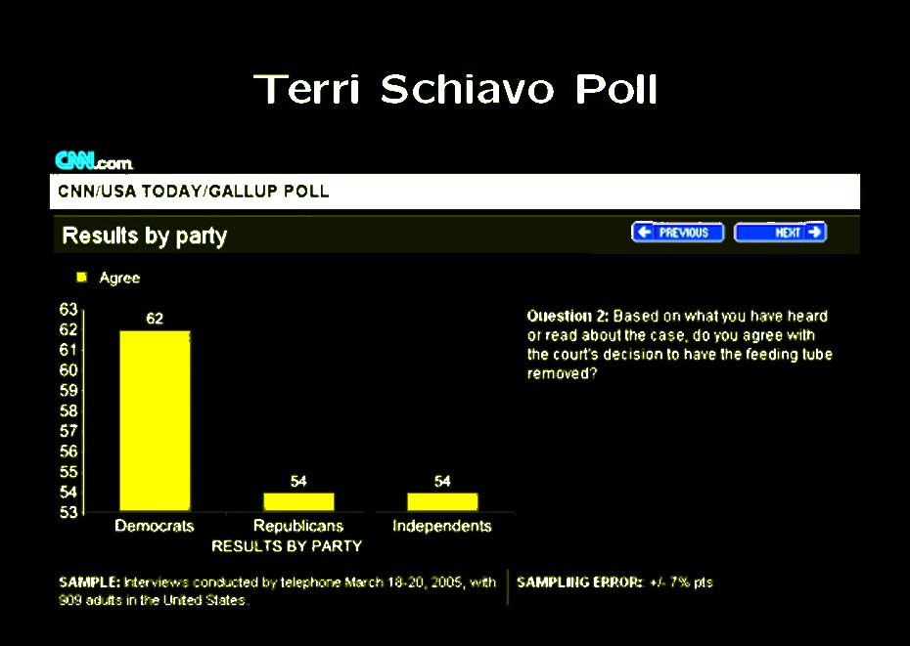

Slide 59
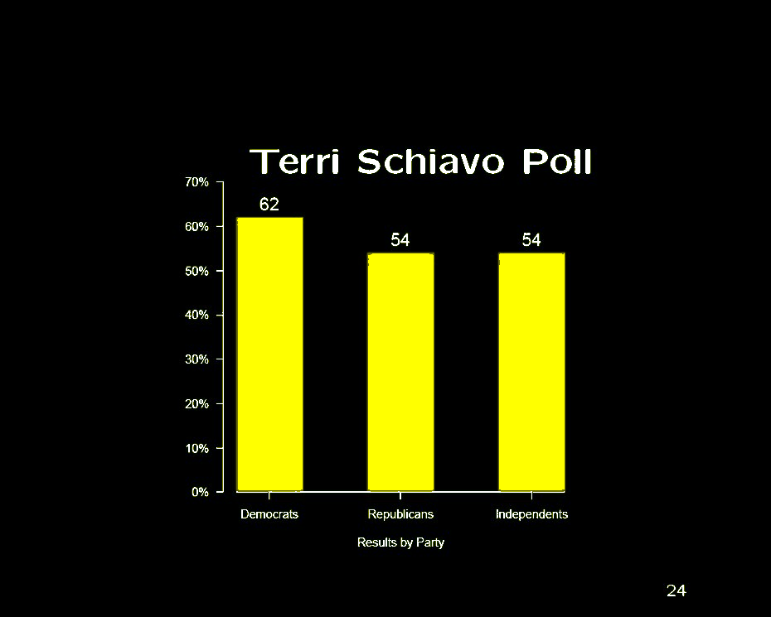
VFrench, 2016

Slide 60
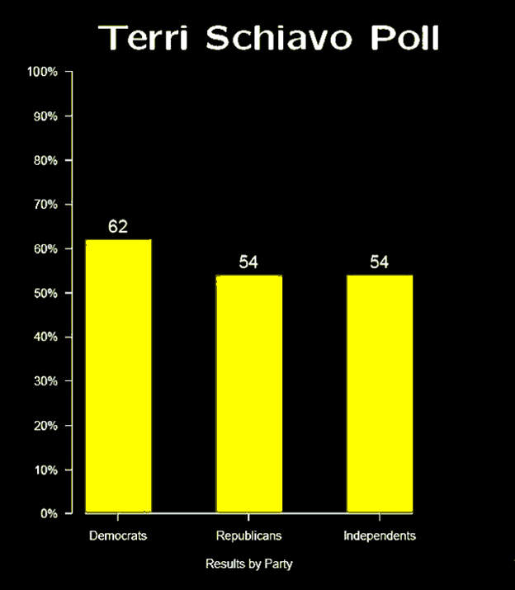
VFrench, 2016

Slide 61
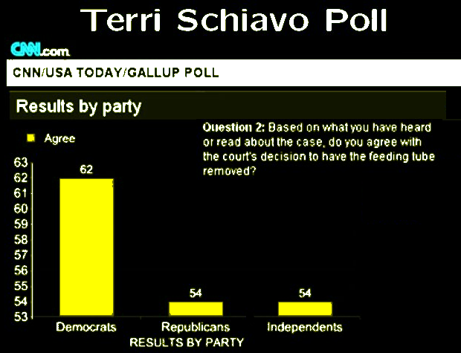
HOW TO LIE WITH GRAPHS
IN-CLASS PROBLEM 3a
What is the “lying’ in the original Terri Schiavo poll graph?

Slide 62
Lying with graphs
Tricks our eyes play on us...

Slide 63
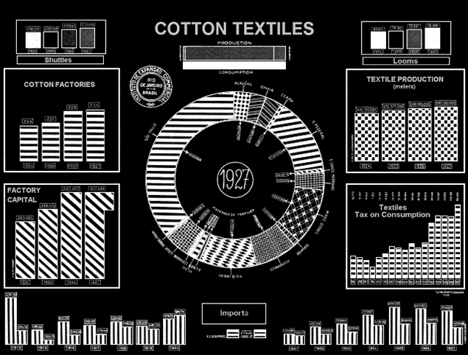
Unintentional Optical Art?
From: How to Lie with Statistics by Darrell Huff

Slide 64
HOW TO LIE WITH GRAPHS
IN-CLASS PROBLEM 3b
What is the problem with the Cotton Textiles graph?
From: How to Lie with Statistics by Darrell Huff

Slide 65
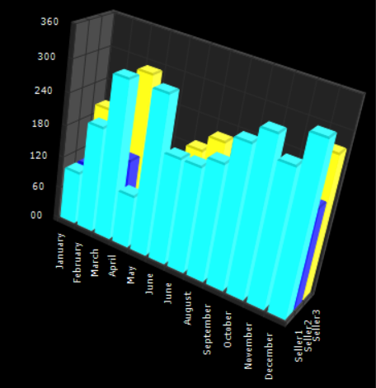
How to Lie with Graphs
Just because technology lets you make a 3D
graph doesn’t
necessarily
mean it’s a
good idea…
http://www.chartingcontrol.net/gallery/Bars3D.png

Slide 66
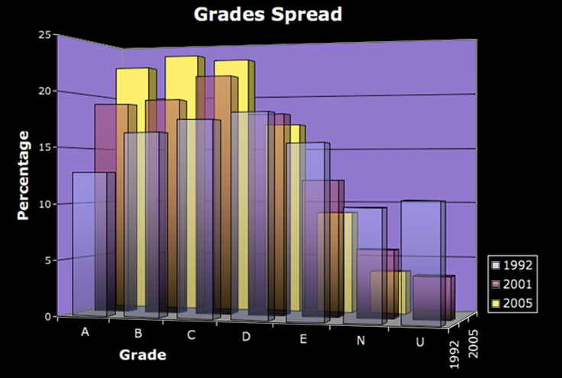
The “Too Pretty to Live” graph
http://www.chartingcontrol.net/gallery/Bars3D.png

Slide 67
Sometimes pretty is just lying…

Slide 68
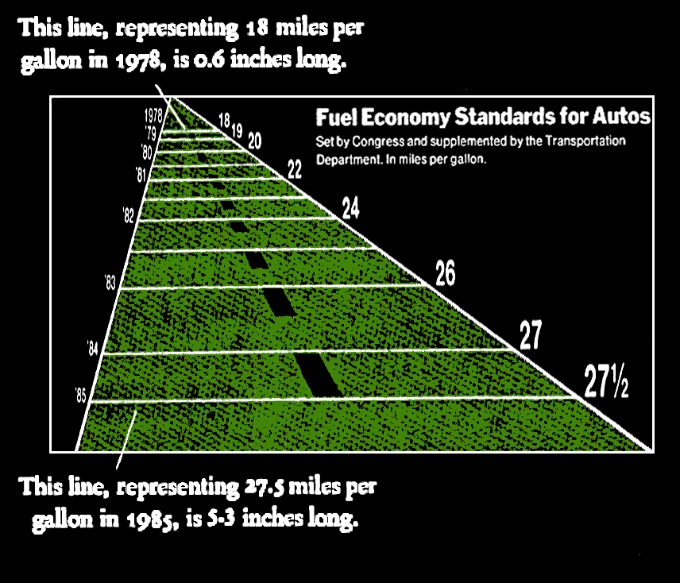
From: How to Lie with Statistics by Darrell Huff

Slide 69
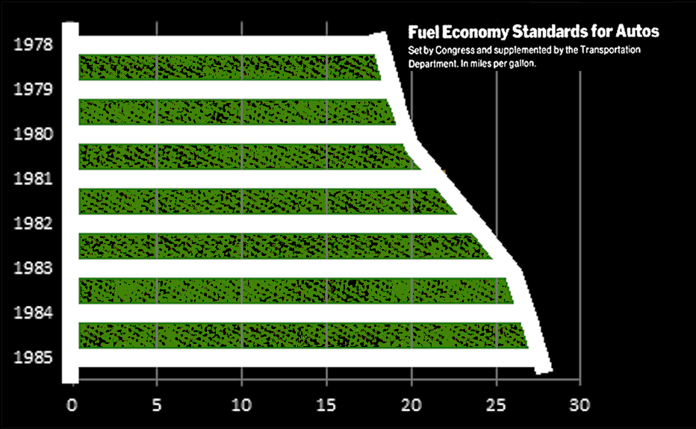
How the real graph should look:
VFrench, 2016

Slide 70
HOW TO LIE WITH GRAPHS
IN-CLASS PROBLEM 3c
What is the problem with the Fuel Economy Standards for Autos graph?
From: How to Lie with Statistics by Darrell Huff

Slide 71
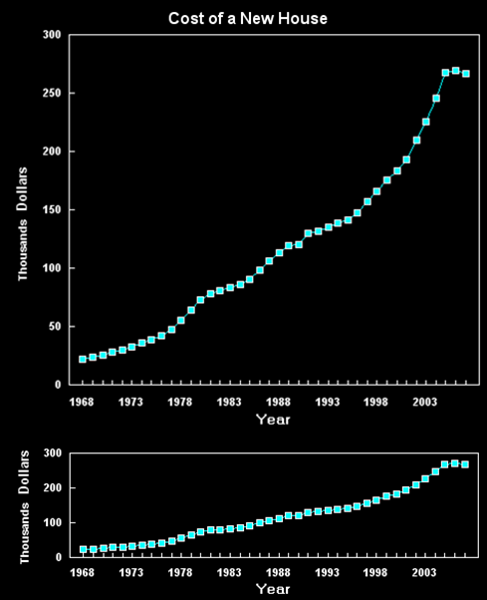
Graphs with an
Agenda
The way a graph is
drawn can have some
powerful psychological
impacts misleading
viewers
Data from National
Association of Realtors
VFrench, 2016

Slide 72
HOW TO LIE WITH GRAPHS
IN-CLASS PROBLEM 3d
Which graph
(top or bottom)
would show a
strong, growing
housing market?
VFrench, 2016

Slide 73
HOW TO LIE WITH GRAPHS
IN-CLASS PROBLEM 3e
Which would
show the cost
of a new house
is not going up
as much as
people think?
VFrench, 2016

Slide 74
Graphs made of things that look like real objects are especially dangerous – our minds think “area” or “volume” and not “width” or “height” alone

Slide 75
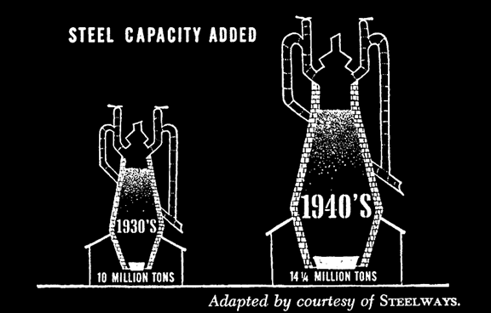
The second image is supposed to show that 1940s steel capacity is 1.45 times that of the 1930s
Our minds
think "area" for
two-dimensional
figures
We see this
as 1.45 x 1.45
or 2.10 times bigger
From: How to Lie with Statistics by Darrell Huff

Slide 76
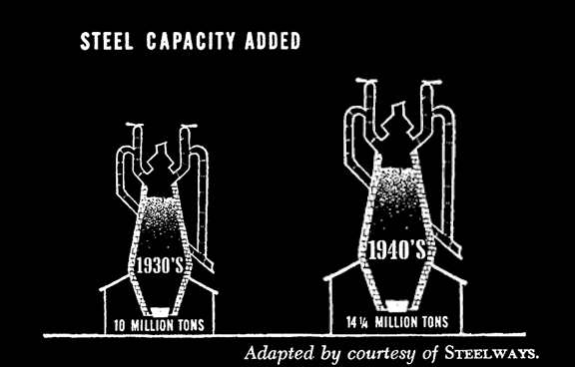
How it should look:
The area of the
second pic is now
1.45 times the
first
VFrench, 2016

Slide 77
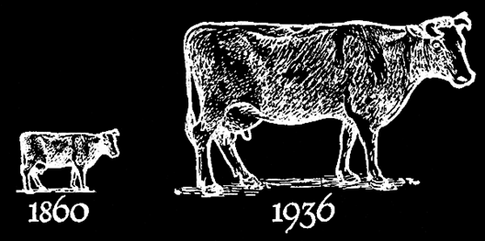
It’s even worse with things that look three dimensional
In 1860, there were 8 million cows in the U.S. vs. 25 million in 1936 (3.125 times more)
Our minds are thinking
“volume”:
3.125 x 3.125 x 3.125
= 30.518
times bigger!
From: How to Lie with Statistics by Darrell Huff

Slide 78

How it should look:
VFrench, 2016

Slide 79
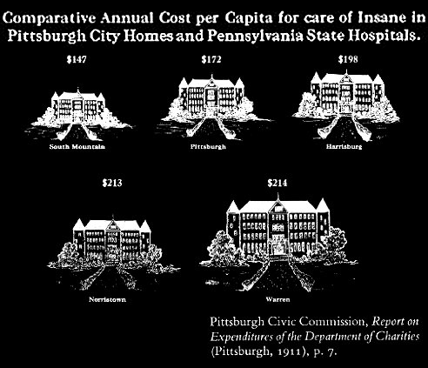
Obviously lying:
From: How to Lie with Statistics by Darrell Huff

Slide 80
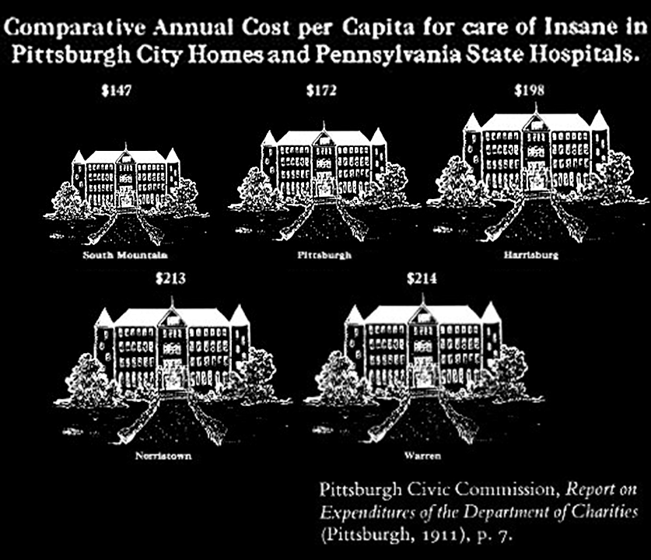
How it should look:
VFrench, 2016

Slide 81
HOW TO LIE WITH GRAPHS
IN-CLASS PROBLEM 3f
What is the problem with using 2D or 3D pictographs?

Slide 82
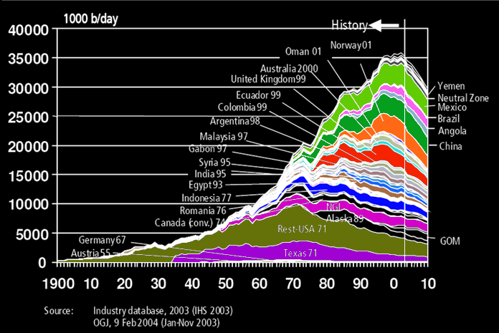
Self-Fulfilling Prophecies

Slide 83
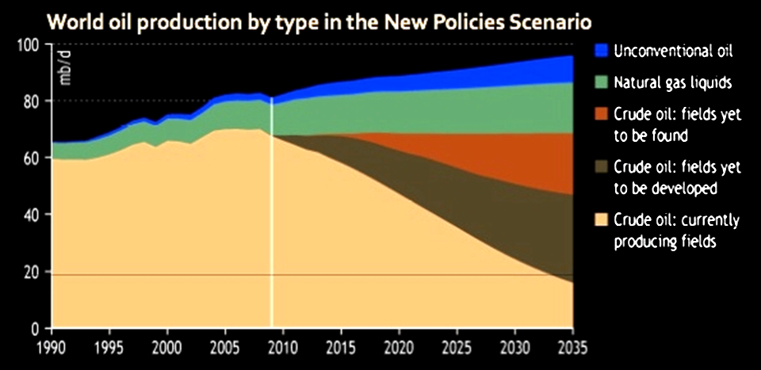
Self-Fulfilling Prophecies
http://globalchangewatch.weebly.com/uploads/5/7/2/1/5721491/304554760.jpg?729

Slide 84
How to Lie with Videos
Video

Slide 85
Questions?
http://i.imgur.com/aliTlT3.jpg

Slide 86
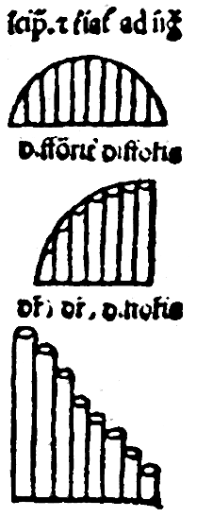
History of Graphs
In the 14th century
Nicole Oresme used a
bar chart to plot the
velocity of a constantly accelerating object
vs time
https://infogram.com/blog/the-infallible-bar-chart-types-and-their-purpose/

Slide 87
History of Graphs
Each bar is of equal width, and this is one of the fundamental rules of bar graphs to this very day

Slide 88
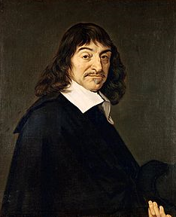
History of Graphs
In the early 1600s René Descartes invented the x-y “scatter” plot
https://en.wikipedia.org/wiki/Ren%C3%A9_Descartes#/media/File:Frans_Hals_-_Portret_van_Ren%C3%A9_Descartes.jpg

Slide 89
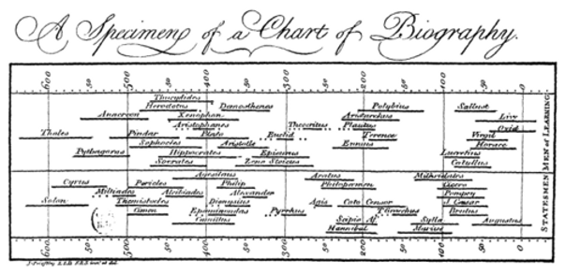
History of Graphs
In 1765 Joseph Priestley created a timeline which was a horizontal bar graph
http://conversableeconomist.blogspot.com/2017/08/william-playfair-inventor-of-bar-graph.html

Slide 90
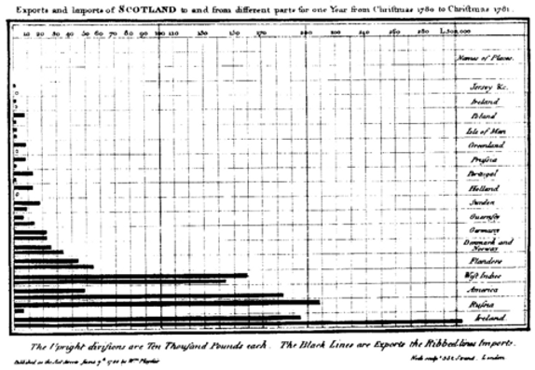
History of Graphs
In 1780, William Playfair used bar charts to show Scottish imports/exports
http://conversableeconomist.blogspot.com/2017/08/william-playfair-inventor-of-bar-graph.html

Slide 91
History of Graphs
This is the first example of numerical data being split into categories and plotted as bars
This is the reason Playfair is credited with the invention of the bar chart

Slide 92
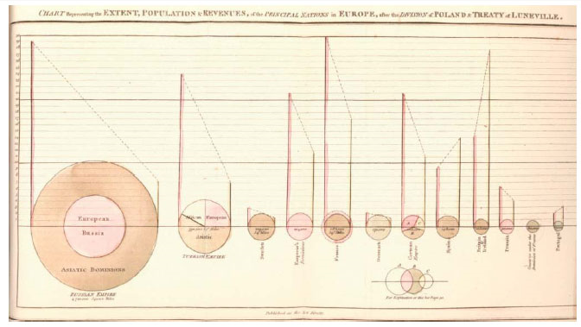
History of Graphs
A fancy pie chart by William Playfair 1801
http://conversableeconomist.blogspot.com/2017/08/william-playfair-inventor-of-bar-graph.html

Slide 93
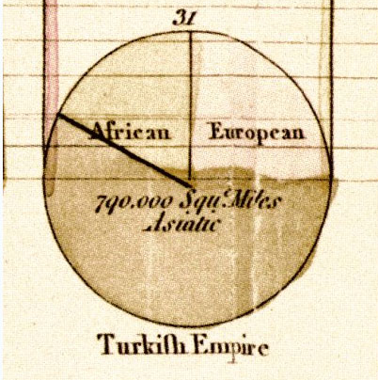
History of Graphs
A close-up of one of the pies:
http://conversableeconomist.blogspot.com/2017/08/william-playfair-inventor-of-bar-graph.html

Slide 94
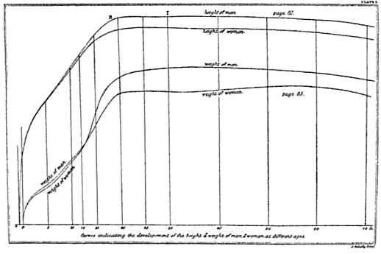
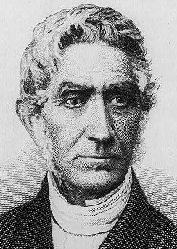
History of Graphs
In the early 1800s, Adolphe Quetelet pioneered graphing things over time – the “time series graph”
https://en.wikipedia.org/wiki/Adolphe_Quetelet#/media/File:Adolphe_Qu%C3%A9telet_by_Joseph-Arnold_Demannez.jpg
https://ia802606.us.archive.org/12/items/adolphequeteleta00hankuoft/adolphequeteleta00hankuoft.pdf

Slide 95
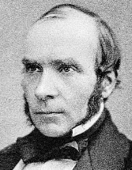
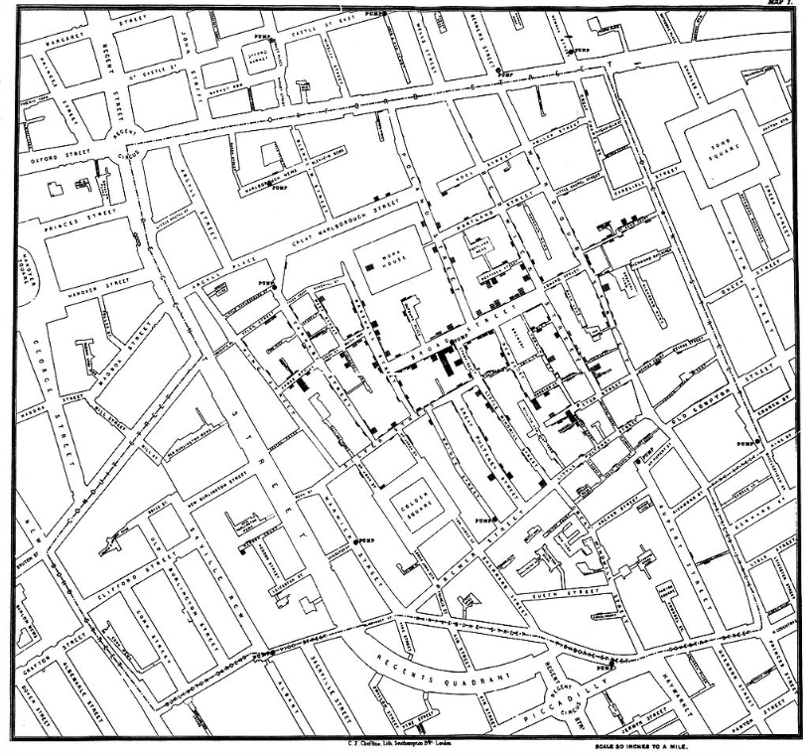
Influential Graphs
John Snow’s
dot plot
map of the
London
cholera
epidemic -
1854
https://en.wikipedia.org/wiki/John_Snow#/media/File:John_Snow.jpg
https://en.wikipedia.org/wiki/John_Snow#/media/File:Snow-cholera-map-1.jpg

Slide 96
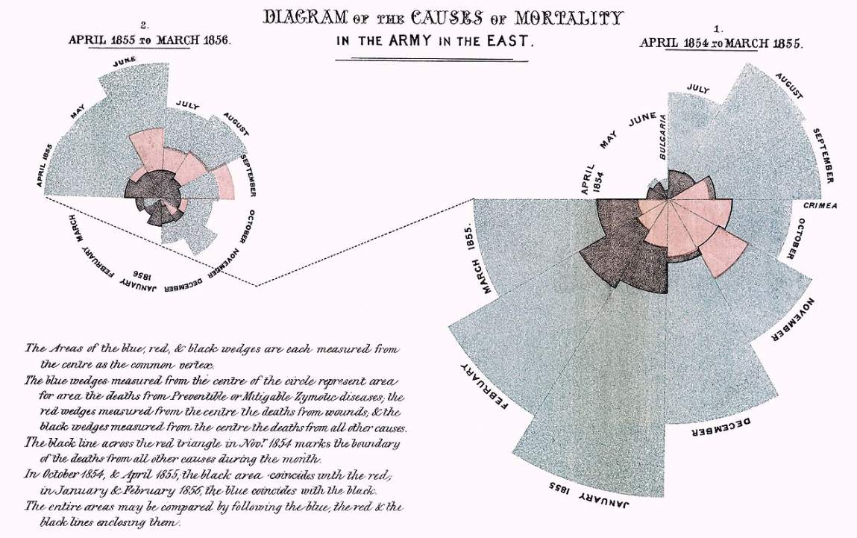
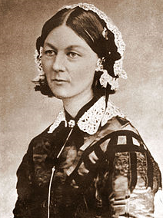
Influential Graphs
Florence Nightingale’s “rose” - 1855
http://www.florence-nightingale-avenging-angel.co.uk/blog/wp-content/uploads/2012/01/Rose.jpg

Slide 97
Florence Nightingale
and the ASA
http://www.natgeokids.com/wp-content/uploads/2017/08/florence-nightingale-facts-3.jpg

Slide 98
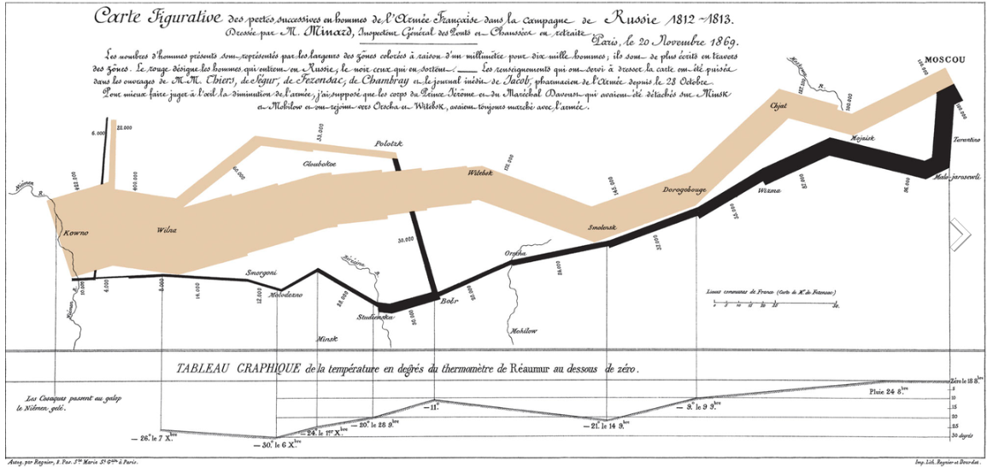
Influential Graphs
Minard’s flow map - 1869
https://upload.wikimedia.org/wikipedia/commons/2/29/Minard.png

Slide 99

Influential Graphs
Mann, Bradley and Hughes Hockey Stick graph - 1994
https://news.psu.edu/story/344876/2015/02/14/research/iconic-graph-center-climate-debate

Slide 100
Questions?
http://i.imgur.com/aliTlT3.jpg

Slide 101
Frequencies
Many bar/column charts display count data
The counts shown in each category are called “frequencies”

Slide 102
Frequencies
There are a lot of graphs that specialize in showing frequencies
These are called “histograms”

Slide 103
FREQUENCIES
IN-CLASS PROBLEM 4
Which type of data are frequencies:
Qualitative
Quantitative

Slide 104
FREQUENCIES
IN-CLASS PROBLEM 4
Which type of data are frequencies:
Qualitative
Quantitative

Slide 105



Measurement Frequencies
So… what if your data are measurements rather than counts?
https://4.bp.blogspot.com/-U-oB4QibwDk/TY89P_lOVhI/AAAAAAAAC9g/X_CrUarm25k/s200/counting.jpg
https://upload.wikimedia.org/wikipedia/commons/thumb/c/c1/FourMetricInstruments.JPG/640px-FourMetricInstruments.JPG

Slide 106
Measurement Frequencies
Often we change the measurements into counts
These derived counts are also “frequencies”

Slide 107
Measurement Frequencies
We can change measured data to categories by splitting the continuum into named categories

Slide 108
Measurement Frequencies
Sale price (in thousand $)
8.0 – 11.0
11.1 - 14.1
14.2 – 17.2
17.3 – 20.3
20.4 – 23.4
23.5 – 26.5
Minutes Internet Usage
1-10
11-20
21-30
31-40
41-50
51-60
60+
Years of experience
1 - 2
3 - 4
5 - 6
7 - 8
9 - 10
11+

Slide 109
Measurement Frequencies
The counts of observations falling in these user-manufactured categories are still called
“frequencies”

Slide 110
Measurement Frequencies
A bar graph of frequencies in user-manufactured categories is still called a “histogram”

Slide 111
Measurement Frequencies
It is less confusing to viewers to keep the numerical categories the same width

Slide 112
Measurement Frequencies
Numerical categories should not overlap
Numerical categories should not leave any blank spaces in the continuum

Slide 113
Measurement Frequencies
Numerical categories are also called “classes”

Slide 114
Measurement Frequencies
For numerical categories, the maximum and minimum values in each category are called the “class limits”

Slide 115
Measurement Frequencies
We want at least 5 categories
This allows us to pretend the data is still “continuous” (one of those statistical things)

Slide 116
FREQUENCIES
IN-CLASS PROBLEMS 5a,b,c
What’s wrong?
Minutes Internet Usage | Number of Users
1-10
11-32
33-35
36+
Minutes Internet Usage | Number of Users
1-20
41-60
61-80
81+
Minutes Internet Usage | Number of Users
1.1-20.3
20.4-30.8
30.9-49.2
49.3+

Slide 117
Measurement Frequencies
For psychological reasons, we usually limit the number of categories to a maximum of 8

Slide 118
Measurement Frequencies
For psychological reasons, we usually limit the number of categories to a maximum of 8
Typically the human brain can compare only 7-8 things before becoming overloaded

Slide 119
Measurement Frequencies
So you should aim for 5-8 classes with “kinda-nice” class limit values

Slide 120
Measurement Frequencies
You can have a first class limit that is “a value or lower” and a last class limit that is “a value or higher” for rare classes

Slide 121
FREQUENCIES
IN-CLASS PROBLEM 5d
Which would be better?
a
Minutes Internet Usage | Number of Users
1-15
16-30
31-45
46-60
61-75
76-90
91-105
106-120
121+
c
Minutes Internet Usage | Number of Users
1.1-20.3
20.4-30.8
30.9-49.2
49.3-59.0
59.1+
b
Minutes Internet Usage | Number of Users
1-20
21-40
41-60
61-80
81-100
101-120
121+

Slide 122
Questions?
http://i.imgur.com/aliTlT3.jpg

Slide 123
Histograms
There are several popular types of histograms

Slide 124

Histograms
Dot plot (automatic graph)
http://www.icoachmath.com/image_md/Dot%20plot2.jpg

Slide 125

Histograms
Fancy dot plot using pictographs:
http://www.icoachmath.com/

Slide 126




Histograms
https://i2.wp.com/f.tqn.com/y/spreadsheets/1/S/N/6/-/-/2007pictograph3.gif
http://www.icoachmath.com
https://students.ga.desire2learn.com/d2l/lor/viewer/viewFile.d2lfile/414293/11554/world-pop-pictograph.png
http://studyzone.org/testprep/math4/e/readpi13.gif

Slide 127

Histograms
Living Histogram
VFrench, 2009

Slide 128
Histograms
Stem and leaf plot
Also changes the data into a bar graph
For measurement data
Let you see the original data values

Slide 129
Histograms
the stem is usually the leftmost
digit/s
the leaf is the rightmost digit
(the "ones")

Slide 130

Histograms
It forms a sort of dot plot…
But the data are still there!

Slide 131


Histograms
More stem and leaf:
http://www.analyzemath.com/

Slide 132


Histograms
Comparative stem and leaf

Slide 133
Histograms
Note that the stem and leaf doesn’t follow the 5-8 category rule

Slide 134
Questions?
http://i.imgur.com/aliTlT3.jpg

Slide 135
Summary
Today we studied:
Review of population, sample,
and types of data
Graphs

Slide 136

You Survived!
www.playbuzz.com

