Slide 1
Welcome to
Unit 10
Part 20!
MATH 207 Integral Calculus

Slide 2
What’s Up?
Review:
Vectors
New stuff:
Vector calculus

Slide 3
What’s Up?
Outcome 7) Solve PROBLEMS by identifying the requirements, making a sketch as appropriate

Slide 4

Review
http://995642590.r.lightningbase-cdn.com/wp-content/uploads/2010/12/looking-back-hrexaminer-v144-cover425px.jpg

Slide 5
Vectors
A vector is a directed line segment - from an initial point P to terminal point Q

Slide 6
Vectors
Vectors have both magnitude and direction
(ex: N 5mph)
direction
magnitude

Slide 7

Vectors
Direction can be shown by slope:
m = $\frac{y_{1}−y_{2}}{x_{1}−x_{2}}$
if $x_{1}−x_{2}$≠0

Slide 8
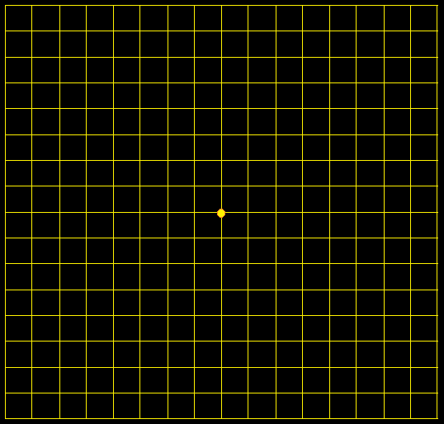
Vectors
Because vectors are designated by only their magnitude and direction…
These are all the
same vector!
Location doesn’t
matter!
VFrench, 2017

Slide 9
Vectors
So we usually start them at (0,0)
(called the
“standard
position”
VFrench, 2017

Slide 10
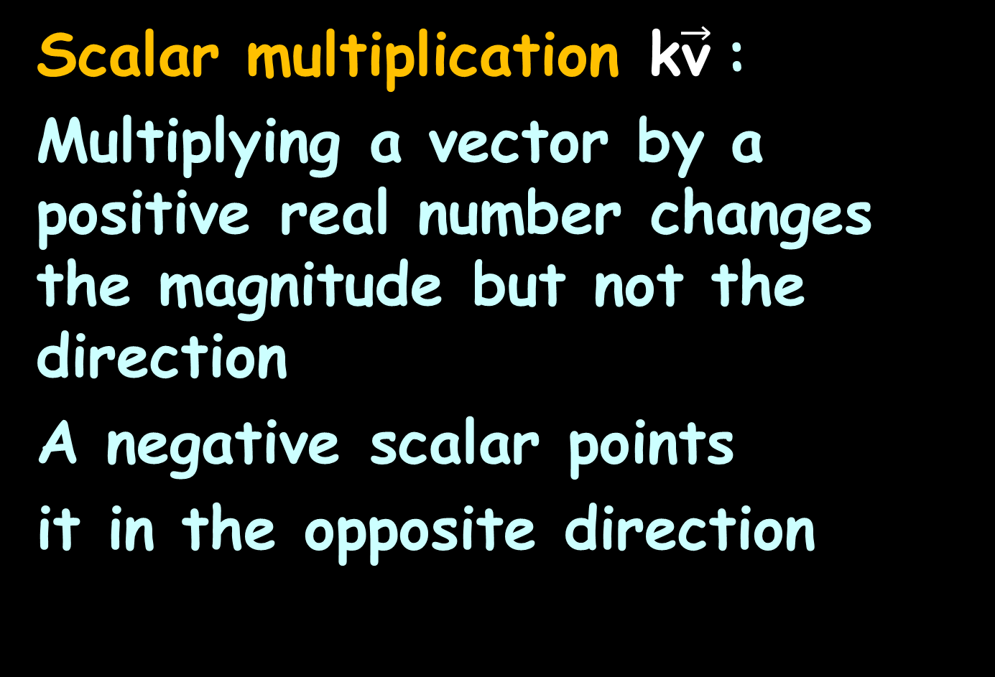
Vectors
Scalar multiplication k$\vec{\text{v}}$:
Multiplying a vector by a positive real number changes the magnitude but not the direction
A negative scalar points
it in the opposite direction

Slide 11
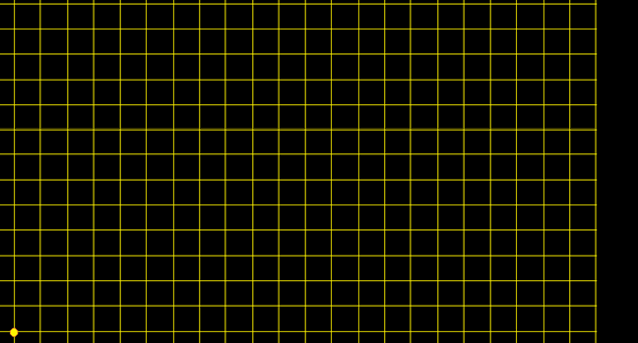

Vectors
The sum of two vectors is called the resultant…$\left[\begin{matrix}6 \\ 5\end{matrix}\right]$ + $\left[\begin{matrix}3 \\ 7\end{matrix}\right]$ = $\left[\begin{matrix}9 \\ 12\end{matrix}\right]$
1211
10
9
8
7
6
5
4
3
2
1
0
0 1 2 3 4 5 6 7 8 9 1 1 1 1 1 1
0 1 2 3 4 5
VFrench, 2017

Slide 12
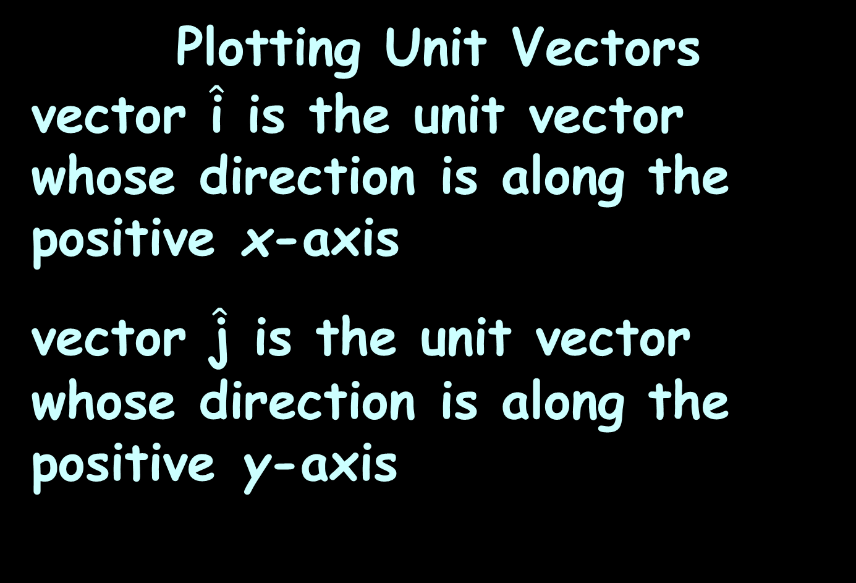
Vectors
Plotting Unit Vectors
vector $\hat{\text{i}}$ is the unit vector whose direction is along the positive x-axis
vector $\hat{\text{j}}$ is the unit vector whose direction is along the positive y-axis

Slide 13
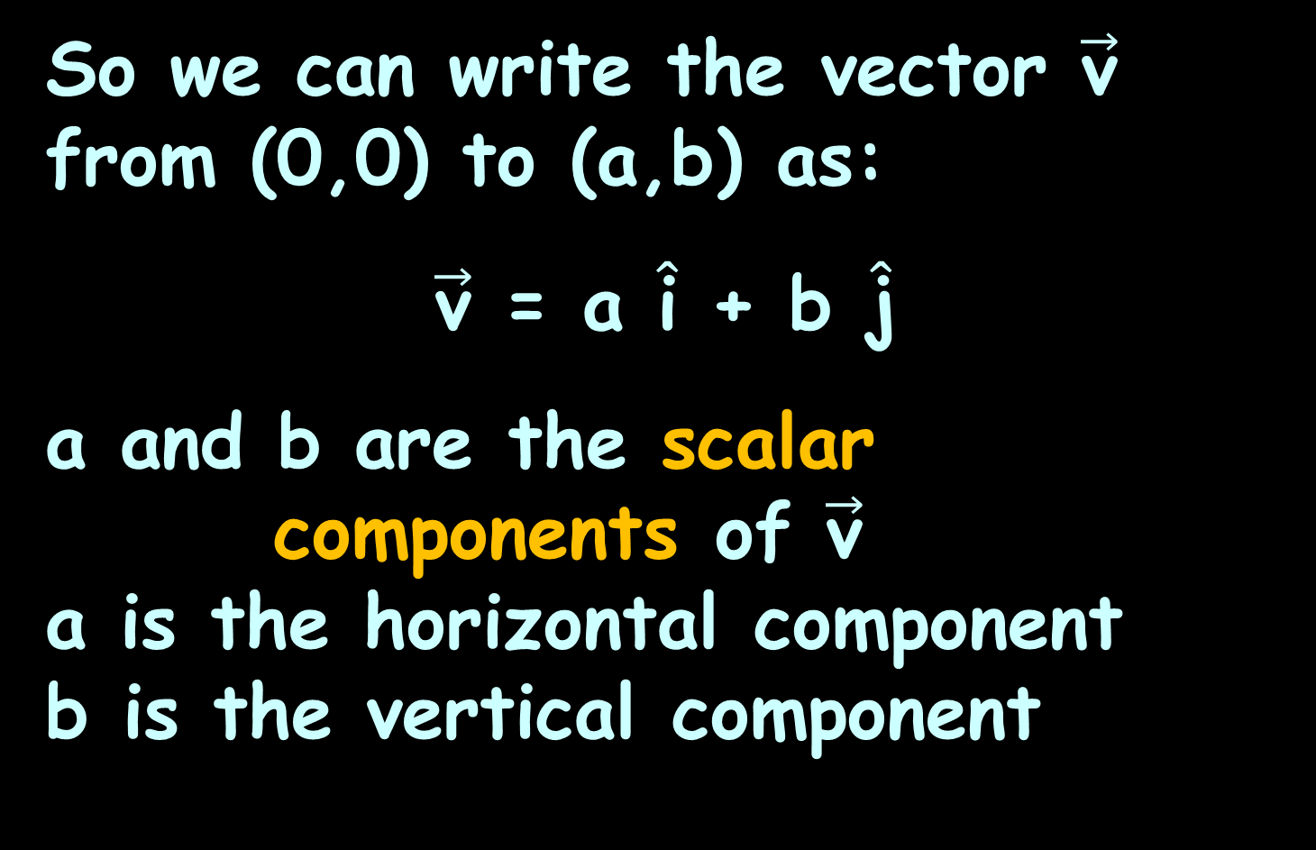
Vectors
So we can write the vector $\vec{\text{v}}$ from (0,0) to (a,b) as:
$\vec{\text{v}}$ = a $\hat{\text{i}}$ + b $\hat{\text{j}}$
a and b are the scalar
components of $\vec{\text{v}}$
a is the horizontal component
b is the vertical component

Slide 14

Vectors
$\vec{\text{v}}$ = a $\hat{\text{i}}$ + b $\hat{\text{j}}$
is called component form
or
“ai + bj form”

Slide 15
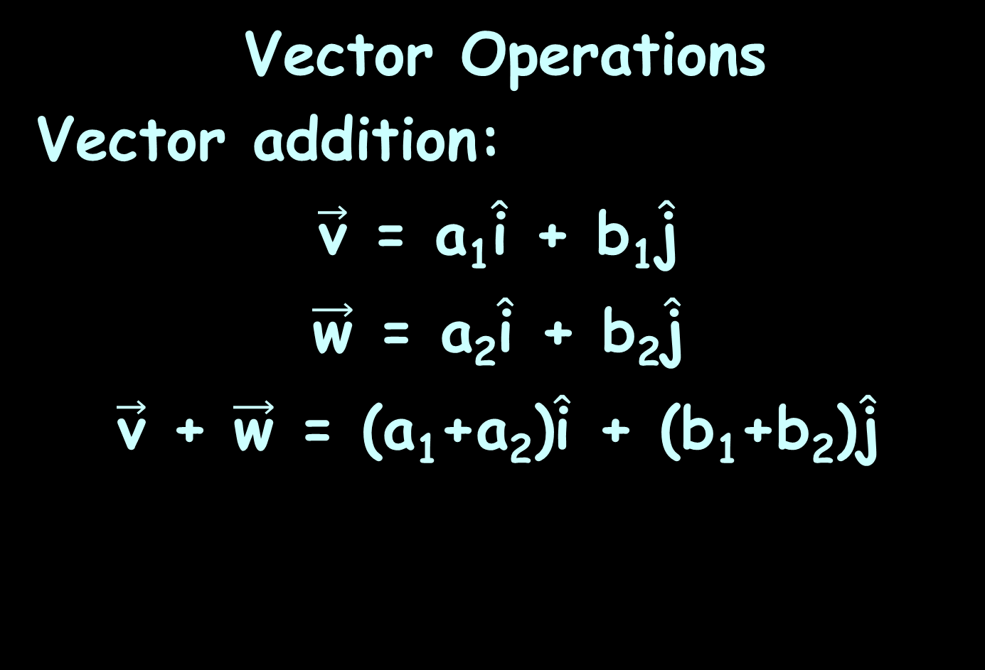
Vectors
Vector Operations
Vector addition:
$\vec{\text{v}}$ = a₁$\hat{\text{i}}$ + b₁$\hat{\text{j}}$
$\vec{\text{w}}$ = a₂$\hat{\text{i}}$ + b₂$\hat{\text{j}}$
$\vec{\text{v}}$ + $\vec{\text{w}}$ = (a₁+a₂)$\hat{\text{i}}$ + (b₁+b₂)$\hat{\text{j}}$

Slide 16
Vectors
The component form describes lines in 2-D

Slide 17
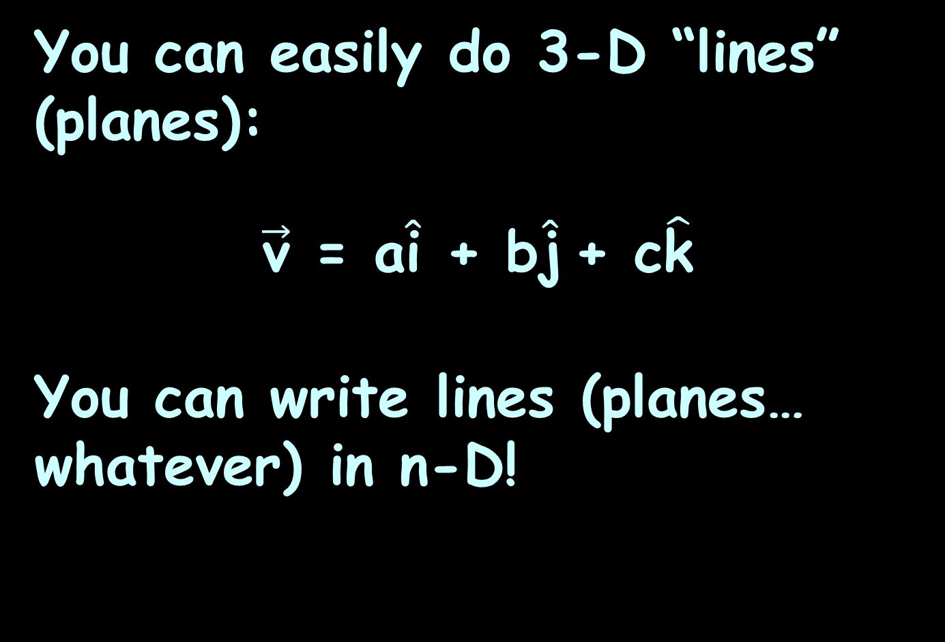
Vectors
You can easily do 3-D “lines” (planes):
$\vec{\text{v}}$ = a$\hat{\text{i}}$ + b$\hat{\text{j}}$+ c$\hat{\text{k}}$
You can write lines (planes… whatever) in n-D!

Slide 18

Vectors
The magnitude of $\vec{\text{v}}$
||$\vec{\text{v}}$|| = $\sqrt{{\text{a}}^{2}+{\text{b}}^{2}}$

Slide 19

Vectors
Position Vector
if $\vec{\text{v}}$ doesn't start at (0,0):
$\vec{\text{v}}$ = (x₂-x₁) $\hat{\text{i}}$ + (y₂-y₁) $\hat{\text{j}}$

Slide 20
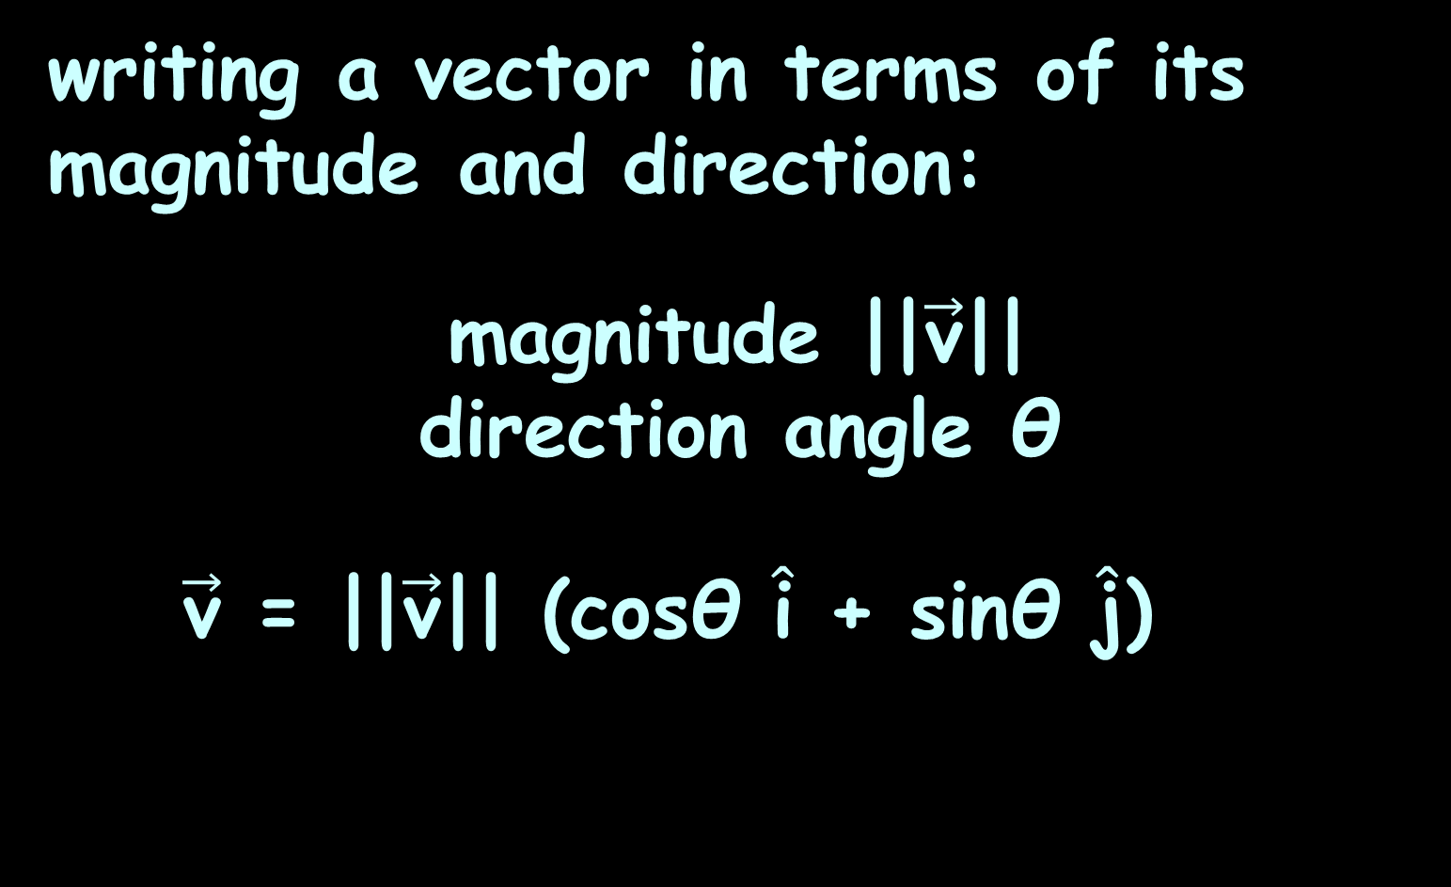
Vectors
writing a vector in terms of its magnitude and direction:
magnitude ||$\vec{\text{v}}$|| direction angle θ
$\vec{\text{v}}$ = ||$\vec{\text{v}}$|| (cosθ $\hat{\text{i}}$ + sinθ $\hat{\text{j}}$)

Slide 21
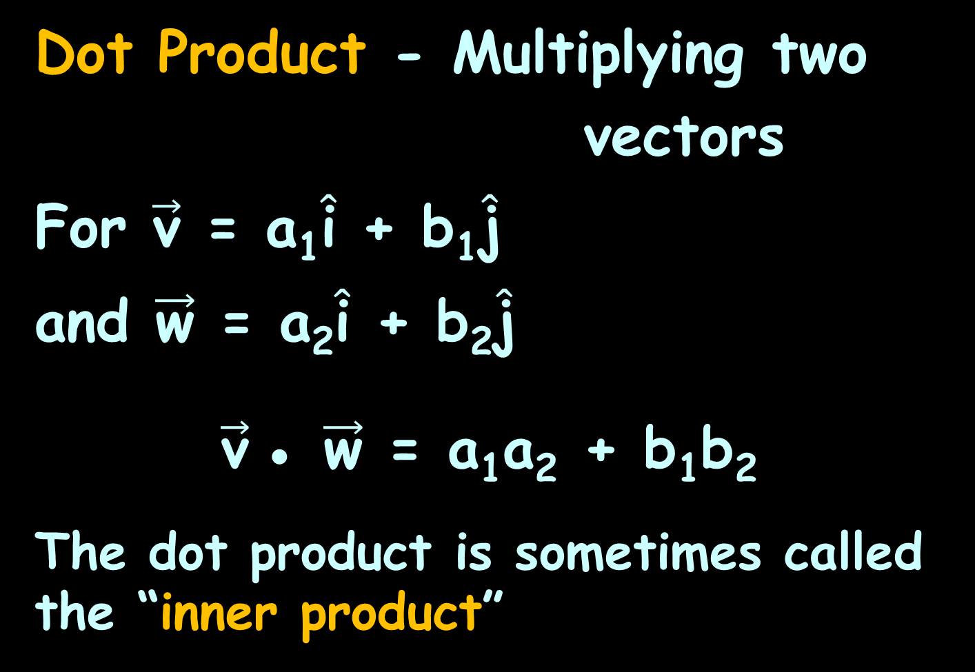
Vectors
Dot Product - Multiplying two
vectors
For $\vec{\text{v}}$ = a₁$\hat{\text{i}}$ + b₁$\hat{\text{j}}$
and $\vec{\text{w}}$ = a₂$\hat{\text{i}}$ + b₂$\hat{\text{j}}$
$\vec{\text{v}}$● $\vec{\text{w}}$ = a₁a₂ + b₁b₂
The dot product is sometimes called the “inner product”

Slide 22
Vectors
The cross product or vector product between two vectors notation: a × b
(read "a cross b")
is a vector that is perpendicular
to both a and b

Slide 23
Vectors
There is a major difference between dot products and cross products: The result of a dot product is a number and the result of a cross product is a vector!

Slide 24

Questions?
http://i.imgur.com/aliTlT3.jpg

Slide 25

This is the last class!
I’ve enjoyed having you in MATH207!
I’m wishing you the best in your future career!
And Addie the calculus cat does, too!

Slide 26
Questions?
http://i.imgur.com/aliTlT3.jpg

Slide 27
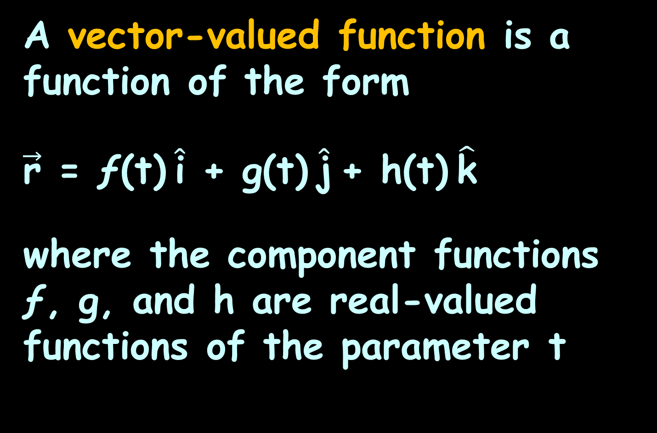
Vector Calculus
A vector-valued function is a function of the form
$\vec{\text{r}}$ = ƒ(t) $\hat{\text{i}}$ + g(t) $\hat{\text{j}}$+ h(t) $\hat{\text{k}}$
where the component functions ƒ, g, and h are real-valued functions of the parameter t
https://math.libretexts.org/Bookshelves/Calculus/Map%3A_Calculus__Early_Transcendentals_(Stewart)/13%3A_Vector_Functions/13.01%3A_Vector_Functions_and_Space_Curves

Slide 28

Vector Calculus
They are also written:
$\vec{\text{r}}$(t) = ⟨ƒ(t),g(t),h(t)⟩
https://math.libretexts.org/Bookshelves/Calculus/Map%3A_Calculus__Early_Transcendentals_(Stewart)/13%3A_Vector_Functions/13.01%3A_Vector_Functions_and_Space_Curves

Slide 29
Vector Calculus
Both of these describe a three-dimensional vector-valued function
https://math.libretexts.org/Bookshelves/Calculus/Map%3A_Calculus__Early_Transcendentals_(Stewart)/13%3A_Vector_Functions/13.01%3A_Vector_Functions_and_Space_Curves

Slide 30
Vector Calculus
We often use t as a parameter to represent time
https://math.libretexts.org/Bookshelves/Calculus/Map%3A_Calculus__Early_Transcendentals_(Stewart)/13%3A_Vector_Functions/13.01%3A_Vector_Functions_and_Space_Curves

Slide 31
Vector Calculus
The parameter t can lie between two real numbers: a≤t≤b
Another possibility is that the value of t might take on all real numbers ℝ
https://math.libretexts.org/Bookshelves/Calculus/Map%3A_Calculus__Early_Transcendentals_(Stewart)/13%3A_Vector_Functions/13.01%3A_Vector_Functions_and_Space_Curves

Slide 32
Vector Calculus
The component functions themselves may have domain restrictions that enforce restrictions on the value of t
https://math.libretexts.org/Bookshelves/Calculus/Map%3A_Calculus__Early_Transcendentals_(Stewart)/13%3A_Vector_Functions/13.01%3A_Vector_Functions_and_Space_Curves

Slide 33

VECTOR CALCULUS
IN-CLASS PROBLEM 1
$\vec{\text{r}}$(t) = 4cos(t) $\hat{\text{i}}$ + 3tan(t) $\hat{\text{j}}$
Does this function have domain restrictions?
https://math.libretexts.org/Bookshelves/Calculus/Map%3A_Calculus__Early_Transcendentals_(Stewart)/13%3A_Vector_Functions/13.01%3A_Vector_Functions_and_Space_Curves

Slide 34
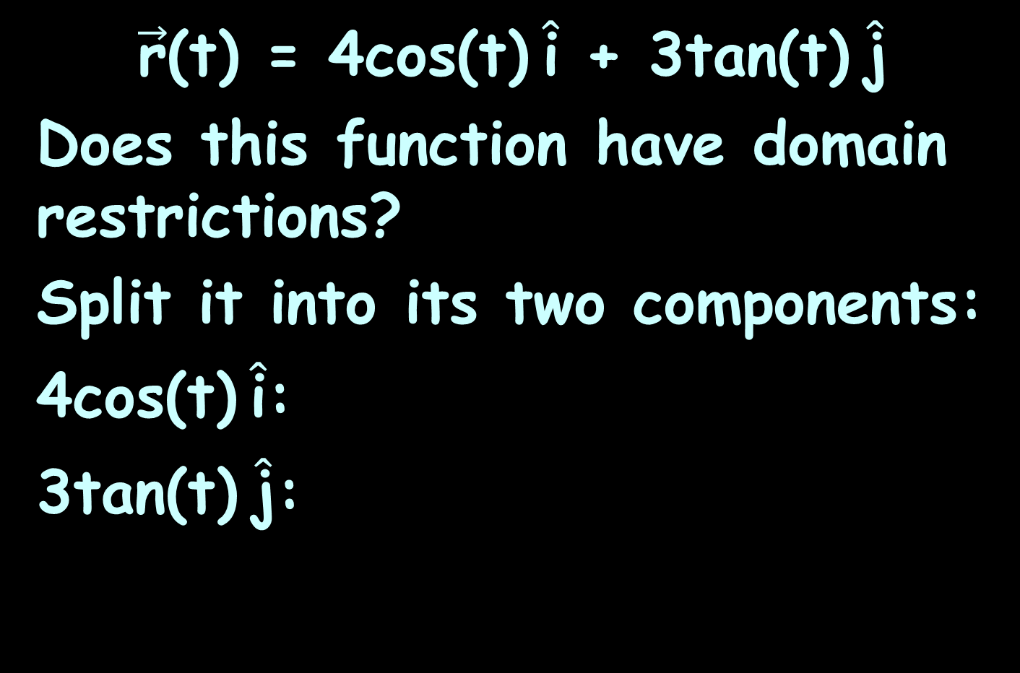
VECTOR CALCULUS
IN-CLASS PROBLEM 1
$\vec{\text{r}}$(t) = 4cos(t) $\hat{\text{i}}$ + 3tan(t) $\hat{\text{j}}$
Does this function have domain restrictions?
Split it into its two components:
4cos(t) $\hat{\text{i}}$:
3tan(t) $\hat{\text{j}}$:
https://math.libretexts.org/Bookshelves/Calculus/Map%3A_Calculus__Early_Transcendentals_(Stewart)/13%3A_Vector_Functions/13.01%3A_Vector_Functions_and_Space_Curves

Slide 35
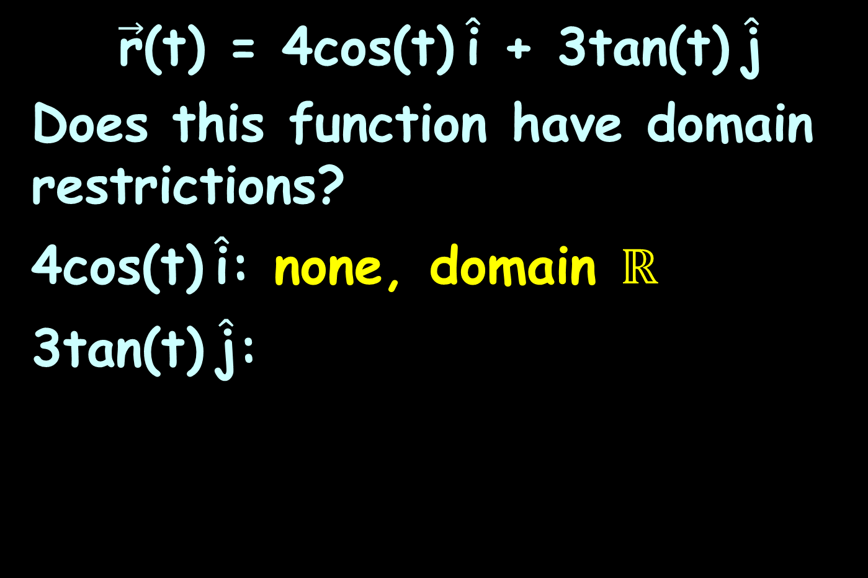
VECTOR CALCULUS
IN-CLASS PROBLEM 1
$\vec{\text{r}}$(t) = 4cos(t) $\hat{\text{i}}$ + 3tan(t) $\hat{\text{j}}$
Does this function have domain restrictions?
4cos(t) $\hat{\text{i}}$: none, domain ℝ
3tan(t) $\hat{\text{j}}$:
https://math.libretexts.org/Bookshelves/Calculus/Map%3A_Calculus__Early_Transcendentals_(Stewart)/13%3A_Vector_Functions/13.01%3A_Vector_Functions_and_Space_Curves

Slide 36
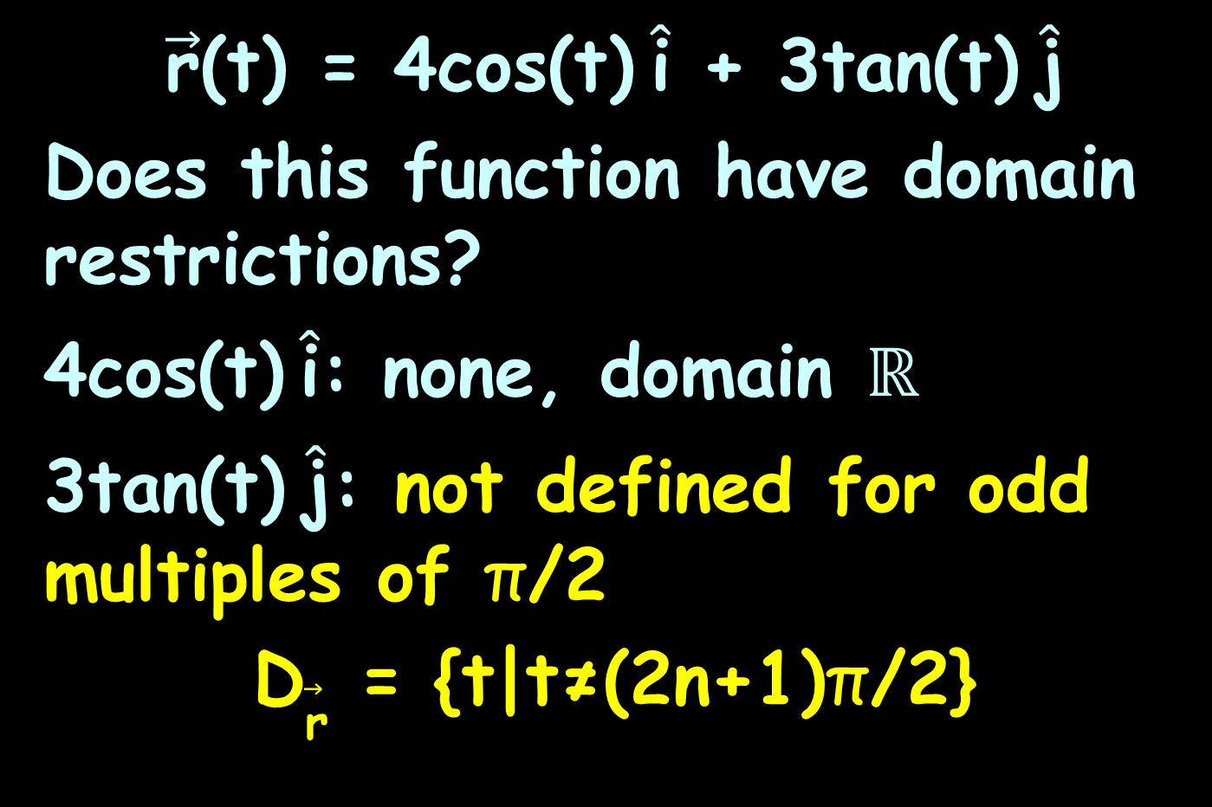
VECTOR CALCULUS
IN-CLASS PROBLEM 1
$\vec{\text{r}}$(t) = 4cos(t) $\hat{\text{i}}$ + 3tan(t) $\hat{\text{j}}$
Does this function have domain restrictions?
4cos(t) $\hat{\text{i}}$: none, domain ℝ
3tan(t) $\hat{\text{j}}$: not defined for odd multiples of π/2
D$\vec{\text{r}}$ = {t|t≠(2n+1)π/2}
https://math.libretexts.org/Bookshelves/Calculus/Map%3A_Calculus__Early_Transcendentals_(Stewart)/13%3A_Vector_Functions/13.01%3A_Vector_Functions_and_Space_Curves

Slide 37
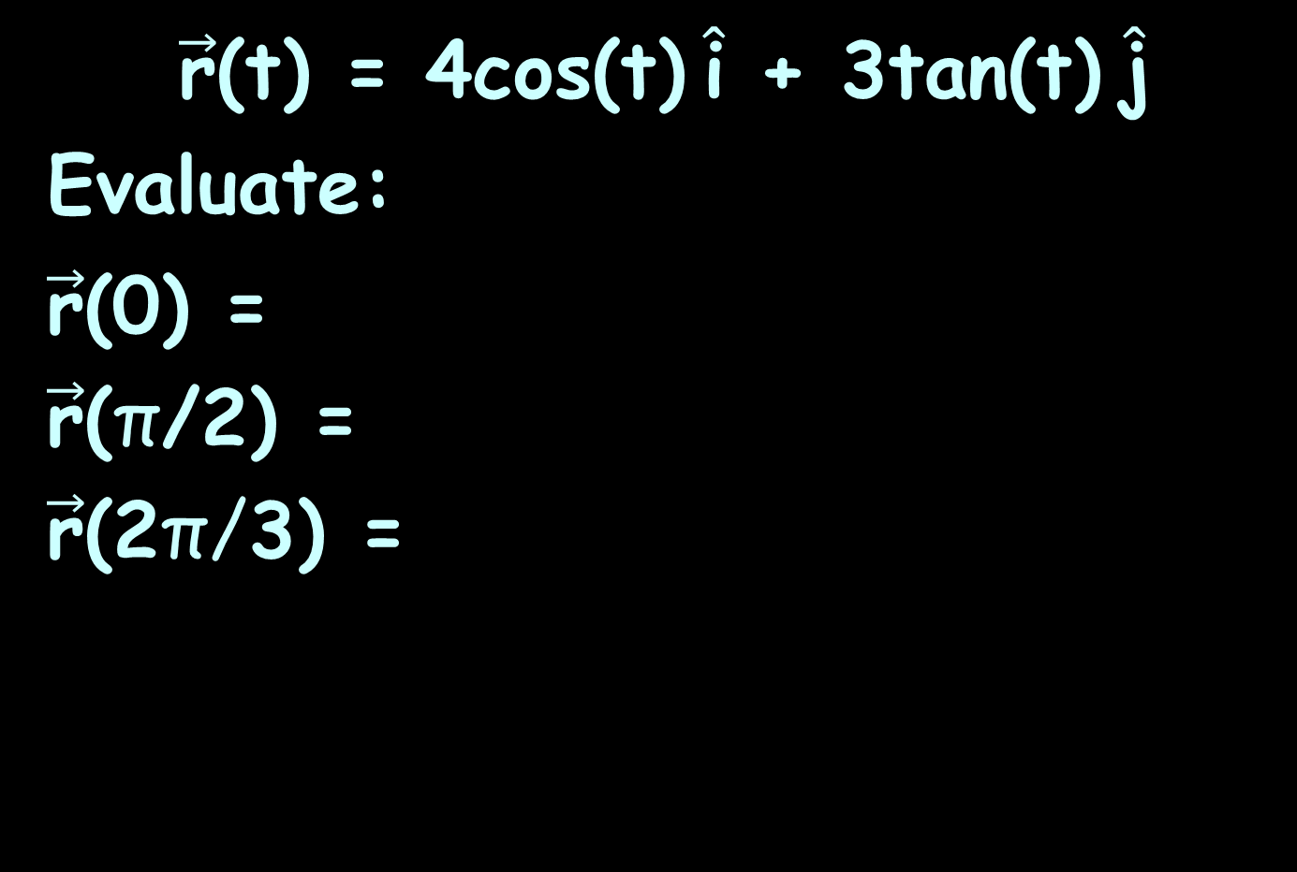
VECTOR CALCULUS
IN-CLASS PROBLEM 2
$\vec{\text{r}}$(t) = 4cos(t) $\hat{\text{i}}$ + 3tan(t) $\hat{\text{j}}$
Evaluate:
$\vec{\text{r}}$(0) =
$\vec{\text{r}}$(π/2) =
$\vec{\text{r}}$(2π/3) =
https://math.libretexts.org/Bookshelves/Calculus/Map%3A_Calculus__Early_Transcendentals_(Stewart)/13%3A_Vector_Functions/13.01%3A_Vector_Functions_and_Space_Curves

Slide 38
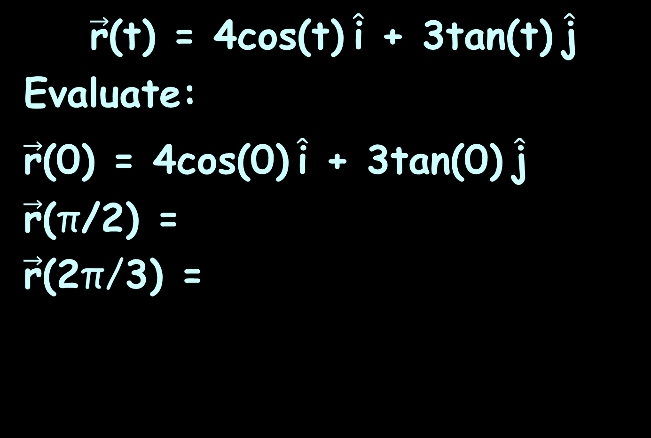
VECTOR CALCULUS
IN-CLASS PROBLEM 2
$\vec{\text{r}}$(t) = 4cos(t) $\hat{\text{i}}$ + 3tan(t) $\hat{\text{j}}$
Evaluate:
$\vec{\text{r}}$(0) = 4cos(0) $\hat{\text{i}}$ + 3tan(0) $\hat{\text{j}}$
$\vec{\text{r}}$(π/2) =
$\vec{\text{r}}$(2π/3) =
https://math.libretexts.org/Bookshelves/Calculus/Map%3A_Calculus__Early_Transcendentals_(Stewart)/13%3A_Vector_Functions/13.01%3A_Vector_Functions_and_Space_Curves

Slide 39
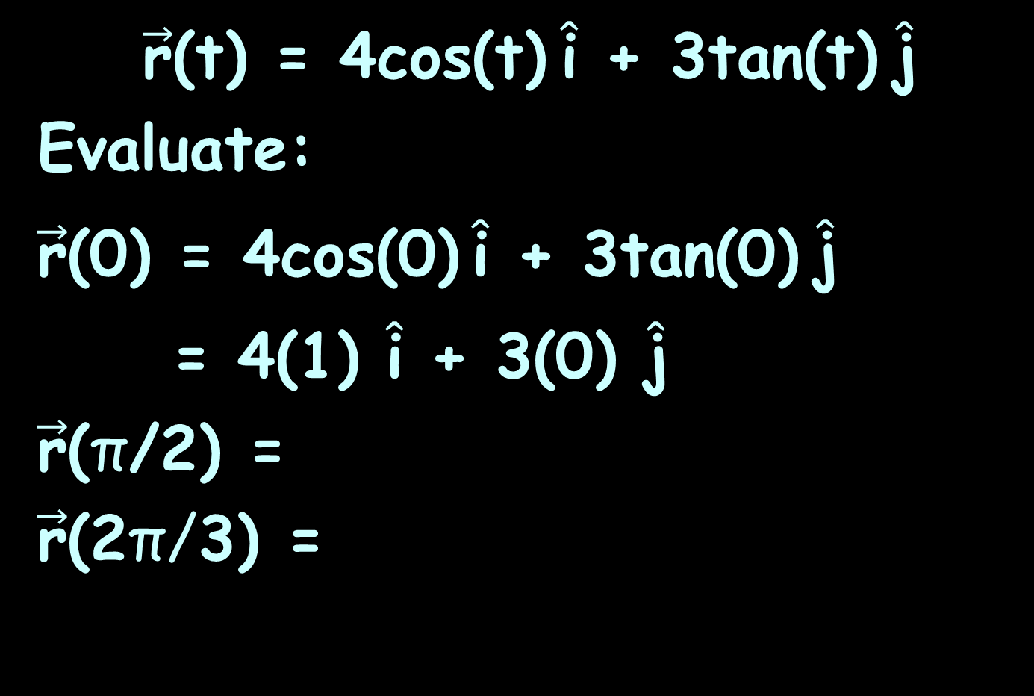
VECTOR CALCULUS
IN-CLASS PROBLEM 2
$\vec{\text{r}}$(t) = 4cos(t) $\hat{\text{i}}$ + 3tan(t) $\hat{\text{j}}$
Evaluate:
$\vec{\text{r}}$(0) = 4cos(0) $\hat{\text{i}}$ + 3tan(0) $\hat{\text{j}}$
= 4(1) $\hat{\text{i}}$ + 3(0) $\hat{\text{j}}$
$\vec{\text{r}}$(π/2) =
$\vec{\text{r}}$(2π/3) =
https://math.libretexts.org/Bookshelves/Calculus/Map%3A_Calculus__Early_Transcendentals_(Stewart)/13%3A_Vector_Functions/13.01%3A_Vector_Functions_and_Space_Curves

Slide 40
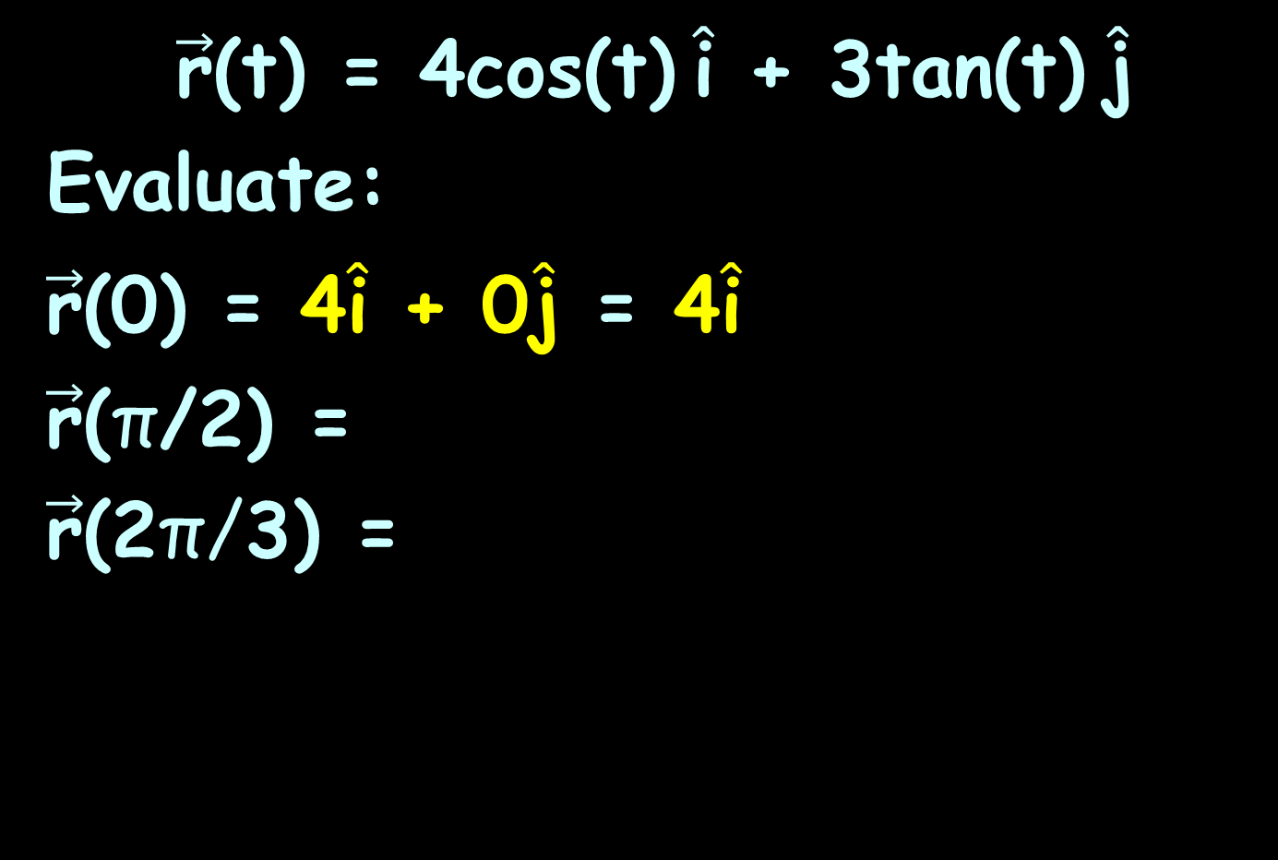
VECTOR CALCULUS
IN-CLASS PROBLEM 2
$\vec{\text{r}}$(t) = 4cos(t) $\hat{\text{i}}$ + 3tan(t) $\hat{\text{j}}$
Evaluate:
$\vec{\text{r}}$(0) = 4$\hat{\text{i}}$ + 0$\hat{\text{j}}$ = 4$\hat{\text{i}}$
$\vec{\text{r}}$(π/2) =
$\vec{\text{r}}$(2π/3) =
https://math.libretexts.org/Bookshelves/Calculus/Map%3A_Calculus__Early_Transcendentals_(Stewart)/13%3A_Vector_Functions/13.01%3A_Vector_Functions_and_Space_Curves

Slide 41
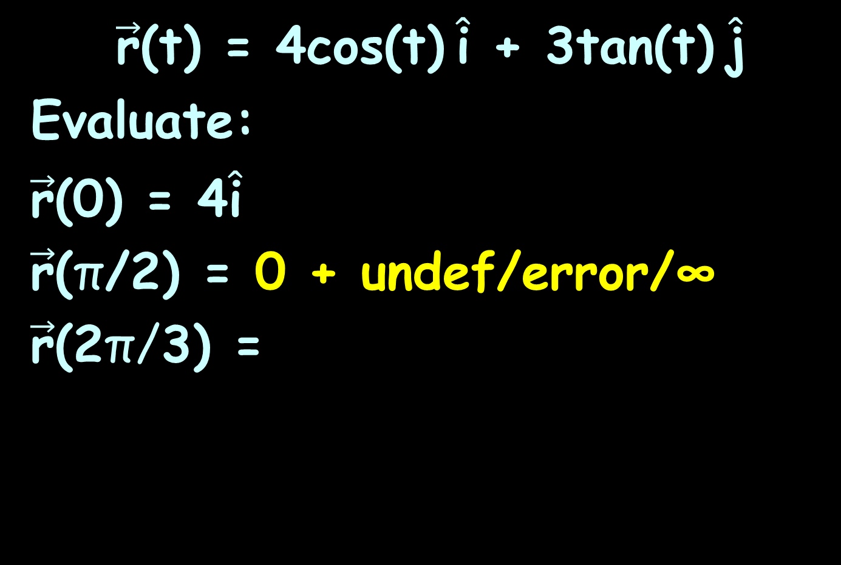
VECTOR CALCULUS
IN-CLASS PROBLEM 2
$\vec{\text{r}}$(t) = 4cos(t) $\hat{\text{i}}$ + 3tan(t) $\hat{\text{j}}$
Evaluate:
$\vec{\text{r}}$(0) = 4$\hat{\text{i}}$
$\vec{\text{r}}$(π/2) = 0 + undef/error/∞
$\vec{\text{r}}$(2π/3) =
https://math.libretexts.org/Bookshelves/Calculus/Map%3A_Calculus__Early_Transcendentals_(Stewart)/13%3A_Vector_Functions/13.01%3A_Vector_Functions_and_Space_Curves

Slide 42
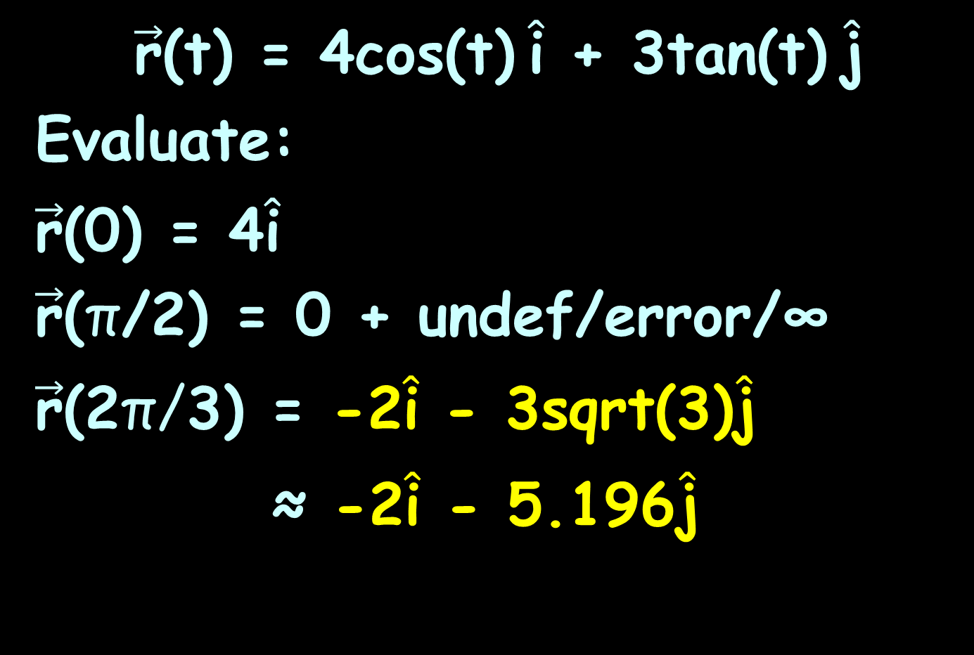
VECTOR CALCULUS
IN-CLASS PROBLEM 2
$\vec{\text{r}}$(t) = 4cos(t) $\hat{\text{i}}$ + 3tan(t) $\hat{\text{j}}$
Evaluate:
$\vec{\text{r}}$(0) = 4$\hat{\text{i}}$
$\vec{\text{r}}$(π/2) = 0 + undef/error/∞
$\vec{\text{r}}$(2π/3) = -2$\hat{\text{i}}$ - 3sqrt(3)$\hat{\text{j}}$
≈ -2$\hat{\text{i}}$ - 5.196$\hat{\text{j}}$
https://math.libretexts.org/Bookshelves/Calculus/Map%3A_Calculus__Early_Transcendentals_(Stewart)/13%3A_Vector_Functions/13.01%3A_Vector_Functions_and_Space_Curves

Slide 43
Vector Calculus
The domain of a vector-valued function consists of real numbers
The domain can be all real numbers or a subset of the real numbers
https://math.libretexts.org/Bookshelves/Calculus/Map%3A_Calculus__Early_Transcendentals_(Stewart)/13%3A_Vector_Functions/13.01%3A_Vector_Functions_and_Space_Curves

Slide 44
Vector Calculus
The range of a vector-valued function consists of vectors
Each real number in the domain of a vector-valued function is mapped to either a two- or a three-dimensional vector
https://math.libretexts.org/Bookshelves/Calculus/Map%3A_Calculus__Early_Transcendentals_(Stewart)/13%3A_Vector_Functions/13.01%3A_Vector_Functions_and_Space_Curves

Slide 45
Questions?
http://i.imgur.com/aliTlT3.jpg

Slide 46
Vector Calculus
When graphing a vector-valued function, we typically graph the vectors in the domain of the function in standard position, because doing so guarantees the uniqueness of the graph
https://math.libretexts.org/Bookshelves/Calculus/Map%3A_Calculus__Early_Transcendentals_(Stewart)/13%3A_Vector_Functions/13.01%3A_Vector_Functions_and_Space_Curves

Slide 47
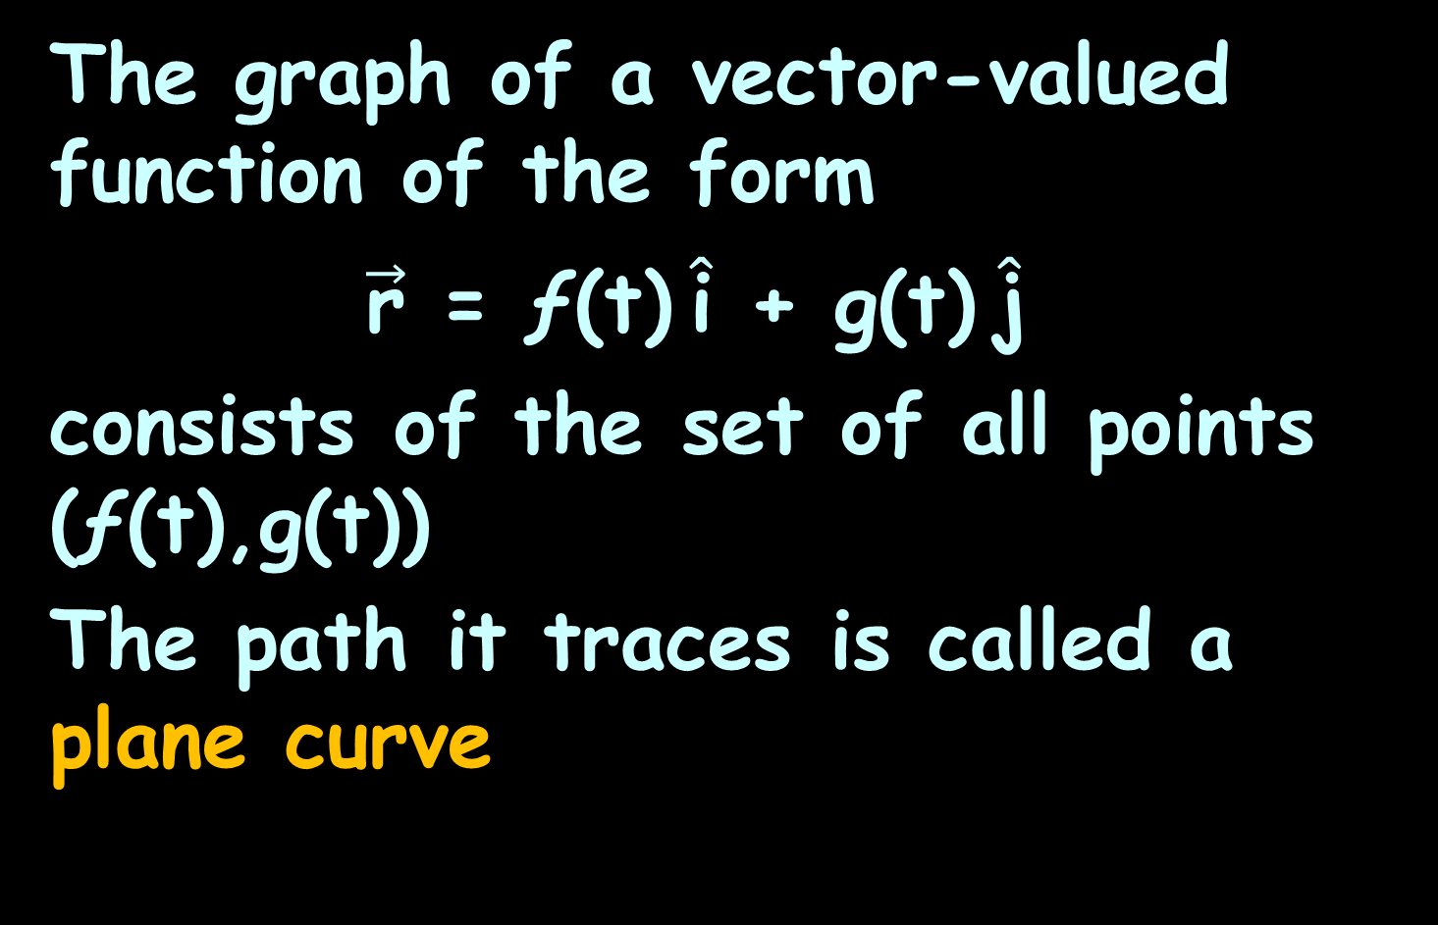
Vector Calculus
The graph of a vector-valued function of the form
$\vec{\text{r}}$ = ƒ(t) $\hat{\text{i}}$ + g(t) $\hat{\text{j}}$
consists of the set of all points (ƒ(t),g(t))
The path it traces is called a plane curve
https://math.libretexts.org/Bookshelves/Calculus/Map%3A_Calculus__Early_Transcendentals_(Stewart)/13%3A_Vector_Functions/13.01%3A_Vector_Functions_and_Space_Curves

Slide 48
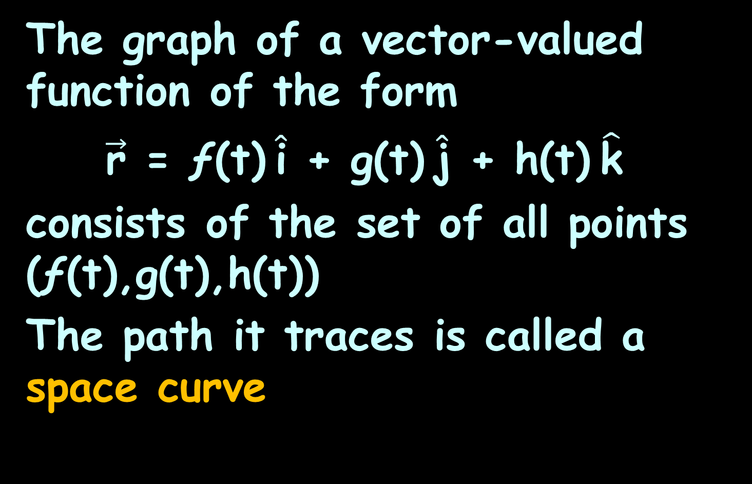
Vector Calculus
The graph of a vector-valued function of the form
$\vec{\text{r}}$ = ƒ(t) $\hat{\text{i}}$ + g(t) $\hat{\text{j}}$ + h(t) $\hat{\text{k}}$
consists of the set of all points (ƒ(t),g(t),h(t))
The path it traces is called a space curve
https://math.libretexts.org/Bookshelves/Calculus/Map%3A_Calculus__Early_Transcendentals_(Stewart)/13%3A_Vector_Functions/13.01%3A_Vector_Functions_and_Space_Curves

Slide 49
Vector Calculus
Any representation of a plane curve or space curve using a vector-valued function is called a vector parameterization of the curve
https://math.libretexts.org/Bookshelves/Calculus/Map%3A_Calculus__Early_Transcendentals_(Stewart)/13%3A_Vector_Functions/13.01%3A_Vector_Functions_and_Space_Curves

Slide 50
Vector Calculus
Each plane curve and space curve has an orientation, indicated by arrows drawn in on the curve, that shows the direction of motion along the curve as the value of the parameter t increases
https://math.libretexts.org/Bookshelves/Calculus/Map%3A_Calculus__Early_Transcendentals_(Stewart)/13%3A_Vector_Functions/13.01%3A_Vector_Functions_and_Space_Curves

Slide 51
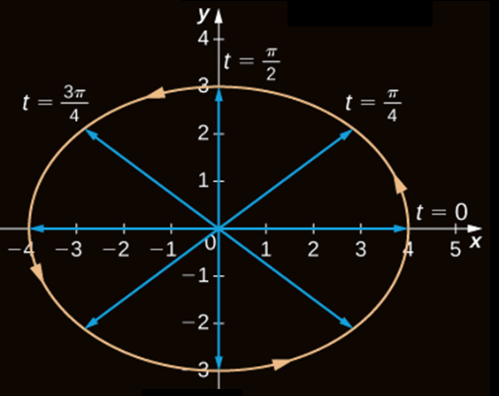

Vector Calculus
A 2D
plane curve
graph of:
$\vec{\text{r}}$=4cos(t) $\hat{\text{i}}$+3sin(t) $\hat{\text{j}}$
0≤t≤2π
https://math.libretexts.org/Bookshelves/Calculus/Map%3A_Calculus__Early_Transcendentals_(Stewart)/13%3A_Vector_Functions/13.01%3A_Vector_Functions_and_Space_Curves

Slide 52
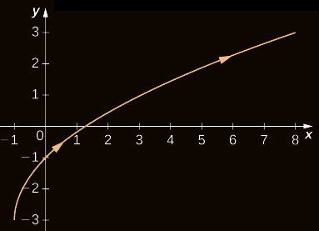

Vector Calculus
A 2D plane curve graph of:
$\vec{\text{r}}$=(t²-1) $\hat{\text{i}}$+(2t-3) $\hat{\text{j}}$ 0≤t≤3
https://math.libretexts.org/Bookshelves/Calculus/Map%3A_Calculus__Early_Transcendentals_(Stewart)/13%3A_Vector_Functions/13.01%3A_Vector_Functions_and_Space_Curves

Slide 53
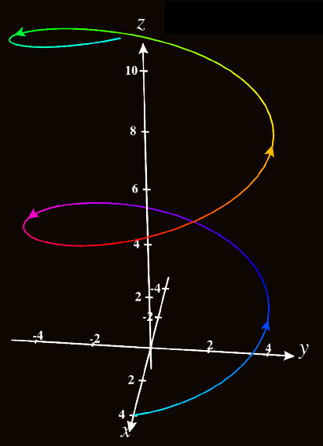

Vector Calculus
A 3D
space curve
graph
of:
$\vec{\text{r}}$=4cos(t) $\hat{\text{i}}$+4sin(t) $\hat{\text{j}}$+t $\hat{\text{k}}$
0≤t≤4π
https://math.libretexts.org/Bookshelves/Calculus/Map%3A_Calculus__Early_Transcendentals_(Stewart)/13%3A_Vector_Functions/13.01%3A_Vector_Functions_and_Space_Curves

Slide 54
Vector Calculus
Some graphs are identical
This happens because the function describing the second curve is a “reparameterization” of the function describing the first curve
https://math.libretexts.org/Bookshelves/Calculus/Map%3A_Calculus__Early_Transcendentals_(Stewart)/13%3A_Vector_Functions/13.01%3A_Vector_Functions_and_Space_Curves

Slide 55
Vector Calculus
Any curve has an infinite number of reparameterizations
The interval over which t is defined may change, but not the shape of the curve
https://math.libretexts.org/Bookshelves/Calculus/Map%3A_Calculus__Early_Transcendentals_(Stewart)/13%3A_Vector_Functions/13.01%3A_Vector_Functions_and_Space_Curves

Slide 56
Questions?
http://i.imgur.com/aliTlT3.jpg

Slide 57
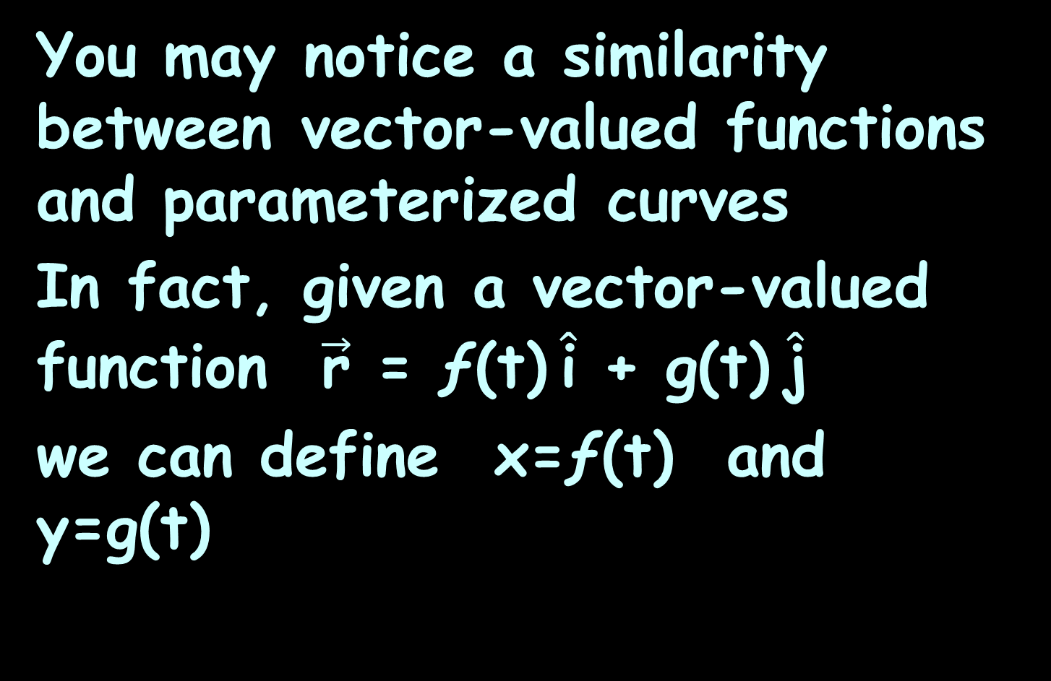
Vector Calculus
You may notice a similarity between vector-valued functions and parameterized curves
In fact, given a vector-valued function $\vec{\text{r}}$ = ƒ(t) $\hat{\text{i}}$ + g(t) $\hat{\text{j}}$
we can define x=ƒ(t) and y=g(t)
https://math.libretexts.org/Bookshelves/Calculus/Map%3A_Calculus__Early_Transcendentals_(Stewart)/13%3A_Vector_Functions/13.01%3A_Vector_Functions_and_Space_Curves

Slide 58
Vector Calculus
If a restriction exists on the values of t (for example, t is restricted to the interval [a,b] for some constants a<b, then this restriction is enforced on the parameter
https://math.libretexts.org/Bookshelves/Calculus/Map%3A_Calculus__Early_Transcendentals_(Stewart)/13%3A_Vector_Functions/13.01%3A_Vector_Functions_and_Space_Curves

Slide 59
Vector Calculus
The graph of the parameterized
function would then agree with the graph of the vector-valued function, except that the vector-valued graph would represent vectors rather than points
https://math.libretexts.org/Bookshelves/Calculus/Map%3A_Calculus__Early_Transcendentals_(Stewart)/13%3A_Vector_Functions/13.01%3A_Vector_Functions_and_Space_Curves

Slide 60
Vector Calculus
Since we can parameterize a curve defined by a function y=ƒ(x), it is also possible to represent an arbitrary plane curve by a vector-valued function
https://math.libretexts.org/Bookshelves/Calculus/Map%3A_Calculus__Early_Transcendentals_(Stewart)/13%3A_Vector_Functions/13.01%3A_Vector_Functions_and_Space_Curves

Slide 61
Vector Calculus
Since we can do calculus on parametrized functions (remember polars?), this lets us do calculus on vector-valued functions!
https://math.libretexts.org/Bookshelves/Calculus/Map%3A_Calculus__Early_Transcendentals_(Stewart)/13%3A_Vector_Functions/13.01%3A_Vector_Functions_and_Space_Curves

Slide 62
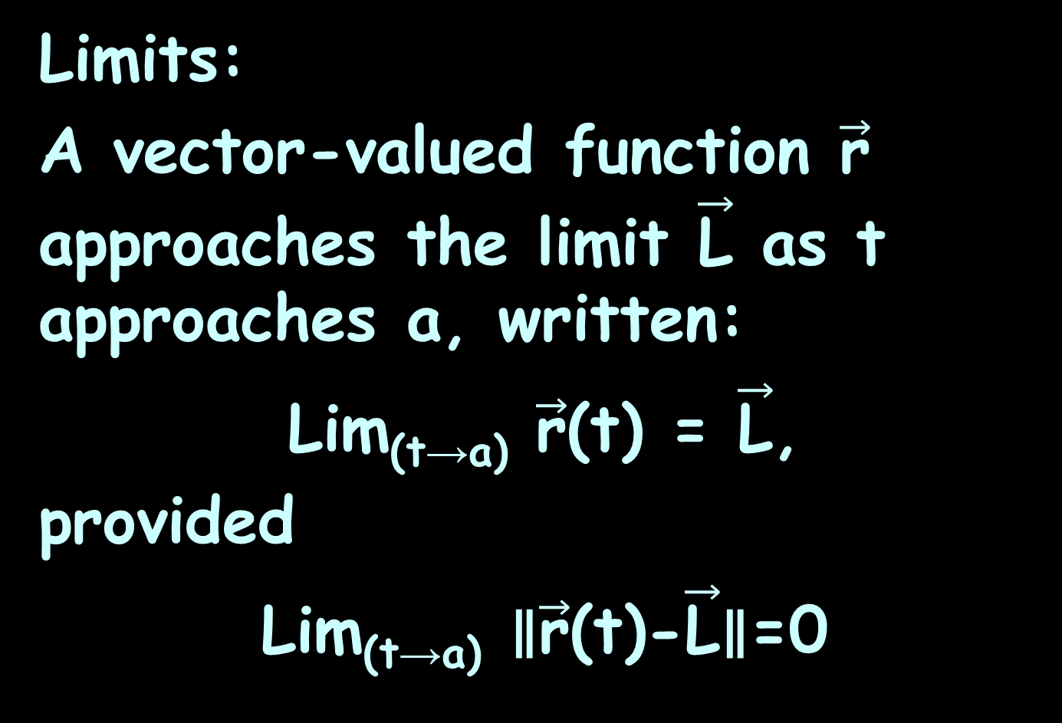
Vector Calculus
Limits:
A vector-valued function $\vec{\text{r}}$ approaches the limit $\vec{\text{L}}$ as t approaches a, written:
Lim_{(t→a)} $\vec{\text{r}}$(t) = $\vec{\text{L}}$,
provided
Lim_{(t→a)} ∥$\vec{\text{r}}$(t)-$\vec{\text{L}}$∥=0
https://math.libretexts.org/Bookshelves/Calculus/Map%3A_Calculus__Early_Transcendentals_(Stewart)/13%3A_Vector_Functions/13.01%3A_Vector_Functions_and_Space_Curves

Slide 63
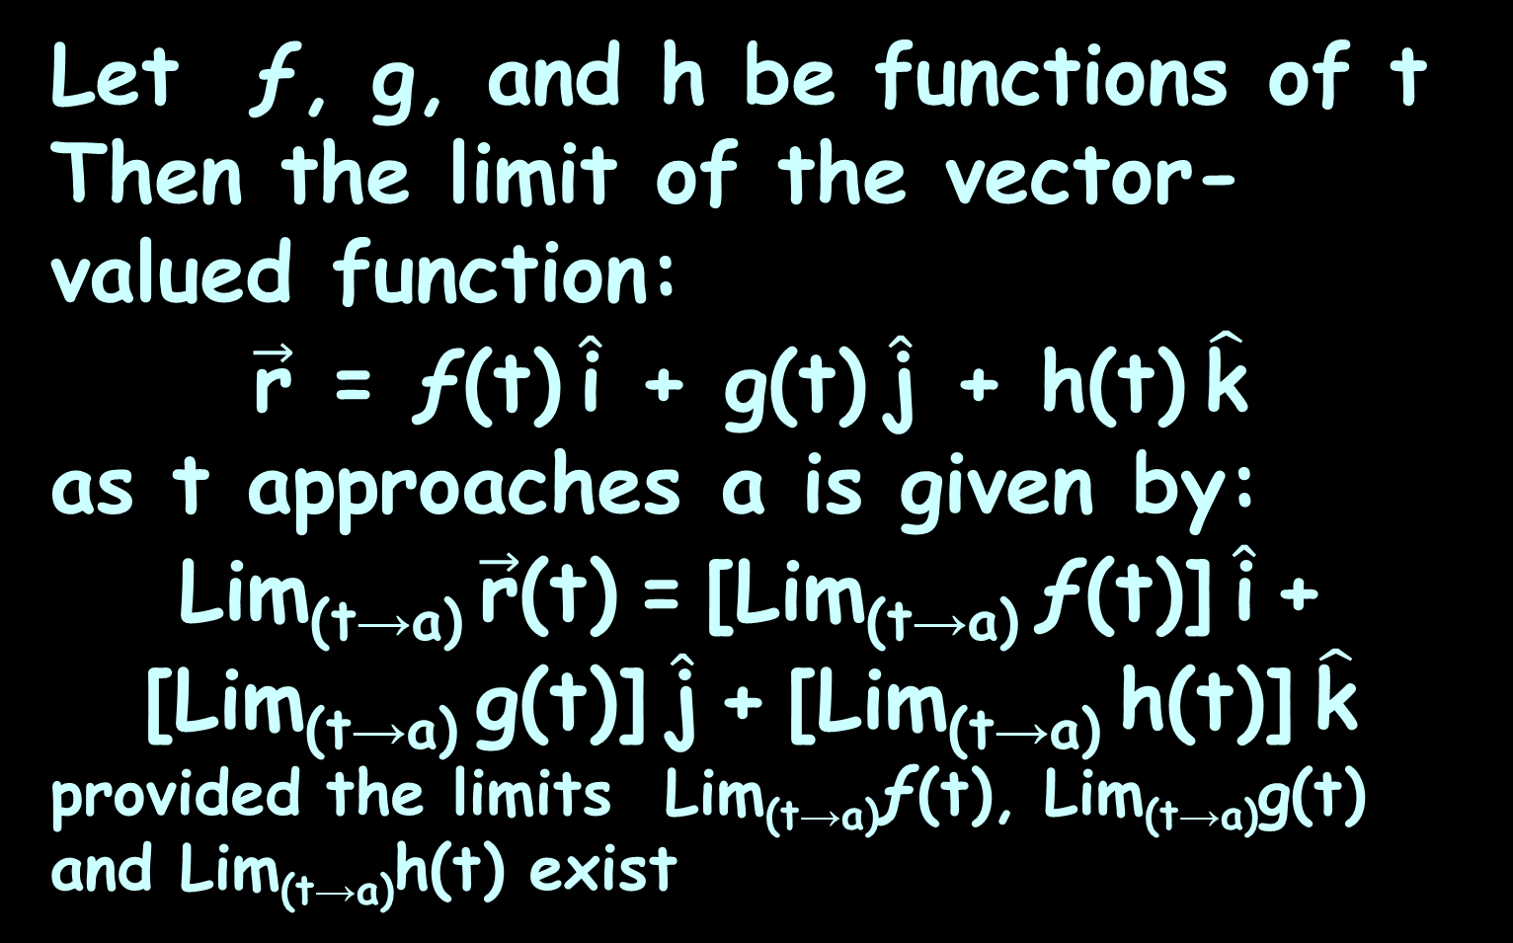
Vector Calculus
Let ƒ, g, and h be functions of t
Then the limit of the vector-valued function:
$\vec{\text{r}}$ = ƒ(t) $\hat{\text{i}}$ + g(t) $\hat{\text{j}}$ + h(t) $\hat{\text{k}}$
as t approaches a is given by:
Lim_{(t→a)} $\vec{\text{r}}$(t) = [Lim_{(t→a)} ƒ(t)] $\hat{\text{i}}$ + [Lim_{(t→a)} g(t)] $\hat{\text{j}}$ + [Lim_{(t→a)} h(t)] $\hat{\text{k}}$
provided the limits Lim_{(t→a)}ƒ(t), Lim_{(t→a)}g(t) and Lim_{(t→a)}h(t) exist
https://math.libretexts.org/Bookshelves/Calculus/Map%3A_Calculus__Early_Transcendentals_(Stewart)/13%3A_Vector_Functions/13.01%3A_Vector_Functions_and_Space_Curves

Slide 64
Vector Calculus
If you can find the limit of a vector-valued function, you can define continuity at a point for such a function
https://math.libretexts.org/Bookshelves/Calculus/Map%3A_Calculus__Early_Transcendentals_(Stewart)/13%3A_Vector_Functions/13.01%3A_Vector_Functions_and_Space_Curves

Slide 65
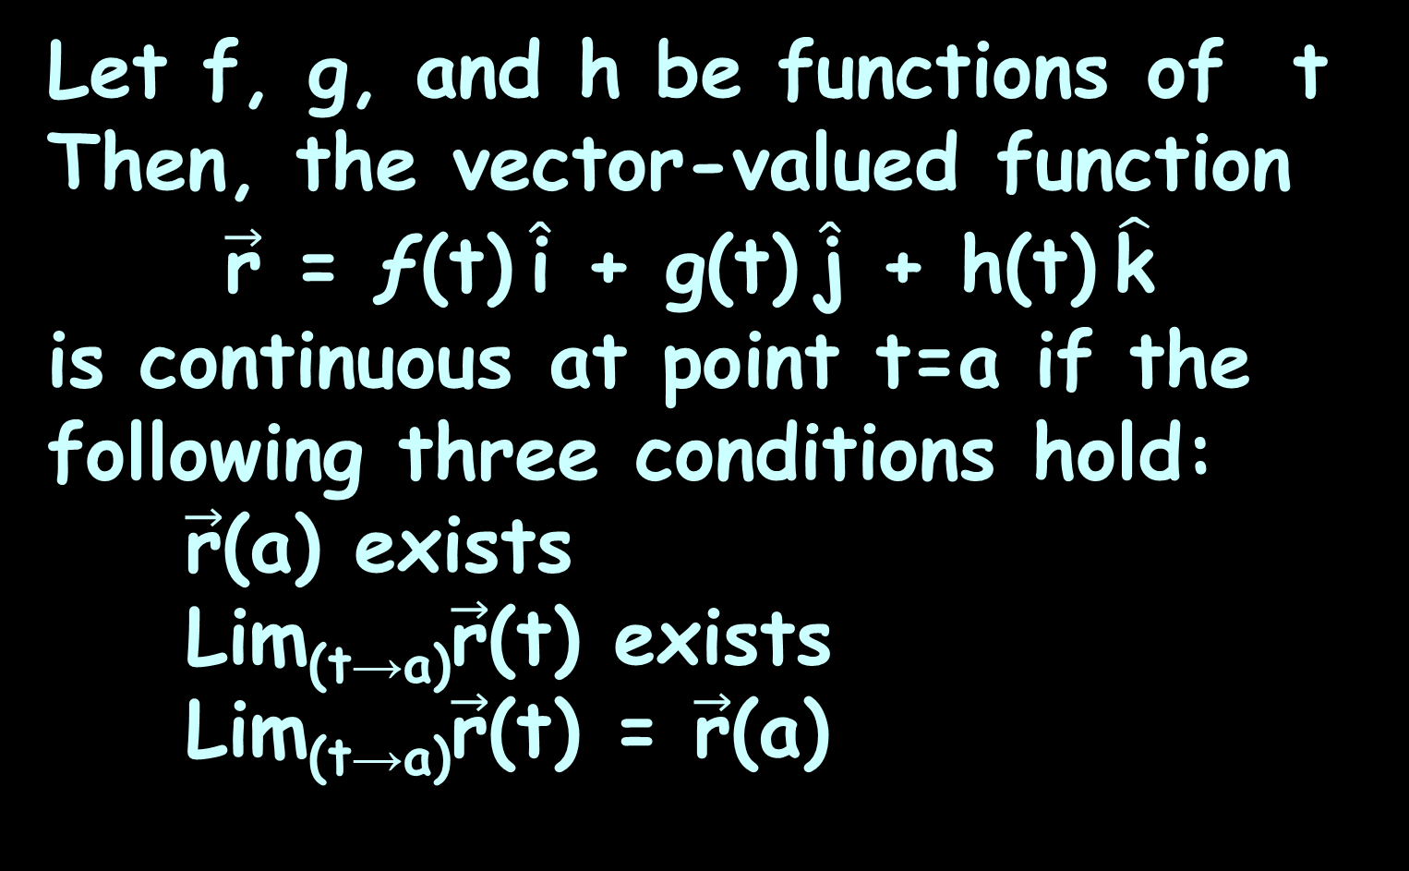
Vector Calculus
Let f, g, and h be functions of t Then, the vector-valued function
$\vec{\text{r}}$ = ƒ(t) $\hat{\text{i}}$ + g(t) $\hat{\text{j}}$ + h(t) $\hat{\text{k}}$
is continuous at point t=a if the following three conditions hold:
$\vec{\text{r}}$(a) exists
Lim_{(t→a)}$\vec{\text{r}}$(t) exists
Lim_{(t→a)}$\vec{\text{r}}$(t) = $\vec{\text{r}}$(a)
https://math.libretexts.org/Bookshelves/Calculus/Map%3A_Calculus__Early_Transcendentals_(Stewart)/13%3A_Vector_Functions/13.01%3A_Vector_Functions_and_Space_Curves

Slide 66
Questions?
http://i.imgur.com/aliTlT3.jpg

Slide 67
Vector Calculus
If you know what a vector-valued function is and how to take its limit, the next step is to learn how to differentiate it
https://math.libretexts.org/Bookshelves/Calculus/Map%3A_Calculus__Early_Transcendentals_(Stewart)/13%3A_Vector_Functions/13.01%3A_Vector_Functions_and_Space_Curves

Slide 68
Vector Calculus
The definition of the derivative of a vector-valued function is nearly identical to the definition of a real-valued function of one variable
https://math.libretexts.org/Bookshelves/Calculus/Map%3A_Calculus__Early_Transcendentals_(Stewart)/13%3A_Vector_Functions/13.01%3A_Vector_Functions_and_Space_Curves

Slide 69
Vector Calculus
However, because the range of a vector-valued function consists of vectors, the same is true for the range of the derivative of a vector-valued function
https://math.libretexts.org/Bookshelves/Calculus/Map%3A_Calculus__Early_Transcendentals_(Stewart)/13%3A_Vector_Functions/13.01%3A_Vector_Functions_and_Space_Curves

Slide 70
Vector Calculus
Many of the rules for calculating derivatives of real-valued functions can be applied to calculating the derivatives of vector-valued functions as well
https://math.libretexts.org/Bookshelves/Calculus/Map%3A_Calculus__Early_Transcendentals_(Stewart)/13%3A_Vector_Functions/13.01%3A_Vector_Functions_and_Space_Curves

Slide 71
Vector Calculus
A real-valued function can be interpreted as the slope of a tangent line or the instantaneous rate of change of the function
The derivative of a vector-valued function can be understood to be an instantaneous rate of change as well
https://math.libretexts.org/Bookshelves/Calculus/Map%3A_Calculus__Early_Transcendentals_(Stewart)/13%3A_Vector_Functions/13.01%3A_Vector_Functions_and_Space_Curves

Slide 72
Vector Calculus
For example, when the function represents the position of an object at a given point in time, the derivative represents its velocity at that same point in time
https://math.libretexts.org/Bookshelves/Calculus/Map%3A_Calculus__Early_Transcendentals_(Stewart)/13%3A_Vector_Functions/13.01%3A_Vector_Functions_and_Space_Curves

Slide 73

VECTOR CALCULUS
IN-CLASS PROBLEM 3a
Find the derivative of:
$\vec{\text{r}}$(t) = (3t+4) $\hat{\text{i}}$ + (t²-4t+3) $\hat{\text{j}}$
Just pretend $\hat{\text{i}}$ and $\hat{\text{j}}$ are x and y!
https://math.libretexts.org/Bookshelves/Calculus/Map%3A_Calculus__Early_Transcendentals_(Stewart)/13%3A_Vector_Functions/13.01%3A_Vector_Functions_and_Space_Curves

Slide 74
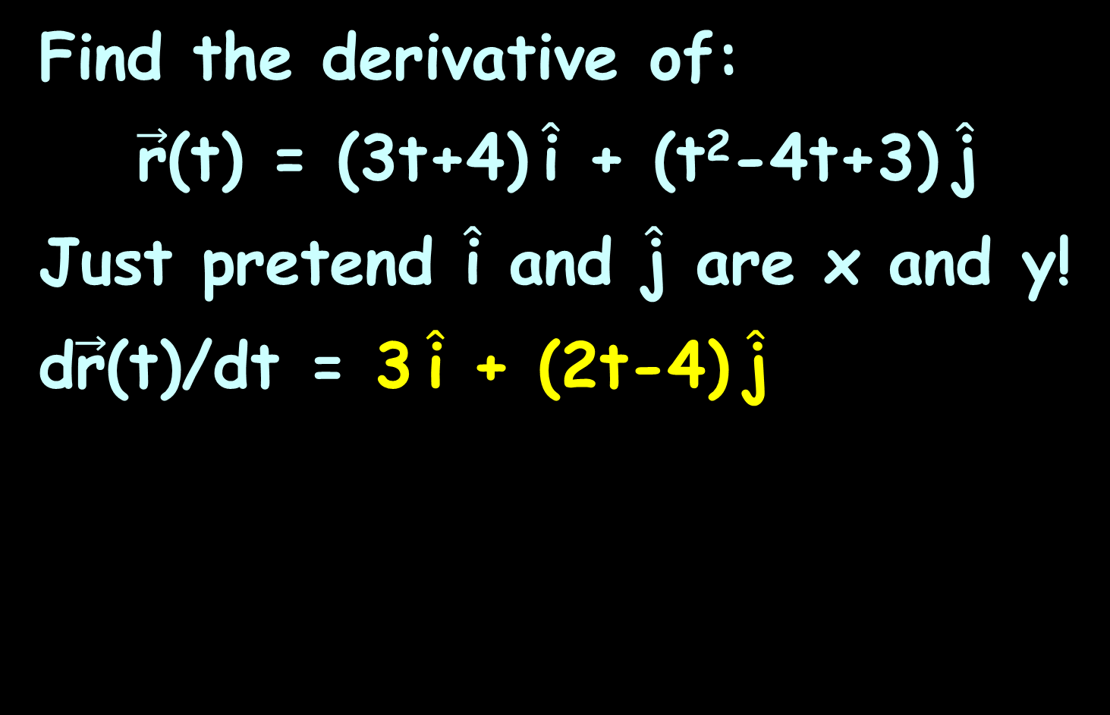
VECTOR CALCULUS
IN-CLASS PROBLEM 3a
Find the derivative of:
$\vec{\text{r}}$(t) = (3t+4) $\hat{\text{i}}$ + (t²-4t+3) $\hat{\text{j}}$
Just pretend $\hat{\text{i}}$ and $\hat{\text{j}}$ are x and y!
d$\vec{\text{r}}$(t)/dt = 3 $\hat{\text{i}}$ + (2t-4) $\hat{\text{j}}$
https://math.libretexts.org/Bookshelves/Calculus/Map%3A_Calculus__Early_Transcendentals_(Stewart)/13%3A_Vector_Functions/13.01%3A_Vector_Functions_and_Space_Curves

Slide 75

VECTOR CALCULUS
IN-CLASS PROBLEM 3b
Find the derivative of:
$\vec{\text{r}}$(t) = 3cos(t) $\hat{\text{i}}$ + 4sin(t) $\hat{\text{j}}$
https://math.libretexts.org/Bookshelves/Calculus/Map%3A_Calculus__Early_Transcendentals_(Stewart)/13%3A_Vector_Functions/13.01%3A_Vector_Functions_and_Space_Curves

Slide 76
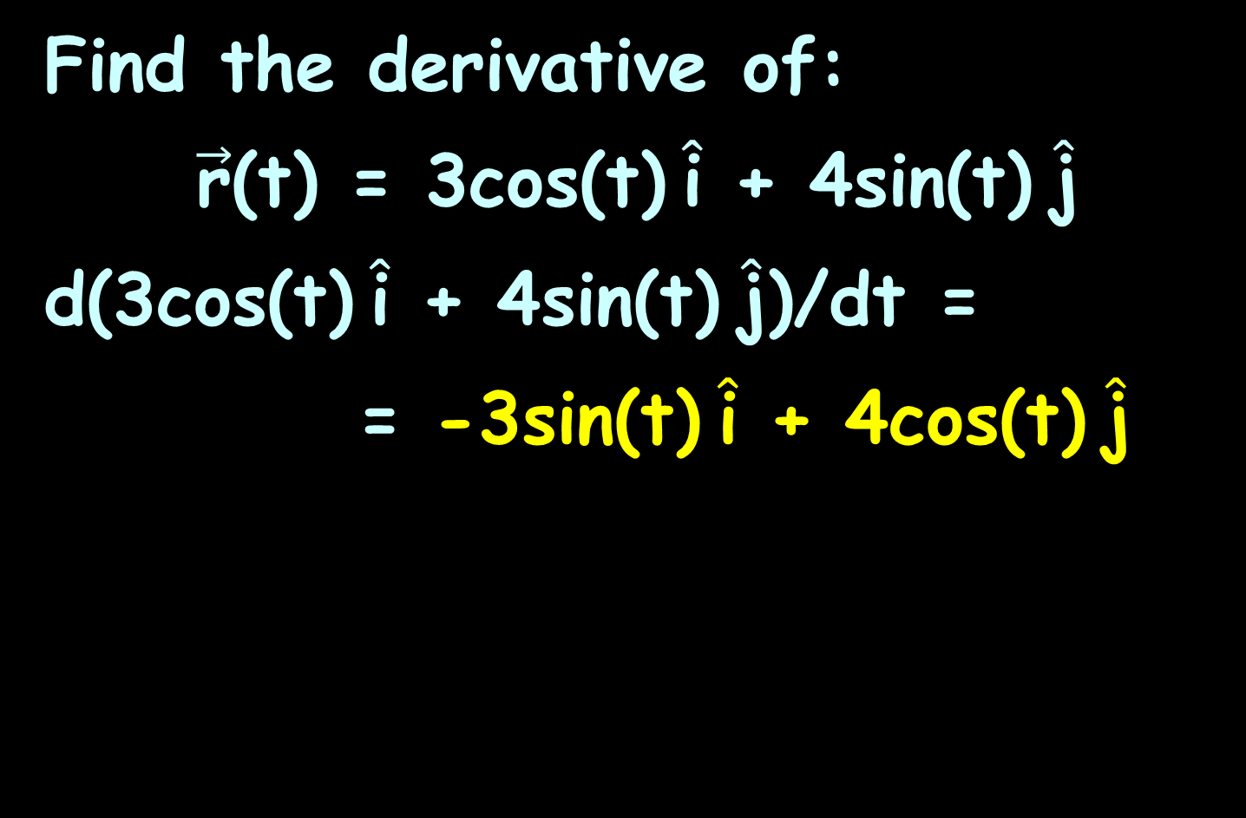
VECTOR CALCULUS
IN-CLASS PROBLEM 3b
Find the derivative of:
$\vec{\text{r}}$(t) = 3cos(t) $\hat{\text{i}}$ + 4sin(t) $\hat{\text{j}}$
d(3cos(t) $\hat{\text{i}}$ + 4sin(t) $\hat{\text{j}}$)/dt =
= -3sin(t) $\hat{\text{i}}$ + 4cos(t) $\hat{\text{j}}$
https://math.libretexts.org/Bookshelves/Calculus/Map%3A_Calculus__Early_Transcendentals_(Stewart)/13%3A_Vector_Functions/13.01%3A_Vector_Functions_and_Space_Curves

Slide 77
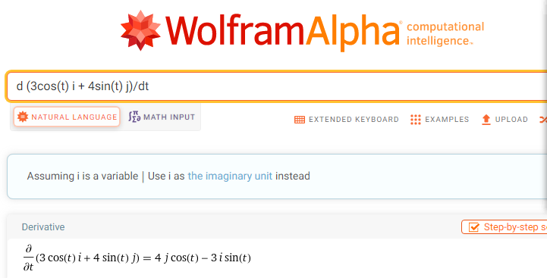

Slide 78
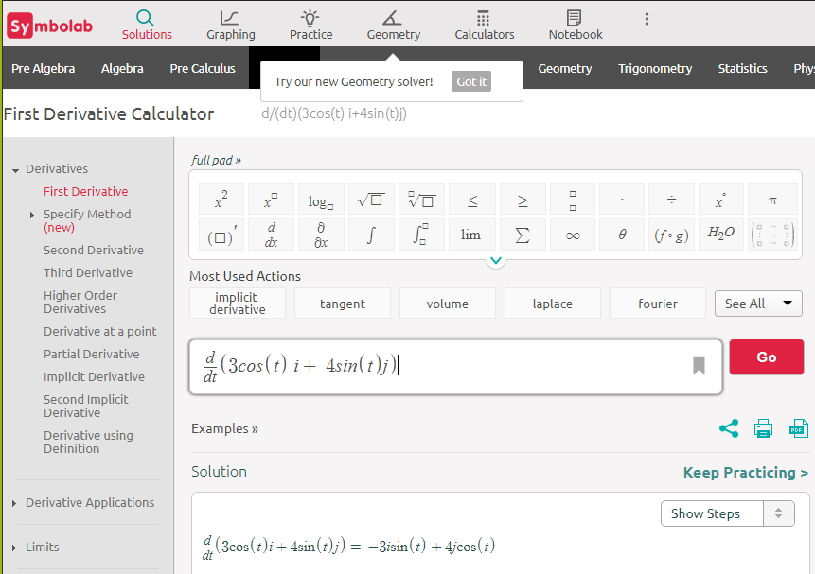

Slide 79

VECTOR CALCULUS
IN-CLASS PROBLEM 3c
Find the derivative of:
$\vec{\text{r}}$(t) = t ln(t) $\hat{\text{i}}$ + 5e^{t} $\hat{\text{j}}$
https://math.libretexts.org/Bookshelves/Calculus/Map%3A_Calculus__Early_Transcendentals_(Stewart)/13%3A_Vector_Functions/13.01%3A_Vector_Functions_and_Space_Curves

Slide 80
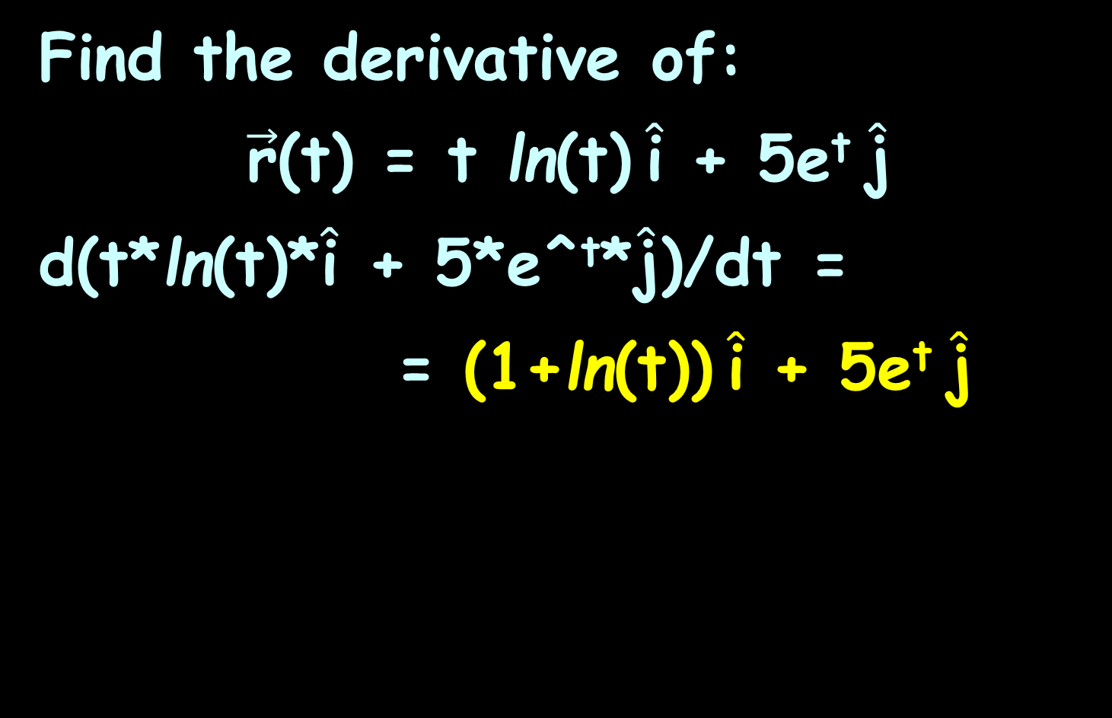
VECTOR CALCULUS
IN-CLASS PROBLEM 3c
Find the derivative of:
$\vec{\text{r}}$(t) = t ln(t) $\hat{\text{i}}$ + 5e^{t} $\hat{\text{j}}$
d(t*ln(t)*$\hat{\text{i}}$ + 5*e^^{t}*$\hat{\text{j}}$)/dt =
= (1+ln(t)) $\hat{\text{i}}$ + 5e^{t} $\hat{\text{j}}$
https://math.libretexts.org/Bookshelves/Calculus/Map%3A_Calculus__Early_Transcendentals_(Stewart)/13%3A_Vector_Functions/13.01%3A_Vector_Functions_and_Space_Curves

Slide 81
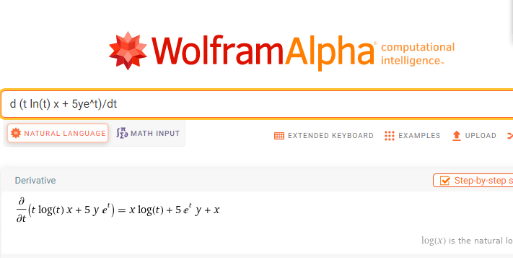
I had to change it to x and y or it wouldn’t work!
As of 2/22/2022 – it worked fine!

Slide 82
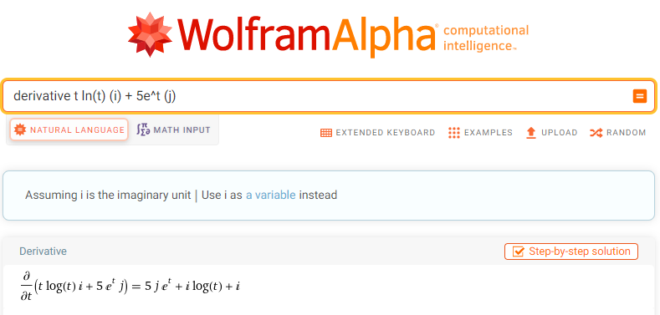
You do have to click: “Use i as a variable”

Slide 83
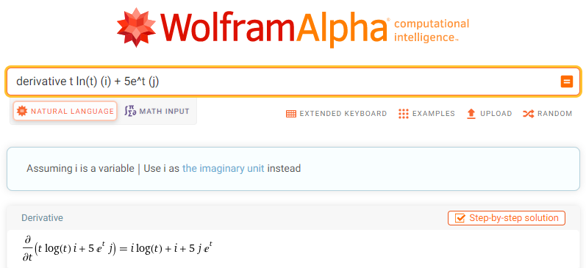
Tah-Dah!

Slide 84
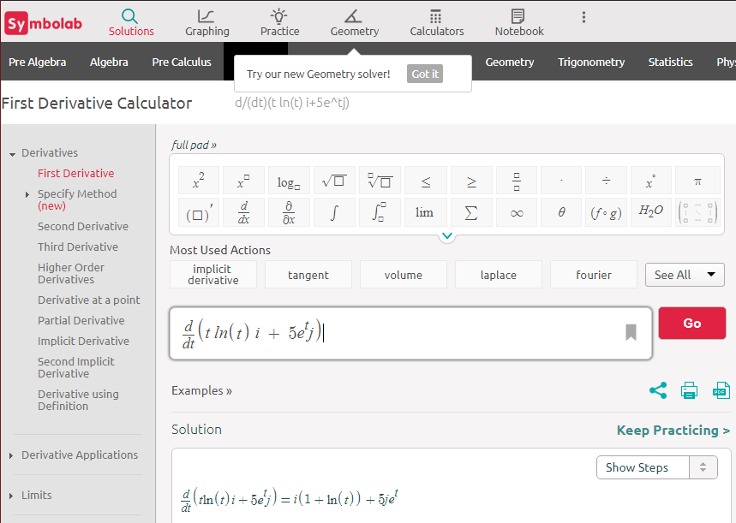
Works fine!

Slide 85
Questions?
http://i.imgur.com/aliTlT3.jpg

Slide 86
Vector Calculus
We can extend to vector-valued functions the properties of the derivative that we presented previously
https://math.libretexts.org/Bookshelves/Calculus/Map%3A_Calculus__Early_Transcendentals_(Stewart)/13%3A_Vector_Functions/13.01%3A_Vector_Functions_and_Space_Curves

Slide 87
Vector Calculus
In particular, the constant multiple rule, the sum and difference rules, the product rule, and the chain rule all extend to vector-valued functions
https://math.libretexts.org/Bookshelves/Calculus/Map%3A_Calculus__Early_Transcendentals_(Stewart)/13%3A_Vector_Functions/13.01%3A_Vector_Functions_and_Space_Curves

Slide 88
Vector Calculus
In the case of the product rule, there are actually three extensions:
for a real-valued function multiplied by a vector-valued
function
for the dot product of two
vector-valued functions
for the cross product of two
vector-valued functions
https://math.libretexts.org/Bookshelves/Calculus/Map%3A_Calculus__Early_Transcendentals_(Stewart)/13%3A_Vector_Functions/13.01%3A_Vector_Functions_and_Space_Curves

Slide 89

Vector Calculus
Let $\vec{\text{r}}$ and $\vec{\text{u}}$ be differentiable vector-valued functions of t, let ƒ be a differentiable real-valued function of t, and let c be a scalar
https://math.libretexts.org/Bookshelves/Calculus/Map%3A_Calculus__Early_Transcendentals_(Stewart)/13%3A_Vector_Functions/13.01%3A_Vector_Functions_and_Space_Curves

Slide 90

Vector Calculus
dot
dot
dot
multiply
https://math.libretexts.org/Bookshelves/Calculus/Map%3A_Calculus__Early_Transcendentals_(Stewart)/13%3A_Vector_Functions/13.01%3A_Vector_Functions_and_Space_Curves

Slide 91
Questions?
http://i.imgur.com/aliTlT3.jpg

Slide 92
Vector Calculus
Tangent vectors are really important
https://math.libretexts.org/Bookshelves/Calculus/Map%3A_Calculus__Early_Transcendentals_(Stewart)/13%3A_Vector_Functions/13.01%3A_Vector_Functions_and_Space_Curves

Slide 93
Vector Calculus
Remember the derivative at a point can be interpreted as the slope of the tangent line to the graph at that point
For a vector-valued function, the derivative provides a tangent vector to the curve represented by the function
https://math.libretexts.org/Bookshelves/Calculus/Map%3A_Calculus__Early_Transcendentals_(Stewart)/13%3A_Vector_Functions/13.01%3A_Vector_Functions_and_Space_Curves

Slide 94

Vector Calculus
Consider the vector-valued function: $\vec{\text{r}}$(t) = cos(t) $\hat{\text{i}}$ + sin(t) $\hat{\text{j}}$
The derivative of this function is −sin(t) $\hat{\text{i}}$ + cos(t) $\hat{\text{j}}$
If we substitute the value t=π/6 into both functions, we get $\vec{\text{r}}$(π/6) = $\sqrt{\text{3}}$/2 $\hat{\text{i}}$ + ½ $\hat{\text{j}}$
and $\vec{\text{r}}$'(π/6) = −½ $\hat{\text{i}}$ + $\sqrt{\text{3}}$/2 $\hat{\text{j}}$
https://math.libretexts.org/Bookshelves/Calculus/Map%3A_Calculus__Early_Transcendentals_(Stewart)/13%3A_Vector_Functions/13.01%3A_Vector_Functions_and_Space_Curves

Slide 95


Vector Calculus
The vector $\vec{\text{r}}$'(π/6)
is tangent to the
circle at the
point
corresponding
to t=π/6
https://math.libretexts.org/Bookshelves/Calculus/Map%3A_Calculus__Early_Transcendentals_(Stewart)/13%3A_Vector_Functions/13.01%3A_Vector_Functions_and_Space_Curves

Slide 96

Vector Calculus
Principal Unit Tangent Vector
Let C be a curve defined by a vector-valued function $\vec{\text{r}}$, and assume that $\vec{\text{r}}$'(t) exists when t=t₀
https://math.libretexts.org/Bookshelves/Calculus/Map%3A_Calculus__Early_Transcendentals_(Stewart)/13%3A_Vector_Functions/13.01%3A_Vector_Functions_and_Space_Curves

Slide 97

Vector Calculus
Principal Unit Tangent Vector
A tangent vector $\vec{\text{r}}$ at t=t₀ is any vector such that, when the tail of the vector is placed at point $\vec{\text{r}}$(t₀) on the graph, vector $\vec{\text{r}}$ is tangent to curve C Vector $\vec{\text{r}}$'(t₀) is a tangent vector at point t=t₀
https://math.libretexts.org/Bookshelves/Calculus/Map%3A_Calculus__Early_Transcendentals_(Stewart)/13%3A_Vector_Functions/13.01%3A_Vector_Functions_and_Space_Curves

Slide 98

Vector Calculus
Principal Unit Tangent Vector
Also, assume that $\vec{\text{r}}$'(t)≠0
The principal unit tangent vector at t is defined to be:
$\vec{\text{T}}$(t) = $\vec{\text{r}}$’(t) / ∥$\vec{\text{r}}$’(t)∥
provided ∥$\vec{\text{r}}$(t)∥≠0
https://math.libretexts.org/Bookshelves/Calculus/Map%3A_Calculus__Early_Transcendentals_(Stewart)/13%3A_Vector_Functions/13.01%3A_Vector_Functions_and_Space_Curves

Slide 99
Vector Calculus
The unit tangent vector is exactly what it sounds like: a unit vector that is tangent to the curve
https://math.libretexts.org/Bookshelves/Calculus/Map%3A_Calculus__Early_Transcendentals_(Stewart)/13%3A_Vector_Functions/13.01%3A_Vector_Functions_and_Space_Curves

Slide 100

Vector Calculus
To calculate a unit tangent vector:
First, find the derivative $\vec{\text{r}}$'(t)
Second, calculate the magnitude
of the derivative
Third, divide the derivative by
its magnitude
https://math.libretexts.org/Bookshelves/Calculus/Map%3A_Calculus__Early_Transcendentals_(Stewart)/13%3A_Vector_Functions/13.01%3A_Vector_Functions_and_Space_Curves

Slide 101
Questions?
http://i.imgur.com/aliTlT3.jpg

Slide 102
Vector Calculus
Antiderivatives and definite integrals can be extended to vector-valued functions
https://math.libretexts.org/Bookshelves/Calculus/Map%3A_Calculus__Early_Transcendentals_(Stewart)/13%3A_Vector_Functions/13.01%3A_Vector_Functions_and_Space_Curves

Slide 103
Vector Calculus
Just as we can calculate the derivative of a vector-valued function by differentiating the component functions separately, we can calculate the antiderivative in the same way
https://math.libretexts.org/Bookshelves/Calculus/Map%3A_Calculus__Early_Transcendentals_(Stewart)/13%3A_Vector_Functions/13.01%3A_Vector_Functions_and_Space_Curves

Slide 104
Vector Calculus
And the Fundamental Theorem of Calculus applies to vector-valued functions as well
https://math.libretexts.org/Bookshelves/Calculus/Map%3A_Calculus__Early_Transcendentals_(Stewart)/13%3A_Vector_Functions/13.01%3A_Vector_Functions_and_Space_Curves

Slide 105
Vector Calculus
Let ƒ, g, and h be integrable real-valued functions over the closed interval [a,b]
https://math.libretexts.org/Bookshelves/Calculus/Map%3A_Calculus__Early_Transcendentals_(Stewart)/13%3A_Vector_Functions/13.01%3A_Vector_Functions_and_Space_Curves

Slide 106

Vector Calculus
The indefinite integral of a vector-valued function
$\vec{\text{r}}$ = ƒ(t) $\hat{\text{i}}$ + g(t) $\hat{\text{j}}$ + h(t) $\hat{\text{k}}$ is:
∫[ƒ(t) $\hat{\text{i}}$ + g(t) $\hat{\text{j}}$ + h(t) $\hat{\text{k}}$] dt =
∫[ƒ(t) $\hat{\text{i}}$]dt + ∫[g(t) $\hat{\text{j}}$]dt + ∫[h(t) $\hat{\text{k}}$]dt
https://math.libretexts.org/Bookshelves/Calculus/Map%3A_Calculus__Early_Transcendentals_(Stewart)/13%3A_Vector_Functions/13.01%3A_Vector_Functions_and_Space_Curves

Slide 107
Vector Calculus
The definite integral includes the limits
https://math.libretexts.org/Bookshelves/Calculus/Map%3A_Calculus__Early_Transcendentals_(Stewart)/13%3A_Vector_Functions/13.01%3A_Vector_Functions_and_Space_Curves

Slide 108
Vector Calculus
When you do the integration for an indefinite integral, each of the components will have its own “+c”
Therefore, the integration constants become a constant vector!
https://math.libretexts.org/Bookshelves/Calculus/Map%3A_Calculus__Early_Transcendentals_(Stewart)/13%3A_Vector_Functions/13.01%3A_Vector_Functions_and_Space_Curves

Slide 109

VECTOR CALCULUS
IN-CLASS PROBLEM 4
Find: ∫₁³[(2t+4) $\hat{\text{i}}$ + (3t²-4t) $\hat{\text{j}}$] dt
https://math.libretexts.org/Bookshelves/Calculus/Map%3A_Calculus__Early_Transcendentals_(Stewart)/13%3A_Vector_Functions/13.01%3A_Vector_Functions_and_Space_Curves

Slide 110

VECTOR CALCULUS
IN-CLASS PROBLEM 4
Find: ∫₁³[(2t+4) $\hat{\text{i}}$ + (3t²-4t) $\hat{\text{j}}$] dt
= 16 $\hat{\text{i}}$ + 10 $\hat{\text{j}}$
https://math.libretexts.org/Bookshelves/Calculus/Map%3A_Calculus__Early_Transcendentals_(Stewart)/13%3A_Vector_Functions/13.01%3A_Vector_Functions_and_Space_Curves

Slide 111

You do have to click: “Use i as a variable”

Slide 112

Again: Tah-Dah!

Slide 113
Questions?
http://i.imgur.com/aliTlT3.jpg

Slide 114
Summary
Today we studied:
Review of vectors
Vector calculus

Slide 115

You Survived!
www.playbuzz.com

