Slide 1
Welcome to
Unit 9
Part 17!
MATH 207 Integral Calculus

Slide 2
What’s Up?
Review:
Integral Transforms
New stuff:
Parametrics
Polars

Slide 3
What’s Up?
Outcome 7) Solve problems by identifying the requirements, making a sketch as appropriate

Slide 4

Review
http://995642590.r.lightningbase-cdn.com/wp-content/uploads/2010/12/looking-back-hrexaminer-v144-cover425px.jpg

Slide 5
Integral Transforms
Integrals are functions…
So, we can transform them, just like we transform functions!

Slide 6
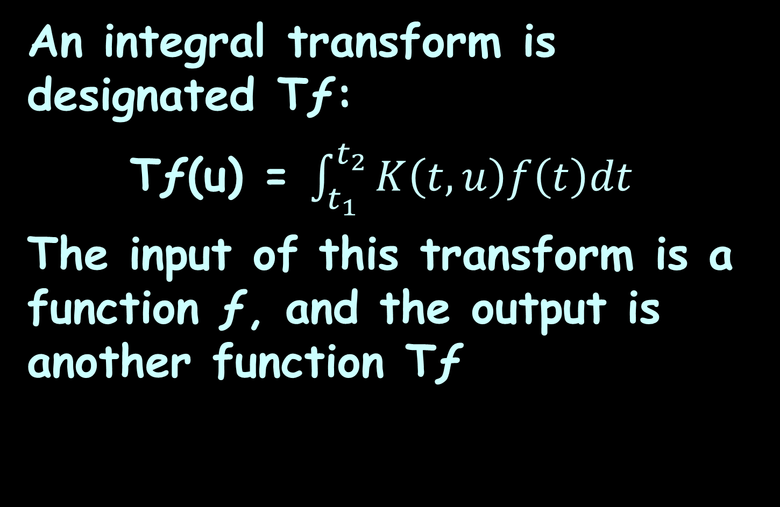
Integral Transforms
An integral transform is designated Tƒ:
Tƒ(u) = $\int_{t_{1}}^{t_{2}}{K\left(t,u\right)f\left(t\right)dt}$
The input of this transform is a function ƒ, and the output is another function Tƒ

Slide 7
Integral Transforms
We do this because an integral transform "maps" an equation from its original "domain" into another domain
Manipulating and solving the equation in the target domain can be much easier

Slide 8
Integral Transforms
The solution is then mapped back to the original domain with the inverse of the integral

Slide 9
Laplace Transforms
The Laplace Transform of a function ƒ(t) for t > 0 is defined by the following integral defined over 0 to ∞:
L{ƒ(t)} = ∫₀∞ e ^{–pt} ƒ(t) dt

Slide 10
Laplace Transforms
Laplace Transforms are used to reduce a differential equation to an algebra problem
They are especially useful when the initial values are zero

Slide 11

Questions?
http://i.imgur.com/aliTlT3.jpg

Slide 12
Parametric Equations
We’ve looked almost exclusively at functions:
y=f(x) or x=h(y)

Slide 13
Parametric Equations
The problem is that not all curves or equations that we’d like to look at are functions

Slide 14
Parametric Equations
Take, for example, a circle
It is easy enough to write down the equation of a circle centered at the origin with radius r:
x² + y² = r²

Slide 15
Parametric Equations
However, we will never be able to write the equation of a circle down as function

Slide 16
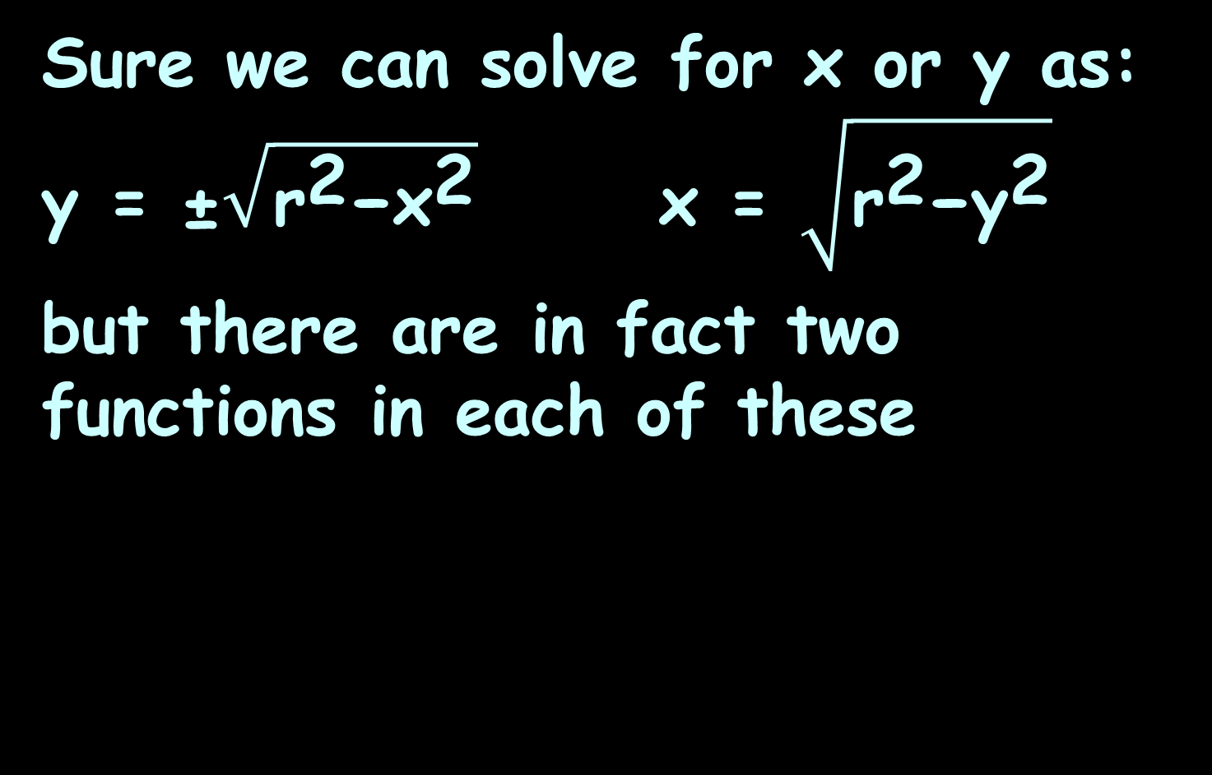
Parametric Equations
Sure we can solve for x or y as:
y = ±$\sqrt{{\text{r}}^{\text{2}}\text{−}{\text{x}}^{\text{2}}}$ x = $\sqrt{{\text{r}}^{\text{2}}\text{−}{\text{y}}^{\text{2}}}$
but there are in fact two functions in each of these

Slide 17
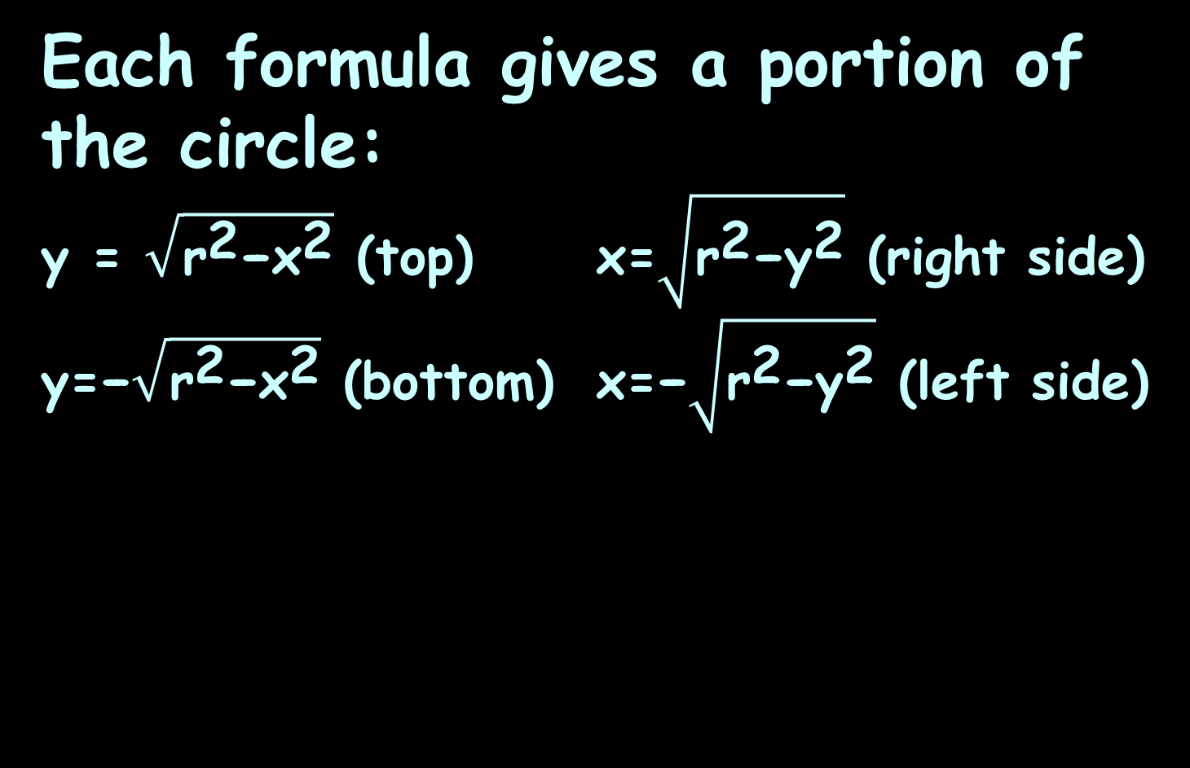
Parametric Equations
Each formula gives a portion of the circle:
y = $\sqrt{{\text{r}}^{\text{2}}\text{−}{\text{x}}^{\text{2}}}$ (top) x=$\sqrt{{\text{r}}^{\text{2}}\text{−}{\text{y}}^{\text{2}}}$ (right side)
y=−$\sqrt{{\text{r}}^{\text{2}}\text{−}{\text{x}}^{\text{2}}}$ (bottom) x=−$\sqrt{{\text{r}}^{\text{2}}\text{−}{\text{y}}^{\text{2}}}$ (left side)

Slide 18
Parametric Equations
Unfortunately, we usually are working on the whole circle, or simply can’t say that we’re going to be working only on one portion of it

Slide 19
Parametric Equations
Even if we can narrow things down to only one of these portions, the function is still often fairly unpleasant to work with

Slide 20
Parametric Equations
There are also a great many curves out there that we can’t even write down as a single equation in terms of only x and y

Slide 21
Parametric Equations
So, to deal with some of these problems we introduce parametric equations

Slide 22
Parametric Equations
Parametric equations of a curve express the coordinates of the points of the curve as functions of a variable called a “parameter”

Slide 23
Parametric Equations
Instead of defining y in terms of x (y=f(x)) or x in terms of y (x=h(y)) we define both x and y in terms of a third variable called a parameter

Slide 24
Parametric Equations
x=f(t) y=g(t)
This third variable is usually denoted by t (but doesn’t have to be)

Slide 25
Parametric Equations
Each value of t defines a point (x,y)=(f(t),g(t)) that we can plot

Slide 26
Parametric Equations
The collection of points that we get by letting t be all possible values is the graph of the parametric equations and is called the parametric curve

Slide 27
Parametric Equations
Think of dropping a ping-pong ball into a tub of sloshing water
https://tutorial.math.lamar.edu/classes/calcii/parametriceqn.aspx

Slide 28
Parametric Equations
The point (x,y)=(f(t),g(t)) will represent the location of the ping pong ball in the tank at time t
https://tutorial.math.lamar.edu/classes/calcii/parametriceqn.aspx

Slide 29
Parametric Equations
The parametric curve will be a trace of all the locations of the ping pong ball including direction of motion
https://tutorial.math.lamar.edu/classes/calcii/parametriceqn.aspx

Slide 30
Parametric Equations
Parametric functions often occur in dynamics
The parameter t represents time
(x(t), y(t)) represents the position of a particle as it varies with time
http://www3.ul.ie/~mlc/support/Loughborough%20website/chap12/12_3.pdf

Slide 31
Parametric Equations
We will calculate the derivative dy/dx from the parametric derivatives dx/dt and dy/dt

Slide 32

Parametric Equations
The parametric approach to describing a curve:
x=h(t) y=g(t) t₀≤t≤t₁
parametric equations parametric range

Slide 33
Parametric Equations
As various values of t are chosen within the parameter range, the corresponding values of x, y are calculated from the parametric equations

Slide 34
Parametric Equations
When these points are plotted on an xy plane, they trace out a curve

Slide 35
Parametric Equations
The Cartesian equation of this curve is obtained by eliminating the parameter t from the parametric equations

Slide 36
PARAMETRIC EQUATIONS
IN-CLASS PROBLEM 1
Suppose I had a non-function:
x² + y² = 4
Are the equations:
x=2cos(t) y=2sin(t) 0≤t≤2π
parametric equations parametric range
the same?

Slide 37
PARAMETRIC EQUATIONS
IN-CLASS PROBLEM 1
Strategy: eliminate the “t” from both parametric equations
x=2cos(t) y=2sin(t)
We’ll divide both parametric equations by 2, square each and then add them together

Slide 38
PARAMETRIC EQUATIONS
IN-CLASS PROBLEM 1
x 2cos(t) y 2sin(t)
2 2 2 2
=
=

Slide 39
PARAMETRIC EQUATIONS
IN-CLASS PROBLEM 1
x 2cos(t) y 2sin(t)
2 2 2 2
x/2 = cos(t) y/2 = sin(t)
=
=

Slide 40
PARAMETRIC EQUATIONS
IN-CLASS PROBLEM 1
x 2cos(t) y 2sin(t)
2 2 2 2
x/2 = cos(t) y/2 = sin(t)
x²/4 = cos²(t) y²/4 = sin²(t)
=
=

Slide 41
PARAMETRIC EQUATIONS
IN-CLASS PROBLEM 1
x²/4 = cos²(t) y²/4 = sin²(t)
Now add the two:
x²/4 + y²/4 = cos²(t) + sin²(t)

Slide 42
PARAMETRIC EQUATIONS
IN-CLASS PROBLEM 1
x²/4 = cos²(t) y²/4 = sin²(t)
Now add the two:
x²/4 + y²/4 = cos²(t) + sin²(t)
But cos²(t) + sin²(t) = 1
(one of those identities…)

Slide 43
PARAMETRIC EQUATIONS
IN-CLASS PROBLEM 1
So
x²/4 + y²/4 = 1
Which means
x² + y² = 4

Slide 44
PARAMETRIC EQUATIONS
IN-CLASS PROBLEM 1
And…
x² + y² = 4
IS the equation of a circle with center at (0,0) and radius 2 - our original equation!

Slide 45
Parametric Equations
Important point:
If x = h(t) and y = g(t)
Then dy/dx = dy/dt ÷ dx/dt

Slide 46
Questions?
http://i.imgur.com/aliTlT3.jpg

Slide 47
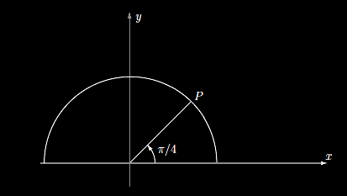
PARAMETRIC DIFFERENTIATION
IN-CLASS PROBLEM 2
Determine the equation of the tangent line to the semi-circle
x = cos(t) y = sin(t) 0≤t≤π
at t = π/4
VFrench, 2015

Slide 48
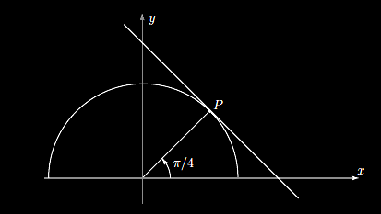
PARAMETRIC DIFFERENTIATION
IN-CLASS PROBLEM 2
Drawing the tangent line at
t = π/4:
VFrench, 2015

Slide 49
PARAMETRIC DIFFERENTIATION
IN-CLASS PROBLEM 2
The slope of the tangent line will be rise/run = dy/dx
VFrench, 2015

Slide 50
PARAMETRIC DIFFERENTIATION
IN-CLASS PROBLEM 2
We’re going to calculate:
dy/dx = dy/dt ÷ dx/dt

Slide 51
PARAMETRIC DIFFERENTIATION
IN-CLASS PROBLEM 2
We’re going to calculate:
dy/dx = dy/dt ÷ dx/dt
dy/dt = d(sin(t))/dt

Slide 52
PARAMETRIC DIFFERENTIATION
IN-CLASS PROBLEM 2
We’re going to calculate:
dy/dx = dy/dt ÷ dx/dt
dy/dt = d(sin(t))/dt
= cos(t)

Slide 53
PARAMETRIC DIFFERENTIATION
IN-CLASS PROBLEM 2
We’re going to calculate:
dy/dx = dy/dt ÷ dx/dt
dy/dt = d(sin(t))/dt
= cos(t)
dx/dt = d(cos(t))/dt

Slide 54
PARAMETRIC DIFFERENTIATION
IN-CLASS PROBLEM 2
We’re going to calculate:
dy/dx = dy/dt ÷ dx/dt
dy/dt = d(sin(t))/dt
= cos(t)
dx/dt = d(cos(t))/dt
= -sin(t)

Slide 55
PARAMETRIC DIFFERENTIATION
IN-CLASS PROBLEM 2
We’re going to calculate:
dy/dx = dy/dt ÷ dx/dt
dy/dt = d(sin(t))/dt
= cos(t)
dx/dt = d(cos(t))/dt
= -sin(t)
So, dy/dt ÷ dx/dt = cos(t)/-sin(t)

Slide 56
PARAMETRIC DIFFERENTIATION
IN-CLASS PROBLEM 2
dy/dx = dy/dt ÷ dx/dt
  = cos(t)/-sin(t)
= -cot(t)
And, at t = π/4:
dy/dx = -cot(π/4) = -1
So, -1 is the slope of the tangent line

Slide 57
PARAMETRIC DIFFERENTIATION
IN-CLASS PROBLEM 2
Since the equation of a line is:
y = mx + b
y = -1x + b
or
y = -x + b

Slide 58
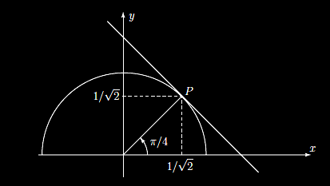
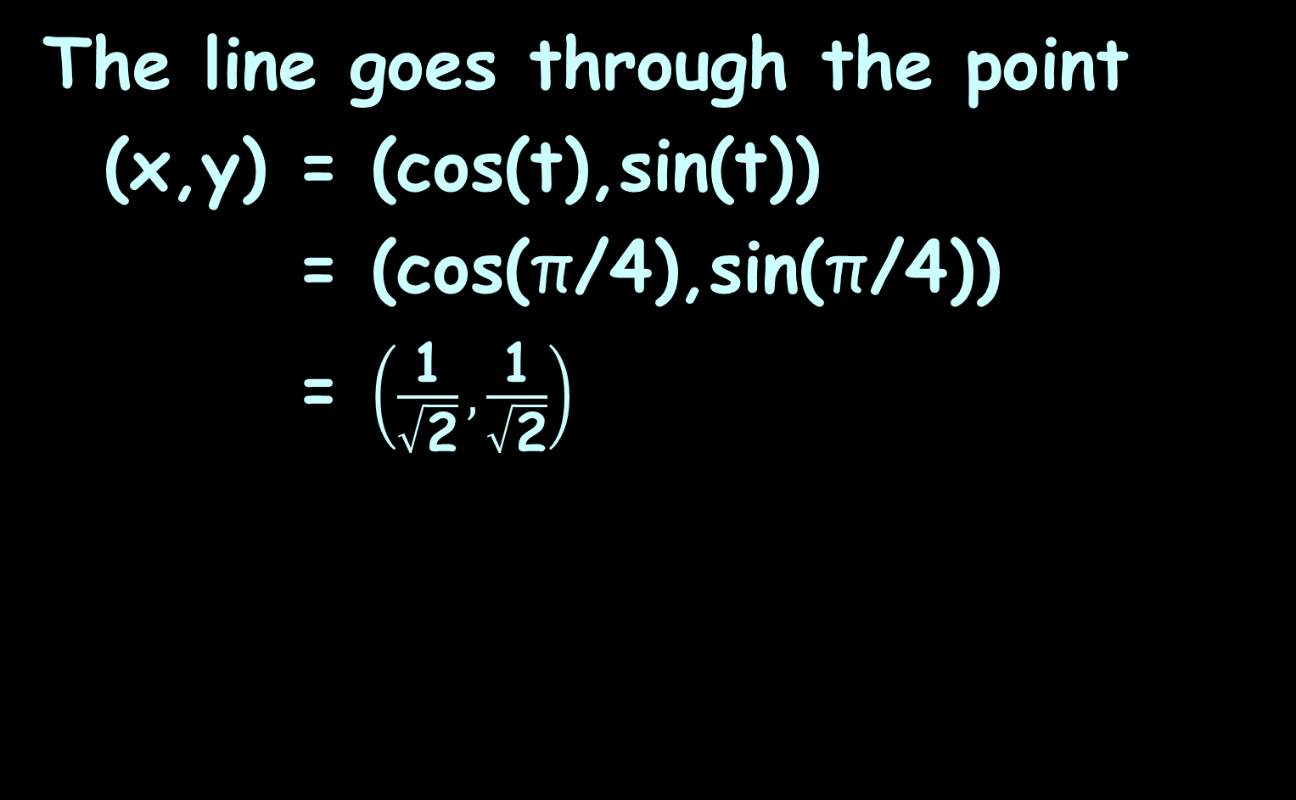
PARAMETRIC DIFFERENTIATION
IN-CLASS PROBLEM 2
The line goes through the point
(x,y) = (cos(t),sin(t))
= (cos(π/4),sin(π/4))
= $\left(\frac{\text{1}}{\sqrt{\text{2}}},\frac{\text{1}}{\sqrt{\text{2}}}\right)$
VFrench, 2015

Slide 59
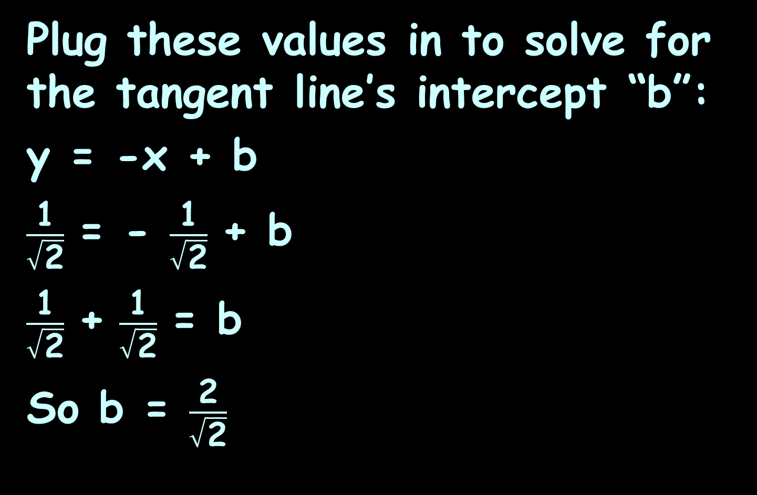
PARAMETRIC DIFFERENTIATION
IN-CLASS PROBLEM 2
Plug these values in to solve for the tangent line’s intercept “b”:
y = -x + b
$\frac{\text{1}}{\sqrt{\text{2}}}$ = - $\frac{\text{1}}{\sqrt{\text{2}}}$ + b
$\frac{\text{1}}{\sqrt{\text{2}}}$ + $\frac{\text{1}}{\sqrt{\text{2}}}$ = b
So b = $\frac{\text{2}}{\sqrt{\text{2}}}$

Slide 60

PARAMETRIC DIFFERENTIATION
IN-CLASS PROBLEM 2
And the equation of the tangent line is:
y = -x + $\frac{\text{2}}{\sqrt{\text{2}}}$

Slide 61
Questions?
http://i.imgur.com/aliTlT3.jpg

Slide 62
Parametric Equations
The most common use of parametric equations is in polar coordinates

Slide 63

Polar Coordinates
We know about square graph paper
VFrench, 2015

Slide 64
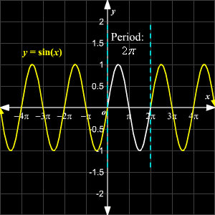
Polar Coordinates
All of the graphs we have done so far have been plotted on square graph paper
https://www.varsitytutors.com/assets/vt-hotmath-legacy/hotmath_help/topics/graphing-sine-function/sine-graph.gif

Slide 65
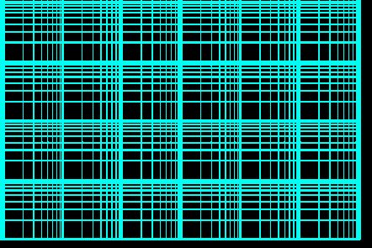
Polar Coordinates
You may have run into some exotic types of graph paper
This type (log/log) is used to graph relationships between variables that
change very
rapidly
https://cdn.eeweb.com/tools/assets/extras/log-log-graph-paper-small.png

Slide 66
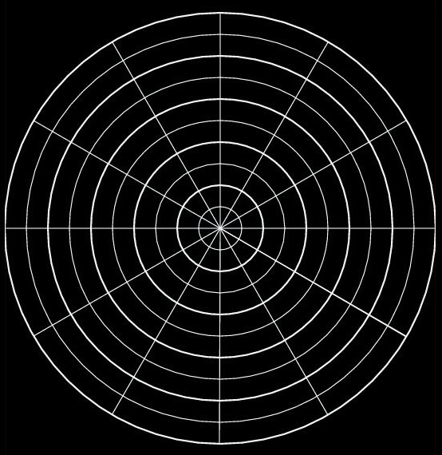
Polar Coordinates
Now we’re going to learn about circular graph paper!
VFrench, 2015

Slide 67
Polar Coordinates
In the 700s and 800s AD, Arabic astronomers developed methods for calculating the direction and distance to Mecca from any point on Earth

Slide 68
Polar Coordinates
They were using
spherical
trigonometry
to do this
Mecca
VFrench, 2015

Slide 69
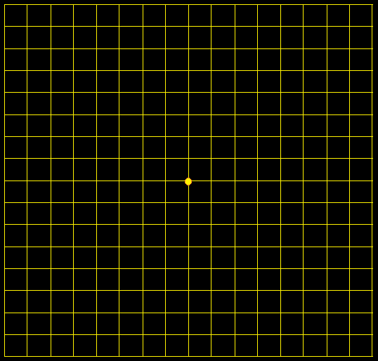
Polar Coordinates
Just like with square graph paper, polar graph paper has a starting point
VFrench, 2015

Slide 70
Polar Coordinates
For square graph paper, this point is called the origin
For polar graph paper, it is called the pole
VFrench, 2015

Slide 71
Polar Coordinates
Just like square graph paper, the starting position is the right horizontal line
VFrench, 2015

Slide 72
Polar Coordinates
This is called the “polar axis”
VFrench, 2015

Slide 73
Polar Coordinates
The rotation for both square and polar graphs is counterclockwise
II I
III IV
VFrench, 2015

Slide 74
Polar Coordinates
Just like for (x,y) coordinates, there are a pair of polar coordinates (r,θ)
These are called the “polar coordinates”

Slide 75
Polar Coordinates
point P = (r,θ)
r is the distance (radius) from the pole to P (+,- or 0)
θ is the angle from the polar axis to the terminal side of the angle (degrees or radians)

Slide 76
Polar Coordinates
r is the distance from the pole (the radius)
θ is the angle around the circle
.
.
r
θ
VFrench, 2015

Slide 77
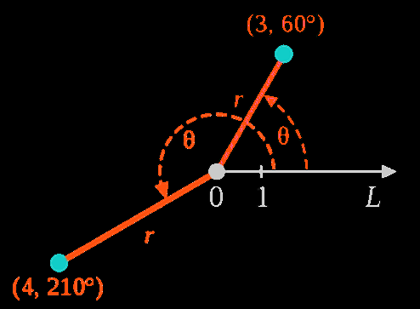
Polar Coordinates
r is the distance from the pole (the radius)
θ is the angle around the circle
VFrench, 2015

Slide 78
Polar Coordinates
point P = (r,θ)
Hint: plot the angle θ first
Then the “r”

Slide 79
POLAR COORDINATES
IN-CLASS PROBLEM 3a
Plot (2,135º)
Begin with the
angle θ=135º
105º
90º
75º
120º
60º
135º
45º
150º
30º
165º
15º
180º
0º, 360º
2
4
6
195º
345º
210º
330º
225º
315º
240º
300º
255º
270º
285º
VFrench, 2015

Slide 80
POLAR COORDINATES
IN-CLASS PROBLEM 3a
Plot (2,135º)
Begin with the
angle θ=135º
105º
90º
75º
120º
60º
135º
45º
150º
30º
165º
15º
180º
0º, 360º
2
4
6
195º
345º
210º
330º
225º
315º
240º
300º
255º
270º
285º
VFrench, 2015

Slide 81
POLAR COORDINATES
IN-CLASS PROBLEM 3a
Plot (2,135º)
Now find the point
on the line
corresponding
to the
radius “r”
105º
90º
75º
120º
60º
135º
45º
150º
30º
165º
15º
180º
0º, 360º
2
4
6
195º
345º
210º
330º
225º
315º
240º
300º
255º
270º
285º
VFrench, 2015

Slide 82
POLAR COORDINATES
IN-CLASS PROBLEM 3a
Plot (2,135º)
Because the radius
is positive, the
point will be
along this
line - it
will be
r=2 radii
from the pole
105º
90º
75º
120º
60º
135º
45º
150º
30º
(2,135º)
165º
15º
180º
0º, 360º
2
4
6
195º
345º
210º
330º
225º
315º
240º
300º
255º
270º
285º
VFrench, 2015

Slide 83
Questions?
http://i.imgur.com/aliTlT3.jpg

Slide 84
Polar Coordinates
Positive angles are measured counterclockwise from the polar axis
Negative angles are measured clockwise from the polar axis
(you can subtract them from 360º)

Slide 85
Polar Coordinates
If the angle is negative, just rotate it in a clockwise direction
VFrench, 2015

Slide 86
POLAR COORDINATES
IN-CLASS PROBLEM 3b
Plot the polar coordinates:
P = (3.5,-45º)
105º
90º
75º
120º
60º
135º
45º
150º
30º
165º
15º
180º
0º, 360º
2
4
6
195º
345º
r is the distance from the pole
Positive angles are measured counterclockwise from the polar axis
Negative angles are measured clockwise from the polar axis
210º
330º
225º
315º
240º
300º
255º
270º
285º
VFrench, 2015

Slide 87
POLAR COORDINATES
IN-CLASS PROBLEM 3b
Plot the polar coordinates:
P = (3.5,-45º)
Begin with the
angle θ=-45º
105º
90º
75º
120º
60º
135º
45º
150º
30º
165º
15º
180º
0º, 360º
2
4
6
195º
345º
r is the distance from the pole
Positive angles are measured counterclockwise from the polar axis
Negative angles are measured clockwise from the polar axis
210º
330º
225º
315º
240º
300º
255º
270º
285º
VFrench, 2015

Slide 88
POLAR COORDINATES
IN-CLASS PROBLEM 3b
Plot the polar coordinates:
P = (3.5,-45º)
Positive 45º
would be:
105º
90º
75º
120º
60º
135º
45º
150º
30º
165º
15º
180º
0º, 360º
2
4
6
195º
345º
r is the distance from the pole
Positive angles are measured counterclockwise from the polar axis
Negative angles are measured clockwise from the polar axis
210º
330º
225º
315º
240º
300º
255º
270º
285º
VFrench, 2015

Slide 89
POLAR COORDINATES
IN-CLASS PROBLEM 3b
Plot the polar coordinates:
P = (3.5,-45º)
-45º rotates
clockwise:
105º
90º
75º
120º
60º
135º
45º
150º
30º
165º
15º
180º
0º, 360º
2
4
6
195º
345º
r is the distance from the pole
Positive angles are measured counterclockwise from the polar axis
Negative angles are measured clockwise from the polar axis
210º
330º
225º
315º
240º
300º
-45º
255º
270º
285º
VFrench, 2015

Slide 90
POLAR COORDINATES
IN-CLASS PROBLEM 3b
Plot the polar coordinates:
P = (3.5,-45º)
You can
calculate
it using
360 + θ:
360+(-45)
= 315º
105º
90º
75º
120º
60º
135º
45º
150º
30º
165º
15º
180º
0º, 360º
2
4
6
195º
345º
210º
330º
225º
315º
240º
300º
-45º
255º
270º
285º
VFrench, 2015

Slide 91
POLAR COORDINATES
IN-CLASS PROBLEM 3b
Plot the polar coordinates:
P = (3.5,-45º)
Now find the
point on the
line
corresponding
to the
radius “r”
105º
90º
75º
120º
60º
135º
45º
150º
30º
165º
15º
0º, 360º
2
4
6
195º
345º
210º
330º
225º
315º
240º
300º
-45º
255º
270º
285º
VFrench, 2015

Slide 92
POLAR COORDINATES
IN-CLASS PROBLEM 3b
Plot the polar coordinates:
P = (3.5,-45º)
Tah-dah!
105º
90º
75º
120º
60º
135º
45º
150º
30º
165º
15º
180º
0º, 360º
2
4
6
195º
345º
210º
330º
225º
315º
240º
300º
255º
270º
285º
VFrench, 2015

Slide 93
Questions?
http://i.imgur.com/aliTlT3.jpg

Slide 94
Polar Coordinates
P = (r,θ ) is located | r | units from the pole

Slide 95
Polar Coordinates
If the radius “r” is negative, it’s a little more complicated
VFrench, 2015

Slide 96
Polar Coordinates
Remember, when you “negativize” a number, it’s graph mirrors across 0
-3
0
3
VFrench, 2015

Slide 97
Polar Coordinates
In an ordered pair, the “negativized” number mirrors across it’s 0
(-3,1)
1
(3,1)
0
-3
0
3
VFrench, 2015

Slide 98
Polar Coordinates
In an ordered pair, the “negativized” number mirrors across it’s 0
1
(3,1)
0
-3
0
3
-1
(3,-1)
VFrench, 2015

Slide 99
Polar Coordinates
In an ordered pair, the “negativized” numbers mirror across both 0s
1
(3,1)
0
-3
0
3
(-3,-1)
-1
VFrench, 2015

Slide 100
Polar Coordinates
r > 0 – the point lies on the terminal side of θ
r < 0 - point lies along the ray opposite the terminal side of θ
r = 0 the point lies on the pole no matter what the value of θ is!

Slide 101

Polar Coordinates
As usual, it’s
easier to DO it than to explain
it!
http://ahungryrunner.files.wordpress.com/2013/07/confused-baby.png

Slide 102
POLAR COORDINATES
IN-CLASS PROBLEM 3c
Plot (-4,270º)
Plot the angle
105º
90º
75º
120º
60º
135º
45º
150º
30º
165º
15º
180º
0º, 360º
2
4
6
195º
345º
210º
330º
225º
315º
240º
300º
255º
270º
285º
VFrench, 2015

Slide 103
POLAR COORDINATES
IN-CLASS PROBLEM 3c
Plot (-4,270º)
Next mirror
the angle
105º
90º
75º
120º
60º
135º
45º
150º
30º
165º
15º
180º
0º, 360º
2
4
6
195º
345º
210º
330º
225º
315º
240º
300º
255º
270º
285º
VFrench, 2015

Slide 104
POLAR COORDINATES
IN-CLASS PROBLEM 3c
Plot (-4,270º)
Now plot the
(positiv-ized)
point value
on the
mirrored
line
105º
90º
75º
120º
60º
135º
45º
150º
30º
165º
15º
180º
0º, 360º
2
4
6
195º
345º
210º
330º
225º
315º
240º
300º
255º
270º
285º
VFrench, 2015

Slide 105
POLAR COORDINATES
IN-CLASS PROBLEM 3c
Plot (-4,270º)
(-4,270º)
105º
90º
75º
120º
60º
135º
45º
150º
30º
165º
15º
180º
0º, 360º
2
4
6
195º
345º
210º
330º
225º
315º
240º
300º
255º
270º
285º
VFrench, 2015

Slide 106
POLAR COORDINATES
IN-CLASS PROBLEM 3d
Plot (-5,-45º)
105º
90º
75º
120º
60º
135º
45º
150º
30º
165º
15º
180º
0º, 360º
1
2
3
195º
345º
210º
330º
225º
315º
240º
300º
255º
270º
285º
VFrench, 2015

Slide 107
POLAR COORDINATES
IN-CLASS PROBLEM 3d
Plot (-5,-45º)
Did you get
it right?
105º
90º
75º
120º
60º
135º
45º
150º
30º
165º
15º
180º
0º, 360º
2
4
6
195º
345º
210º
330º
225º
315º
240º
300º
255º
270º
285º
VFrench, 2015

Slide 108
Questions?
http://i.imgur.com/aliTlT3.jpg

Slide 109
Polar Coordinates
Angles in polar notation can be expressed in either degrees or radians
105º
90º
75º
7π/12
π/2
5π/12
120º
60º
2π/3
π/3
135º
45º
3π/4
π/4
150º
30º
5π/6
π/6
165º
15º
11π/12
π/12
180º
1
2
3
0º, 360º
π
1
2
3
0, 2π
195º
345º
13π/12
23π/12
210º
330º
7π/6
11π/6
225º
315º
5π/4
7π/4
240º
300º
4π/3
5π/3
255º
270º
285º
17π/12
3π/2
19π/12
VFrench, 2015

Slide 110
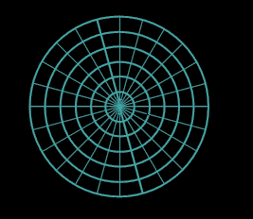
Polar Coordinates
So polar graph paper can use either degrees or (everybody’s favorite):
radians!
π/2
3π/4
π/4
π
1
2
3
4
5
6
0, 2π
5π/4
7π/4
3π/2
VFrench, 2021

Slide 111
Polar Coordinates
Degrees are traditionally used in navigation, surveying, and many applied disciplines
Radians are more common in mathematics, physics and engineering

Slide 112
POLAR COORDINATES
IN-CLASS PROBLEM 3e
Plot the polar coordinates:
P = (2.5,5π/4)
π/2
3π/4
π/4
π
1
2
3
4
5
6
0, 2π
5π/4
7π/4
3π/2
VFrench, 2021

Slide 113
POLAR COORDINATES
IN-CLASS PROBLEM 3e
Plot the polar coordinates:
P = (2.5,5π/4)
Did you get it right?
π/2
3π/4
π/4
π
1
2
3
4
5
6
0, 2π
5π/4
7π/4
3π/2
VFrench, 2021

Slide 114
POLAR COORDINATES
IN-CLASS PROBLEM 3f
Plot the polar coordinates:
P = (-4,-π/4)
π/2
3π/4
π/4
π
1
2
3
4
5
6
0, 2π
5π/4
7π/4
3π/2
VFrench, 2021

Slide 115
POLAR COORDINATES
IN-CLASS PROBLEM 3f
Plot the polar coordinates:
P = (-4,-π/4)
π/2
3π/4
π/4
π
1
2
3
4
5
6
0, 2π
(+4,-π/4)
5π/4
7π/4
3π/2
VFrench, 2021

Slide 116
POLAR COORDINATES
IN-CLASS PROBLEM 3f
Plot the polar coordinates:
P = (-4,-π/4)
Did you get it right?
π/2
3π/4
π/4
(-4,-π/4)
π
1
2
3
4
5
6
0, 2π
5π/4
7π/4
3π/2
VFrench, 2021

Slide 117
Questions?
http://i.imgur.com/aliTlT3.jpg

Slide 118
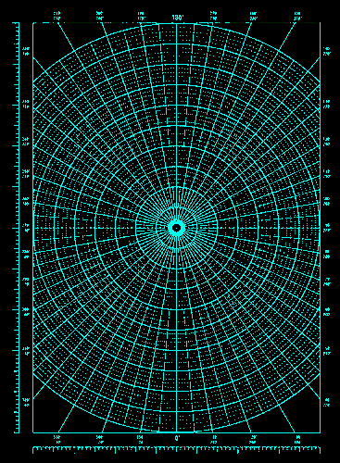
Polar Coordinates
In the West, polar graphs were originally created to plot complex numbers
That way,
no one could
confuse a
real number
graph with
a complex
one
3+4i
https://as1.ftcdn.net/v2/jpg/01/60/91/68/500_F_160916843_COfIenCS2NSkxfS8rqbLs20gmNEJzxv2.jpg

Slide 119
Polar Coordinates
Well, somebody figured out right away you could plop rectangular graph paper
right on top
and make it
an (x,y)
graph!
3+4i
https://as1.ftcdn.net/v2/jpg/01/60/91/68/500_F_160916843_COfIenCS2NSkxfS8rqbLs20gmNEJzxv2.jpg

Slide 120
Polar Coordinates
3 + 4i can be graphed:
i
4
3
2
1
0
ℝ
-4
-3
-2
-1
0
1
2
3
4
-1
-2
-3
-4

Slide 121
Polar Coordinates
In electrical engineering, this way of graphing complex numbers is called an Argand Diagram
https://www.electronics-tutorials.ws/accircuits/complex-numbers.html

Slide 122
Polar Coordinates
But, it’s not the same as a true polar graph!
How would you graph 30º or 2π?

Slide 123
Polar Coordinates
So then they needed a way to convert from polar to rectangular in a mathematically accurate way (not just by plopping rectangular graph paper over polar graphs!)

Slide 124
Polar Coordinates
Polar to rectangular conversion
If you have a polar point
P = (r,θ)
To convert to (x,y) coordinates:
x = r cos θ
y = r sin θ

Slide 125
POLAR COORDINATES
IN-CLASS PROBLEM 4a
Find the rectangular coordinates:
P = (-8,π/6)
x =
y =
x = r cos θ
y = r sin θ

Slide 126
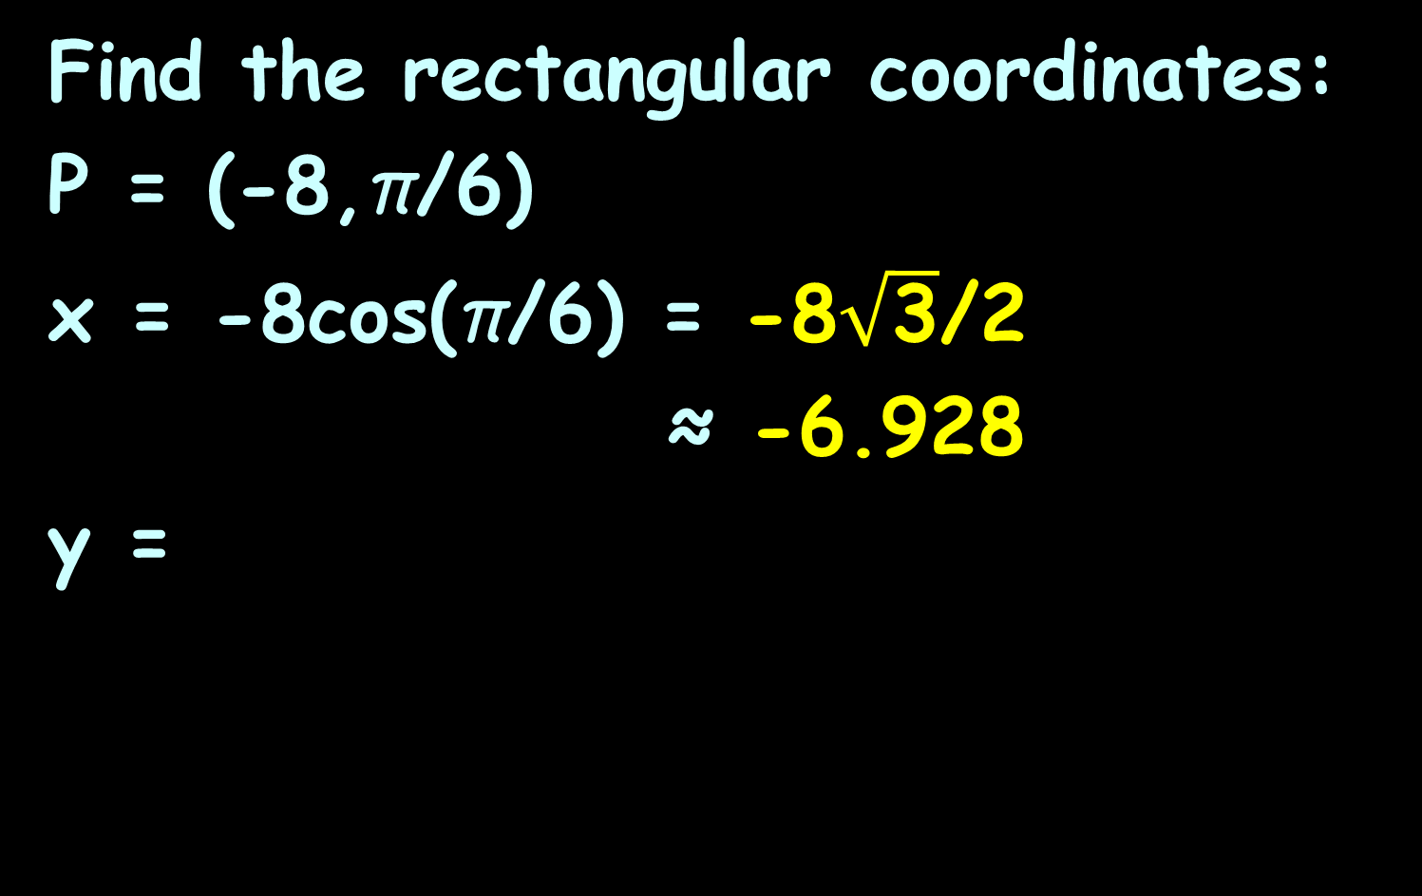
POLAR COORDINATES
IN-CLASS PROBLEM 4a
Find the rectangular coordinates:
P = (-8,π/6)
x = -8cos(π/6) = -8$\sqrt{\text{3}}$/2
≈ -6.928
y =
x = r cos θ
y = r sin θ

Slide 127
POLAR COORDINATES
IN-CLASS PROBLEM 4a
Find the rectangular coordinates:
P = (-8,π/6)
x ≈ -6.928
y = -8sin(π/6) = -4
What quadrant is it in?
II
I
III
IV
x = r cos θ
y = r sin θ

Slide 128
POLAR COORDINATES
IN-CLASS PROBLEM 4a
Find the rectangular coordinates:
P = (-8,π/6)
x ≈ -6.928
y = -4
What quadrant is it in? III
II
I
III
IV
x = r cos θ
y = r sin θ

Slide 129
Polar to Rectangular
Is P = (-8,π/6) in polar coordinates the same as
(x,y) = (-6.928,-4) in rectangular?

Slide 130
Polar to Rectangular
?
P = (-8,π/6) = (x,y) = (-6.928,-4)
(pretty close – just rounding error) and both are in QIII
7π/12
π/2
5π/12
2π/3
π/3
3π/4
π/4
6
5π/6
π/6
4
11π/12
π/12
2
π
0, 2π
0
2
4
6
-6
-4
-2
2
4
6
13π/12
23π/12
-2
7π/6
11π/6
-4
5π/4
7π/4
-6
4π/3
5π/3
17π/12
19π/12
VFrench, 2015
3π/2

Slide 131
POLAR COORDINATES
IN-CLASS PROBLEM 4b
Find the rectangular coordinates:
P = (3,π)
x =
y =
x = r cos θ
y = r sin θ

Slide 132
POLAR COORDINATES
IN-CLASS PROBLEM 4b
Find the rectangular coordinates:
P = (3,π)
x = 3cos(π) = -3
y =
x = r cos θ
y = r sin θ

Slide 133
POLAR COORDINATES
IN-CLASS PROBLEM 4b
Find the rectangular coordinates:
P = (3,π)
x = 3cos(π) = -3
y = 3sin(π) = 0
What quadrant is it in?
x = r cos θ
y = r sin θ

Slide 134
POLAR COORDINATES
IN-CLASS PROBLEM 4b
Find the rectangular coordinates:
P = (3,π)
x = 3cos(π) = -3
y = 3sin(π) = 0
What quadrant is it in?
“interquadrantal”
x = r cos θ
y = r sin θ

Slide 135
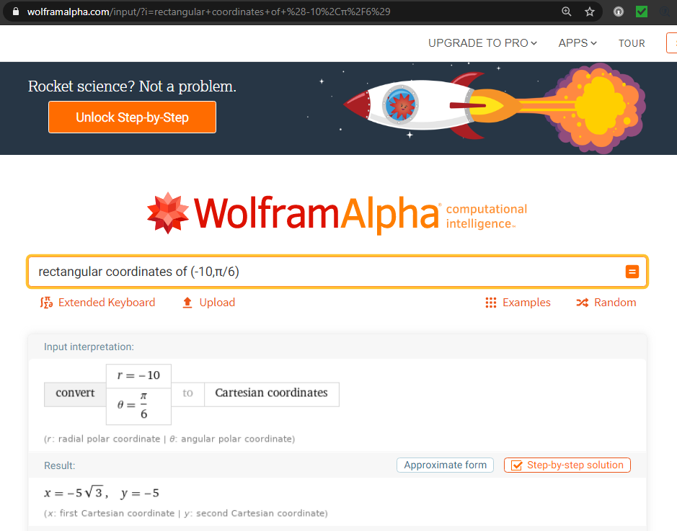

Slide 136
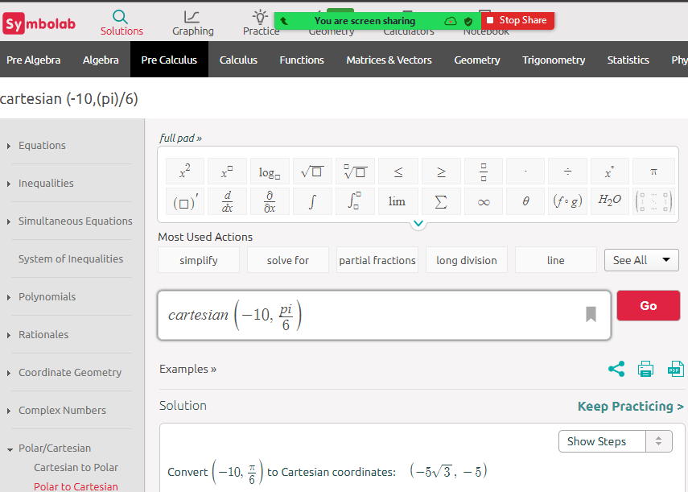

Slide 137
Questions?
http://i.imgur.com/aliTlT3.jpg

Slide 138
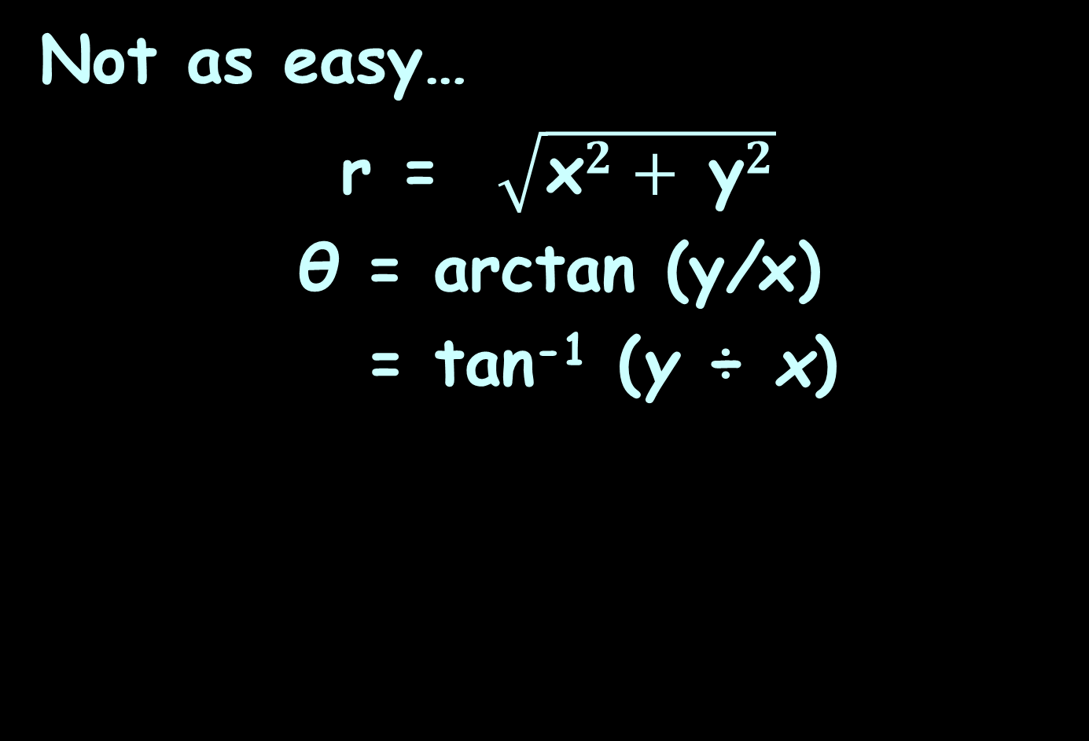
Rectangular to Polar
Not as easy…
r = $\sqrt{{\text{x}}^{2}+ {\text{y}}^{2}}$
θ = arctan (y/x)
= tan⁻¹ (y ÷ x)

Slide 139
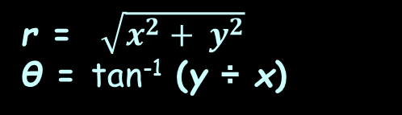
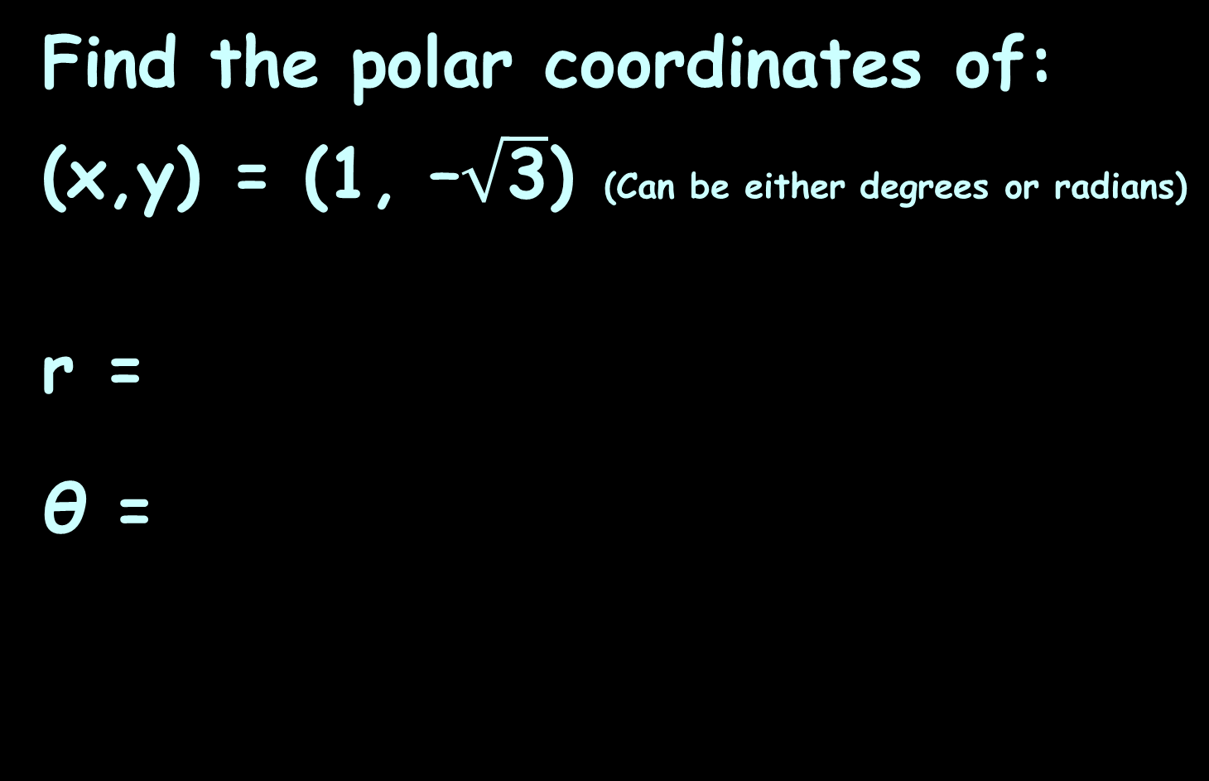
POLAR COORDINATES
IN-CLASS PROBLEM 5a
Find the polar coordinates of:
(x,y) = (1, –$\sqrt{\text{3}}$) (Can be either degrees or radians)
r =
θ =
r = $\sqrt{x^{2}+ y^{2}}$
θ = tan⁻¹ (y ÷ x)

Slide 140
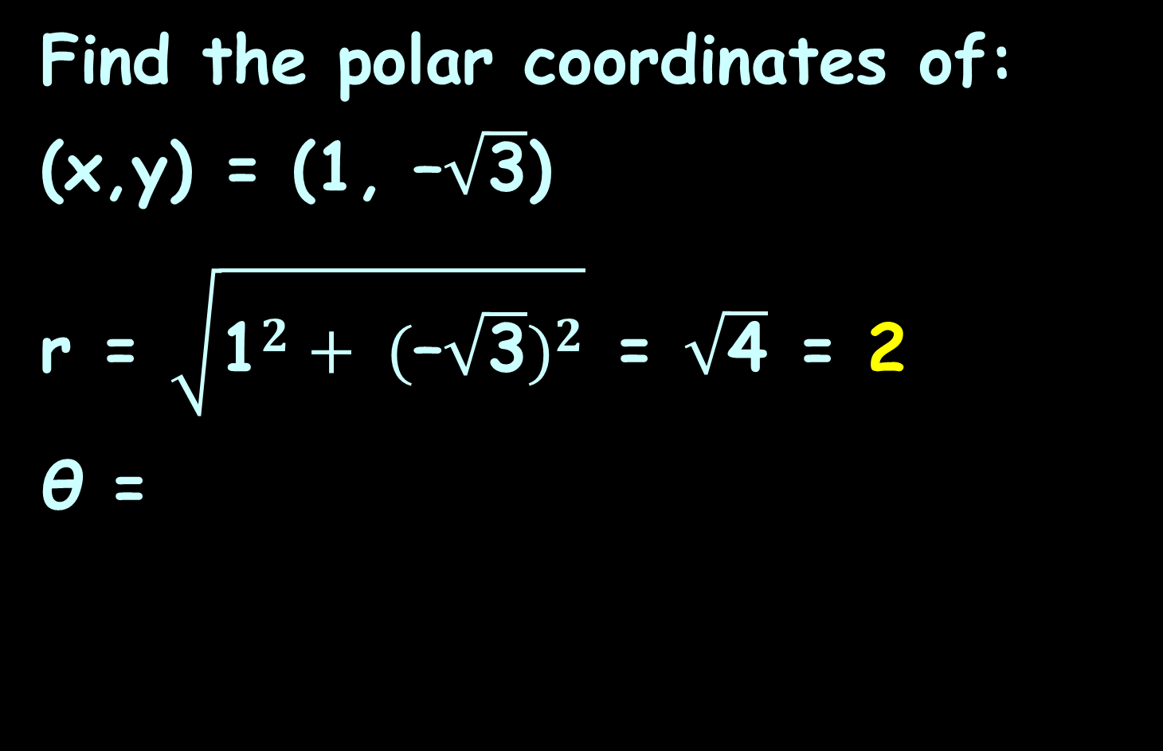
POLAR COORDINATES
IN-CLASS PROBLEM 5a
Find the polar coordinates of:
(x,y) = (1, –$\sqrt{\text{3}}$)
r = $\sqrt{{\text{1}}^{2}+ {(\text{–}\sqrt{\text{3}})}^{2}}$ = $\sqrt{\text{4}}$ = 2
θ =
r = $\sqrt{x^{2}+ y^{2}}$
θ = tan⁻¹ (y ÷ x)

Slide 141
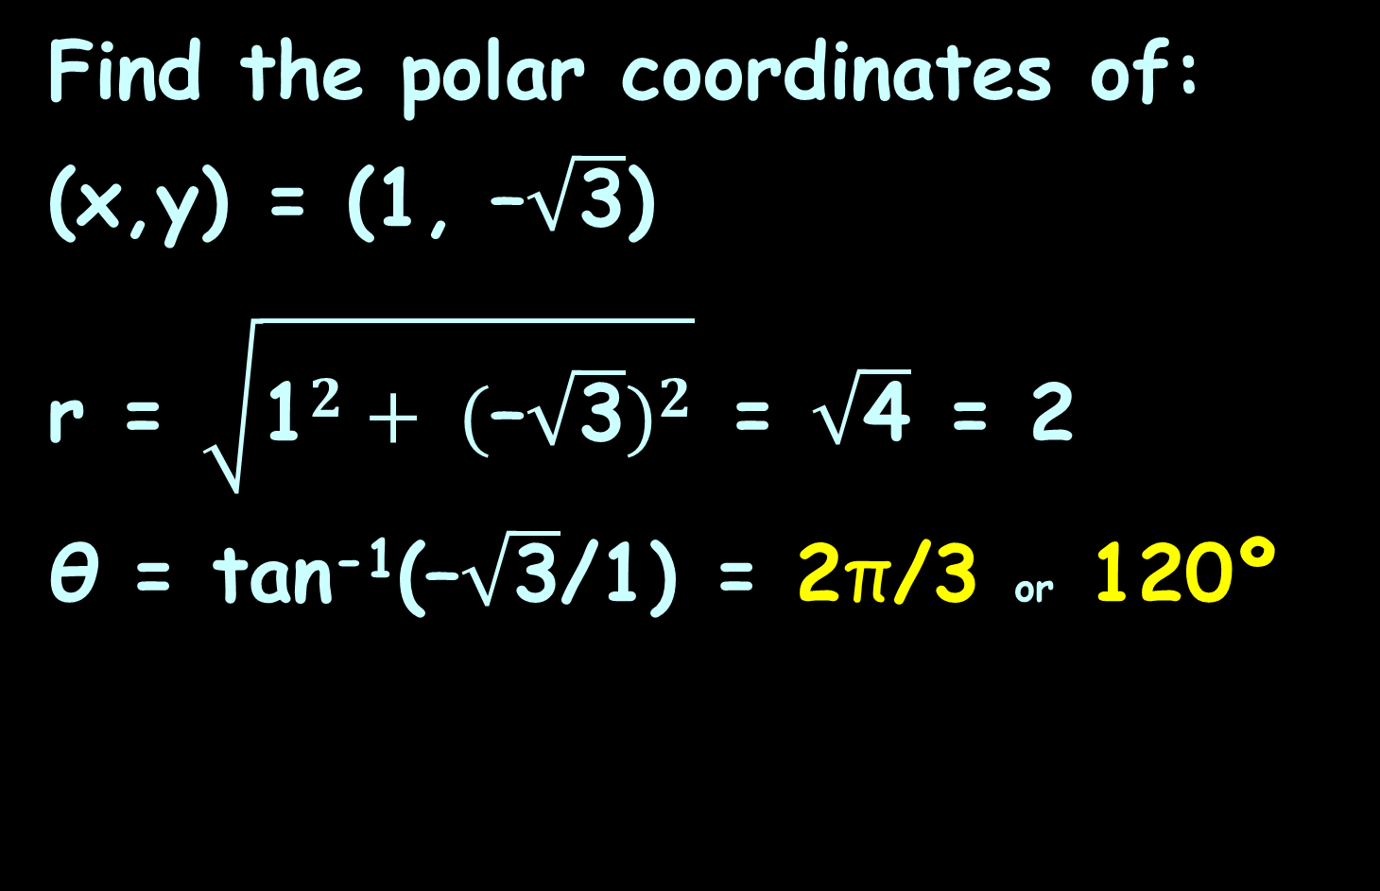
POLAR COORDINATES
IN-CLASS PROBLEM 5a
Find the polar coordinates of:
(x,y) = (1, –$\sqrt{\text{3}}$)
r = $\sqrt{{\text{1}}^{2}+ {(\text{–}\sqrt{\text{3}})}^{2}}$ = $\sqrt{\text{4}}$ = 2
θ = tan⁻¹($\text{–}\sqrt{\text{3}}$/1) = 2π/3 or 120º
r = $\sqrt{x^{2}+ y^{2}}$
θ = tan⁻¹ (y ÷ x)

Slide 142

Polar Coordinates
(2,–$\text{π}\text{/3}$) (1, –$\sqrt{\text{3}}$)
7π/12
π/2
5π/12
2π/3
π/3
4
3π/4
π/4
3
5π/6
π/6
2
11π/12
π/12
1
π
0, 2π
1
2
3
0
13π/12
23π/12
-4
-3
-2
-1
0
1
2
3
4
-1
7π/6
11π/6
-2
5π/4
7π/4
4π/3
5π/3
-3
17π/12
19π/12
3π/2
-4
VFrench, 2015

Slide 143
Polar Coordinates
You have to be VERY careful with these conversions to get the right quadrant!
(You see why we’ve been emphasizing quadrants?)

Slide 144
POLAR COORDINATES
IN-CLASS PROBLEM 5b
Find the polar coordinates of:
(x,y) = (0, – 4)
r =
θ =
r = $\sqrt{x^{2}+ y^{2}}$
θ = tan⁻¹ (y ÷ x)

Slide 145
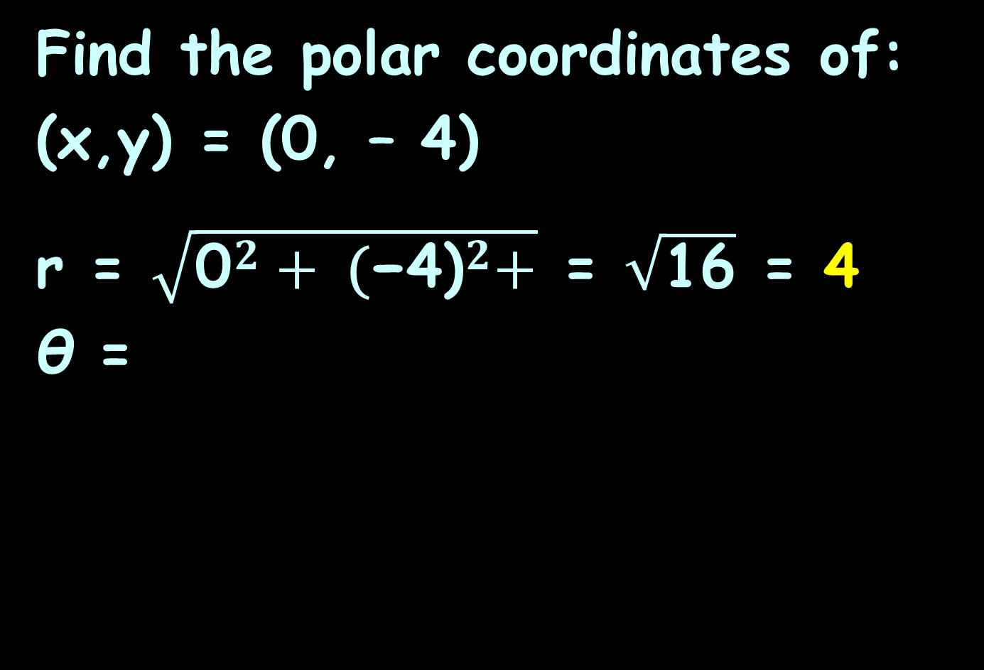
POLAR COORDINATES
IN-CLASS PROBLEM 5b
Find the polar coordinates of:
(x,y) = (0, – 4)
r = $\sqrt{{\text{0}}^{2}+ {\text{(}\text{−4)}}^{2}+}$ = $\sqrt{\text{16}}$ = 4
θ =
r = $\sqrt{x^{2}+ y^{2}}$
θ = tan⁻¹ (y ÷ x)

Slide 146
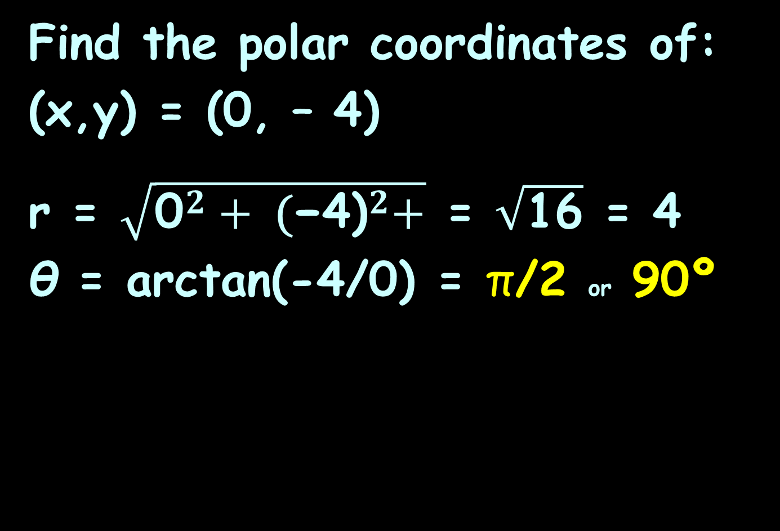
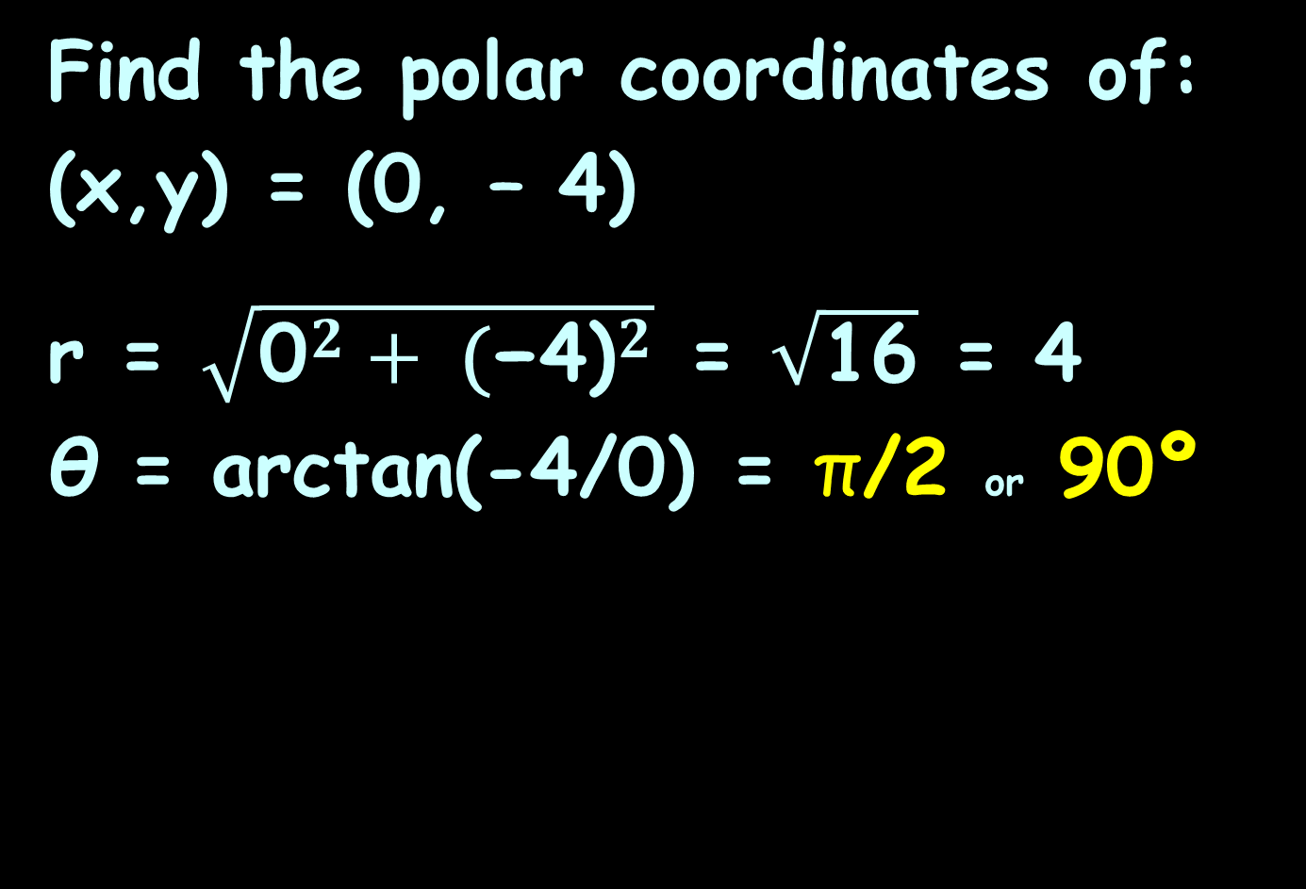
POLAR COORDINATES
IN-CLASS PROBLEM 5b
Find the polar coordinates of:
(x,y) = (0, – 4)
r = $\sqrt{{\text{0}}^{2}+ {\text{(}\text{−4)}}^{2}}$ = $\sqrt{\text{16}}$ = 4
θ = arctan(-4/0) = π/2 or 90º
r = $\sqrt{x^{2}+ y^{2}}$
θ = tan⁻¹ (y ÷ x)

Slide 147
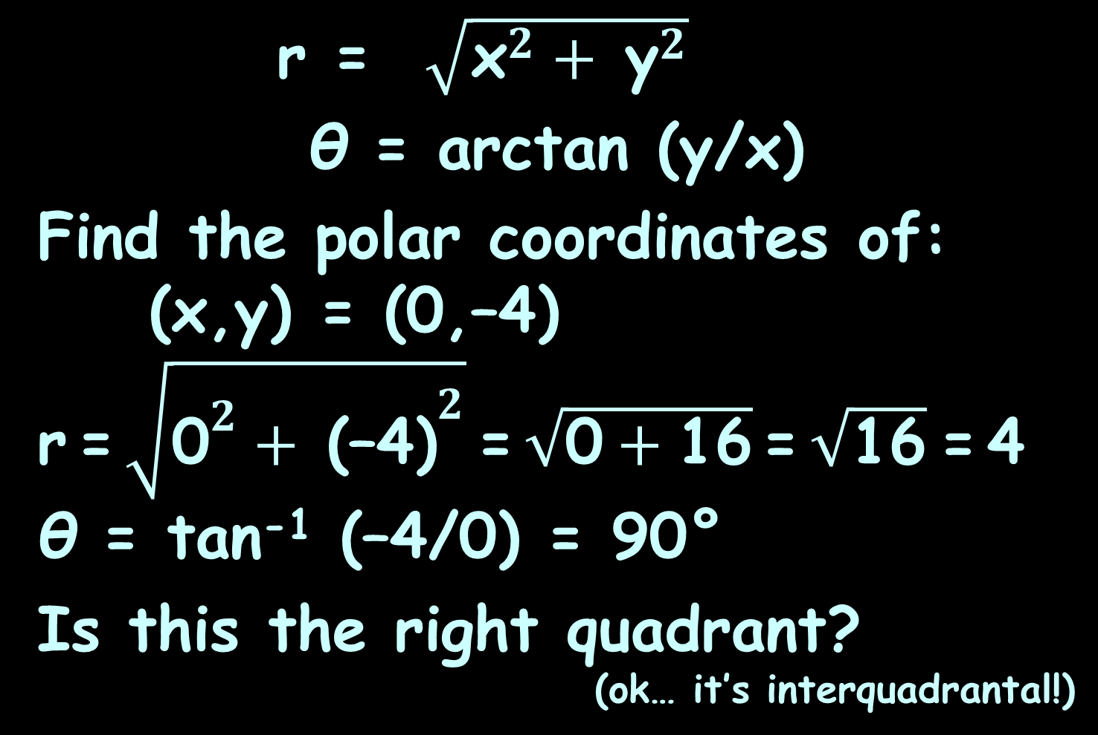
POLAR COORDINATES
IN-CLASS PROBLEM 5b
r = $\sqrt{{\text{x}}^{2}+ {\text{y}}^{2}}$
θ = arctan (y/x)
Find the polar coordinates of: (x,y) = (0,–4)
r = $\sqrt{{\text{0}}^{2}+ {\text{(–4)}}^{2}}$ = $\sqrt{\text{0}+\text{16}}$ = $\sqrt{\text{16}}$ = 4
θ = tan⁻¹ (–4/0) = 90°
Is this the right quadrant?
(ok… it’s interquadrantal!)

Slide 148
Polar Coordinates
(x,y) = (0,–4)
105º
90º
75º
4
120º
60º
3
135º
45º
2
150º
30º
165º
15º
1
0
180º
0º, 360º
-4
-3
-2
-1
0
1
2
3
4
2
4
-1
195º
345º
-2
210º
330º
-3
225º
315º
240º
300º
-4
255º
270º
285º
VFrench, 2015

Slide 149
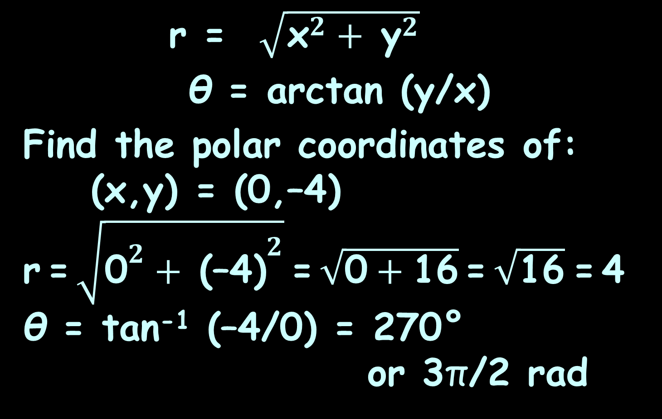
POLAR COORDINATES
IN-CLASS PROBLEM 5b
r = $\sqrt{{\text{x}}^{2}+ {\text{y}}^{2}}$
θ = arctan (y/x)
Find the polar coordinates of: (x,y) = (0,–4)
r = $\sqrt{{\text{0}}^{2}+ {\text{(–4)}}^{2}}$ = $\sqrt{\text{0}+\text{16}}$ = $\sqrt{\text{16}}$ = 4
θ = tan⁻¹ (–4/0) = 270°
or 3π/2 rad

Slide 150
Polar Coordinates
The TI84 doesn’t work on this problem, but the TI89 does!

Slide 151
Questions?
http://i.imgur.com/aliTlT3.jpg

Slide 152
Polar Equations
Polar equations
have variables r and θ

Slide 153
Polar Equations
Converting rectangular equations to polar equations:
replace
x with r cosθ and
y with r sinθ

Slide 154
Polar Equations
This is, of course, an example of parametric equations

Slide 155
Polar Equations
x = cos t
y = sin t
Together, these equations are called a parametric representation of the curve

Slide 156
Polar Equations
Converting polar equations to rectangular equations is not easy –
you may have to square both sides,
take the tangent of both sides,
multiply both sides by r

Slide 157
Polar Equations
Try:
r ² = x² + y²
r cosθ = x
r sinθ = y
tanθ = y/x

Slide 158
Polar Equations
People actually use polar equations for real work…
But mostly you graph them because they change a ho-hum rectangular graph to a really interesting polar graph

Slide 159
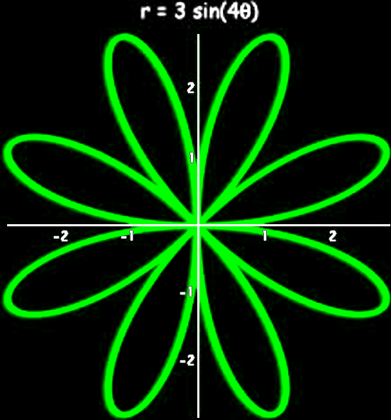
Polar Equations
14590966_346732725686454_3523543190558736384_n.jpg

Slide 160
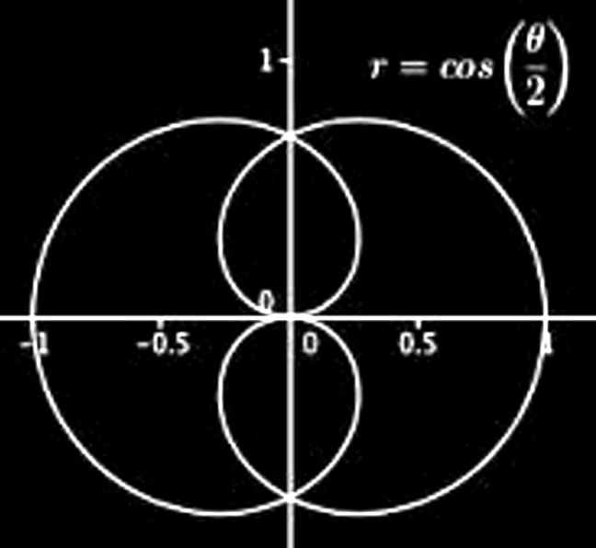
Polar Equations
14590966_346732725686454_3523543190558736384_q.jpg

Slide 161
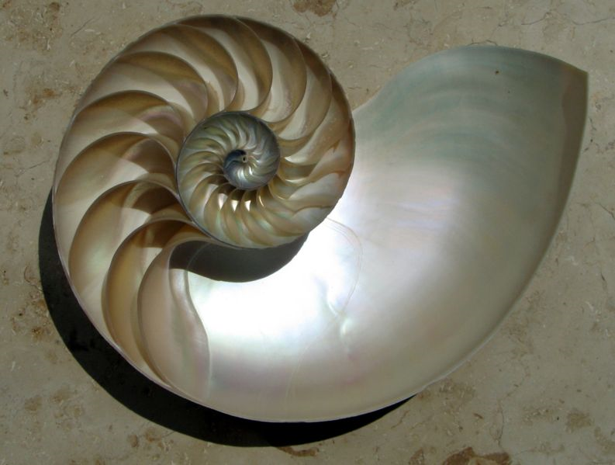
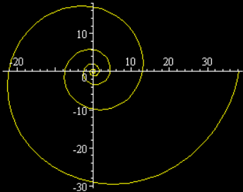
Polar Equations
Spiral of Archimedes
r = aθ
http://www.ceramicforms.com/wp-content/uploads/Nautilus_Cutaway_Logarithmic_Spiral.jpg

Slide 162
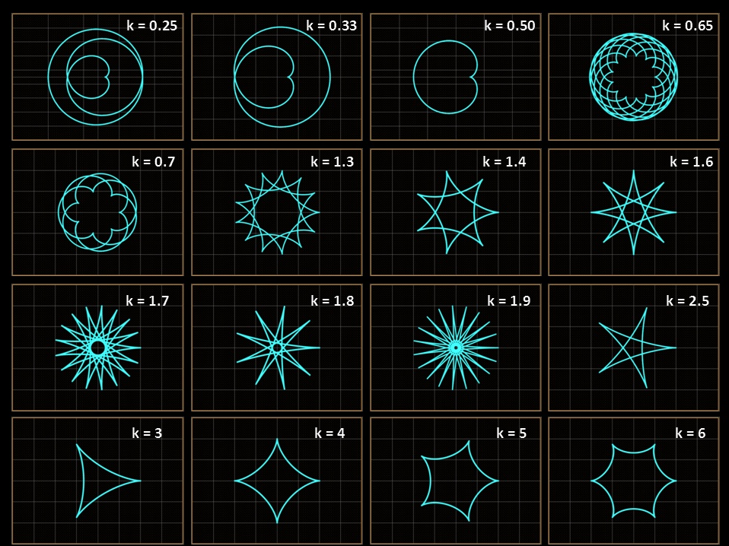
http://en.wikipedia.org/wiki/Parametric_equation#mediaviewer/File:Param_02.jpg

Slide 163
Polar Equations
https://telegrafi.com/wp-content/uploads/2016/01/dashuria-euml-sht-euml-matematik-euml-partneri-i-pest-euml-euml-sht-euml-ideali_hd.jpg

Slide 164
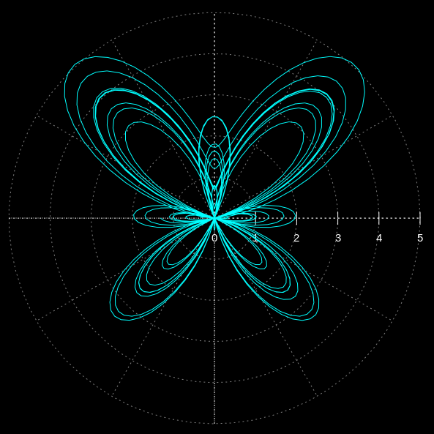
Polar Equations
http://en.wikipedia.org/wiki/Parametric_equation#mediaviewer/File:Butterfly_trans01.svg

Slide 165
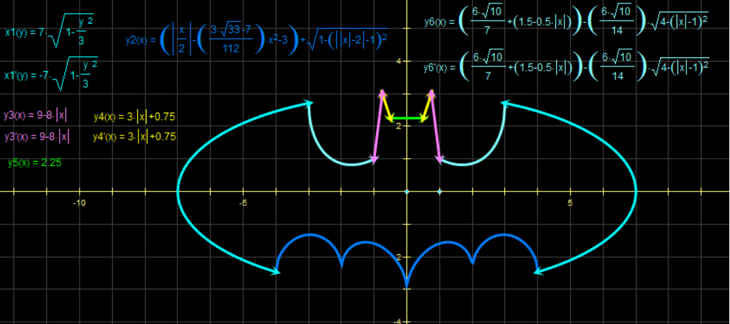
Polar Equations
http://4.bp.blogspot.com/-969pickI75I/Ud3W-cMdoRI/AAAAAAAACIo/H_umPfzRMeI/s1600/
1006005_681476468534370_67717180_n.png

Slide 166
Polar Coordinates
For the graphs, you can use:
https://www.geogebra.org/m/jhKUc6Hm

Slide 167
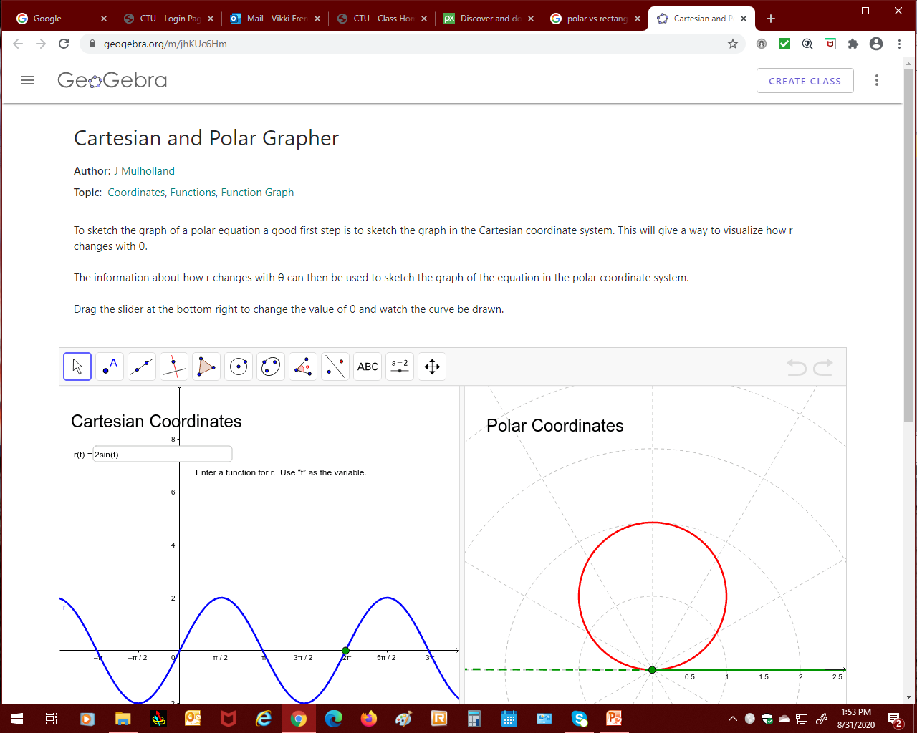
Graphing Polar Equations
https://www.geogebra.org

Slide 168
Questions?
http://i.imgur.com/aliTlT3.jpg

Slide 169
Summary
Today we studied:
Review of integral transforms
Polar Coordinates

Slide 170

You Survived!

