Slide 1
Welcome to
Unit 8
Part 16!
MATH 207 Integral Calculus
http://en.wikipedia.org/wiki/Differential_equation#mediaviewer/File:Elmer-pump-heatequation.png

Slide 2
What’s Up?
Review:
Taylor and Fourier Series
New stuff:
Transforms!

Slide 3
What’s Up?
Outcome 1) Demonstrate a high level of proficiency in differentiation and integration for linear, polynomial, rational, trigonometric, inverse trigonometric, exponential and logarithmic function, including using the method of substitution, integration by parts and partial fraction decomposition
Outcome 7) Solve problems by identifying the requirements, making a sketch as appropriate

Slide 4

Review
http://995642590.r.lightningbase-cdn.com/wp-content/uploads/2010/12/looking-back-hrexaminer-v144-cover425px.jpg

Slide 5
Taylor Series
Remember when we used a geometric series to estimate 1/(1-x)?
It worked when x was less than 1
It didn’t work for larger values of x

Slide 6
Taylor Series
In general,
When x is large, many terms are needed to give an accurate
approximation for ƒ(x)
When x is less than 1, only a few terms are needed

Slide 7
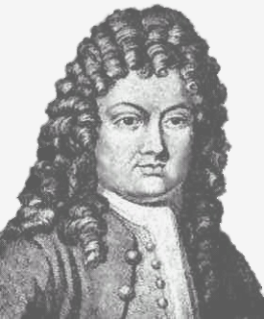
Taylor Series
The Taylor Series was invented to develop estimation series for large values of x
Brook Taylor
https://upload.wikimedia.org/wikipedia/commons/thumb/2/25/BTaylor.jpg/220px-BTaylor.jpg

Slide 8
Taylor Series
A Taylor series is writing a function as an infinite sum of the function's derivatives at a single point

Slide 9
Taylor Series
With an offset of “b”, the Taylor series is:
ƒ(x) = ƒ(a) + ƒ '(a)(x-b) +
ƒ ''(a)(x-b)²/2 +
ƒ '''(a)(x-b)³/3! +
ƒ ''''(a)(x-b)⁴/4! + …

Slide 10
Taylor Series
This can also be written:
ƒ^{(n)} (a)
n!
Where ƒ^{(n)} means the nth derivative of ƒ evaluated at point “a”
∞
∑ (x-b)^{n}
k=0

Slide 11
Taylor Series
Any finite number of initial terms of the Taylor series of a function is called a Taylor polynomial

Slide 12
Taylor Series
If a Taylor series is centered at zero, then that series is a Maclaurin series

Slide 13
Taylor Series
Rule of thumb:
If a series is needed for a function whose x values will always be less than 1, use Maclaurin

Slide 14
Taylor Series
Rule of thumb:
For functions whose x values are larger than one, use Taylor

Slide 15
Taylor Series
Rule of thumb:
For quick convergence in Taylor, use a “b” value close to the common x values

Slide 16
Taylor Series
Taylor seems to be more common in electronics than Maclaurin

Slide 17
Fourier Series
The sine wave is a continuous periodic wave

Slide 18
Fourier Series
The sine wave is a continuous periodic wave
Not all waves are continuous

Slide 19
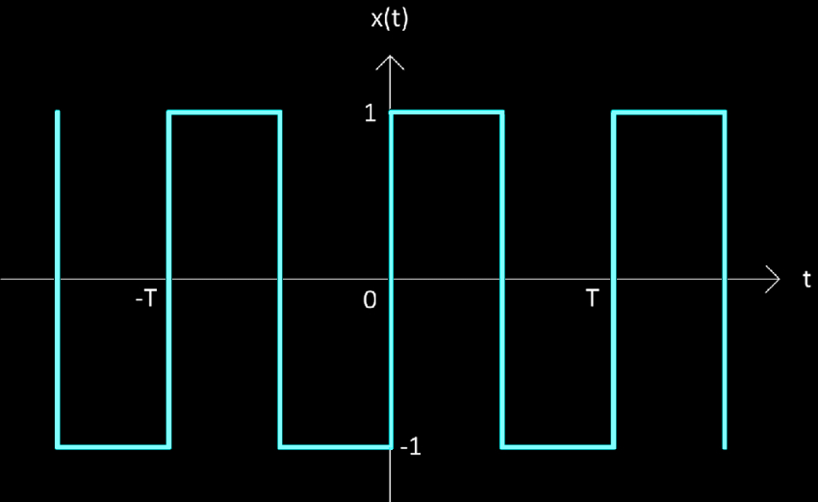
Fourier Series
The square wave is not continuous over a complete cycle T
V_{m}
-V_{m}
https://www.researchgate.net/publication/312928999/figure/fig1/AS:669069531430915@1536530015313/Square-wave-with-fifty-percent-duty-cycle-and-zero-volt-DC-offset.png

Slide 20
Fourier Series
There is no simple equation to describe it
V_{m}
-V_{m}
https://www.researchgate.net/publication/312928999/figure/fig1/AS:669069531430915@1536530015313/Square-wave-with-fifty-percent-duty-cycle-and-zero-volt-DC-offset.png

Slide 21
Fourier Series
Mathematical convention describes it piece-by-piece
v(t) =
V_{m} 0<t<T/2
-V_{m} T/2<t<T
period T
V_{m}
-V_{m}
https://www.researchgate.net/publication/312928999/figure/fig1/AS:669069531430915@1536530015313/Square-wave-with-fifty-percent-duty-cycle-and-zero-volt-DC-offset.png

Slide 22
Fourier Series
These functions can be integrated only piece-by-piece

Slide 23
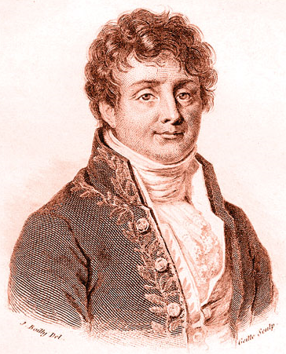
Fourier Series
Jean-Baptiste Joseph Fourier (1768-1830) discovered any periodic equation could be
written as an infinite
series of sine and
cosine terms
called a Fourier
Series
https://en.wikipedia.org/wiki/Joseph_Fourier#/media/File:Fourier2.jpg

Slide 24
Fourier Series
As you add sine/cosine waves of increasingly higher frequency, the approximation gets better and better
The addition of higher frequencies better approximates the details, (i.e., the change in slope) in the original function

Slide 25
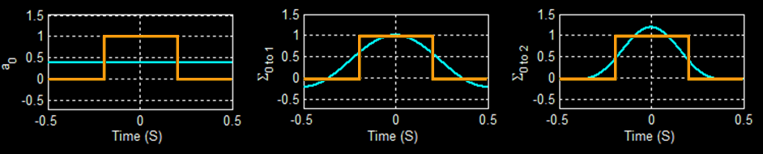
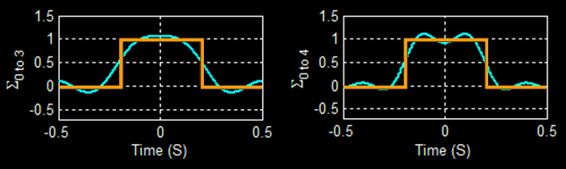
Fourier Series
Sum of a_{n}cos(n×ω₀,t) n= 0 to 4
https://lpsa.swarthmore.edu/Fourier/Series/WhyFS.html

Slide 26
Fourier Series
Today we use Fourier series to describe the many periodic waveforms of voltage and current that appear in the field of electronics

Slide 27
Fourier Series
Trigonometric:
Exponential:
∞
x(t) = a₀ + ∑ (a_{n}cos(nω₀t)+b_{n}sin(nω₀t))
n=0
∞
x(t) = ∑ (c_{n}e^{jnω0t})
n=0

Slide 28
Fourier Series
“Even” functions are represented by cosines (which are even)
“Odd” functions are represented by sines (which are odd)
“Arbitrary” functions include both

Slide 29
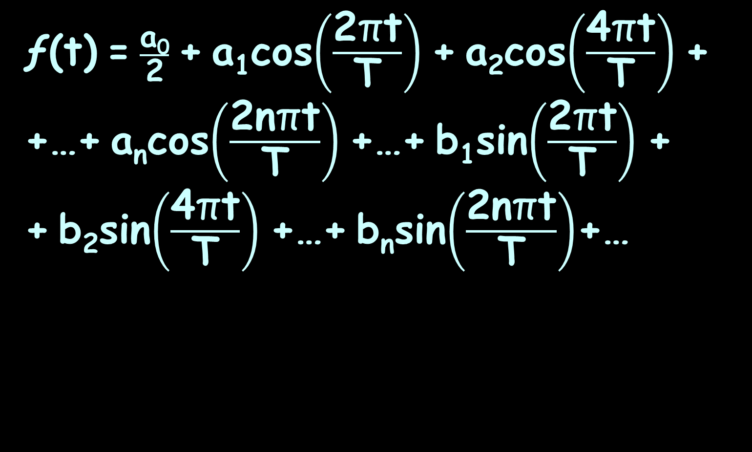
Fourier Series
ƒ(t) = $\frac{\text{a}\text{0}}{\text{2}}$ + a₁cos$\left(\frac{\text{2}\text{π}\text{t}}{\text{T}}\right)$ + a₂cos$\left(\frac{\text{4}\text{π}\text{t}}{\text{T}}\right)$ + +…+ a_{n}cos$\left(\frac{\text{2}\text{n}\text{π}\text{t}}{\text{T}}\right)$ +…+ b₁sin$\left(\frac{\text{2}\text{π}\text{t}}{\text{T}}\right)$ +
+ b₂sin$\left(\frac{\text{4}\text{π}\text{t}}{\text{T}}\right)$ +…+ b_{n}sin$\left(\frac{\text{2}\text{n}\text{π}\text{t}}{\text{T}}\right)$+…

Slide 30
Fourier Series
where:
a₀ = 2/T ∫₀^{T} ƒ(t) dt
a_{n} = 2/T ∫₀^{T} ƒ(t) cos$\left(\frac{\text{2}\text{n}\text{π}\text{t}}{\text{T}}\right)$ dt
b_{n} = 2/T ∫₀^{T} ƒ(t) sin$\left(\frac{\text{2}\text{n}\text{π}\text{t}}{\text{T}}\right)$ dt

Slide 31
Fourier Series
The different coefficients a₀, a_{n}, b_{n} show how much of each frequency the function contains

Slide 32
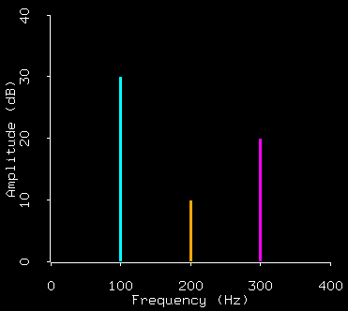
Spectrum Analysis
Graphs are used of the frequency components in the Fourier series
https://home.cc.umanitoba.ca/~krussll/138/sec4/spectrum1.gif

Slide 33
Spectrum Analysis
These are useful because they show the relative contributions of the various frequencies in the overall wave

Slide 34

Questions?
http://i.imgur.com/aliTlT3.jpg

Slide 35
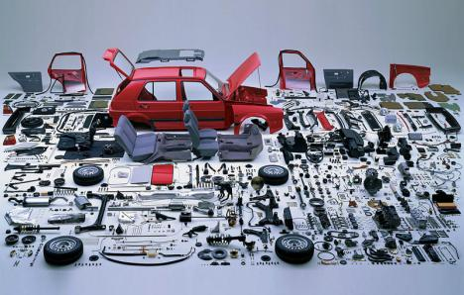
Review of Functions
In a factory, the inputs are the components

Slide 36
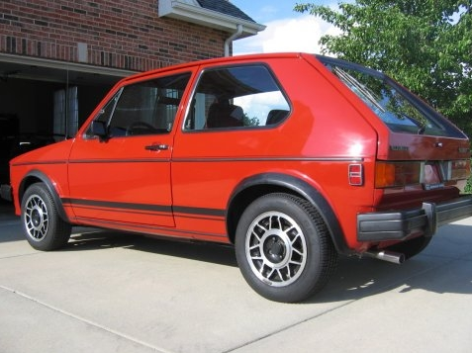
Review of Functions
The output is the final product

Slide 37
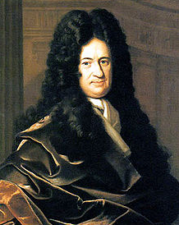
Review of Functions
Leibnitz came up with a way to express real-world processes with inputs and outputs
mathematically –
http://upload.wikimedia.org/wikipedia/commons/6/6a/Gottfried_Wilhelm_von_Leibniz.jpg

Slide 38
Review of Functions
Leibnitz came up with a way to express real-world processes with inputs and outputs
mathematically –
functions!

Slide 39
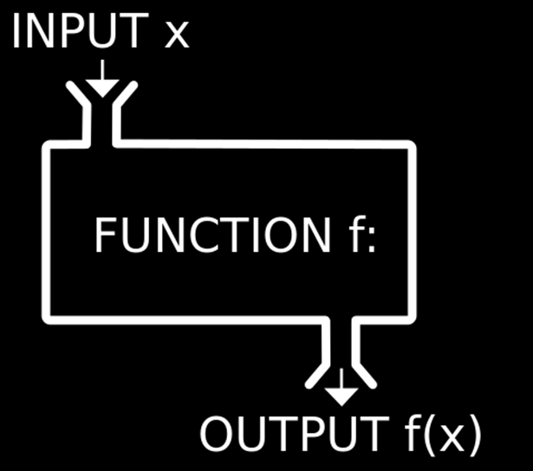
Review of Functions

Slide 40
Review of Functions
What value the output turns out to be depends on what the input value is
The output variable is often called the “dependent” variable

Slide 41
Review of Functions
The input is called the “independent” variable because it’s value comes from an outside (sometimes uncontrollable) source

Slide 42
Review of Functions
When you have a certain input, you want to be able to forecast exactly what the output will be

Slide 43

Review of Functions
You don’t want several possible outputs

Slide 44
Review of Functions
For a formula to be a function, every x (input) can have only one y (output)

Slide 45
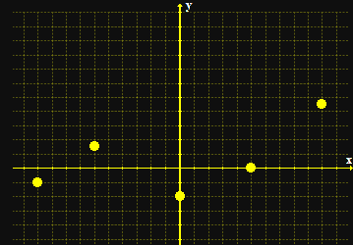
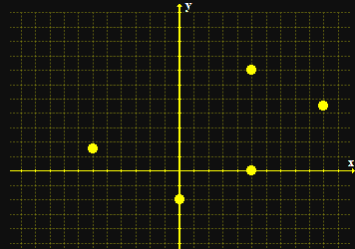
Review of Functions
When you graph a function, none of the points fall on a vertical line
a function not a function

Slide 46
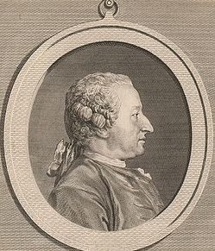
Review of Functions
Naturally, there is a special symbol for functions
Alexis Claude Clairaut
introduced the
notation "ƒ(x)"
in 1734
http://upload.wikimedia.org/wikipedia/commons/thumb/a/a0/Alexis_Clairault.jpg/250px-Alexis_Clairault.jpg

Slide 47
Review of Functions
ƒ(x) shows that the formula uses “x” as the input and that the output depends on it

Slide 48
Review of Functions
When you evaluate a function, you need to substitute the given value for x in the formula
ƒ(3) means “evaluate the function for x=3”

Slide 49
Review of Functions
The “legal” values for a function are called:
Domain - the xs
Range - the ys

Slide 50
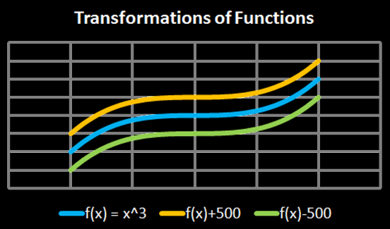
Review of Functions
Transforming functions
vertical shifts:
ƒ(x) + c plus shifts up
ƒ(x) - c minus shifts down

Slide 51
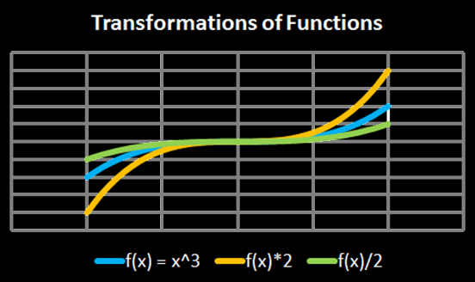
Review of Functions
Transforming functions
vertical stretch:
ƒ(x) × c stretches
ƒ(x) ÷ c squashes

Slide 52
Review of Functions
Any operations done to the function outside of the parentheses affects the “y” values
These operations lead to an intuitive result

Slide 53
Review of Functions
Any operations done to the function inside the parentheses affects the “x” values
These operations lead to an counterintuitive result

Slide 54
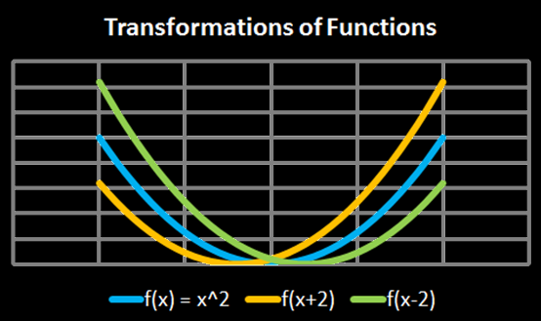
Review of Functions
horizontal shifts:
ƒ(x + c) shifts left
ƒ(x - c) shifts right

Slide 55
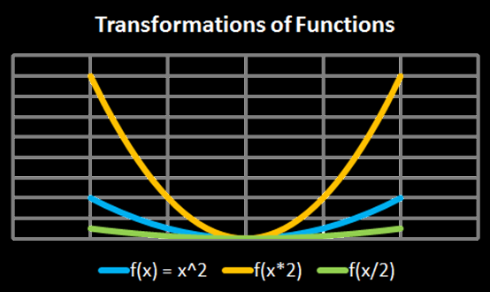
Review of Functions
horizontal shifts:
ƒ(x × c) squashes
ƒ(x ÷ c) stretches

Slide 56
Review of Functions
Another way to look at it:
y-transformations affect the graph but keep the graph paper the same
x-transformations keep the graph the same but modify the graph paper

Slide 57
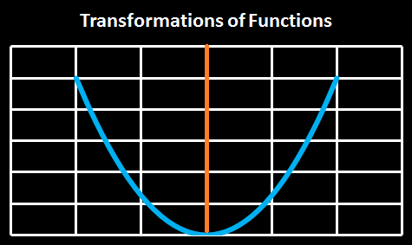
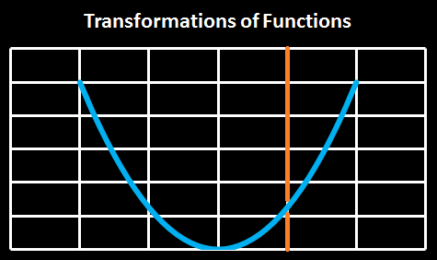
Review of Functions
ƒ(x + c)
shifts the
origin right
(which shifts
the graph left)

Slide 58
Review of Functions
ƒ(x - c)
shifts the
origin left
(which shifts
the graph
right)

Slide 59
Questions?
http://i.imgur.com/aliTlT3.jpg

Slide 60
Integral Transforms
Integrals are functions…

Slide 61
Integral Transforms
Integrals are functions…
So we can transform them, too!

Slide 62
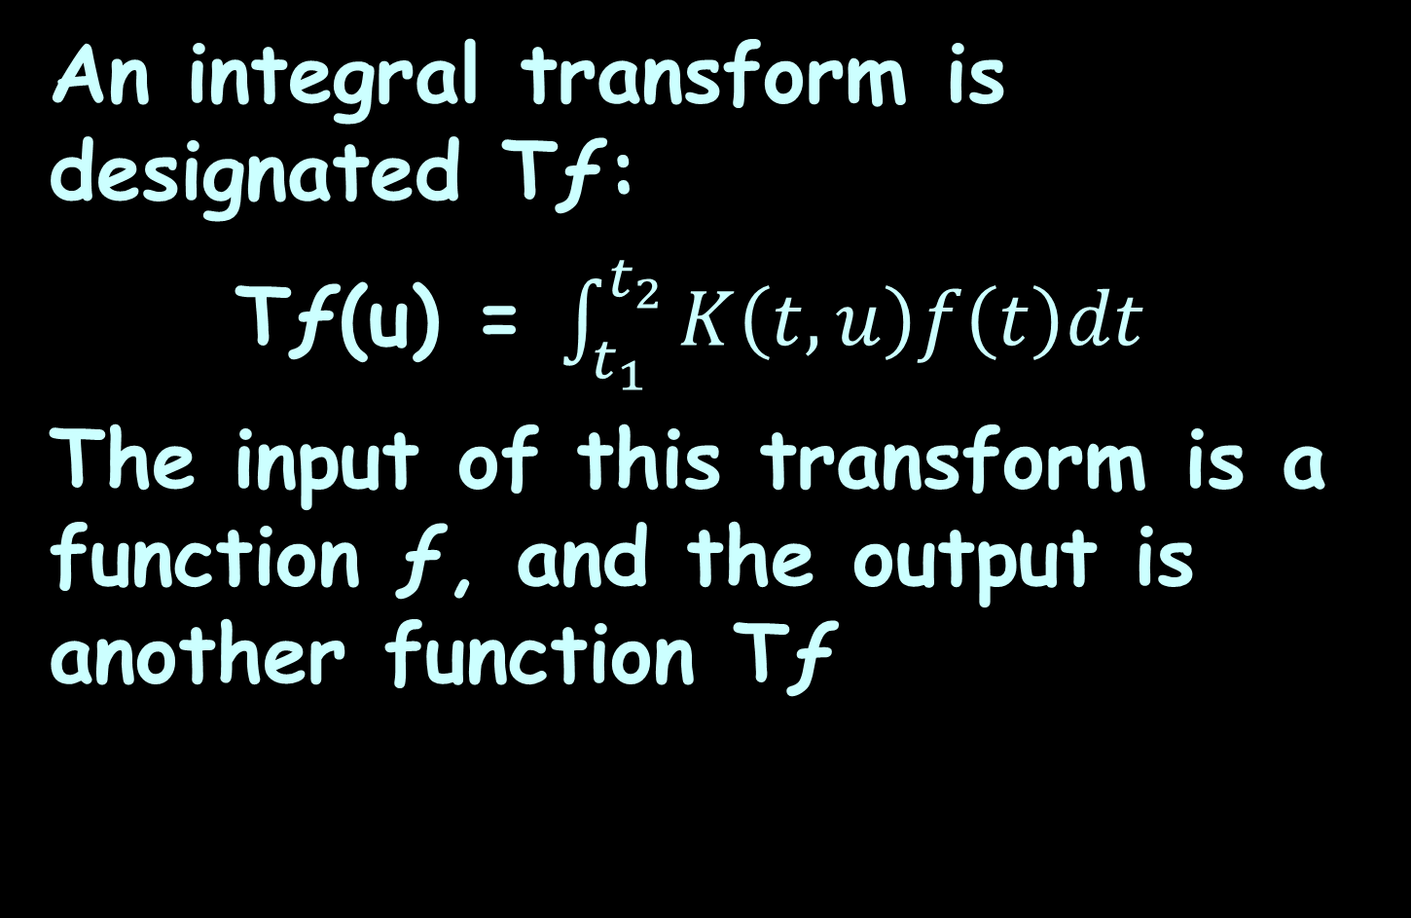
Integral Transforms
An integral transform is designated Tƒ:
Tƒ(u) = $\int_{t_{1}}^{t_{2}}{K\left(t,u\right)f\left(t\right)dt}$
The input of this transform is a function ƒ, and the output is another function Tƒ

Slide 63

Integral Transforms
Why would we want to do such a crazy thing???
http://ahungryrunner.files.wordpress.com/2013/07/confused-baby.png

Slide 64
Integral Transforms
Many problems are hard to solve in their original form

Slide 65
Integral Transforms
An integral transform "maps" an equation from its original "domain" into another domain

Slide 66
Integral Transforms
Manipulating and solving the equation in the target domain can be much easier

Slide 67
Integral Transforms
The solution is then mapped back to the original domain with the inverse of the integral

Slide 68
Integral Transforms
A Tale of Two Frenchmen…

Slide 69
Fourier Transforms
Jean-Baptiste Joseph Fourier (1768-1830) worked on these transforms to make solving
complex problems
easier
https://en.wikipedia.org/wiki/Joseph_Fourier#/media/File:Fourier2.jpg

Slide 70
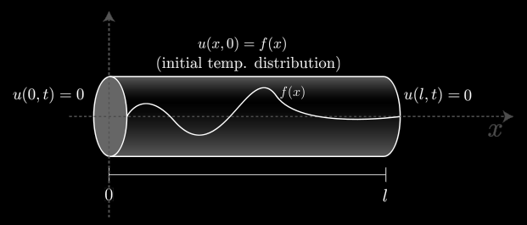
Fourier Transforms
Fourier introduced the transform in his study of heat transfer
http://upload.wikimedia.org/wikipedia/commons/thumb/9/97/Temp_Rod_homobc.svg/300px-Temp_Rod_homobc.svg.png

Slide 71
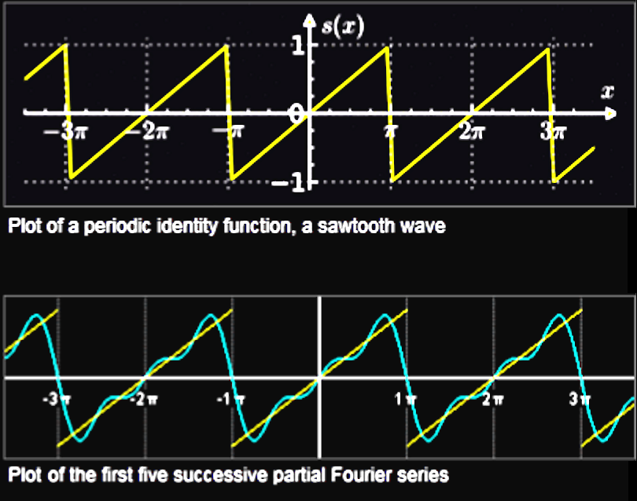
Fourier Transforms
http://wpcontent.answcdn.com/wikipedia/commons/thumb/0/04/Sawtooth_pi.svg/400px-Sawtooth_pi.svg.png

Slide 72
Fourier Transforms
decompose a function of time (a signal) into the frequencies that make it up
Example: a musical chord can be expressed as the amplitude (or loudness) of its constituent notes

Slide 73
Fourier Transforms
For many functions of practical interest one can define an operation that reverses this: the inverse Fourier transformation, also called Fourier synthesis

Slide 74
Fourier Transforms
The Fourier synthesis of a frequency domain representation combines the contributions of all the different frequencies to recover the original function of time

Slide 75
Fourier Transforms
Any linear time-invariant system, such as an electronic filter applied to a signal, can be expressed relatively simply as an operation on frequencies

Slide 76
Fourier Transforms
Significant simplification is often achieved by transforming time functions to the frequency domain, performing the desired operations, and transforming the result back to time

Slide 77
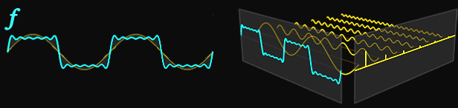
Fourier Transforms
https://thumbs.gfycat.com/HospitableDigitalGrosbeak-poster.jpg
http://www.flw88.net/img/aHR0cDovL2ltZzUuaW1ndG4uYmRpbWcuY29tL2l0L3U9MjU0NDYwMjM0MCwxMTQ5OTg5NTY3JmZtPTIzJmdwPTAuanBn.jpg

Slide 78
Fourier Transforms
These are popular in physics:
  Particle diffusion
  Brownian motion
  Schrödinger’s equation

Slide 79
Fourier Transforms
They use partial derivatives

Slide 80
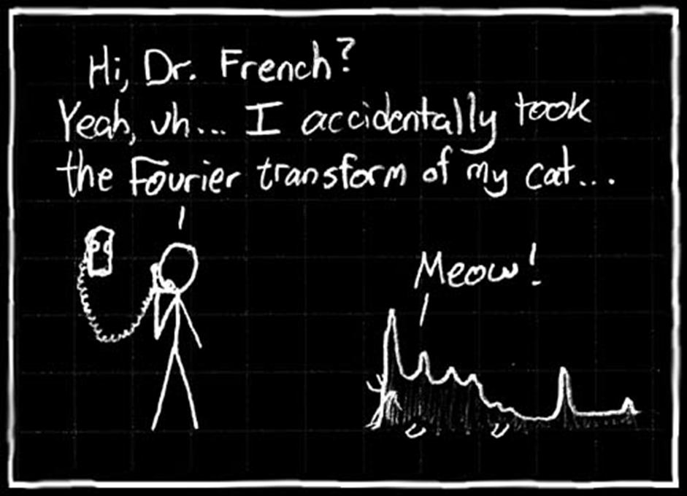

Slide 81
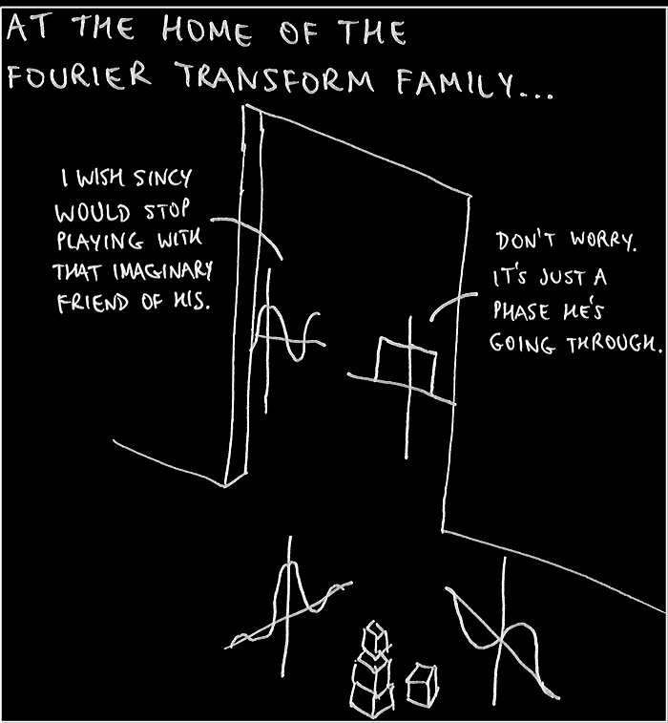

Slide 82
Questions?
http://i.imgur.com/aliTlT3.jpg

Slide 83
Integral Transforms
So… if Fourier Transforms are good for solving hard problems containing partial derivatives

Slide 84
Integral Transforms
So… if Fourier Transforms are good for solving hard problems containing partial derivatives
HOW ABOUT THE ONES WE CAN DO NOW???

Slide 85
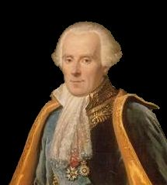
Laplace Transforms
Pierre-Simon, marquis de Laplace (1749-1827)
http://upload.wikimedia.org/wikipedia/commons/b/bf/Pierre-Simon,_marquis_de_Laplace_(1745-1827)_-_Gu%C3%A9rin.jpg

Slide 86
Laplace Transforms
Laplace Transforms are used to reduce a differential equation to an algebra problem

Slide 87
Laplace Transforms
Laplace Transforms are especially useful when the initial values are zero

Slide 88
Laplace Transforms
The Laplace Transform is widely used in electronic engineering applications, especially where the driving force is discontinuous

Slide 89
Laplace Transforms
In engineering applications, we frequently encounter functions whose values change abruptly at specified values of time t

Slide 90
Laplace Transforms
One common example is when a voltage is switched on or off in an electrical circuit at a specified value of time t

Slide 91
Laplace Transforms
The value of t = 0 is usually taken as a convenient time to switch on or off the given voltage

Slide 92
Laplace Transforms
The Laplace Transform is often used in circuit analysis, and simple conversions to the s-Domain of circuit elements can be made
Circuit elements can be transformed into impedances, very similar to phasor impedances

Slide 93
Laplace Transforms
Also used in:
PID controllers
DC motor speed control
systems
DC motor position control
systems

Slide 94

Laplace Transforms
A Laplace Transform is symbolized by:
L or $L$

Slide 95
Laplace Transforms
The Laplace Transform of a function ƒ(t) for t > 0 is defined by the following integral defined over 0 to ∞:
L{ƒ(t)} = ∫₀∞ e ^{–pt} ƒ(t) dt

Slide 96
Laplace Transforms
The resulting expression is a function of p, which we write as F(p)

Slide 97
Laplace Transforms
In words we say:
The Laplace Transform of ƒ(t) equals function F of p

Slide 98
Laplace Transforms
and write it as:
L{ƒ(t)} = F(p)

Slide 99
Laplace Transforms
Similarly, the Laplace Transform of a function g(t) would be written:
L{g(t)} = G(p)

Slide 100
Laplace Transforms
Before the TI:
Table of Laplace Transforms in handouts
Note: the table uses the variable "s" (British) while the TI uses the variable "p" (American)

Slide 101
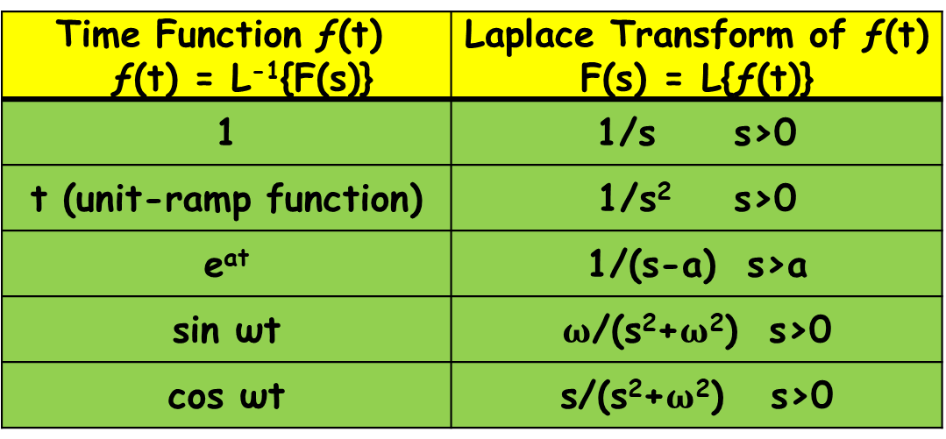
LAPLACE TRANSFORMS
IN-CLASS PROBLEM 1
Solve for the Laplace Transform of the function: ƒ(t) = 1
Time Function ƒ(t) ƒ(t) = L⁻¹{F(s)} | Laplace Transform of ƒ(t) F(s) = L{ƒ(t)}
1 | 1/s s>0
t (unit-ramp function) | 1/s² s>0
e^{at} | 1/(s-a) s>a
sin ωt | $ω$/(s²+$ω$²) s>0
cos ωt | $\text{s}$/(s²+$ω$²) s>0

Slide 102
LAPLACE TRANSFORMS
IN-CLASS PROBLEM 1
Calculate the Laplace Transform of the function: ƒ(t) = 1
F(s) = 1/s
Time Function ƒ(t) ƒ(t) = L⁻¹{F(s)} | Laplace Transform of ƒ(t) F(s) = L{ƒ(t)}
1 | 1/s s>0
t (unit-ramp function) | 1/s² s>0
e^{at} | 1/(s-a) s>a
sin ωt | $ω$/(s²+$ω$²) s>0
cos ωt | $\text{s}$/(s²+$ω$²) s>0

Slide 103
LAPLACE TRANSFORMS
IN-CLASS PROBLEM 2
Solve for the Laplace Transform of the function: g(t) = t
Time Function ƒ(t) ƒ(t) = L⁻¹{F(s)} | Laplace Transform of ƒ(t) F(s) = L{ƒ(t)}
1 | 1/s s>0
t (unit-ramp function) | 1/s² s>0
e^{at} | 1/(s-a) s>a
sin ωt | $ω$/(s²+$ω$²) s>0
cos ωt | $\text{s}$/(s²+$ω$²) s>0

Slide 104
LAPLACE TRANSFORMS
IN-CLASS PROBLEM 2
Solve for the Laplace Transform of the function: g(t) = t
G(s) = 1/s²
Time Function ƒ(t) ƒ(t) = L⁻¹{F(s)} | Laplace Transform of ƒ(t) F(s) = L{ƒ(t)}
1 | 1/s s>0
t (unit-ramp function) | 1/s² s>0
e^{at} | 1/(s-a) s>a
sin ωt | $ω$/(s²+$ω$²) s>0
cos ωt | $\text{s}$/(s²+$ω$²) s>0

Slide 105
LAPLACE TRANSFORMS
IN-CLASS PROBLEM 3
Solve for the Laplace Transform of the function: ƒ(t) = e^{at}
Time Function ƒ(t) ƒ(t) = L⁻¹{F(s)} | Laplace Transform of ƒ(t) F(s) = L{ƒ(t)}
1 | 1/s s>0
t (unit-ramp function) | 1/s² s>0
e^{at} | 1/(s-a) s>a
sin ωt | $ω$/(s²+$ω$²) s>0
cos ωt | $\text{s}$/(s²+$ω$²) s>0

Slide 106
LAPLACE TRANSFORMS
IN-CLASS PROBLEM 3
Solve for the Laplace Transform of the function: ƒ(t) = e^{at}
F(s) = 1/(s-a)
Time Function ƒ(t) ƒ(t) = L⁻¹{F(s)} | Laplace Transform of ƒ(t) F(s) = L{ƒ(t)}
1 | 1/s s>0
t (unit-ramp function) | 1/s² s>0
e^{at} | 1/(s-a) s>a
sin ωt | $ω$/(s²+$ω$²) s>0
cos ωt | $\text{s}$/(s²+$ω$²) s>0

Slide 107
LAPLACE TRANSFORMS
IN-CLASS PROBLEM 4
Solve for the Laplace Transform of the function: v(t) = sin4t
Time Function ƒ(t) ƒ(t) = L⁻¹{F(s)} | Laplace Transform of ƒ(t) F(s) = L{ƒ(t)}
1 | 1/s s>0
t (unit-ramp function) | 1/s² s>0
e^{at} | 1/(s-a) s>a
sin ωt | $ω$/(s²+$ω$²) s>0
cos ωt | $\text{s}$/(s²+$ω$²) s>0

Slide 108
LAPLACE TRANSFORMS
IN-CLASS PROBLEM 4
Solve for the Laplace Transform of the function: v(t) = sin4t
V(s) = 4/(s²+(4)²) = 4/(s²+16)
Time Function ƒ(t) ƒ(t) = L⁻¹{F(s)} | Laplace Transform of ƒ(t) F(s) = L{ƒ(t)}
1 | 1/s s>0
t (unit-ramp function) | 1/s² s>0
e^{at} | 1/(s-a) s>a
sin ωt | $ω$/(s²+$ω$²) s>0
cos ωt | $\text{s}$/(s²+$ω$²) s>0

Slide 109
Questions?
http://i.imgur.com/aliTlT3.jpg

Slide 110
Laplace Transforms
An inverse Laplace Transform brings back the original function

Slide 111
Laplace Transforms
If F(p) = {ƒ(t)}, then the inverse transform of F(p) is defined as:
L⁻¹F(p) = ƒ(t)

Slide 112
Laplace Transforms
Look up the F(s) in the “LaPlace Transform of ƒ(t) column in the table
The original function will be in the Time Function ƒ(t) column

Slide 113
LAPLACE TRANSFORMS
IN-CLASS PROBLEM 5
Solve for the inverse Laplace Transform of the function:
F(s) = 1/s
Time Function ƒ(t) ƒ(t) = L⁻¹{F(s)} | Laplace Transform of ƒ(t) F(s) = L{ƒ(t)}
1 | 1/s s>0
t (unit-ramp function) | 1/s² s>0
e^{at} | 1/(s-a) s>a
sin ωt | $ω$/(s²+$ω$²) s>0
cos ωt | $\text{s}$/(s²+$ω$²) s>0

Slide 114
LAPLACE TRANSFORMS
IN-CLASS PROBLEM 5
Solve for the inverse Laplace Transform of the function:
L⁻¹(1/s) = 1 = ƒ(t)
Time Function ƒ(t) ƒ(t) = L⁻¹{F(s)} | Laplace Transform of ƒ(t) F(s) = L{ƒ(t)}
1 | 1/s s>0
t (unit-ramp function) | 1/s² s>0
e^{at} | 1/(s-a) s>a
sin ωt | $ω$/(s²+$ω$²) s>0
cos ωt | $\text{s}$/(s²+$ω$²) s>0

Slide 115
LAPLACE TRANSFORMS
IN-CLASS PROBLEM 6
Solve for the inverse Laplace Transform of the function:
G(p) = 1/p²
Time Function ƒ(t) ƒ(t) = L⁻¹{F(s)} | Laplace Transform of ƒ(t) F(s) = L{ƒ(t)}
1 | 1/s s>0
t (unit-ramp function) | 1/s² s>0
e^{at} | 1/(s-a) s>a
sin ωt | $ω$/(s²+$ω$²) s>0
cos ωt | $\text{s}$/(s²+$ω$²) s>0

Slide 116
LAPLACE TRANSFORMS
IN-CLASS PROBLEM 6
Solve for the inverse Laplace Transform of the function:
L⁻¹(1/p²) = t = g(t)
Time Function ƒ(t) ƒ(t) = L⁻¹{F(s)} | Laplace Transform of ƒ(t) F(s) = L{ƒ(t)}
1 | 1/s s>0
t (unit-ramp function) | 1/s² s>0
e^{at} | 1/(s-a) s>a
sin ωt | $ω$/(s²+$ω$²) s>0
cos ωt | $\text{s}$/(s²+$ω$²) s>0

Slide 117
Questions?
http://i.imgur.com/aliTlT3.jpg

Slide 118
Laplace Transforms
But…
What’s the problem with using tables?

Slide 119
Laplace Transforms
But…
What’s the problem with using tables?
Real-life problems are always too complicated to be on the tables!

Slide 120
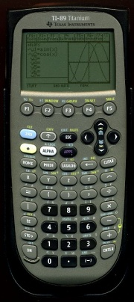
Laplace Transforms
Our buddy
needs
a new app!
https://www.schoolmart.com/wp-content/uploads/2016/04/ti-nspcxii-cas.jpg
https://www.ubookstore.com/site/product_images/TI-89-Titanium-Calculator_Main-1.jpg?resizeid=6&resizeh=1920&resizew=1920

Slide 121
Laplace Transforms
Home
CATALOG
F4
LAPL
https://www.schoolmart.com/wp-content/uploads/2016/04/ti-nspcxii-cas.jpg
https://www.ubookstore.com/site/product_images/TI-89-Titanium-Calculator_Main-1.jpg?resizeid=6&resizeh=1920&resizew=1920

Slide 122
Laplace Transforms
enter the DiffEq
comma
the independent variable
(on the bottom of the
derivative ratio)
close parenthesis
enter

Slide 123
Laplace Transforms
Note1: The @ numbers are the constants "C" or "K"
Note2: The "s" on this Laplace Transforms sheet is a "p" on the TI
Note3: always include the “∗”

Slide 124
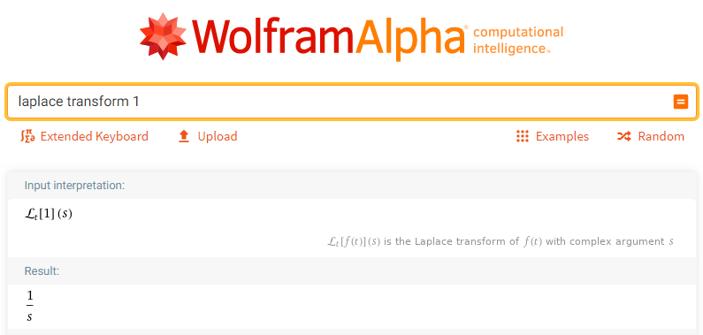
Laplace Transforms

Slide 125
Laplace Transforms
Note: with WolframAlpha, you can use: “Laplace Transform”
or “Laplace”
BUT
If you use “laplace” it will give you the Laplace Operator
Click “Use the Laplace transform instead”

Slide 126
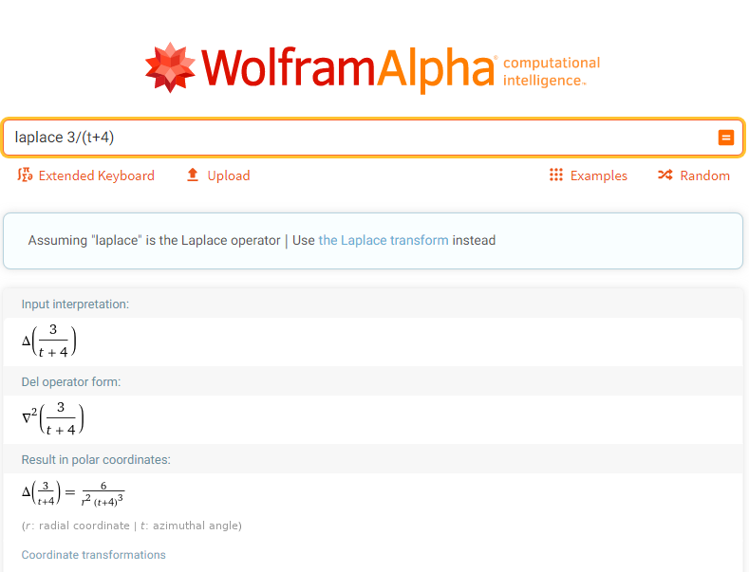
Laplace Transforms

Slide 127
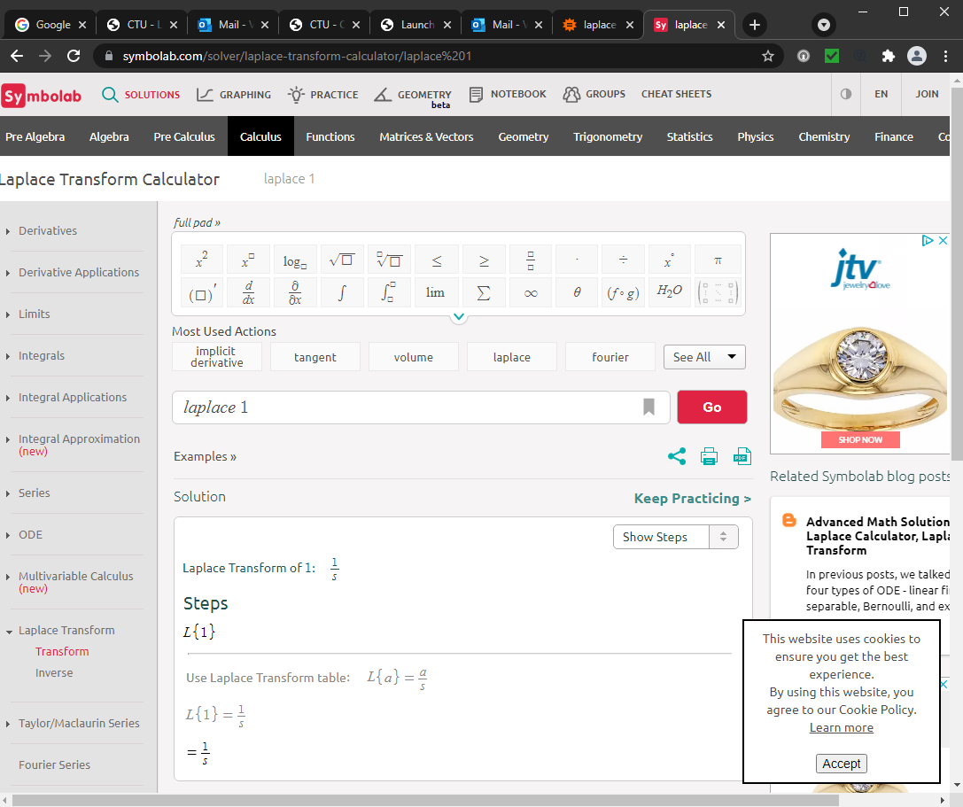

Slide 128
LAPLACE TRANSFORMS
IN-CLASS PROBLEM 7
Solve for the Laplace Transform of the function:
ƒ(t) = 6e^{–5t}

Slide 129
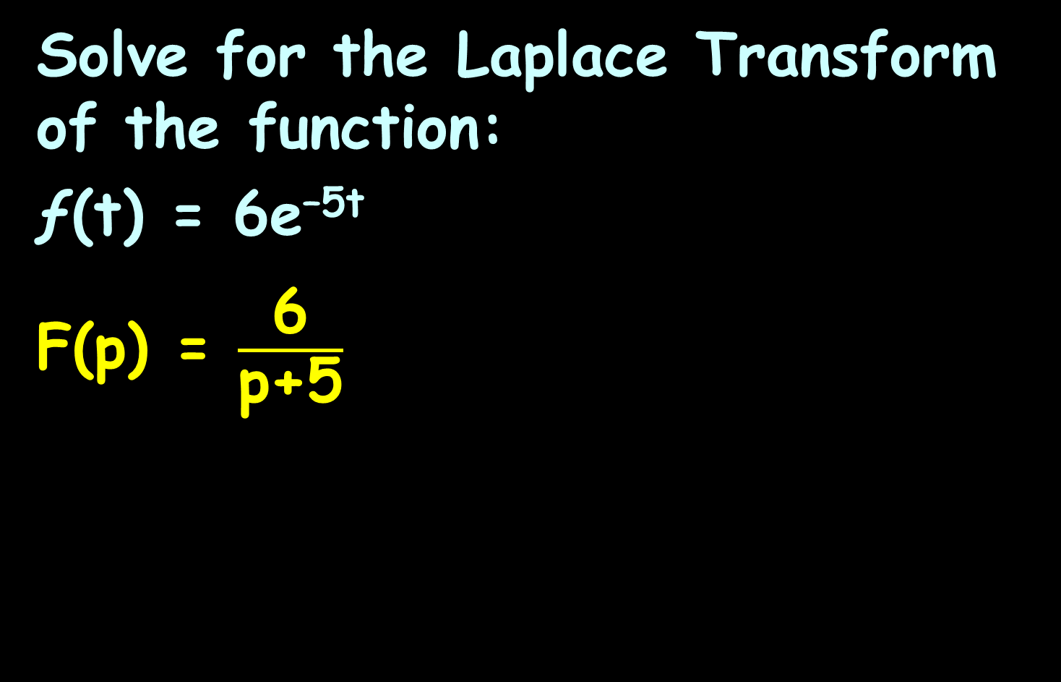
LAPLACE TRANSFORMS
IN-CLASS PROBLEM 7
Solve for the Laplace Transform of the function:
ƒ(t) = 6e^{–5t}
F(p) = $\frac{\text{6}}{\text{p}\text{+5}}$

Slide 130
LAPLACE TRANSFORMS
IN-CLASS PROBLEM 8
Solve for the Laplace Transform of the function:
ƒ(t) = 4t sin(2t)

Slide 131
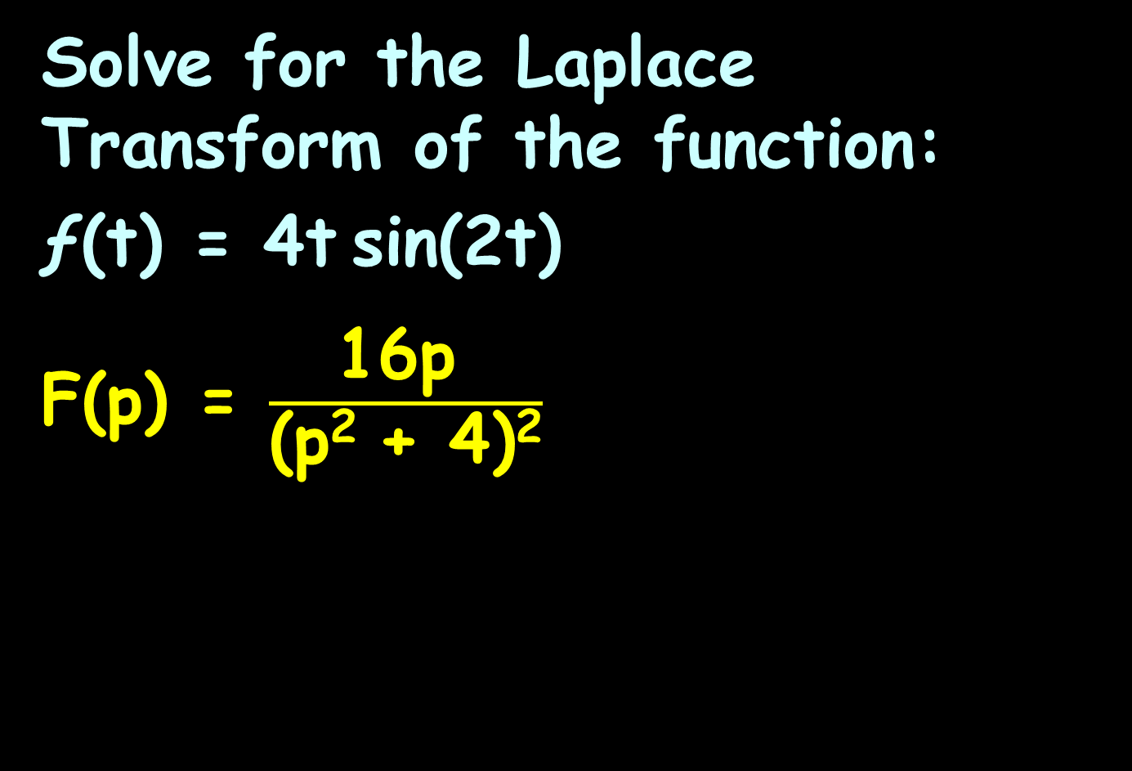
LAPLACE TRANSFORMS
IN-CLASS PROBLEM 8
Solve for the Laplace Transform of the function:
ƒ(t) = 4t sin(2t)
F(p) = $\frac{\text{16}\text{p} }{\text{(}\text{p}\text{2 }\text{+}\text{ 4)}\text{2}}$

Slide 132
Laplace Transforms
OK… so we can find the transform…
How about the inverse?

Slide 133
Laplace Transforms
Home
CATALOG
F4
INVLAPL
https://www.schoolmart.com/wp-content/uploads/2016/04/ti-nspcxii-cas.jpg
https://www.ubookstore.com/site/product_images/TI-89-Titanium-Calculator_Main-1.jpg?resizeid=6&resizeh=1920&resizew=1920

Slide 134
Laplace Transforms
enter the DiffEq
comma
p
close parenthesis
enter

Slide 135
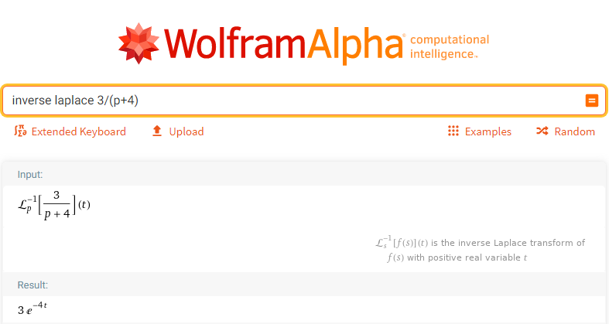
Laplace Transforms

Slide 136
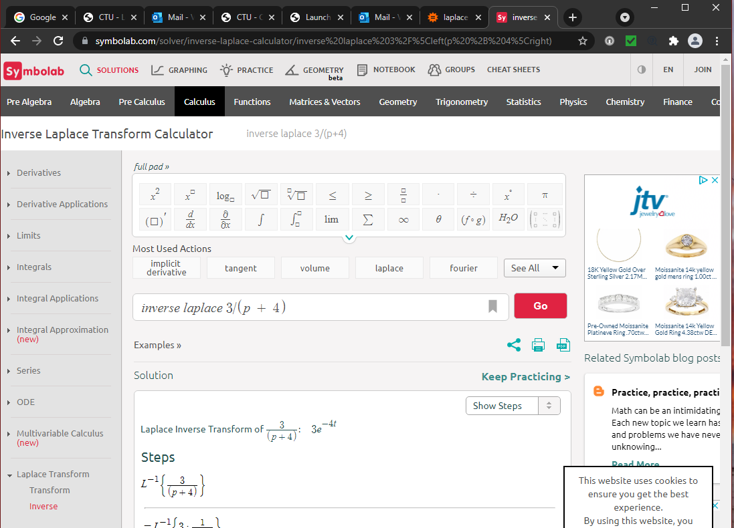
Laplace Transforms

Slide 137
LAPLACE TRANSFORMS
IN-CLASS PROBLEM 9
Solve for the inverse Laplace Transform of the function:
F(p) = 3/(p + 4)

Slide 138
LAPLACE TRANSFORMS
IN-CLASS PROBLEM 9
Solve for the inverse Laplace Transform of the function:
F(p) = 3/(p + 4)
ƒ(t) = 3e^{-4t}

Slide 139
Laplace Transforms
Remember, Laplace takes you from the t-domain to the (mythical) “p” domain

Slide 140
LAPLACE TRANSFORMS
IN-CLASS PROBLEM 10
Solve for the Laplace Transform of the function:
ƒ(t) = 6e^{–5t} + e^{3t} + 5t³ – 9

Slide 141
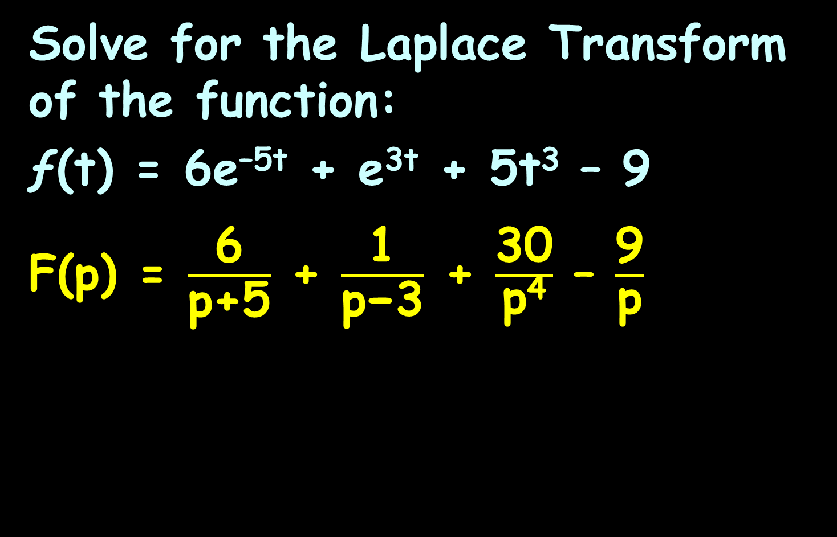
LAPLACE TRANSFORMS
IN-CLASS PROBLEM 10
Solve for the Laplace Transform of the function:
ƒ(t) = 6e^{–5t} + e^{3t} + 5t³ – 9
F(p) = $\frac{\text{6}}{\text{p}\text{+5}}$ + $\frac{\text{1}}{\text{p}\text{−3}}$ + $\frac{\text{30}}{\text{p}\text{4}}$ – $\frac{\text{9}}{\text{p}}$

Slide 142
LAPLACE TRANSFORMS
IN-CLASS PROBLEM 11
Solve for the Laplace Transform of the function:
ƒ(t) = t²sin(2t)

Slide 143
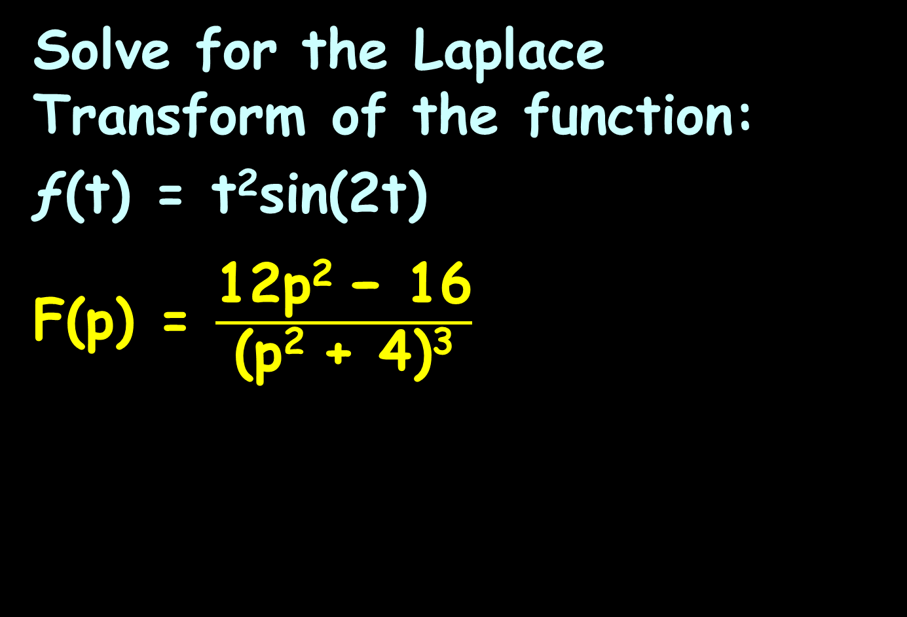
LAPLACE TRANSFORMS
IN-CLASS PROBLEM 11
Solve for the Laplace Transform of the function:
ƒ(t) = t²sin(2t)
F(p) = $\frac{\text{12}\text{p}\text{2} \text{− 16}}{\text{(}\text{p}\text{2 }\text{+}\text{ 4)}\text{3}}$

Slide 144
Laplace Transforms
https://www.emathhelp.net/calculators/differential-equations/laplace-transform-calculator/?f=1
https://www.emathhelp.net/calculators/differential-equations/inverse-laplace-transform-calculator/?f=1%2Fs

Slide 145
Questions?
http://i.imgur.com/aliTlT3.jpg

Slide 146
Summary
Today we studied:
Review of Taylor and Fourier Series
Integral Transforms
What are they?
History
Fourier Transforms
Laplace Transforms

Slide 147

You Survived!

