Slide 1
Welcome to
Unit 8
Part 15!
MATH 207 Integral Calculus

Slide 2
What’s Up?
Review:
Power series and Maclaurin series
New stuff:
Taylor series
Fourier series

Slide 3
What’s Up?
Outcome 3) Approximate functions using Taylor and MacLaurin polynomials
Outcome 7) Solve problems by identifying the requirements, making a sketch as appropriate

Slide 4

Review
http://995642590.r.lightningbase-cdn.com/wp-content/uploads/2010/12/looking-back-hrexaminer-v144-cover425px.jpg

Slide 5
Standard Series
A standard series is the power series (p-series)
ƒ = a₀ + a₁u + a₂u² + a₃u³ + … + a_{n}u^{n} + …
u will be some function of x
the a’s are the coefficients of
each term in the series

Slide 6
Power Series
A geometric series is a special case of the power series
Geometric series:
y = 1 + x + x² + x³ + …
Power series:
y = a₀ +a₁u + a₂u² + a₃u³ + …

Slide 7
Power Series
General form of a power series:
ƒ(x) = a_{n}(x-c)^{n}
= a₀(x-c)⁰ + a₁(x-c)¹ +
a₂(x-c)² + a₃(x-c)³ + …
∞
∑
n=0

Slide 8
Power Series
Negative powers are not permitted in a power series
Fractional powers are also not allowed
The coefficients a_{n} are not allowed to depend on x

Slide 9
Power Series
All power series ƒ(x) in powers of (x-c) will converge at x = c
A number r such that the series converges whenever
|x−c|<r and diverges whenever |x−c|>r is called the radius of convergence of the power series

Slide 10
Maclaurin Series
A Maclaurin series approximates a function by using an infinite sum of the function's derivatives at x=0
ƒ(x) = ƒ(0) + ƒ '(0)x + ƒ ''(0)x²/2 +
ƒ '''(0) x³/3! + ƒ ''''(0) x⁴/4! …

Slide 11
Maclaurin Series
The Maclaurin series works best when x<1
This is because the x³, x⁴, … terms tend to become zero

Slide 12

Questions?
http://i.imgur.com/aliTlT3.jpg

Slide 13
Taylor Series
The Greek philosopher Zeno considered the problem of summing an infinite series to achieve a finite result, but rejected it as an impossibility: the result was Zeno's paradox

Slide 14

Motion is a change of position over time
At any INSTANT, no change of position takes place
https://lh3.googleusercontent.com/proxy/oCsIsvTd6J1M-ASQNw5u5XbMXeTZ8Yfi953qz0SR2i81
whEze0JWvw5Y0tpohuziOZln2vLrORgh0raQy4UlKvz-LDlbMpE8vwy_8ExqIsejy8Qo_VF_nbHOmIcr

Slide 15

Therefore there can be no motion at any instant
But time is a succession of instants…
https://lh3.googleusercontent.com/proxy/oCsIsvTd6J1M-ASQNw5u5XbMXeTZ8Yfi953qz0SR2i81
whEze0JWvw5Y0tpohuziOZln2vLrORgh0raQy4UlKvz-LDlbMpE8vwy_8ExqIsejy8Qo_VF_nbHOmIcr

Slide 16

Therefore motion never takes place!
Hey! How did I get over here?
https://lh3.googleusercontent.com/proxy/oCsIsvTd6J1M-ASQNw5u5XbMXeTZ8Yfi953qz0SR2i81
whEze0JWvw5Y0tpohuziOZln2vLrORgh0raQy4UlKvz-LDlbMpE8vwy_8ExqIsejy8Qo_VF_nbHOmIcr

Slide 17
Taylor Series
It was through Archimedes's method of exhaustion that an infinite number of progressive subdivisions could be performed to achieve a finite result

Slide 18
Taylor Series
Almost all of calculus is used to show Zeno was wrong (or at least not very useful in the real world)

Slide 19
Taylor Series
Remember when we used a geometric series to estimate 1/(1-x)?
It worked when x was less than 1
It didn’t work for larger values of x

Slide 20
Taylor Series
In general,
When x is large, many terms are needed to give an accurate
approximation for ƒ(x)
When x is less than 1, only a few terms are needed

Slide 21
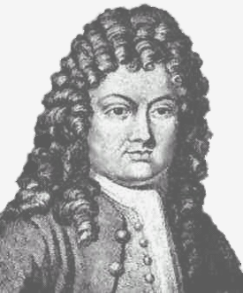
Taylor Series
The Taylor Series was invented to develop estimation series for large values of x
Brook Taylor
https://upload.wikimedia.org/wikipedia/commons/thumb/2/25/BTaylor.jpg/220px-BTaylor.jpg

Slide 22
Taylor Series
It is common practice to approximate a function by using a finite number of terms from its Taylor series

Slide 23
Taylor Series
A Taylor series is writing a function as an infinite sum of the function's derivatives at a single point

Slide 24
Taylor Series
With an offset of “b”, the Taylor series is:
ƒ(x) = ƒ(a) + ƒ '(a)(x-b) +
ƒ ''(a)(x-b)²/2 +
ƒ '''(a)(x-b)³/3! +
ƒ ''''(a)(x-b)⁴/4! + …

Slide 25
Taylor Series
This can also be written:
ƒ^{(n)} (a)
n!
Where ƒ^{(n)} means the nth derivative of ƒ evaluated at point “a”
∞
∑ (x-b)^{n}
n=0

Slide 26
Taylor Series
Any finite number of initial terms of the Taylor series of a function is called a Taylor polynomial

Slide 27
Taylor Series
For 1/(1-x)
We used long division to find:
1/(1-x) = 1 + x + x² + x³ + …

Slide 28
TAYLOR SERIES
IN-CLASS PROBLEM 1
The Taylor series for 1/x is:
1 – (x-b) + (x-b)² – (x-b)³ + …
For our series:
1/(1-x) = 1 + x + x² + x³ + …
is there a “b”?

Slide 29
TAYLOR SERIES
IN-CLASS PROBLEM 1
The Taylor series for 1/x is:
1 – (x-b) + (x-b)² – (x-b)³ + …
For our series:
1/(1-x) = 1 + x + x² + x³ + …
is there a “b”? No, because Taylor is an alternating series!

Slide 30
TAYLOR SERIES
IN-CLASS PROBLEM 1
The Taylor series for 1/x is:
1 – (x-b) + (x-b)² – (x-b)³ + …
Express this series for b=1?

Slide 31
TAYLOR SERIES
IN-CLASS PROBLEM 1
The Taylor series for 1/x is:
1 – (x-b) + (x-b)² – (x-b)³ + …
This series for b=1:
1 – (x-1) + (x-1)² – (x-1)³ + …

Slide 32
Taylor Series
If a Taylor series is centered at zero, then that series is a Maclaurin series

Slide 33
Taylor Series
Rule of thumb:
If a series is needed for a function whose x values will always be less than 1, use Maclaurin

Slide 34
Taylor Series
Rule of thumb:
For functions whose x values are larger than one, use Taylor

Slide 35
Taylor Series
Rule of thumb:
For quick convergence in Taylor, use a “b” value close to the common x values

Slide 36
Taylor Series
Taylor seems to be more common in electronics than Maclaurin

Slide 37
Questions
http://i.imgur.com/aliTlT3.jpg

Slide 38
Taylor Series
Last class we used a Maclaurin series to approximate e^{x}
It worked fine for x=0.15 but not for x=4.65

Slide 39
TAYLOR SERIES
IN-CLASS PROBLEM 2a
Find a Taylor series for e^{x} that converges with a few terms for x values near 5
We’ll be using this to find the value for x=4.65 (which is close to “5”)

Slide 40
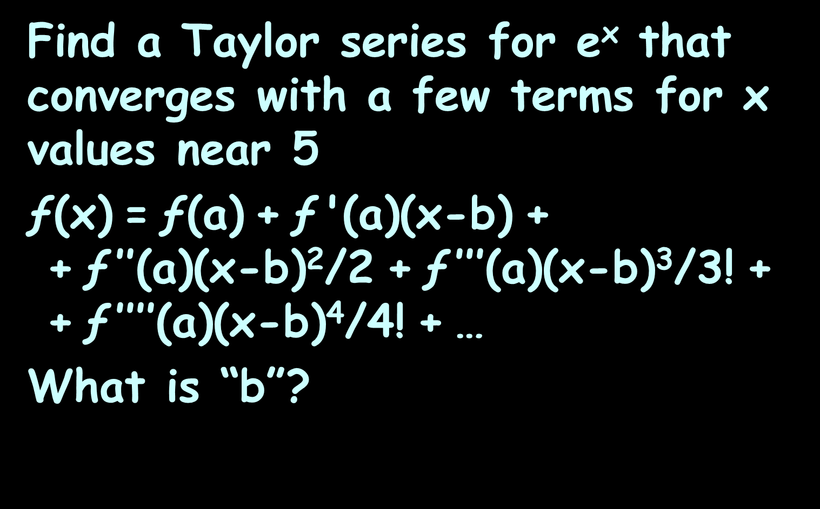
TAYLOR SERIES
IN-CLASS PROBLEM 2a
Find a Taylor series for e^{x} that converges with a few terms for x values near 5
ƒ(x) = ƒ(a) + ƒ '(a)(x-b) +
+ ƒ $\text{′′}$(a)(x-b)²/2 + ƒ $\text{′′′}$(a)(x-b)³/3! +
+ ƒ $\text{′′′′}$(a)(x-b)⁴/4! + …
What is “b”?

Slide 41
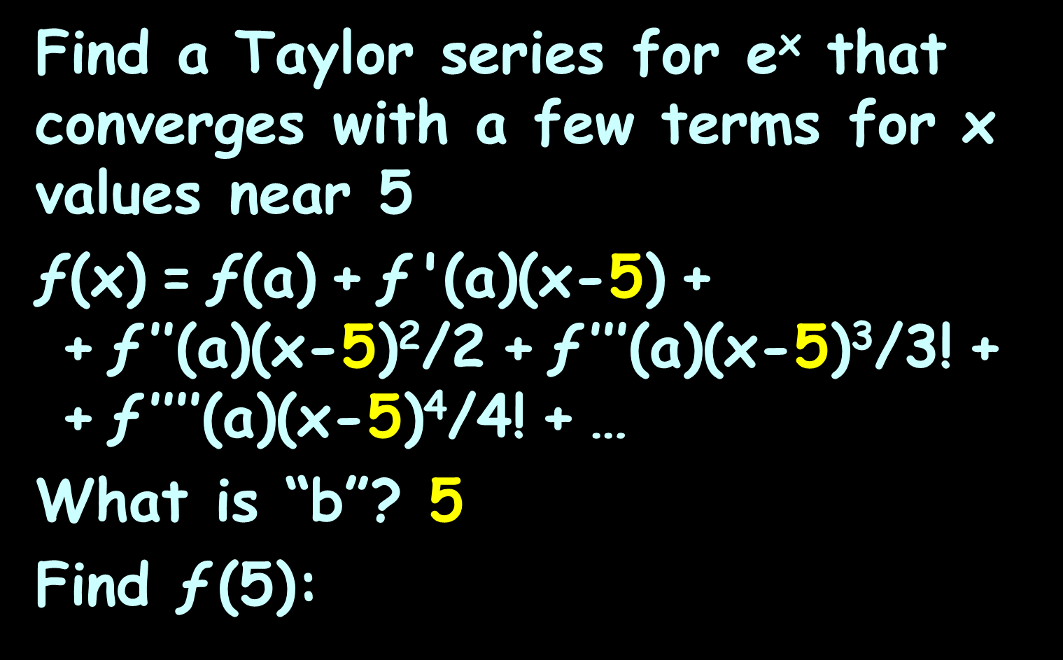
TAYLOR SERIES
IN-CLASS PROBLEM 2a
Find a Taylor series for e^{x} that converges with a few terms for x values near 5
ƒ(x) = ƒ(a) + ƒ '(a)(x-5) +
+ ƒ $\text{′′}$(a)(x-5)²/2 + ƒ $\text{′′′}$(a)(x-5)³/3! +
+ ƒ $\text{′′′′}$(a)(x-5)⁴/4! + …
What is “b”? 5
Find ƒ (5):
this means we’re also using “a” as 5

Slide 42
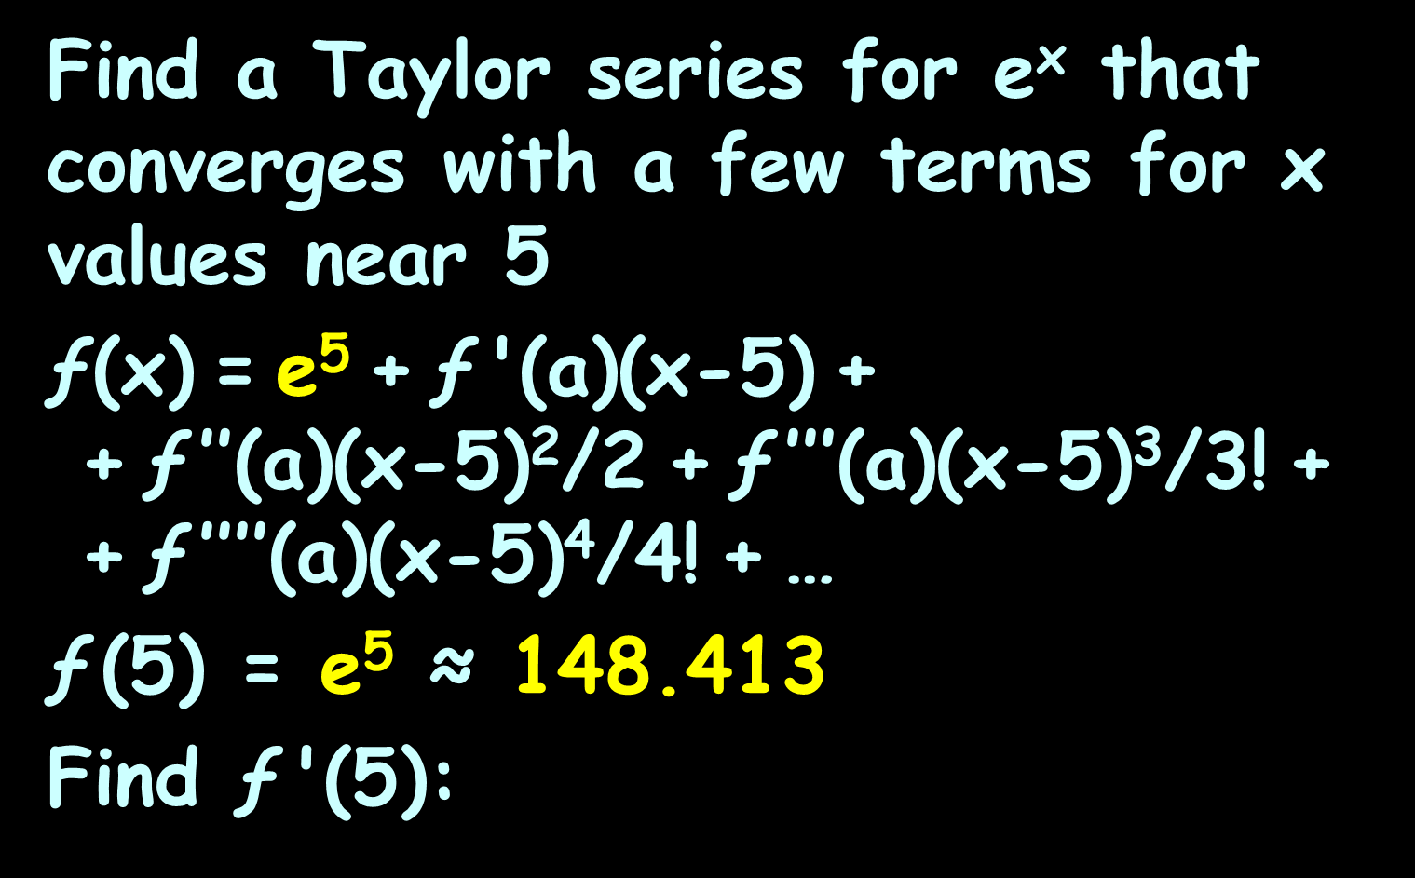
TAYLOR SERIES
IN-CLASS PROBLEM 2a
Find a Taylor series for e^{x} that converges with a few terms for x values near 5
ƒ(x) = e⁵ + ƒ '(a)(x-5) +
+ ƒ $\text{′′}$(a)(x-5)²/2 + ƒ $\text{′′′}$(a)(x-5)³/3! +
+ ƒ $\text{′′′′}$(a)(x-5)⁴/4! + …
ƒ (5) = e⁵ ≈ 148.413
Find ƒ '(5):

Slide 43
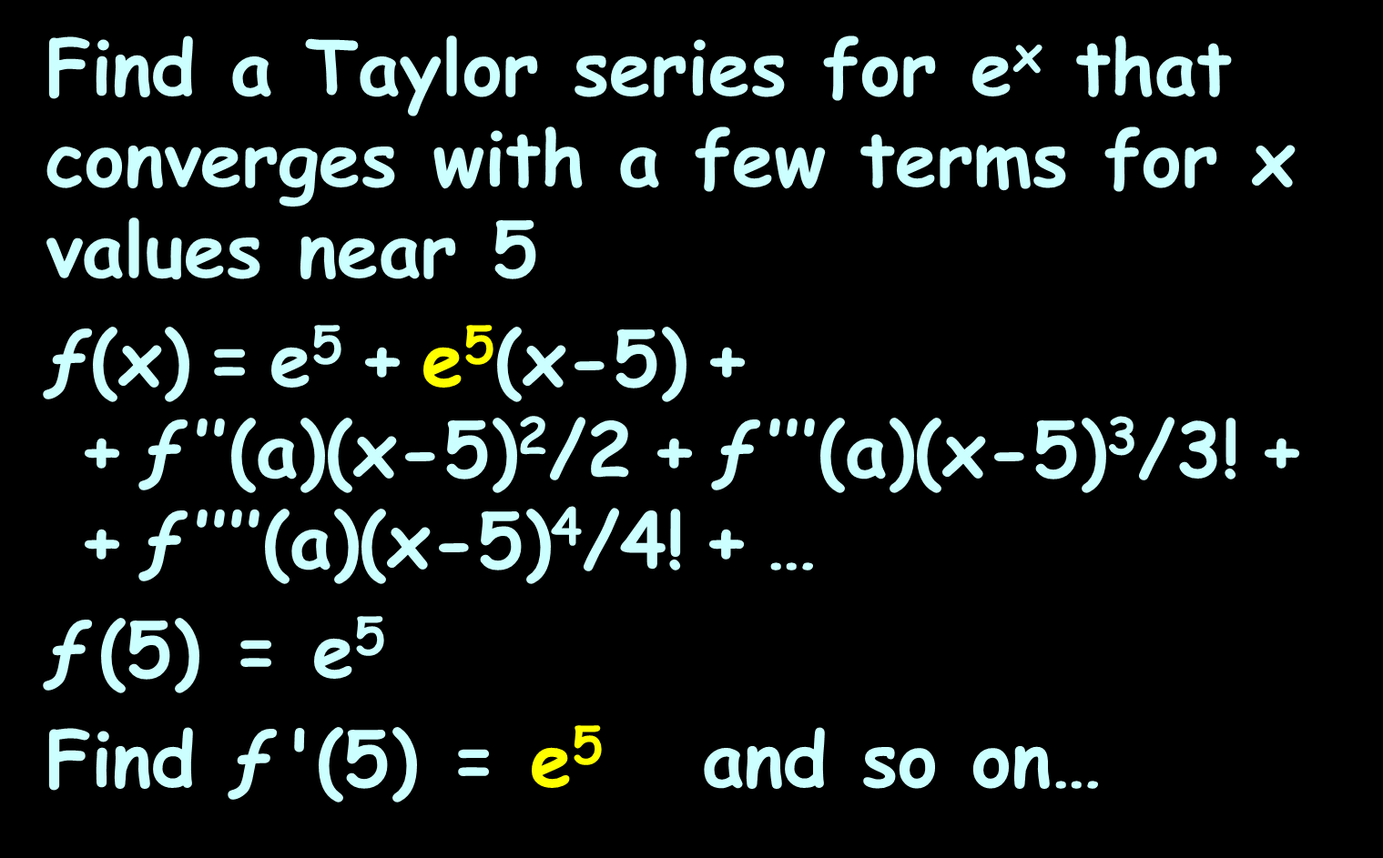
TAYLOR SERIES
IN-CLASS PROBLEM 2a
Find a Taylor series for e^{x} that converges with a few terms for x values near 5
ƒ(x) = e⁵ + e⁵(x-5) +
+ ƒ $\text{′′}$(a)(x-5)²/2 + ƒ $\text{′′′}$(a)(x-5)³/3! +
+ ƒ $\text{′′′′}$(a)(x-5)⁴/4! + …
ƒ (5) = e⁵
Find ƒ '(5) = e⁵ and so on…

Slide 44
TAYLOR SERIES
IN-CLASS PROBLEM 2a
Find a Taylor series for e^{x} that converges with a few terms for x values near 5
ƒ(x) = e⁵ + e⁵(x-5) +
+ e⁵(x-5)²/2 + e⁵(x-5)³/3! +
+ e⁵(x-5)⁴/4! + …
Or:
ƒ(x) = e⁵ (1+(x-5)+(x-5)²/2+
+(x-5)³/3!+(x-5)⁴/4! + …)

Slide 45
TAYLOR SERIES
IN-CLASS PROBLEM 2b
Use this series and your calculator (or Wolfram) to find e^{4.65}

Slide 46
TAYLOR SERIES
IN-CLASS PROBLEM 2b
Use your calculator (or Wolfram) to find e^{4.65} ≈ 104.5849856

Slide 47
TAYLOR SERIES
IN-CLASS PROBLEM 2b
Use this Taylor series to find e^{4.65}
ƒ(x) = e⁵ (1+(x-5)+(x-5)²/2+
+(x-5)³/3!+(x-5)⁴/4! + …)
One term:
ƒ(4.65) = e⁵ (1)
Which we know is ≈ 104.5849856

Slide 48
TAYLOR SERIES
IN-CLASS PROBLEM 2b
Use this Taylor series to find e^{4.65}
ƒ(x) = e⁵ (1+(x-5)+(x-5)²/2+
+(x-5)³/3!+(x-5)⁴/4! + …)
One term:
ƒ(4.65) = e⁵ (1) ≈ 148.4131591
Which we know is ≈ 104.5849856
vs 104.5849856
Already a lot closer than the 33.2187 we got using MacLaurin!

Slide 49
TAYLOR SERIES
IN-CLASS PROBLEM 2b
Use this Taylor series to find e^{4.65}
ƒ(x) = e⁵ (1+(x-5)+(x-5)²/2+
+(x-5)³/3!+(x-5)⁴/4! + …)
Try two terms:
ƒ(4.65) = e⁵ (1+(x-5))
Which we know is ≈ 104.5849856

Slide 50
TAYLOR SERIES
IN-CLASS PROBLEM 2b
Use this Taylor series to find e^{4.65}
ƒ(x) = e⁵ (1+(x-5)+(x-5)²/2+
+(x-5)³/3!+(x-5)⁴/4! + …)
Try two terms:
ƒ(4.65) = e⁵ (1+(x-5))
≈ 96.46855342
Which we know is ≈ 104.5849856
148.4131591
-0.35
vs 104.5849856
Getting closer!

Slide 51
TAYLOR SERIES
IN-CLASS PROBLEM 2b
Use this Taylor series to find e^{4.65}
ƒ(x) = e⁵ (1+(x-5)+(x-5)²/2+
+(x-5)³/3!+(x-5)⁴/4! + …)
Try three terms:
ƒ(4.65) = e⁵ (1+(x-5)+(x-5)²/2)
Which we know is ≈ 104.5849856
-0.35
0.06125

Slide 52
TAYLOR SERIES
IN-CLASS PROBLEM 2b
In WolframAlpha:
e^5 (1+(4.65-5)+(4.65-5)^2/2)
On the TI-89:
e^5*(1+(4.65-5)+(4.65-5)^2/2)

Slide 53
TAYLOR SERIES
IN-CLASS PROBLEM 2b
Use this Taylor series to find e^{4.65}
ƒ(x) = e⁵ (1+(x-5)+(x-5)²/2+
+(x-5)³/3!+(x-5)⁴/4! + …)
Try three terms:
ƒ(4.65) = e⁵ (1+(x-5)+(x-5)²/2)
≈ 105.5588594
Which we know is ≈ 104.5849856
-0.35
0.06125
vs 104.5849856
Even closer!

Slide 54
TAYLOR SERIES
IN-CLASS PROBLEM 2b
Use this Taylor series to find e^{4.65}
ƒ(x) = e⁵ (1+(x-5)+(x-5)²/2+
+(x-5)³/3!+(x-5)⁴/4! + …)
Try four terms:
ƒ(4.65) = e⁵ (1+(x-5)+(x-5)²/2
+(x-5)³/3!)
Which we know is ≈ 104.5849856
-0.35
0.06125
-0.007145833

Slide 55
TAYLOR SERIES
IN-CLASS PROBLEM 2b
In WolframAlpha:
e^5 (1+(4.65-5)+(4.65-5)^2/2 +(4.65-5)^3/3!))
On the TI-89:
e^5*(1+(4.65-5)+(4.65-5)^2/2 +(4.65-5)^3/3!)
2nd 5 7 1

Slide 56
TAYLOR SERIES
IN-CLASS PROBLEM 2b
Use this Taylor series to find e^{4.65}
ƒ(x) = e⁵ (1+(x-5)+(x-5)²/2+
+(x-5)³/3!+(x-5)⁴/4! + …)
Try four terms:
ƒ(4.65) = e⁵ (1+(x-5)+(x-5)²/2
+(x-5)³/3!)
≈ 104.4983237
Which we know is ≈ 104.5849856
-0.35
0.06125
-0.007145833
vs 104.5849856
Getting closer!

Slide 57
TAYLOR SERIES
IN-CLASS PROBLEM 2b
Use this Taylor series to find e^{4.65}
ƒ(x) = e⁵ (1+(x-5)+(x-5)²/2+
+(x-5)³/3!+(x-5)⁴/4! + …)
Try five terms:
ƒ(4.65) = e⁵ (1+(x-5)+(x-5)²/2
+(x-5)³/3!+(x-5)⁴/4! )
Which we know is ≈ 104.5849856
-0.35
0.06125
-0.007145833
0.00062526

Slide 58
TAYLOR SERIES
IN-CLASS PROBLEM 2b
Use this Taylor series to find e^{4.65}
ƒ(x) = e⁵ (1+(x-5)+(x-5)²/2+
+(x-5)³/3!+(x-5)⁴/4! + …)
Try five terms:
ƒ(4.65) = e⁵ (1+(x-5)+(x-5)²/2
+(x-5)³/3!+(x-5)⁴/4! )
≈ 104.5911206
Which we know is ≈ 104.5849856
-0.35
0.06125
-0.007145833
0.00062526
vs 104.5849856
Really close!

Slide 59
TAYLOR SERIES
IN-CLASS PROBLEM 2b
Using the Maclaurin series, it would have taken 11 iterations to get “really” close
Using Taylor, it took 5

Slide 60
Questions
http://i.imgur.com/aliTlT3.jpg

Slide 61
Taylor Series
AC circuits consisting of components having unity values (R=1ohm, L=1henry, C=1farad, Vs=1volt) are useful for studying resonance (easier arithmetic!)

Slide 62
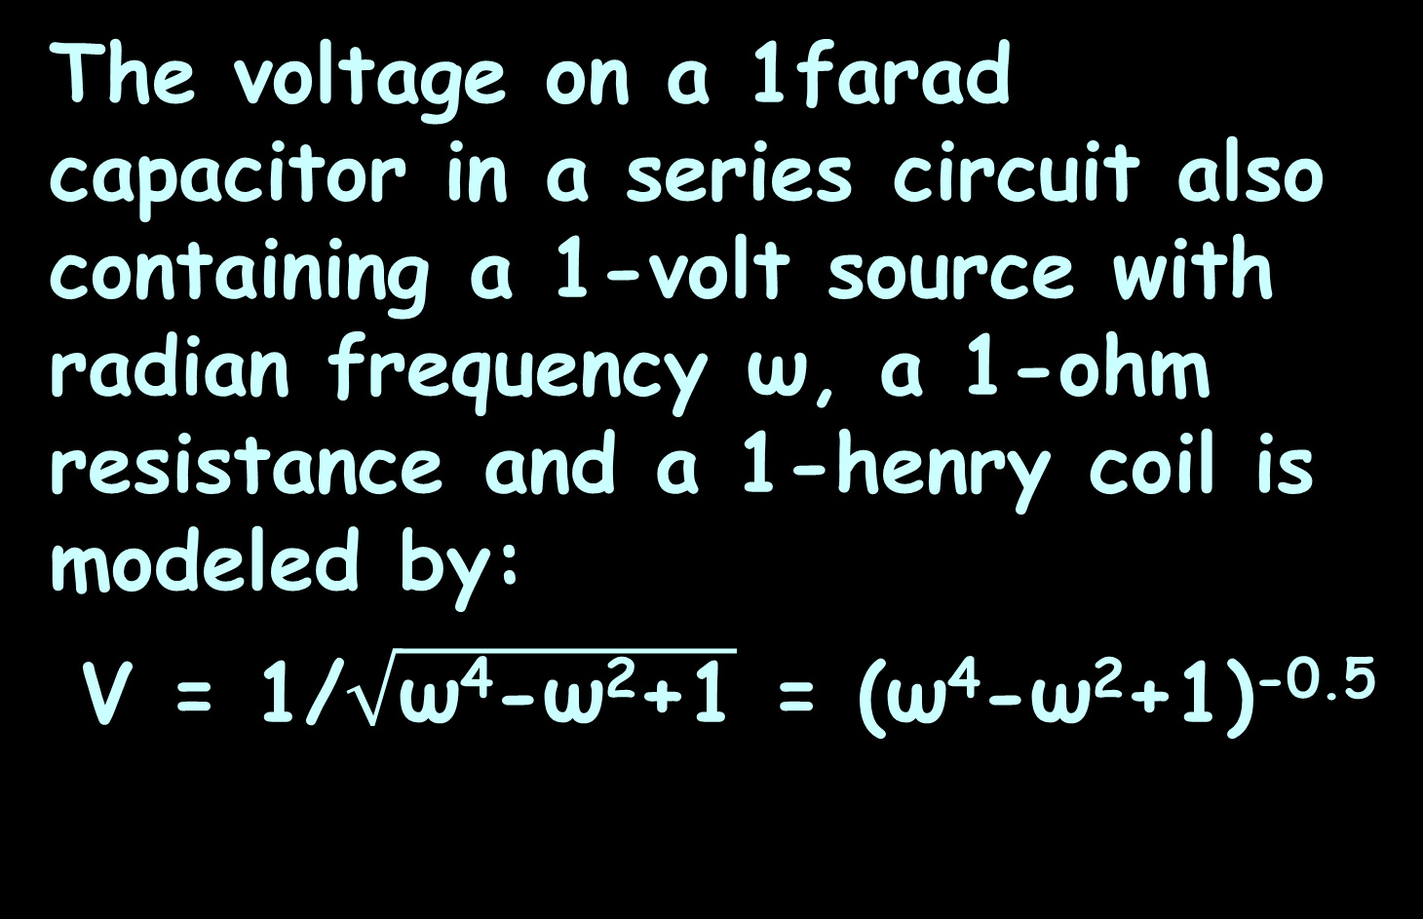
Taylor Series
The voltage on a 1farad capacitor in a series circuit also containing a 1-volt source with radian frequency ω, a 1-ohm resistance and a 1-henry coil is modeled by:
V = 1/$\sqrt{\text{ω}\text{4}\text{−}\text{ω}\text{2}\text{+1}}$ = (ω⁴-ω²+1)^{-0.5}

Slide 63
TAYLOR SERIES
IN-CLASS PROBLEM 3a
Find a 3-term Taylor series for V = (ω⁴-ω²+1)^{-0.5} for values of ω near 1
First term?
ƒ(x) = ƒ(a) + ƒ '(a)(x-b) + ƒ $\text{′′}$(a)(x-b)²/2 + ƒ $\text{′′′}$(a)(x-b)³/3! + ƒ $\text{′′′′}$(a)(x-b)⁴/4! + …

Slide 64
TAYLOR SERIES
IN-CLASS PROBLEM 3a
Find a 3-term Taylor series for V = (ω⁴-ω²+1)^{-0.5} for values of ω near 1
First term?
V = (ω⁴-ω²+1)^{-0.5}
First derivative?
ƒ(x) = ƒ(a) + ƒ '(a)(x-b) + ƒ $\text{′′}$(a)(x-b)²/2 + ƒ $\text{′′′}$(a)(x-b)³/3! + ƒ $\text{′′′′}$(a)(x-b)⁴/4! + …

Slide 65
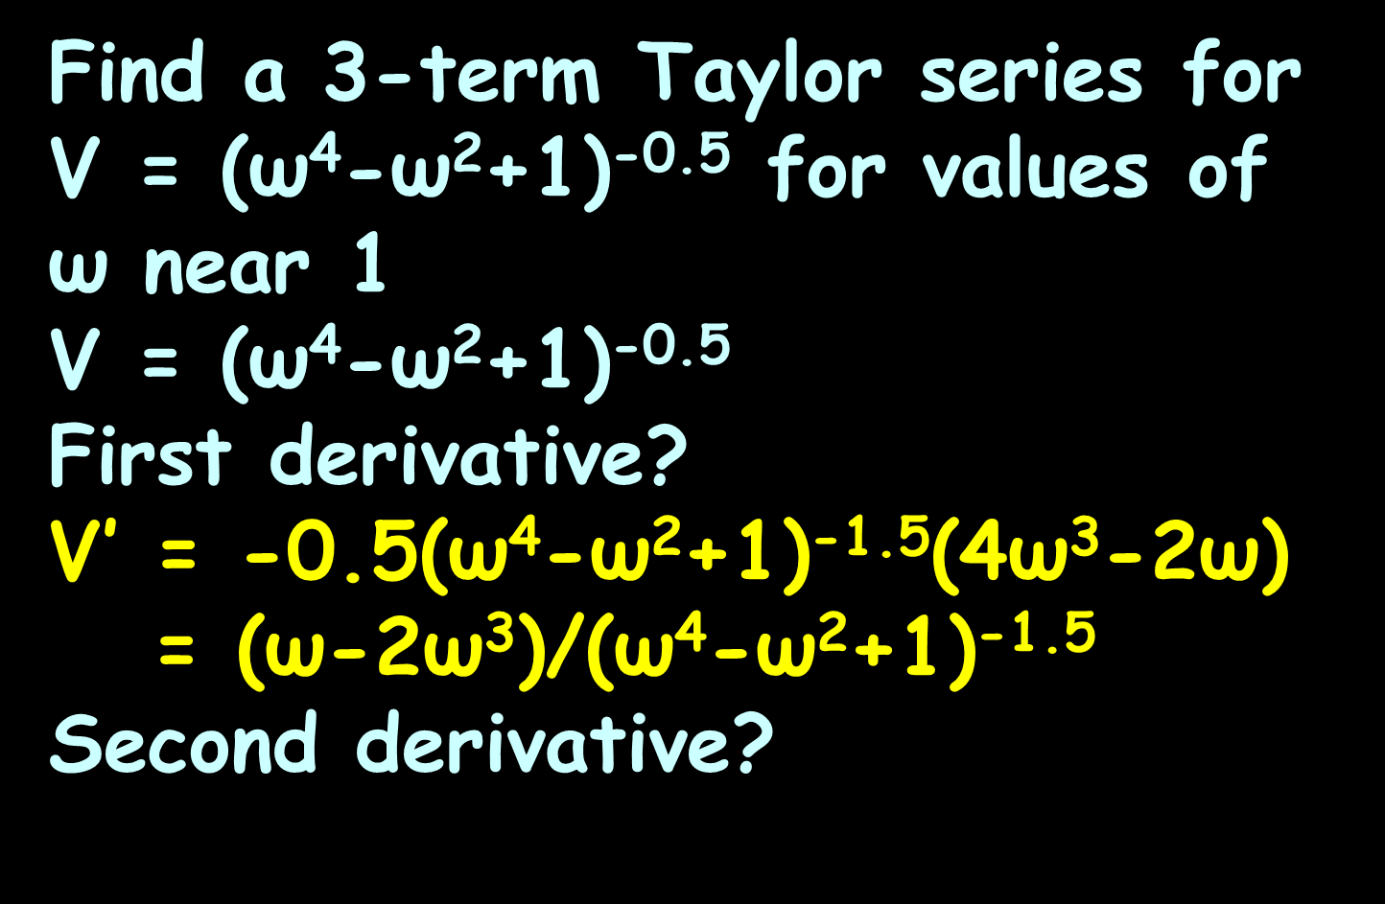
TAYLOR SERIES
IN-CLASS PROBLEM 3a
Find a 3-term Taylor series for V = (ω⁴-ω²+1)^{-0.5} for values of ω near 1
V = (ω⁴-ω²+1)^{-0.5}
First derivative?
V$\text{′}$ = -0.5(ω⁴-ω²+1)^{-1.5}(4ω³-2ω)
= (ω-2ω³)/(ω⁴-ω²+1)^{-1.5}
Second derivative?
ƒ(x) = ƒ(a) + ƒ '(a)(x-b) + ƒ $\text{′′}$(a)(x-b)²/2 + ƒ $\text{′′′}$(a)(x-b)³/3! + ƒ $\text{′′′′}$(a)(x-b)⁴/4! + …

Slide 66
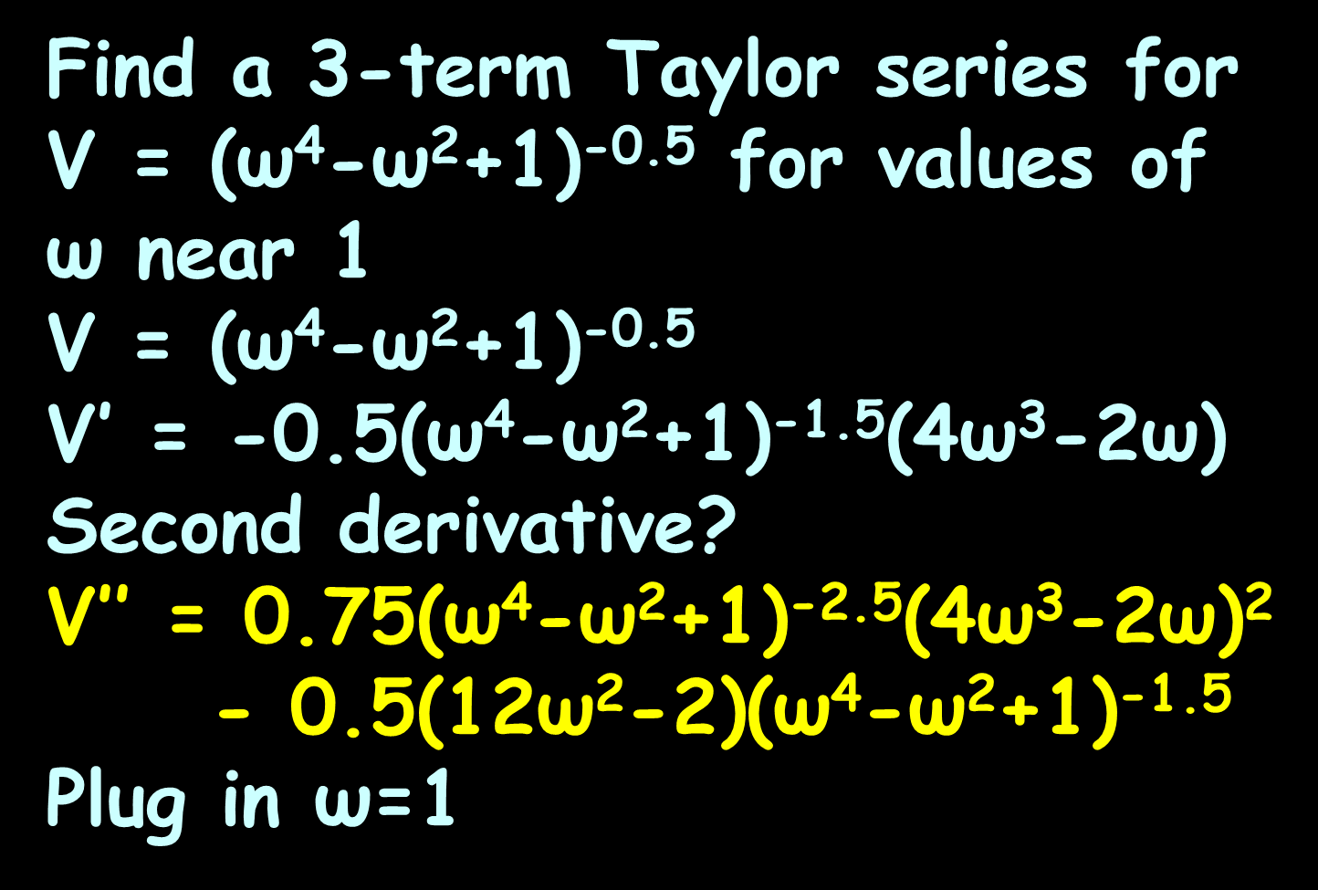
TAYLOR SERIES
IN-CLASS PROBLEM 3a
Find a 3-term Taylor series for V = (ω⁴-ω²+1)^{-0.5} for values of ω near 1
V = (ω⁴-ω²+1)^{-0.5}
V$\text{′}$ = -0.5(ω⁴-ω²+1)^{-1.5}(4ω³-2ω)
Second derivative?
V$\text{′}\text{′}$ = 0.75(ω⁴-ω²+1)^{-2.5}(4ω³-2ω)²
- 0.5(12ω²-2)(ω⁴-ω²+1)^{-1.5}
Plug in ω=1
ƒ(x) = ƒ(a) + ƒ '(a)(x-b) + ƒ $\text{′′}$(a)(x-b)²/2 + ƒ $\text{′′′}$(a)(x-b)³/3!

Slide 67
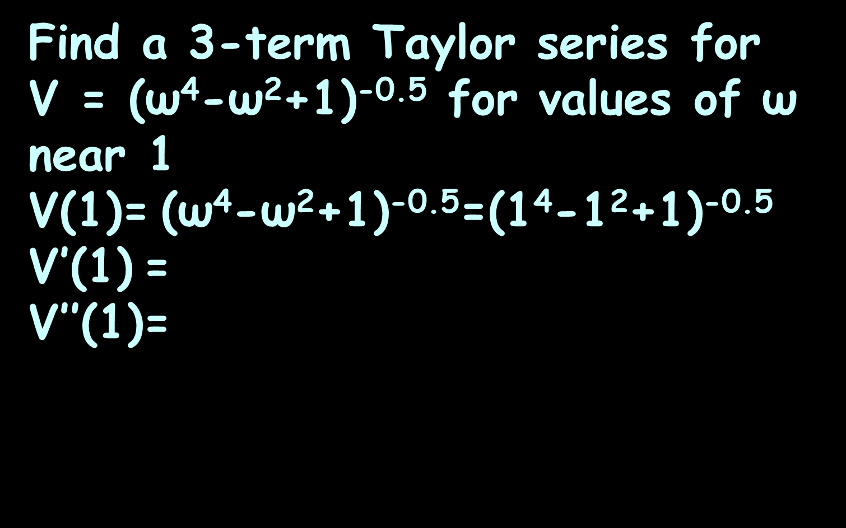
TAYLOR SERIES
IN-CLASS PROBLEM 3a
Find a 3-term Taylor series for
V = (ω⁴-ω²+1)^{-0.5} for values of ω near 1
V(1)= (ω⁴-ω²+1)^{-0.5}=(1⁴-1²+1)^{-0.5} V$\text{′}$(1) =
V$\text{′}\text{′}$(1)=
ƒ(x) = ƒ(a) + ƒ '(a)(x-b) + ƒ $\text{′′}$(a)(x-b)²/2 + ƒ $\text{′′′}$(a)(x-b)³/3!

Slide 68
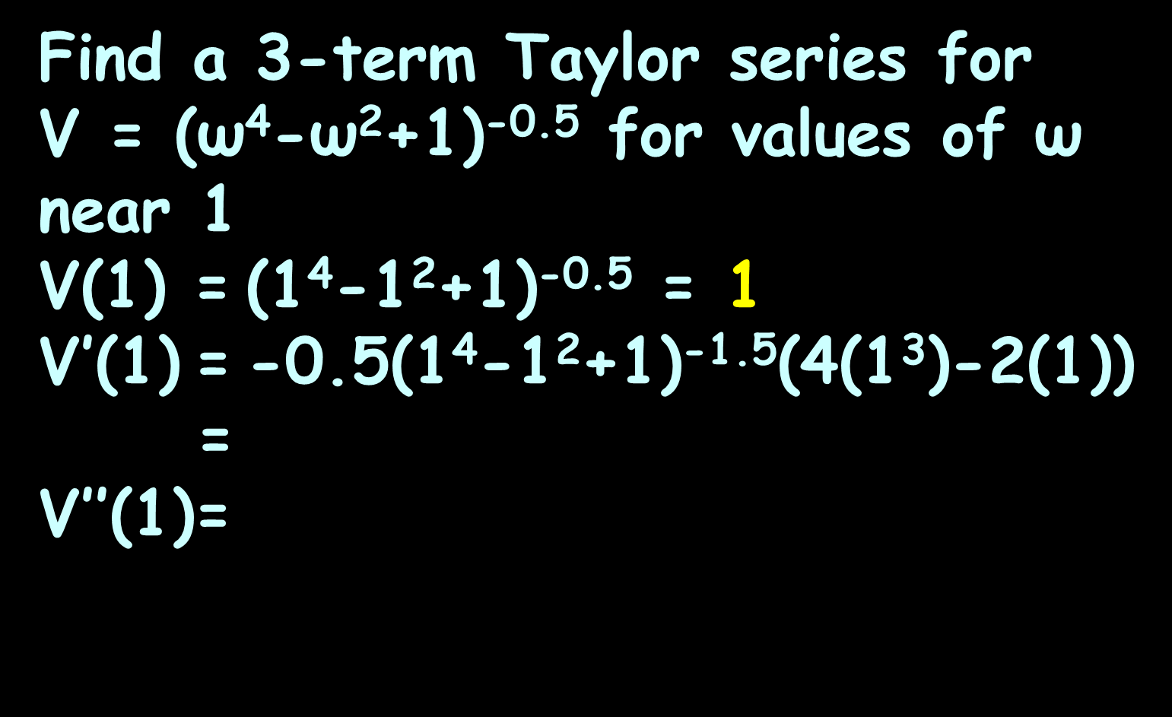
TAYLOR SERIES
IN-CLASS PROBLEM 3a
Find a 3-term Taylor series for
V = (ω⁴-ω²+1)^{-0.5} for values of ω near 1
V(1) = (1⁴-1²+1)^{-0.5} = 1
V$\text{′}$(1) = -0.5(1⁴-1²+1)^{-1.5}(4(1³)-2(1))
=
V$\text{′}\text{′}$(1)=

Slide 69
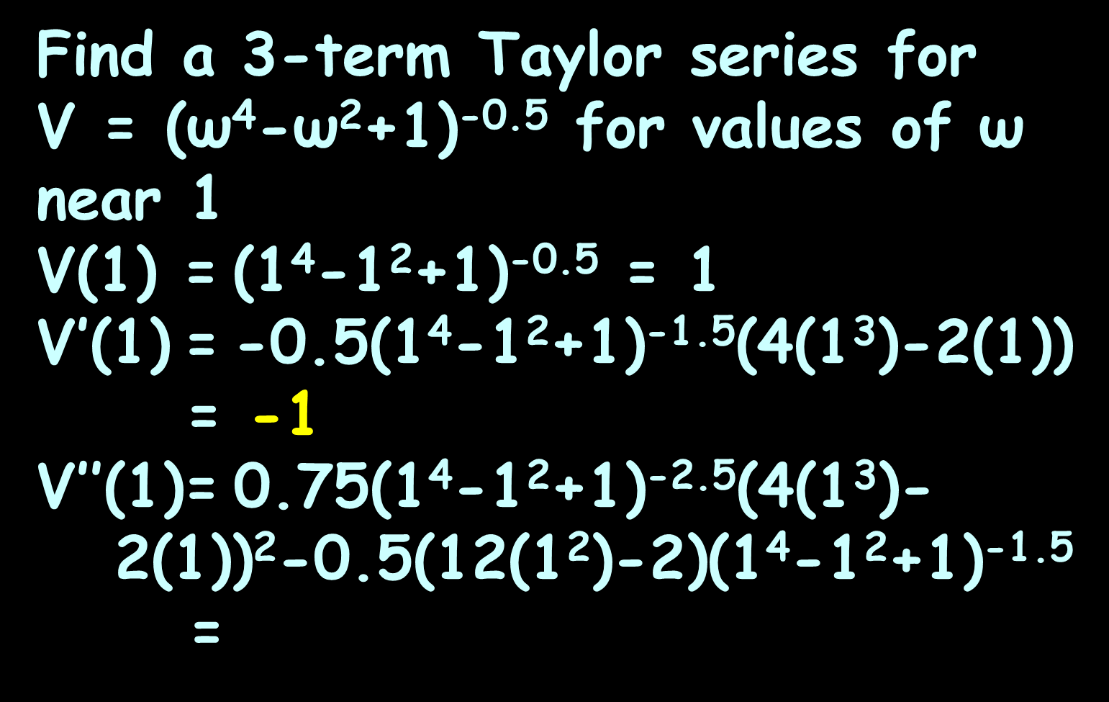
TAYLOR SERIES
IN-CLASS PROBLEM 3a
Find a 3-term Taylor series for
V = (ω⁴-ω²+1)^{-0.5} for values of ω near 1
V(1) = (1⁴-1²+1)^{-0.5} = 1
V$\text{′}$(1) = -0.5(1⁴-1²+1)^{-1.5}(4(1³)-2(1))
= -1
V$\text{′}\text{′}$(1)= 0.75(1⁴-1²+1)^{-2.5}(4(1³)-
2(1))²-0.5(12(1²)-2)(1⁴-1²+1)^{-1.5}
=

Slide 70
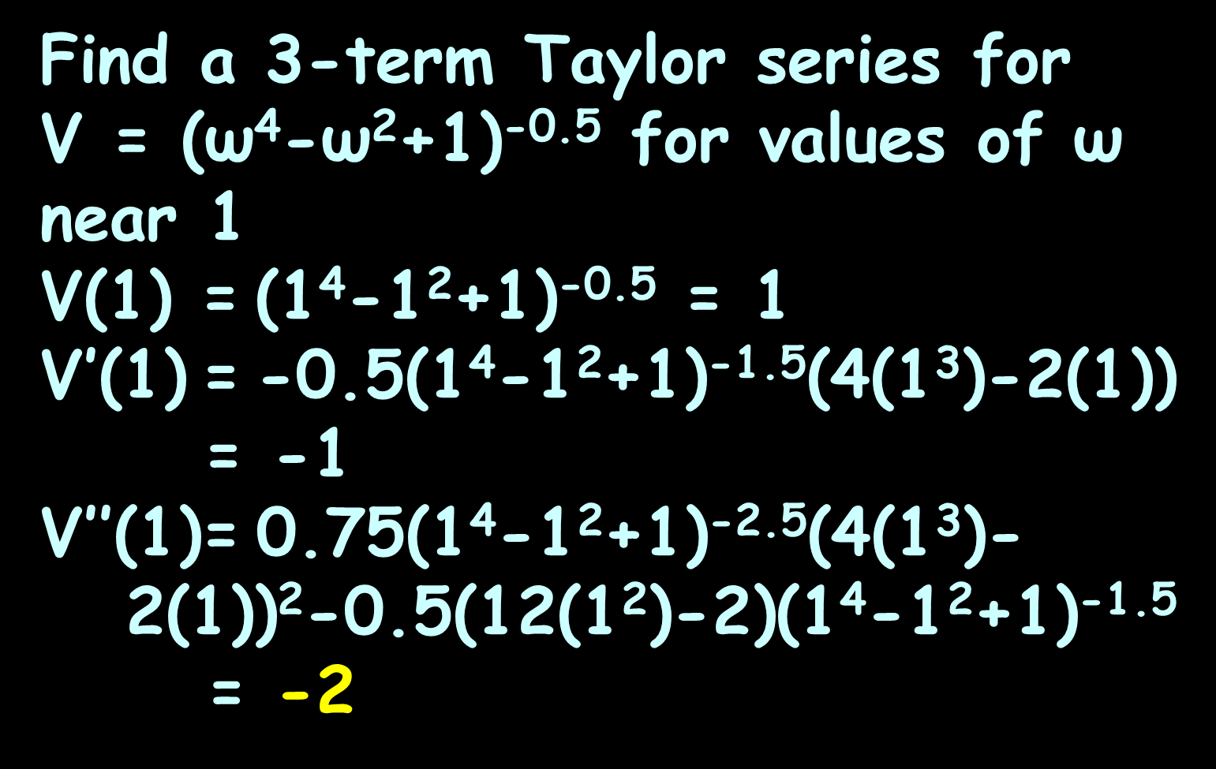
TAYLOR SERIES
IN-CLASS PROBLEM 3a
Find a 3-term Taylor series for
V = (ω⁴-ω²+1)^{-0.5} for values of ω near 1
V(1) = (1⁴-1²+1)^{-0.5} = 1
V$\text{′}$(1) = -0.5(1⁴-1²+1)^{-1.5}(4(1³)-2(1))
= -1
V$\text{′}\text{′}$(1)= 0.75(1⁴-1²+1)^{-2.5}(4(1³)-
2(1))²-0.5(12(1²)-2)(1⁴-1²+1)^{-1.5}
= -2

Slide 71
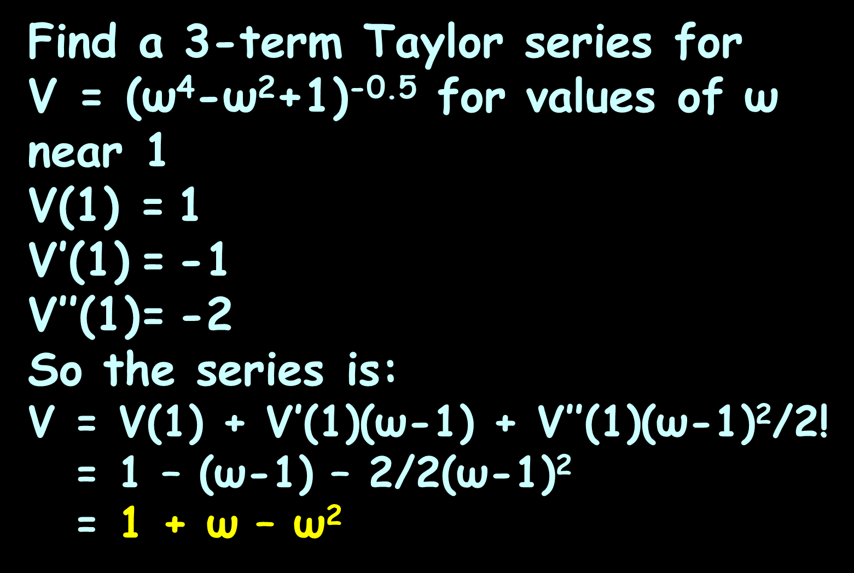
TAYLOR SERIES
IN-CLASS PROBLEM 3a
Find a 3-term Taylor series for
V = (ω⁴-ω²+1)^{-0.5} for values of ω near 1
V(1) = 1
V$\text{′}$(1) = -1
V$\text{′}\text{′}$(1)= -2
So the series is:
V = V(1) + V$\text{′}$(1)(ω-1) + V$\text{′′}$(1)(ω-1)²/2!
= 1 – (ω-1) – 2/2(ω-1)²
= 1 + ω – ω²
2 – ω
- (ω² - 2ω + 1)

Slide 72
TAYLOR SERIES
IN-CLASS PROBLEM 3b
What would the value of this Taylor series be for ω=1.05?
V = 1 + ω – ω²

Slide 73
TAYLOR SERIES
IN-CLASS PROBLEM 3b
What would the value of this Taylor series be for ω=1.05?
V = 1 + ω – ω²
= 1 + 1.05 – 1.1025
= 0.9475 whats?

Slide 74
TAYLOR SERIES
IN-CLASS PROBLEM 3b
What would the value of this Taylor series be for ω=1.05?
V = 1 + ω – ω²
= 1 + 1.05 – 1.1025
= 0.9475 volts
Check it against the original function: V = (ω⁴-ω²+1)^{-0.5}
1.21550625
1.1025

Slide 75
TAYLOR SERIES
IN-CLASS PROBLEM 3b
What would the value of this Taylor series be for ω=1.05?
V = 1 + ω – ω²
= 1 + 1.05 – 1.1025
= 0.9475 volts
V = (1.05⁴-1.05²+1)^{-0.5}
≈ 0.94785283 volts
Is this close enough?

Slide 76
Questions
http://i.imgur.com/aliTlT3.jpg

Slide 77
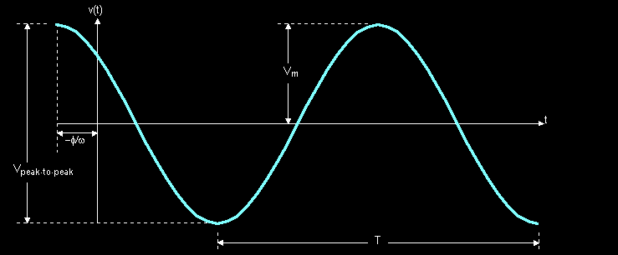
Fourier Series
When you study AC circuits you learn the most common periodic voltage waveform: the sine wave
https://www.allaboutcircuits.com/uploads/articles/L10-1.gif

Slide 78
Fourier Series
This waveform’s equation contains all the necessary characteristics to completely describe it as an oscilloscope picture
https://www.edn.com/rescued-analog-oscilloscope-works-fine-still-has-value/

Slide 79
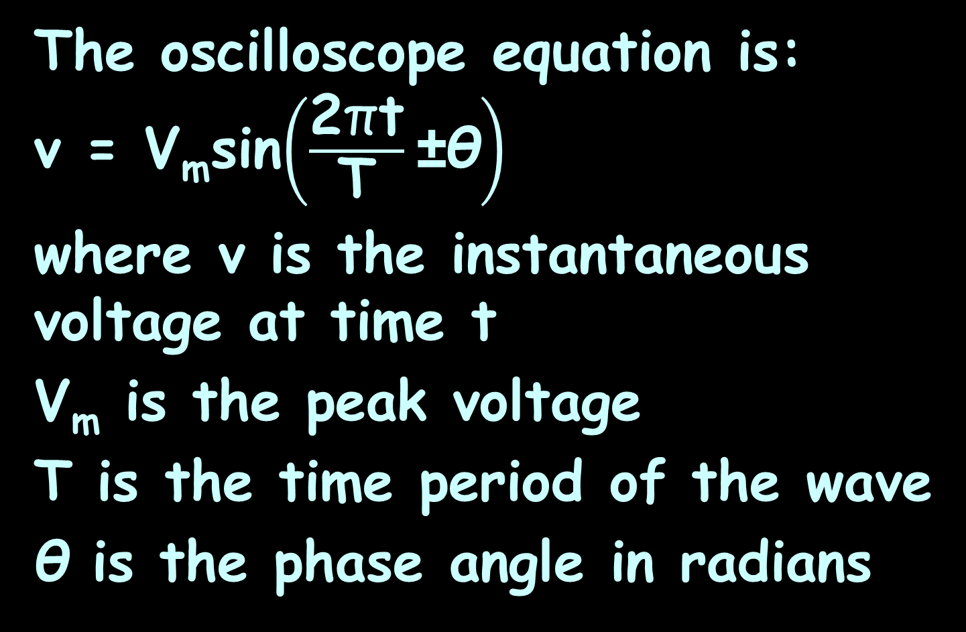
Fourier Series
The oscilloscope equation is:
v = V_{m}sin$\left(\frac{\text{2}\text{π}\text{t}}{\text{T}}\text{±}\text{θ}\right)$
where v is the instantaneous voltage at time t
V_{m} is the peak voltage
T is the time period of the wave
θ is the phase angle in radians

Slide 80
Fourier Series
The sine wave is a continuous periodic wave

Slide 81
Fourier Series
The sine wave is a continuous periodic wave
Not all waves are continuous

Slide 82
Continuity
The Heaviside function H (named after the electrical engineer Oliver Heaviside (1850–1925)) is defined by
H(t)=
{
0 if t<0
1 if t≥0
https://en.wikipedia.org/wiki/Oliver_Heaviside#/media/File:Oheaviside.jpg

Slide 83
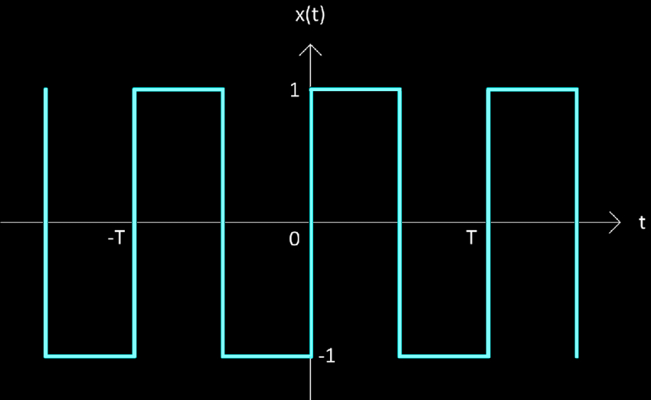
Fourier Series
The square wave (Heaviside function) is not continuous over a complete cycle T
V_{m}
-V_{m}
https://www.researchgate.net/publication/312928999/figure/fig1/AS:669069531430915@1536530015313/Square-wave-with-fifty-percent-duty-cycle-and-zero-volt-DC-offset.png

Slide 84
Fourier Series
There is no simple equation to describe it
V_{m}
-V_{m}
https://www.researchgate.net/publication/312928999/figure/fig1/AS:669069531430915@1536530015313/Square-wave-with-fifty-percent-duty-cycle-and-zero-volt-DC-offset.png

Slide 85
Fourier Series
Mathematical convention describes it piece-by-piece
v(t) =
V_{m} 0<t<T/2
-V_{m} T/2<t<T
period T
V_{m}
-V_{m}
https://www.researchgate.net/publication/312928999/figure/fig1/AS:669069531430915@1536530015313/Square-wave-with-fifty-percent-duty-cycle-and-zero-volt-DC-offset.png

Slide 86
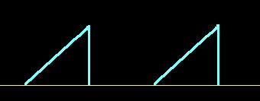
Fourier Series
Ramp waves are similar v = 5t
5v
v = 5t
0v
t sec
0 1 2 3
v(t) =
5t 0≤t<1 sec
0 1<t≤2 sec
period T = 2 sec
https://4.bp.blogspot.com/-QG45lniljYA/WfibOVK003I/AAAAAAAAAwE/
vjYj1UQM8lYOZMiM8XPsR_QKtEzAbF83wCLcBGAs/s1600/sawtooth%2Bwave.jpg

Slide 87
Fourier Series
Ditto for a half-rectified sine wave
170v
0ms 17ms 34ms 51ms
v(t) =
170sin(377t) 0≤t≤17 ms
0 17ms≤t≤34 ms
period T = 34 ms
VFrench 2021

Slide 88
Fourier Series
…and a staircase waveform
15v
10v
5v
0ms 1ms 2ms 3ms 4ms 5ms 6ms 7ms
v(t) =
5 0<t<1ms
1<t<2ms
15 2<t<3ms
0 3<t<4ms
period T = 4 ms
VFrench 2021

Slide 89
Fourier Series
These functions can be integrated only piece-by-piece

Slide 90
Questions?
http://i.imgur.com/aliTlT3.jpg

Slide 91
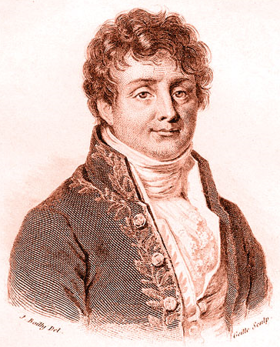
Fourier Series
Jean-Baptiste Joseph Fourier (1768-1830) developed the heat equation in 1822 to describe the temperature at a point within a mass
https://en.wikipedia.org/wiki/Joseph_Fourier#/media/File:Fourier2.jpg

Slide 92
Fourier Series
Fourier discovered his equation could be written as an infinite series of sine and cosine terms
He later generalized that to ANY periodic function

Slide 93
Fourier Series
Today we use Fourier series to describe the many periodic waveforms of voltage and current that appear in the field of electronics

Slide 94
Fourier Series
Any function can be represented as a sum of sines and cosines of different frequencies called a Fourier Series

Slide 95
Fourier Series
As you add sine waves of increasingly higher frequency, the approximation gets better and better
The addition of higher frequencies better approximates the details, (i.e., the change in slope) in the original function

Slide 96
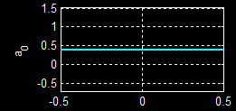
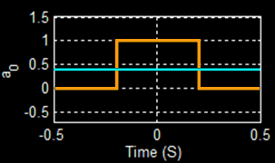
Fourier Series
a₀ is a constant term
It is the average value of the original function
This is often called the DC or the zero frequency component of the Fourier series
https://lpsa.swarthmore.edu/Fourier/Series/WhyFS.html

Slide 97
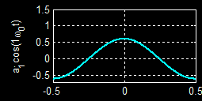
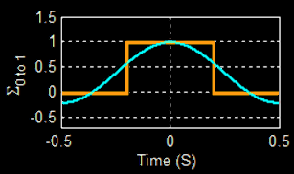
Fourier Series
The second component a₁cos(ω₀t) has exactly one oscillation of the cosine in the period T=1
We call this the 1st or fundamental harmonic (frequency)
Adding a₀ adjusts its vertical location
a₀ + a₁cos(ω₀t)
https://lpsa.swarthmore.edu/Fourier/Series/WhyFS.html

Slide 98
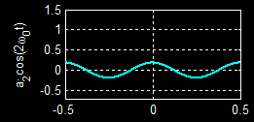
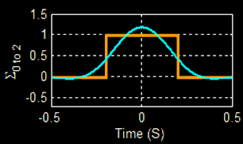
Fourier Series
The 2nd harmonic (frequency) (n=2) has exactly two oscillations in one period T=1 of the original function
Added to the zero-eth and first harmonic still looks like a cosine
A little fitting
A little fitting
https://lpsa.swarthmore.edu/Fourier/Series/WhyFS.html

Slide 99
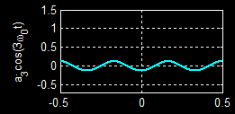
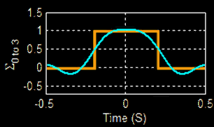
Fourier Series
The 3rd harmonic (frequency) (n=3) has exactly three oscillations in one period, T=1, of the original function
Added to the earlier harmonics you begin to get some “fitting”
A little fitting
A little more fitting
A little more fitting
https://lpsa.swarthmore.edu/Fourier/Series/WhyFS.html

Slide 100
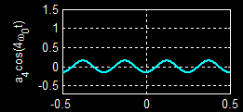
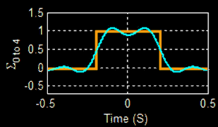
Fourier Series
The 4th harmonic (frequency) (n=4) has exactly four oscillations in one period, T=1, of the original function
Added to the earlier harmonics gives a better “fit”
A little
more fitting
A little more fitting
A little more fitting
https://lpsa.swarthmore.edu/Fourier/Series/WhyFS.html

Slide 101
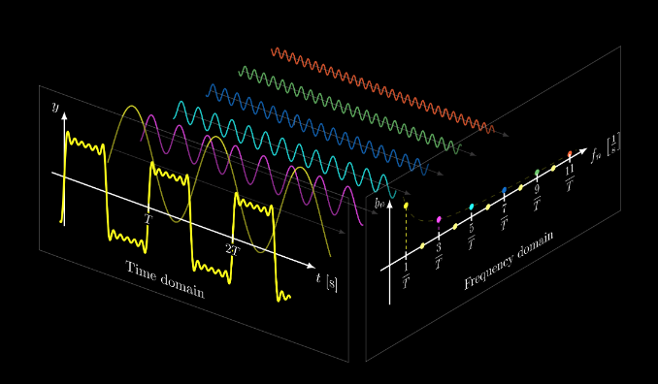
Fourier Series
How the terms add up:
https://tikz.net/fourier_series/

Slide 102
Fourier Series
“Even” functions are represented by cosines (which are even)
“Odd” functions are represented by sines (which are odd)
“Arbitrary” functions include both

Slide 103
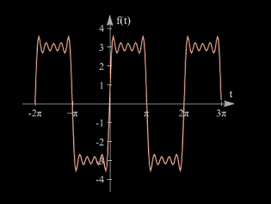
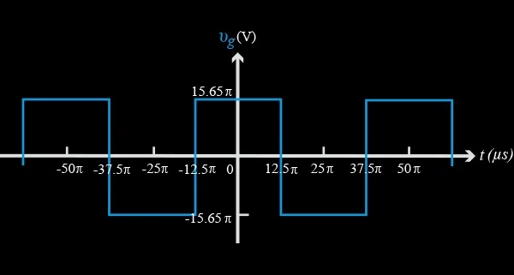
Fourier Series
Odd function
use sines
Even function
use cosines

Slide 104
Questions?
http://i.imgur.com/aliTlT3.jpg

Slide 105
Fourier Series
There are certain limitations inherent in the use of the Fourier Series, but these are almost never a problem in engineering applications

Slide 106
Fourier Series
The Fourier series converges:
if ∫x_{T}(t) dt < ∞ (as long as the function is not infinite over a finite interval)

Slide 107
Fourier Series
The Fourier series converges:
if x_{T} has a finite number of discontinuities in one period

Slide 108
Fourier Series
The Fourier series converges:
if x_{T} has a finite number of maxima and minima in one period

Slide 109
Fourier Series
The Fourier series converges:
except at discontinuities, where it converges to the midpoint of the discontinuity

Slide 110
Fourier Series
At a discontinuity there is an overshoot (Gibb's phenomenon - about 9% for a square wave). However this discontinuity becomes vanishingly narrow (and it's area, and energy, are zero), and therefore irrelevant as we sum up more terms of the series

Slide 111
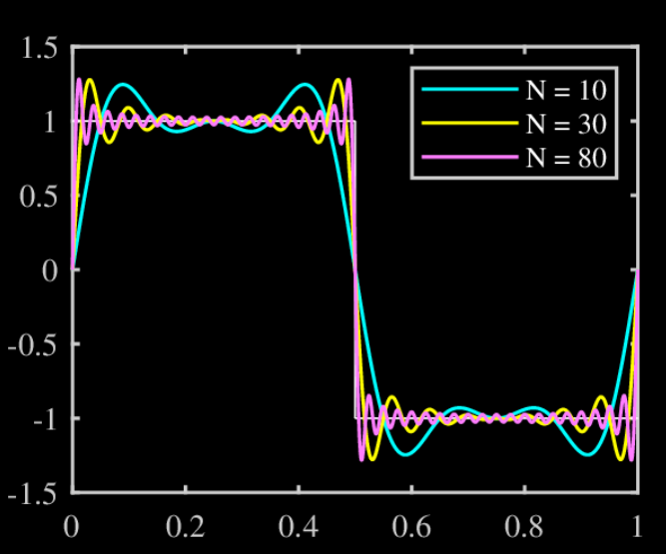
Fourier Series
Gibb’s overshoot
https://www.researchgate.net/figure/Fourier-series-approximation-of-a-square-wave-N-is-the-number-of-number-of-terms-used-to_fig1_337768291

Slide 112
Questions?
http://i.imgur.com/aliTlT3.jpg

Slide 113
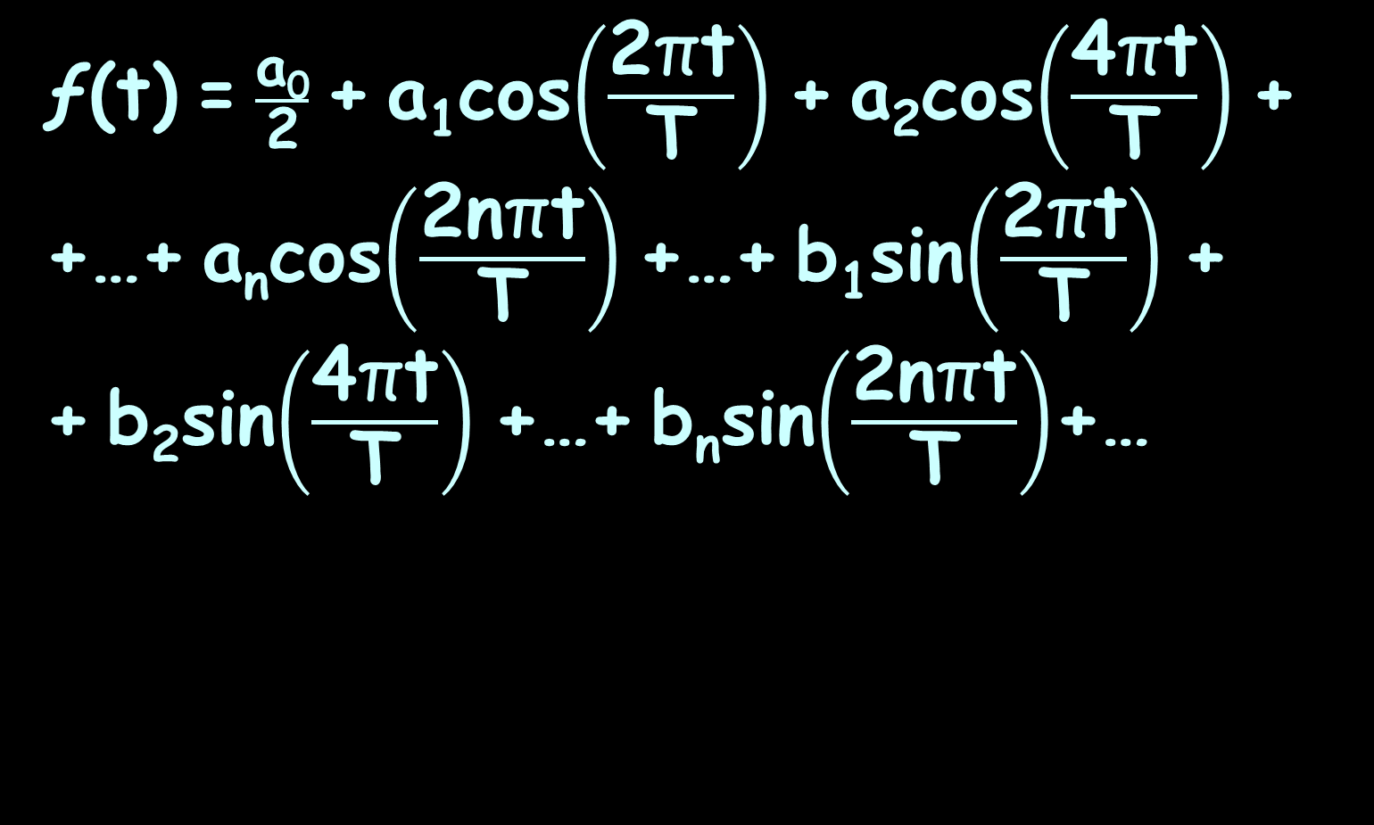
Fourier Series
ƒ(t) = $\frac{\text{a}\text{0}}{\text{2}}$ + a₁cos$\left(\frac{\text{2}\text{π}\text{t}}{\text{T}}\right)$ + a₂cos$\left(\frac{\text{4}\text{π}\text{t}}{\text{T}}\right)$ + +…+ a_{n}cos$\left(\frac{\text{2}\text{n}\text{π}\text{t}}{\text{T}}\right)$ +…+ b₁sin$\left(\frac{\text{2}\text{π}\text{t}}{\text{T}}\right)$ +
+ b₂sin$\left(\frac{\text{4}\text{π}\text{t}}{\text{T}}\right)$ +…+ b_{n}sin$\left(\frac{\text{2}\text{n}\text{π}\text{t}}{\text{T}}\right)$+…

Slide 114
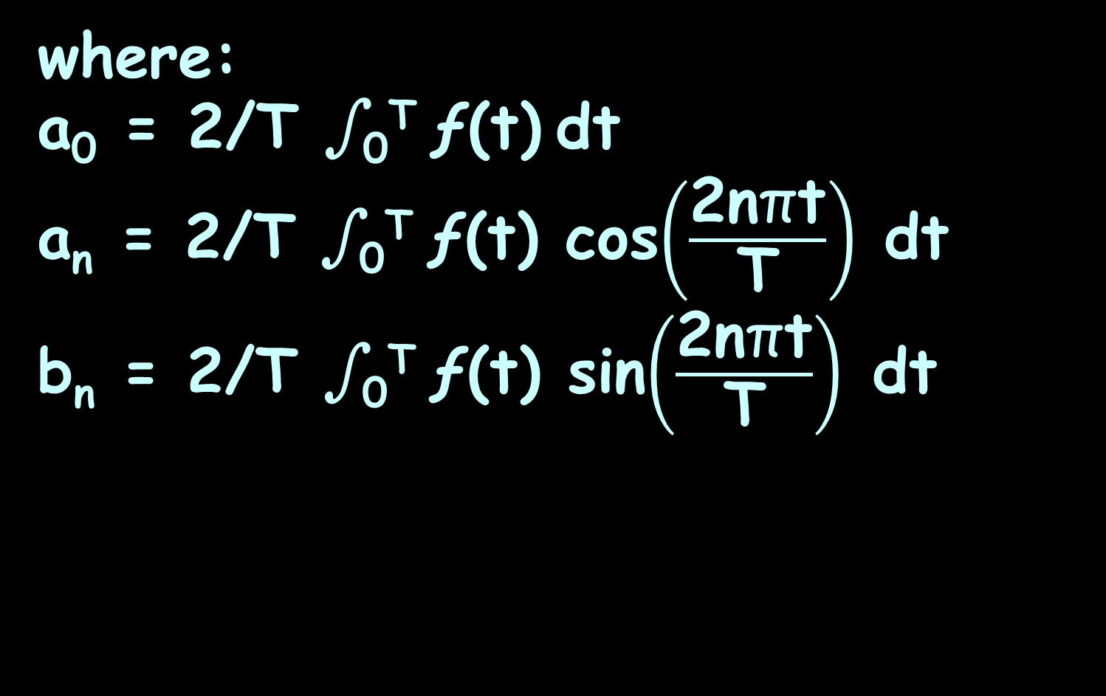
Fourier Series
where:
a₀ = 2/T ∫₀^{T} ƒ(t) dt
a_{n} = 2/T ∫₀^{T} ƒ(t) cos$\left(\frac{\text{2}\text{n}\text{π}\text{t}}{\text{T}}\right)$ dt
b_{n} = 2/T ∫₀^{T} ƒ(t) sin$\left(\frac{\text{2}\text{n}\text{π}\text{t}}{\text{T}}\right)$ dt

Slide 115
Fourier Series
The different coefficients a₀, a_{n}, b_{n} show how much of each frequency the function contains

Slide 116
Fourier Series
If a₁ is much larger than a₂, then the function contains a lot more of the one-oscillation frequency than the two-oscillation frequency

Slide 117
Fourier Series
This begins to move us into signal processing and spectral analysis

Slide 118
Fourier Series
Can you tell the calculations are going to be painful?

Slide 119
Fourier Series
Can you tell this is going to be painful?
Can you tell your calculator/
computer is going to once again be your best friend?

Slide 120
Fourier Series
Can you tell this is going to be painful?
Can you tell your calculator/
computer is going to once again be your best friend?
Alas that it were so! These are so awful even calculators and computers are baffled!

Slide 121
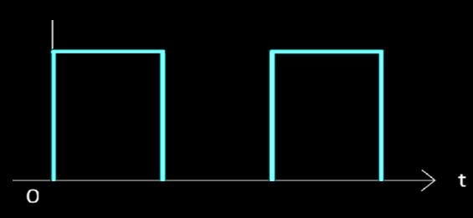
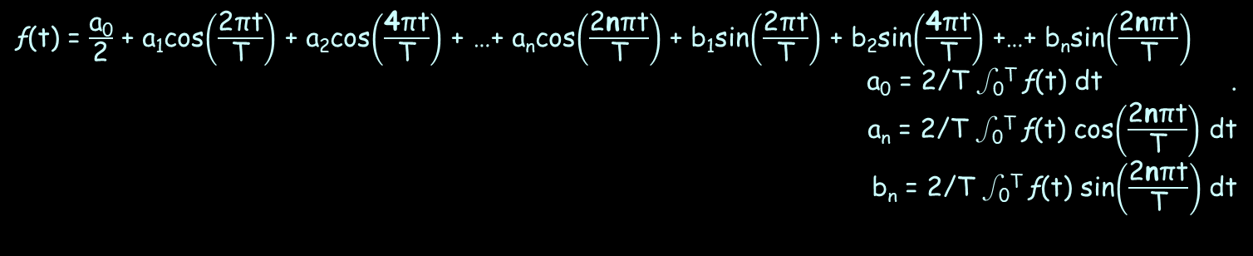
FOURIER SERIES
IN-CLASS PROBLEM 4
Find the Fourier series of the pulse voltage waveform:
v(t) =
10 0<t<1
0 1<t<2
period T=2
10
0 1 2 3
ƒ(t) = $\frac{\text{a}\text{0}}{\text{2}}$ + a₁cos$\left(\frac{\text{2}\text{π}\text{t}}{\text{T}}\right)$ + a₂cos$\left(\frac{\text{4}\text{π}\text{t}}{\text{T}}\right)$ + …+ a_{n}cos$\left(\frac{\text{2}\text{n}\text{π}\text{t}}{\text{T}}\right)$ + b₁sin$\left(\frac{\text{2}\text{π}\text{t}}{\text{T}}\right)$ + b₂sin$\left(\frac{\text{4}\text{π}\text{t}}{\text{T}}\right)$ +…+ b_{n}sin$\left(\frac{\text{2}\text{n}\text{π}\text{t}}{\text{T}}\right)$
a₀ = 2/T ∫₀^{T} ƒ(t) dt .
a_{n} = 2/T ∫₀^{T} ƒ(t) cos$\left(\frac{\text{2}\text{n}\text{π}\text{t}}{\text{T}}\right)$ dt
b_{n} = 2/T ∫₀^{T} ƒ(t) sin$\left(\frac{\text{2}\text{n}\text{π}\text{t}}{\text{T}}\right)$ dt
VFrench, 2021

Slide 122
FOURIER SERIES
IN-CLASS PROBLEM 4
Find the Fourier series of the pulse voltage waveform:
a₀ = 2/T ∫₀^{T} ƒ(t) dt =
v(t) =
10 0<t<1
0 1<t<2
period T=2
10
0 1 2 3
ƒ(t) = $\frac{\text{a}\text{0}}{\text{2}}$ + a₁cos$\left(\frac{\text{2}\text{π}\text{t}}{\text{T}}\right)$ + a₂cos$\left(\frac{\text{4}\text{π}\text{t}}{\text{T}}\right)$ + …+ a_{n}cos$\left(\frac{\text{2}\text{n}\text{π}\text{t}}{\text{T}}\right)$ + b₁sin$\left(\frac{\text{2}\text{π}\text{t}}{\text{T}}\right)$ + b₂sin$\left(\frac{\text{4}\text{π}\text{t}}{\text{T}}\right)$ +…+ b_{n}sin$\left(\frac{\text{2}\text{n}\text{π}\text{t}}{\text{T}}\right)$
a₀ = 2/T ∫₀^{T} ƒ(t) dt .
a_{n} = 2/T ∫₀^{T} ƒ(t) cos$\left(\frac{\text{2}\text{n}\text{π}\text{t}}{\text{T}}\right)$ dt
b_{n} = 2/T ∫₀^{T} ƒ(t) sin$\left(\frac{\text{2}\text{n}\text{π}\text{t}}{\text{T}}\right)$ dt
VFrench, 2021

Slide 123
FOURIER SERIES
IN-CLASS PROBLEM 4
Find the Fourier series of the pulse voltage waveform:
a₀ = 2/T ∫₀^{T} ƒ(t) dt
= 2/2[∫₀¹ 10 dt + ∫₁² 0 dt]
v(t) =
10 0<t<1
0 1<t<2
period T=2
10
0 1 2 3
VFrench, 2021

Slide 124
FOURIER SERIES
IN-CLASS PROBLEM 4
Find the Fourier series of the pulse voltage waveform:
a₀ = 2/T ∫₀^{T} ƒ(t) dt
= 2/2[∫₀¹ 10 dt + ∫₁² 0 dt]
= 2/2[10t|₀¹+0 = 10 that’s the easy one!
v(t) =
10 0<t<1
0 1<t<2
period T=2
10
0 1 2 3
VFrench, 2021

Slide 125
FOURIER SERIES
IN-CLASS PROBLEM 4
Find the Fourier series of the pulse voltage waveform:
a_{n} = 2/T ∫₀^{T} ƒ(t) cos(2nπt/T) dt
v(t) =
10 0<t<1
0 1<t<2
period T=2
10
0 1 2 3
ƒ(t) = $\frac{\text{a}\text{0}}{\text{2}}$ + a₁cos$\left(\frac{\text{2}\text{π}\text{t}}{\text{T}}\right)$ + a₂cos$\left(\frac{\text{4}\text{π}\text{t}}{\text{T}}\right)$ + …+ a_{n}cos$\left(\frac{\text{2}\text{n}\text{π}\text{t}}{\text{T}}\right)$ + b₁sin$\left(\frac{\text{2}\text{π}\text{t}}{\text{T}}\right)$ + b₂sin$\left(\frac{\text{4}\text{π}\text{t}}{\text{T}}\right)$ +…+ b_{n}sin$\left(\frac{\text{2}\text{n}\text{π}\text{t}}{\text{T}}\right)$
a₀ = 2/T ∫₀^{T} ƒ(t) dt .
a_{n} = 2/T ∫₀^{T} ƒ(t) cos$\left(\frac{\text{2}\text{n}\text{π}\text{t}}{\text{T}}\right)$ dt
b_{n} = 2/T ∫₀^{T} ƒ(t) sin$\left(\frac{\text{2}\text{n}\text{π}\text{t}}{\text{T}}\right)$ dt
VFrench, 2021

Slide 126
FOURIER SERIES
IN-CLASS PROBLEM 4
Find the Fourier series of the pulse voltage waveform:
a_{n} = 2/T ∫₀^{T} ƒ(t) cos(2nπ/T) t dt
= 2/2[∫₀¹ 10cos(2nπt/2) dt +
+ ∫₁² 0 dt] = 10/nπ sin(nπ) |₀¹ = 0
v(t) =
10 0<t<1
0 1<t<2
period T=2
10
0 1 2 3
VFrench, 2021

Slide 127
FOURIER SERIES
IN-CLASS PROBLEM 4
Find the Fourier series of the pulse voltage waveform:
a_{n} = 0
Means all the “cos” terms go away!
v(t) =
10 0<t<1
0 1<t<2
period T=2
10
0 1 2 3
VFrench, 2021

Slide 128
FOURIER SERIES
IN-CLASS PROBLEM 4
Find the Fourier series of the pulse voltage waveform:
b_{n} = 2/T ∫₀^{T} ƒ(t) sin(2nπ/T) t dt
v(t) =
10 0<t<1
0 1<t<2
period T=2
10
0 1 2 3
ƒ(t) = $\frac{\text{a}\text{0}}{\text{2}}$ + a₁cos$\left(\frac{\text{2}\text{π}\text{t}}{\text{T}}\right)$ + a₂cos$\left(\frac{\text{4}\text{π}\text{t}}{\text{T}}\right)$ + …+ a_{n}cos$\left(\frac{\text{2}\text{n}\text{π}\text{t}}{\text{T}}\right)$ + b₁sin$\left(\frac{\text{2}\text{π}\text{t}}{\text{T}}\right)$ + b₂sin$\left(\frac{\text{4}\text{π}\text{t}}{\text{T}}\right)$ +…+ b_{n}sin$\left(\frac{\text{2}\text{n}\text{π}\text{t}}{\text{T}}\right)$
a₀ = 2/T ∫₀^{T} ƒ(t) dt .
a_{n} = 2/T ∫₀^{T} ƒ(t) cos$\left(\frac{\text{2}\text{n}\text{π}\text{t}}{\text{T}}\right)$ dt
b_{n} = 2/T ∫₀^{T} ƒ(t) sin$\left(\frac{\text{2}\text{n}\text{π}\text{t}}{\text{T}}\right)$ dt
VFrench, 2021

Slide 129
FOURIER SERIES
IN-CLASS PROBLEM 4
Find the Fourier series of the pulse voltage waveform:
b_{n} = 2/T ∫₀^{T} ƒ(t) sin(2nπt/T) dt
= 2/2[∫₀¹ 10sin(2nπt/2) dt +
+ ∫₁² 0 dt] = -10cos(nπt)/nπ |₀¹
v(t) =
10 0<t<1
0 1<t<2
period T=2
10
0 1 2 3
VFrench, 2021

Slide 130
FOURIER SERIES
IN-CLASS PROBLEM 4
Find the Fourier series of the pulse voltage waveform:
b_{n} = -10cos(nπt)/nπ |₀¹
= -10(cos(nπ) – 1)/nπ
v(t) =
10 0<t<1
0 1<t<2
period T=2
10
0 1 2 3
cos(0)
VFrench, 2021

Slide 131
FOURIER SERIES
IN-CLASS PROBLEM 4
Find the Fourier series of the pulse voltage waveform:
b_{n} = -10(cos(nπ) – 1)/nπ
When n is even: b_{n} = 0
When n is odd: b_{n} = 20/nπ
v(t) =
10 0<t<1
0 1<t<2
period T=2
10
0 1 2 3
cos(nπ) = 1
cos(nπ) = -1
VFrench, 2021

Slide 132

FOURIER SERIES
IN-CLASS PROBLEM 4
The Fourier series of the pulse voltage waveform:
ƒ(t) = 5+$\frac{\text{20}}{\text{π}}$sin$\left(\frac{\text{2}\text{π}\text{t}}{\text{2}}\right)$+$\frac{\text{20}}{\text{3}\text{π}}$sin$\left(\frac{\text{6}\text{π}\text{t}}{\text{2}}\right)$+
+$\frac{\text{20}}{\text{5}\text{π}}$sin$\left(\frac{\text{10}\text{π}\text{t}}{\text{2}}\right)$+$\frac{\text{20}}{\text{7}\text{π}}$sin$\left(\frac{\text{1}\text{4}\text{π}\text{t}}{\text{2}}\right)$+…
v(t) =
10 0<t<1
0 1<t<2
period T=2
10
0 1 2 3
VFrench, 2021

Slide 133
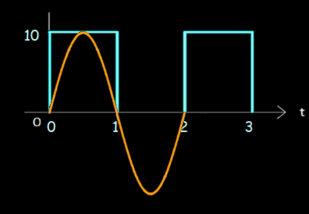
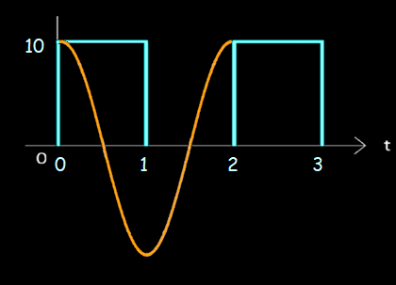
FOURIER SERIES
IN-CLASS PROBLEM 4
It makes sense that the cosines are not included while the sines
are:
sine
cosine
VFrench, 2021

Slide 134
Fourier Series
To use Wolfram Alpha, you have to convert the cycle into radians

Slide 135
FOURIER SERIES
IN-CLASS PROBLEM 4
ExptoTrig[FourierSeries[Piecewise[{{10,0<t<1pi},{0,1pi<t<2pi}}],t,5]]

Slide 136
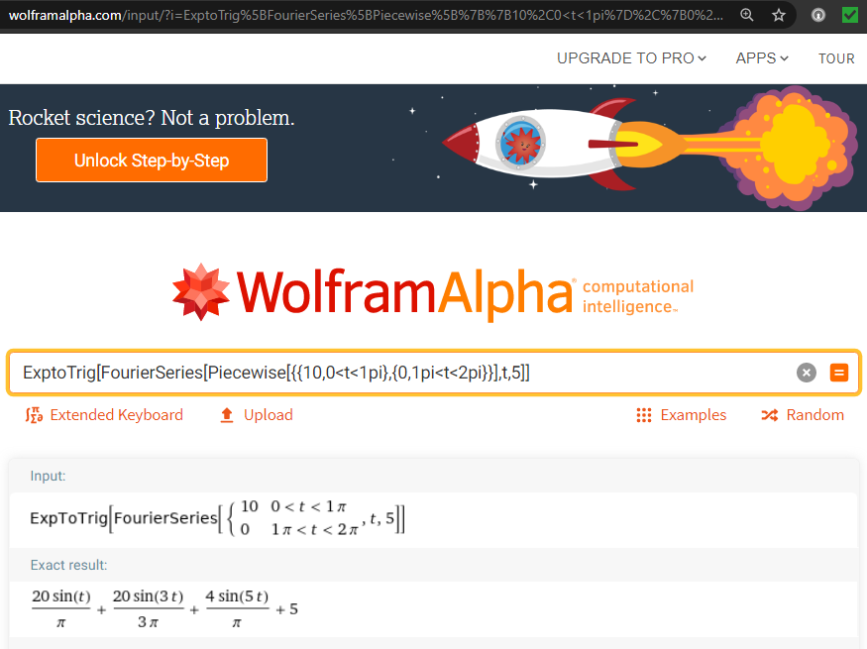

Slide 137
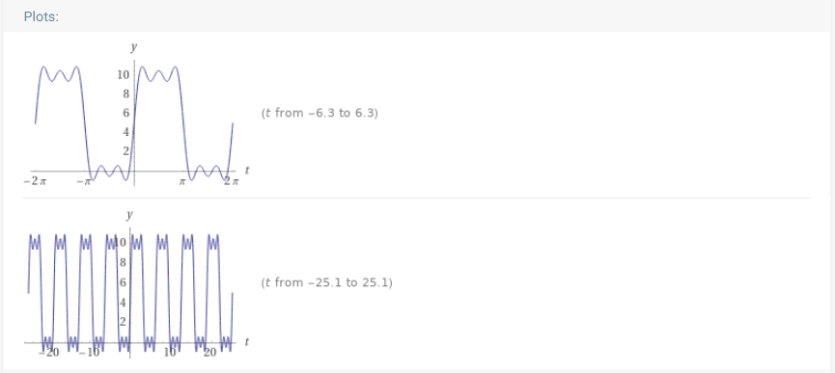

Slide 138
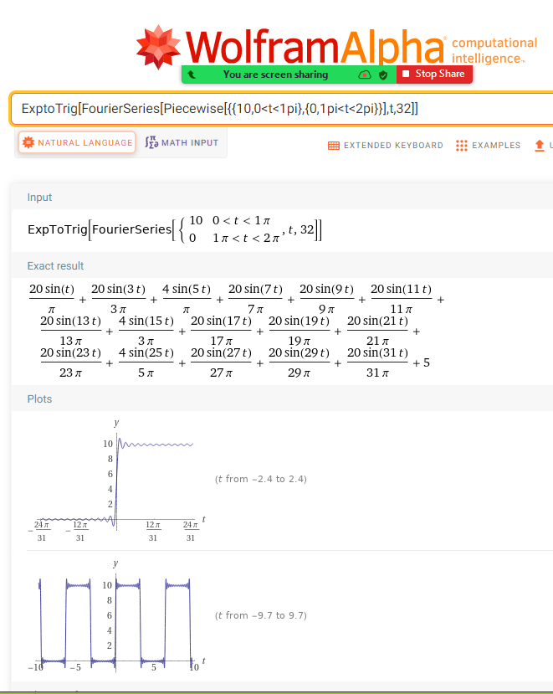

Slide 139
Fourier Series
Symbolab has a Fourier series button, but seems unable to handle piecewise Fourier series

Slide 140
Questions?
http://i.imgur.com/aliTlT3.jpg

Slide 141
Spectrum Analysis
Fourier analysis is the study of approximating functions using the sum of sine and cosine terms
This sum is called the Fourier series representation of the function

Slide 142
Spectrum Analysis
Spectrum analysis is identical to Fourier analysis except that instead of approximating a function, the sum of sine and cosine terms approximates a time series that includes a random component

Slide 143
Spectrum Analysis
This is where engineering and statistics become the same thing!

Slide 144
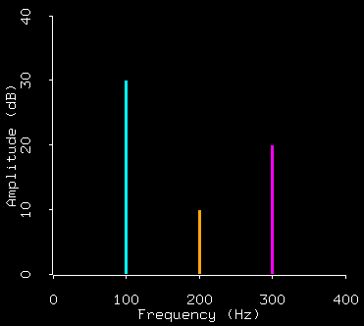
Spectrum Analysis
Graphs are used of the frequency components in the Fourier series
https://home.cc.umanitoba.ca/~krussll/138/sec4/spectrum1.gif

Slide 145
Spectrum Analysis
These are useful because they show the relative contributions of the various frequencies in the overall wave

Slide 146
Spectrum Analysis
Knowing the spectrum of a complex waveform allows us to extract the frequency components we choose using resonant circuit theory

Slide 147
SPECTRUM ANALYSIS
IN-CLASS PROBLEMS 5a,b
What is the frequency with the greatest contribution to the overall wave?
What is the frequency with the contribution closest to 20%?
%
30
20
10
freq
0 100Hz 200Hz 300Hz 400Hz 500Hz
VFrench, 2021

Slide 148
SPECTRUM ANALYSIS
IN-CLASS PROBLEMS 5a,b
What is the frequency with the greatest contribution to the overall wave?
500Hz
What is the frequency with the contribution closest to 20%?
%
30
20
10
freq
0 100Hz 200Hz 300Hz 400Hz 500Hz
VFrench, 2021

Slide 149
SPECTRUM ANALYSIS
IN-CLASS PROBLEMS 5a,b
What is the frequency with the greatest contribution to the overall wave?
500Hz
What is the frequency with the contribution closest to 20%?
400Hz
%
30
20
10
freq
0 100Hz 200Hz 300Hz 400Hz 500Hz
VFrench, 2021

Slide 150
Questions?
http://i.imgur.com/aliTlT3.jpg

Slide 151
Summary
Today we studied:
Review of Power and Maclaurin series
Taylor series
Fourier series
Spectrum Analysis

Slide 152

You Survived!

