Slide 1
Welcome to
Unit 7
Part 13!
MATH 207 Integral Calculus
http://en.wikipedia.org/wiki/Differential_equation#mediaviewer/File:Elmer-pump-heatequation.png

Slide 2
What’s Up?
Review:
Series
New stuff:
Convergence and Divergence

Slide 3
What’s Up?
Outcome 4) Determine convergence or divergence of improper integrals using the comparison test and by direct computation
Outcome 7) Solve problems by identifying the requirements, making a sketch as appropriate

Slide 4

Review
http://995642590.r.lightningbase-cdn.com/wp-content/uploads/2010/12/looking-back-hrexaminer-v144-cover425px.jpg

Slide 5
Sequences
Sequences are ordered lists

Slide 6

Sequences
They don’t have to be numbers

Slide 7
Sequences
Each member of a sequence is called a “term”

Slide 8
Sequences
Each term is designated by a subscript:
a_{1,} a_{2,} a_{3, ...,} a_{n, ...}
The 2nd term in the sequence
is a₂
The n^{th} term is a_{n}

Slide 9
Sequences
An infinite sequence goes on forever:
a_{1,} a_{2,} a_{3, ...}
A finite sequence stops at some point:
a_{1,} a_{2,} a_{3, ...,} a₁₂

Slide 10
Sequences
Numerical sequences are often formed by a formula that uses one term to calculate the next term in the sequence

Slide 11
Sequences
These are called “recursion formulas” - the formula calculates each term based on the previous term
a_{n} = a_{n-1} + 1

Slide 12
Sequences
You have to be given a starting term to evaluate these

Slide 13
Sequences
You evaluate a sequence by plugging in the requested numbers for each term

Slide 14
Sequences
note: sequences are discrete points, not a smooth function!

Slide 15
Sequences
Arithmetic Sequences:
Each term in the sequence (after the first) differs from the preceding by a constant amount (positive or negative)
a_{n} = a_{n-1} + d

Slide 16
Sequences
Geometric Sequences:
Each term in the sequence (after the first) is a common
multiple (positive or negative) of the previous term
a_{n} = r × a_{n-1}

Slide 17
Sequences
Limit of a sequence
if the terms of a sequence approach a specific number, we say the limit of the sequence exists and it converges to the number

Slide 18
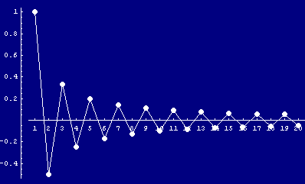
Sequences
Alternating Sequence:
Each term: (-1)^{n} a_{n}
5 -5 5 -5 5 -5 5 -5
http://www.cs.cas.cz/portal/AlgoMath/MathematicalAnalysis/InfiniteSeriesAndProducts/InfiniteSeries/SeriesWithArbitraryTerms/HTMLFiles/AlternatingSeries_38.gif

Slide 19
Series
If you combine the numbers in a sequence into a single number, it’s called a “series”

Slide 20
Series
This is usually done by adding up all of the terms or multiplying all of them together

Slide 21
Series
It’s math class… so there’s always a new symbol!
∑
means “add ‘em up!”

Slide 22
Series
We could have written:
What is the sum of the first 10 counting numbers?
as:
∑1 2 3…10

Slide 23
Series
We usually use ∑ with a formula:
10
∑ n
n=1
This means “add up the n’s where n goes from 1 to 10”

Slide 24
Series
It’s math class… so there’s always a new symbol!
Π
means “multiply ‘em up!”

Slide 25
Series
More new symbols!
Factorial notation
n! = n(n-1)(n-2)...3 × 2 × 1

Slide 26
Series
So, 4! would be:
4 × (4-1) × (4-2) × (4-3)
Don’t go to 4-4 (that would be zero…)
4! = 4 × 3 × 2 × 1 = ?

Slide 27
Series
Factorials are used a LOT in what are called “counting” problems

Slide 28
Series
Given a sequence of numbers {a_{n}}, the sum of the terms of this sequence:
a₁ + a₂ + a₃ + ... + a_{n} + ...
is called an infinite series

Slide 29
Series
The sequence Sn defined by
S₁ = a₁
S₂ = a₁ + a₂
S_{n} = a₁ + a₂ + a₃ + ... + a_{n}
n
= ∑ a_{k}
k=1
is the sequence of partial sums of the series

Slide 30
Series
The number S_{n} is the nth partial sum

Slide 31

Questions?
http://i.imgur.com/aliTlT3.jpg

Slide 32
Series Convergence
If the sequence of partial sums converge to a limit L, then we can say that the series converges and its sum is L

Slide 33
Series Convergence
If the sequence of partial sums of the series does not converge, then the series diverges

Slide 34

Standard Series
The formula for the sum of an arithmetic series is:
S_{n} = n $\frac{\text{a}\text{1}\text{ +} \text{a}\text{n}}{\text{2}}$

Slide 35

Standard Series
Similarly, the sum of a geometric series is:
S_{n} = $\frac{\text{a}\text{1}\text{(1−}\text{r}\text{n}\text{)}}{\text{1−}\text{r}}$

Slide 36
Series Convergence
So, how do you come up with a series to estimate a function?

Slide 37
Series Convergence
There are some different ways…
But one popular way is through long division
(Remember long division?)

Slide 38
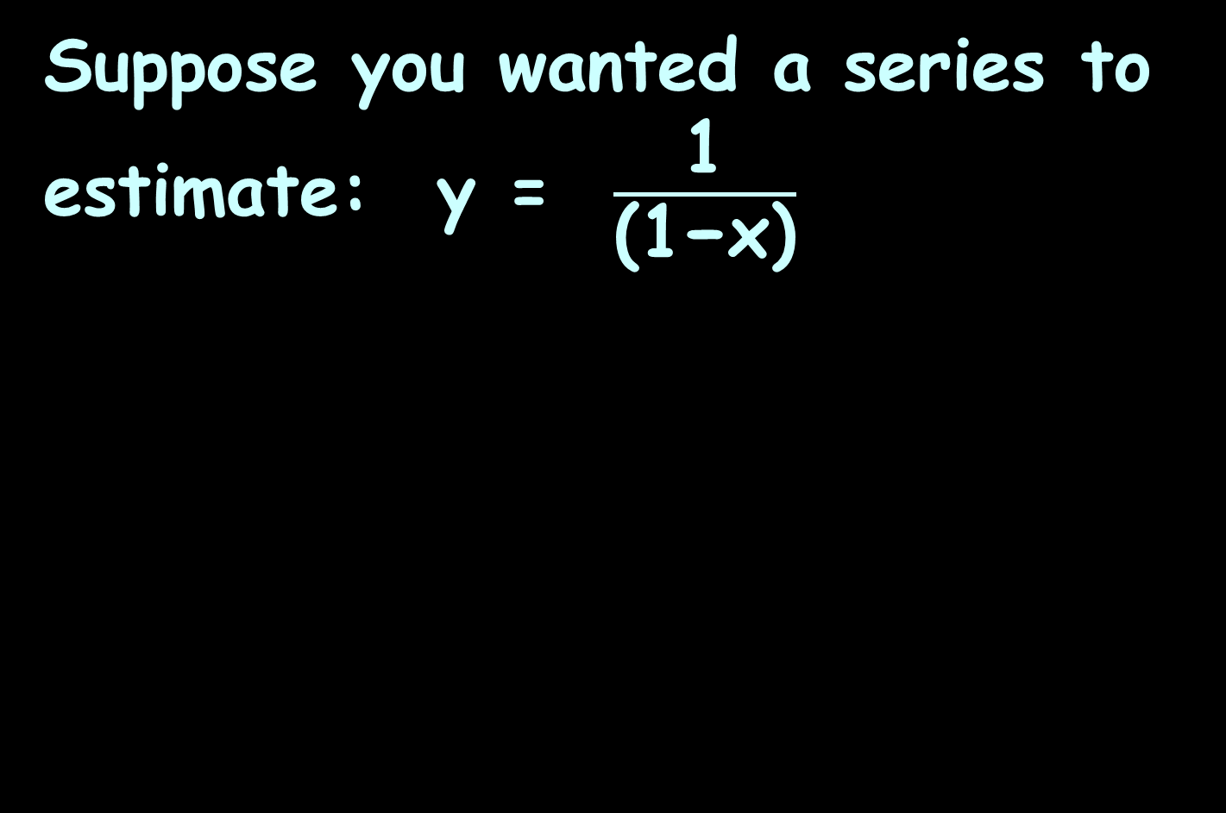
Series Convergence
Suppose you wanted a series to estimate: y = $\frac{\text{1}}{\text{(1−}\text{x}\text{)}}$

Slide 39
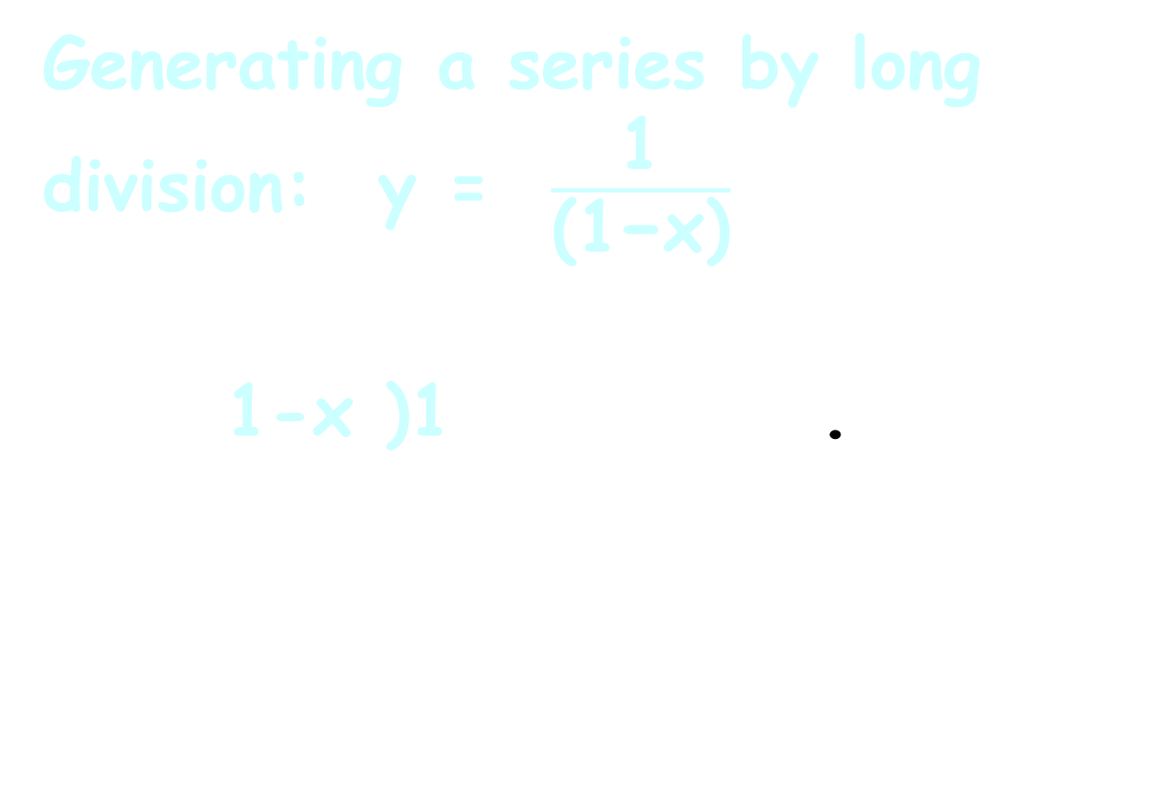
Series Convergence
Generating a series by long division: y = $\frac{\text{1}}{\text{(1−}\text{x}\text{)}}$
1-x )1 .
¯¯¯

Slide 40
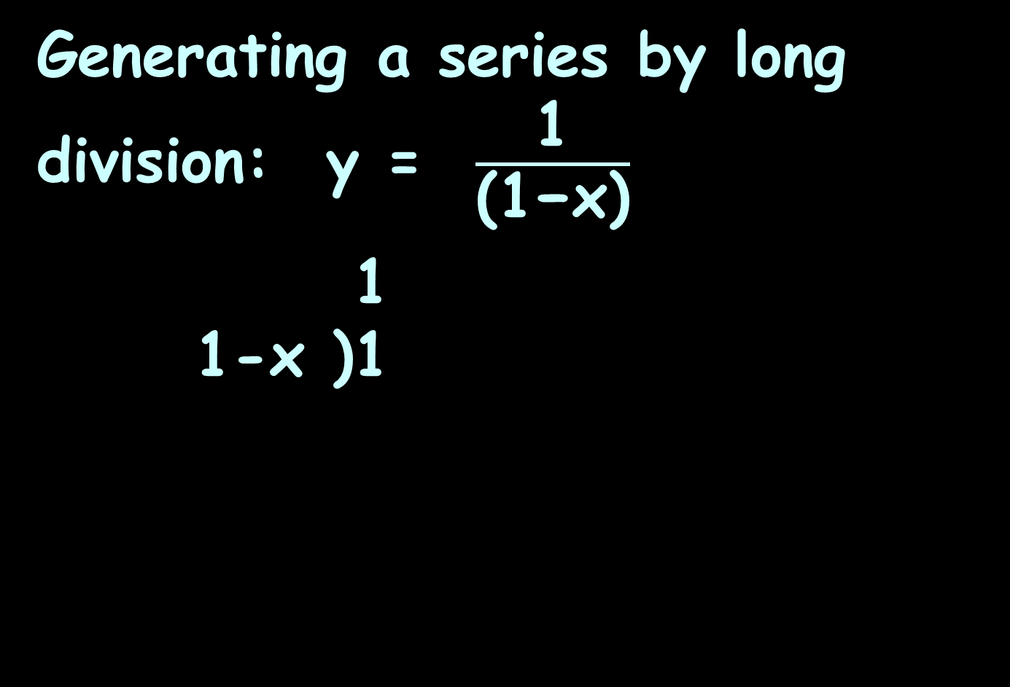
Series Convergence
Generating a series by long division: y = $\frac{\text{1}}{\text{(1−}\text{x}\text{)}}$
1
1-x )1
¯¯¯

Slide 41
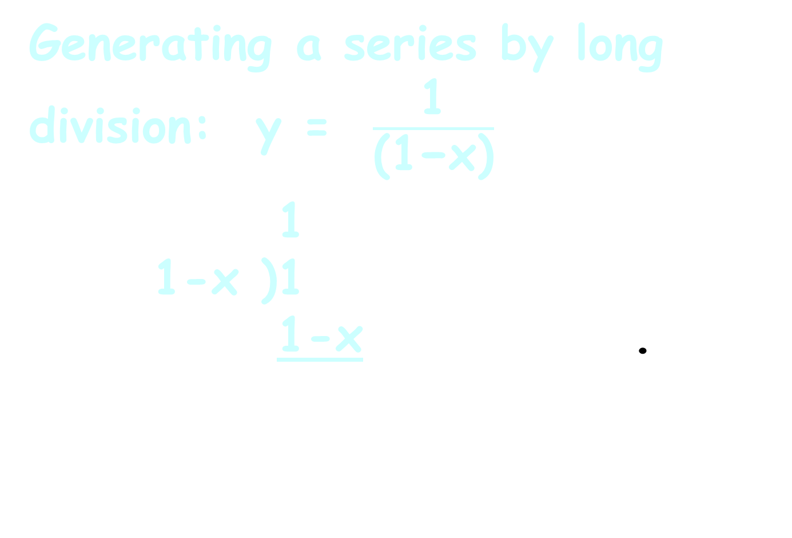
Series Convergence
Generating a series by long division: y = $\frac{\text{1}}{\text{(1−}\text{x}\text{)}}$
1
1-x )1
1-x .
¯¯¯

Slide 42
Series Convergence
Generating a series by long division: y = $\frac{\text{1}}{\text{(1−}\text{x}\text{)}}$
1
1-x )1
1-x .
¯¯¯
-( )

Slide 43
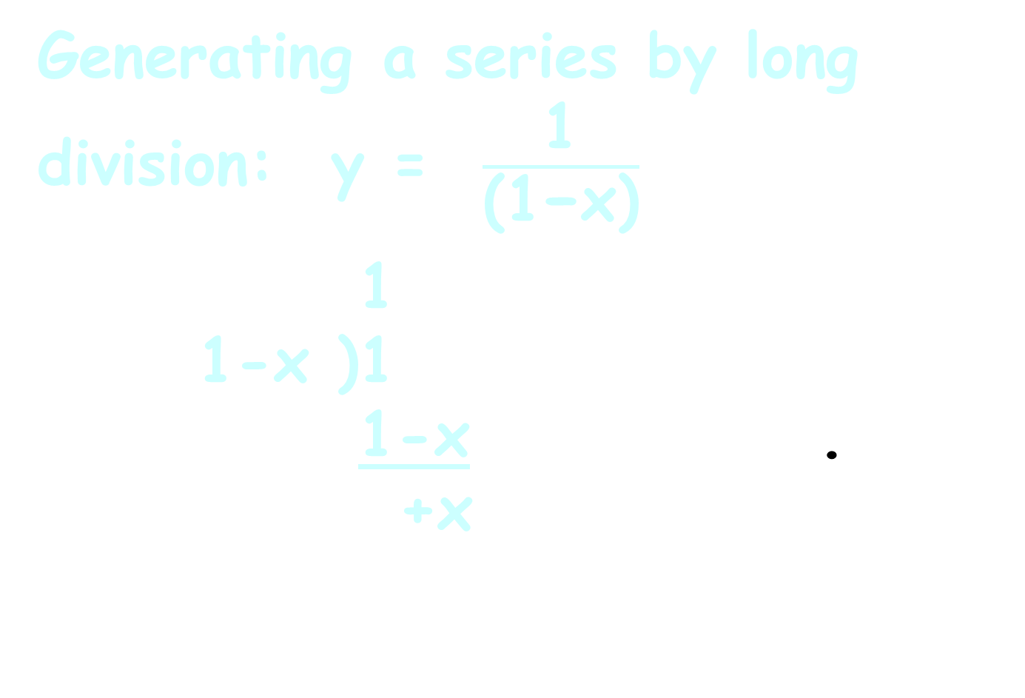
Series Convergence
Generating a series by long division: y = $\frac{\text{1}}{\text{(1−}\text{x}\text{)}}$
1
1-x )1
1-x .
+x
¯¯¯
-( )

Slide 44
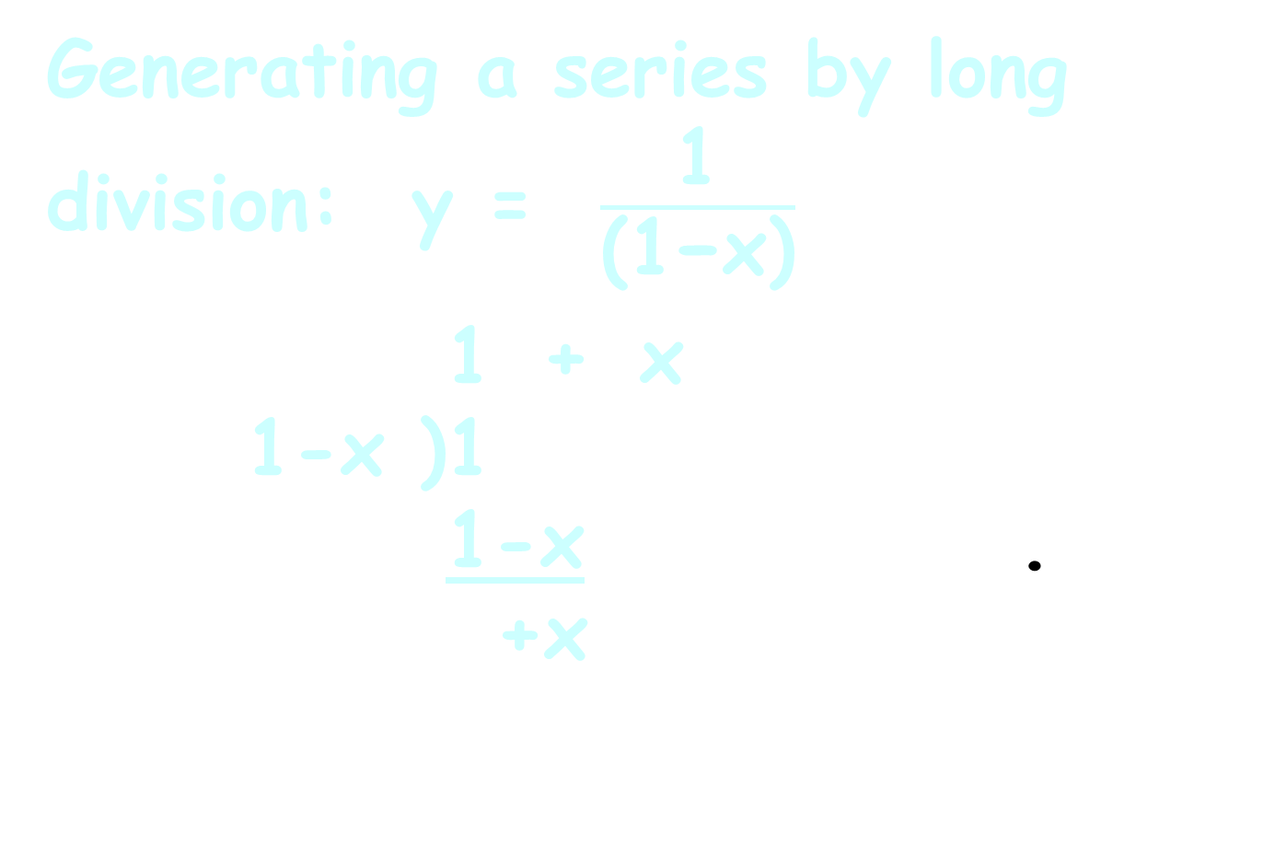
Series Convergence
Generating a series by long division: y = $\frac{\text{1}}{\text{(1−}\text{x}\text{)}}$
1 + x
1-x )1
1-x .
+x
¯¯¯¯¯¯
-( )

Slide 45
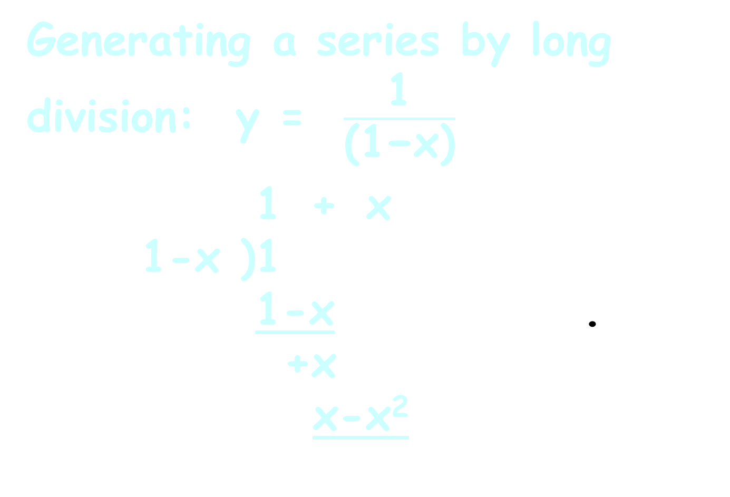
Series Convergence
Generating a series by long division: y = $\frac{\text{1}}{\text{(1−}\text{x}\text{)}}$
1 + x
1-x )1
1-x .
+x
x-x²
¯¯¯¯¯¯
-( )

Slide 46
Series Convergence
Generating a series by long division: y = $\frac{\text{1}}{\text{(1−}\text{x}\text{)}}$
1 + x
1-x )1
1-x .
+x
x-x²
¯¯¯¯¯¯
-( )
-( )

Slide 47
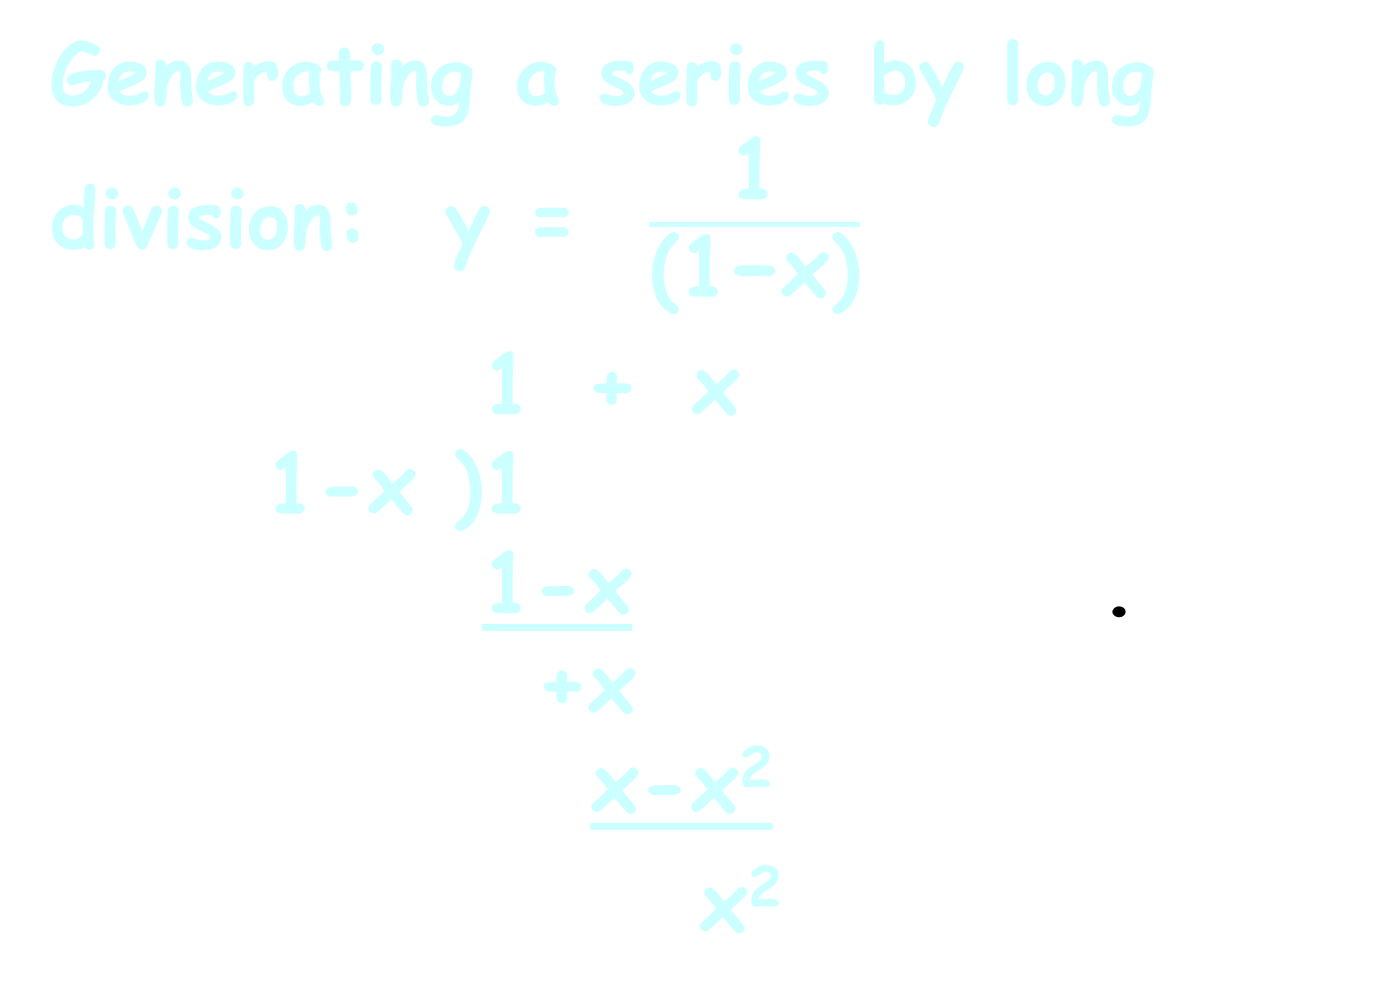
Series Convergence
Generating a series by long division: y = $\frac{\text{1}}{\text{(1−}\text{x}\text{)}}$
1 + x
1-x )1
1-x .
+x
x-x²
x²
¯¯¯¯¯¯
-( )
-( )

Slide 48
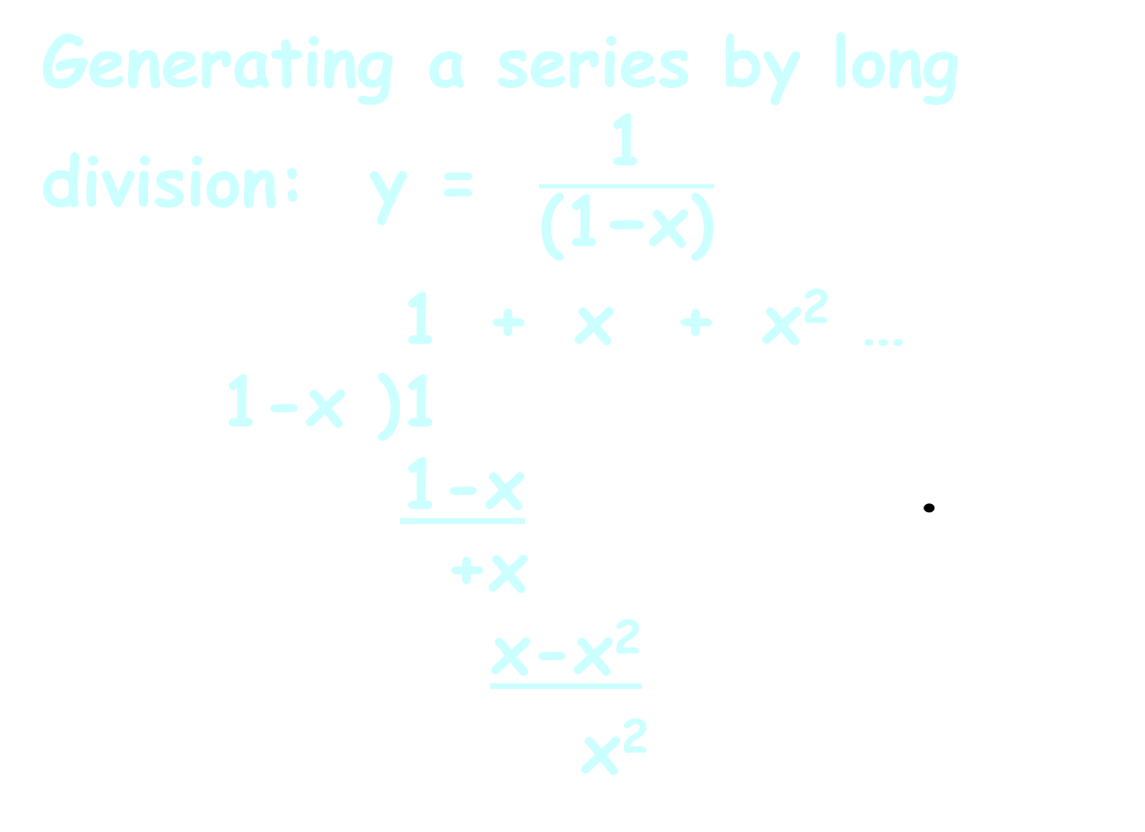
Series Convergence
Generating a series by long division: y = $\frac{\text{1}}{\text{(1−}\text{x}\text{)}}$
1 + x + x² …
1-x )1
1-x .
+x
x-x²
x²
¯¯¯¯¯¯¯¯¯¯¯

Slide 49
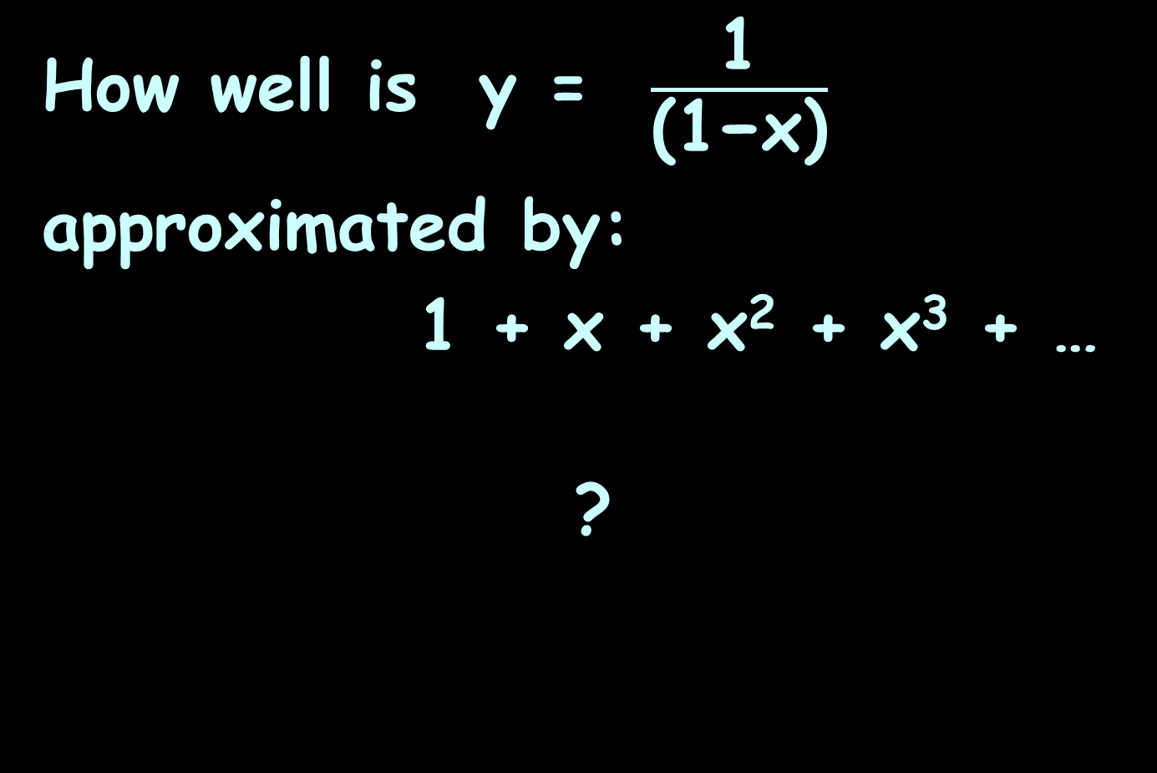
Series Convergence
How well is y = $\frac{\text{1}}{\text{(1−}\text{x}\text{)}}$
approximated by:
1 + x + x² + x³ + …
?

Slide 50
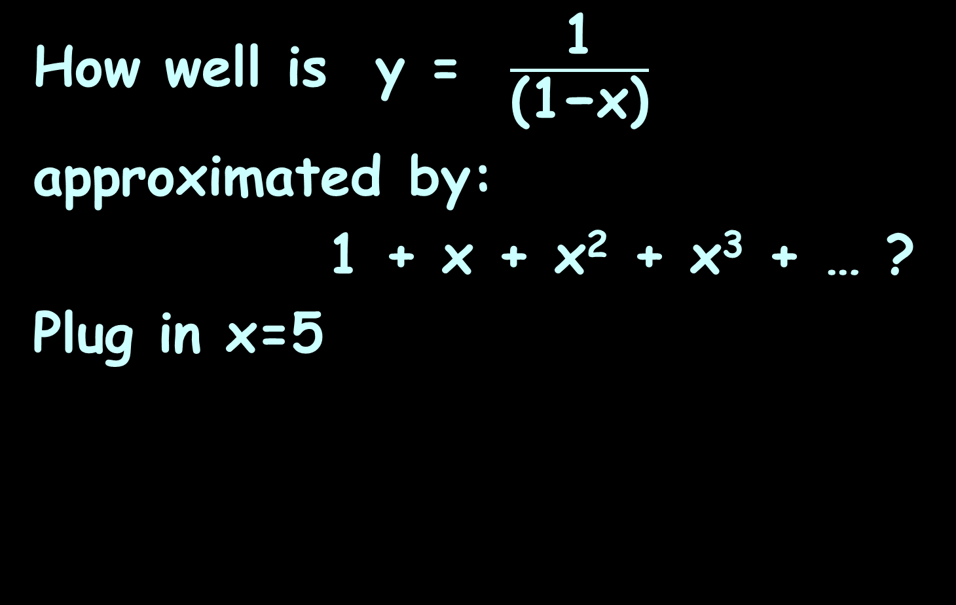
SERIES CONVERGENCE
IN-CLASS PROBLEM 1a
How well is y = $\frac{\text{1}}{\text{(1−}\text{x}\text{)}}$
approximated by:
1 + x + x² + x³ + … ?
Plug in x=5

Slide 51
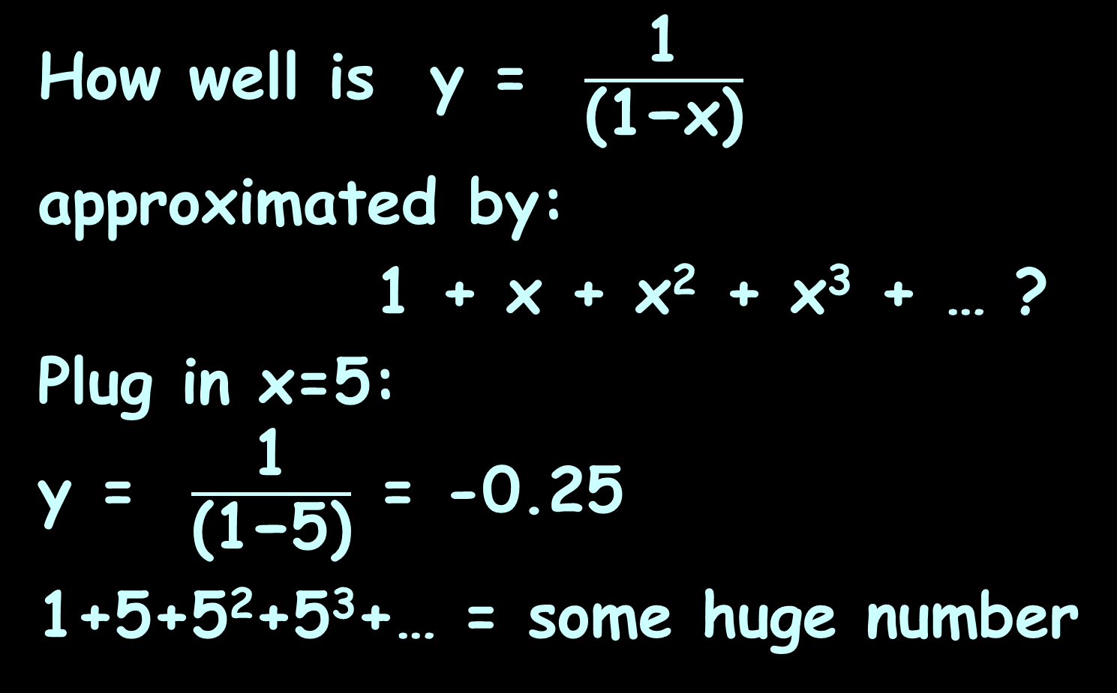
SERIES CONVERGENCE
IN-CLASS PROBLEM 1a
How well is y = $\frac{\text{1}}{\text{(1−}\text{x}\text{)}}$
approximated by:
1 + x + x² + x³ + … ?
Plug in x=5:
y = $\frac{\text{1}}{\text{(1−}\text{5}\text{)}}$ = -0.25
1+5+5²+5³+… = some huge number

Slide 52
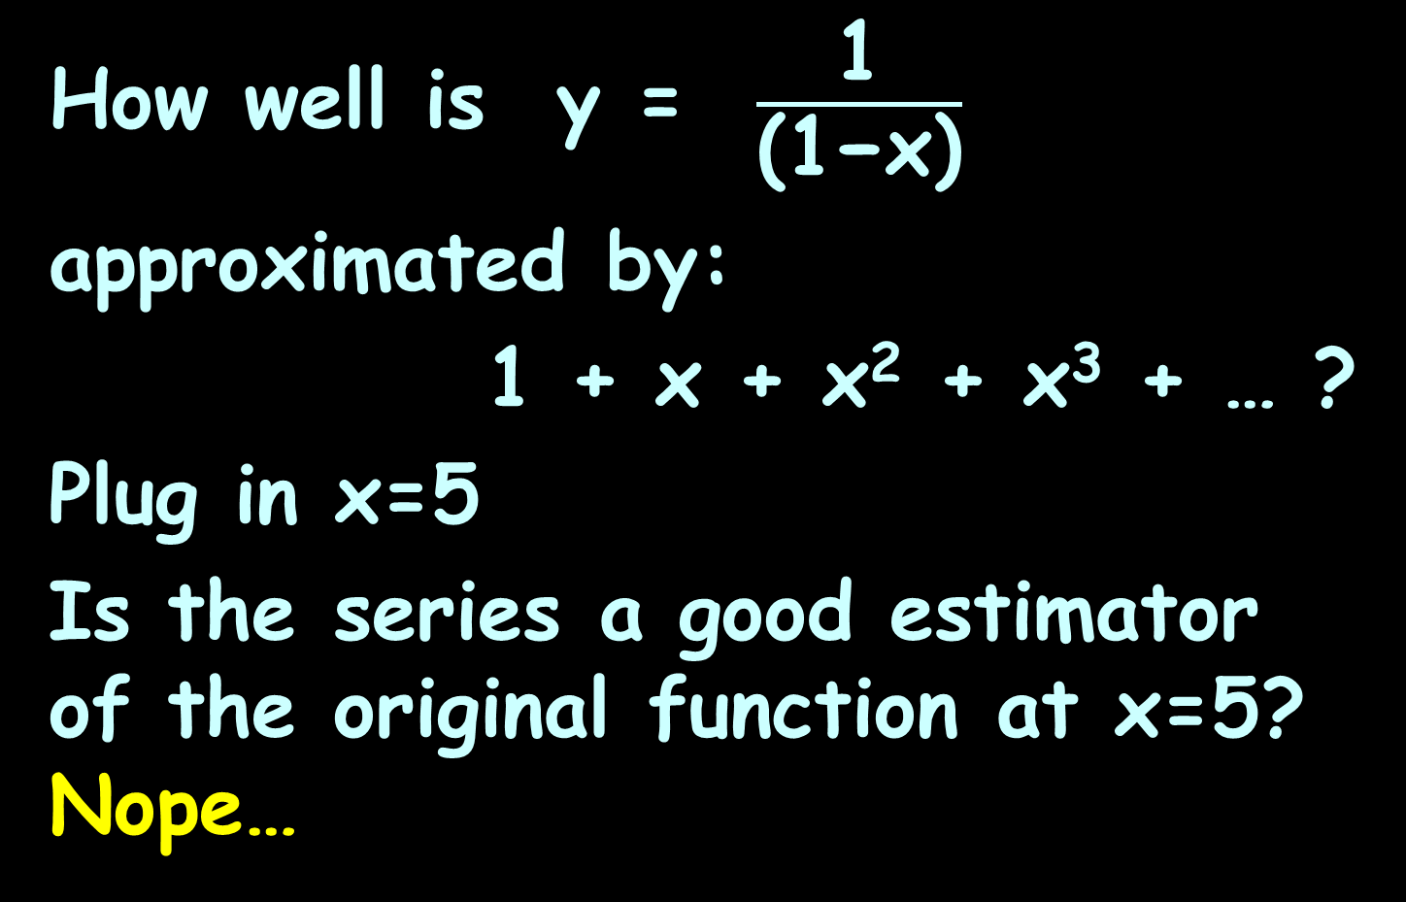
SERIES CONVERGENCE
IN-CLASS PROBLEM 1a
How well is y = $\frac{\text{1}}{\text{(1−}\text{x}\text{)}}$
approximated by:
1 + x + x² + x³ + … ?
Plug in x=5
Is the series a good estimator of the original function at x=5? Nope…

Slide 53
Series Convergence
If not, the series is said to diverge

Slide 54
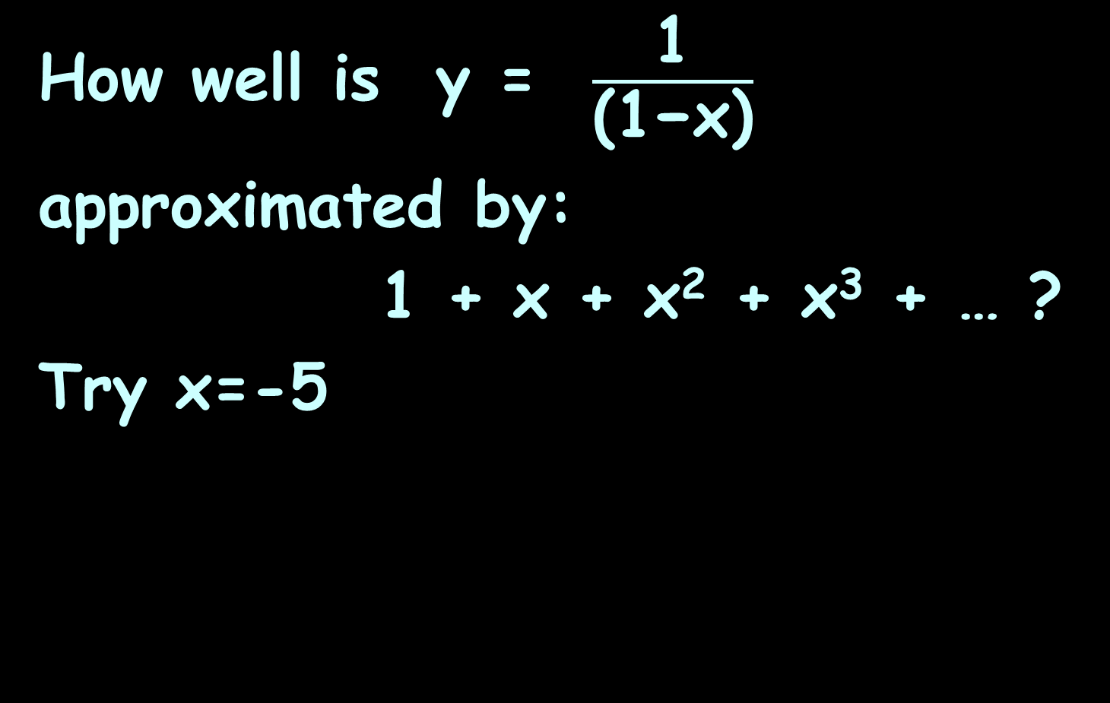
SERIES CONVERGENCE
IN-CLASS PROBLEM 1a
How well is y = $\frac{\text{1}}{\text{(1−}\text{x}\text{)}}$
approximated by:
1 + x + x² + x³ + … ?
Try x=-5

Slide 55
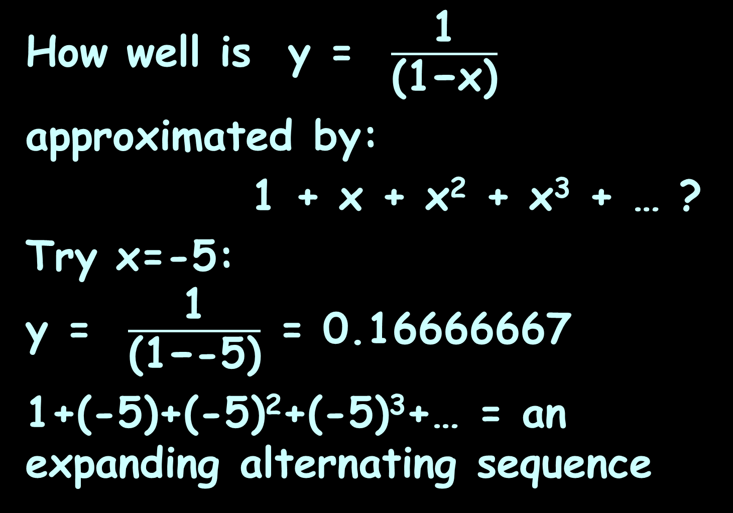
SERIES CONVERGENCE
IN-CLASS PROBLEM 1a
How well is y = $\frac{\text{1}}{\text{(1−}\text{x}\text{)}}$
approximated by:
1 + x + x² + x³ + … ?
Try x=-5:
y = $\frac{\text{1}}{\text{(1−}\text{−5}\text{)}}$ = 0.16666667
1+(-5)+(-5)²+(-5)³+… = an expanding alternating sequence

Slide 56
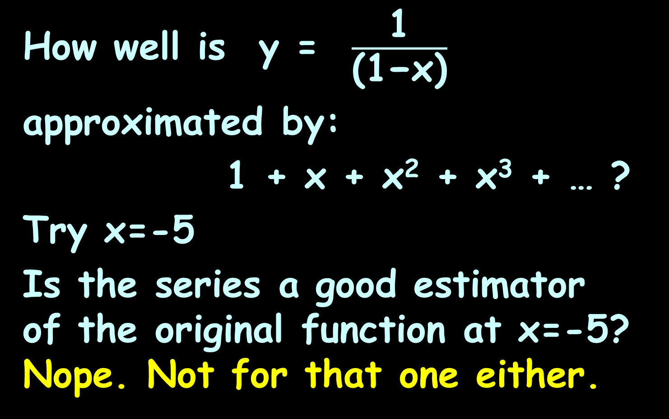
SERIES CONVERGENCE
IN-CLASS PROBLEM 1a
How well is y = $\frac{\text{1}}{\text{(1−}\text{x}\text{)}}$
approximated by:
1 + x + x² + x³ + … ?
Try x=-5
Is the series a good estimator of the original function at x=-5? Nope. Not for that one either.

Slide 57
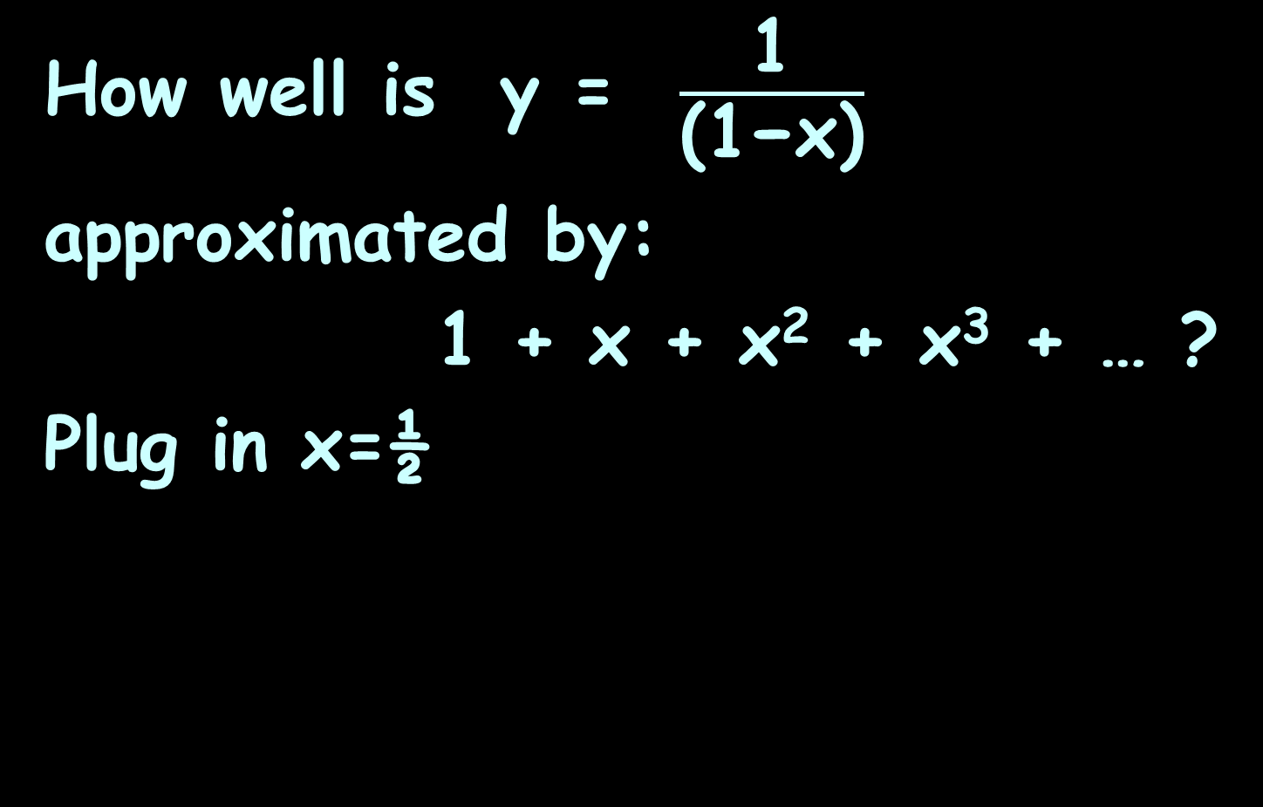
SERIES CONVERGENCE
IN-CLASS PROBLEM 1b
How well is y = $\frac{\text{1}}{\text{(1−}\text{x}\text{)}}$
approximated by:
1 + x + x² + x³ + … ?
Plug in x=½

Slide 58
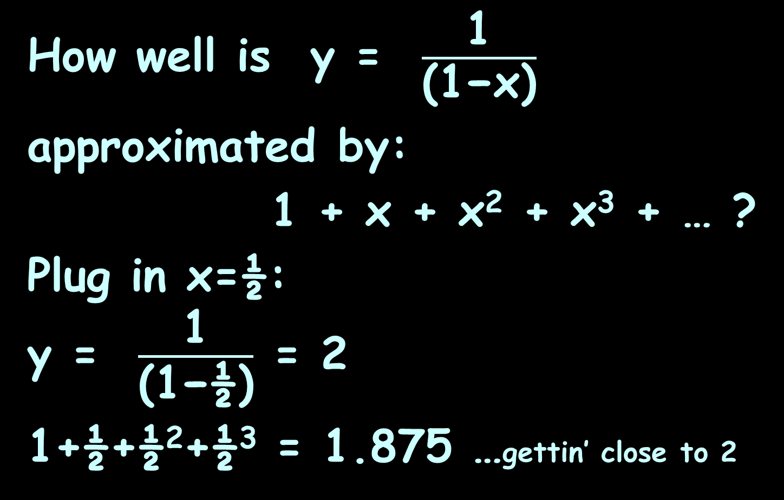
SERIES CONVERGENCE
IN-CLASS PROBLEM 1b
How well is y = $\frac{\text{1}}{\text{(1−}\text{x}\text{)}}$
approximated by:
1 + x + x² + x³ + … ?
Plug in x=½:
y = $\frac{\text{1}}{\text{(1−½)}}$ = 2
1+½+½²+½³ = 1.875 …gettin’ close to 2

Slide 59
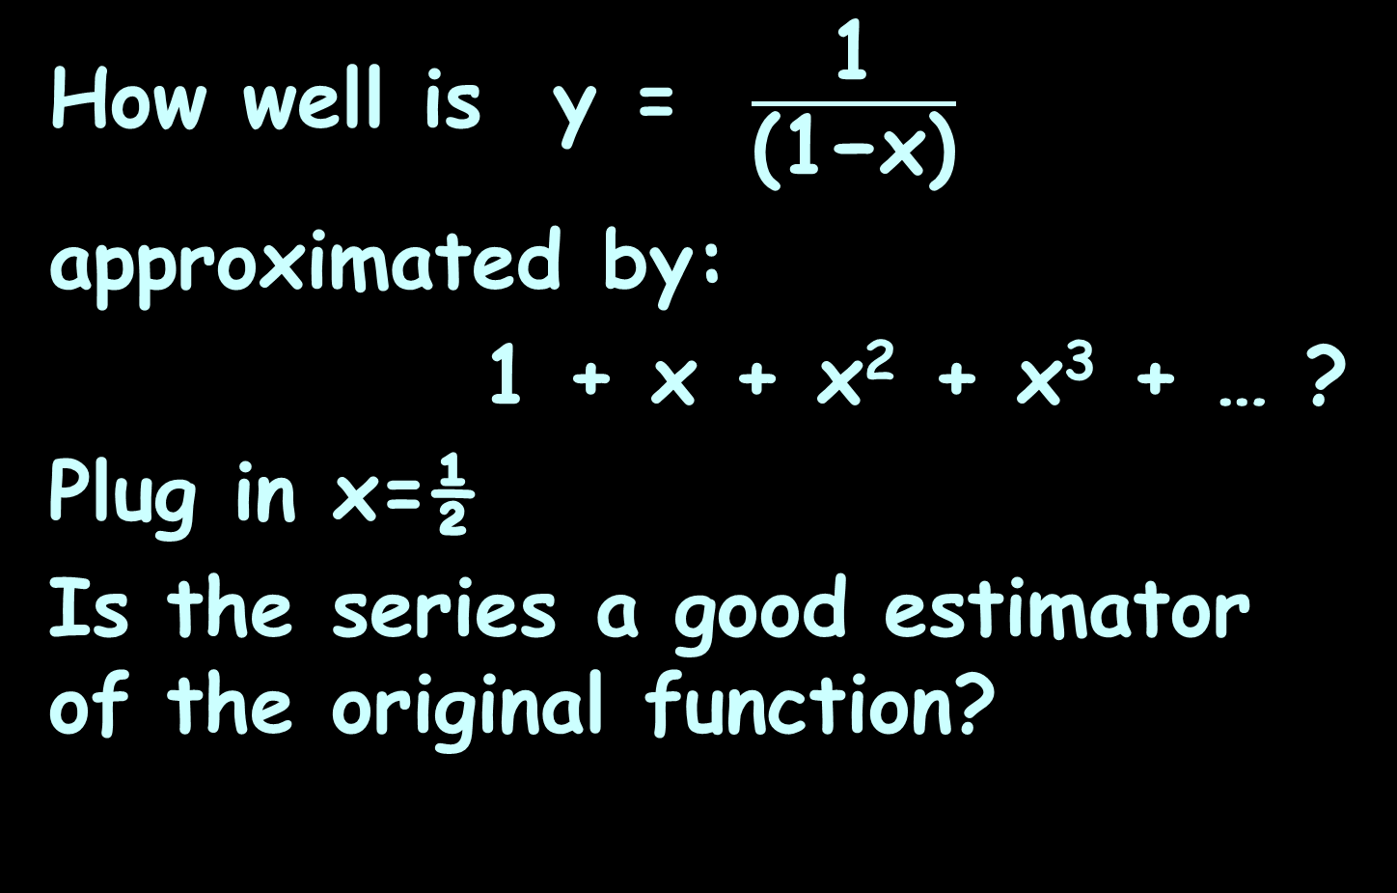
SERIES CONVERGENCE
IN-CLASS PROBLEM 1b
How well is y = $\frac{\text{1}}{\text{(1−}\text{x}\text{)}}$
approximated by:
1 + x + x² + x³ + … ?
Plug in x=½
Is the series a good estimator of the original function?

Slide 60
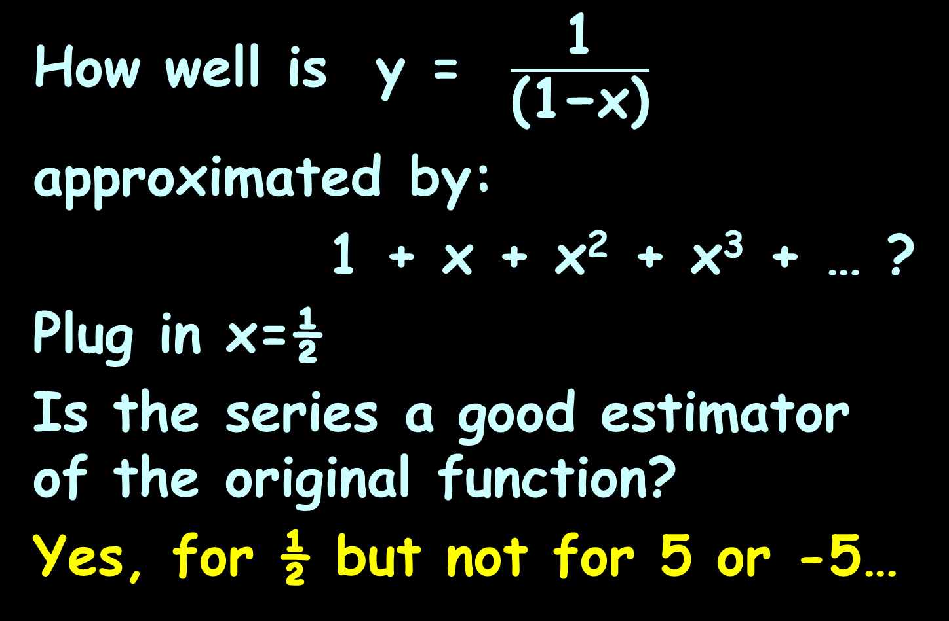
SERIES CONVERGENCE
IN-CLASS PROBLEM 1b
How well is y = $\frac{\text{1}}{\text{(1−}\text{x}\text{)}}$
approximated by:
1 + x + x² + x³ + … ?
Plug in x=½
Is the series a good estimator of the original function?
Yes, for ½ but not for 5 or -5…

Slide 61
Series Convergence
If so, the series is said to converge

Slide 62
Series Convergence
To what extent does the original function equal the series?

Slide 63
Series Convergence
To what extent does the original function equal the series?
A good estimator converges

Slide 64
Series Convergence
To what extent does the original function equal the series?
A good estimator converges
A bad estimator diverges

Slide 65
Series Convergence
Range of convergence
Where is the series a good estimator of the original?

Slide 66
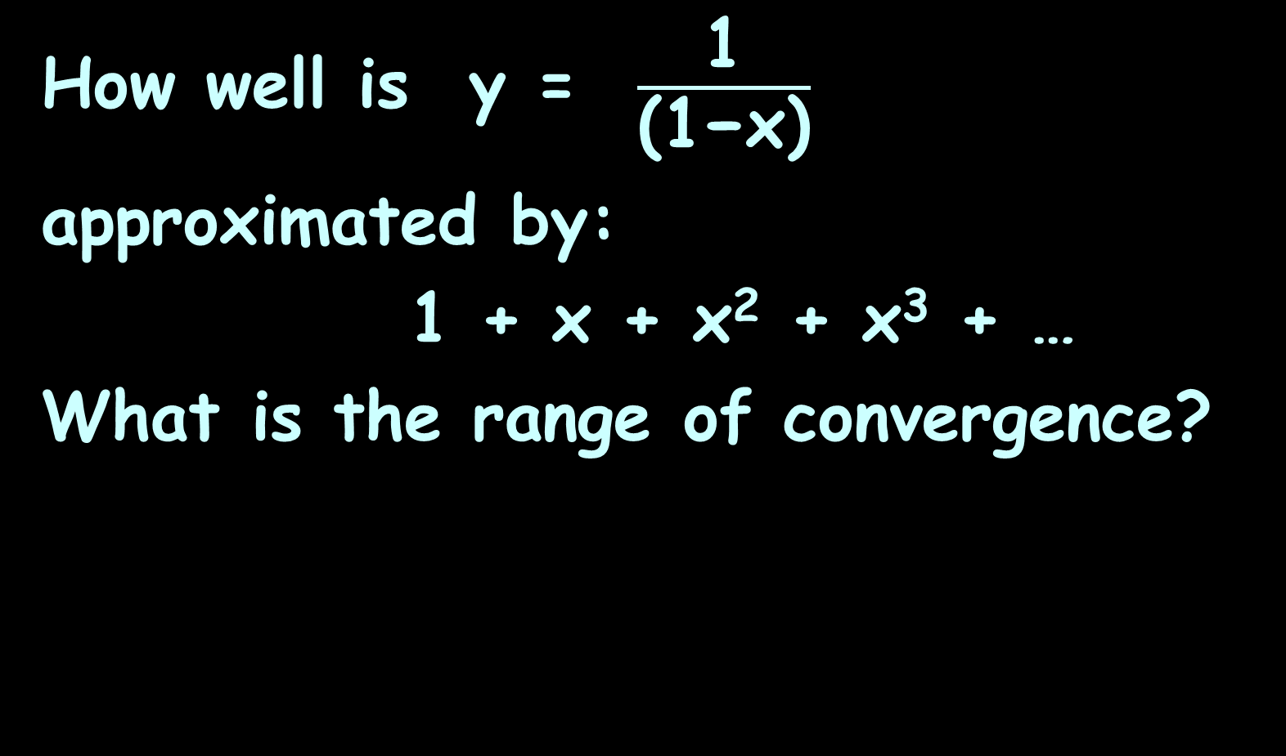
SERIES CONVERGENCE
IN-CLASS PROBLEM 1c
How well is y = $\frac{\text{1}}{\text{(1−}\text{x}\text{)}}$
approximated by:
1 + x + x² + x³ + …
What is the range of convergence?

Slide 67
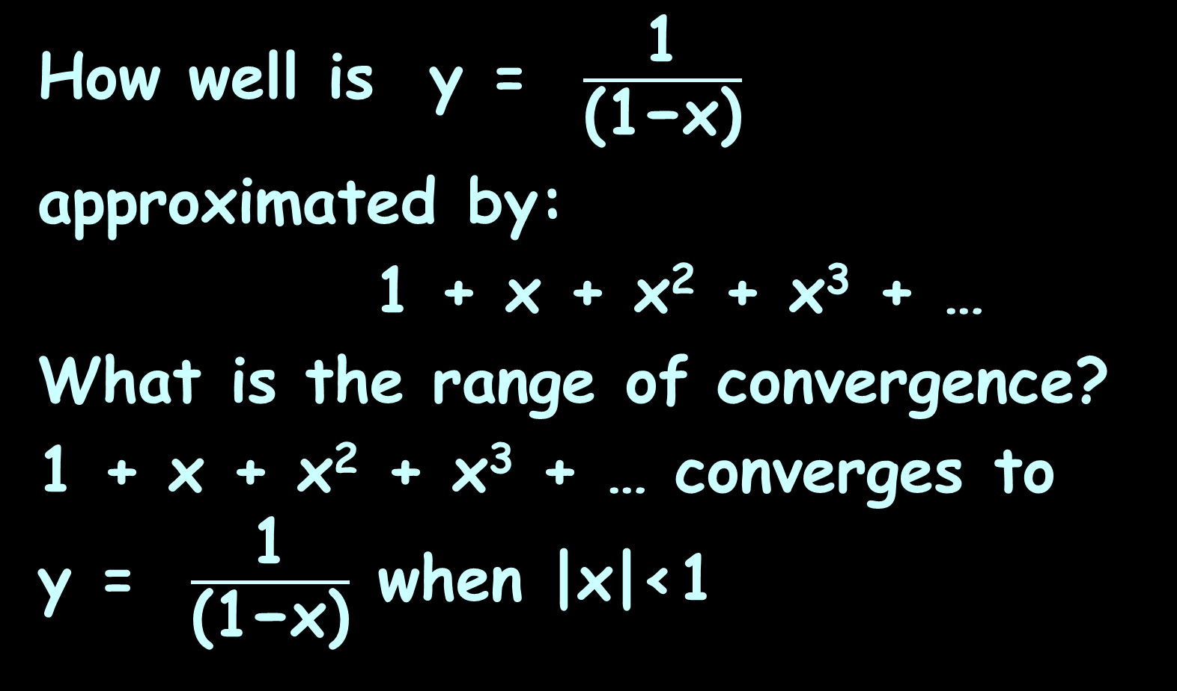
SERIES CONVERGENCE
IN-CLASS PROBLEM 1c
How well is y = $\frac{\text{1}}{\text{(1−}\text{x}\text{)}}$
approximated by:
1 + x + x² + x³ + …
What is the range of convergence?
1 + x + x² + x³ + … converges to
y = $\frac{\text{1}}{\text{(1−}\text{x}\text{)}}$ when |x|<1

Slide 68
Series Convergence
Our series
1 + x + x² + x³ + …
is a geometric series

Slide 69
Series Convergence
For a geometric series:
a + ax + ax² + ax³ + …
=
if |x|<1 then the geometric series will converge
∞
∑ ar^{k-1}
k=1

Slide 70

Standard Series
Remember, the sum of a geometric series is:
S_{n} = $\frac{\text{a}\text{1}\text{(1−}\text{r}\text{n}\text{)}}{\text{1−}\text{r}}$

Slide 71
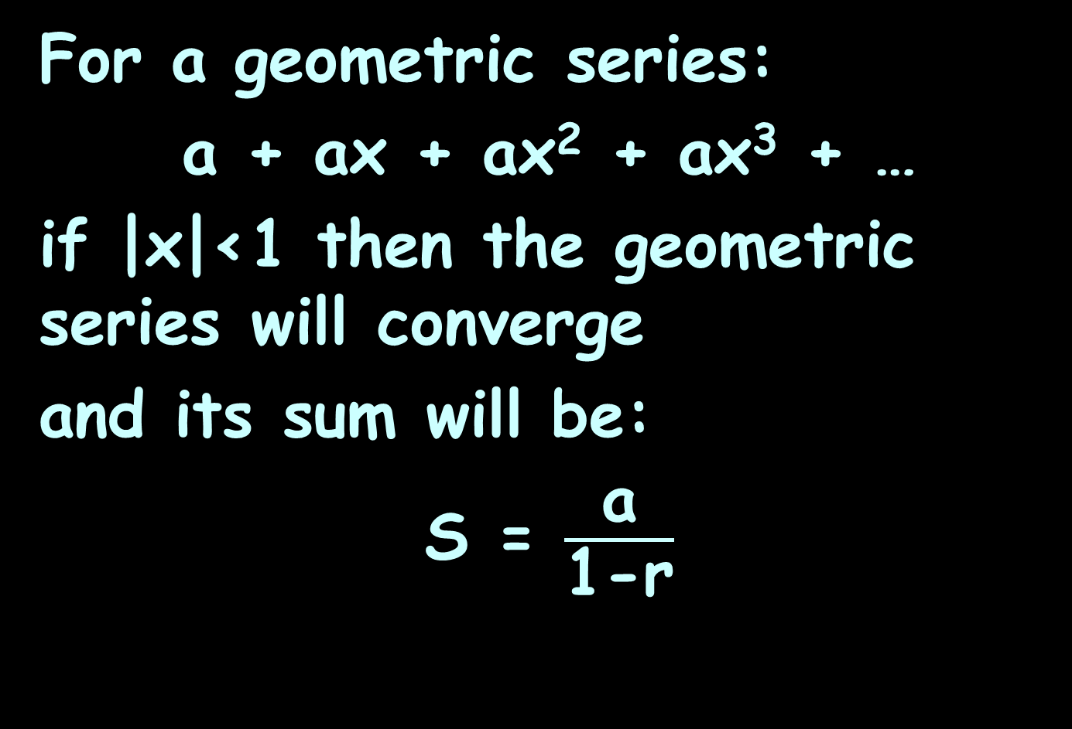
Series Convergence
For a geometric series:
a + ax + ax² + ax³ + …
if |x|<1 then the geometric series will converge
and its sum will be:
S = $\frac{\text{a}}{\text{1}\text{−}\text{r}}$

Slide 72
Series Convergence
For a geometric series:
a + ax + ax² + ax³ + …
=
if |r|≥1 then the geometric series will diverge
∞
∑ ar^{k-1}
k=1

Slide 73

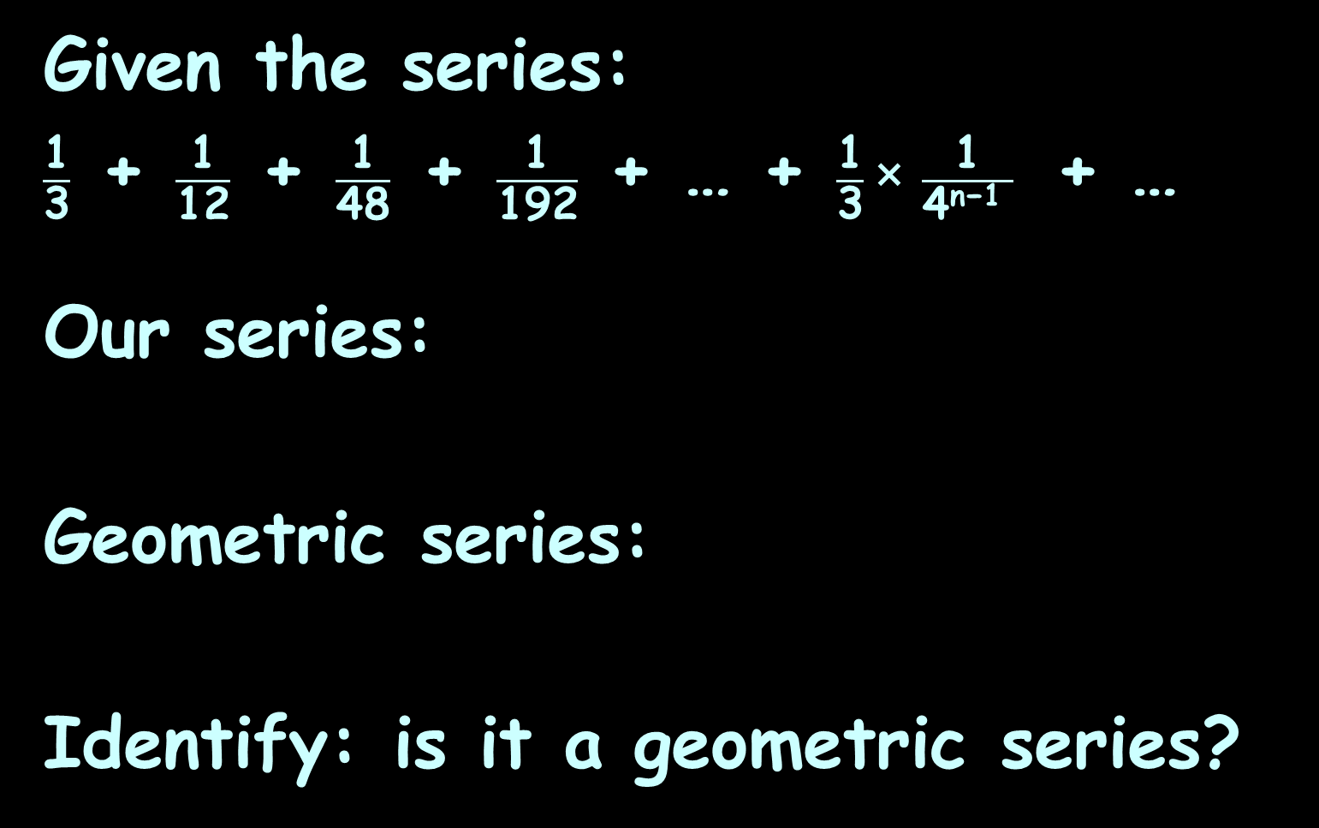
SERIES CONVERGENCE
IN-CLASS PROBLEM 2a
Given the series:
$\frac{\text{1}}{\text{3}}$ + $\frac{\text{1}}{\text{12}}$ + $\frac{\text{1}}{\text{48}}$ + $\frac{\text{1}}{\text{192}}$ + … + $\frac{\text{1}}{\text{3}}$× $\frac{\text{1}}{\text{4}\text{n}\text{−1 }}$ + …
Our series:
Geometric series:
Identify: is it a geometric series?
∞
∑ $\frac{\text{1}}{\text{3}}$ ($\frac{\text{1}}{\text{4}}$)^{n-1}
n=1
∞
∑ a r^{k-1}
k=1

Slide 74
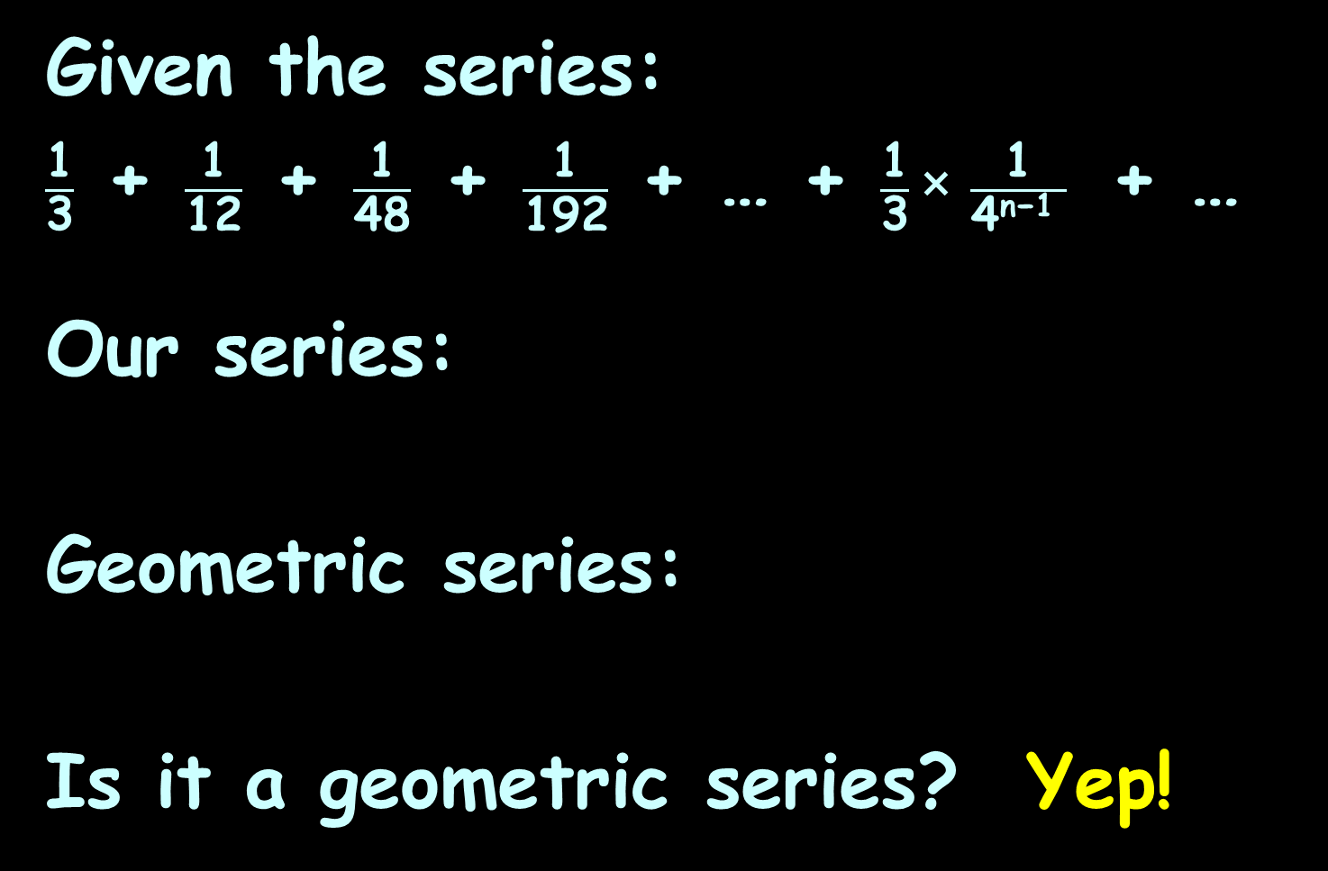
SERIES CONVERGENCE
IN-CLASS PROBLEM 2a
Given the series:
$\frac{\text{1}}{\text{3}}$ + $\frac{\text{1}}{\text{12}}$ + $\frac{\text{1}}{\text{48}}$ + $\frac{\text{1}}{\text{192}}$ + … + $\frac{\text{1}}{\text{3}}$× $\frac{\text{1}}{\text{4}\text{n}\text{−1 }}$ + …
Our series:
Geometric series:
Is it a geometric series? Yep!
∞
∑ $\frac{\text{1}}{\text{3}}$ ($\frac{\text{1}}{\text{4}}$)^{n-1}
n=1
∞
∑ a r^{k-1}
k=1

Slide 75

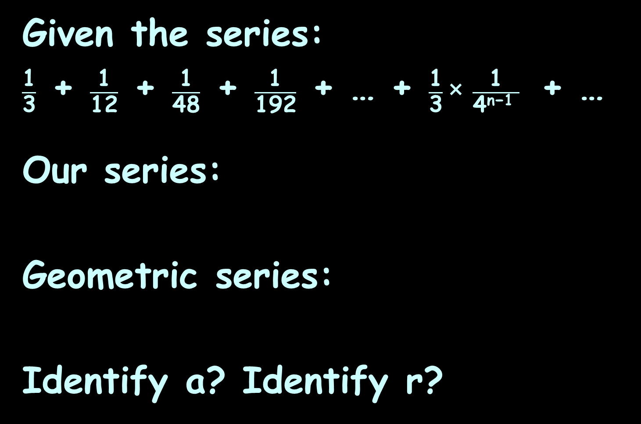
SERIES CONVERGENCE
IN-CLASS PROBLEM 2c
Given the series:
$\frac{\text{1}}{\text{3}}$ + $\frac{\text{1}}{\text{12}}$ + $\frac{\text{1}}{\text{48}}$ + $\frac{\text{1}}{\text{192}}$ + … + $\frac{\text{1}}{\text{3}}$× $\frac{\text{1}}{\text{4}\text{n}\text{−1 }}$ + …
Our series:
Geometric series:
Identify a? Identify r?
∞
∑ $\frac{\text{1}}{\text{3}}$ ($\frac{\text{1}}{\text{4}}$)^{n-1}
n=1
∞
∑ a r^{k-1}
k=1

Slide 76
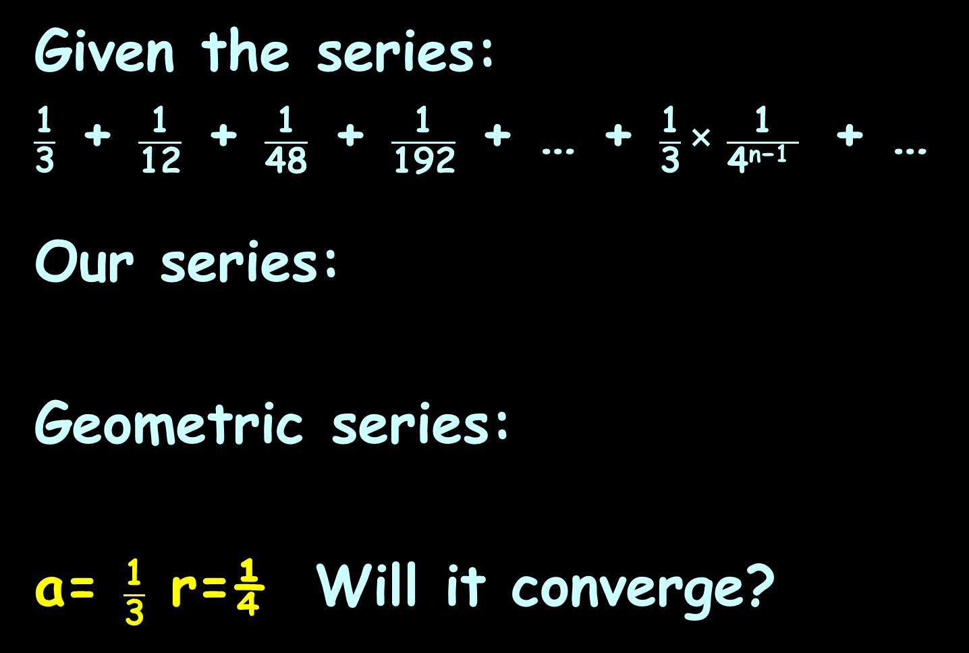
SERIES CONVERGENCE
IN-CLASS PROBLEM 2c
Given the series:
$\frac{\text{1}}{\text{3}}$ + $\frac{\text{1}}{\text{12}}$ + $\frac{\text{1}}{\text{48}}$ + $\frac{\text{1}}{\text{192}}$ + … + $\frac{\text{1}}{\text{3}}$× $\frac{\text{1}}{\text{4}\text{n}\text{−1 }}$ + …
Our series:
Geometric series:
a= $\frac{\text{1}}{\text{3}}$ r=¼ Will it converge?
∞
∑ $\frac{\text{1}}{\text{3}}$ ($\frac{\text{1}}{\text{4}}$)^{n-1}
n=1
∞
∑ a r^{k-1}
k=1
|r|<1 then the geometric series will converge

Slide 77
Series Convergence
For a geometric series:
a + ar + ar² + ar³ + …
=
if |r|<1 then the geometric series will converge
∞
∑ a r^{k-1}
k=1

Slide 78

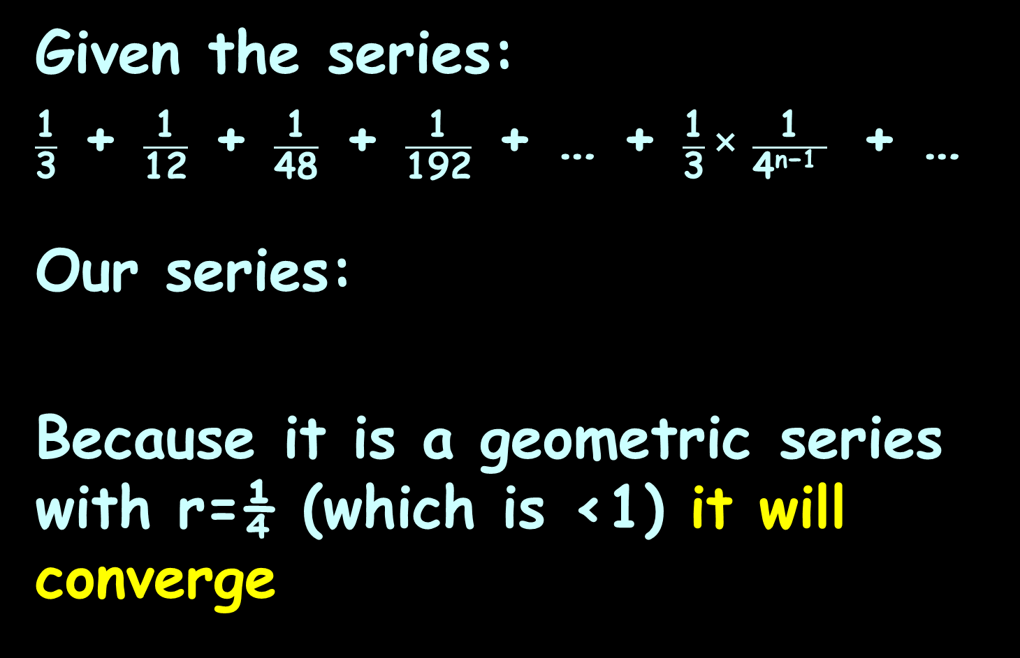
SERIES CONVERGENCE
IN-CLASS PROBLEM 2d
Given the series:
$\frac{\text{1}}{\text{3}}$ + $\frac{\text{1}}{\text{12}}$ + $\frac{\text{1}}{\text{48}}$ + $\frac{\text{1}}{\text{192}}$ + … + $\frac{\text{1}}{\text{3}}$× $\frac{\text{1}}{\text{4}\text{n}\text{−1 }}$ + …
Our series:
Because it is a geometric series with r=¼ (which is <1) it will converge
∞
∑ $\frac{\text{1}}{\text{3}}$ ($\frac{\text{1}}{\text{4}}$)^{n-1}
n=1

Slide 79
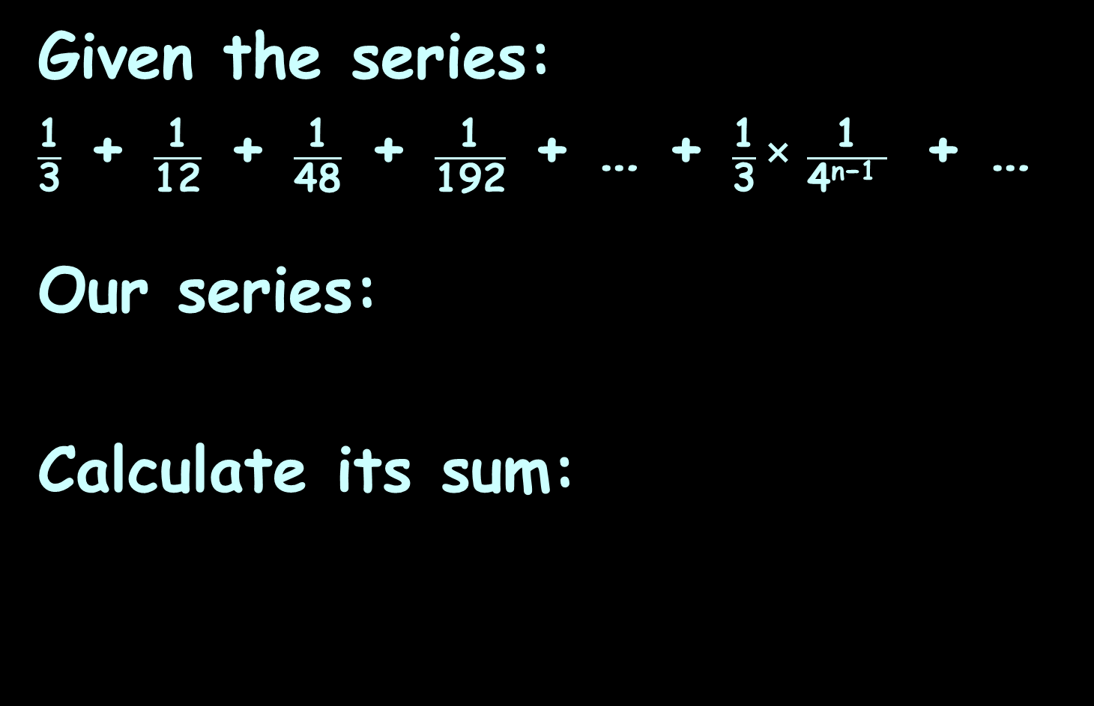

SERIES CONVERGENCE
IN-CLASS PROBLEM 2d
Given the series:
$\frac{\text{1}}{\text{3}}$ + $\frac{\text{1}}{\text{12}}$ + $\frac{\text{1}}{\text{48}}$ + $\frac{\text{1}}{\text{192}}$ + … + $\frac{\text{1}}{\text{3}}$× $\frac{\text{1}}{\text{4}\text{n}\text{−1 }}$ + …
Our series:
Calculate its sum:
∞
∑ $\frac{\text{1}}{\text{3}}$ ($\frac{\text{1}}{\text{4}}$)^{n-1}
n=1
S = $\frac{\text{a}}{\text{1−}\text{r}}$

Slide 80
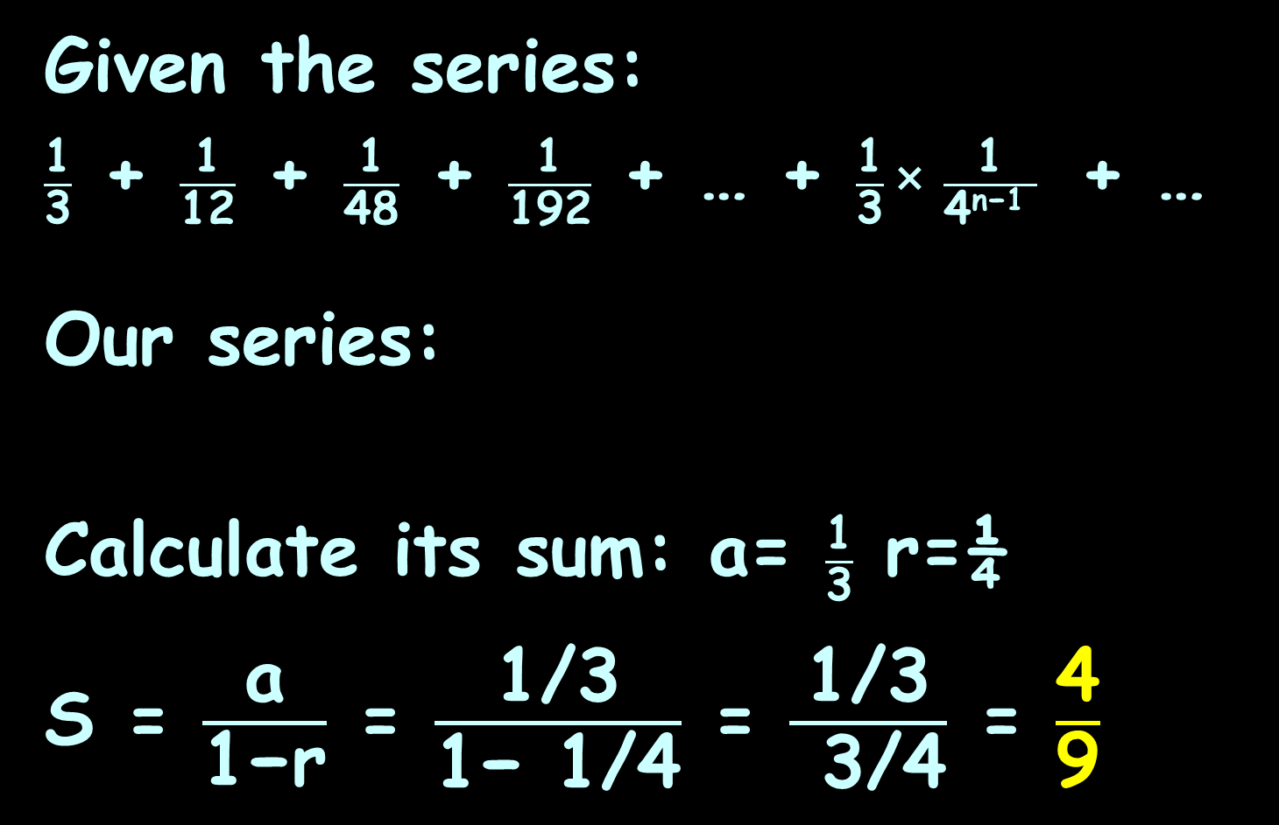
SERIES CONVERGENCE
IN-CLASS PROBLEM 2e
Given the series:
$\frac{\text{1}}{\text{3}}$ + $\frac{\text{1}}{\text{12}}$ + $\frac{\text{1}}{\text{48}}$ + $\frac{\text{1}}{\text{192}}$ + … + $\frac{\text{1}}{\text{3}}$× $\frac{\text{1}}{\text{4}\text{n}\text{−1 }}$ + …
Our series:
Calculate its sum: a= $\frac{\text{1}}{\text{3}}$ r=¼
S = $\frac{\text{a}}{\text{1−}\text{r}}$ = $\frac{\text{1/3}}{\text{1−}\text{ 1/4}}$ = $\frac{\text{1/3}}{ \text{3}\text{/4}}$ = $\frac{\text{4}}{\text{9}}$
∞
∑ $\frac{\text{1}}{\text{3}}$ ($\frac{\text{1}}{\text{4}}$)^{n-1}
n=1
S = $\frac{\text{a}}{\text{1−}\text{r}}$

Slide 81
Questions?
http://i.imgur.com/aliTlT3.jpg

Slide 82
Iteration
Means repeating a process until you reach a goal

Slide 83
Series Convergence
Iteration is used by your calculator and in computer software to do calculations

Slide 84
Series Convergence
The formulas in calculators and
computers are not lookup
tables
The formulas are calculated
using series approximations

Slide 85
Series Convergence
The calculator has a formula for every function that will zero in on the right answer after a short number of calculations

Slide 86
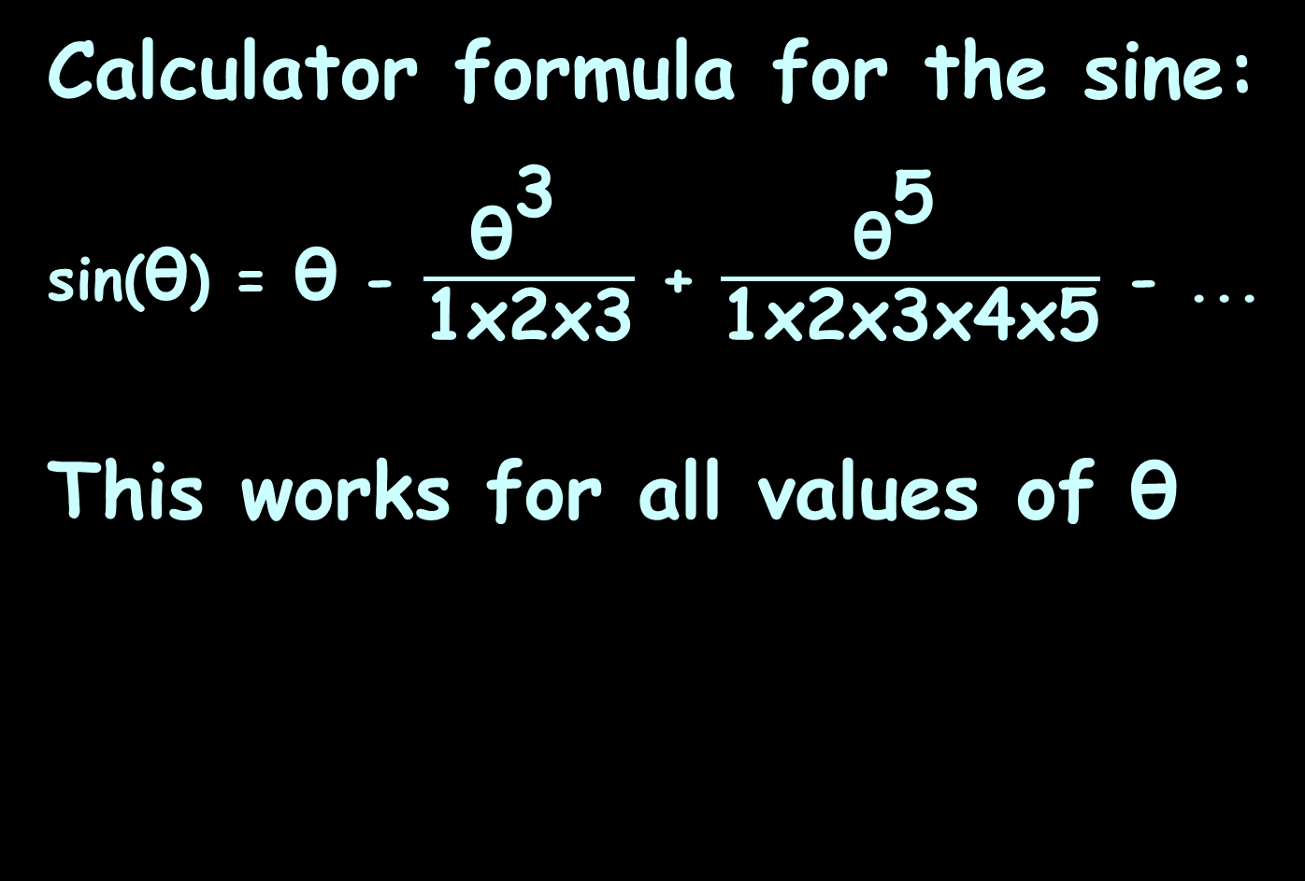
Series Convergence
Calculator formula for the sine:
sin(θ) = θ - $\frac{{\text{θ}}^{\text{3 }}}{\text{1}\text{x}\text{2}\text{x}\text{3}}$ + $\frac{{\text{θ}}^{\text{5} }}{\text{1}\text{x}\text{2}\text{x}\text{3}\text{x}\text{4}\text{x}\text{5}}$ - ...
This works for all values of θ

Slide 87
Series Convergence
Companies look for:
accurate approximations
approximations that
converge quickly (after
only a few iterations)

Slide 88
Series Convergence
Obviously, only series that converge are of interest

Slide 89
Series Convergence
Obviously, only series that converge are of interest
… so, how can we tell if a series converges?

Slide 90
Series Convergence
Obviously, only series that converge are of interest
… so, how can we tell if a series converges?
… because it is such an important topic, lots of methods have been developed to test for convergence

Slide 91
Series Convergence
Divergence & Convergence Tests
If ≠ 0, then the series
diverges
lim
n→∞

Slide 92
Series Convergence
Divergence & Convergence Tests
If a series converges, then the
= 0
But… if = 0, there is still
no guarantee the series
converges!
lim
n→∞
lim
n→∞

Slide 93
Series Convergence
Squeeze theorem for sequences:
Let {a_{n}} {b_{n}} and {c_{n}} be
sequences
With a_{n} ≤ b_{n} ≤ c_{n} for all integers
n greater than some index N
If a_{n} = c_{n} = L
then b_{n} = L
lim
n→∞
lim
n→∞
lim
n→∞

Slide 94
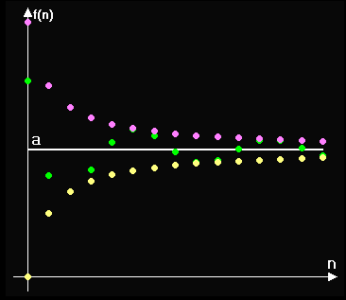
Series Convergence

Slide 95
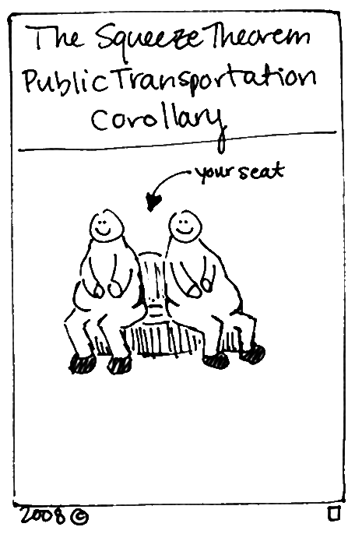
http://brownsharpie.courtneygibbons.org/wp-content/comics/2008-11-10-squeeze.jpg

Slide 96
Series Convergence
Harmonic series:
1 + 1/2 + 1/3 + 1/4 + 1/5 + …
Does it converge?

Slide 97
Series Convergence
Harmonic series:
1 + 1/2 + 1/3 + 1/4 + 1/5 + …
Does it converge?
The series increases but at a
decreasing rate

Slide 98
Series Convergence
Harmonic series:
1 + 1/2 + 1/3 + 1/4 + 1/5 + …
Does it converge?
The series increases but at a
decreasing rate
Even though the terms tend to
zero, the series diverges
(believe it or not!)

Slide 99
Series Convergence
Nicole Oresme (Oh-rehm) (1300s France) used the squeeze theorem to show that the harmonic series actually is divergent!
https://www.khanacademy.org/math/integral-calculus/sequences_series_
approx_calc/convergence-divergence-tests/v/harmonic-series-divergent

Slide 100
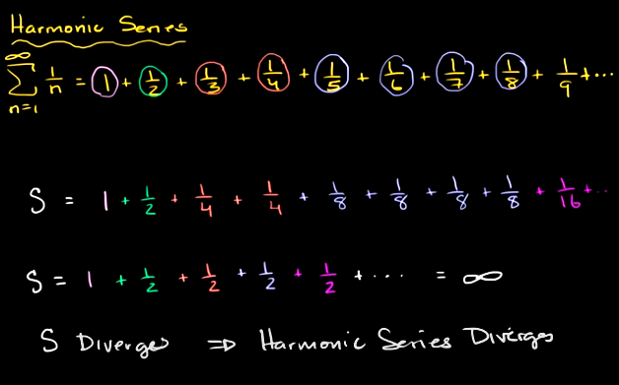
Series Convergence
…..is greater than or equal to
https://www.khanacademy.org/math/integral-calculus/sequences_series_approx_calc/
convergence-divergence-tests/v/harmonic-series-divergent

Slide 101
Series Convergence
…..is greater than or equal to
https://www.khanacademy.org/math/integral-calculus/sequences_series_approx_calc/
convergence-divergence-tests/v/harmonic-series-divergent

Slide 102
Series Convergence
…..is greater than or equal to
https://www.khanacademy.org/math/integral-calculus/sequences_series_approx_calc/
convergence-divergence-tests/v/harmonic-series-divergent

Slide 103
Series Convergence
So even though it LOOKS like it is convergent… it’s not!
https://tutorial.math.lamar.edu/Classes/CalcII/IntegralTest.aspx

Slide 104
Questions?
http://i.imgur.com/aliTlT3.jpg

Slide 105
Series Convergence
Divergence Test
Cannot be used to prove
convergence
Form of series:
Condition for divergence:
a_{k} ≠ 0
∞
∑ a_{k}
k=1
lim
k→∞

Slide 106
Series Convergence
Do NOT misuse this test!
It only says that a series is guaranteed to diverge if the series terms don’t go to zero in the limit
If the series terms do happen to go to zero, the series may or may not converge

Slide 107
Series Convergence
One of the more common mistakes that students make when they first get into series is to assume that if a_{n} = 0
then ∑ a_{n} will converge
But there is just no way to guarantee this - so be careful!
lim
n→∞

Slide 108

SERIES CONVERGENCE
IN-CLASS PROBLEM 3,4,5
Does it converge?
∞
∑ n
n=1
∞
∑ $\frac{\text{1}}{\text{n}}$
n=1
∞
∑ (-1)^{n}
n=1

Slide 109
SERIES CONVERGENCE
IN-CLASS PROBLEM 3,4,5
Does it converge?
it diverges: = ∞
∞
∑ n
n=1
lim
n→∞
∞
∑ $\frac{\text{1}}{\text{n}}$
n=1
∞
∑ (-1)^{n}
n=1

Slide 110
SERIES CONVERGENCE
IN-CLASS PROBLEM 3,4,5
Does it converge?
it diverges: = ∞
it may converge: = 0
∞
∑ n
n=1
lim
n→∞
∞
∑ $\frac{\text{1}}{\text{n}}$
n=1
lim
n→∞
∞
∑ (-1)^{n}
n=1

Slide 111
SERIES CONVERGENCE
IN-CLASS PROBLEM 3,4,5
Does it converge?
it diverges: = ∞
it may converge: = 0
it diverges: =
∞
∑ n
n=1
lim
n→∞
∞
∑ $\frac{\text{1}}{\text{n}}$
n=1
lim
n→∞
∞
∑ (-1)^{n}
n=1
lim
n→∞
doesn’t exist

Slide 112
Questions?
http://i.imgur.com/aliTlT3.jpg

Slide 113
Series Convergence
Integral Tests
Suppose ƒ is a continuous, positive, decreasing function for x≥1 and let a_{k}=ƒ(k) for k=1,2,3,…
then and ∫₁∞ ƒ(x) dx
either both converge or both diverge
∞
∑ a_{k}
k=1

Slide 114
Series Convergence
In the case of convergence, the value of the integral is not, in
general, equal to the value of the series

Slide 115

Series Convergence
The Integral test is used to
analyze the convergence of
an entire family of infinite
series
known as the p-series
∞
∑ $\frac{\text{1}}{\text{k}\text{p}}$
k=1

Slide 116

SERIES CONVERGENCE
IN-CLASS PROBLEM 6
For what values of p does the
p-series converge?
∞
∑ $\frac{\text{1}}{\text{k}\text{p}}$
k=1
https://tutorial.math.lamar.edu/Classes/CalcII/IntegralTest.aspx

Slide 117
SERIES CONVERGENCE
IN-CLASS PROBLEM 6
For what values of p does the
p-series converge?
try p=0
∞
∑ $\frac{\text{1}}{\text{k}\text{p}}$
k=1
https://tutorial.math.lamar.edu/Classes/CalcII/IntegralTest.aspx

Slide 118
SERIES CONVERGENCE
IN-CLASS PROBLEM 6
For what values of p does the
p-series converge?
try p=0
diverges try p=1
∞
∑ $\frac{\text{1}}{\text{k}\text{p}}$
k=1
https://tutorial.math.lamar.edu/Classes/CalcII/IntegralTest.aspx

Slide 119
SERIES CONVERGENCE
IN-CLASS PROBLEM 6
For what values of p does the
p-series converge?
try p=1
diverges try p=2
∞
∑ $\frac{\text{1}}{\text{k}\text{p}}$
k=1
https://tutorial.math.lamar.edu/Classes/CalcII/IntegralTest.aspx

Slide 120
SERIES CONVERGENCE
IN-CLASS PROBLEM 6
For what values of p does the
p-series converge?
try p=2
Converges! Something happens between p=1 and p=2
Try p=1.0000001
∞
∑ $\frac{\text{1}}{\text{k}\text{p}}$
k=1
https://tutorial.math.lamar.edu/Classes/CalcII/IntegralTest.aspx

Slide 121

SERIES CONVERGENCE
IN-CLASS PROBLEM 6
For what values of p does the
p-series converge?
try p=1.0000001
Converges!
converges for p>1
∞
∑ $\frac{\text{1}}{\text{k}\text{p}}$
k=1
∞
∑ $\frac{\text{1}}{\text{k}\text{p}}$
k=1
https://tutorial.math.lamar.edu/Classes/CalcII/IntegralTest.aspx

Slide 122

SERIES CONVERGENCE
IN-CLASS PROBLEM 6
converges for p>1
This is called the p-series test or power series test
∞
∑ $\frac{\text{1}}{\text{k}\text{p}}$
k=1
https://tutorial.math.lamar.edu/Classes/CalcII/IntegralTest.aspx

Slide 123


Slide 124
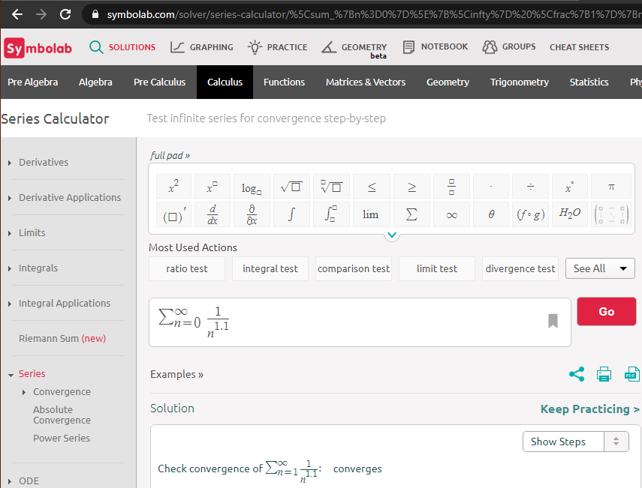

Slide 125
Questions?
http://i.imgur.com/aliTlT3.jpg

Slide 126
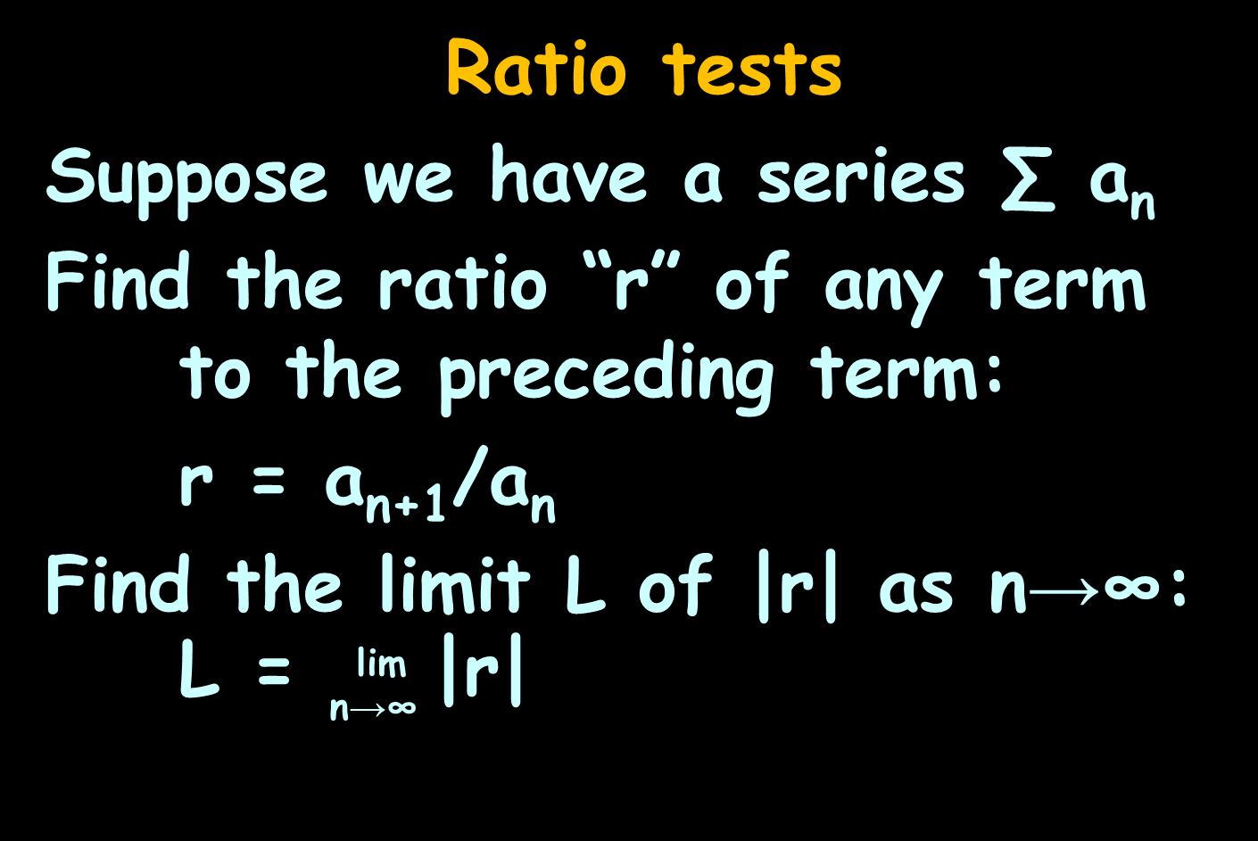
Series Convergence
Ratio tests
Suppose we have a series ∑ a_{n}
Find the ratio “r” of any term to the preceding term:
r = a_{n+1}/a_{n}
Find the limit L of |r| as n→∞:
L = $\begin{matrix}\text{lim} \\ \text{n}\text{→∞ }\end{matrix}$|r|

Slide 127
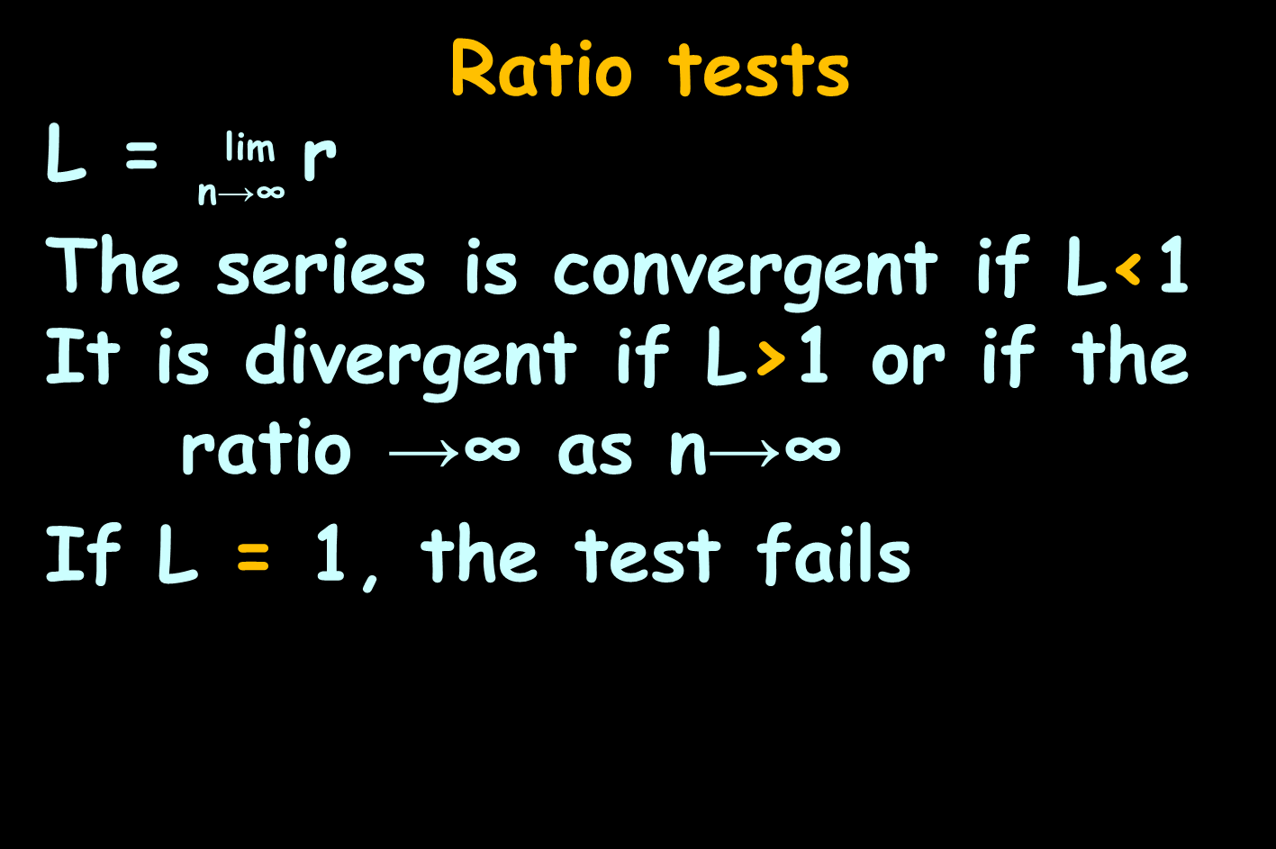
Series Convergence
Ratio tests
L = $\begin{matrix}\text{lim} \\ \text{n}\text{→∞ }\end{matrix}$r
The series is convergent if L<1 It is divergent if L>1 or if the ratio →∞ as n→∞
If L = 1, the test fails

Slide 128
SERIES CONVERGENCE
IN-CLASS PROBLEM 7
Does the series
1/2 + 2/4 + 3/8 + … + n/2^{n}
converge?
lim
n→∞
L = r
convergent if L<1
divergent if L>1
inconclusive if L=1

Slide 129
SERIES CONVERGENCE
IN-CLASS PROBLEM 7
Does the series
1/2 + 2/4 + 3/8 + … + n/2^{n}
converge?
First find the general form of each term

Slide 130
SERIES CONVERGENCE
IN-CLASS PROBLEM 7
Does the series
1/2 + 2/4 + 3/8 + … + n/2^{n}
converge?
First find the general form of each term:
something/something
as “n” is counting up 1,2,3,…

Slide 131
SERIES CONVERGENCE
IN-CLASS PROBLEM 7
Does the series
1/2 + 2/4 + 3/8 + … + n/2^{n}
converge?
First find the general form of each term:
n/something
as “n” is counting up 1,2,3,…

Slide 132
SERIES CONVERGENCE
IN-CLASS PROBLEM 7
Does the series
1/2 + 2/4 + 3/8 + … + n/2^{n}
converge?
First find the general form of each term:
n/2^{n}
as “n” is counting up 1,2,3,…

Slide 133

SERIES CONVERGENCE
IN-CLASS PROBLEM 7
Does the series
1/2 + 2/4 + 3/8 + … + n/2^{n}
converge?
Each term a_{n} is: n/2^{n}
So another way of writing this series is:
∞
∑ $\frac{\text{n}}{\text{2}\text{n}}$
n=1
lim
n→∞
L = r
convergent if L<1
divergent if L>1
inconclusive if L=1

Slide 134
SERIES CONVERGENCE
IN-CLASS PROBLEM 5
Remember the power series:
converges for p>1
We’ve got:
So will this series converge?
∞
∑ $\frac{\text{1}}{\text{k}\text{p}}$
k=1
∞
∑ $\frac{\text{n}}{\text{2}\text{n}}$
n=1
https://tutorial.math.lamar.edu/Classes/CalcII/IntegralTest.aspx

Slide 135
SERIES CONVERGENCE
IN-CLASS PROBLEM 5
Remember the power series:
converges for p>1
We’ve got:
So will this series converge? yep
Let’s test it using the Ratio Test
∞
∑ $\frac{\text{1}}{\text{k}\text{p}}$
k=1
∞
∑ $\frac{\text{n}}{\text{2}\text{n}}$
n=1
https://tutorial.math.lamar.edu/Classes/CalcII/IntegralTest.aspx

Slide 136
SERIES CONVERGENCE
IN-CLASS PROBLEM 7
Does the series
1/2 + 2/4 + 3/8 + … + n/2^{n}
converge?
Each term a_{n} is: n/2^{n}
For the Ratio Test, find “r”: a_{n+1}/a_{n}
lim
n→∞
L = r
convergent if L<1
divergent if L>1
inconclusive if L=1

Slide 137
SERIES CONVERGENCE
IN-CLASS PROBLEM 7
Does the series
1/2 + 2/4 + 3/8 + … + n/2^{n}
converge?
Each term a_{n} is: n/2^{n}
(n+1)/2^{(n+1)}
n/2^{n}
r = a_{n+1}/a_{n} =

Slide 138
SERIES CONVERGENCE
IN-CLASS PROBLEM 7
The series
1/2 + 2/4 + 3/8 + … + n/2^{n}
has a ratio of one term to the previous that can be written:
(n+1)/2^{n+1}
(n/2^{n})
= (n + 1)/2n
r = a little algebra later…
lim
n→∞
L = r
convergent if L<1
divergent if L>1
inconclusive if L=1

Slide 139
SERIES CONVERGENCE
IN-CLASS PROBLEM 7
The series
1/2 + 2/4 + 3/8 + … + n/2^{n}
r = (n + 1)/2n
Then L = (n+1)/2n)
= (n/n +1/n) / 2
= (1+(1/n))/2
= (1+(1/∞))/2
= 1/2
lim
n→∞
lim
n→∞
lim
n→∞
lim
n→∞
L = r
convergent if L<1
divergent if L>1
inconclusive if L=1

Slide 140
SERIES CONVERGENCE
IN-CLASS PROBLEM 7
The series
1/2 + 2/4 + 3/8 + … + n/2^{n}
r = (n + 1)/2n
Then L = 1/2
Because L = 1/2 (which is < 1),
it is convergent
lim
n→∞
L = r
convergent if L<1
divergent if L>1
inconclusive if L=1

Slide 141


Slide 142
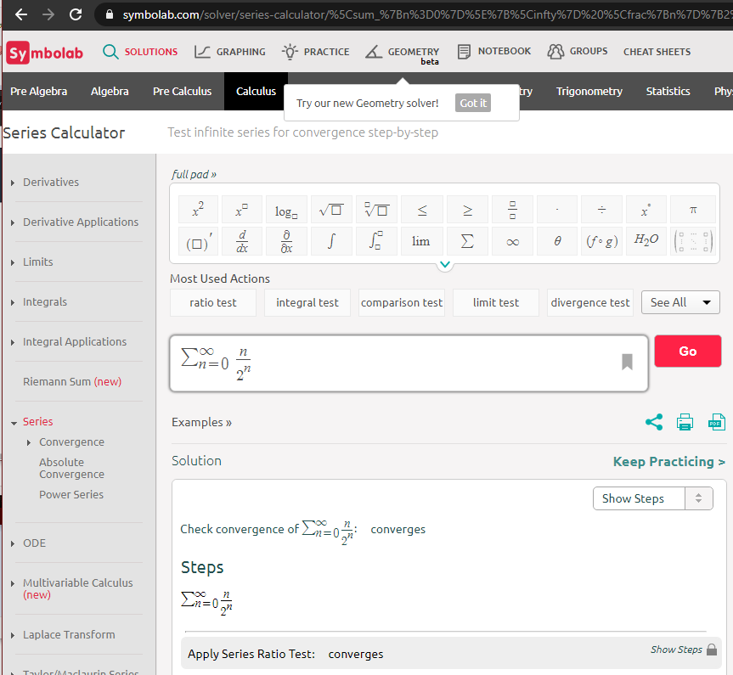

Slide 143
Series Convergence
I haven’t figured out how to get the convergence value (the sum) out of Symbolab…
(I’m sure you can…)
(Still not 7/11/2022)

Slide 144
Questions?
http://i.imgur.com/aliTlT3.jpg

Slide 145

Series Convergence
Root tests
Let be an infinite series
with nonnegative terms
and let p = (a_{k})^{1/k}
1. If 0≤p<1 the series converges
2. If p>1, (including p=∞), the series diverges
3. If p=1, the test is inconclusive
∞
∑ $\frac{\text{1}}{\text{k}\text{p}}$
k=1
lim
k→∞

Slide 146
SERIES CONVERGENCE
IN-CLASS PROBLEM 8
Identify for what values of n does
∞
∑ 1/k^{1/n} converge?
k=0
0≤lim_{k→∞} (a_{k})^{1/k} <1 the series converges
lim_{k→∞} (a_{k})^{1/k} >1, (including p=∞), the series diverges
lim_{k→∞} (a_{k})^{1/k} =1, the test is inconclusive

Slide 147
SERIES CONVERGENCE
IN-CLASS PROBLEM 8
Identify for what values of n does
∞
∑ 1/k^{1/n} converge?
k=0
For n=1?
1. If 0≤lim_{k→∞} (a_{k})^{1/k} <1 the series converges
2. If lim_{k→∞} (a_{k})^{1/k} >1, (including p=∞), the series diverges
3. If lim_{k→∞} (a_{k})^{1/k} =1, the test is inconclusive

Slide 148
SERIES CONVERGENCE
IN-CLASS PROBLEM 8
Identify for what values of n does
∞
∑ 1/k^{1/n} converge?
k=0
For n=1? diverges
For n=2?
1. If 0≤lim_{k→∞} (a_{k})^{1/k} <1 the series converges
2. If lim_{k→∞} (a_{k})^{1/k} >1, (including p=∞), the series diverges
3. If lim_{k→∞} (a_{k})^{1/k} =1, the test is inconclusive

Slide 149
SERIES CONVERGENCE
IN-CLASS PROBLEM 8
Identify for what values of n does
∞
∑ 1/k^{1/n} converge?
k=0
For n=1? diverges
For n=2? diverges
For n=½?
1. If 0≤lim_{k→∞} (a_{k})^{1/k} <1 the series converges
2. If lim_{k→∞} (a_{k})^{1/k} >1, (including p=∞), the series diverges
3. If lim_{k→∞} (a_{k})^{1/k} =1, the test is inconclusive

Slide 150
SERIES CONVERGENCE
IN-CLASS PROBLEM 8
Identify for what values of n does
∞
∑ 1/k^{1/n} converge?
k=0
For n=1? diverges
For n=2? diverges
For n=½? converges!
Try n=0.999999?

Slide 151
SERIES CONVERGENCE
IN-CLASS PROBLEM 8
Identify for what values of n does
∞
∑ 1/k^{1/n} converge?
k=0
For n=1? diverges
For n=2? diverges
For n=½? converges!
Try n=0.999999? converges!

Slide 152


Slide 153
Questions?
http://i.imgur.com/aliTlT3.jpg

Slide 154
Series Convergence
Alternating series
Where a_{k}>0 0<a_{k+1}≤a_{k}
What does this graph look like?
Convergence where a_{k} = 0
Divergence where a_{k} ≠ 0
∞
∑ (-1)^{k}a_{k}
k=1
lim
k→∞
lim
k→∞

Slide 155
Questions?
http://i.imgur.com/aliTlT3.jpg

Slide 156
Series Convergence
Strategy:
1) If it looks like the series terms don’t converge to zero, use the Divergence Test

Slide 157
Series Convergence
Strategy:
2) Is it a p-series?
These converge if p>1
3) Is it a geometric series?
These converge if |r|<1

Slide 158
Series Convergence
Strategy:
4) Is it ALMOST a p-series or geometric series?
Try the Comparison Test

Slide 159
Series Convergence
Strategy:
5) Is the series a rational expression?
Try the Comparison Test and/or the Limit Comparison Test

Slide 160
Series Convergence
Strategy:
6) Does the series contain factorials or constants raised to powers involving n?
Try the Ratio Test

Slide 161
Series Convergence
Strategy:
7) Can the series terms be written in the form
a_{n}=(b_{n})^{n}?
Try the Root Test

Slide 162
Series Convergence
Strategy:
8) Is it an alternating sequence?
Try the Alternating Series Test

Slide 163

Series Convergence
Aren’t you GLAD you live in the age of WolframAlpha/
Symbolab?
http://l7.alamy.com/zooms/1e68251a782547fea9e24ad09cd85a6d/full-body-asian-male-university-student-in-graduation-gown-thumb-up-dagnd3.jpg

Slide 164

Series Convergence
Symbolab checks using:

Slide 165
Questions?
http://i.imgur.com/aliTlT3.jpg

Slide 166
Summary
Today we studied:
Review of sequences and series
Convergence and divergence

Slide 167

You Survived!

