Slide 1
Welcome to
Unit 5
Part 10!
MATH 207 Integral Calculus

Slide 2
What’s Up?
New stuff:
Higher order integrals

Slide 3
What’s Up?
Outcome 5) Find partial derivatives of functions of several variables and iterated integrals
Outcome 7) Solve problems by identifying the requirements, making a sketch as appropriate

Slide 4
Multiple Integrals
If there are higher-order derivatives, there are probably Multiple Integrals, too!

Slide 5
Multiple Integrals
With functions of one variable we integrated over an interval (a one-dimensional space)

Slide 6
Multiple Integrals
When integrating a function of two variables we will integrate over a region

Slide 7
Multiple Integrals
They look like:
∫_{c}^{d} ∫_{a}^{b} (something) dy dx
Do this one first
Do this one second

Slide 8
Multiple Integrals
Do the integrations in-order , inside first then outwards, outside one last
∫_{c}^{d} ∫_{a}^{b} dy dx
}
first

Slide 9

Multiple Integrals
Do the integrations in-order , inside first then outwards, outside one last
∫_{c}^{d} ∫_{a}^{b} dy dx
first
second

Slide 10
Multiple Integrals
Frequently not all of the integrals are with respect to the same variable
∫_{c}^{d} ∫_{a}^{b} dx dx
∫_{c}^{d} ∫_{a}^{b} dy dx

Slide 11

Multiple Integrals
Frequently use functions of variables for the limits
∫_{a}^{b} ∫₀^{ƒ(x)} dy dx
http://translationbiz.files.wordpress.com/2012/07/tearing-out-hair2.jpg

Slide 12
Multiple Integrals
It’s ok…
The TI can handle it!

Slide 13
MULTIPLE INTEGRATION
IN-CLASS PROBLEM 1
Find: ∫₀⁴ ∫₀^{4-x} (xy) dy dx
first

Slide 14
MULTIPLE INTEGRATION
IN-CLASS PROBLEM 1
Find: ∫₀⁴ ∫₀^{4-x} xy dy dx
∫₀^{4-x} xy dy = xy²/2 + c
Next do:
The limits

Slide 15
MULTIPLE INTEGRATION
IN-CLASS PROBLEM 1
Find: ∫₀⁴ ∫₀^{4-x} xy dy dx
∫₀^{4-x} xy dy = xy²/2 +c |₀^{4-x}
x(4-x)²/2 +c – (0 +c )=
x(16-8x+x^2)/2
=8x-4x^2+(x^3)/2
Next do:
∫₀⁴ (8x-4x^2+(x^3)/2) dx

Slide 16
MULTIPLE INTEGRATION
IN-CLASS PROBLEM 1
Find: ∫₀⁴ ∫₀^{4-x} xy dy dx
Next do:
∫₀⁴ (8x-4x²+(x³)/2) dx
= x⁴/8 - (4x³)/3 + 4x² +c |₀⁴
= 4⁴/8 - (4×4³)/3 + 4×4² +c –
(0⁴/8 - (4×0³)/3 + 4×0² +c)
= 32/3

Slide 17

Questions?
http://i.imgur.com/aliTlT3.jpg

Slide 18
Multiple Integration
Just like you can keep taking derivatives of derivatives until you end up with zero
you can keep taking integrals of integrals!

Slide 19
Multiple Integration
∫ jerk dt = acceleration
∫∫ jerk dt dt = velocity
∫∫∫ jerk dt dt dt= position

Slide 20
Multiple Integration
You do the inside integral first including evaluating the limits before moving to the outer
integrals

Slide 21
MULTIPLE INTEGRATION
IN-CLASS PROBLEM 2
Find: ∫₂³∫₀¹ 3x dx dx
do this first

Slide 22
MULTIPLE INTEGRATION
IN-CLASS PROBLEM 2
Find: ∫₂³∫₀¹ 3x dx dx
∫₂³ 3/2 x² +c |₀¹ dx

Slide 23
MULTIPLE INTEGRATION
IN-CLASS PROBLEM 2
Find: ∫₂³∫₀¹ 3x dx dx
∫₂³ 3/2 x² +c |₀¹ dx
Now take the limits:
3/2 x² + C |₀¹
= (3/2(1²) + C) – (3/2(0²) + C)
= 3/2

Slide 24
MULTIPLE INTEGRATION
IN-CLASS PROBLEM 2
Find: ∫₂³∫₀¹ 3x dx dx
∫₂³ 3/2 x² |₀¹ dx
∫₂³ 3/2(1² ) – 3/2(0²) dx
∫₂³ 3/2 – 0 dx
∫₂³ 3/2 dx
Now not so scary !

Slide 25
MULTIPLE INTEGRATION
IN-CLASS PROBLEM 2
Find: ∫₂³∫₀¹ 3x dx dx
∫₂³ 3/2 dx
∫₂³ 3/2 dx = 3/2 x +c |₂³
= 3/2(3) +c – (3/2(2) +c)
= 9/2 – 6/2
= 3/2 or 1.5

Slide 26
Questions?
http://i.imgur.com/aliTlT3.jpg

Slide 27
MULTIPLE INTEGRATION
IN-CLASS PROBLEM 3
Find: ∫₁³ ∫₀¹ ∫₀² (5x² – y) dx dy dx

Slide 28
MULTIPLE INTEGRATION
IN-CLASS PROBLEM 3
Find: ∫₁³ ∫₀¹ ∫₀² (5x² – y) dx dy dx
∫₁³ ∫₀¹ (40/3 - 2y) dy dx
∫₁³ (37/3) dx
= 74/3 ≈ 24.67

Slide 29
MULTIPLE INTEGRATION
IN-CLASS PROBLEM 3
Note: for some unknown reason, while most multiple integrals work fine in Symbolab, this one didn’t back in 2022… (a mystery glitch!)

Slide 30
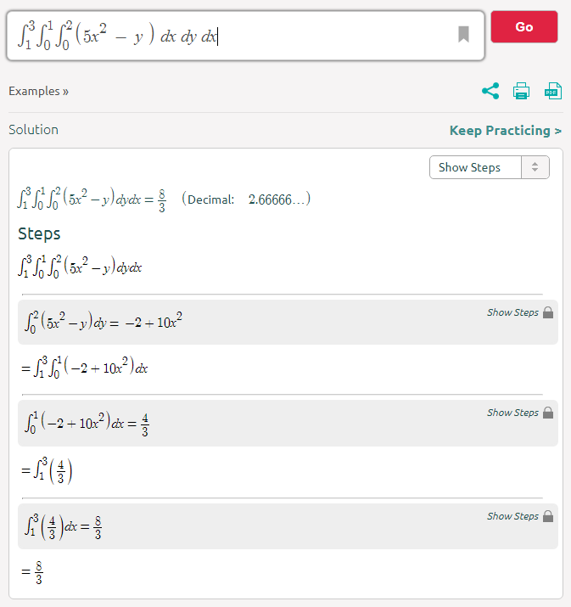
It’s doing dy dx dx not dx dy dx like we want!
…and giving the wrong answer!!

Slide 31
MULTIPLE INTEGRATION
IN-CLASS PROBLEM 3
It worked if you entered:
∫₁³ ∫₀¹ ∫₀² (5x² – y) dx dy dz
Because the last integral is a constant: ∫₁³ (37/3) dx
it doesn’t matter what variable you use, so long as it goes from 1 to 3

Slide 32
MULTIPLE INTEGRATION
IN-CLASS PROBLEM 3
As of 7/25/2022, it seems to be working…
but I would recommend checking Symbolab with WolframAlpha just to be sure

Slide 33

Multiple Integrals
Notice you have to input your variable of integration each time
This means that you don’t
have to use the same
variable in each stage
of the integration!
big-eek.png

Slide 34
Questions?
http://i.imgur.com/aliTlT3.jpg

Slide 35
Double Integrals
These are often used to calculate volumes:
v = ∫∫ ƒ(x,y) dA

Slide 36
Double Integrals and Volume
Given:
∫∫ ƒ(x,y) dy dx
think of dy dx as the area of a small rectangle of width dx and length dy
http://faculty.bucks.edu/taylors/Math242/Volumes.pdf

Slide 37
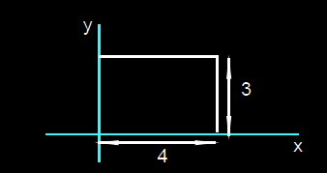
Double Integrals and Volume
The integral
∫ ₀⁴ ∫ ₀³ dy dx
gives the area of the rectangle
http://faculty.bucks.edu/taylors/Math242/Volumes.pdf

Slide 38
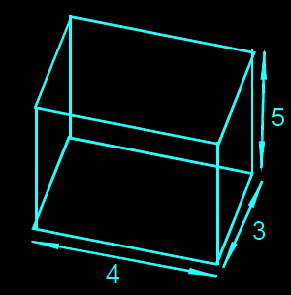
DOUBLE INTEGRALS AND VOLUME
IN-CLASS PROBLEM 4
What if we wanted to find the volume of a box?
http://faculty.bucks.edu/taylors/Math242/Volumes.pdf

Slide 39
DOUBLE INTEGRALS AND VOLUME
IN-CLASS PROBLEM 4
The integral
∫ ₀⁴ ∫ ₀³ dy dx
gives the area of the base
http://faculty.bucks.edu/taylors/Math242/Volumes.pdf

Slide 40
DOUBLE INTEGRALS AND VOLUME
IN-CLASS PROBLEM 4
The integral
∫ ₀⁴ ∫ ₀³ ∫ ₀⁵ dz dy dx
gives the volume of the box
http://faculty.bucks.edu/taylors/Math242/Volumes.pdf

Slide 41
DOUBLE INTEGRALS AND VOLUME
IN-CLASS PROBLEM 4
The integral
∫ ₀⁴ ∫ ₀³ ∫ ₀⁵ dz dy dx
∫ ₀⁴ ∫ ₀³ 5 dy dx
http://faculty.bucks.edu/taylors/Math242/Volumes.pdf

Slide 42
DOUBLE INTEGRALS AND VOLUME
IN-CLASS PROBLEM 4
The integral
∫ ₀⁴ ∫ ₀³ ∫ ₀⁵ dz dy dx
∫ ₀⁴ ∫ ₀³ 5 dy dx
∫ ₀⁴ 15 dx
http://faculty.bucks.edu/taylors/Math242/Volumes.pdf

Slide 43
DOUBLE INTEGRALS AND VOLUME
IN-CLASS PROBLEM 4
The integral
∫ ₀⁴ ∫ ₀³ ∫ ₀⁵ dz dy dx
∫ ₀⁴ ∫ ₀³ 5 dy dx
∫ ₀⁴ 15 dx
Volume = 60
http://faculty.bucks.edu/taylors/Math242/Volumes.pdf

Slide 44
Questions?
http://i.imgur.com/aliTlT3.jpg

Slide 45
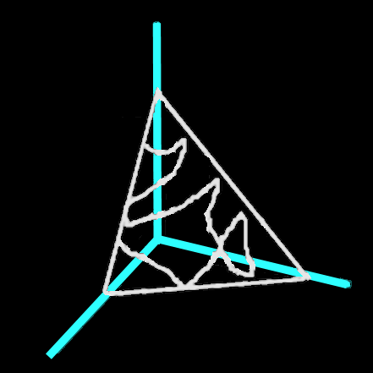
DOUBLE INTEGRALS AND VOLUME
IN-CLASS PROBLEM 5
Use double integrals to find the volume of a tetrahedron bounded by the planes:
(x=0, y=0, z=0),
and the plane:
2x + y + z = 2
z
y
x
http://faculty.bucks.edu/taylors/Math242/Volumes.pdf

Slide 46
DOUBLE INTEGRALS AND VOLUME
IN-CLASS PROBLEM 5
As usual, we’re going to construct a bunch of little boxes and add up their volumes to find the volume of
the tetrahedron
z
y
x
http://faculty.bucks.edu/taylors/Math242/Volumes.pdf

Slide 47
DOUBLE INTEGRALS AND VOLUME
IN-CLASS PROBLEM 5
This will be a double integral, one for the dy’s and one for the dx’s
z
dy
dx
y
x
http://faculty.bucks.edu/taylors/Math242/Volumes.pdf

Slide 48
DOUBLE INTEGRALS AND VOLUME
IN-CLASS PROBLEM 5
We can only have one set of variable limits go from a number (0) to a number (max)
The other must go from
0 to a formula
(because it varies)
z
dy
dx
y
x
http://faculty.bucks.edu/taylors/Math242/Volumes.pdf

Slide 49
DOUBLE INTEGRALS AND VOLUME
IN-CLASS PROBLEM 5
We can only have one set of variable limits go from a number (0) to a number (max)
The other must go from
0 to a formula
(because it varies)
(and otherwise, it
won’t work!
z
dy
dx
y
x
http://faculty.bucks.edu/taylors/Math242/Volumes.pdf

Slide 50
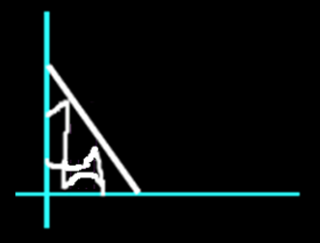
DOUBLE INTEGRALS AND VOLUME
IN-CLASS PROBLEM 5
By setting z = 0, and solving for y, you will be looking at the area on the xy-plane which is bounded by 2x + y = 2:
y = -2x + 2
z
y
Graph
for z=0
y goes from
0 to -2x + 2
y
x
x
http://faculty.bucks.edu/taylors/Math242/Volumes.pdf

Slide 51
DOUBLE INTEGRALS AND VOLUME
IN-CLASS PROBLEM 5
If y can go from o to –2x + 2
x can go from zero to…?
find the x-intercept (where y=0) for y = –2x + 2
y
Graph
for z=0
y goes from
0 to -2x + 2
x
http://faculty.bucks.edu/taylors/Math242/Volumes.pdf

Slide 52
DOUBLE INTEGRALS AND VOLUME
IN-CLASS PROBLEM 5
For y = –2x + 2
y = 0 at x = 1
So x can go from 0 to 1
y
Graph
for z=0
y goes from
0 to -2x + 2
x
x goes from
0 to 1
http://faculty.bucks.edu/taylors/Math242/Volumes.pdf

Slide 53
DOUBLE INTEGRALS AND VOLUME
IN-CLASS PROBLEM 5
Divide up the triangle into small rectangles all of which have width dx and depth dy
y
Graph
for z=0
y goes from
0 to -2x + 2
dy
dx
x
x goes from
0 to 1
http://faculty.bucks.edu/taylors/Math242/Volumes.pdf

Slide 54
DOUBLE INTEGRALS AND VOLUME
IN-CLASS PROBLEM 5
The volume of the solid (tower) above the little rectangle is:
(2 – 2x – y) dy dx
Our original formula was:
2x + y + z = 2
Solving for z:
z = 2 – 2x - y
z
{
y
Graph
for z=0
z = 2 – 2x - y
y goes from
0 to -2x + 2
dy
dx
dy
dx
x
y
x goes from
0 to 1
x
http://faculty.bucks.edu/taylors/Math242/Volumes.pdf

Slide 55
DOUBLE INTEGRALS AND VOLUME
IN-CLASS PROBLEM 5
Volume = sum of the volumes of all these vertical towers:
V = ∫ ₀¹ ∫ ₀^{-2x+2} (2-2x-y) dy dx
= ?
z
z = 2 – 2x - y
dy
dx
y
x
http://faculty.bucks.edu/taylors/Math242/Volumes.pdf

Slide 56
DOUBLE INTEGRALS AND VOLUME
IN-CLASS PROBLEM 5
Volume = sum of the volumes of all these vertical towers:
V = ∫ ₀¹ ∫ ₀^{-2x+2} (2-2x-y) dy dx
= 2/3
z
z = 2 – 2x - y
dy
dx
y
x
http://faculty.bucks.edu/taylors/Math242/Volumes.pdf

Slide 57
Questions?
http://i.imgur.com/aliTlT3.jpg

Slide 58
Summary
Today we studied:
Review of partial derivatives
and higher-order partials
Multiple Integration

Slide 59

You Survived!
www.playbuzz.com

