Slide 1
Welcome to
Unit 5
Part 9!
MATH 207 Integral Calculus

Slide 2
What’s Up?
New stuff:
Partial Derivatives

Slide 3
What’s Up?
Outcome 5) Find partial derivatives of functions of several variables and iterated integrals
Outcome 7) Solve problems by identifying the requirements, making a sketch as appropriate

Slide 4
Partial Derivatives
Many formulas contain more than 2 variables (x, y)

Slide 5
Partial Derivatives
In 3-space, derivatives can be with respect to x, y, or z!

Slide 6
Partial Derivatives
If z = ƒ(x,y)
then partial derivatives will be used

Slide 7
Partial Derivatives
This function must be such that for every pair of x- and y- values there exists a unique z

Slide 8
Partial Derivatives
The symbol used is: ∂

Slide 9
Partial Derivatives
It will look like: $\frac{\text{∂}\text{z} }{\text{∂}\text{x} }$
(the partial derivative of z with respect to x)
and $\frac{\text{∂}\text{z} }{\text{∂}\text{y} }$
(the partial derivative of z with respect to y)

Slide 10
Partial Derivatives
lim
∆x→0
$\frac{\text{∂}\text{z} }{\text{∂}\text{x} }$ = $\frac{\text{ƒ(}\text{x}\text{+∆}\text{x}\text{,}\text{y}\text{) – ƒ(}\text{x}\text{,}\text{y}\text{)}}{\text{∆}\text{x}}$
$\frac{\text{∂}\text{z} }{\text{∂}\text{y} }$ = $\frac{\text{ƒ(}\text{x}\text{,}\text{y}\text{+∆}\text{y}\text{) – ƒ(}\text{x}\text{,}\text{y}\text{)}}{\text{∆}\text{y}}$
lim
∆y→0

Slide 11
Partial Derivatives
Another notation:
ƒ_{x} or ƒ_{x} (x,y)

Slide 12
Partial Derivatives
When evaluating a function at ∂z/∂x y is treated as a constant (held steady)
only x is allowed to vary

Slide 13
Partial Derivatives
Strategy: consider z as a function with only one variable, x, and find the derivative with y considered a constant

Slide 14
Partial Derivatives
For ∂z/∂y
hold x steady and vary y

Slide 15
Partial Derivatives
Total or Full derivative - combine and multiply by the appropriate partial

Slide 16
Partial Derivatives
Once the partial derivative is found, evaluate each partial by
replacing the variable with its value from (x, y, z) and solve

Slide 17
Partial Derivatives
Each partial derivative will return the slope of a line tangent to the surface at that 3-space point parallel to the respective axis

Slide 18
Partial Derivatives
Partial derivatives can be used to find changes in the function as small changes are made in the independent variable

Slide 19
Partial Derivatives
The total derivative can be used to find changes in a function of two variables as small changes are made to one or both variables

Slide 20
PARTIALS
IN-CLASS PROBLEM 1
Find both partial derivatives and the total derivative of:
z = ƒ (x,y) = 2x²y + xy²

Slide 21
PARTIALS
IN-CLASS PROBLEM 1
Find both partial derivatives and the total derivative of:
z = ƒ (x,y) = 2x²y + xy²
First take the derivative versus x pretending y is a constant
∂z/∂x =

Slide 22
PARTIALS
IN-CLASS PROBLEM 1
Find both partial derivatives and the total derivative of:
z = ƒ (x,y) = 2x²y + xy²
∂z/∂x = 4xy + y²
in the TI: d(2*x^2*y+x*y^2,x)
Next do the same versus y
∂z/∂y =

Slide 23
PARTIALS
IN-CLASS PROBLEM 1
Find both partial derivatives and the total derivative of:
z = ƒ (x,y) = 2x²y + xy²
∂z/∂x = 4xy + y²
∂z/∂y = 2x² + 2xy
For the total derivative, add the two pieces and multiply by the appropriate partial
dz =

Slide 24
PARTIALS
IN-CLASS PROBLEM 1
Find both partial derivatives and the total derivative of:
z = ƒ (x,y) = 2x²y + xy²
∂z/∂x = 4xy + y²
∂z = (4xy + y) ∂x
∂z/∂y = 2x² + 2xy
∂z = (2x² + 2xy) ∂y
dz = ∂z (x version) + ∂z (y version)

Slide 25
PARTIALS
IN-CLASS PROBLEM 1
Find both partial derivatives and the total derivative of:
z = ƒ (x,y) = 2x²y + xy²
∂z/∂x = 4xy + y² => (4xy + y) ∂x
∂z/∂y = 2x² + 2xy => (2x²+2xy) ∂y
dz = (4xy+y²) ∂x + (2x²+2xy) ∂y
Now you see how it works!

Slide 26
Partial Derivatives
On the TI, use the regular derivative
It’s smart enough to treat the other variable as a constant

Slide 27
Partial Derivatives
In WolframAlpha:
total derivative of 2x^2y + xy^2

Slide 28
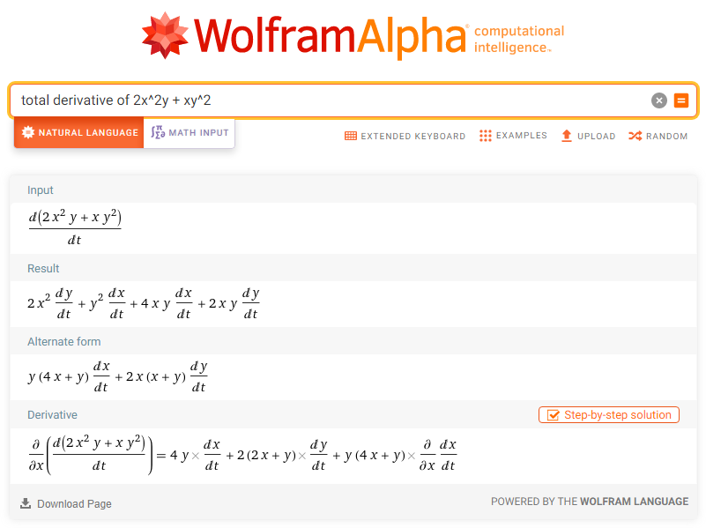
Doesn’t actually work!
(4xy+y²) ∂x + (2x²+2xy) ∂y

Slide 29
A Wolfram Widget:
https://www.wolframalpha.com/widgets/view.jsp?id=d824757fee2698b6b4207386016bcc9d

Slide 30
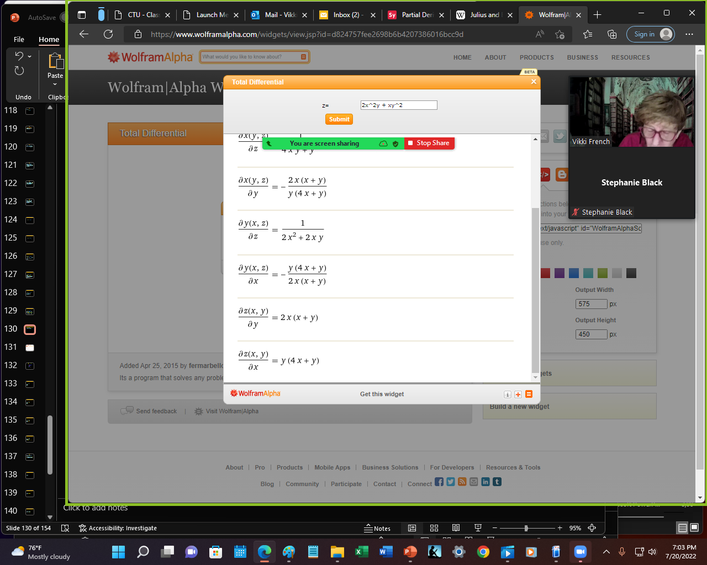
Didn’t give the total derivative BUT did at least give the partials
(4xy+y²) ∂x + (2x²+2xy) ∂y

Slide 31
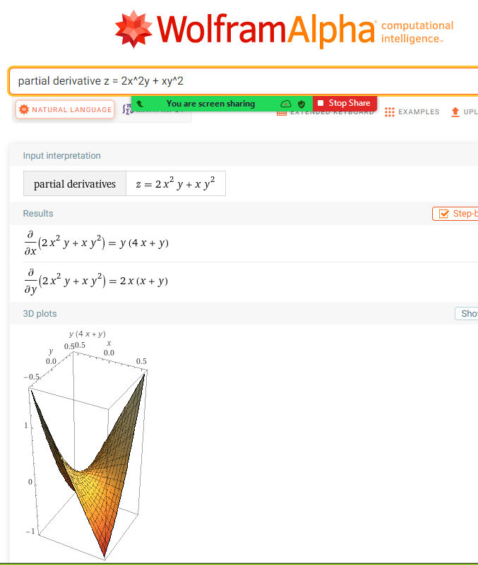
AT least
you CAN
get the
partials!
(4xy+y²) ∂x + (2x²+2xy) ∂y

Slide 32
The best solution:
derivative z = 2x^2y + xy^2

Slide 33
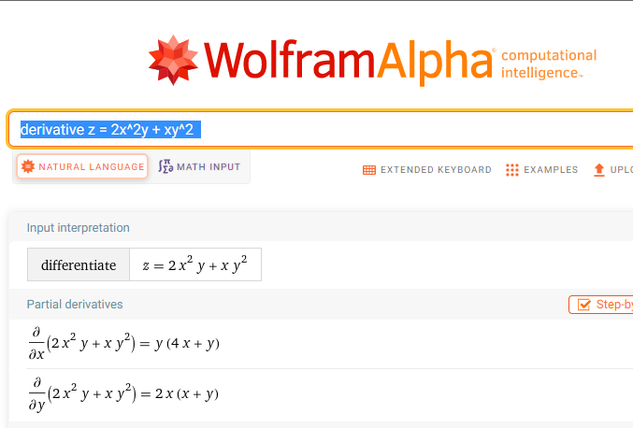
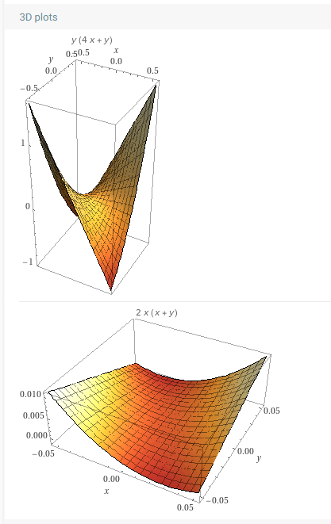

OK except they are using dx rather than ∂x and dy rather than ∂y

Slide 34

Questions?
http://i.imgur.com/aliTlT3.jpg

Slide 35
PARTIALS
IN-CLASS PROBLEM 2
Find both partial derivatives and the total derivative of:
z = 1/3 πx²y
∂z/∂x =
∂z/∂y
dz

Slide 36
PARTIALS
IN-CLASS PROBLEM 2
Find both partial derivatives and the total derivative of:
z = 1/3 πx²y
∂z/∂x = 2πxy/3
∂z/∂y =
dz

Slide 37
PARTIALS
IN-CLASS PROBLEM 2
Find both partial derivatives and the total derivative of:
z = 1/3 πx²y
∂z/∂x = 2πxy/3
∂z/∂y = πx²/3
dz =

Slide 38
PARTIALS
IN-CLASS PROBLEM 2
Find both partial derivatives and the total derivative of:
z = 1/3 πx²y
∂z/∂x = 2πxy/3
∂z/∂y = πx²/3
dz = (2πxy/3) ∂x + (πx²/3) ∂y

Slide 39
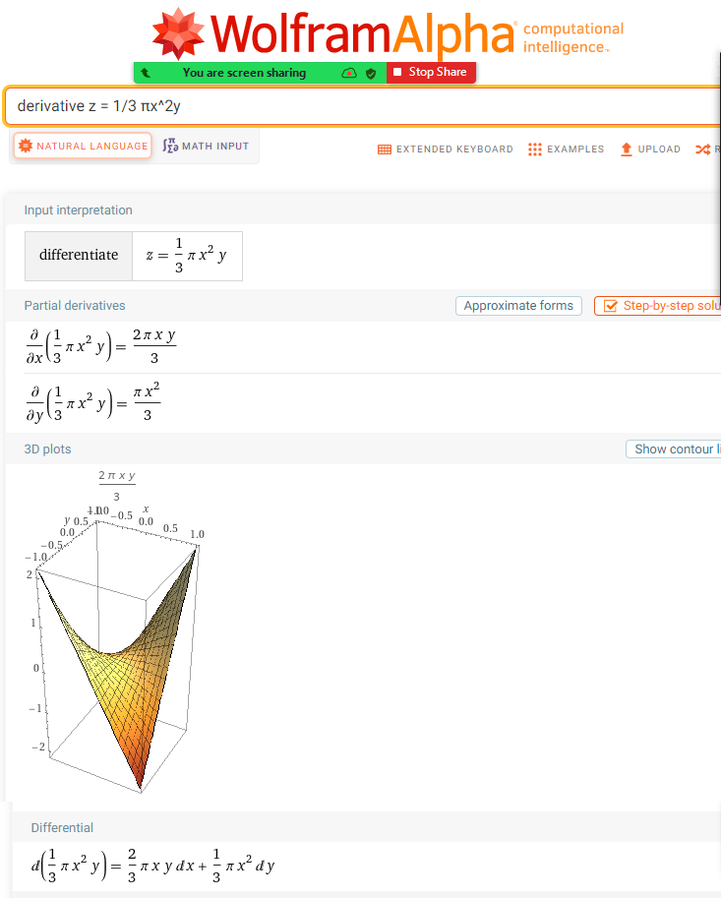
In Wolfram:
derivative
z = 1/3 πx²y

Slide 40
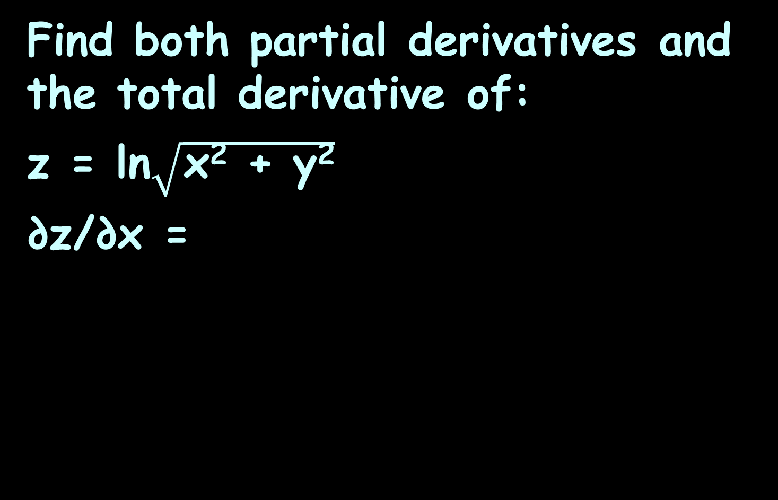
PARTIALS
IN-CLASS PROBLEM 3
Find both partial derivatives and the total derivative of:
z = ln$\sqrt{\text{x}\text{2}\text{ + }\text{y}\text{2}}$
∂z/∂x =

Slide 41
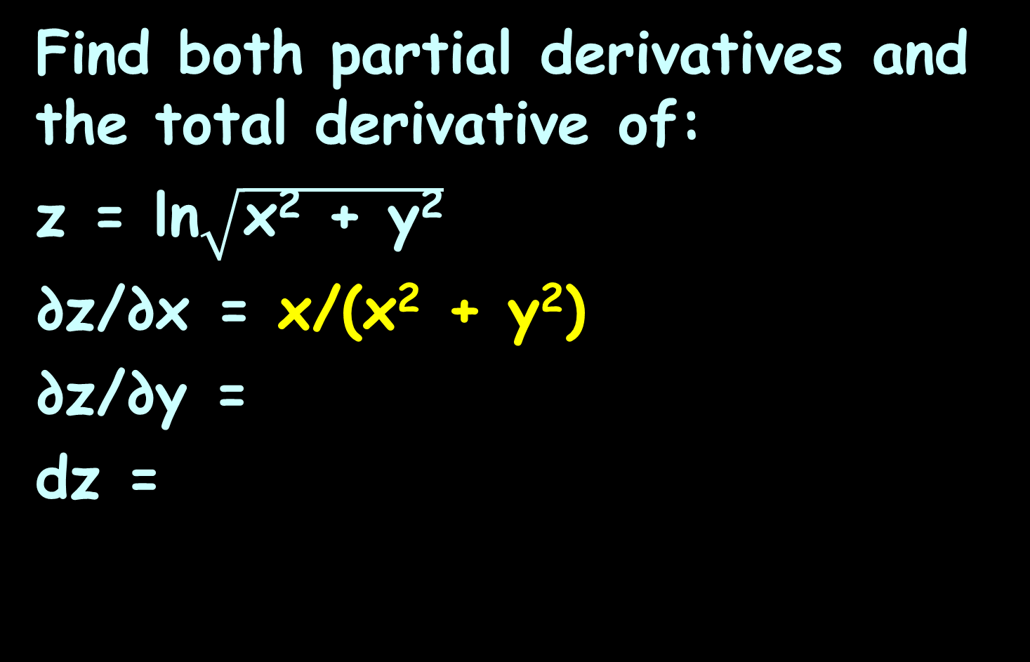
PARTIALS
IN-CLASS PROBLEM 3
Find both partial derivatives and the total derivative of:
z = ln$\sqrt{\text{x}\text{2}\text{ + }\text{y}\text{2}}$
∂z/∂x = x/(x² + y²)
∂z/∂y =
dz =

Slide 42
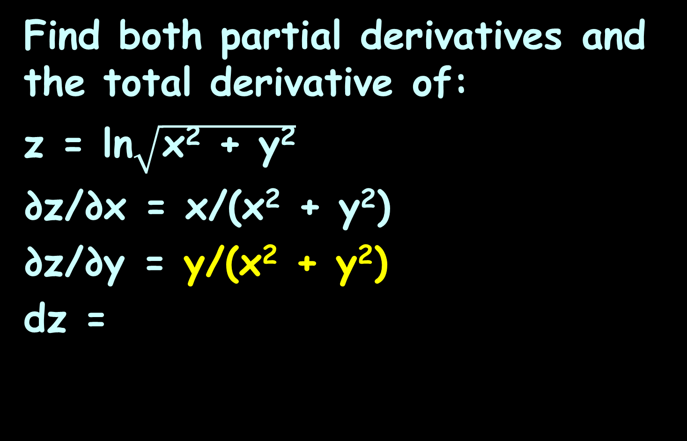
PARTIALS
IN-CLASS PROBLEM 3
Find both partial derivatives and the total derivative of:
z = ln$\sqrt{\text{x}\text{2}\text{ + }\text{y}\text{2}}$
∂z/∂x = x/(x² + y²)
∂z/∂y = y/(x² + y²)
dz =

Slide 43
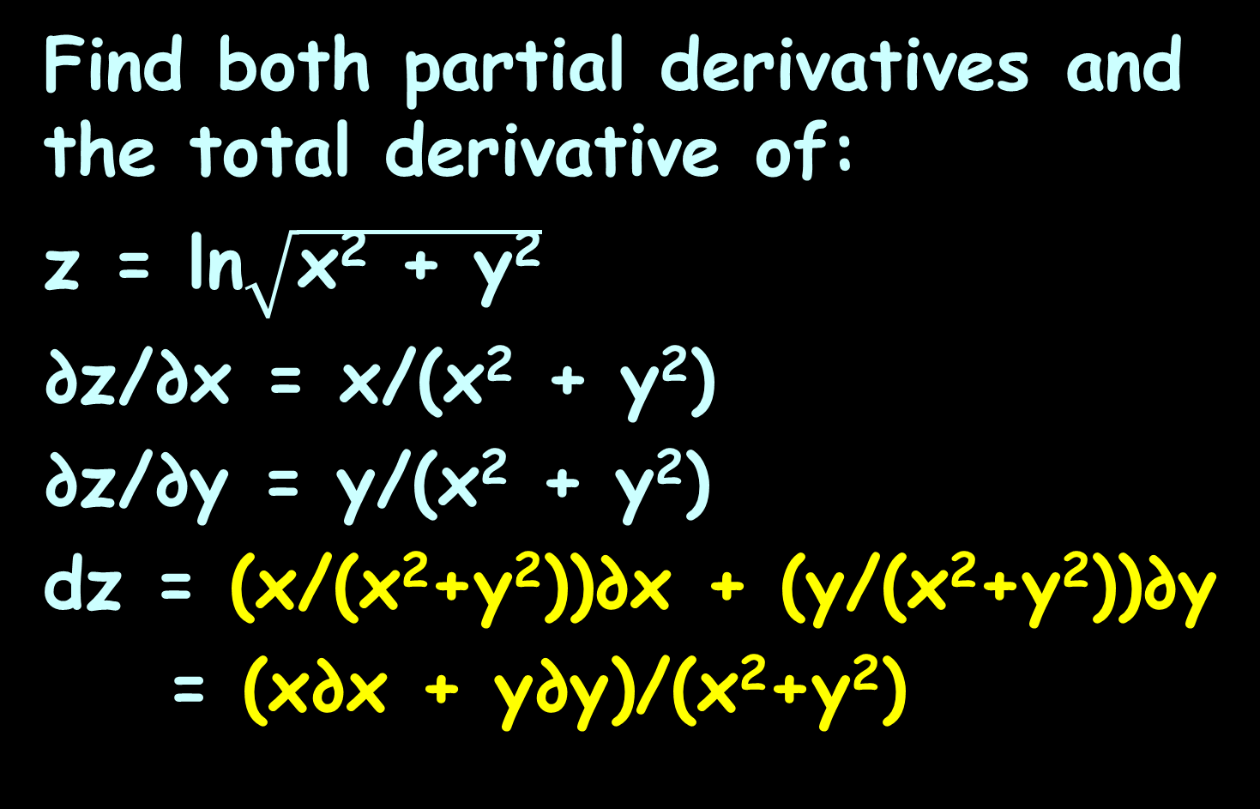
PARTIALS
IN-CLASS PROBLEM 3
Find both partial derivatives and the total derivative of:
z = ln$\sqrt{\text{x}\text{2}\text{ + }\text{y}\text{2}}$
∂z/∂x = x/(x² + y²)
∂z/∂y = y/(x² + y²)
dz = (x/(x²+y²))∂x + (y/(x²+y²))∂y
= (x∂x + y∂y)/(x²+y²)

Slide 44
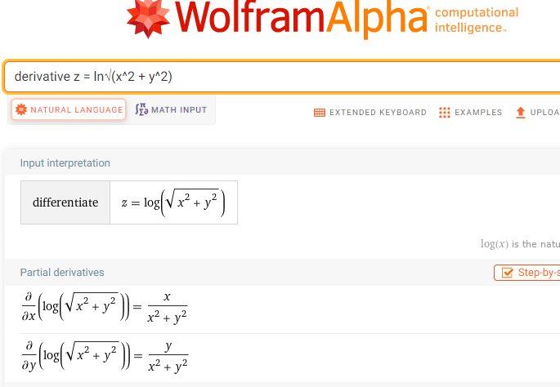
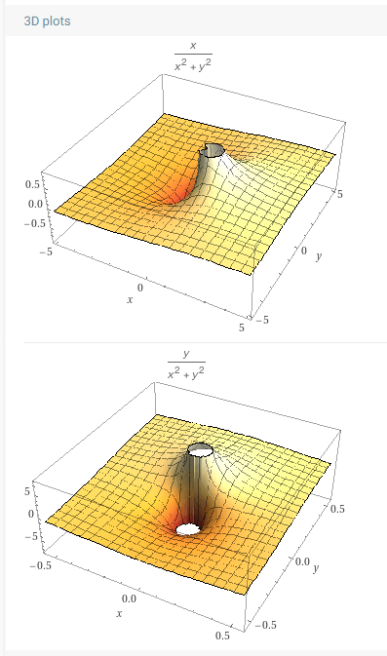
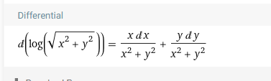

Slide 45
PARTIALS
IN-CLASS PROBLEM 4
Find both partial derivatives and the full derivative of:
z = (x² – y²)^{–3}
∂z/∂x =

Slide 46
PARTIALS
IN-CLASS PROBLEM 4
Find both partial derivatives and the full derivative of:
z = (x² – y²)^{–3}
∂z/∂x = –6x/(x² – y²)⁴
∂z/∂y =
dz=

Slide 47
PARTIALS
IN-CLASS PROBLEM 4
Find both partial derivatives and the full derivative of:
z = (x² – y²)^{–3}
∂z/∂x = –6x/(x² – y²)⁴
∂z/∂y = 6y/(x² – y²)⁴
dz=

Slide 48
PARTIALS
IN-CLASS PROBLEM 4
Find both partial derivatives and the full derivative of:
z = (x² – y²)^{–3}
∂z/∂x = –6x/(x² – y²)⁴
∂z/∂y = 6y/(x² – y²)⁴
dz=(–6x/(x²–y²)⁴)∂x+(6y/(x²–y²)⁴)∂y
= (–6x∂x+6y∂y)/(x²–y²)⁴

Slide 49
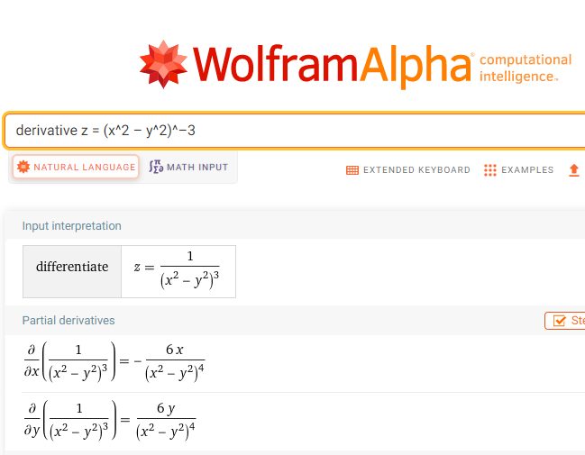
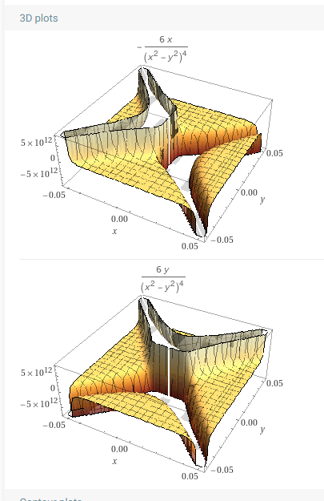
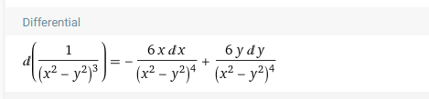

Slide 50
Questions?
http://i.imgur.com/aliTlT3.jpg

Slide 51
PARTIALS
IN-CLASS PROBLEM 5
Find both partial derivatives and the full derivative of:
z = ye^{sinx}
∂z/∂x =
∂z/∂y =
dz =

Slide 52
PARTIALS
IN-CLASS PROBLEM 5
Find both partial derivatives and the full derivative of:
z = ye^{sinx}
∂z/∂x = ycosx e^{sinx}
∂z/∂y =
dz =

Slide 53
PARTIALS
IN-CLASS PROBLEM 5
Find both partial derivatives and the full derivative of:
z = ye^{sinx}
∂z/∂x = ycosx e^{sinx}
∂z/∂y = e^{sinx}
dz =

Slide 54
PARTIALS
IN-CLASS PROBLEM 5
Find both partial derivatives and the full derivative of:
z = ye^{sinx}
∂z/∂x = ycos(x) e^^{sinx}
∂z/∂y = e^{sinx}
dz = (y cosx e^{sinx})∂x + (e^{sinx})∂y

Slide 55
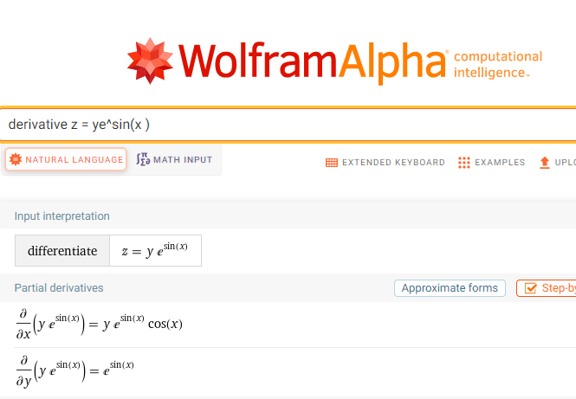
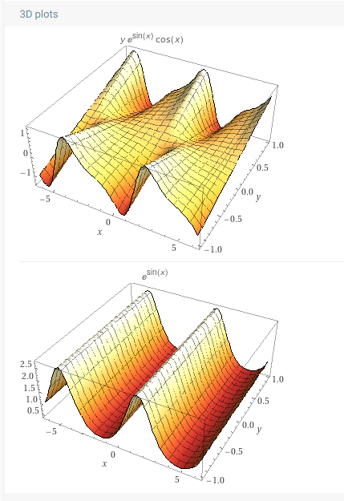


Slide 56
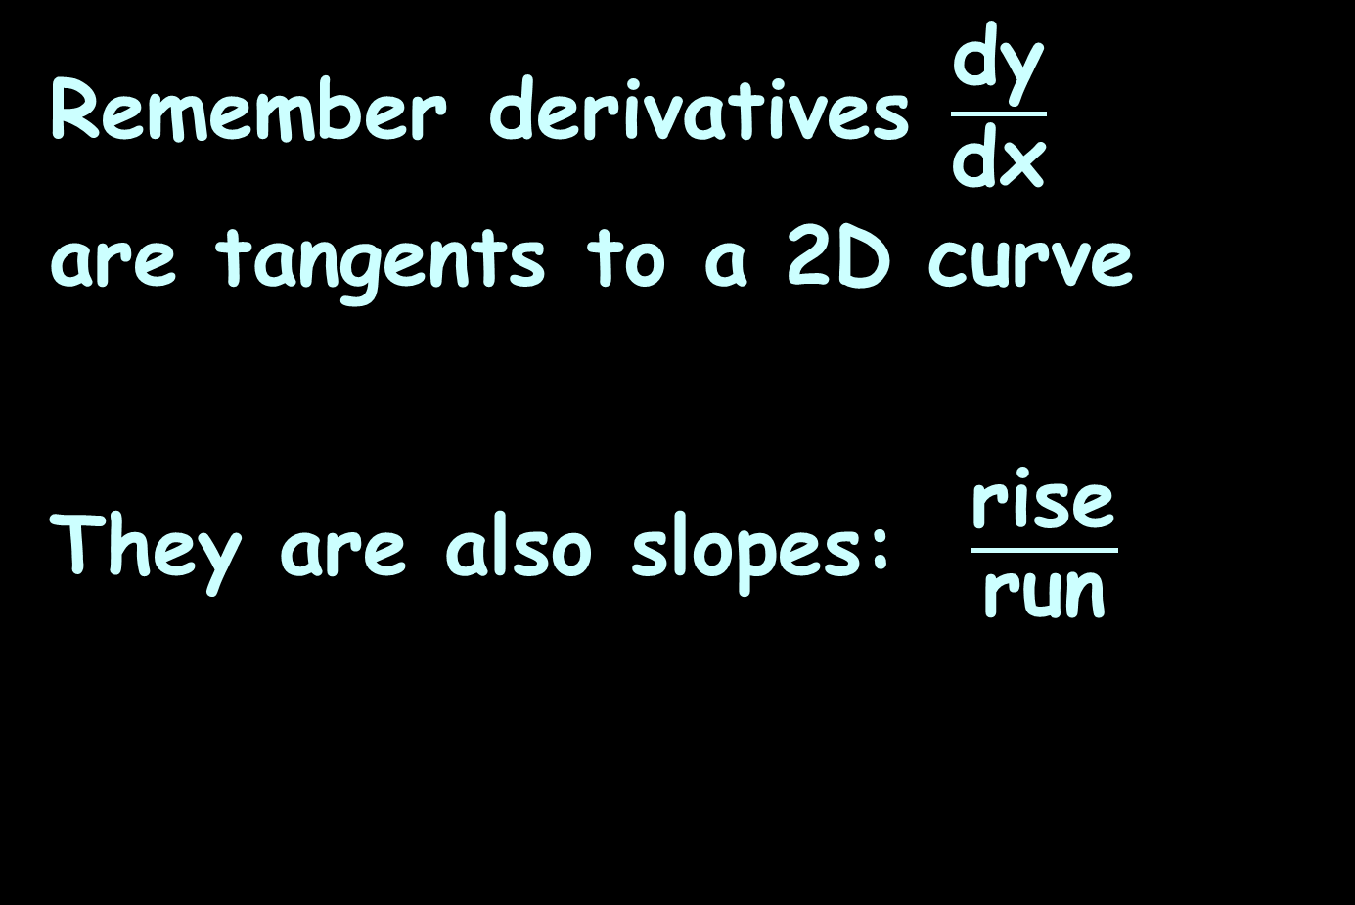
Partial Derivatives
Remember derivatives $\frac{\text{dy}}{\text{d}\text{x}}$
are tangents to a 2D curve
They are also slopes: $\frac{\text{rise}}{\text{run}}$

Slide 57
Partial Derivatives
Similarly, partial derivatives are also tangents and slopes
$\frac{\text{∂}\text{y}}{\text{∂}\text{x}}$ = $\frac{\text{rise}}{\text{run}}$

Slide 58
Partial Derivatives
For a 2D curve, you have 1 slope
y = mx + b

Slide 59
Partial Derivatives
For a 3D curved surface, you have 2 slopes (from the two parametric equations)
z = m₁x + m₂y + intercepts

Slide 60
PARTIALS
IN-CLASS PROBLEM 6
Find the slope of the tangent line parallel to the xz plane and the yz plane through the given point: z = 8y² – x² (2,1,4)
Find the tangent line parallel to the xz plane: ∂z/∂x =

Slide 61
PARTIALS
IN-CLASS PROBLEM 6
Find the slope of the tangent line parallel to the xz plane and the yz plane through the given point: z = 8y² – x² (2,1,4)
tangent line parallel to the xz plane: ∂z/∂x = –2x =
Plug in the appropriate value from (2,1,4)

Slide 62
PARTIALS
IN-CLASS PROBLEM 6
Find the slope of the tangent line parallel to the xz plane and the yz plane through the given point: z = 8y² – x² (2,1,4)
tangent line parallel to the xz plane: ∂z/∂x = –2x = -2(2) = -4
Find the tangent line parallel to the yz plane: ∂z/∂y =

Slide 63
PARTIALS
IN-CLASS PROBLEM 6
Find the slope of the tangent line parallel to the xz plane and the yz plane through the given point: z = 8y² – x² (2,1,4)
tangent line parallel to the xz plane: ∂z/∂x = –2x = -4
tangent line parallel to the yz plane: ∂z/∂y = 16y =
Plug in the appropriate value from (2,1,4)

Slide 64
PARTIALS
IN-CLASS PROBLEM 6
Find the slope of the tangent line parallel to the xz plane and the yz plane through the given point: z = 8y² – x² (2,1,4)
tangent line parallel to the xz plane: ∂z/∂x = –2x = -4
tangent line parallel to the yz plane: ∂z/∂y = 16y = 16(1) = 16

Slide 65
Questions?
http://i.imgur.com/aliTlT3.jpg

Slide 66
Partial Derivatives
The partial derivative gives the instantaneous rate of change of a variable in terms of another variable, assuming that all other variables are held constant

Slide 67
Partial Derivatives
The total derivative gives the instantaneous rate of change of a variable in terms of another variable, without assuming that all other variables are held constant

Slide 68
Partial Derivatives
The partial derivative only captures some of the information regarding the dependence of one variable upon another at a given point
The total derivative is built up from several partial derivatives in order to capture all of the information
https://spin0r.wordpress.com/2013/01/04/the-difference-between-partial-and-total-derivatives/

Slide 69

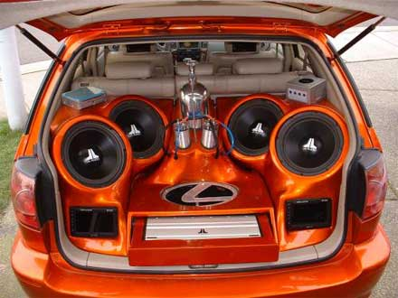
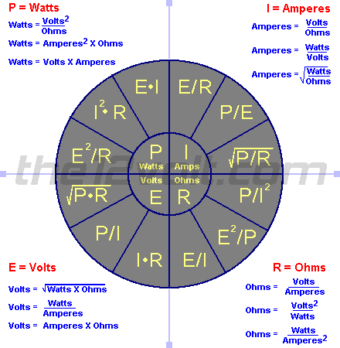
Car audio’s use of Calculus
From a previous CTU student

Slide 70
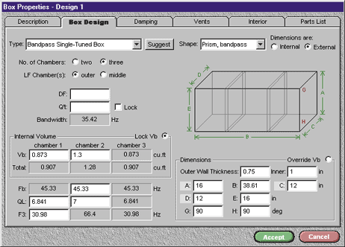
Partial Derivatives were used to develop this program in order to make it easier for the everyday user to build a box with the correct volume.
From a previous CTU student

Slide 71
The more in-depth you go with the box design the more you need to know about the full build (like speaker size) to calculate the speaker displacement to insure you still have the volume intended for the box after the speaker is mounted.
From a previous CTU student

Slide 72
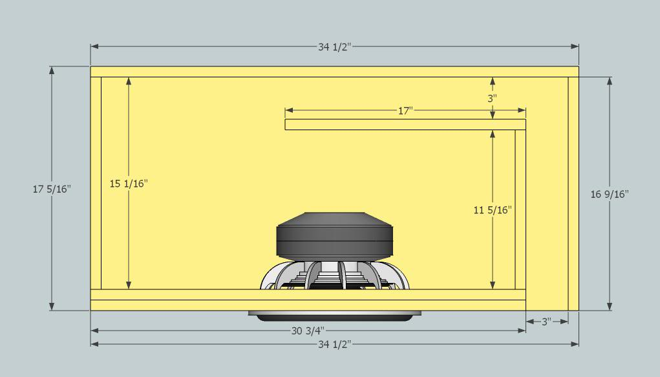
∂f/∂x = lim f(x + h , y) - f(x , y) h
h→0
∂f/∂y = lim f(x , y + k) - f(x , y) k
k→0
From a previous CTU student

Slide 73
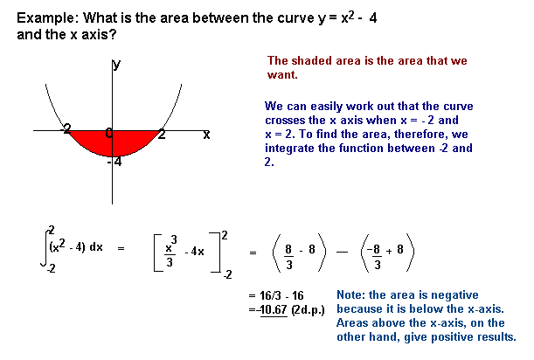
Integrals help with the more advanced box designs with using fiberglass to help calculate the volume of the box there are a lot more angles and curves to the design of the box
From a previous CTU student

Slide 74
Questions?
http://i.imgur.com/aliTlT3.jpg

Slide 75
Higher-Order Partials
Remember, we had higher-order derivatives with functions of one variable?

Slide 76

Higher-Order Partials
They looked like:
y" = $\frac{d^{2}y}{dx^{2}}$

Slide 77
Higher-Order Partials
You could keep going: y’’’ y’’’’ …

Slide 78
Higher-Order Partials
We will also have higher-order derivatives of functions of more than one variable

Slide 79
Higher-Order Partials
In single variable calculus we saw that the second derivative is often useful:
it measures acceleration
it identifies maximum and
minimum points
it tells us something about
how sharply curved a
graph is

Slide 80
Higher-Order Partials
Second derivatives are also useful in the multi-variable case

Slide 81

Higher-Order Partials
But (not surprisingly) things are a bit more complicated…
http://1.bp.blogspot.com/-o6VoKoz9RRk/Uk1FfScUyeI/AAAAAAAAAno/eHm6IuPcfhA/s1600/
scared+man.JPG

Slide 82
Higher-Order Partials
To take a “derivative,” we must take a partial derivative with respect to x or y

Slide 83
Higher-Order Partials
…and there are four ways to do it:
x then x
x then y
y then x
y then y

Slide 84
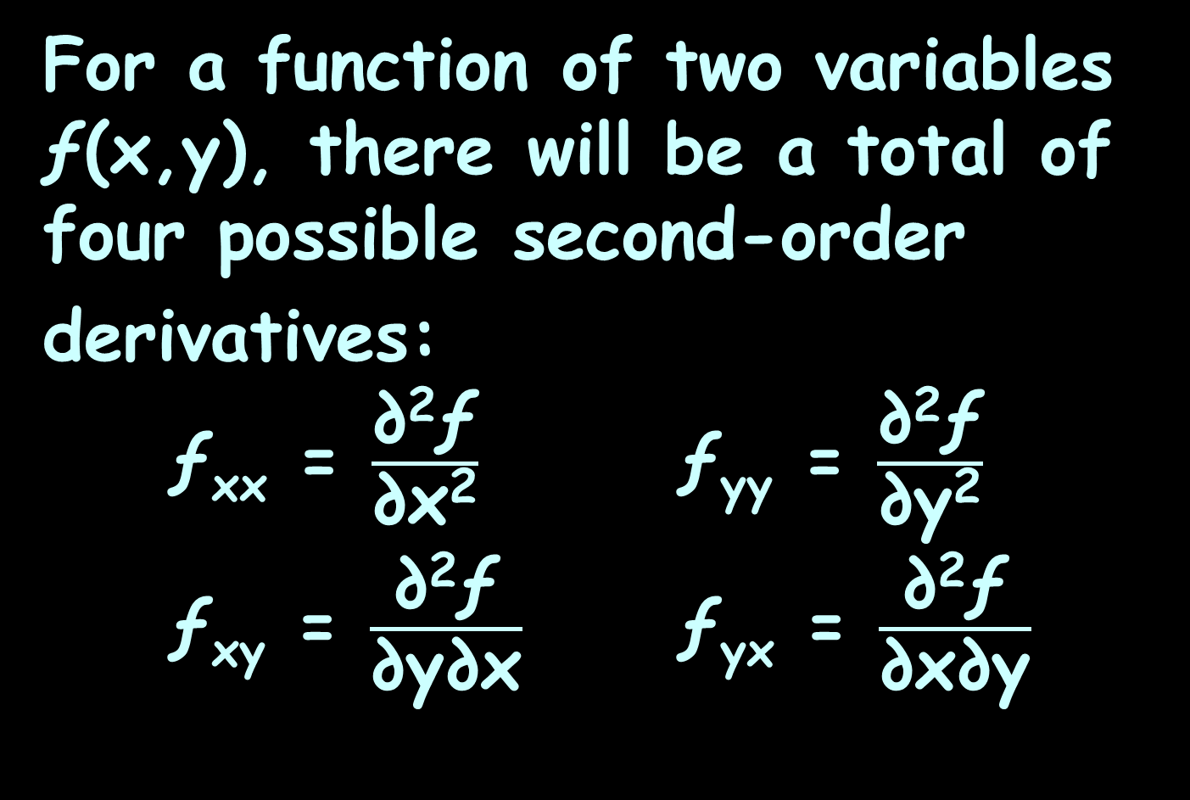
Higher-Order Partials
For a function of two variables ƒ(x,y), there will be a total of four possible second-order
derivatives:
ƒ_{xx} = $\frac{\text{∂}\text{2}\text{ƒ}}{\text{∂}\text{x}\text{2}}$ ƒ_{yy} = $\frac{\text{∂}\text{2}\text{ƒ}}{\text{∂}\text{y}\text{2}}$
ƒ_{xy} = $\frac{\text{∂}\text{2}\text{ƒ}}{\text{∂}\text{y}\text{∂}\text{x}}$ ƒ_{yx} = $\frac{\text{∂}\text{2}\text{ƒ}}{\text{∂}\text{x}\text{∂}\text{y}}$

Slide 85
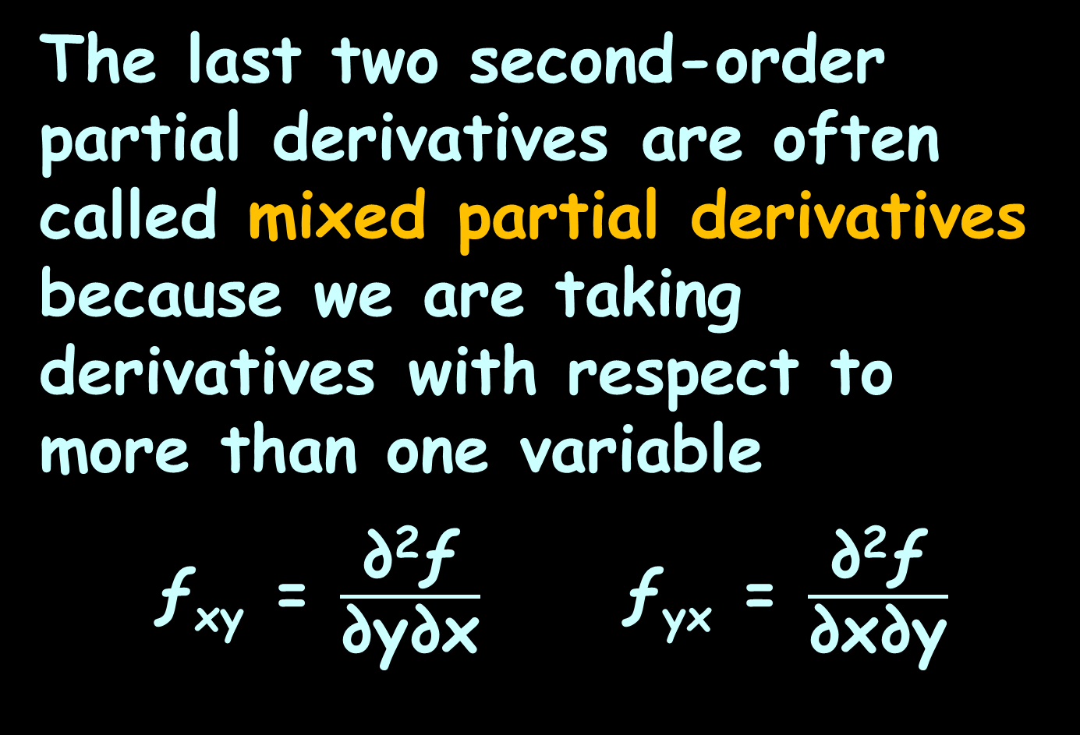
Higher-Order Partials
The last two second-order partial derivatives are often called mixed partial derivatives because we are taking derivatives with respect to more than one variable
ƒ_{xy} = $\frac{\text{∂}\text{2}\text{ƒ}}{\text{∂}\text{y}\text{∂}\text{x}}$ ƒ_{yx} = $\frac{\text{∂}\text{2}\text{ƒ}}{\text{∂}\text{x}\text{∂}\text{y}}$

Slide 86
Higher-Order Partials
Note that the order that we take the derivatives in is given by the notation:
ƒ_{xy}
means first differentiate with respect to x then with respect to y

Slide 87
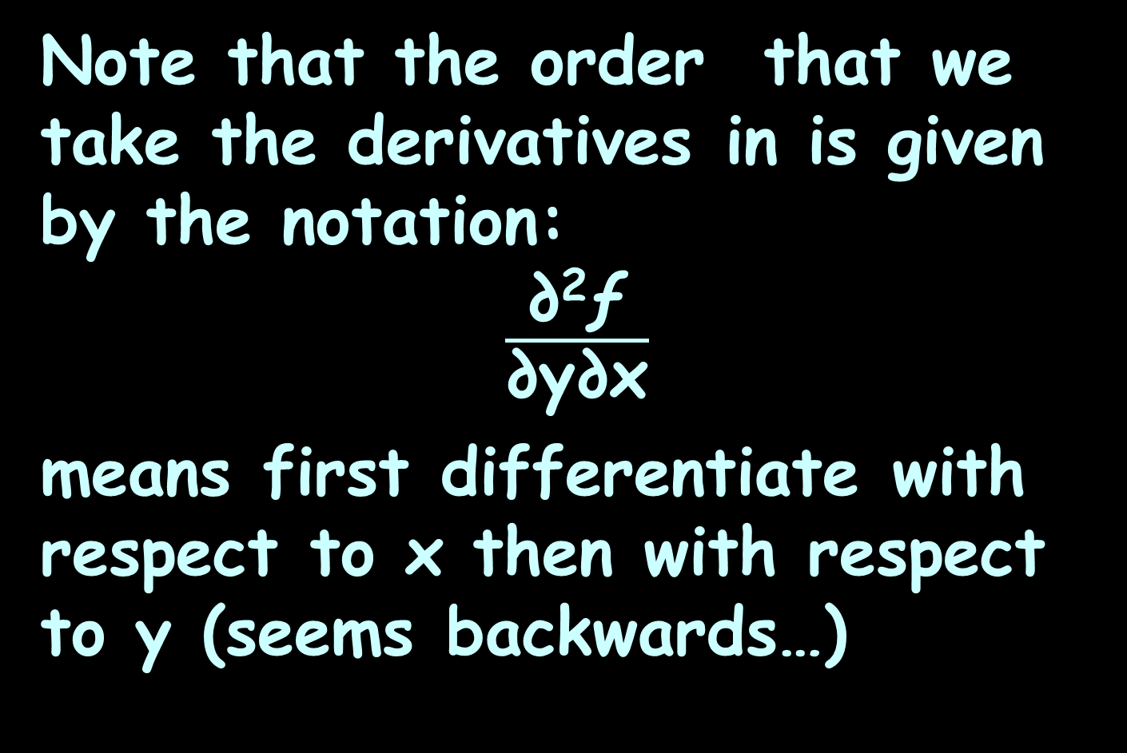
Higher-Order Partials
Note that the order that we take the derivatives in is given by the notation:
$\frac{\text{∂}\text{2}\text{ƒ}}{\text{∂}\text{y}\text{∂}\text{x}}$
means first differentiate with respect to x then with respect to y (seems backwards…)

Slide 88
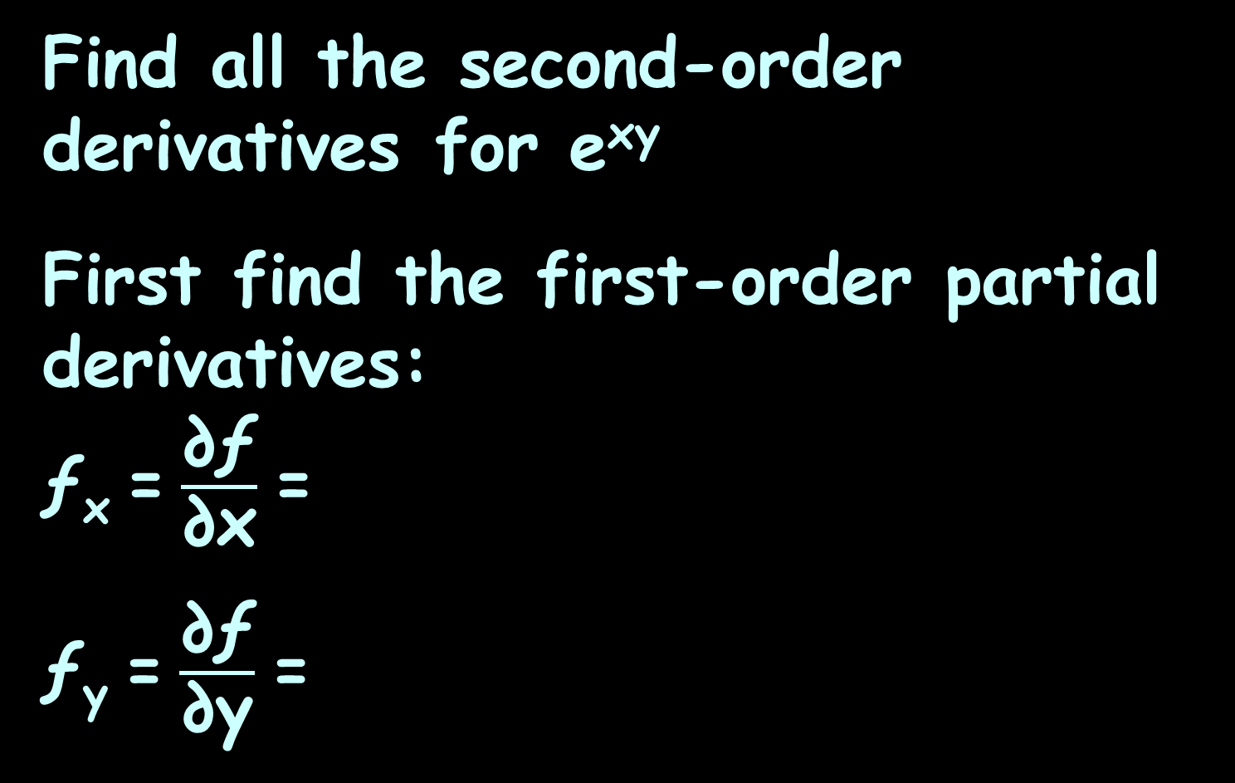
HIGHER-ORDER PARTIALS
IN-CLASS PROBLEM 7
Find all the second-order derivatives for e^{xy}
First find the first-order partial derivatives:
ƒ_{x} = $\frac{\text{∂ƒ}}{\text{∂}\text{x}}$ =
ƒ_{y} = $\frac{\text{∂ƒ}}{\text{∂}\text{y}}$ =

Slide 89
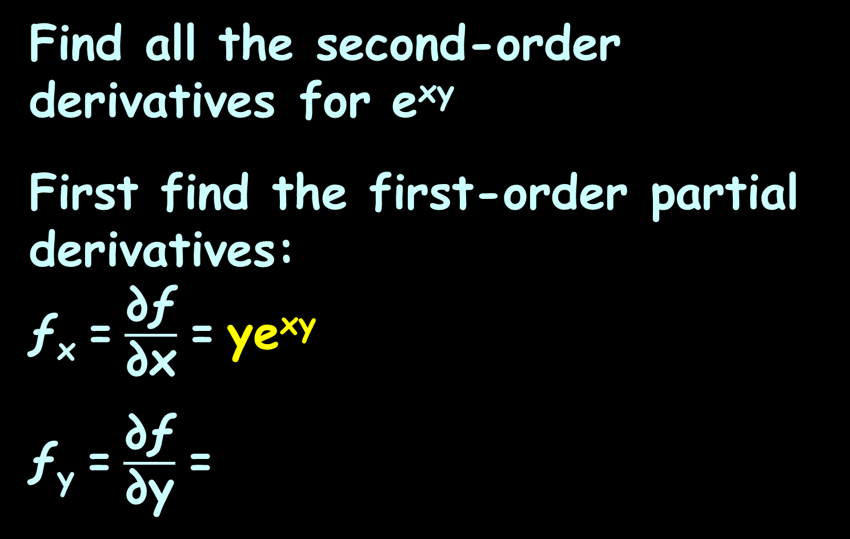
HIGHER-ORDER PARTIALS
IN-CLASS PROBLEM 7
Find all the second-order derivatives for e^{xy}
First find the first-order partial derivatives:
ƒ_{x} = $\frac{\text{∂ƒ}}{\text{∂}\text{x}}$ = ye^{xy}
ƒ_{y} = $\frac{\text{∂ƒ}}{\text{∂}\text{y}}$ =

Slide 90
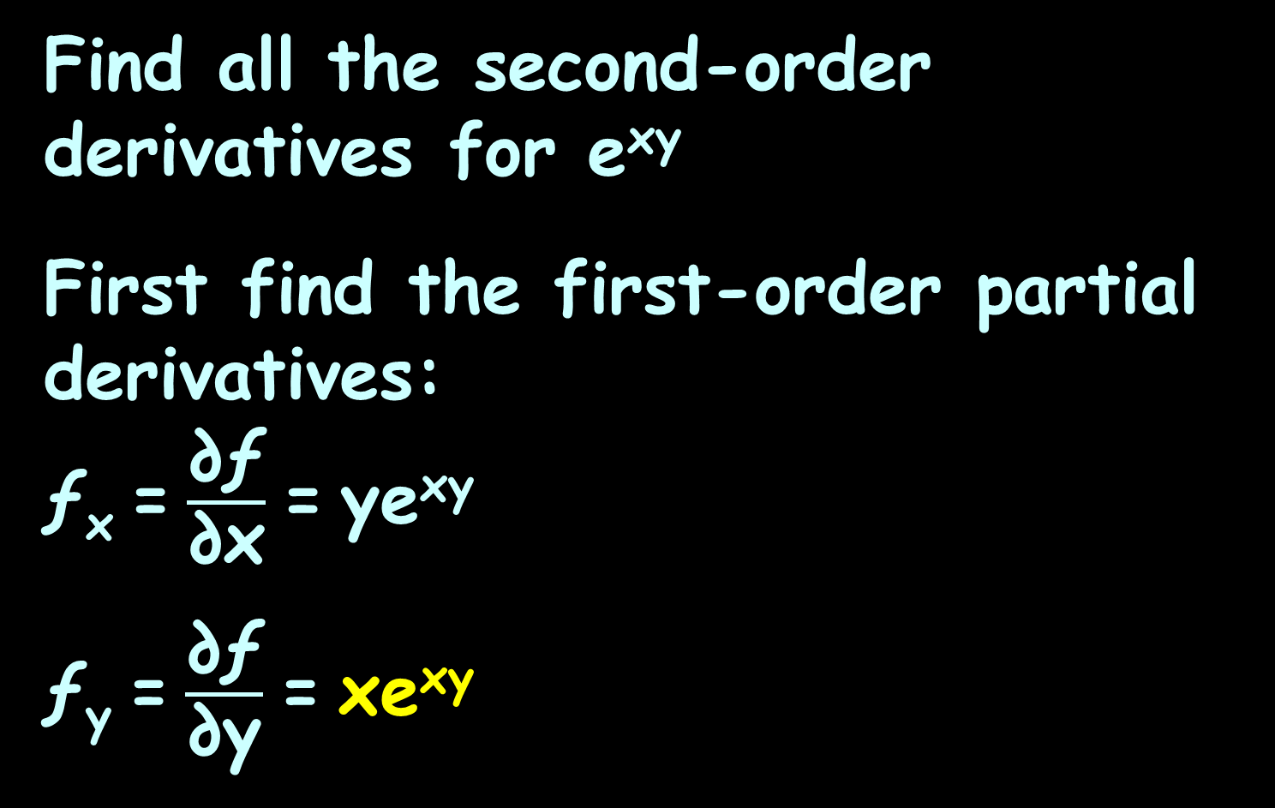
HIGHER-ORDER PARTIALS
IN-CLASS PROBLEM 7
Find all the second-order derivatives for e^{xy}
First find the first-order partial derivatives:
ƒ_{x} = $\frac{\text{∂ƒ}}{\text{∂}\text{x}}$ = ye^{xy}
ƒ_{y} = $\frac{\text{∂ƒ}}{\text{∂}\text{y}}$ = xe^{xy}

Slide 91
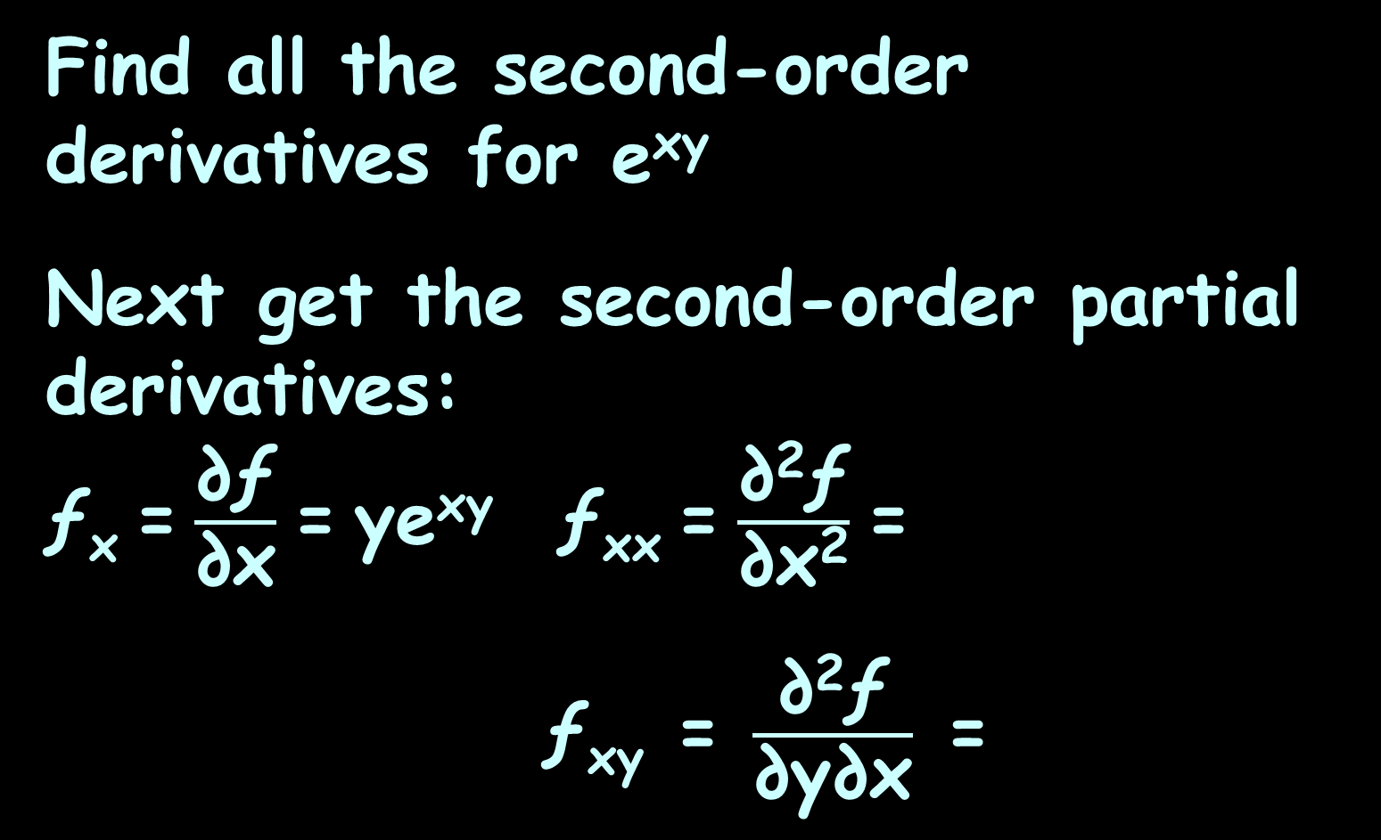
HIGHER-ORDER PARTIALS
IN-CLASS PROBLEM 7
Find all the second-order derivatives for e^{xy}
Next get the second-order partial derivatives:
ƒ_{x} = $\frac{\text{∂ƒ}}{\text{∂}\text{x}}$ = ye^{xy} ƒ_{xx} = $\frac{\text{∂}\text{2}\text{ƒ}}{\text{∂}\text{x}\text{2}}$ =
ƒ_{xy} = $\frac{\text{∂}\text{2}\text{ƒ}}{\text{∂}\text{y}\text{∂}\text{x}}$ =
In Wolfram: derivative ye^xy

Slide 92
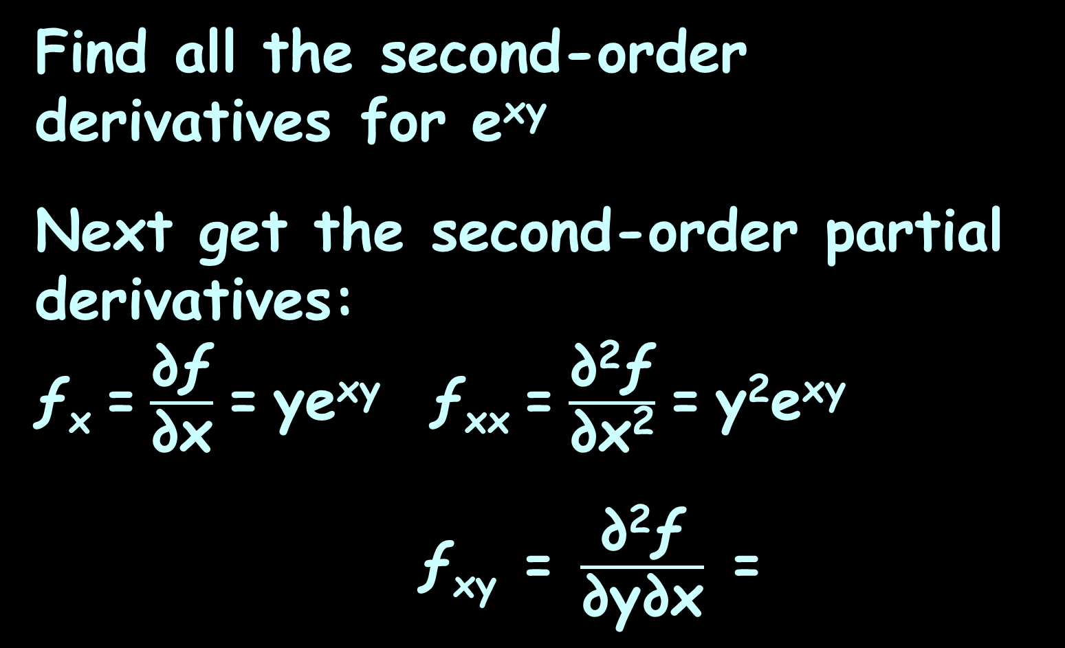
HIGHER-ORDER PARTIALS
IN-CLASS PROBLEM 7
Find all the second-order derivatives for e^{xy}
Next get the second-order partial derivatives:
ƒ_{x} = $\frac{\text{∂ƒ}}{\text{∂}\text{x}}$ = ye^{xy} ƒ_{xx} = $\frac{\text{∂}\text{2}\text{ƒ}}{\text{∂}\text{x}\text{2}}$ = y²e^{xy}
ƒ_{xy} = $\frac{\text{∂}\text{2}\text{ƒ}}{\text{∂}\text{y}\text{∂}\text{x}}$ =

Slide 93
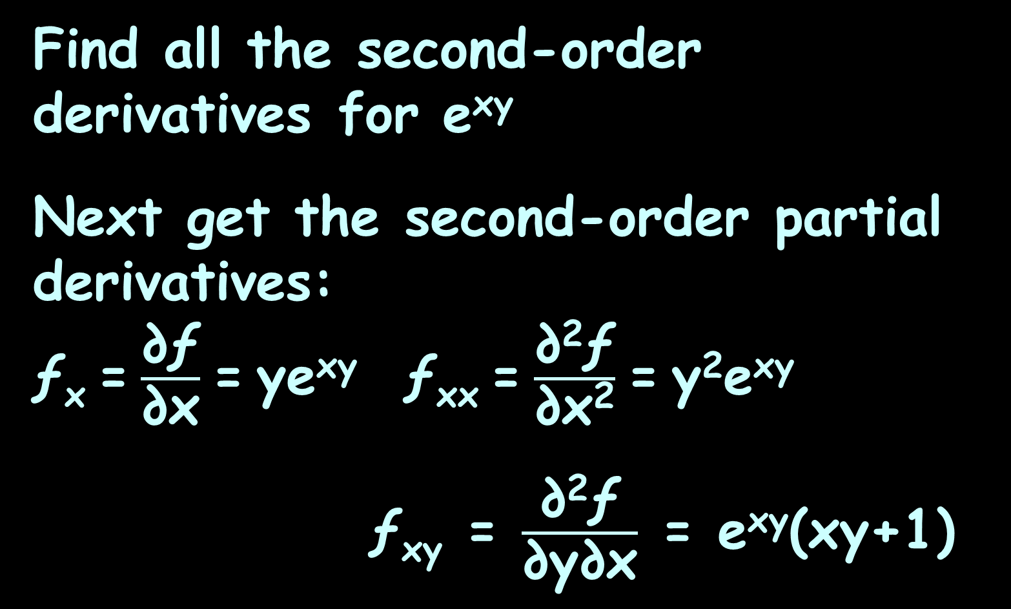
HIGHER-ORDER PARTIALS
IN-CLASS PROBLEM 7
Find all the second-order derivatives for e^{xy}
Next get the second-order partial derivatives:
ƒ_{x} = $\frac{\text{∂ƒ}}{\text{∂}\text{x}}$ = ye^{xy} ƒ_{xx} = $\frac{\text{∂}\text{2}\text{ƒ}}{\text{∂}\text{x}\text{2}}$ = y²e^{xy}
ƒ_{xy} = $\frac{\text{∂}\text{2}\text{ƒ}}{\text{∂}\text{y}\text{∂}\text{x}}$ = e^{xy}(xy+1)

Slide 94
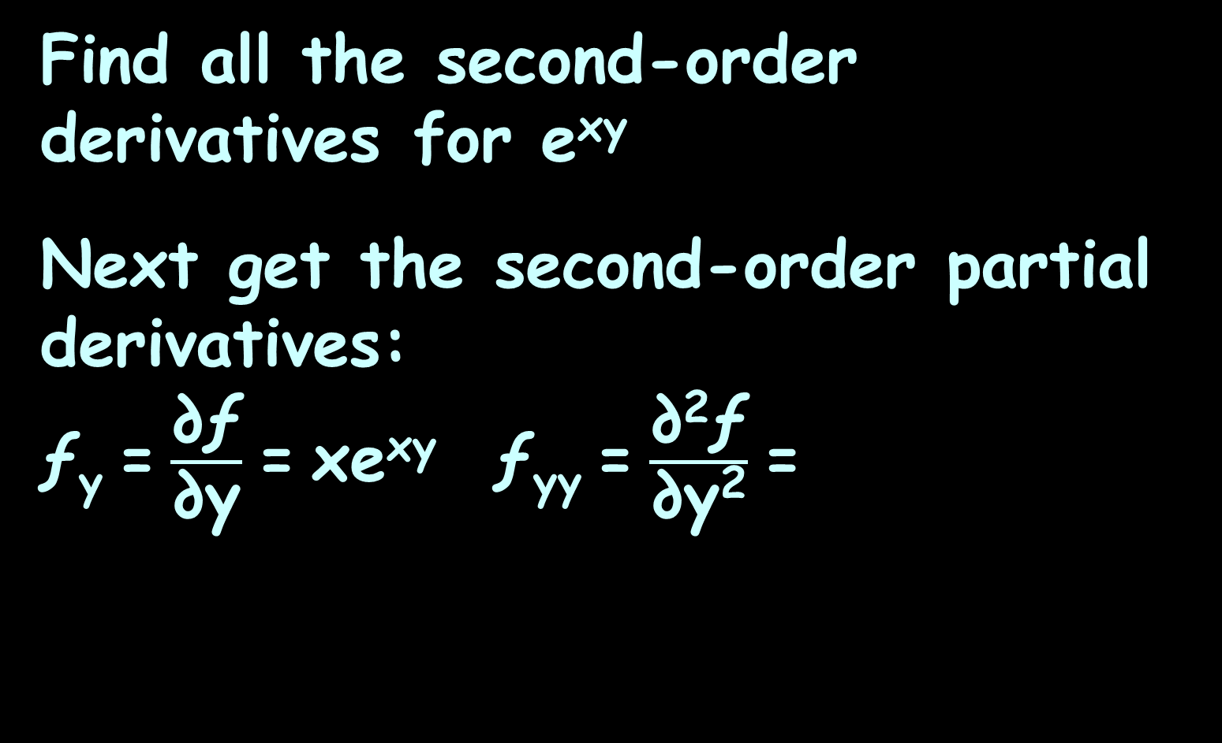
HIGHER-ORDER PARTIALS
IN-CLASS PROBLEM 7
Find all the second-order derivatives for e^{xy}
Next get the second-order partial derivatives:
ƒ_{y} = $\frac{\text{∂ƒ}}{\text{∂}\text{y}}$ = xe^{xy} ƒ_{yy} = $\frac{\text{∂}\text{2}\text{ƒ}}{\text{∂}\text{y}\text{2}}$ =
In Wolfram: derivative xe^xy

Slide 95
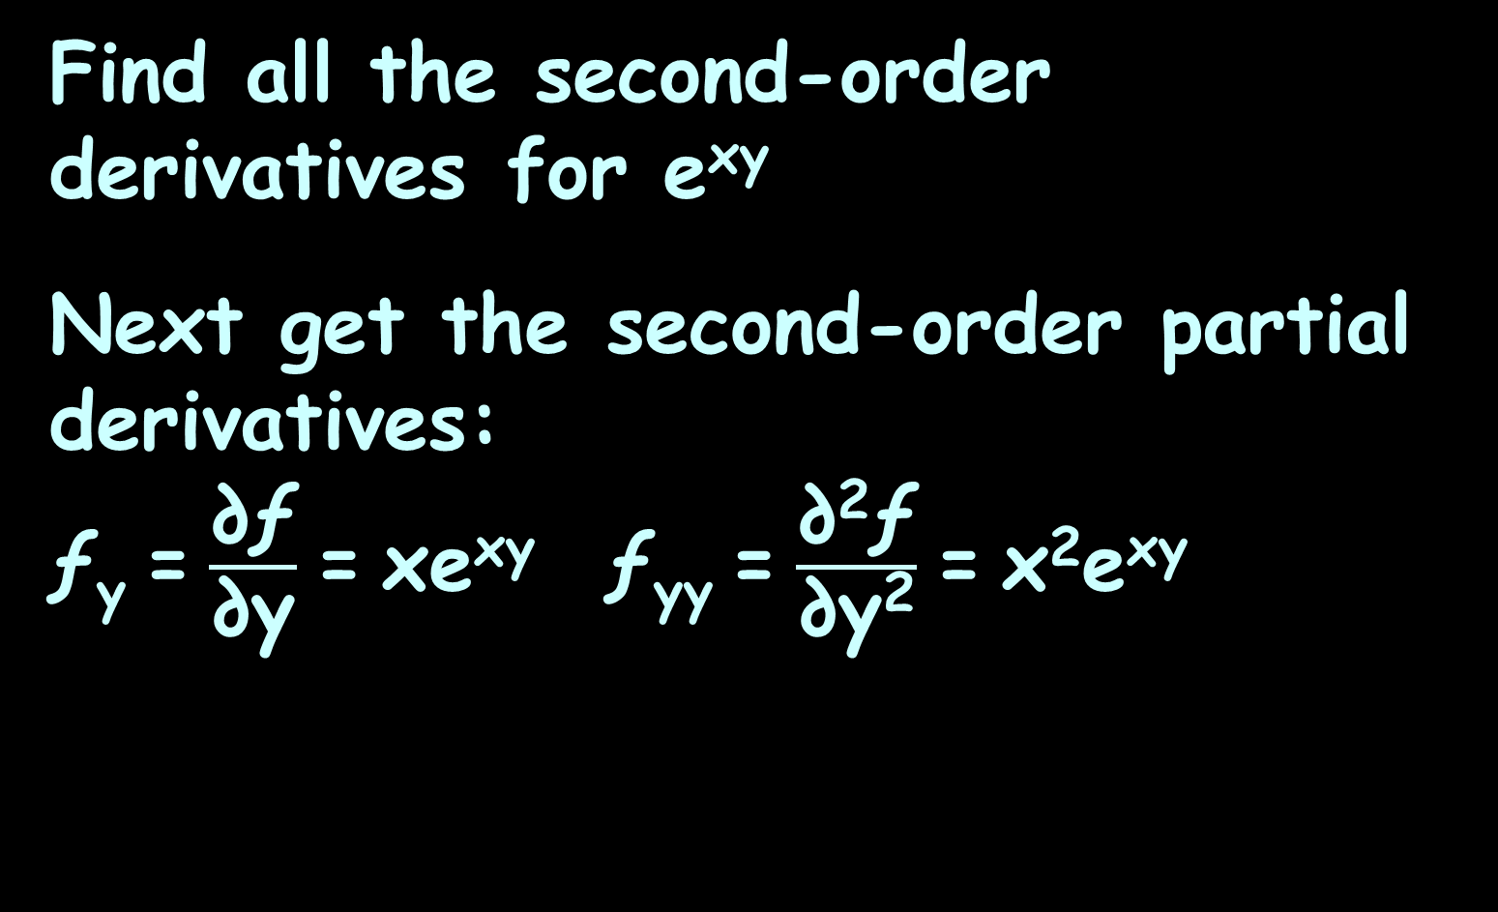
HIGHER-ORDER PARTIALS
IN-CLASS PROBLEM 7
Find all the second-order derivatives for e^{xy}
Next get the second-order partial derivatives:
ƒ_{y} = $\frac{\text{∂ƒ}}{\text{∂}\text{y}}$ = xe^{xy} ƒ_{yy} = $\frac{\text{∂}\text{2}\text{ƒ}}{\text{∂}\text{y}\text{2}}$ = x²e^{xy}

Slide 96
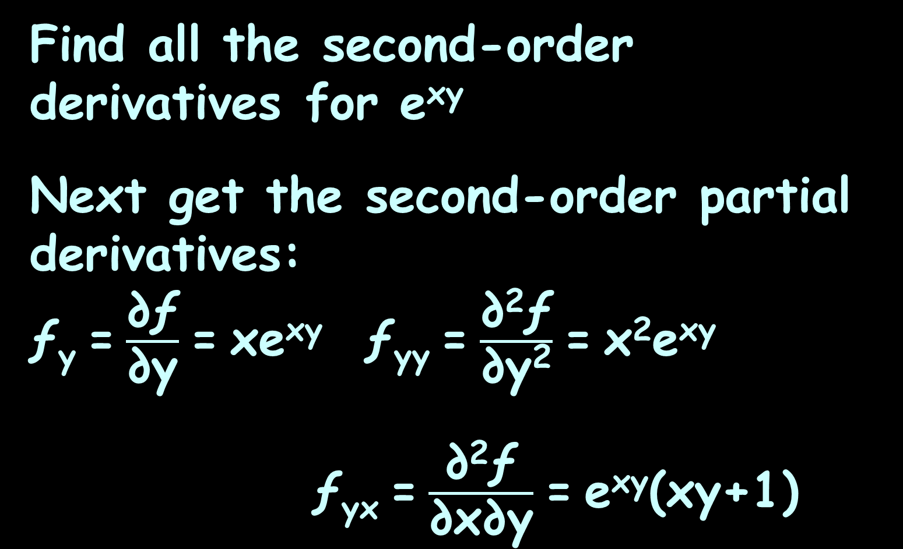
HIGHER-ORDER PARTIALS
IN-CLASS PROBLEM 7
Find all the second-order derivatives for e^{xy}
Next get the second-order partial derivatives:
ƒ_{y} = $\frac{\text{∂ƒ}}{\text{∂}\text{y}}$ = xe^{xy} ƒ_{yy} = $\frac{\text{∂}\text{2}\text{ƒ}}{\text{∂}\text{y}\text{2}}$ = x²e^{xy}
ƒ_{yx} = $\frac{\text{∂}\text{2}\text{ƒ}}{\text{∂}\text{x}\text{∂}\text{y}}$ = e^{xy}(xy+1)

Slide 97
HIGHER-ORDER PARTIALS
IN-CLASS PROBLEM 7
Find all the second-order derivatives for e^{xy}:
ƒ_{xx} = y²e^{xy}
ƒ_{yy} = x²e^{xy}
ƒ_{xy} = xye^{xy} + e^{xy} or e^{xy}(xy +1)
ƒ_{yx} = xye^{xy} + e^{xy} or e^{xy}(xy +1)

Slide 98
Questions?
http://i.imgur.com/aliTlT3.jpg

Slide 99
HIGHER-ORDER PARTIALS
IN-CLASS PROBLEM 8
Find all four second derivatives of ƒ(x, y) = x² y²
ƒ_{xx} =
ƒ_{xy} =
ƒ_{yy} =
ƒ_{yx} =
Find the first derivative of ƒx

Slide 100
HIGHER-ORDER PARTIALS
IN-CLASS PROBLEM 8
Find all four second derivatives of ƒ(x, y) = x² y²
ƒ_{xx} = ∂ 2xy² /∂x =
ƒ_{xy} =
ƒ_{yy} =
ƒ_{yx} =

Slide 101
HIGHER-ORDER PARTIALS
IN-CLASS PROBLEM 8
Find all four second derivatives of ƒ(x, y) = x² y²
ƒ_{xx} = ∂ 2xy² /∂x = 2y²
ƒ_{xy} = ∂ 2xy² /∂y =
ƒ_{yy} =
ƒ_{yx} =

Slide 102
HIGHER-ORDER PARTIALS
IN-CLASS PROBLEM 8
Find all four second derivatives of ƒ(x, y) = x² y²
ƒ_{xx} = ∂ 2xy² /∂x = 2y²
ƒ_{xy} = ∂ 2xy² /∂y = 4xy
ƒ_{yy} =
ƒ_{yx} =

Slide 103
HIGHER-ORDER PARTIALS
IN-CLASS PROBLEM 8
Find all four second derivatives of ƒ(x, y) = x² y²
ƒ_{xx} = ∂ 2xy² /∂x = 2y²
ƒ_{xy} = ∂ 2xy² /∂y = 4xy
ƒ_{yy} = ∂ 2x²y /∂y =
ƒ_{yx} =

Slide 104
HIGHER-ORDER PARTIALS
IN-CLASS PROBLEM 8
Find all four second derivatives of ƒ(x, y) = x² y²
ƒ_{xx} = ∂ 2xy² /∂x = 2y²
ƒ_{xy} = ∂ 2xy² /∂y = 4xy
ƒ_{yy} = ∂ 2x²y /∂y = 2x²
ƒ_{yx} = ∂ 2x²y /∂x

Slide 105
HIGHER-ORDER PARTIALS
IN-CLASS PROBLEM 8
Find all four second derivatives of ƒ(x, y) = x² y²
ƒ_{xx} = ∂ 2xy² /∂x = 2y²
ƒ_{xy} = ∂ 2xy² /∂y = 4xy
ƒ_{yy} = ∂ 2x²y /∂y = 2x²
ƒ_{yx} = ∂ 2x²y /∂x = 4xy

Slide 106
Bad News
While I would expect Wolfram Alpha and Symbolab to easily generate higher order partials, so far they do not…
You have to do them one by one

Slide 107
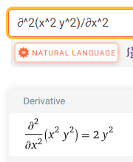
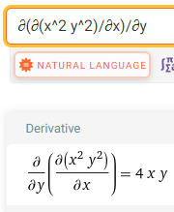
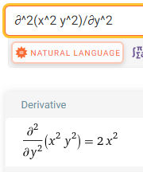
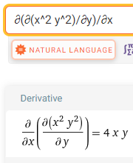

Slide 108
Questions?
http://i.imgur.com/aliTlT3.jpg

Slide 109
Higher-Order Partials
Notice that ƒ_{xy} = ƒ_{yx}

Slide 110
Higher-Order Partials
Clairaut’s Theorem
If the mixed partial derivatives are continuous, they are equal

Slide 111
Higher-Order Partials
If partials are equal, they are not “distinct”

Slide 112
HIGHER-ORDER PARTIALS
IN-CLASS PROBLEM 9
For #3, how many distinct derivatives are there?
ƒ_{xx} = ∂ 2xy² /∂x = 2y²
ƒ_{xy} = ∂ 2xy² /∂y = 4xy
ƒ_{yx} = ∂ 2x²y /∂x = 4xy
ƒ_{yy} = ∂ 2x²y /∂y = 2x²

Slide 113
HIGHER-ORDER PARTIALS
IN-CLASS PROBLEM 9
For #3, how many distinct derivatives are there? 3
ƒ_{xx} = ∂ 2xy² /∂x = 2y²
ƒ_{xy} = ∂ 2xy² /∂y = 4xy
ƒ_{yx} = ∂ 2x²y /∂x = 4xy
ƒ_{yy} = ∂ 2x²y /∂y = 2x²

Slide 114
Questions?
http://i.imgur.com/aliTlT3.jpg

Slide 115
Higher-Order Partials
There are, of course, even higher-order partial derivatives as well:
ƒ_{xxx} ƒ_{xxxx} ƒ_{xxxxx} ƒ_{xxxxxx} …

Slide 116
HIGHER-ORDER PARTIALS
IN-CLASS PROBLEM 10
How many third-order partial derivatives would there be for a two-variable function?

Slide 117
HIGHER-ORDER PARTIALS
IN-CLASS PROBLEM 10
How many third-order partial derivatives would there be for
a two-variable function?
ƒ_{xxx} ƒ_{yxx} ƒ_{xyx} ƒ_{xxy} ƒ_{xyy} ƒ_{yxy} ƒ_{yyx} ƒ_{yyy}

Slide 118
HIGHER-ORDER PARTIALS
IN-CLASS PROBLEM 10
How many third-order partial derivatives would there be for
a two-variable function? 8
ƒ_{xxx} ƒ_{yxx} ƒ_{xyx} ƒ_{xxy} ƒ_{xyy} ƒ_{yxy} ƒ_{yyx} ƒ_{yyy}

Slide 119
Higher-Order Partials
The methods used for second-order partials will work for any number of variables as well –

Slide 120
Higher-Order Partials
The methods used for second-order partials will work for any number of variables as well – these will be VERY painful to solve…

Slide 121
Questions?
http://i.imgur.com/aliTlT3.jpg

Slide 122
Summary
Today we studied:
Review of
Partial derivatives
Total derivative for 3D

Slide 123

You Survived!

