Slide 1
Welcome to
Unit 3
Part 6!
MATH 207 Integral Calculus
http://en.wikipedia.org/wiki/Differential_equation#mediaviewer/File:Elmer-pump-heatequation.png

Slide 2
What’s Up?
Review:
Improper integrals
New stuff:
Volumes

Slide 3
What’s Up?
Outcome 2) Apply integration to compute the area of a region bounded by curves or of a surface of revolution, the volume of a solid and the length of a curve.
Outcome 7) Solve problems by identifying the requirements, making a sketch as appropriate

Slide 4

Review
http://995642590.r.lightningbase-cdn.com/wp-content/uploads/2010/12/looking-back-hrexaminer-v144-cover425px.jpg

Slide 5
Area Under a Curve
The Fundamental Theorem of Calculus says if ƒ(x) is continuous on the interval a≤x≤b
then = F(b) – F(a)
where F’(x) = ƒ(x)
b
∫ ƒ(x) dx
a

Slide 6
Area Under a Curve
In other words, the technique for evaluating a definite integral is the same as finding the area under the curve

Slide 7
Improper Integrals
There are “proper” integrals and “improper” ones!
(We’ve been doing the “proper” ones”)

Slide 8
Improper Integrals
One type of “improper” integral has ∞ or -∞ for one or both of the limits

Slide 9
Improper Integrals
In general, we will replace the infinity with a variable (usually “b”), do the integral and then take the limit of the result as b goes to infinity

Slide 10
Improper Integrals
Note: we might have expected the area under a curve on an infinite interval would be infinity…
But it’s actually not usually the case!

Slide 11
Improper Integrals
We call integrals convergent if the associated limit exists and is a finite number (it’s not plus or minus infinity) and divergent if the associated limit either doesn’t exist or is (plus or minus) infinity

Slide 12
Improper Integrals
There are basically three cases:
1) ∫_{a}∞ƒ(x) dx infinity on the top
is convergent
2) ∫_{-∞}^{b}ƒ(x) dx negative infinity
on the bottom is convergent
3) Both ∫_{a}∞ƒ(x) dx and ∫_{-∞}^{b}ƒ(x) dx
are convergent

Slide 13
Improper Integrals
1) If ∫_{a}∞ ƒ(x) dx is convergent
∫_{a}∞ƒ(x) dx = lim(b→∞)∫_{a}^{b}ƒ(x) dx

Slide 14
Improper Integrals
2) If ∫_{-∞}^{b} ƒ(x) dx is convergent
∫_{-∞}^{b}ƒ(x) dx = lim(a→-∞)∫_{a}^{b}ƒ(x) dx

Slide 15
Improper Integrals
3) If both ∫_{a}∞ƒ(x) dx and
∫_{-∞}^{b} ƒ(x) dx are convergent
∫_{-∞}∞ ƒ(x) dx =
= ∫_{a}^{b} ƒ(x) dx + ∫_{a}^{b}ƒ(x) dx
= lim(b→∞)∫_{a}^{b}ƒ(x) dx
+ lim(a→-∞)∫_{a}^{b}ƒ(x) dx

Slide 16
Improper Integrals
Another type of improper integral has non-infinite limits BUT is discontinuous in the interval

Slide 17
Improper Integrals
To solve these, split the area into “before the discontinuity” and “after the discontinuity” and take the limits for each at the discontinuity

Slide 18
IMPROPER INTEGRALS
IN-CLASS PROBLEM 6
i = e^{-t} μamps
q = ∫₀∞ e^{-t} dt
= -e^{-b} + 1
lim(b→∞) (-e^{-b} + 1) = 0 + 1
= 1 μamps × sec
or
= 1 μcoulombs
because amps × sec = coulombs
i (μamps)
t (sec)
Oliver p207
VFrench 2021

Slide 19

Questions?
http://i.imgur.com/aliTlT3.jpg

Slide 20
Volumes
One application of integration was to find the area under a curve
Another was to find the area between two curves

Slide 21
Volumes
One application of integration was to find the area under a curve
Another was to find the area between two curves
Both of these uses were for two-dimensional surfaces

Slide 22
Volumes
What if you had something that was 3D?

Slide 23
Volumes
If the 3D object has an outside surface that follows a mathematical formula, you can use integration to find its volume

Slide 24
Volumes
Some of the mathematical formulas come from what we call a solid of revolution

Slide 25
Volumes
To get a solid of revolution we start out with a function on an interval
VFrench 2021

Slide 26
Volumes
Rotate this curve about an axis (any axis!)
VFrench 2021

Slide 27
Volumes
Rotating the curve about an axis provides the surface of the solid of revolution
VFrench 2021

Slide 28
Volumes
What we want to do is to determine the volume of this object
VFrench 2021

Slide 29
Volumes
The volume is going to be based on the cross-sectional area of the solid (A):
V = ∫_{a}^{b} A(x) dx (revolved around the x-axis)
V = ∫_{c}^{d} A(y) dy (revolved around the y-axis)

Slide 30
Volumes
To get the cross-sectional area, cut the solid perpendicular to the axis of rotation (a 3D version of the “area under”)
VFrench 2021

Slide 31
Volumes
The cross sections will be solid disks
VFrench 2021

Slide 32
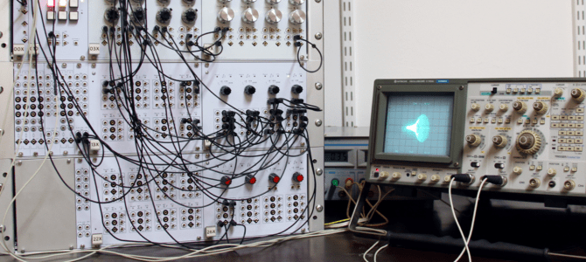
https://i1.wp.com/chalkdustmagazine.com/wp-content/uploads/2016/03/
analoguefeature.png?resize=670%2C300&ssl=1

Slide 33
Volumes
To find the volume, we will be adding an infinite number of thin (0-width) disks with area:
A=π(radius)²
where the radius will depend upon the function and on the axis of rotation

Slide 34
Volumes
This method is called the method of disks

Slide 35
VOLUMES
IN-CLASS PROBLEM 1
Determine the volume of the solid obtained by rotating the region bounded by
y=x²−4x+5, x=1, x=4, and the x-axis about the x-axis
https://tutorial.math.lamar.edu/classes/calci/volumewithrings.aspx

Slide 36
VOLUMES
IN-CLASS PROBLEM 1
Determine the volume of the solid of revolution: y=x²−4x+5, 1≤x≤4 about the x-axis
Try to visualize the shape…
Which axis is it revolving around?
https://tutorial.math.lamar.edu/classes/calci/volumewithrings.aspx

Slide 37
VOLUMES
IN-CLASS PROBLEM 1
Determine the volume of the solid of revolution: y=x²−4x+5, 1≤x≤4 about the x-axis
Which axis is it revolving around?
x-axis
What shape are the
slices?
https://tutorial.math.lamar.edu/classes/calci/volumewithrings.aspx

Slide 38
VOLUMES
IN-CLASS PROBLEM 1
Determine the volume of the solid of revolution: y=x²−4x+5, 1≤x≤4 about the x-axis
What shape are the
slices? disks
smallest
largest
smallest
largest
https://tutorial.math.lamar.edu/classes/calci/volumewithrings.aspx

Slide 39
VOLUMES
IN-CLASS PROBLEM 1
Determine the volume of the solid of revolution: y=x²−4x+5, 1≤x≤4 about the x-axis
What is the radius of the disks?
smallest
largest
smallest
largest
https://tutorial.math.lamar.edu/classes/calci/volumewithrings.aspx

Slide 40
VOLUMES
IN-CLASS PROBLEM 1
Determine the volume of the solid of revolution: y=x²−4x+5, 1≤x≤4 about the x-axis
What is the radius of the disks?
r = y
smallest
largest
smallest
largest
https://tutorial.math.lamar.edu/classes/calci/volumewithrings.aspx

Slide 41
VOLUMES
IN-CLASS PROBLEM 1
Determine the volume of the solid of revolution: y=x²−4x+5, 1≤x≤4 about the x-axis
What is the radius of the disks?
r = y = x²−4x+5
smallest
largest
smallest
largest
https://tutorial.math.lamar.edu/classes/calci/volumewithrings.aspx

Slide 42

VOLUMES
IN-CLASS PROBLEM 1
That’s the trick!
http://markvanderpool.naiwe.com/files/2013/01/bigstock-Bright-Idea-Kid.jpg

Slide 43
Volumes
For functions revolved around the x-axis:
V = ∫_{a}^{b} A(x) dx
A=π(radius)²
where the radius will depend upon the function

Slide 44
VOLUMES
IN-CLASS PROBLEM 1
Determine the volume of the solid of revolution: y=x²−4x+5, 1≤x≤4 about the x-axis
A=π(r)²=π(x²−4x+5)²
So V = ∫_{a}^{b} A(x) dx
= what?
smallest
largest
https://tutorial.math.lamar.edu/classes/calci/volumewithrings.aspx

Slide 45
VOLUMES
IN-CLASS PROBLEM 1
Determine the volume of the solid of revolution: y=x²−4x+5, 1≤x≤4 about the x-axis
A=π(r)²=π(x²−4x+5)²
So V = ∫_{a}^{b} A(x) dx
= ∫_{a}^{b} π(x²−4x+5)² dx
What are the limits?
https://tutorial.math.lamar.edu/classes/calci/volumewithrings.aspx

Slide 46
VOLUMES
IN-CLASS PROBLEM 1
Determine the volume of the solid of revolution: y=x²−4x+5, 1≤x≤4 about the x-axis
So V = ∫₁⁴ π(x²−4x+5)² dx
Do it!
https://tutorial.math.lamar.edu/classes/calci/volumewithrings.aspx

Slide 47
VOLUMES
IN-CLASS PROBLEM 1
Determine the volume of the solid of revolution: y=x²−4x+5, 1≤x≤4 about the x-axis
So V = ∫₁⁴ π(x²−4x+5)² dx
First expand the square:
= π∫₁⁴ (x⁴−8x³+26x²-40x+25) dx
= π(1/5x⁵−2x⁴+26/3x³-
20x²+25x)|₁⁴
= 78π/5 ≈ 49.0088

Slide 48
VOLUMES
IN-CLASS PROBLEM 1
Determine the volume of the solid of revolution: y=x²−4x+5, 1≤x≤4 about the x-axis
V= 78π/5 ≈ 49.0088
If the original units were in inches, what are the units for the volume?

Slide 49
VOLUMES
IN-CLASS PROBLEM 1
Determine the volume of the solid of revolution: y=x²−4x+5, 1≤x≤4 about the x-axis
V= 78π/5 ≈ 49.0088
If the original units were in inches, what are the units for the volume? inches³

Slide 50
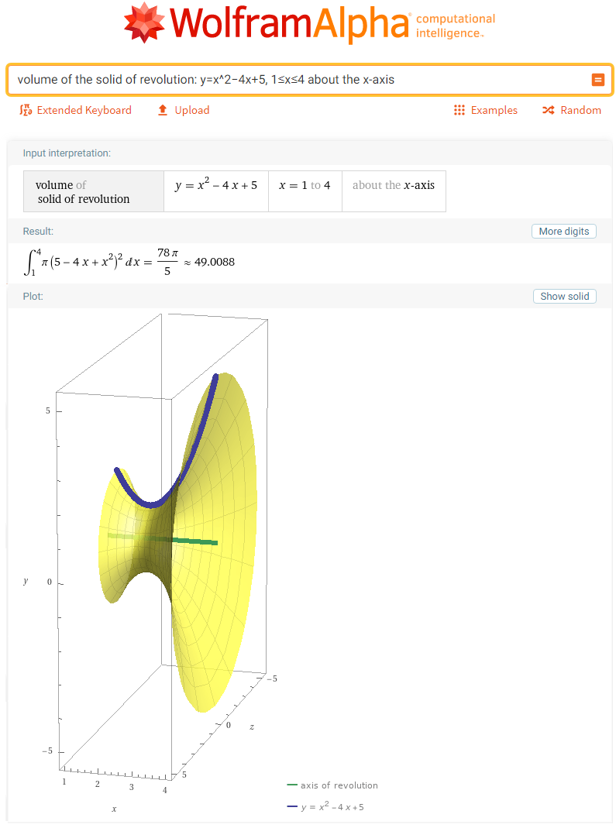
volume of solid of revolution: y=x^2−4x+5, 1<=x<=4 about x-axis

Slide 51
Questions?
http://i.imgur.com/aliTlT3.jpg

Slide 52
Volumes
If two functions are revolved around an axis, you will get a solid with a donut-hole in it (the 3D version of the “area between”)

Slide 53
Volumes
We call these shapes “rings” or “washers”

Slide 54
Volumes
The area of each ring is:
A=π((outer radius)² − (inner radius)²)
where again both of the radii will depend on the functions and the axis of rotation

Slide 55
Volumes
The volume is still based on the cross-sectional area of the solid (A):
V = ∫_{a}^{b} A(x) dx (revolved around the x-axis)
V = ∫_{c}^{d} A(y) dy (revolved around the y-axis)

Slide 56
Volumes
In the case of a solid disk we can think of the inner radius as zero, so this is a more general formula to use

Slide 57
Volumes
This method is called the method of rings or washers

Slide 58
Volumes
If we revolve about the x-axis then the cross-sectional area will be a function of x
Likewise, if we revolve about the y‑axis then the cross-sectional area will be a function of y

Slide 59
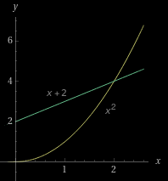
VOLUMES
IN-CLASS PROBLEM 2
Use the method of disks/rings to determine the volume of the solid obtained by rotating the region bounded by y=x² and y=x+2
from x = 0 to 2 about the x-axis
https://www.wolframalpha.com/input?i=y%3Dx%5E2%C2%A0and%C2%A0y%3Dx

Slide 60
VOLUMES
IN-CLASS PROBLEM 2
Use the method of disks/rings to determine the volume of the solid obtained by rotating the region bounded by y=x² and y=x+2
from x = 0 to 2 about the x-axis
A=π((outer radius)²−(inner radius)²)
Which?
https://www.wolframalpha.com/input?i=y%3Dx%5E2%C2%A0and%C2%A0y%3Dx

Slide 61
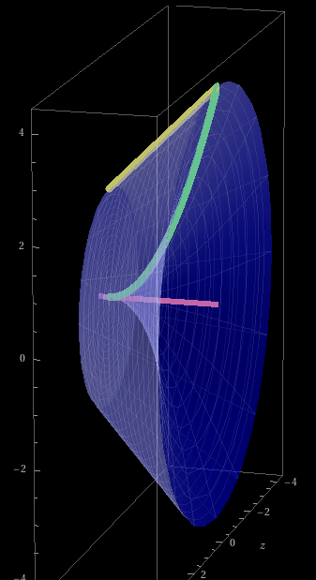
VOLUMES
IN-CLASS PROBLEM 2
Use the method of disks/rings to determine the volume of the solid obtained by rotating the region bounded by y=x² and y=x+2
from x = 0 to 2 about the x-axis
A=π((x+2)²−(x²)²)
V = ?
https://www.wolframalpha.com/input?i=y%3Dx%5E2%C2%A0and%C2%A0y%3Dx

Slide 62
VOLUMES
IN-CLASS PROBLEM 2
Use the method of disks/rings to determine the volume of the solid obtained by rotating the region bounded by y=x² and y=x+2
from x = 0 to 2 about the x-axis
A=π((x+2)² − (x²)²)
V = ∫_{a}^{b} π((x+2)² − (x²)²) dx
What are the limits?
https://www.wolframalpha.com/input?i=y%3Dx%5E2%C2%A0and%C2%A0y%3Dx

Slide 63
VOLUMES
IN-CLASS PROBLEM 2
Use the method of disks/rings to determine the volume of the solid obtained by rotating the region bounded by y=x² and y=x+2
from x = 0 to 2 about the x-axis
V = ∫₀² π((x+2)²−(x²)²) dx
https://www.wolframalpha.com/input?i=y%3Dx%5E2%C2%A0and%C2%A0y%3Dx

Slide 64
VOLUMES
IN-CLASS PROBLEM 2
Use the method of disks/rings to determine the volume of the solid obtained by rotating the region bounded by y=x² and y=x+2
from x = 0 to 2 about the x-axis
V = ∫₀² π((x+2)²−(x²)²) dx
= 184π/15 ≈ 38.537
https://www.wolframalpha.com/input?i=y%3Dx%5E2%C2%A0and%C2%A0y%3Dx

Slide 65
VOLUMES
IN-CLASS PROBLEM 2
Use the method of disks/rings to determine the volume of the solid obtained by rotating the region bounded by y=x² and y=x+2
from x = 0 to 2 about the x-axis
V = 184π/15 ≈ 38.537
If the original units were
mm, what are the volume
units?
https://www.wolframalpha.com/input?i=y%3Dx%5E2%C2%A0and%C2%A0y%3Dx

Slide 66
VOLUMES
IN-CLASS PROBLEM 2
Use the method of disks/rings to determine the volume of the solid obtained by rotating the region bounded by y=x² and y=x+2
from x = 0 to 2 about the x-axis
V = 184π/15 ≈ 38.537
If the original units were
mm, what are the volume
units? mm³
https://www.wolframalpha.com/input?i=y%3Dx%5E2%C2%A0and%C2%A0y%3Dx

Slide 67
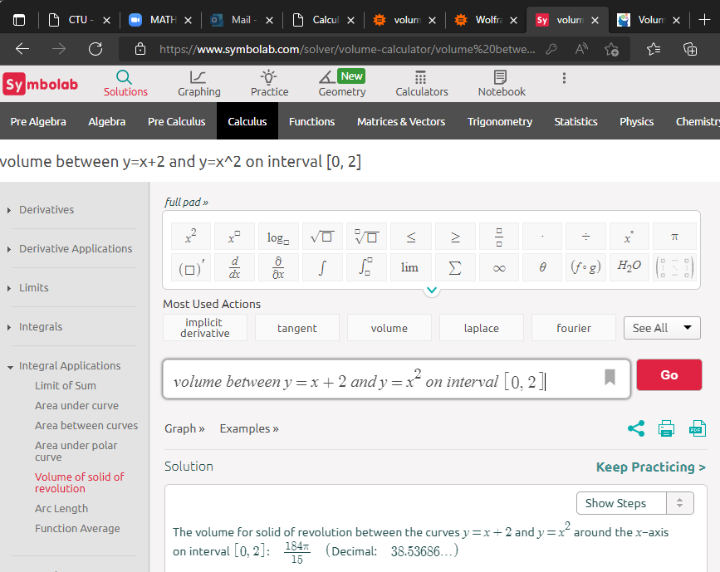
Order doesn’t matter!

Slide 68
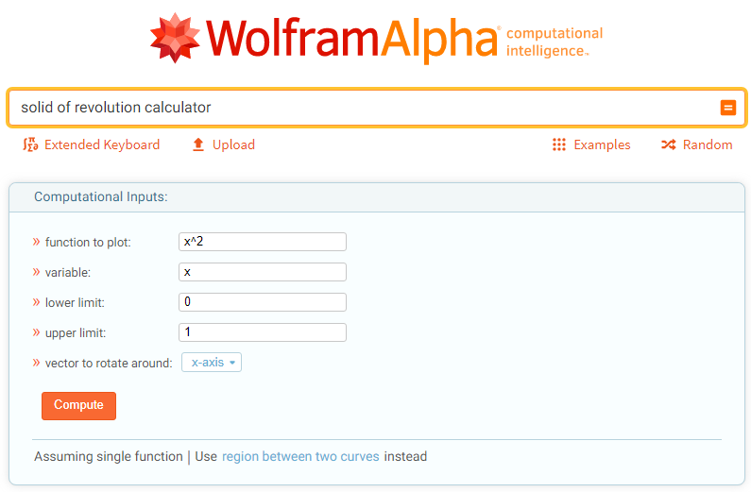
Note: WolframAlpha USED to do these, then didn’t …
… but now is doing them again!

Slide 69
Questions?
http://i.imgur.com/aliTlT3.jpg

Slide 70
VOLUMES
IN-CLASS PROBLEM 3
Use the method of disks/rings to determine the volume of the solid obtained by rotating the region bounded by y=x² and y=x+2
from x = 0 to 2 about the y-axis
https://www.wolframalpha.com/input?i=y%3Dx%5E2%C2%A0and%C2%A0y%3Dx

Slide 71
VOLUMES
IN-CLASS PROBLEM 3
Use the method of disks/rings to determine the volume of the solid obtained by rotating the region bounded by y=x² and y=x+2
from x = 0 to 2 about the y-axis
For a y-axis rotation, we’ll need: V = ∫_{c}^{d} A(y) dy
https://www.wolframalpha.com/input?i=y%3Dx%5E2%C2%A0and%C2%A0y%3Dx

Slide 72
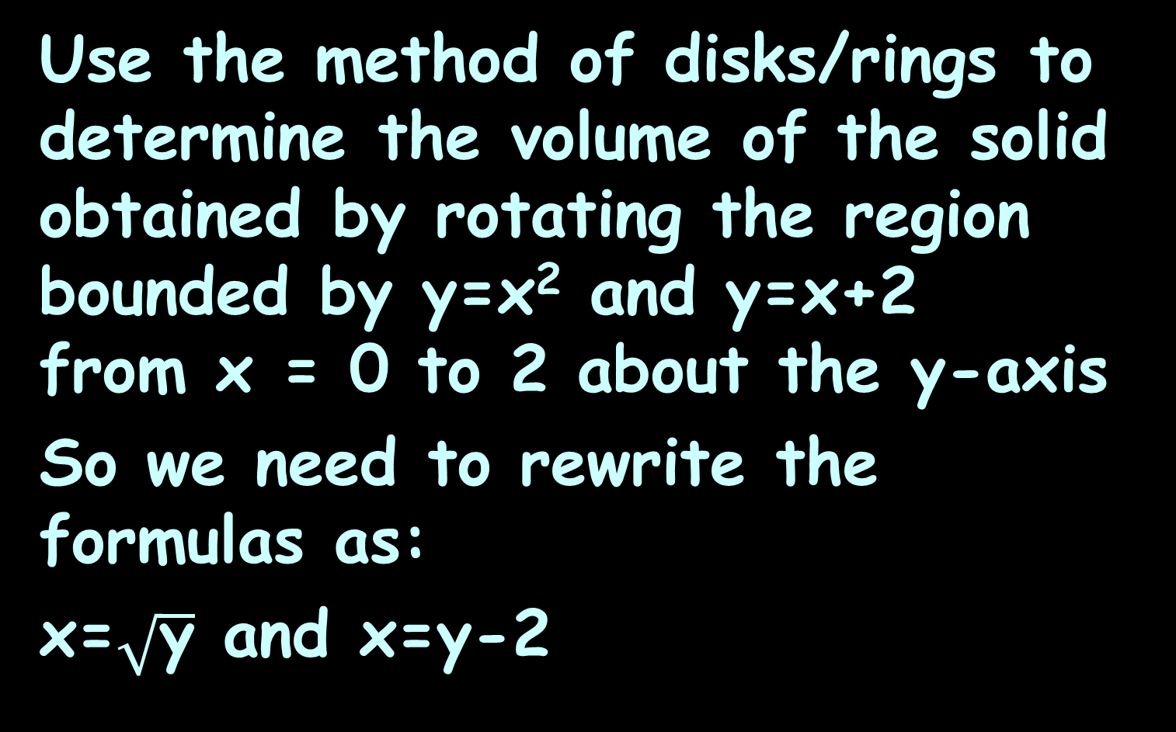

VOLUMES
IN-CLASS PROBLEM 3
Use the method of disks/rings to determine the volume of the solid obtained by rotating the region bounded by y=x² and y=x+2
from x = 0 to 2 about the y-axis
So we need to rewrite the formulas as:
x=$\sqrt{\text{y}}$ and x=y-2
y-2
$$\sqrt{\text{y}}$$
https://www.wolframalpha.com/input?i=y%3Dx%5E2%C2%A0and%C2%A0y%3Dx

Slide 73
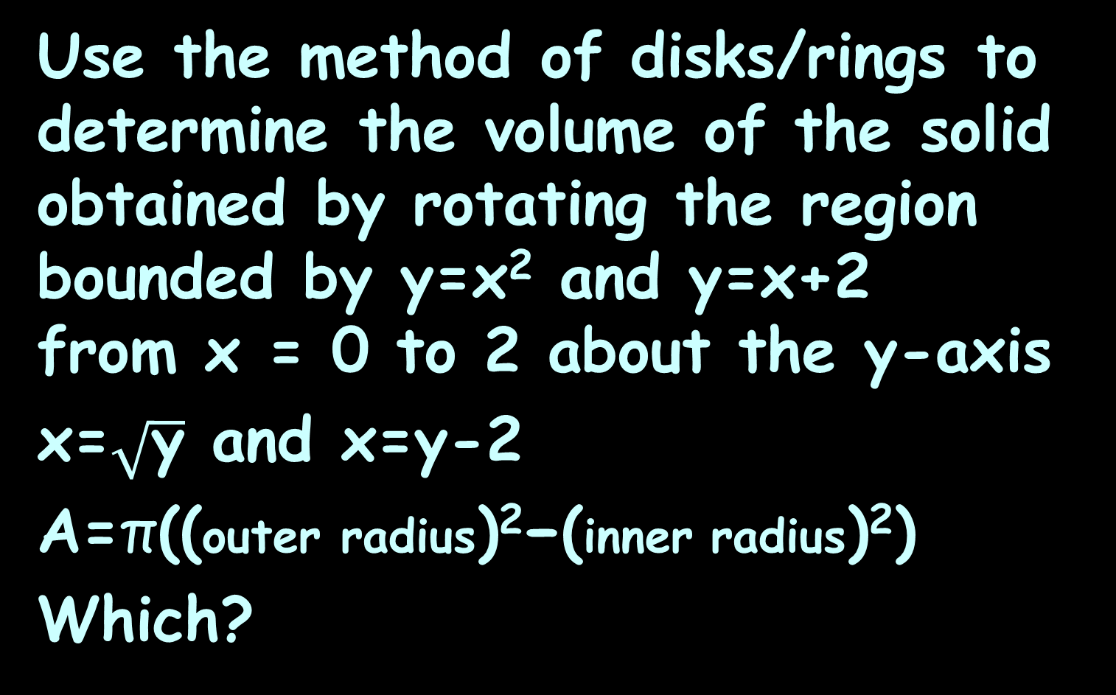
VOLUMES
IN-CLASS PROBLEM 3
Use the method of disks/rings to determine the volume of the solid obtained by rotating the region bounded by y=x² and y=x+2
from x = 0 to 2 about the y-axis
x=$\sqrt{\text{y}}$ and x=y-2
A=π((outer radius)²−(inner radius)²)
Which?
y-2
$$\sqrt{\text{y}}$$
https://www.wolframalpha.com/input?i=y%3Dx%5E2%C2%A0and%C2%A0y%3Dx

Slide 74
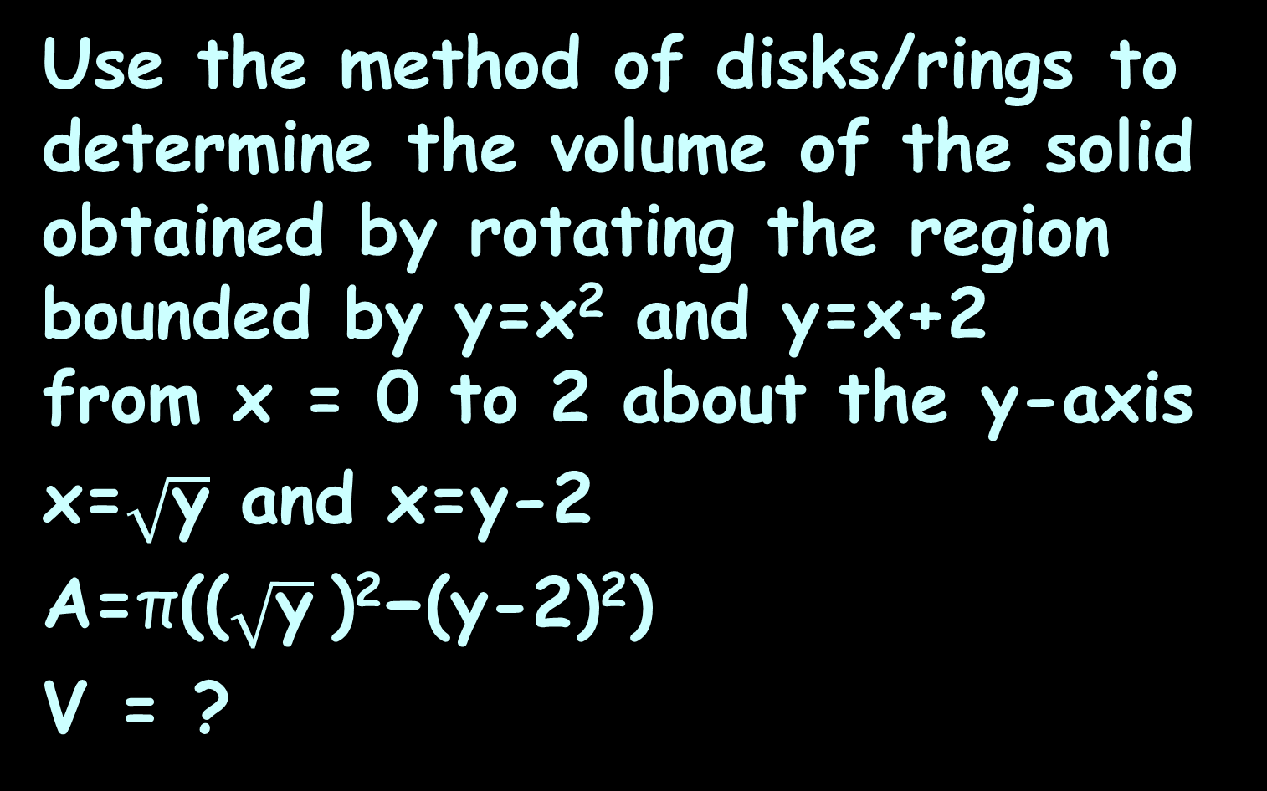
VOLUMES
IN-CLASS PROBLEM 3
Use the method of disks/rings to determine the volume of the solid obtained by rotating the region bounded by y=x² and y=x+2
from x = 0 to 2 about the y-axis
x=$\sqrt{\text{y}}$ and x=y-2
A=π(($\sqrt{\text{y}}$)²−(y-2)²)
V = ?
y-2
$$\sqrt{\text{y}}$$
https://www.wolframalpha.com/input?i=y%3Dx%5E2%C2%A0and%C2%A0y%3Dx

Slide 75
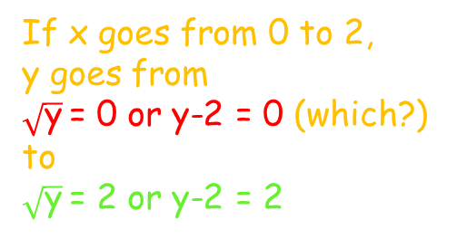
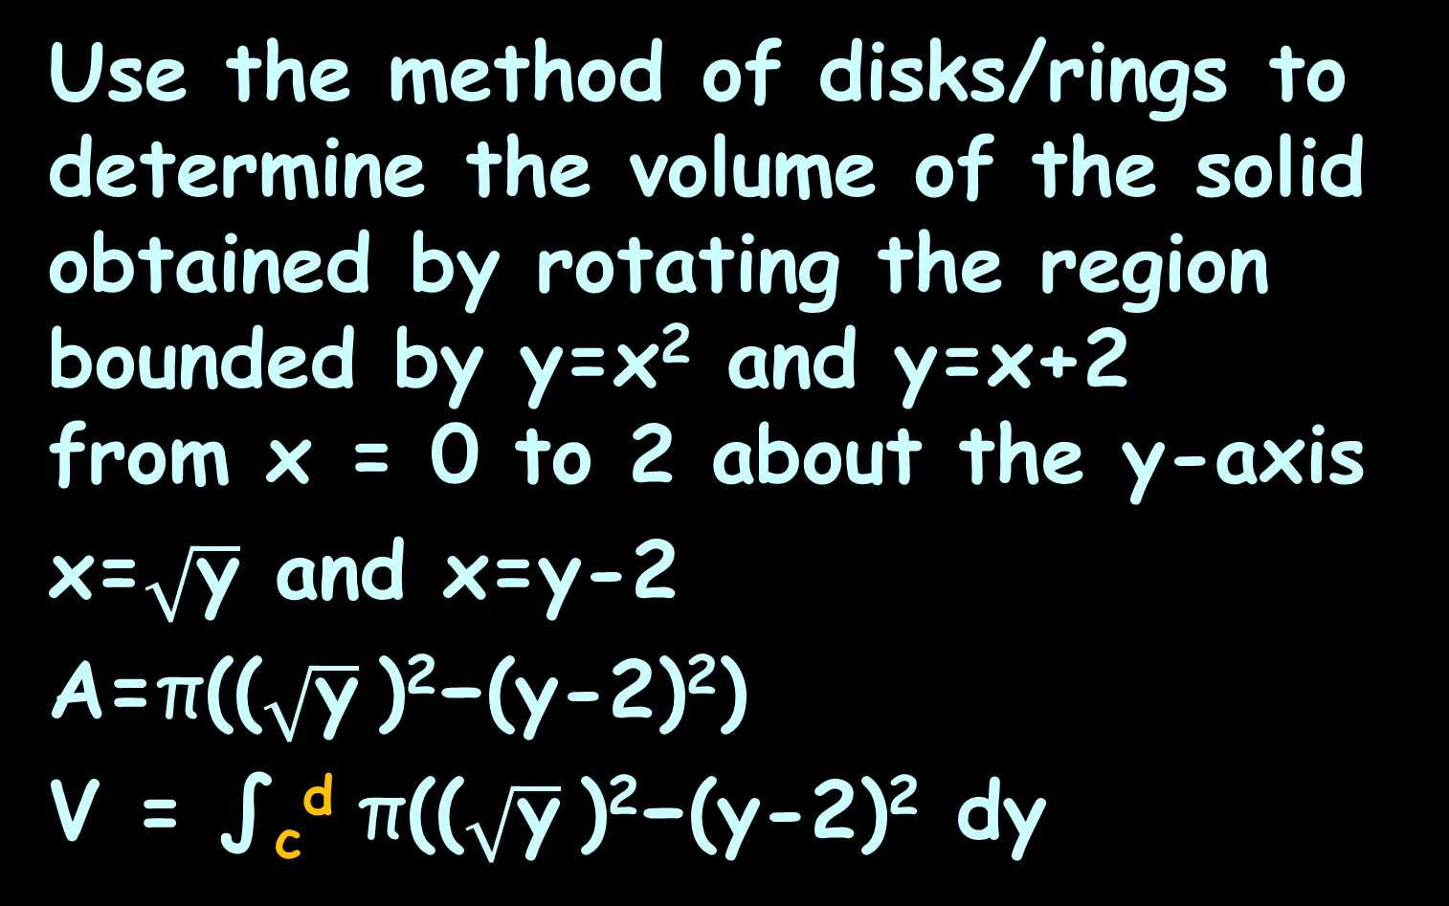
VOLUMES
IN-CLASS PROBLEM 3
Use the method of disks/rings to determine the volume of the solid obtained by rotating the region bounded by y=x² and y=x+2
from x = 0 to 2 about the y-axis
x=$\sqrt{\text{y}}$ and x=y-2
A=π(($\sqrt{\text{y}}$)²−(y-2)²)
V = ∫_{c}^{d} π(($\sqrt{\text{y}}$)²−(y-2)² dy
If x goes from 0 to 2,
y goes from
$\sqrt{\text{y}}$= 0 or y-2 = 0 (which?)
to
$\sqrt{\text{y}}$= 2 or y-2 = 2
y-2
$$\sqrt{\text{y}}$$
https://www.wolframalpha.com/input?i=y%3Dx%5E2%C2%A0and%C2%A0y%3Dx

Slide 76
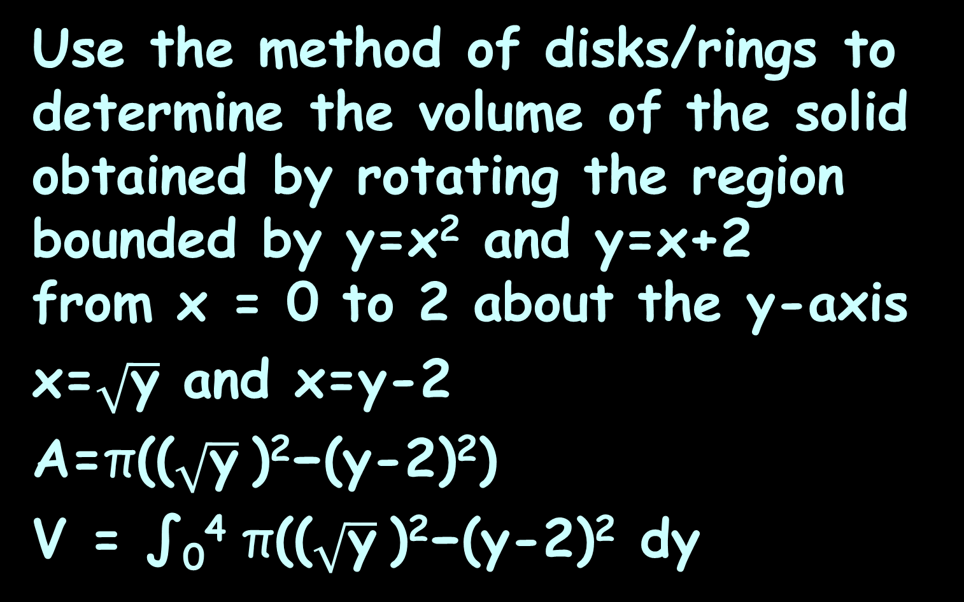
VOLUMES
IN-CLASS PROBLEM 3
Use the method of disks/rings to determine the volume of the solid obtained by rotating the region bounded by y=x² and y=x+2
from x = 0 to 2 about the y-axis
x=$\sqrt{\text{y}}$ and x=y-2
A=π(($\sqrt{\text{y}}$)²−(y-2)²)
V = ∫₀⁴ π(($\sqrt{\text{y}}$)²−(y-2)² dy
y-2
$$\sqrt{\text{y}}$$
https://www.wolframalpha.com/input?i=y%3Dx%5E2%C2%A0and%C2%A0y%3Dx

Slide 77
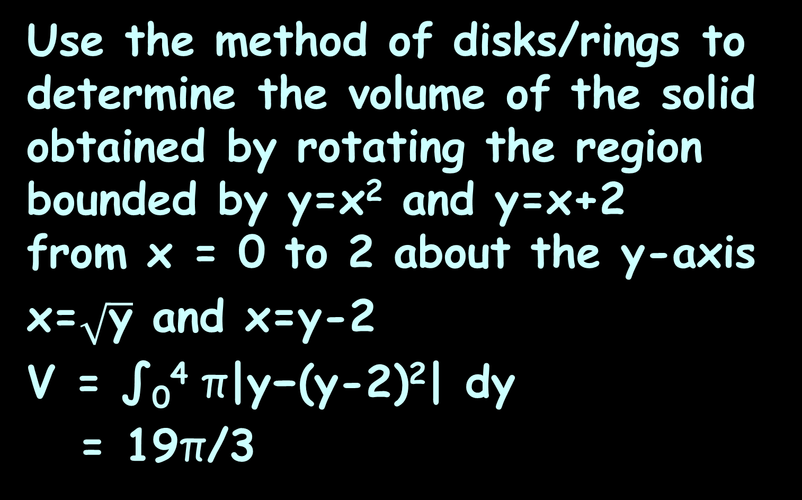
VOLUMES
IN-CLASS PROBLEM 3
Use the method of disks/rings to determine the volume of the solid obtained by rotating the region bounded by y=x² and y=x+2
from x = 0 to 2 about the y-axis
x=$\sqrt{\text{y}}$ and x=y-2
V = ∫₀⁴ π|y−(y-2)²| dy
= 19π/3
Because sqrt(y) has to be positive
y-2
$$\sqrt{\text{y}}$$
https://www.wolframalpha.com/input?i=y%3Dx%5E2%C2%A0and%C2%A0y%3Dx

Slide 78
Volume Between
You have to trick Symbolab into doing a rotation about the
y-axis
Wolfram is no longer doing again able to do washers problems

Slide 79
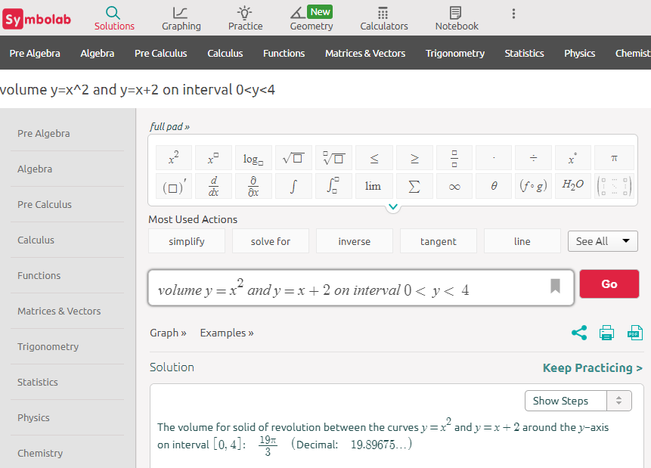

Slide 80
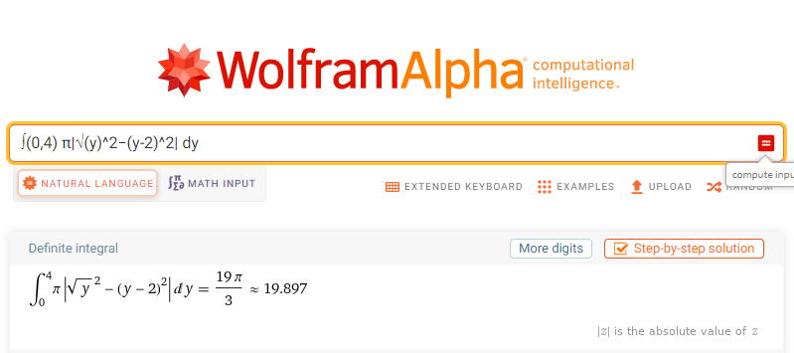

Slide 81
Questions?
http://i.imgur.com/aliTlT3.jpg

Slide 82
Volumes
We aren’t limited to finding volumes using areas in the shape of rings or disks

Slide 83
Volumes
We can use any shape for the cross sections as long as it can be expanded or contracted to completely cover the solid we’re looking at
This is a good thing because rings and disks don’t always work!

Slide 84
Volumes
As always,
V = ∫_{a}^{b} A(x) dx (revolved around the x-axis)
V = ∫_{c}^{d} A(y) dy (revolved around the y-axis)

Slide 85
VOLUMES
IN-CLASS PROBLEM 4
Calculate the volume of the solid formed by rotating the region bounded by y=(x−1)(x−3)² and the x-axis about the y-axis
https://tutorial.math.lamar.edu/classes/calci/volumewithrings.aspx

Slide 86
VOLUMES
IN-CLASS PROBLEM 4
Calculate the volume of the solid formed by rotating the region bounded by y=(x−1)(x−3)² and the x-axis about the y-axis
This would be hard to do – we’d need to rewrite it as x = f(y)
https://tutorial.math.lamar.edu/classes/calci/volumewithrings.aspx

Slide 87
VOLUMES
IN-CLASS PROBLEM 4
Calculate the volume of the solid formed by rotating the region bounded by y=(x−1)(x−3)² and the x-axis about the y-axis
Think of it as a lump of cookie dough
https://tutorial.math.lamar.edu/classes/calci/volumewithrings.aspx

Slide 88
VOLUMES
IN-CLASS PROBLEM 4
Calculate the volume of the solid formed by rotating the region bounded by y=(x−1)(x−3)² and the x-axis about the y-axis
Cut out cylinders using a circular cookie cutter centered at the origin
https://tutorial.math.lamar.edu/classes/calci/volumewithrings.aspx

Slide 89
VOLUMES
IN-CLASS PROBLEM 4
Calculate the volume of the solid formed by rotating the region bounded by y=(x−1)(x−3)² and the x-axis about the y-axis
Cut out cylinders using a circular cookie cutter centered at the origin
https://tutorial.math.lamar.edu/classes/calci/volumewithrings.aspx

Slide 90
VOLUMES
IN-CLASS PROBLEM 4
Calculate the volume of the solid formed by rotating the region bounded by y=(x−1)(x−3)² and the x-axis about the y-axis
The radius of the cylinders starts at the widest point and ends at zero
The thickness of each
cylinder is zero
https://tutorial.math.lamar.edu/classes/calci/volumewithrings.aspx

Slide 91
VOLUMES
IN-CLASS PROBLEM 4
Calculate the volume of the solid formed by rotating the region bounded by y=(x−1)(x−3)² and the x-axis about the y-axis
We’ll be adding the areas of an infinite number of 0-width cylinders called “shells”
https://tutorial.math.lamar.edu/classes/calci/volumewithrings.aspx

Slide 92
VOLUMES
IN-CLASS PROBLEM 4
Calculate the volume of the solid formed by rotating the region bounded by y=(x−1)(x−3)² and the x-axis about the y-axis
The surface area of this shell is:
A(x)=2π(radius)(height)
https://tutorial.math.lamar.edu/classes/calci/volumewithrings.aspx

Slide 93
VOLUMES
IN-CLASS PROBLEM 4
Calculate the volume of the solid formed by rotating the region bounded by y=(x−1)(x−3)² and the x-axis about the y-axis
A(x)=2π(radius)(height)
What is the radius?
https://tutorial.math.lamar.edu/classes/calci/volumewithrings.aspx

Slide 94
VOLUMES
IN-CLASS PROBLEM 4
Calculate the volume of the solid formed by rotating the region bounded by y=(x−1)(x−3)² and the x-axis about the y-axis
A(x)=2π(radius)(height)
What is the radius? x
What is the height?
https://tutorial.math.lamar.edu/classes/calci/volumewithrings.aspx

Slide 95
VOLUMES
IN-CLASS PROBLEM 4
Calculate the volume of the solid formed by rotating the region bounded by y=(x−1)(x−3)² and the x-axis about the y-axis
A(x)=2π(radius)(height)
What is the radius? x
What is the height?
y=(x−1)(x−3)²
What is the area?
https://tutorial.math.lamar.edu/classes/calci/volumewithrings.aspx

Slide 96
VOLUMES
IN-CLASS PROBLEM 4
Calculate the volume of the solid formed by rotating the region bounded by y=(x−1)(x−3)² and the x-axis about the y-axis
Radius = x
Height = (x−1)(x−3)²
A(x)=2π(radius)(height)
=2π(x)(x−1)(x−3)²
https://tutorial.math.lamar.edu/classes/calci/volumewithrings.aspx

Slide 97
VOLUMES
IN-CLASS PROBLEM 4
Calculate the volume of the solid formed by rotating the region bounded by y=(x−1)(x−3)² and the x-axis about the y-axis
A(x)=2π(radius)(height)
=2π(x)(x−1)(x−3)²
=2π(x⁴-7x³+15x²-9x)
What is the volume?
https://tutorial.math.lamar.edu/classes/calci/volumewithrings.aspx

Slide 98
VOLUMES
IN-CLASS PROBLEM 4
Calculate the volume of the solid formed by rotating the region bounded by y=(x−1)(x−3)² and the x-axis about the y-axis
A(x)=2π(x⁴-7x³+15x²-9x)
What is the volume?
V = ∫_{a}^{b} 2π(x⁴-7x³+15x²-9x) d?
https://tutorial.math.lamar.edu/classes/calci/volumewithrings.aspx

Slide 99
VOLUMES
IN-CLASS PROBLEM 4
Calculate the volume of the solid formed by rotating the region bounded by y=(x−1)(x−3)² and the x-axis about the y-axis
V = ∫_{a}^{b} 2π(x⁴-7x³+15x²-9x) dx
What are the limits?
Think of the original formula:
https://tutorial.math.lamar.edu/classes/calci/volumewithrings.aspx

Slide 100
VOLUMES
IN-CLASS PROBLEM 4
Calculate the volume of the solid formed by rotating the region bounded by y=(x−1)(x−3)² and the x-axis about the y-axis
V = ∫₁³ 2π(x⁴-7x³+15x²-9x) dx
Do it!
https://tutorial.math.lamar.edu/classes/calci/volumewithrings.aspx

Slide 101
VOLUMES
IN-CLASS PROBLEM 4
Calculate the volume of the solid formed by rotating the region bounded by y=(x−1)(x−3)² and the x-axis about the y-axis
V = ∫₁³ 2π(x⁴-7x³+15x²-9x) dx
= 24/5 π ≈ 15.08
https://tutorial.math.lamar.edu/classes/calci/volumewithrings.aspx

Slide 102
VOLUMES
IN-CLASS PROBLEM 4
Calculate the volume of the solid formed by rotating the region bounded by y=(x−1)(x−3)² and the x-axis about the y-axis
V = ∫₁³ 2π(x⁴-7x³+15x²-9x) dx
= 24/5 π ≈ 15.08
If the original units were cm, what are the volume units?
https://tutorial.math.lamar.edu/classes/calci/volumewithrings.aspx

Slide 103
VOLUMES
IN-CLASS PROBLEM 4
Calculate the volume of the solid formed by rotating the region bounded by y=(x−1)(x−3)² and the x-axis about the y-axis
V = ∫₁³ 2π(x⁴-7x³+15x²-9x) dx
= 24/5 π ≈ 15.08
If the original units were cm, what are the volume units?
cm³
https://tutorial.math.lamar.edu/classes/calci/volumewithrings.aspx

Slide 104
Volumes
This is called the method of cylinders or method of shells

Slide 105
Volumes
Online calculator that does shells:
https://calculator-online.net/shell-method-calculator/
Enter the problem as:
(x-1)*(x-3)^2
or it won’t work…
And, 11/16/2022 it still didn’t work!

Slide 106
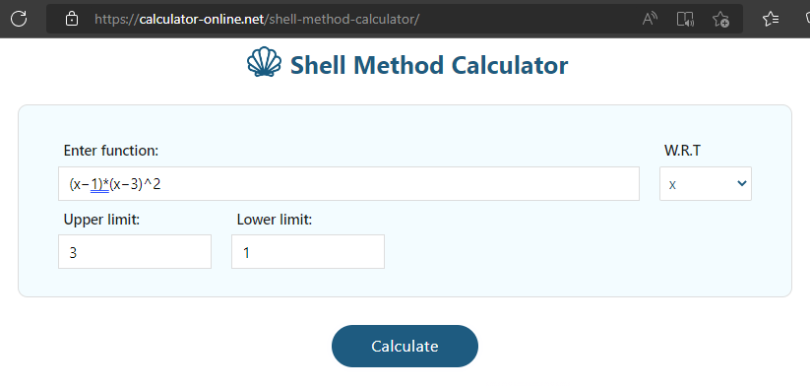

Slide 107
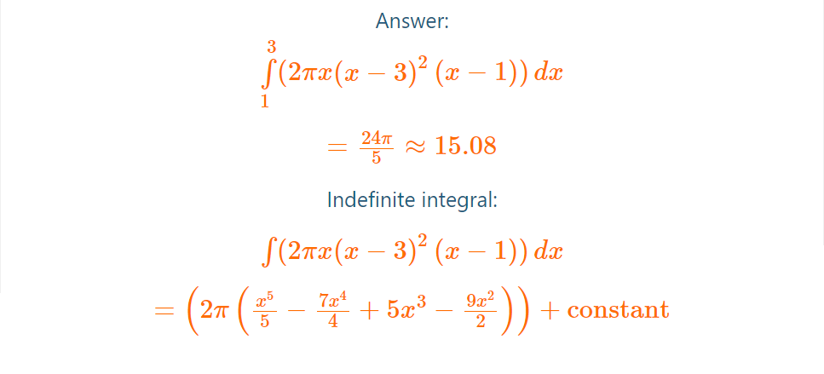
It also shows the steps for the indefinite integral

Slide 108
Questions?
http://i.imgur.com/aliTlT3.jpg

Slide 109
VOLUMES
IN-CLASS PROBLEM 5
Calculate the volume of a cylinder of radius r and height h
OK, this is a standard formula… but where did the formula come from?
https://tutorial.math.lamar.edu/classes/calci/MoreVolume.aspx

Slide 110
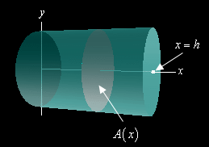
VOLUMES
IN-CLASS PROBLEM 5
Calculate the volume of a cylinder of radius r and height h
We could use any orientation, but let’s use the easiest one:
https://tutorial.math.lamar.edu/classes/calci/MoreVolume.aspx

Slide 111
VOLUMES
IN-CLASS PROBLEM 5
Calculate the volume of a cylinder of radius r and height h
We’ll center the cylinder on the x-axis, and the cylinder will start at x=0 and end at x=h
https://tutorial.math.lamar.edu/classes/calci/MoreVolume.aspx

Slide 112
VOLUMES
IN-CLASS PROBLEM 5
Calculate the volume of a cylinder of radius r and height h
What will the cross-sections look like?
https://tutorial.math.lamar.edu/classes/calci/MoreVolume.aspx

Slide 113
VOLUMES
IN-CLASS PROBLEM 5
Calculate the volume of a cylinder of radius r and height h
The cross-sectional areas are constant and will be disks of radius r
What is the formula?
https://tutorial.math.lamar.edu/classes/calci/MoreVolume.aspx

Slide 114
VOLUMES
IN-CLASS PROBLEM 5
Calculate the volume of a cylinder of radius r and height h
The cross-sectional areas are constant and will be disks of radius r
What is the formula?
A(x)=πr²
What’s the volume?
https://tutorial.math.lamar.edu/classes/calci/MoreVolume.aspx

Slide 115
VOLUMES
IN-CLASS PROBLEM 5
Calculate the volume of a cylinder of radius r and height h
A(x)=πr²
What’s the volume?
V = ∫_{a}^{b} A(x) d? = ∫_{a}^{b} πr² d?
https://tutorial.math.lamar.edu/classes/calci/MoreVolume.aspx

Slide 116
VOLUMES
IN-CLASS PROBLEM 5
Calculate the volume of a cylinder of radius r and height h
V = ∫_{a}^{b} A(x) d? = ∫_{a}^{b} πr² dx
https://tutorial.math.lamar.edu/classes/calci/MoreVolume.aspx

Slide 117
VOLUMES
IN-CLASS PROBLEM 5
Calculate the volume of a cylinder of radius r and height h
V = ∫_{a}^{b} A(x) d? = ∫₀^{h} πr² dx
Do it!
https://tutorial.math.lamar.edu/classes/calci/MoreVolume.aspx

Slide 118
VOLUMES
IN-CLASS PROBLEM 5
Calculate the volume of a cylinder of radius r and height h
V = ∫_{a}^{b} A(x) d? = ∫₀^{h} πr² dx
= πr²x |₀^{h} ‘cause “r” is a constant
= πr²h - πr²(0)
= πr²h
Just what we expected!
https://tutorial.math.lamar.edu/classes/calci/MoreVolume.aspx

Slide 119
Questions?
http://i.imgur.com/aliTlT3.jpg

Slide 120
Volumes
While I’ve never felt these volume techniques had much use in the real world, there is now an application in 3D printing!

Slide 121
Volumes
There are many solids out there that cannot be generated as solids of revolution

Slide 122
Volumes
So, to work these problems we’ll first need to get a sketch of the solid with a set of x- and y-axes to help us see what’s going on

Slide 123
Volumes
At the very least we’ll need the sketch to get the limits of the integral, but we will often need it to see just what the cross-sectional area is

Slide 124
Volumes
Once we have the sketch, we’ll need to determine a formula for the cross-sectional area and then do the integral

Slide 125
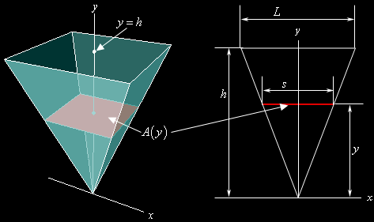
VOLUMES
IN-CLASS PROBLEM 6
Calculate the volume of a pyramid whose base is a square with sides of length L and whose height is h
Again, orient the sketch so it makes the problem easier
https://tutorial.math.lamar.edu/classes/calci/MoreVolume.aspx

Slide 126
VOLUMES
IN-CLASS PROBLEM 6
Calculate the volume of a pyramid whose base is a square with sides of length L and whose height is h
What do the cross-sections look like?
https://tutorial.math.lamar.edu/classes/calci/MoreVolume.aspx

Slide 127
VOLUMES
IN-CLASS PROBLEM 6
Calculate the volume of a pyramid whose base is a square with sides of length L and whose height is h
What do the cross-sections look like? squares
If their sides
are “s” the
length of “s”
depends on y
https://tutorial.math.lamar.edu/classes/calci/MoreVolume.aspx

Slide 128
VOLUMES
IN-CLASS PROBLEM 6
Calculate the volume of a pyramid whose base is a square with sides of length L and whose height is h
If we look at the pyramid directly from the front, we’ll see two similar triangles
https://tutorial.math.lamar.edu/classes/calci/MoreVolume.aspx

Slide 129
VOLUMES
IN-CLASS PROBLEM 6
Calculate the volume of a pyramid whose base is a square with sides of length L and whose height is h
The ratio of any two sides of similar triangles must be equal:
s/L = y/h
Solve for s
https://tutorial.math.lamar.edu/classes/calci/MoreVolume.aspx

Slide 130
VOLUMES
IN-CLASS PROBLEM 6
Calculate the volume of a pyramid whose base is a square with sides of length L and whose height is h
The ratio of any two sides of similar triangles must be equal:
s/L = y/h
Solve for s:
s = yL/h = L/h y
https://tutorial.math.lamar.edu/classes/calci/MoreVolume.aspx

Slide 131
VOLUMES
IN-CLASS PROBLEM 6
Calculate the volume of a pyramid whose base is a square with sides of length L and whose height is h
What is the area of the square cross-sections with side “s”?
https://tutorial.math.lamar.edu/classes/calci/MoreVolume.aspx

Slide 132
VOLUMES
IN-CLASS PROBLEM 6
Calculate the volume of a pyramid whose base is a square with sides of length L and whose height is h
What is the area of the square cross-sections with side “s”?
A = s² = L²/h² y²
What is the
volume?
https://tutorial.math.lamar.edu/classes/calci/MoreVolume.aspx

Slide 133
VOLUMES
IN-CLASS PROBLEM 6
Calculate the volume of a pyramid whose base is a square with sides of length L and whose height is h
A = s² = L²/h² y²
What is the volume?
V = ∫_{a}^{b} A(x) d?
= ∫_{a}^{b} L²/h² y² d?
https://tutorial.math.lamar.edu/classes/calci/MoreVolume.aspx

Slide 134
VOLUMES
IN-CLASS PROBLEM 6
Calculate the volume of a pyramid whose base is a square with sides of length L and whose height is h
A = s² = L²/h² y²
What is the volume?
V = ∫_{a}^{b} A(x) d?
= ∫_{a}^{b} L²/h² y² dy
https://tutorial.math.lamar.edu/classes/calci/MoreVolume.aspx

Slide 135
VOLUMES
IN-CLASS PROBLEM 6
Calculate the volume of a pyramid whose base is a square with sides of length L and whose height is h
A = s² = L²/h² y²
What is the volume?
V = ∫_{a}^{b} A(x) d?
= ∫₀^{h} L²/h² y² dy
Do it!
https://tutorial.math.lamar.edu/classes/calci/MoreVolume.aspx

Slide 136
VOLUMES
IN-CLASS PROBLEM 6
Calculate the volume of a pyramid whose base is a square with sides of length L and whose height is h
V = ∫₀^{h} L²/h² y² dy
= L²/h² ∫₀^{h} y² dy = L²/h²(y³/3)|₀^{h}
= L²h/3
(btw – you can Google this!)
https://tutorial.math.lamar.edu/classes/calci/MoreVolume.aspx

Slide 137
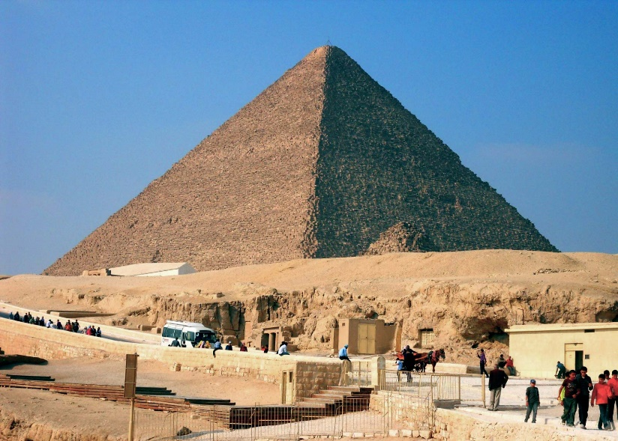
VOLUMES
IN-CLASS PROBLEM 6
V = L²h/3
For the great pyramid at Giza:
h = 481’
L = 756’
https://www.google.com/url?sa=i&url=https%3A%2F%2Fwww.britannica.com%2Fplace%2FGreat-Pyramid&psig=AOvVaw2L_OI6TyEK0aBlRkfplu1e&ust=1626226167322000&source=images&cd=vfe&ved=0CAcQjRxqFwoTCIiF0Nry3vECFQAAAAAdAAAAABAP

Slide 138
VOLUMES
IN-CLASS PROBLEM 6
V = L²h/3
For the great pyramid at Giza:
h = 481’
L = 756’
V ≈ 91,636,272 whats?
https://www.google.com/url?sa=i&url=https%3A%2F%2Fwww.britannica.com%2Fplace%2FGreat-Pyramid&psig=AOvVaw2L_OI6TyEK0aBlRkfplu1e&ust=1626226167322000&source=images&cd=vfe&ved=0CAcQjRxqFwoTCIiF0Nry3vECFQAAAAAdAAAAABAP

Slide 139
VOLUMES
IN-CLASS PROBLEM 6
V = L²h/3
For the great pyramid at Giza:
h = 481’
L = 756’
V ≈ 91,636,272 feet³
https://www.google.com/url?sa=i&url=https%3A%2F%2Fwww.britannica.com%2Fplace%2FGreat-Pyramid&psig=AOvVaw2L_OI6TyEK0aBlRkfplu1e&ust=1626226167322000&source=images&cd=vfe&ved=0CAcQjRxqFwoTCIiF0Nry3vECFQAAAAAdAAAAABAP

Slide 140
VOLUMES
IN-CLASS PROBLEM 6
V ≈ 91,636,272 feet³
If the average filler stone used in building the pyramids was
3’x7.5’x3.75’tall, how many blocks were used to build the pyramid?
https://www.google.com/url?sa=i&url=https%3A%2F%2Fwww.britannica.com%2Fplace%2FGreat-Pyramid&psig=AOvVaw2L_OI6TyEK0aBlRkfplu1e&ust=1626226167322000&source=images&cd=vfe&ved=0CAcQjRxqFwoTCIiF0Nry3vECFQAAAAAdAAAAABAP

Slide 141
VOLUMES
IN-CLASS PROBLEM 6
V ≈ 91,636,272 feet³
If the average filler stone used in building the pyramids was
3’x7.5’x3.75’tall, how many blocks were used to build the pyramid?
≈ 1,086,060 whats?
https://www.google.com/url?sa=i&url=https%3A%2F%2Fwww.britannica.com%2Fplace%2FGreat-Pyramid&psig=AOvVaw2L_OI6TyEK0aBlRkfplu1e&ust=1626226167322000&source=images&cd=vfe&ved=0CAcQjRxqFwoTCIiF0Nry3vECFQAAAAAdAAAAABAP

Slide 142
VOLUMES
IN-CLASS PROBLEM 6
V ≈ 91,636,272 feet³
If the average filler stone used in building the pyramids was
3’x7.5’x3.75’tall, how many blocks were used to build the pyramid?
≈ 1,086,060 blocks
https://www.google.com/url?sa=i&url=https%3A%2F%2Fwww.britannica.com%2Fplace%2FGreat-Pyramid&psig=AOvVaw2L_OI6TyEK0aBlRkfplu1e&ust=1626226167322000&source=images&cd=vfe&ved=0CAcQjRxqFwoTCIiF0Nry3vECFQAAAAAdAAAAABAP

Slide 143
VOLUMES
IN-CLASS PROBLEM 6
≈ 1,086,060 blocks
Assuming the builders spent 240 days a year working on the pyramid over approximately 60 years (the length of King Khufu’s reign), how many
blocks did the
builders set each
day?
https://www.google.com/url?sa=i&url=https%3A%2F%2Fwww.britannica.com%2Fplace%2FGreat-Pyramid&psig=AOvVaw2L_OI6TyEK0aBlRkfplu1e&ust=1626226167322000&source=images&cd=vfe&ved=0CAcQjRxqFwoTCIiF0Nry3vECFQAAAAAdAAAAABAP

Slide 144
VOLUMES
IN-CLASS PROBLEM 6
≈ 1,086,060 blocks
Assuming the builders spent 240 days a year working on the pyramid over approximately 60 years (the length of King Khufu’s reign), how many
blocks did the
builders set each
day? ≈ 75 or 76
https://www.google.com/url?sa=i&url=https%3A%2F%2Fwww.britannica.com%2Fplace%2FGreat-Pyramid&psig=AOvVaw2L_OI6TyEK0aBlRkfplu1e&ust=1626226167322000&source=images&cd=vfe&ved=0CAcQjRxqFwoTCIiF0Nry3vECFQAAAAAdAAAAABAP

Slide 145
VOLUMES
IN-CLASS PROBLEM 6
≈ 75 or 76 blocks
Since each block weighed about 2.5 tons, that is a LOT of work at an amazingly fast speed!
(about 1 every 7 minutes)
(about 16 men would
be needed to move
each stone)
https://www.google.com/url?sa=i&url=https%3A%2F%2Fwww.britannica.com%2Fplace%2FGreat-Pyramid&psig=AOvVaw2L_OI6TyEK0aBlRkfplu1e&ust=1626226167322000&source=images&cd=vfe&ved=0CAcQjRxqFwoTCIiF0Nry3vECFQAAAAAdAAAAABAP

Slide 146
VOLUMES
IN-CLASS PROBLEM 6
Herodotus was told (about 2000 years later) that is took 20 years to build the pyramid…
Do you believe it?
https://www.google.com/url?sa=i&url=https%3A%2F%2Fwww.britannica.com%2Fplace%2FGreat-Pyramid&psig=AOvVaw2L_OI6TyEK0aBlRkfplu1e&ust=1626226167322000&source=images&cd=vfe&ved=0CAcQjRxqFwoTCIiF0Nry3vECFQAAAAAdAAAAABAP

Slide 147
Questions?
http://i.imgur.com/aliTlT3.jpg

Slide 148
Summary
Today we studied:
Review of Integration by
Parts and Partial Fraction
Decomposition
Review of Improper Integrals
New stuff: Volumes

Slide 149

You Survived!

