Slide 1
Welcome to
Unit 2
Part 4!
MATH 207 Integral Calculus
http://en.wikipedia.org/wiki/Differential_equation#mediaviewer/File:Elmer-pump-heatequation.png

Slide 2
What’s Up?
Review:
Hyperbolic Functions
New stuff:
Integration techniques

Slide 3
What’s Up?
Outcome 1) Demonstrate a high level of proficiency in differentiation and integration for linear, polynomial, rational, trigonometric, inverse trigonometric, exponential and logarithmic function, including using the method of substitution, integration by parts and partial fraction decomposition
Outcome 7) Solve problems by identifying the requirements, making a sketch as appropriate

Slide 4

Review
http://995642590.r.lightningbase-cdn.com/wp-content/uploads/2010/12/looking-back-hrexaminer-v144-cover425px.jpg

Slide 5
Hyperbolics
Problems in advanced electronics can include
a hyperbolic function
https://en.wikipedia.org/wiki/Hyperbola#/media/File:Hyperbeln-gs-3.svg

Slide 6
Hyperbolics
Trig functions are
based on the
circle
Hyperbolics are
similar but
based on the
hyperbola
https://en.wikipedia.org/wiki/Hyperbola#/media/File:Hyperbolic_functions-2.svg

Slide 7
Hyperbolics
The hyperbolic functions are not periodic like trig functions
Both x and y just keep getting bigger and bigger as the hyperbolas arms expand outward

Slide 8
Hyperbolics
There are three basic hyperbolic functions:
sinh
cosh
tanh
https://en.wikipedia.org/wiki/Hyperbola#/media/File:Hyperbolic_functions-2.svg

Slide 9
Hyperbolics
-∞ < sinh(u) < +∞
1 ≤ cosh(u) < +∞
-1 ≤ tanh(u) ≤ +1
https://en.wikipedia.org/wiki/Hyperbola#/media/File:Hyperbolic_functions-2.svg

Slide 10
Hyperbolics
The hyperbolics can be defined in different ways:
in terms of exponentials
in terms of complex trig functions
in terms of differential equations

Slide 11
Hyperbolics
In terms of the exponential function:
sinh(x) = (e^{x} – e^{-x})/2
cosh(x) = (e^{x} + e^{-x})/2
tanh(x) = (e^{x} - e^{-x})/(e^{x} + e^{-x})

Slide 12
Hyperbolics
In terms of complex trig functions:
sinh(x) = - i sin(i x)
cosh(x) = cos(ix)
tanh(x) = -i (tan(i x)

Slide 13
Hyperbolics
The hyperbolic functions satisfy many identities, all of them similar in form to the trigonometric identities

Slide 14
Hyperbolics
sinh(-x) = -sinh(x) (an odd function)
cosh(-x) = cosh(x) (an even function)
tanh(-x) = -tanh(x) (an odd function)
cosh(x) + sinh(x) = e^{x}
cosh(x) - sinh(x) = e^{-x}
cosh²(x) - sinh² (x) = 1
(which is similar to the Pythagorean theorem identity)
(but… it’s not…)
https://en.wikipedia.org/wiki/Hyperbolic_functions#Derivatives

Slide 15
Calculus of Hyperbolics
d(sinh(u))/dx = (e^{u} + e^{-u})/2 du/dx
= cosh(u) du/dx
d(cosh(u))/dx = (e^{u} - e^{-u})/2 du/dx
= sinh(u) du/dx
d(tanh(u))/dx = 4/(e^{u} + e^{-u})² du/dx
= 1/cosh²(u) du/dx

Slide 16
Calculus of Hyperbolics
∫ sinh(u) du = cosh(u) + k
∫ cosh(u) du = sinh(u) + k
∫ tanh(u) du = sinh(u)/cosh(u) + k

Slide 17
Hyperbolics
Remember the “arc”s undo a trig function
The arcsine (sin⁻¹) of a sine value gives the original angle used to calculate the sine

Slide 18
Hyperbolics
If hyperbolics are being defined as exponentials, their “arcs” will be logarithms

Slide 19
Hyperbolics
In math class, these are often called “arsinh” rather than “arcsinh” or “sinh⁻¹”
(in electronics, sinh⁻¹ seems to be used)

Slide 20
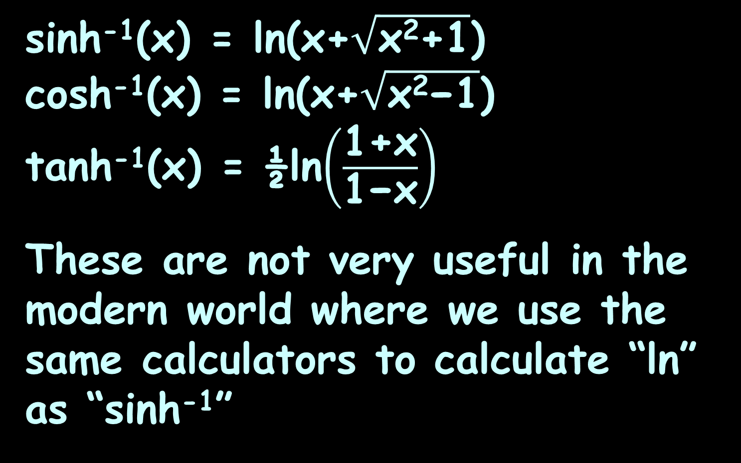
Hyperbolics
sinh⁻¹(x) = ln(x+$\sqrt{\text{x}\text{2}\text{+1}}$)
cosh⁻¹(x) = ln(x+$\sqrt{\text{x}\text{2}\text{−}\text{1}}$)
tanh⁻¹(x) = ½ln$\left(\frac{\text{1+}\text{x}}{\text{1−}\text{x}}\right)$
These are not very useful in the modern world where we use the same calculators to calculate “ln” as “sinh⁻¹”

Slide 21
Calculus of Hyperbolics
The derivatives of inverse hyperbolics are used in electronics (Sorry…!)
There are models like:
N = cosh⁻¹(Z₁/Z₂)^{½}

Slide 22

Calculus of Hyperbolics
d(sinh⁻¹(u)/dx = 1/$\sqrt{\text{u}\text{2}\text{+1}}$ du/dx
d(cosh⁻¹(u)/dx = 1/$\sqrt{\text{u}\text{2}\text{−}\text{1}}$ du/dx
d(tanh⁻¹(u)/dx = 1/(1-u²) du/dx

Slide 23
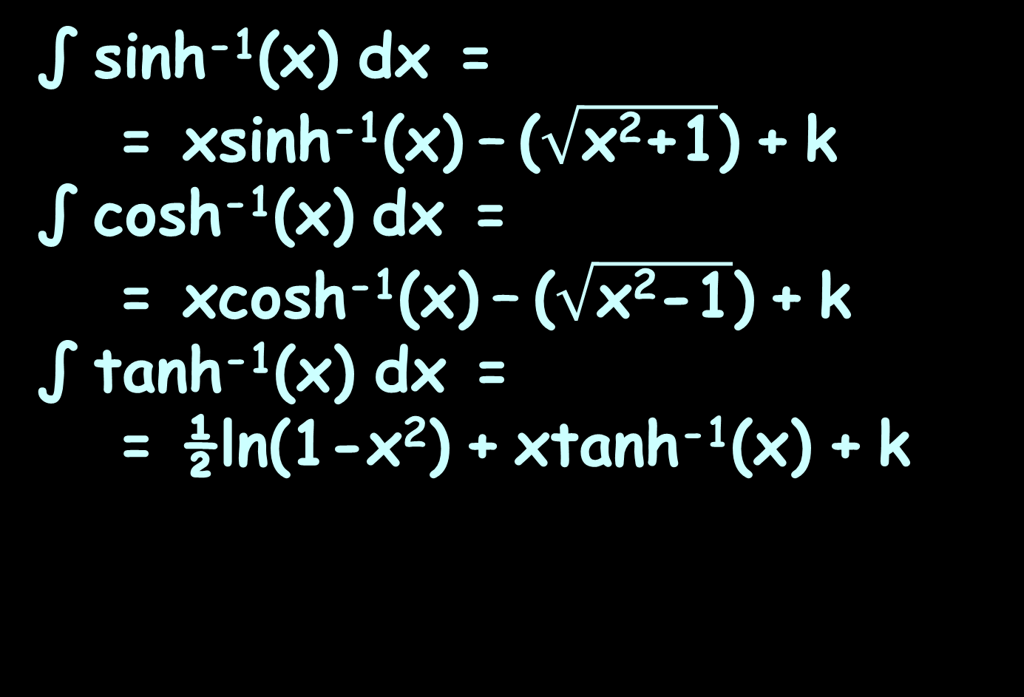
Calculus of Hyperbolics
∫ sinh⁻¹(x) dx =
= xsinh⁻¹(x) – ($\sqrt{\text{x}\text{2}\text{+}\text{1}}$) + k
∫ cosh⁻¹(x) dx =
= xcosh⁻¹(x) – ($\sqrt{\text{x}\text{2}\text{−1}}$) + k
∫ tanh⁻¹(x) dx =
= ½ln(1-x²) + xtanh⁻¹(x) + k

Slide 24
Calculus of Hyperbolics
Since the exponential function can be defined for any complex argument, we can also extend the definitions of the hyperbolic functions to complex arguments

Slide 25
Calculus of Hyperbolics
The functions sinh(z) and cosh(z) are then holomorphic

Slide 26
Calculus of Hyperbolics
sinh(x+iy) =
sin(x)cos(y) + i cosh(x)sin(y)
cosh(x+iy) =
cos(x)cos(y) + i sinh(x)sin(y)
(tanh(x)+ i tan(y))
(1+i tanh(x)tan(y)
no hyperbolic
no hyperbolic
no hyperbolic
no hyperbolic
no hyperbolic
no hyperbolic
no hyperbolic
tanh(x+iy) =
no hyperbolic

Slide 27
Calculus of Hyperbolics
Thus, hyperbolic functions are periodic with respect to the imaginary component, with period 2πi (πi for hyperbolic tangent and cotangent)

Slide 28

Questions?
http://i.imgur.com/aliTlT3.jpg

Slide 29
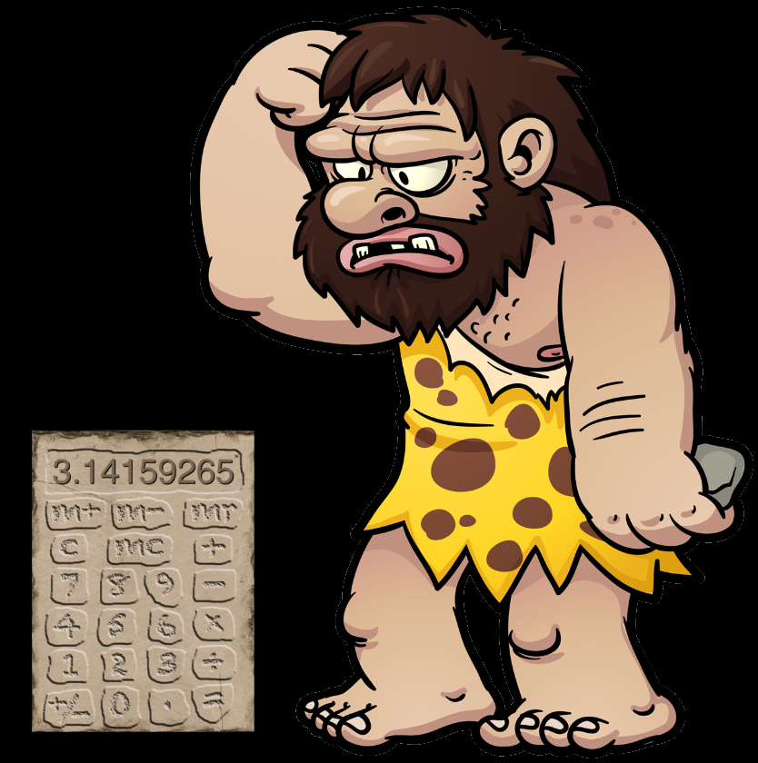
Integration Methods
Back in the stone age before fancy calculators
people came
up with a lot
of tricks to
help solve
NASTY
integrals
http://www.auburn.edu/academic/education/reading_genie/vowels/caveman.jpg
http://i.i.cbsi.com/cnwk.1d/i/tim/2010/10/01/fmimg63222559117213962_257x343.jpg

Slide 30
Integration Methods
We study them now to make you appreciate how nice your calculator is…

Slide 31
Tables of Integrals
Since people had trouble remembering all of the gazillions of integrals, tables were constructed as reminders

Slide 32



Tables of Integrals
Your problem:
Table entries:
Which would you use?
$$\int{\frac{dx}{(1−x^{2})}}$$
$$\int{\frac{dx}{(a−x^{2})}}$$
$$\int{\frac{dx}{(x^{2}−a)}}$$

Slide 33
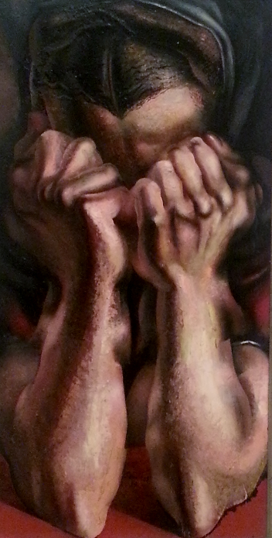
Tables of Integrals
Of course, whatever
problem you needed
to solve would not be
on the table…
http://mommyneedscoffee.com/wp-content/uploads/2012/09/TheSob.jpg

Slide 34
Tables of Integrals
For any given problem, the strategy was to rearrange and simplify your problem so it would look like something in the table

Slide 35

Tables of Integrals
Students really loved doing this
http://translationbiz.files.wordpress.com/2012/07/tearing-out-hair2.jpg

Slide 36
Integration by Parts
A way to get nasty integrals containing multiplications to look like something in the table

Slide 37
Integration by Parts
A common student mistake is:
∫f(x) g(x)dx = ∫f(x)dx × ∫g(x)dx
DO NOT WRITE THIS DOWN!!
This would be too easy… therefore it is not true…

Slide 38
Integration by Parts
Remember when we did derivatives of multiples…

Slide 39
Integration by Parts
Remember when we did derivatives of multiples…
it wasn't easy either

Slide 40
Integration by Parts
So… how do you solve integrals including multiplications ?

Slide 41
Integration by Parts
So… how do you solve integrals including multiplications ?
(Yes… I know… calculator…)

Slide 42
Integration by Parts
So… how do you solve integrals including multiplications ?
(Yes… I know… calculator…)
Suppose your calculator is dead or missing (no, I don’t mean WolframAlpha)

Slide 43
Integration by Parts
Sometimes you can use a technique called
Integration by Parts
This is just the product rule run backwards

Slide 44
Integration by Parts
Remember the derivative formula for products:
d(u × v)/dx = (u × dv) + (v × du)

Slide 45
Integration by Parts
d(u × v)/dx = (u × dv) + (v × du)
Since integration is anti-derivation, this means:
∫(d(u × v)/dx) dx=
= ∫(u×dv)dx + ∫(v×du)dx

Slide 46
Integration by Parts
But
∫(d(u × v)/dx) dx=
= ∫(u×dv)dx + ∫(v×du)dx
is the same as:
u × v = ∫(u×dv)dx + ∫(v×du)dx

Slide 47
Integration by Parts
u × v = ∫(u×dv) dx + ∫(v×du) dx
Then:
∫(v×du) dx = u × v - ∫(u×dv) dx

Slide 48
Integration by Parts
∫(v×du/dx)dx = (u×v) -∫(u×dv/dx)dx
But (dv/dx)dx = dv, and (du/dx)dx = du, so it’s really:
∫ v du = (u×v) -∫ u dv

Slide 49
Integration by Parts
So, if there is an integral:
∫ du × v dx
that is easy to evaluate, we can use it to solve the problem!

Slide 50
Integration by Parts
This is the main idea behind integration by parts

Slide 51
Integration by Parts
Steps to perform integration by parts:
Given the integral:
∫ f(x) g(x) dx
1) Identify the two functions
being multiplied f(x) and g(x)

Slide 52
Integration by Parts
2) Make the function with the easiest antiderivative a derivative (g’(x) or f’(x)) and put it into the “dv" slot. The other becomes “u”:
u = f(x)
dv = g’(x) dx

Slide 53
Integration by Parts
3) Take the derivative of f(x)
and the integral of g’(x)dx
(ignore the +c) for:
du/dx = f'(x)
v = g(x)

Slide 54
Integration by Parts
4) Use the formula:
∫ u dv = (u×v) -∫ v du

Slide 55
INTEGRATION BY PARTS
IN-CLASS PROBLEM 1
Calculate: ∫x e^{x} dx
v = ? dv = ?
u = ? du = ?
Which has the easiest integral?
Use that for “dv”

Slide 56
INTEGRATION BY PARTS
IN-CLASS PROBLEM 1
Calculate: ∫x e^{x} dx
v = ? dv = e^{x} dx
u = du =

Slide 57
INTEGRATION BY PARTS
IN-CLASS PROBLEM 1
Calculate: ∫x e^{x} dx
v = e^{x} dv = e^{x} dx
u = ? du =

Slide 58
INTEGRATION BY PARTS
IN-CLASS PROBLEM 1
Calculate: ∫x e^{x} dx
v = e^{x} dv = e^{x} dx
u = x du = ?

Slide 59
INTEGRATION BY PARTS
IN-CLASS PROBLEM 1
Calculate: ∫x e^{x} dx
v = e^{x} dv = e^{x} dx
u = x du = 1 dx
Now use: ∫u dv = (u×v) - ∫v du

Slide 60
INTEGRATION BY PARTS
IN-CLASS PROBLEM 1
Calculate: ∫x e^{x} dx
v = e^{x} dv = e^{x} dx
u = x du = dx
∫ u dv = u × v - ∫ v du
∫ x e^{x} dx = x × e^{x} - ∫ e^{x} dx

Slide 61
INTEGRATION BY PARTS
IN-CLASS PROBLEM 1
Calculate: ∫x e^{x} dx
v = e^{x} dv = e^{x} dx
u = x du = dx
∫ u dv = u × v - ∫ v du
∫ x e^{x} dx = x × e^{x} - ∫ e^{x} dx
= x × e^{x} - e^{x} + c
= e^{x}(x-1) + c

Slide 62
Integration by Parts
BAD NEWS: Most of the time the integration by parts will not be enough to give you the answer after one shot
You may need to do some extra work: another integration by parts or use other technique

Slide 63
Integration by Parts
BAD NEWS: Most of the time the integration by parts will not be enough to give you the answer after one shot
You may need to do some extra work: another integration by parts or some other technique (Like the fancy calculator…)

Slide 64
Questions?
http://i.imgur.com/aliTlT3.jpg

Slide 65
INTEGRATION BY PARTS
IN-CLASS PROBLEM 2
Calculate ∫x sin(x) dx
v = ? dv = ?
u = ? du = ?
Which has the easiest antiderivative?
Use that for “dv”

Slide 66
INTEGRATION BY PARTS
IN-CLASS PROBLEM 2
Calculate ∫x sin(x) dx
v = ? dv = sin(x) dx
u = du =

Slide 67
INTEGRATION BY PARTS
IN-CLASS PROBLEM 2
Calculate ∫x sin(x) dx
v = -cos(x) dv = sin(x) dx
u = ? du =

Slide 68
INTEGRATION BY PARTS
IN-CLASS PROBLEM 2
Calculate ∫x sin(x) dx
v = -cos(x) dv = sin(x) dx
u = x du = ?

Slide 69
INTEGRATION BY PARTS
IN-CLASS PROBLEM 2
Calculate ∫x sin(x) dx
v = -cos(x) dv = sin(x) dx
u = x du = dx
Now for: ∫ u dv = u × v - ∫v du

Slide 70
INTEGRATION BY PARTS
IN-CLASS PROBLEM 2
Calculate ∫x sin(x) dx
v = -cos(x) dv = sin(x) dx
u = x du = dx
∫u dv = u × v -∫ v du
∫xsin(x)dx = x(-cos(x))-∫-cos(x)dx

Slide 71
INTEGRATION BY PARTS
IN-CLASS PROBLEM 2
Calculate ∫x sin(x) dx
v = -cos(x) dv = sin(x) dx
u = x du = dx
∫u dv = u × v -∫ v du
∫xsin(x)dx = x(-cos(x))-∫-cos(x)dx
= -xcos(x) + sin(x) + c
= sin(x) – xcos(x) + c

Slide 72
Questions?
http://i.imgur.com/aliTlT3.jpg

Slide 73
INTEGRATION BY PARTS
IN-CLASS PROBLEMS 3-5
Evaluate the integral:
∫θcsc²θ dθ = ∫θ(csc(θ))² dθ
∫cot⁵(x) csc²(x) dx
∫₀^{π} t sin(2t) dt

Slide 74
INTEGRATION BY PARTS
IN-CLASS PROBLEMS 3-5
Evaluate the integral:
∫θcsc²θ dθ = ln(sin(θ))-θcot(θ)+c
∫cot⁵(x) csc²(x) dx
∫₀^{π} t sin(2t) dt

Slide 75
INTEGRATION BY PARTS
IN-CLASS PROBLEMS 3-5
Evaluate the integral:
∫θcsc²θ dθ = ln(sin(θ))-θcot(θ)+c
∫cot⁵(x) csc²(x) dx = -1/6 cot⁶(x)+c
∫₀^{π} t sin(2t) dt

Slide 76
INTEGRATION BY PARTS
IN-CLASS PROBLEMS 3-5
Evaluate the integral:
∫θcsc²θ dθ = ln(sin(θ))-θcot(θ)+c
∫cot⁵(x) csc²(x) dx = -1/6 cot⁶(x)+c
∫₀^{π} t sin(2t) dt = -π/2

Slide 77
Questions?
http://i.imgur.com/aliTlT3.jpg

Slide 78
Integration
Because pre-calculator folks hated division so much, there are several techniques to make integrals that include division look like something in the table

Slide 79

Integration
They are all scary…
http://www.gettyimages.com/detail/photo/businessman-crying-close-up-high-res-stock-photography/AB34183

Slide 80

Trig Substitutions
These are used when an integral has a nasty divisor
in it:
$$\int{\frac{dx}{(1−x^{2})}}$$

Slide 81
Trig Substitutions
If the divisor of an integral contains a² − x²,
let x = a sin(θ)
and use the identity:
1 – sin²(θ) = cos²(θ)
http://en.wikipedia.org/wiki/Trigonometric_substitution

Slide 82
Trig Substitutions
If the divisor of an integral contains a² + x²,
let x = a tan(θ)
and use the identity:
1 + tan²(θ) = sec²(θ)

Slide 83
Trig Substitutions
If the divisor of an integral contains x² − a²,
let x = a sec(θ)
and use the identity:
sec²(θ) – 1 = tan²(θ)

Slide 84

INTEGRATION BY TRIG SUBSTITUTION
IN-CLASS PROBLEM 6
Which could you use?
$$\int{\frac{dx}{(1−x^{2})}}$$
For a² − x², let x = a sin(θ) and use: 1 – sin²(θ) = cos²(θ)
For a² + x², let x = a tan(θ) and use: 1 + tan²(θ) = sec²(θ)
For x² − a², let x = a sec(θ) and use: sec²(θ) – 1 = tan²(θ)

Slide 85
INTEGRATION BY TRIG SUBSTITUTION
IN-CLASS PROBLEM 6
Which could you use?
For a² − x², let x = a sin(θ)
and use: 1 – sin²(θ) = cos²(θ)
$$\int{\frac{dx}{(1−x^{2})}}$$
For a² − x², let x = a sin(θ) and use: 1 – sin²(θ) = cos²(θ)
For a² + x², let x = a tan(θ) and use: 1 + tan²(θ) = sec²(θ)
For x² − a², let x = a sec(θ) and use: sec²(θ) – 1 = tan²(θ)

Slide 86

INTEGRATION BY TRIG SUBSTITUTION
IN-CLASS PROBLEM 7
Which could you use?
$$\int{\frac{dx}{(x^{2}−25)}}$$
For a² − x², let x = a sin(θ) and use: 1 – sin²(θ) = cos²(θ)
For a² + x², let x = a tan(θ) and use: 1 + tan²(θ) = sec²(θ)
For x² − a², let x = a sec(θ) and use: sec²(θ) – 1 = tan²(θ)

Slide 87
INTEGRATION BY TRIG SUBSTITUTION
IN-CLASS PROBLEM 7
Which could you use?
For x² − a², let x = a sec(θ) and use: sec²(θ) – 1 = tan²(θ)
$$\int{\frac{dx}{(x^{2}−25)}}$$
For a² − x², let x = a sin(θ) and use: 1 – sin²(θ) = cos²(θ)
For a² + x², let x = a tan(θ) and use: 1 + tan²(θ) = sec²(θ)
For x² − a², let x = a sec(θ) and use: sec²(θ) – 1 = tan²(θ)

Slide 88

INTEGRATION BY TRIG SUBSTITUTION
IN-CLASS PROBLEM 8
Which could you use?
$$\int{\frac{dx}{(9+x^{2})}}$$
For a² − x², let x = a sin(θ) and use: 1 – sin²(θ) = cos²(θ)
For a² + x², let x = a tan(θ) and use: 1 + tan²(θ) = sec²(θ)
For x² − a², let x = a sec(θ) and use: sec²(θ) – 1 = tan²(θ)

Slide 89
INTEGRATION BY TRIG SUBSTITUTION
IN-CLASS PROBLEM 8
Which could you use?
For a² + x², let x = a tan(θ) and use: 1 + tan²(θ) = sec²(θ)
$$\int{\frac{dx}{(9+x^{2})}}$$
For a² − x², let x = a sin(θ) and use: 1 – sin²(θ) = cos²(θ)
For a² + x², let x = a tan(θ) and use: 1 + tan²(θ) = sec²(θ)
For x² − a², let x = a sec(θ) and use: sec²(θ) – 1 = tan²(θ)

Slide 90

INTEGRATION BY TRIG SUBSTITUTION
IN-CLASS PROBLEM 9
Which could you use?
$$\int{\frac{dx}{(x^{2}+50)}}$$
For a² − x², let x = a sin(θ) and use: 1 – sin²(θ) = cos²(θ)
For a² + x², let x = a tan(θ) and use: 1 + tan²(θ) = sec²(θ)
For x² − a², let x = a sec(θ) and use: sec²(θ) – 1 = tan²(θ)

Slide 91
INTEGRATION BY TRIG SUBSTITUTION
IN-CLASS PROBLEM 9
Which could you use?
Hmm… that doesn’t fit any of the tricks…
$$\int{\frac{dx}{(x^{2}+50)}}$$
For a² − x², let x = a sin(θ) and use: 1 – sin²(θ) = cos²(θ)
For a² + x², let x = a tan(θ) and use: 1 + tan²(θ) = sec²(θ)
For x² − a², let x = a sec(θ) and use: sec²(θ) – 1 = tan²(θ)

Slide 92
INTEGRATION BY TRIG SUBSTITUTION
IN-CLASS PROBLEM 9
Which could you use?
Hmm… that doesn’t fit any of the tricks…
That leaves the calculator!
$$\int{\frac{dx}{(x^{2}+50)}}$$
For a² − x², let x = a sin(θ) and use: 1 – sin²(θ) = cos²(θ)
For a² + x², let x = a tan(θ) and use: 1 + tan²(θ) = sec²(θ)
For x² − a², let x = a sec(θ) and use: sec²(θ) – 1 = tan²(θ)

Slide 93
INTEGRATION BY TRIG SUBSTITUTION
IN-CLASS PROBLEM 10
Calculate:
$$\int{\frac{dx}{(x^{2}+50)}}$$

Slide 94


INTEGRATION BY TRIG SUBSTITUTION
IN-CLASS PROBLEM 10
Calculate:
= tan⁻¹(x/5$\sqrt{\text{2}}$)/5$\sqrt{\text{2}}$+c
$$\int{\frac{dx}{(x^{2}+50)}}$$

Slide 95

INTEGRATION BY TRIG SUBSTITUTION
IN-CLASS PROBLEM 11
Calculate:
$$\int{\frac{dx}{(1−x^{2})}}$$

Slide 96
INTEGRATION BY TRIG SUBSTITUTION
IN-CLASS PROBLEM 11
Calculate:
= ½(ln(x+1)-ln(1-x))+c
$$\int{\frac{dx}{(1−x^{2})}}$$

Slide 97

INTEGRATION BY TRIG SUBSTITUTION
IN-CLASS PROBLEM 12
Calculate:
$$\int{\frac{dx}{(x^{2}−25)}}$$

Slide 98
INTEGRATION BY TRIG SUBSTITUTION
IN-CLASS PROBLEM 12
Calculate:
= 0.1(ln(5-x)-ln(5+x)+c
$$\int{\frac{dx}{(x^{2}−25)}}$$

Slide 99

INTEGRATION BY TRIG SUBSTITUTION
IN-CLASS PROBLEM 13
Calculate:
$$\int{\frac{dx}{(9+x^{2})}}$$

Slide 100
INTEGRATION BY TRIG SUBSTITUTION
IN-CLASS PROBLEM 13
Calculate:
= 1/3 tan⁻¹(x/3)+c
$$\int{\frac{dx}{(9+x^{2})}}$$

Slide 101
Questions?
http://i.imgur.com/aliTlT3.jpg

Slide 102
Partial Fractions
Combining rational functions (fractions) using a common denominator

Slide 103
Partial Fractions
Partial fractions can be pretty tough to solve—especially if fractions are not your strong point

Slide 104
Partial Fractions
Problems typically involve the splitting up of a single fraction into two or more fractions that each contain a single factor in the denominators

Slide 105
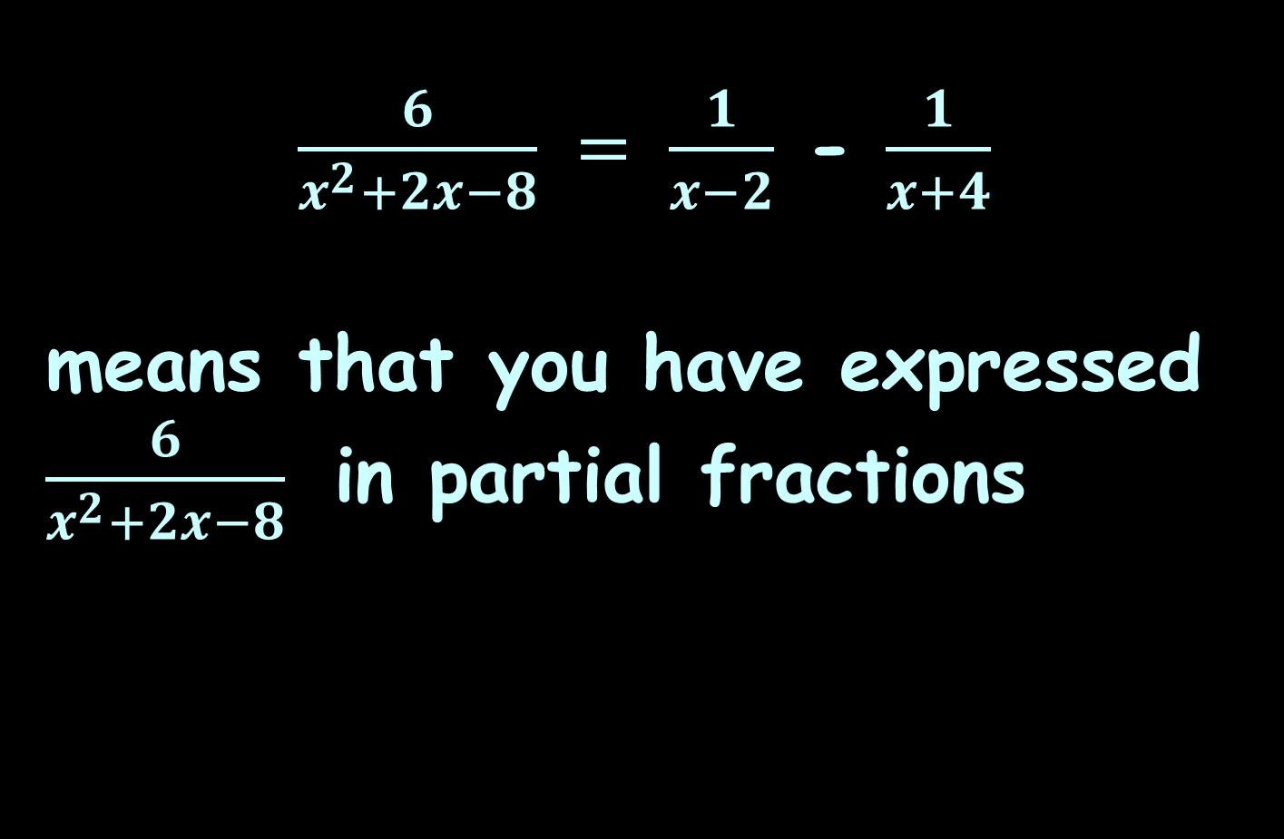
Partial Fractions
$\frac{6}{x^{2}+2x−8} = \frac{1}{x−2}$ - $\frac{1}{x+4}$
means that you have expressed $\frac{6}{x^{2}+2x−8}$ in partial fractions

Slide 106
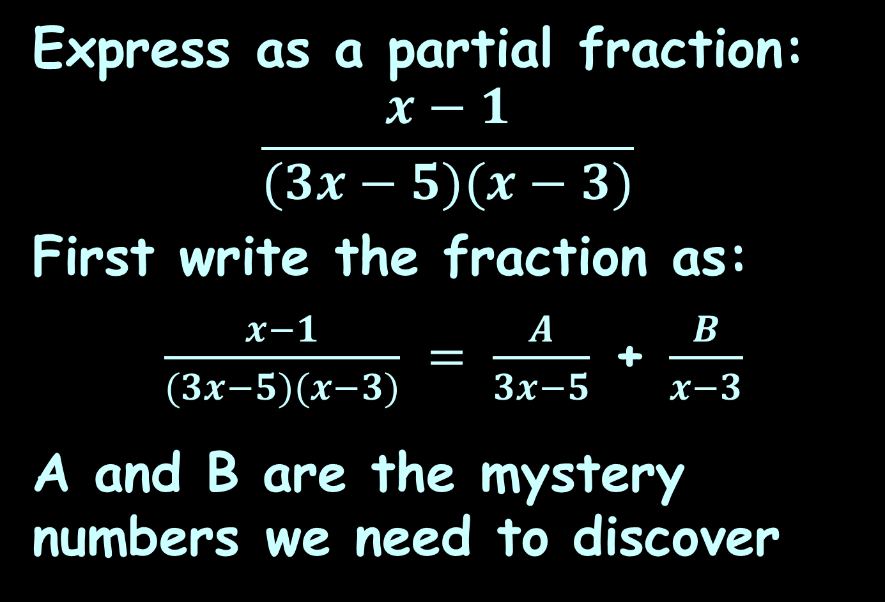
Partial Fractions
Express as a partial fraction:
$$\frac{x−1}{(3x−5)(x−3)}$$
First write the fraction as:
$\frac{x−1}{(3x−5)(x−3)} = \frac{A}{3x−5}$ + $\frac{B}{x−3}$
A and B are the mystery numbers we need to discover

Slide 107

Partial Fractions
We’ll be solving this using algebra…
http://images.sodahead.com/polls/001429875/yuck_answer_8_xlarge_answer_2_xlarge.jpeg

Slide 108
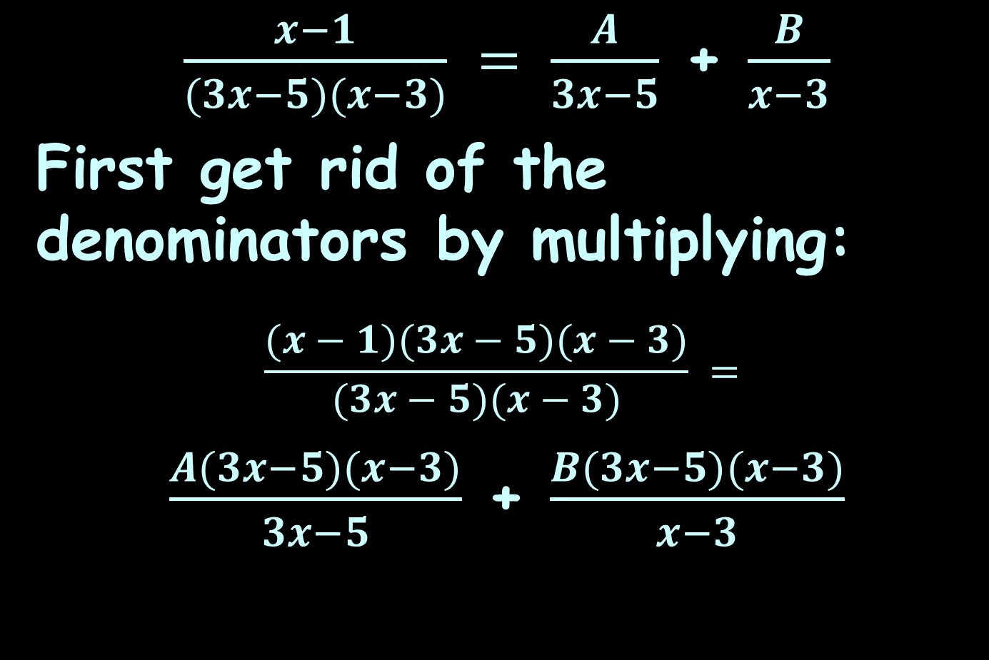
Partial Fractions
$\frac{x−1}{(3x−5)(x−3)} = \frac{A}{3x−5}$ + $\frac{B}{x−3}$
First get rid of the denominators by multiplying:
$$\frac{(x−1)(3x−5)(x−3)}{(3x−5)(x−3)} =$$
$\frac{A(3x−5)(x−3)}{3x−5}$ + $\frac{B(3x−5)(x−3)}{x−3}$

Slide 109
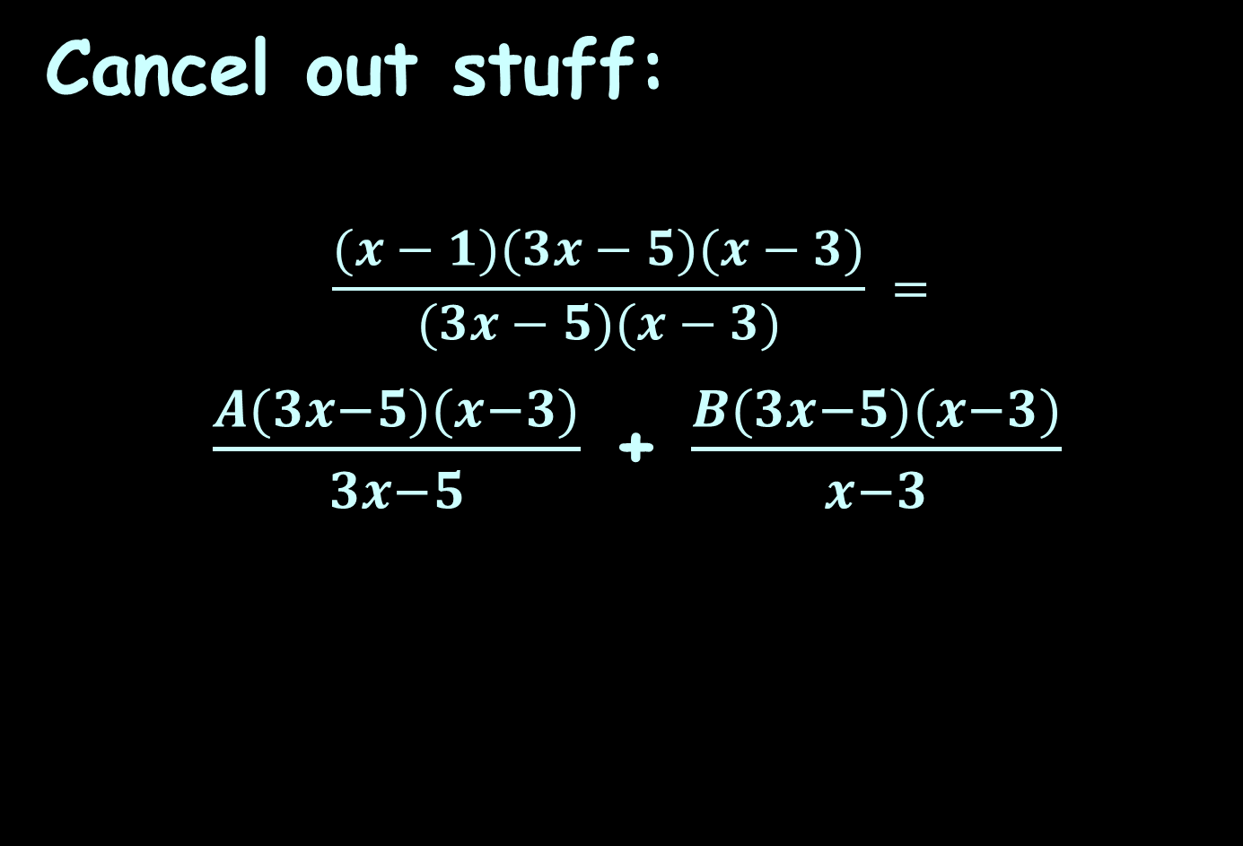
Partial Fractions
Cancel out stuff:
$$\frac{(x−1)(3x−5)(x−3)}{(3x−5)(x−3)} =$$
$\frac{A(3x−5)(x−3)}{3x−5}$ + $\frac{B(3x−5)(x−3)}{x−3}$

Slide 110
Partial Fractions
Now we have:
x - 1 = A(x-3) + B(3x-5)
Our strategy: get one of the factors multiplying A or B to be 0…

Slide 111
Partial Fractions
Now we have:
x - 1 = A(x-3) + B(3x-5)
Our strategy: get one of the factors multiplying A or B to be 0…
Like if x=3

Slide 112
Partial Fractions
x - 1 = A(x-3) + B(3x-5)
Plug in x=3
3 – 1 = A(3-3) + B(3*3 -5)
2 = B(4)
So B = ½
Repeat to calculate “A”

Slide 113
Partial Fractions
x - 1 = A(x-3) + B(3x-5)
What would x have to be to make the “B” factor 0?

Slide 114
Partial Fractions
x - 1 = A(x-3) + B(3x-5)
What would x have to be to make the “B” factor 0?
3x-5 = 0
3x = 5
x = 5/3

Slide 115
Partial Fractions
x - 1 = A(x-3) + B(3x-5)
What would x have to be to make the “B” factor 0?
x = 5/3

Slide 116
Partial Fractions
x - 1 = A(x-3) + B(3x-5)
Plug in x=5/3

Slide 117
Partial Fractions
x - 1 = A(x-3) + B(3x-5)
Plug in x=5/3
5/3 – 1 = A(5/3-3) + B(3*5/3-5)
2/3 = A(-4/3)
So A = -½
Now we have the answer to our problem!

Slide 118
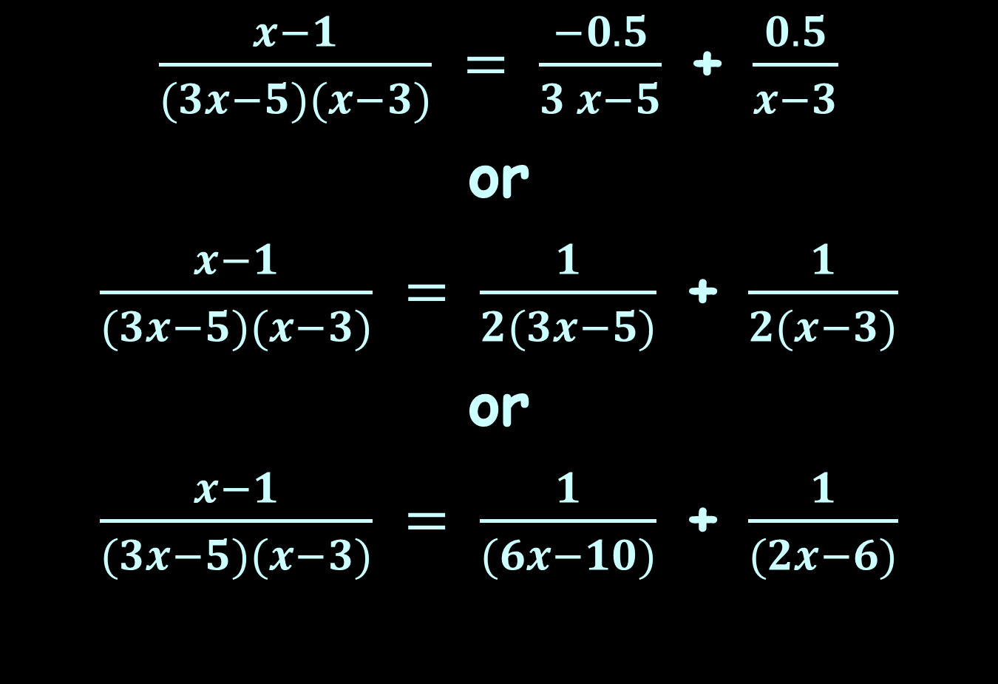
Partial Fractions
$\frac{x−1}{(3x−5)(x−3)} = \frac{−0.5}{3 x−5}$ + $\frac{0.5}{x−3}$
or
$\frac{x−1}{(3x−5)(x−3)} = \frac{1}{2(3x−5)}$ + $\frac{1}{2(x−3)}$
or
$\frac{x−1}{(3x−5)(x−3)} = \frac{1}{(6x−10)}$ + $\frac{1}{(2x−6)}$

Slide 119
Partial Fractions
Integration using partial fraction decomposition (abbreviated as PFD) is also known as partial fraction expansion (abbreviated as PFE)

Slide 120
Partial Fractions
Partial fraction decomposition (PFD) is the “undo” of combining rational functions over a common denominator

Slide 121
Partial Fractions
Suppose we had:
2/(x-1) – 1/(x+2)
Taking them to a common denominator we get:
2(x+2) – 1(x-1) x+5 .
(x-1)(x+2) x²+x-2
=
=

Slide 122
Partial Fractions
To undo the process:
x+5 .
x²+x-2
2 . 1 .
x-1 x+2
= 2ln|x-1| - ln|x+2| + c
∫
dx
∫
(
)
-
dx
=

Slide 123
Partial Fractions
In general: if f(x) = P(x)/Q(x)
where P and Q are polynomials
and the degree of P is less than the degree of Q (a “proper” fraction) then it is possible to express f as a sum of simpler fractions

Slide 124

Partial Fractions
Because students love doing partial fractions so much, they REALLY LOVE doing them as part of an integration problem
http://2.bp.blogspot.com/-FO4FNaHVPdg/TlnSJr9Sv8I/AAAAAAAACxI/SM31CPHBgQA/
s1600/I%20hate%20myself%20wallpaper1.jpg

Slide 125
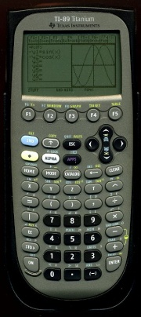

INTEGRATION BY PARTIAL FRACTIONS
IN-CLASS PROBLEM 14
Evaluate:
$\int{\frac{x+5}{x^{2}+x−2}} dx$
https://www.schoolmart.com/wp-content/uploads/2016/04/ti-nspcxii-cas.jpg
https://www.ubookstore.com/site/product_images/TI-89-Titanium-Calculator_Main-1.jpg?resizeid=6&resizeh=1920&resizew=1920

Slide 126

INTEGRATION BY PARTIAL FRACTIONS
IN-CLASS PROBLEM 14
Evaluate:
$\int{\frac{x+5}{x^{2}+x−2}} dx$
= 2ln(x-1) - ln(x+2) + c

Slide 127

INTEGRATION BY PARTIAL FRACTIONS
IN-CLASS PROBLEM 15
Evaluate:
$\int{\frac{x−1}{(3x−5)(x−3)}} dx$
https://www.schoolmart.com/wp-content/uploads/2016/04/ti-nspcxii-cas.jpg
https://www.ubookstore.com/site/product_images/TI-89-Titanium-Calculator_Main-1.jpg?resizeid=6&resizeh=1920&resizew=1920

Slide 128

INTEGRATION BY PARTIAL FRACTIONS
IN-CLASS PROBLEM 15
Evaluate:
$\int{\frac{x−1}{(3x−5)(x−3)}} dx$ =
= ½ ln|x-3| – 1/6 ln|3x-5| + c

Slide 129
Partial Fractions
Note: these logarithms are generally “complex” – they have a real component and an imaginary one
More about this later…

Slide 130
Questions?
http://i.imgur.com/aliTlT3.jpg

Slide 131
Integration Techniques
OK, so we’ve got a gazillion methods for doing integration
Does that mean that ANY function can be integrated?

Slide 132
Integration Techniques
OK, so we’ve got a gazillion methods for doing integration
Does that mean that ANY function can be integrated?
That would be negatory…

Slide 133
Integration Techniques
We’ve been dealing with what are called in mathland “elementary functions” (believe it or not)

Slide 134
Integration Techniques
Not all functions are “elementary”

Slide 135
Integration Techniques
t²
e is not an elementary function
It has an antiderivative, but that antiderivative is not an elementary function

Slide 136
Integration Techniques
No matter how hard we try, no matter the integration techniques we us
∫ e dt cannot be evaluated
t²

Slide 137
Integration Techniques
In fact, the majority of elementary functions do not have elementary antiderivatives

Slide 138
Numerical Methods
Calculus is usually “mathy” – that is, it aims for a single solution that everyone that does the problem correctly will get
http://en.wikipedia.org/wiki/Numerical_integration

Slide 139
Numerical Methods
Numerical methods are used when a “close-enough” (statistical) answer is acceptable (like when there is no integration technique that will provide an answer)

Slide 140
Numerical Methods
The basic problem in numerical integration is to compute an approximate solution to a definite integral to a given degree of accuracy

Slide 141
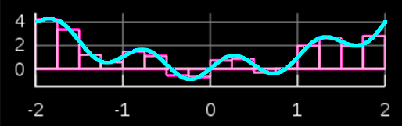
Numerical Methods
Techniques include rectangular interpolations
Rectangular interpolation
(The red shapes are estimating the area under the blue curve)
VFrench 2020

Slide 142
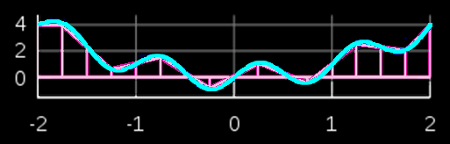
Numerical Methods
Techniques include trapezoidal interpolations
Trapezoidal interpolation
(The red shapes are estimating the area under the blue curve)
VFrench 2020

Slide 143
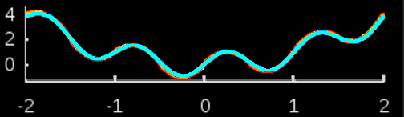
Numerical Methods
Simpson’s rule uses parabolas rather than straight lines – it is more complicated but more accurate
Simpson’s Rule
(The red shapes are estimating the area under the blue curve)
VFrench 2020

Slide 144
Numerical Methods
These approximations are the basis for many computer programs that estimate areas under curves

Slide 145
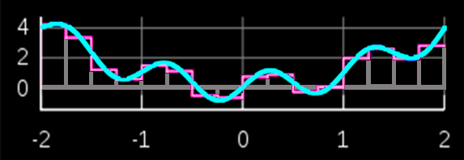

INTEGRATION BY NUMERICAL METHODS
IN-CLASS PROBLEM 16
Which will
provide the
best estimate
for the
curve?
Rectangular interpolation
Trapezoidal interpolation
Simpson’s Rule
VFrench 2020

Slide 146
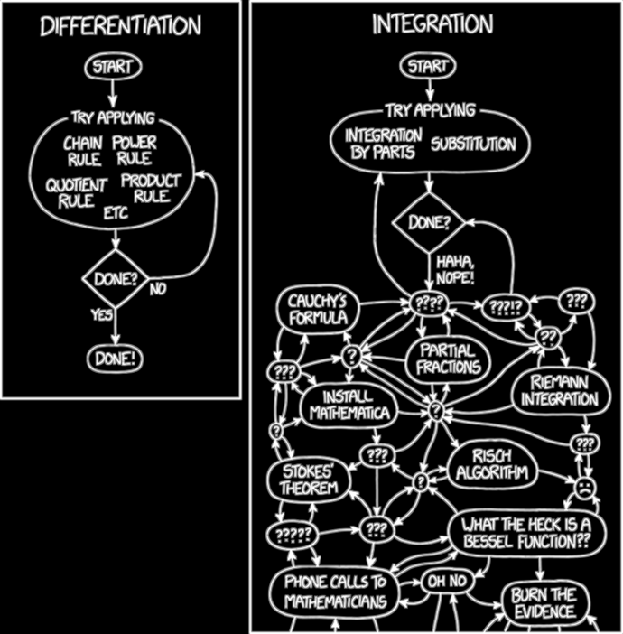
https://imgs.xkcd.com/comics/differentiation_and_integration.png

Slide 147
Questions?
http://i.imgur.com/aliTlT3.jpg

Slide 148
Summary
Today we studied:
Review of Hyperbolic
Functions
Integration by Parts and
Partial Fraction
Decomposition

Slide 149

You Survived!

