Slide 1

Welcome to
Unit 10 Part 20!
MATH 205 Differential Calculus
https://www.smu.edu.sg/programmes/core-curriculum/course-structure/calculus

Slide 2
What’s Up?
Review:
What integration is used for
New stuff:
What integration is used for

Slide 3
What’s Up?
Outcome 5) Use basic integration techniques, including the method of substitution and the Fundamental Theorem of Calculus

Slide 4

Review
http://995642590.r.lightningbase-cdn.com/wp-content/uploads/2010/12/looking-back-hrexaminer-v144-cover425px.jpg

Slide 5
Applications of Integration
Finances!
Compound interest:
Given an initial value $₀
the future value of $ at time
t ≥ 0 is:
$₀ + ∫₀^{t} $’ dt

Slide 6
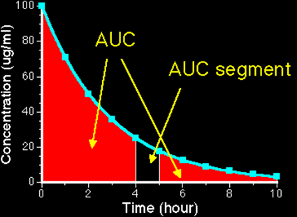
Applications of Integration
Exposure to a drug = Area under the plasma concentration time curve (AUC)
AUC = ∫₄⁵ 100/15 e ^{-0.5t} dt
c/p1/Ch04/Ch0410.html

Slide 7
Applications of Integration
Physics has a lot of uses of integration:
To undo all of the position, velocity, acceleration, jerk calculations
But there’s a lot more!

Slide 8
Applications of Integration
And, of course, in electrical and computer engineering!

Slide 9
Applications of Integration
Some new tricks:
Trick 0: come up with an equation involving dy/dx (y and x will be the variables you are interested in)
Trick 1: split the dy and dx into two sides of the equation
Trick 2: integrate both sides
Trick 3: combine the “c”s

Slide 10

Questions?
http://i.imgur.com/aliTlT3.jpg

Slide 11

This Is the Last Class!
I’ve enjoyed having you in MATH205!
I’m looking forward to seeing you again in MATH207!
And Addie the calculus cat does, too!

Slide 12
Questions?
http://i.imgur.com/aliTlT3.jpg

Slide 13
APPLICATIONS OF INTEGRATION
IN-CLASS PROBLEM 1
A 6-henry inductor has a voltage given by v_{L} = t^{5/3} – 5 volts. At what time will the current be 42 amps? Assume i=0 when t=0.
What first?

Slide 14
APPLICATIONS OF INTEGRATION
IN-CLASS PROBLEM 1
A 6-henry inductor has a voltage given by v_{L} = t^{5/3} – 5 volts. At what time will the current be 42 amps? Assume i=0 when t=0.
First:
This will use the Useful Equation: v_{L} = L di/dt
What next?

Slide 15
APPLICATIONS OF INTEGRATION
IN-CLASS PROBLEM 1
A 6-henry inductor has a voltage given by v_{L} = t^{5/3} – 5 volts. At what time will the current be 42 amps? Assume i=0 when t=0.
v_{L} = L di/dt
What next?
v_{L} = t^{5/3} – 5 = L di/dt
What’s L?

Slide 16
APPLICATIONS OF INTEGRATION
IN-CLASS PROBLEM 1
A 6-henry inductor has a voltage given by v_{L} = t^{5/3} – 5 volts. At what time will the current be 42 amps? Assume i=0 when t=0.
v_{L} = L di/dt
What next?
v_{L} = t^{5/3} – 5 = L di/dt
What’s L? 6
So it’s: v_{L} = t^{5/3} – 5 = 6 di/dt

Slide 17
APPLICATIONS OF INTEGRATION
IN-CLASS PROBLEM 1
A 6-henry inductor has a voltage given by v_{L} = t^{5/3} – 5 volts. At what time will the current be 42 amps? Assume i=0 when t=0.
v_{L} = L di/dt
What next?
v_{L} = t^{5/3} – 5 = 6 di/dt
Now what?

Slide 18
APPLICATIONS OF INTEGRATION
IN-CLASS PROBLEM 1
A 6-henry inductor has a voltage given by v_{L} = t^{5/3} – 5 volts. At what time will the current be 42 amps? Assume i=0 when t=0.
v_{L} = t^{5/3} – 5 = 6 di/dt
Now what?
(t^{5/3} – 5) dt = 6 di
(t^{5/3} – 5)/6 dt = di
will work better!

Slide 19
APPLICATIONS OF INTEGRATION
IN-CLASS PROBLEM 1
A 6-henry inductor has a voltage given by v_{L} = t^{5/3} – 5 volts. At what time will the current be 42 amps? Assume i=0 when t=0.
(t^{5/3} – 5)/6 dt = di
Now what?

Slide 20
APPLICATIONS OF INTEGRATION
IN-CLASS PROBLEM 1
A 6-henry inductor has a voltage given by v_{L} = t^{5/3} – 5 volts. At what time will the current be 42 amps? Assume i=0 when t=0.
(t^{5/3} – 5)/6 dt = di
Now what?
∫ (t^{5/3} – 5)/6 dt = ∫ di

Slide 21
APPLICATIONS OF INTEGRATION
IN-CLASS PROBLEM 1
A 6-henry inductor has a voltage given by v_{L} = t^{5/3} – 5 volts. At what time will the current be 42 amps? Assume i=0 when t=0.
∫ (t^{5/3} – 5)/6 dt = ∫ di
(3/8 t^{8/3} – 5t)/6 + c1 = i + c2
Now what?

Slide 22
APPLICATIONS OF INTEGRATION
IN-CLASS PROBLEM 1
A 6-henry inductor has a voltage given by v_{L} = t^{5/3} – 5 volts. At what time will the current be 42 amps? Assume i=0 when t=0.
(3/8 t^{8/3} – 5t)/6 + c1 = i + c2
Now what?
i = (3/8 t^{8/3} – 5t)/6 + c
Now what?

Slide 23
APPLICATIONS OF INTEGRATION
IN-CLASS PROBLEM 1
A 6-henry inductor has a voltage given by v_{L} = t^{5/3} – 5 volts. At what time will the current be 42 amps? Assume i=0 when t=0.
i = (3/8 t^{8/3} – 5t)/6 + c
Now what?
0 = (3/8(0^{8/3}) – 5(0))/6 + c
So c = 0

Slide 24
APPLICATIONS OF INTEGRATION
IN-CLASS PROBLEM 1
A 6-henry inductor has a voltage given by v_{L} = t^{5/3} – 5 volts. At what time will the current be 42 amps? Assume i=0 when t=0.
i = (3/8 t^{8/3} – 5t)/6 + 0
i = (3/8 t^{8/3} – 5t)/6
Now what?

Slide 25
APPLICATIONS OF INTEGRATION
IN-CLASS PROBLEM 1
A 6-henry inductor has a voltage given by v_{L} = t^{5/3} – 5 volts. At what time will the current be 42 amps? Assume i=0 when t=0.
i = (3/8 t^{8/3} – 5t)/6
So it’s:
42 = (3/8 t^{8/3} – 5t)/6
And we can solve for t
(or at least your calculator can)

Slide 26
APPLICATIONS OF INTEGRATION
IN-CLASS PROBLEM 1
A 6-henry inductor has a voltage given by v_{L} = t^{5/3} – 5 volts. At what time will the current be 42 amps? Assume i=0 when t=0.
i = (3/8 t^{8/3} – 5t)/6
So it’s:
42 = (3/8 t^{8/3} – 5t)/6
t ≈ 12.48 whats?

Slide 27
APPLICATIONS OF INTEGRATION
IN-CLASS PROBLEM 1
A 6-henry inductor has a voltage given by v_{L} = t^{5/3} – 5 volts. At what time will the current be 42 amps? Assume i=0 when t=0.
i = (3/8 t^{8/3} – 5t)/6
So it’s:
42 = (3/8 t^{8/3} – 5t)/6
t ≈ 12.48 seconds

Slide 28
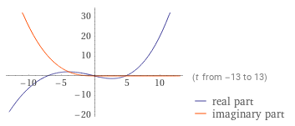

Slide 29
Questions?
http://i.imgur.com/aliTlT3.jpg

Slide 30
Average Value of a Function
Calculating the average for a list of numbers is easy:

Slide 31
Average Value of a Function
Calculating the average for a list of numbers is easy:
Add ‘em up

Slide 32
Average Value of a Function
Calculating the average for a list of numbers is easy:
Add ‘em up
Divide by how many there are

Slide 33

Average Value of a Function
How would you calculate the average for an infinite number of numbers?
stock-photo-skeptical-senior-man-1724336.jpg

Slide 34

Average Value of a Function
Uh… maybe… calculus?
http://dartoidsworld.net/wp-content/uploads/2015/02/so-what-pic.jpg

Slide 35

Average Value of a Function
Yep!
http://www.brocku.ca/blogs/futurestudents/files/2014/08/studentsupport_small.jpg

Slide 36
AVERAGE VALUE OF A FUNCTION
IN-CLASS PROBLEM 2
Calculate the average value of
y = x² for values of x from 0 to 5
https://www.wolframalpha.com/input/?i=y+%3D+x%5E2+from+0+to+5

Slide 37
AVERAGE VALUE OF A FUNCTION
IN-CLASS PROBLEM 2
Calculate the average value of y = x² for values of x from 0 to 5
You could do a table of values:
Add ‘em all up and divide by “n”
x | 0 | 1 | 2 | 3 | 4 | 5
y | 0 | 1 | 4 | 9 | 16 | 25
https://www.wolframalpha.com/input/?i=y+%3D+x%5E2+from+0+to+5

Slide 38
AVERAGE VALUE OF A FUNCTION
IN-CLASS PROBLEM 2
Calculate the average value of y = x² for values of x from 0 to 5
More values would be closer:
But it’s definitely feeling like area under a curve…
x | 0 | 0.5 | 1 | 1.5 | 2 | 2.5 | 3 | 3.5 | 4 | 4.5 | 5
y | 0 | 0.25 | 1 | 2.25 | 4 | 6.25 | 9 | 12.25 | 16 | 20.25 | 25
https://www.wolframalpha.com/input/?i=y+%3D+x%5E2+from+0+to+5

Slide 39
Average Value of a Function
The average value of a curve over an interval x=a to x=b is:
∫ ƒ(x) dx
b
a
y_{avg} =
b - a

Slide 40
AVERAGE VALUE OF A FUNCTION
IN-CLASS PROBLEM 2
Calculate the average value of
y = x² for values of x from 0 to 5
What’s b?
∫ ƒ(x) dx
b
a
y_{avg} =
b - a
https://www.wolframalpha.com/input/?i=y+%3D+x%5E2+from+0+to+5

Slide 41
AVERAGE VALUE OF A FUNCTION
IN-CLASS PROBLEM 2
Calculate the average value of
y = x² for values of x from 0 to 5
What’s b? 5
What’s a?
∫ ƒ(x) dx
5
a
y_{avg} =
5 - a
https://www.wolframalpha.com/input/?i=y+%3D+x%5E2+from+0+to+5

Slide 42
AVERAGE VALUE OF A FUNCTION
IN-CLASS PROBLEM 2
Calculate the average value of
y = x² for values of x from 0 to 5
What’s b? 5
What’s a? 0
What’s ƒ(x)?
∫ ƒ(x) dx
5
y_{avg} =
0
5 - 0
https://www.wolframalpha.com/input/?i=y+%3D+x%5E2+from+0+to+5

Slide 43
AVERAGE VALUE OF A FUNCTION
IN-CLASS PROBLEM 2
Calculate the average value of
y = x² for values of x from 0 to 5
What’s b? 5
What’s a? 0
What’s ƒ(x)? x²
∫ x² dx
5
y_{avg} =
0
5 - 0
https://www.wolframalpha.com/input/?i=y+%3D+x%5E2+from+0+to+5

Slide 44
AVERAGE VALUE OF A FUNCTION
IN-CLASS PROBLEM 2
Calculate the average value of y = x² for values of x from 0 to 5
Do it!
∫ x² dx
5
y_{avg} =
0
5 - 0
https://www.wolframalpha.com/input/?i=y+%3D+x%5E2+from+0+to+5

Slide 45
AVERAGE VALUE OF A FUNCTION
IN-CLASS PROBLEM 2
Calculate the average value of y = x² for values of x from 0 to 5
= x³/15
∫ x² dx
5
y_{avg} =
0
5 - 0
|
5
0
https://www.wolframalpha.com/input/?i=y+%3D+x%5E2+from+0+to+5

Slide 46
AVERAGE VALUE OF A FUNCTION
IN-CLASS PROBLEM 2
Calculate the average value of y = x² for values of x from 0 to 5
= x³/15
= 5³/15 - 0³/15
= 125/15 = 25/3
≈ 8.33
∫ x² dx
5
y_{avg} =
0
5 - 0
|
5
0
https://www.wolframalpha.com/input/?i=y+%3D+x%5E2+from+0+to+5

Slide 47
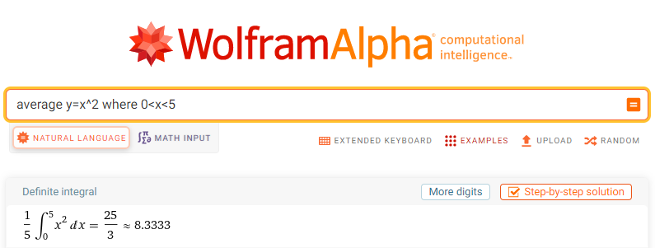

Slide 48
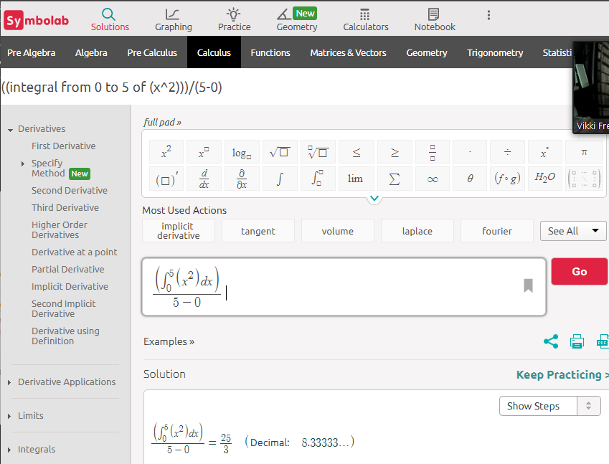

Slide 49
Questions?
http://i.imgur.com/aliTlT3.jpg

Slide 50
AVERAGE VALUE OF A FUNCTION
IN-CLASS PROBLEM 3
A function generator was programmed to provide a slowly rising voltage given by
v = 0.0056t³ + 0.23t² volts when t is in seconds. Calculate its average value between t=0 and t=30 seconds.
What do we need?

Slide 51
AVERAGE VALUE OF A FUNCTION
IN-CLASS PROBLEM 3
A function generator was programmed to provide a slowly rising voltage given by
v = 0.0056t³ + 0.23t² volts when t is in seconds. Calculate its average value between t=0 and t=30 seconds.
∫ ƒ(x) dx
b
y_{avg} =
a
Fill it in!
b - a

Slide 52
AVERAGE VALUE OF A FUNCTION
IN-CLASS PROBLEM 3
A function generator was programmed to provide a slowly rising voltage given by
v = 0.0056t³ + 0.23t² volts when t is in seconds. Calculate its average value between t=0 and t=30 seconds.
∫ (0.0056t³ + 0.23t²) dt
30
v_{avg} =
0
30 - 0
Do it!

Slide 53
AVERAGE VALUE OF A FUNCTION
IN-CLASS PROBLEM 3
A function generator was programmed to provide a slowly rising voltage given by
v = 0.0056t³ + 0.23t² volts when t is in seconds. Calculate its average value between t=0 and t=30 seconds.
≈ (.0014t⁴ + .077t³)/30
|
30
0

Slide 54
AVERAGE VALUE OF A FUNCTION
IN-CLASS PROBLEM 3
A function generator was programmed to provide a slowly rising voltage given by
v = 0.0056t³ + 0.23t² volts when t is in seconds. Calculate its average value between t=0 and t=30 seconds.
≈ (.0014t⁴ + .077t³)/30
≈ ((.0014(30⁴)+(.077(30³) – 0)/30
|
30
0

Slide 55
AVERAGE VALUE OF A FUNCTION
IN-CLASS PROBLEM 3
A function generator was programmed to provide a slowly rising voltage given by
v = 0.0056t³ + 0.23t² volts when t is in seconds. Calculate its average value between t=0 and t=30 seconds.
≈ ((.0014(30⁴)+(.077(30³) – 0)/30
≈ 37.8 + 69.3 ≈ 106.8 whats?

Slide 56
AVERAGE VALUE OF A FUNCTION
IN-CLASS PROBLEM 3
A function generator was programmed to provide a slowly rising voltage given by
v = 0.0056t³ + 0.23t² volts when t is in seconds. Calculate its average value between t=0 and t=30 seconds.
≈ 106.8 volts

Slide 57
Questions?
http://i.imgur.com/aliTlT3.jpg

Slide 58
Arc (Curve) Length
We want to determine the length of a continuous function
y=f(x) on the interval [a,b]

Slide 59
Arc (Curve) Length
To estimate the length of the curve, divide the interval up into equal subintervals each of width Δx
Δx
https://tutorial.math.lamar.edu/Classes/CalcII/ArcLength.aspx

Slide 60
Arc (Curve) Length
Approximate the curve by a series of straight lines connecting the points
Δx
https://tutorial.math.lamar.edu/Classes/CalcII/ArcLength.aspx

Slide 61
Arc (Curve) Length
The length of the curve can be
estimated by the sum of the lengths of the lines
Δx
https://tutorial.math.lamar.edu/Classes/CalcII/ArcLength.aspx

Slide 62

Arc (Curve) Length
The length of each line is: $\sqrt{\left({\text{x}}_{\text{i}}\text{−}{\text{x}}_{\text{i}\text{−1}}\right)\text{2}\text{+}\left({\text{y}}_{\text{i}}\text{−}{\text{y}}_{\text{i}\text{−1}}\right)\text{2}}$ =$\sqrt{\text{Δx}\text{2}\text{+}\text{Δ}\text{y}\text{2}}$
Δy
{
- - -
Δx
https://tutorial.math.lamar.edu/Classes/CalcII/ArcLength.aspx

Slide 63

Arc (Curve) Length
As Δx→0, the length of the curve becomes:
L = ∫_{a}^{b} $\sqrt{{\text{1+(}\text{dy}\text{/}\text{dx}\text{)}}^{\text{2}}}$ dx
Δy
{
- - -
Δx
https://tutorial.math.lamar.edu/Classes/CalcII/ArcLength.aspx

Slide 64

Arc (Curve) Length
Note: this is often given the letter “S”
S = ∫_{a}^{b} $\sqrt{{\text{1+(}\text{dy}\text{/}\text{dx}\text{)}}^{\text{2}}}$ dx
Δy
{
- - -
Δx
https://tutorial.math.lamar.edu/Classes/CalcII/ArcLength.aspx

Slide 65
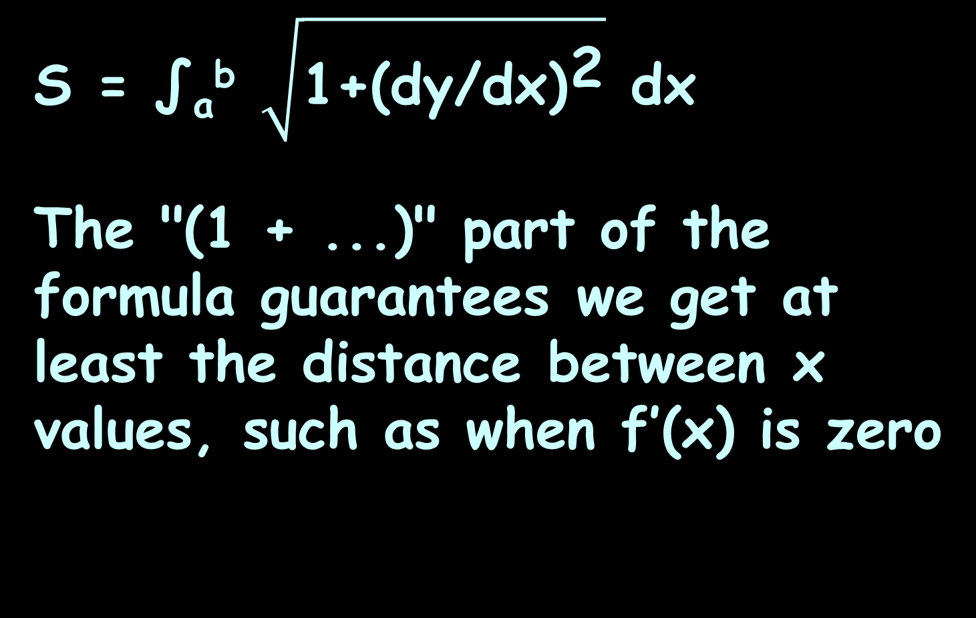
Arc (Curve) Length
S = ∫_{a}^{b} $\sqrt{{\text{1+(}\text{dy}\text{/}\text{dx}\text{)}}^{\text{2}}}$ dx
The "(1 + ...)" part of the formula guarantees we get at least the distance between x values, such as when f’(x) is zero

Slide 66
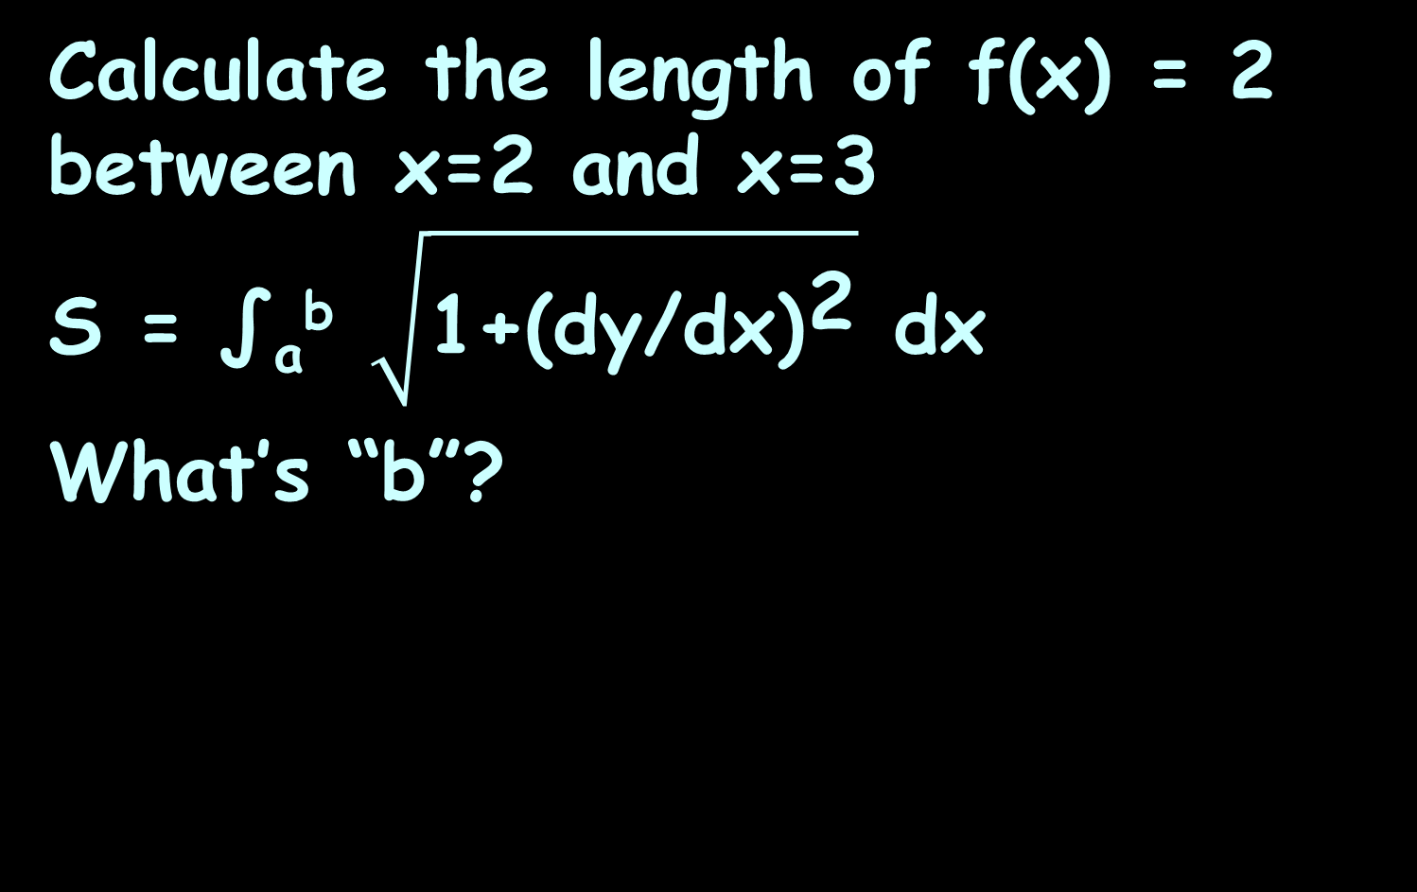
ARC (CURVE) LENGTH
IN-CLASS PROBLEM 4
Calculate the length of f(x) = 2 between x=2 and x=3
S = ∫_{a}^{b} $\sqrt{{\text{1+(}\text{dy}\text{/}\text{dx}\text{)}}^{\text{2}}}$ dx
What’s “b”?
2
2
3
https://www.mathsisfun.com/calculus/arc-length.html

Slide 67
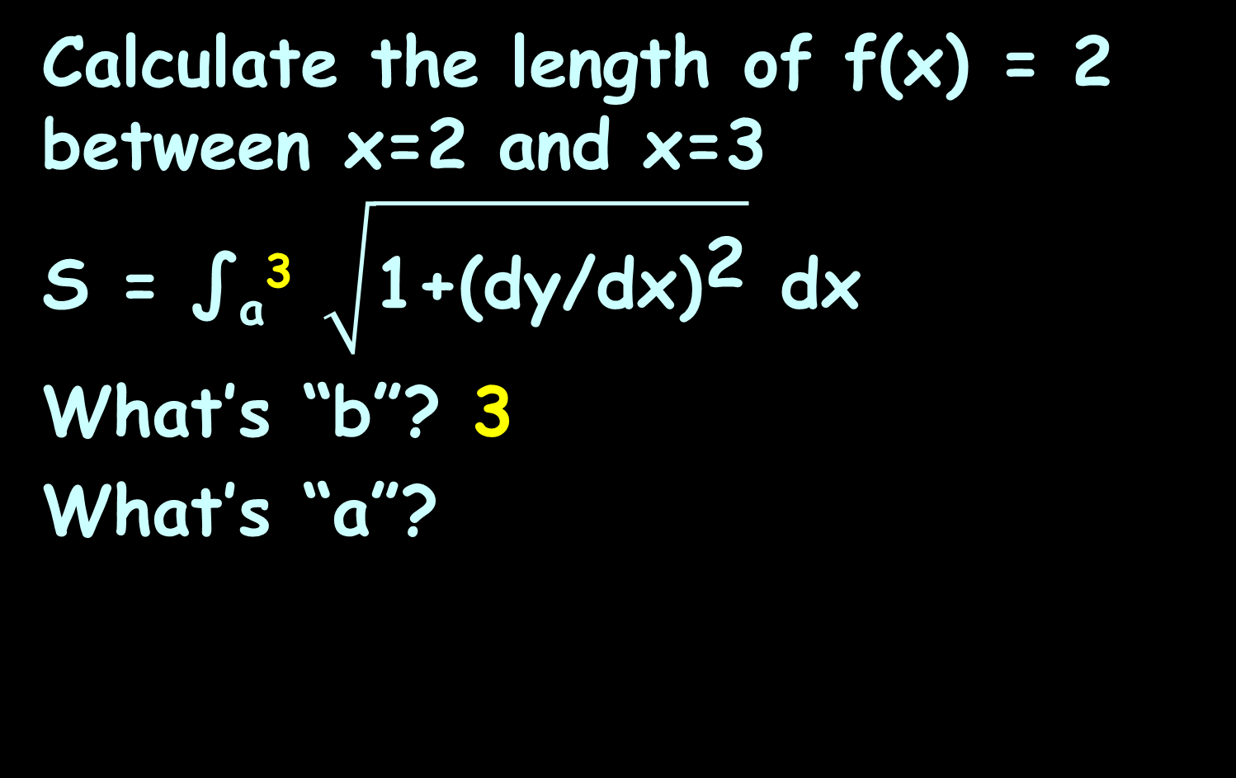
ARC (CURVE) LENGTH
IN-CLASS PROBLEM 4
Calculate the length of f(x) = 2 between x=2 and x=3
S = ∫_{a}³ $\sqrt{{\text{1+(}\text{dy}\text{/}\text{dx}\text{)}}^{\text{2}}}$ dx
What’s “b”? 3
What’s “a”?
2
2
3
https://www.mathsisfun.com/calculus/arc-length.html

Slide 68
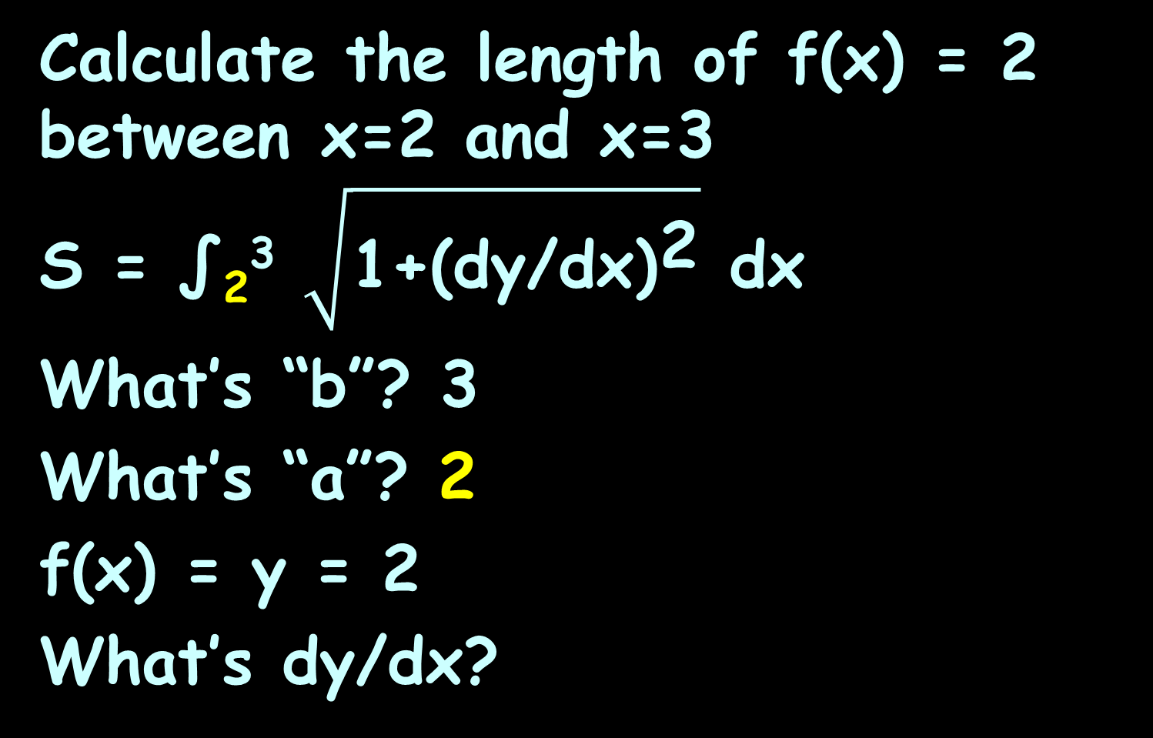
ARC (CURVE) LENGTH
IN-CLASS PROBLEM 4
Calculate the length of f(x) = 2 between x=2 and x=3
S = ∫₂³ $\sqrt{{\text{1+(}\text{dy}\text{/}\text{dx}\text{)}}^{\text{2}}}$ dx
What’s “b”? 3
What’s “a”? 2
f(x) = y = 2
What’s dy/dx?
2
2
3
https://www.mathsisfun.com/calculus/arc-length.html

Slide 69
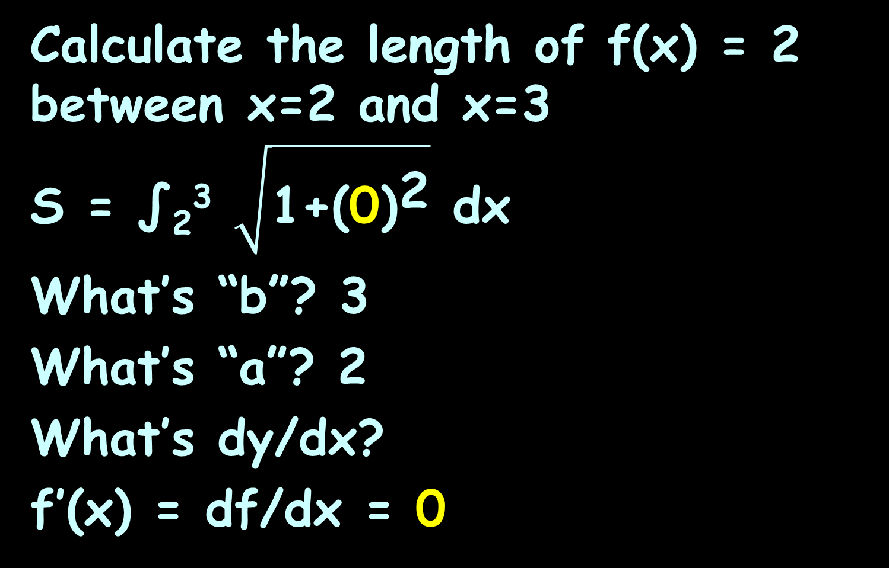
ARC (CURVE) LENGTH
IN-CLASS PROBLEM 4
Calculate the length of f(x) = 2 between x=2 and x=3
S = ∫₂³ $\sqrt{{\text{1+(}\text{0}\text{)}}^{\text{2}}}$ dx
What’s “b”? 3
What’s “a”? 2
What’s dy/dx?
f’(x) = df/dx = 0
2
2
3
https://www.mathsisfun.com/calculus/arc-length.html

Slide 70
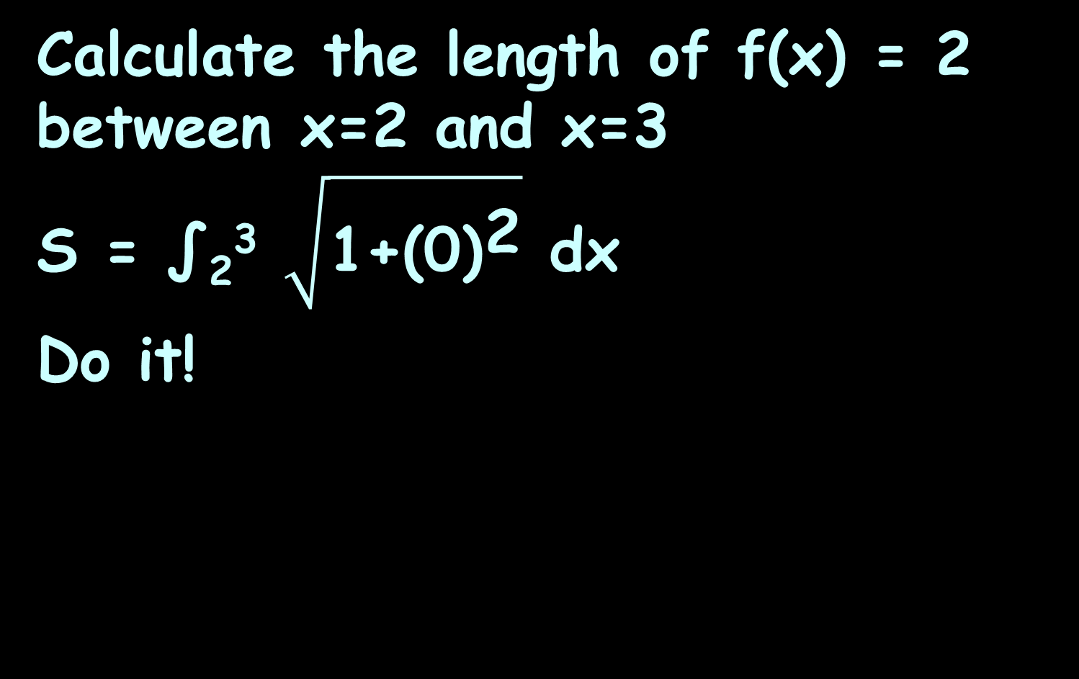
ARC (CURVE) LENGTH
IN-CLASS PROBLEM 4
Calculate the length of f(x) = 2 between x=2 and x=3
S = ∫₂³ $\sqrt{{\text{1+(}\text{0}\text{)}}^{\text{2}}}$ dx
Do it!
2
2
3
https://www.mathsisfun.com/calculus/arc-length.html

Slide 71

ARC (CURVE) LENGTH
IN-CLASS PROBLEM 4
Calculate the length of f(x) = 2 between x=2 and x=3
= 3 – 2 = 1
(which you probably
knew already!!)
S = ∫ $\sqrt{\text{1+(0)}\text{2}}$ dx = ∫ $\sqrt{\text{1}}$ dx
3
3
2
2
|
3
3
= ∫ dx = x
2
2
2
2
3
https://www.mathsisfun.com/calculus/arc-length.html

Slide 72
Questions?
http://i.imgur.com/aliTlT3.jpg

Slide 73
ARC (CURVE) LENGTH
IN-CLASS PROBLEM 5
Calculate the length of f(x) = x between x=2 and x=3
2
3
https://www.mathsisfun.com/calculus/arc-length.html

Slide 74

ARC (CURVE) LENGTH
IN-CLASS PROBLEM 5
Calculate the length of f(x) = x
between x=2 and x=3
S = ∫_{a}^{b} $\sqrt{{\text{1+(}\text{dy}\text{/}\text{dx}\text{)}}^{\text{2}}}$ dx
What’s “b”?
https://www.mathsisfun.com/calculus/arc-length.html

Slide 75
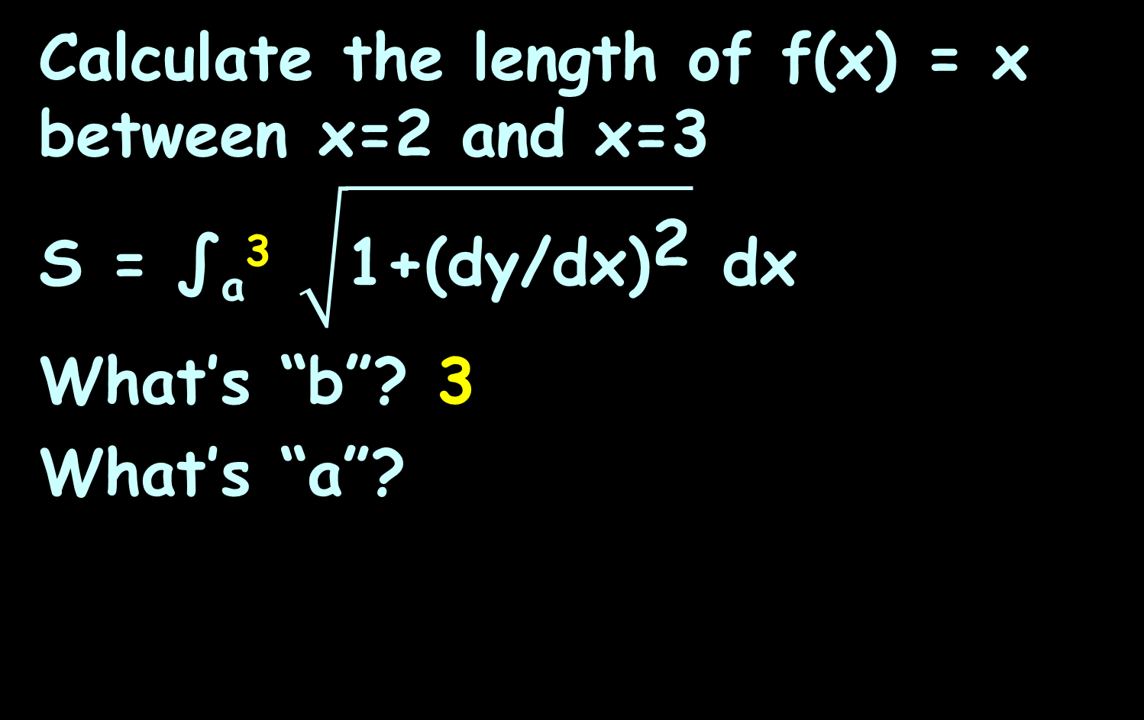
ARC (CURVE) LENGTH
IN-CLASS PROBLEM 5
Calculate the length of f(x) = x
between x=2 and x=3
S = ∫_{a}³ $\sqrt{{\text{1+(}\text{dy}\text{/}\text{dx}\text{)}}^{\text{2}}}$ dx
What’s “b”? 3
What’s “a”?
2
3
https://www.mathsisfun.com/calculus/arc-length.html

Slide 76

ARC (CURVE) LENGTH
IN-CLASS PROBLEM 5
Calculate the length of f(x) = x
between x=2 and x=3
S = ∫₂³ $\sqrt{{\text{1+(}\text{dy}\text{/}\text{dx}\text{)}}^{\text{2}}}$ dx
What’s “b”? 3
What’s “a”? 2
f(x) = y = x
What’s dy/dx?
2
3
https://www.mathsisfun.com/calculus/arc-length.html

Slide 77
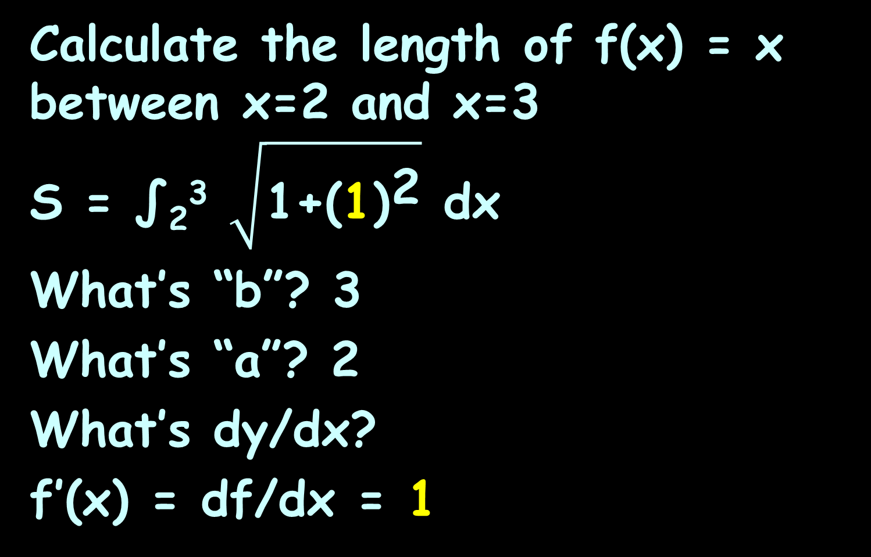
ARC (CURVE) LENGTH
IN-CLASS PROBLEM 5
Calculate the length of f(x) = x
between x=2 and x=3
S = ∫₂³ $\sqrt{{\text{1+(}\text{1}\text{)}}^{\text{2}}}$ dx
What’s “b”? 3
What’s “a”? 2
What’s dy/dx?
f’(x) = df/dx = 1
2
3
https://www.mathsisfun.com/calculus/arc-length.html

Slide 78

ARC (CURVE) LENGTH
IN-CLASS PROBLEM 5
Calculate the length of f(x) = x
between x=2 and x=3
Do it!
S = ∫ $\sqrt{\text{1+(1)}\text{2}}$ dx
3
2
2
3
https://www.mathsisfun.com/calculus/arc-length.html

Slide 79
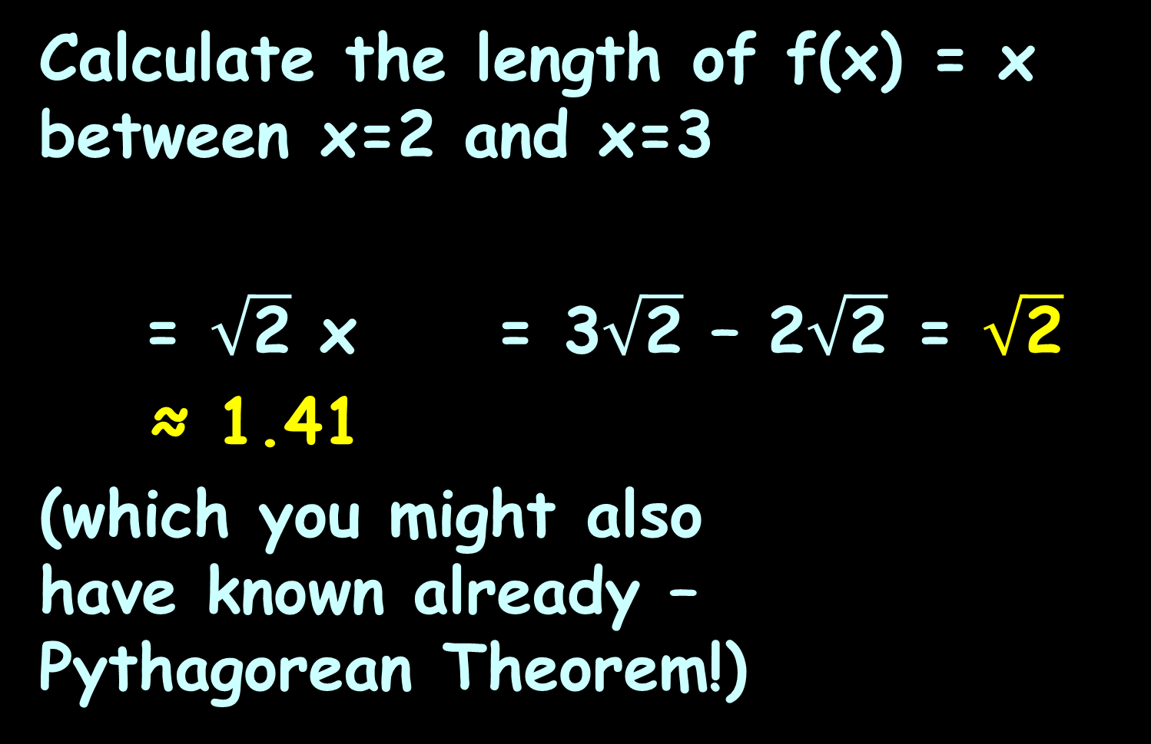

ARC (CURVE) LENGTH
IN-CLASS PROBLEM 5
Calculate the length of f(x) = x between x=2 and x=3
= $\sqrt{\text{2}}$ x = 3$\sqrt{\text{2}}$ – 2$\sqrt{\text{2}}$ = $\sqrt{\text{2}}$
≈ 1.41
(which you might also
have known already –
Pythagorean Theorem!)
S = ∫ $\sqrt{\text{1+(1)}\text{2}}$ dx = ∫ $\sqrt{\text{2}}$ dx
3
3
2
2
|
3
2
2
3
https://www.mathsisfun.com/calculus/arc-length.html

Slide 80
Questions?
http://i.imgur.com/aliTlT3.jpg

Slide 81
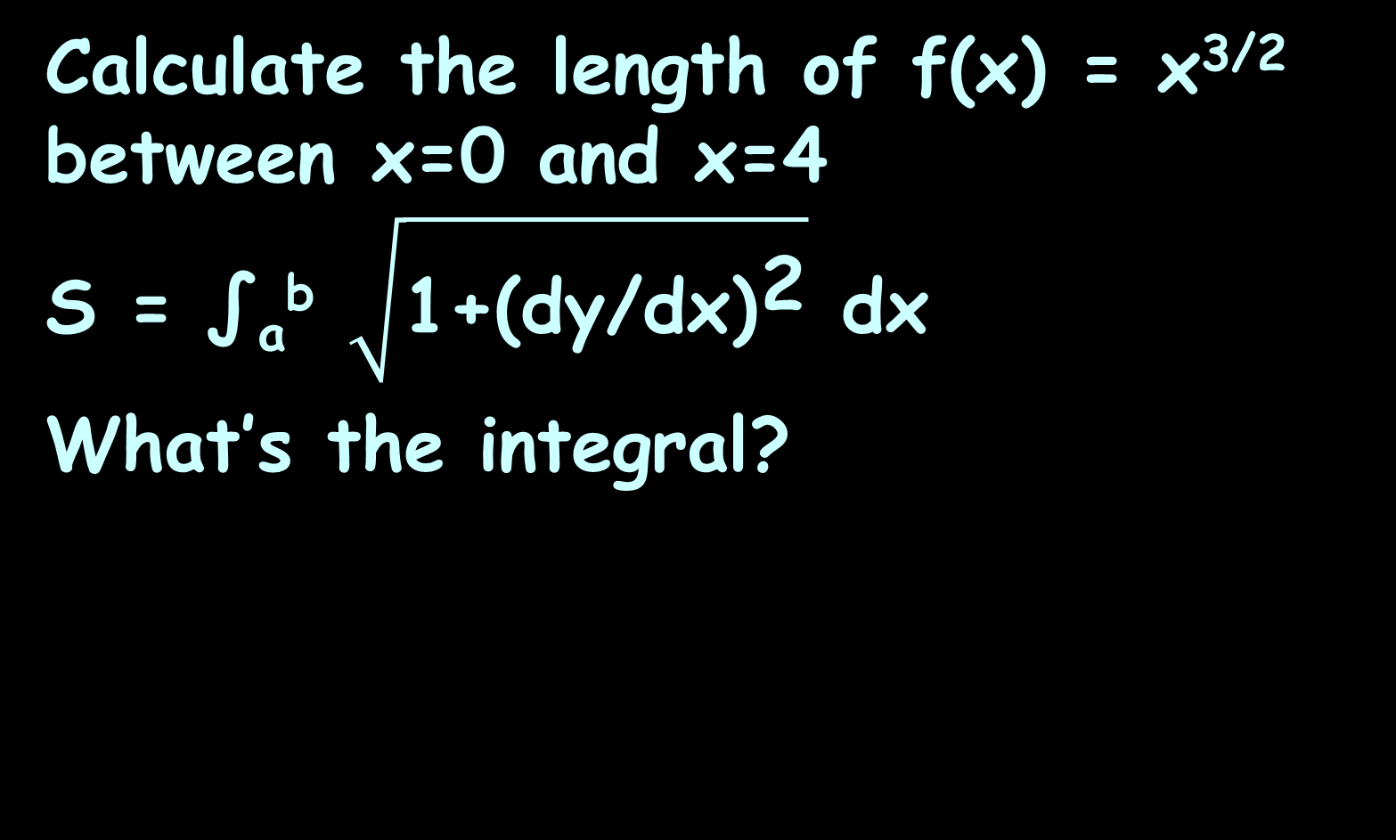
ARC (CURVE) LENGTH
IN-CLASS PROBLEM 6
Calculate the length of f(x) = x^{3/2} between x=0 and x=4
S = ∫_{a}^{b} $\sqrt{{\text{1+(}\text{dy}\text{/}\text{dx}\text{)}}^{\text{2}}}$ dx
What’s the integral?
https://www.mathsisfun.com/calculus/arc-length.html

Slide 82
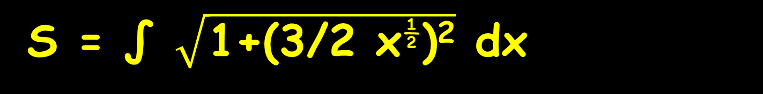
ARC (CURVE) LENGTH
IN-CLASS PROBLEM 6
Calculate the length of f(x) = x^{3/2} between x=0 and x=4
Do it!
S = ∫ $\sqrt{\text{1+(3/2 }\text{x}\text{½}\text{)}\text{2}}$ dx
4
0
https://www.mathsisfun.com/calculus/arc-length.html

Slide 83

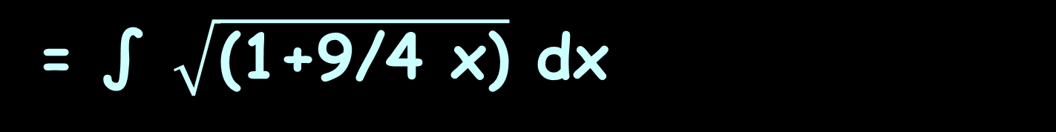

ARC (CURVE) LENGTH
IN-CLASS PROBLEM 6
Calculate the length of f(x) = x^{3/2} between x=0 and x=4
u = $\text{1+9/4 }\text{x}$ du = 9/4 dx
b = 1 + 9/4(4) = 10
a = 1 + 9/4(0) = 1
S = ∫ $\sqrt{\text{1+(3/2 }\text{x}\text{½}\text{)}\text{2}}$ dx
4
0
= ∫ $\sqrt{\text{(1+9/4 }\text{x}\text{)}}$ dx
4
0
= ∫ 4/9 u^{½} du
10
1
https://www.mathsisfun.com/calculus/arc-length.html

Slide 84
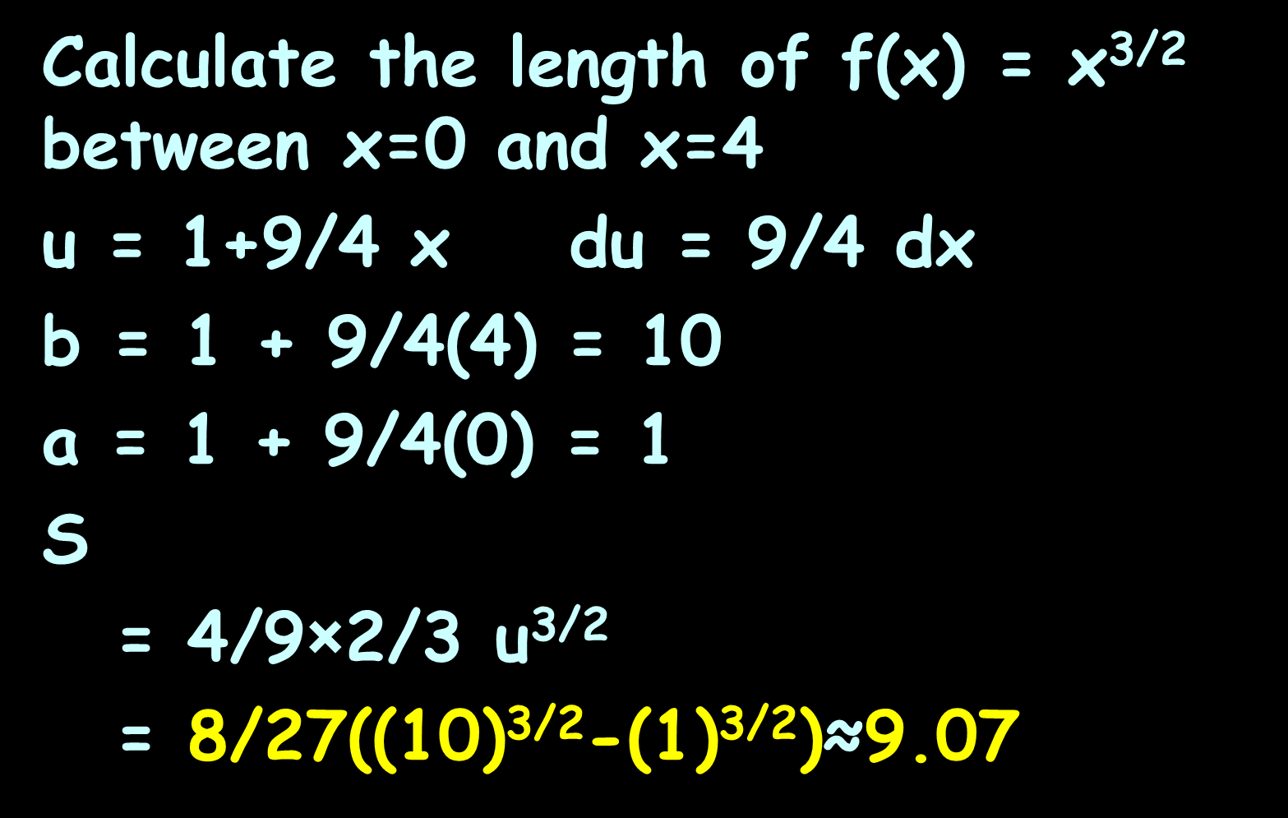
ARC (CURVE) LENGTH
IN-CLASS PROBLEM 6
Calculate the length of f(x) = x^{3/2} between x=0 and x=4
u = $\text{1+9/4 }\text{x}$ du = 9/4 dx
b = 1 + 9/4(4) = 10
a = 1 + 9/4(0) = 1
S
= 4/9×2/3 u^{3/2}
= 8/27((10)^{3/2}-(1)^{3/2})≈9.07
= ∫ 4/9 u^{½} du
10
1
|
10
1
https://www.mathsisfun.com/calculus/arc-length.html

Slide 85
Arc (Curve) Length
Note: because these involve sqrt(difference) they often will be sin⁻¹ or cos⁻¹
There is also a hyperbolic function (which you don’t know yet)

Slide 86
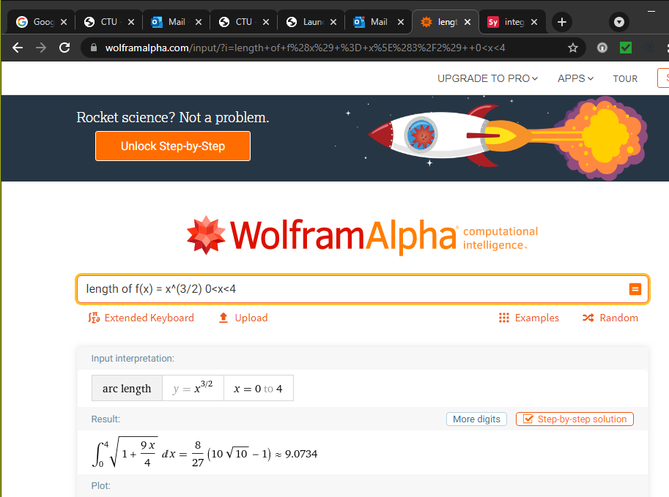

Slide 87
Questions?
http://i.imgur.com/aliTlT3.jpg

Slide 88
Probability
Every continuous random variable has a probability density function (pdf)

Slide 89
Probability
Probability density functions satisfy these 2 conditions:
1) f(x)≥0 for all x (no negative probabilities)
2) The integral over the entire domain is 1 (the sum of probabilities for all possible values of x is 100%)

Slide 90
PROBABILITY
IN-CLASS PROBLEM 7a
Let f(x) = (x³/5000) (10−x)
for 0≤x≤10 and f(x)=0 for all other values of x
https://tutorial.math.lamar.edu/Classes/CalcII/Probability.aspx

Slide 91
PROBABILITY
IN-CLASS PROBLEM 7a
Let f(x) = (x³/5000) (10−x)
for 0≤x≤10 and f(x)=0 for all other values of x
Is it a pdf?
https://tutorial.math.lamar.edu/Classes/CalcII/Probability.aspx

Slide 92
PROBABILITY
IN-CLASS PROBLEM 7a
Let f(x) = (x³/5000) (10−x)
for 0≤x≤10 and f(x)=0 for all other values of x
Is it a pdf? It adds to 1 (100%):
= x⁴/2000 – x⁵/25000
= 10000/2000 – 100000/25000 - 0
= 1
P(0≤x≤10) = ∫ x³/5000 (10−x)dx
10
0
= ∫ (x³/500 – x⁴/5000) dx
10
0
|
10
0
https://tutorial.math.lamar.edu/Classes/CalcII/Probability.aspx

Slide 93
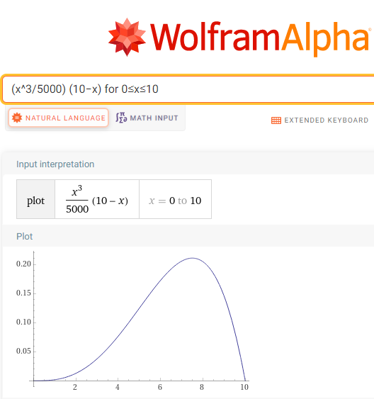
PROBABILITY
IN-CLASS PROBLEM 7a
And it is always positive,
so it is a pdf

Slide 94
PROBABILITY
IN-CLASS PROBLEM 7b
Let f(x) = (x³/5000) (10−x)
for 0≤x≤10 and f(x)=0 for all other values of x
Calculate P(1≤x≤4)
https://tutorial.math.lamar.edu/Classes/CalcII/Probability.aspx

Slide 95
PROBABILITY
IN-CLASS PROBLEM 7b
Let f(x) = (x³/5000) (10−x)
for 0≤x≤10 and f(x)=0 for all other values of x
Calculate P(1≤x≤4)
= ∫₁⁴ (x³/5000) (10−x) dx
https://tutorial.math.lamar.edu/Classes/CalcII/Probability.aspx

Slide 96
PROBABILITY
IN-CLASS PROBLEM 7b
Let f(x) = (x³/5000) (10−x)
for 0≤x≤10 and f(x)=0 for all other values of x
Calculate P(1≤x≤4)
= x⁴/2000 – x⁵/25000
= (4⁴/2000–4⁵/25000)
- (1⁴/2000 – 1⁵/25000)
= 4329/50000 ≈ .08658 ≈ 8.66%
|
4
1
https://tutorial.math.lamar.edu/Classes/CalcII/Probability.aspx

Slide 97
Probability
Percentages are easier for most people to understand

Slide 98
PROBABILITY
IN-CLASS PROBLEM 7c
Let f(x)=x³/5000(10−x)
for 0≤x≤10 and f(x)=0 for all other values of x
Calculate P(6≤x)
https://tutorial.math.lamar.edu/Classes/CalcII/Probability.aspx

Slide 99
PROBABILITY
IN-CLASS PROBLEM 7c
Let f(x)=x³/5000(10−x)
for 0≤x≤10 and f(x)=0 for all other values of x
Calculate P(6≤x)
Since 0≤x≤10 this is the same as asking you to Calculate P(6≤x≤10)
https://tutorial.math.lamar.edu/Classes/CalcII/Probability.aspx

Slide 100
PROBABILITY
IN-CLASS PROBLEM 7c
Let f(x)=x³/5000(10−x)
for 0≤x≤10 and f(x)=0 for all other values of x
Calculate P(6≤x)
= ∫₆¹⁰ (x³/5000)(10−x) dx
https://tutorial.math.lamar.edu/Classes/CalcII/Probability.aspx

Slide 101
PROBABILITY
IN-CLASS PROBLEM 7c
Let f(x)=x³/5000(10−x)
for 0≤x≤10 and f(x)=0 for all other values of x
Calculate P(6≤x)
= ∫₆¹⁰ x³/5000 x (10−x) dx
= x⁴/2000 – x⁵/25000
= (10⁴/2000–10⁵/25000)
- (6⁴/2000 – 6⁵/25000)
= 2072/3125 ≈ .66304 ≈ 66.30%
|
10
6
https://tutorial.math.lamar.edu/Classes/CalcII/Probability.aspx

Slide 102
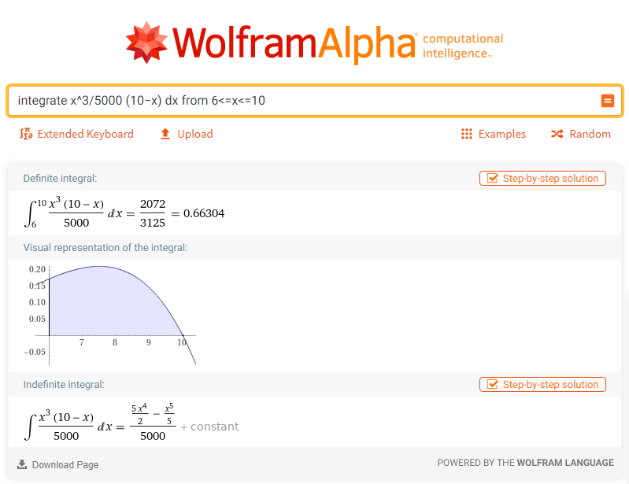

Slide 103
Questions?
http://i.imgur.com/aliTlT3.jpg

Slide 104
Hydrostatic Force
Submerge a vertical plate in water
How much force is exerted on the plate by the pressure of the water?
This force is often called the hydrostatic force F

Slide 105
Hydrostatic Force
The hydrostatic force is
where w is the weight density of the fluid (for water: 9800 N/m³ or 62.4 lbs/ft³)
h(y) is the depth of the plate
L(y) is the width of the plate
d
F= w∫ h(y) L(y) dy
c

Slide 106
Hydrostatic Force
N/m³ is Newtons/cubic meter
a measure of density

Slide 107
Hydrostatic Force
Note: this is one of those horizontal integrations
That’s because the variation is in depth (vertical)

Slide 108
HYDROSTATIC FORCE
IN-CLASS PROBLEM 8
A 2-meter square metal plate is submerged 2 meters below the water’s surface. Calculate the hydrostatic force on the plate.
2m
2m
2m
https://www.youtube.com/watch?v=3jG-hWgUJko

Slide 109
HYDROSTATIC FORCE
IN-CLASS PROBLEM 8
We’re going to slice the plate horizontally – because the pressure varies with depth, a narrow slice will have a constant pressure
2m
2m
2m
https://www.youtube.com/watch?v=3jG-hWgUJko

Slide 110
HYDROSTATIC FORCE
IN-CLASS PROBLEM 8
The pressure will increase on the deeper slices. We call this depth h(y).
2m
h(y)
2m
2m
https://www.youtube.com/watch?v=3jG-hWgUJko

Slide 111
HYDROSTATIC FORCE
IN-CLASS PROBLEM 8
It’s beginning to look a lot like integration!
2m
2m
2m
https://www.youtube.com/watch?v=3jG-hWgUJko

Slide 112
HYDROSTATIC FORCE
IN-CLASS PROBLEM 8
The width is constant (2m) for a plate with this shape. The width is called L(y) because it could be different for each depth
2m
2m
2m
L(y)
https://www.youtube.com/watch?v=3jG-hWgUJko

Slide 113
HYDROSTATIC FORCE
IN-CLASS PROBLEM 8
A 2-meter square metal plate is submerged 2 meters below the water’s surface. Calculate the hydrostatic force on the plate.
The hydrostatic force is modeled:
What do we know?
d
F= w∫ h(y) L(y) dy
c
2m
2m
2m
https://www.youtube.com/watch?v=3jG-hWgUJko

Slide 114
HYDROSTATIC FORCE
IN-CLASS PROBLEM 8
A 2-meter square metal plate is submerged 2 meters below the water’s surface. Calculate the hydrostatic force on the plate.
What are c and d?
d
F= w∫ h(y) L(y) dy
c
d
F= 9800∫ h(y) 2 dy
c
2m
d
2m
2m
c
https://www.youtube.com/watch?v=3jG-hWgUJko

Slide 115
HYDROSTATIC FORCE
IN-CLASS PROBLEM 8
A 2-meter square metal plate is submerged 2 meters below the water’s surface. Calculate the hydrostatic force on the plate.
What are c and d?
-4 and -2
d
F= w∫ h(y) L(y) dy
c
-2
F= 9800∫ h(y) 2 dy
-4
2m
-2
2m
2m
-4
https://www.youtube.com/watch?v=3jG-hWgUJko

Slide 116
HYDROSTATIC FORCE
IN-CLASS PROBLEM 8
A 2-meter square metal plate is submerged 2 meters below the water’s surface. Calculate the hydrostatic force on the plate.
What’s the depth h(y)?
d
F= w∫ h(y) L(y) dy
c
-2
F= 9800∫ h(y) 2 dy
-4
2m
-2
2m
2m
-4
https://www.youtube.com/watch?v=3jG-hWgUJko

Slide 117
HYDROSTATIC FORCE
IN-CLASS PROBLEM 8
A 2-meter square metal plate is submerged 2 meters below the water’s surface. Calculate the hydrostatic force on the plate.
What’s the depth h(y)?
It’s almost always -y
d
F= w∫ h(y) L(y) dy
c
-2
F= 9800∫ (-y) 2 dy
-4
2m
-2
2m
2m
-4
https://www.youtube.com/watch?v=3jG-hWgUJko

Slide 118
HYDROSTATIC FORCE
IN-CLASS PROBLEM 8
A 2-meter square metal plate is submerged 2 meters below the water’s surface. Calculate the hydrostatic force on the plate.
Do it!
F= ∫₋₄⁻² -19,600y dy
2m
-2
2m
2m
-4
https://www.youtube.com/watch?v=3jG-hWgUJko

Slide 119
HYDROSTATIC FORCE
IN-CLASS PROBLEM 8
A 2-meter square metal plate is submerged 2 meters below the water’s surface. Calculate the hydrostatic force on the plate.
= -2×9800/2 y²
-2
F= 9800∫ -2y dy
-4
|
-2
-4
2m
-2
2m
2m
-4
https://www.youtube.com/watch?v=3jG-hWgUJko

Slide 120
HYDROSTATIC FORCE
IN-CLASS PROBLEM 8
A 2-meter square metal plate is submerged 2 meters below the water’s surface. Calculate the hydrostatic force on the plate.
= -2×9800/2 y²
= -9800 ((-2²) - (-4²))
= 117,600 any idea about the units?
-2
F= 9800∫ -2y dy
-4
|
-2
-4
2m
-2
2m
2m
-4
https://www.youtube.com/watch?v=3jG-hWgUJko

Slide 121
HYDROSTATIC FORCE
IN-CLASS PROBLEM 8
A 2-meter square metal plate is submerged 2 meters below the water’s surface. Calculate the hydrostatic force on the plate.
= -2×9800/2 y²
= -9800 ((-2²) - (-4²))
= 117,600 N (newtons)
-2
F= 9800∫ -2y dy
-4
|
-2
-4
2m
-2
2m
2m
-4
https://www.youtube.com/watch?v=3jG-hWgUJko

Slide 122
HYDROSTATIC FORCE
IN-CLASS PROBLEM 8
A 2-meter square metal plate is submerged 2 meters below the water’s surface. Calculate the hydrostatic force on the plate.
= -2×9800/2 y²
= -9800 ((-2²) - (-4²))
= 117,600 kg m/sec²
-2
F= 9800∫ -2y dy
-4
|
-2
-4
2m
-2
2m
2m
-4
https://www.youtube.com/watch?v=3jG-hWgUJko

Slide 123
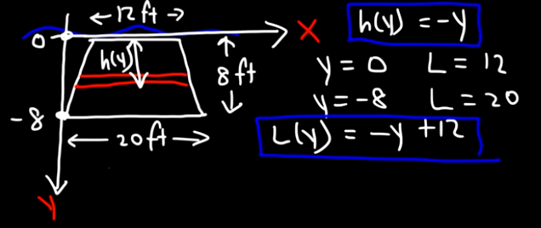
Hydrostatic Force
Other shapes will have a more
complicated L(y)

Slide 124
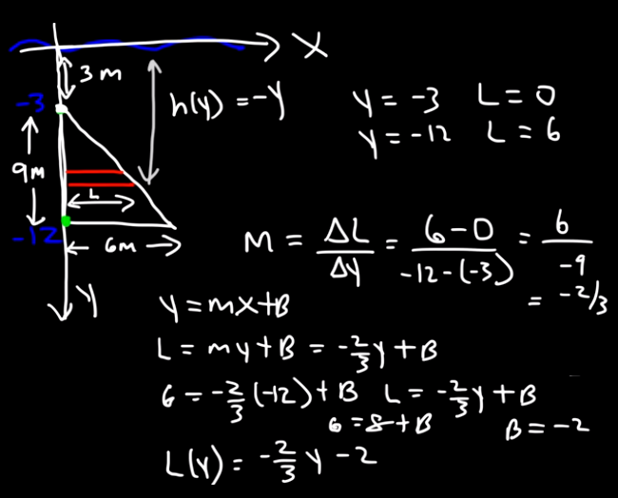
Hydrostatic Force

Slide 125
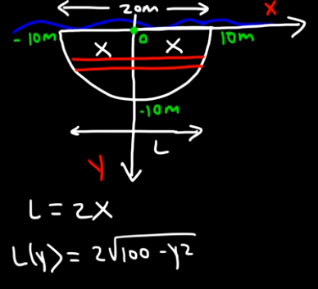
Hydrostatic Force

Slide 126
Hydrostatic Force
Note: be careful of the terminology and notation on these!
Pressure P = force/area = F/A
Weight force w = mg
Weight density w = mg/volume
Aagh!
Density = ρ = m/v
Aagh!

Slide 127
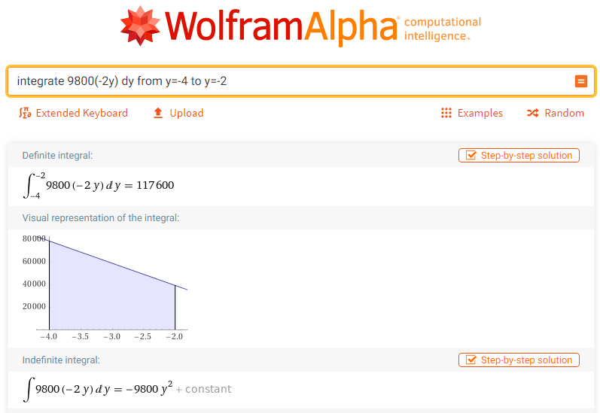

Slide 128
Questions?
http://i.imgur.com/aliTlT3.jpg

Slide 129
Center of Mass
The center of mass or centroid of a region is the point in which the region will be perfectly balanced if suspended from that point

Slide 130
Center of Mass
The center of mass of a thin plate with uniform density ρ will be a pair of (x,y) coordinates designated x̅ and y̅

Slide 131
Center of Mass
Suppose that the plate is the region bounded by the two curves f(x) and g(x) on the interval [a,b]
We want to calculate
the center of
mass of the
region
https://tutorial.math.lamar.edu/Classes/CalcII/CenterOfMass.aspx

Slide 132
Center of Mass
First, we need the mass of this plate:
M = ρ(Area of plate)
=
b
ρ∫ f(x)−g(x) dx
a
https://tutorial.math.lamar.edu/Classes/CalcII/CenterOfMass.aspx

Slide 133
Center of Mass
Next, we need “moments”
There are two moments, denoted by Mx and My
The moments measure the tendency of the region to rotate about the x and y-axis respectively

Slide 134
Center of Mass
The moments are given by:
b
Mx = ρ∫ ½(f(x)²−(g(x)²) dx
a
b
My = ρ∫ x(f(x)−g(x)) dx
a

Slide 135
Center of Mass
The coordinates of the center of mass are given by (are you ready for this…)

Slide 136
Center of Mass
x̅ = My/M
=
y̅ = Mx/M
=
the density (ρ) cancels out
b
∫ x(f(x)−g(x)) dx
a
b
∫ f(x)−g(x) dx
a
b
∫ ½(f(x)²−g(x)²) dx
a
b
∫ f(x)−g(x) dx
a

Slide 137
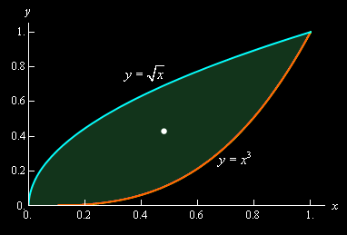
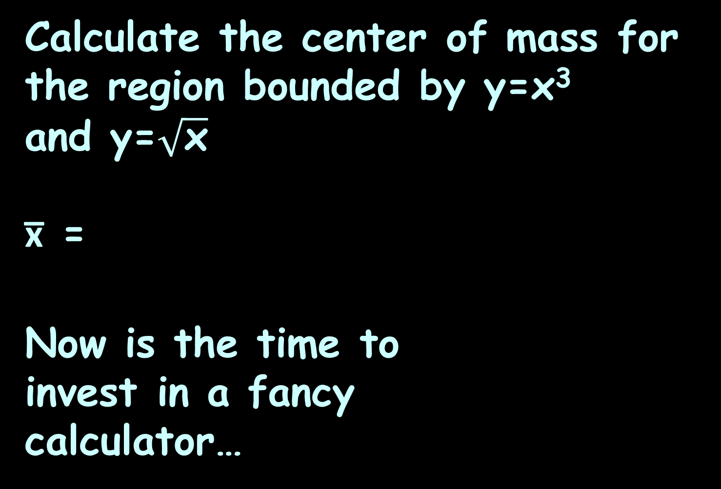


CENTER OF MASS
IN-CLASS PROBLEM 9
Calculate the center of mass for the region bounded by y=x³ and y=$\sqrt{\text{x}}$
x̅ =
Now is the time to
invest in a fancy
calculator…
1
∫ x($\sqrt{\text{x}}$− x³) dx
0
1
∫ ($\sqrt{\text{x}}$− x³) dx
x=1
0
x=0
https://tutorial.math.lamar.edu/Classes/CalcII/CenterOfMass.aspx

Slide 138
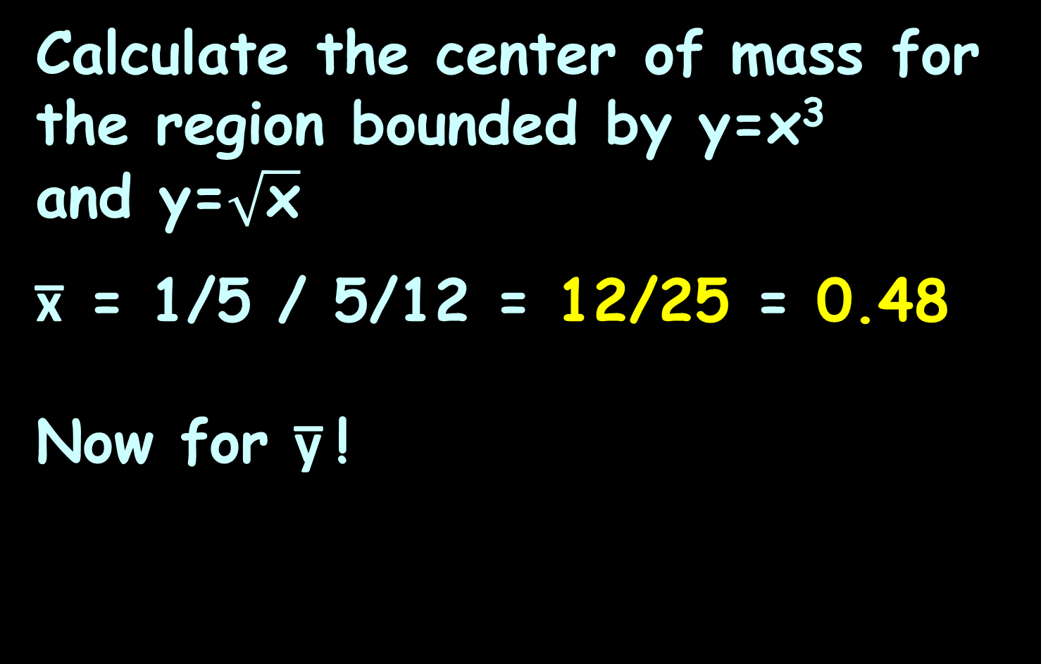
CENTER OF MASS
IN-CLASS PROBLEM 9
Calculate the center of mass for the region bounded by y=x³ and y=$\sqrt{\text{x}}$
x̅ = 1/5 / 5/12 = 12/25 = 0.48
Now for y̅ !
x=1
x=0
x=0.48
https://tutorial.math.lamar.edu/Classes/CalcII/CenterOfMass.aspx

Slide 139
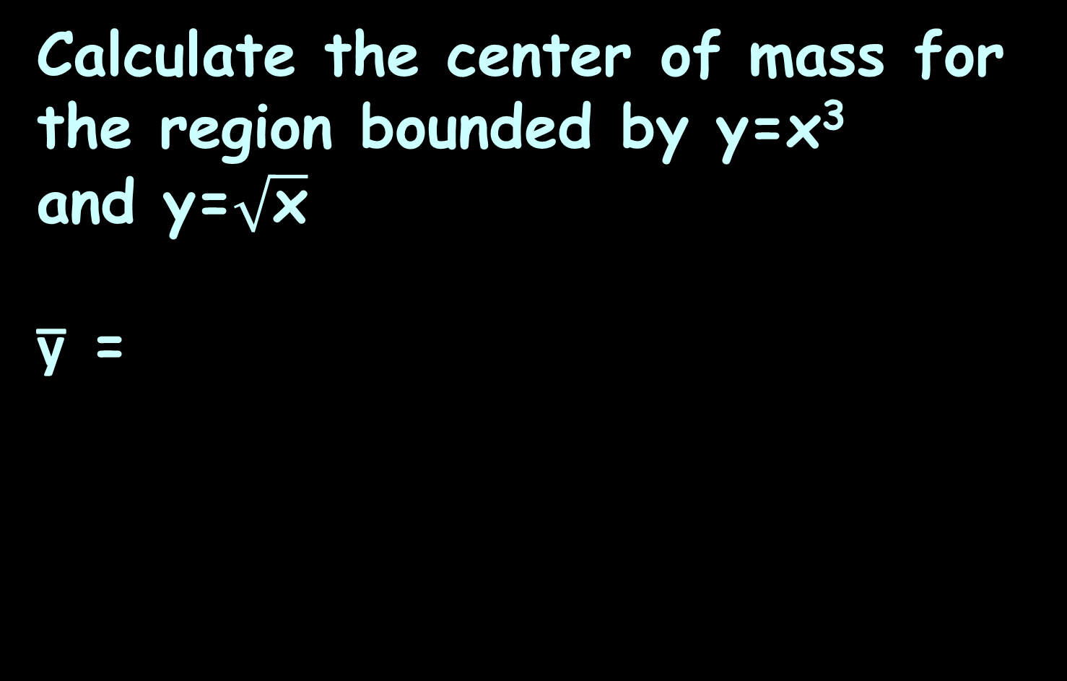


CENTER OF MASS
IN-CLASS PROBLEM 9
Calculate the center of mass for the region bounded by y=x³ and y=$\sqrt{\text{x}}$
y̅ =
1
∫ ½(($\sqrt{\text{x}}$)²−(x³)²) dx
0
1
∫ ($\sqrt{\text{x}}$− x³) dx
x=1
0
x=0
https://tutorial.math.lamar.edu/Classes/CalcII/CenterOfMass.aspx

Slide 140
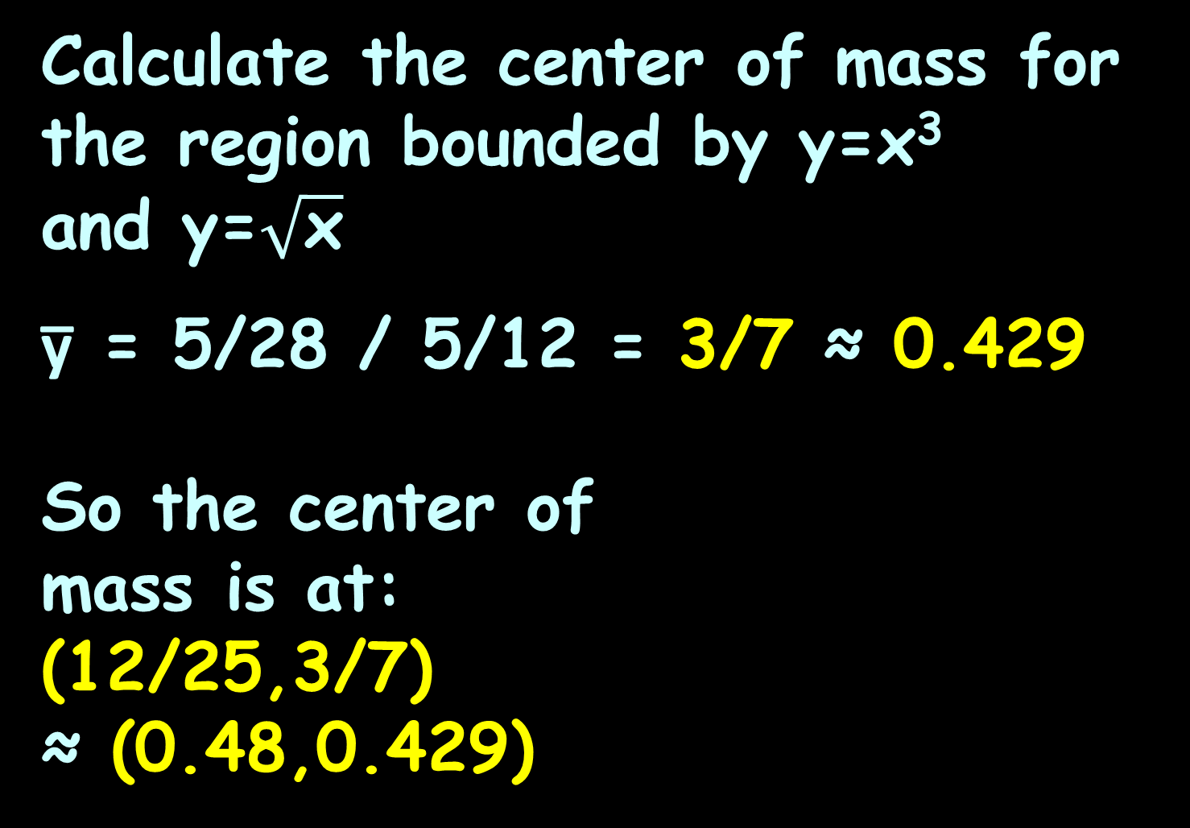
CENTER OF MASS
IN-CLASS PROBLEM 9
Calculate the center of mass for the region bounded by y=x³ and y=$\sqrt{\text{x}}$
y̅ = 5/28 / 5/12 = 3/7 ≈ 0.429
So the center of
mass is at:
(12/25,3/7)
≈ (0.48,0.429)
x=1
x=0
https://tutorial.math.lamar.edu/Classes/CalcII/CenterOfMass.aspx

Slide 141
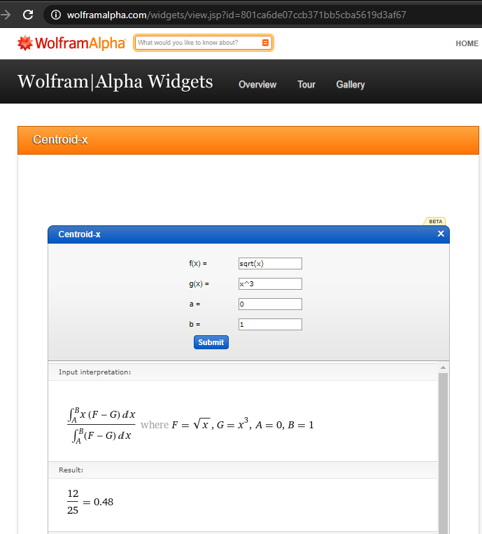
https://www.wolframalpha.com/widgets/view.jsp?id=801ca6de07ccb371bb5cba5619d3af67
Gives the x̅

Slide 142
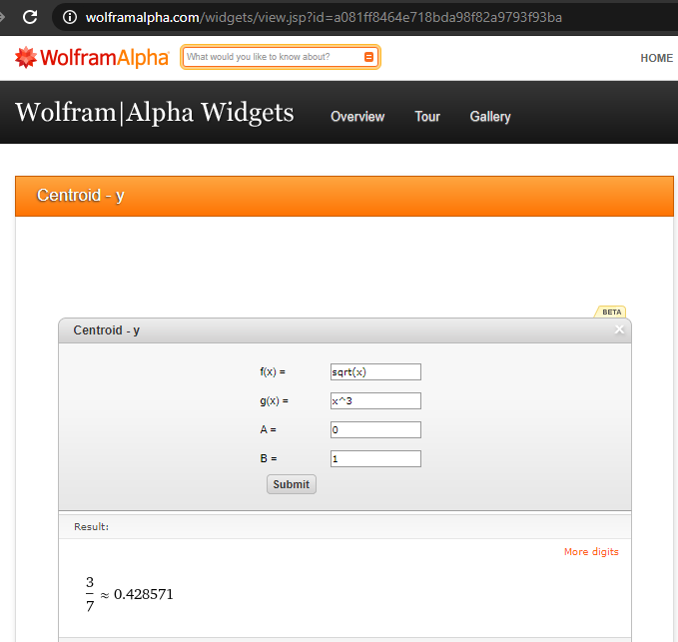
https://www.wolframalpha.com/widgets/view.jsp?id=a081ff8464e718bda98f82a9793f93ba
Gives the y̅

Slide 143
Questions?
http://i.imgur.com/aliTlT3.jpg

Slide 144
Summary
Today we covered:
What integration is used for

Slide 145

You Survived!
www.playbuzz.com

