Slide 1

Welcome to
Unit 10 Part 19!
MATH 205 Differential Calculus
https://www.smu.edu.sg/programmes/core-curriculum/course-structure/calculus

Slide 2
What’s Up?
Review:
Area between two curves
New stuff:
What integration is used for

Slide 3
What’s Up?
Outcome 5) Use basic integration techniques, including the method of substitution and the Fundamental Theorem of Calculus
Outcome 6) Use definite integrals to find areas under and between curves

Slide 4

Review
http://995642590.r.lightningbase-cdn.com/wp-content/uploads/2010/12/looking-back-hrexaminer-v144-cover425px.jpg

Slide 5
Area Between Curves
The area under a curve is pretty easy if you know how to integrate the curve
https://www.math24.net/area-region-bounded-by-curves/

Slide 6
Area Between Curves
What if you wanted to know the area between two curves?
https://www.math24.net/area-region-bounded-by-curves/

Slide 7
Area Between Curves
Both curves have to be continuous over the interval
https://www.math24.net/area-region-bounded-by-curves/

Slide 8
Area Between Curves
The area between the curves is:
- =
∫ ƒ(x) – g(x) dx
b
a
ƒ(x)
g(x)
The area below the upper curve
The area below the lower curve
The area between the curves
https://www.math24.net/area-region-bounded-by-curves/

Slide 9
Area Between Curves
Another way to look at it: what height is each rectangle in the Riemann sum?
https://www.math24.net/area-region-bounded-by-curves/

Slide 10
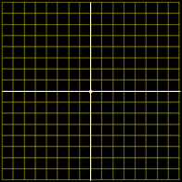
Area Between Curves
Find the area between the curves on the interval -1,1
4
3
2
1
-4
-3
0
-2
-1
0
1
2
3
4
-1
-2
-3
-4
VFrench 2020

Slide 11
Area Between Curves
Find the area between the curves on the interval -1,1
It’s not 0…
Area = 4
4
3
2
1
-4
-3
0
-2
-1
0
1
2
3
4
-1
-2
-3
-4
VFrench 2020

Slide 12
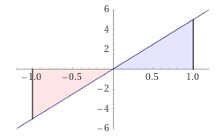

Area Between Curves
Hold it! Last week we had:
Evaluate
= 0
Why is this
different???
1
∫ 5x dx
-1
https://www.wolframalpha.com/
input/?i=definite+integral
http://www.testically.org/wp-content/uploads/2010/11/hmm.jpg

Slide 13
Area Between Curves
Last class was
about the area
UNDER a curve
There was an
required location
(between the
curve and the x-axis)
and direction (below the curve)
https://www.wolframalpha.com/input/?i=definite+integral

Slide 14
Area Between Curves
This part is going
in the wrong
direction, so it’s
negative
https://www.wolframalpha.com/input/?i=definite+integral

Slide 15
Area Between Curves
The area between curves, though, doesn’t specify which curve is on top
You just
calculate the
area between
the two curves
Area = 4
4
3
2
1
-4
-3
0
-2
-1
0
1
2
3
4
-1
-2
-3
-4
VFrench 2020

Slide 16
Area Under a Curve
Note: WolframAlpha and Symbolab do “area under a curve” as an absolute value and do NOT subtract the negative half from the positive half
(hence, their answers are wrong under the traditional rules)

Slide 17
Area Under a Curve
To get the right answer, use:
“definite integral” rather than “area under curve”

Slide 18
Area Between Curves
Sometimes the question is about areas between the intersections of two curves (they’re not telling you the interval…)
You have to figure out what values will be the same for both curves

Slide 19
Area Between Curves
The Coefficient Rule
means you don’t really
have to know which curve is higher than
the other – if you get
a negative area (and
didn’t intend to) you
just make your answer
positive - No sweat!
http://www.vsexamprep.com/online-test.html

Slide 20
Area Between Curves
So if you have a question like:
Find the area between the curves y = 8 - x² and y = x + 2 between x = 0 and x = 1
And you don’t know which is the “top” curve - just pick one at random!
You can adjust your answer later

Slide 21
Area Between Curves
Sometimes the area between the curves crosses the axes
That doesn’t matter…

Slide 22
Area Between Curves
Sometimes the areas are complicated by overlapping curves

Slide 23
Area Between Curves
What would you have to do to calculate the area between these curves?
https://www.wolframalpha.com/input/?i=area+between+curves

Slide 24
Area Between Curves
What would you have to do to calculate the area between these curves?
Calculate piecewise
areas and add
them up!
https://www.wolframalpha.com/input/?i=area+between+curves

Slide 25
Area Between Curves
How many pieces would you need to find the area between the curves?
https://www.wolframalpha.com/input/?i=area+between+curves

Slide 26
Area Between Curves
How many pieces would you need to find the area between the curves? 2
https://www.wolframalpha.com/input/?i=area+between+curves

Slide 27
Area Between Curves
You can do this “sideways” too!
https://www.wolframalpha.com/input/?i=area+between+curves+x%3D-y%2B2++and+++x%3D4-y%5E2

Slide 28
Area Between Curves
When you do it sideways, write the formulas as x =
x=4-y²
x=4-y²
y=-x+2
x=-y+2
https://www.wolframalpha.com/input/?i=area+between+curves+x%3D-y%2B2++and+++x%3D4-y%5E2

Slide 29
Area Between Curves
Find the area between the line x = -y + 2 and the parabola
x = 4 – y²
The interval is now
the ys not the xs
The variable is y not x
It’s dy not dx!
∫ (4-y²)-(-y+2)) dy
2
-1
https://www.wolframalpha.com/input/?i=area+between+curves+x%3D-y%2B2++and+++x%3D4-y%5E2
https://www.wolframalpha.com/input/?i=area+between+curves+x%3D-y%2B2++and+++x%3D4-y%5E2

Slide 30

Questions?
http://i.imgur.com/aliTlT3.jpg

Slide 31
Applications of Integration
Finances!
Compound interest:
Given an initial value $₀
the future value of $ at time
t ≥ 0 is:
$₀ + ∫₀^{t} $’ dt

Slide 32
APPLICATIONS OF INTEGRATION
IN-CLASS PROBLEM 1
Annual sales (in millions of units) of a certain brand of tablet computer are modeled to grow: ƒ(t)=0.18t²+0.16t+2.64 per year where t is in years.
How many tablets will be sold over the next 6 years?

Slide 33
APPLICATIONS OF INTEGRATION
IN-CLASS PROBLEM 1
Annual sales (in millions of units) of a certain brand of tablet computer are modeled to grow: ƒ(t)=0.18t²+0.16t+2.64 per year where t is in years.
How many tablets will be sold over the next 6 years?
This formula is a rate of growth, so it is ACTUALLY dƒ/dt

Slide 34
APPLICATIONS OF INTEGRATION
IN-CLASS PROBLEM 1
Annual sales (in millions of units) of a certain brand of tablet computer are modeled to grow: dƒ/dt=0.18t²+0.16t+2.64 per year where t is in years.
How many tablets will be sold over the next 6 years?
We can take:
∫₀⁶ (0.18t²+0.16t+2.64) dt do it!

Slide 35
APPLICATIONS OF INTEGRATION
IN-CLASS PROBLEM 1
Annual sales (in millions of units) of a certain brand of tablet computer are modeled to grow: dƒ/dt=0.18t²+0.16t+2.64 per year where t is in years.
How many tablets will be sold over the next 6 years?
∫₀⁶ (0.18t²+0.16t+2.64) dt
0.18/3 t³+0.16/2t²+2.64t
|
6
0

Slide 36
APPLICATIONS OF INTEGRATION
IN-CLASS PROBLEM 1
Annual sales (in millions of units) of a certain brand of tablet computer are modeled to grow: dƒ/dt=0.18t²+0.16t+2.64 per year where t is in years.
How many tablets will be sold over the next 6 years?
(0.18/3 (6³)+0.16/2 (6²)+2.64(6))
-(0.18/3 (0³)+0.16/2 (0²)+2.64(0))

Slide 37
APPLICATIONS OF INTEGRATION
IN-CLASS PROBLEM 1
Annual sales (in millions of units) of a certain brand of tablet computer are modeled to grow: dƒ/dt=0.18t²+0.16t+2.64 per year where t is in years.
How many tablets will be sold over the next 6 years?
≈ 31.68 whats?

Slide 38
APPLICATIONS OF INTEGRATION
IN-CLASS PROBLEM 1
Annual sales (in millions of units) of a certain brand of tablet computer are modeled to grow: dƒ/dt=0.18t²+0.16t+2.64 per year where t is in years.
How many tablets will be sold over the next 6 years?
≈ 31.68 million tablets

Slide 39
Questions?
http://i.imgur.com/aliTlT3.jpg

Slide 40
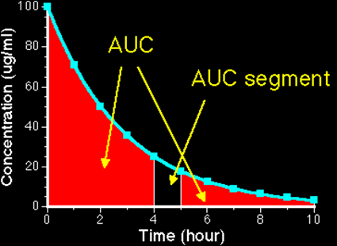
Applications of Integration
Exposure to a drug = Area under the plasma concentration time curve (AUC)
c/p1/Ch04/Ch0410.html

Slide 41
APPLICATIONS OF INTEGRATION
IN-CLASS PROBLEM 2
Find exposure to the drug if:
AUC = ∫₄⁵ 100/15 e ^{-0.5t} dt

Slide 42
APPLICATIONS OF INTEGRATION
IN-CLASS PROBLEM 2
Find exposure to the drug if:
AUC = ∫₄⁵ 100/15 e ^{-0.5t} dt
Calculator or Wolframalpha:

Slide 43
APPLICATIONS OF INTEGRATION
IN-CLASS PROBLEM 2
Find exposure to the drug if:
AUC = ∫₄⁵ 100/15 e ^{-0.5t} dt
Calculator or Wolframalpha:
AUC ≈ 0.71 can you figure out the units?

Slide 44
APPLICATIONS OF INTEGRATION
IN-CLASS PROBLEM 2
Find exposure to the drug if:
AUC = ∫₄⁵ 100/15 e ^{-0.5t} dt
Calculator or Wolframalpha:
AUC ≈ 0.71 μg/ml × hour believe it or not…
μg h /ml

Slide 45
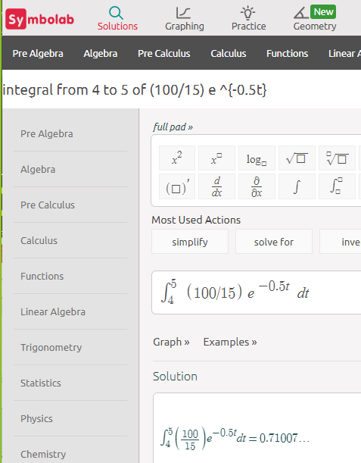
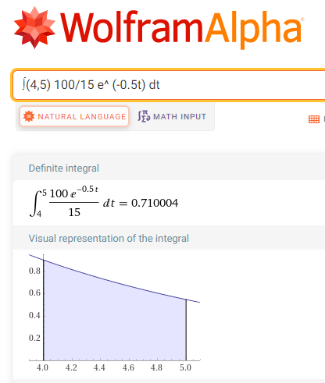
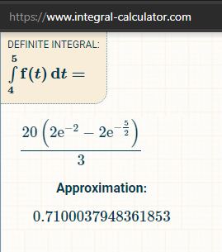
This one is wrong…

Slide 46
Applications of Integration
Notice how this used
e^{-some tiny number}
We’ll be covering these in more detail in Integral Calculus

Slide 47
Questions?
http://i.imgur.com/aliTlT3.jpg

Slide 48
Applications of Integration
Physics has a lot of uses of integration

Slide 49
Applications of Integration
Physics has a lot of uses of integration:
To undo all of the velocity, acceleration, jerk calculations
But there’s a lot more!

Slide 50
APPLICATIONS OF INTEGRATION
IN-CLASS PROBLEM 3
A starburst bomb is launched vertically at 265 ft/sec velocity from a mortar on the ground. If gravity gives it an acceleration of -32.2 ft/sec², how high will it be 5 seconds after launch?

Slide 51
APPLICATIONS OF INTEGRATION
IN-CLASS PROBLEM 3
A starburst bomb is launched vertically at 265 ft/sec velocity from a mortar on the ground. If gravity gives it an acceleration of -32.2 ft/sec², how high will it be 5 seconds after launch?
Why is the acceleration of gravity MINUS 32.2 ft/sec²?

Slide 52
APPLICATIONS OF INTEGRATION
IN-CLASS PROBLEM 3
A starburst bomb is launched vertically at 265 ft/sec velocity from a mortar on the ground. If gravity gives it an acceleration of -32.2 ft/sec², how high will it be 5 seconds after launch?
Why is the acceleration of gravity MINUS 32.2 ft/sec²?
Gravity is trying to pull it down

Slide 53
APPLICATIONS OF INTEGRATION
IN-CLASS PROBLEM 3
A starburst bomb is launched vertically at 265 ft/sec velocity from a mortar on the ground. If gravity gives it an acceleration of -32.2 ft/sec², how high will it be 5 seconds after launch?
We need an equation…

Slide 54
APPLICATIONS OF INTEGRATION
IN-CLASS PROBLEM 3
A starburst bomb is launched vertically at 265 ft/sec velocity from a mortar on the ground. If gravity gives it an acceleration of -32.2 ft/sec², how high will it be 5 seconds after launch?
Remember, acceleration is the derivative of velocity…

Slide 55
APPLICATIONS OF INTEGRATION
IN-CLASS PROBLEM 3
A starburst bomb is launched vertically at 265 ft/sec velocity from a mortar on the ground. If gravity gives it an acceleration of -32.2 ft/sec², how high will it be 5 seconds after launch?
Remember, acceleration is the derivative of velocity…
a = dv/dt

Slide 56
APPLICATIONS OF INTEGRATION
IN-CLASS PROBLEM 3
A starburst bomb is launched vertically at 265 ft/sec velocity from a mortar on the ground. If gravity gives it an acceleration of -32.2 ft/sec², how high will it be 5 seconds after launch?
a = dv/dt
Here’s a trick: split up the derivative!

Slide 57
APPLICATIONS OF INTEGRATION
IN-CLASS PROBLEM 3
A starburst bomb is launched vertically at 265 ft/sec velocity from a mortar on the ground. If gravity gives it an acceleration of -32.2 ft/sec², how high will it be 5 seconds after launch?
a = dv/dt
Here’s a trick: split up the derivative! Solving for dv: dv = a dt

Slide 58
APPLICATIONS OF INTEGRATION
IN-CLASS PROBLEM 3
A starburst bomb is launched vertically at 265 ft/sec velocity from a mortar on the ground. If gravity gives it an acceleration of -32.2 ft/sec², how high will it be 5 seconds after launch?
Here’s another trick used a lot:
Integrate both sides of the equation: dv = a dt

Slide 59
APPLICATIONS OF INTEGRATION
IN-CLASS PROBLEM 3
A starburst bomb is launched vertically at 265 ft/sec velocity from a mortar on the ground. If gravity gives it an acceleration of -32.2 ft/sec², how high will it be 5 seconds after launch?
Integrate both sides of the equation: ∫dv = ∫a dt
v + c1 = at + c2

Slide 60
APPLICATIONS OF INTEGRATION
IN-CLASS PROBLEM 3
A starburst bomb is launched vertically at 265 ft/sec velocity from a mortar on the ground. If gravity gives it an acceleration of -32.2 ft/sec², how high will it be 5 seconds after launch?
Another trick: combine the cs:
v + c1 = at + c2
v = at + c where c = c2 – c1

Slide 61
APPLICATIONS OF INTEGRATION
IN-CLASS PROBLEM 3
A starburst bomb is launched vertically at 265 ft/sec velocity from a mortar on the ground. If gravity gives it an acceleration of -32.2 ft/sec², how high will it be 5 seconds after launch?
v = at + c
When t=0, v=265 and a=-32.2
(we can solve for “c”)

Slide 62
APPLICATIONS OF INTEGRATION
IN-CLASS PROBLEM 3
A starburst bomb is launched vertically at 265 ft/sec velocity from a mortar on the ground. If gravity gives it an acceleration of -32.2 ft/sec², how high will it be 5 seconds after launch?
v = at + c
265 = -32.2(0) + c
So c = 265

Slide 63
APPLICATIONS OF INTEGRATION
IN-CLASS PROBLEM 3
A starburst bomb is launched vertically at 265 ft/sec velocity from a mortar on the ground. If gravity gives it an acceleration of -32.2 ft/sec², how high will it be 5 seconds after launch?
So the velocity equation is:
v = -32.2t + 265

Slide 64
APPLICATIONS OF INTEGRATION
IN-CLASS PROBLEM 3
A starburst bomb is launched vertically at 265 ft/sec velocity from a mortar on the ground. If gravity gives it an acceleration of -32.2 ft/sec², how high will it be 5 seconds after launch?
The velocity equation was the first derivative of the location equation (s_{t}): ds/dt = v

Slide 65
APPLICATIONS OF INTEGRATION
IN-CLASS PROBLEM 3
A starburst bomb is launched vertically at 265 ft/sec velocity from a mortar on the ground. If gravity gives it an acceleration of -32.2 ft/sec², how high will it be 5 seconds after launch?
ds/dt = v = -32.2t + 265
Follow the same tricks!
1) Split up the ds/dt

Slide 66
APPLICATIONS OF INTEGRATION
IN-CLASS PROBLEM 3
A starburst bomb is launched vertically at 265 ft/sec velocity from a mortar on the ground. If gravity gives it an acceleration of -32.2 ft/sec², how high will it be 5 seconds after launch?
ds/dt = v = -32.2t + 265
ds = (-32.2t + 265) dt

Slide 67
APPLICATIONS OF INTEGRATION
IN-CLASS PROBLEM 3
A starburst bomb is launched vertically at 265 ft/sec velocity from a mortar on the ground. If gravity gives it an acceleration of -32.2 ft/sec², how high will it be 5 seconds after launch?
ds = (-32.2t + 265) dt
(now do you see why the integrand should be in parentheses?

Slide 68
APPLICATIONS OF INTEGRATION
IN-CLASS PROBLEM 3
A starburst bomb is launched vertically at 265 ft/sec velocity from a mortar on the ground. If gravity gives it an acceleration of -32.2 ft/sec², how high will it be 5 seconds after launch?
ds = (-32.2t + 265) dt
What’s next?

Slide 69
APPLICATIONS OF INTEGRATION
IN-CLASS PROBLEM 3
A starburst bomb is launched vertically at 265 ft/sec velocity from a mortar on the ground. If gravity gives it an acceleration of -32.2 ft/sec², how high will it be 5 seconds after launch?
ds = (-32.2t + 265) dt
Trick 2: integrate both sides of the equation

Slide 70
APPLICATIONS OF INTEGRATION
IN-CLASS PROBLEM 3
A starburst bomb is launched vertically at 265 ft/sec velocity from a mortar on the ground. If gravity gives it an acceleration of -32.2 ft/sec², how high will it be 5 seconds after launch?
ds = (-32.2t + 265) dt
∫ ds = ∫(-32.2t + 265) dt
s + c1 = -32.2/2 t² + 265t + c2

Slide 71
APPLICATIONS OF INTEGRATION
IN-CLASS PROBLEM 3
A starburst bomb is launched vertically at 265 ft/sec velocity from a mortar on the ground. If gravity gives it an acceleration of -32.2 ft/sec², how high will it be 5 seconds after launch?
s + c1 = -32.2/2 t² + 265t + c2
Remember the next trick?

Slide 72
APPLICATIONS OF INTEGRATION
IN-CLASS PROBLEM 3
A starburst bomb is launched vertically at 265 ft/sec velocity from a mortar on the ground. If gravity gives it an acceleration of -32.2 ft/sec², how high will it be 5 seconds after launch?
s + c1 = -32.2/2 t² + 265t + c2
Remember the next trick?
Trick 3: Combine the “c”s

Slide 73
APPLICATIONS OF INTEGRATION
IN-CLASS PROBLEM 3
A starburst bomb is launched vertically at 265 ft/sec velocity from a mortar on the ground. If gravity gives it an acceleration of -32.2 ft/sec², how high will it be 5 seconds after launch?
s + c1 = -32.2/2 t² + 265t + c2
s = -16.1t² + 265t + c

Slide 74
APPLICATIONS OF INTEGRATION
IN-CLASS PROBLEM 3
A starburst bomb is launched vertically at 265 ft/sec velocity from a mortar on the ground. If gravity gives it an acceleration of -32.2 ft/sec², how high will it be 5 seconds after launch?
s = -16.1t² + 265t + c
When t was 0, s was 0 (‘cause the bomb was on the ground where it started)

Slide 75
APPLICATIONS OF INTEGRATION
IN-CLASS PROBLEM 3
A starburst bomb is launched vertically at 265 ft/sec velocity from a mortar on the ground. If gravity gives it an acceleration of -32.2 ft/sec², how high will it be 5 seconds after launch?
s = -16.1t² + 265t + c
0 = -16.1(0²) + 265(0) + c
And c = 0

Slide 76
APPLICATIONS OF INTEGRATION
IN-CLASS PROBLEM 3
A starburst bomb is launched vertically at 265 ft/sec velocity from a mortar on the ground. If gravity gives it an acceleration of -32.2 ft/sec², how high will it be 5 seconds after launch?
All this just to get the location equation:
s = -16.1t² + 265t + 0

Slide 77
APPLICATIONS OF INTEGRATION
IN-CLASS PROBLEM 3
A starburst bomb is launched vertically at 265 ft/sec velocity from a mortar on the ground. If gravity gives it an acceleration of -32.2 ft/sec², how high will it be 5 seconds after launch?
s = -16.1t² + 265t
So, what is the bomb’s location at t=5 seconds?

Slide 78
APPLICATIONS OF INTEGRATION
IN-CLASS PROBLEM 3
A starburst bomb is launched vertically at 265 ft/sec velocity from a mortar on the ground. If gravity gives it an acceleration of -32.2 ft/sec², how high will it be 5 seconds after launch?
s = -16.1(5²) + 265(5)

Slide 79
APPLICATIONS OF INTEGRATION
IN-CLASS PROBLEM 3
A starburst bomb is launched vertically at 265 ft/sec velocity from a mortar on the ground. If gravity gives it an acceleration of -32.2 ft/sec², how high will it be 5 seconds after launch?
s = -16.1(5²) + 265(5)
= -402.5 + 1325 = 922.5 whats?

Slide 80
APPLICATIONS OF INTEGRATION
IN-CLASS PROBLEM 3
A starburst bomb is launched vertically at 265 ft/sec velocity from a mortar on the ground. If gravity gives it an acceleration of -32.2 ft/sec², how high will it be 5 seconds after launch?
s = -16.1(5²) + 265(5)
= -402.5 + 1325 = 922.5 ft

Slide 81
APPLICATIONS OF INTEGRATION
IN-CLASS PROBLEM 4
Can we use calculus to find the max height of the bomb?
s = -16.1t² + 265t

Slide 82
APPLICATIONS OF INTEGRATION
IN-CLASS PROBLEM 4
Can we use calculus to find the max height of the bomb?
s = -16.1t² + 265t
The max height would be where the first derivative (velocity) was zero
v = -32.2t + 265
Which is zero where?

Slide 83
APPLICATIONS OF INTEGRATION
IN-CLASS PROBLEM 4
Can we use calculus to find the max height of the bomb?
s = -16.1t² + 265t
The max height would be where the first derivative (velocity) was zero
v = -32.2t + 265 = 0
when t = -265/-32.2 ≈ 8.23 whats?

Slide 84
APPLICATIONS OF INTEGRATION
IN-CLASS PROBLEM 4
Can we use calculus to find the max height of the bomb?
s = -16.1t² + 265t
The max height would be where the first derivative (velocity) was zero: v = -32.2t + 265 = 0
when t = -265/-32.2 ≈ 8.23 sec
Hmmm… that doesn’t answer the question about height…

Slide 85
APPLICATIONS OF INTEGRATION
IN-CLASS PROBLEM 4
Can we use calculus to find the max height of the bomb?
s = -16.1t² + 265t
The max height would be where the first derivative (velocity) was zero: v = -32.2t + 265 = 0
when t = -265/-32.2 ≈ 8.23 sec
Plug it into the location equation!

Slide 86
APPLICATIONS OF INTEGRATION
IN-CLASS PROBLEM 4
Can we use calculus to find the max height of the bomb?
s = -16.1t² + 265t
The max height would be when
t ≈ 8.23 sec
Or s ≈ -16.1(8.23²) + 265(8.23)
≈ -1090.45 + 2180.95
≈ 1090.5 whats?

Slide 87
APPLICATIONS OF INTEGRATION
IN-CLASS PROBLEM 4
Can we use calculus to find the max height of the bomb?
s = -16.1t² + 265t
The max height would be when
t ≈ 8.23 sec
Or s ≈ -16.1(8.23²) + 265(8.23)
≈ -1090.45 + 2180.95
≈ 1090.5 ft

Slide 88
APPLICATIONS OF INTEGRATION
IN-CLASS PROBLEM 4
1090.5 ft
You could test to verify this is a max (not a min), but since you know the bomb started at 0 ft, this has to be a max

Slide 89
Applications of Integration
So we’ve got some new tricks:
Trick 0: come up with an equation involving dy/dx (y and x will be the variables you are interested in)
Trick 1: split the dy and dx into two sides of the equation
Trick 2: integrate both sides
Trick 3: combine the “c”s

Slide 90
Questions?
http://i.imgur.com/aliTlT3.jpg

Slide 91
Applications of Integration
Useful equations for electronics:

Slide 92
Applications of Integration
Useful equations for electronics:
v(t) = dw/dq
v(t) is the voltage (volts)
w is the energy (joules)
q is the charge (coulombs)

Slide 93
Applications of Integration
Useful equations for electronics:
i(t) = dq/dt
i(t) is the current (amps)
t is the time (sec)

Slide 94
Applications of Integration
Useful equations for electronics:
p(t) = dw/dt
= (dw/dq)(dq/dt)
= v(t)×i(t)
p(t) is the power in
joules/sec or watts

Slide 95
Applications of Integration
Useful equations for electronics:
i_{c} = C dv/dt
i_{c} is instantaneous capacitor
current in amps
C is capacitance in Farads

Slide 96
Applications of Integration
Useful equations for electronics:
v_{coil} = N dw/dt
v_{coil} is the instantaneous coil
voltage (in volts)
N is the number of primary
turns

Slide 97
Applications of Integration
Useful equations for electronics:
V_{L} = L di/dt
V_{L} is the instantaneous
inductor voltage
L is the inductance in Henrys
(H)

Slide 98
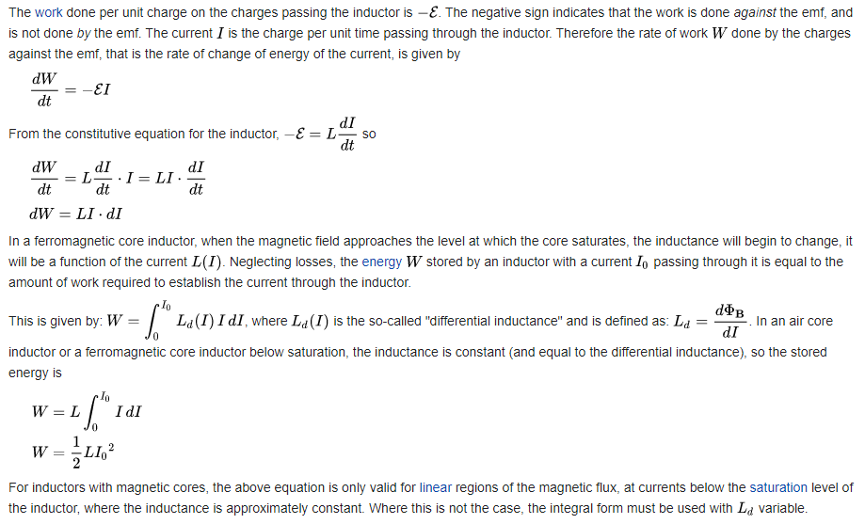
Applications of Integration

Slide 99
Applications of Integration
Differentiation can help analyze the operation of certain electrical circuits
How about integration?

Slide 100
APPLICATIONS OF INTEGRATION
IN-CLASS PROBLEM 5
A current of i = 3t² was maintained in a battery charger circuit for 5 seconds. How many coulombs of charge were delivered?
(Assume the battery was uncharged: q=0 at t=0)

Slide 101
APPLICATIONS OF INTEGRATION
IN-CLASS PROBLEM 5
A current of i = 3t² was maintained in a battery charger circuit for 5 seconds. How many coulombs of charge were delivered? (at t=0, q=0)
We’ve got an equation: i(t)=dq/dt
What now?

Slide 102
APPLICATIONS OF INTEGRATION
IN-CLASS PROBLEM 5
A current of i = 3t² was maintained in a battery charger circuit for 5 seconds. How many coulombs of charge were delivered? (at t=0, q=0)
We’ve got an equation: i(t)=dq/dt
What now? Split the ds:
i dt = dq
What next?

Slide 103
APPLICATIONS OF INTEGRATION
IN-CLASS PROBLEM 5
A current of i = 3t² was maintained in a battery charger circuit for 5 seconds. How many coulombs of charge were delivered? (at t=0, q=0)
We’ve got an equation: i(t)=dq/dt
What now? Split the ds:
i dt = dq
What next? Integrate both sides

Slide 104
APPLICATIONS OF INTEGRATION
IN-CLASS PROBLEM 5
A current of i = 3t² was maintained in a battery charger circuit for 5 seconds. How many coulombs of charge were delivered? (at t=0, q=0)
Integrate both sides:
∫ i dt = ∫ dq
But… i is a function of t – you need to first include the function

Slide 105
APPLICATIONS OF INTEGRATION
IN-CLASS PROBLEM 5
A current of i = 3t² was maintained in a battery charger circuit for 5 seconds. How many coulombs of charge were delivered? (at t=0, q=0)
∫ i dt = ∫ dq
∫ 3t² dt = ∫ dq
t³ + c1 = q + c2
(Now what?)

Slide 106
APPLICATIONS OF INTEGRATION
IN-CLASS PROBLEM 5
A current of i = 3t² was maintained in a battery charger circuit for 5 seconds. How many coulombs of charge were delivered? (at t=0, q=0)
Combine the “c”s:
q = t³ + c
(Now what?)

Slide 107
APPLICATIONS OF INTEGRATION
IN-CLASS PROBLEM 5
A current of i = 3t² was maintained in a battery charger circuit for 5 seconds. How many coulombs of charge were delivered? (at t=0, q=0)
Combine the “c”s:
q = t³ + c
(Now what?) can we solve for c?

Slide 108
APPLICATIONS OF INTEGRATION
IN-CLASS PROBLEM 5
A current of i = 3t² was maintained in a battery charger circuit for 5 seconds. How many coulombs of charge were delivered? (at t=0, q=0)
q = t³ + c
At q=0, t=0:
0 = 0³ + c so c=0

Slide 109
APPLICATIONS OF INTEGRATION
IN-CLASS PROBLEM 5
A current of i = 3t² was maintained in a battery charger circuit for 5 seconds. How many coulombs of charge were delivered? (at t=0, q=0)
So our charge equation is:
q = t³
Are we done?

Slide 110
APPLICATIONS OF INTEGRATION
IN-CLASS PROBLEM 5
A current of i = 3t² was maintained in a battery charger circuit for 5 seconds. How many coulombs of charge were delivered? (at t=0, q=0)
So our charge equation is:
q = t³
Plug in t=5

Slide 111
APPLICATIONS OF INTEGRATION
IN-CLASS PROBLEM 5
A current of i = 3t² was maintained in a battery charger circuit for 5 seconds. How many coulombs of charge were delivered? (at t=0, q=0)
So our charge equation is:
q = t³
q = 5³ = 125 whats?

Slide 112
APPLICATIONS OF INTEGRATION
IN-CLASS PROBLEM 5
A current of i = 3t² was maintained in a battery charger circuit for 5 seconds. How many coulombs of charge were delivered? (at t=0, q=0)
So our charge equation is:
q = t³
q = 5³ = 125 coulombs

Slide 113
Questions?
http://i.imgur.com/aliTlT3.jpg

Slide 114
APPLICATIONS OF INTEGRATION
IN-CLASS PROBLEM 6
An uncharged 450 μF capacitor is attached to a 12-volt dc supply unit until it is fully charged. Then a current modeled by i = 0.04t³ amps is applied to charge it even more. When will the capacitor’s voltage reach 28v?

Slide 115
APPLICATIONS OF INTEGRATION
IN-CLASS PROBLEM 6
Looking at the first part:
An uncharged 450 μF capacitor is attached to a 12-volt dc supply unit until it is fully charged.
This part of the problem is modeled by:
q = Cv
What is C?

Slide 116
APPLICATIONS OF INTEGRATION
IN-CLASS PROBLEM 6
An uncharged 450 μF capacitor is attached to a 12-volt dc supply unit until it is fully charged.
This part of the problem is modeled by:
What is C? 450 μF = .00045 F
q = Cv (where C is in Farads)
= .000450 × v
How about v?

Slide 117
APPLICATIONS OF INTEGRATION
IN-CLASS PROBLEM 6
An uncharged 450 μF capacitor is attached to a 12-volt dc supply unit until it is fully charged.
This part of the problem is modeled by:
How about v? v=12
q = Cv = .00045×12 = 0.0054 whats?

Slide 118
APPLICATIONS OF INTEGRATION
IN-CLASS PROBLEM 6
An uncharged 450 μF capacitor is attached to a 12-volt dc supply unit until it is fully charged.
This part of the problem is modeled by:
q = Cv = 0.0054 coulombs

Slide 119
APPLICATIONS OF INTEGRATION
IN-CLASS PROBLEM 6
An uncharged 450 μF capacitor is attached to a 12-volt dc supply unit until it is fully charged.
This part of the problem is modeled by:
q = Cv = 0.0054 coulombs
This is the initial charge (t=0)
Now we need to do part 2

Slide 120
APPLICATIONS OF INTEGRATION
IN-CLASS PROBLEM 6
Then a current modeled by
i = 0.04t³ amps is applied to charge it even more
q = Cv = 0.0054
Part 2: we’ll use the Useful Equation: i(t) = dq/dt
Trick 1:

Slide 121
APPLICATIONS OF INTEGRATION
IN-CLASS PROBLEM 6
Then a current modeled by
i = 0.04t³ amps is applied to charge it even more
q = Cv = 0.0054
Part 2: we’ll use the Useful Equation: i(t) = dq/dt
Trick 1: i(t) dt = dq
Or: 0.04t³ dt = dq

Slide 122
APPLICATIONS OF INTEGRATION
IN-CLASS PROBLEM 6
Then a current modeled by
i = 0.04t³ amps is applied to charge it even more
q = Cv = 0.0054
0.04t³ dt = dq
Trick 2:

Slide 123
APPLICATIONS OF INTEGRATION
IN-CLASS PROBLEM 6
Then a current modeled by
i = 0.04t³ amps is applied to charge it even more
q = Cv = 0.0054
0.04t³ dt = dq
Trick 2: ∫ 0.04t³ dt = ∫ dq

Slide 124
APPLICATIONS OF INTEGRATION
IN-CLASS PROBLEM 6
Then a current modeled by
i = 0.04t³ amps is applied to charge it even more
q = Cv = 0.0054
0.04t³ dt = dq
Trick 2: ∫ 0.04t³ dt = ∫ dq
.01t⁴ + c1 = q + c2
Trick 3:

Slide 125
APPLICATIONS OF INTEGRATION
IN-CLASS PROBLEM 6
Then a current modeled by
i = 0.04t³ amps is applied to charge it even more
q = Cv = 0.0054
Trick 3: q = .01t⁴ + c
But q = 0.0054 at t=0,
so c=?

Slide 126
APPLICATIONS OF INTEGRATION
IN-CLASS PROBLEM 6
Then a current modeled by
i = 0.04t³ amps is applied to charge it even more
q = Cv = 0.0054
But q = 0.0054 at t=0,
0.0054 = .01(0)⁴ + c
so c = 0.0054
q = .01t⁴ + 0.0054

Slide 127
APPLICATIONS OF INTEGRATION
IN-CLASS PROBLEM 6
q = .01t⁴ + 0.0054
When will the capacitor’s voltage reach 28v?

Slide 128
APPLICATIONS OF INTEGRATION
IN-CLASS PROBLEM 6
q = .01t⁴ + 0.0054
When will the capacitor’s voltage reach 28v?
Back to: q = Cv = .00045 (28)
Use this in the last derived equation

Slide 129
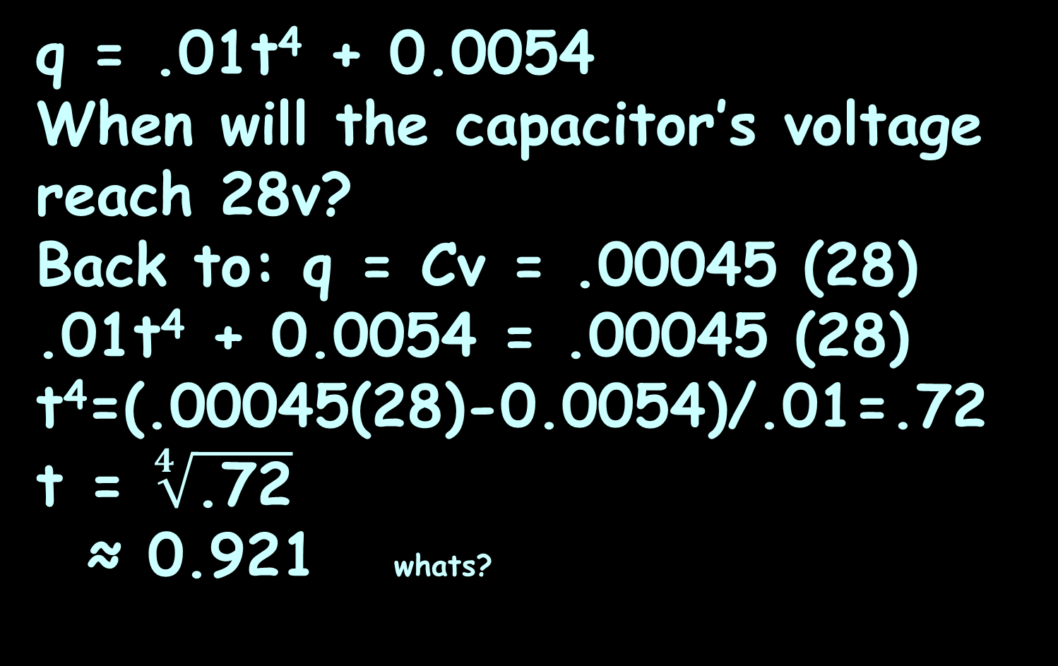
APPLICATIONS OF INTEGRATION
IN-CLASS PROBLEM 6
q = .01t⁴ + 0.0054
When will the capacitor’s voltage reach 28v?
Back to: q = Cv = .00045 (28)
.01t⁴ + 0.0054 = .00045 (28)
t⁴=(.00045(28)-0.0054)/.01=.72
t = $\sqrt[4]{\text{.72}}$
≈ 0.921 whats?

Slide 130
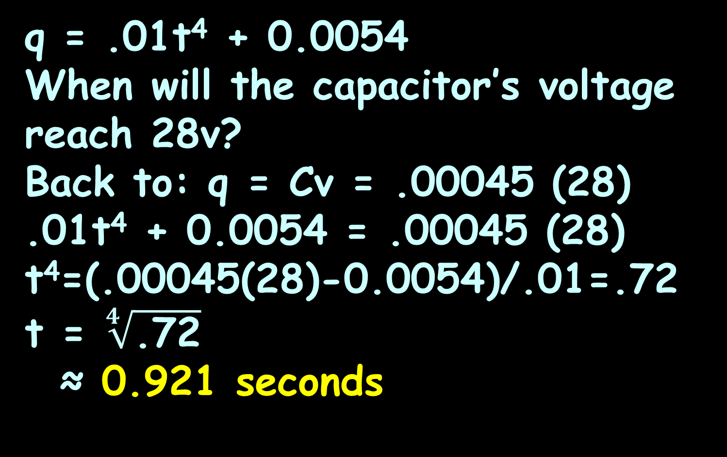
APPLICATIONS OF INTEGRATION
IN-CLASS PROBLEM 6
q = .01t⁴ + 0.0054
When will the capacitor’s voltage reach 28v?
Back to: q = Cv = .00045 (28)
.01t⁴ + 0.0054 = .00045 (28)
t⁴=(.00045(28)-0.0054)/.01=.72
t = $\sqrt[4]{\text{.72}}$
≈ 0.921 seconds

Slide 131
Questions?
http://i.imgur.com/aliTlT3.jpg

Slide 132
APPLICATIONS OF INTEGRATION
IN-CLASS PROBLEM 7
The voltage applied to a circuit was v = 3t² + 2 volts. This caused a current i = 5t amps to flow. Find the equation for the energy (w) delivered.

Slide 133
APPLICATIONS OF INTEGRATION
IN-CLASS PROBLEM 7
The voltage applied to a circuit was v = 3t² + 2 volts. This caused a current i = 5t amps to flow. Find the equation for the energy (w) delivered.
Which equation?

Slide 134
APPLICATIONS OF INTEGRATION
IN-CLASS PROBLEM 7
The voltage applied to a circuit was v = 3t² + 2 volts. This caused a current i = 5t amps to flow. Find the equation for the energy (w) delivered.
Which equation?
p = vi
What do we know?

Slide 135
APPLICATIONS OF INTEGRATION
IN-CLASS PROBLEM 7
The voltage applied to a circuit was v = 3t² + 2 volts. This caused a current i = 5t amps to flow. Find the equation for the energy (w) delivered.
p = vi
What do we know?
p = (3t² + 2)(5t) = 15t³ + 10t
Which Useful Equation?

Slide 136
APPLICATIONS OF INTEGRATION
IN-CLASS PROBLEM 7
v(t) = dω/dq v(t) is the voltage (volts) ω is the energy (joules) q is the charge (coulombs) | p(t) = dω/dt = (dω/dq)(dq/dt) = v(t)×i(t) p(t) is the power in joules/sec or watts
i(t) = dq/dt i(t) is the current (amps) t is the time (sec) | v_{coil} = N dw/dt v_{coil} is the instantaneous coil voltage (in volts) N is the number of primary turns
i_{c} = C dv/dt i_{c} is instantaneous capacitor current in amps C is capacitance in farads | V_{L} = L di/dt V_{L} is the instantaneous \ inductor voltage L is the inductance in henrys

Slide 137
APPLICATIONS OF INTEGRATION
IN-CLASS PROBLEM 7
The voltage applied to a circuit was v = 3t² + 2 volts. This caused a current i = 5t amps to flow. Find the equation for the energy (w) delivered.
p = vi = 15t³ + 10t
Which Useful Equation?
p(t) = dw/dt
Now what?

Slide 138
APPLICATIONS OF INTEGRATION
IN-CLASS PROBLEM 7
The voltage applied to a circuit was v = 3t² + 2 volts. This caused a current i = 5t amps to flow. Find the equation for the energy (w) delivered.
p = 15t³ + 10t = dw/dt
Now what?

Slide 139
APPLICATIONS OF INTEGRATION
IN-CLASS PROBLEM 7
The voltage applied to a circuit was v = 3t² + 2 volts. This caused a current i = 5t amps to flow. Find the equation for the energy (w) delivered.
15t³ + 10t = dw/dt
Now what?

Slide 140
APPLICATIONS OF INTEGRATION
IN-CLASS PROBLEM 7
The voltage applied to a circuit was v = 3t² + 2 volts. This caused a current i = 5t amps to flow. Find the equation for the energy (w) delivered.
15t³ + 10t = dw/dt
Now what?
dw = (15t³ + 10t) dt
Now what?

Slide 141
APPLICATIONS OF INTEGRATION
IN-CLASS PROBLEM 7
The voltage applied to a circuit was v = 3t² + 2 volts. This caused a current i = 5t amps to flow. Find the equation for the energy (w) delivered.
dw = (15t³ + 10t) dt
Now what?
∫ dw = ∫ (15t³ + 10t) dt
Do it!

Slide 142
APPLICATIONS OF INTEGRATION
IN-CLASS PROBLEM 7
The voltage applied to a circuit was v = 3t² + 2 volts. This caused a current i = 5t amps to flow. Find the equation for the energy (w) delivered.
∫ dw = ∫ (15t³ + 10t) dt
w + c1 = 15/4 t⁴ + 10/2 t² + c2
Now what?

Slide 143
APPLICATIONS OF INTEGRATION
IN-CLASS PROBLEM 7
The voltage applied to a circuit was v = 3t² + 2 volts. This caused a current i = 5t amps to flow. Find the equation for the energy (w) delivered.
w + c1 = 15/4 t⁴ + 10/2 t² + c2
Now what?
w = 15/4 t⁴ + 10/2 t² + c
Now what?

Slide 144
APPLICATIONS OF INTEGRATION
IN-CLASS PROBLEM 7
The voltage applied to a circuit was v = 3t² + 2 volts. This caused a current i = 5t amps to flow. Find the equation for the energy (w) delivered.
w = 15/4 t⁴ + 10/2 t² + c
When t=0, i=0, so w=0:
0 = 15/4×0⁴ + 10/2×0² + c
so: c=0

Slide 145
APPLICATIONS OF INTEGRATION
IN-CLASS PROBLEM 7
The voltage applied to a circuit was v = 3t² + 2 volts. This caused a current i = 5t amps to flow. Find the equation for the energy (w) delivered.
w = 15/4 t⁴ + 10/2 t² + 0
or: w = 15/4 t⁴ + 10/2 t²
= 15/4 t⁴ + 5 t²
Are we done?

Slide 146
APPLICATIONS OF INTEGRATION
IN-CLASS PROBLEM 7
The voltage applied to a circuit was v = 3t² + 2 volts. This caused a current i = 5t amps to flow. Find the equation for the energy (w) delivered.
w = 15/4 t⁴ + 10/2 t² + 0
or: w = 15/4 t⁴ + 10/2 t²
= 15/4 t⁴ + 5 t²
Are we done? Yep! (Surprise!)

Slide 147
Questions?
http://i.imgur.com/aliTlT3.jpg

Slide 148
Summary
Today we covered:
Review of area between two
curves
What integration is used for

Slide 149

You Survived!
www.playbuzz.com

