Slide 1

Welcome to
Unit 10 ! .
MATH 205 Differential Calculus
https://www.smu.edu.sg/programmes/core-curriculum/course-structure/calculus

Slide 2
What’s Up?
New stuff:
What integration is used for

Slide 3
What’s Up?
Outcome 5) Use basic integration techniques, including the method of substitution and the Fundamental Theorem of Calculus
Outcome 6) Use definite integrals to find areas under and between curves

Slide 4

This Is the Last Unit!
I’ve enjoyed having you in MATH205!
I’m looking forward to seeing you again in MATH207!
And Addie the calculus cat does, too!

Slide 5
Applications of Integration
Finances!
Compound interest:
Given an initial value $₀
the future value of $ at time
t ≥ 0 is:
$₀ + ∫₀^{t} $’ dt

Slide 6
APPLICATIONS OF INTEGRATION
IN-CLASS PROBLEM 1
Annual sales (in millions of units) of a certain brand of tablet computer are modeled to grow: ƒ(t)=0.18t²+0.16t+2.64 per year where t is in years.
How many tablets will be sold over the next 6 years?

Slide 7
APPLICATIONS OF INTEGRATION
IN-CLASS PROBLEM 1
Annual sales (in millions of units) of a certain brand of tablet computer are modeled to grow: ƒ(t)=0.18t²+0.16t+2.64 per year where t is in years.
How many tablets will be sold over the next 6 years?
This formula is a rate of growth, so it is ACTUALLY dƒ/dt

Slide 8
APPLICATIONS OF INTEGRATION
IN-CLASS PROBLEM 1
Annual sales (in millions of units) of a certain brand of tablet computer are modeled to grow: dƒ/dt=0.18t²+0.16t+2.64 per year where t is in years.
How many tablets will be sold over the next 6 years?
We can take:
∫₀⁶ (0.18t²+0.16t+2.64) dt do it!

Slide 9
APPLICATIONS OF INTEGRATION
IN-CLASS PROBLEM 1
Annual sales (in millions of units) of a certain brand of tablet computer are modeled to grow: dƒ/dt=0.18t²+0.16t+2.64 per year where t is in years.
How many tablets will be sold over the next 6 years?
∫₀⁶ (0.18t²+0.16t+2.64) dt
0.18/3 t³+0.16/2 t²+2.64t
|
6
0

Slide 10
APPLICATIONS OF INTEGRATION
IN-CLASS PROBLEM 1
Annual sales (in millions of units) of a certain brand of tablet computer are modeled to grow: dƒ/dt=0.18t²+0.16t+2.64 per year where t is in years.
How many tablets will be sold over the next 6 years?
(0.18/3 (6³)+0.16/2 (6²)+2.64(6))
-(0.18/3 (0³)+0.16/2 (0²)+2.64(0))

Slide 11
APPLICATIONS OF INTEGRATION
IN-CLASS PROBLEM 1
Annual sales (in millions of units) of a certain brand of tablet computer are modeled to grow: dƒ/dt=0.18t²+0.16t+2.64 per year where t is in years.
How many tablets will be sold over the next 6 years?
≈ 31.68 whats?

Slide 12
APPLICATIONS OF INTEGRATION
IN-CLASS PROBLEM 1
Annual sales (in millions of units) of a certain brand of tablet computer are modeled to grow: dƒ/dt=0.18t²+0.16t+2.64 per year where t is in years.
How many tablets will be sold over the next 6 years?
≈ 31.68 million tablets

Slide 13

Questions?
http://i.imgur.com/aliTlT3.jpg

Slide 14
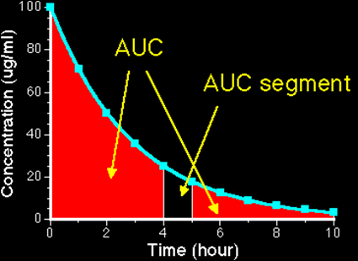
Applications of Integration
Exposure to a drug = Area under the plasma concentration time curve (AUC)
c/p1/Ch04/Ch0410.html

Slide 15
APPLICATIONS OF INTEGRATION
IN-CLASS PROBLEM 2
Find exposure to the drug if:
AUC = ∫₄⁵ 100/15 e ^{-0.5t} dt

Slide 16
APPLICATIONS OF INTEGRATION
IN-CLASS PROBLEM 2
Find exposure to the drug if:
AUC = ∫₄⁵ 100/15 e ^{-0.5t} dt
Calculator or Wolframalpha:

Slide 17
APPLICATIONS OF INTEGRATION
IN-CLASS PROBLEM 2
Find exposure to the drug if:
AUC = ∫₄⁵ 100/15 e ^{-0.5t} dt
Calculator or Wolframalpha:
AUC ≈ 0.71 can you figure out the units?

Slide 18
APPLICATIONS OF INTEGRATION
IN-CLASS PROBLEM 2
Find exposure to the drug if:
AUC = ∫₄⁵ 100/15 e ^{-0.5t} dt
Calculator or Wolframalpha:
AUC ≈ 0.71 μg/ml × hour believe it or not…
μg h /ml

Slide 19
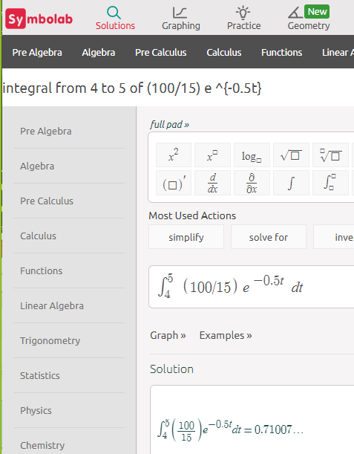
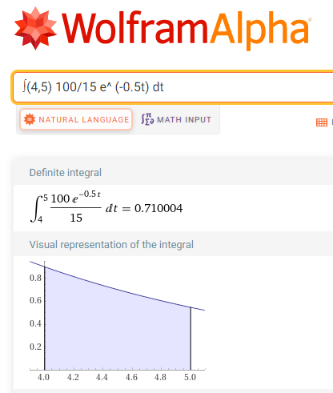
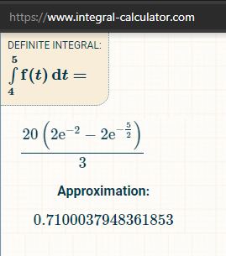
This one was wrong…

Slide 20
Applications of Integration
Notice how this used
e^{-some tiny number}
We’ll be covering these in more detail in Integral Calculus

Slide 21
Questions?
http://i.imgur.com/aliTlT3.jpg

Slide 22
Applications of Integration
Physics has a lot of uses of integration

Slide 23
Applications of Integration
Physics has a lot of uses of integration:
To undo all of the velocity, acceleration, jerk calculations
But there’s a lot more!

Slide 24
APPLICATIONS OF INTEGRATION
IN-CLASS PROBLEM 3
A starburst bomb is launched vertically at 265 ft/sec velocity from a mortar on the ground. If gravity gives it an acceleration of -32.2 ft/sec², how high will it be 5 seconds after launch?

Slide 25
APPLICATIONS OF INTEGRATION
IN-CLASS PROBLEM 3
A starburst bomb is launched vertically at 265 ft/sec velocity from a mortar on the ground. If gravity gives it an acceleration of -32.2 ft/sec², how high will it be 5 seconds after launch?
Why is the acceleration of gravity MINUS 32.2 ft/sec²?

Slide 26
APPLICATIONS OF INTEGRATION
IN-CLASS PROBLEM 3
A starburst bomb is launched vertically at 265 ft/sec velocity from a mortar on the ground. If gravity gives it an acceleration of -32.2 ft/sec², how high will it be 5 seconds after launch?
Why is the acceleration of gravity MINUS 32.2 ft/sec²?
Gravity is trying to pull it down

Slide 27
APPLICATIONS OF INTEGRATION
IN-CLASS PROBLEM 3
A starburst bomb is launched vertically at 265 ft/sec velocity from a mortar on the ground. If gravity gives it an acceleration of -32.2 ft/sec², how high will it be 5 seconds after launch?
We need an equation…

Slide 28
APPLICATIONS OF INTEGRATION
IN-CLASS PROBLEM 3
A starburst bomb is launched vertically at 265 ft/sec velocity from a mortar on the ground. If gravity gives it an acceleration of -32.2 ft/sec², how high will it be 5 seconds after launch?
Remember, acceleration is the derivative of velocity…

Slide 29
APPLICATIONS OF INTEGRATION
IN-CLASS PROBLEM 3
A starburst bomb is launched vertically at 265 ft/sec velocity from a mortar on the ground. If gravity gives it an acceleration of -32.2 ft/sec², how high will it be 5 seconds after launch?
Remember, acceleration is the derivative of velocity…
a = dv/dt

Slide 30
APPLICATIONS OF INTEGRATION
IN-CLASS PROBLEM 3
A starburst bomb is launched vertically at 265 ft/sec velocity from a mortar on the ground. If gravity gives it an acceleration of -32.2 ft/sec², how high will it be 5 seconds after launch?
a = dv/dt
Here’s a trick: split up the derivative!

Slide 31
APPLICATIONS OF INTEGRATION
IN-CLASS PROBLEM 3
A starburst bomb is launched vertically at 265 ft/sec velocity from a mortar on the ground. If gravity gives it an acceleration of -32.2 ft/sec², how high will it be 5 seconds after launch?
a = dv/dt
Here’s a trick: split up the derivative! Solving for dv: dv = a dt

Slide 32
APPLICATIONS OF INTEGRATION
IN-CLASS PROBLEM 3
A starburst bomb is launched vertically at 265 ft/sec velocity from a mortar on the ground. If gravity gives it an acceleration of -32.2 ft/sec², how high will it be 5 seconds after launch?
Here’s another trick used a lot:
Integrate both sides of the equation: dv = a dt

Slide 33
APPLICATIONS OF INTEGRATION
IN-CLASS PROBLEM 3
A starburst bomb is launched vertically at 265 ft/sec velocity from a mortar on the ground. If gravity gives it an acceleration of -32.2 ft/sec², how high will it be 5 seconds after launch?
Integrate both sides of the equation: ∫dv = ∫a dt
v + c1 = at + c2

Slide 34
APPLICATIONS OF INTEGRATION
IN-CLASS PROBLEM 3
A starburst bomb is launched vertically at 265 ft/sec velocity from a mortar on the ground. If gravity gives it an acceleration of -32.2 ft/sec², how high will it be 5 seconds after launch?
Another trick: combine the cs:
v + c1 = at + c2
v = at + c where c = c2 – c1

Slide 35
APPLICATIONS OF INTEGRATION
IN-CLASS PROBLEM 3
A starburst bomb is launched vertically at 265 ft/sec velocity from a mortar on the ground. If gravity gives it an acceleration of -32.2 ft/sec², how high will it be 5 seconds after launch?
v = at + c
When t=0, v=265 and a=-32.2
(we can solve for “c”)

Slide 36
APPLICATIONS OF INTEGRATION
IN-CLASS PROBLEM 3
A starburst bomb is launched vertically at 265 ft/sec velocity from a mortar on the ground. If gravity gives it an acceleration of -32.2 ft/sec², how high will it be 5 seconds after launch?
v = at + c
265 = -32.2(0) + c
So c = 265

Slide 37
APPLICATIONS OF INTEGRATION
IN-CLASS PROBLEM 3
A starburst bomb is launched vertically at 265 ft/sec velocity from a mortar on the ground. If gravity gives it an acceleration of -32.2 ft/sec², how high will it be 5 seconds after launch?
So the velocity equation is:
v = -32.2t + 265

Slide 38
APPLICATIONS OF INTEGRATION
IN-CLASS PROBLEM 3
A starburst bomb is launched vertically at 265 ft/sec velocity from a mortar on the ground. If gravity gives it an acceleration of -32.2 ft/sec², how high will it be 5 seconds after launch?
The velocity equation was the first derivative of the location equation (s_{t}): ds/dt = v

Slide 39
APPLICATIONS OF INTEGRATION
IN-CLASS PROBLEM 3
A starburst bomb is launched vertically at 265 ft/sec velocity from a mortar on the ground. If gravity gives it an acceleration of -32.2 ft/sec², how high will it be 5 seconds after launch?
ds/dt = v = -32.2t + 265
Follow the same tricks!
1) Split up the ds/dt

Slide 40
APPLICATIONS OF INTEGRATION
IN-CLASS PROBLEM 3
A starburst bomb is launched vertically at 265 ft/sec velocity from a mortar on the ground. If gravity gives it an acceleration of -32.2 ft/sec², how high will it be 5 seconds after launch?
ds/dt = v = -32.2t + 265
ds = (-32.2t + 265) dt

Slide 41
APPLICATIONS OF INTEGRATION
IN-CLASS PROBLEM 3
A starburst bomb is launched vertically at 265 ft/sec velocity from a mortar on the ground. If gravity gives it an acceleration of -32.2 ft/sec², how high will it be 5 seconds after launch?
ds = (-32.2t + 265) dt
(now do you see why the integrand should be in parentheses?

Slide 42
APPLICATIONS OF INTEGRATION
IN-CLASS PROBLEM 3
A starburst bomb is launched vertically at 265 ft/sec velocity from a mortar on the ground. If gravity gives it an acceleration of -32.2 ft/sec², how high will it be 5 seconds after launch?
ds = (-32.2t + 265) dt
What’s next?

Slide 43
APPLICATIONS OF INTEGRATION
IN-CLASS PROBLEM 3
A starburst bomb is launched vertically at 265 ft/sec velocity from a mortar on the ground. If gravity gives it an acceleration of -32.2 ft/sec², how high will it be 5 seconds after launch?
ds = (-32.2t + 265) dt
Trick 2: integrate both sides of the equation

Slide 44
APPLICATIONS OF INTEGRATION
IN-CLASS PROBLEM 3
A starburst bomb is launched vertically at 265 ft/sec velocity from a mortar on the ground. If gravity gives it an acceleration of -32.2 ft/sec², how high will it be 5 seconds after launch?
ds = (-32.2t + 265) dt
∫ ds = ∫(-32.2t + 265) dt
s + c1 = -32.2/2 t² + 265t + c2

Slide 45
APPLICATIONS OF INTEGRATION
IN-CLASS PROBLEM 3
A starburst bomb is launched vertically at 265 ft/sec velocity from a mortar on the ground. If gravity gives it an acceleration of -32.2 ft/sec², how high will it be 5 seconds after launch?
s + c1 = -32.2/2 t² + 265t + c2
Remember the next trick?

Slide 46
APPLICATIONS OF INTEGRATION
IN-CLASS PROBLEM 3
A starburst bomb is launched vertically at 265 ft/sec velocity from a mortar on the ground. If gravity gives it an acceleration of -32.2 ft/sec², how high will it be 5 seconds after launch?
s + c1 = -32.2/2 t² + 265t + c2
Remember the next trick?
Trick 3: Combine the “c”s

Slide 47
APPLICATIONS OF INTEGRATION
IN-CLASS PROBLEM 3
A starburst bomb is launched vertically at 265 ft/sec velocity from a mortar on the ground. If gravity gives it an acceleration of -32.2 ft/sec², how high will it be 5 seconds after launch?
s + c1 = -32.2/2 t² + 265t + c2
s = -16.1t² + 265t + c

Slide 48
APPLICATIONS OF INTEGRATION
IN-CLASS PROBLEM 3
A starburst bomb is launched vertically at 265 ft/sec velocity from a mortar on the ground. If gravity gives it an acceleration of -32.2 ft/sec², how high will it be 5 seconds after launch?
s = -16.1t² + 265t + c
When t was 0, s was 0 (‘cause the bomb was on the ground where it started)

Slide 49
APPLICATIONS OF INTEGRATION
IN-CLASS PROBLEM 3
A starburst bomb is launched vertically at 265 ft/sec velocity from a mortar on the ground. If gravity gives it an acceleration of -32.2 ft/sec², how high will it be 5 seconds after launch?
s = -16.1t² + 265t + c
0 = -16.1(0²) + 265(0) + c
And c = 0

Slide 50
APPLICATIONS OF INTEGRATION
IN-CLASS PROBLEM 3
A starburst bomb is launched vertically at 265 ft/sec velocity from a mortar on the ground. If gravity gives it an acceleration of -32.2 ft/sec², how high will it be 5 seconds after launch?
All this just to get the location equation:
s = -16.1t² + 265t + 0

Slide 51
APPLICATIONS OF INTEGRATION
IN-CLASS PROBLEM 3
A starburst bomb is launched vertically at 265 ft/sec velocity from a mortar on the ground. If gravity gives it an acceleration of -32.2 ft/sec², how high will it be 5 seconds after launch?
s = -16.1t² + 265t
So, what is the bomb’s location at t=5 seconds?

Slide 52
APPLICATIONS OF INTEGRATION
IN-CLASS PROBLEM 3
A starburst bomb is launched vertically at 265 ft/sec velocity from a mortar on the ground. If gravity gives it an acceleration of -32.2 ft/sec², how high will it be 5 seconds after launch?
s = -16.1(5²) + 265(5)

Slide 53
APPLICATIONS OF INTEGRATION
IN-CLASS PROBLEM 3
A starburst bomb is launched vertically at 265 ft/sec velocity from a mortar on the ground. If gravity gives it an acceleration of -32.2 ft/sec², how high will it be 5 seconds after launch?
s = -16.1(5²) + 265(5)
= -402.5 + 1325 = 922.5 whats?

Slide 54
APPLICATIONS OF INTEGRATION
IN-CLASS PROBLEM 3
A starburst bomb is launched vertically at 265 ft/sec velocity from a mortar on the ground. If gravity gives it an acceleration of -32.2 ft/sec², how high will it be 5 seconds after launch?
s = -16.1(5²) + 265(5)
= -402.5 + 1325 = 922.5 ft

Slide 55
APPLICATIONS OF INTEGRATION
IN-CLASS PROBLEM 4
Can we use calculus to find the max height of the bomb?
s = -16.1t² + 265t

Slide 56
APPLICATIONS OF INTEGRATION
IN-CLASS PROBLEM 4
Can we use calculus to find the max height of the bomb?
s = -16.1t² + 265t
The max height would be where the first derivative (velocity) was zero
v = -32.2t + 265
Which is zero where?

Slide 57
APPLICATIONS OF INTEGRATION
IN-CLASS PROBLEM 4
Can we use calculus to find the max height of the bomb?
s = -16.1t² + 265t
The max height would be where the first derivative (velocity) was zero
v = -32.2t + 265 = 0
when t = -265/-32.2 ≈ 8.23 whats?

Slide 58
APPLICATIONS OF INTEGRATION
IN-CLASS PROBLEM 4
Can we use calculus to find the max height of the bomb?
s = -16.1t² + 265t
The max height would be where the first derivative (velocity) was zero: v = -32.2t + 265 = 0
when t = -265/-32.2 ≈ 8.23 sec
Hmmm… that doesn’t answer the question about height…

Slide 59
APPLICATIONS OF INTEGRATION
IN-CLASS PROBLEM 4
Can we use calculus to find the max height of the bomb?
s = -16.1t² + 265t
The max height would be where the first derivative (velocity) was zero: v = -32.2t + 265 = 0
when t = -265/-32.2 ≈ 8.23 sec
Plug it into the location equation!

Slide 60
APPLICATIONS OF INTEGRATION
IN-CLASS PROBLEM 4
Can we use calculus to find the max height of the bomb?
s = -16.1t² + 265t
The max height would be when
t ≈ 8.23 sec
Or s ≈ -16.1(8.23²) + 265(8.23)
≈ -1090.45 + 2180.95
≈ 1090.5 whats?

Slide 61
APPLICATIONS OF INTEGRATION
IN-CLASS PROBLEM 4
Can we use calculus to find the max height of the bomb?
s = -16.1t² + 265t
The max height would be when
t ≈ 8.23 sec
Or s ≈ -16.1(8.23²) + 265(8.23)
≈ -1090.45 + 2180.95
≈ 1090.5 ft

Slide 62
APPLICATIONS OF INTEGRATION
IN-CLASS PROBLEM 4
1090.5 ft
You could test to verify this is a max (not a min), but since you know the bomb started at 0 ft, this has to be a max

Slide 63
Applications of Integration
So we’ve got some new tricks:
Trick 0: come up with an equation involving dy/dx (y and x will be the variables you are interested in)
Trick 1: split the dy and dx into two sides of the equation
Trick 2: integrate both sides
Trick 3: combine the “c”s

Slide 64
Questions?
http://i.imgur.com/aliTlT3.jpg

Slide 65
Applications of Integration
Useful equations for electronics:

Slide 66
Applications of Integration
Useful equations for electronics:
v(t) = dw/dq
v(t) is the voltage (volts)
w is the energy (joules)
q is the charge (coulombs)

Slide 67
Applications of Integration
Useful equations for electronics:
i(t) = dq/dt
i(t) is the current (amps)
t is the time (sec)

Slide 68
Applications of Integration
Useful equations for electronics:
p(t) = dw/dt
= (dw/dq)(dq/dt)
= v(t)×i(t)
p(t) is the power in
joules/sec or watts

Slide 69
Applications of Integration
Useful equations for electronics:
i_{c} = C dv/dt
i_{c} is instantaneous capacitor
current in amps
C is capacitance in Farads

Slide 70
Applications of Integration
Useful equations for electronics:
v_{coil} = N dw/dt
v_{coil} is the instantaneous coil
voltage (in volts)
N is the number of primary
turns

Slide 71
Applications of Integration
Useful equations for electronics:
V_{L} = L di/dt
V_{L} is the instantaneous
inductor voltage
L is the inductance in Henrys
(H)

Slide 72
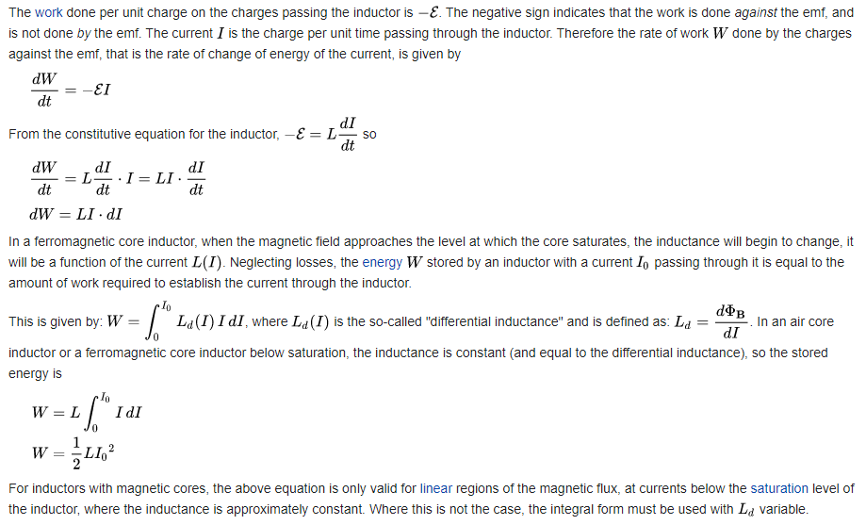
Applications of Integration

Slide 73
Applications of Integration
Differentiation can help analyze the operation of certain electrical circuits
How about integration?

Slide 74
APPLICATIONS OF INTEGRATION
IN-CLASS PROBLEM 5
A current of i = 3t² was maintained in a battery charger circuit for 5 seconds. How many coulombs of charge were delivered?
(Assume the battery was uncharged: q=0 at t=0)

Slide 75
APPLICATIONS OF INTEGRATION
IN-CLASS PROBLEM 5
A current of i = 3t² was maintained in a battery charger circuit for 5 seconds. How many coulombs of charge were delivered? (at t=0, q=0)
We’ve got an equation: i(t)=dq/dt
What now?

Slide 76
APPLICATIONS OF INTEGRATION
IN-CLASS PROBLEM 5
A current of i = 3t² was maintained in a battery charger circuit for 5 seconds. How many coulombs of charge were delivered? (at t=0, q=0)
We’ve got an equation: i(t)=dq/dt
What now? Split the ds:
i dt = dq
What next?

Slide 77
APPLICATIONS OF INTEGRATION
IN-CLASS PROBLEM 5
A current of i = 3t² was maintained in a battery charger circuit for 5 seconds. How many coulombs of charge were delivered? (at t=0, q=0)
We’ve got an equation: i(t)=dq/dt
What now? Split the ds:
i dt = dq
What next? Integrate both sides

Slide 78
APPLICATIONS OF INTEGRATION
IN-CLASS PROBLEM 5
A current of i = 3t² was maintained in a battery charger circuit for 5 seconds. How many coulombs of charge were delivered? (at t=0, q=0)
Integrate both sides:
∫ i dt = ∫ dq
But… i is a function of t – you need to first include the function

Slide 79
APPLICATIONS OF INTEGRATION
IN-CLASS PROBLEM 5
A current of i = 3t² was maintained in a battery charger circuit for 5 seconds. How many coulombs of charge were delivered? (at t=0, q=0)
∫ i dt = ∫ dq
∫ 3t² dt = ∫ dq
t³ + c1 = q + c2
(Now what?)

Slide 80
APPLICATIONS OF INTEGRATION
IN-CLASS PROBLEM 5
A current of i = 3t² was maintained in a battery charger circuit for 5 seconds. How many coulombs of charge were delivered? (at t=0, q=0)
Combine the “c”s:
q = t³ + c
(Now what?)

Slide 81
APPLICATIONS OF INTEGRATION
IN-CLASS PROBLEM 5
A current of i = 3t² was maintained in a battery charger circuit for 5 seconds. How many coulombs of charge were delivered? (at t=0, q=0)
Combine the “c”s:
q = t³ + c
(Now what?) can we solve for c?

Slide 82
APPLICATIONS OF INTEGRATION
IN-CLASS PROBLEM 5
A current of i = 3t² was maintained in a battery charger circuit for 5 seconds. How many coulombs of charge were delivered? (at t=0, q=0)
q = t³ + c
At q=0, t=0:
0 = 0³ + c so c=0

Slide 83
APPLICATIONS OF INTEGRATION
IN-CLASS PROBLEM 5
A current of i = 3t² was maintained in a battery charger circuit for 5 seconds. How many coulombs of charge were delivered? (at t=0, q=0)
So our charge equation is:
q = t³
Are we done?

Slide 84
APPLICATIONS OF INTEGRATION
IN-CLASS PROBLEM 5
A current of i = 3t² was maintained in a battery charger circuit for 5 seconds. How many coulombs of charge were delivered? (at t=0, q=0)
So our charge equation is:
q = t³
Plug in t=5

Slide 85
APPLICATIONS OF INTEGRATION
IN-CLASS PROBLEM 5
A current of i = 3t² was maintained in a battery charger circuit for 5 seconds. How many coulombs of charge were delivered? (at t=0, q=0)
So our charge equation is:
q = t³
q = 5³ = 125 whats?

Slide 86
APPLICATIONS OF INTEGRATION
IN-CLASS PROBLEM 5
A current of i = 3t² was maintained in a battery charger circuit for 5 seconds. How many coulombs of charge were delivered? (at t=0, q=0)
So our charge equation is:
q = t³
q = 5³ = 125 coulombs

Slide 87
Questions?
http://i.imgur.com/aliTlT3.jpg

Slide 88
The secret word for this unit is:
DONE!

Slide 89
APPLICATIONS OF INTEGRATION
IN-CLASS PROBLEM 6
An uncharged 450 μF capacitor is attached to a 12-volt dc supply unit until it is fully charged. Then a current modeled by i = 0.04t³ amps is applied to charge it even more. When will the capacitor’s voltage reach 28v?

Slide 90
APPLICATIONS OF INTEGRATION
IN-CLASS PROBLEM 6
Looking at the first part:
An uncharged 450 μF capacitor is attached to a 12-volt dc supply unit until it is fully charged.
This part of the problem is modeled by:
q = Cv
What is C?

Slide 91
APPLICATIONS OF INTEGRATION
IN-CLASS PROBLEM 6
An uncharged 450 μF capacitor is attached to a 12-volt dc supply unit until it is fully charged.
This part of the problem is modeled by:
What is C? 450 μF = .00045 F
q = Cv (where C is in Farads)
= .000450 × v
How about v?

Slide 92
APPLICATIONS OF INTEGRATION
IN-CLASS PROBLEM 6
An uncharged 450 μF capacitor is attached to a 12-volt dc supply unit until it is fully charged.
This part of the problem is modeled by:
How about v? v=12
q = Cv = .00045×12 = 0.0054 whats?

Slide 93
APPLICATIONS OF INTEGRATION
IN-CLASS PROBLEM 6
An uncharged 450 μF capacitor is attached to a 12-volt dc supply unit until it is fully charged.
This part of the problem is modeled by:
q = Cv = 0.0054 coulombs

Slide 94
APPLICATIONS OF INTEGRATION
IN-CLASS PROBLEM 6
An uncharged 450 μF capacitor is attached to a 12-volt dc supply unit until it is fully charged.
This part of the problem is modeled by:
q = Cv = 0.0054 coulombs
This is the initial charge (t=0)
Now we need to do part 2

Slide 95
APPLICATIONS OF INTEGRATION
IN-CLASS PROBLEM 6
Then a current modeled by
i = 0.04t³ amps is applied to charge it even more
q = Cv = 0.0054
Part 2: we’ll use the Useful Equation: i(t) = dq/dt
Trick 1:

Slide 96
APPLICATIONS OF INTEGRATION
IN-CLASS PROBLEM 6
Then a current modeled by
i = 0.04t³ amps is applied to charge it even more
q = Cv = 0.0054
Part 2: we’ll use the Useful Equation: i(t) = dq/dt
Trick 1: i(t) dt = dq
Or: 0.04t³ dt = dq

Slide 97
APPLICATIONS OF INTEGRATION
IN-CLASS PROBLEM 6
Then a current modeled by
i = 0.04t³ amps is applied to charge it even more
q = Cv = 0.0054
0.04t³ dt = dq
Trick 2:

Slide 98
APPLICATIONS OF INTEGRATION
IN-CLASS PROBLEM 6
Then a current modeled by
i = 0.04t³ amps is applied to charge it even more
q = Cv = 0.0054
0.04t³ dt = dq
Trick 2: ∫ 0.04t³ dt = ∫ dq

Slide 99
APPLICATIONS OF INTEGRATION
IN-CLASS PROBLEM 6
Then a current modeled by
i = 0.04t³ amps is applied to charge it even more
q = Cv = 0.0054
0.04t³ dt = dq
Trick 2: ∫ 0.04t³ dt = ∫ dq
.01t⁴ + c1 = q + c2
Trick 3:

Slide 100
APPLICATIONS OF INTEGRATION
IN-CLASS PROBLEM 6
Then a current modeled by
i = 0.04t³ amps is applied to charge it even more
q = Cv = 0.0054
Trick 3: q = .01t⁴ + c
But q = 0.0054 at t=0,
so c=?

Slide 101
APPLICATIONS OF INTEGRATION
IN-CLASS PROBLEM 6
Then a current modeled by
i = 0.04t³ amps is applied to charge it even more
q = Cv = 0.0054
But q = 0.0054 at t=0,
0.0054 = .01(0)⁴ + c
so c = 0.0054
q = .01t⁴ + 0.0054

Slide 102
APPLICATIONS OF INTEGRATION
IN-CLASS PROBLEM 6
q = .01t⁴ + 0.0054
When will the capacitor’s voltage reach 28v?

Slide 103
APPLICATIONS OF INTEGRATION
IN-CLASS PROBLEM 6
q = .01t⁴ + 0.0054
When will the capacitor’s voltage reach 28v?
Back to: q = Cv = .00045 (28)
Use this in the last derived equation

Slide 104
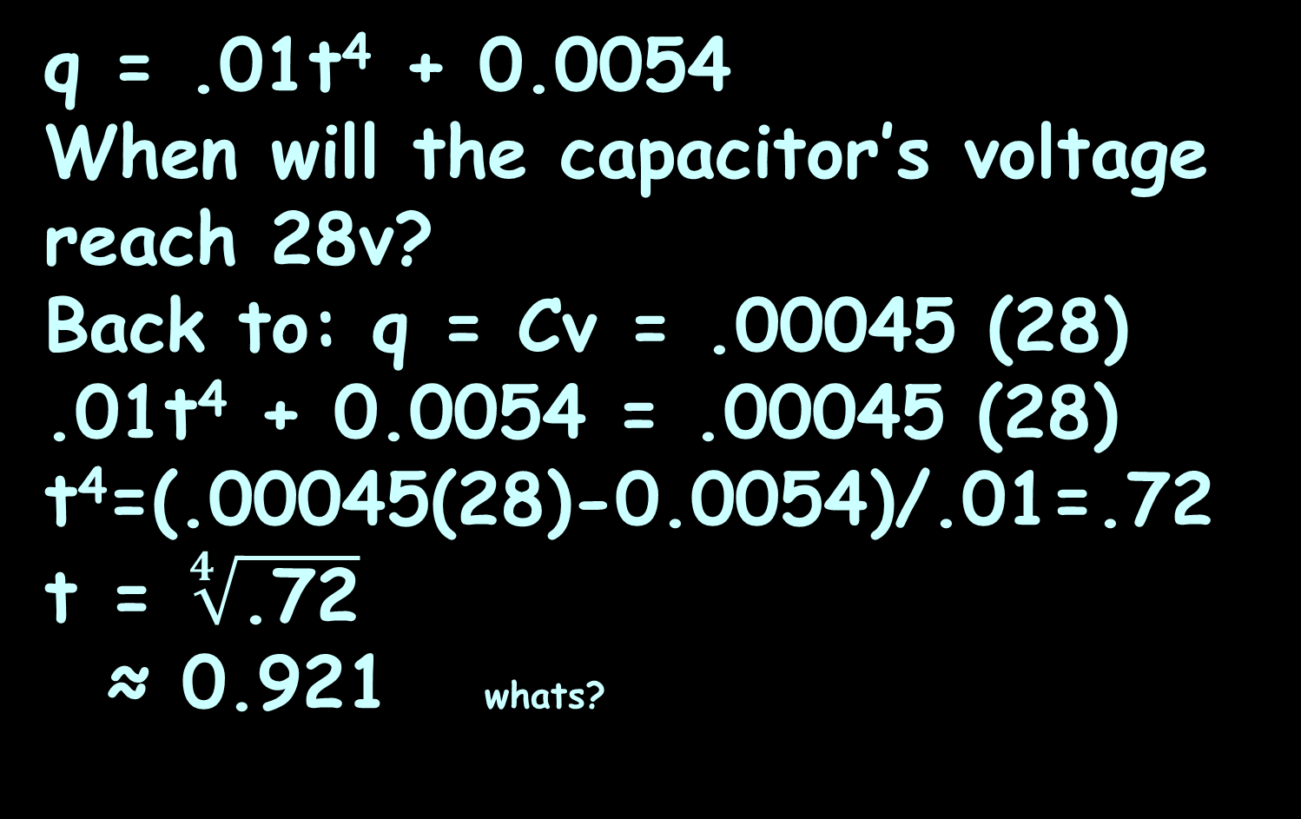
APPLICATIONS OF INTEGRATION
IN-CLASS PROBLEM 6
q = .01t⁴ + 0.0054
When will the capacitor’s voltage reach 28v?
Back to: q = Cv = .00045 (28)
.01t⁴ + 0.0054 = .00045 (28)
t⁴=(.00045(28)-0.0054)/.01=.72
t = $\sqrt[4]{\text{.72}}$
≈ 0.921 whats?

Slide 105
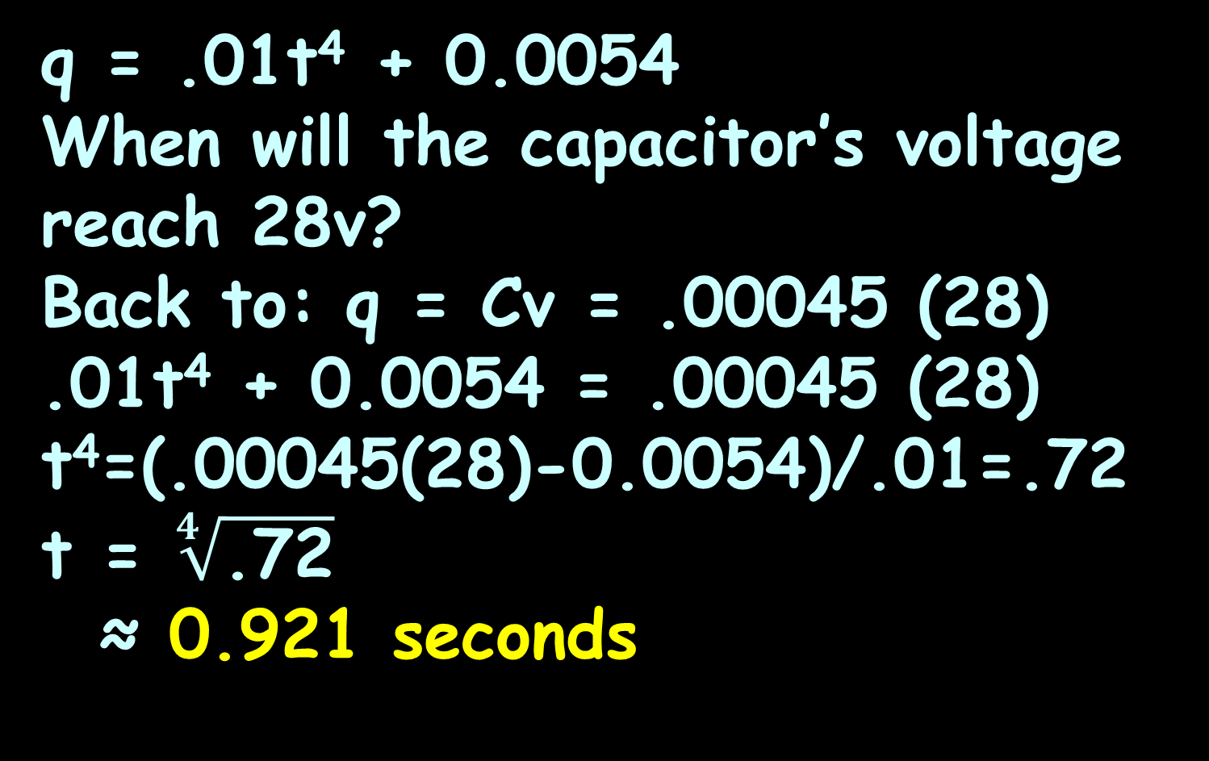
APPLICATIONS OF INTEGRATION
IN-CLASS PROBLEM 6
q = .01t⁴ + 0.0054
When will the capacitor’s voltage reach 28v?
Back to: q = Cv = .00045 (28)
.01t⁴ + 0.0054 = .00045 (28)
t⁴=(.00045(28)-0.0054)/.01=.72
t = $\sqrt[4]{\text{.72}}$
≈ 0.921 seconds

Slide 106
Questions?
http://i.imgur.com/aliTlT3.jpg

Slide 107
Applications of Integration
Valdez Gant video

Slide 108
Questions?
http://i.imgur.com/aliTlT3.jpg

Slide 109
Average Value of a Function
Calculating the average for a list of numbers is easy:

Slide 110
Average Value of a Function
Calculating the average for a list of numbers is easy:
Add ‘em up

Slide 111
Average Value of a Function
Calculating the average for a list of numbers is easy:
Add ‘em up
Divide by how many there are

Slide 112

Average Value of a Function
How would you calculate the average for an infinite number of numbers?
stock-photo-skeptical-senior-man-1724336.jpg

Slide 113

Average Value of a Function
Uh… maybe… calculus?
http://dartoidsworld.net/wp-content/uploads/2015/02/so-what-pic.jpg

Slide 114

Average Value of a Function
Yep!
http://www.brocku.ca/blogs/futurestudents/files/2014/08/studentsupport_small.jpg

Slide 115
AVERAGE VALUE OF A FUNCTION
IN-CLASS PROBLEM 7
Calculate the average value of
y = x² for values of x from 0 to 5
https://www.wolframalpha.com/input/?i=y+%3D+x%5E2+from+0+to+5

Slide 116
AVERAGE VALUE OF A FUNCTION
IN-CLASS PROBLEM 7
Calculate the average value of y = x² for values of x from 0 to 5
You could do a table of values:
Add ‘em all up and divide by “n”
x | 0 | 1 | 2 | 3 | 4 | 5
y | 0 | 1 | 4 | 9 | 16 | 25
https://www.wolframalpha.com/input/?i=y+%3D+x%5E2+from+0+to+5

Slide 117
AVERAGE VALUE OF A FUNCTION
IN-CLASS PROBLEM 7
Calculate the average value of y = x² for values of x from 0 to 5
More values would be closer:
But it’s definitely feeling like area under a curve…
x | 0 | 0.5 | 1 | 1.5 | 2 | 2.5 | 3 | 3.5 | 4 | 4.5 | 5
y | 0 | 0.25 | 1 | 2.25 | 4 | 6.25 | 9 | 12.25 | 16 | 20.25 | 25
https://www.wolframalpha.com/input/?i=y+%3D+x%5E2+from+0+to+5

Slide 118
Average Value of a Function
The average value of a curve over an interval x=a to x=b is:
∫ ƒ(x) dx
b
a
y_{avg} =
b - a

Slide 119
AVERAGE VALUE OF A FUNCTION
IN-CLASS PROBLEM 7
Calculate the average value of
y = x² for values of x from 0 to 5
What’s b?
∫ ƒ(x) dx
b
a
y_{avg} =
b - a
https://www.wolframalpha.com/input/?i=y+%3D+x%5E2+from+0+to+5

Slide 120
AVERAGE VALUE OF A FUNCTION
IN-CLASS PROBLEM 7
Calculate the average value of
y = x² for values of x from 0 to 5
What’s b? 5
What’s a?
∫ ƒ(x) dx
5
a
y_{avg} =
5 - a
https://www.wolframalpha.com/input/?i=y+%3D+x%5E2+from+0+to+5

Slide 121
AVERAGE VALUE OF A FUNCTION
IN-CLASS PROBLEM 7
Calculate the average value of
y = x² for values of x from 0 to 5
What’s b? 5
What’s a? 0
What’s ƒ(x)?
∫ ƒ(x) dx
5
y_{avg} =
0
5 - 0
https://www.wolframalpha.com/input/?i=y+%3D+x%5E2+from+0+to+5

Slide 122
AVERAGE VALUE OF A FUNCTION
IN-CLASS PROBLEM 7
Calculate the average value of
y = x² for values of x from 0 to 5
What’s b? 5
What’s a? 0
What’s ƒ(x)? x²
∫ x² dx
5
y_{avg} =
0
5 - 0
https://www.wolframalpha.com/input/?i=y+%3D+x%5E2+from+0+to+5

Slide 123
AVERAGE VALUE OF A FUNCTION
IN-CLASS PROBLEM 7
Calculate the average value of y = x² for values of x from 0 to 5
Do it!
∫ x² dx
5
y_{avg} =
0
5 - 0
https://www.wolframalpha.com/input/?i=y+%3D+x%5E2+from+0+to+5

Slide 124
AVERAGE VALUE OF A FUNCTION
IN-CLASS PROBLEM 7
Calculate the average value of y = x² for values of x from 0 to 5
= x³/15
∫ x² dx
5
y_{avg} =
0
5 - 0
|
5
0
https://www.wolframalpha.com/input/?i=y+%3D+x%5E2+from+0+to+5

Slide 125
AVERAGE VALUE OF A FUNCTION
IN-CLASS PROBLEM 7
Calculate the average value of y = x² for values of x from 0 to 5
= x³/15
= 5³/15 - 0³/15
= 125/15 = 25/3
≈ 8.33
∫ x² dx
5
y_{avg} =
0
5 - 0
|
5
0
https://www.wolframalpha.com/input/?i=y+%3D+x%5E2+from+0+to+5

Slide 126
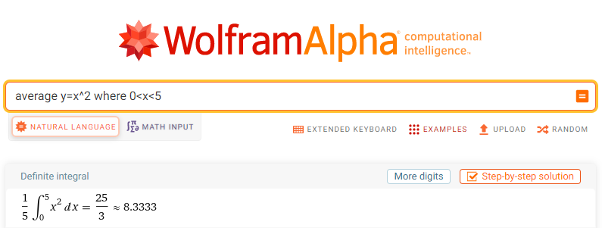

Slide 127
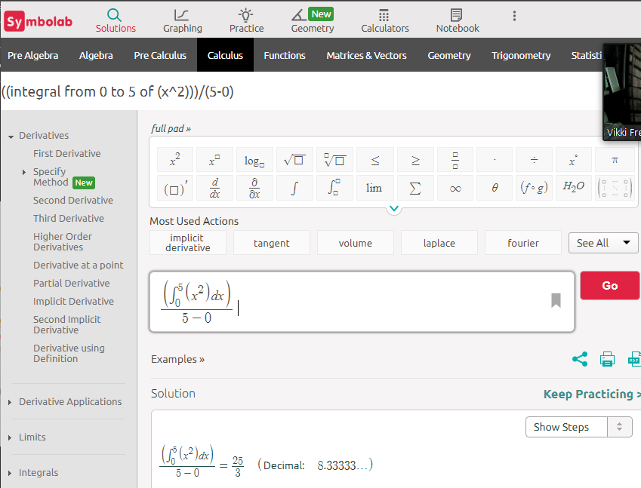

Slide 128
Questions?
http://i.imgur.com/aliTlT3.jpg

Slide 129
Arc (Curve) Length
We want to determine the length of a continuous function
y=f(x) on the interval [a,b]

Slide 130
Arc (Curve) Length
To estimate the length of the curve, divide the interval up into equal subintervals each of width Δx
Δx
https://tutorial.math.lamar.edu/Classes/CalcII/ArcLength.aspx

Slide 131
Arc (Curve) Length
Approximate the curve by a series of straight lines connecting the points
Δx
https://tutorial.math.lamar.edu/Classes/CalcII/ArcLength.aspx

Slide 132
Arc (Curve) Length
The length of the curve can be
estimated by the sum of the lengths of the lines
Δx
https://tutorial.math.lamar.edu/Classes/CalcII/ArcLength.aspx

Slide 133

Arc (Curve) Length
The length of each line is: $\sqrt{\left({\text{x}}_{\text{i}}\text{−}{\text{x}}_{\text{i}\text{−1}}\right)\text{2}\text{+}\left({\text{y}}_{\text{i}}\text{−}{\text{y}}_{\text{i}\text{−1}}\right)\text{2}}$ =$\sqrt{\text{Δx}\text{2}\text{+}\text{Δ}\text{y}\text{2}}$
Δy
{
- - -
Δx
https://tutorial.math.lamar.edu/Classes/CalcII/ArcLength.aspx

Slide 134

Arc (Curve) Length
As Δx→0, the length of the curve becomes:
L = ∫_{a}^{b}$\sqrt{{\text{1+(}\text{dy}\text{/}\text{dx}\text{)}}^{\text{2}}}$dx
Δy
{
- - -
Δx
https://tutorial.math.lamar.edu/Classes/CalcII/ArcLength.aspx

Slide 135

Arc (Curve) Length
Note: this is often given the letter “S”
S = ∫_{a}^{b} $\sqrt{{\text{1+(}\text{dy}\text{/}\text{dx}\text{)}}^{\text{2}}}$ dx
Δy
{
- - -
Δx
https://tutorial.math.lamar.edu/Classes/CalcII/ArcLength.aspx

Slide 136
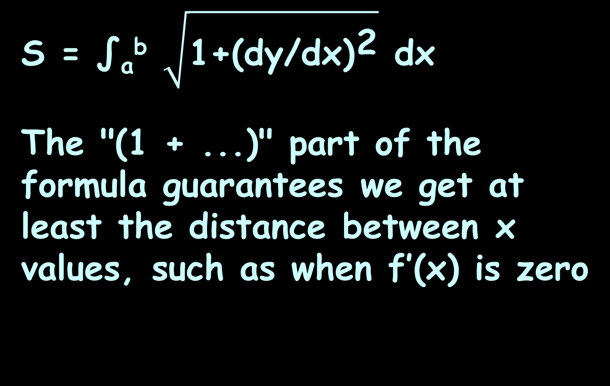
Arc (Curve) Length
S = ∫_{a}^{b} $\sqrt{{\text{1+(}\text{dy}\text{/}\text{dx}\text{)}}^{\text{2}}}$ dx
The "(1 + ...)" part of the formula guarantees we get at least the distance between x values, such as when f’(x) is zero

Slide 137
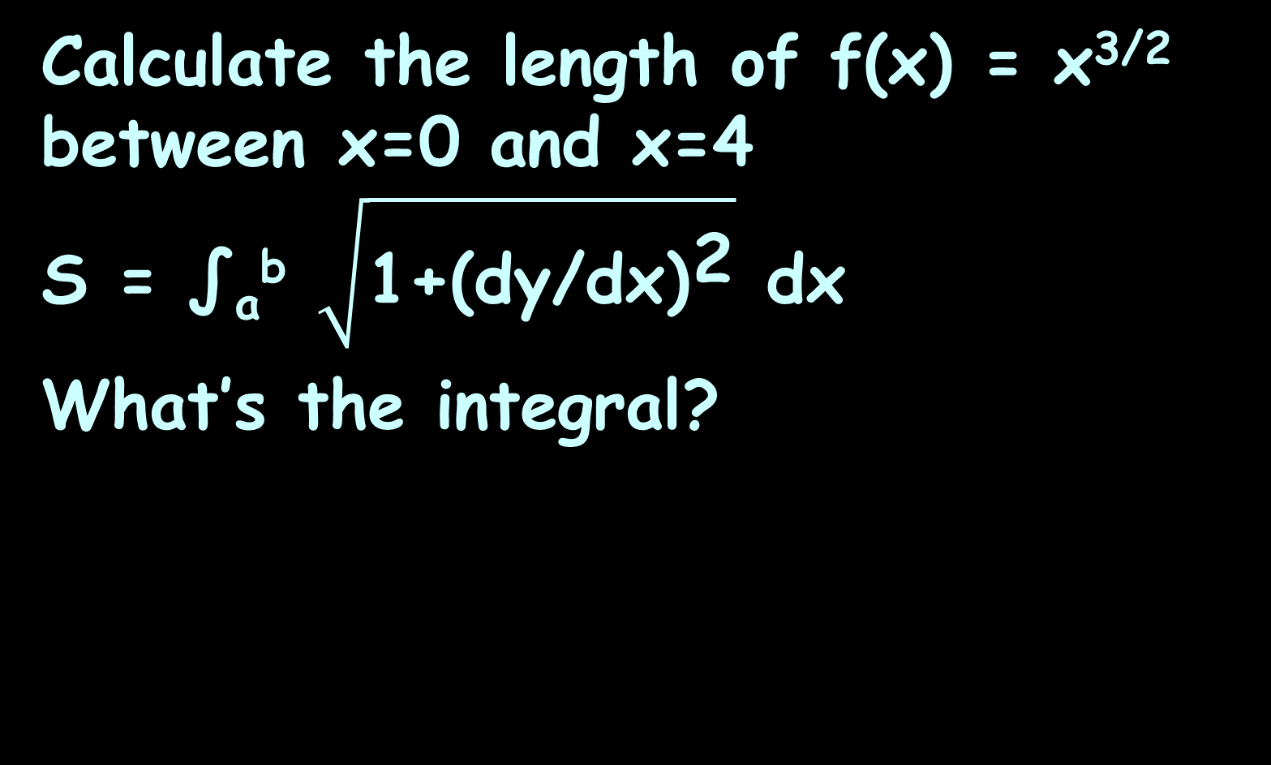
ARC (CURVE) LENGTH
IN-CLASS PROBLEM 8
Calculate the length of f(x) = x^{3/2} between x=0 and x=4
S = ∫_{a}^{b} $\sqrt{{\text{1+(}\text{dy}\text{/}\text{dx}\text{)}}^{\text{2}}}$ dx
What’s the integral?
https://www.mathsisfun.com/calculus/arc-length.html

Slide 138

ARC (CURVE) LENGTH
IN-CLASS PROBLEM 8
Calculate the length of f(x) = x^{3/2} between x=0 and x=4
Do it!
S = ∫ $\sqrt{\text{1+(3/2 }\text{x}\text{½}\text{)}\text{2}}$ dx
4
0
https://www.mathsisfun.com/calculus/arc-length.html

Slide 139



ARC (CURVE) LENGTH
IN-CLASS PROBLEM 8
Calculate the length of f(x) = x^{3/2} between x=0 and x=4
u = $\text{1+9/4 }\text{x}$ du = 9/4 dx
b = 1 + 9/4(4) = 10
a = 1 + 9/4(0) = 1
S = ∫ $\sqrt{\text{1+(3/2 }\text{x}\text{½}\text{)}\text{2}}$ dx
4
0
= ∫ $\sqrt{\text{(1+9/4 }\text{x}\text{)}}$ dx
4
0
= ∫ 4/9 u^{½} du
10
1
https://www.mathsisfun.com/calculus/arc-length.html

Slide 140
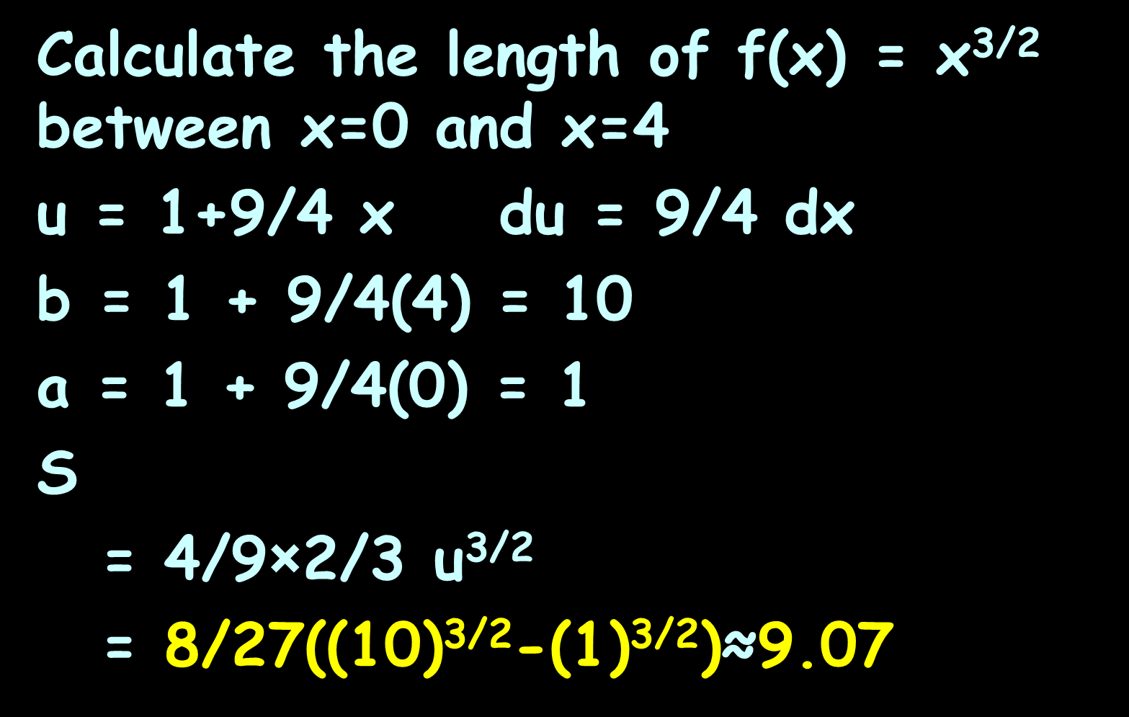
ARC (CURVE) LENGTH
IN-CLASS PROBLEM 8
Calculate the length of f(x) = x^{3/2} between x=0 and x=4
u = $\text{1+9/4 }\text{x}$ du = 9/4 dx
b = 1 + 9/4(4) = 10
a = 1 + 9/4(0) = 1
S
= 4/9×2/3 u^{3/2}
= 8/27((10)^{3/2}-(1)^{3/2})≈9.07
= ∫ 4/9 u^{½} du
10
1
|
10
1
https://www.mathsisfun.com/calculus/arc-length.html

Slide 141
Arc (Curve) Length
Note: because these involve sqrt(difference) they often will be sin⁻¹ or cos⁻¹
There is also a hyperbolic function (which you don’t know yet)

Slide 142
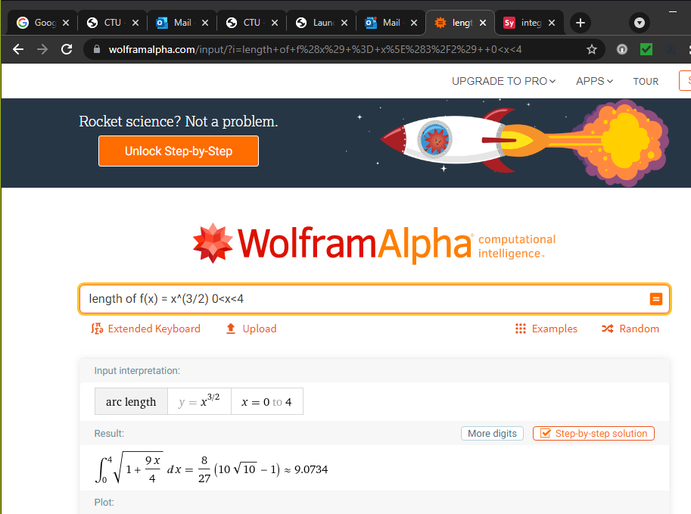

Slide 143
Questions?
http://i.imgur.com/aliTlT3.jpg

Slide 144
We got this far…

Slide 145
Probability
Every continuous random variable has a probability density function (pdf)

Slide 146
Probability
Probability density functions satisfy these 2 conditions:
1) f(x)≥0 for all x (no negative probabilities)
2) The integral over the entire domain is 1 (the sum of probabilities for all possible values of x is 100%)

Slide 147
PROBABILITY
IN-CLASS PROBLEM 9a
Let f(x) = (x³/5000) (10−x)
for 0≤x≤10 and f(x)=0 for all other values of x
https://tutorial.math.lamar.edu/Classes/CalcII/Probability.aspx

Slide 148
PROBABILITY
IN-CLASS PROBLEM 9a
Let f(x) = (x³/5000) (10−x)
for 0≤x≤10 and f(x)=0 for all other values of x
Is it a pdf?
https://tutorial.math.lamar.edu/Classes/CalcII/Probability.aspx

Slide 149
PROBABILITY
IN-CLASS PROBLEM 9a
Let f(x) = (x³/5000) (10−x)
for 0≤x≤10 and f(x)=0 for all other values of x
Is it a pdf? It adds to 1 (100%):
= x⁴/2000 – x⁵/25000
= 10000/2000 – 100000/25000 - 0
= 1
P(0≤x≤10) = ∫ x³/5000 (10−x)dx
10
0
= ∫ (x³/500 – x⁴/5000) dx
10
0
|
10
0
https://tutorial.math.lamar.edu/Classes/CalcII/Probability.aspx

Slide 150
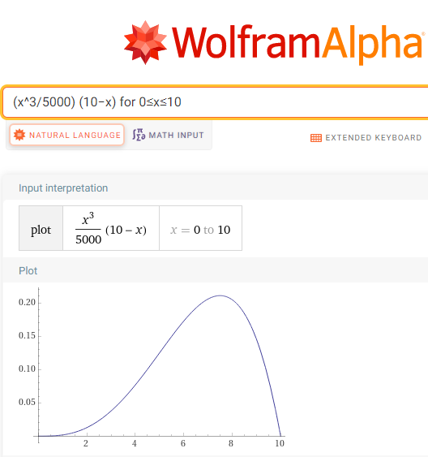
PROBABILITY
IN-CLASS PROBLEM 9a
And it is always positive,
so it is a pdf

Slide 151
PROBABILITY
IN-CLASS PROBLEM 9b
Let f(x) = (x³/5000) (10−x)
for 0≤x≤10 and f(x)=0 for all other values of x
Calculate P(1≤x≤4)
https://tutorial.math.lamar.edu/Classes/CalcII/Probability.aspx

Slide 152
PROBABILITY
IN-CLASS PROBLEM 9b
Let f(x) = (x³/5000) (10−x)
for 0≤x≤10 and f(x)=0 for all other values of x
Calculate P(1≤x≤4)
= ∫₁⁴ (x³/5000) (10−x) dx
https://tutorial.math.lamar.edu/Classes/CalcII/Probability.aspx

Slide 153
PROBABILITY
IN-CLASS PROBLEM 9b
Let f(x) = (x³/5000) (10−x)
for 0≤x≤10 and f(x)=0 for all other values of x
Calculate P(1≤x≤4)
= x⁴/2000 – x⁵/25000
= (4⁴/2000–4⁵/25000)
- (1⁴/2000 – 1⁵/25000)
= 4329/50000 ≈ .08658 ≈ 8.66%
|
4
1
https://tutorial.math.lamar.edu/Classes/CalcII/Probability.aspx

Slide 154
Probability
Percentages are easier for most people to understand

Slide 155
PROBABILITY
IN-CLASS PROBLEM 9c
Let f(x)=x³/5000(10−x)
for 0≤x≤10 and f(x)=0 for all other values of x
Calculate P(6≤x)
https://tutorial.math.lamar.edu/Classes/CalcII/Probability.aspx

Slide 156
PROBABILITY
IN-CLASS PROBLEM 9c
Let f(x)=x³/5000(10−x)
for 0≤x≤10 and f(x)=0 for all other values of x
Calculate P(6≤x)
Since 0≤x≤10 this is the same as asking you to calculate P(6≤x≤10)
https://tutorial.math.lamar.edu/Classes/CalcII/Probability.aspx

Slide 157
PROBABILITY
IN-CLASS PROBLEM 9c
Let f(x)=x³/5000(10−x)
for 0≤x≤10 and f(x)=0 for all other values of x
Calculate P(6≤x)
= ∫₆¹⁰ (x³/5000)(10−x) dx
https://tutorial.math.lamar.edu/Classes/CalcII/Probability.aspx

Slide 158
PROBABILITY
IN-CLASS PROBLEM 9c
Let f(x)=x³/5000(10−x)
for 0≤x≤10 and f(x)=0 for all other values of x
Calculate P(6≤x)
= ∫₆¹⁰ x³/5000 x (10−x) dx
= x⁴/2000 – x⁵/25000
= (10⁴/2000–10⁵/25000)
- (6⁴/2000 – 6⁵/25000)
= 2072/3125 ≈ .66304 ≈ 66.30%
|
10
6
https://tutorial.math.lamar.edu/Classes/CalcII/Probability.aspx

Slide 159
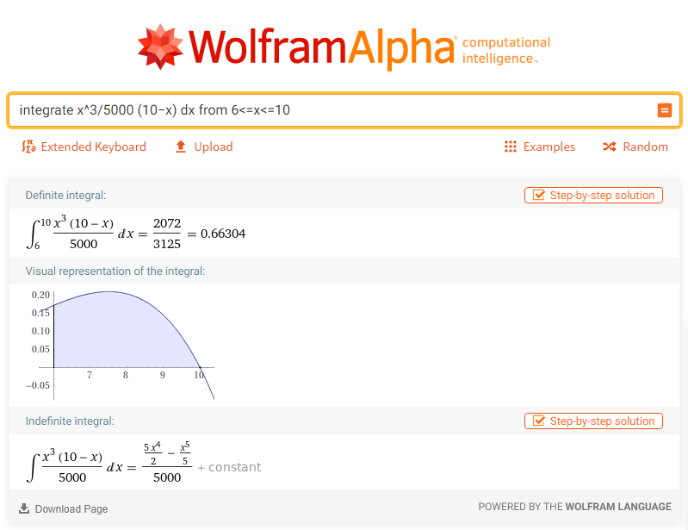

Slide 160
Questions?
http://i.imgur.com/aliTlT3.jpg

Slide 161

You Survived!
Today we covered:
What integration is used for
www.playbuzz.com

