Slide 1

Welcome to
Unit 9 Part 17!
MATH 205 Differential Calculus
https://www.smu.edu.sg/programmes/core-curriculum/course-structure/calculus

Slide 2
What’s Up?
Review:
Reverse Chain Rule
New stuff:
Area Under a Curve and the
Fundamental Theorem of
Calculus

Slide 3
What’s Up?
Outcome 5) Use basic integration techniques, including the method of substitution and the Fundamental Theorem of Calculus
Outcome 6) Use definite integrals to find areas under and between curves

Slide 4

Review
http://995642590.r.lightningbase-cdn.com/wp-content/uploads/2010/12/looking-back-hrexaminer-v144-cover425px.jpg

Slide 5
Integration
Suppose we wanted to find:
∫ 5(x³+4)⁴(3x²) dx
This doesn’t fit any of our rules so far

Slide 6
Integration
Suppose we wanted to find:
∫ 5(x³+4)⁴(3x²) dx
But… if you are alert and notice that 3x² is the derivative of x³
In fact, since it’s the derivative of x³+4 (even better!) you could do a “Chain Rule-like” thing and call x³+4 “u” and 3x² “du”

Slide 7
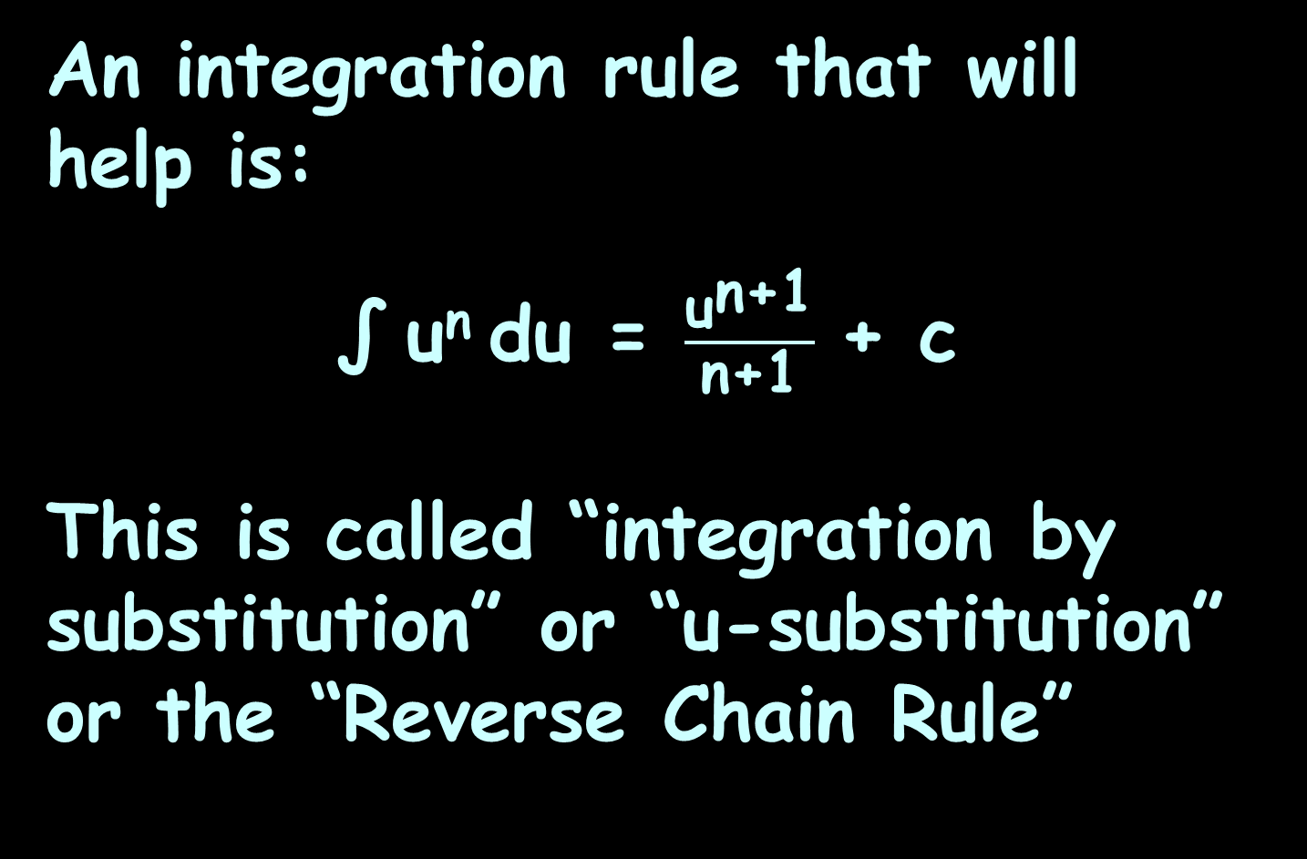
Reverse Chain Rule
An integration rule that will help is:
∫ u^{n} du = $\frac{{\text{u}}^{\text{n}\text{+1}}}{\text{n}\text{+1}}$ + c
This is called “integration by substitution” or “u-substitution” or the “Reverse Chain Rule”

Slide 8
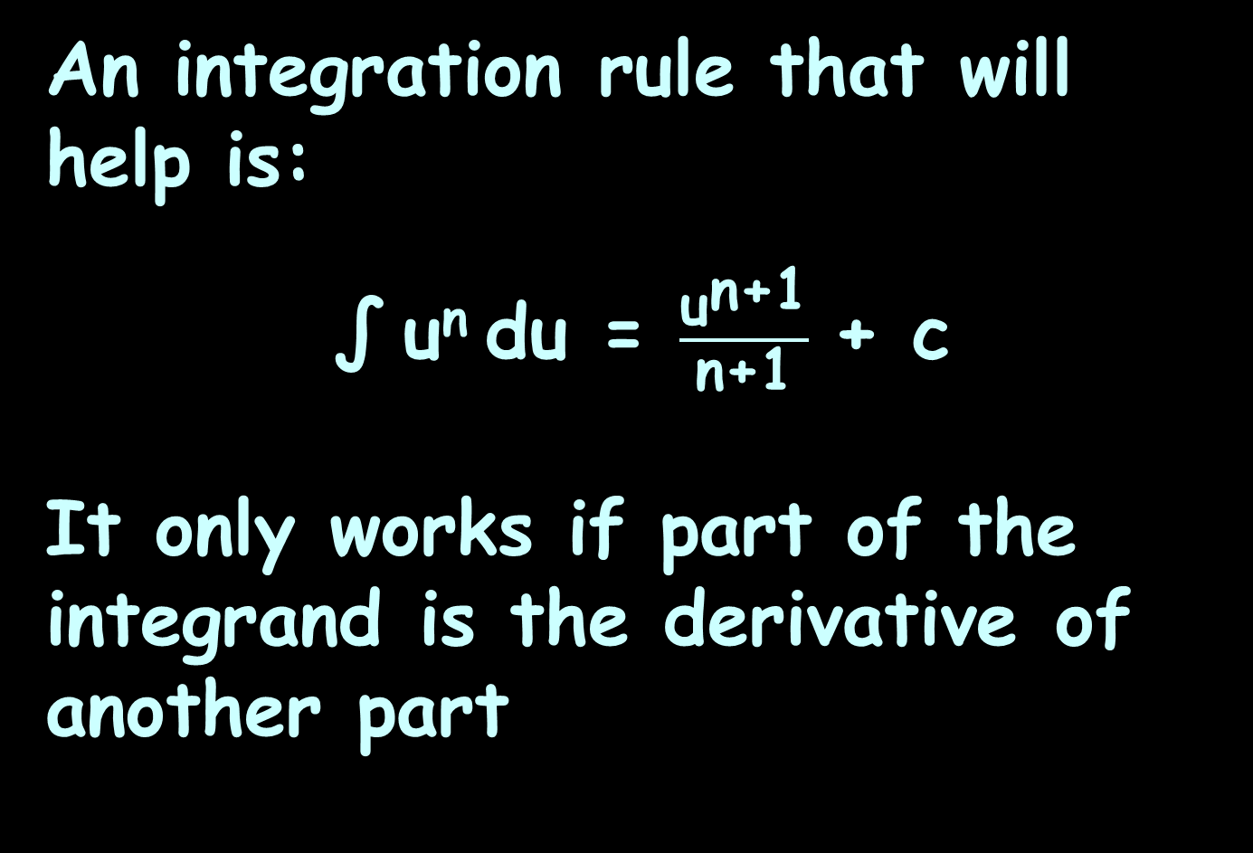
Reverse Chain Rule
An integration rule that will help is:
∫ u^{n} du = $\frac{{\text{u}}^{\text{n}\text{+1}}}{\text{n}\text{+1}}$ + c
It only works if part of the integrand is the derivative of another part

Slide 9
Reverse Chain Rule
This is a very powerful tool for doing integration
But you have to be alert and know your derivatives
Look for exponents
Include stray constants if you can

Slide 10
Reverse Chain Rule
The Reverse Chain Rule works for transcendentals, too

Slide 11
Reverse Chain Rule
Sometimes we are just SO CLOSE to having the right derivative…
Include two coefficient multipliers:
1/whatever you need and
whatever you need

Slide 12
Reverse Chain Rule
Find: ∫ (5x+2)⁷ dx
Find: 1/5 ∫ 5(5x+2)⁷ dx
1/what we need
what we need

Slide 13
Reverse Chain Rule
Again, if you have a value, you can solve to get rid of the
“+ c” and make the integral “determinate”

Slide 14

Questions?
http://i.imgur.com/aliTlT3.jpg

Slide 15
Area Under a Curve
We’ve been using integration as the inverse operation to undo differentiation

Slide 16
Area Under a Curve
We’ve been using integration as the inverse operation to undo differentiation
That’s important, but there’s an even more important use for integration

Slide 17
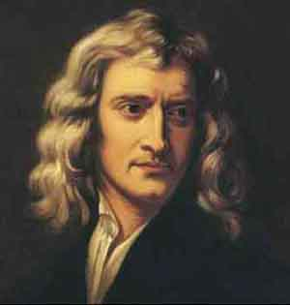
Area Under a Curve
Differentiation was invented by Newton to investigate the orbits of the planets
https://en.wikipedia.org/wiki/Isaac_Newton#/media/File:Sir_Isaac_Newton_(1643-1727).jpg
https://i.pinimg.com/originals/9a/de/89/9ade89ff4770e0390e40f6c168e80a26.png

Slide 18
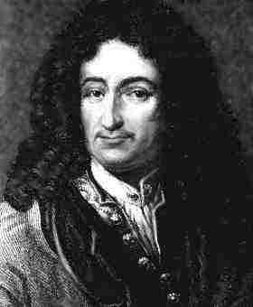
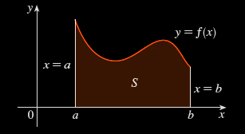
Area Under a Curve
Leibnitz was interested in solving the area problem: find the area of the region that lies under the curve
y = f(x) from a to b
https://coloradotech.vitalsource.com/#/books/9780357233375/cfi/6/28!/4/14@0:0
https://www.britannica.com/biography/Gottfried-Wilhelm-Leibniz

Slide 19
Area Under a Curve
What is an area?

Slide 20
Area Under a Curve
What is an area?
The area of a rectangle is: lw
l
w
VFrench 2020

Slide 21
Area Under a Curve
What is an area?
The area of a triangle is: ½bh
h
b
VFrench 2020

Slide 22
Area Under a Curve
What is an area?
An area is easy to find for regions with straight sides

Slide 23
Area Under a Curve
What is an area?
It isn't so easy to find the area of a region with curved sides

Slide 24
Area Under a Curve
For a curve, you can draw rectangles (which you CAN find the area for) to sort of fit the curve
http://archives.math.utk.edu/visual.calculus/4/midpoint.1/integral.html

Slide 25
Area Under a Curve
You can build
rectangles
above the
curve, below
the curve,
or going
through
midpoints
Kalkulus_Integral__cover.png

Slide 26
Area Under a Curve
You know the
true area under
the curve is a
number between
the sum of the
blue rectangles
and the sum of
the tan
rectangles
VFrench 2020

Slide 27
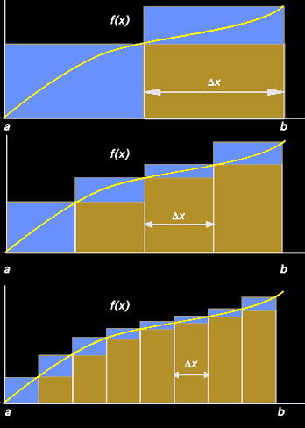
Area Under a Curve
As the rectangles
get narrower and
narrower (closer
and closer to
zero-width) the
area estimate
gets better
and better
VFrench 2020

Slide 28
Area Under a Curve
The true area is
going to be the
limit of the sum
of the blue or
tan rectangles (it
will converge)
VFrench 2020

Slide 29
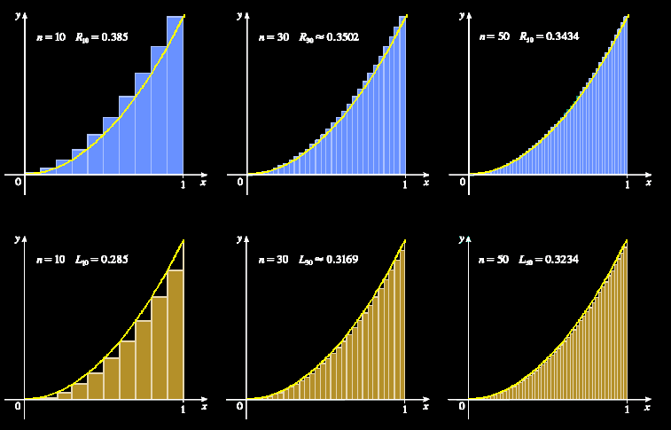
Area Under a Curve
https://coloradotech.vitalsource.com/#/books/9780357233375/cfi/6/28!/4/14@0:0

Slide 30
Area Under a Curve
This is what you are “adding up” that is the ∫um in integration – zillions of zero-width rectangles

Slide 31
Area Under a Curve
…and this is also why integral calculus is “nonsense”: you are adding up a whole bunch of zeros (areas of rectangles with zero width) to get something bigger than zero – the area under the curve

Slide 32
Area Under a Curve
…and this is also why integral calculus is “nonsense”: you are adding up a whole bunch of zeros (areas of rectangles with zero width) to get something bigger than zero – the area under the curve
Still, it works so well… let’s use it anyway!

Slide 33
Area Under a Curve
It’s also why this part of calculus is called “integration”: we are integrating all the slices together into a whole area

Slide 34
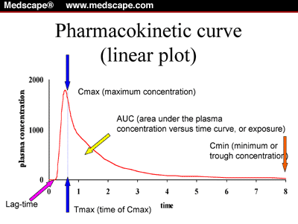
Area Under a Curve
Integration is used more that differentiation because a lot of people want to find areas under curves
(AUC means
“Area Under
Curve”)
cm.v17.fig1.gif

Slide 35
Area Under a Curve
Note: engineers use differentiation more than anybody else (physicists come close) and use differentiation more than integration

Slide 36
Questions?
http://i.imgur.com/aliTlT3.jpg

Slide 37
Area Under a Curve
This is the geometric interpretation of the integral (like tangent lines to the curve was the geometric interpretation of the derivative)

Slide 38
https://i2.wp.com/fractalkitty.com/wp-content/uploads/2019/07/untitled_artwork-10.jpg?fit=
2048%2C2048&ssl=1

Slide 39
Area Under a Curve
The height of each rectangle is the value of the function at some point “t” along the base of the rectangle
{
ƒ (t)
t
VFrench 2020

Slide 40
Area Under a Curve
The width of each rectangle is a constant Δt
Δt
{
t
VFrench 2020

Slide 41
Area Under a Curve
The area of each rectangle is area = height x width = ƒ(t)Δt
Δt
{
{
ƒ (t)
t
VFrench 2020

Slide 42
Area Under a Curve
The area under the curve between a and b (“n” rectangles) is approximately equal to the sum:
S_{n} = ƒ(t₁)Δt + ƒ(t₂)Δt +…+ ƒ(t_{n})Δt
Δt
{
{
ƒ (t)
a
t
b
VFrench 2020

Slide 43
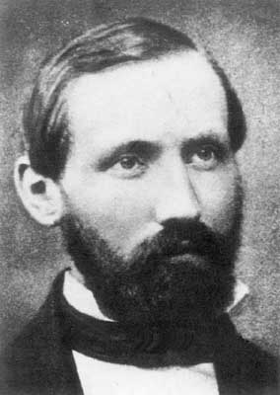
Area Under a Curve
S_{n} = ƒ(t₁)Δt + ƒ(t₂)Δt +…+ ƒ(t_{n})Δt
is called a “Riemann Sum”
Δt
{
{
ƒ (t)
Bernhard Riemann
a
t
b
https://www.usna.edu/Users/math/meh/riemann.html
VFrench 2020

Slide 44
Area Under a Curve
The smaller we choose the width Δx, the better the approximation for the area under the curve

Slide 45
Area Under a Curve
As Δx→0,
the number of terms n→∞
and the sum S_{n}→true area
under the curve:
S_{n} = A
lim
n→∞

Slide 46
Area Under a Curve
But, you wouldn’t want to actually do this to find the area under a curve

Slide 47
Area Under a Curve
But, you wouldn’t want to actually do this to find the area under a curve (it would take days to do even a simple problem)

Slide 48
Area Under a Curve
Instead, we use calculus:
A = ∫ƒ(b) dx - ∫ƒ(a) dx
Ending value
Starting value
VFrench 2020

Slide 49

AREA UNDER A CURVE
IN-CLASS PROBLEM 1
Find the area under the curve
y = x² from x=1 to x=2
4
3
2
1
A = ∫ƒ(b) dx - ∫ƒ(a) dx
-2
-1
0
1
2
Ending value
Starting value
VFrench 2022

Slide 50
AREA UNDER A CURVE
IN-CLASS PROBLEM 1
Find the area under the curve
y = x² from x=1 to x=2
What’s b?
4
3
2
1
A = ∫ƒ(b) dx - ∫ƒ(a) dx
-2
-1
0
1
2
Ending value
Starting value
VFrench 2022

Slide 51
AREA UNDER A CURVE
IN-CLASS PROBLEM 1
Find the area under the curve
y = x² from x=1 to x=2
What’s b? 2
What’s a?
4
3
2
1
A = ∫ƒ(b) dx - ∫ƒ(a) dx
-2
-1
0
1
2
Ending value
Starting value
VFrench 2022

Slide 52
AREA UNDER A CURVE
IN-CLASS PROBLEM 1
Find the area under the curve
y = x² from x=1 to x=2
What’s b? 2
What’s a? 1
What’s the formula?
A = ∫ƒ(b) dx - ∫ƒ(a) dx
Ending value
Starting value

Slide 53
AREA UNDER A CURVE
IN-CLASS PROBLEM 1
Find the area under the curve
y = x² from x=1 to x=2
What’s b? 2
What’s a? 1
What’s the formula?
A = ∫x² dx - ∫x² dx
First we do the integration
Where x = 2
Where x = 1
A = ∫ƒ(b) dx - ∫ƒ(a) dx

Slide 54
AREA UNDER A CURVE
IN-CLASS PROBLEM 1
Find the area under the curve
y = x² from x=1 to x=2
A = ∫x² dx - ∫x² dx
First we do the integration:
A = (x³/3 + c) – (x³/3 + c)
= (2³/3 + c) – (1³/3 + c)
= 8/3 + c – 1/3 – c = 7/3
Where x = 2
Where x = 1
Where x = 2
Where x = 1

Slide 55
AREA UNDER A CURVE
IN-CLASS PROBLEM 1
Find the area under the curve
y = x² from x=1 to x=2
A = ∫x² dx - ∫x² dx
First we do the integration:
A = (x³/3 + c) – (x³/3 + c)
= 8/3 + c – 1/3 – c = 7/3
Notice the c’s go away
Where x = 2
Where x = 1
Where x = 2
Where x = 1

Slide 56

Area Under a Curve
Each square is $\frac{\text{1}}{\text{3}}$ x $\frac{\text{1}}{\text{3}}$ with
area = $\frac{\text{1}}{\text{9}}$
How many squares?
4
3
2
1
-2
-1
0
1
2
VFrench 2022

Slide 57

Area Under a Curve
Each square is $\frac{\text{1}}{\text{3}}$ x $\frac{\text{1}}{\text{3}}$, area = $\frac{\text{1}}{\text{9}}$
How many squares? 16 full squares (16/9) and a bunch of bits (about 5)
All add up to 7/3 (21/9)
4
3
2
1
-2
-1
0
1
2
VFrench 2022

Slide 58
AREA UNDER A CURVE
IN-CLASS PROBLEM 1
Find the area under the curve
y = x² from x=1 to x=2
A = ∫x² dx - ∫x² dx
First we do the integration:
A = (x³/3 + c) – (x³/3 + c)
= 8/3 + c – 1/3 – c = 7/3
Where x = 2
Where x = 1
Where x = 2
Where x = 1

Slide 59
AREA UNDER A CURVE
IN-CLASS PROBLEM 1
Find the area under the curve
y = x² from x=1 to x=2
A = ∫x² dx - ∫x² dx
First we do the integration:
A = (x³/3 + c) – (x³/3 + c)
= 8/3 + c – 1/3 – c = 7/3
It’s now a definite integral!
Where x = 2
Where x = 1
Where x = 2
Where x = 1

Slide 60
Area Under a Curve
We write this symbolically as:
∫_{a}^{b} ƒ(x) dx
Where b is the upper limit and a the lower limit of the interval

Slide 61
Questions?
http://i.imgur.com/aliTlT3.jpg

Slide 62
Area Under a Curve
The Fundamental Theorem of Calculus says if ƒ(x) is continuous on the interval a≤x≤b
then ∫_{a}^{b} ƒ(x) dx = F(b) – F(a)
where F’(x) = ƒ(x)

Slide 63
Area Under a Curve
In other words, the technique for evaluating a definite integral is the same as finding the area under the curve

Slide 64
AREA UNDER A CURVE
IN-CLASS PROBLEM 2
Find the area under the curve
y = x³ from x=1 to x=3
What does our integral look like?
b
∫ ƒ(x) dx
a

Slide 65
AREA UNDER A CURVE
IN-CLASS PROBLEM 2
Find the area under the curve
y = x³ from x=1 to x=3
What does our integral look like? ∫_{a}^{b} ƒ(x) dx
What’s b?
b
∫ ƒ(x) dx
a

Slide 66
AREA UNDER A CURVE
IN-CLASS PROBLEM 2
Find the area under the curve
y = x³ from x=1 to x=3
What does our integral look like? ∫_{a}³ ƒ(x) dx
What’s b? 3
What’s a?
b
∫ ƒ(x) dx
a

Slide 67
AREA UNDER A CURVE
IN-CLASS PROBLEM 2
Find the area under the curve
y = x³ from x=1 to x=3
What does our integral look like? ∫₁³ ƒ(x) dx
What’s b? 3
What’s a? 1
What’s ƒ(x)?
b
∫ ƒ(x) dx
a

Slide 68
AREA UNDER A CURVE
IN-CLASS PROBLEM 2
Find the area under the curve
y = x³ from x=1 to x=3
What does our integral look like? ∫₁³ (x³) dx
What’s b? 3
What’s a? 1
What’s ƒ(x)? x³
What’s dx?

Slide 69
AREA UNDER A CURVE
IN-CLASS PROBLEM 2
Find the area under the curve
y = x³ from x=1 to x=3
What does our integral look like? ∫₁³ (x³) dx
What’s b? 3
What’s a? 1
What’s ƒ(x)? x³
What’s dx? dx (but it isn’t ALWAYS!)

Slide 70
AREA UNDER A CURVE
IN-CLASS PROBLEM 2
Find the area under the curve
y = x³ from x=1 to x=3
What does our integral look like? ∫₁³ (x³) dx
Now we can find the area!
(What do we do?)

Slide 71
AREA UNDER A CURVE
IN-CLASS PROBLEM 2
Find the area under the curve
y = x³ from x=1 to x=3
What does our integral look like? ∫₁³ (x³) dx
Now we can find the area!
(What do we do?) INTEGRATE!

Slide 72
AREA UNDER A CURVE
IN-CLASS PROBLEM 2
Find the area under the curve
y = x³ from x=1 to x=3
Area = ∫₁³ (x³) dx = x⁴/4 |₁³
Note: we don’t even bother with the “c”s for these!
new symbol

Slide 73
AREA UNDER A CURVE
IN-CLASS PROBLEM 2
Find the area under the curve
y = x³ from x=1 to x=3
Area = ∫₁³ (x³) dx = x⁴/4 |₁³
= 3⁴/4 - 1⁴/4 = 81/4 – 1/4
= 80/4 = 20

Slide 74
Questions?
http://i.imgur.com/aliTlT3.jpg

Slide 75
AREA UNDER A CURVE
IN-CLASS PROBLEM 3
Evaluate each definite integral:
∫₀¹ 5 dx

Slide 76
AREA UNDER A CURVE
IN-CLASS PROBLEM 3
Evaluate each definite integral:
∫₀¹ 5 dx = ∫₀¹ 5x⁰ dx = 5x |₀¹
= 5(1) – 5(0)

Slide 77
AREA UNDER A CURVE
IN-CLASS PROBLEM 3
Evaluate each definite integral:
∫₀¹ 5 dx = 5
∫₋₁¹ 5 dx =
https://www.wolframalpha.com/input/?i=definite+integral

Slide 78
AREA UNDER A CURVE
IN-CLASS PROBLEM 3
Evaluate each definite integral:
∫₀¹ 5 dx = 5
∫₋₁¹ 5 dx = 10
∫₀¹ 5x dx =
https://www.wolframalpha.com/input/?i=definite+integral

Slide 79
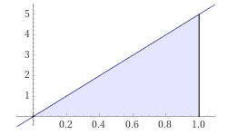
AREA UNDER A CURVE
IN-CLASS PROBLEM 3
Evaluate each definite integral:
∫₀¹ 5 dx = 5
∫₋₁¹ 5 dx = 10
∫₀¹ 5x dx = 2.5
∫₋₁¹ 5x dx =
= 5/2 x² |₀¹ = 2.5
=
https://www.wolframalpha.com/input/?i=definite+integral

Slide 80
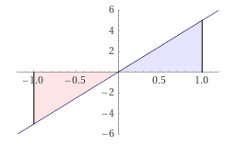
AREA UNDER A CURVE
IN-CLASS PROBLEM 3
Evaluate each definite integral:
∫₀¹ 5 dx = 5
∫₋₁¹ 5 dx = 10
∫₀¹ 5x dx = 2.5
∫₋₁¹ 5x dx = 0
https://www.wolframalpha.com/input/?i=definite+integral

Slide 81
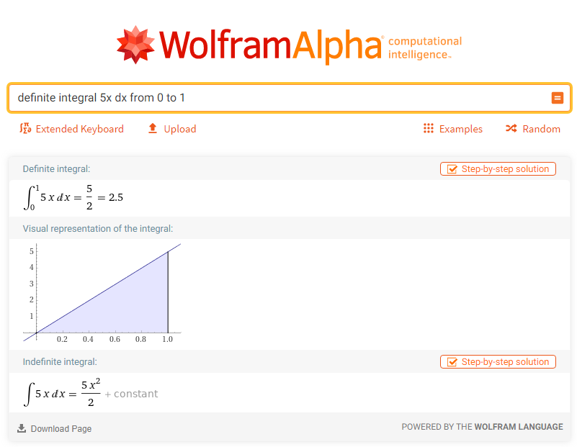

Slide 82
Area Under a Curve
Note: WolframAlpha does “area under a curve” as an absolute value and does NOT subtract the negative half from the positive half
(hence, their answers are wrong under the traditional rules)

Slide 83
Area Under a Curve
To get the right answer, use:
“definite integral” rather than “area under curve”

Slide 84
Questions?
http://i.imgur.com/aliTlT3.jpg

Slide 85
Area Under a Curve
You can have any function for your curve (even ones you can’t integrate)

Slide 86
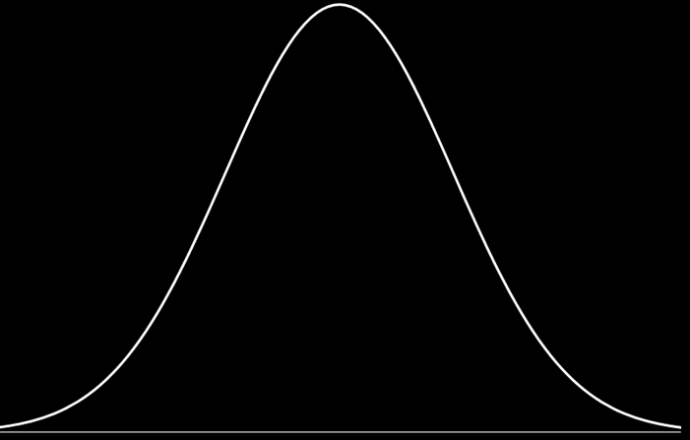
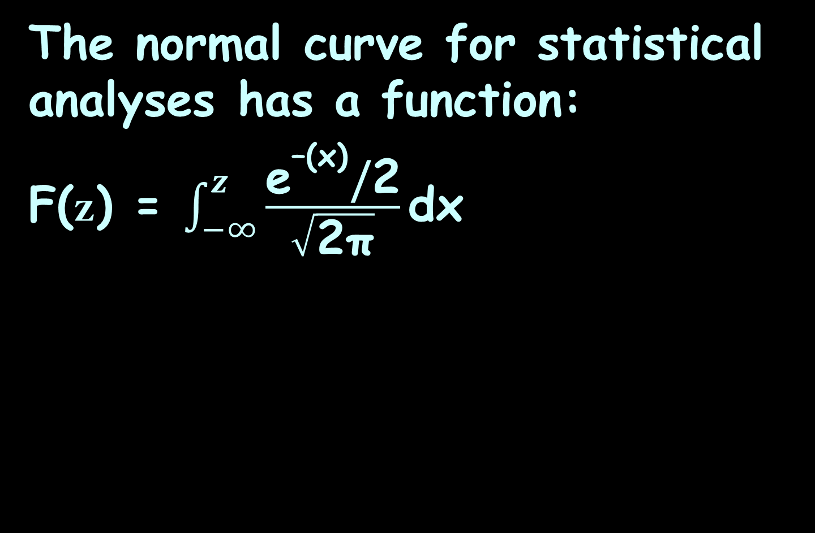
Area Under a Curve
The normal curve for statistical analyses has a function:
F(z) = $\int_{−∞}^{z}{\frac{{\text{e}}^{\text{–(}\text{x}\text{)}}\text{/}\text{2}}{\sqrt{\text{2}\text{π}}}\text{dx}}$
https://www.google.com/url?sa=i&url=http%3A%2F%2Fsciences.usca.edu%2Fbiology%2Fzelmer%2F305%2Fnorm%2F&psig=AOvVaw07wKhR9qMhfHqS4DcnjpYs&ust=1606637469634000&source=images&cd=vfe&ved=0CAIQjRxqFwoTCKiF4JXlpO0CFQAAAAAdAAAAABAD

Slide 87
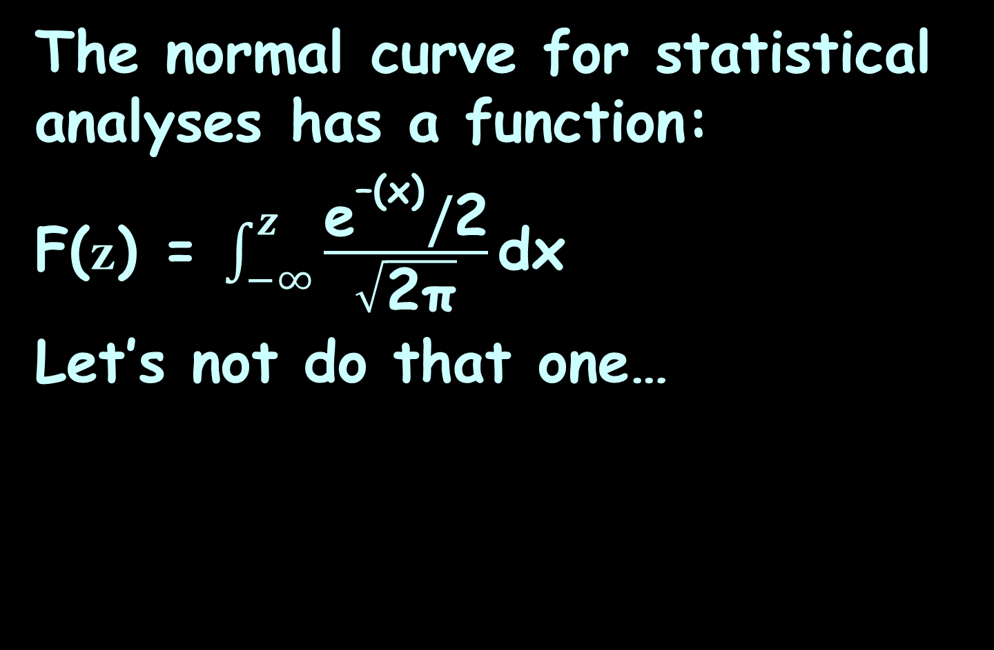
Area Under a Curve
The normal curve for statistical analyses has a function:
F(z) = $\int_{−∞}^{z}{\frac{{\text{e}}^{\text{–(}\text{x}\text{)}}\text{/}\text{2}}{\sqrt{\text{2}\text{π}}}\text{dx}}$
Let’s not do that one…
https://www.google.com/url?sa=i&url=http%3A%2F%2Fsciences.usca.edu%2Fbiology%2Fzelmer%2F305%2Fnorm%2F&psig=AOvVaw07wKhR9qMhfHqS4DcnjpYs&ust=1606637469634000&source=images&cd=vfe&ved=0CAIQjRxqFwoTCKiF4JXlpO0CFQAAAAAdAAAAABAD

Slide 88
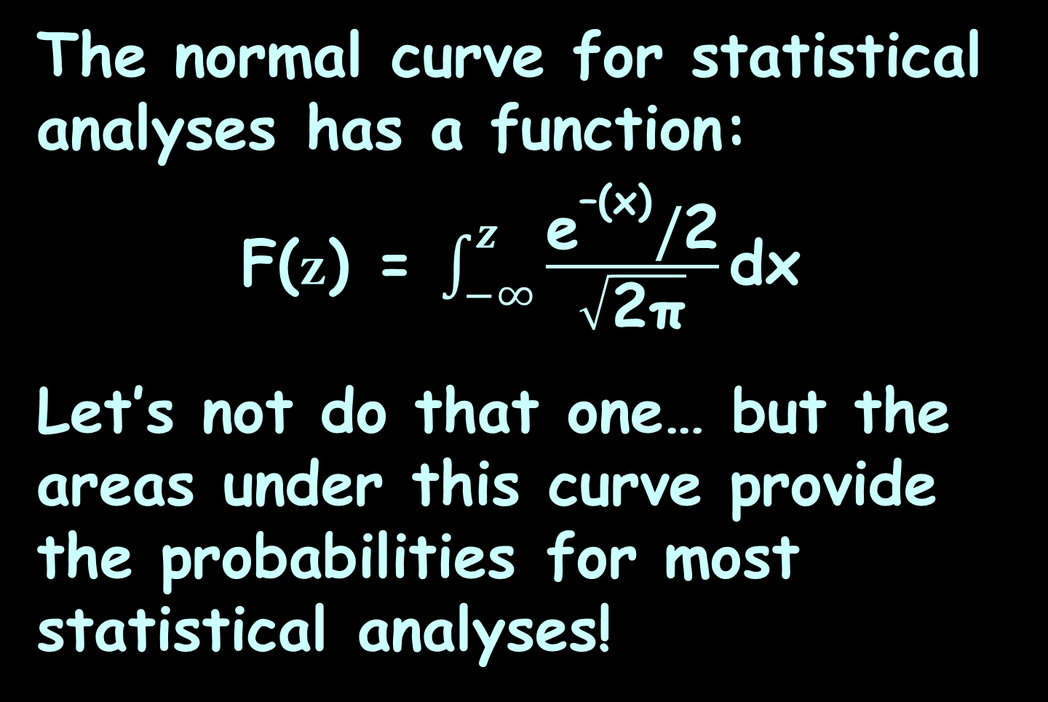
Area Under a Curve
The normal curve for statistical analyses has a function:
F(z) = $\int_{−∞}^{z}{\frac{{\text{e}}^{\text{–(}\text{x}\text{)}}\text{/}\text{2}}{\sqrt{\text{2}\text{π}}}\text{dx}}$
Let’s not do that one… but the areas under this curve provide the probabilities for most statistical analyses!

Slide 89
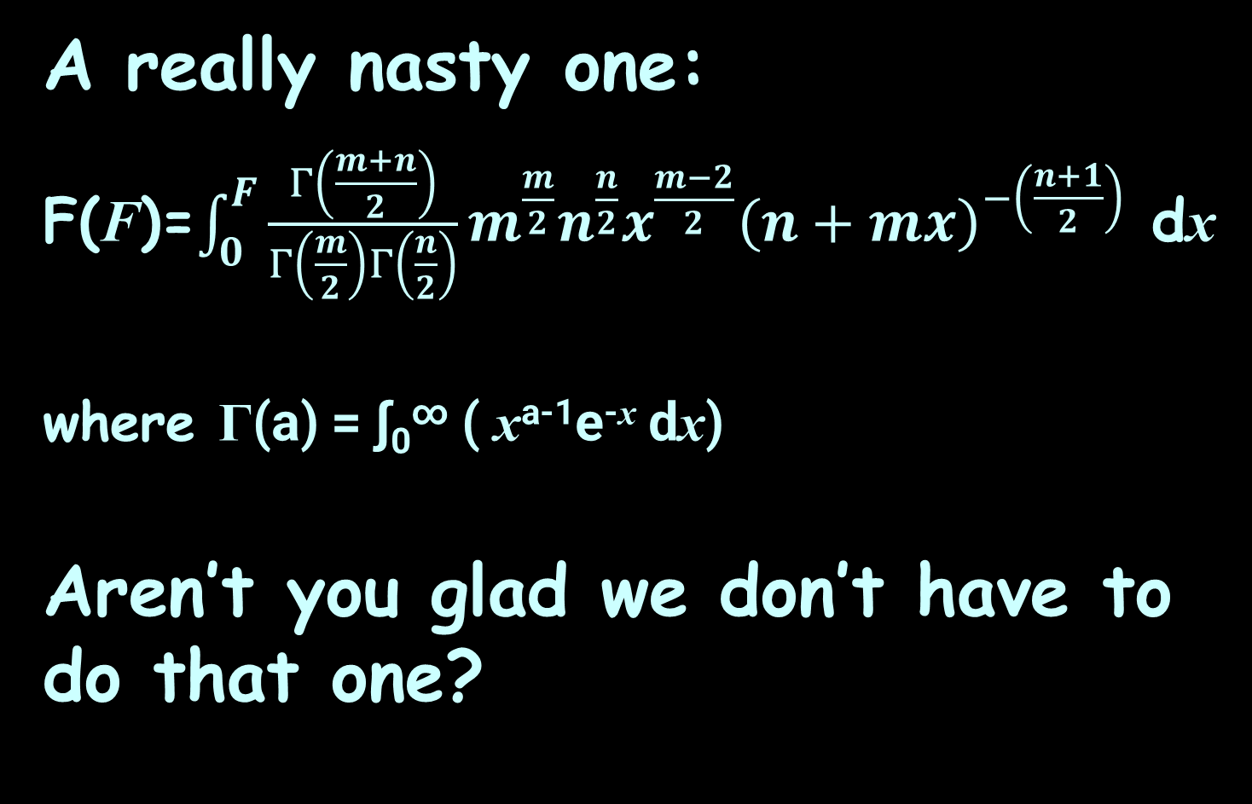
Area Under a Curve
A really nasty one:
F(F)=$\int_{0}^{F}{\frac{Γ\left(\frac{m+n}{2}\right)}{Γ\left(\frac{m}{2}\right)Γ\left(\frac{n}{2}\right)}}m^{\frac{m}{2}}n^{\frac{n}{2}}x^{\frac{m−2}{2}}{\left(n+mx\right)}^{−\left(\frac{n+1}{2}\right)}$ dx
where Γ(a) = ∫₀∞ ( x^{a-1}e^{-x} dx)
Aren’t you glad we don’t have to do that one?

Slide 90
AREA UNDER A CURVE
IN-CLASS PROBLEM 4
Find the area under the curve
y = 1/x³ from x=1 to x=3
What does our integral look like?
Area = ∫_{a}^{b} ƒ(x) dx

Slide 91
AREA UNDER A CURVE
IN-CLASS PROBLEM 4
Find the area under the curve
y = 1/x³ from x=1 to x=3
What does our integral look like?
Area = ∫₁³ 1/x³ dx = ∫₁³ x⁻³ dx
So… do it!

Slide 92
AREA UNDER A CURVE
IN-CLASS PROBLEM 4
Find the area under the curve
y = 1/x³ from x=1 to x=3
Area = ∫₁³ 1/x³ dx = ∫₁³ x⁻³ dx

Slide 93
AREA UNDER A CURVE
IN-CLASS PROBLEM 4
Find the area under the curve
y = 1/x³ from x=1 to x=3
Area = ∫₁³ 1/x³ dx = ∫₁³ x⁻³ dx
= -½ x⁻² |₁³ = -1/(2x²) |₁³
= -1/2(3²) - -1/2(1²)
= -1/18 + 1/2 = 8/18 = 4/9

Slide 94
Questions?
http://i.imgur.com/aliTlT3.jpg

Slide 95
Area Under a Curve
The limits can also be anything you want!

Slide 96
AREA UNDER A CURVE
IN-CLASS PROBLEM 5
Find the area under the curve
y = x² from x=-2 to x=1
What does our integral look like?
Area = ∫_{a}^{b} ƒ(x) dx

Slide 97
AREA UNDER A CURVE
IN-CLASS PROBLEM 5
Find the area under the curve
y = x² from x=-2 to x=1
What does our integral look like?
Area = ∫₋₂¹ x² dx
So do it!

Slide 98
AREA UNDER A CURVE
IN-CLASS PROBLEM 5
Find the area under the curve
y = x² from x=-2 to x=1
Area = ∫₋₂¹ x² dx
= 1/3 x³ |₋₂¹ = x³/3 |₋₂¹
= 1³/3 – (-2)³/3
= 1/3 - -8/3 = 9/3 = 3

Slide 99
Questions?
http://i.imgur.com/aliTlT3.jpg

Slide 100
AREA UNDER A CURVE
IN-CLASS PROBLEM 6
Find ∫₁² (x²+3) dx
Just do it!

Slide 101
AREA UNDER A CURVE
IN-CLASS PROBLEM 6
Find ∫₁² (x²+3) dx
∫₁² (x²+3) dx = 1/3 x³ + 3x |₁²

Slide 102
AREA UNDER A CURVE
IN-CLASS PROBLEM 6
Find ∫₁² (x²+3) dx
∫₁² (x²+3) dx = 1/3 x³ + 3x |₁²
= x³/3 + 3x |₁²

Slide 103
AREA UNDER A CURVE
IN-CLASS PROBLEM 6
Find ∫₁² (x²+3) dx
∫₁² (x²+3) dx = 1/3 x³ + 3x |₁²
= x³/3 + 3x |₁²
= (2³/3+3(2)) – (1³/3+3(1))
Be careful to include all of the second calculation in the “minus”

Slide 104
AREA UNDER A CURVE
IN-CLASS PROBLEM 6
Find ∫₁² (x²+3) dx
∫₁² (x²+3) dx = 1/3 x³ + 3x |₁²
= x³/3 + 3x |₁²
= (2³/3+3(2)) – (1³/3+3(1))
= (8/3+6) – (1/3+3)
= (8/3+18/3) – (1/3+9/3)
= 26/3 – 10/3 = 16/3
= 5 1/3

Slide 105
Questions?
http://i.imgur.com/aliTlT3.jpg

Slide 106
Area Under a Curve
For more complicated integrals, there are some tricks!

Slide 107
AREA UNDER A CURVE
IN-CLASS PROBLEM 7
Find ∫₁⁰ x(x²+1)² dx
Note: the b and a don’t seem to be in order – that’s ok, too!

Slide 108
AREA UNDER A CURVE
IN-CLASS PROBLEM 7
Find ∫₁⁰ x(x²+1)² dx
Note: the b and a don’t seem to be in order – that’s ok, too!
It means we are adding from right to left and will get a negative area!

Slide 109
AREA UNDER A CURVE
IN-CLASS PROBLEM 7
Find ∫₁⁰ x(x²+1)² dx
Does it look like Reverse Chain Rule will work? (Is there a “u” and a “du”?)

Slide 110
AREA UNDER A CURVE
IN-CLASS PROBLEM 7
Find ∫₁⁰ x(x²+1)² dx
u = x²+1 du = 2x dx

Slide 111
AREA UNDER A CURVE
IN-CLASS PROBLEM 7
Find ∫₁⁰ x(x²+1)² dx
u = x²+1 du = 2x dx
Remember we can make this work by rewriting the original
as: ∫₁⁰ ½×2x(x²+1)² dx
or: ½∫₁⁰ u² du

Slide 112
AREA UNDER A CURVE
IN-CLASS PROBLEM 7
Find ∫₁⁰ x(x²+1)² dx
u = x²+1 du = 2x dx
½∫₁⁰ u² du
But… everything is in terms of “u” now EXCEPT the “b” and “a”

Slide 113
AREA UNDER A CURVE
IN-CLASS PROBLEM 7
Find ∫₁⁰ x(x²+1)² dx
u = x²+1 du = 2x dx
½∫_{x=1}^{x=0} u² du
Now, here’s a trick: rewrite the limits using the u, too!

Slide 114
AREA UNDER A CURVE
IN-CLASS PROBLEM 7
Find ∫₁⁰ x(x²+1)² dx
u = x²+1 du = 2x dx
½∫_{x=1}^{x=0} u² du
Now, here’s a trick: rewrite the limits using the u, too!
If x = 0, then u = 0²+1 = 1
and if x = 1, then u = 1²+1 = 2
½∫₁⁰ u² du gee… that almost looks easy!

Slide 115
AREA UNDER A CURVE
IN-CLASS PROBLEM 7
Find ∫₁⁰ x(x²+1)² dx
u = x²+1 du = 2x dx
½∫₁⁰ u² du = ½ (1/3 u³) |₂¹
= u³/6 |₂¹
= 1³/6 - 2³/6
= 1/6 – 8/6 = -7/6
Yes, there’s our negative area!

Slide 116
AREA UNDER A CURVE
IN-CLASS PROBLEM 7
Find ∫₁⁰ x(x²+1)² dx
u = x²+1 du = 2x dx
½∫₁⁰ u² du = ½ (1/3 u³) |₂¹
= -7/6
Because we changed the limits to “u” values, we don’t have to change anything back to x’s at the end!

Slide 117
Area Under a Curve
And, we just proved another calculus theorem:
∫_{a}^{b} ƒ(x) dx = -∫_{b}ª ƒ(x) dx

Slide 118
Questions?
http://i.imgur.com/aliTlT3.jpg

Slide 119
Area Under a Curve
How about a really scary one?

Slide 120
AREA UNDER A CURVE
IN-CLASS PROBLEM 8
Find ∫₀¹ (2x+3)/(x²+3x-7)² dx
What do you think would be a good plan for this one?

Slide 121
AREA UNDER A CURVE
IN-CLASS PROBLEM 8
Find ∫₀¹ (2x+3)/(x²+3x-7)² dx
What do you think would be a good plan for this one? I’m thinkin’ Reverse Chain Rule…

Slide 122
AREA UNDER A CURVE
IN-CLASS PROBLEM 8
Find ∫₀¹ (2x+3)/(x²+3x-7)² dx
What’s u? What’s du?

Slide 123
AREA UNDER A CURVE
IN-CLASS PROBLEM 8
Find ∫₀¹ (2x+3)/(x²+3x-7)² dx
u = x²+3x-7 du = (2x+3) dx
What’s the “new” problem?

Slide 124
AREA UNDER A CURVE
IN-CLASS PROBLEM 8
Find ∫₀¹ (2x+3)/(x²+3x-7)² dx
u = x²+3x-7 du = 2x+3 dx
∫_{x=0}^{x=1} u⁻² du
But, remember, we need to redo the limits, too! What will they be?

Slide 125
AREA UNDER A CURVE
IN-CLASS PROBLEM 8
Find ∫₀¹ (2x+3)/(x²+3x-7)² dx
u = x²+3x-7 du = 2x+3 dx
∫₋₇⁻³ u⁻² du
Upper limit b: 1²+3(1)-7 = -3
Lower limit a: 0²+3(0)-7 = -7

Slide 126
AREA UNDER A CURVE
IN-CLASS PROBLEM 8
Find ∫₀¹ (2x+3)/(x²+3x-7)² dx
u = x²+3x-7 du = 2x+3 dx
∫₋₇⁻³ u⁻² du
Do it!

Slide 127
AREA UNDER A CURVE
IN-CLASS PROBLEM 8
Find ∫₀¹ (2x+3)/(x²+3x-7)² dx
u = x²+3x-7 du = 2x+3 dx
∫₋₇⁻³ u⁻² du = 1/(-1) u⁻¹ |₋₇⁻³
= -1/u |₋₇⁻³

Slide 128
AREA UNDER A CURVE
IN-CLASS PROBLEM 8
Find ∫₀¹ (2x+3)/(x²+3x-7)² dx
u = x²+3x-7 du = 2x+3 dx
∫₋₇⁻³ u⁻² du = 1/(-1) u⁻¹ |₋₇⁻³
= -1/u |₋₇⁻³ = -1/(-3) - -1/(-7)
= 1/3 - 1/7
= 7/21 – 3/21
= 4/21

Slide 129
Area Under a Curve
If you can Reverse Chain Rule it – you can solve it!

Slide 130
Questions?
http://i.imgur.com/aliTlT3.jpg

Slide 131
AREA UNDER A CURVE
IN-CLASS PROBLEM 9
The rate of change of resistance with respect to temperature is given by:
dR/dT = 0.009T² + 0.02T – 0.7

Slide 132
AREA UNDER A CURVE
IN-CLASS PROBLEM 9
The rate of change of resistance with respect to temperature is given by:
dR/dT = 0.009T² + 0.02T – 0.7
A little algebra:
dR = (0.009T² + 0.02T – 0.7) dT
Kinda lookin’ like an integral…

Slide 133
AREA UNDER A CURVE
IN-CLASS PROBLEM 9
The rate of change of resistance with respect to temperature is given by:
dR/dT = 0.009T² + 0.02T – 0.7
A little algebra:
dR = (0.009T² + 0.02T – 0.7) dT
∫dR = ∫(0.009T² + 0.02T – 0.7) dT
These cancel

Slide 134
AREA UNDER A CURVE
IN-CLASS PROBLEM 9
The rate of change of resistance with respect to temperature is given by:
dR/dT = 0.009T² + 0.02T – 0.7
A little algebra:
dR = (0.009T² + 0.02T – 0.7) dT
R = ∫ (0.009T² + 0.02T – 0.7) dT

Slide 135
AREA UNDER A CURVE
IN-CLASS PROBLEM 9
The rate of change of resistance with respect to temperature is given by:
dR/dT = 0.009T² + 0.02T – 0.7
Suppose they ask:
Find the area under the curve between T=20°C and 25°C
What does the integral look like?

Slide 136
AREA UNDER A CURVE
IN-CLASS PROBLEM 9
The rate of change of resistance with respect to temperature is given by:
dR/dT = 0.009T² + 0.02T – 0.7
Find the area under the curve between T=20°C and 25°C
What does the integral look like?
∫₂₀²⁵ (0.009T² +0.02T – 0.7) dT

Slide 137
AREA UNDER A CURVE
IN-CLASS PROBLEM 9
The rate of change of resistance with respect to temperature is given by:
dR/dT = 0.009T² + 0.02T – 0.7
Find the area under the curve between T=20°C and 25°C
∫₂₀²⁵ (0.009T² +0.02T – 0.7) dT
Do it!

Slide 138
AREA UNDER A CURVE
IN-CLASS PROBLEM 9
The rate of change of resistance with respect to temperature is given by:
dR/dT = 0.009T² + 0.02T – 0.7
Find the area under the curve between T=20°C and 25°C
∫₂₀²⁵ (0.009T² +0.02T – 0.7) dT
(0.009/3)T³+(0.02/2)T²-0.7T|₂₀²⁵

Slide 139
AREA UNDER A CURVE
IN-CLASS PROBLEM 9
∫₂₀²⁵ (0.009T² +0.02T – 0.7) dT
=(0.009/3)T³+(0.02/2)T²-0.7T |₂₀²⁵
= (0.003(25³)+0.01(25²)-0.7(25))
-(0.003(20³)+0.01(20²)-0.7(20))
≈ (46.9+6.25-17.5)-(24+4-14)
≈ 21.625
what are the units on this?

Slide 140
AREA UNDER A CURVE
IN-CLASS PROBLEM 9
∫₂₀²⁵ (0.009T² +0.02T – 0.7) dT
=(0.009/3)T³+(0.02/2)T²-0.7T |₂₀²⁵
= (0.003(25³)+0.01(25²)-0.7(25))
-(0.003(20³)+0.01(20²)-0.7(20))
≈ (46.9+6.25-17.5)-(24+4-14)
≈ 21.625
what are the units on this?
You would think it would be ohms/degree C… but…

Slide 141
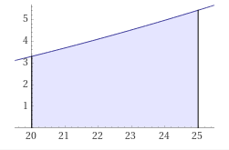
AREA UNDER A CURVE
IN-CLASS PROBLEM 9
The graph is ΔR/ΔT vs temp
ΔR/ΔT seems to be called “sensitivity” – it’s units would be ohms per degree C
The area will be
ΔR/ΔT x ΔT
So the units
should be ohms
ΔR/ΔT ohms/°C
Temperature °C
https://www.wolframalpha.com/input/?i=definite+integral+%280.009T%5E2+%2B0.02T+%E2%80%93+0.7%29+dT+from+20+to+25

Slide 142
AREA UNDER A CURVE
IN-CLASS PROBLEM 9
The rate of change of resistance with respect to temperature is given by:
dR/dT = 0.009T² + 0.02T – 0.7
A little algebra:
dR = (0.009T² + 0.02T – 0.7) dT
R = ∫ (0.009T² + 0.02T – 0.7) dT
ohms!

Slide 143
Area Under a Curve
The units of the area under the curve are the units of the Y axis times units of the x axis

Slide 144
Questions?
http://i.imgur.com/aliTlT3.jpg

Slide 145
Summary
Today we covered:
Review of reverse chain rule
Area Under a Curve and the
Fundamental Theorem of
Calculus

Slide 146

You Survived!
www.playbuzz.com

