Slide 1

Welcome to
Unit 7 Part 13!
MATH 205 Differential Calculus
https://www.smu.edu.sg/programmes/core-curriculum/course-structure/calculus

Slide 2
What’s Up?
Review: Related rates
New stuff: Optimization

Slide 3
What’s Up?
Outcome 3) Apply derivatives to solve optimization and related rates problems.

Slide 4

Review
http://995642590.r.lightningbase-cdn.com/wp-content/uploads/2010/12/looking-back-hrexaminer-v144-cover425px.jpg

Slide 5
Related Rates
Changing one variable’s value changes the value of another variable that depended on it

Slide 6
Related Rates
Problems including variables whose rates of change are related and can be modeled by an equation are called related rates problems

Slide 7
Related Rates
        One or more rates are given, and other rates are to be calculated using the equation

Slide 8
Related Rates
This can be done for any combination of variables in the model
The others are considered to be constants

Slide 9
Related Rates
How to do it:
Draw a picture
What are you trying to find?
3) Find an equation relating the variables
4) Find dy/dx (usually chain rule)
5) Plug in known values
6) Solve for the rate of change

Slide 10

Questions?
http://i.imgur.com/aliTlT3.jpg

Slide 11
Optimization
In optimization problems we are looking for the largest value or the smallest value that a function can take

Slide 12
Optimization
One kind of optimization problem is the extrema - the largest and smallest value that a function would be on an interval

Slide 13
Optimization
Now we will be looking for the largest or smallest value of a function subject to some kind of constraint

Slide 14
Optimization
The constraint can usually be described by some equation
The constraint must absolutely, positively be met no matter what the solution is

Slide 15
Optimization
You must identify the quantity to be optimized and its equation
You must also identify the constraint equation
A subtle change of wording can completely change the problem to be solved

Slide 16
Optimization
How to do it:
1) Draw a picture
2) What are you trying to maximize/minimize?
3) Find an equation relating the
variables
4) What is the constraint equation?
5) Combine the two equations
6) Find the derivative
7) Set = 0 and solve
8) Is it the max or min you want?
9) If not, try the endpoints of the
interval

Slide 17
OPTIMIZATION
IN-CLASS PROBLEM 1
Find two positive numbers whose sum is 300 and whose product is a maximum
No real pic for this one…
Step 2:
2) What are you trying to maximize/minimize?

Slide 18
OPTIMIZATION
IN-CLASS PROBLEM 1
Find two positive numbers whose sum is 300 and whose product is a maximum
No real pic for this one…
Step 2: maximize the product
Step 3:
3) Find an equation relating the variables

Slide 19
OPTIMIZATION
IN-CLASS PROBLEM 1
Find two positive numbers whose sum is 300
maximize the product
Step 3: P = xy
Step 4
4) What is the constraint equation?

Slide 20
OPTIMIZATION
IN-CLASS PROBLEM 1
Find two positive numbers whose sum is 300
maximize the product P = xy
Step 4: x + y = 300
Step 5:
5) Combine the two equations

Slide 21
Optimization
When we calculated extrema, we only had one variable… now we have two…

Slide 22
Optimization
When we calculated extrema, we only had one variable… now we have two…
But we can write either variable as a function of the other

Slide 23
Optimization
When we calculated extrema, we only had one variable… now we have two…
But we can write either variable as a function of the other
(in this case, either way is equally easy)

Slide 24
OPTIMIZATION
IN-CLASS PROBLEM 1
Find two positive numbers whose sum is 300
maximize the product P = xy
Step 4: x + y = 300
Step 5: solve for y:
y = 300 – x
Now, combine the two equations:
5) Combine the two equations

Slide 25
OPTIMIZATION
IN-CLASS PROBLEM 1
Find two positive numbers whose sum is 300
maximize the product P = xy
Step 4: x + y = 300
Step 5: solve for y:
y = 300 – x
Now, combine the two equations:
P = x(300-x)
5) Combine the two equations

Slide 26
OPTIMIZATION
IN-CLASS PROBLEM 1
maximize the product P = xy
x + y = 300
Step 5: y = 300-x
P = x(300-x) = 300x – x²
Step 6:
6) Find the derivative

Slide 27
OPTIMIZATION
IN-CLASS PROBLEM 1
maximize the product
P = xy = 300x – x²
x + y = 300
Step 6:
P = 300x - x²
P’ = 300 - 2x
Step 7:
7) Set = 0 and solve

Slide 28
OPTIMIZATION
IN-CLASS PROBLEM 1
maximize the product
P = xy = 300x – x²
x + y = 300
P’ = 300 - 2x
Step 7: P’ = 300 – 2x = 0
if x = 150
Step 8:
8) Is it the max or min you want?
9) If not, try the endpoints of the
interval

Slide 29
OPTIMIZATION
IN-CLASS PROBLEM 1
maximize the product
P = xy = 300x – x²
x + y = 300
P’ = 300 - 2x = 0 if x = 150
Step 8:
P = 300(150) – (150)² = 22500
P = 300(149) – (149)² = 22499
P = 300(151) – (151)² = 22499
So it’s a max!

Slide 30
OPTIMIZATION
IN-CLASS PROBLEM 1
maximize the product
P = xy = 300x – x²
x + y = 300
x = 150
y = 300 – x = 150
P = (150)(150) = 22,500

Slide 31
Questions?
http://i.imgur.com/aliTlT3.jpg

Slide 32
OPTIMIZATION
IN-CLASS PROBLEM 2
Let x and y be two positive numbers such that x+2y=50 and (x+1)(y+2) is a maximum
Still no pic!
Step 2:
2) What are you trying to maximize/minimize?

Slide 33
OPTIMIZATION
IN-CLASS PROBLEM 2
Let x and y be two positive numbers such that x+2y=50 and (x+1)(y+2) is a maximum
Still no pic!
Step 2:
Maximize (x+1)(y+2)
Step 3:
3) Find an equation relating the variables

Slide 34
OPTIMIZATION
IN-CLASS PROBLEM 2
Let x and y be two positive numbers such that x+2y=50 and Maximize P=(x+1)(y+2)
Step 3: (x+1)(y+2)
Step 4:
4) What is the constraint equation?

Slide 35
OPTIMIZATION
IN-CLASS PROBLEM 2
Let x and y be two positive numbers such that x+2y=50 and Maximize P=(x+1)(y+2)
Step 4:
x+2y=50
Step 5:
5) Combine the two equations

Slide 36
OPTIMIZATION
IN-CLASS PROBLEM 2
Let x and y be positive x+2y=50
Maximize P=(x+1)(y+2)
Step 5:
x = 50-2y
P=(50-2y+1)(y+2)=(51-2y)(y+2)
= 51y+102-2y²-4y
= -2y²+47y+102
Step 6:
6) Find the derivative

Slide 37
OPTIMIZATION
IN-CLASS PROBLEM 2
Let x and y be positive x+2y=50
Maximize P=(x+1)(y+2)
P = -2y²+47y+102
Step 6:
P’ = -4y + 47
Step 7:
7) Set = 0 and solve

Slide 38
OPTIMIZATION
IN-CLASS PROBLEM 2
Let x and y be positive x+2y=50
Maximize P=(x+1)(y+2)
P = -2y²+47y+102
Step 7:
P’ = -4y + 47 = 0 if y = 47/4
Step 8:
8) Is it the max or min you want?
9) If not, try the endpoints of the interval

Slide 39
OPTIMIZATION
IN-CLASS PROBLEM 2
Let x and y be positive x+2y=50
Maximize P=(x+1)(y+2)
P = -2y²+47y+102
P’ = -4y + 47 = 0 if y = 47/4
Step 8:
P =-2(47/4)²+47(47/4)+102
= 378.125
P = -2(12)²+47(12)+102 = 378
P = -2(11)²+47(11)+102 = 377
So y = 47/4 is a max…

Slide 40
OPTIMIZATION
IN-CLASS PROBLEM 2
Let x and y be positive x+2y=50
Maximize P=(x+1)(y+2)
P = -2y²+47y+102
P’ = -4y + 47 = 0 if y = 47/4
x = 50 – 2y = 50 – 2(47/4)
= 106/4 or 53/2 or 26.5
And the maximum P = 378.125

Slide 41
OPTIMIZATION
IN-CLASS PROBLEM 2
Let x and y be positive x+2y=50
Maximize P=(x+1)(y+2)
P = -2y²+47y+102
P’ = -4y + 47 = 0 if y = 47/4
x = 50 – 2y = 50 – 2(47/4)
= 106/4 or 53/2 or 26.5
And the maximum P = 378.125
AND y=47/4 and x=106/4 are both positive numbers

Slide 42
Questions?
http://i.imgur.com/aliTlT3.jpg

Slide 43
OPTIMIZATION
IN-CLASS PROBLEM 3
Find two positive numbers whose product is 750 and for which the sum of one and 10 times the other is a minimum
Again, no pic…
Step 2:
2) What are you trying to maximize/minimize?

Slide 44
OPTIMIZATION
IN-CLASS PROBLEM 3
Find two positive numbers whose product is 750 and for which the sum of one and 10 times the other is a minimum
Again, no pic…
Step 2:
sum of one and 10 times the other is a minimum
Step 3:
3) Find an equation relating the variables

Slide 45
OPTIMIZATION
IN-CLASS PROBLEM 3
Find two positive numbers whose product is 750 and for which the sum of one and 10 times the other is a minimum
sum of one and 10 times the other is a minimum
Step 3: x + 10y is a minimum
Step 4:
4) What is the constraint equation?

Slide 46
OPTIMIZATION
IN-CLASS PROBLEM 3
Find two positive numbers whose product is 750
S = x + 10y is a minimum
Step 4: xy = 750
Step 5:
5) Combine the two equations

Slide 47
OPTIMIZATION
IN-CLASS PROBLEM 3
Find two positive numbers whose product is 750
S = x + 10y is a minimum
xy = 750 Step 5: y = 750/x
S = x + 10(750/x) = x + 7500/x
Step 6:
6) Find the derivative

Slide 48
OPTIMIZATION
IN-CLASS PROBLEM 3
Find two positive numbers whose product is 750
S = x + 10y is a minimum
xy = 750 y = 750/x
S = x + 10(750/x) = x + 7500/x
Step 6:
S’ = 1 – 7500x⁻²
Step 7:
7) Set = 0 and solve

Slide 49
OPTIMIZATION
IN-CLASS PROBLEM 3
Find two positive numbers whose product is 750
S = x + 10y is a minimum
xy = 750 y = 750/x
S = x + 10(750/x) = x + 7500/x
S’ = 1 – 7500x⁻²
Step 7: 1 – 7500x⁻² = 0
– 7500x⁻² = -1
x⁻² = -1/-7500 = 1/7500
x² = 7500
7) Set = 0 and solve

Slide 50
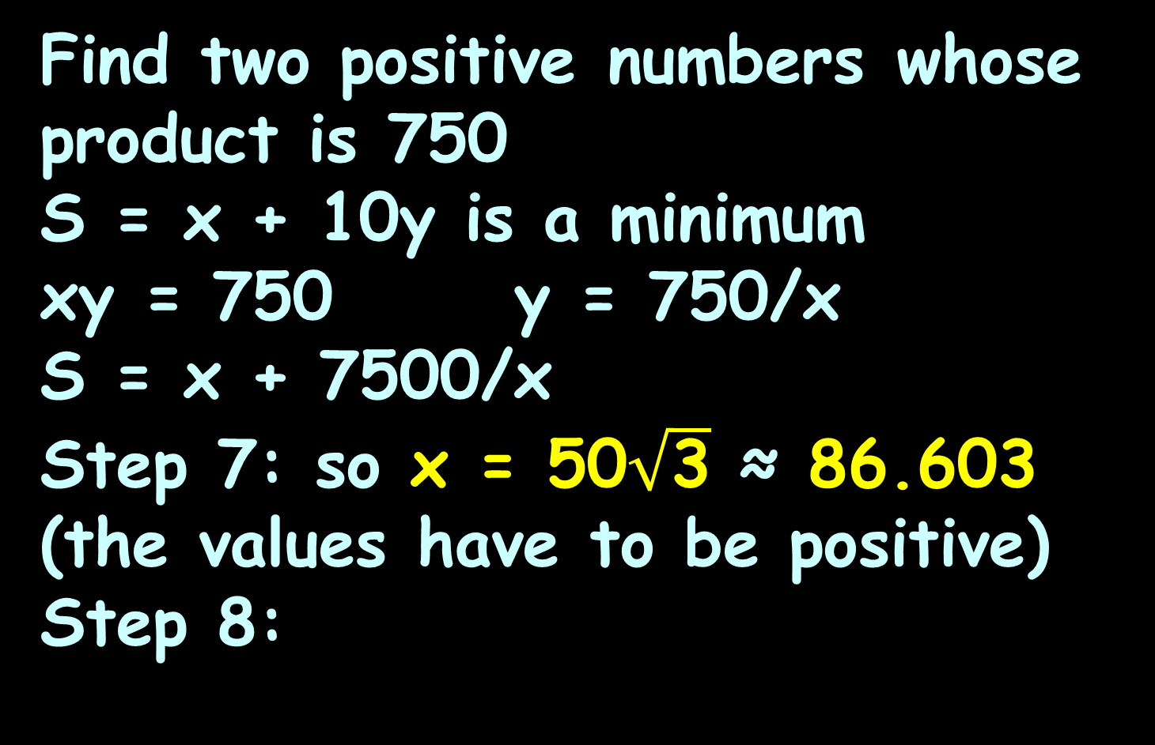
OPTIMIZATION
IN-CLASS PROBLEM 3
Find two positive numbers whose product is 750
S = x + 10y is a minimum
xy = 750 y = 750/x
S = x + 7500/x
Step 7: so x = 50$\sqrt{\text{3}}$ ≈ 86.603
(the values have to be positive)
Step 8:
8) Is it the max or min you want?
9) If not, try the endpoints of the interval

Slide 51
OPTIMIZATION
IN-CLASS PROBLEM 3
Find two positive numbers whose product is 750
S = x + 10y is a minimum
xy = 750 y = 750/x
S = x + 7500/x
Step 8: S ≈ 86.603+ 7500/86.603
≈ 173.205
Is it a minimum?

Slide 52
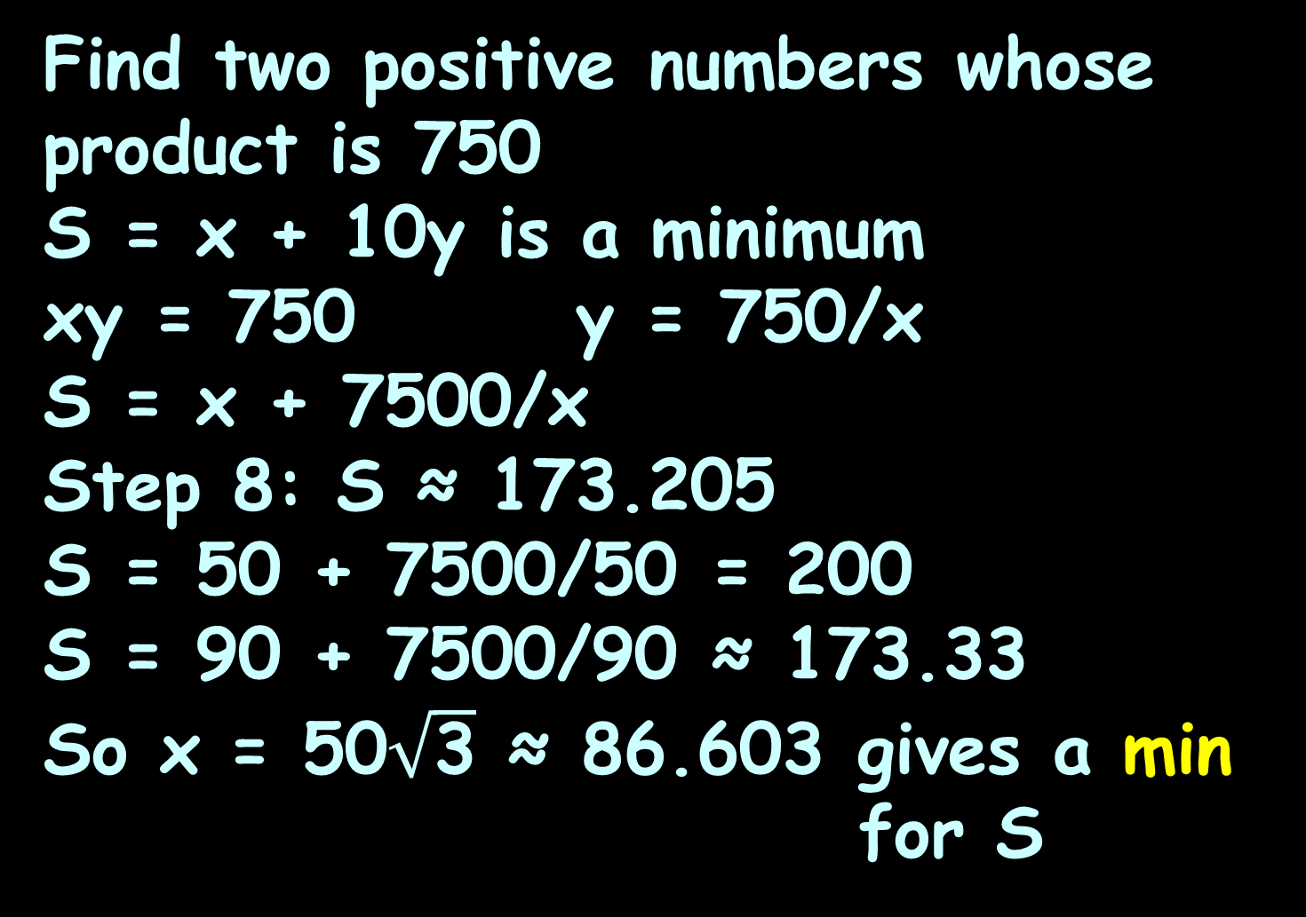
OPTIMIZATION
IN-CLASS PROBLEM 3
Find two positive numbers whose product is 750
S = x + 10y is a minimum
xy = 750 y = 750/x
S = x + 7500/x
Step 8: S ≈ 173.205
S = 50 + 7500/50 = 200
S = 90 + 7500/90 ≈ 173.33
So x = 50$\sqrt{\text{3}}$ ≈ 86.603 gives a min for S

Slide 53
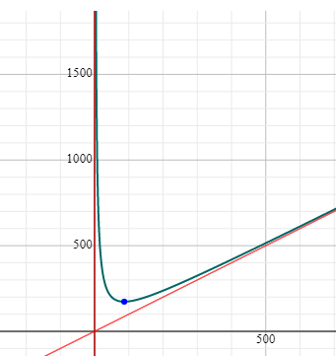
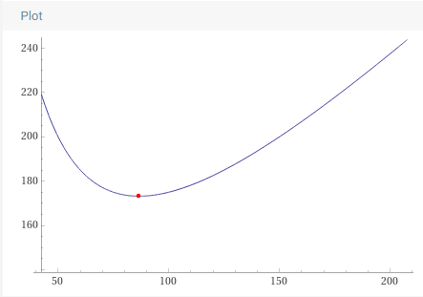
OPTIMIZATION
IN-CLASS PROBLEM 3
Symbolab graph:
Wolfram graph:

Slide 54
OPTIMIZATION
IN-CLASS PROBLEM 3
Find two positive numbers whose product is 750
So x ≈ 86.603 makes S a min
And y ≈ 750/x = 750/86.603
≈ 8.660 makes S a min
Minimum value: S = 173.205

Slide 55
OPTIMIZATION
IN-CLASS PROBLEM 3
Find two positive numbers whose product is 750
So x ≈ 86.603 is a min
And y ≈ 750/x = 750/86.603
≈ 8.660
Minimum value: S = 173.205
And x ≈ 86.603 and y ≈ 8.660 are both positive

Slide 56
Questions?
http://i.imgur.com/aliTlT3.jpg

Slide 57
Optimization
These first three problems are all “mathy” problems – not very “real world”
Optimization is one of those topics that has a LOT of real-world applications
These are more tricky!

Slide 58
OPTIMIZATION
IN-CLASS PROBLEM 4
We need to enclose a rectangular field with a fence.
We have 500 feet of fencing material.
A building is on one side of the field and won’t need any fencing.
Determine the dimensions of the field that will enclose the largest area.
https://tutorial.math.lamar.edu/classes/calci/optimization.aspx

Slide 59
OPTIMIZATION
IN-CLASS PROBLEM 4
We need to enclose a rectangular field with a fence. We have 500 feet of fencing material. A building is on one side of the field and won’t need any fencing. Determine the dimensions of the field that will enclose the largest area.
Step1: draw a pic:
building
y
x
VFrench 2020

Slide 60
OPTIMIZATION
IN-CLASS PROBLEM 4
We need to enclose a rectangular field with a fence. We have 500 feet of fencing material.
Determine the dimensions of the field that will enclose the largest area
Step 2: What do we want to
maximize or minimize?
building
y
x
VFrench 2020

Slide 61
OPTIMIZATION
IN-CLASS PROBLEM 4
We need to enclose a rectangular field with a fence. We have 500 feet of fencing material.
Determine the dimensions of the field that will enclose the largest area
Step 2: What do we want to maximize/minimize?
Maximize area
building
y
x
VFrench 2020

Slide 62
OPTIMIZATION
IN-CLASS PROBLEM 4
We need to enclose a rectangular field with a fence. We have 500 feet of fencing material.
We want to maximize the area of the field
Step 3: What is that equation?
building
y
x
VFrench 2020

Slide 63
OPTIMIZATION
IN-CLASS PROBLEM 4
We need to enclose a rectangular field with a fence. We have 500 feet of fencing material.
We want to maximize the area of the field
Step 3: What is that equation?
A = xy
building
y
x
VFrench 2020

Slide 64
OPTIMIZATION
IN-CLASS PROBLEM 4
We need to enclose a rectangular field with a fence. We have 500 feet of fencing material.
Maximize the area of the field: A = xy
Step 4: What is the constraint?
building
y
x
VFrench 2020

Slide 65
OPTIMIZATION
IN-CLASS PROBLEM 4
We need to enclose a rectangular field with a fence. We have 500 feet of fencing material.
Maximize the area of the field: A = xy
Step 4: What is the constraint? x+2y=500
building
y
x
VFrench 2020

Slide 66
OPTIMIZATION
IN-CLASS PROBLEM 4
We need to enclose a rectangular field with a fence. We have 500 feet of fencing material.
Maximize the area of the field: A = xy
Using the constraint: x+2y=500
Step 5: combine the two equations
building
y
x
VFrench 2020

Slide 67
OPTIMIZATION
IN-CLASS PROBLEM 4
We need to enclose a rectangular field with a fence. We have 500 feet of fencing material.
Maximize the area of the field: A = xy
Using the constraint: x+2y=500
Step 5: combine the two equations
x + 2y = 500
x = 500 – 2y
Put that into A = xy:
A = (500-2y)y = 500y - 2y²
Step 6: Find the derivative
building
y
x
VFrench 2020

Slide 68
OPTIMIZATION
IN-CLASS PROBLEM 4
We need to enclose a rectangular field with a fence. We have 500 feet of fencing material.
Maximize the area of the field: A = xy
Using the constraint: x+2y=500
x = 500 – 2y A=500y-2y²
Step 6: Find the derivative
In this case with respect to “y”:
dA/dy = 500 – 4y
building
y
x
VFrench 2020

Slide 69
Optimization
The maximum value of a continuous function on a closed interval will occur either where the first derivative is zero and/or at end points of the interval

Slide 70
Optimization
So we need to determine the interval y can be

Slide 71
Optimization
We need to determine the interval y can be:
y can be 0 (a really long, skinny area)

Slide 72
Optimization
We need to determine the interval y can be:
y can be 0 (a really long, skinny area)
Since we have 2ys of fencing, the longest y can be (when x=0) is 500/2 = 250 ft
building
y
x

Slide 73
Optimization
We need to determine the interval y can be:
y can be 0 (a really long, skinny area)
Since we have 2ys of fencing, the longest y can be (when x=0) is 500/2 = 250 ft
So 0≤y≤250

Slide 74
Optimization
But, the end points in this case will give zero area (which will not be a max)
The maximum value of our continuous function on a closed interval will occur where the first derivative is zero

Slide 75
OPTIMIZATION
IN-CLASS PROBLEM 4
We need to enclose a rectangular field with a fence. We have 500 feet of fencing material.
Maximize the area of the field: A = xy
Using the constraint: x+2y=500
x = 500 – 2y A=500y-2y²
dA/dy = 500 – 4y
Step 7: Find the extrema:
dA/dy = 500 – 4y = 0 if
building
y
x
VFrench 2020

Slide 76
OPTIMIZATION
IN-CLASS PROBLEM 4
We need to enclose a rectangular field with a fence. We have 500 feet of fencing material.
Maximize the area of the field: A = xy
Using the constraint: x+2y=500
x = 500 – 2y A=500y-2y²
dA/dy = 500 – 4y
Step 7: Find the extrema:
dA/dy = 500 – 4y = 0 if
y = 500/4 = 125
Step 8: is this a max or min?
building
y
x
VFrench 2020

Slide 77
OPTIMIZATION
IN-CLASS PROBLEM 4
We need to enclose a rectangular field with a fence. We have 500 feet of fencing material.
Maximize the area of the field: A = xy
Using the constraint: x+2y=500
x = 500 – 2y A=500y-2y²
dA/dy = 500 – 4y y = 125
Step 8: is this a max or min?
A = 500(125)-2(125²)
= 62500 – 31250 = 31250
A = 500(124)-2(124²) = 31248
A = 500(126)-2(126²) = 31248
So it’s a max!
building
y
x
VFrench 2020

Slide 78
OPTIMIZATION
IN-CLASS PROBLEM 4
We need to enclose a rectangular field with a fence. We have 500 feet of fencing material.
Maximize the area of the field: A = xy
Using the constraint: x+2y=500
x = 500 – 2y A=500y-2y²
dA/dy = 500 – 4y
So the max occurs where y = 125 …
building
y
x
VFrench 2020

Slide 79
OPTIMIZATION
IN-CLASS PROBLEM 4
We need to enclose a rectangular field with a fence. We have 500 feet of fencing material.
Maximize the area of the field: A = xy
Using the constraint: x+2y=500
x = 500 – 2y A=500y-2y²
dA/dy = 500 – 4y
So the max occurs where y = 125 ft
A = 31250 …
building
y
x
VFrench 2020

Slide 80
OPTIMIZATION
IN-CLASS PROBLEM 4
We need to enclose a rectangular field with a fence. We have 500 feet of fencing material.
Maximize the area of the field: A = xy
Using the constraint: x+2y=500
x = 500 – 2y A=500y-2y²
dA/dy = 500 – 4y
So the max occurs where y = 125 ft
A = 31250 ft²
Are we done?
building
y
x
VFrench 2020

Slide 81
OPTIMIZATION
IN-CLASS PROBLEM 4
We need to enclose a rectangular field with a fence. We have 500 feet of fencing material.
Maximize the area of the field: A = xy
Using the constraint: x+2y=500
x = 500 – 2y A=500y-2y²
dA/dy = 500 – 4y
So the max occurs where y = 125 ft
A = 31250 ft²
Are we done? No, we need x…
building
y
x
VFrench 2020

Slide 82
OPTIMIZATION
IN-CLASS PROBLEM 4
We need to enclose a rectangular field with a fence. We have 500 feet of fencing material.
Maximize the area of the field: A = xy
Using the constraint: x+2y=500
x = 500 – 2y A=500y-2y²
dA/dy = 500 – 4y
So the max occurs where y = 125 …
A = 31,250 ft²
x = 500 – 2(125) = 250 …
building
y
x
VFrench 2020

Slide 83
OPTIMIZATION
IN-CLASS PROBLEM 4
We need to enclose a rectangular field with a fence. We have 500 feet of fencing material.
Maximize the area of the field: A = xy
Using the constraint: x+2y=500
x = 500 – 2y A=500y-2y²
dA/dy = 500 – 4y
So the max occurs where y = 125 ft
A = 31,250 ft²
x = 500 – 2(125) = 250 ft
building
y
x
VFrench 2020

Slide 84
Optimization
Because these are word problems, they are everybody’s favorite thing and there is little opportunity to read them wrong and get the wrong answer

Slide 85
Optimization
Because these are word problems, they are everybody’s favorite thing and there is little opportunity to read them wrong and get the wrong answer
~NOT~

Slide 86
Questions?
http://i.imgur.com/aliTlT3.jpg

Slide 87
OPTIMIZATION
IN-CLASS PROBLEM 5
A company wants to manufacture cans to supply the brewing industry.
Minimizing the surface area, A = 2πr² + 2πrh results in minimal cost of material to manufacture.
But the can must have
volume V = πr²h = 400cm³
Find the dimensions that will
minimize the cost of the
metal to manufacture
the cans.
Step 1: the pic
VFrench 2020

Slide 88
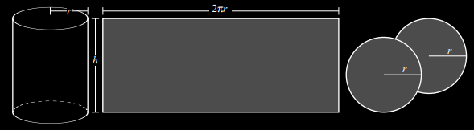
OPTIMIZATION
IN-CLASS PROBLEM 5
FYI: the surface area, A = 2πr² + 2πrh
VFrench 2020

Slide 89
OPTIMIZATION
IN-CLASS PROBLEM 5
Minimizing the surface area, A = 2πr² + 2πrh results in minimal cost of material to manufacture.
But the can must have
volume V = πr²h = 400cm³
Find the dimensions that will
minimize the cost of the
metal to manufacture the cans.
Step 2: What are you trying
to maximize/minimize?
VFrench 2020

Slide 90
OPTIMIZATION
IN-CLASS PROBLEM 5
Minimizing the surface area, A = 2πr² + 2πrh results in minimal cost of material to manufacture.
But the can must have
volume V = πr²h = 400cm³
Find the dimensions that will
minimize the cost of the
metal to manufacture the cans.
Step 2: What are you trying
to maximize/minimize?
Minimize surface area
Step 3: What is the equation?
VFrench 2020

Slide 91
OPTIMIZATION
IN-CLASS PROBLEM 5
Surface area, A = 2πr² + 2πrh
But the can must have
volume V = πr²h = 400cm³
We need to minimize the surface area
Step 3: What is the equation?
A = 2πr² + 2πrh
Step 4: What is the
constraint?
VFrench 2020

Slide 92
OPTIMIZATION
IN-CLASS PROBLEM 5
We need to minimize the surface area:
A = 2πr² + 2πrh
But the can must have
volume V = πr²h = 400cm³
Step 4: What is the
constraint? V = πr²h = 400cm³
Step 5: Combine the two
equations
VFrench 2020

Slide 93
OPTIMIZATION
IN-CLASS PROBLEM 5
We need to minimize the surface area:
A = 2πr² + 2πrh
Subject to the constraint: V = πr²h = 400cm³
Step 5: Combine the two equations:
πr²h = 400
h = 400/πr² plug this into:
A = 2πr² + 2πrh
A = 2πr² + 2πr(400/πr²)
= 2πr² + 800/r
Step 6: Find the derivative
VFrench 2020

Slide 94
OPTIMIZATION
IN-CLASS PROBLEM 5
We need to minimize the surface area:
A = 2πr² + 2πrh
Subject to the constraint: V = πr²h = 400cm³
A = 2πr² + 800/r where h = 400/πr²
Step 6: Find the derivative:
dA/dr = 4πr - 800r⁻²
Step 7: Set it equal to zero
VFrench 2020

Slide 95
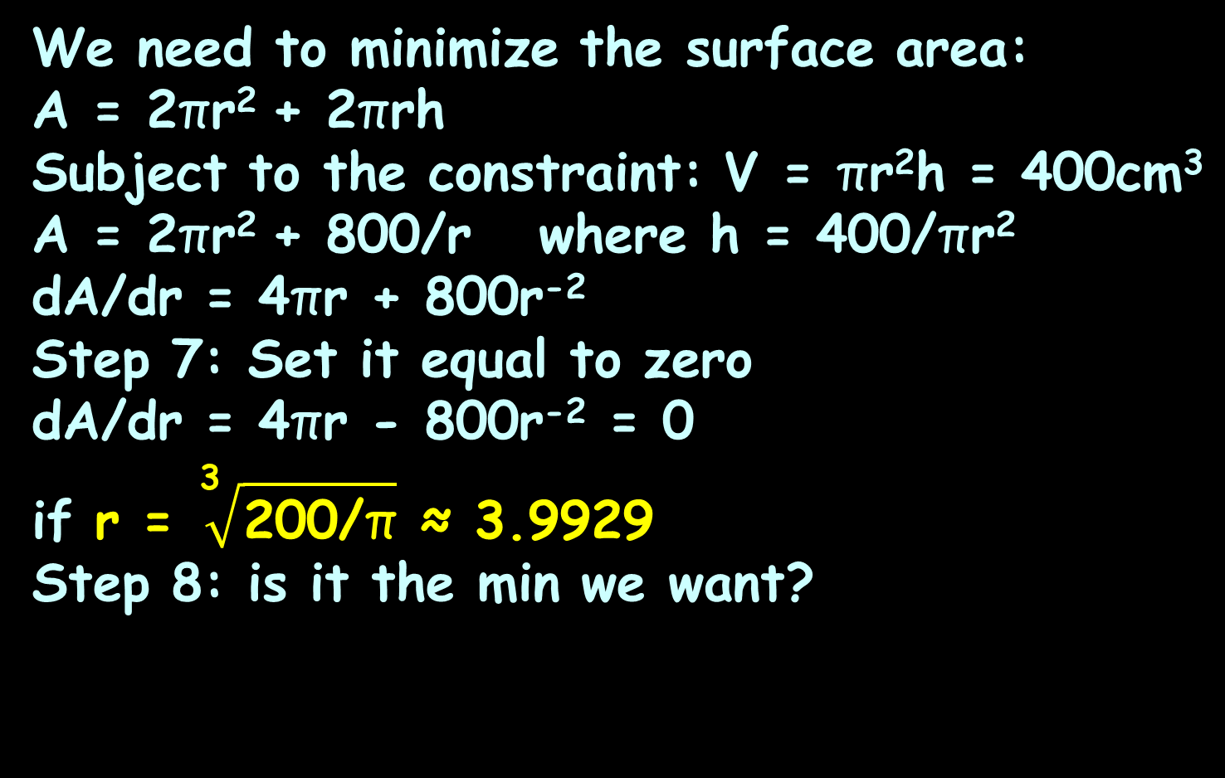
OPTIMIZATION
IN-CLASS PROBLEM 5
We need to minimize the surface area:
A = 2πr² + 2πrh
Subject to the constraint: V = πr²h = 400cm³
A = 2πr² + 800/r where h = 400/πr²
dA/dr = 4πr + 800r⁻²
Step 7: Set it equal to zero
dA/dr = 4πr - 800r⁻² = 0
if r = $\sqrt[\text{3}]{\text{2}\text{00/}\text{π}}$ ≈ 3.9929
Step 8: is it the min we want?
VFrench 2020

Slide 96
OPTIMIZATION
IN-CLASS PROBLEM 5
We need to minimize the surface area:
A = 2πr² + 2πrh
Subject to the constraint: V = πr²h = 400cm³
A = 2πr² + 800/r where h = 400/πr²
dA/dr = 4πr + 800 = 0 if r = 150/π
Step 8: is it the min we want?
A = 2πr² + 800/r
A ≈ 2π(3.99)² + 800/(3.99)
≈ 100.03 + 200.5 = 300.53
A ≈ 2π(5)² + 800/(5)
≈ 157.08 + 160 = 317.08
A ≈ 2π(3)² + 800/(3)
≈ 56.55 + 266.67 = 323.22
4 is too close!
VFrench 2020

Slide 97
OPTIMIZATION
IN-CLASS PROBLEM 5
We need to minimize the surface area:
A = 2πr² + 2πrh
Subject to the constraint: V = πr²h = 400cm³
A = 2πr² + 800/r where h = 400/πr²
dA/dr = 4πr + 800 = 0 if r = 150/π
Step 8: is it the min we want?
A = 2πr² + 800/r
So r = 3.99 is a min!
VFrench 2020

Slide 98
OPTIMIZATION
IN-CLASS PROBLEM 5
We need to minimize the surface area:
A = 2πr² + 2πrh
Subject to the constraint: V = πr²h = 400cm³
A = 2πr² + 800/r where h = 400/πr²
dA/dr = 4πr + 800 = 0 if r = 150/π
The minimum surface area is:
A = 2πr² + 800/r ≈ 300.53 …
where r ≈ 3.99 …
and h = 400/π(3.99)² ≈ 8.0 …
VFrench 2020

Slide 99
OPTIMIZATION
IN-CLASS PROBLEM 5
We need to minimize the surface area:
A = 2πr² + 2πrh
Subject to the constraint: V = πr²h = 400cm³
A = 2πr² + 800/r where h = 400/πr²
dA/dr = 4πr + 800 = 0 if r = 150/π
The minimum surface area is:
A = 2πr² + 800/r ≈ 300.53 cm²
where r ≈ 3.99 cm
and h = 400/π(3.99)² ≈ 8.0 cm
VFrench 2020

Slide 100
Questions?
http://i.imgur.com/aliTlT3.jpg

Slide 101
OPTIMIZATION
IN-CLASS PROBLEM 6
An open-top box is to be made from a 24in by 36in piece of cardboard by removing a square from each corner of the box and folding up the flaps on each side. What size square should be cut out of each corner to get a box with the
maximum volume?
Step 1: pic
l
w
h
https://math.libretexts.org/Bookshelves/Calculus/Map%3A_Calculus__Early_Transcendentals_(Stewart)/04%3A_Applications_of_Differentiation/4.07%3A_Optimization_Problems

Slide 102
OPTIMIZATION
IN-CLASS PROBLEM 6
An open-top box is to be made from a 24in by 36in piece of cardboard by removing a square from each corner of the box and folding up the flaps on each side. What size square should be cut out of each corner to get a box with the
maximum volume?
Step 2: What are you trying to maximize/minimize?
l
w
h
https://math.libretexts.org/Bookshelves/Calculus/Map%3A_Calculus__Early_Transcendentals_(Stewart)/04%3A_Applications_of_Differentiation/4.07%3A_Optimization_Problems

Slide 103
OPTIMIZATION
IN-CLASS PROBLEM 6
An open-top box is to be made from a 24in by 36in piece of cardboard by removing a square from each corner of the box and folding up the flaps on each side. What size square should be cut out of each corner to get a box with the
maximum volume?
Step 2: What are you trying to maximize/minimize?
maximize volume
Step 3: What’s the equation?
l
w
h
https://math.libretexts.org/Bookshelves/Calculus/Map%3A_Calculus__Early_Transcendentals_(Stewart)/04%3A_Applications_of_Differentiation/4.07%3A_Optimization_Problems

Slide 104
OPTIMIZATION
IN-CLASS PROBLEM 6
An open-top box is to be made from a 24in by 36in piece of cardboard by removing a square from each corner of the box and folding up the flaps on each side. What size square should be cut out of each corner to get a box with the
maximum volume?
Step 3: What’s the equation?
v = h×l×w
Step 4: What’s the constraint?
l
w
h
https://math.libretexts.org/Bookshelves/Calculus/Map%3A_Calculus__Early_Transcendentals_(Stewart)/04%3A_Applications_of_Differentiation/4.07%3A_Optimization_Problems

Slide 105
OPTIMIZATION
IN-CLASS PROBLEM 6
An open-top box is to be made from a 24in by 36in piece of cardboard by removing a square from each corner of the box and folding up the flaps on each side. What size square should be cut out of each corner to get a box with the
maximum volume?
Maximize: v = h×l×w
Step 4: What’s the constraint?
24 × 36
Step 5: combine the two…
l
w
h
https://math.libretexts.org/Bookshelves/Calculus/Map%3A_Calculus__Early_Transcendentals_(Stewart)/04%3A_Applications_of_Differentiation/4.07%3A_Optimization_Problems

Slide 106
OPTIMIZATION
IN-CLASS PROBLEM 6
An open-top box is to be made from a 24in by 36in piece of cardboard by removing a square from each corner of the box and folding up the flaps on each side. What size square should be cut out of each corner to get a box with the
maximum volume?
Maximize: v = h×l×w
Constraint: 24 × 36
Step 5: v = x(24-2x)(36-2x)
l
w
h
https://math.libretexts.org/Bookshelves/Calculus/Map%3A_Calculus__Early_Transcendentals_(Stewart)/04%3A_Applications_of_Differentiation/4.07%3A_Optimization_Problems

Slide 107
OPTIMIZATION
IN-CLASS PROBLEM 6
An open-top box is to be made from a 24in by 36in piece of cardboard by removing a square from each corner of the box and folding up the flaps on each side. What size square should be cut out of each corner to get a box with the
maximum volume?
Maximize: v = x(24-2x)(36-2x)
Step 6: find the derivative
l
w
h
https://math.libretexts.org/Bookshelves/Calculus/Map%3A_Calculus__Early_Transcendentals_(Stewart)/04%3A_Applications_of_Differentiation/4.07%3A_Optimization_Problems

Slide 108
OPTIMIZATION
IN-CLASS PROBLEM 6
An open-top box is to be made from a 24in by 36in piece of cardboard by removing a square from each corner of the box and folding up the flaps on each side. What size square should be cut out of each corner to get a box with the
maximum volume?
Maximize: v = x(24-2x)(36-2x)
Step 6: find the derivative
dv/dx = aagh!…ok, let’s simplify
l
w
h
https://math.libretexts.org/Bookshelves/Calculus/Map%3A_Calculus__Early_Transcendentals_(Stewart)/04%3A_Applications_of_Differentiation/4.07%3A_Optimization_Problems

Slide 109
OPTIMIZATION
IN-CLASS PROBLEM 6
An open-top box is to be made from a 24in by 36in piece of cardboard by removing a square from each corner of the box and folding up the flaps on each side. What size square should be cut out of each corner to get a box with the
maximum volume?
Maximize: v = x(24-2x)(36-2x)
Step 6: find the derivative
v = 864x - 72x² - 48x² + 4x³
= 4x³ - 120x² + 864x
dv/dx = ok, do it!
l
w
h
https://math.libretexts.org/Bookshelves/Calculus/Map%3A_Calculus__Early_Transcendentals_(Stewart)/04%3A_Applications_of_Differentiation/4.07%3A_Optimization_Problems

Slide 110
OPTIMIZATION
IN-CLASS PROBLEM 6
An open-top box is to be made from a 24in by 36in piece of cardboard by removing a square from each corner of the box and folding up the flaps on each side. What size square should be cut out of each corner to get a box with the
maximum volume?
Maximize: v = x(24-2x)(36-2x)
Step 6: find the derivative
v = 4x³ - 120x² + 864x
dv/dx = 12x² - 240x + 864
Step 7: find extrema
l
w
h
https://math.libretexts.org/Bookshelves/Calculus/Map%3A_Calculus__Early_Transcendentals_(Stewart)/04%3A_Applications_of_Differentiation/4.07%3A_Optimization_Problems

Slide 111
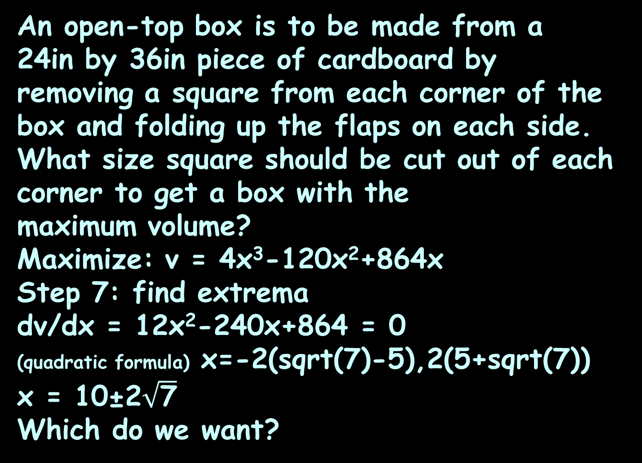
OPTIMIZATION
IN-CLASS PROBLEM 6
An open-top box is to be made from a 24in by 36in piece of cardboard by removing a square from each corner of the box and folding up the flaps on each side. What size square should be cut out of each corner to get a box with the
maximum volume?
Maximize: v = 4x³-120x²+864x
Step 7: find extrema
dv/dx = 12x²-240x+864 = 0
(quadratic formula) x=-2(sqrt(7)-5),2(5+sqrt(7))
x = 10±2$\sqrt{\text{7}}$
Which do we want?
l
w
h
https://math.libretexts.org/Bookshelves/Calculus/Map%3A_Calculus__Early_Transcendentals_(Stewart)/04%3A_Applications_of_Differentiation/4.07%3A_Optimization_Problems

Slide 112
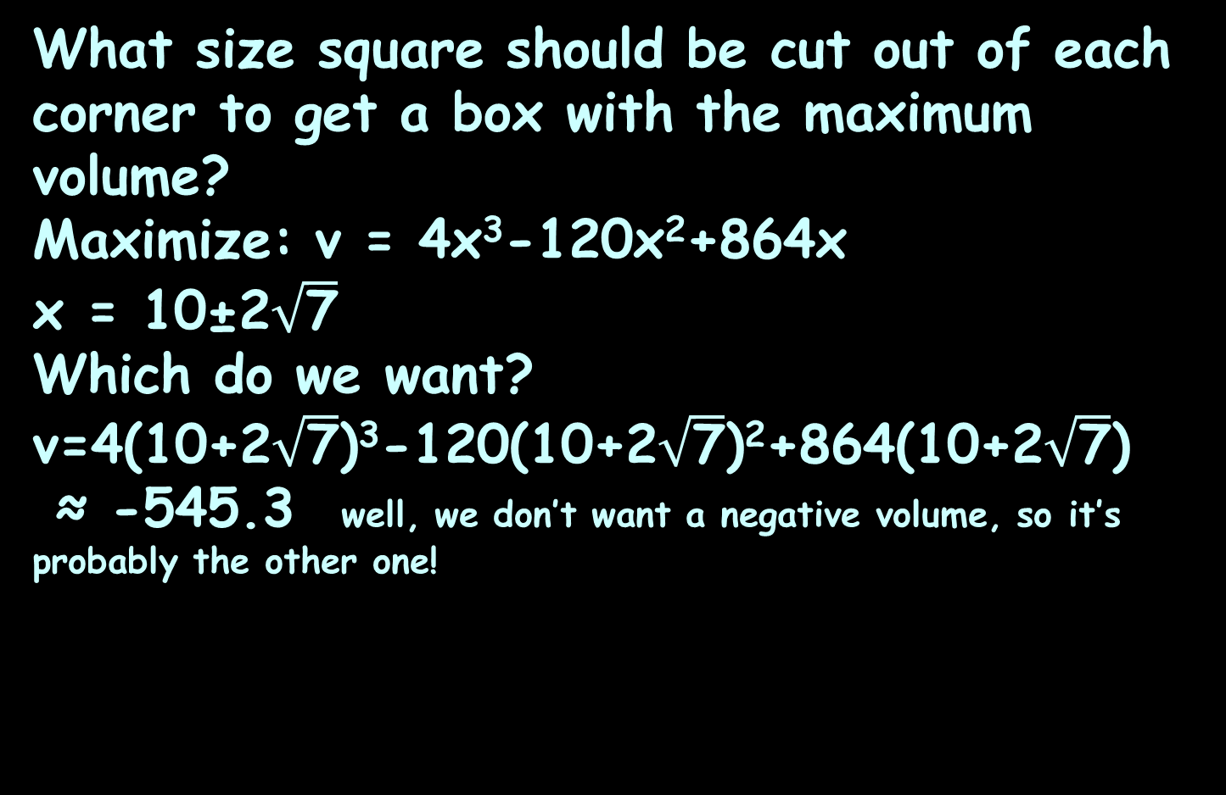
OPTIMIZATION
IN-CLASS PROBLEM 6
What size square should be cut out of each corner to get a box with the maximum volume?
Maximize: v = 4x³-120x²+864x
x = 10±2$\sqrt{\text{7}}$
Which do we want?
v=4(10+2$\sqrt{\text{7}}$)³-120(10+2$\sqrt{\text{7}}$)²+864(10+2$\sqrt{\text{7}}$)
≈ -545.3 well, we don’t want a negative volume, so it’s probably the other one!
https://math.libretexts.org/Bookshelves/Calculus/Map%3A_Calculus__Early_Transcendentals_(Stewart)/04%3A_Applications_of_Differentiation/4.07%3A_Optimization_Problems

Slide 113
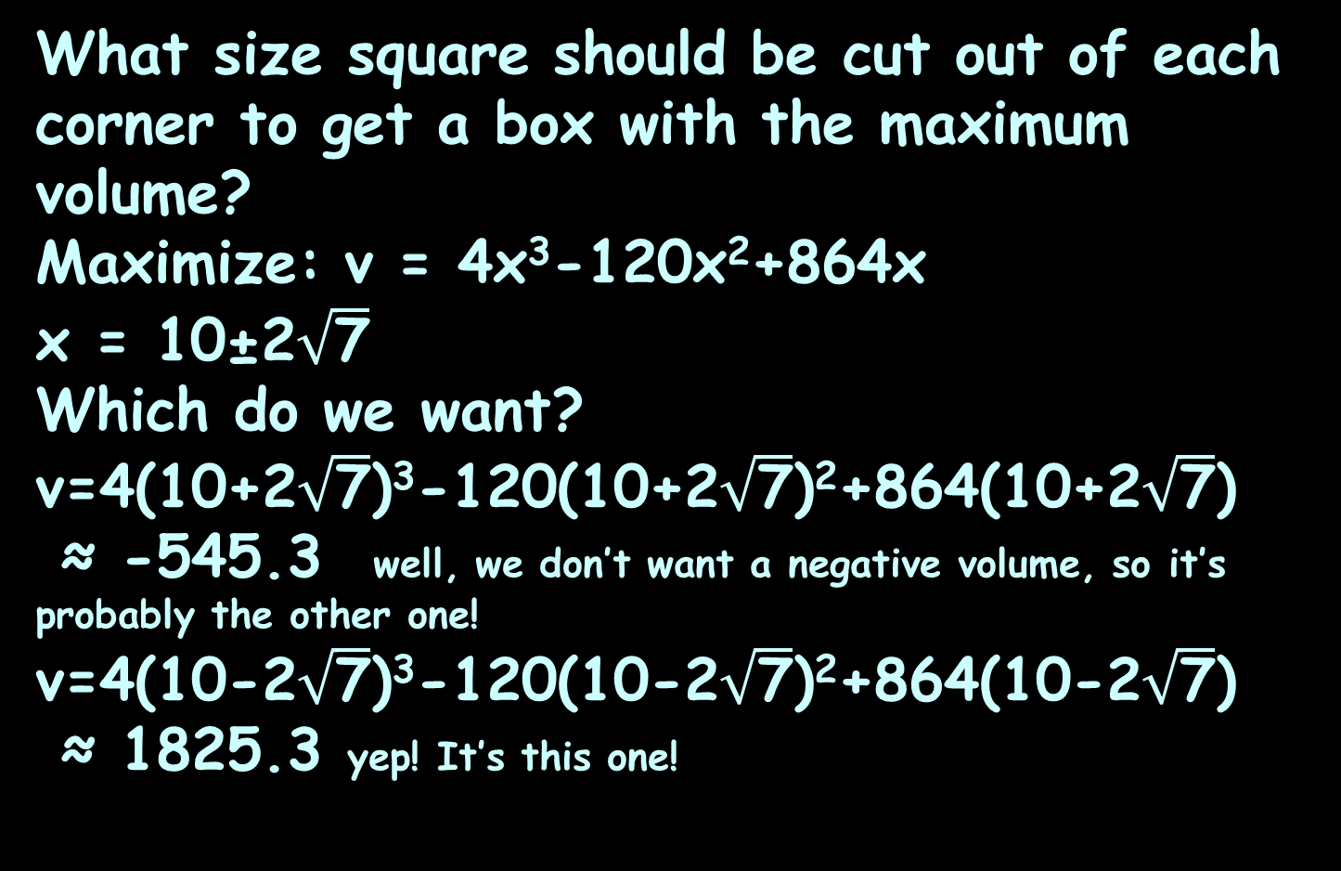
OPTIMIZATION
IN-CLASS PROBLEM 6
What size square should be cut out of each corner to get a box with the maximum volume?
Maximize: v = 4x³-120x²+864x
x = 10±2$\sqrt{\text{7}}$
Which do we want?
v=4(10+2$\sqrt{\text{7}}$)³-120(10+2$\sqrt{\text{7}}$)²+864(10+2$\sqrt{\text{7}}$)
≈ -545.3 well, we don’t want a negative volume, so it’s probably the other one!
v=4(10-2$\sqrt{\text{7}}$)³-120(10-2$\sqrt{\text{7}}$)²+864(10-2$\sqrt{\text{7}}$)
≈ 1825.3 yep! It’s this one!
https://math.libretexts.org/Bookshelves/Calculus/Map%3A_Calculus__Early_Transcendentals_(Stewart)/04%3A_Applications_of_Differentiation/4.07%3A_Optimization_Problems

Slide 114

OPTIMIZATION
IN-CLASS PROBLEM 6
What size square should be cut out of each corner to get a box with the maximum volume?
Maximize: v = 4x³-120x²+864x
So x = 10-2$\sqrt{\text{7}}$ ≈ 4.71 …
For a volume of v ≈ 1825.3 …
l
w
h
https://math.libretexts.org/Bookshelves/Calculus/Map%3A_Calculus__Early_Transcendentals_(Stewart)/04%3A_Applications_of_Differentiation/4.07%3A_Optimization_Problems

Slide 115

OPTIMIZATION
IN-CLASS PROBLEM 6
What size square should be cut out of each corner to get a box with the maximum volume?
Maximize: v = 4x³-120x²+864x
So x = 10-2$\sqrt{\text{7}}$ ≈ 4.71 in
For a volume of v ≈ 1825.3 in³
l
w
h
https://math.libretexts.org/Bookshelves/Calculus/Map%3A_Calculus__Early_Transcendentals_(Stewart)/04%3A_Applications_of_Differentiation/4.07%3A_Optimization_Problems

Slide 116
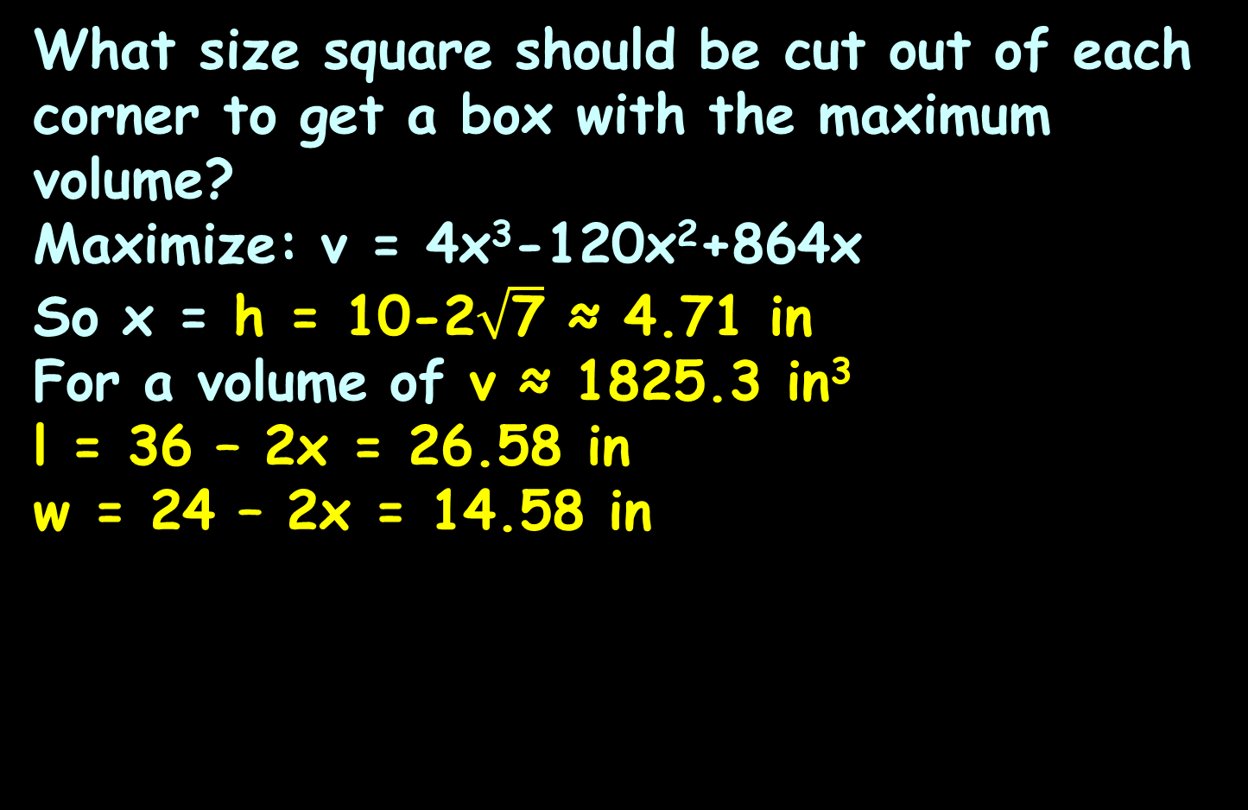
OPTIMIZATION
IN-CLASS PROBLEM 6
What size square should be cut out of each corner to get a box with the maximum volume?
Maximize: v = 4x³-120x²+864x
So x = h = 10-2$\sqrt{\text{7}}$ ≈ 4.71 in
For a volume of v ≈ 1825.3 in³
l = 36 – 2x = 26.58 in
w = 24 – 2x = 14.58 in
l
w
h
https://math.libretexts.org/Bookshelves/Calculus/Map%3A_Calculus__Early_Transcendentals_(Stewart)/04%3A_Applications_of_Differentiation/4.07%3A_Optimization_Problems

Slide 117
Optimization
These last three problems are the “classics” – almost every calculus book includes some variation on these

Slide 118
Optimization
Other problems involving optimization may be more complicated, but to solve them, use the 9 Steps

Slide 119
Questions?
http://i.imgur.com/aliTlT3.jpg

Slide 120
Summary
Today we covered:
Review of related rates
Optimization

Slide 121

You Survived!
www.playbuzz.com

