Slide 1

Welcome to
Unit 6 Part 12!
MATH 205 Differential Calculus
https://www.smu.edu.sg/programmes/core-curriculum/course-structure/calculus

Slide 2
What’s Up?
Review:
Continuity, extrema,
inflection points,
concavity, monotonicity
New stuff:
Related rates

Slide 3
What’s Up?
Outcome 3) Apply derivatives to solve optimization and related rates problems.

Slide 4

Review
http://995642590.r.lightningbase-cdn.com/wp-content/uploads/2010/12/looking-back-hrexaminer-v144-cover425px.jpg

Slide 5
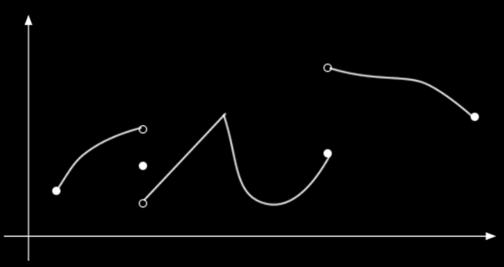
Continuity
If graphs are discontinuous, they are not differentiable at the discontinuous points
VFrench 2013

Slide 6
Continuity
If graphs are discontinuous, they are not differentiable at the discontinuous points or the pointy-points
VFrench 2013

Slide 7
Extrema
The maximum or minimum over the entire function is called an "Absolute" or "Global" maximum or minimum
A local maximum is the point where the height of the function is greater than (or equal to) the height anywhere else in that interval (ditto mins)

Slide 8
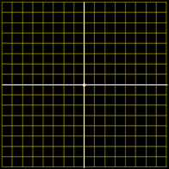
Extrema
The maximums and minimums of a graph occur where the slope of the tangent line is zero!
VFrench 2020

Slide 9
Extrema
Given a specific interval, the max and min can occur at the endpoints
Interval Max
Interval Min
VFrench 2020

Slide 10
Extrema
The max and min occur where the first derivative is zero
They are bookended by derivatives that are NOT zero

Slide 11
Extrema
A max will occur where the first derivative is zero and the derivatives on the left side are positive while the derivatives on the right side
are negative
VFrench 2020

Slide 12
Extrema
A min will occur where the first derivative is zero and the derivatives on the left side are negative while the derivatives on the right side
are positive
This is called
the Max-Min
Test
VFrench 2020

Slide 13
Shape of a Curve
Concave upward
is when the
slope increases
moving from
left to right
Also called “convex” or “convex downward”
https://www.mathsisfun.com/calculus/inflection-points.html

Slide 14
Shape of a Curve
Concave
downward
is when the
slope decreases
moving from
left to right
Also called “concave” or “convex upward”
https://www.mathsisfun.com/calculus/inflection-points.html

Slide 15
Shape of a Curve
An inflection point is where a curve changes from concave upward to concave downward (or vice versa)
Concave
upward
Concave
upward
Concave
downward
Concave
downward
Concave
upward
Concave
downward
https://www.mathsisfun.com/calculus/inflection-points.html

Slide 16
Shape of a Curve
Derivatives help us!
The derivative of a function gives the slope
The second derivative tells us if the slope increases or decreases

Slide 17
Shape of a Curve
When the second derivative is positive, the function is concave upward (cup)
When the second derivative is negative, the function is concave downward (hill)

Slide 18
Shape of a Curve
And the inflection point is where it goes from concave upward to concave downward (or vice versa) and the second derivative is zero

Slide 19
Monotonicity
A function is called “increasing” (or non-decreasing) if its values are only rising and never falling with increasing values of x
It is strictly increasing if values always become larger and cannot be constant

Slide 20
Monotonicity
A function is called “decreasing” (or non-increasing) if its values are only falling and never rising with increasing values of x
It is strictly decreasing if values always become smaller and cannot be constant

Slide 21
Monotonicity
If a function is either increasing, strictly increasing, decreasing, or strictly decreasing, the function is called monotonic

Slide 22
Monotonicity
To find the monotonicity of a function, we use the first derivative
The derivative is positive at a point if the function is rising and negative if it is falling

Slide 23
Monotonicity
If the first derivative can only be positive or only positive or zero, it is monotonic (increasing)
If the first derivative can only be negative or only negative or zero, it is monotonic (decreasing)

Slide 24

Questions?
http://i.imgur.com/aliTlT3.jpg

Slide 25
Related Rates
Remember when we did functions on week 2?

Slide 26
Related Rates
Changing one variable’s value changes the value of another variable that depended on it

Slide 27
Related Rates
Problems including variables whose rates of change are related and can be modeled by an equation are called related rates problems

Slide 28
Related Rates
        One or more rates are given, and other rates are to be calculated using the equation

Slide 29
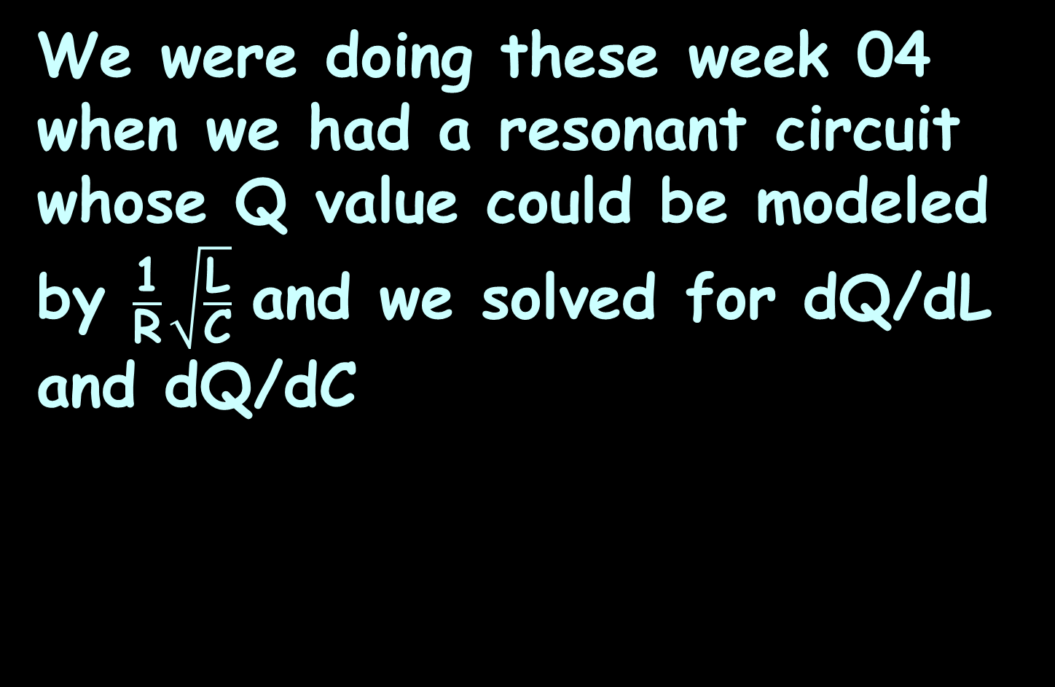
Related Rates
We were doing these week 04 when we had a resonant circuit whose Q value could be modeled by $\frac{\text{1}}{\text{R}}\sqrt{\frac{\text{L}}{\text{C}}}$ and we solved for dQ/dL and dQ/dC

Slide 30
Related Rates
This can be done for any combination of variables in the model
The others are considered to be constants

Slide 31
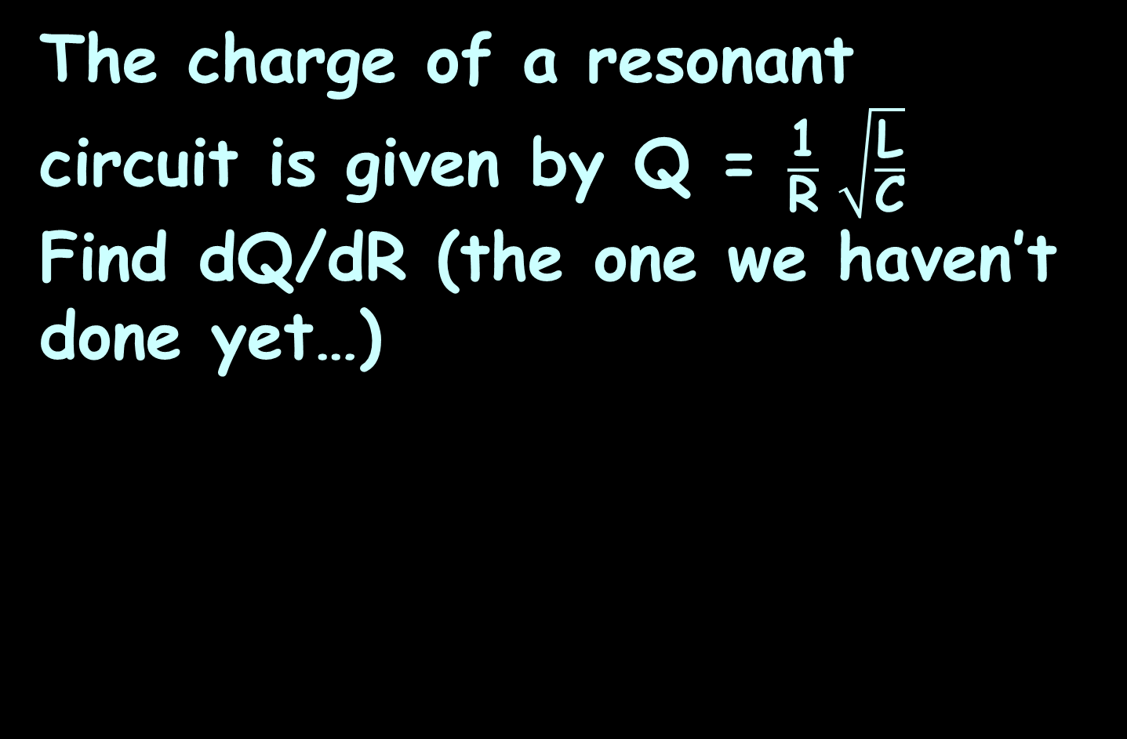
RELATED RATES
IN-CLASS PROBLEM 1
The charge of a resonant circuit is given by Q = $\frac{\text{1}}{\text{R}} \sqrt{\frac{\text{L}}{\text{C}}}$
Find dQ/dR (the one we haven’t done yet…)

Slide 32
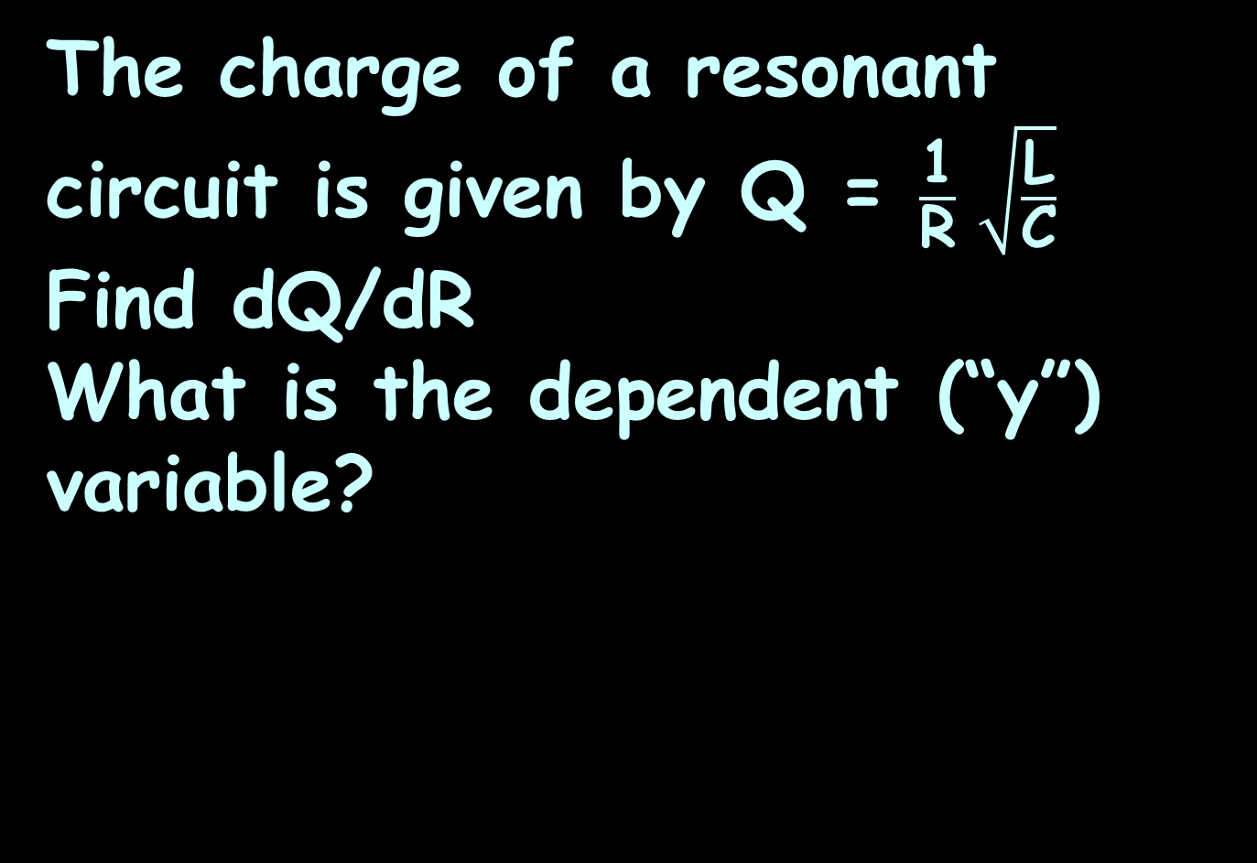
RELATED RATES
IN-CLASS PROBLEM 1
The charge of a resonant circuit is given by Q = $\frac{\text{1}}{\text{R}} \sqrt{\frac{\text{L}}{\text{C}}}$
Find dQ/dR
What is the dependent (“y”) variable?

Slide 33
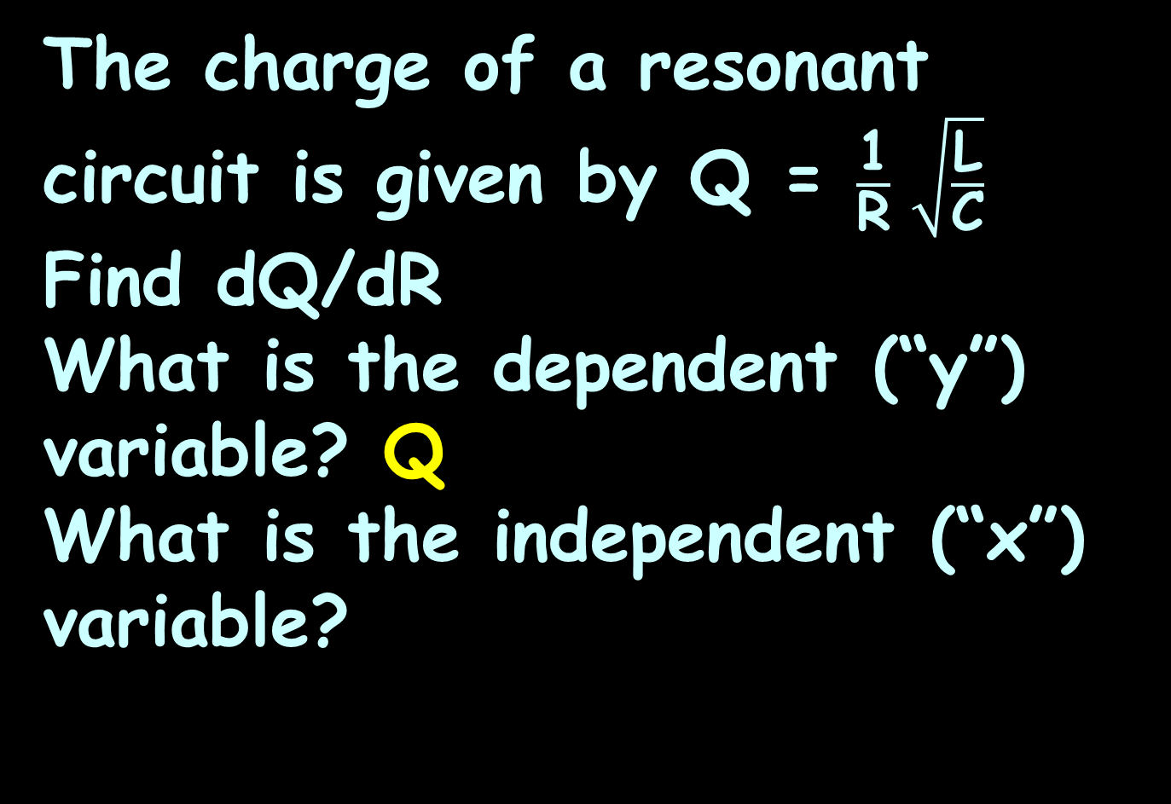
RELATED RATES
IN-CLASS PROBLEM 1
The charge of a resonant circuit is given by Q = $\frac{\text{1}}{\text{R}} \sqrt{\frac{\text{L}}{\text{C}}}$
Find dQ/dR
What is the dependent (“y”) variable? Q
What is the independent (“x”) variable?

Slide 34
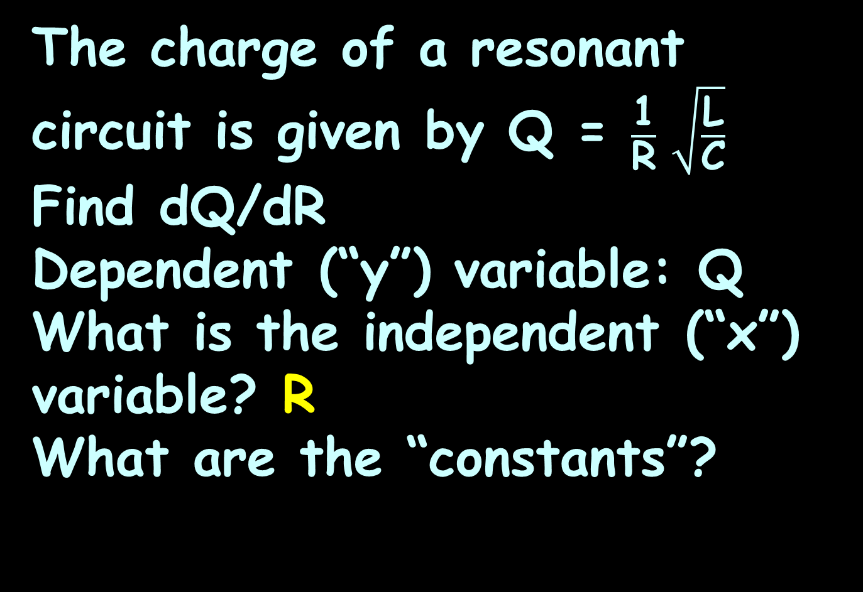
RELATED RATES
IN-CLASS PROBLEM 1
The charge of a resonant circuit is given by Q = $\frac{\text{1}}{\text{R}} \sqrt{\frac{\text{L}}{\text{C}}}$
Find dQ/dR
Dependent (“y”) variable: Q
What is the independent (“x”) variable? R
What are the “constants”?

Slide 35
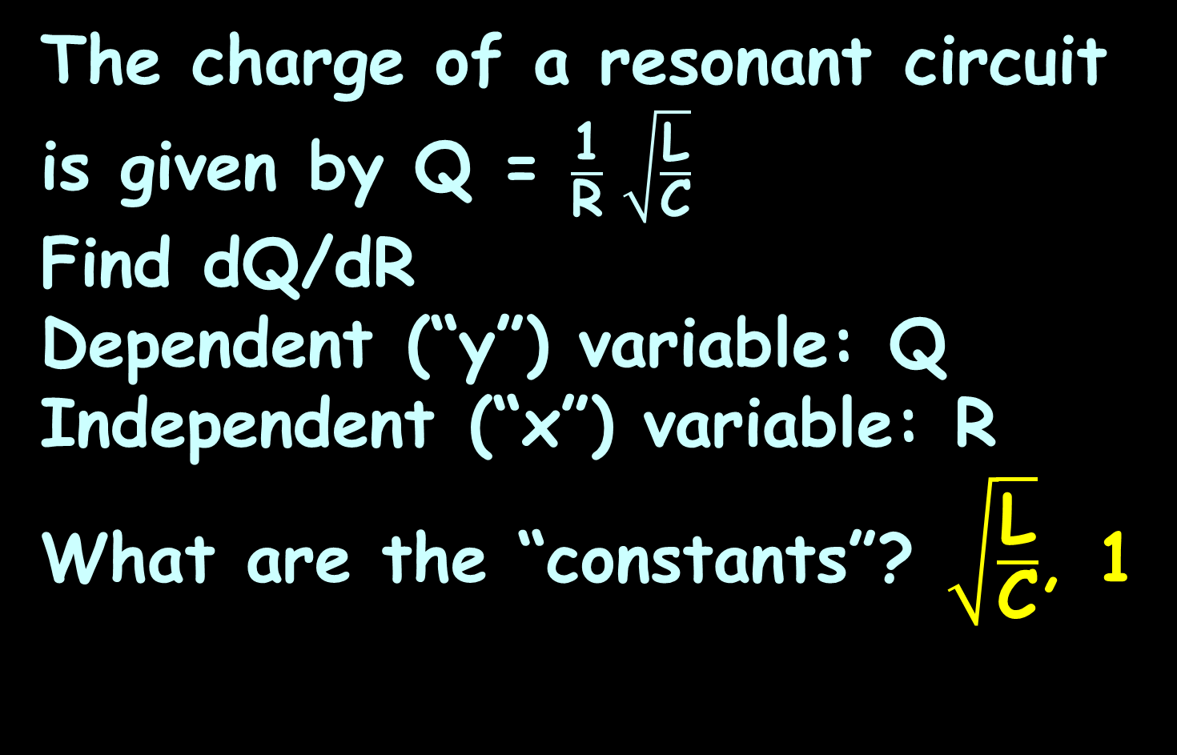
RELATED RATES
IN-CLASS PROBLEM 1
The charge of a resonant circuit is given by Q = $\frac{\text{1}}{\text{R}} \sqrt{\frac{\text{L}}{\text{C}}}$
Find dQ/dR
Dependent (“y”) variable: Q
Independent (“x”) variable: R
What are the “constants”? $\sqrt{\frac{\text{L}}{\text{C}}}$, 1

Slide 36
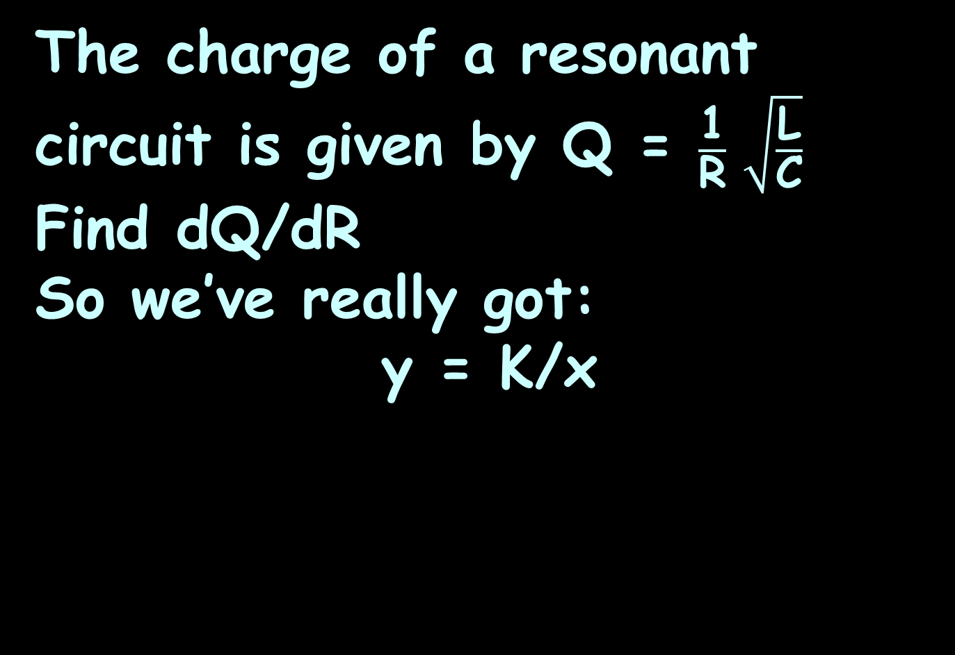

RELATED RATES
IN-CLASS PROBLEM 1
The charge of a resonant circuit is given by Q = $\frac{\text{1}}{\text{R}} \sqrt{\frac{\text{L}}{\text{C}}}$
Find dQ/dR
So we’ve really got:
y = K/x
Q
R
$$\sqrt{\frac{\text{L}}{\text{C}}}$$

Slide 37
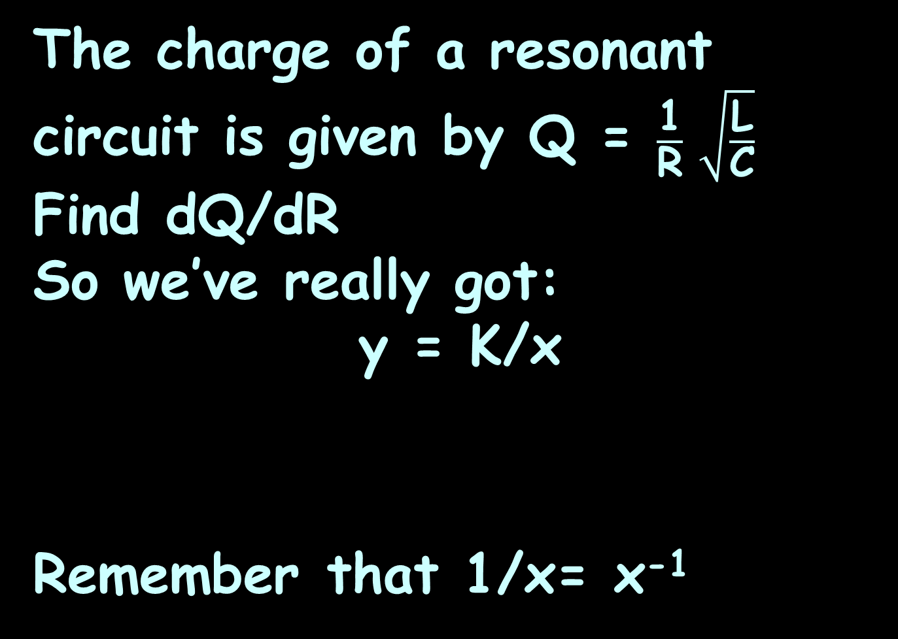
RELATED RATES
IN-CLASS PROBLEM 1
The charge of a resonant circuit is given by Q = $\frac{\text{1}}{\text{R}} \sqrt{\frac{\text{L}}{\text{C}}}$
Find dQ/dR
So we’ve really got:
y = K/x
Remember that 1/x= x⁻¹
Q
R
$$\sqrt{\frac{\text{L}}{\text{C}}}$$

Slide 38
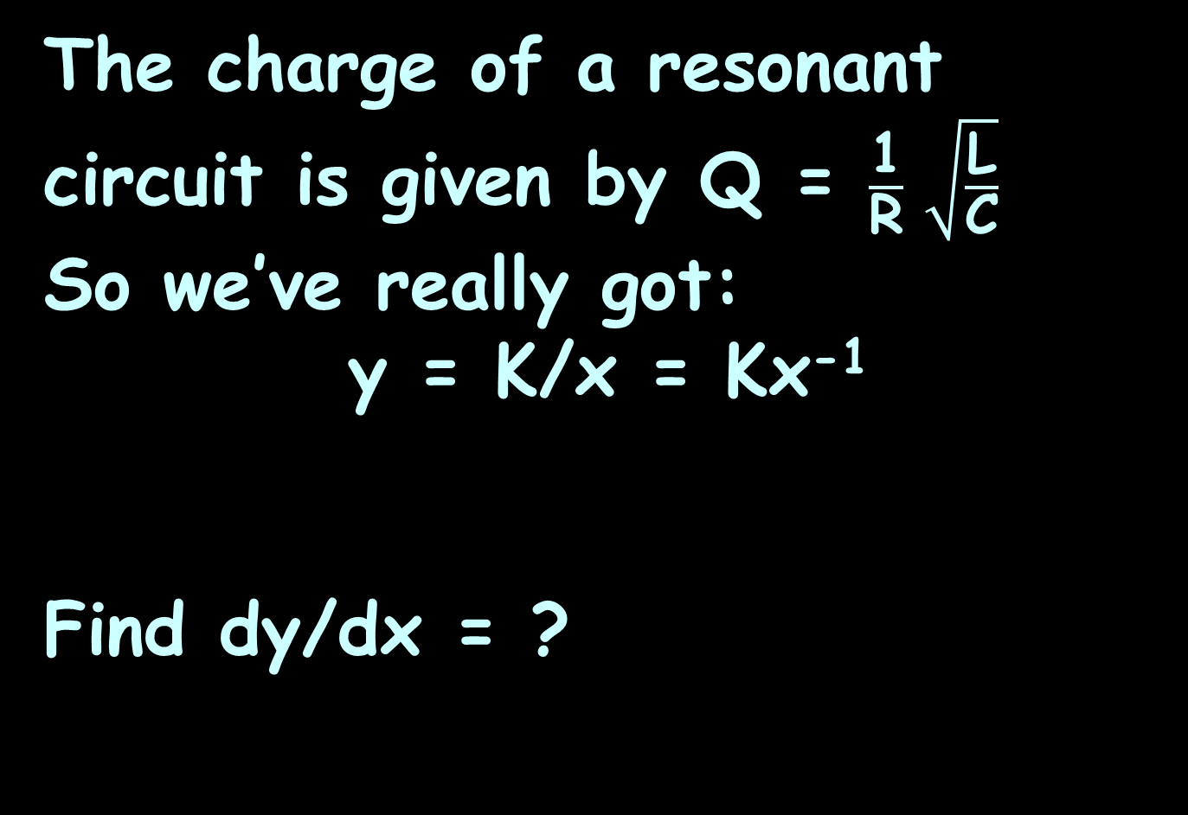

RELATED RATES
IN-CLASS PROBLEM 1
The charge of a resonant circuit is given by Q = $\frac{\text{1}}{\text{R}} \sqrt{\frac{\text{L}}{\text{C}}}$
So we’ve really got:
y = K/x = Kx⁻¹
Find dy/dx = ?
Q
R
$$\sqrt{\frac{\text{L}}{\text{C}}}$$

Slide 39
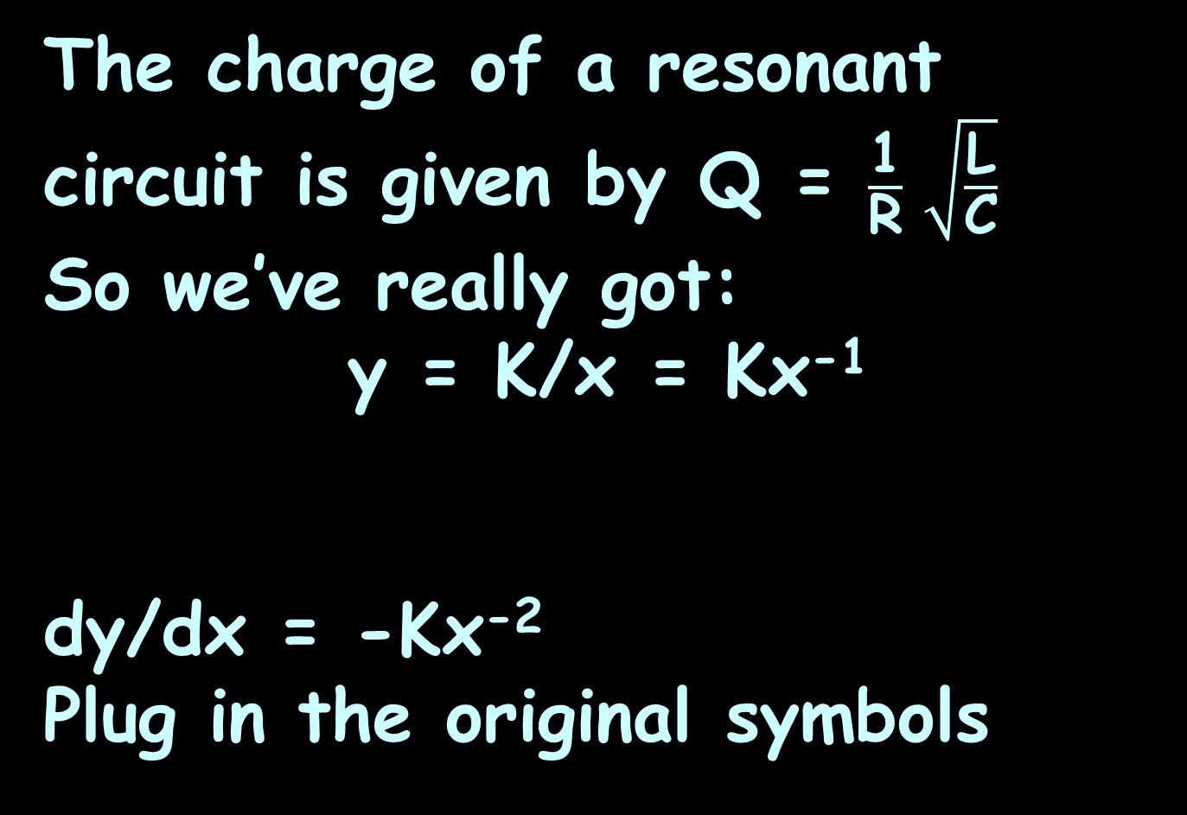
RELATED RATES
IN-CLASS PROBLEM 1
The charge of a resonant circuit is given by Q = $\frac{\text{1}}{\text{R}} \sqrt{\frac{\text{L}}{\text{C}}}$
So we’ve really got:
y = K/x = Kx⁻¹
dy/dx = -Kx⁻²
Plug in the original symbols
Q
R
$$\sqrt{\frac{\text{L}}{\text{C}}}$$

Slide 40
RELATED RATES
IN-CLASS PROBLEM 1
The charge of a resonant circuit is given by Q = $\frac{\text{1}}{\text{R}} \sqrt{\frac{\text{L}}{\text{C}}}$
So we’ve really got:
y = K/x = Kx⁻¹
dy/dx = -Kx⁻²
Plug in the original symbols
Q
R
$$\sqrt{\frac{\text{L}}{\text{C}}}$$

Slide 41
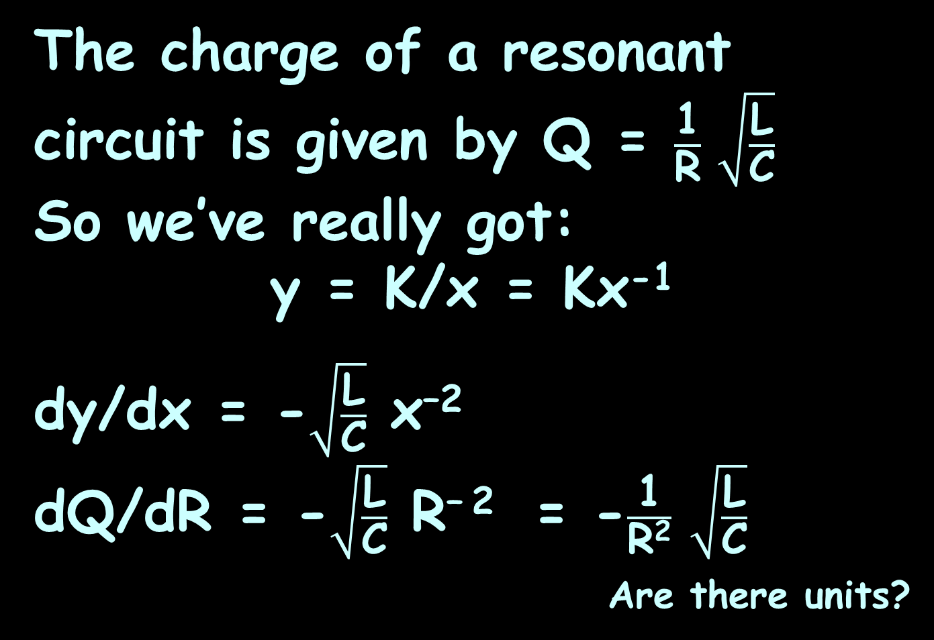
RELATED RATES
IN-CLASS PROBLEM 1
The charge of a resonant circuit is given by Q = $\frac{\text{1}}{\text{R}} \sqrt{\frac{\text{L}}{\text{C}}}$
So we’ve really got:
y = K/x = Kx⁻¹
dy/dx = -$\sqrt{\frac{\text{L}}{\text{C}}}$ x^{–2}
dQ/dR = -$\sqrt{\frac{\text{L}}{\text{C}}}$ R^{– 2} = -$\frac{\text{1}}{\text{R}\text{2}}$ $\sqrt{\frac{\text{L}}{\text{C}}}$
_{Are there units?}
or

Slide 42
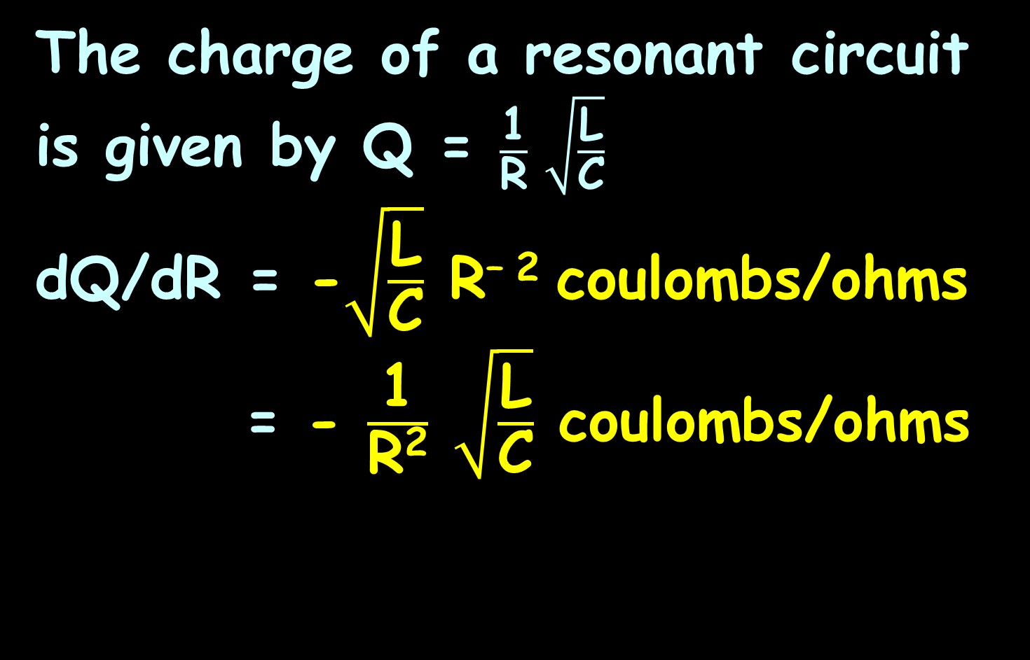
RELATED RATES
IN-CLASS PROBLEM 1
The charge of a resonant circuit is given by Q = $\frac{\text{1}}{\text{R}} \sqrt{\frac{\text{L}}{\text{C}}}$
dQ/dR = -$\sqrt{\frac{\text{L}}{\text{C}}}$ R^{– 2} coulombs/ohms
= - $\frac{\text{1}}{\text{R}\text{2}}$ $\sqrt{\frac{\text{L}}{\text{C}}}$ coulombs/ohms

Slide 43
Questions?
http://i.imgur.com/aliTlT3.jpg

Slide 44
Related Rates
        One or more rates are given, and other rates are to be calculated using the equation

Slide 45
Related Rates
This can be done for any combination of variables in the model
The others are considered to be constants

Slide 46
Related Rates
How to do it:
Draw a picture
What are you trying to find?
3) Find an equation relating the variables
4) Find dy/dx (usually chain rule)
5) Plug in known values
6) Solve for the rate of change

Slide 47
Related Rates
If there are values for the variables, plug them in at the end

Slide 48
RELATED RATES
IN-CLASS PROBLEM 2
The relationship between temperature and resistance for a device is modeled by:
R = 3 + 0.001T² (in ohms)
If the temperature T is increasing at the rate of 0.3°C/sec, how fast is the resistance changing when T=100°C?

Slide 49
RELATED RATES
IN-CLASS PROBLEM 2
The relationship between temperature and resistance for a device is modeled by:
R = 3 + 0.001T² (in ohms)
If the temperature T is increasing at the rate of 0.3°C/sec, how fast is the resistance changing when T=100°C?

Slide 50
RELATED RATES
IN-CLASS PROBLEM 2
R = 3 + 0.001T² (in ohms)
Temperature T is increasing at
the rate of 0.3°C/sec,
When T=100°C,
how fast (t) is the resistance
changing?
What do we want to know?

Slide 51
RELATED RATES
IN-CLASS PROBLEM 2
R = 3 + 0.001T² (in ohms)
Temperature T is increasing at
the rate of 0.3°C/sec,
When T=100°C,
how fast (t) is the resistance
changing?
What do we want to know?
dR/dt

Slide 52
RELATED RATES
IN-CLASS PROBLEM 2
R = 3 + 0.001T² (in ohms)
Temperature T is increasing at
the rate of 0.3°C/sec,
When T=100°C,
how fast is the resistance
changing?
We want to know: dR/dt
What do we know? dT/dt

Slide 53
RELATED RATES
IN-CLASS PROBLEM 2
We want to know: dR/dt
when T=100ºC
We know: dT/dt = 0.3ºC/sec
From the equation,
R = 3 + 0.001T² (in ohms)
we can find dR/dT:
dR/dT = 0 + 2(0.001)T = 0.002T

Slide 54
RELATED RATES
IN-CLASS PROBLEM 2
Find dR/dt for: R = 3 + 0.001T²
dR/dT = 2×0.001T = 0.002T
Are we done?

Slide 55
RELATED RATES
IN-CLASS PROBLEM 2
Find dR/dt for: R = 3 + 0.001T²
dR/dT = 0.002T
Are we done? Not a chance…
If the temperature T is increasing at the rate of 0.3°C/sec, how fast is the resistance changing when T=100°C?
Hmmm…

Slide 56
RELATED RATES
IN-CLASS PROBLEM 2
Find dR/dt for: R = 3 + 0.001T²
dR/dT = 0.002T
If the temperature T is increasing at the rate of 0.3°C/sec, how fast is the resistance changing when T=100°C?
“How fast” means change in time…

Slide 57
RELATED RATES
IN-CLASS PROBLEM 2
Find dR/dt for: R = 3 + 0.001T²
dR/dT = 0.002T
If the temperature T is increasing at the rate of 0.3°C/sec, how fast is the resistance changing when T=100°C?
And “how fast is it changing” means “dsomething/dt”

Slide 58
RELATED RATES
IN-CLASS PROBLEM 2
Find dR/dt for: R = 3 + 0.001T²
dR/dT = 0.002T
If the temperature T is increasing at the rate of 0.3°C/sec, how fast is the resistance changing when T=100°C?
Our equation related R and T but not dR/dt and dT/dt

Slide 59
RELATED RATES
IN-CLASS PROBLEM 2
Find dR/dt for: R = 3 + 0.001T²
dR/dT = 0.002T
If the temperature T is increasing at the rate of 0.3°C/sec, how fast is the resistance changing when T=100°C?
Do we have either dR/dt or dT/dt?

Slide 60
RELATED RATES
IN-CLASS PROBLEM 2
Find dR/dt for: R = 3 + 0.001T²
dR/dT = 0.002T
If the temperature T is increasing at the rate of 0.3°C/sec, how fast is the resistance changing when T=100°C?
Do we have either dR/dt or dT/dt?
dT/dt = 0.3°C/sec

Slide 61
RELATED RATES
IN-CLASS PROBLEM 2
Find dR/dt for: R = 3 + 0.001T²
dR/dT = 0.002T
If the temperature T is increasing at the rate of 0.3°C/sec, how fast is the resistance changing when T=100°C?
We have: dT/dt = 0.3°C/sec
dR/dT = 0.002T
Can we use these to find dR/dt?

Slide 62
RELATED RATES
IN-CLASS PROBLEM 2
Find dR/dt for: R = 3 + 0.001T²
Algebraically: mathematicians use this trick all the time
dR/dT × dT/dt = dR/dt (what we want)
dR/dT = 0.002T
dT/dt = 0.3
0.002T × 0.3 = dR/dt

Slide 63
RELATED RATES
IN-CLASS PROBLEM 2
Find dR/dt for: R = 3 + 0.001T²
0.002T × 0.3 = dR/dt
Rewriting it:
dR/dt = 0.002T × 0.3°C/sec
Now what?

Slide 64
RELATED RATES
IN-CLASS PROBLEM 2
Find dR/dt for: R = 3 + 0.001T²
dR/dt = 0.002T × 0.3°C/sec
If the temperature T is increasing at the rate of 0.3°C/sec, how fast is the resistance changing when T=100°C?
Now what? Plug in T=100

Slide 65
RELATED RATES
IN-CLASS PROBLEM 2
Find dR/dt for: R = 3 + 0.001T²
dR/dt = 0.002T × 0.3°C/sec
Plug in T = 100°C
dR/dt = 0.002T x 0.3°C/sec
= 0.002(100) x 0.3
= 0.06 …

Slide 66
RELATED RATES
IN-CLASS PROBLEM 2
Find dR/dt for: R = 3 + 0.001T²
dR/dt = 0.002T × 0.3°C/sec
Plug in T = 100°C
dR/dt = 0.002T x 0.3°C/sec
= 0.002(100) x 0.3
= 0.06 Ω/sec

Slide 67
Related Rates
How to do it:
Find the equation relating the variables rates
Figure out which is “y” and which is “x”
Find dy/dx
Plug in any known rates and values
Solve for the desired rate of change

Slide 68
Questions?
http://i.imgur.com/aliTlT3.jpg

Slide 69
RELATED RATES
IN-CLASS PROBLEM 3
The edge of a square is increasing at the rate of 3 cm/sec. At what rate is the square’s area changing when the edge of the square is 10 cm?

Slide 70
RELATED RATES
IN-CLASS PROBLEM 3
The edge of a square is increasing at the rate of 3 cm/sec. At what rate is the square’s area changing when the edge of the square is 10 cm?
Step 1: Draw a picture
dx/dt =
3 cm/sec
https://www.math.ucdavis.edu/~kouba/CalcOneDIRECTORY/relatedratesdirectory/solution01.html

Slide 71
RELATED RATES
IN-CLASS PROBLEM 3
The edge of a square is increasing at the rate of 3 cm/sec. At what rate is the square’s area changing when the edge of the square is 10 cm?
Step 2: What are you
trying to find?
dx/dt =
3 cm/sec
https://www.math.ucdavis.edu/~kouba/CalcOneDIRECTORY/relatedratesdirectory/solution01.html

Slide 72
RELATED RATES
IN-CLASS PROBLEM 3
The edge of a square is increasing at the rate of 3 cm/sec. At what rate is the square’s area changing when the edge of the square is 10 cm?
Step 2: What are you
trying to find? dA/dt
dx/dt =
3 cm/sec
https://www.math.ucdavis.edu/~kouba/CalcOneDIRECTORY/relatedratesdirectory/solution01.html

Slide 73
RELATED RATES
IN-CLASS PROBLEM 3
The edge of a square is increasing at the rate of 3 cm/sec. At what rate is the square’s area changing when the edge of the square is 10 cm?
Step 3: Find an equation
that relates the variables
dx/dt =
3 cm/sec
https://www.math.ucdavis.edu/~kouba/CalcOneDIRECTORY/relatedratesdirectory/solution01.html

Slide 74
RELATED RATES
IN-CLASS PROBLEM 3
The edge of a square is increasing at the rate of 3 cm/sec. At what rate is the square’s area changing when the edge of the square is 10 cm?
Step 3: Find an equation
that relates the variables
area A = x²
dx/dt =
3 cm/sec
https://www.math.ucdavis.edu/~kouba/CalcOneDIRECTORY/relatedratesdirectory/solution01.html

Slide 75
RELATED RATES
IN-CLASS PROBLEM 3
The edge of a square is increasing at the rate of 3 cm/sec. At what rate is the square’s area changing when the edge of the square is 10 cm?
Step 4: Take the derivative
with respect to time
(usually Chain Rule)
dx/dt =
3 cm/sec
https://www.math.ucdavis.edu/~kouba/CalcOneDIRECTORY/relatedratesdirectory/solution01.html

Slide 76
RELATED RATES
IN-CLASS PROBLEM 3
The edge of a square is increasing at the rate of 3 cm/sec. At what rate is the square’s area changing when the edge of the square is 10 cm?
Step 4: Take the derivative
with respect to time
dA/dt = dx²/dt
= 2x dx/dt
dx/dt =
3 cm/sec
https://www.math.ucdavis.edu/~kouba/CalcOneDIRECTORY/relatedratesdirectory/solution01.html

Slide 77
RELATED RATES
IN-CLASS PROBLEM 3
The edge of a square is increasing at the rate of 3 cm/sec. At what rate is the square’s area changing when the edge of the square is 10 cm?
Step 5: Plug in stuff you
know
dA/dt = 2x dx/dt
= 2(10)(3) = 60 whats?
dx/dt =
3 cm/sec
https://www.math.ucdavis.edu/~kouba/CalcOneDIRECTORY/relatedratesdirectory/solution01.html

Slide 78
RELATED RATES
IN-CLASS PROBLEM 3
The edge of a square is increasing at the rate of 3 cm/sec. At what rate is the square’s area changing when the edge of the square is 10 cm?
Step 5: Plug in stuff you
know
dA/dt = 60 cm²/sec
dx/dt =
3 cm/sec
https://www.math.ucdavis.edu/~kouba/CalcOneDIRECTORY/relatedratesdirectory/solution01.html

Slide 79
Questions?
http://i.imgur.com/aliTlT3.jpg

Slide 80
RELATED RATES
IN-CLASS PROBLEM 4
A ladder 13 feet long is leaning against a high wall. If the base of the ladder is pushed toward the wall at the rate of 2 ft/sec., at what rate is the top of the ladder moving up the wall when the base of the ladder is 5 feet from the wall ?

Slide 81
RELATED RATES
IN-CLASS PROBLEM 4
A ladder 13 feet long is leaning against a high wall. If the base of the ladder is pushed toward the wall at the rate of 2 ft/sec., at what rate is the top of the ladder moving up the wall when the base
of the ladder is 5 feet
from the wall ?
Step 1: Pic
dx/dt =
-2 ft/sec
https://www.math.ucdavis.edu/~kouba/CalcOneDIRECTORY/relatedratesdirectory/solution06.html

Slide 82
RELATED RATES
IN-CLASS PROBLEM 4
A ladder 13 feet long is leaning against a high wall. If the base of the ladder is pushed toward the wall at the rate of 2 ft/sec., at what rate is the top of the ladder moving up the wall when the base
of the ladder is 5 feet
from the wall ?
Step 2: What are you trying
to find?
dx/dt =
-2 ft/sec
https://www.math.ucdavis.edu/~kouba/CalcOneDIRECTORY/relatedratesdirectory/solution06.html

Slide 83
RELATED RATES
IN-CLASS PROBLEM 4
A ladder 13 feet long is leaning against a high wall. If the base of the ladder is pushed toward the wall at the rate of 2 ft/sec., at what rate is the top of the ladder moving up the wall when the base
of the ladder is 5 feet
from the wall ?
Step 2: What are you trying
to find? dy/dt
dx/dt =
-2 ft/sec
https://www.math.ucdavis.edu/~kouba/CalcOneDIRECTORY/relatedratesdirectory/solution06.html

Slide 84
RELATED RATES
IN-CLASS PROBLEM 4
A ladder 13 feet long is leaning against a high wall. If the base of the ladder is pushed toward the wall at the rate of 2 ft/sec., at what rate is the top of the ladder moving up the wall when the base
of the ladder is 5 feet
from the wall ?
Step 3: Eq?
dx/dt =
-2 ft/sec
https://www.math.ucdavis.edu/~kouba/CalcOneDIRECTORY/relatedratesdirectory/solution06.html

Slide 85
RELATED RATES
IN-CLASS PROBLEM 4
A ladder 13 feet long is leaning against a high wall. If the base of the ladder is pushed toward the wall at the rate of 2 ft/sec., at what rate is the top of the ladder moving up the wall when the base
of the ladder is 5 feet
from the wall ?
Step 3: x² + y² = 13² = 169
dx/dt =
-2 ft/sec
https://www.math.ucdavis.edu/~kouba/CalcOneDIRECTORY/relatedratesdirectory/solution06.html

Slide 86
RELATED RATES
IN-CLASS PROBLEM 4
A ladder 13 feet long is leaning against a high wall. If the base of the ladder is pushed toward the wall at the rate of 2 ft/sec., at what rate is the top of the ladder moving up the wall when the base
of the ladder is 5 feet
from the wall ?
Step 4: x² + y² = 169
d /dt
dx/dt =
-2 ft/sec
https://www.math.ucdavis.edu/~kouba/CalcOneDIRECTORY/relatedratesdirectory/solution06.html

Slide 87
RELATED RATES
IN-CLASS PROBLEM 4
A ladder 13 feet long is leaning against a high wall. If the base of the ladder is pushed toward the wall at the rate of 2 ft/sec., at what rate is the top of the ladder moving up the wall when the base
of the ladder is 5 feet
from the wall ?
Step 4: x² + y² = 169
2x dx/dt + 2y dy/dt = 0
x dx/dt + y dy/dt = 0
dx/dt =
-2 ft/sec
(what we want)
https://www.math.ucdavis.edu/~kouba/CalcOneDIRECTORY/relatedratesdirectory/solution06.html

Slide 88
RELATED RATES
IN-CLASS PROBLEM 4
A ladder 13 feet long is leaning against a high wall. If the base of the ladder is pushed toward the wall at the rate of 2 ft/sec., at what rate is the top of the ladder moving up the wall when the base
of the ladder is 5 feet
from the wall ?
x dx/dt + y dy/dt = 0
dy/dt = (-x dx/dt)/y
Step 5: Plug in stuff!
(what we want)
dx/dt =
-2 ft/sec
https://www.math.ucdavis.edu/~kouba/CalcOneDIRECTORY/relatedratesdirectory/solution06.html

Slide 89
RELATED RATES
IN-CLASS PROBLEM 4
A ladder 13 feet long is leaning against a high wall. If the base of the ladder is pushed toward the wall at the rate of 2 ft/sec., at what rate is the top of the ladder moving up the wall when the base
of the ladder is 5 feet
from the wall ?
Step 5: Plug in stuff!
dy/dt = (-x dx/dt)/y
dx/dt =
-2 ft/sec
(the thing we’re looking for)
https://www.math.ucdavis.edu/~kouba/CalcOneDIRECTORY/relatedratesdirectory/solution06.html

Slide 90
RELATED RATES
IN-CLASS PROBLEM 4
A ladder 13 feet long is leaning against a high wall. If the base of the ladder is pushed toward the wall at the rate of 2 ft/sec., at what rate is the top of the ladder moving up the wall when the base
of the ladder is 5 feet
from the wall ?
dy/dt = (-5 (-2))/y hmm…
dx/dt =
-2 ft/sec
https://www.math.ucdavis.edu/~kouba/CalcOneDIRECTORY/relatedratesdirectory/solution06.html

Slide 91
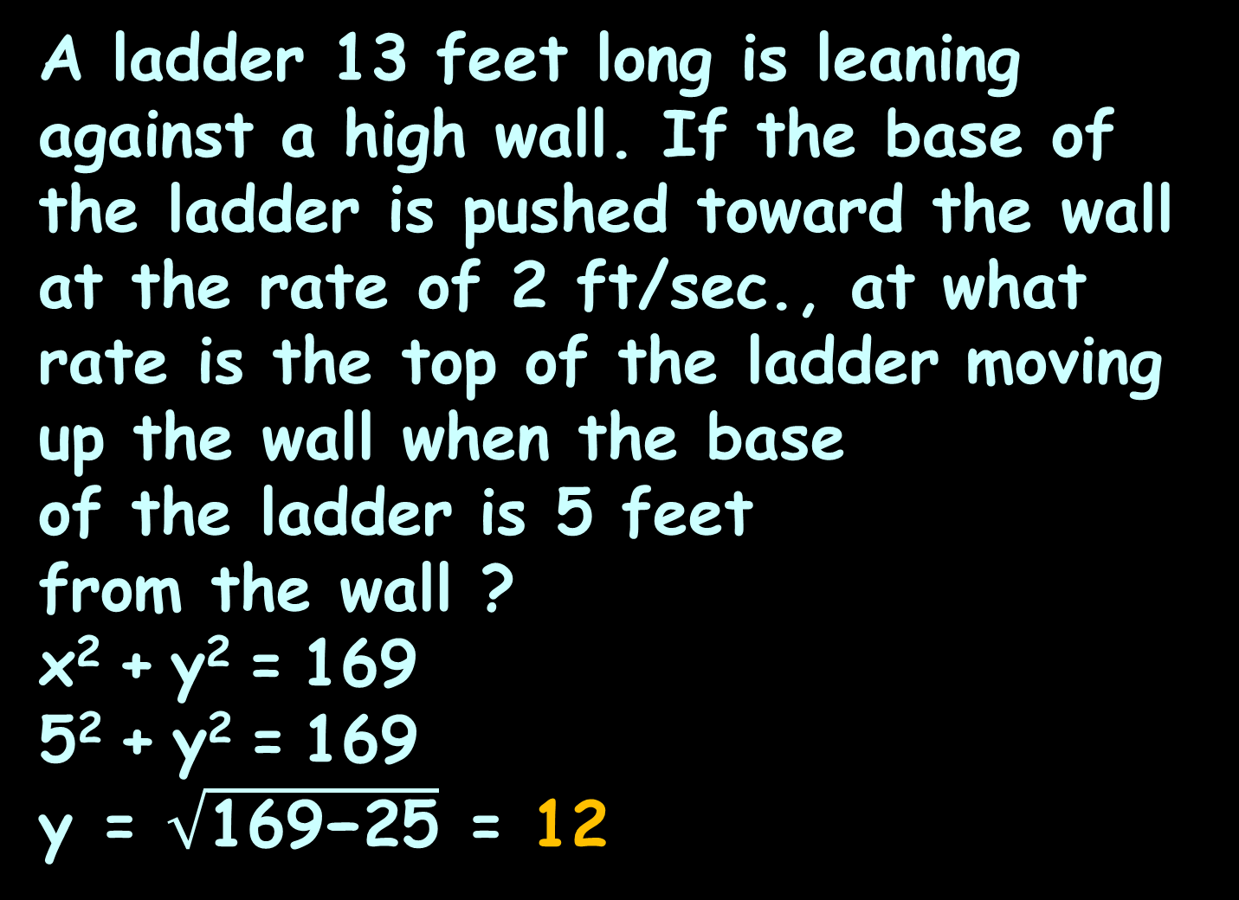
RELATED RATES
IN-CLASS PROBLEM 4
A ladder 13 feet long is leaning against a high wall. If the base of the ladder is pushed toward the wall at the rate of 2 ft/sec., at what rate is the top of the ladder moving up the wall when the base
of the ladder is 5 feet
from the wall ?
x² + y² = 169
5² + y² = 169
y = $\sqrt{\text{169−25}}$ = 12
dx/dt =
-2 ft/sec
https://www.math.ucdavis.edu/~kouba/CalcOneDIRECTORY/relatedratesdirectory/solution06.html

Slide 92
RELATED RATES
IN-CLASS PROBLEM 4
A ladder 13 feet long is leaning against a high wall. If the base of the ladder is pushed toward the wall at the rate of 2 ft/sec., at what rate is the top of the ladder moving up the wall when the base
of the ladder is 5 feet
from the wall ?
dy/dt = (-5 (-2))/12
= 10/12 = 5/6 whats?
dx/dt =
-2 ft/sec
https://www.math.ucdavis.edu/~kouba/CalcOneDIRECTORY/relatedratesdirectory/solution06.html

Slide 93
RELATED RATES
IN-CLASS PROBLEM 4
A ladder 13 feet long is leaning against a high wall. If the base of the ladder is pushed toward the wall at the rate of 2 ft/sec., at what rate is the top of the ladder moving up the wall when the base
of the ladder is 5 feet
from the wall ?
dy/dt = (-5 (-2))/12
= 10/12 = 5/6 ft/sec
dx/dt =
-2 ft/sec
https://www.math.ucdavis.edu/~kouba/CalcOneDIRECTORY/relatedratesdirectory/solution06.html

Slide 94
Questions?
http://i.imgur.com/aliTlT3.jpg

Slide 95
RELATED RATES
IN-CLASS PROBLEM 5
The radius of a circular oil slick on the surface of a pond is increasing at the rate of 10 meters/min. At what rate is the circle’s area changing when the radius of the oil slick is 20 m.?
Step 1:
dr/dt =
10m/min
https://www.math.ucdavis.edu/~kouba/CalcOneDIRECTORY/relatedratesdirectory/solution04.html

Slide 96
RELATED RATES
IN-CLASS PROBLEM 5
The radius of a circular oil slick on the surface of a pond is increasing at the rate of 10 meters/min. At what rate is the circle’s area changing when the radius of the oil slick is 20 m.?
Step 2:
dr/dt =
10m/min
https://www.math.ucdavis.edu/~kouba/CalcOneDIRECTORY/relatedratesdirectory/solution04.html

Slide 97
RELATED RATES
IN-CLASS PROBLEM 5
The radius of a circular oil slick on the surface of a pond is increasing at the rate of 10 meters/min. At what rate is the circle’s area changing when the radius of the oil slick is 20 m.?
Step 2: dA/dt
dr/dt =
10m/min
https://www.math.ucdavis.edu/~kouba/CalcOneDIRECTORY/relatedratesdirectory/solution04.html

Slide 98
RELATED RATES
IN-CLASS PROBLEM 5
The radius of a circular oil slick on the surface of a pond is increasing at the rate of 10 meters/min. At what rate is the circle’s area changing when the radius of the oil slick is 20 m.?
Step 3:
dr/dt =
10m/min
https://www.math.ucdavis.edu/~kouba/CalcOneDIRECTORY/relatedratesdirectory/solution04.html

Slide 99
RELATED RATES
IN-CLASS PROBLEM 5
The radius of a circular oil slick on the surface of a pond is increasing at the rate of 10 meters/min. At what rate is the circle’s area changing when the radius of the oil slick is 20 m?
Step 3: A = πr²
Step 4:
dr/dt =
10m/min
https://www.math.ucdavis.edu/~kouba/CalcOneDIRECTORY/relatedratesdirectory/solution04.html

Slide 100
RELATED RATES
IN-CLASS PROBLEM 5
The radius of a circular oil slick on the surface of a pond is increasing at the rate of 10 meters/min. At what rate is the circle’s area changing when the radius of the oil slick is 20 m?
A = πr²
Step 4: dA/dt = 2πr dr/dt
Step 5:
dr/dt =
10m/min
https://www.math.ucdavis.edu/~kouba/CalcOneDIRECTORY/relatedratesdirectory/solution04.html

Slide 101
RELATED RATES
IN-CLASS PROBLEM 5
The radius of a circular oil slick on the surface of a pond is increasing at the rate of 10 meters/min. At what rate is the circle’s area changing when the radius of the oil slick is 20 m?
dA/dt = 2πr dr/dt
Step 5: dA/dt = 2π(20) (10)
≈ 1256.64 ?
dr/dt =
10m/min
https://www.math.ucdavis.edu/~kouba/CalcOneDIRECTORY/relatedratesdirectory/solution04.html

Slide 102
RELATED RATES
IN-CLASS PROBLEM 5
The radius of a circular oil slick on the surface of a pond is increasing at the rate of 10 meters/min. At what rate is the circle’s area changing when the radius of the oil slick is 20 m?
dA/dt = 2πr dr/dt
dA/dt ≈ 1256.64 m²/min
dr/dt =
10m/min
https://www.math.ucdavis.edu/~kouba/CalcOneDIRECTORY/relatedratesdirectory/solution04.html

Slide 103
Questions?
http://i.imgur.com/aliTlT3.jpg

Slide 104
RELATED RATES
IN-CLASS PROBLEM 6
Car B starts 30 miles directly east of car A and begins moving west at 90 mph. At the same moment car A begins moving north at 60 mph. At what rate is the distance between the cars changing after t=1/3 hr.?
Step 1:
Step 2:
dy/dt =
60mph
dx/dt =
-90mph
https://www.math.ucdavis.edu/~kouba/CalcOneDIRECTORY/relatedratesdirectory/solution15.html

Slide 105
RELATED RATES
IN-CLASS PROBLEM 6
Car B starts 30 miles directly east of car A and begins moving west at 90 mph. At the same moment car A begins moving north at 60 mph. At what rate is the distance between the cars changing after t=1/3 hr.?
Step 2: dz/dt
Step 3:
dy/dt =
60mph
dx/dt =
-90mph
https://www.math.ucdavis.edu/~kouba/CalcOneDIRECTORY/relatedratesdirectory/solution15.html

Slide 106
RELATED RATES
IN-CLASS PROBLEM 6
Car B starts 30 miles directly east of car A and begins moving west at 90 mph. At the same moment car A begins moving north at 60 mph. At what rate is the distance between the cars changing after t=1/3 hr.?
Step 3: x² + y² = z²
Step 4:
dy/dt =
60mph
dx/dt =
-90mph
https://www.math.ucdavis.edu/~kouba/CalcOneDIRECTORY/relatedratesdirectory/solution15.html

Slide 107
RELATED RATES
IN-CLASS PROBLEM 6
Car B starts 30 miles directly east of car A and begins moving west at 90 mph. At the same moment car A begins moving north at 60 mph. At what rate is the distance between the cars changing after t=1/3 hr.?
x² + y² = z²
Step 4:
2x dx/dt + 2y dy/dt = 2z dz/dt
x dx/dt + y dy/dt = z dz/dt
Step 5:
dy/dt =
60mph
dx/dt =
-90mph
https://www.math.ucdavis.edu/~kouba/CalcOneDIRECTORY/relatedratesdirectory/solution15.html

Slide 108
RELATED RATES
IN-CLASS PROBLEM 6
Car B starts 30 miles directly east of car A and begins moving west at 90 mph. At the same moment car A begins moving north at 60 mph. At what rate is the distance between the cars changing after t=1/3 hr.?
x dx/dt + y dy/dt = z dz/dt
Step 5:
x(-90)+y(60) = z dz/dt
dy/dt =
60mph
(the thing we’re
looking for)
dx/dt =
-90mph
https://www.math.ucdavis.edu/~kouba/CalcOneDIRECTORY/relatedratesdirectory/solution15.html

Slide 109
RELATED RATES
IN-CLASS PROBLEM 6
Car B starts 30 miles directly east of car A and begins moving west at 90 mph. At the same moment car A begins moving north at 60 mph. At what rate is the distance between the cars changing after t=1/3 hr.?
Step 5:
x = 1/3 × (-90) = -30
But B started at 30, so:
x = 30 – 30 = 0
dy/dt =
60mph
dx/dt =
-90mph
https://www.math.ucdavis.edu/~kouba/CalcOneDIRECTORY/relatedratesdirectory/solution15.html

Slide 110
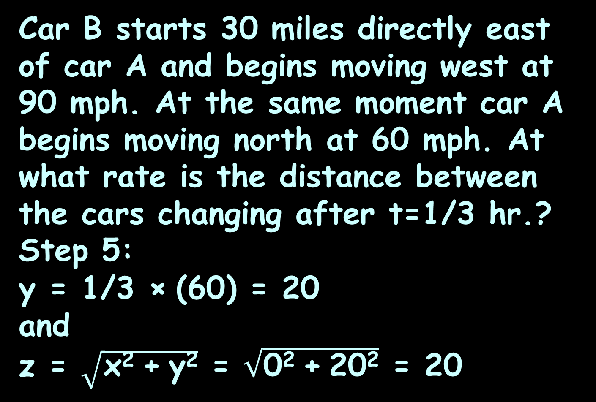
RELATED RATES
IN-CLASS PROBLEM 6
Car B starts 30 miles directly east of car A and begins moving west at 90 mph. At the same moment car A begins moving north at 60 mph. At what rate is the distance between the cars changing after t=1/3 hr.?
Step 5:
y = 1/3 × (60) = 20
and
z = $\sqrt{\text{x}\text{2} \text{+} \text{y}\text{2}}$ = $\sqrt{\text{0}\text{2} \text{+} \text{20}\text{2}}$ = 20
dy/dt =
60mph
dx/dt =
-90mph
https://www.math.ucdavis.edu/~kouba/CalcOneDIRECTORY/relatedratesdirectory/solution15.html

Slide 111
RELATED RATES
IN-CLASS PROBLEM 6
Car B starts 30 miles directly east of car A and begins moving west at 90 mph. At the same moment car A begins moving north at 60 mph. At what rate is the distance between the cars changing after t=1/3 hr.?
Step 5:
x dx/dt + y dy/dt = z dz/dt
dz/dt = (x dx/dt + y dy/dt )/z
dz/dt=((0)(-90)+(20)(60))/20
= 60 …

Slide 112
RELATED RATES
IN-CLASS PROBLEM 6
Car B starts 30 miles directly east of car A and begins moving west at 90 mph. At the same moment car A begins moving north at 60 mph. At what rate is the distance between the cars changing after t=1/3 hr.?
Step 5:
dz/dt=((0)(-90)+(20)(60))/20
= 60 mph

Slide 113
Questions?
http://i.imgur.com/aliTlT3.jpg

Slide 114
RELATED RATES
IN-CLASS PROBLEM 7
The volume of a large spherical balloon is increasing at the rate of 64π m³/hr (≈201.06 m³/hr). At what rate is the balloon's surface area changing when the radius of the balloon is 2 m?
Step 1:
Step 2:
dv/dt =
64π m³/hr
v
https://www.math.ucdavis.edu/~kouba/CalcOneDIRECTORY/relatedratesdirectory/solution11.html

Slide 115
RELATED RATES
IN-CLASS PROBLEM 7
The volume of a large spherical balloon is increasing at the rate of 64π m³/hr (≈201.06 m³/hr). At what rate is the balloon's surface area changing when the radius of the balloon is 2 m?
Step 2: d(surface area)/dt
Step 3:
dv/dt =
64π m³/hr
v
https://www.math.ucdavis.edu/~kouba/CalcOneDIRECTORY/relatedratesdirectory/solution11.html

Slide 116
RELATED RATES
IN-CLASS PROBLEM 7
The volume of a large spherical balloon is increasing at the rate of 64π m³/hr (≈201.06 m³/hr). At what rate is the balloon's surface area changing when the radius of the balloon is 2 m?
Step 3: v = 4/3πr³
Are we done?
dv/dt =
64π m³/hr
v
https://www.math.ucdavis.edu/~kouba/CalcOneDIRECTORY/relatedratesdirectory/solution11.html

Slide 117
RELATED RATES
IN-CLASS PROBLEM 7
The volume of a large spherical balloon is increasing at the rate of 64π m³/hr (≈201.06 m³/hr). At what rate is the balloon's surface area changing when the radius of the balloon is 2 m?
Step 3: v = 4/3πr³
Surface area S = 4πr²
Guess where that came from?
dv/dt =
64π m³/hr
v
https://www.math.ucdavis.edu/~kouba/CalcOneDIRECTORY/relatedratesdirectory/solution11.html

Slide 118
Related Rates
If you take the derivative of a 3-dimensional thing, you get a 2-dimensional thing
If you take the derivative of a 2-D thing, you get a 1-D thing

Slide 119
RELATED RATES
IN-CLASS PROBLEM 7
The volume of a large spherical balloon is increasing at the rate of 64π m³/hr (≈201.06 m³/hr). At what rate is the balloon's surface area changing when the radius of the balloon is 2 m?
v = 4/3πr³ S = 4πr²
What are we trying to find?
dv/dt =
64π m³/hr
v
https://www.math.ucdavis.edu/~kouba/CalcOneDIRECTORY/relatedratesdirectory/solution11.html

Slide 120
RELATED RATES
IN-CLASS PROBLEM 7
The volume of a large spherical balloon is increasing at the rate of 64π m³/hr (≈201.06 m³/hr). At what rate is the balloon's surface area changing when the radius of the balloon is 2 m?
v = 4/3πr³ S = 4πr²
What are we trying to find?
dS/dt
Step 4:
dv/dt =
64π m³/hr
v
https://www.math.ucdavis.edu/~kouba/CalcOneDIRECTORY/relatedratesdirectory/solution11.html

Slide 121
RELATED RATES
IN-CLASS PROBLEM 7
The volume of a large spherical balloon is increasing at the rate of 64π m³/hr (≈201.06 m³/hr). At what rate is the balloon's surface area changing when the radius of the balloon is 2 m?
v = 4/3πr³ S = 4πr²
Step 4: dS/dt = 8πr dr/dt
Step 5: What do we know?
dv/dt =
64π m³/hr
v
https://www.math.ucdavis.edu/~kouba/CalcOneDIRECTORY/relatedratesdirectory/solution11.html

Slide 122
RELATED RATES
IN-CLASS PROBLEM 7
The volume of a large spherical balloon is increasing at the rate of 64π m³/hr (≈201.06 m³/hr). At what rate is the balloon's surface area changing when the radius of the balloon is 2 m?
v = 4/3πr³ S = 4πr²
dS/dt = 8πr dr/dt
What do we need?
dv/dt =
64π m³/hr
v
https://www.math.ucdavis.edu/~kouba/CalcOneDIRECTORY/relatedratesdirectory/solution11.html

Slide 123
RELATED RATES
IN-CLASS PROBLEM 7
The volume of a large spherical balloon is increasing at the rate of 64π m³/hr (≈201.06 m³/hr). At what rate is the balloon's surface area changing when the radius of the balloon is 2 m?
v = 4/3πr³ S = 4πr²
dS/dt = 8πr dr/dt
Where can we get dr/dt?
We need this…
dv/dt =
64π m³/hr
v
https://www.math.ucdavis.edu/~kouba/CalcOneDIRECTORY/relatedratesdirectory/solution11.html

Slide 124
RELATED RATES
IN-CLASS PROBLEM 7
The volume of a large spherical balloon is increasing at the rate of 64π m³/hr (≈201.06 m³/hr). At what rate is the balloon's surface area changing when the radius of the balloon is 2 m?
v = 4/3πr³ S = 4πr²
If we take:
dv/dt = d(4/3πr³)/dt
dv/dt = 3(4/3πr²) dr/dt
dv/dt =
64π m³/hr
chain rule, what we want!
v
https://www.math.ucdavis.edu/~kouba/CalcOneDIRECTORY/relatedratesdirectory/solution11.html

Slide 125
RELATED RATES
IN-CLASS PROBLEM 7
The volume of a large spherical balloon is increasing at the rate of 64π m³/hr (≈201.06 m³/hr). At what rate is the balloon's surface area changing when the radius of the balloon is 2 m?
v = 4/3πr³ S = 4πr²
dv/dt = 3(4/3πr²) dr/dt
64π = 4π(2²) dr/dt
dr/dt = 64π/4π(2²) = 4 (just for fun) whats?
dv/dt =
64π m³/hr
v
https://www.math.ucdavis.edu/~kouba/CalcOneDIRECTORY/relatedratesdirectory/solution11.html

Slide 126
RELATED RATES
IN-CLASS PROBLEM 7
The volume of a large spherical balloon is increasing at the rate of 64π m³/hr (≈201.06 m³/hr). At what rate is the balloon's surface area changing when the radius of the balloon is 2 m?
v = 4/3πr³ S = 4πr²
dv/dt = 3(4/3πr²) dr/dt
64π = 4π(2²) dr/dt
dr/dt = 64π/4π(2²) = 4 m/hr
Remember, we want dS/dt
dv/dt =
64π m³/hr
v
https://www.math.ucdavis.edu/~kouba/CalcOneDIRECTORY/relatedratesdirectory/solution11.html

Slide 127
RELATED RATES
IN-CLASS PROBLEM 7
The volume of a large spherical balloon is increasing at the rate of 64π m³/hr (≈201.06 m³/hr). At what rate is the balloon's surface area changing when the radius of the balloon is 2 m?
v = 4/3πr³ S = 4πr²
dr/dt = 4 m/hr
dS/dt = 8πr dr/dt
Plug in stuff!
dv/dt =
64π m³/hr
v
https://www.math.ucdavis.edu/~kouba/CalcOneDIRECTORY/relatedratesdirectory/solution11.html

Slide 128
RELATED RATES
IN-CLASS PROBLEM 7
The volume of a large spherical balloon is increasing at the rate of 64π m³/hr (≈201.06 m³/hr). At what rate is the balloon's surface area changing when the radius of the balloon is 2 m?
v = 4/3πr³ S = 4πr²
dr/dt = 4 m/hr
dS/dt = 8πr dr/dt
= 8π(2) (4)
dv/dt =
64π m³/hr
v
https://www.math.ucdavis.edu/~kouba/CalcOneDIRECTORY/relatedratesdirectory/solution11.html

Slide 129
RELATED RATES
IN-CLASS PROBLEM 7
The volume of a large spherical balloon is increasing at the rate of 64π m³/hr (≈201.06 m³/hr). At what rate is the balloon's surface area changing when the radius of the balloon is 2 m?
v = 4/3πr³ S = 4πr²
dr/dt = 4 m/hr
dS/dt = 8π(2) (4)
= 64π ≈ 201.06 whats?
dv/dt =
64π m³/hr
v
https://www.math.ucdavis.edu/~kouba/CalcOneDIRECTORY/relatedratesdirectory/solution11.html

Slide 130
RELATED RATES
IN-CLASS PROBLEM 7
The volume of a large spherical balloon is increasing at the rate of 64π m³/hr (≈201.06 m³/hr). At what rate is the balloon's surface area changing when the radius of the balloon is 2 m?
v = 4/3πr³ S = 4πr²
dr/dt = 4 m/hr
dS/dt = 8π(2) (4)
= 64π m²/hr
≈ 201.06 m²/hr
dv/dt =
64π m³/hr
v
https://www.math.ucdavis.edu/~kouba/CalcOneDIRECTORY/relatedratesdirectory/solution11.html

Slide 131
Questions?
http://i.imgur.com/aliTlT3.jpg

Slide 132
Summary
Today we covered:
Review of “extrema”
Related Rates

Slide 133

You Survived!
www.playbuzz.com

