Slide 1
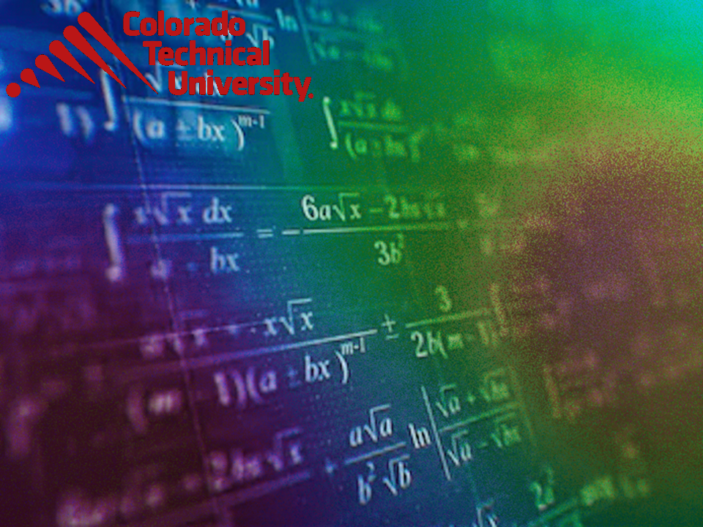
Welcome to
Unit 5 Part 10!
MATH 205 Differential Calculus
https://www.smu.edu.sg/programmes/core-curriculum/course-structure/calculus

Slide 2
What’s Up?
Review:
Chain Rule
New stuff:
Implicit Differentiation

Slide 3
What’s Up?
Outcome 1) Demonstrate differentiation skills for linear, polynomial, rational, trigonometric, exponential, and logarithmic functions and proper application of the Product, Quotient and Chain Rules of differentiation
Outcome 2) Use algebra, limits and derivatives to examine the properties and graphs of functions, including finding their extrema, inflection points, and intervals of monotonicity and concavity

Slide 4

Review
http://995642590.r.lightningbase-cdn.com/wp-content/uploads/2010/12/looking-back-hrexaminer-v144-cover425px.jpg

Slide 5
Chain Rule
A composite function is a function of a function

Slide 6
Chain Rule
y = (3x² + 7x + 5)³
is a composite function
Think of it as:
y = u³
where
u = 3x² + 7x + 5

Slide 7
Chain Rule
Rule #6: derivative of the power of a function: y = u^{n} where u is a function of x
dy/dx = dy/du × du/dx
This one is so important it has its own name: The Chain Rule

Slide 8
Chain Rule
In practice, I find:
dy/dx = du/dx × dy/du
is what I actually use more than:
dy/dx = dy/du × du/dx

Slide 9
Chain Rule
Find the derivative of:
y = (3x + 1)²
It looks like: y = u ^{n}
So, we’ll use the chain rule
^{u}
^{n}

Slide 10
Chain Rule
Find the derivative of: y=(3x+1)²
using: y = u²
What is u? 3x + 1
What is du/dx? 3
What is dy/du? d(u²)/du = 2u
Now the chain:
dy/dx = du/dx × dy/du

Slide 11
Chain Rule
du/dx = 3
dy/du = d(u²)/du = 2u
dy/dx = du/dx × dy/du
= 3 × 2u
= 3 × 2(3x + 1)
= 6(3x + 1)
= 18x + 6

Slide 12
Chain Rule
It’s not just for exponents of functions
Our transcendental functions can have functions lurking in them, too!

Slide 13
Chain Rule
Find the derivative of:
y = sin (u)
y'= cos (u) du/dx

Slide 14

Questions?
http://i.imgur.com/aliTlT3.jpg

Slide 15
Implicit Differentiation
A special case of the chain rule

Slide 16
Implicit Differentiation
Many functions are written explicitly as a function of x:
y = sin(13x-2)
y = 3x² – 7x + 5
y = e^{x}

Slide 17
Implicit Differentiation
Some functions are written implicitly as a function of x:
x² + y = 25
xy = 41.9

Slide 18
Implicit Differentiation
By the way … these don’t have to be functions at all!
x² + y² = 25

Slide 19
Implicit Differentiation
Suppose you had the problem:
Find the derivative dy/dx for:
x² + y² = 25

Slide 20
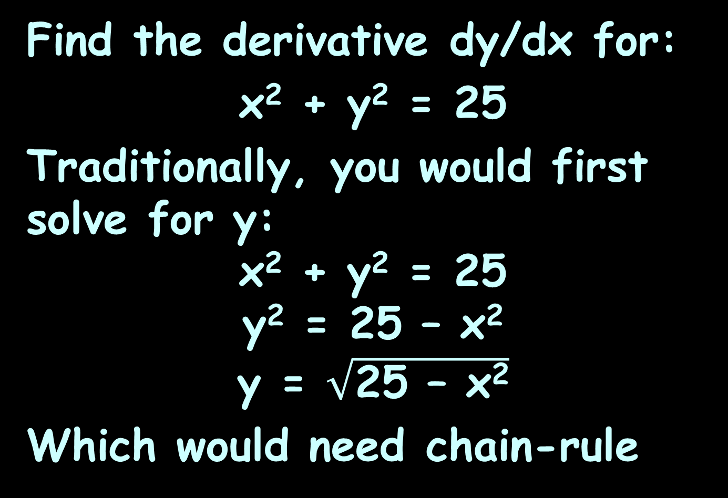
Implicit Differentiation
Find the derivative dy/dx for:
x² + y² = 25
Traditionally, you would first solve for y:
x² + y² = 25
y² = 25 – x²
y = $\sqrt{\text{25 – }\text{x}\text{2}}$
Which would need chain-rule

Slide 21
Good News!
You don’t have to solve for “y” to do the differentiation!

Slide 22
Good News!
You don’t have to solve for “y” to do the differentiation!
Just do the derivatives of everything “in place”

Slide 23
Implicit Differentiation
This is especially good news since some formulas are really, really hard to solve for “y”

Slide 24
IMPLICIT DIFFERENTIATION
IN-CLASS PROBLEM 1a
Find dy/dx for: x² + y² = 25

Slide 25
IMPLICIT DIFFERENTIATION
IN-CLASS PROBLEM 1a
Find dy/dx for: x² + y² = 25
First put in some “d”s:
d(x² + y²)/dx = d(25)/dx

Slide 26
IMPLICIT DIFFERENTIATION
IN-CLASS PROBLEM 1a
Find dy/dx for: x² + y² = 25
First put in some “d”s:
d(x² + y²)/dx = d(25)/dx
This can be rewritten (using Rule 3):
d(x²)/dx + d(y²)/dx = d(25)/dx

Slide 27
IMPLICIT DIFFERENTIATION
IN-CLASS PROBLEM 1a
Find dy/dx for: x² + y² = 25
First put in some “d”s:
d(x² + y²)/dx = d(25)/dx
Now just take the derivative of each term:
d(x²)/dx + d(y²)/dx = d(25)/dx

Slide 28
IMPLICIT DIFFERENTIATION
IN-CLASS PROBLEM 1a
Find dy/dx for: x² + y² = 25
First put in some “d”s:
d(x² + y²)/dx = d(25)/dx
Now just take the derivative of each term:
d(x²)/dx + d(y²)/dx = d(25)/dx
This one is easy: 2x dx/dx

Slide 29
IMPLICIT DIFFERENTIATION
IN-CLASS PROBLEM 1a
Find dy/dx for: x² + y² = 25
First put in some “d”s:
d(x² + y²)/dx = d(25)/dx
Now just take the derivative of each term:
d(x²)/dx + d(y²)/dx = d(25)/dx
2x dx/dx but dx/dx = 1 so:

Slide 30
IMPLICIT DIFFERENTIATION
IN-CLASS PROBLEM 1a
Find dy/dx for: x² + y² = 25
First put in some “d”s:
d(x² + y²)/dx = d(25)/dx
Now just take the derivative of each term:
d(x²)/dx + d(y²)/dx = d(25)/dx
2x

Slide 31
IMPLICIT DIFFERENTIATION
IN-CLASS PROBLEM 1a
Find dy/dx for: x² + y² = 25
First put in some “d”s:
d(x² + y²)/dx = d(25)/dx
Now just take the derivative of each term:
d(x²)/dx + d(y²)/dx = d(25)/dx
2x also easy:
0

Slide 32
IMPLICIT DIFFERENTIATION
IN-CLASS PROBLEM 1a
Find dy/dx for: x² + y² = 25
First put in some “d”s:
d(x² + y²)/dx = d(25)/dx
Now just take the derivative of each term:
d(x²)/dx + d(y²)/dx = d(25)/dx
2x + chain rule 0

Slide 33
IMPLICIT DIFFERENTIATION
IN-CLASS PROBLEM 1a
Find dy/dx for: x² + y² = 25
First put in some “d”s:
d(x² + y²)/dx = d(25)/dx
Now just take the derivative of each term:
d(x²)/dx + d(y²)/dx = d(25)/dx
2x + 2y dy/dx = 0

Slide 34
IMPLICIT DIFFERENTIATION
IN-CLASS PROBLEM 1a
2x + 2y dy/dx = 0
Now for some algebra…
Solve for dy/dx (the thing we’re looking for , remember?:
2x + 2y dy/dx = 0

Slide 35
IMPLICIT DIFFERENTIATION
IN-CLASS PROBLEM 1a
Solve for dy/dx:
2x + 2y dy/dx = 0
2x + 2y dy/dx -2x = 0 -2x
2y dy/dx = -2x

Slide 36
IMPLICIT DIFFERENTIATION
IN-CLASS PROBLEM 1a
Solve for dy/dx:
2x + 2y dy/dx = 0
2y dy/dx = -2x
2y dy/dx /2y = -2x /2y
dy/dx = -2x/2y

Slide 37
IMPLICIT DIFFERENTIATION
IN-CLASS PROBLEM 1a
Solve for dy/dx:
2x + 2y dy/dx = 0
2y dy/dx = -2x
dy/dx = -2x/2y
dy/dx = -x/y
Since we wanted to find the derivative of y… which is dy/dx, we’re done!

Slide 38
Questions?
http://i.imgur.com/aliTlT3.jpg

Slide 39
IMPLICIT DIFFERENTIATION
IN-CLASS PROBLEMS 1b,c,d
Solve for dy/dx:
61y = x
y¹⁵ = x d(y¹⁵)/dx = d(x)/dx
xy = 42

Slide 40
IMPLICIT DIFFERENTIATION
IN-CLASS PROBLEMS 1b,c,d
Solve for dy/dx:
61y = x
61dy/dx = dx/dx = 1
y¹⁵ = x
xy = 42

Slide 41
IMPLICIT DIFFERENTIATION
IN-CLASS PROBLEMS 1b,c,d
Solve for dy/dx:
61y = x
61dy/dx = 1
dy/dx = 1/61
y¹⁵ = x
xy = 42

Slide 42
IMPLICIT DIFFERENTIATION
IN-CLASS PROBLEMS 1b,c,d
Solve for dy/dx:
61y = x
dy/dx = 1/61
y¹⁵ = x
xy = 42

Slide 43
IMPLICIT DIFFERENTIATION
IN-CLASS PROBLEMS 1b,c,d
Solve for dy/dx:
61y = x
dy/dx = 1/61
y¹⁵ = x
(15y¹⁴)dy/dx = d(x)/dx = 1
xy = 42

Slide 44
IMPLICIT DIFFERENTIATION
IN-CLASS PROBLEMS 1b,c,d
Solve for dy/dx:
61y = x
dy/dx = 1/61
y¹⁵ = x
15y¹⁴dy/dx = 1
dy/dx = 1/15y¹⁴
xy = 42

Slide 45
IMPLICIT DIFFERENTIATION
IN-CLASS PROBLEMS 1b,c,d
Solve for dy/dx:
61y = x
dy/dx = 1/61
y¹⁵ = 12x
dy/dx = 12/15y¹⁴
xy = 42

Slide 46
IMPLICIT DIFFERENTIATION
IN-CLASS PROBLEMS 1b,c,d
Solve for dy/dx:
61y = x
dy/dx = 1/61
y¹⁵ = 12x
dy/dx = 12/15y¹⁴ = 4/5y¹⁴
xy = 42
x × y = 42
x × dy/dx + y × dx/dx = 0

Slide 47
IMPLICIT DIFFERENTIATION
IN-CLASS PROBLEMS 1b,c,d
Solve for dy/dx:
61y = x
dy/dx = 1/61
y¹⁵ = 12x
dy/dx = 12/15y¹⁴ = 4/5y¹⁴
xy = 42
x × dy/dx + y = 0
x × dy/dx = -y
dy/dx = -y/x

Slide 48
Questions?
http://i.imgur.com/aliTlT3.jpg

Slide 49
Implicit Differentiation
Do you get the same answers for implicit differentiation as you do for explicit differentiation?

Slide 50
Implicit Differentiation
Yes!
(sort of…)

Slide 51
Implicit Differentiation
xy = 42
can be solved explicitly as:
y = 42/x = 42x⁻¹

Slide 52
Implicit Differentiation
xy = 42
can be solved explicitly as:
y = 42/x = 42x⁻¹
The derivative dy/dx would be:

Slide 53
Implicit Differentiation
xy = 42
can be solved explicitly as:
y = 42/x = 42x⁻¹
The derivative dy/dx would be:
dy/dx = -42x⁻²

Slide 54
Implicit Differentiation
xy = 42
can be solved explicitly as:
y = 42/x = 42x⁻¹
dy/dx = -42x⁻²
But when we did implicit differentiation, we got:
dy/dx = -y/x

Slide 55

Implicit Differentiation
y = 42/x = 42x⁻¹
dy/dx = -42x⁻²
xy = 42
dy/dx = -y/x
Hmm… they don’t
LOOK the same?!
http://www.testically.org/wp-content/uploads/2010/11/hmm.jpg

Slide 56
Implicit Differentiation
y = 42/x = 42x⁻¹ dy/dx = -42x⁻²
xy = 42 dy/dx = -y/x
But, let’s test it to be sure:
If y = 42/x, plug that into:
dy/dx = -y/x = -(42/x)/x
= -42/x² = -42x⁻²
So -y/x DOES = -42x⁻² (even though it doesn’t look like it!)

Slide 57
Implicit Differentiation
So, you DO get the same answers for implicit differentiation as you do for explicit differentiation, but it will probably LOOK quite different!

Slide 58
Questions?
http://i.imgur.com/aliTlT3.jpg

Slide 59
Implicit Differentiation
For more complex formulas, just keep going!

Slide 60
IMPLICIT DIFFERENTIATION
IN-CLASS PROBLEM 2a
Find dy/dx for 2x – 3y = y²

Slide 61
IMPLICIT DIFFERENTIATION
IN-CLASS PROBLEM 2a
Find dy/dx for 2x – 3y = y²
Take the derivatives in place:
2x –3y = y²
?

Slide 62
IMPLICIT DIFFERENTIATION
IN-CLASS PROBLEM 2a
Find dy/dx for 2x – 3y = y²
Take the derivatives in place:
2x –3y = y²
2 ?

Slide 63
IMPLICIT DIFFERENTIATION
IN-CLASS PROBLEM 2a
Find dy/dx for 2x – 3y = y²
Take the derivatives in place:
2x –3y = y²
2 -3 dy/dx ?

Slide 64
IMPLICIT DIFFERENTIATION
IN-CLASS PROBLEM 2a
Find dy/dx for 2x – 3y = y²
Take the derivatives in place:
2x –3y = y²
2 -3 dy/dx = 2y dy/dx

Slide 65
IMPLICIT DIFFERENTIATION
IN-CLASS PROBLEM 2a
Algebra time… solve for dy/dx:
2 – 3 dy/dx = 2y dy/dx

Slide 66
IMPLICIT DIFFERENTIATION
IN-CLASS PROBLEM 2a
Algebra time… solve for dy/dx:
2 – 3 dy/dx = 2y dy/dx
2 = 2y dy/dx + 3 dy/dx

Slide 67
IMPLICIT DIFFERENTIATION
IN-CLASS PROBLEM 2a
Algebra time… solve for dy/dx:
2 – 3 dy/dx = 2y dy/dx
2 = 2y dy/dx + 3 dy/dx
2 = dy/dx(2y + 3)

Slide 68
IMPLICIT DIFFERENTIATION
IN-CLASS PROBLEM 2a
Algebra time… solve for dy/dx:
2 – 3 dy/dx = 2y dy/dx
2 = 2y dy/dx + 3 dy/dx
2 = dy/dx(2y + 3)
2/(2y + 3) = dy/dx
Remember, we are trying to find dy/dx!

Slide 69
Questions?
http://i.imgur.com/aliTlT3.jpg

Slide 70
Implicit Differentiation
These can be very nasty polynomials!

Slide 71
IMPLICIT DIFFERENTIATION
IN-CLASS PROBLEM 2b
Find dy/dx for: x²y² + 3y² = 36

Slide 72
IMPLICIT DIFFERENTIATION
IN-CLASS PROBLEM 2b
Find dy/dx for:
x²y² + 3y² = 36
Product
Rule

Slide 73
IMPLICIT DIFFERENTIATION
IN-CLASS PROBLEM 2b
Find dy/dx for:
x²y² + 3y² = 36
u=
v=
du=
dv=

Slide 74
IMPLICIT DIFFERENTIATION
IN-CLASS PROBLEM 2b
Find dy/dx for:
x²y² + 3y² = 36
u=x²
v=
du=
dv=

Slide 75
IMPLICIT DIFFERENTIATION
IN-CLASS PROBLEM 2b
Find dy/dx for:
x²y² + 3y² = 36
u=x²
v=y²
du=
dv=

Slide 76
IMPLICIT DIFFERENTIATION
IN-CLASS PROBLEM 2b
Find dy/dx for:
x²y² + 3y² = 36
u=x²
v=y²
du=2x dx/dx
dv=

Slide 77
IMPLICIT DIFFERENTIATION
IN-CLASS PROBLEM 2b
Find dy/dx for:
x²y² + 3y² = 36
u=x²
v=y²
du=2x
dv=2y dy/dx
Plug into: u dv + v du

Slide 78
IMPLICIT DIFFERENTIATION
IN-CLASS PROBLEM 2b
Find dy/dx for:
x²y² + 3y² = 36
u=x²
v=y²
du=2x
dv=2y dy/dx
u dv + v du
x²(2y dy/dx) + y²(2x)

Slide 79
IMPLICIT DIFFERENTIATION
IN-CLASS PROBLEM 2b
Find dy/dx for:
x²y² + 3y² = 36
x²(2y dy/dx)+y²(2x)
~sigh~ we’re not done…

Slide 80
IMPLICIT DIFFERENTIATION
IN-CLASS PROBLEM 2b
Find dy/dx for:
x²y² + 3y² = 36
x²(2y dy/dx)+y²(2x) ?

Slide 81
IMPLICIT DIFFERENTIATION
IN-CLASS PROBLEM 2b
Find dy/dx for:
x²y² + 3y² = 36
x²(2y dy/dx)+y²(2x) + 6y dydx ?

Slide 82
IMPLICIT DIFFERENTIATION
IN-CLASS PROBLEM 2b
Find dy/dx for:
x²y² + 3y² = 36
x²(2y dy/dx)+y²(2x) + 6y dydx = 0
Are we done?

Slide 83
IMPLICIT DIFFERENTIATION
IN-CLASS PROBLEM 2b
Find dy/dx for:
x²y² + 3y² = 36
x²(2y dy/dx)+y²(2x) + 6y dydx = 0
Are we done? Of course not…

Slide 84
IMPLICIT DIFFERENTIATION
IN-CLASS PROBLEM 2b
Solve for dy/dx:
x²(2y dy/dx)+y²(2x) + 6y dydx = 0

Slide 85
IMPLICIT DIFFERENTIATION
IN-CLASS PROBLEM 2b
Solve for dy/dx:
x²(2y dy/dx)+y²(2x) + 6y dydx = 0
dy/dx(2x²y) + 2xy² + dy/dx(6y) = 0

Slide 86
IMPLICIT DIFFERENTIATION
IN-CLASS PROBLEM 2b
Solve for dy/dx:
x²(2y dy/dx)+y²(2x) + 6y dydx = 0
dy/dx(2x²y) + 2xy² + dy/dx(6y) = 0
dy/dx(2x²y+6y) + 2xy² = 0

Slide 87
IMPLICIT DIFFERENTIATION
IN-CLASS PROBLEM 2b
Solve for dy/dx:
x²(2y dy/dx)+y²(2x) + 6y dydx = 0
dy/dx(2x²y) + 2xy² + dy/dx(6y) = 0
dy/dx(2x²y+6y) + 2xy² = 0
dy/dx(2x²y+6y) = -2xy²

Slide 88
IMPLICIT DIFFERENTIATION
IN-CLASS PROBLEM 2b
Solve for dy/dx:
x²(2y dy/dx)+y²(2x) + 6y dydx = 0
dy/dx(2x²y) + 2xy² + dy/dx(6y) = 0
dy/dx(2x²y+6y) + 2xy² = 0
dy/dx(2x²y+6y) = -2xy²
dy/dx = -2xy²/(2x²y+6y)

Slide 89
IMPLICIT DIFFERENTIATION
IN-CLASS PROBLEM 2b
Solve for dy/dx:
x²(2y dy/dx)+y²(2x) + 6y dydx = 0
dy/dx(2x²y) + 2xy² + dy/dx(6y) = 0
dy/dx(2x²y+6y) + 2xy² = 0
dy/dx(2x²y+6y) = -2xy²
dy/dx = -2xy²/(2x²y+6y)
dy/dx = -xy/(x²+3)

Slide 90
http://m.demotivation.us/whew-1281259.html

Slide 91
Implicit Differentiation
Note: this is on page 60 of the Larry Oliver book – and he’s got the wrong answer (oops!)

Slide 92
Questions?
http://i.imgur.com/aliTlT3.jpg

Slide 93
IMPLICIT DIFFERENTIATION
IN-CLASS PROBLEM 2c
Find dy/dx for: x²y³ – xy + 2y = 0

Slide 94

IMPLICIT DIFFERENTIATION
IN-CLASS PROBLEM 2c
Find dy/dx for:
x²y³ – xy + 2y = 0
(x²3y² $\frac{\text{dy}}{\text{dx}}$+y³2x)

Slide 95

IMPLICIT DIFFERENTIATION
IN-CLASS PROBLEM 2c
Find dy/dx for:
x²y³ – xy + 2y = 0
(x²3y² $\frac{\text{dy}}{\text{dx}}$+y³2x) – (x $\frac{\text{dy}}{\text{dx}}$+y)

Slide 96

IMPLICIT DIFFERENTIATION
IN-CLASS PROBLEM 2c
Find dy/dx for:
x²y³ – xy + 2y = 0
(x²3y² $\frac{\text{dy}}{\text{dx}}$+y³2x) – (x $\frac{\text{dy}}{\text{dx}}$+y) + 2 $\frac{\text{dy}}{\text{dx}}$

Slide 97

IMPLICIT DIFFERENTIATION
IN-CLASS PROBLEM 2c
Find dy/dx for:
x²y³ – xy + 2y = 0
(x²3y² $\frac{\text{dy}}{\text{dx}}$+y³2x) – (x $\frac{\text{dy}}{\text{dx}}$+y) + 2 $\frac{\text{dy}}{\text{dx}}$ = 0

Slide 98
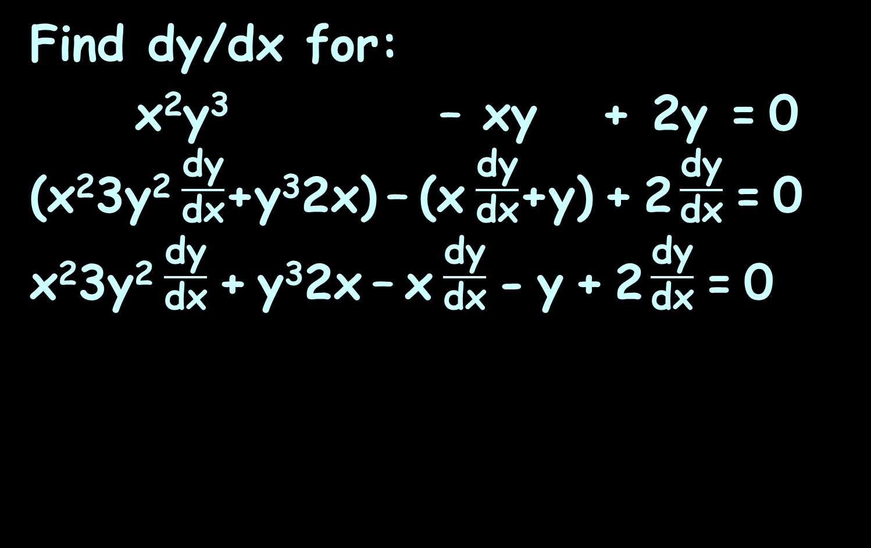
IMPLICIT DIFFERENTIATION
IN-CLASS PROBLEM 2c
Find dy/dx for:
x²y³ – xy + 2y = 0
(x²3y² $\frac{\text{dy}}{\text{dx}}$+y³2x) – (x $\frac{\text{dy}}{\text{dx}}$+y) + 2 $\frac{\text{dy}}{\text{dx}}$ = 0
x²3y² $\frac{\text{dy}}{\text{dx}}$ + y³2x – x $\frac{\text{dy}}{\text{dx}}$ - y + 2 $\frac{\text{dy}}{\text{dx}}$ = 0

Slide 99
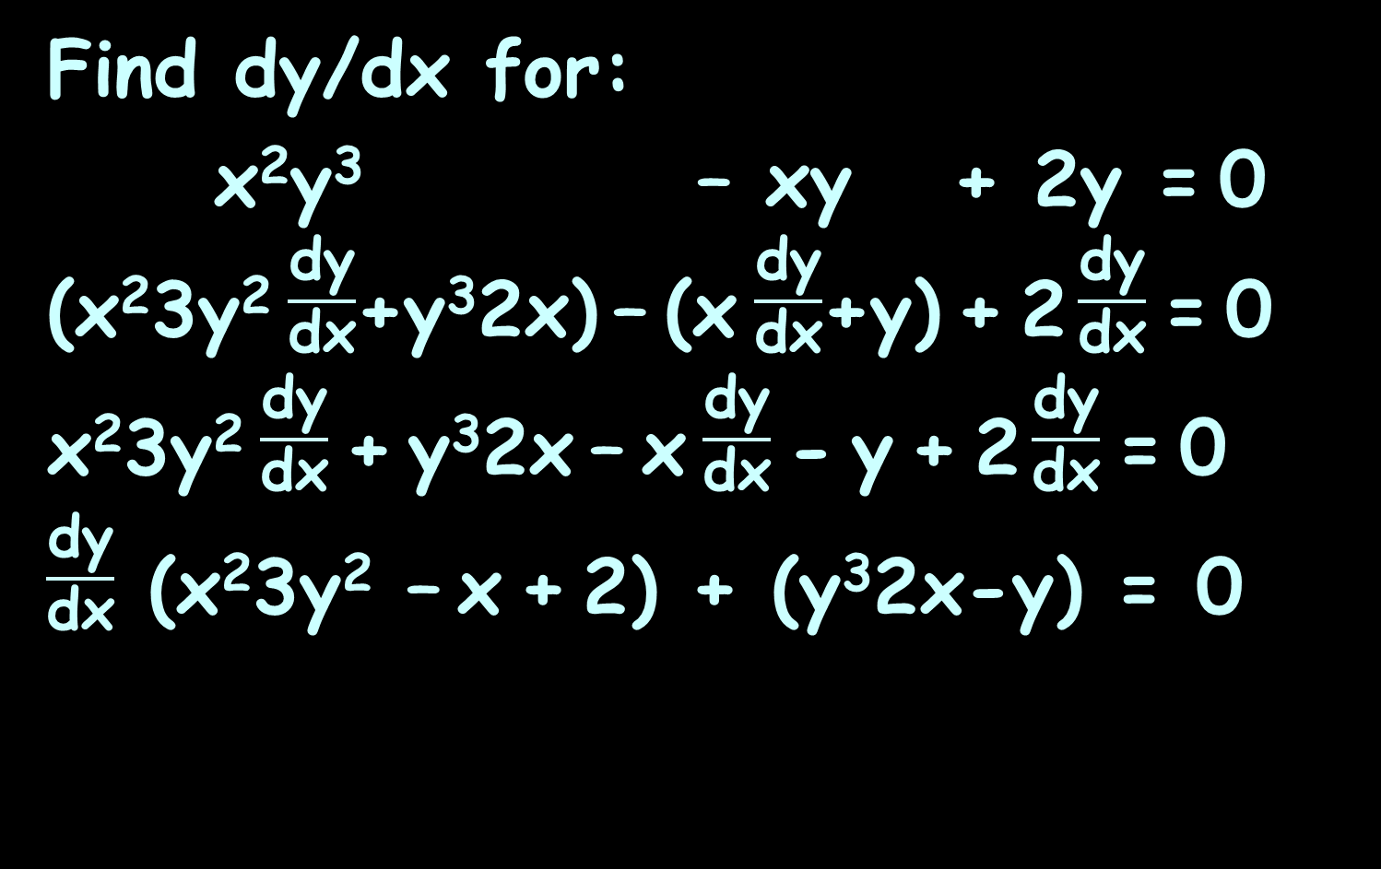
IMPLICIT DIFFERENTIATION
IN-CLASS PROBLEM 2c
Find dy/dx for:
x²y³ – xy + 2y = 0
(x²3y² $\frac{\text{dy}}{\text{dx}}$+y³2x) – (x $\frac{\text{dy}}{\text{dx}}$+y) + 2 $\frac{\text{dy}}{\text{dx}}$ = 0
x²3y² $\frac{\text{dy}}{\text{dx}}$ + y³2x – x $\frac{\text{dy}}{\text{dx}}$ - y + 2 $\frac{\text{dy}}{\text{dx}}$ = 0
$\frac{\text{dy}}{\text{dx}}$ (x²3y² – x + 2) + (y³2x-y) = 0

Slide 100
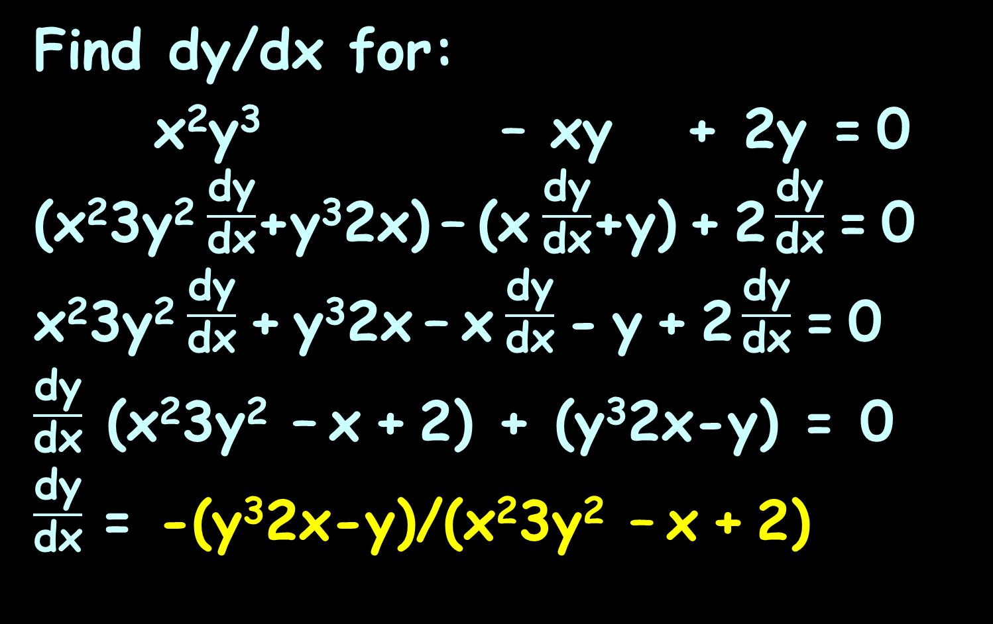
IMPLICIT DIFFERENTIATION
IN-CLASS PROBLEM 2c
Find dy/dx for:
x²y³ – xy + 2y = 0
(x²3y² $\frac{\text{dy}}{\text{dx}}$+y³2x) – (x $\frac{\text{dy}}{\text{dx}}$+y) + 2 $\frac{\text{dy}}{\text{dx}}$ = 0
x²3y² $\frac{\text{dy}}{\text{dx}}$ + y³2x – x $\frac{\text{dy}}{\text{dx}}$ - y + 2 $\frac{\text{dy}}{\text{dx}}$ = 0
$\frac{\text{dy}}{\text{dx}}$ (x²3y² – x + 2) + (y³2x-y) = 0
$\frac{\text{dy}}{\text{dx}}$ = -(y³2x-y)/(x²3y² – x + 2)

Slide 101
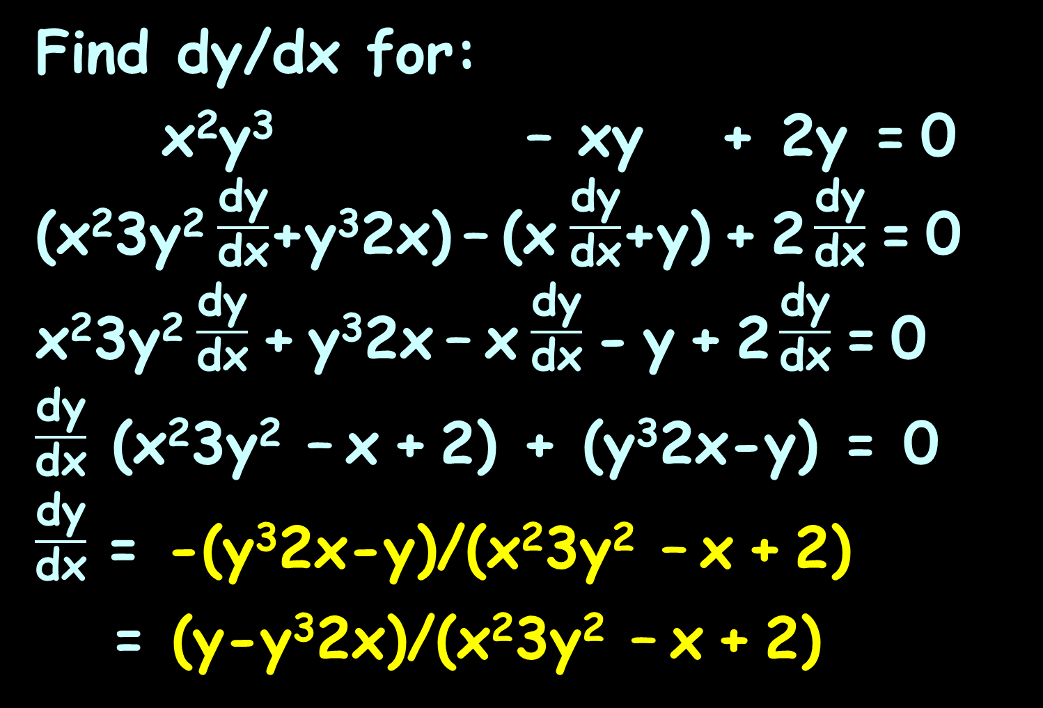
IMPLICIT DIFFERENTIATION
IN-CLASS PROBLEM 2c
Find dy/dx for:
x²y³ – xy + 2y = 0
(x²3y² $\frac{\text{dy}}{\text{dx}}$+y³2x) – (x $\frac{\text{dy}}{\text{dx}}$+y) + 2 $\frac{\text{dy}}{\text{dx}}$ = 0
x²3y² $\frac{\text{dy}}{\text{dx}}$ + y³2x – x $\frac{\text{dy}}{\text{dx}}$ - y + 2 $\frac{\text{dy}}{\text{dx}}$ = 0
$\frac{\text{dy}}{\text{dx}}$ (x²3y² – x + 2) + (y³2x-y) = 0
$\frac{\text{dy}}{\text{dx}}$ = -(y³2x-y)/(x²3y² – x + 2)
= (y-y³2x)/(x²3y² – x + 2)

Slide 102
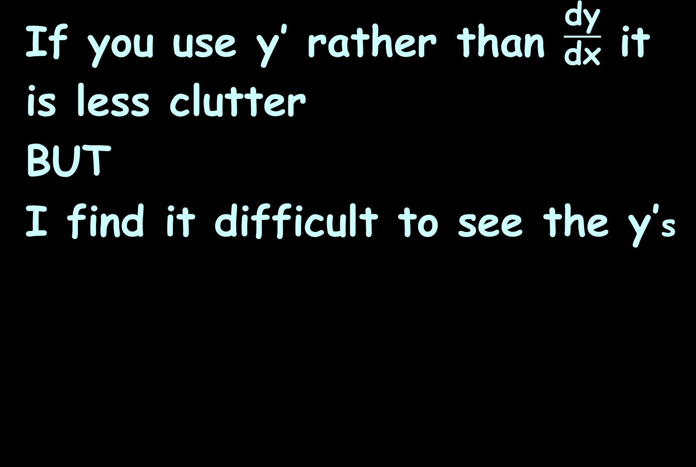
Implicit Differentiation
If you use y’ rather than $\frac{\text{dy}}{\text{dx}}$ it is less clutter
BUT
I find it difficult to see the y’s

Slide 103
Questions?
http://i.imgur.com/aliTlT3.jpg

Slide 104
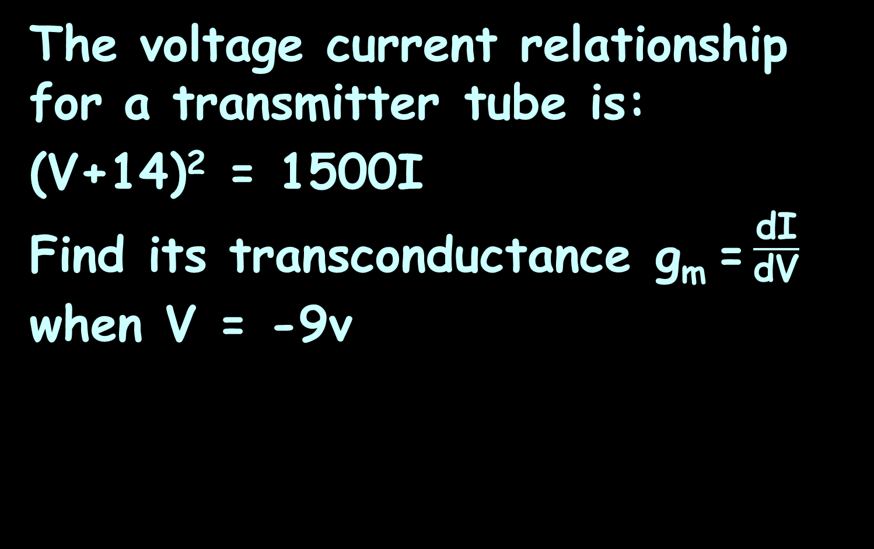
IMPLICIT DIFFERENTIATION
IN-CLASS PROBLEM 3
The voltage current relationship for a transmitter tube is:
(V+14)² = 1500I
Find its transconductance g_{m} = $\frac{\text{d}\text{I}}{\text{d}\text{V}}$ when V = -9v

Slide 105
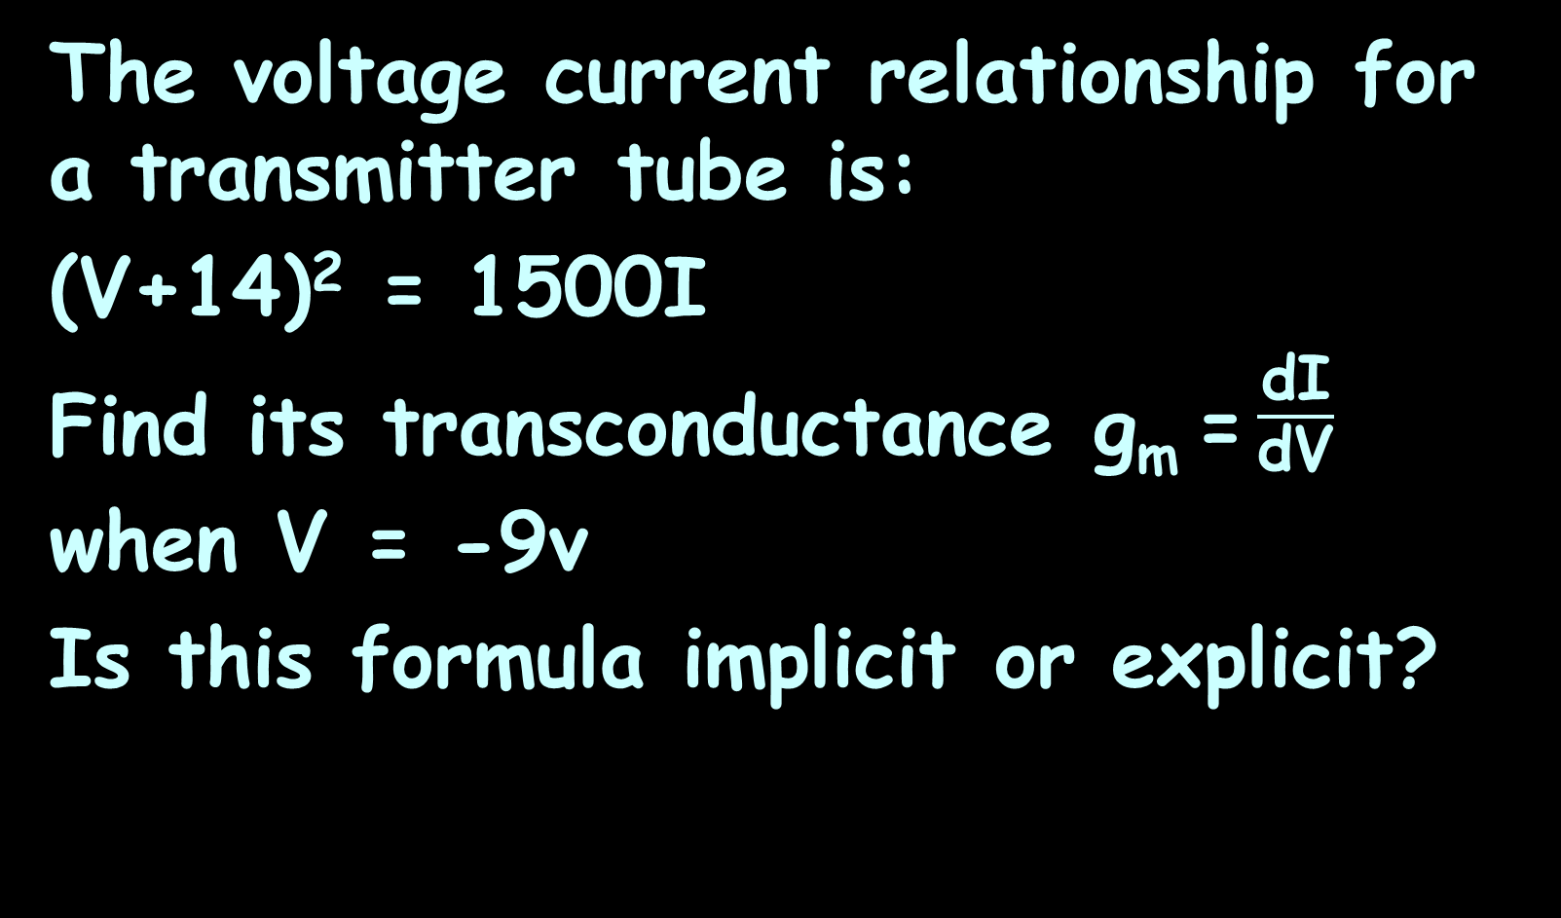
IMPLICIT DIFFERENTIATION
IN-CLASS PROBLEM 3
The voltage current relationship for a transmitter tube is:
(V+14)² = 1500I
Find its transconductance g_{m} = $\frac{\text{d}\text{I}}{\text{d}\text{V}}$ when V = -9v
Is this formula implicit or explicit?

Slide 106
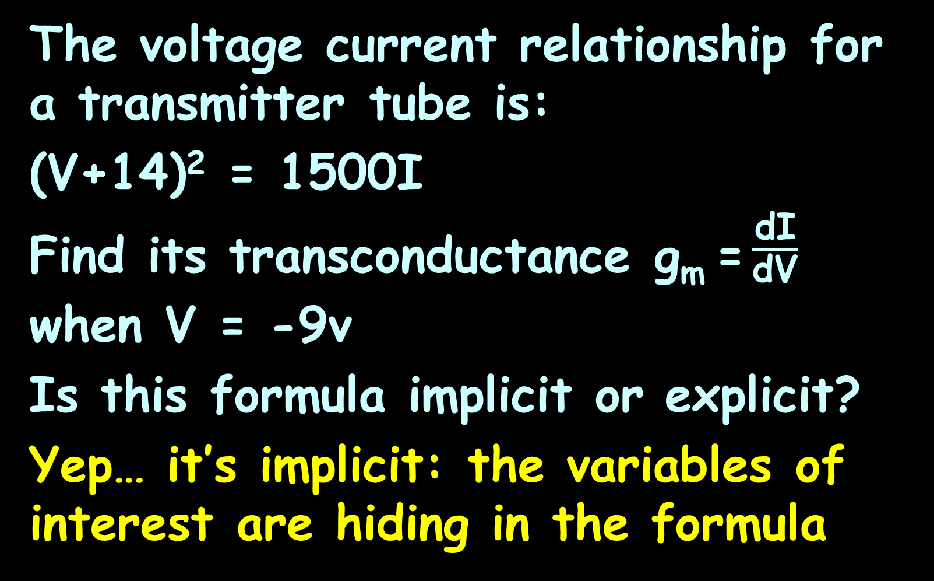
IMPLICIT DIFFERENTIATION
IN-CLASS PROBLEM 3
The voltage current relationship for a transmitter tube is:
(V+14)² = 1500I
Find its transconductance g_{m} = $\frac{\text{d}\text{I}}{\text{d}\text{V}}$ when V = -9v
Is this formula implicit or explicit?
Yep… it’s implicit: the variables of interest are hiding in the formula

Slide 107
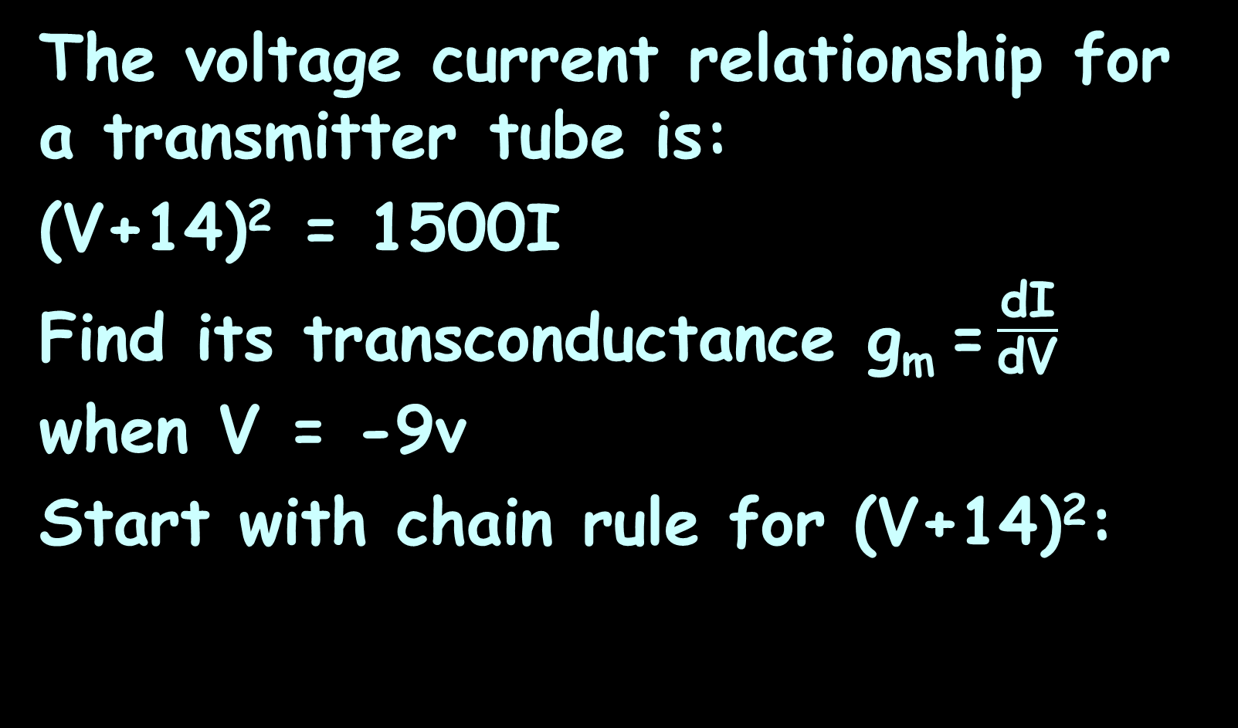
IMPLICIT DIFFERENTIATION
IN-CLASS PROBLEM 3
The voltage current relationship for a transmitter tube is:
(V+14)² = 1500I
Find its transconductance g_{m} = $\frac{\text{d}\text{I}}{\text{d}\text{V}}$ when V = -9v
Start with chain rule for (V+14)²:

Slide 108
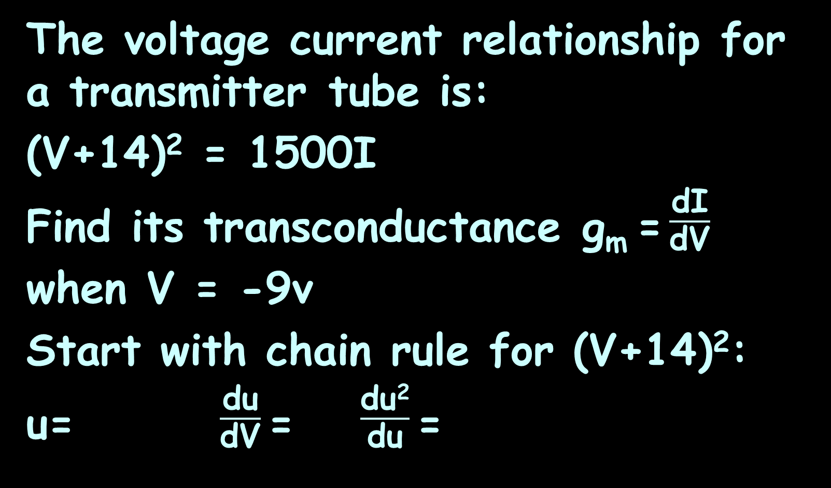
IMPLICIT DIFFERENTIATION
IN-CLASS PROBLEM 3
The voltage current relationship for a transmitter tube is:
(V+14)² = 1500I
Find its transconductance g_{m} = $\frac{\text{d}\text{I}}{\text{d}\text{V}}$ when V = -9v
Start with chain rule for (V+14)²:
u= $\frac{\text{d}\text{u}}{\text{d}\text{V}}$= $\frac{\text{du}\text{2}}{\text{d}\text{u}}$=

Slide 109
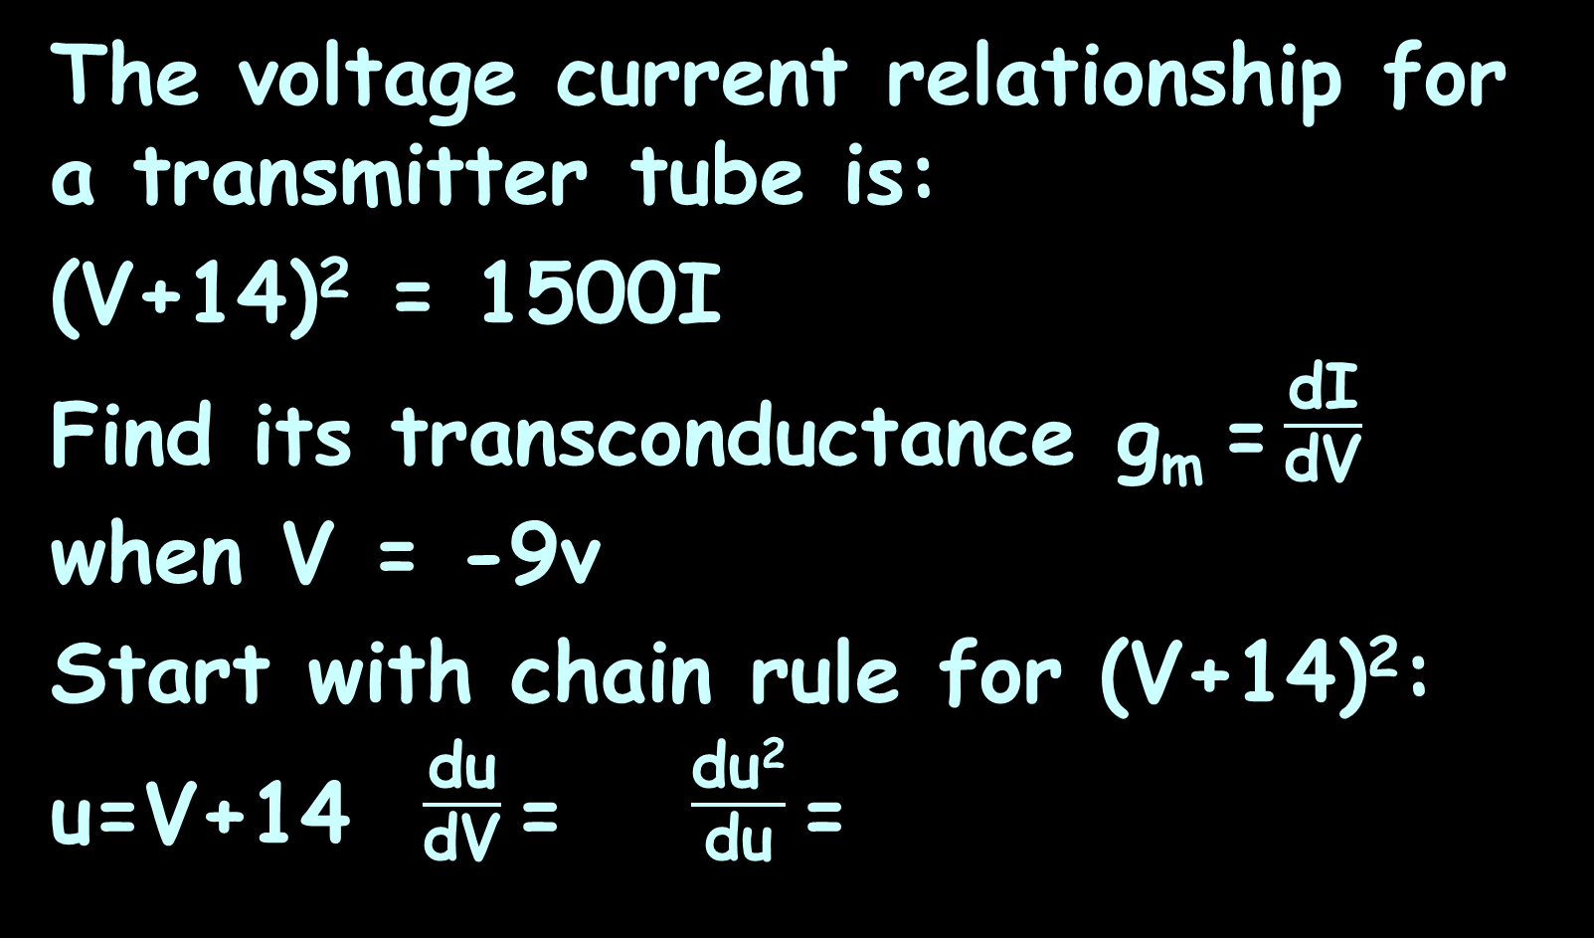
IMPLICIT DIFFERENTIATION
IN-CLASS PROBLEM 3
The voltage current relationship for a transmitter tube is:
(V+14)² = 1500I
Find its transconductance g_{m} = $\frac{\text{d}\text{I}}{\text{d}\text{V}}$ when V = -9v
Start with chain rule for (V+14)²:
u=V+14 $\frac{\text{d}\text{u}}{\text{d}\text{V}}$= $\frac{\text{du}\text{2}}{\text{d}\text{u}}$=

Slide 110
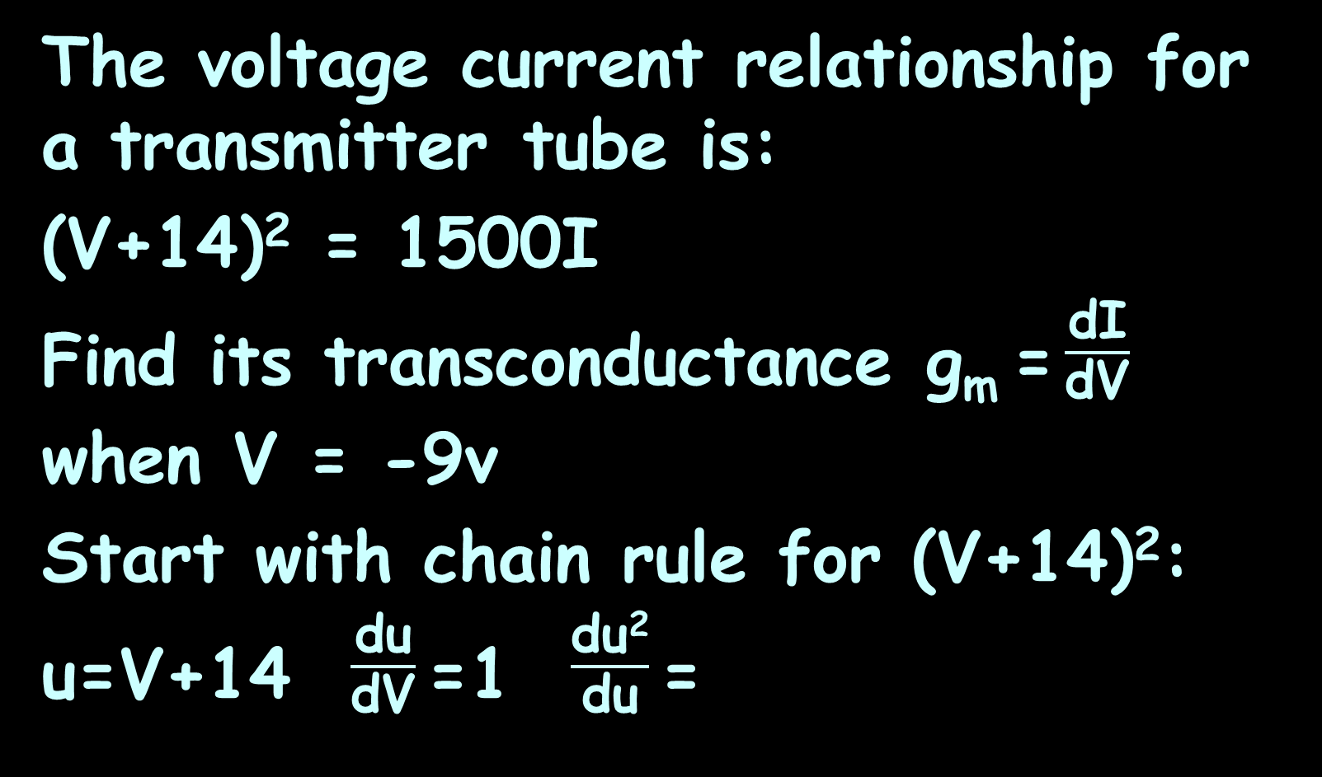
IMPLICIT DIFFERENTIATION
IN-CLASS PROBLEM 3
The voltage current relationship for a transmitter tube is:
(V+14)² = 1500I
Find its transconductance g_{m} = $\frac{\text{d}\text{I}}{\text{d}\text{V}}$ when V = -9v
Start with chain rule for (V+14)²:
u=V+14 $\frac{\text{d}\text{u}}{\text{d}\text{V}}$=1 $\frac{\text{du}\text{2}}{\text{d}\text{u}}$=

Slide 111
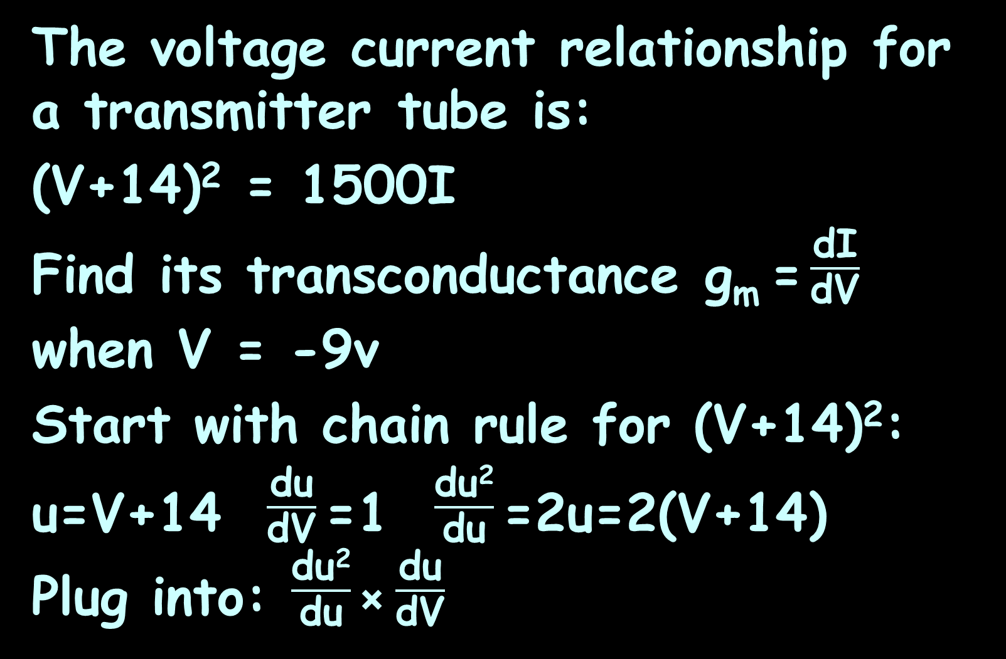
IMPLICIT DIFFERENTIATION
IN-CLASS PROBLEM 3
The voltage current relationship for a transmitter tube is:
(V+14)² = 1500I
Find its transconductance g_{m} = $\frac{\text{d}\text{I}}{\text{d}\text{V}}$ when V = -9v
Start with chain rule for (V+14)²:
u=V+14 $\frac{\text{d}\text{u}}{\text{d}\text{V}}$=1 $\frac{\text{du}\text{2}}{\text{d}\text{u}}$=2u=2(V+14)
Plug into: $\frac{\text{du}\text{2}}{\text{d}\text{u}}$× $\frac{\text{du}}{\text{d}\text{V}}$

Slide 112
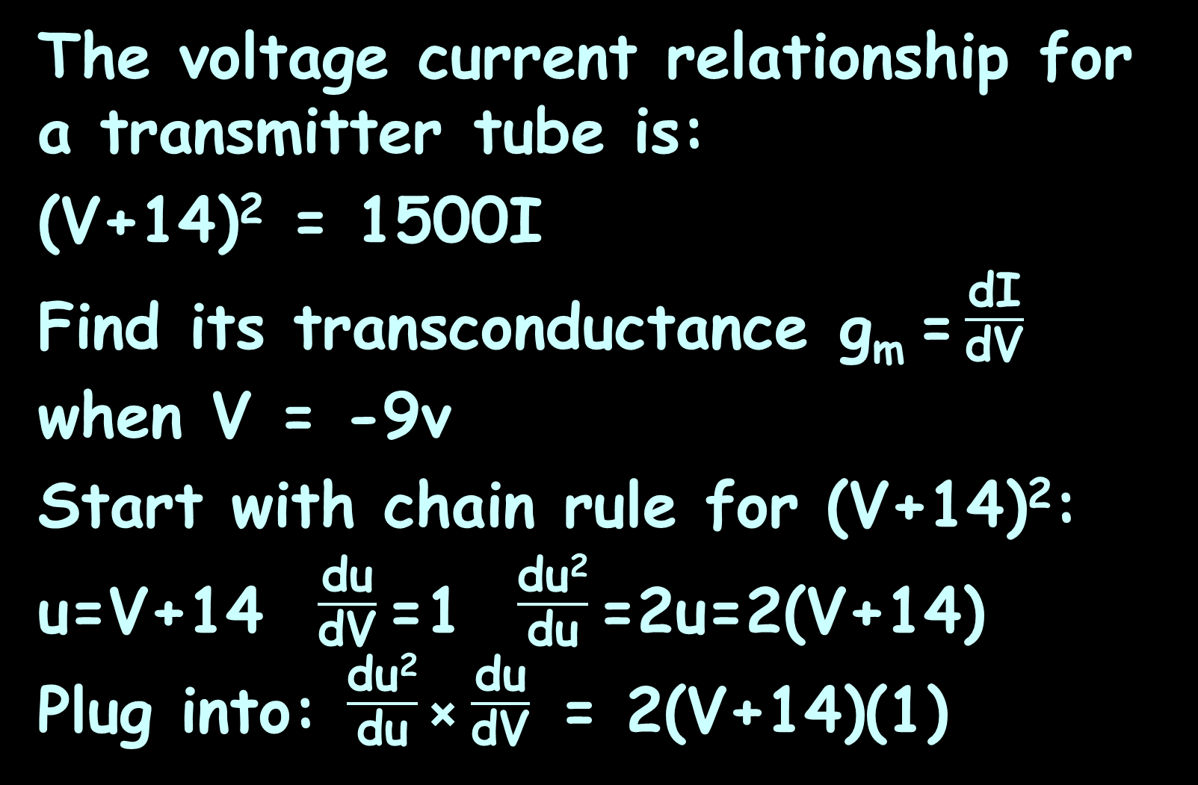
IMPLICIT DIFFERENTIATION
IN-CLASS PROBLEM 3
The voltage current relationship for a transmitter tube is:
(V+14)² = 1500I
Find its transconductance g_{m} = $\frac{\text{d}\text{I}}{\text{d}\text{V}}$ when V = -9v
Start with chain rule for (V+14)²:
u=V+14 $\frac{\text{d}\text{u}}{\text{d}\text{V}}$=1 $\frac{\text{du}\text{2}}{\text{d}\text{u}}$=2u=2(V+14)
Plug into: $\frac{\text{du}\text{2}}{\text{d}\text{u}}$× $\frac{\text{du}}{\text{d}\text{V}}$ = 2(V+14)(1)

Slide 113
IMPLICIT DIFFERENTIATION
IN-CLASS PROBLEM 3
The voltage current relationship for a transmitter tube is:
(V+14)² = 1500I
2(V+14)(1) ?

Slide 114
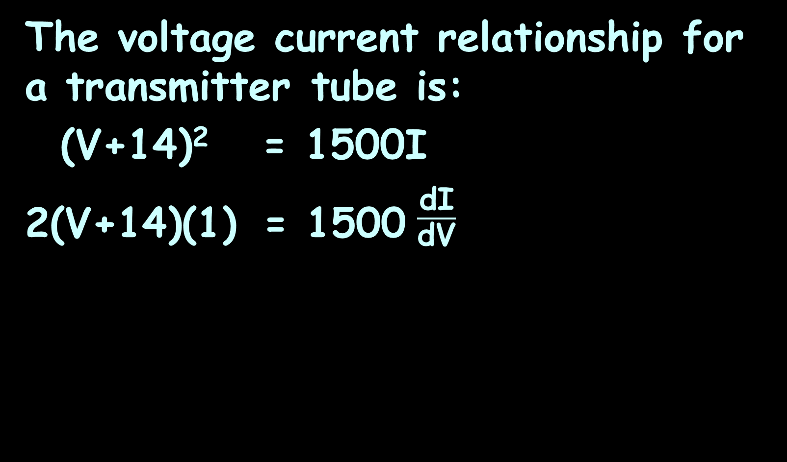
IMPLICIT DIFFERENTIATION
IN-CLASS PROBLEM 3
The voltage current relationship for a transmitter tube is:
(V+14)² = 1500I
2(V+14)(1) = 1500 $\frac{\text{d}\text{I}}{\text{d}\text{V}}$

Slide 115
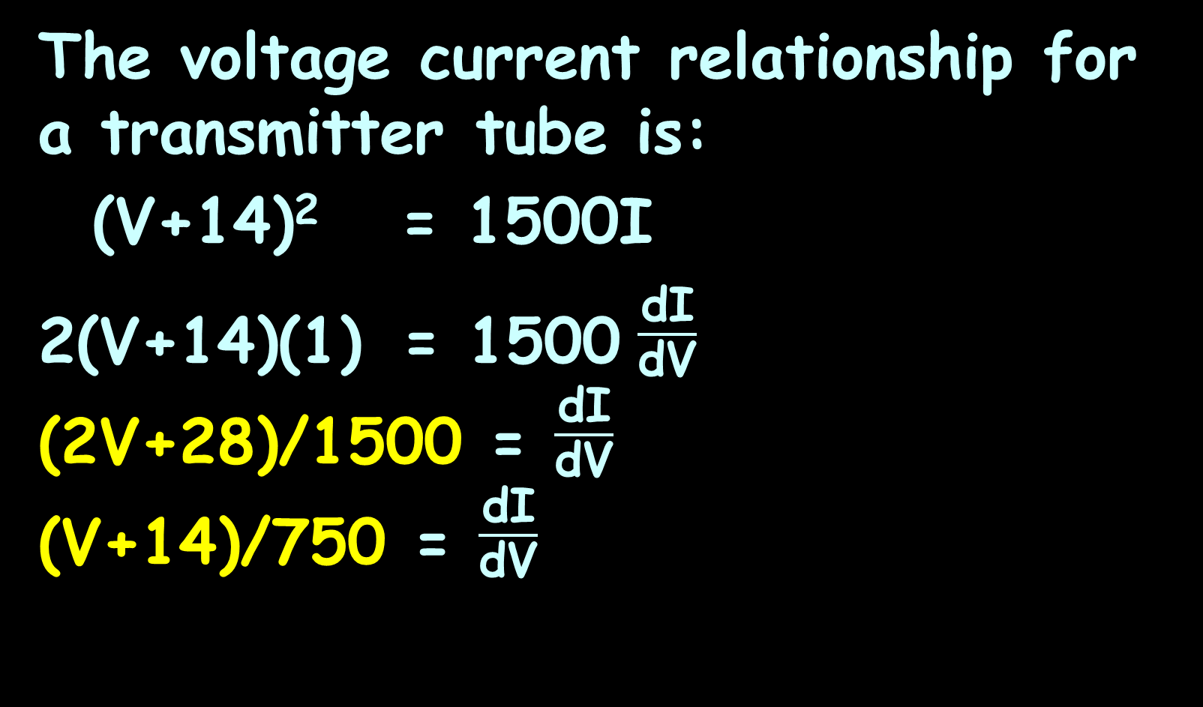
IMPLICIT DIFFERENTIATION
IN-CLASS PROBLEM 3
The voltage current relationship for a transmitter tube is:
(V+14)² = 1500I
2(V+14)(1) = 1500 $\frac{\text{d}\text{I}}{\text{d}\text{V}}$
(2V+28)/1500 = $\frac{\text{d}\text{I}}{\text{d}\text{V}}$
(V+14)/750 = $\frac{\text{d}\text{I}}{\text{d}\text{V}}$

Slide 116
Implicit Differentiation
That one wasn’t actually so hard!
But are we done?

Slide 117
Implicit Differentiation
That one wasn’t actually so hard!
But are we done? Nope…

Slide 118
IMPLICIT DIFFERENTIATION
IN-CLASS PROBLEM 3
The voltage current relationship for a transmitter tube is:
(V+14)² = 1500I
Find its transconductance g_{m} = $\frac{\text{d}\text{I}}{\text{d}\text{V}}$ when V = -9v

Slide 119
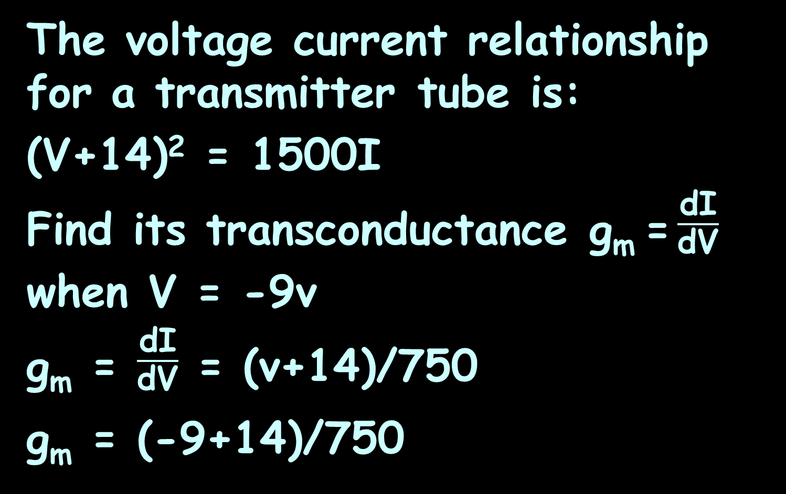
IMPLICIT DIFFERENTIATION
IN-CLASS PROBLEM 3
The voltage current relationship for a transmitter tube is:
(V+14)² = 1500I
Find its transconductance g_{m} = $\frac{\text{d}\text{I}}{\text{d}\text{V}}$ when V = -9v
g_{m} = $\frac{\text{d}\text{I}}{\text{d}\text{V}}$ = (v+14)/750
g_{m} = (-9+14)/750

Slide 120
IMPLICIT DIFFERENTIATION
IN-CLASS PROBLEM 3
The voltage current relationship for a transmitter tube is:
(V+14)² = 1500I
Find its transconductance g_{m} = $\frac{\text{d}\text{I}}{\text{d}\text{V}}$ when V = -9v
g_{m} = $\frac{\text{d}\text{I}}{\text{d}\text{V}}$ = (v+14)/750
g_{m} = (-9+14)/750 ≈ 6667 μ A/v
or 6.67 m A/v
named after Ernst Werner von Siemens
siemens (S)

Slide 121
Questions?
http://i.imgur.com/aliTlT3.jpg

Slide 122
Summary
Today we covered:
Review of Chain Rule
Implicit Differentiation

Slide 123

You Survived!
www.playbuzz.com

