Slide 1

Welcome to
Unit 4 Part 7!
MATH 205 Differential Calculus
https://www.smu.edu.sg/programmes/core-curriculum/course-structure/calculus

Slide 2
What’s Up?
Review: Graphical Rates of
Change and Applications
Derivatives and
differentiation
New stuff:
Differentiation of
transcendentals

Slide 3
What’s Up?
Outcome 1) Demonstrate differentiation skills for linear, polynomial, rational, trigonometric, exponential, and logarithmic functions and proper application of the Product and Quotient Rules of differentiation
Outcome 2) Use algebra, limits, and derivatives to examine the properties and graphs of functions

Slide 4

Review
http://995642590.r.lightningbase-cdn.com/wp-content/uploads/2010/12/looking-back-hrexaminer-v144-cover425px.jpg

Slide 5
Remember Trig?
A tangent (tan) is the sin/cos
A sin in a unit circle is the rise
A cos in a unit circle is the run
So a tangent is a slope: rise/run

Slide 6
Remember Trig?
AND a “tangent” is actually the line tangent to the unit circle at the point where
the right
triangle
intersects
the circle
tan
sin
.
θ
…and that’s why it’s called the “tangent”
cos
VFrench, 2015

Slide 7
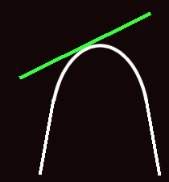
Remember Trig?
In fact, a “tangent” is the line tangent to any curve at a given point
VFrench, 2015

Slide 8
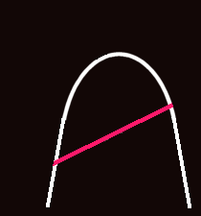
Remember Trig?
The line joining any two points on a curve is the “secant”
VFrench, 2015

Slide 9
Remember Trig?
The slope of the secant line is:
m_{sec} = ∆y / ∆x

Slide 10
Limits in Trig
As you move the secant line in a parallel fashion toward the curve
VFrench, 2020

Slide 11
Limits in Trig
As you move the secant line in a parallel fashion toward the curve
VFrench, 2020

Slide 12
Limits in Trig
As you move the secant line in a parallel fashion toward the curve
VFrench, 2020

Slide 13
Limits in Trig
It becomes the tangent when it hits the edge of the curve
VFrench, 2020

Slide 14
Another Way to Look at It
Pick any secant
Move the secant closer and
closer to one of its endpoints
When it touches an endpoint, it
becomes the tangent
secant
secant
secant
tangent
VFrench, 2020

Slide 15
Limits in Trig
The concept of getting closer and closer to a value or a location on a graph is called a
taking a “limit”

Slide 16
Derivatives
An average rate of change can be written:
Δy/Δx
Where:
Δx = x_{final} - x_{initial} = x₁ - x₀
Δy = y_{final} - y_{initial} = y₁ - y₀

Slide 17
Derivatives
An exact rate of change can be written:
lim Δy/Δx
Δx → 0

Slide 18
Derivatives
This is usually written:
dy/dx
and is called the derivative

Slide 19
Derivatives
The process of finding the
lim Δy/Δx
Δx → 0
or dy/dx
is called differentiation

Slide 20
Derivatives
When differentiating a function, it is usually written:
put the function here
d/dx
Example: for y = 3x² - 4x + 5
write: d/dx (3x² - 4x + 5)

Slide 21
Derivatives/Differentiation
Remember how I said calculus wasn’t REAL…

Slide 22
Derivatives/Differentiation
Remember how I said calculus wasn’t REAL…
That’s because the slope of a “line” with 0 length is nonsense

Slide 23
Derivatives/Differentiation
Remember how I said calculus wasn’t REAL…
That’s because the slope of a “line” with 0 length is nonsense
But we know what value the slope is approaching

Slide 24
Derivatives/Differentiation
Remember how I said calculus wasn’t REAL…
That’s because the slope of a “line” with 0 length is nonsense
But we know what value the slope is approaching
And it’s a way to do hard calculations more easily…

Slide 25

Derivatives/Differentiation
In order to do the calculations, you need to know some RULES
https://henrytrocino.files.wordpress.com/2013/08/weeping-and-gnashing-of-teeth-300x236.jpg

Slide 26
Derivatives/Differentiation
Rule #1: derivative of a constant:
d/dx c = 0

Slide 27
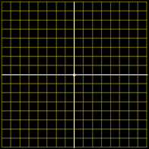
Derivatives/Differentiation
Remember it’s a slope at a given value of x
4
3
2
1
-4
-3
0
-2
-1
0
1
2
3
4
-1
-2
-3
-4
VFrench, 2015

Slide 28
Derivatives/Differentiation
What’s the slope (rise over run) at any x?
4
3
2
1
-4
-3
0
-2
-1
0
1
2
3
4
-1
-2
-3
-4
VFrench, 2015

Slide 29
Derivatives/Differentiation
What’s the slope (rise over run) at any x? 0
4
3
2
1
-4
-3
0
-2
-1
0
1
2
3
4
-1
-2
-3
-4
VFrench, 2015

Slide 30
Derivatives/Differentiation
What’s the slope at any x?
4
3
2
1
-4
-3
0
-2
-1
0
1
2
3
4
-1
-2
-3
-4
VFrench, 2015

Slide 31
Derivatives/Differentiation
What’s the slope at any x?
Well, it
changes
with every x
4
3
2
1
-4
-3
0
-2
-1
0
1
2
3
4
-1
-2
-3
-4
VFrench, 2015

Slide 32
Derivatives/Differentiation
What’s the slope at any x?
Well, it
changes
with every x
So the slope
will be a
function of x
4
3
2
1
-4
-3
0
-2
-1
0
1
2
3
4
-1
-2
-3
-4
VFrench, 2015

Slide 33
Derivatives/Differentiation
Rule #2: derivative of a power function:
d/dx cx^{n} = cn × x ^{n-1}

Slide 34
Derivatives/Differentiation
Rule #3:
derivative of a sum u + v:
du/dx + dv/dx

Slide 35
Derivatives/Differentiation
Rule #3:
derivative of a sum u + v:
du/dx + dv/dx
7x²
- 3.2

Slide 36
Derivatives
Not every function has a derivative at every point

Slide 37
Derivatives
Find the derivative dy/dx for |x|
at x=0:
Well, there is no UNIQUE tangent line at that point…
So there is no
derivative at x=0
VFrench, 2021

Slide 38
Derivatives
In addition, if the limit doesn’t exist (like at a cliff),
then the derivative doesn’t exist either

Slide 39
Derivatives
A function ƒ (x) is called differentiable at x = a if ƒ ′(a) exists

Slide 40
Derivatives
ƒ ′(x) is called globally differentiable if the derivative exists for every point on the number line

Slide 41
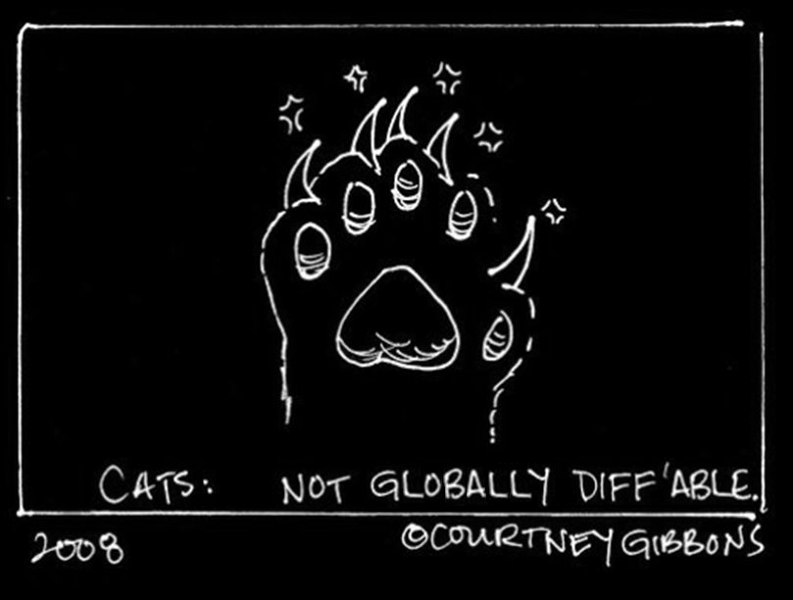
Derivatives

Slide 42

Questions?
http://i.imgur.com/aliTlT3.jpg

Slide 43
Derivatives/Differentiation
Two Rules important enough to be included in the “Outcomes”

Slide 44
Derivatives/Differentiation
Rule #4: derivatives of function
multiplications u × v:
d(u × v)/dx = (u)×(dv/dx) + (v)×(du/dx)
The Product Rule

Slide 45
DERIVATIVES
IN-CLASS PROBLEM 1
Find the derivative dy/dx of:
y = (3x + 2)(7x – 5)
What is u?
What is v?
What is du/dx?
What is dv/dx?
d(u × v)/dx = (u)×(dv/dx) + (v)×(du/dx)

Slide 46
DERIVATIVES
IN-CLASS PROBLEM 1
Find dy/dx (3x + 2)(7x – 5):
u = 3x + 2 v =
du/dx = dv/dx =
d(u × v)/dx = (u)×(dv/dx) + (v)×(du/dx)

Slide 47
DERIVATIVES
IN-CLASS PROBLEM 1
Find dy/dx (3x + 2)(7x – 5):
u = 3x + 2 v = 7x - 5
du/dx = dv/dx =
d(u × v)/dx = (u)×(dv/dx) + (v)×(du/dx)

Slide 48
DERIVATIVES
IN-CLASS PROBLEM 1
Find dy/dx (3x + 2)(7x – 5):
u = 3x + 2 v = 7x - 5
du/dx = 3 dv/dx =

Slide 49
DERIVATIVES
IN-CLASS PROBLEM 1
Find dy/dx (3x + 2)(7x – 5):
u = 3x + 2 v = 7x - 5
du/dx = 3 dv/dx = 7
Plug these into:
d(u × v)/dx = u×dv/dx + v×du/dx

Slide 50
DERIVATIVES
IN-CLASS PROBLEM 1
Find dy/dx (3x + 2)(7x – 5):
u = 3x + 2 v = 7x - 5
du/dx = 3 dv/dx = 7
d(u × v)/dx = u×dv/dx + v×du/dx
= (3x+2)×7 + (7x-5)×3
u
dv/dx
v
du/dx

Slide 51
DERIVATIVES
IN-CLASS PROBLEM 1
Find dy/dx (3x + 2)(7x – 5):
u = 3x + 2 v = 7x - 5
du/dx = 3 dv/dx = 7
d(u × v)/dx = u×dv/dx + v×du/dx
= (3x+2)×7 + (7x-5)×3
= 21x+14 + 21x-15

Slide 52
DERIVATIVES
IN-CLASS PROBLEM 1
Find dy/dx (3x + 2)(7x – 5):
u = 3x + 2 v = 7x - 5
du/dx = 3 dv/dx = 7
d(u × v)/dx = u×dv/dx + v×du/dx
= (3x+2)×7 + (7x-5)×3
= 21x + 14 + 21x - 15
= 42x - 1

Slide 53
DERIVATIVES
IN-CLASS PROBLEM 1
OR:
Find dy/dx (3x + 2)(7x – 5):
y = 21x² – x - 10
dy/dx = 2(21)x²⁻¹ – 1 + 0
= 42x - 1

Slide 54
Questions?
http://i.imgur.com/aliTlT3.jpg

Slide 55
Derivatives/Differentiation
Rule #5: derivative of a ratio
u / v:
d(u / v)/dx = v×du/dx - u×dv/dx
v²
The Quotient Rule

Slide 56
Derivatives/Differentiation
Rule #5: derivative of a ratio
u / v: hi/lo
d(u / v)/dx = v×du/dx - u×dv/dx
v²
Lo-de-hi minus Hi-de-lo over
lo square and away we go!

Slide 57
DERIVATIVES
IN-CLASS PROBLEM 2
Find the derivative dy/dx of:
y = (x² -1)/x
Find hi, lo, dhi, dlo

Slide 58
DERIVATIVES
IN-CLASS PROBLEM 2
y = (x² -1)/x
hi = lo =
dhi/dx = dlo/dx =

Slide 59
DERIVATIVES
IN-CLASS PROBLEM 2
y = (x² -1)/x
hi = (x² -1) lo =
dhi/dx = dlo/dx =

Slide 60
DERIVATIVES
IN-CLASS PROBLEM 2
y = (x² -1)/x
hi = (x² -1) lo = x
dhi/dx = dlo/dx =

Slide 61
DERIVATIVES
IN-CLASS PROBLEM 2
y = (x² -1)/x
hi = (x² -1) lo = x
dhi/dx = 2x dlo/dx =

Slide 62
DERIVATIVES
IN-CLASS PROBLEM 2
y = (x² -1)/x
u=hi=(x² -1) v=lo=x
du/dx=dhi/dx=2x dv/dx=dlo/dx=1
Lo-de-hi minus Hi-de-lo
over lo squared:
d(u / v)/dx = v×du/dx - u×dv/dx
v²

Slide 63
DERIVATIVES
IN-CLASS PROBLEM 2
y = (x² -1)/x
u=hi=(x² -1) v=lo=x
du/dx=dhi/dx=2x dv/dx=dlo/dx=1
Lo-de-hi minus Hi-de-lo
over lo square:
(x)(2x) – (x² -1)(1) 2x² – x² +1
(x)² x²
=
d(u / v)/dx = v×du/dx - u×dv/dx
v²

Slide 64
DERIVATIVES
IN-CLASS PROBLEM 2
y = (x² -1)/x
hi = (x² -1) lo = x
dhi/dx = 2x dlo/dx = 1
Lo-de-hi minus Hi-de-lo
over lo square:
(x)(2x) – (x² -1)(1) 2x² – x² + 1
(x)² x²
= (x²+1)/x² Away we go!
2x² – x² = x² – 1
=

Slide 65
Questions?
http://i.imgur.com/aliTlT3.jpg

Slide 66
Derivatives
Remember… when we calculate the derivative of a function, we are finding the exact rate of change of that function
This exact rate of change is also a function – because it is changing, too!

Slide 67
Derivatives
While mathematicians need to know and understand and be able to replicate the theory behind all mathematical concepts, engineers really need to be able to get THE RIGHT ANSWER for important real-world problems

Slide 68
Derivatives
As a statistician, I am AWFUL at getting the exact answer (close enuf is good enuf…)

Slide 69
Derivatives
As a statistician, I am AWFUL at getting the exact answer (close enuf is good enuf…)
You all need more accuracy!

Slide 70
Derivatives
To this end, the universe has kindly invented calculators and computers

Slide 71
Derivatives
The TI calculators are specifically designed by engineers for engineers

Slide 72
Derivatives
The TI 83, 84 and 85 can do many (but not all) of the problems we do in MATH205 and 207

Slide 73
Derivatives
The TI 89 titanium and
TI nspire can download apps to do virtually every problem
(the TI89 app is often free)

Slide 74
Derivatives
How to do a derivative problem with a TI 83, 84 or 85:
nDeriv(expression,variable,value,tolerance)

Slide 75
Derivatives
How to do a derivative problem with a TI 83, 84 or 85:
nDeriv(expression,variable,value,tolerance)
MATH 8 will bring up nDeriv

Slide 76
Derivatives
Suppose we want to find the derivative dy/dx for:
(4x²+7x +1)/(3x+5) at x=0
nDeriv((4x^2+7x+1)÷(3x+5),x,0)
ENTER
1.279999981

Slide 77
Derivatives
There is no built-in function on the TI-83 Plus to take a derivative in general

Slide 78
Derivatives
Theoretically you can access this functionality for the TI83 using an app on:
http://www.calcblog.com/three-applications-turn-ti83-ti84-into-ti89/
(I’ve never tried it… let me know what happens!)

Slide 79
Derivatives
There is no built-in function on the TI-84 Plus to take a derivative in general

Slide 80
Derivatives
Theoretically you can access this functionality for the TI84 using an app on:
https://www.ti84calcwiz.com/
mathprograms/symbolic-derivative-solver/
(I’ve never tried it… again, let me know what happens!)

Slide 81
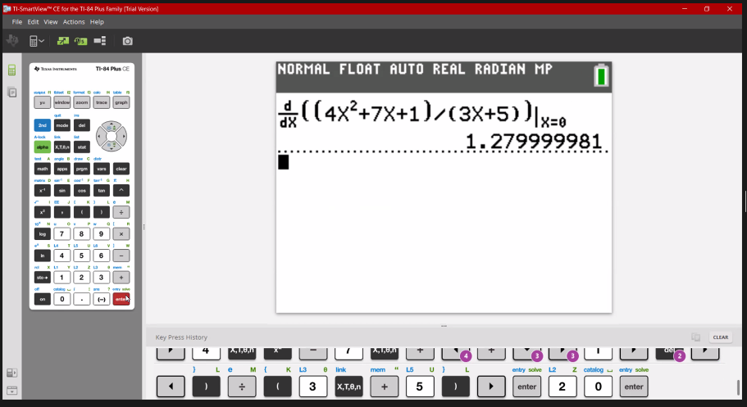
Derivatives
How to do a derivative problem with a TI 83, 84 or 85: MATH 8
Jose Mares, 2021

Slide 82
Derivatives
How to do a derivative problem with a TI 89:
HOME
2nd 8
Gives you the d
d( (4x^2+7x+1)÷(3x+5) , x )
ENTER

Slide 83
Derivatives
You get:
4·(3·x² + 10·x + 8)
(3·x + 5)²

Slide 84

Derivatives
How to do a derivative problem with a TI nspire:
menu
4: Calculus
1: Derivative
4x^2+7x+1
3x+5
https://www.google.com/search?q=how+to+find+the+general+derivative+of+a+function+on+ti+nspire+cx&ei=pMV8YPObDZaqtQaFt4eACw&oq=how+to+find+the+general+derivative+of+a+function+on+ti+nspire+cx&gs_lcp=Cgdnd3Mtd2l6EAM6BwgAEEcQsAM6BAgAEA06BQgAEM0COgQIIRAKUMHFA1iv0gNgltcDaAFwAngAgAGGAYgBjAaSAQM4LjGYAQCgAQGqAQdnd3Mtd2l6yAEIwAEB&sclient=gws-wiz&ved=0ahUKEwjz_ZP2_YjwAhUWVc0KHYXbAbAQ4dUDCA4&uact=5#kpvalbx=_4cV8YPC2MprWtQar4ZjADw19

Slide 85
Derivatives
What if you can’t afford a new calculator right now?

Slide 86
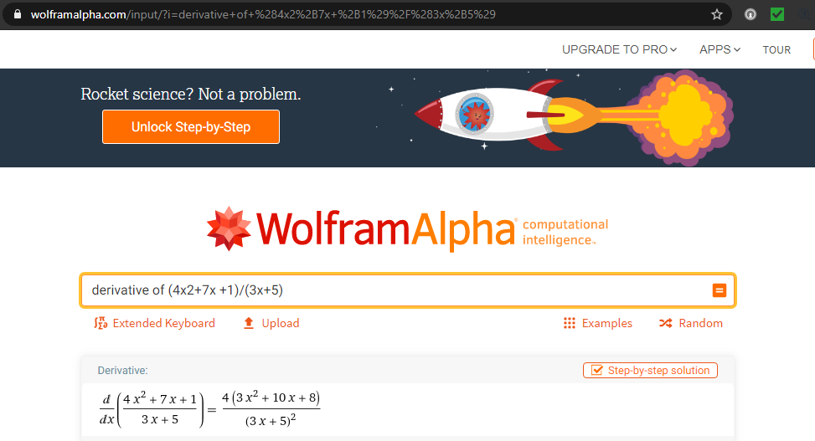
Derivatives
WolframAlpha:
https://www.wolframalpha.com/input/?i=derivative+of+%284x2%2B7x+%2B1%29%2F%283x%2B5%29

Slide 87
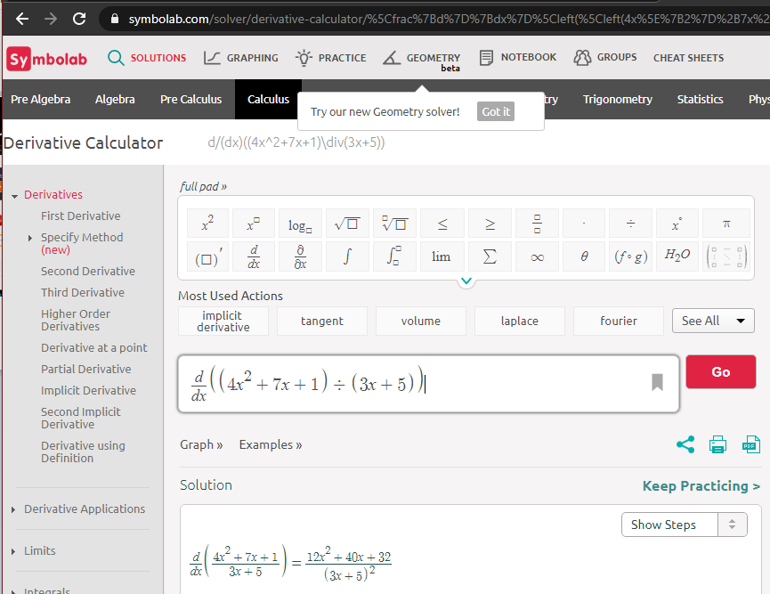
Derivatives
Symbolab:
https://www.symbolab.com/solver/derivative-calculator/%5Cfrac%7Bd%7D%7Bdx%7D%5Cleft
(%5Cleft(4x%5E%7B2%7D%2B7x%2B1%5Cright)%5Cdiv%5Cleft(3x%2B5%5Cright)%5Cright)

Slide 88
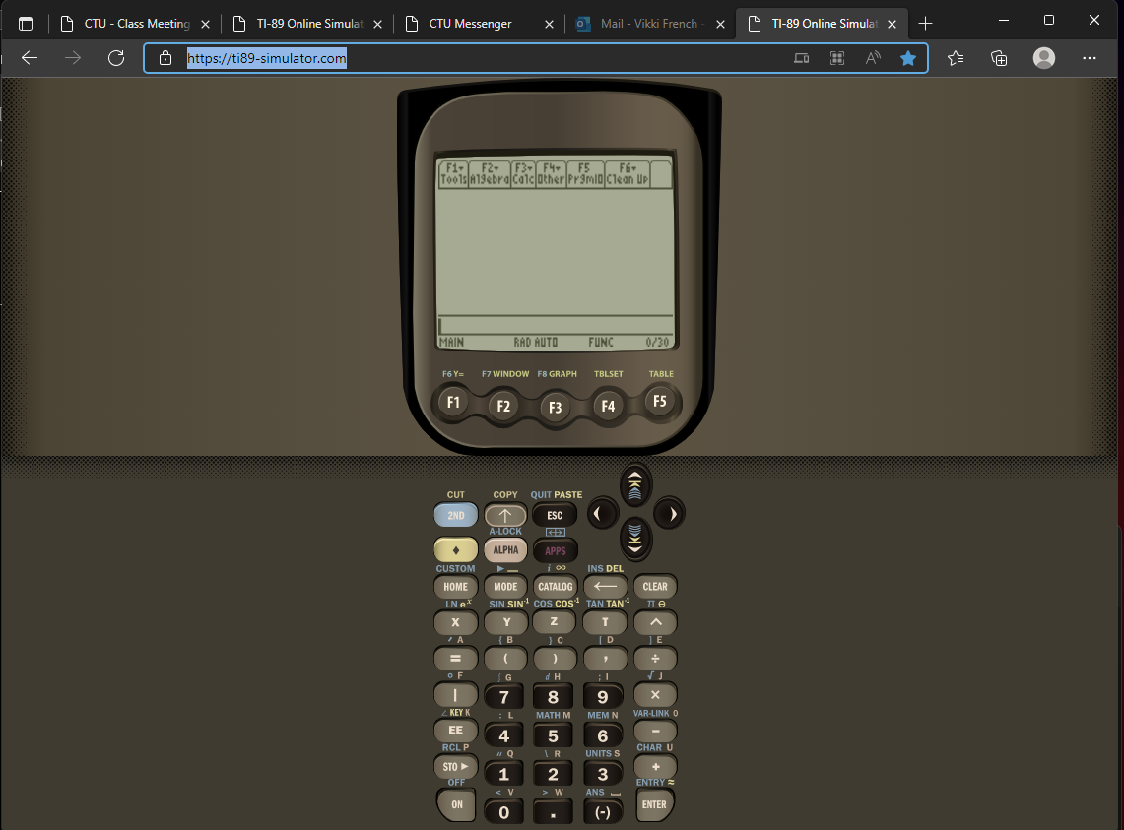
https://ti89-simulator.com/
The last time I tried to access this, it was no longer available...

Slide 89
Questions?
http://i.imgur.com/aliTlT3.jpg

Slide 90
Fancy Derivatives
More rules for more complicated functions you might need to take a derivative of!

Slide 91
Transcendental Derivatives
Remember the title of our book implied we would be doing transcendentals early

Slide 92
Transcendental Derivatives
Remember the title of our book implied we would be doing transcendentals early…
That moment has come…

Slide 93
Transcendental Derivatives
A transcendental function is not a polynomial equation

Slide 94
Transcendental Derivatives
A transcendental function is not a polynomial equation
Trig functions, exponentials (c^{x}) and logarithms are transcendentals

Slide 95
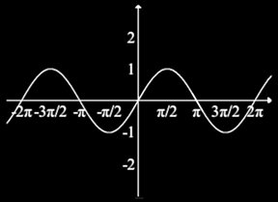
Transcendental Derivatives
sin(x):

Slide 96
Transcendental Derivatives
Remember, dy/dx is a tangent
sin(x) tangents:
slope = 0
slope = 1
slope = -1
slope = 0

Slide 97
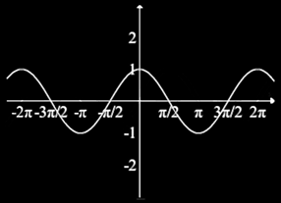
Transcendental Derivatives
When you graph the SLOPES:
…you get the cosine
slope = 0
slope = 1
slope = -1
slope = 0

Slide 98
Transcendental Derivatives
Rule: d(sin(x))/dx = cos(x)

Slide 99

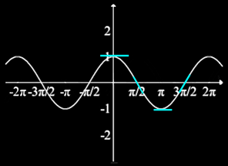
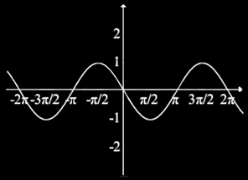
Transcendental Derivatives
Likewise d(cos(x))/dx = -sin(x)
graph of
cos tangents slopes

Slide 100
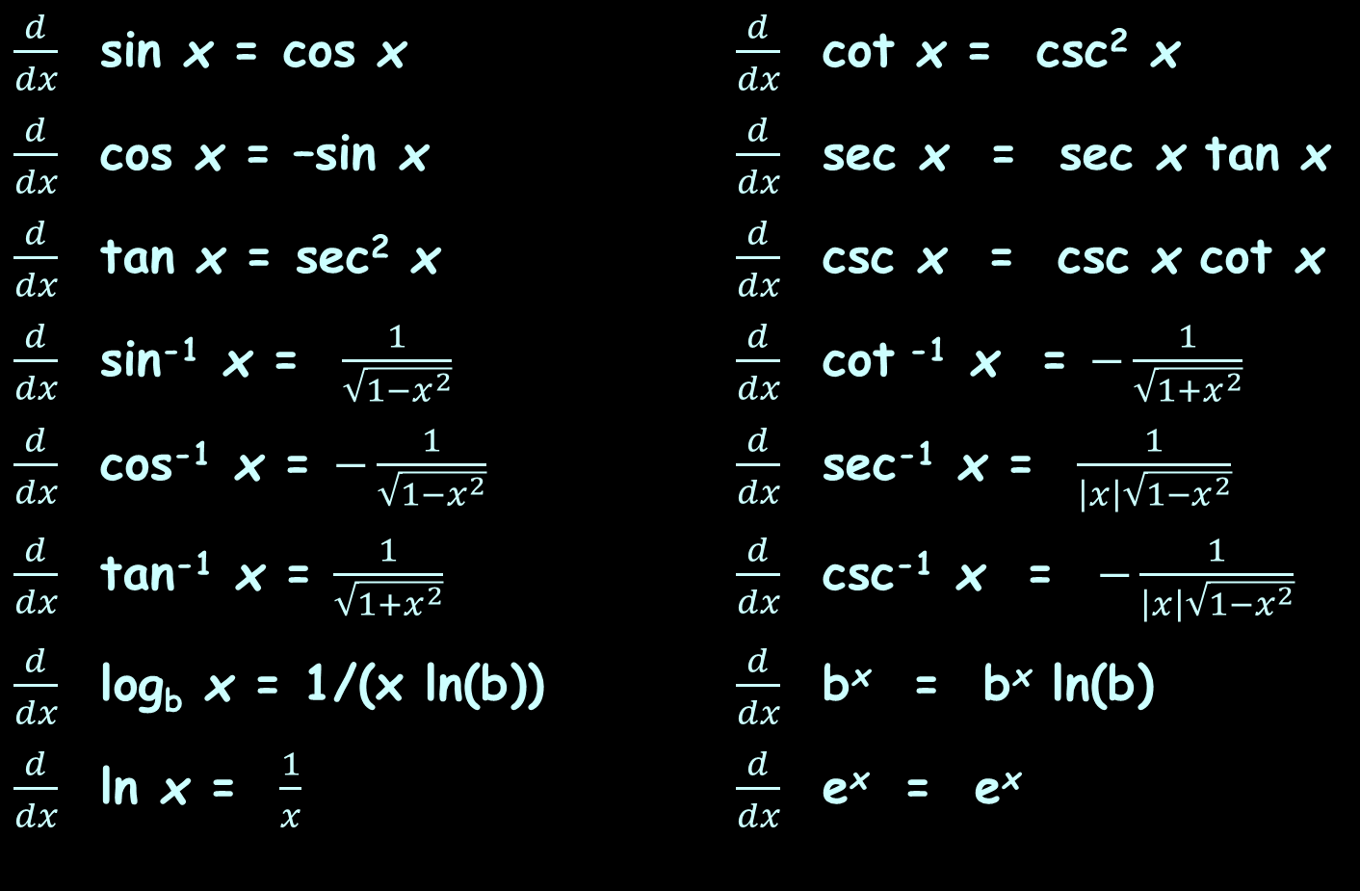
Transcendental Derivatives
$\frac{d}{dx}$ sin x = cos x $\frac{d}{dx}$ cot x = csc² x
$\frac{d}{dx}$ cos x = –sin x $\frac{d}{dx}$ sec x = sec x tan x
$\frac{d}{dx}$ tan x = sec² x $\frac{d}{dx}$ csc x = csc x cot x
$\frac{d}{dx}$ sin⁻¹ x = $\frac{1}{\sqrt{1−x^{2}}}$ $\frac{d}{dx}$ cot ⁻¹ x = $−\frac{1}{\sqrt{1+x^{2}}}$
$\frac{d}{dx}$ cos⁻¹ x = $−\frac{1}{\sqrt{1−x^{2}}}$ $\frac{d}{dx}$ sec⁻¹ x = $\frac{1}{\left|x\right|\sqrt{1−x^{2}}}$
$\frac{d}{dx}$ tan⁻¹ x = $\frac{1}{\sqrt{1+x^{2}}}$ $\frac{d}{dx}$ csc⁻¹ x = $−\frac{1}{\left|x\right|\sqrt{1−x^{2}}}$
$\frac{d}{dx}$ log_{b} x = 1/(x ln(b)) $\frac{d}{dx}$ b^{x} = b^{x} ln(b)
$\frac{d}{dx}$ ln x = $\frac{1}{x}$ $\frac{d}{dx}$ e^{x} = e^{x}

Slide 101

TRANSCENDENTAL DERIVATIVES
IN-CLASS PROBLEMS 3,4,5,6
Find the derivative d/dx:
y = sin x
y = - sin x
y = cos x
y = tan x
$\frac{d}{dx}$ sin x = cos x
$\frac{d}{dx}$ cot x = csc² x
$\frac{d}{dx}$ cos x = –sin x
$\frac{d}{dx}$ sec x = sec x tan x
$\frac{d}{dx}$ tan x = sec² x
$\frac{d}{dx}$ csc x = csc x cot x
$\frac{d}{dx}$ sin⁻¹ x = $\frac{1}{\sqrt{1−x^{2}}}$
$\frac{d}{dx}$ cot ⁻¹ x = $−\frac{1}{\sqrt{1+x^{2}}}$
$\frac{d}{dx}$ cos⁻¹ x = $−\frac{1}{\sqrt{1−x^{2}}}$
$\frac{d}{dx}$ sec⁻¹ x = $\frac{1}{\left|x\right|\sqrt{1−x^{2}}}$
$\frac{d}{dx}$ tan⁻¹ x = $\frac{1}{\sqrt{1+x^{2}}}$
$\frac{d}{dx}$ csc⁻¹ x = $−\frac{1}{\left|x\right|\sqrt{1−x^{2}}}$
$\frac{d}{dx}$ log_{b} x = 1/(x ln(b))
$\frac{d}{dx}$ b^{x} = b^{x} ln(b)
$\frac{d}{dx}$ ln x = $\frac{1}{x}$
$\frac{d}{dx}$ e^{x} = e^{x}

Slide 102
TRANSCENDENTAL DERIVATIVES
IN-CLASS PROBLEMS 3,4,5,6
Find the derivative:
d(sin x)/dx = cos x
d(-sin x)/dx =
d(cos x)/dx =
d(tan x)/dx =
$\frac{d}{dx}$ sin x = cos x
$\frac{d}{dx}$ cot x = csc² x
$\frac{d}{dx}$ cos x = –sin x
$\frac{d}{dx}$ sec x = sec x tan x
$\frac{d}{dx}$ tan x = sec² x
$\frac{d}{dx}$ csc x = csc x cot x
$\frac{d}{dx}$ sin⁻¹ x = $\frac{1}{\sqrt{1−x^{2}}}$
$\frac{d}{dx}$ cot ⁻¹ x = $−\frac{1}{\sqrt{1+x^{2}}}$
$\frac{d}{dx}$ cos⁻¹ x = $−\frac{1}{\sqrt{1−x^{2}}}$
$\frac{d}{dx}$ sec⁻¹ x = $\frac{1}{\left|x\right|\sqrt{1−x^{2}}}$
$\frac{d}{dx}$ tan⁻¹ x = $\frac{1}{\sqrt{1+x^{2}}}$
$\frac{d}{dx}$ csc⁻¹ x = $−\frac{1}{\left|x\right|\sqrt{1−x^{2}}}$
$\frac{d}{dx}$ log_{b} x = 1/(x ln(b))
$\frac{d}{dx}$ b^{x} = b^{x} ln(b)
$\frac{d}{dx}$ ln x = $\frac{1}{x}$
$\frac{d}{dx}$ e^{x} = e^{x}

Slide 103
TRANSCENDENTAL DERIVATIVES
IN-CLASS PROBLEMS 3,4,5,6
Find the derivative:
d(sin x)/dx = cos x
d(-sin x)/dx = -cos x
d(cos x)/dx =
d(tan x)/dx =
$\frac{d}{dx}$ sin x = cos x
$\frac{d}{dx}$ cot x = csc² x
$\frac{d}{dx}$ cos x = –sin x
$\frac{d}{dx}$ sec x = sec x tan x
$\frac{d}{dx}$ tan x = sec² x
$\frac{d}{dx}$ csc x = csc x cot x
$\frac{d}{dx}$ sin⁻¹ x = $\frac{1}{\sqrt{1−x^{2}}}$
$\frac{d}{dx}$ cot ⁻¹ x = $−\frac{1}{\sqrt{1+x^{2}}}$
$\frac{d}{dx}$ cos⁻¹ x = $−\frac{1}{\sqrt{1−x^{2}}}$
$\frac{d}{dx}$ sec⁻¹ x = $\frac{1}{\left|x\right|\sqrt{1−x^{2}}}$
$\frac{d}{dx}$ tan⁻¹ x = $\frac{1}{\sqrt{1+x^{2}}}$
$\frac{d}{dx}$ csc⁻¹ x = $−\frac{1}{\left|x\right|\sqrt{1−x^{2}}}$
$\frac{d}{dx}$ log_{b} x = 1/(x ln(b))
$\frac{d}{dx}$ b^{x} = b^{x} ln(b)
$\frac{d}{dx}$ ln x = $\frac{1}{x}$
$\frac{d}{dx}$ e^{x} = e^{x}

Slide 104
TRANSCENDENTAL DERIVATIVES
IN-CLASS PROBLEMS 3,4,5,6
Find the derivative:
d(sin x)/dx = cos x
d(-sin x)/dx = -cos x
d(cos x)/dx = -sin x
d(tan x)/dx =
$\frac{d}{dx}$ sin x = cos x
$\frac{d}{dx}$ cot x = csc² x
$\frac{d}{dx}$ cos x = –sin x
$\frac{d}{dx}$ sec x = sec x tan x
$\frac{d}{dx}$ tan x = sec² x
$\frac{d}{dx}$ csc x = csc x cot x
$\frac{d}{dx}$ sin⁻¹ x = $\frac{1}{\sqrt{1−x^{2}}}$
$\frac{d}{dx}$ cot ⁻¹ x = $−\frac{1}{\sqrt{1+x^{2}}}$
$\frac{d}{dx}$ cos⁻¹ x = $−\frac{1}{\sqrt{1−x^{2}}}$
$\frac{d}{dx}$ sec⁻¹ x = $\frac{1}{\left|x\right|\sqrt{1−x^{2}}}$
$\frac{d}{dx}$ tan⁻¹ x = $\frac{1}{\sqrt{1+x^{2}}}$
$\frac{d}{dx}$ csc⁻¹ x = $−\frac{1}{\left|x\right|\sqrt{1−x^{2}}}$
$\frac{d}{dx}$ log_{b} x = 1/(x ln(b))
$\frac{d}{dx}$ b^{x} = b^{x} ln(b)
$\frac{d}{dx}$ ln x = $\frac{1}{x}$
$\frac{d}{dx}$ e^{x} = e^{x}

Slide 105
TRANSCENDENTAL DERIVATIVES
IN-CLASS PROBLEMS 3,4,5,6
Find the derivative:
d(sin x)/dx = cos x
d(-sin x)/dx = -cos x
d(cos x)/dx = -sin x
d(tan x)/dx = sec² x
$\frac{d}{dx}$ sin x = cos x
$\frac{d}{dx}$ cot x = csc² x
$\frac{d}{dx}$ cos x = –sin x
$\frac{d}{dx}$ sec x = sec x tan x
$\frac{d}{dx}$ tan x = sec² x
$\frac{d}{dx}$ csc x = csc x cot x
$\frac{d}{dx}$ sin⁻¹ x = $\frac{1}{\sqrt{1−x^{2}}}$
$\frac{d}{dx}$ cot ⁻¹ x = $−\frac{1}{\sqrt{1+x^{2}}}$
$\frac{d}{dx}$ cos⁻¹ x = $−\frac{1}{\sqrt{1−x^{2}}}$
$\frac{d}{dx}$ sec⁻¹ x = $\frac{1}{\left|x\right|\sqrt{1−x^{2}}}$
$\frac{d}{dx}$ tan⁻¹ x = $\frac{1}{\sqrt{1+x^{2}}}$
$\frac{d}{dx}$ csc⁻¹ x = $−\frac{1}{\left|x\right|\sqrt{1−x^{2}}}$
$\frac{d}{dx}$ log_{b} x = 1/(x ln(b))
$\frac{d}{dx}$ b^{x} = b^{x} ln(b)
$\frac{d}{dx}$ ln x = $\frac{1}{x}$
$\frac{d}{dx}$ e^{x} = e^{x}

Slide 106
TRANSCENDENTAL DERIVATIVES
IN-CLASS PROBLEMS 7,8
Find the derivative:
d/dx 276^{x} =
d/dx log₁₀x =
$\frac{d}{dx}$ sin x = cos x
$\frac{d}{dx}$ cot x = csc² x
$\frac{d}{dx}$ cos x = –sin x
$\frac{d}{dx}$ sec x = sec x tan x
$\frac{d}{dx}$ tan x = sec² x
$\frac{d}{dx}$ csc x = csc x cot x
$\frac{d}{dx}$ sin⁻¹ x = $\frac{1}{\sqrt{1−x^{2}}}$
$\frac{d}{dx}$ cot ⁻¹ x = $−\frac{1}{\sqrt{1+x^{2}}}$
$\frac{d}{dx}$ cos⁻¹ x = $−\frac{1}{\sqrt{1−x^{2}}}$
$\frac{d}{dx}$ sec⁻¹ x = $\frac{1}{\left|x\right|\sqrt{1−x^{2}}}$
$\frac{d}{dx}$ tan⁻¹ x = $\frac{1}{\sqrt{1+x^{2}}}$
$\frac{d}{dx}$ csc⁻¹ x = $−\frac{1}{\left|x\right|\sqrt{1−x^{2}}}$
$\frac{d}{dx}$ log_{b} x = 1/(x ln(b))
$\frac{d}{dx}$ b^{x} = b^{x} ln(b)
$\frac{d}{dx}$ ln x = $\frac{1}{x}$
$\frac{d}{dx}$ e^{x} = e^{x}

Slide 107
TRANSCENDENTAL DERIVATIVES
IN-CLASS PROBLEMS 7,8
Find the derivative:
d/dx 276^{x} =
= 276^{x} ln(276)
≈ 276^{x} × 5.620
Don’t be tempted to
combine 276 and 5.62
$\frac{d}{dx}$ sin x = cos x
$\frac{d}{dx}$ cot x = csc² x
$\frac{d}{dx}$ cos x = –sin x
$\frac{d}{dx}$ sec x = sec x tan x
$\frac{d}{dx}$ tan x = sec² x
$\frac{d}{dx}$ csc x = csc x cot x
$\frac{d}{dx}$ sin⁻¹ x = $\frac{1}{\sqrt{1−x^{2}}}$
$\frac{d}{dx}$ cot ⁻¹ x = $−\frac{1}{\sqrt{1+x^{2}}}$
$\frac{d}{dx}$ cos⁻¹ x = $−\frac{1}{\sqrt{1−x^{2}}}$
$\frac{d}{dx}$ sec⁻¹ x = $\frac{1}{\left|x\right|\sqrt{1−x^{2}}}$
$\frac{d}{dx}$ tan⁻¹ x = $\frac{1}{\sqrt{1+x^{2}}}$
$\frac{d}{dx}$ csc⁻¹ x = $−\frac{1}{\left|x\right|\sqrt{1−x^{2}}}$
$\frac{d}{dx}$ log_{b} x = 1/(x ln(b))
$\frac{d}{dx}$ b^{x} = b^{x} ln(b)
$\frac{d}{dx}$ ln x = $\frac{1}{x}$
$\frac{d}{dx}$ e^{x} = e^{x}

Slide 108
TRANSCENDENTAL DERIVATIVES
IN-CLASS PROBLEMS 7,8
Find the derivative:
d/dx 276^{x} =
= 276^{x} ln(276)
≈ 276^{x} × 5.62
d/dx log₁₀x = ?
$\frac{d}{dx}$ sin x = cos x
$\frac{d}{dx}$ cot x = csc² x
$\frac{d}{dx}$ cos x = –sin x
$\frac{d}{dx}$ sec x = sec x tan x
$\frac{d}{dx}$ tan x = sec² x
$\frac{d}{dx}$ csc x = csc x cot x
$\frac{d}{dx}$ sin⁻¹ x = $\frac{1}{\sqrt{1−x^{2}}}$
$\frac{d}{dx}$ cot ⁻¹ x = $−\frac{1}{\sqrt{1+x^{2}}}$
$\frac{d}{dx}$ cos⁻¹ x = $−\frac{1}{\sqrt{1−x^{2}}}$
$\frac{d}{dx}$ sec⁻¹ x = $\frac{1}{\left|x\right|\sqrt{1−x^{2}}}$
$\frac{d}{dx}$ tan⁻¹ x = $\frac{1}{\sqrt{1+x^{2}}}$
$\frac{d}{dx}$ csc⁻¹ x = $−\frac{1}{\left|x\right|\sqrt{1−x^{2}}}$
$\frac{d}{dx}$ log_{b} x = 1/(x ln(b))
$\frac{d}{dx}$ b^{x} = b^{x} ln(b)
$\frac{d}{dx}$ ln x = $\frac{1}{x}$
$\frac{d}{dx}$ e^{x} = e^{x}

Slide 109
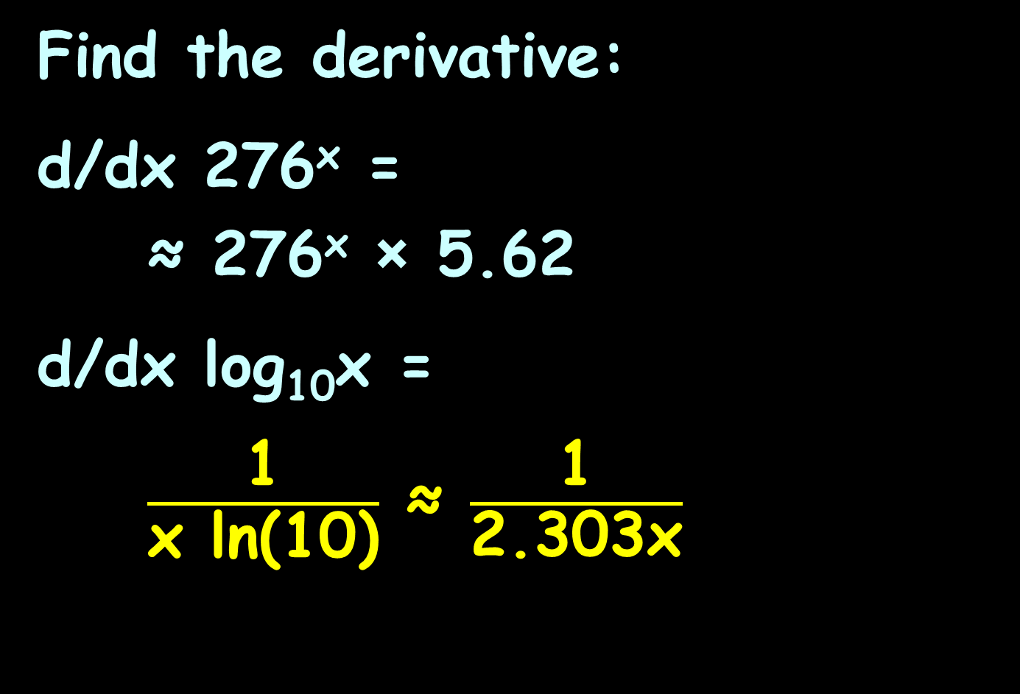
TRANSCENDENTAL DERIVATIVES
IN-CLASS PROBLEMS 7,8
Find the derivative:
d/dx 276^{x} =
≈ 276^{x} × 5.62
d/dx log₁₀x =
$\frac{\text{1}}{\text{x} \text{ln}\text{(10)}}$ ≈ $\frac{\text{1}}{\text{2.303}\text{x}}$
$\frac{d}{dx}$ sin x = cos x
$\frac{d}{dx}$ cot x = csc² x
$\frac{d}{dx}$ cos x = –sin x
$\frac{d}{dx}$ sec x = sec x tan x
$\frac{d}{dx}$ tan x = sec² x
$\frac{d}{dx}$ csc x = csc x cot x
$\frac{d}{dx}$ sin⁻¹ x = $\frac{1}{\sqrt{1−x^{2}}}$
$\frac{d}{dx}$ cot ⁻¹ x = $−\frac{1}{\sqrt{1+x^{2}}}$
$\frac{d}{dx}$ cos⁻¹ x = $−\frac{1}{\sqrt{1−x^{2}}}$
$\frac{d}{dx}$ sec⁻¹ x = $\frac{1}{\left|x\right|\sqrt{1−x^{2}}}$
$\frac{d}{dx}$ tan⁻¹ x = $\frac{1}{\sqrt{1+x^{2}}}$
$\frac{d}{dx}$ csc⁻¹ x = $−\frac{1}{\left|x\right|\sqrt{1−x^{2}}}$
$\frac{d}{dx}$ log_{b} x = 1/(x ln(b))
$\frac{d}{dx}$ b^{x} = b^{x} ln(b)
$\frac{d}{dx}$ ln x = $\frac{1}{x}$
$\frac{d}{dx}$ e^{x} = e^{x}

Slide 110

Derivatives
Note: if you use WolframAlpha, they use “log” to mean “ln” (really confusing!)
If you want log₁₀, you can select that

Slide 111
Questions?
http://i.imgur.com/aliTlT3.jpg

Slide 112
Derivatives
We’ve been doing all our derivatives vs “x”

Slide 113
Derivatives
We’ve been doing all our derivatives vs “x”
It doesn’t have to be that way!

Slide 114
Derivatives
The formula for the volume of a box is: v = l × w × h
Any one of the measures could change, which would cause the volume to change

Slide 115
Derivatives
To solve these problems, think of any variable that is not changing as a constant

Slide 116
DERIVATIVES
IN-CLASS PROBLEMS 9
The formula for the volume of a box is: v = l × w × h
Find dv/dw

Slide 117
DERIVATIVES
IN-CLASS PROBLEMS 9
The formula for the volume of a box is: v = l × w × h
Find dv/dw
That means v and w are free to change (variables)
BUT l and h are NOT free to change (constants)

Slide 118
DERIVATIVES
IN-CLASS PROBLEMS 9
The formula for the volume of a box is: v = l × w × h
Find dv/dw
Think of the formula as:
v = (c) × w
with c=lh (a constant)
w is the independent variable
v is the dependent variable

Slide 119
DERIVATIVES
IN-CLASS PROBLEMS 9
The formula for the volume of
a box is: v = l × w × h
Find dv/dw
Think of the formula as:
v = c w¹
dv/dw = c(1)w¹⁻¹ = c(1)(w⁰) =
= c(1)(1) = c (= lh)

Slide 120
DERIVATIVES
IN-CLASS PROBLEMS 9
The formula for the volume of a box is: v = l × w × h
Find dv/dw
Think of the formula as:
v = (lh) × w
Now it’s easy! What is dv/dw?
lh

Slide 121
DERIVATIVES
IN-CLASS PROBLEMS 9
The formula for the volume of a box is: v = l × w × h
Find dv/dh

Slide 122
DERIVATIVES
IN-CLASS PROBLEMS 9
The formula for the volume of a box is: v = l × w × h
Find dv/dh
v and h are now the variables
l and w are now the constants
v = (lw) h = c h

Slide 123
DERIVATIVES
IN-CLASS PROBLEMS 9
The formula for the volume of a box is: v = l × w × h
Find dv/dh
Think of the formula as:
v = c h
Now it’s easy! What is dv/dh?

Slide 124
DERIVATIVES
IN-CLASS PROBLEMS 9
The formula for the volume of a box is: v = l × w × h
Find dv/dh
Think of the formula as:
v = (c) h
Now it’s easy! What is dv/dh?
c = lw

Slide 125
DERIVATIVES
IN-CLASS PROBLEMS 9
The formula for the volume of a box is: v = l × w × h
Find dv/dl
Think of the formula as:
v = (wh) l = c l
Now it’s easy! What is dv/dl?
c = wh

Slide 126
Derivatives
Engineering applications are rarely in “x”s and “y”s

Slide 127

DERIVATIVES
IN-CLASS PROBLEMS 10
The charge of a resonant circuit is given by Q = $\frac{\text{1}}{\text{R}} \sqrt{\frac{\text{L}}{\text{C}}}$
Find dQ/dL
inductance

Slide 128
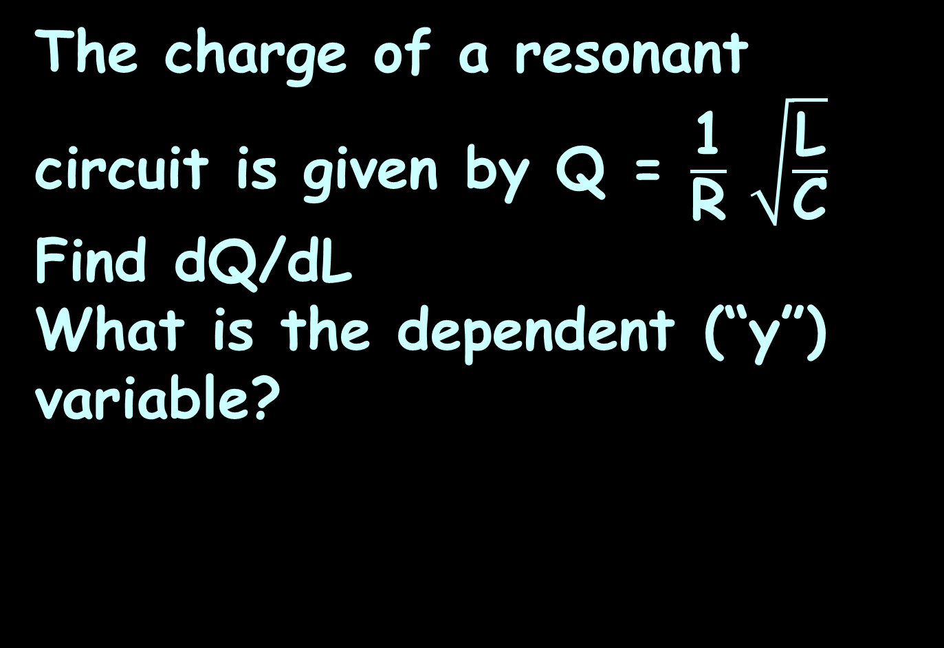
DERIVATIVES
IN-CLASS PROBLEMS 10
The charge of a resonant circuit is given by Q = $\frac{\text{1}}{\text{R}} \sqrt{\frac{\text{L}}{\text{C}}}$
Find dQ/dL
What is the dependent (“y”) variable?

Slide 129
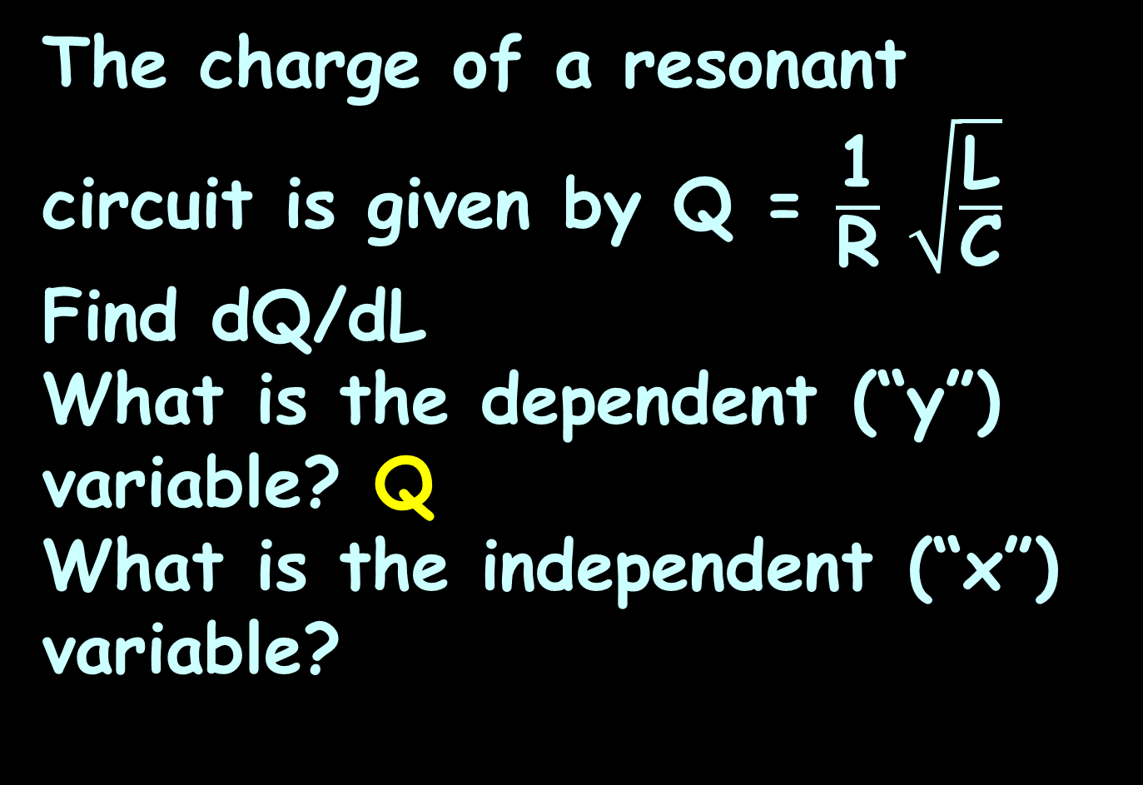
DERIVATIVES
IN-CLASS PROBLEMS 10
The charge of a resonant circuit is given by Q = $\frac{\text{1}}{\text{R}} \sqrt{\frac{\text{L}}{\text{C}}}$
Find dQ/dL
What is the dependent (“y”) variable? Q
What is the independent (“x”) variable?

Slide 130
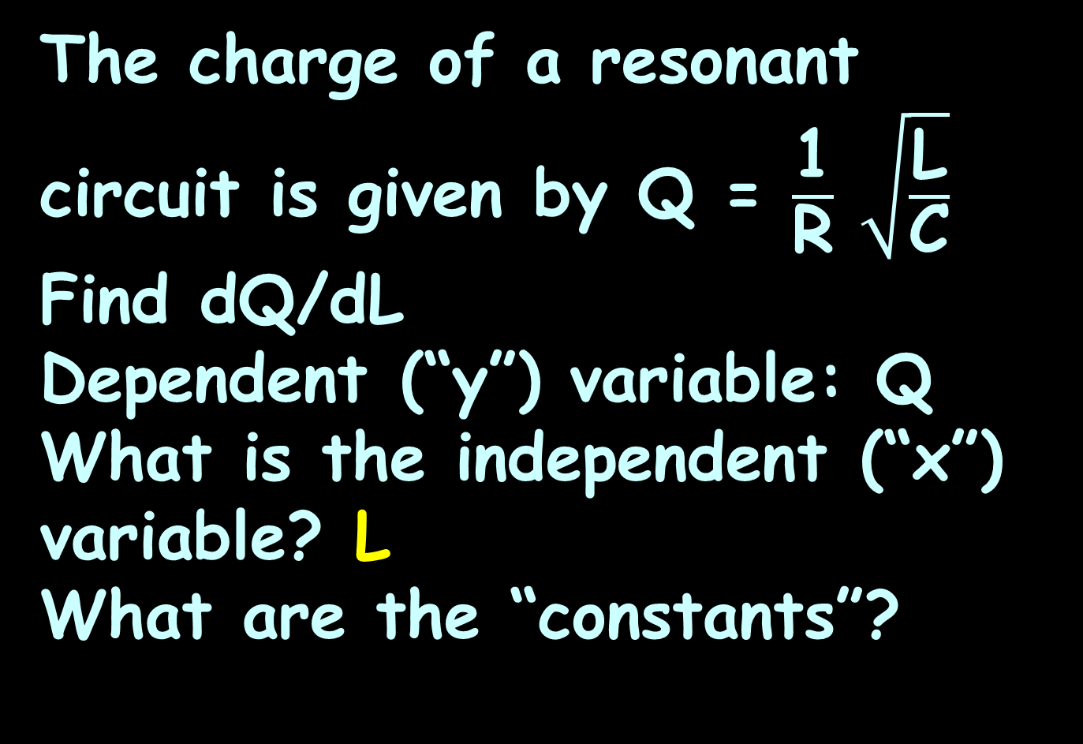
DERIVATIVES
IN-CLASS PROBLEMS 10
The charge of a resonant circuit is given by Q = $\frac{\text{1}}{\text{R}} \sqrt{\frac{\text{L}}{\text{C}}}$
Find dQ/dL
Dependent (“y”) variable: Q
What is the independent (“x”) variable? L
What are the “constants”?

Slide 131
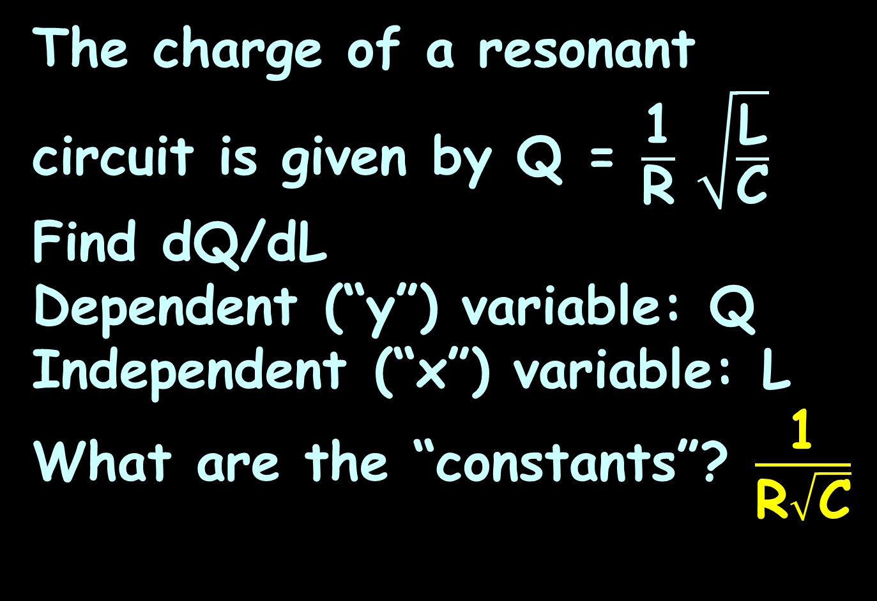
DERIVATIVES
IN-CLASS PROBLEMS 10
The charge of a resonant circuit is given by Q = $\frac{\text{1}}{\text{R}} \sqrt{\frac{\text{L}}{\text{C}}}$
Find dQ/dL
Dependent (“y”) variable: Q
Independent (“x”) variable: L
What are the “constants”? $\frac{\text{1}}{\text{R}\sqrt{\text{C}}}$

Slide 132
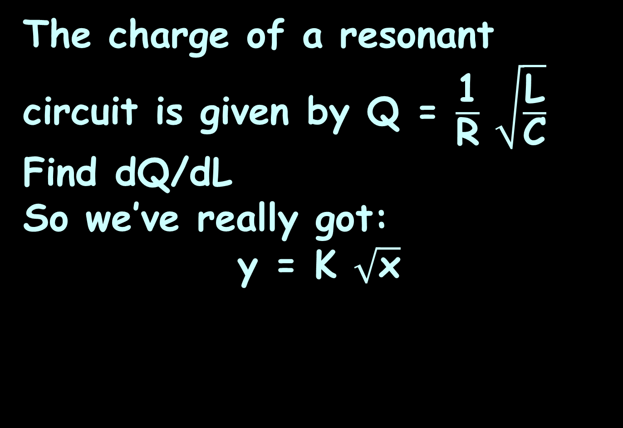


DERIVATIVES
IN-CLASS PROBLEMS 10
The charge of a resonant circuit is given by Q = $\frac{\text{1}}{\text{R}} \sqrt{\frac{\text{L}}{\text{C}}}$
Find dQ/dL
So we’ve really got:
y = K $\sqrt{\text{x}}$
Q
$$\sqrt{\text{L}}$$
$$\frac{\text{1}}{\text{R}\sqrt{\text{C}}}$$

Slide 133
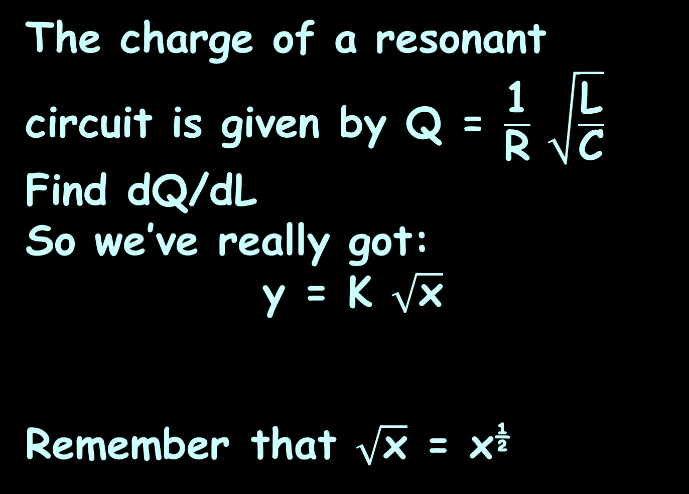
DERIVATIVES
IN-CLASS PROBLEMS 10
The charge of a resonant circuit is given by Q = $\frac{\text{1}}{\text{R}} \sqrt{\frac{\text{L}}{\text{C}}}$
Find dQ/dL
So we’ve really got:
y = K $\sqrt{\text{x}}$
Remember that $\sqrt{\text{x}}$ = x^{½}
Q
$$\sqrt{\text{L}}$$
$$\frac{\text{1}}{\text{R}\sqrt{\text{C}}}$$

Slide 134
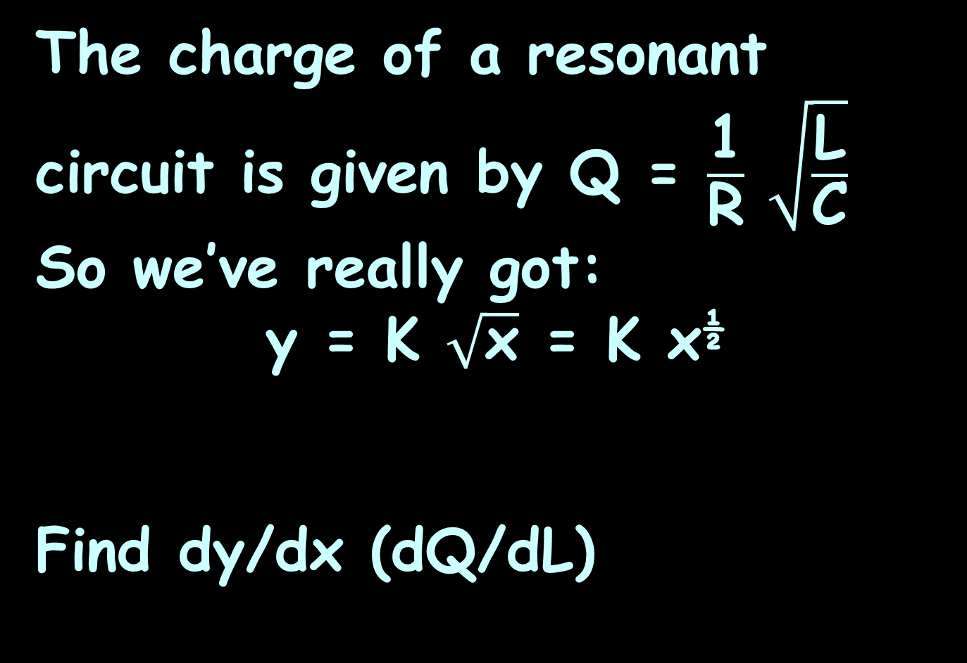


DERIVATIVES
IN-CLASS PROBLEMS 10
The charge of a resonant circuit is given by Q = $\frac{\text{1}}{\text{R}} \sqrt{\frac{\text{L}}{\text{C}}}$
So we’ve really got:
y = K $\sqrt{\text{x}}$ = K x^{½}
Find dy/dx (dQ/dL)
Q
$$\sqrt{\text{L}}$$
$$\frac{\text{1}}{\text{R}\sqrt{\text{C}}}$$

Slide 135
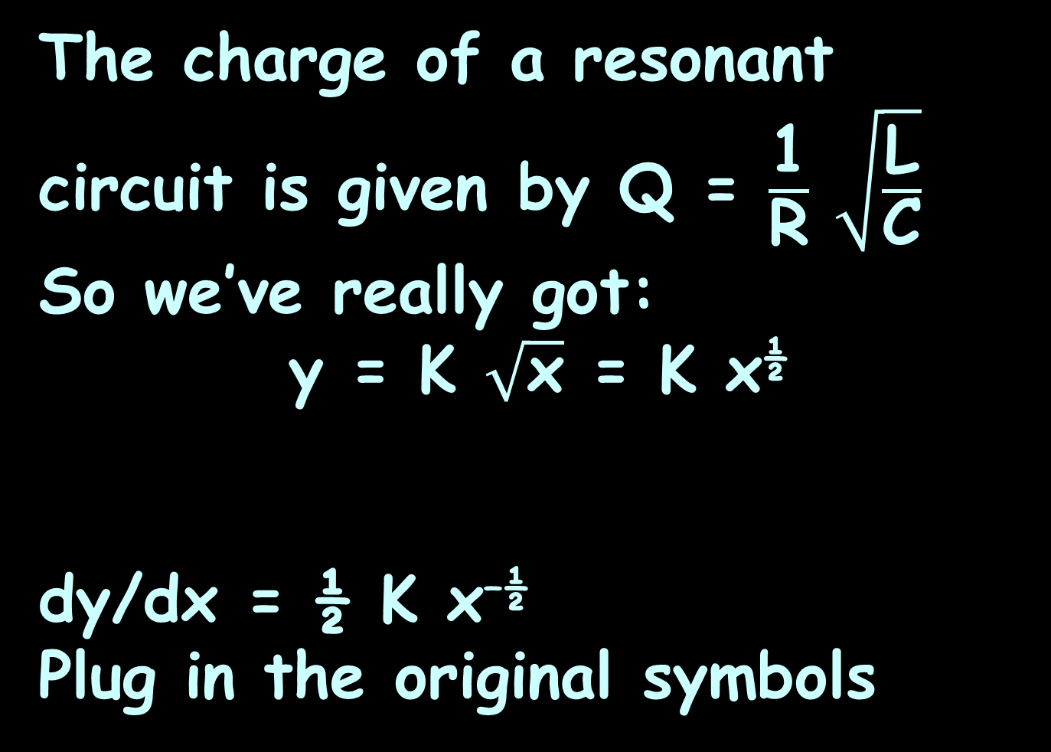
DERIVATIVES
IN-CLASS PROBLEMS 10
The charge of a resonant circuit is given by Q = $\frac{\text{1}}{\text{R}} \sqrt{\frac{\text{L}}{\text{C}}}$
So we’ve really got:
y = K $\sqrt{\text{x}}$ = K x^{½}
dy/dx = ½ K x^{–½}
Plug in the original symbols
Q
L
$$\frac{\text{1}}{\text{R}\sqrt{\text{C}}}$$

Slide 136

DERIVATIVES
IN-CLASS PROBLEMS 10
The charge of a resonant circuit is given by Q = $\frac{\text{1}}{\text{R}} \sqrt{\frac{\text{L}}{\text{C}}}$
So we’ve really got:
y = K $\sqrt{\text{x}}$ = k x^{½}
dy/dx = ½ K x^{–½}
Plug in the original symbols
Q
L
$$\frac{\text{1}}{\text{R}\sqrt{\text{C}}}$$

Slide 137
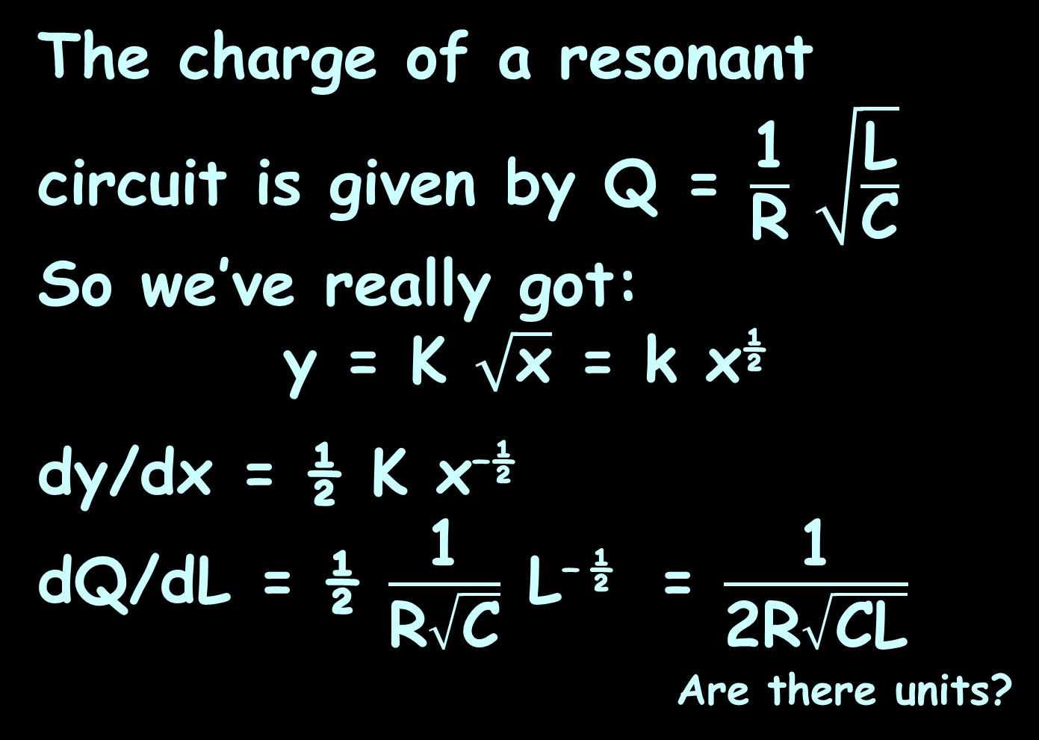
DERIVATIVES
IN-CLASS PROBLEMS 10
The charge of a resonant circuit is given by Q = $\frac{\text{1}}{\text{R}} \sqrt{\frac{\text{L}}{\text{C}}}$
So we’ve really got:
y = K $\sqrt{\text{x}}$ = k x^{½}
dy/dx = ½ K x^{–½}
dQ/dL = ½ $\frac{\text{1}}{\text{R}\sqrt{\text{C}}}$ L^{– ½} = $\frac{\text{1}}{\text{2}\text{R}\sqrt{\text{C}\text{L}}}$
_{Are there units?}
or

Slide 138
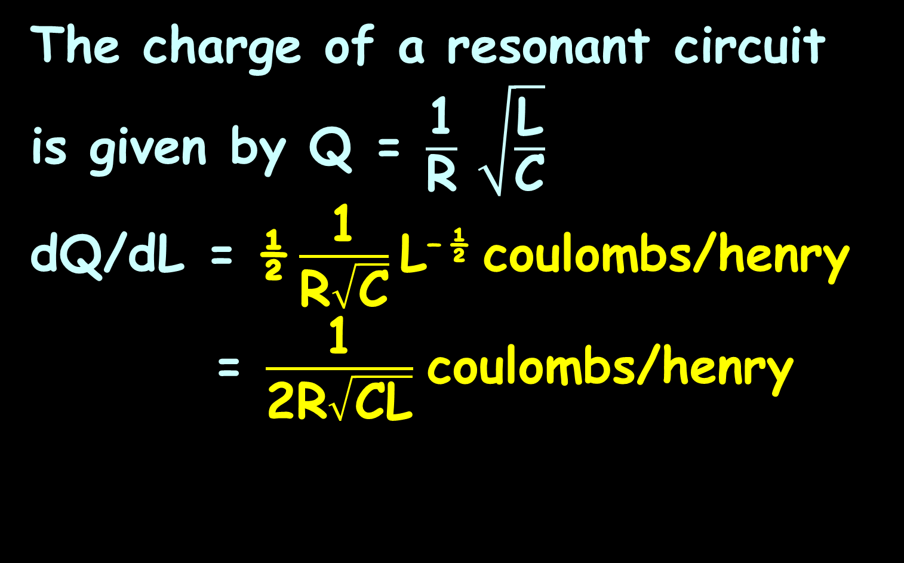
DERIVATIVES
IN-CLASS PROBLEMS 10
The charge of a resonant circuit is given by Q = $\frac{\text{1}}{\text{R}} \sqrt{\frac{\text{L}}{\text{C}}}$
dQ/dL = ½ $\frac{\text{1}}{\text{R}\sqrt{\text{C}}}$ L^{– ½} coulombs/henry
= $\frac{\text{1}}{\text{2}\text{R}\sqrt{\text{C}\text{L}}}$ coulombs/henry
or

Slide 139
Questions?
http://i.imgur.com/aliTlT3.jpg

Slide 140
Summary
Today we covered:
Review of graphical rates of
change and applications,
derivatives and differentiation
differentiation of
transcendentals

Slide 141

You Survived!
www.playbuzz.com

