Slide 1
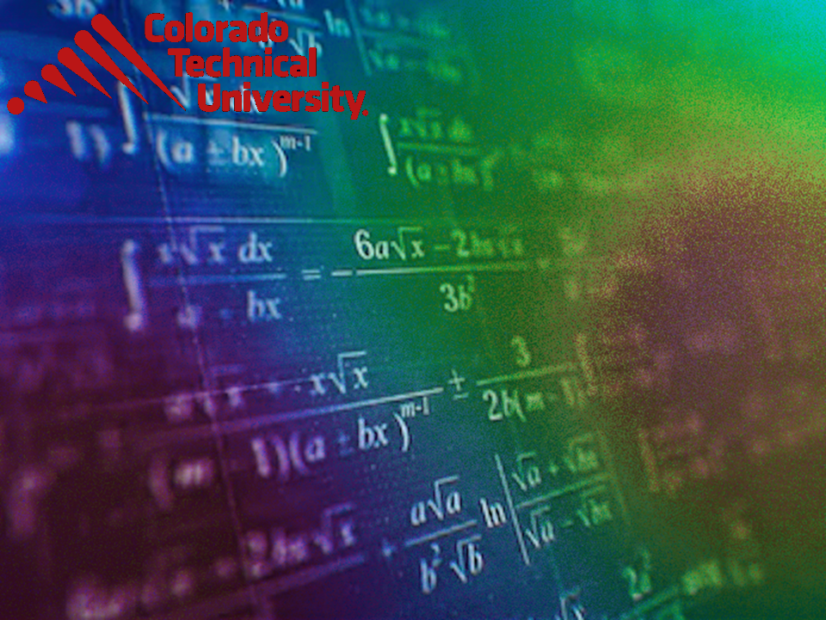
Welcome to
Unit 3 Part 6!
MATH 205 Differential Calculus
https://www.smu.edu.sg/programmes/core-curriculum/course-structure/calculus

Slide 2
What’s Up?
Review: Infinite limits
Graphical Rates of Change
Applications for Rates of
Change
New stuff:
Applications for Rates of
Change (continued)
Differentiation!

Slide 3
What’s Up?
Outcome 1) Demonstrate differentiation skills for linear and polynomial functions
Outcome 2) Use algebra and limits to examine the properties and graphs of functions
Outcome 7) Solve problems by identifying the requirements, making a sketch as appropriate, and using calculus techniques to model the problem, calculating the final answer and verifying the solution

Slide 4

Review
http://995642590.r.lightningbase-cdn.com/wp-content/uploads/2010/12/looking-back-hrexaminer-v144-cover425px.jpg

Slide 5
Review Stuff
What about the limit as x approaches infinity?

Slide 6
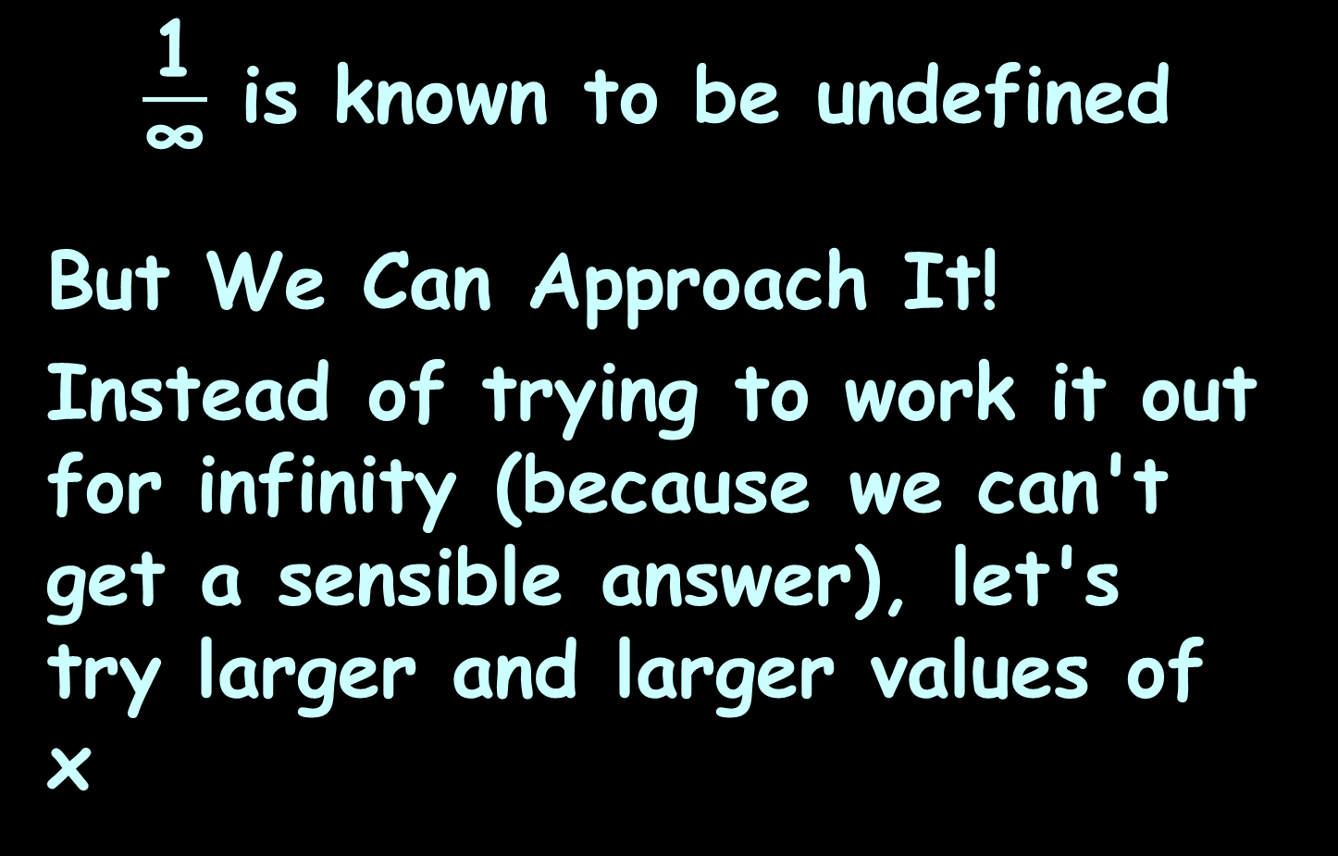
Infinite Limits
$\frac{\text{1}}{\text{∞}}$ is known to be undefined
But We Can Approach It!
Instead of trying to work it out for infinity (because we can't get a sensible answer), let's try larger and larger values of x

Slide 7
Infinite Limits
In other words:
As x approaches infinity, then 1/x approaches 0
When you see "limit", think "approaching"

Slide 8
Infinite Limits
lim formula = value
indep var → ∞

Slide 9
Infinite Limits
But don't be fooled by the "=“
We cannot actually get to infinity, but in "limits" language the limit is infinity
(which is really saying the function is limitless)

Slide 10
Infinite Limits
What would be?
x² grows more rapidly than x,
so 2x² − 5x will head towards +infinity
lim
x→∞
2x²-5x

Slide 11
Infinite Limits
When we look at the degree of a term in a function we can tell the limit for that term:
When the degree is:
greater than 0, the limit is
infinity (or −infinity)

Slide 12
Infinite Limits
When we look at the degree of a term in a function we can tell the limit for that term:
When the degree is:
greater than 0, the limit is
infinity (or −infinity)
less than 0, the limit is 0

Slide 13
Infinite Limits
Use the limit for the largest degree of a term in a function

Slide 14

Limits of Ratios
When we do infinite limits, we are using a type of mathematics called “Cantor Arithmetic”
Some infinities are
bigger than others!
http://themacadvocate.com/Home/wp-content/uploads/2009/07/skeptical.jpg

Slide 15
Limits of Ratios
A rational function is the ratio of two polynomials:
ƒ(x) = P(x)/Q(x)

Slide 16
Limits of Ratios
For example, suppose
P(x) = x³ + 2x − 1,
and Q(x) = 6x²:
ƒ(x) = (x³+2x-1)/6x²

Slide 17
Limits of Ratios
ƒ(x) = (x³+2x-1)/6x²
Following on from our idea of the degree of the equation, the first step to find the limit is to
Compare the degree of the top
to the degree of the bottom

Slide 18
Limits of Ratios
If the degree of the top is greater than the degree of the bottom …

Slide 19
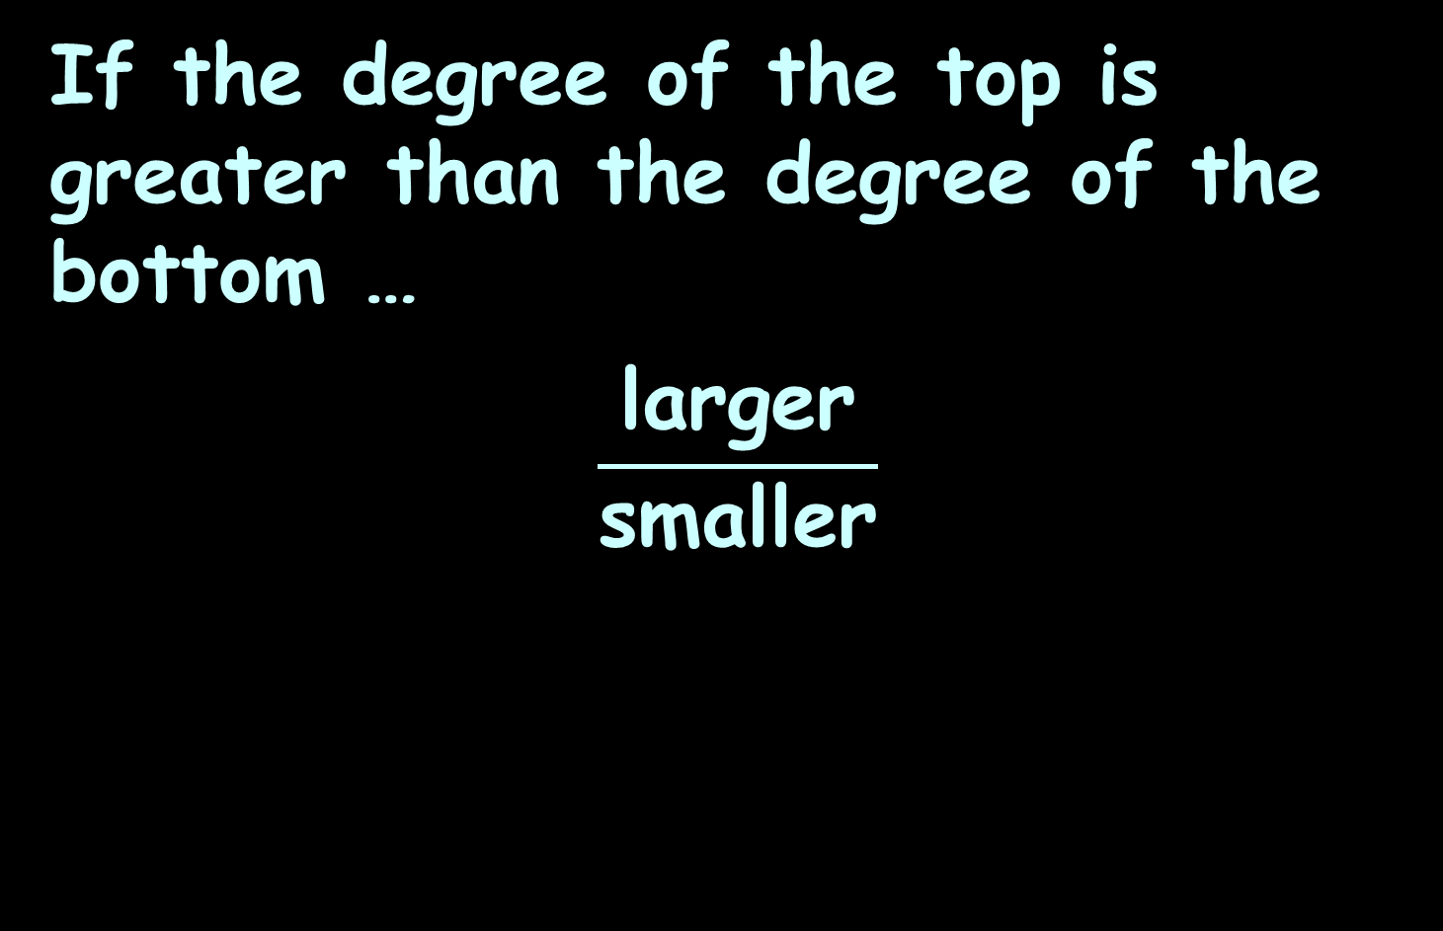
Limits of Ratios
If the degree of the top is greater than the degree of the bottom …
$$\frac{\text{larger}}{\text{small}\text{er}}$$

Slide 20

Limits of Ratios
If the degree of the top is greater than the degree of the bottom …
the limit is positive infinity…
…or maybe negative infinity
We need to look at the signs of the coefficients!
$$\frac{\text{larger}}{\text{small}\text{er}}$$

Slide 21
Limits of Ratios
We figure out the sign (positive or negative) by looking at the sign of the coefficient ratio of the top vs the bottom

Slide 22
Limits of Ratios
(x³+2x-1)/6x²
Sign: +1/+6 so the sign is positive
(-4x³+2x-1)/6x²
Sign: -4/+6 so the sign is negative
(-4x³+2x-1)/(-6x²)
Sign: -4/-6 so the sign is positive

Slide 23
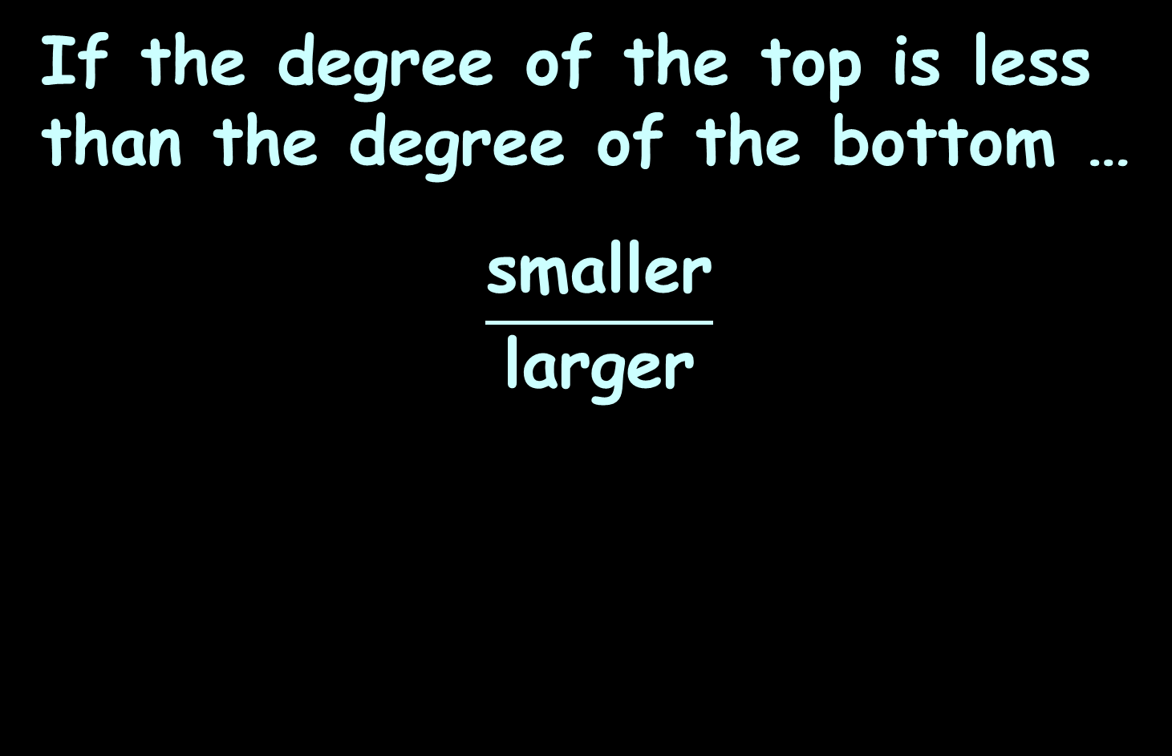
Limits of Ratios
If the degree of the top is less than the degree of the bottom …
$$\frac{\text{s}\text{maller}}{\text{l}\text{arg}\text{er}}$$

Slide 24
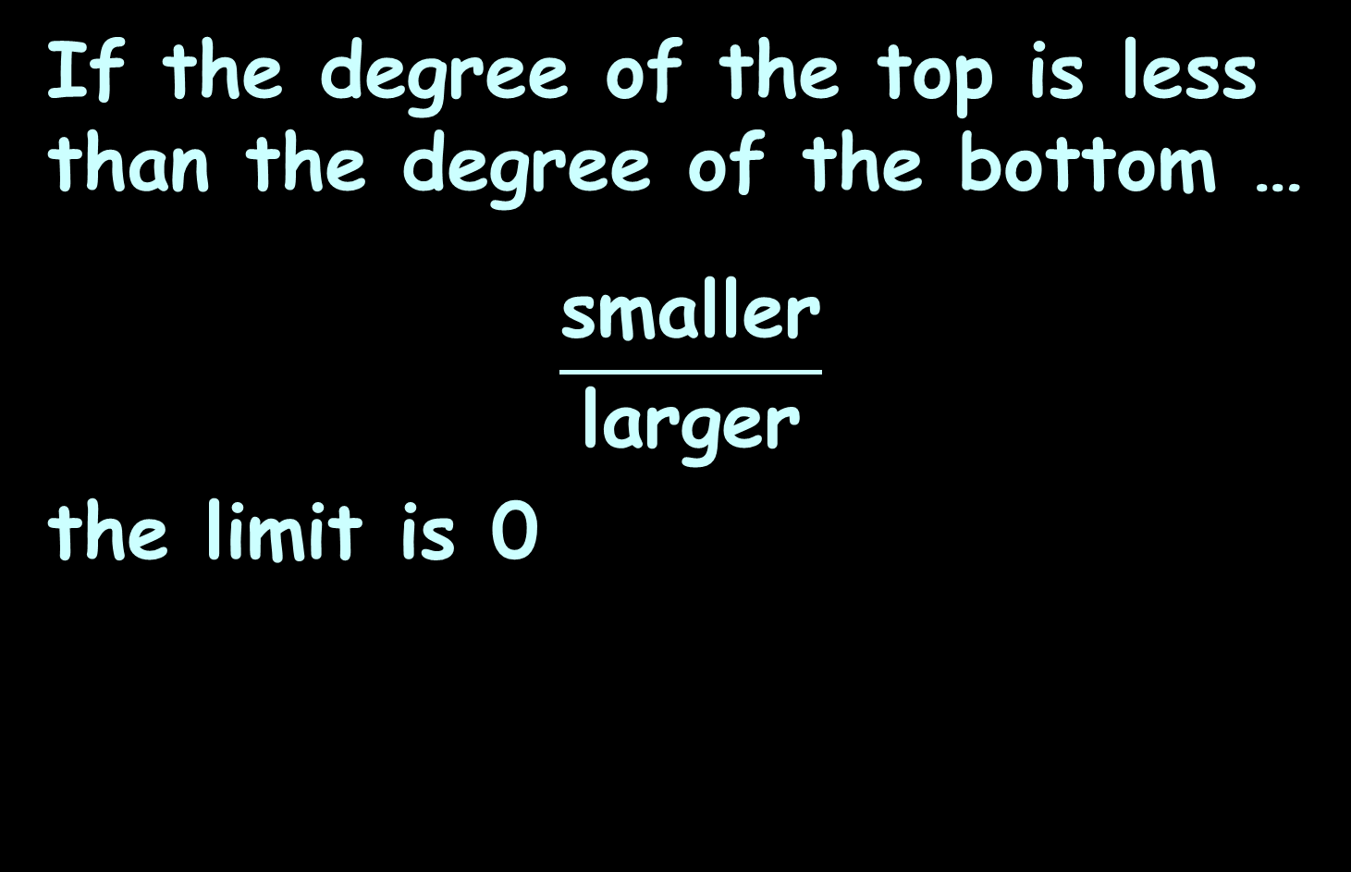
Limits of Ratios
If the degree of the top is less than the degree of the bottom …
$$\frac{\text{s}\text{maller}}{\text{l}\text{arg}\text{er}}$$
the limit is 0

Slide 25
Limits of Ratios
If the degree of the top is the same as the degree of the bottom …

Slide 26
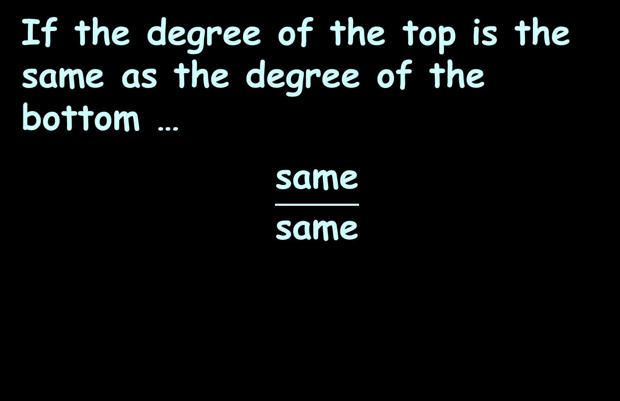
Limits of Ratios
If the degree of the top is the same as the degree of the bottom …
$$\frac{\text{same}}{\text{sam}\text{e}}$$

Slide 27
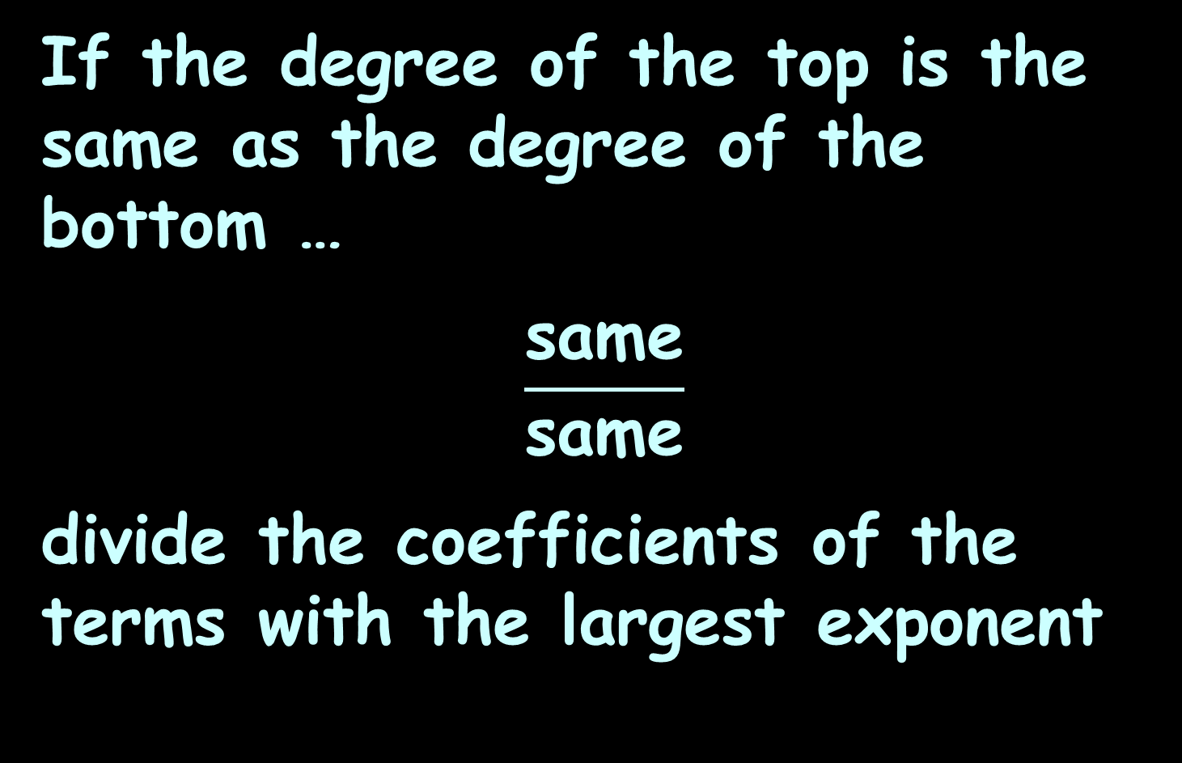
Limits of Ratios
If the degree of the top is the same as the degree of the bottom …
$$\frac{\text{same}}{\text{sam}\text{e}}$$
divide the coefficients of the terms with the largest exponent

Slide 28
Limits of Ratios
(x³+2x-1)/6x³
The limit is: +1/+6
(-4x³+2x-1)/6x³
The limit is: -4/+6
(-4x³+2x-1)/(-6x³)
The limit is: -4/-6 or 4/6

Slide 29
Graphical Increments
Suppose we have an equation:
y = 3x
L. Oliver, 2009

Slide 30
Graphical Increments
y = 3x
For a particular value of x (x₁) you can calculate a y value (y₁):
y₁ = 3x₁
L. Oliver, 2009

Slide 31
Graphical Increments
y₁ = 3x₁
For the value x₁ you can have a second x value an increment away in
distance:
x₁ + Δx
L. Oliver, 2009

Slide 32
Graphical Increments
y₁ = 3x₁
You can now calculate a y for that new x value:
3(x₁ + Δx)
L. Oliver, 2009

Slide 33
Graphical Increments
y₁ = 3x₁
Using 3(x₁ + Δx) the new y value will be some increment away from
y₁:
y₁ + Δy
L. Oliver, 2009

Slide 34
Graphical Increments
So, the new y will be:
y₁ + Δy = 3(x₁ + Δx)
Algebraically, this is the same as:
Δy = 3(x₁ + Δx) – y₁
which allows us to calculate the y increment

Slide 35
Graphical Increments
y₁ + Δy = 3(x₁ + Δx)
Algebraically, we can solve for the increment in y:
Δy = 3(x₁ + Δx) – y₁
Δy = 3x₁ + 3Δx – y₁

Slide 36
Graphical Increments
Δy = 3x₁ + 3Δx – y₁
But remember y₁= 3x₁:
Δy = 3x₁ + 3Δx – 3x₁
So:
Δy = 3Δx

Slide 37
Graphical Increments
Δy = 3Δx
Means no matter what x is, the increment in y will always be 3 times the increment in x

Slide 38
Graphical Rates of Change
What is the slope (rise/run) of the curve between x=6 and x=10?
15
10
5
0
0 1 2 3 4 5 6 7 8 9 10
https://ximera.osu.edu/mooculus/calculus1/derivativeAsAFunction/digInTheDerivativeAsAFunction

Slide 39
Graphical Rates of Change
If you have a well-drawn graph, this is easy!
15
10
5
0
0 1 2 3 4 5 6 7 8 9 10
https://ximera.osu.edu/mooculus/calculus1/derivativeAsAFunction/digInTheDerivativeAsAFunction

Slide 40
Graphical Rates of Change
Note: two very different functions can have the same average rate of change
http://www.mesacc.edu/~marfv02121/readings/average/index.html

Slide 41
Applications
MOST rates of change are “versus time”
That is because (remember) we want to do forecasts

Slide 42

Questions?
http://i.imgur.com/aliTlT3.jpg

Slide 43
Applications
Another engineering formula is:
V_{avg} = L Δi /Δt
L is the coil’s inductance (in henrys)
i is the current (in amps)

Slide 44
APPLICATIONS OF RATES OF CHANGE
IN-CLASS PROBLEM 1
A technician noticed that when the current in a coil is increased at a steady 4 amps per second a steady 1.2v DC was observed across the coil. What was its inductance?
V_{avg} = L Δi /Δt

Slide 45
APPLICATIONS OF RATES OF CHANGE
IN-CLASS PROBLEM 1
A technician noticed that when the current in a coil is increased at a steady 4 amps per second a steady 1.2v DC was observed across the coil. What was its inductance?
Which variable are you trying to solve for?
V_{avg} = L Δi /Δt

Slide 46
APPLICATIONS OF RATES OF CHANGE
IN-CLASS PROBLEM 1
A technician noticed that when the current in a coil is increased at a steady 4 amps per second a steady 1.2v DC was observed across the coil. What was its inductance?
Which variable are you trying to solve for?
You are trying to solve for L
What is the formula for L?
V_{avg} = L Δi /Δt

Slide 47
APPLICATIONS OF RATES OF CHANGE
IN-CLASS PROBLEM 1
A technician noticed that when the current in a coil is increased at a steady 4 amps per second a steady 1.2v DC was observed across the coil. What was its inductance?
What is the formula for L?
L = Δt V_{avg} / (Δi) or
L = V_{avg} / (Δi /Δt)
What is V_{avg}?
V_{avg} = L Δi /Δt

Slide 48
APPLICATIONS OF RATES OF CHANGE
IN-CLASS PROBLEM 1
A technician noticed that when the current in a coil is increased at a steady 4 amps per second a steady 1.2v DC was observed across the coil. What was its inductance?
L = V_{avg} / (Δi /Δt)
What is V_{avg}? 1.2v
What is Δi /Δt ?

Slide 49
APPLICATIONS OF RATES OF CHANGE
IN-CLASS PROBLEM 1
A technician noticed that when the current in a coil is increased at a steady 4 amps per second a steady 1.2v DC was observed across the coil. What was its inductance?
L = V_{avg} / (Δi /Δt)
What is V_{avg}? 1.2v
What is Δi /Δt ? 4 amps per second
(now it’s easy…)

Slide 50
APPLICATIONS OF RATES OF CHANGE
IN-CLASS PROBLEM 1
A technician noticed that when the current in a coil is increased at a steady 4 amps per second a steady 1.2v DC was observed across the coil. What was its inductance?
L = V_{avg} / (Δi /Δt)
= 1.2/4
= 0.3 …

Slide 51
APPLICATIONS OF RATES OF CHANGE
IN-CLASS PROBLEM 1
A technician noticed that when the current in a coil is increased at a steady 4 amps per second a steady 1.2v DC was observed across the coil. What was its inductance?
L = V_{avg} / (Δi /Δt)
= 1.2/4
= 0.3 H or 300 mH

Slide 52
Applications
Notice how MOST of these ratios are “versus time”

Slide 53
Applications
Notice how MOST of these ratios are “versus time”
That is because (remember) we want to do forecasts

Slide 54
Questions?
http://i.imgur.com/aliTlT3.jpg

Slide 55
Remember Trig?
A tangent (tan) is the sin/cos
A sin in a unit circle is the rise
A cos in a unit circle is the run
So a tangent is a slope: rise/run

Slide 56
Remember Trig?
AND a “tangent” is actually the line tangent to the unit circle at the point where
the right
triangle
intersects
the circle
tan
sin
.
θ
…and that’s why it’s called the “tangent”
cos
VFrench, 2015

Slide 57
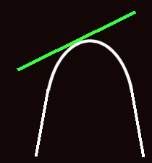
Remember Trig?
In fact, a “tangent” is the line tangent to any curve at a given point
VFrench, 2015

Slide 58
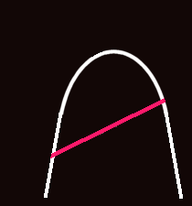
Remember Trig?
The line joining any two points on a curve is the “secant”
VFrench, 2015

Slide 59
Remember Trig?
The slope of the secant line is:
m_{sec} = ∆y / ∆x
VFrench, 2015

Slide 60
Limits in Trig
As you move the secant line in a parallel fashion toward the curve…
VFrench, 2020

Slide 61
Limits in Trig
As you move the secant line in a parallel fashion toward the curve…
VFrench, 2020

Slide 62
Limits in Trig
As you move the secant line in a parallel fashion toward the curve…
VFrench, 2020

Slide 63
Limits in Trig
It becomes the tangent when it hits the edge of the curve
VFrench, 2020

Slide 64
Another Way to Look at It
Pick any secant
Move the secant closer and
closer to one of its endpoints
When it touches an endpoint, it
becomes the tangent
secant
secant
secant
tangent
VFrench, 2020

Slide 65
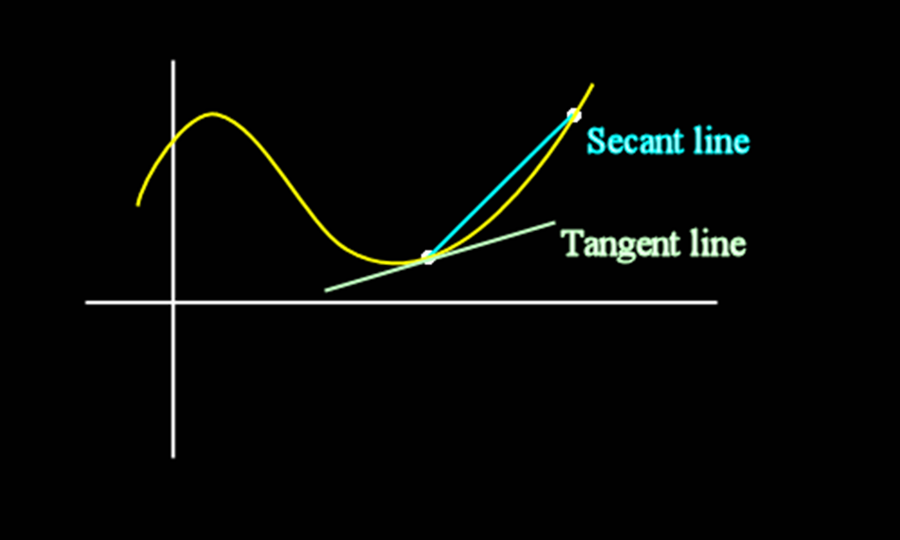
Secant vs Tangent
VFrench, 2015

Slide 66
Limits in Trig
This concept of getting closer and closer to a value or a location on a graph is called a
taking a “limit”

Slide 67
Questions?
http://i.imgur.com/aliTlT3.jpg

Slide 68
Derivatives
An average rate of change can be written:
Δy/Δx
Where:
Δx = x_{final} - x_{initial} = x₁ - x₀
Δy = y_{final} - y_{initial} = y₁ - y₀

Slide 69
Derivatives
An exact rate of change can be written:
lim Δy/Δx
Δx → 0

Slide 70
Derivatives
This is usually written:
dy/dx
and is called the derivative

Slide 71

Derivatives
The formal definition of a derivative is:
ƒ ′(x) = lim(h→0) $\frac{\text{ƒ}\text{(}\text{x}\text{+}\text{h}\text{)−}\text{ƒ}\text{(}\text{x}\text{)}}{\text{h}}$

Slide 72
Derivatives
The process of finding the
lim Δy/Δx
Δx → 0
or dy/dx
is called differentiation

Slide 73
Derivatives
When differentiating a function, it is usually written:
put the function here
d/dx
Example: for y = 3x² - 4x + 5
write: d/dx (3x² - 4x + 5)

Slide 74
Derivatives/Differentiation
Remember how I said calculus wasn’t REAL…

Slide 75
Derivatives/Differentiation
Remember how I said calculus wasn’t REAL…
That’s because the slope of a “line” with 0 length is nonsense

Slide 76
Derivatives/Differentiation
Remember how I said calculus wasn’t REAL…
That’s because the slope of a “line” with 0 length is nonsense
But we know what value the slope is approaching

Slide 77
Derivatives/Differentiation
Remember how I said calculus wasn’t REAL…
That’s because the slope of a “line” with 0 length is nonsense
But we know what value the slope is approaching
And it’s a way to do hard calculations more easily…

Slide 78
Questions?
http://i.imgur.com/aliTlT3.jpg

Slide 79

Derivatives/Differentiation
In order to do the calculations, you need to know some RULES
https://henrytrocino.files.wordpress.com/2013/08/weeping-and-gnashing-of-teeth-300x236.jpg

Slide 80
Derivatives/Differentiation
Rule #1: derivative of a constant:
d/dx c = 0

Slide 81
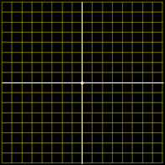
Derivatives/Differentiation
Remember it’s a slope at a given value of x
4
3
2
1
-4
-3
0
-2
-1
0
1
2
3
4
-1
-2
-3
-4
VFrench, 2015

Slide 82
Derivatives/Differentiation
What’s the slope (rise over run) at any x?
4
3
2
1
-4
-3
0
-2
-1
0
1
2
3
4
-1
-2
-3
-4
VFrench, 2015

Slide 83
Derivatives/Differentiation
What’s the slope (rise over run) at any x? 0
4
3
2
1
-4
-3
0
-2
-1
0
1
2
3
4
-1
-2
-3
-4
VFrench, 2015

Slide 84
DERIVATIVES
IN-CLASS PROBLEMS 2,3
Find the derivative dy/dx of:
y = 5
y = -752.36
y = -763.87π
d/dx c = 0

Slide 85
DERIVATIVES
IN-CLASS PROBLEMS 2,3
Find the derivative dy/dx of:
y = 5 d/dx 5 = 0
y = -752.36 d/dx -752.36 = 0
y = -763.87π

Slide 86
DERIVATIVES
IN-CLASS PROBLEMS 2,3
Find the derivative dy/dx of:
y = 5
dy/dx (5) = 0
y = -763.87π
dy/dx (-763.87π) = 0

Slide 87
Questions?
http://i.imgur.com/aliTlT3.jpg

Slide 88
Derivatives/Differentiation
What’s the slope at any x?
4
3
2
1
-4
-3
0
-2
-1
0
1
2
3
4
-1
-2
-3
-4
VFrench, 2015

Slide 89
Derivatives/Differentiation
What’s the slope at any x?
Well, it
changes
with every x
4
3
2
1
-4
-3
0
-2
-1
0
1
2
3
4
-1
-2
-3
-4
VFrench, 2015

Slide 90
Derivatives/Differentiation
What’s the slope at any x?
Well, it
changes
with every x
So the slope
will be a
function of x
4
3
2
1
-4
-3
0
-2
-1
0
1
2
3
4
-1
-2
-3
-4
VFrench, 2015

Slide 91
Derivatives/Differentiation
Rule #2: derivative of a power function:
d/dx cx^{n} = cn × x ^{n-1}

Slide 92
DERIVATIVES
IN-CLASS PROBLEMS 4,5,6
Find the derivative dy/dx of:
y = x²
y = 7x⁵
y = -83.2x^{7.8}
d/dx cx^{n} = cn × x ^{n-1}

Slide 93
DERIVATIVES
IN-CLASS PROBLEMS 4,5,6
Find the derivative dy/dx of:
y = x²
dy/dx (1x²) = 1*2x¹ = 2x
y = 7x⁵
y = -83.2x^{7.8}
d/dx cx^{n} = cn × x ^{n-1}

Slide 94
DERIVATIVES
IN-CLASS PROBLEMS 4,5,6
Find the derivative dy/dx of:
y = x²
dy/dx x² = 2x
y = 7x⁵
dy/dx 7x⁵ = 35x⁴
y = -83.2x^{7.8}
d/dx cx^{n} = cn × x ^{n-1}

Slide 95
DERIVATIVES
IN-CLASS PROBLEMS 4,5,6
Find the derivative dy/dx of:
y = x²
dy/dx x² = 2x
y = 7x⁵
dy/dx 7x⁵ = 35x⁴
y = -83.2x^{7.8}
dy/dx -83.2x^{7.8} = -648.96x^{6.8}
d/dx cx^{n} = cn × x ^{n-1}

Slide 96
Questions?
http://i.imgur.com/aliTlT3.jpg

Slide 97
Derivatives/Differentiation
Rule #3:
derivative of a sum u + v:
du/dx + dv/dx

Slide 98
Derivatives/Differentiation
Suppose we had:
derivative of a sum u + v:
7x² -3.2
du/dx + dv/dx

Slide 99
Derivatives/Differentiation
Suppose we had:
derivative of a sum u + v:
7x² -3.2
du/dx + dv/dx
14x + 0
or 14x

Slide 100
DERIVATIVES
IN-CLASS PROBLEMS 7,8,9
Find the derivative dy/dx of:
y = x³ + 10
y = 6x⁴ - 97
y = -12.2x^{2.1} + 75.2
d/dx cx^{n} = cn x ^{n-1}
du/dx + dv/dx

Slide 101
DERIVATIVES
IN-CLASS PROBLEMS 7,8,9
Find the derivative dy/dx of:
y = x³ + 10
d/dx x³ + d/dx 10 = 3x²
y = 6x⁴ - 97
y = -12.2x^{2.1} + 75.2
d/dx cx^{n} = cn x ^{n-1}
du/dx + dv/dx

Slide 102
DERIVATIVES
IN-CLASS PROBLEMS 7,8,9
Find the derivative dy/dx of:
y = x³ + 10 dy/dx = 3x²
y = 6x⁴ - 97
d/dx 6x⁴ - d/dx 97 = 24x³
y = -12.2x^{2.1} + 75.2
d/dx cx^{n} = cn x ^{n-1}
du/dx + dv/dx

Slide 103
DERIVATIVES
IN-CLASS PROBLEMS 7,8,9
Find the derivative dy/dx of:
y = x³ + 10 dy/dx = 3x²
y = 6x⁴ - 97 dy/dx = 24x³
y = -12.2x^{2.1} + 75.2
d/dx -12.2x^{2.1} + d/dx 75.2 =
= -25.62x^{1.1}
d/dx cx^{n} = cn x ^{n-1}
du/dx + dv/dx

Slide 104
DERIVATIVES
IN-CLASS PROBLEM 10
Find the derivative dy/dx of:
y = 3x² + 8x³ + 5x⁴ + 63
d/dx cx^{n} = cn x ^{n-1}
du/dx + dv/dx

Slide 105
DERIVATIVES
IN-CLASS PROBLEM 10
Find the derivative dy/dx of:
dy/dx = d/dx 3x² + d/dx 8x³ +
d/dx 5x⁴ + d/dx 63

Slide 106
DERIVATIVES
IN-CLASS PROBLEM 10
Find the derivative dy/dx of:
dy/dx = d/dx 3x² + d/dx 8x³ +
d/dx 5x⁴ + d/dx 63
= 6x¹ + _____

Slide 107
DERIVATIVES
IN-CLASS PROBLEM 10
Find the derivative dy/dx of:
dy/dx = d/dx 3x² + d/dx 8x³ +
d/dx 5x⁴ + d/dx 63
= 6x + 24x² + _____

Slide 108
DERIVATIVES
IN-CLASS PROBLEM 10
Find the derivative dy/dx of:
dy/dx = d/dx 3x² + d/dx 8x³ +
d/dx 5x⁴ + d/dx 63
= 6x + 24x² + 20x³ + ___

Slide 109
DERIVATIVES
IN-CLASS PROBLEM 10
Find the derivative dy/dx of:
dy/dx = d/dx 3x² + d/dx 8x³ +
d/dx 5x⁴ + d/dx 63
= 6x + 24x² + 20x³ + 0
or = 6x + 24x² + 20x³

Slide 110
Questions?
http://i.imgur.com/aliTlT3.jpg

Slide 111
Derivatives
Different symbols are used for derivatives:
y’ or ƒ ′(x) (Newton’s symbol)
dy/dx (Leibnitz’s symbol)
∆y/∆x

Slide 112
Derivatives
Order matters!
dy/dx ≠ dx/dy

Slide 113
Derivatives
This is why I actually prefer Leibnitz’s dy/dx over Newton’s ƒ ′(x)
There are times we want to find dx/dy not dy/dx, and Newton’s symbols don’t handle that possibility

Slide 114
Derivatives
dy/dx is the rate of change of y vs x
dx/dy is the rate of change of x vs y
Both are useful!

Slide 115
DERIVATIVES
IN-CLASS PROBLEM 11
Suppose we had: y = 3x + 40
Find the derivative dy/dx:
Find the derivative dx/dy:

Slide 116
DERIVATIVES
IN-CLASS PROBLEM 11
Suppose we had: y = 3x + 40
Find the derivative dy/dx:
dy/dx = 3
Find the derivative dx/dy:

Slide 117
DERIVATIVES
IN-CLASS PROBLEM 11
Suppose we had: y = 3x + 40
Find the derivative dy/dx:
dy/dx = 3
Find the derivative dx/dy:
Rewrite it as x = _______

Slide 118
DERIVATIVES
IN-CLASS PROBLEM 11
Suppose we had: y = 3x + 40
Find the derivative dy/dx:
dy/dx = 3
Find the derivative dx/dy:
Rewrite it as x = _______
y -40 = 3x + 40 -40
(y – 40)/3 = 3x/3

Slide 119
DERIVATIVES
IN-CLASS PROBLEM 11
Suppose we had: y = 3x + 40
Find the derivative dy/dx:
dy/dx = 3
Find the derivative dx/dy:
x = (y – 40)/3 = 1/3 y¹ – 40/3
now you can find dx/dy!

Slide 120
DERIVATIVES
IN-CLASS PROBLEM 11
Suppose we had: y = 3x + 40
Find the derivative dy/dx:
dy/dx = 3
Find the derivative dx/dy:
x = 1/3 y¹ – 40/3 x

Slide 121
DERIVATIVES
IN-CLASS PROBLEM 11
Suppose we had: y = 3x + 40
Find the derivative dy/dx:
dy/dx = 3
Find the derivative dx/dy:
x = 1/3 y¹ – 40/3
dx/dy = 1/3

Slide 122
DERIVATIVES
IN-CLASS PROBLEM 11
Suppose we had: y = 3x + 40
Find the derivative dy/dx:
dy/dx = 3
Find the derivative dx/dy:
x = (y – 40)/3
x = y/3 – 40/3
dx/dy = 1/3
So dy/dx ≠ dx/dy

Slide 123
DERIVATIVES
IN-CLASS PROBLEM 11
Notice:
dy/dx is the inverse
of dx/dy
AND 3 is the inverse of 1/3
The “/” in dy/dx is a true division!

Slide 124
DERIVATIVES
IN-CLASS PROBLEM 11
Notice:
dy/dx is the inverse
of dx/dy
AND 3 is the inverse of 1/3
The “/” in dy/dx is a true division!
BUT dy is not d × y (it is an operator: ∆)

Slide 125
Questions?
http://i.imgur.com/aliTlT3.jpg

Slide 126
Derivatives
Not every function has a derivative at every point

Slide 127
DERIVATIVES
IN-CLASS PROBLEM 12
Find the derivative dy/dx for |x|
at x=0:
VFrench, 2021

Slide 128
DERIVATIVES
IN-CLASS PROBLEM 12
Find the derivative dy/dx for |x|
at x=0:
Well, there is no UNIQUE tangent line at that point…
VFrench, 2021

Slide 129
DERIVATIVES
IN-CLASS PROBLEM 12
Find the derivative dy/dx for |x|
at x=0:
Well, there is no UNIQUE tangent line at that point…
So there is no
derivative at x=0
VFrench, 2021

Slide 130
Derivatives
In addition, if the limit doesn’t exist (like at a cliff),
then the derivative doesn’t exist either

Slide 131
Derivatives
There’s no unique tangent line
so there’s no derivative
https://www.mathsisfun.com/calculus/limits.html

Slide 132
Derivatives
There’s no unique tangent line
so there’s no derivative
https://www.mathsisfun.com/calculus/limits.html

Slide 133
Derivatives
This doesn’t say anything about whether or not the derivative exists anywhere else
In fact, the derivative of the absolute value function exists at every point except the one we just looked at, x=0

Slide 134
Derivatives
…and there is a derivative for
every point except x=5.5
https://www.mathsisfun.com/calculus/limits.html

Slide 135
Derivatives
A function ƒ (x) is called differentiable at x = a if
ƒ ′(a) exists

Slide 136
Derivatives
ƒ (x) is called differentiable on an interval if the derivative exists for each point in that interval

Slide 137
Derivatives
Differentiable on the intervals:
0<x<5.5 and 5.5<x<10.1
(not 0≤x≤5.5 and 5.5≤x≤10.1)
https://www.mathsisfun.com/calculus/limits.html

Slide 138
Derivatives
In fact,
if ƒ (x) is differentiable
at x = a
then ƒ (x) is continuous
at x = a
https://tutorial.math.lamar.edu/Classes/CalcI/DefnOfDerivative.aspx

Slide 139
Derivatives
If ƒ (x) is not
continuous at x=a
then the derivative
does not exist
either!
https://www.mathsisfun.com/calculus/limits.html

Slide 140
Derivatives
If ƒ (x) is not
continuous at x=a
then the derivative
does not exist
either!
https://www.mathsisfun.com/calculus/limits.html

Slide 141
Derivatives
ƒ (x) is called globally differentiable if the derivative exists for every point on the number line

Slide 142
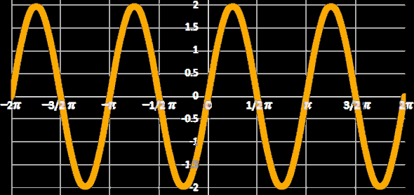
Derivatives
Does a tangent line exist for every point on a sine?
VFrench, 2015

Slide 143
Derivatives
Does a tangent line exist for every point on a sine? yes! So it is globally differentiable!
VFrench, 2015

Slide 144
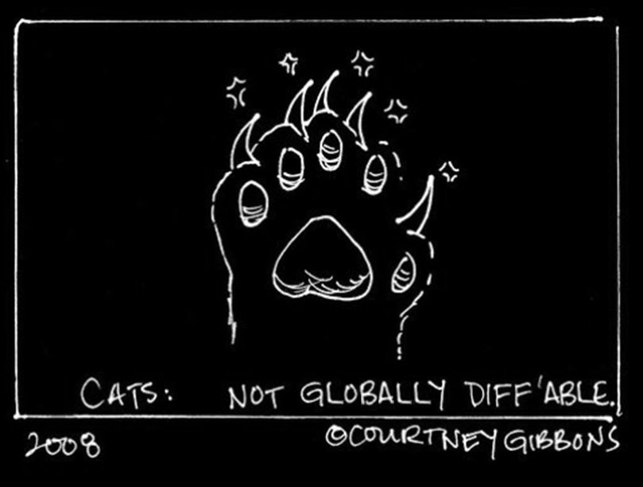
Derivatives

Slide 145
Questions?
http://i.imgur.com/aliTlT3.jpg

Slide 146
Summary
Today we covered:
Review of infinite limits,
graphical rates of change,
applications of rates of
change
more applications for rates
of change (continued)
Differentiation!

Slide 147

You Survived!
www.playbuzz.com

