Slide 1
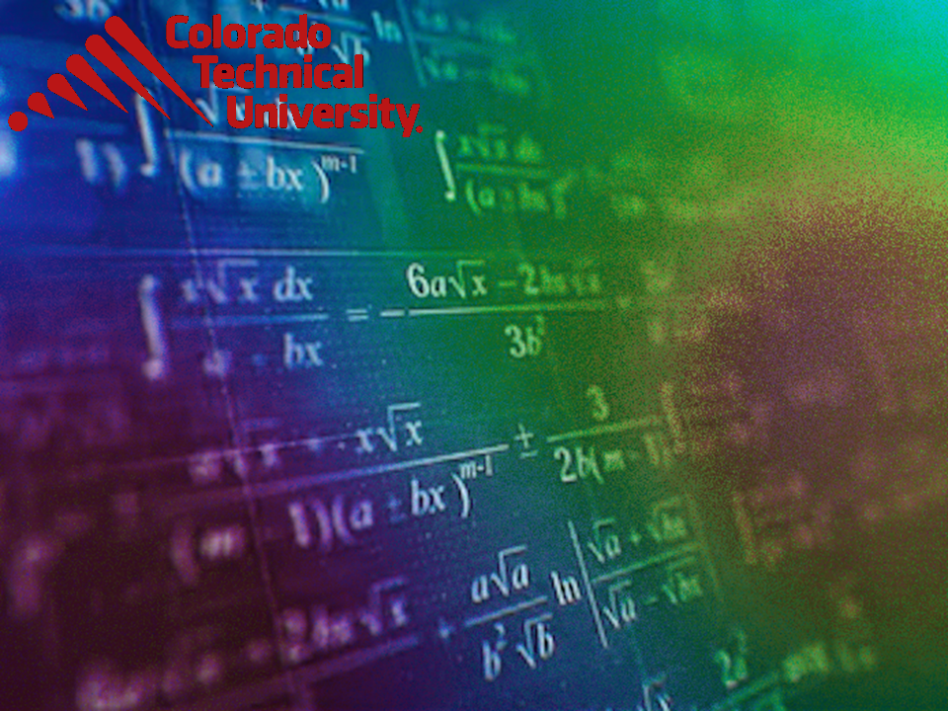
Welcome to
Unit 2 Part 3!
MATH 205 Differential Calculus
https://www.smu.edu.sg/programmes/core-curriculum/course-structure/calculus

Slide 2
What’s Up?
Review: functions, polynomials
New stuff: transforming functions, mathematical modeling, trig

Slide 3
What’s Up?
Outcome 2) Use algebra and limits to examine the properties and graphs of functions
Outcome 7) Solve problems by identifying the requirements, making a sketch as appropriate, and using calculus techniques to model the problem, calculating the final answer and verifying the solution

Slide 4

Review
http://995642590.r.lightningbase-cdn.com/wp-content/uploads/2010/12/looking-back-hrexaminer-v144-cover425px.jpg

Slide 5
Functions
In formulas, some variables are “input” variables
The thing you are calculating with the formula is the “output”

Slide 6
Functions
The input variable is ALWAYS graphed on the x-axis (horizontal axis)
No reason – it’s a TRADITION!

Slide 7
Functions
What the output turns out to be depends on what the input is
The output is frequently called the “dependent” variable

Slide 8
Functions
The input is called the “independent” variable because it’s value comes from an outside (sometimes uncontrollable) source

Slide 9
Functions
For a formula to be a function, every x can have only one y

Slide 10
Functions
To test whether a formula is a function, you graph it and do the “vertical line test”
If it passes the VLT, it is a function

Slide 11
Functions
Naturally, there is a special symbol for functions
Where you used to write
y = 8x + 13
A function is written:
ƒ(x) = 8x + 13
read as: “f of x”

Slide 12
Functions
ƒ(x) shows that the formula uses “x” as the input and the output depends on it

Slide 13

Questions?
http://i.imgur.com/aliTlT3.jpg

Slide 14
Mathematical Modeling
A mathematical model is a mathematical description (often by means of a function or an equation) of a real-world phenomenon

Slide 15
Mathematical Modeling
Mathematical Models
(real-world formulas)
are usually polynomial equations

Slide 16
Mathematical Modeling
The purpose of the model is to understand the phenomenon and often to make predictions about future behavior (forecasts)

Slide 17
Mathematical Modeling
A mathematical model is never a completely accurate representation of a physical
situation

Slide 18
Mathematical Modeling
Unless it was developed as part of a scientific experiment to validate the particular relationship, there is no scientific evidence to show a particular model accurately explains a phenomenon

Slide 19
Mathematical Modeling
Still, it may be useful for forecasting

Slide 20
Mathematical Modeling
“Forecasts are expectations. The future can fail to meet expectations.”
Stephanie Black, 2022
Thanks, Stephanie!

Slide 21
Mathematical Modeling
Functions are often used to model real-world phenomena

Slide 22
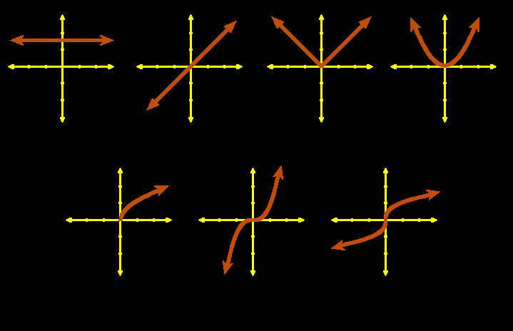
Mathematical Modeling
Graphs of common algebraic functions:
constant identity abs value quadratic
square root cubic cube root
VFrench, 2010

Slide 23
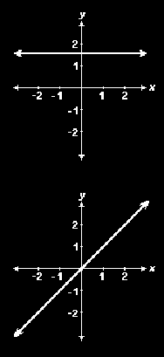
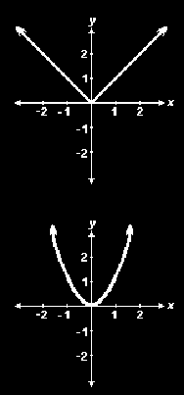
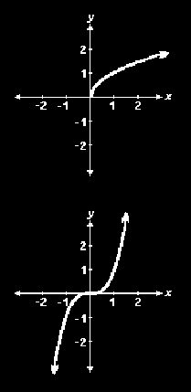
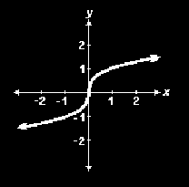
GRAPHS OF COMMON FUNCTIONS
IN-CLASS PROBLEM 1
Which function?
constant identity abs value quadratic
square root cubic cube root
Vfrench, 2010

Slide 24
Mathematical Modeling
We use these known functions to see if they will fit our observed data because we know their mathematical formulas
It’s a place to start!

Slide 25
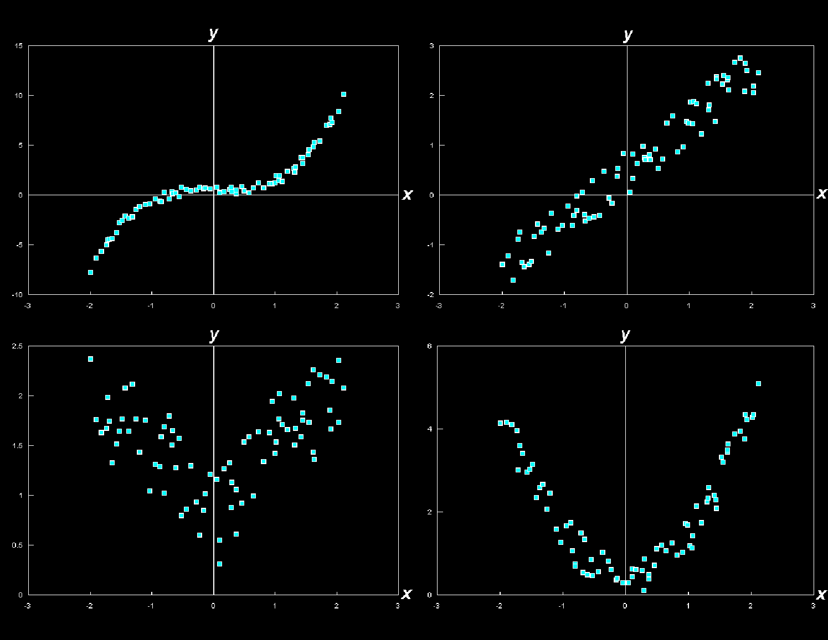
GRAPHS OF COMMON FUNCTIONS
IN-CLASS PROBLEM 2
Which might fit?
constant line abs value quadratic
VFrench, 2010
square root cubic cube root

Slide 26
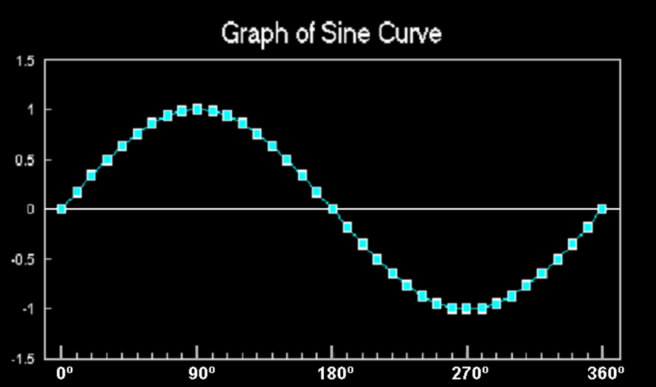
Mathematical Modeling
Trig functions (especially sine and cosine) are used to model cyclical phenomena
VFrench, 2015

Slide 27
Mathematical Modeling
Exponential functions use:
ƒ(x) = a^{x}
where the base
a is a positive
constant
https://www.quora.com/How-do-you-find-the-domain-and-range-of-an-exponential-function

Slide 28
Mathematical Modeling
Logarithmic functions use:
ƒ(x) = log_{a}x
where the base a is a positive constant
https://en.wikipedia.org/wiki/Logarithm

Slide 29
Questions?
http://i.imgur.com/aliTlT3.jpg

Slide 30
Mathematical Modeling
Because data RARELY fits the known functions exactly, we have to transform the functions to fit the data

Slide 31
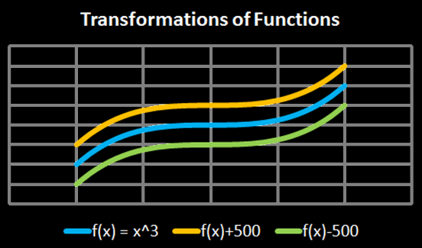
Transforming Functions
vertical shifts:
ƒ(x) + c plus shifts up
ƒ(x) - c minus shifts down
Vfrench, 2010

Slide 32
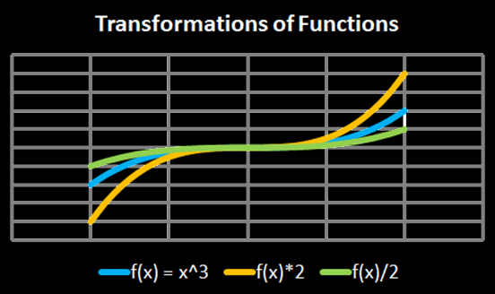
Transforming Functions
vertical stretch:
ƒ(x) × c stretches
ƒ(x) ÷ c squashes
Vfrench, 2010

Slide 33
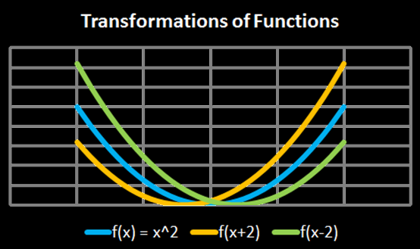
Transforming Functions
horizontal shifts:
ƒ(x + c) shifts left
ƒ(x - c) shifts right
Vfrench, 2010

Slide 34
Transforming Functions
Another way to look at it:
y-transformations affect the graph but keep the graph paper the same
x-transformations keep the graph the same but modify the graph paper

Slide 35
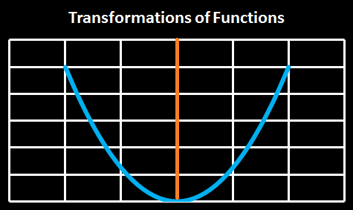
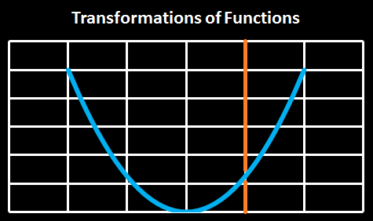
Transforming Functions
ƒ(x + c)
shifts the
origin right
(which shifts
the graph left)
Vfrench, 2010

Slide 36
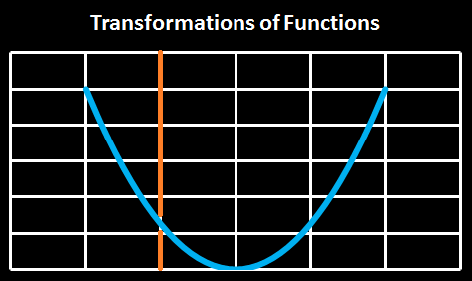
Transforming Functions
ƒ(x - c)
shifts the
origin left
(which shifts
the graph
right)
Vfrench, 2010

Slide 37
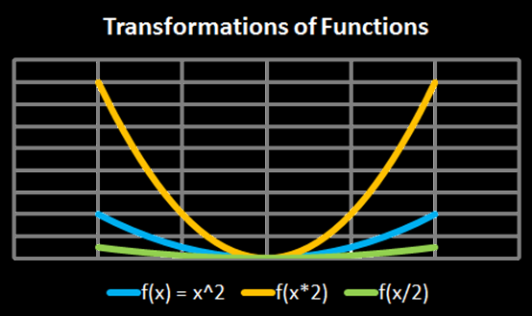
Transforming Functions
horizontal shifts:
ƒ(x × c) squashes
ƒ(x ÷ c) stretches
Vfrench, 2010

Slide 38
Transforming Functions
Any operations done to the function outside of the parentheses affects the “y” values
These operations lead to an intuitive result

Slide 39
Transforming Functions
Any operations done to the function inside the parentheses affects the “x” values
These operations lead to a counterintuitive result

Slide 40
GRAPHS OF COMMON FUNCTIONS
IN-CLASS PROBLEM 3
Which is the transform
ƒ(x) - 2?
ƒ(x)
a)
b)
c)
1
1
1
1
Vfrench, 2020

Slide 41
GRAPHS OF COMMON FUNCTIONS
IN-CLASS PROBLEM 3
Which is the transform
ƒ(x) - 2?
ƒ(x)
a)
b)
c)
Vfrench, 2020

Slide 42
GRAPHS OF COMMON FUNCTIONS
IN-CLASS PROBLEM 3
Which is the transform
2ƒ(x)?
a)
b)
c)
ƒ(x)
Vfrench, 2020

Slide 43
GRAPHS OF COMMON FUNCTIONS
IN-CLASS PROBLEM 3
Which is the transform
2ƒ(x)?
a)
b)
c)
ƒ(x)
Vfrench, 2020

Slide 44
GRAPHS OF COMMON FUNCTIONS
IN-CLASS PROBLEM 3
Which is the transform
ƒ(x – 1)?
a)
b)
c)
ƒ(x)
Vfrench, 2020

Slide 45
GRAPHS OF COMMON FUNCTIONS
IN-CLASS PROBLEM 3
Which is the transform
ƒ(x – 1)?
a)
b)
c)
ƒ(x)
Vfrench, 2020

Slide 46
GRAPHS OF COMMON FUNCTIONS
IN-CLASS PROBLEM 3
Which is the transform
ƒ(2x)?
a)
b)
c)
ƒ(x)
Vfrench, 2020

Slide 47
GRAPHS OF COMMON FUNCTIONS
IN-CLASS PROBLEM 3
Which is the transform
ƒ(2x)?
a)
b)
c)
ƒ(x)
Vfrench, 2020

Slide 48
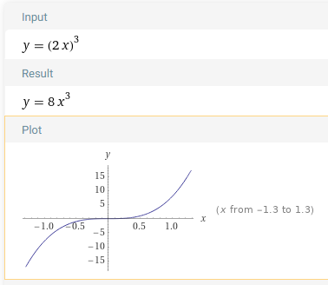
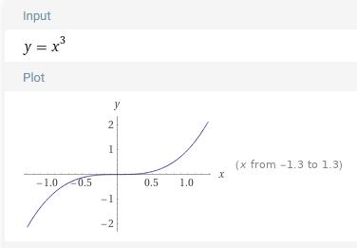

Slide 49
Questions?
www.career.gatech.edu

Slide 50
Trigonometry
You did trig in MATH114, but just to ensure you remember the important topics

Slide 51
Trigonometry
Positive angles - counterclockwise rotation from initial side
Negative angles - clockwise rotation from initial side
θ
θ
VFrench, 2015

Slide 52
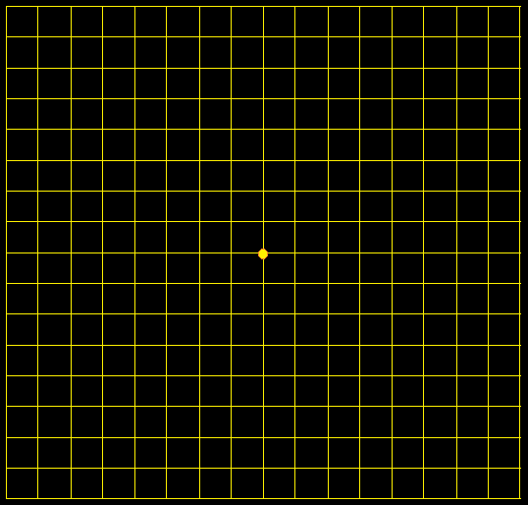
Trigonometry
An angle with a terminal side in a quadrant
"lies" in that
quadrant
II
I
III
IV
VFrench, 2015

Slide 53
Trigonometry
The Pythagorean Theorem
Based on a right triangle:
a² + b² = c²
B
Hypotenuse
c
a
Side opposite θ
θ
A
C
b
Side adjacent to θ
VFrench, 2015

Slide 54
Trigonometry
Pythagorean Theorem
hypotenuse
Long side
=
Short side
hypotenuse
Long side
hypotenuse
Long side
Short side
Short side
Long side
Short side
hypotenuse

Slide 55
Trigonometry
Square of the
short side (9)
Square of the hypotenuse (25)
Square of the
long side (16)
=
+

Slide 56
Trigonometry
Square of the hypotenuse (25)
Square of the
long side (16)
Square of the
short side (9)
=

Slide 57
Trigonometry
The Greeks drew triangles inside circles
This is called a “central angle”
.
VFrench, 2015

Slide 58
Trigonometry
Angles are “swept” around the circle like a backwards clock
.
θ
VFrench, 2015

Slide 59
Trigonometry
Remember, the slope of a line is rise
run
.
rise
θ
θ
run
VFrench, 2015

Slide 60
Trigonometry
So, the slope of the hypotenuse is: rise
run
hypotenuse
.
rise
θ
θ
run
VFrench, 2015

Slide 61
Trigonometry
According to the Pythagorean Theorem, the length of the hypotenuse will be:
hyp² = rise² + run²
hypotenuse
.
rise
θ
run
VFrench, 2015

Slide 62
Trigonometry
There are six trig functions:
sine(θ) = length of side opposite θ
length of hypotenuse
cosine(θ) = length of side adjacent θ
length of hypotenuse
tangent(θ) = sin(θ)/cos(θ)
cotangentθ) = cos(θ)/sin(θ)
cosecant(θ) = 1/sin(θ)
secant(θ) = 1/cos(θ)

Slide 63
Questions?
http://i.imgur.com/aliTlT3.jpg

Slide 64
Graphs of Trig Functions
The graph of sin undulates back and forth
It has a value of 0 at 0°
VFrench, 2015

Slide 65
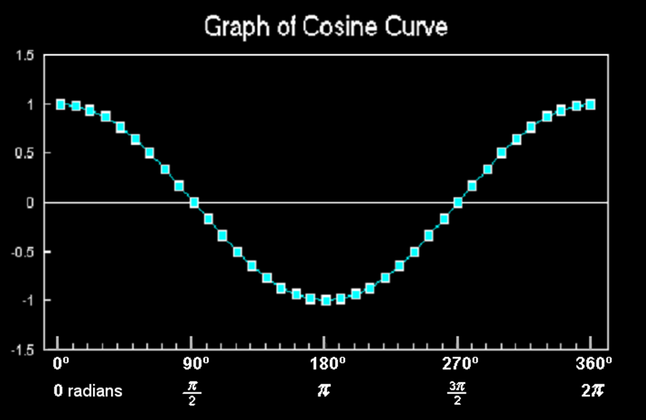
Graphs of Trig Functions
The graph of cos also undulates back and forth
It doesn’t have a value of 0 at 0°
VFrench, 2015

Slide 66
Graphs of Trig Functions
Sines and cosines are useful because of the shape of their curves
Many natural phenomena undulate back and forth

Slide 67
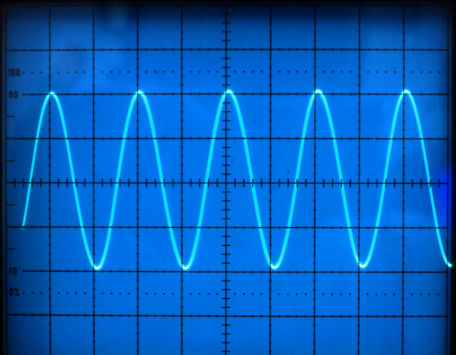
Graphs of Trig Functions
http://www.t4science.com/images/general/frequency.jpg

Slide 68
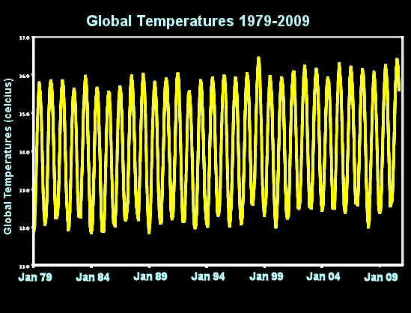
Graphs of Trig Functions
VFrench, 2012

Slide 69
Graphs of Trig Functions
A lot of mathematical models for real-world phenomena have a “sine” or “cosine” in them to include this cyclical pattern

Slide 70
Graphs of Trig Functions
A tangent isn’t important because it is a useful graph shape for mathematical modeling
A tangent is useful because it is a slope ($\frac{rise}{run}$)

Slide 71
Graphs of Trig Functions
The secant is used (briefly) in calculus

Slide 72
Questions?
www.career.gatech.edu

Slide 73
Transforming Functions
General form of trig functions:
y = A sin (Bx - C) + D
y = A cos (Bx - C) + D

Slide 74
Transforming Functions
General form of trig functions:
y = A sin (Bx - C) + D
y = A cos (Bx - C) + D
They put in a minus sign so that when you add a value to the “x” it will move the function to the (intuitive) right!

Slide 75
Transforming Functions
y = A sin (Bx - C) + D
“A” stretches the graph up and down – “Amplitude”

Slide 76
Transforming Functions
y = A sin (Bx - C) + D
“A” stretches the graph up and down – “Amplitude”
“B” stretches the graph side to side – “Period” “frequency”

Slide 77
Transforming Functions
y = A sin (Bx - C) + D
“A” stretches the graph up and down – “Amplitude”
“B” stretches the graph side to side – “Period” “frequency”
“C” moves the graph side to side – “Phase shift”

Slide 78
Transforming Functions
y = A sin (Bx - C) + D
“A” stretches the graph up and down – “Amplitude”
“B” stretches the graph side to side – “Period” “frequency”
“C” moves the graph side to side – “Phase shift”
“D” moves the graph up and down – “Vertical shift”

Slide 79
Questions?
www.career.gatech.edu

Slide 80
Transforming Functions
Is my function transformed?
If the tops and bottoms of the sine/cosine curves are at 1 and -1, it is a “regular” curve
(“A” is 1)

Slide 81
Transforming Functions
Is my function transformed?
If the inflexion point of a tan/cot curve is at the x-axis, it is a “regular” curve (“A” is 1)

Slide 82
Transforming Functions
Is my function transformed?
If the tops and bottoms of the “Us” for sec /csc curves are at 1 and -1, it is a “regular” curve (“A” is 1)

Slide 83
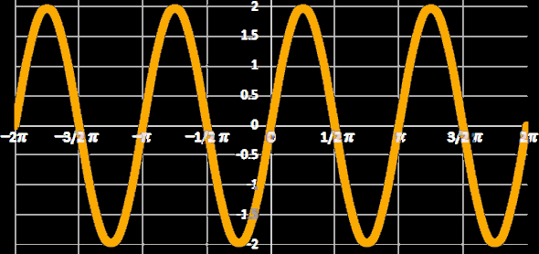
Transforming Functions
What is the equation for the graph?
VFrench, 2015

Slide 84
Transforming Functions
Is it a sin/cos/tan/cot/sec/csc?
VFrench, 2015

Slide 85
Transforming Functions
Is it a sin/cos/tan/cot/sec/csc?
A sin (it undulates and goes thru (0,0)
VFrench, 2015

Slide 86
Transforming Functions
Does it have the natural amplitude for a sin?
VFrench, 2015

Slide 87
Transforming Functions
Does it have the natural amplitude for a sin? No, it goes from -2 to 2 rather than -1 to 1
VFrench, 2015

Slide 88
Transforming Functions
So it’s going to be 2sin… but is the frequency the natural one?
VFrench, 2015

Slide 89
Transforming Functions
So it’s going to be 2sin… but is the frequency the natural one?
No, it cycles twice as often
VFrench, 2015

Slide 90
Transforming Functions
So it’s going to be: 2sin(2x)
VFrench, 2015

Slide 91
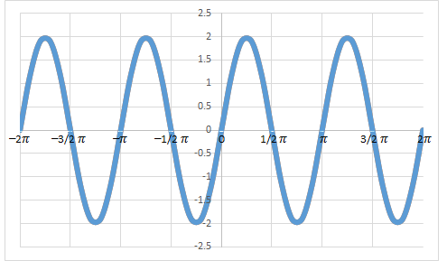
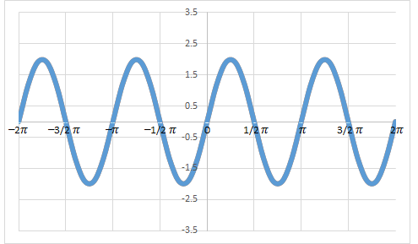
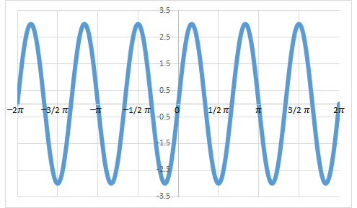
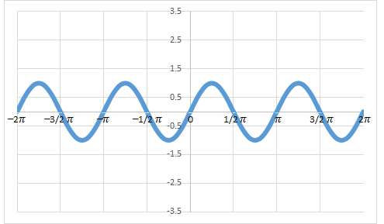
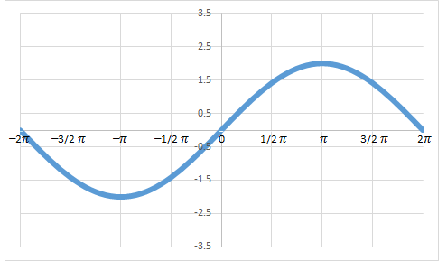
For your Homework:
What is the equation for the graph?
a) y = 2sin (2x)
b) y = 3sin (3x)
c) y = sin (2x)
d) y = 2sin (x/2)

Slide 92
How It’s Used
Applying transformations to sound waves results in effects that are prevalent in audio industries: altering pitch, and amplifying or diminishing sound waves and their echoes

Slide 93
How It’s Used
Transformed sound waves can be combined, resulting in a different quality of sound - the difference between a voice and a violin, for instance, or between two different voices

Slide 94
How It’s Used
Synthesizers use these combinations to recreate the sounds of common musical instruments

Slide 95
Transforming Functions
Excel demo video

Slide 96
Questions?
http://i.imgur.com/aliTlT3.jpg

Slide 97
Summary
Today we studied:
Review of functions
New stuff: polynomials, trig, mathematical modeling, transforming functions

Slide 98

You Survived!
www.playbuzz.com

