Slide 1
Welcome to
Unit 9- Part 17
MATH116-Foundations for Calculus
https://media.istockphoto.com/vectors/green-blackboard-mathematical-with-thin-line-shapes-and-inscriptions-vector-id1084380192?k=6&m=1084380192&s=612x612&w=0&h=TcEOVpnUmyuswT4Pay
AL6lNiHU8SS8g33yOSg-jR5BE=

Slide 2
What’s Up?
Review: Conics
New stuff: Systems of equations
(linear and nonlinear)

Slide 3
What’s Up?
Outcome 9) Solve systems of nonlinear equations, by substitution and elimination

Slide 4
Review
http://995642590.r.lightningbase-cdn.com/wp-content/uploads/2010/12/looking-back-hrexaminer-v144-cover425px.jpg

Slide 5
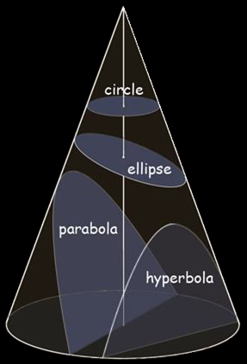
Conics
A “conic” is a slice of a cone
Any plane cutting a cone will produce a conic
The angle of the cut
will determine which
conic it is
https://encrypted-tbn0.gstatic.com/images?q=tbn:ANd9GcSZxzK5mwZI2zwK4hs3_
n46LHjjrN4nNMJAuw&usqp=CAU

Slide 6
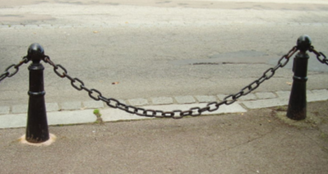
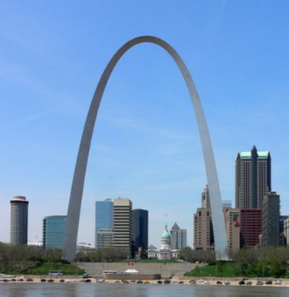
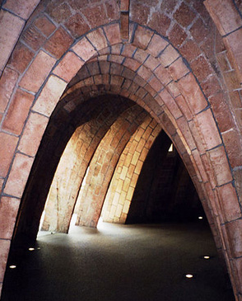
Conics
Catenary (not a conic)
https://en.wikipedia.org/wiki/Catenary#/

Slide 7
Conics
The most common use of conics is in calculating and describing orbits

Slide 8
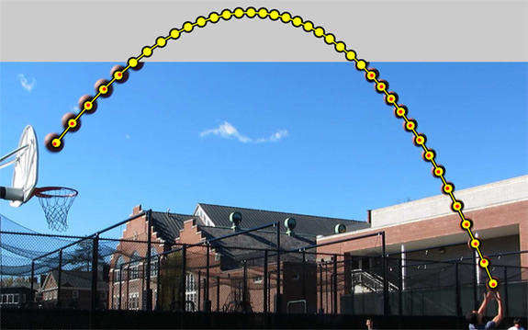
Conics
A trajectory sketches a parabola
pixgood.com

Slide 9
Conics
Circle: set of points in a plane whose distances from a fixed
point (the center) are constant (denoted "r")
( x - h )² + ( y - k )² = r²
Radius: r
Center: (h,k)

Slide 10
Conics
Ellipse: “squashed circle”
set of points in a plane whose distances from two fixed points
(the foci) have a constant sum

Slide 11
Conics
The “eccentricity” of an ellipse is how flat it is vs a circle

Slide 12
Conics
Parabola: set of points in a plane that are equidistant from a fixed point F (the focus)
and a fixed line (the directrix)
ax² + bx + c = y

Slide 13
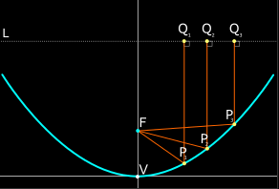
Conics
A particle or wave approaching a parabola on a line parallel to the axis is reflected through the focus
VFrench 2012

Slide 14
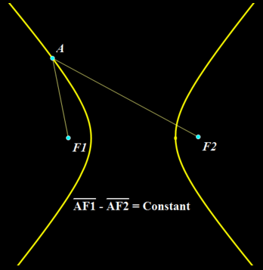
Conics
Hyperbola: set of points in a plane whose distances from two fixed points
(the foci) have
a constant
difference
VFrench 2021

Slide 15
Questions?
http://i.imgur.com/aliTlT3.jpg

Slide 16
Systems of Equations
Sometimes equations fly solo:
y = 4x +10

Slide 17
Systems of Equations
More often in the real world they come in a pack:
income = price x #sold
cost = rent + salaries + materials
profit = income - cost

Slide 18
Systems of Equations
A set of two equations containing two variables ...
A set of three equations containing three variables ...
Are you seeing a pattern?

Slide 19
Systems of Equations
2x + 5y = 38
x + 7y = 37
Lots of equations come in groups!

Slide 20
Systems of Equations
A "system" of equations is a set or collection of equations that you deal with all together at once

Slide 21
Systems of Equations
A system of equations is a collection of two or more equations with the same set of unknowns (variables)

Slide 22
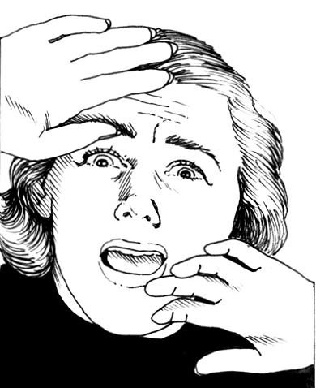
Systems of Equations
All of the dreaded word problems that haunted your past were systems of equations
scared-pic.jpg

Slide 23
Systems of Equations
We’re finally going to tell you how to solve them…
https://www.yourdictionary.com/images/main.shriek.jpg

Slide 24
Systems of Equations
In solving a system of equations, we try to find values for each of the unknowns that will satisfy every equation in the system

Slide 25
Systems of Equations
The air-mail rate for letters to Europe is 45 cents per half-ounce and to Africa is 65 cents per half-ounce.
If Shirley paid $18.55 to send 35 half-ounce letters abroad, how many did she send to Africa?

Slide 26
Systems of Equations
In algebra (equation) terms, these sentences would be:
$0.45(#E) + $0.65(#A) = $18.55
(#E) + (#A) = 35
Find #A

Slide 27
Systems of Equations
OK, THAT was SCARY!
Let’s start with a simple example…
Money is usually good (we understand money…)

Slide 28
Systems of Equations
Suppose your monthly expenses are:
Car $ 200
Rent $ 900
Utilities $ 200
Food $ 200
Total $1600

Slide 29
Systems of Equations
Suppose your income is:
Salary $1800

Slide 30
Systems of Equations
Are you making your expenses?
http://www.testically.org/wp-content/uploads/2010/11/hmm.jpg

Slide 31
Systems of Equations
You just solved a system of equations!
hooray.jpg

Slide 32
Systems of Equations
Equation 1:
Expenses = Car + Rent + Utilities + Food

Slide 33
Systems of Equations
Equation 2:
Income = Salary

Slide 34
Systems of Equations
Equation 3:
Am I Solvent? = Income - Expenses

Slide 35
Systems of Equations
The simplest linear system is one with two equations and two variables

Slide 36
Systems of Equations
If they give you values for “x” and “y” and ask if they are true values, plug them in to both equations – both equations must be true for the values

Slide 37
SYSTEMS OF EQUATIONS
IN-CLASS PROBLEM 1
Are x = 4 and y = 6 true values for the system:
2x + 5y = 38
x + 7y = 37
Plug in x = 4 and y = 6

Slide 38
SYSTEMS OF EQUATIONS
IN-CLASS PROBLEM 1
Plug in x = 4 and y = 6
2(4) + 5(6) = 38
(4) + 7(6) = 37
Are the values x = 4 and y = 6 a true solution to this system?
?
?

Slide 39
SYSTEMS OF EQUATIONS
IN-CLASS PROBLEM 1
Plug in x = 4 and y = 6
2(4) + 5(6) = 38
(4) + 7(6) = 37
Are the values x = 4 and y = 6 a true solution to this system?
Yep!
?
?

Slide 40
Systems of Equations
If they give you values for “x” and “y” and ask if they are true values, plug them in to both equations – both equations must be true for the values
If they are, it is called a “true system”

Slide 41
Questions?
http://i.imgur.com/aliTlT3.jpg

Slide 42
Systems of Equations
A solution to a system of equations is any set of values for all of the variables that "works" in all of the equations

Slide 43
Systems of Equations
To solve a system, you must have at least as many equations as you have variables

Slide 44
SYSTEMS OF EQUATIONS
IN-CLASS PROBLEM 2a
Suppose we wanted to find “x” and “y” for the equations:
2x + 5y = 38
x + 7y = 37

Slide 45
SYSTEMS OF EQUATIONS
IN-CLASS PROBLEM 2a
Strategy: try to get one of the variables written in terms of the other variable:
2x + 5y = 38
x + 7y = 37
Look for a “loner”

Slide 46
SYSTEMS OF EQUATIONS
IN-CLASS PROBLEM 2a
x + 7y = 37
Use algebra to solve for “x”:
x = 37 – 7y
Now, plug in this “x” into the other equation

Slide 47
SYSTEMS OF EQUATIONS
IN-CLASS PROBLEM 2a
2x + 5y = 38
x = 37 – 7y
To get:
2(37-7y) + 5y = 38
Now, solve for “y”!

Slide 48
SYSTEMS OF EQUATIONS
IN-CLASS PROBLEM 2a
2(37-7y) + 5y = 38
74 – 14y + 5y = 38
-9y = 38 – 74 = -36
y = -36/-9
y = 4
Then we plug in this value for “y” and solve for “x”

Slide 49
SYSTEMS OF EQUATIONS
IN-CLASS PROBLEM 2a
We already have:
x = 37 – 7y
y = 4
So just plug in y = 4:
x = 37 – 7(4)
x = 37 – 28
x = 9

Slide 50
SYSTEMS OF EQUATIONS
IN-CLASS PROBLEM 2a
So, the true solution to the system:
2x + 5y = 38
x + 7y = 37
is x = 9, y = 4
or (x,y) = (9,4)

Slide 51
Systems of Equations
This method of solving systems of equations is called “substitution”

Slide 52
SYSTEMS OF EQUATIONS
IN-CLASS PROBLEM 2b
To find the true solution to the system:
2x + 5y = 38
3x + 7y = 50
Solve one of the equations for either “x” or “y”

Slide 53
SYSTEMS OF EQUATIONS
IN-CLASS PROBLEM 2b
2x + 5y = 38
2x = 38 – 5y
x = 38 – 5y
2
Then plug in this “x” into the other equation

Slide 54
SYSTEMS OF EQUATIONS
IN-CLASS PROBLEM 2b
3x + 7y = 50
x = 38 – 5y
2

Slide 55
SYSTEMS OF EQUATIONS
IN-CLASS PROBLEM 2b
3(38/2 - 5y/2) + 7y = 50
57 – 7.5y + 7y = 50
Solve for “y”:
-7.5y + 7y = 50 – 57
-0.5y = -7
y = -7/-0.5
y = 14

Slide 56
SYSTEMS OF EQUATIONS
IN-CLASS PROBLEM 2b
You already have:
x = 38 – 5y
2
and y = 14
so: x = 38 – 5(14) = 38-70
2 2
x = -32/2 = -16

Slide 57
SYSTEMS OF EQUATIONS
IN-CLASS PROBLEM 2b
So the true solution to the system:
2x + 5y = 38
3x + 7y = 50
is x = -16, y = 14
or (x,y) = (-16,14)

Slide 58
Questions?
http://i.imgur.com/aliTlT3.jpg

Slide 59
SYSTEMS OF EQUATIONS
IN-CLASS PROBLEM 2c
Solve the system:
2x + 3y = 1
-x + y = -3
We could isolate “y” in the second equation and use substitution, but we could also use a different technique called “elimination”

Slide 60
SYSTEMS OF EQUATIONS
IN-CLASS PROBLEM 2c
Solve the system:
2x + 3y = 1
-x + y = -3
Some people like one, some like the other. Use the one you like!

Slide 61
SYSTEMS OF EQUATIONS
IN-CLASS PROBLEM 2c
Solve the system:
2x + 3y = 1
-x + y = -3
If we multiply equation 2 by “2” on both sides of the “=” sign, we get:
2x + 3y = 1
-2x + 2y = -6

Slide 62
SYSTEMS OF EQUATIONS
IN-CLASS PROBLEM 2c
Adding the two equations (since the terms are aligned, we can just add the terms vertically):
2x + 3y = 1
-2x + 2y = -6
0 5y -5
So 5y = -5 and y = 5

Slide 63
SYSTEMS OF EQUATIONS
IN-CLASS PROBLEM 2c
Back-substitute y = -1:
2x + 3y = 1
2x + 3(-1) = 1
2x -3 = 1
2x = 1 + 3 = 4
So x = 2
And the solution is:
x=2, y=-1

Slide 64
Questions?

Slide 65
Systems of Equations
For more equations –
Same stuff, just more of it!

Slide 66
SYSTEMS OF EQUATIONS
IN-CLASS PROBLEM 2d
Solve the system:
x + z = 3
x + 2y – z = 1
2x – y + z = 3

Slide 67
SYSTEMS OF EQUATIONS
IN-CLASS PROBLEM 2d
x + z = 3
is the easiest – let’s start there:
z = 3 – x
Plug that in!

Slide 68
SYSTEMS OF EQUATIONS
IN-CLASS PROBLEM 2d
z = 3 – x
x + 2y – z = 1
2x – y + z = 3
become:
x + 2y – (3 – x) = 1
2x – y + (3 – x) = 3
Now it’s just two equations!

Slide 69
SYSTEMS OF EQUATIONS
IN-CLASS PROBLEM 2d
x + 2y – 3 + x = 1
2x – y + 3 – x = 3
or
2x + 2y = 4
x – y = 0
Use x – y = 0 → x = y

Slide 70
SYSTEMS OF EQUATIONS
IN-CLASS PROBLEM 2d
x = y
2x + 2y = 4
2x + 2x = 4
4x = 4
x = 1

Slide 71
SYSTEMS OF EQUATIONS
IN-CLASS PROBLEM 2d
So, now we have:
x = 1
x = y
z = 3 – x
So, (x,y,z) = (1,1,2)

Slide 72
Questions?
http://i.imgur.com/aliTlT3.jpg

Slide 73
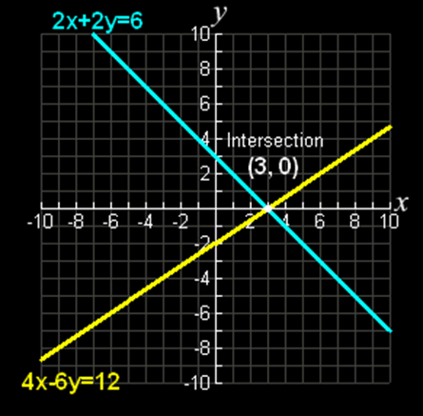
Systems of Equations
If you graph the equations in a system, the solution is where the lines
cross
Vfrench, 2010

Slide 74
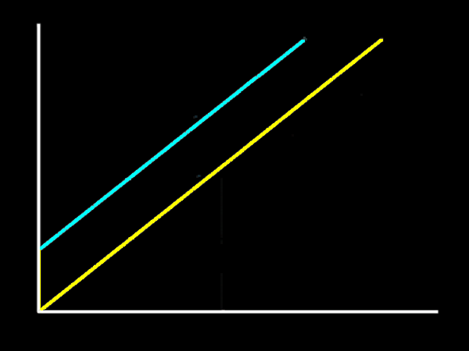
Systems of Equations
If they do not cross, there is no real solution (there may be a complex
solution)
Vfrench, 2010

Slide 75
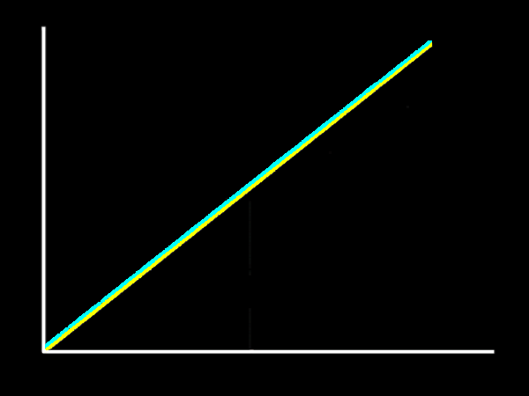
Systems of Equations
If they are identical, there are an infinite number of solutions!
Vfrench, 2010

Slide 76
SYSTEMS OF EQUATIONS
IN-CLASS PROBLEM 2c
Graphs of Systems demo

Slide 77
Questions?
http://i.imgur.com/aliTlT3.jpg

Slide 78
Systems of Equations
To solve a system for specific values, you must have at least as many equations as you have variables

Slide 79
Systems of Equations
The number of equations is not required to be the same as the number of unknowns

Slide 80
Systems of Equations
A solution to any system is the set of values for the variables which make all the equations true

Slide 81
Systems of Equations
A system is called consistent if there is a solution

Slide 82
Systems of Equations
A system is called inconsistent if there is no solution

Slide 83
Systems of Equations
A system of equations is considered overdetermined if there are more equations than unknowns

Slide 84
Systems of Equations
A system of equations is considered underdetermined if there are fewer equations than unknowns

Slide 85
Systems of Equations
A system of equations is considered determined if there are an equal number of equations and unknowns

Slide 86
SYSTEMS OF EQUATIONS
IN-CLASS PROBLEM 3a
Consider a system:
-2x – y = 1
3x – y = 2
x – y = -1
Is it overdetermined?

Slide 87
SYSTEMS OF EQUATIONS
IN-CLASS PROBLEM 3b
Consider a system:
-2x – y = 1
3x – y = 2
Is it overdetermined?

Slide 88
Systems of Equations
Remember, the solution of a system will be the point where the lines of all of the equations cross

Slide 89
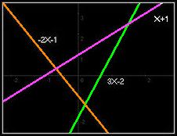
SYSTEMS OF EQUATIONS
IN-CLASS PROBLEM 3c
Is the system overdetermined?

Slide 90
Questions?
http://i.imgur.com/aliTlT3.jpg

Slide 91
Systems of Equations
An overdetermined system is almost always inconsistent (it has no solution)

Slide 92
Systems of Equations
However, an overdetermined system can have solutions in some cases

Slide 93
Systems of Equations
Overdetermined systems have solutions if an equation occurs several times in the system
or if some equations are linear combinations of the others

Slide 94
SYSTEMS OF EQUATIONS
IN-CLASS PROBLEM 4a
For these three equations, is there a solution?

Slide 95
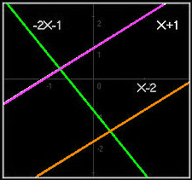
SYSTEMS OF EQUATIONS
IN-CLASS PROBLEM 4b
For these three equations, is there a solution?

Slide 96
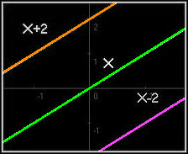
SYSTEMS OF EQUATIONS
IN-CLASS PROBLEM 4c
For these three equations, is there a solution?

Slide 97
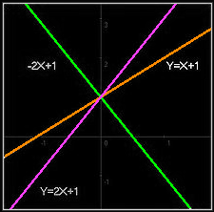
SYSTEMS OF EQUATIONS
IN-CLASS PROBLEM 4d
For these three equations, is there a solution?

Slide 98
Systems of Equations
An overdetermined system can have solutions in some cases:
if some equation occurs several times in the system

Slide 99
Systems of Equations
An overdetermined system can have solutions in some cases:
if some equation occurs several times in the system
if some equations are linear combinations of the others (linearly dependent)

Slide 100
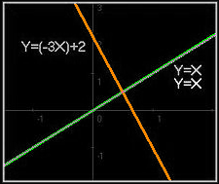
SYSTEMS OF EQUATIONS
IN-CLASS PROBLEM 4e
For these three equations, is there a solution?

Slide 101
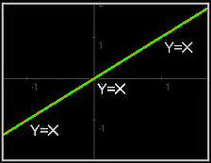
SYSTEMS OF EQUATIONS
IN-CLASS PROBLEM 4f
For these three equations, is there a solution?

Slide 102
Questions?
http://i.imgur.com/aliTlT3.jpg

Slide 103
Systems of Equations
Linear dependence means that some equations can be obtained from linearly combining other equations

Slide 104
Systems of Equations
A linear combination means addition of equations, subtraction of equations or multiplying by a scalar constant (a number with no variables in it)

Slide 105
Systems of Equations
For example:
y = x + 1 and
2y = 2x + 2
are linearly dependent equations because the second one can be obtained by taking twice the first one

Slide 106
Systems of Equations
Linearly independent equations cannot be obtained from linearly combining each other

Slide 107
Systems of Equations
An overdetermined system will have a solution only if the system the number of linearly independent equations does not exceed the number of unknowns

Slide 108
Questions?

Slide 109
SYSTEMS OF EQUATIONS
IN-CLASS PROBLEM 5a
solve: x + 3y + 4z = -14
and 6x + 4y + 2z = -22
and 3x + 7y - z = -1
x + 3y + 4z = -14,
6x + 4y + 2z = -22,
3x + 7y - z = -1

Slide 110
SYSTEMS OF EQUATIONS
IN-CLASS PROBLEM 5b
solve: x + 3y + 4z +6q = -14 and 6x + 4y + 2z -4q = -22 and 3x + 7y - z -7q = -1
and 4x +5y -3z +q =10
x + 3y + 4z +6q = -14 ,
6x + 4y + 2z -4q = -22,
3x + 7y - z -7q = -1,
4x +5y -3z +q =10

Slide 111
SYSTEMS OF EQUATIONS
IN-CLASS PROBLEM 5c
solve: x + 3y + 4z +2p+6q = -14 and 6x + 4y + 2z +3p-4q = -22 and 3x + 7y - z +4p-7q = -1 and 4x +5y -3z +5p+q =10 and 7x -6y +5z + 4p +3q =15
Wolfram won’t
Symbolab won’t

Slide 112
SYSTEMS OF EQUATIONS
IN-CLASS PROBLEM 5d
solve: 7u+6v+15w–44x+18y+11z=70
and 9u+25v+10w+3x–14y+8z=161
and 13u+8v+2w+6x+62y+15z=671
and –2u+v–5w+57x+9y–3z=354
and 5u–17v+18w+9x–7y+5z=82
and 4u+3v+16w+14x+2y+7z=258
http://onlinemschool.com/math/assistance/equation/gaus/

Slide 113
Questions?

Slide 114
Systems of Nonlinears
Linear equations are just that – equations of lines

Slide 115
Systems of Nonlinears
Linear equations are just that – equations of lines
They will all be of the form:
y = mx + b

Slide 116
Systems of Nonlinears
What about the x,y,z ones?

Slide 117
Systems of Nonlinears
What about the x,y,z ones?
Those will form a flat plane in 3D space

Slide 118
Systems of Nonlinears
Nonlinear equations are the equations of curves

Slide 119
Systems of Nonlinears
Nonlinear equations are the equations of curves
They will have squares and cubes and other higher-order exponents in the equations

Slide 120
Systems of Nonlinears
Some of the equations in the system may be linear and others nonlinear
You can mix the two types!

Slide 121
Systems of Nonlinears
NATURALLY,
linear equations (ones that graph as straight lines) are simpler than non-linear (curved) equations

Slide 122
Systems of Nonlinears
NATURALLY,
linear equations (ones that graph as straight lines) are simpler than non-linear (curved) equations
BUT you still use the same tricks to solve them!

Slide 123
SYSTEMS OF NONLINEARS
IN-CLASS PROBLEM 6a
Solve the system:
3x - y = -2
2x² – y = 0

Slide 124
SYSTEMS OF NONLINEARS
IN-CLASS PROBLEM 6a
Solve the system:
3x - y = -2
2x² – y = 0
You could use either substitution or elimination…
But let’s try substitution!

Slide 125
SYSTEMS OF NONLINEARS
IN-CLASS PROBLEM 6a
Solve the system:
3x - y = -2
2x² – y = 0
Using 3x – y = -2 (‘cause it’s easier)
- y = -2-3x

Slide 126
SYSTEMS OF NONLINEARS
IN-CLASS PROBLEM 6a
Solve the system:
3x - y = -2
2x² – y = 0
Using 3x – y = -2 (‘cause it’s easier)
- y = -2-3x
y = (-2-3x)/-1

Slide 127
SYSTEMS OF NONLINEARS
IN-CLASS PROBLEM 6a
Solve the system:
3x - y = -2
2x² – y = 0
Using 3x – y = -2 (‘cause it’s easier)
- y = -2-3x
y = (-2-3x)/-1
y = 2+3x
Now substitute that into the
2nd equation

Slide 128
SYSTEMS OF NONLINEARS
IN-CLASS PROBLEM 6a
Solve the system:
3x - y = -2 → y = 2+3x
2x² – y = 0
2x² – (2+3x) = 0

Slide 129
SYSTEMS OF NONLINEARS
IN-CLASS PROBLEM 6a
Solve the system:
3x - y = -2 → y = 2+3x
2x² – y = 0
2x² – (2+3x) = 0
2x² - 3x – 2 = 0

Slide 130
SYSTEMS OF NONLINEARS
IN-CLASS PROBLEM 6a
Solve the system:
3x - y = -2 → y = 2+3x
2x² – y = 0
2x² – (2+3x) = 0
2x² - 3x – 2 = 0
Hmm… looks a lot like a quadratic equation… (never goes away…)

Slide 131
SYSTEMS OF NONLINEARS
IN-CLASS PROBLEM 6a
Solve the system:
3x - y = -2 → y = 2+3x
2x² – y = 0
2x² - 3x – 2 = 0
a=2 b=-3 c=-2
x =
$$\frac{\text{−}\text{b}±\sqrt{\text{b}\text{2}\text{−}\text{4}\text{ac}}}{\text{2}\text{a}}$$

Slide 132
SYSTEMS OF NONLINEARS
IN-CLASS PROBLEM 6a
Solve the system:
3x - y = -2 → y = 2+3x
2x² – y = 0
2x² - 3x – 2 = 0
a=2 b=-3 c=-2
x =
x = -½, 2
$$\frac{\text{−}\text{b}±\sqrt{\text{b}\text{2}\text{−}\text{4}\text{ac}}}{\text{2}\text{a}}$$

Slide 133
SYSTEMS OF NONLINEARS
IN-CLASS PROBLEM 6a
Solve the system:
3x - y = -2 → y = 2+3x
2x² – y = 0
x = -½, 2
Now plug these values into the first equation to solve for “y”

Slide 134
SYSTEMS OF NONLINEARS
IN-CLASS PROBLEM 6a
Solve the system:
3x - y = -2 → y = 2+3x
2x² – y = 0
x = -½, 2
y = 2+3x = 2+3(-½) = 2-1.5
y = ½ when x = -½
Now for the next “x” and “y”

Slide 135
SYSTEMS OF NONLINEARS
IN-CLASS PROBLEM 6a
Solve the system:
3x - y = -2 → y = 2+3x
2x² – y = 0
x = -½, 2
y = 2+3x = 2+3(2) = 2+6
y = 8 when x = 2
So, our apparent solutions are:
(x,y) = (-½,½) and (2,8)
Now we have to check them!

Slide 136
SYSTEMS OF NONLINEARS
IN-CLASS PROBLEM 6a
(x,y) = (-½,½)
3x - y = -2 2x² – y = 0
3(-½) – (½) = -2 2(-½)² – (½) = 0
-1.5-0.5 = -2 2(¼) – (½) = 0
0.5 -0.5 = 0
Now for: (x,y) = (2,8)
?
?
does!
?
does!

Slide 137
SYSTEMS OF NONLINEARS
IN-CLASS PROBLEM 6a
(x,y) = (-½,½)
3x - y = -2 2x² – y = 0
3(-½) – (½) = -2 2(-½)² – (½) = 0
-1.5-0.5 = -2 2(¼) – (½) = 0
0.5 -0.5 = 0
(x,y) = (2,8)
3x - y = -2 2x² – y = 0
3(2) – (8) = -2 2(2)² – (8) = 0
6 - 8 = -2 2(4) – (8) = 0
8 - 8 = 0
?
?
does!
?
does!
?
?
does!
?
does!

Slide 138
SYSTEMS OF NONLINEARS
IN-CLASS PROBLEM 6a
Solve the system:
3x - y = -2
2x² – y = 0
So the true solution is:
(x,y) = (-½,½) and (2,8)
Graph demo

Slide 139
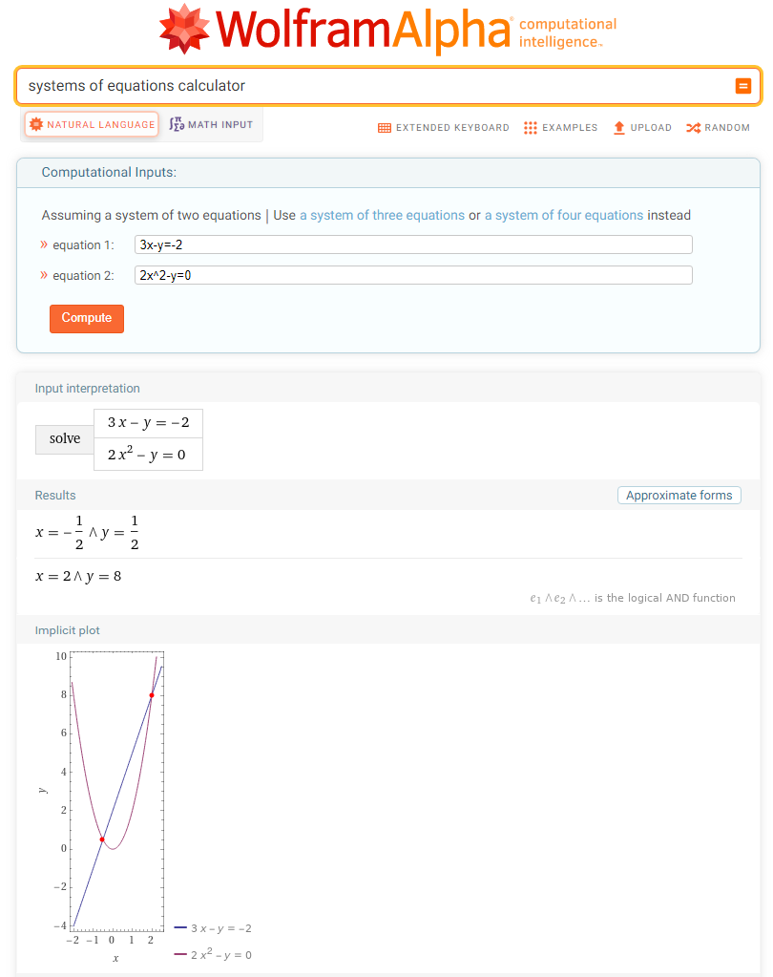
WolframAlpha has a calculator!

Slide 140
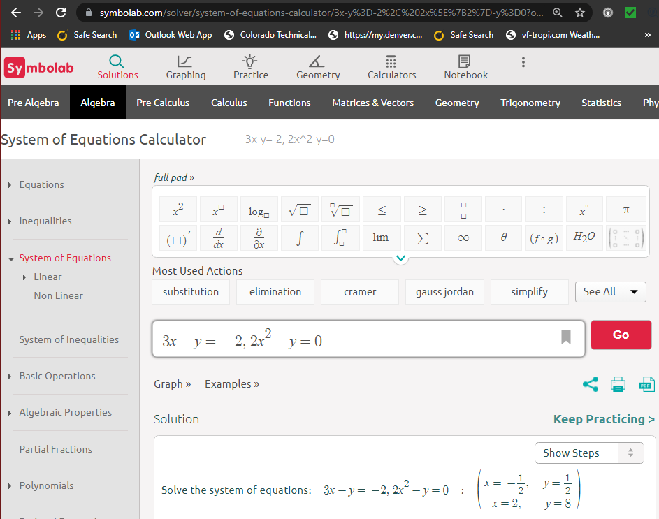

Slide 141
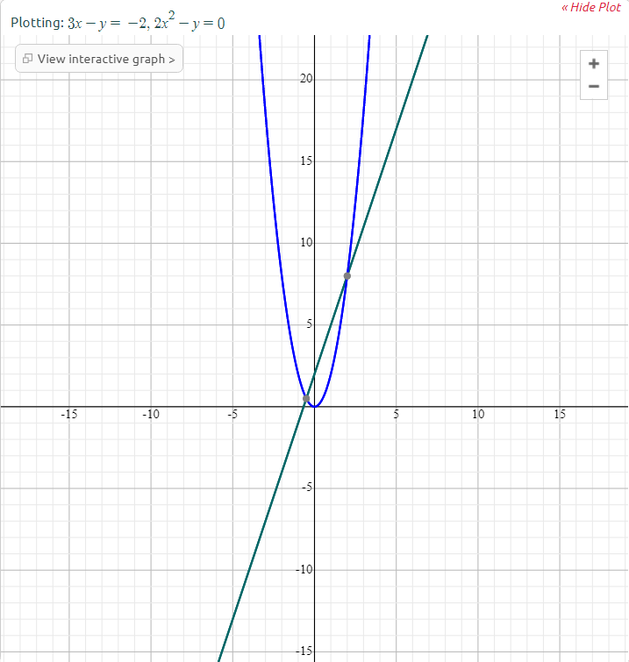

Slide 142
Questions?
http://i.imgur.com/aliTlT3.jpg

Slide 143
Systems of Nonlinears
To solve the previous problem, you could use either substitution or elimination…
Now let’s try an elimination problem!

Slide 144
SYSTEMS OF NONLINEARS
IN-CLASS PROBLEM 6b
Solve the system:
x² + y² = 13 hmm… a circle…
x² – y = 7 hmm… a parabola…

Slide 145
SYSTEMS OF NONLINEARS
IN-CLASS PROBLEM 6b
Solve the system:
x² + y² = 13
x² – y = 7
Let’s just subtract the 2nd equation from the 1st to get rid of that pesky x²!

Slide 146
SYSTEMS OF NONLINEARS
IN-CLASS PROBLEM 6b
Solve the system:
x² + y² = 13
-(x² – y = 7)

Slide 147
SYSTEMS OF NONLINEARS
IN-CLASS PROBLEM 6b
Solve the system:
x² + y² = 13
-x² + y = - 7

Slide 148
SYSTEMS OF NONLINEARS
IN-CLASS PROBLEM 6b
Solve the system:
x² + y² = 13
-x² + y = - 7
0 + y² + y = 6
Hmm…
This can be rewritten:
y² + y – 6 = 0

Slide 149
SYSTEMS OF NONLINEARS
IN-CLASS PROBLEM 6b
Solve the system:
x² + y² = 13
x² - y = 7
y² + y – 6 = 0
which factors:
(y+3)(y-2) = 0

Slide 150
SYSTEMS OF NONLINEARS
IN-CLASS PROBLEM 6b
Solve the system:
x² + y² = 13
x² - y = 7
y² + y – 6 = 0
which factors:
(y+3)(y-2) = 0
So y=-3 or y=2
Plug these into the easier equation (I pick the 2nd)

Slide 151
SYSTEMS OF NONLINEARS
IN-CLASS PROBLEM 6b
Solve the system:
x² + y² = 13
x² - y = 7
y=-3 or y=2
x² – (-3) = 7 x² – (2) = 7
x² + 3 = 7 x² – 2 = 7
x² = 7-3 = 4 x² = 7+2 = 9
x = 2 or -2 x = 3 or -3

Slide 152
SYSTEMS OF NONLINEARS
IN-CLASS PROBLEM 6b
Solve the system:
x² + y² = 13
x² - y = 7
y=-3 or y=2
x = 2 or -2 x = 3 or -3
AAGH! This means there are four solutions:
(x,y) = (2,-3),(-2,-3),(3,2),(-3,2)

Slide 153
SYSTEMS OF NONLINEARS
IN-CLASS PROBLEM 6b
Solve the system:
x² + y² = 13
x² - y = 7
(x,y) = (2,-3),(-2,-3),(3,2),(-3,2)
We can check them algebraically (aagh!) or by graphing them (let’s pick that one!)

Slide 154
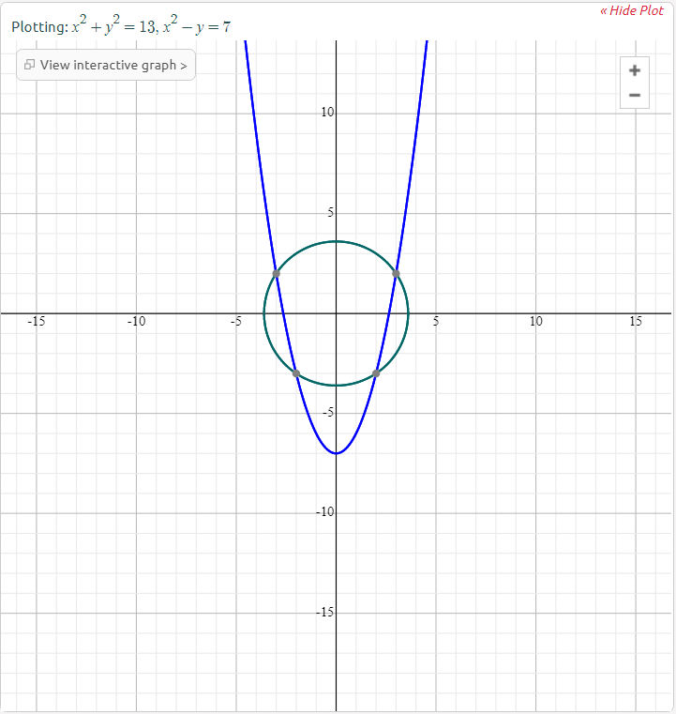
Looks like
(2,-3)
(-2,-3)
(3,2)
(-3,2)
are OK!

Slide 155
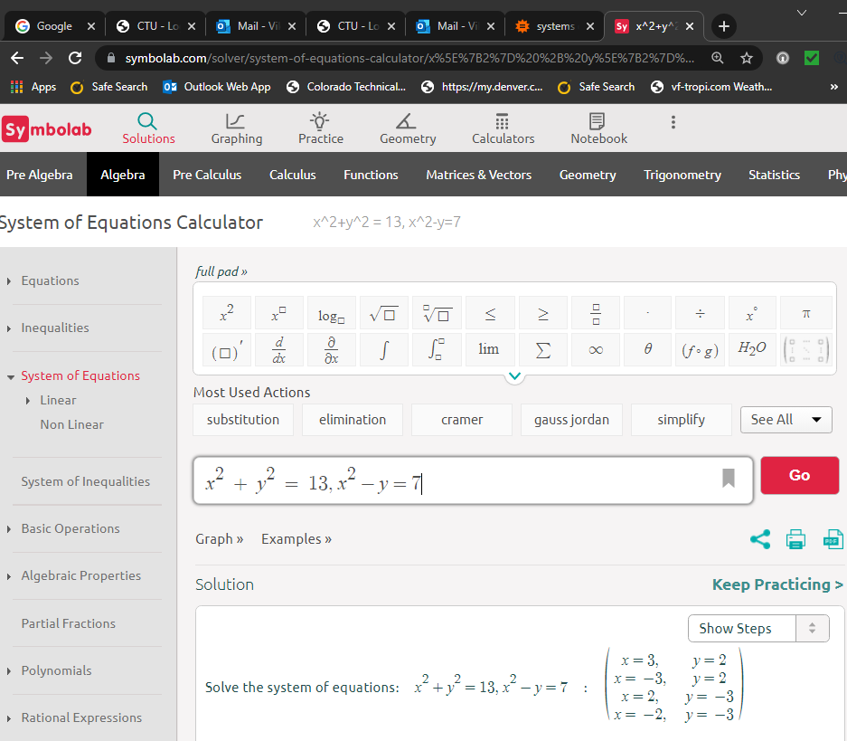

Slide 156
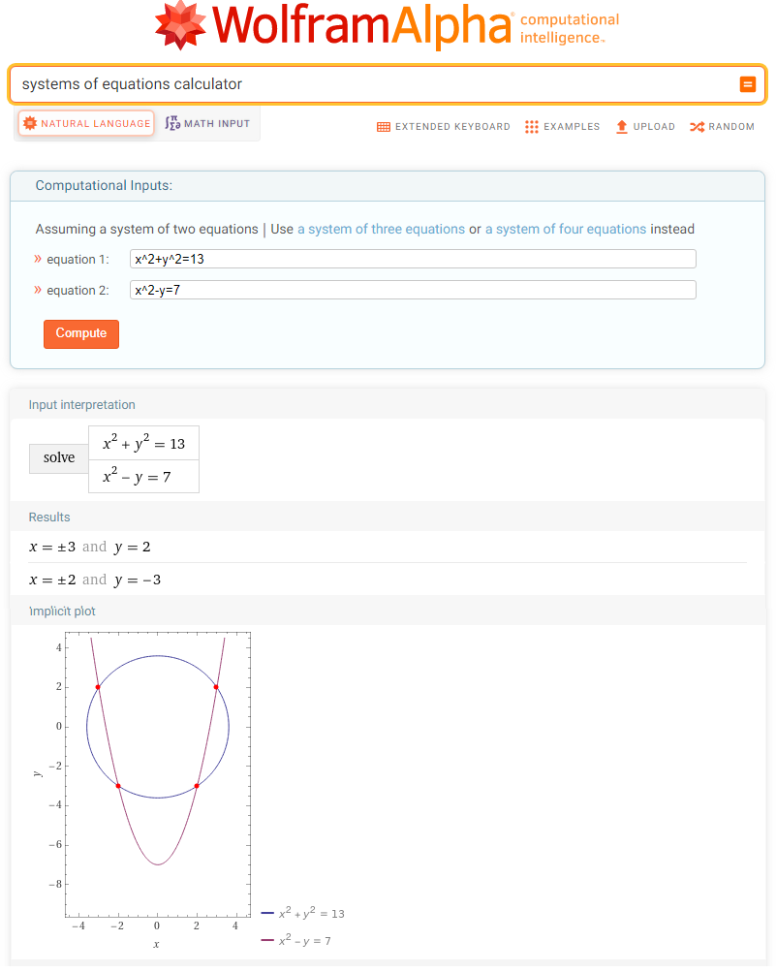

Slide 157
Questions?
http://i.imgur.com/aliTlT3.jpg

Slide 158
You Survived!
Today we studied:
Review of Conics
Systems of equations
(linear
and nonlinear)
www.playbuzz.com

