Slide 1

Welcome to
Unit 8- Part 15
MATH116-Foundations for Calculus
https://media.istockphoto.com/vectors/green-blackboard-mathematical-with-thin-line-shapes-and-inscriptions-vector-id1084380192?k=6&m=1084380192&s=612x612&w=0&h=TcEOVpnUmyuswT4Pay
AL6lNiHU8SS8g33yOSg-jR5BE=

Slide 2
What’s Up?
Review:
Sequences
New stuff:
Series

Slide 3
What’s Up?
Outcome 11) Find a formula for a general term of a sequence and find partial sums of arithmetic and geometric series
Outcome 12) Solve problems by identifying the given data, making a sketch as appropriate, and calculating the final answer

Slide 4

Review
http://995642590.r.lightningbase-cdn.com/wp-content/uploads/2010/12/looking-back-hrexaminer-v144-cover425px.jpg

Slide 5
Iteration
Means repeating a process until you reach a goal

Slide 6
Iteration
Iteration gives a sequence of values that are (hopefully) zeroing in on the desired solution

Slide 7
Sequences
Sequences are ordered lists

Slide 8

Sequences
They don’t have to be numbers

Slide 9
Sequences
Each member of a sequence is called a “term”

Slide 10
Sequences
Each term is designated by a subscript:
a_{1,} a_{2,} a_{3, ...,} a_{n, ...}
The 2nd term in the sequence
is a₂
The n^{th} term is a_{n}

Slide 11
Sequences
An infinite sequence goes on forever:
a_{1,} a_{2,} a_{3, ...}
A finite sequence stops at some point:
a_{1,} a_{2,} a_{3, ...,} a₁₂
ellipsis

Slide 12
Sequences
Numerical sequences are often formed by a formula that uses one term to calculate the next term in the sequence
You evaluate the sequence by plugging in the requested numbers for each term

Slide 13
Sequences
“Recursion formulas” - the formula calculates each term based on the previous term
Ex: a_{n} = a_{n-1} + 1

Slide 14
Sequences
You have to be given a starting term (usually a₁) to evaluate these

Slide 15
Sequences
Remember, we said that a model that relies on the previous value to forecast the next value is called a “time series” model
Time series models are all recursion models

Slide 16
Sequences
note: sequences are discrete points, not a smooth function!

Slide 17
Arithmetic Sequences
Arithmetic Sequences:
Each term in the sequence (after the first) differs from the preceding by a constant amount (positive or negative)
start with a₁
increase each time by "d"

Slide 18
Arithmetic Sequences
The recursion formula for an arithmetic sequence is:
a_{n} = a_{n-1} + d
You can calculate any term in an arithmetic sequence using:
a_{n} = a₁+(n-1)d
“d” stands for “difference”

Slide 19
Geometric Sequences
Geometric Sequences:
Each term in the sequence (after the first) is a common
multiple (positive or negative) of the previous term

Slide 20
Geometric Sequences
The recursion formula for a geometric sequence is:
a_{n} = r × a_{n-1}
You can calculate any term in a geometric sequence using:
a_{n} = a₁r ^{n-1}
“r” stands for “ratio”

Slide 21

Questions?
http://i.imgur.com/aliTlT3.jpg

Slide 22
Sequences
If the terms of a sequence approach a specific number (or state), we say the sequence converges to the number (or state)

Slide 23
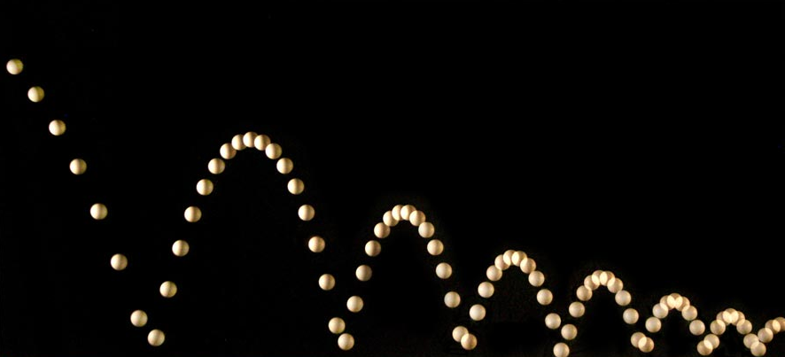
Sequences
Example: height of a bouncing ball
http://people.rit.edu/andpph/photofile-sci/bouncing-ball-7810.jpg

Slide 24
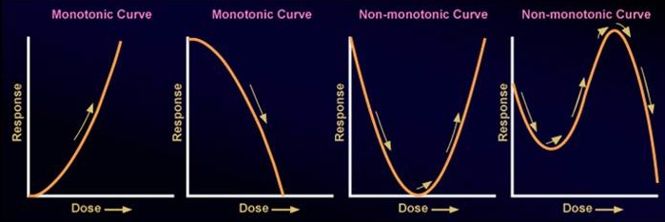
Sequences
Monotonic – either increasing or decreasing only
http://epa.gov/ncct/edr/images/nonmonotoniccurves2.jpg

Slide 25
Sequences
Non-decreasing – each term is greater than or equal to
the preceding term

Slide 26
Sequences
Non-increasing – each term is less than or equal to the preceding term

Slide 27
Sequences
Δƒ(x) ≥ 0 | Nondecreasing
Δƒ(x) ≤ 0 | Nonincreasing
Δƒ(x) > 0 | Increasing
Δƒ(x) < 0 | Decreasing
http://img.tfd.com/ggse/2c/gsed_0001_0016_0_img4169.png

Slide 28
Sequences
Bounded – all terms are less than or equal to some finite number in magnitude

Slide 29
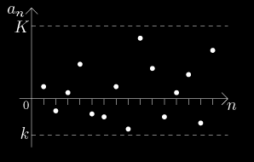
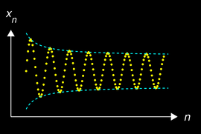
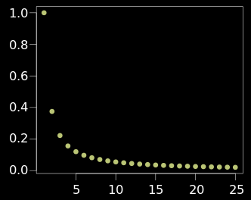
Sequences
http://math.feld.cvut.cz/mt/txta/1/gifa1/pc3aa1ba.gif
http://upload.wikimedia.org/wikipedia/commons/thumb/e/e4/Converging_Sequence_example.svg/320px-Converging_Sequence_example.svg.png
http://upload.wikimedia.org/wikipedia/commons/thumb/f/f4/Cauchy_sequence_illustration2.png/250px-Cauchy_sequence_illustration2.png

Slide 30
Sequences
Alternating Sequence:
Each term: (-1)^{n} a_{n}

Slide 31
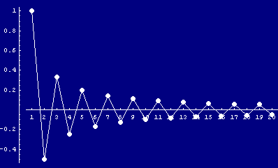
Sequences
5 -5 5 -5 5 -5 5 -5
http://www.cs.cas.cz/portal/AlgoMath/MathematicalAnalysis/InfiniteSeriesAndProducts/InfiniteSeries/SeriesWithArbitraryTerms/HTMLFiles/AlternatingSeries_38.gif

Slide 32
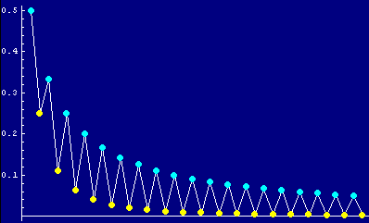
SEQUENCES
IN-CLASS PROBLEM 1
Is this an alternating sequence?
http://www.cs.cas.cz/portal/AlgoMath/MathematicalAnalysis/InfiniteSeriesAndProducts/InfiniteSeries/SeriesWithArbitraryTerms/HTMLFiles/AlternatingSeries_28.gif

Slide 33
SEQUENCES
IN-CLASS PROBLEM 1
Is this an alternating sequence?
yes, it is
http://www.cs.cas.cz/portal/AlgoMath/MathematicalAnalysis/InfiniteSeriesAndProducts/InfiniteSeries/SeriesWithArbitraryTerms/HTMLFiles/AlternatingSeries_28.gif

Slide 34
Questions?
http://i.imgur.com/aliTlT3.jpg

Slide 35
Series
If you combine the numbers in a sequence into a single number, it’s called a “series”

Slide 36
Series
This is usually done by adding up all of the terms or multiplying all of them together

Slide 37
SERIES
IN-CLASS PROBLEM 2a
What is the sum of the first 10 counting numbers?

Slide 38
SERIES
IN-CLASS PROBLEM 2a
What is the sum of the first 10 counting numbers?
1+2+3+4+5+6+7+8+9+10

Slide 39
SERIES
IN-CLASS PROBLEM 2a
Here’s a trick:
1 + 10 = 11
2 + 9 = 11
3 + 8 = 11
4 + 7 = 11
5 + 6 = 11
So the answer is 5 × 11 = 55

Slide 40
Series
It’s math class… so there’s always a new symbol!
∑
means “add ‘em up!”

Slide 41
Series
If you want to multiply them all together rather than adding them:
Π
means “multiply ‘em up!”

Slide 42
Series
We could have written:
What is the sum of the first 10 counting numbers?
as:
∑ 1 2 3…10

Slide 43
Series
We usually use ∑ with a formula:
This means “add up the n’s where n goes from 1 to 10”
10
∑ n
n=1

Slide 44
SERIES
IN-CLASS PROBLEM 2b
4
Calculate the series ∑ (n + 1)
n=1

Slide 45
SERIES
IN-CLASS PROBLEM 2b
4
Calculate the series ∑ (n + 1)
n=1
Just start adding up the (n + 1)s
Plugging in n=1, n=2, n=3, n=4

Slide 46
SERIES
IN-CLASS PROBLEM 2b
4
Calculate the series ∑ (n + 1)
n=1
= 1 + 1
+ 2 + 1
+ 3 + 1
+ 4 + 1
= 2 + 3 + 4 + 5 = ?

Slide 47
SERIES
IN-CLASS PROBLEM 2b
4
Calculate the series ∑ (n + 1)
n=1
= 1 + 1
+ 2 + 1
+ 3 + 1
+ 4 + 1
= 2 + 3 + 4 + 5 = 14

Slide 48
Questions?
http://i.imgur.com/aliTlT3.jpg

Slide 49
Series
The sequence Sn defined by:
S₁ = a₁
S₂ = a₁ + a₂
S_{n} = a₁ + a₂ + a₃ + ... + a_{n}

Slide 50
Series
The sequence Sn defined by:
S₁ = a₁
S₂ = a₁ + a₂
S_{n} = a₁ + a₂ + a₃ + ... + a_{n}
n
= ∑ a_{k}
k=1

Slide 51
Series
The sequence Sn defined by:
S₁ = a₁
S₂ = a₁ + a₂
S_{n} = a₁ + a₂ + a₃ + ... + a_{n}
n
= ∑ a_{k}
k=1
is called the sequence of partial sums of the series

Slide 52
Series
The sequence Sn defined by:
S₁ = a₁
S₂ = a₁ + a₂
S_{n} = a₁ + a₂ + a₃ + ... + a_{n}
n
= ∑ a_{k}
k=1
S_{n} is the nth partial sum

Slide 53
Questions?
http://i.imgur.com/aliTlT3.jpg

Slide 54
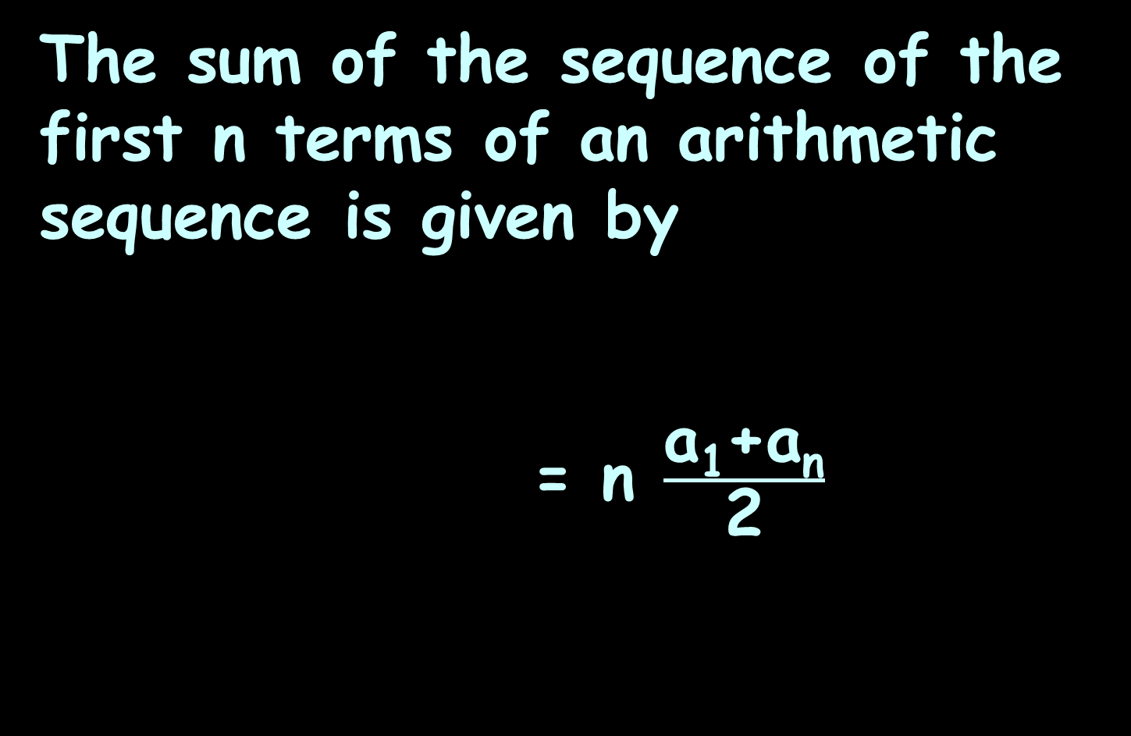
Arithmetic Series
The sum of the sequence of the first n terms of an arithmetic sequence is given by
= n $\frac{\text{a}\text{1}\text{+}\text{an}}{\text{2}}$
n
S_{n} = ∑ a_{k}
k=1
average

Slide 55
ARITHMETIC SEQUENCES AND SERIES
IN-CLASS PROBLEM 3a
If a₁ = 5 and d = 2 what are the first four terms of the arithmetic sequence?
a₁ = 5 + (1-1)2 = 5
a₂ = 5 + (2-1)2 =
a₃ = 5 + (3-1)2 =
a₄ = 5 + (4-1)2 =

Slide 56
ARITHMETIC SEQUENCES AND SERIES
IN-CLASS PROBLEM 3a
If a₁ = 5 and d = 2 what are the first four terms of the arithmetic sequence?
a₁ = 5 + (1-1)2 = 5
a₂ = 5 + (2-1)2 = 7
a₃ = 5 + (3-1)2 =
a₄ = 5 + (4-1)2 =

Slide 57
ARITHMETIC SEQUENCES AND SERIES
IN-CLASS PROBLEM 3a
If a₁ = 5 and d = 2 what are the first four terms of the arithmetic sequence?
a₁ = 5 + (1-1)2 = 5
a₂ = 5 + (2-1)2 = 7
a₃ = 5 + (3-1)2 = 9
a₄ = 5 + (4-1)2 =

Slide 58
ARITHMETIC SEQUENCES AND SERIES
IN-CLASS PROBLEM 3a
If a₁ = 5 and d = 2 what are the first four terms of the arithmetic sequence?
a₁ = 5 + (1-1)2 = 5
a₂ = 5 + (2-1)2 = 7
a₃ = 5 + (3-1)2 = 9
a₄ = 5 + (4-1)2 = 11
What is the sum?

Slide 59
ARITHMETIC SEQUENCES AND SERIES
IN-CLASS PROBLEM 3a
If a₁ = 5 and d = 2 what are the first four terms of the arithmetic sequence?
a₁ = 5 + (1-1)2 = 5
a₂ = 5 + (2-1)2 = 7
a₃ = 5 + (3-1)2 = 9
a₄ = 5 + (4-1)2 = 11
What is the sum? 32

Slide 60
ARITHMETIC SEQUENCES AND SERIES
IN-CLASS PROBLEM 3a
If a₁ = 5 and d = 2 what are the first four terms of the arithmetic sequence?
a₁ = 5 + (1-1)2 = 5
a₂ = 5 + (2-1)2 = 7
a₃ = 5 + (3-1)2 = 9
a₄ = 5 + (4-1)2 = 11
What is the sum? 32

Slide 61
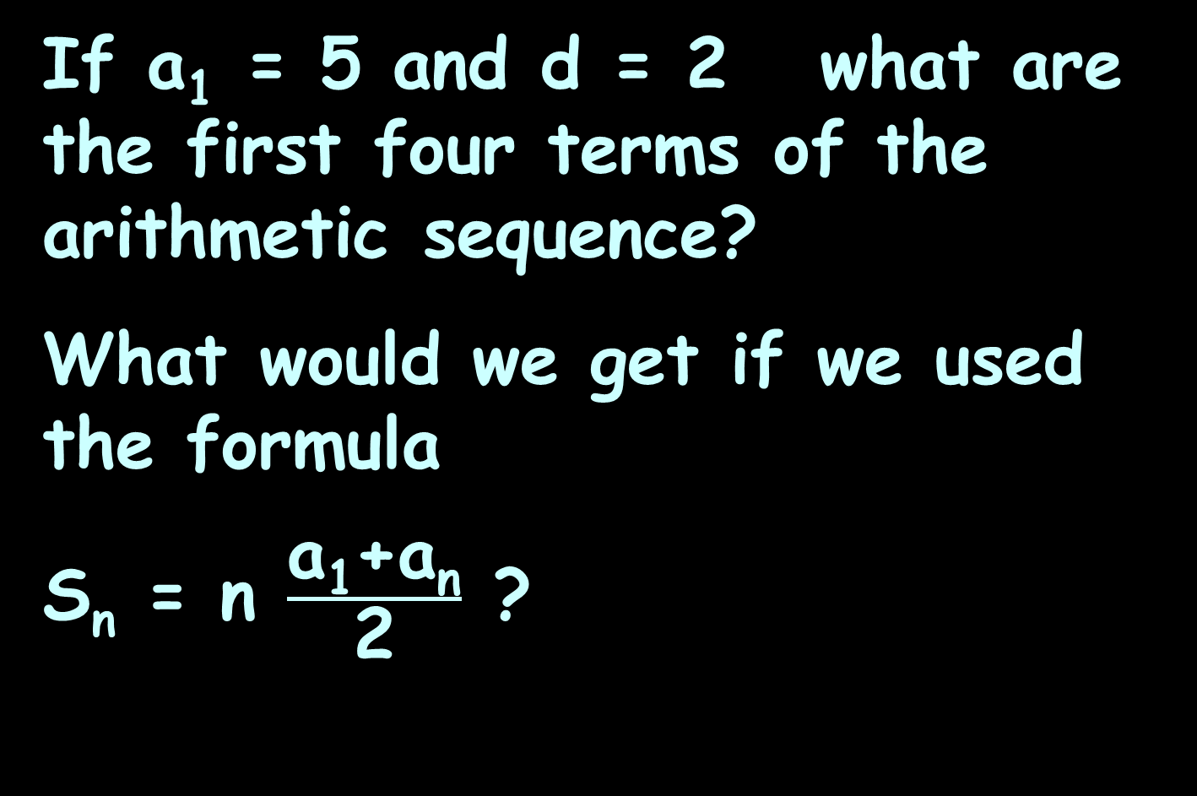
ARITHMETIC SEQUENCES AND SERIES
IN-CLASS PROBLEM 3a
If a₁ = 5 and d = 2 what are the first four terms of the arithmetic sequence?
What would we get if we used the formula
S_{n} = n $\frac{\text{a}\text{1}\text{+}\text{an}}{\text{2}}$ ?

Slide 62
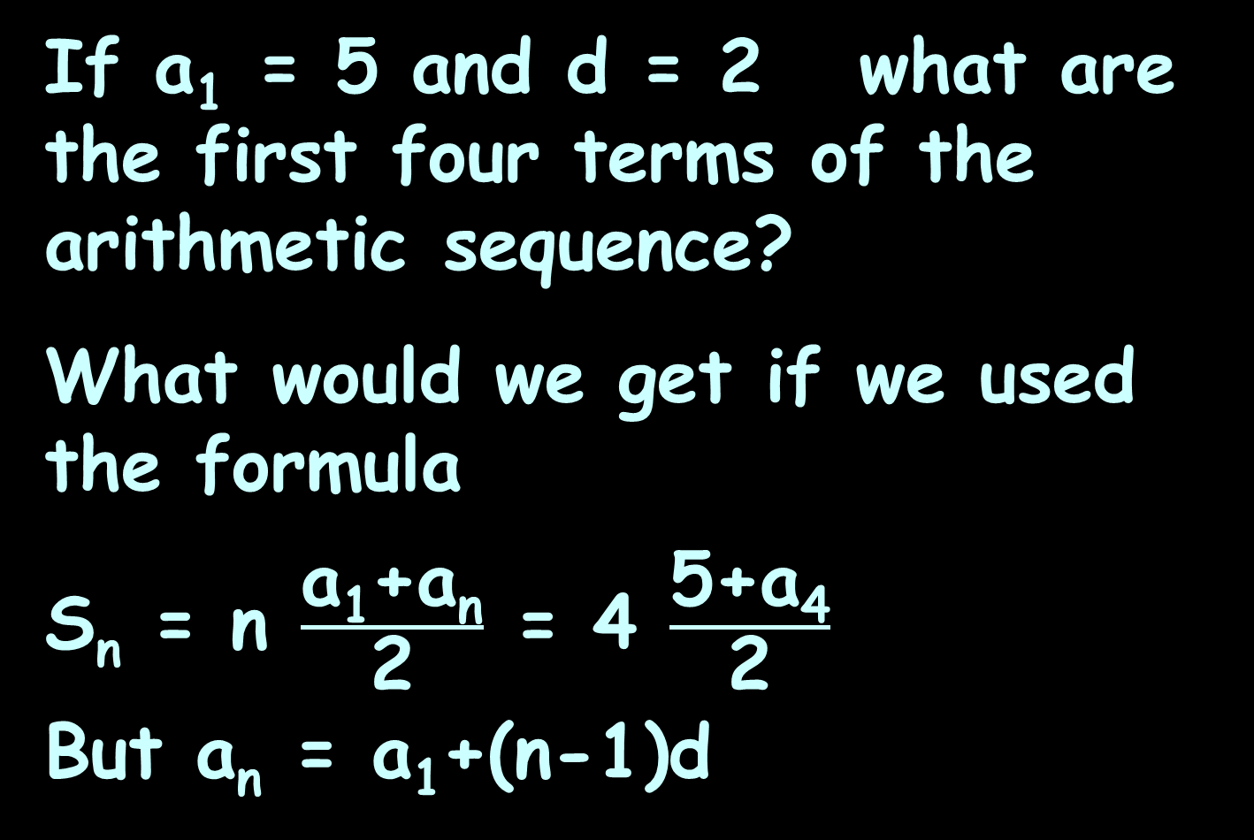
ARITHMETIC SEQUENCES AND SERIES
IN-CLASS PROBLEM 3a
If a₁ = 5 and d = 2 what are the first four terms of the arithmetic sequence?
What would we get if we used the formula
S_{n} = n $\frac{\text{a}\text{1}\text{+}\text{an}}{\text{2}}$ = 4 $\frac{\text{5}\text{+}\text{a}\text{4}}{\text{2}}$
But a_{n} = a₁+(n-1)d

Slide 63
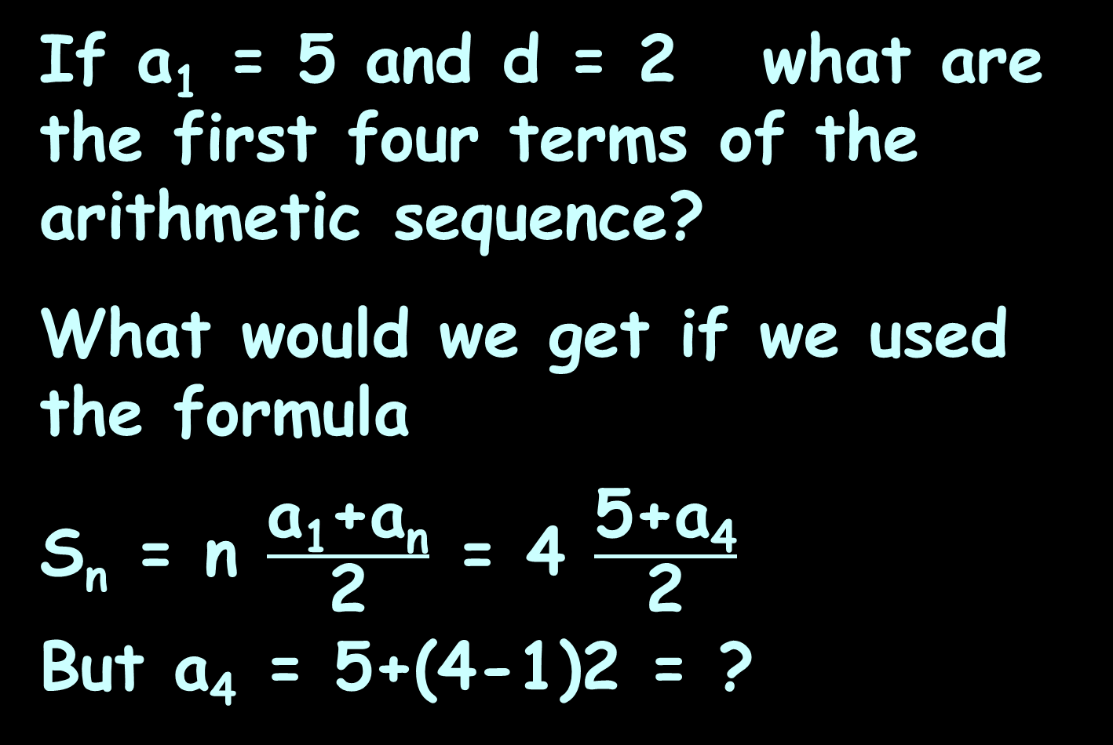
ARITHMETIC SEQUENCES AND SERIES
IN-CLASS PROBLEM 3a
If a₁ = 5 and d = 2 what are the first four terms of the arithmetic sequence?
What would we get if we used the formula
S_{n} = n $\frac{\text{a}\text{1}\text{+}\text{an}}{\text{2}}$ = 4 $\frac{\text{5}\text{+}\text{a}\text{4}}{\text{2}}$
But a₄ = 5+(4-1)2 = ?

Slide 64
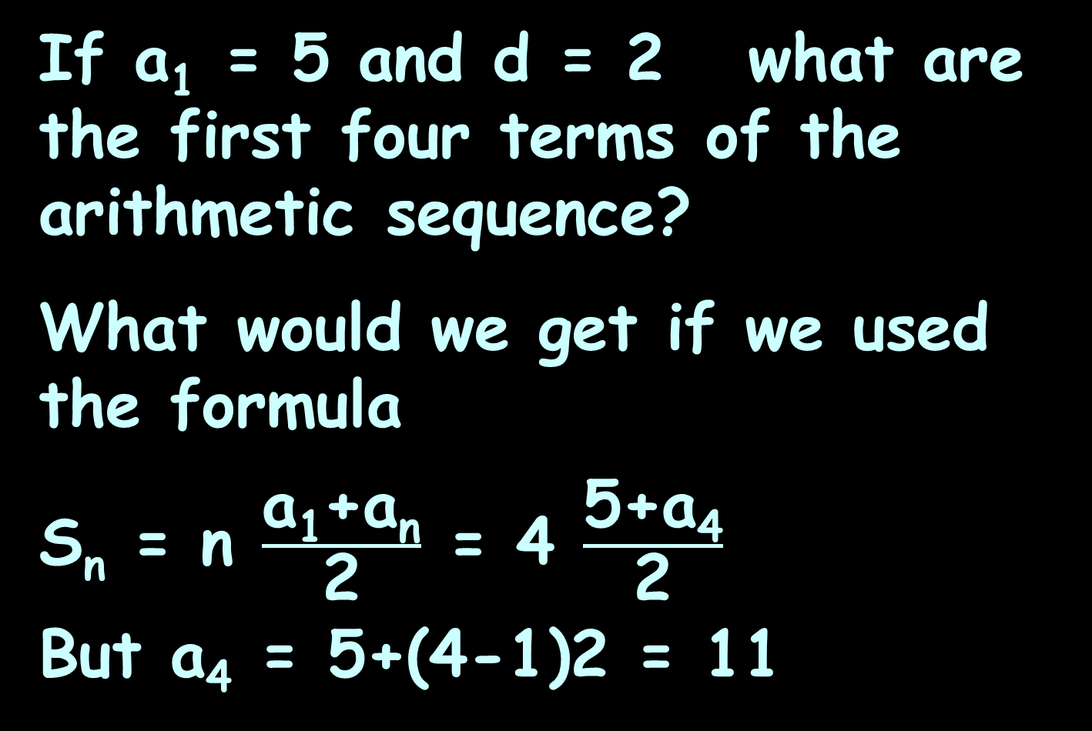
ARITHMETIC SEQUENCES AND SERIES
IN-CLASS PROBLEM 3a
If a₁ = 5 and d = 2 what are the first four terms of the arithmetic sequence?
What would we get if we used the formula
S_{n} = n $\frac{\text{a}\text{1}\text{+}\text{an}}{\text{2}}$ = 4 $\frac{\text{5}\text{+}\text{a}\text{4}}{\text{2}}$
But a₄ = 5+(4-1)2 = 11

Slide 65
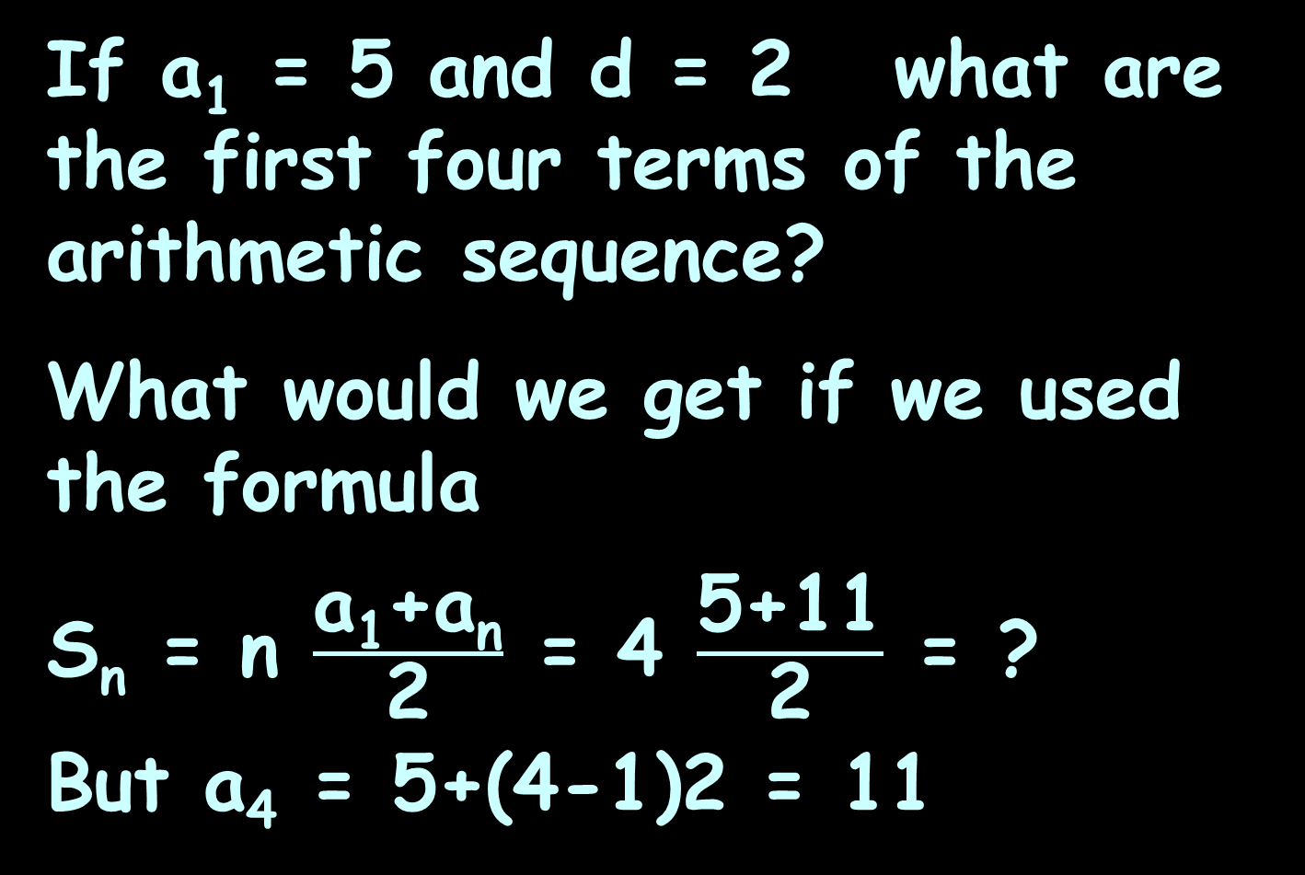
ARITHMETIC SEQUENCES AND SERIES
IN-CLASS PROBLEM 3a
If a₁ = 5 and d = 2 what are the first four terms of the arithmetic sequence?
What would we get if we used the formula
S_{n} = n $\frac{\text{a}\text{1}\text{+}\text{an}}{\text{2}}$ = 4 $\frac{\text{5}\text{+}\text{11}}{\text{2}}$ = ?
But a₄ = 5+(4-1)2 = 11

Slide 66
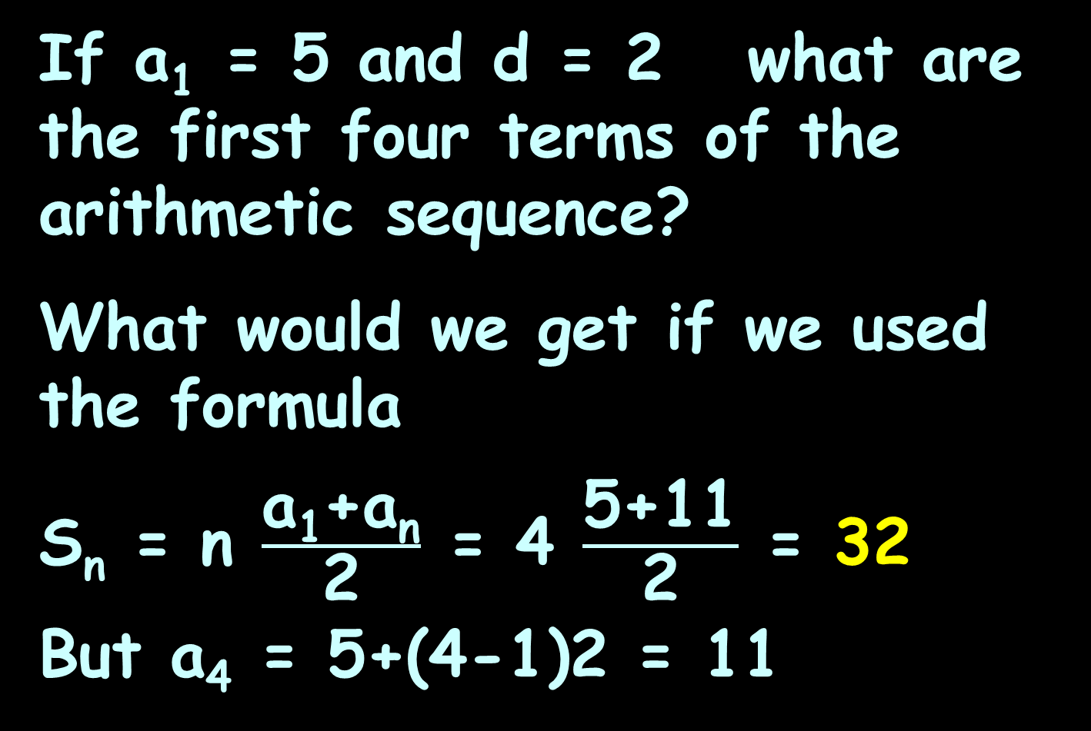
ARITHMETIC SEQUENCES AND SERIES
IN-CLASS PROBLEM 3a
If a₁ = 5 and d = 2 what are the first four terms of the arithmetic sequence?
What would we get if we used the formula
S_{n} = n $\frac{\text{a}\text{1}\text{+}\text{an}}{\text{2}}$ = 4 $\frac{\text{5}\text{+}\text{11}}{\text{2}}$ = 32
But a₄ = 5+(4-1)2 = 11
Which is what we got before!

Slide 67
Questions?
http://i.imgur.com/aliTlT3.jpg

Slide 68
ARITHMETIC SEQUENCES AND SERIES
IN-CLASS PROBLEM 3b
What is the sum of the first five terms in the arithmetic sequence 1, 4, 7…?

Slide 69
ARITHMETIC SEQUENCES AND SERIES
IN-CLASS PROBLEM 3b
What is the sum of the first five terms in the arithmetic sequence 1, 4, 7…?
What is a₁?
What is d?
What is n?

Slide 70
ARITHMETIC SEQUENCES AND SERIES
IN-CLASS PROBLEM 3b
What is the sum of the first five terms in the arithmetic sequence 1, 4, 7…?
Use whichever method you choose!

Slide 71
ARITHMETIC SEQUENCES AND SERIES
IN-CLASS PROBLEM 3b
What is the sum of the first five terms in the arithmetic sequence 1, 4, 7…?
a₁ = 1 + (1-1)3 =
a₂ = 1 + (2-1)3 =
a₃ = 1 + (3-1)3 =
a₄ = 1 + (4-1)3 =
a₅ = 1 + (5-1)3 =

Slide 72
ARITHMETIC SEQUENCES AND SERIES
IN-CLASS PROBLEM 3b
What is the sum of the first five terms in the arithmetic sequence 1, 4, 7…?
a₁ = 1 + (1-1)3 = 1
a₂ = 1 + (2-1)3 =
a₃ = 1 + (3-1)3 =
a₄ = 1 + (4-1)3 =
a₅ = 1 + (5-1)3 =

Slide 73
ARITHMETIC SEQUENCES AND SERIES
IN-CLASS PROBLEM 3b
What is the sum of the first five terms in the arithmetic sequence 1, 4, 7…?
a₁ = 1 + (1-1)3 = 1
a₂ = 1 + (2-1)3 = 4
a₃ = 1 + (3-1)3 =
a₄ = 1 + (4-1)3 =
a₅ = 1 + (5-1)3 =

Slide 74
ARITHMETIC SEQUENCES AND SERIES
IN-CLASS PROBLEM 3b
What is the sum of the first five terms in the arithmetic sequence 1, 4, 7…?
a₁ = 1 + (1-1)3 = 1
a₂ = 1 + (2-1)3 = 4
a₃ = 1 + (3-1)3 = 7
a₄ = 1 + (4-1)3 =
a₅ = 1 + (5-1)3 =

Slide 75
ARITHMETIC SEQUENCES AND SERIES
IN-CLASS PROBLEM 3b
What is the sum of the first five terms in the arithmetic sequence 1, 4, 7…?
a₁ = 1 + (1-1)3 = 1
a₂ = 1 + (2-1)3 = 4
a₃ = 1 + (3-1)3 = 7
a₄ = 1 + (4-1)3 = 10
a₅ = 1 + (5-1)3 =

Slide 76
ARITHMETIC SEQUENCES AND SERIES
IN-CLASS PROBLEM 3b
What is the sum of the first five terms in the arithmetic sequence 1, 4, 7…?
a₁ = 1 + (1-1)3 = 1
a₂ = 1 + (2-1)3 = 4
a₃ = 1 + (3-1)3 = 7
a₄ = 1 + (4-1)3 = 10
a₅ = 1 + (5-1)3 = 13
So, what is the sum?

Slide 77
ARITHMETIC SEQUENCES AND SERIES
IN-CLASS PROBLEM 3b
So the sum is:
1+4+7+10+13 = 14×2 + 7 = 35

Slide 78
ARITHMETIC SEQUENCES AND SERIES
IN-CLASS PROBLEM 3b
OR use the sum of the first n terms of an arithmetic sequence:
S_{n} = n(a₁ + a_{n})/2
a₅ = 1 + (5-1)3 = 13

Slide 79
ARITHMETIC SEQUENCES AND SERIES
IN-CLASS PROBLEM 3b
OR use the sum of the first n terms of an arithmetic sequence:
S_{n} = n(a₁ + a_{n})/2
S₅ = 5(1 + 13)/2 = 35
You only have to calculate one term using this method!

Slide 80
Questions?
http://i.imgur.com/aliTlT3.jpg

Slide 81
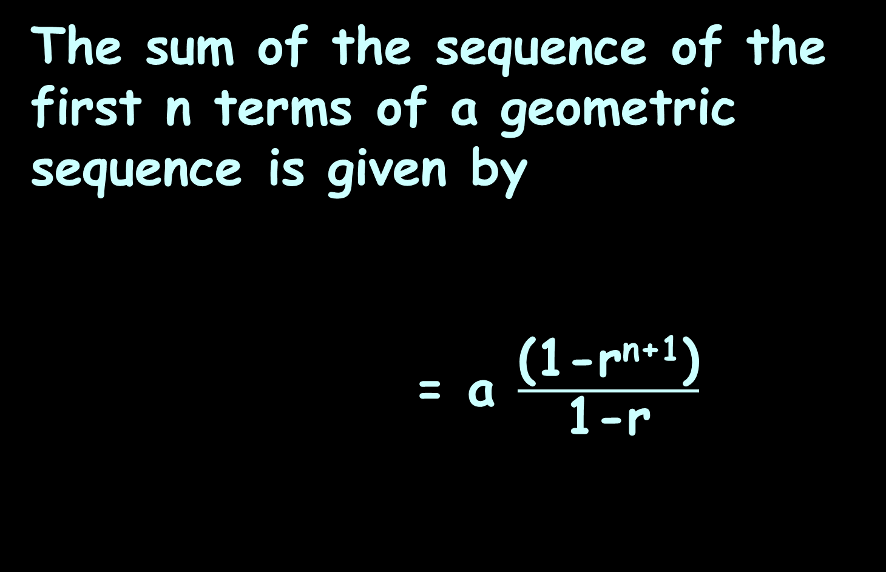
Geometric Series
The sum of the sequence of the first n terms of a geometric sequence is given by
= a $\frac{\text{(1−}\text{rn}\text{+1)}}{\text{1−}\text{r}}$
n
S_{n} = ∑ ar^{k}
k=1

Slide 82
GEOMETRIC SEQUENCES AND SERIES
IN-CLASS PROBLEM 4a
What is the sum of the first five terms in the geometric sequence 1, 4, 16…?
What is a₁?
What is r?

Slide 83
GEOMETRIC SEQUENCES AND SERIES
IN-CLASS PROBLEM 4a
What is the sum of the first five terms in the geometric sequence 1, 4, 16…?
What is a₁? 1
What is r?

Slide 84
GEOMETRIC SEQUENCES AND SERIES
IN-CLASS PROBLEM 4a
What is the sum of the first five terms in the geometric sequence 1, 4, 16…?
What is a₁? 1
What is r? 4

Slide 85
GEOMETRIC SEQUENCES AND SERIES
IN-CLASS PROBLEM 4b
What is the sum of the first five terms in the geometric sequence 1, 4, 16…?
a₁ = 1(4 ¹⁻¹) = ?
a₂ = 1(4 ²⁻¹) = ?
a₃ = 1(4 ³⁻¹) = ?
a₄ = 1(4 ⁴⁻¹) = ?
a₅ = 1(4 ⁵⁻¹) = ?

Slide 86
GEOMETRIC SEQUENCES AND SERIES
IN-CLASS PROBLEM 4b
What is the sum of the first five terms in the geometric sequence 1, 4, 16…?
a₁ = 1(4 ¹⁻¹) = 1
a₂ = 1(4 ²⁻¹) =
a₃ = 1(4 ³⁻¹) =
a₄ = 1(4 ⁴⁻¹) =
a₅ = 1(4 ⁵⁻¹) =

Slide 87
GEOMETRIC SEQUENCES AND SERIES
IN-CLASS PROBLEM 4b
What is the sum of the first five terms in the geometric sequence 1, 4, 16…?
a₁ = 1(4 ¹⁻¹) = 1
a₂ = 1(4 ²⁻¹) = 4
a₃ = 1(4 ³⁻¹) =
a₄ = 1(4 ⁴⁻¹) =
a₅ = 1(4 ⁵⁻¹) =

Slide 88
GEOMETRIC SEQUENCES AND SERIES
IN-CLASS PROBLEM 4b
What is the sum of the first five terms in the geometric sequence 1, 4, 16…?
a₁ = 1(4 ¹⁻¹) = 1
a₂ = 1(4 ²⁻¹) = 4
a₃ = 1(4 ³⁻¹) = 16
a₄ = 1(4 ⁴⁻¹) =
a₅ = 1(4 ⁵⁻¹) =

Slide 89
GEOMETRIC SEQUENCES AND SERIES
IN-CLASS PROBLEM 4b
What is the sum of the first five terms in the geometric sequence 1, 4, 16…?
a₁ = 1(4 ¹⁻¹) = 1
a₂ = 1(4 ²⁻¹) = 4
a₃ = 1(4 ³⁻¹) = 16
a₄ = 1(4 ⁴⁻¹) = 64
a₅ = 1(4 ⁵⁻¹) =

Slide 90
GEOMETRIC SEQUENCES AND SERIES
IN-CLASS PROBLEM 4b
What is the sum of the first five terms in the geometric sequence 1, 4, 16…?
a₁ = 1(4 ¹⁻¹) = 1
a₂ = 1(4 ²⁻¹) = 4
a₃ = 1(4 ³⁻¹) = 16
a₄ = 1(4 ⁴⁻¹) = 64
a₅ = 1(4 ⁵⁻¹) = 256
So what is the sum?

Slide 91
GEOMETRIC SEQUENCES AND SERIES
IN-CLASS PROBLEM 4b
What is the sum of the first five terms in the geometric sequence 1, 4, 16…?
1 + 4 + 16 + 64 + 256
= 341

Slide 92
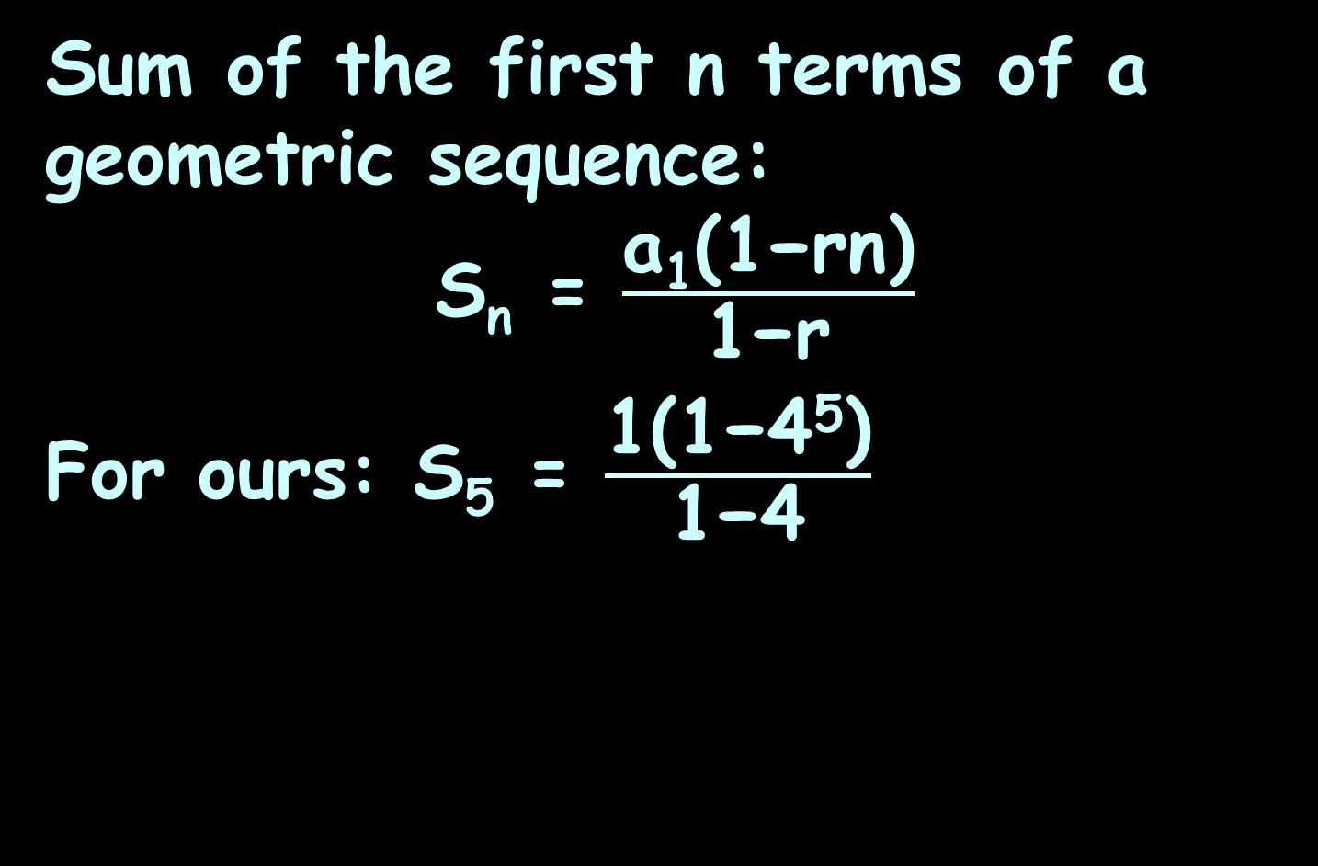
GEOMETRIC SEQUENCES AND SERIES
IN-CLASS PROBLEM 4b
Sum of the first n terms of a geometric sequence:
S_{n} = $\frac{\text{a}\text{1}\text{(1−}\text{rn}\text{)}}{\text{1−}\text{r}}$
For ours: S₅ = $\frac{\text{1}\text{(1−}\text{4}\text{5}\text{)}}{\text{1−}\text{4}}$

Slide 93
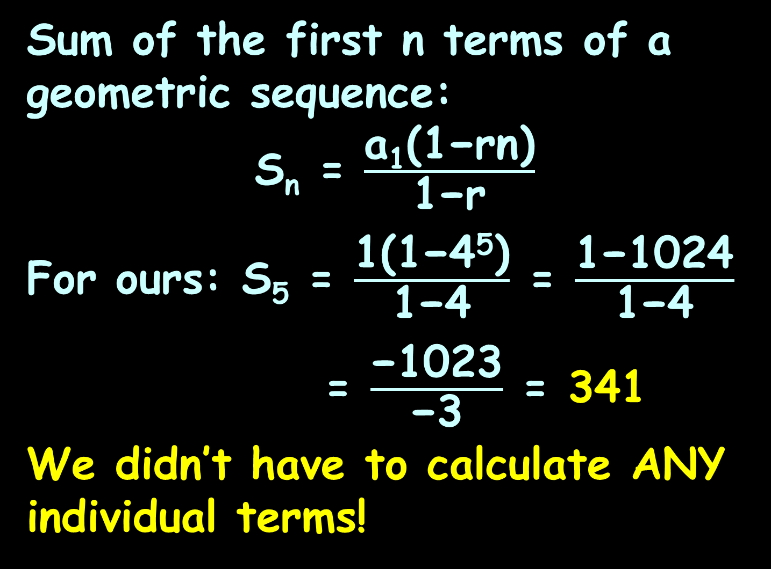
GEOMETRIC SEQUENCES AND SERIES
IN-CLASS PROBLEM 4b
Sum of the first n terms of a geometric sequence:
S_{n} = $\frac{\text{a}\text{1}\text{(1−}\text{rn}\text{)}}{\text{1−}\text{r}}$
For ours: S₅ = $\frac{\text{1}\text{(1−}\text{4}\text{5}\text{)}}{\text{1−}\text{4}}$= $\frac{\text{1−}\text{1024}}{\text{1−4}}$
= $\frac{\text{−102}\text{3}}{\text{−}\text{3}}$ = 341
We didn’t have to calculate ANY individual terms!

Slide 94
Questions?
http://i.imgur.com/aliTlT3.jpg

Slide 95
GEOMETRIC SEQUENCES AND SERIES
IN-CLASS PROBLEM 5a
Consider a string of amplifiers each with a voltage gain ‘A’.
If a signal V is applied to the first amplifier, develop the sequence that describes the successive output voltages
of each stage:

Slide 96
GEOMETRIC SEQUENCES AND SERIES
IN-CLASS PROBLEM 5a
Consider a string of amplifiers each with a voltage gain ‘A’.
If a signal V is applied to the first amplifier, develop the sequence that describes the successive output voltages
of each stage:
V AV A²V A³V A⁴V …

Slide 97
GEOMETRIC SEQUENCES AND SERIES
IN-CLASS PROBLEM 5b
Explain why is this a geometric sequence?

Slide 98
GEOMETRIC SEQUENCES AND SERIES
IN-CLASS PROBLEM 5c
Consider a string of amplifiers each with a voltage gain ‘A’.
If a signal V is applied to the first amplifier, the sequence is: V AV A²V A³V A⁴V …
Develop the recursion formula for this sequence:
a_{n} = r × a_{n-1}

Slide 99
GEOMETRIC SEQUENCES AND SERIES
IN-CLASS PROBLEM 5c
Consider a string of amplifiers each with a voltage gain ‘A’.
If a signal V is applied to the first amplifier, the sequence is: V AV A²V A³V A⁴V …
Develop the recursion formula for this sequence:
a_{n} = A a_{n-1}
a_{n} = r × a_{n-1}

Slide 100
GEOMETRIC SEQUENCES AND SERIES
IN-CLASS PROBLEM 5d
Consider a string of amplifiers each with a voltage gain ‘A’.
If a signal V is applied to the first amplifier, the sequence is: V AV A²V A³V A⁴V …
If A=2 and V₀ = 3, calculate the value for the 17th term:
a_{n} = r^{n}a₀

Slide 101
GEOMETRIC SEQUENCES AND SERIES
IN-CLASS PROBLEM 5d
Consider a string of amplifiers each with a voltage gain ‘A’.
If a signal V is applied to the first amplifier, the sequence is: V AV A²V A³V A⁴V …
If A=2 and V₀ = 3, calculate the value for the 17th term:
a₁₇ = r¹⁷a₀ =
a_{n} = r^{n}a₀

Slide 102
GEOMETRIC SEQUENCES AND SERIES
IN-CLASS PROBLEM 5d
Consider a string of amplifiers each with a voltage gain ‘A’.
If a signal V is applied to the first amplifier, the sequence is: V AV A²V A³V A⁴V …
If A=2 and V₀ = 3, calculate the value for the 17th term:
a₁₇ = r¹⁷a₀ = (2)¹⁷(3)
= 393,216 whats?
a_{n} = r^{n}a₀

Slide 103
GEOMETRIC SEQUENCES AND SERIES
IN-CLASS PROBLEM 5d
Consider a string of amplifiers each with a voltage gain ‘A’.
If a signal V is applied to the first amplifier, the sequence is: V AV A²V A³V A⁴V …
If A=2 and V₀ = 3, calculate the value for the 17th term:
a₁₇ = r¹⁷a₀ = (2)¹⁷(3)
= 393,216 volts
a_{n} = r^{n}a₀

Slide 104
Questions?
http://i.imgur.com/aliTlT3.jpg

Slide 105
Series
Sequences and series can be a mixture of arithmetic and geometric
This is actually VERY common in the real world!

Slide 106
SERIES
IN-CLASS PROBLEM 6
A fishery manager knows that the fish population naturally increases at a rate of 1.5% per month. 80 fish are harvested each month. F₀ = 4000 fish. Let F_{n} be the fish population after the nth month.
Identify is this a geometric or an arithmetic series?

Slide 107
SERIES
IN-CLASS PROBLEM 6
A fishery manager knows that the fish population naturally increases at a rate of 1.5% per month. 80 fish are harvested each month. F₀ = 4000 fish. Let F_{n} be the fish population after the nth month.
Identify is this a geometric or an arithmetic series? both

Slide 108
SERIES
IN-CLASS PROBLEM 6
A fishery manager knows that the fish population naturally increases at a rate of 1.5% per month. 80 fish are harvested each month. F₀ = 4000 fish. Let F_{n} be the fish population after the nth month.
Identify what is r?

Slide 109
SERIES
IN-CLASS PROBLEM 6
Rate = 1.5% = 0.015
But… if we multiply each recursive term by 0.015 the population will decrease each month!
Now what?

Slide 110
SERIES
IN-CLASS PROBLEM 6
Rate = 1.5% = 0.015
But… if we multiply each recursive term by 0.015 the population will decrease each month!
For r as a multiplier use
r = 1 + 0.015 = 1.015
That will give a 0.015 increase each month

Slide 111
SERIES
IN-CLASS PROBLEM 6
A fishery manager knows that the fish population naturally increases at a rate of 1.5% per month. 80 fish are harvested each month. F₀ = 4000 fish. Let F_{n} be the fish population after the nth month.
Identify what is d?

Slide 112
SERIES
IN-CLASS PROBLEM 6
A fishery manager knows that the fish population naturally increases at a rate of 1.5% per month. 80 fish are harvested each month. F₀ = 4000 fish. Let F_{n} be the fish population after the nth month.
Identify what is d? -80

Slide 113
SERIES
IN-CLASS PROBLEM 6
A fishery manager knows that the fish population naturally increases at a rate of 1.5% per month. 80 fish are harvested each month. F₀ = 4000 fish. Let F_{n} be the fish population after the nth month.
Identify what is a₀?

Slide 114
SERIES
IN-CLASS PROBLEM 6
A fishery manager knows that the fish population naturally increases at a rate of 1.5% per month. 80 fish are harvested each month. F₀ = 4000 fish. Let F_{n} be the fish population after the nth month.
Identify what is a₀? 4000

Slide 115
SERIES
IN-CLASS PROBLEM 6
r = 1.015
k = -80
a₀ = 4000
Find the fish population at the end of the fourth month
Tempting, but wrong:
a_{n} = a₀+nk
a_{n} = r^{n}a₀
a_{n} = r^{n}a₀+nk

Slide 116
SERIES
IN-CLASS PROBLEM 6
The n^{th}-term model:
F_{n} = r(F_{n-1}) + d
F₀ = a₀
F₁ = r(F₀)+d
F₂ = r(F₁)+d
= r(r(F₀)+d)+d
= r²F₀+rd+d
= r²F₀+(r+1)d

Slide 117
SERIES
IN-CLASS PROBLEM 6
The n^{th}-term model:
F_{n} = r(F_{n-1}) + d
F₀ = a₀
F₁ = r(F₀)+d
F₂ = r²F₀+(r+1)d
F₃ = r(F₂)+d
= r(r²F₀+(r+1)d)+d
= r³F₀+(r²+r)d+d
= r³F₀+(r²+r+1)d

Slide 118
SERIES
IN-CLASS PROBLEM 6
F_{n} = r(F_{n-1}) + d
Develop the n^{th}-term model:
F₀ = a₀
F₁ = r(F₀)+d
F₂ = r²F₀+(r+1)d
F₃ = r³F₀+(r²+r+1)d
following the pattern:
F₄ = r⁴F₀+(r³+r²+r+1)d
Yuck!

Slide 119
SERIES
IN-CLASS PROBLEM 6
r = 1.015
d = -80
a₀ = 4000
F₄ = r⁴F₀+(r³+r²+r+1)d
Calculate the fish population at the end of the fourth month

Slide 120
SERIES
IN-CLASS PROBLEM 6
r = 1.015
d = -80
a₀ = 4000
F₄ = r⁴F₀+(r³+r²+r+1)d
Calculate the fish population at the end of the fourth month
F₄ = (1.015)⁴(4000)+((1.015)³+
(1.015)²+(1.015)+1)(-80)
≈ 3918.18 whats?

Slide 121
SERIES
IN-CLASS PROBLEM 6
r = 1.015
d = -80
a₀ = 4000
F₄ = r⁴F₀+(r³+r²+r+1)d
Calculate the fish population at the end of the fourth month
F₄ = (1.015)⁴(4000)+((1.015)³+
(1.015)²+(1.015)+1)(-80)
≈ 3918.18 fish but is it?

Slide 122
SERIES
IN-CLASS PROBLEM 6
r = 1.015
d = -80
a₀ = 4000
F₄ = r⁴F₀+(r³+r²+r+1)d
Calculate the fish population at the end of the fourth month
F₄ = (1.015)⁴(4000)+((1.015)³+
(1.015)²+(1.015)+1)(-80)
≈ 3918 fish
so is harvesting 80 fish per month too many?

Slide 123
SERIES
IN-CLASS PROBLEM 6
r = 1.015
d = what if it was -79?
a₀ = 4000
F₄ = r⁴F₀+(r³+r²+r+1)d
Calculate the fish population at the end of the fourth month
F₄ = (1.015)⁴(4000)+((1.015)³+
(1.015)²+(1.015)+1)(-79)
≈ 3922 fish not good enough!

Slide 124
SERIES
IN-CLASS PROBLEM 6
r = 1.015
d = -60
a₀ = 4000
F₄ = r⁴F₀+(r³+r²+r+1)d
Calculate the fish population at the end of the fourth month
F₄ = (1.015)⁴(4000)+((1.015)³+
(1.015)²+(1.015)+1)(-60)
≈ 4000 fish if none die from natural causes!

Slide 125
Questions?
http://i.imgur.com/aliTlT3.jpg

Slide 126
Counting
More new symbols!
Factorial notation
n! = n(n-1)(n-2)...3 × 2 × 1

Slide 127
Counting
So, 4! would be:
4 × (4-1) × (4-2) × (4-3)
Don’t go to 4-4 (that would be zero…)
4! = 4 × 3 × 2 × 1 = ?

Slide 128
COUNTING
IN-CLASS PROBLEM 7
Calculate 5! ?
Calculate 9! ?
Calculate 9!/5! ?

Slide 129
COUNTING
IN-CLASS PROBLEM 7
Calculate 5! ? 120
Calculate 9! ?
Calculate 9!/5! ?

Slide 130
COUNTING
IN-CLASS PROBLEM 7
Calculate 5! ? 120
Calculate 9! ? 362,880
Calculate 9!/5! ?

Slide 131
COUNTING
IN-CLASS PROBLEM 7
Calculate 5! ? 120
Calculate 9! ? 362,880
Calculate 9!/5! ? 3024

Slide 132
Questions?
http://i.imgur.com/aliTlT3.jpg

Slide 133
Counting
Factorials are used a LOT in what are called “counting” problems

Slide 134
COUNTING
IN-CLASS PROBLEM 8
A safe code has four numbers
The first number can be any number between 1-9
The second can be any number 1-9 not used as the first number
The third can be any number 1-9 not used as the first two numbers
The fourth can be any number 1-9 not used as the first three numbers
How many codes are there?

Slide 135
COUNTING
IN-CLASS PROBLEM 8
Calculate how many codes are there?
. . . .
The first number can be any number between 1-9

Slide 136
COUNTING
IN-CLASS PROBLEM 8
Calculate how many codes are there?
9 . . . .
The first number can be any number between 1-9
The second can be any number 1-9 not used as the first number

Slide 137
COUNTING
IN-CLASS PROBLEM 8
Calculate how many codes are there?
9 . 8 . . .
The first number can be any number between 1-9
The second can be any number 1-9 not used as the first number
The third can be any number 1-9 not used as the first two numbers

Slide 138
COUNTING
IN-CLASS PROBLEM 8
Calculate how many codes are there?
9 . 8 . 7 . .
The first number can be any number between 1-9
The second can be any number 1-9 not used as the first number
The third can be any number 1-9 not used as the first two numbers
The fourth can be any number 1-9 not used as the first three numbers

Slide 139
COUNTING
IN-CLASS PROBLEM 8
Calculate how many codes are there?
9 . 8 . 7 . 6 .
The first number can be any number between 1-9
The second can be any number 1-9 not used as the first number
The third can be any number 1-9 not used as the first two numbers
The fourth can be any number 1-9 not used as the first three numbers

Slide 140
COUNTING
IN-CLASS PROBLEM 8
Calculate how many codes are there?
9 . 8 . 7 . 6 .
So how many codes? Hmm…

Slide 141
COUNTING
IN-CLASS PROBLEM 8
Calculate how many codes are there?
9 . 1 . 7 . 6 .
Well, if we only had two slots and there were nine possibilities in the first slot and only 1 in the second, there would be 9 codes

Slide 142
COUNTING
IN-CLASS PROBLEM 8
Calculate how many codes are there?
9 . 2 . 7 . 6 .
If we only had two slots and there were nine possibilities in the first slot and only 2 in the second, there would be 18 codes

Slide 143
COUNTING
IN-CLASS PROBLEM 8
Calculate how many codes are there?
9 . 2 . 7 . 6 .
So, we are obviously multiplying the numbers in each slot to find the total number of codes

Slide 144
COUNTING
IN-CLASS PROBLEM 8
Calculate how many codes are there?
9 . 8 . 7 . 6 .
Total number of codes =
= 9 × 8 × 7 × 6 = 3024

Slide 145
Questions?
http://i.imgur.com/aliTlT3.jpg

Slide 146
Fundamental Counting Principle
the number of ways things can occur

Slide 147
FUNDAMENTAL COUNTING PRINCIPLE
IN-CLASS PROBLEM 9a
Male/Female and Tall/Short
How many ways can these characteristics combine?

Slide 148
FUNDAMENTAL COUNTING PRINCIPLE
IN-CLASS PROBLEM 9a
Male/Female and Tall/Short
I try to build a tree:

Slide 149
FUNDAMENTAL COUNTING PRINCIPLE
IN-CLASS PROBLEM 9a
Male/Female and Tall/Short
Male Female
/ \ / \
Tall Short Tall Short

Slide 150
FUNDAMENTAL COUNTING PRINCIPLE
IN-CLASS PROBLEM 9a
Male Female
/ \ / \
Tall Short Tall Short
4 possible ways to combine the characteristics:
MT MS FT FS

Slide 151
FUNDAMENTAL COUNTING PRINCIPLE
IN-CLASS PROBLEM 9b
How about: Blonde/Brunette/Redhead and Blue eyes/Green eyes/Brown eyes
Build a tree!

Slide 152
FUNDAMENTAL COUNTING PRINCIPLE
IN-CLASS PROBLEM 9b
Blonde Brunette Red
/ | \ / | \ / | \
Bl Br Gr Bl Br Gr Bl Br Gr
How many ways to combine these characteristics?

Slide 153
FUNDAMENTAL COUNTING PRINCIPLE
IN-CLASS PROBLEM 9b
Blonde Brunette Red
/ | \ / | \ / | \
Bl Br Gr Bl Br Gr Bl Br Gr
How many ways to combine these characteristics? 9:
BdBl BdBr BdGr BtBl BtBr BtGr
RdBl RdBr RdGr

Slide 154
Fundamental Counting Principle
The number of ways in which characteristics can be combined is found by multiplying the possibilities of each characteristic together

Slide 155
FUNDAMENTAL COUNTING PRINCIPLE
IN-CLASS PROBLEM 9c
Two pairs of jeans: black blue Three shirts: white yellow blue Two pairs of shoes: black brown
How many different ways can you get dressed?

Slide 156
FUNDAMENTAL COUNTING PRINCIPLE
IN-CLASS PROBLEM 9c
Two pairs of jeans: black blue Three shirts: white yellow blue Two pairs of shoes: black brown
How many different ways can you get dressed?
2 × 3 × 2 = 12

Slide 157
FUNDAMENTAL COUNTING PRINCIPLE
IN-CLASS PROBLEM 9d
Multiple choice quiz
10 questions
4 choices on each
How many ways are there to answer the questions on the test?

Slide 158
FUNDAMENTAL COUNTING PRINCIPLE
IN-CLASS PROBLEM 9d
Multiple choice quiz
10 questions
4 choices on each
4 × 4 × 4 ×… (10 of them)

Slide 159
FUNDAMENTAL COUNTING PRINCIPLE
IN-CLASS PROBLEM 9d
Multiple choice quiz
10 questions
4 choices on each
4 × 4 × 4 ×… (10 of them)
Otherwise known as 4¹⁰
= ?

Slide 160
FUNDAMENTAL COUNTING PRINCIPLE
IN-CLASS PROBLEM 9d
Multiple choice quiz
10 questions
4 choices on each
4 × 4 × 4 ×… (10 of them)
Otherwise known as 4¹⁰
= 1,048,576

Slide 161
FUNDAMENTAL COUNTING PRINCIPLE
IN-CLASS PROBLEM 9d
Multiple choice quiz
10 questions
4 choices on each
How many ways out of the 1,048,576 can you get a 100?

Slide 162
FUNDAMENTAL COUNTING PRINCIPLE
IN-CLASS PROBLEM 9d
Multiple choice quiz
10 questions
4 choices on each
1/1,048,576 chance of getting 100% if you guess on all questions

Slide 163
FUNDAMENTAL COUNTING PRINCIPLE
IN-CLASS PROBLEM 9e
How many zip codes?
5 slots
Can’t start with a 0 or a 1

Slide 164
FUNDAMENTAL COUNTING PRINCIPLE
IN-CLASS PROBLEM 9e
How many zip codes?
___ ___ ___ ___ ___

Slide 165
FUNDAMENTAL COUNTING PRINCIPLE
IN-CLASS PROBLEM 9e
How many zip codes?
8 0

Slide 166
FUNDAMENTAL COUNTING PRINCIPLE
IN-CLASS PROBLEM 9e
How many zip codes?
8 10 0

Slide 167
FUNDAMENTAL COUNTING PRINCIPLE
IN-CLASS PROBLEM 9e
How many zip codes?
8 10 10 0

Slide 168
FUNDAMENTAL COUNTING PRINCIPLE
IN-CLASS PROBLEM 9e
How many zip codes?
8 10 10 10 0

Slide 169
FUNDAMENTAL COUNTING PRINCIPLE
IN-CLASS PROBLEM 9e
How many zip codes?
8 10 10 10 10 0
Which is how many?
8×10⁴ = 80,000

Slide 170
FUNDAMENTAL COUNTING PRINCIPLE
IN-CLASS PROBLEM 9e
How many zip codes?
8 10 10 10 10 0
Which is how many?
8×10⁴ = 80,000

Slide 171
FUNDAMENTAL COUNTING PRINCIPLE
IN-CLASS PROBLEM 9f
In Canada, they alternate Letter Number Letter
Number Letter Number
How many area codes can they have?

Slide 172
FUNDAMENTAL COUNTING PRINCIPLE
IN-CLASS PROBLEM 9f
In Canada, they alternate Letter Number Letter
Number Letter Number
26×10×26 × 10×26×10
= 26³ × 10³ = 17,576,000
(A whole lot more than 80,000!)

Slide 173
Questions?
http://i.imgur.com/aliTlT3.jpg

Slide 174

You Survived!
Today we studied:
Review of Sequences
Series
www.playbuzz.com

