Slide 1
Welcome to
Unit 7- Part 14
MATH116-Foundations for Calculus
https://media.istockphoto.com/vectors/green-blackboard-mathematical-with-thin-line-shapes-and-inscriptions-vector-id1084380192?k=6&m=1084380192&s=612x612&w=0&h=TcEOVpnUmyuswT4Pay
AL6lNiHU8SS8g33yOSg-jR5BE=

Slide 2
What’s Up?
Review:
Growth and decay models
New stuff:
Sequences

Slide 3
What’s Up?
Outcome 11) Find a formula for a general term of a sequence and find partial sums of arithmetic and geometric series
Outcome 12) Solve problems by identifying the given data, making a sketch as appropriate, and calculating the final answer

Slide 4
Review
http://995642590.r.lightningbase-cdn.com/wp-content/uploads/2010/12/looking-back-hrexaminer-v144-cover425px.jpg

Slide 5
Exponentials
Functions that contain exponents:
ƒ(x) = x^{c}
x is the base
c is the exponent

Slide 6
Exponentials
Exponential functions:
ƒ(x) = c^{x}
c is the base
x is the exponent

Slide 7
Exponentials
Limitations:
the base must be a constant
the base must be >0
the exponent must be a variable

Slide 8
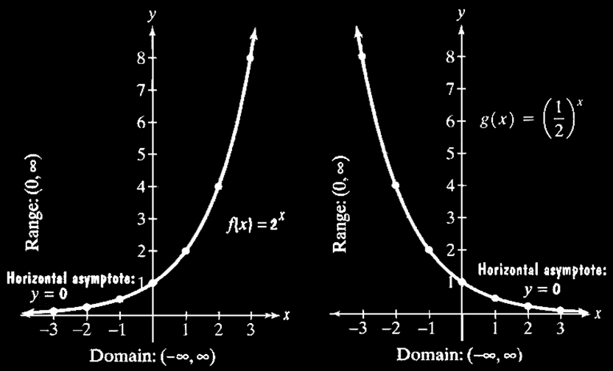
Exponentials
Graphs of Exponential Functions

Slide 9
Exponentials
If the base is > 1, then the graph goes up to the right
If 0<base<1, then the graph goes up to the left
All pass through the point (0,1) because a⁰=1

Slide 10
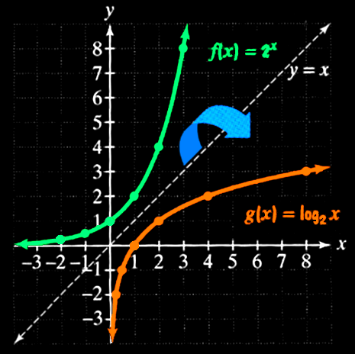
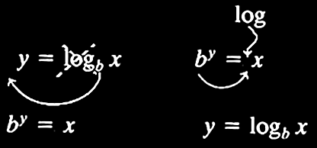
Exponentials
As I mentioned, logarithms
are the inverse of
exponential
functions

Slide 11
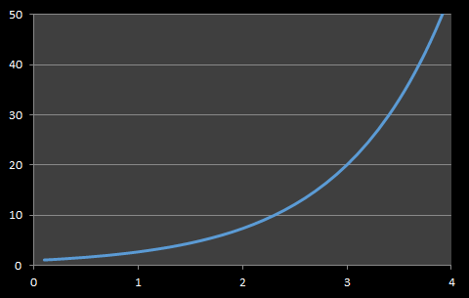
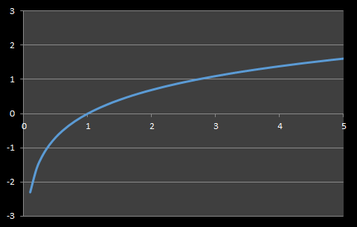
Logarithmic vs Exponential Models
Exponential Curve Logarithmic Curve
Starts slow
Then speeds up
Starts fast
Then slows down

Slide 12
Growth Models
Populations that grow exponentially grow very rapidly as they get larger because there are more adults to produce offspring

Slide 13
Population Ecology Models
The size of a population of a species will increase or decrease depending on a variety of factors

Slide 14
Growth Models
A model that relies on the previous value to forecast the next value is called a “time series” model

Slide 15
Compound Interest
The formula:
A = P(1+r/n)^{nt}
describes accumulated value (A) of a sum of money (P) after t years at an annual percentage interest rate r (decimal) compounded n times each year

Slide 16
Growth and Decay Models
Newton’s Law of Cooling describes the cooling of a warmer object to the cooler temperature of the environment
It is an example of a decay model

Slide 17
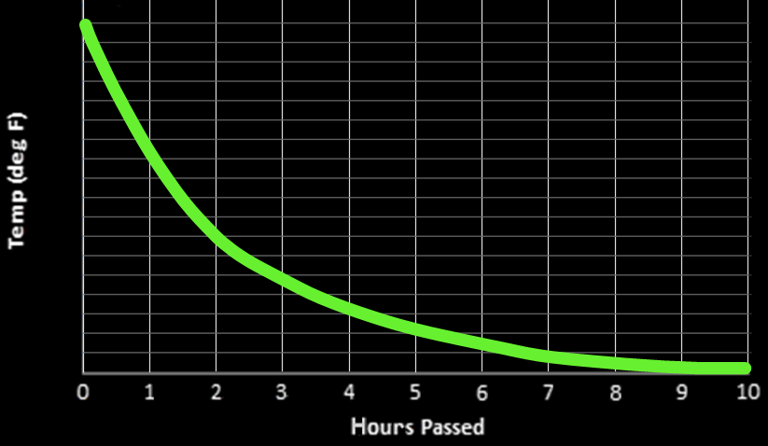
Growth and Decay Models
Temperature of a Human Body in a 70°F Environment
}
98.6
95.6
1st hour: ? degrees
92.6
89.6
86.6
83.6
80.6
77.6
74.6
71.6
VFrench 2021

Slide 18
Growth and Decay Models
The exponential growth or decay model is:
A = A₀e ^{kt}
A is the final amount
A₀ is the initial amount
t is the time (units will be given)

Slide 19
Growth and Decay Models
A = A₀e ^{kt}
k is the growth or decay rate
For growth, k is positive
For decay, k is negative
k = $\frac{−ln(2)}{half−life}$

Slide 20
Questions?
http://i.imgur.com/aliTlT3.jpg

Slide 21
Iteration
Means repeating a process until you reach a goal

Slide 22
Iteration
In math class, we are trying to solve an equation by closer and closer approximations to the “true” answer

Slide 23
Iteration
So, we can manually tweak values of the coefficients until we get the best fit to our data
This is actually how the computer calculates trig functions!

Slide 24
Iteration
When we did the COVID models, we tried different values for each of the constants in the equation until we got a “fit” we liked

Slide 25
Iteration
That was iteration!

Slide 26
Iteration
Iteration is used by your calculator and in computer software to do calculations

Slide 27
Iteration
Some people think their calculators have a huge look-up table for all the answers

Slide 28
Iteration
They don’t – it would be impossible for a calculator to have a look-up table for every possible value a user might enter for every possible function the user might want to use!

Slide 29
Iteration
The calculator has a formula for every function that will zero in on the right answer after a short number of calculations

Slide 30
Iteration
The calculator company wants a formula that zeros in on a stable number after the fewest number of calculations

Slide 31
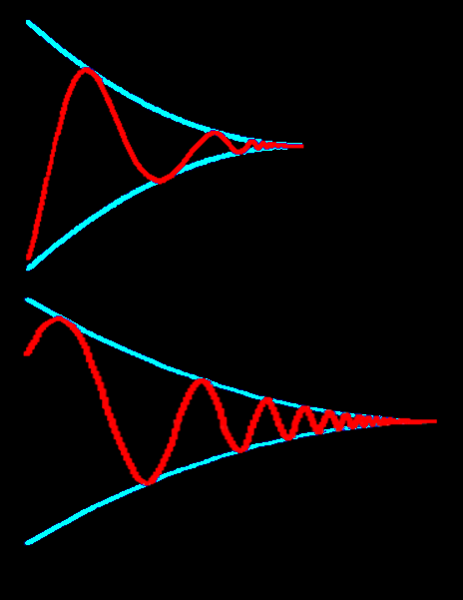
ITERATION
IN-CLASS PROBLEM 1
Identify which
is the better
formula?

Slide 32
ITERATION
IN-CLASS PROBLEM 1
Identify which
is the better
formula?
The one that
gets there
quickest!

Slide 33
ITERATION
IN-CLASS PROBLEM 2
For example, to calculate e:
e = 1 + $\frac{\text{1}}{\text{1}}$ + $\frac{\text{1}}{\text{1}\text{x}\text{2}}$ + $\frac{\text{1}}{\text{1}\text{x}\text{2}\text{x}\text{3}}$ + $\frac{\text{1}}{\text{1}\text{x}\text{2}\text{x}\text{3}\text{x}\text{4}}$ ...
How many iterations would you need before it reaches a stable value? demo!

Slide 34
Iteration
All the functions in your calculator are based on a long series that iterates back and forth and zeros in on the correct answer

Slide 35
Iteration
Calculator formula for the sine:
sin(θ) = θ - $\frac{{\text{θ}}^{\text{3 }}}{\text{1}\text{x}\text{2}\text{x}\text{3}}$ + $\frac{{\text{θ}}^{\text{5} }}{\text{1}\text{x}\text{2}\text{x}\text{3}\text{x}\text{4}\text{x}\text{5}}$ - ...
This works for all values of θ

Slide 36
Iteration
The formula selected by your calculator manufacturer determines how fast and accurate your calculator will be

Slide 37
Iteration
It’s why different people get slightly different answers to calculator problems

Slide 38
Iteration
Iteration gives a sequence of values that are (hopefully) zeroing in on the desired solution

Slide 39
Questions?
http://i.imgur.com/aliTlT3.jpg

Slide 40
Sequences
1 2 3
What’s the next item in this sequence?

Slide 41
Sequences
1 3 5 7
What’s the next item in this sequence?
http://www.intmath.com/laplace-transformation/1a-unit-step-functions-definition.php

Slide 42
Sequences
Sequences are ordered lists

Slide 43
Sequences
They don’t have to be numbers

Slide 44
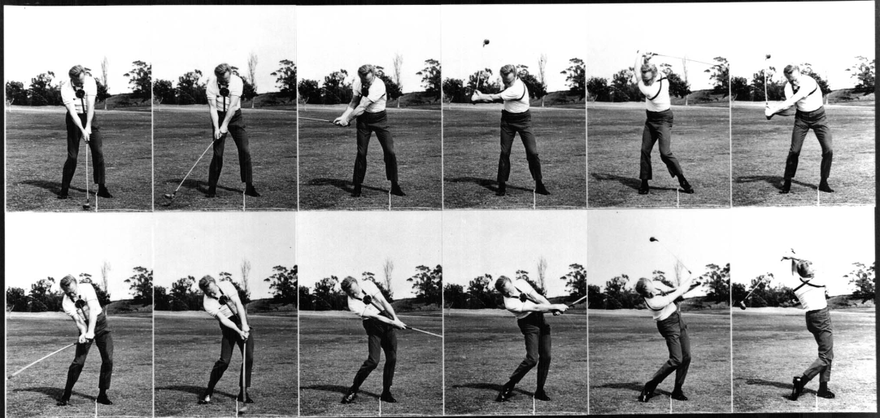
Sequences

Slide 45
Sequences

Slide 46
Sequences
Each member of a sequence is called a “term”

Slide 47
Sequences
Each term is designated by a subscript:
a_{1,} a_{2,} a_{3, ...,} a_{n, ...}
The 2nd term in the sequence
is a₂
The n^{th} term is a_{n}

Slide 48
SEQUENCES
IN-CLASS PROBLEM 3a
Identify a₁₇ in the sequence:
1 2 3 4 5 6 7 8 9 10 11 12 13 14 15 16 17 18 19 20 21 22 23 24 25 26 27 28 29 30

Slide 49
SEQUENCES
IN-CLASS PROBLEM 3a
Identify a₁₇ in the sequence:
1 2 3 4 5 6 7 8 9 10 11 12 13 14 15 16 17 18 19 20 21 22 23 24 25 26 27 28 29 30

Slide 50
SEQUENCES
IN-CLASS PROBLEM 3b
3 7 4 1 6 9 8 8 1 0 2 5
Identify a₇ in the sequence:
Identify a₂ in the sequence:
Identify a₉ in the sequence:
Identify a₁₂ in the sequence:
Identify a₅ in the sequence:

Slide 51
SEQUENCES
IN-CLASS PROBLEM 3b
3 7 4 1 6 9 8 8 1 0 2 5
Identify a₇ in the sequence: 8
Identify a₂ in the sequence:
Identify a₉ in the sequence:
Identify a₁₂ in the sequence:
Identify a₅ in the sequence:

Slide 52
SEQUENCES
IN-CLASS PROBLEM 3b
3 7 4 1 6 9 8 8 1 0 2 5
Identify a₇ in the sequence: 8
Identify a₂ in the sequence: 7
Identify a₉ in the sequence:
Identify a₁₂ in the sequence:
Identify a₅ in the sequence:

Slide 53
SEQUENCES
IN-CLASS PROBLEM 3b
3 7 4 1 6 9 8 8 1 0 2 5
Identify a₇ in the sequence: 8
Identify a₂ in the sequence: 7
Identify a₉ in the sequence: 1
Identify a₁₂ in the sequence:
Identify a₅ in the sequence:

Slide 54
SEQUENCES
IN-CLASS PROBLEM 3b
3 7 4 1 6 9 8 8 1 0 2 5
Identify a₇ in the sequence: 8
Identify a₂ in the sequence: 7
Identify a₉ in the sequence: 1
Identify a₁₂ in the sequence: 5
Identify a₅ in the sequence:

Slide 55
SEQUENCES
IN-CLASS PROBLEM 3b
3 7 4 1 6 9 8 8 1 0 2 5
Identify a₇ in the sequence: 8
Identify a₂ in the sequence: 7
Identify a₉ in the sequence: 1
Identify a₁₂ in the sequence: 5
Identify a₅ in the sequence: 6

Slide 56
Questions?
http://i.imgur.com/aliTlT3.jpg

Slide 57
Sequences
An infinite sequence goes on forever:
a_{1,} a_{2,} a_{3, ...}
A finite sequence stops at some point:
a_{1,} a_{2,} a_{3, ...,} a₁₂
ellipsis

Slide 58
SEQUENCES
IN-CLASS PROBLEM 4
Identify which is the infinite series:
1 2 3 5 8 13 21 …
2 4 6 8 10

Slide 59
SEQUENCES
IN-CLASS PROBLEM 4
Identify which is the infinite series:
1 2 3 5 8 13 21 …
2 4 6 8 10
infinite
finite

Slide 60
Questions?
http://i.imgur.com/aliTlT3.jpg

Slide 61
Sequences
Numerical sequences are often formed by a formula that uses one term to calculate the next term in the sequence

Slide 62
Sequences
You evaluate a sequence by plugging in the requested numbers for each term

Slide 63
SEQUENCES
IN-CLASS PROBLEM 5a
Calculate a_{n} for n = 3 if
a_{n} = 6/n :

Slide 64
SEQUENCES
IN-CLASS PROBLEM 5a
Calculate a_{n} for n = 3 if
a_{n} = 6/n :
Ok, if n=3, plug in “3” for “n” in the a_{n} formula

Slide 65
SEQUENCES
IN-CLASS PROBLEM 5a
Calculate a_{n} for n = 3 if
a_{n} = 6/n :
Ok, if n=3, plug in “3” for “n” in the a_{n} formula
a_{n} = 6/n
a₃ = 6/3
a₃ = 2

Slide 66
SEQUENCES
IN-CLASS PROBLEM 5b
Calculate a_{n}
for n = 4 if a_{n} = 2+n:
for n = 7 if a_{n} = n-4:
for n = 3 if a_{n} = 5n:
for n = 2 if a_{n} = 6n+3:
for n = 5 if a_{n} = 7n-5:

Slide 67
SEQUENCES
IN-CLASS PROBLEM 5b
Calculate a_{n}
for n = 4 if a_{n} = 2+n: 6
for n = 7 if a_{n} = n-4:
for n = 3 if a_{n} = 5n:
for n = 2 if a_{n} = 6n+3:
for n = 5 if a_{n} = 7n-5:

Slide 68
SEQUENCES
IN-CLASS PROBLEM 5b
Calculate a_{n}
for n = 4 if a_{n} = 2+n: 6
for n = 7 if a_{n} = n-4: 3
for n = 3 if a_{n} = 5n:
for n = 2 if a_{n} = 6n+3:
for n = 5 if a_{n} = 7n-5:

Slide 69
SEQUENCES
IN-CLASS PROBLEM 5b
Calculate a_{n}
for n = 4 if a_{n} = 2+n: 6
for n = 7 if a_{n} = n-4: 3
for n = 3 if a_{n} = 5n: 15
for n = 2 if a_{n} = 6n+3:
for n = 5 if a_{n} = 7n-5:

Slide 70
SEQUENCES
IN-CLASS PROBLEM 5b
Calculate a_{n}
for n = 4 if a_{n} = 2+n: 6
for n = 7 if a_{n} = n-4: 3
for n = 3 if a_{n} = 5n: 15
for n = 2 if a_{n} = 6n+3: 15
for n = 5 if a_{n} = 7n-5:

Slide 71
SEQUENCES
IN-CLASS PROBLEM 5b
Calculate a_{n}
for n = 4 if a_{n} = 2+n: 6
for n = 7 if a_{n} = n-4: 3
for n = 3 if a_{n} = 5n: 15
for n = 2 if a_{n} = 6n+3: 15
for n = 5 if a_{n} = 7n-5: 30

Slide 72
Questions?
http://i.imgur.com/aliTlT3.jpg

Slide 73
Sequences
“Recursion formulas” - the formula calculates each term based on the previous term
Ex: a_{n} = a_{n-1} + 1

Slide 74
Sequences
You have to be given a starting term (usually a₁) to evaluate these

Slide 75
Sequences
Remember, we said that a model that relies on the previous value to forecast the next value is called a “time series” model
Time series models are all recursion models

Slide 76
SEQUENCES
IN-CLASS PROBLEM 6
Calculate a_{n} for n = 4 if:
a₁ = 5
a_{n} = a_{n-1} + 1

Slide 77
SEQUENCES
IN-CLASS PROBLEM 6
Calculate a_{n} for n = 4 if:
a₁ = 5
a_{n} = a_{n-1} + 1
Once again, we know n = 4, so plug that in the formula

Slide 78
SEQUENCES
IN-CLASS PROBLEM 6
Calculate a_{n} for n = 4 if:
a₁ = 5
a_{n} = a_{n-1} + 1
Once again, we know n = 4, so plug that in the formula
a₄ = a₄₋₁ + 1 or
a₄ = a₃ + 1
What do we need to solve this?

Slide 79
SEQUENCES
IN-CLASS PROBLEM 6
Calculate a_{n} for n = 4 if:
a₁ = 5
a_{n} = a_{n-1} + 1
Once again, we know n = 4, so plug that in the formula
a₄ = a₄₋₁ + 1 or
a₄ = a₃ + 1
What do we need to solve this?

Slide 80
SEQUENCES
IN-CLASS PROBLEM 6
Calculate a_{n} for n = 4 if:
a₁ = 5
a_{n} = a_{n-1} + 1
a₄ = a₃ + 1
How can we get a₃?

Slide 81
SEQUENCES
IN-CLASS PROBLEM 6
Calculate a_{n} for n = 4 if:
a₁ = 5
a_{n} = a_{n-1} + 1
a₄ = a₃ + 1
How can we get a₃?
a₃ = a₃₋₁ + 1 or
a₃ = a₂ + 1
Now what do we need?

Slide 82
SEQUENCES
IN-CLASS PROBLEM 6
Calculate a_{n} for n = 4 if:
a₁ = 5
a_{n} = a_{n-1} + 1
a₄ = a₃ + 1
a₃ = a₂ + 1
Now what do we need? Yep a₂
How do we get a₂?

Slide 83
SEQUENCES
IN-CLASS PROBLEM 6
Calculate a_{n} for n = 4 if:
a₁ = 5
a_{n} = a_{n-1} + 1
a₄ = a₃ + 1
a₃ = a₂ + 1
Yep a₂ = a₁ + 1
Now what do we need?

Slide 84
SEQUENCES
IN-CLASS PROBLEM 6
Calculate a_{n} for n = 4 if:
a₁ = 5
a_{n} = a_{n-1} + 1
a₄ = a₃ + 1
a₃ = a₂ + 1
Yep a₂ = a₁ + 1
Now what do we need? a₁
How do we get a₁?

Slide 85
SEQUENCES
IN-CLASS PROBLEM 6
Calculate a_{n} for n = 4 if:
a₁ = 5
a_{n} = a_{n-1} + 1
a₄ = a₃ + 1
a₃ = a₂ + 1
Yep a₂ = a₁ + 1
Now what do we need? a₁
How do we get a₁?

Slide 86
SEQUENCES
IN-CLASS PROBLEM 6
Calculate a_{n} for n = 4 if:
a₁ = 5
a_{n} = a_{n-1} + 1
a₄ = a₃ + 1
a₃ = a₂ + 1
a₂ = a₁ + 1
Now just work it back

Slide 87
SEQUENCES
IN-CLASS PROBLEM 6
Calculate a_{n} for n = 4 if:
a₁ = 5
a_{n} = a_{n-1} + 1
a₄ = a₃ + 1
a₃ = a₂ + 1
a₂ = a₁ + 1 = 5 + 1 = 6
Now we have a₂!

Slide 88
SEQUENCES
IN-CLASS PROBLEM 6
Calculate a_{n} for n = 4 if:
a₁ = 5
a_{n} = a_{n-1} + 1
a₄ = a₃ + 1
a₃ = a₂ + 1 = 6 + 1 = 7
a₂ = a₁ + 1 = 6
Now we have a₃!

Slide 89
SEQUENCES
IN-CLASS PROBLEM 6
Calculate a_{n} for n = 4 if:
a₁ = 5
a_{n} = a_{n-1} + 1
a₄ = a₃ + 1 = 7 + 1 = 8
a₃ = a₂ + 1 = 7
a₂ = a₁ + 1 = 6
Now we have a₃!

Slide 90
SEQUENCES
IN-CLASS PROBLEM 6
Calculate a_{n} for n = 4 if:
a₁ = 5
a_{n} = a_{n-1} + 1
a₄ = a₃ + 1 = 8
a₃ = a₂ + 1 = 7
a₂ = a₁ + 1 = 6
Now we have a₄ (which is what we want)

Slide 91
Sequences
note: sequences are discrete points, not a smooth function!

Slide 92
Questions?
http://i.imgur.com/aliTlT3.jpg

Slide 93
Sequences
1 2 3
What’s the next item in this sequence?

Slide 94
Sequences
3 5 7
What’s the next item in this sequence?

Slide 95
Sequences
4 7 10
What’s the next item in this sequence?

Slide 96
Arithmetic Sequences
These are called “arithmetic sequences”
air-rith-MEH-tic
not
ah-RITH-meh-tic

Slide 97
Arithmetic Sequences
Arithmetic Sequences:
Each term in the sequence (after the first) differs from the preceding by a constant amount (positive or negative)

Slide 98
Arithmetic Sequences
start with a₁
increase each time by "d"

Slide 99
ARITHMETIC SEQUENCES
IN-CLASS PROBLEM 7a
start with a₁
increase each time by "d"
3 7 11 15 19 …
What is a₁?
What is d?

Slide 100
ARITHMETIC SEQUENCES
IN-CLASS PROBLEM 7a
start with a₁
increase each time by "d"
3 7 11 15 19 …
What is a₁? 3
What is d?

Slide 101
ARITHMETIC SEQUENCES
IN-CLASS PROBLEM 7a
start with a₁
increase each time by "d"
3 7 11 15 19 …
What is a₁? 3
What is d? 4

Slide 102
ARITHMETIC SEQUENCES
IN-CLASS PROBLEM 7b
a_{n} = a₁ + (n-1)d
If a₁ = 0 and d = 3 what are the first four terms of the arithmetic sequence?
Just plug in a₁ and d
and n= 1,2,3,4

Slide 103
ARITHMETIC SEQUENCES
IN-CLASS PROBLEM 7b
a_{n} = a₁ + (n-1)d
a_{n} = 0 + (n-1)3
a₁ = 0 + (1-1)3 = ?
a₂ = 0 + (2-1)3 =
a₃ = 0 + (3-1)3 =
a₄ = 0 + (4-1)3 =

Slide 104
ARITHMETIC SEQUENCES
IN-CLASS PROBLEM 7b
a_{n} = a₁ + (n-1)d
a_{n} = 0 + (n-1)3
a₁ = 0 + (1-1)3 = 0
a₂ = 0 + (2-1)3 =
a₃ = 0 + (3-1)3 =
a₄ = 0 + (4-1)3 =

Slide 105
ARITHMETIC SEQUENCES
IN-CLASS PROBLEM 7b
a_{n} = a₁ + (n-1)d
a_{n} = 0 + (n-1)3
a₁ = 0 + (1-1)3 = 0
a₂ = 0 + (2-1)3 = 3
a₃ = 0 + (3-1)3 =
a₄ = 0 + (4-1)3 =

Slide 106
ARITHMETIC SEQUENCES
IN-CLASS PROBLEM 7b
a_{n} = a₁ + (n-1)d
a_{n} = 0 + (n-1)3
a₁ = 0 + (1-1)3 = 0
a₂ = 0 + (2-1)3 = 3
a₃ = 0 + (3-1)3 = 6
a₄ = 0 + (4-1)3 =

Slide 107
ARITHMETIC SEQUENCES
IN-CLASS PROBLEM 7b
a_{n} = a₁ + (n-1)d
a_{n} = 0 + (n-1)3
a₁ = 0 + (1-1)3 = 0
a₂ = 0 + (2-1)3 = 3
a₃ = 0 + (3-1)3 = 6
a₄ = 0 + (4-1)3 = 9

Slide 108
Arithmetic Sequences
a_{n} = a_{n-1} + d
For a general sequence:
a₁ = a₀+d
a₂ = a₁+d = (a₀+d)+d = a₀+2d
a₃ = a₂+d = (a₀+2d)+d = a₀+3d
Do you see a pattern?
“d” stands for “difference”

Slide 109
Questions?
http://i.imgur.com/aliTlT3.jpg

Slide 110
Arithmetic Sequences
You can calculate the 10,000th term in an arithmetic sequence using the formula without having to list up the 9,999 that come before it!

Slide 111
ARITHMETIC SEQUENCES
IN-CLASS PROBLEM 7c
If a₁ = 5 and d = 2 what are the first four terms of the arithmetic sequence?
a_{n} = a_{n-1} + d

Slide 112
ARITHMETIC SEQUENCES
IN-CLASS PROBLEM 7c
If a₁ = 5 and d = 2 what are the first four terms of the arithmetic sequence?
a₁ = ?
a_{n} = a_{n-1} + d

Slide 113
ARITHMETIC SEQUENCES
IN-CLASS PROBLEM 7c
If a₁ = 5 and d = 2 what are the first four terms of the arithmetic sequence?
a₁ = 5
a₂ = a₁ + (2-1)(2) = ?
n-1
d
n
n-1
a_{n} = a_{n-1} + d

Slide 114
ARITHMETIC SEQUENCES
IN-CLASS PROBLEM 7c
If a₁ = 5 and d = 2 what are the first four terms of the arithmetic sequence?
a₁ = 5
a₂ = 5 + (2-1)2 = 7
a₃ = 5 + (3-1)2 =
a₄ = 5 + (4-1)2 =
a_{n} = a_{n-1} + d

Slide 115
ARITHMETIC SEQUENCES
IN-CLASS PROBLEM 7c
If a₁ = 5 and d = 2 what are the first four terms of the arithmetic sequence?
a₁ = 5
a₂ = 5 + (2-1)2 = 7
a₃ = 5 + (3-1)2 = 9
a₄ = 5 + (4-1)2 =
a_{n} = a_{n-1} + d

Slide 116
ARITHMETIC SEQUENCES
IN-CLASS PROBLEM 7c
If a₁ = 5 and d = 2 what are the first four terms of the arithmetic sequence?
a₁ = 5
a₂ = 5 + (2-1)2 = 7
a₃ = 5 + (3-1)2 = 9
a₄ = 5 + (4-1)2 = 11
a_{n} = a_{n-1} + d

Slide 117
Questions?
http://i.imgur.com/aliTlT3.jpg

Slide 118
SEQUENCES
IN-CLASS PROBLEM 7d
A 1dBm (decibel milliwatt) signal passes through a series of 3 dB power amplifiers
Show the sequence that describes its progress through the amplifiers:

Slide 119
SEQUENCES
IN-CLASS PROBLEM 7d
A 1dBm signal passes through a series of 3 dB power amplifiers
Show the sequence that describes its progress through the amplifiers:
1dBm 4dBm 7dBm 10dBm …
1dBm 4dBm 7dBm 10dBm …

Slide 120
SEQUENCES
IN-CLASS PROBLEM 7d
Explain why is this an arithmetic sequence?

Slide 121
SEQUENCES
IN-CLASS PROBLEM 7d
A 1dBm signal passes through a series of 3 dB power amplifiers
Develop the recursion formula be for this sequence:
1dBm 4dBm 7dBm 10dBm …
a_{n} = a_{n-1} + k

Slide 122
SEQUENCES
IN-CLASS PROBLEM 7d
A 1dBm signal passes through a series of 3 dB power amplifiers
Develop the recursion formula be for this sequence:
a_{n} = a_{n-1} + 3
1dBm 4dBm 7dBm 10dBm …
a_{n} = a_{n-1} + k

Slide 123
SEQUENCES
IN-CLASS PROBLEM 7d
A 1dBm signal passes through a series of 3 dB power amplifiers
Calculate the value of the 17th term in the sequence?
1dBm 4dBm 7dBm 10dBm …
a_{n} = a₀+nk

Slide 124
SEQUENCES
IN-CLASS PROBLEM 7d
A 1dBm signal passes through a series of 3 dB power amplifiers
Calculate the value of the 17th term in the sequence?
a₁₇ = a₀+17k =
1dBm 4dBm 7dBm 10dBm …
a_{n} = a₀+nk

Slide 125
SEQUENCES
IN-CLASS PROBLEM 7d
A 1dBm signal passes through a series of 3 dB power amplifiers
Calculate the value of the 17th term in the sequence?
a₁₇ = a₀+17k = 1+(17(3))
= 52 whats?
1dBm 4dBm 7dBm 10dBm …
a_{n} = a₀+nk

Slide 126
SEQUENCES
IN-CLASS PROBLEM 7d
A 1dBm signal passes through a series of 3 dB power amplifiers
Calculate the value of the 17th term in the sequence?
a₁₇ = a₀+17k = 1+(17(3))
= 52 dBm
1dBm 4dBm 7dBm 10dBm …
a_{n} = a₀+nk

Slide 127
Questions?
http://i.imgur.com/aliTlT3.jpg

Slide 128
Sequences
What is the next term in this sequence:
1 2 4 8

Slide 129
Sequences
How about this one?
1 3 9 27

Slide 130
Sequences
Not all sequences show a constant Δ change from one to the next

Slide 131
Geometric Sequences
Geometric Sequences:
Each term in the sequence (after the first) is a common
multiple (positive or negative) of the previous term

Slide 132
GEOMETRIC SEQUENCES
IN-CLASS PROBLEM 8a
Which is geometric?
3 6 9 12
1 2 4 8
7 10 13 16
2 3 4.5 6.75
2 4 6 8

Slide 133
Geometric Sequences
The recursion formula for a geometric sequence is:
a_{n} = r × a_{n-1}

Slide 134
Geometric Sequences
For a geometric sequence, you need:
the starting value a₁
the multiple r

Slide 135
GEOMETRIC SEQUENCES
IN-CLASS PROBLEM 8b
For the sequence: 1 4 16 64
What is a₁?
What is r?

Slide 136
GEOMETRIC SEQUENCES
IN-CLASS PROBLEM 8b
For the sequence: 1 4 16 64
What is a₁? 1
What is r?

Slide 137
GEOMETRIC SEQUENCES
IN-CLASS PROBLEM 8b
For the sequence: 1 4 16 64
What is a₁? 1
What is r? 4

Slide 138
Geometric Sequences
a_{n} = r × a_{n-1}
For a general sequence:
a₁ = ra₀
a₂ = ra₁ = r(ra₀) = r²a₀
a₃ = ra₂ = r(r²a₀) = r³a₀
Do you see a pattern?

Slide 139
GEOMETRIC SEQUENCES
IN-CLASS PROBLEM 8c
If a₁ = 1 and r = 2, what are the first four terms of the geometric sequence?

Slide 140
GEOMETRIC SEQUENCES
IN-CLASS PROBLEM 8c
If a₁ = 1 and r = 2, what are the first four terms of the geometric sequence?
a_{n} = a₁r ^{n-1}

Slide 141
GEOMETRIC SEQUENCES
IN-CLASS PROBLEM 8c
If a₁ = 1 and r = 2, what are the first four terms of the geometric sequence?
a_{n} = 1(2 ^{n-1})
What is n?

Slide 142
GEOMETRIC SEQUENCES
IN-CLASS PROBLEM 8c
If a₁ = 1 and r = 2, what are the first four terms of the geometric sequence?
a₁ = 1(2 ¹⁻¹) = ?
a₂ = 1(2 ²⁻¹) = ?
a₃ = 1(2 ³⁻¹) = ?
a₄ = 1(2 ⁴⁻¹) = ?

Slide 143
GEOMETRIC SEQUENCES
IN-CLASS PROBLEM 8c
If a₁ = 1 and r = 2, what are the first four terms of the geometric sequence?
a₁ = 1(2 ¹⁻¹) = 1(1) = 1
a₂ = 1(2 ²⁻¹) = 1(2) = 2
a₃ = 1(2 ³⁻¹) = 1(4) = 4
a₄ = 1(2 ⁴⁻¹) = 1(8) = 8

Slide 144
GEOMETRIC SEQUENCES
IN-CLASS PROBLEM 8d
If a₁ = 2 and r = 2, what are the first four terms of the geometric sequence?

Slide 145
GEOMETRIC SEQUENCES
IN-CLASS PROBLEM 8d
If a₁ = 2 and r = 2, what are the first four terms of the geometric sequence?
a_{n} = a₁r ^{n-1}

Slide 146
GEOMETRIC SEQUENCES
IN-CLASS PROBLEM 8d
If a₁ = 2 and r = 2, what are the first four terms of the geometric sequence?
a_{n} = 2(2 ^{n-1})
What is n?

Slide 147
GEOMETRIC SEQUENCES
IN-CLASS PROBLEM 8d
If a₁ = 2 and r = 2, what are the first four terms of the geometric sequence?
a₁ = 2(2 ¹⁻¹) = ?
a₂ = 2(2 ²⁻¹) = ?
a₃ = 2(2 ³⁻¹) = ?
a₄ = 2(2 ⁴⁻¹) = ?

Slide 148
GEOMETRIC SEQUENCES
IN-CLASS PROBLEM 8d
If a₁ = 2 and r = 2, what are the first four terms of the geometric sequence?
a₁ = 2(2 ¹⁻¹) = 2(1) = 2
a₂ = 2(2 ²⁻¹) = 2(2) = 4
a₃ = 2(2 ³⁻¹) = 2(4) = 8
a₄ = 2(2 ⁴⁻¹) = 2(8) = 16

Slide 149
Questions?
http://i.imgur.com/aliTlT3.jpg

Slide 150
You Survived!
Today we studied:
Review of Integral
Transforms
Sequences

