Slide 1
Welcome to
Unit 7- Part 13
MATH116-Foundations for Calculus
https://media.istockphoto.com/vectors/green-blackboard-mathematical-with-thin-line-shapes-and-inscriptions-vector-id1084380192?k=6&m=1084380192&s=612x612&w=0&h=TcEOVpnUmyuswT4Pay
AL6lNiHU8SS8g33yOSg-jR5BE=

Slide 2
What’s Up?
Review:
Logs and Exponents
New stuff:
Growth and decay models

Slide 3
What’s Up?
Outcome 3) Graph rational, exponential, logarithmic functions, and their transformations
Outcome 7) Use properties of logarithms to solve exponential and logarithmic equations and applied problems involving exponential growth and decay

Slide 4
Review
http://995642590.r.lightningbase-cdn.com/wp-content/uploads/2010/12/looking-back-hrexaminer-v144-cover425px.jpg

Slide 5
Logarithms
Logarithms were originally used to simplify “BIG” calculations
Now they are used solely as an inverse for the exponent function

Slide 6
Logarithms
The logarithmic function
y = log_{b} x
is the same as
b^{y} = x
(if x>0, b>0 and b≠1)

Slide 7
Logarithms
log₂ 16
2 to what power gives 16?

Slide 8
Logarithms
log₂ 16 = 4
because 2⁴ = 16

Slide 9
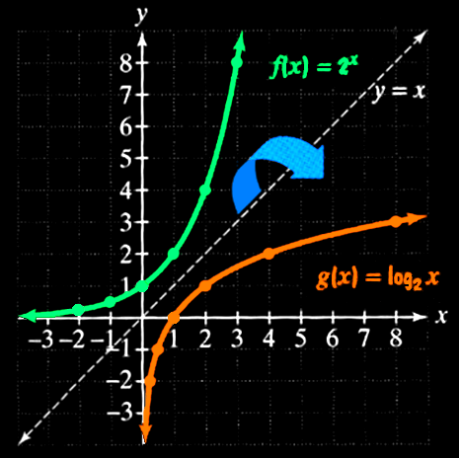
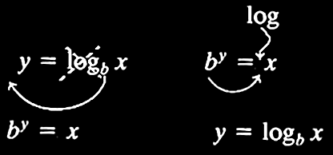
Logarithms
Logarithms are the inverse of exponential functions

Slide 10
Logarithms
logarithmic function with base b
~or~
exponential function with base b

Slide 11
Logarithms
The natural number “e” (for Euler’s number) is an important mathematical constant approximately equal to 2.71828

Slide 12
Logarithms
Logs with base e are called
“natural logarithms”
Written "ln"

Slide 13
Logarithms
Logs with base 10 are called
“common logarithms”
Written "log“
But be careful!
WolframAlpha uses “log” to mean “ln”

Slide 14
Logarithms
Properties of Logarithms:
log_{b} 1 = 0 log 1 = 0 ln 1 = 0
log_{b} b = 1 log 10 = 1 ln e = 1
log_{b} b^{x} = x log 10^{x} = x ln e^{x} = x
b^{logb x} = x 10^{logx} = x e^{ln x} = x

Slide 15
Logarithms
Mathematical facts about logs:
log(AB) = log(A) + log(B)
log(A/B) = log(A) – log(B)
log(A^{B}) = B×log(A)

Slide 16
Logarithms
BTW:
log₁₀(e) = 1/ln(10)

Slide 17
Logarithms
Changing the base of logarithms:
log_{b}M = log_{a}M / log_{a}b

Slide 18
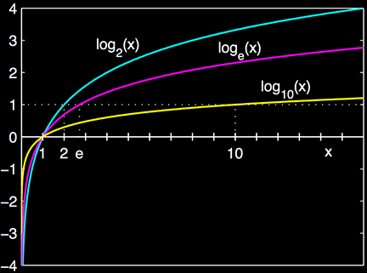
Logarithms
The graph of a logarithm looks like:
https://en.wikipedia.org/wiki/Logarithm

Slide 19
Questions?
http://i.imgur.com/aliTlT3.jpg

Slide 20
Exponentials
Functions that contain exponents:
ƒ(x) = x^{c}
x is the base
c is the exponent

Slide 21
Exponentials
Exponential functions:
ƒ(x) = c^{x}
c is the base
x is the exponent

Slide 22
Exponentials
Limitations:
the base must be a constant
the base must be >0
the exponent must be a variable

Slide 23
EXPONENTIALS
IN-CLASS PROBLEM 7
Function containing an exponent or exponential function?
ƒ(w) = w⁹ ƒ(y) = 72^{y}
ƒ(x) = -83.2^{x} ƒ(x) = x⁵⁰
ƒ(z) = (8z+1)^{z} ƒ(x) = (x²+4)6^{x}

Slide 24
EXPONENTIALS
IN-CLASS PROBLEM 7
Function containing an exponent or exponential function?
ƒ(w) = w⁹ ƒ(y) = 72^{y}
fce
ƒ(x) = -83.2^{x} ƒ(x) = x⁵⁰
ƒ(z) = (8z+1)^{z} ƒ(x) = (x²+4)6^{x}

Slide 25
EXPONENTIALS
IN-CLASS PROBLEM 7
Function containing an exponent or exponential function?
ƒ(w) = w⁹ ƒ(y) = 72^{y}
fce exp fct
ƒ(x) = -83.2^{x} ƒ(x) = x⁵⁰
ƒ(z) = (8z+1)^{z} ƒ(x) = (x²+4)6^{x}

Slide 26
EXPONENTIALS
IN-CLASS PROBLEM 7
Function containing an exponent or exponential function?
ƒ(w) = w⁹ ƒ(y) = 72^{y}
fce exp fct
ƒ(x) = -83.2^{x} ƒ(x) = x⁵⁰
exp fct
ƒ(z) = (8z+1)^{z} ƒ(x) = (x²+4)6^{x}

Slide 27
EXPONENTIALS
IN-CLASS PROBLEM 7
Function containing an exponent or exponential function?
ƒ(w) = w⁹ ƒ(y) = 72^{y}
fce exp fct
ƒ(x) = -83.2^{x} ƒ(x) = x⁵⁰
exp fct fce
ƒ(z) = (8z+1)^{z} ƒ(x) = (x²+4)6^{x}

Slide 28
EXPONENTIALS
IN-CLASS PROBLEM 7
Function containing an exponent or exponential function?
ƒ(w) = w⁹ ƒ(y) = 72^{y}
fce exp fct
ƒ(x) = -83.2^{x} ƒ(x) = x⁵⁰
exp fct fce
ƒ(z) = (8z+1)^{z} ƒ(x) = (x²+4)6^{x}
exp fct

Slide 29
EXPONENTIALS
IN-CLASS PROBLEM 7
Function containing an exponent or exponential function?
ƒ(w) = w⁹ ƒ(y) = 72^{y}
fce exp fct
ƒ(x) = -83.2^{x} ƒ(x) = x⁵⁰
exp fct fce
ƒ(z) = (8z+1)^{z} ƒ(x) = (x²+4)6^{x}
exp fct exp fct

Slide 30
Questions?
http://i.imgur.com/aliTlT3.jpg

Slide 31
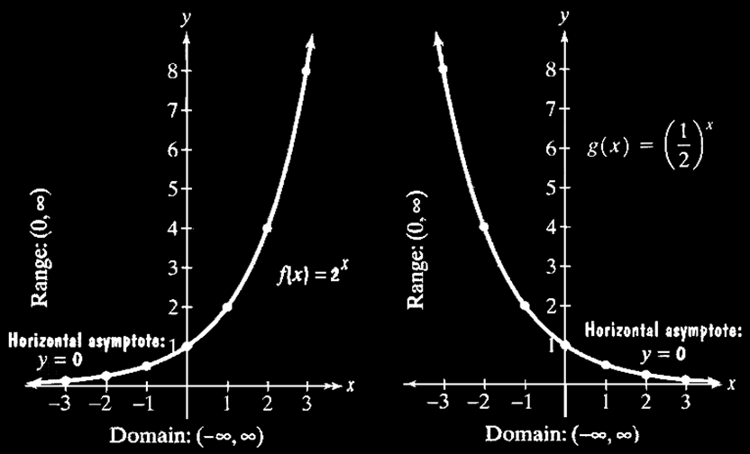
Exponentials
Graphs of Exponential Functions

Slide 32
Exponentials
If the base is > 1, then the graph goes up to the right
If 0<base<1, then the graph goes up to the left

Slide 33
Exponentials
All pass through the point (0,1) because a⁰=1

Slide 34
Exponentials
The domain (xs) is (-∞,∞) The range (ys) is (0,∞)

Slide 35
Exponentials
As I mentioned, logarithms
are the inverse of
exponential
functions

Slide 36
Logarithms vs Exponents
Graph of exponents vs logarithms
Is it getting
bigger faster
and faster
or slower and
slower?

Slide 37
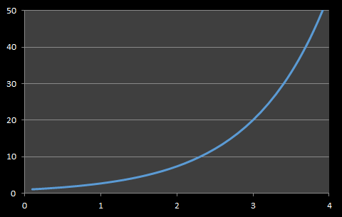
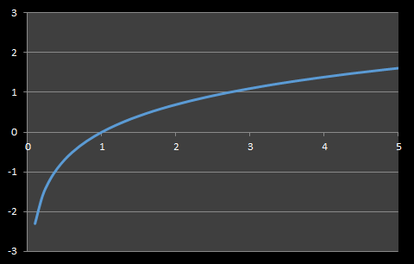
Logarithmic vs Exponential Models
Exponential Curve Logarithmic Curve
Is it getting bigger faster and faster
or slower and slower?

Slide 38
Logarithmic vs Exponential Models
Exponential Curve Logarithmic Curve
Starts slow
Then speeds up
Starts fast
Then slows down

Slide 39
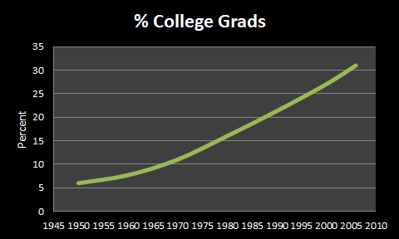
LOGARITHMS vs EXPONENTS
IN-CLASS PROBLEM 8
Percentage of college graduates – exponential or logarithmic?

Slide 40
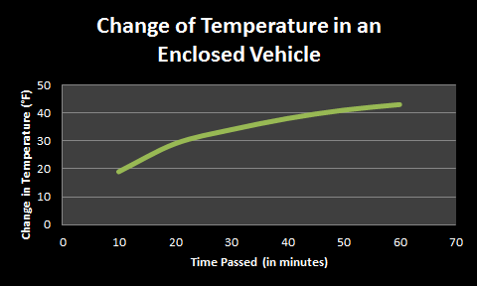
LOGARITHMS vs EXPONENTS
IN-CLASS PROBLEM 8
Change of temperature in an enclosed vehicle - exponential or logarithmic?

Slide 41
Questions?
http://i.imgur.com/aliTlT3.jpg

Slide 42
“e”
The “e”–based exponential usually has it’s own button on your calculator

Slide 43
“e”
The “e”–based exponential usually has it’s own button on your calculator (but it’s usually hiding)

Slide 44
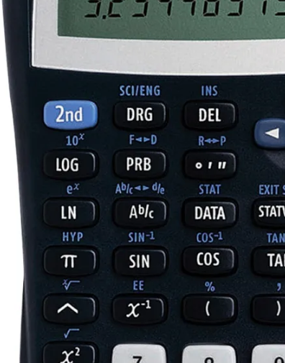
“e”
It’s usually
“shift-ln”
https://www.officedepot.com/a/products/176928/Texas-Instruments-TI-30X-IIS-Solar/?utm_source=google&utm_medium=cpc&mediacampaignid=71700000042240055_1599196543&&gclsrc=aw.ds&gclid=EAIaIQobChMImNqRtueY8wIVB2xvBB2NjgfZEAQYASABEgLZVvD_BwE&gclsrc=aw.ds

Slide 45
“e”
…and (unlike π,
which gets a
value-button),
the button is for
e^{x}
https://www.officedepot.com/a/products/176928/Texas-Instruments-TI-30X-IIS-Solar/?utm_source=google&utm_medium=cpc&mediacampaignid=71700000042240055_1599196543&&gclsrc=aw.ds&gclid=EAIaIQobChMImNqRtueY8wIVB2xvBB2NjgfZEAQYASABEgLZVvD_BwE&gclsrc=aw.ds

Slide 46
“e”
You have to enter
e¹ to get the
value of “e”
https://www.officedepot.com/a/products/176928/Texas-Instruments-TI-30X-IIS-Solar/?utm_source=google&utm_medium=cpc&mediacampaignid=71700000042240055_1599196543&&gclsrc=aw.ds&gclid=EAIaIQobChMImNqRtueY8wIVB2xvBB2NjgfZEAQYASABEgLZVvD_BwE&gclsrc=aw.ds

Slide 47
LOGARITHMS vs EXPONENTS
IN-CLASS PROBLEM 9
Calculate:
e²
2e³
e⁴/3
4e⁵/6

Slide 48
LOGARITHMS vs EXPONENTS
IN-CLASS PROBLEM 9
Calculate:
e² ≈ 7.389
2e³
e⁴/3
4e⁵/6

Slide 49
LOGARITHMS vs EXPONENTS
IN-CLASS PROBLEM 9
Calculate:
e² ≈ 7.389
2e³ ≈ 40.171
e⁴/3
4e⁵/6

Slide 50
LOGARITHMS vs EXPONENTS
IN-CLASS PROBLEM 9
Calculate:
e² ≈ 7.389
2e³ ≈ 40.171
e⁴/3 ≈ 18.199
4e⁵/6

Slide 51
LOGARITHMS vs EXPONENTS
IN-CLASS PROBLEM 9
Calculate:
e² ≈ 7.389
2e³ ≈ 40.171
e⁴/3 ≈ 18.199
4e⁵/6 ≈ 98.942

Slide 52
Questions?
http://i.imgur.com/aliTlT3.jpg

Slide 53
Growth Models
Exponential growth and decay models are often used in science and technology

Slide 54
Growth Models
In these models, quantities grow or decay at a rate proportional to their size

Slide 55
Growth Models
Populations that grow exponentially grow very rapidly as they get larger because there are more adults to produce offspring

Slide 56
GROWTH MODELS
IN-CLASS PROBLEM 1
World population is increasing at about 1.2% per year
In 2007, the population was 6.6 billion
Calculate what would be your estimate of the world’s population in 2008?

Slide 57
GROWTH MODELS
IN-CLASS PROBLEM 1
2008:
6.6 billion + 6.6 billion x 1.2%
or
6.6 billion + 6.6 billion x .012
= 6.68 billion

Slide 58
GROWTH MODELS
IN-CLASS PROBLEM 1
Calculate what would be your estimate of the world’s population in 2009?

Slide 59
GROWTH MODELS
IN-CLASS PROBLEM 1
Calculate what would be your estimate of the world’s population in 2009?
6.68 billion + 6.68 billion x .012
= 6.76 billion

Slide 60
Growth Models
A model that relies on the previous value to forecast the next value is called a “time series” model

Slide 61
Growth Models
Video

Slide 62
GROWTH MODELS
IN-CLASS PROBLEM 2
According to the video, the mathematical model for salmonella microbe populations is:
where N is the number of microbes at a given time t in hours and N_{i} is the initial number of microbes
N = Ni × 2^{3t}

Slide 63
GROWTH MODELS
IN-CLASS PROBLEM 2
N = N_{i} × 2^{3t}
Assume Ni = 5 microbes to start
Calculate what is the number of microbes after 1 hour?

Slide 64
GROWTH MODELS
IN-CLASS PROBLEM 2
If N_{i} = 5 and t = 1:
N = N_{i} × 2^{3t}
N = 5 × 2^{3*1}
N = 40 microbes

Slide 65
GROWTH MODELS
IN-CLASS PROBLEM 2
N = N_{i} × 2^{3t}
Calculate what is the number of microbes after 2 hours?
3 hours?
4 hours?

Slide 66
GROWTH MODELS
IN-CLASS PROBLEM 2
N = N_{i} × 2^{3t}
Calculate what is the number of microbes after 2 hours? 320
3 hours?
4 hours?

Slide 67
GROWTH MODELS
IN-CLASS PROBLEM 2
N = N_{i} × 2^{3t}
Calculate what is the number of microbes after 2 hours? 320
3 hours? 2,560
4 hours?

Slide 68
GROWTH MODELS
IN-CLASS PROBLEM 2
N = N_{i} × 2^{3t}
Calculate what is the number of microbes after 2 hours? 320
3 hours? 2,560
4 hours? 20,480

Slide 69
GROWTH MODELS
IN-CLASS PROBLEM 2
According to the NBHS, 12 or more salmonella microbes can lead to illness and even death in a vulnerable person
Calculate when would the number of microbes reach the danger level?

Slide 70
Questions?
http://i.imgur.com/aliTlT3.jpg

Slide 71
Population Ecology Models
The size of a population of a species will increase or decrease depending on a variety of factors

Slide 72
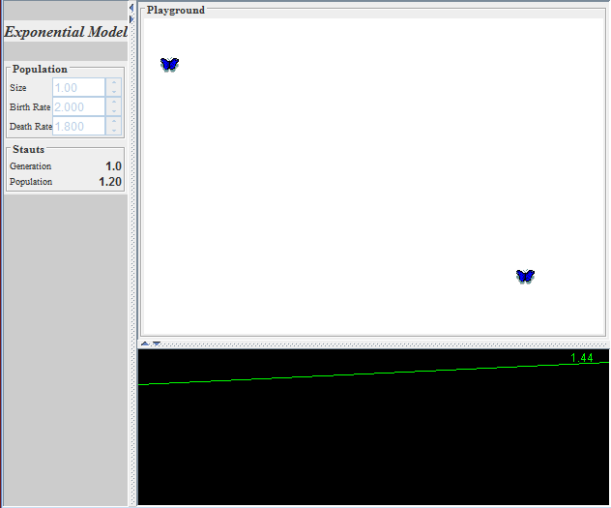

Slide 73
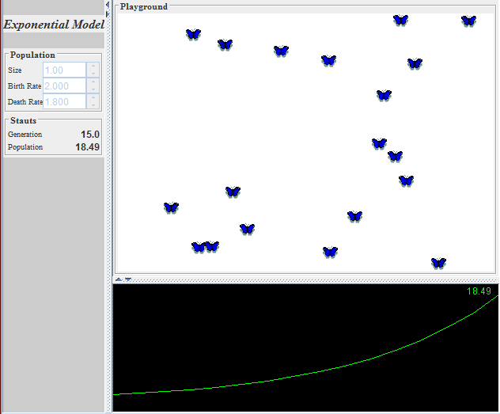

Slide 74
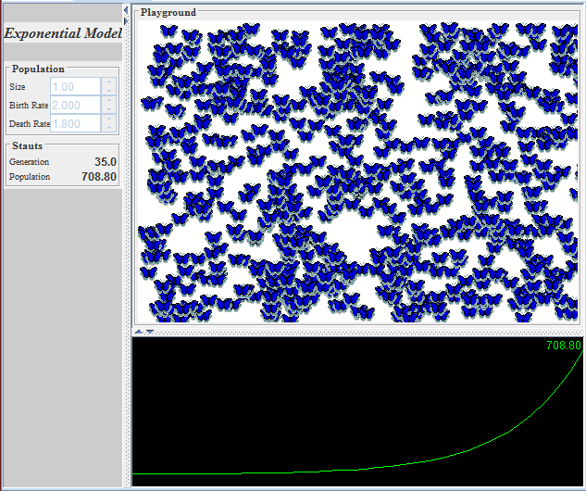

Slide 75
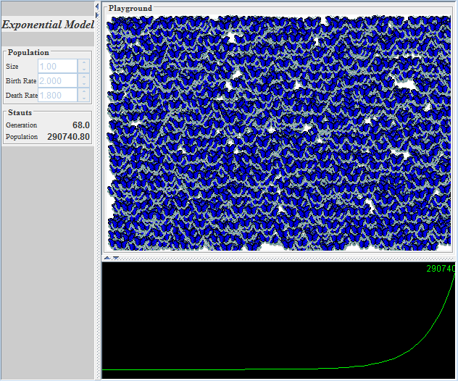

Slide 76
POPULATION ECOLOGY MODELS
IN-CLASS PROBLEM 3
Identify whether an exponential population model would be realistic for moth populations?
Why or why not?

Slide 77
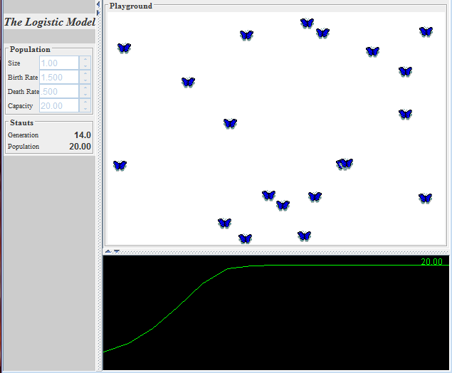

Slide 78
POPULATION ECOLOGY MODELS
IN-CLASS PROBLEM 3
Identify whether a logarithmic population model would be realistic for moth populations?
Why or why not?

Slide 79
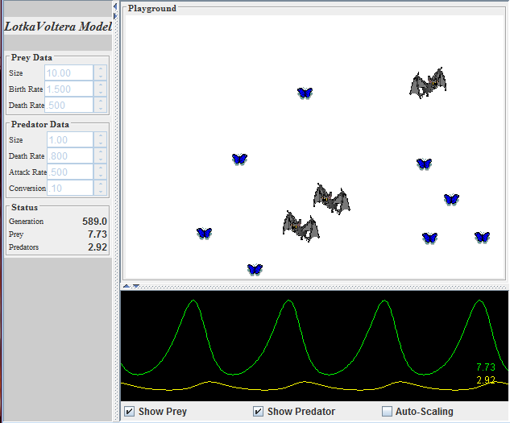

Slide 80
POPULATION ECOLOGY MODELS
IN-CLASS PROBLEM 3
Identify what function you would use to model the populations of moths and bats?

Slide 81
POPULATION ECOLOGY MODELS
IN-CLASS PROBLEM 4
COVID-19 models exercise

Slide 82
Questions?
http://i.imgur.com/aliTlT3.jpg

Slide 83
Compound Interest
The formula:
A = P(1+r/n)^{nt}
describes accumulated value (A) of a sum of money (P) after t years at an annual percentage interest rate r (decimal) compounded n times each year

Slide 84
COMPOUND INTEREST
IN-CLASS PROBLEM 5
How long (to the nearest tenth of a year) will it take $25,000 to grow to $500,000 at 9% interest compounded monthly?
What is A? What is P?
What is t? What is r?
What is n?
A = P(1+r/n)^{nt}

Slide 85
COMPOUND INTEREST
IN-CLASS PROBLEM 5
Plug ‘em in!
A = P(1+r/n)^{nt}
$500,000 = $25,000(1+$\frac{.09}{12}$)^{12t}
What do we do first?

Slide 86
COMPOUND INTEREST
IN-CLASS PROBLEM 5
$500,000 = $25,000(1+$\frac{.09}{12}$)^{12t}
500,000 = 25,000(1+0.0075)^{12t}
Now what?

Slide 87
COMPOUND INTEREST
IN-CLASS PROBLEM 5
500,000 = 25,000(1+0.0075)^{12t}
500,000 = 25,000(1.0075)^{12t}
Now what?

Slide 88
COMPOUND INTEREST
IN-CLASS PROBLEM 5
500,000 = 25,000(1+0.0075)^{12t}
20 = (1.0075)^{12t}
Now what?
How do you undo an exponent…?

Slide 89
COMPOUND INTEREST
IN-CLASS PROBLEM 5
Right! Change it into a log!
20 = (1.0075)^{12t}
ln(20) = ln((1.0075)^{12t})
Now what?

Slide 90
COMPOUND INTEREST
IN-CLASS PROBLEM 5
Right! Use the log function definitions!
ln(20) = ln((1.0075)^{12t})
ln(20) = 12t ln(1.0075)
Now what?

Slide 91
COMPOUND INTEREST
IN-CLASS PROBLEM 5
Right! Algebra!
(It never goes away…)
ln(20) = 12t ln(1.0075)
t = $\frac{\text{ln}\text{(20)}}{\text{12}\text{ln}\text{(1.0075)}}$
Now what?

Slide 92
COMPOUND INTEREST
IN-CLASS PROBLEM 5
Calculator time!
(Aren’t you GLAD we have them…)
t = $\frac{\text{ln}\text{(20)}}{\text{12}\text{ln}\text{(1.0075)}}$
≈ 33.4 whats?

Slide 93
COMPOUND INTEREST
IN-CLASS PROBLEM 5
Calculator time!
(Aren’t you GLAD we have them…)
t = $\frac{\text{ln}\text{(20)}}{\text{12}\text{ln}\text{(1.0075)}}$
≈ 33.4 years

Slide 94
Questions?
http://i.imgur.com/aliTlT3.jpg

Slide 95
Growth and Decay Models
An example of a decay model is Newton’s Law of Cooling

Slide 96
Growth and Decay Models
Newton’s Law of Cooling describes the cooling of a warmer object to the cooler temperature of the environment

Slide 97
Growth and Decay Models
It’s standard in forensics to tell when a murder victim died

Slide 98
Growth and Decay Models
As a general rule, the body
cools at a rate of about 1.5°F (0.8°C) per hour during the first 12 hours
www.sciencedirect.com › topics › medicine-and-dentistry

Slide 99
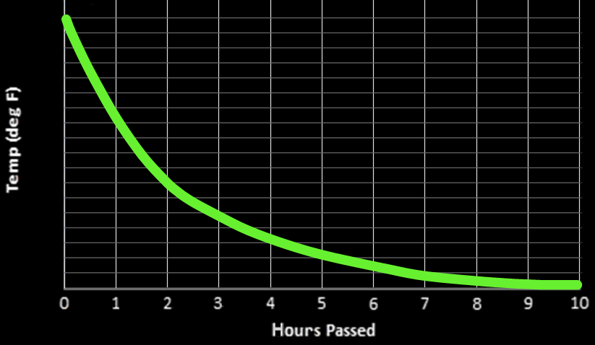
LAW OF COOLING
IN-CLASS PROBLEM 6
Is 1.5°F per hour a good rule of thumb value?
}
}
98.6
1st hour: ? degrees
1st hour: ? degrees
95.6
92.6
89.6
86.6
83.6
80.6
77.6
74.6
71.6
VFrench 2021

Slide 100
LAW OF COOLING
IN-CLASS PROBLEM 6
Is 1.5°F per hour a good rule of thumb value?
}
}
98.6
1st hour: 10.5 degrees
1st hour: ? degrees
95.6
92.6
89.6
}
86.6
2nd hour: ? degrees
83.6
80.6
77.6
74.6
71.6
VFrench 2021

Slide 101
LAW OF COOLING
IN-CLASS PROBLEM 6
Is 1.5°F per hour a good rule of thumb value?
}
}
98.6
1st hour: 10.5 degrees
1st hour: ? degrees
95.6
92.6
89.6
}
86.6
2nd hour: 6 degrees
83.6
}
80.6
3rd hour: ? degrees
77.6
74.6
71.6
VFrench 2021

Slide 102
LAW OF COOLING
IN-CLASS PROBLEM 6
Is 1.5°F per hour a good rule of thumb value?
}
}
98.6
1st hour: 10.5 degrees
1st hour: ? degrees
95.6
92.6
89.6
}
86.6
2nd hour: 6 degrees
83.6
}
80.6
3rd hour: 3.25 degrees
}
77.6
4th hour: ? degrees
74.6
71.6
VFrench 2021

Slide 103
LAW OF COOLING
IN-CLASS PROBLEM 6
Is 1.5°F per hour a good rule of thumb value?
}
}
98.6
1st hour: 10.5 degrees
1st hour: ? degrees
95.6
92.6
89.6
}
86.6
2nd hour: 6 degrees
83.6
}
80.6
3rd hour: 3.25 degrees
}
77.6
4th hour: 3 degrees
}
5th hour: 1.5 degrees
74.6
71.6
VFrench 2021

Slide 104
LAW OF COOLING
IN-CLASS PROBLEM 6
Is 1.5°F per hour a good rule of thumb value?
}
}
98.6
1st hour: 10.5 degrees
1st hour: ? degrees
95.6
92.6
89.6
}
86.6
2nd hour: 6 degrees
83.6
}
80.6
3rd hour: 3.25 degrees
}
77.6
4th hour: 3 degrees
}
5th hour: 1.5 degrees
74.6
}
6th hour: ? degrees
71.6
VFrench 2021

Slide 105
LAW OF COOLING
IN-CLASS PROBLEM 6
Is 1.5°F per hour a good rule of thumb value?
}
}
98.6
1st hour: 10.5 degrees
1st hour: ? degrees
95.6
92.6
89.6
}
86.6
2nd hour: 6 degrees
83.6
}
80.6
3rd hour: 3.25 degrees
}
77.6
4th hour: 3 degrees
}
5th hour: 1.5 degrees
74.6
}
6th hour: 1 degree
71.6
VFrench 2021

Slide 106
Questions?
http://i.imgur.com/aliTlT3.jpg

Slide 107
Growth and Decay Models
Exponential growth and decay models often use the irrational number “e”
Mother nature likes irrationals like π and e
(students not so much…)

Slide 108
Growth and Decay Models
Population growth and radioactive decay are examples of models including e

Slide 109
Growth and Decay Models
The exponential growth or decay model is:
A = A₀e ^{kt}
A is the final amount
A₀ is the initial amount
t is the time (units will be given)

Slide 110
Growth and Decay Models
A = A₀e ^{kt}
k is the growth or decay rate
For growth, k is positive
For decay, k is negative
k = $\frac{−ln(2)}{half−life}$

Slide 111
Growth and Decay Models
A “half-life” is the amount of time it takes for half of the original to be transformed to a non-decaying substance (radioactive elements decay into lead Pb 206)

Slide 112
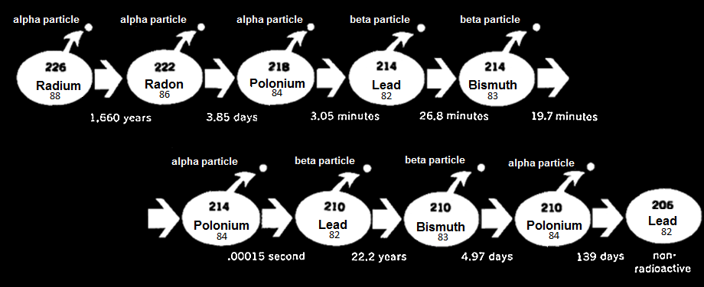
Growth and Decay Models
Atomic Decay
Childcraft

Slide 113
Growth and Decay Models
https://phet.colorado.edu/sims/cheerpj/nuclear-physics/latest/nuclear-physics.html?simulation=alpha-decay

Slide 114
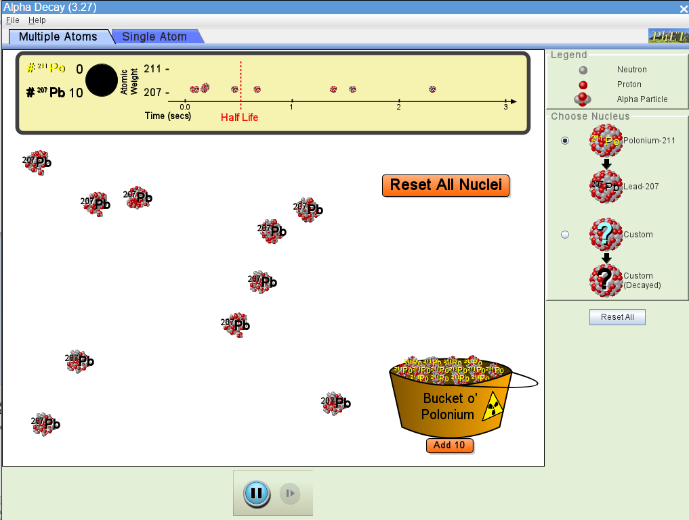

Slide 115
RADIOACTIVE DECAY
IN-CLASS PROBLEM 7
On the “Multiple Atoms" tab, you start out with 10 atoms of Po211
Were half of your atoms converted before the half-life marker?

Slide 116
Growth and Decay Models
If half of the atoms were converted before the half-life and half after, it’s obviously a “half-life”
But… what if it wasn’t half and half?
What would happen if you did the simulation a whole bunch of times?

Slide 117
RADIOACTIVE DECAY
IN-CLASS PROBLEM 7
Run the simulation again
Run the simulation again
Run the simulation again
Were half of your atoms converted before the half-life marker?

Slide 118
Growth and Decay Models
A half-life is based on a gazillion atoms
Any particular atom or small group of atoms is going to respond based on probability but will be unlikely to do exactly what theory dictates

Slide 119
Growth and Decay Models
We deal with probability on a daily basis (is it going to rain? am I going to get the right answers on my quiz? Is my new computer actually going to work when I plug it in? Is my cough
due to a cold or tuberculosis?)

Slide 120
Growth and Decay Models
Still, humans prefer the comfortable feeling of knowing exactly what the answer is, not so much what the answer in the long run tends to be
Mother Nature seems to prefer probabilities…

Slide 121
RADIOACTIVE DECAY
IN-CLASS PROBLEM 7
Describe a situation where you must deal with probabilities:

Slide 122
RADIOACTIVE DECAY
IN-CLASS PROBLEM 8
The half-life of Plutonium-239 is 24,000 years
If 10 grams are present now, how long will it take until only 10% of the original sample remains?
What is A₀? What is A?
A = A₀e ^{kt}

Slide 123
RADIOACTIVE DECAY
IN-CLASS PROBLEM 8
The half-life of Plutonium-239 is 24,000 years
If 10 grams are present now, how long will it take until only 10% of the original sample remains?
What is A₀? 10 grams
What is A? 10×0.1 = 1 gram
A = A₀e ^{kt}

Slide 124
RADIOACTIVE DECAY
IN-CLASS PROBLEM 8
To figure out k you need the handy-dandy half-life formula:
k = $\frac{−ln(2)}{half−life}$ = ?
A = A₀e ^{kt}
http://math.ucsd.edu/~wgarner/math4c/textbook/chapter4/expgrowthdecay.htm

Slide 125
RADIOACTIVE DECAY
IN-CLASS PROBLEM 8
To figure out k you need the handy-dandy half-life formula:
k = $\frac{−ln(2)}{half−life}$
= $\frac{−ln(2)}{24,000}$
≈ -0.000029
A = A₀e ^{kt}
http://math.ucsd.edu/~wgarner/math4c/textbook/chapter4/expgrowthdecay.htm

Slide 126
RADIOACTIVE DECAY
IN-CLASS PROBLEM 8
Now, we need to find when only 10% remains of the original 10 grams (1 gram)
A = A₀e ^{kt}
1g = 10g e ^{-0.000029t}
1 = 10e ^{-0.000029t}
Solve for t!
A = A₀e ^{kt}

Slide 127
RADIOACTIVE DECAY
IN-CLASS PROBLEM 8
1 = 10e ^{-0.000029t}
0.1 = e ^{-0.000029t}
Now what?

Slide 128
RADIOACTIVE DECAY
IN-CLASS PROBLEM 8
Right! Log-time!
0.1 = e ^{-0.000029t}
ln(0.1) = ln(e ^{-0.000029t})
ln(0.1) = -0.000029t
See why we use ln?

Slide 129
RADIOACTIVE DECAY
IN-CLASS PROBLEM 8
ln(0.1) = -0.000029t
t = $\frac{ln(0.1)}{−0.000029}$

Slide 130
RADIOACTIVE DECAY
IN-CLASS PROBLEM 8
t = $\frac{ln(0.1)}{−0.000029}$
t ≈ 80,000 whats?

Slide 131
RADIOACTIVE DECAY
IN-CLASS PROBLEM 8
t = $\frac{ln(0.1)}{−0.000029}$
t ≈ 80,000 years

Slide 132
Questions?
http://i.imgur.com/aliTlT3.jpg

Slide 133
You Survived!
Today we studied:
Review of logarithms and
exponents
Growth and decay models
www.playbuzz.com

