Slide 1
Welcome to
Unit 6- Part 11
MATH116-Foundations for Calculus
https://media.istockphoto.com/vectors/green-blackboard-mathematical-with-thin-line-shapes-and-inscriptions-vector-id1084380192?k=6&m=1084380192&s=612x612&w=0&h=TcEOVpnUmyuswT4Pay
AL6lNiHU8SS8g33yOSg-jR5BE=

Slide 2
What’s Up?
Today we will be going over:
Review: Inequalities,
absolute values, radicals
New stuff: composite
functions
one-to-one functions
inverse functions

Slide 3
What’s Up?
Outcome 6) Calculate a formula and the domain of a composition of functions and of the inverse of a function, if it exists
Outcome 12) Solve a problem by identifying the given data, making a sketch as appropriate, modeling the problem, and calculating the final answer

Slide 4
Review
http://995642590.r.lightningbase-cdn.com/wp-content/uploads/2010/12/looking-back-hrexaminer-v144-cover425px.jpg

Slide 5
Absolute Value Equations
Here’s the strategy:
Isolate the absolute value

Slide 6
Absolute Value Equations
Set the quantity inside the absolute value notation equal to
+ the quantity on the other side and
- the quantity on the other side of the equation

Slide 7
Absolute Value Equations
Solve both equations
Check your answer analytically or graphically

Slide 8
Absolute Value Equations
Always check the answers!
There may be only one real solution, or even none!
Solving the "derived" equation may create false solutions ("extraneous roots")

Slide 9
Radical Equations
Contain a root
When solving radical equation, isolate one root on one side of the equation
Raise both sides to the nth power in order to remove the nth root

Slide 10
Radical Equations
Always check the answers!
Squaring the sides of an equation creates a "derived" equation which may not be equivalent to the original!
Solving the "derived" equation may create false solutions ("extraneous roots")

Slide 11
Radical Equations
You can eliminate the problem of extraneous roots by graphing
Graph lines for each of the two sides of the unsquared equation
If the lines cross – that is the solution (or solutions)

Slide 12
Inequalities
When you have < > ≤ ≥
rather than =
You can solve “inequations” for a variable
Just pretend the “<” or “>”
is an “=”

Slide 13
Inequalities
Exception to the rule:
If you multiply or divide by a negative number, it flips the inequality sign

Slide 14
Inequalities
For a double-sided inequality (bounded), it is safest to change it into two problems, then combine the answers at the end into a bounded interval

Slide 15
Interval Notation
When there are two inequalities hemming in the function

Slide 16
Interval Notation
Several ways to express these:
x<1, x≥2 inequality notation
(–∞,1) ∪ [2,∞) interval, or set,
notation
Parentheses are used if the point is not included (open interval)
Square brackets are used if the point is included (closed interval)

Slide 17
Interval Notation
Several ways to express these:
number line with parentheses/square brackets
number line with dots
Open dots are used when the point is
not included (open intervals)
Filled-in dots are used when the point
is included (closed intervals)
)
1
[
2
1
2

Slide 18
Questions?
http://i.imgur.com/aliTlT3.jpg

Slide 19
Composite Functions
Composite functions have an order - the output of g(x) is the input to ƒ(x)

Slide 20
Composite Functions
New symbols: ƒ ○ g
ƒ of g
ƒ (g (x))

Slide 21
Composite Functions
ƒ ○ g
means calculate g first, then input the result into ƒ

Slide 22
Composite Functions
If no calculations are possible in g, just plug g into the “x” slot of ƒ

Slide 23
COMPOSITE FUNCTIONS
IN-CLASS PROBLEM 1
ƒ = 3x–5
g = 7x+4
Calculate ƒ ○ g

Slide 24
COMPOSITE FUNCTIONS
IN-CLASS PROBLEM 1
ƒ = 3x–5
g = 7x+4
ƒ ○ g = 3(7x+4) - 5
= 21x+12– 5
= 21x+7

Slide 25
Composite Functions
ƒ ○ g ≠ g ○ ƒ

Slide 26
COMPOSITE FUNCTIONS
IN-CLASS PROBLEM 2
ƒ = 3x–5
g = 7x+4
Calculate g ○ ƒ

Slide 27
COMPOSITE FUNCTIONS
IN-CLASS PROBLEM 2
ƒ = 3x–5
g = 7x+4
g ○ ƒ = 7(3x-5) +4
= 21x-35+4
= 21x-31

Slide 28
COMPOSITE FUNCTIONS
IN-CLASS PROBLEM 2
So: ƒ ○ g = 21x+7
And: g ○ ƒ = 21x–31
ƒ ○ g ≠ g ○ ƒ

Slide 29
COMPOSITE FUNCTIONS
IN-CLASS PROBLEM 3
ƒ(x) = 5x+6 g(x) = 2x –1 Calculate (ƒ ○ g)

Slide 30
COMPOSITE FUNCTIONS
IN-CLASS PROBLEM 3
ƒ(x) = 5x+6 g(x) = 2x –1 Calculate (ƒ ○ g) = 10x + 1

Slide 31
COMPOSITE FUNCTIONS
IN-CLASS PROBLEM 4
ƒ(x) = 5x+6 g(x) = 2x –1 Calculate (g ○ ƒ)

Slide 32
COMPOSITE FUNCTIONS
IN-CLASS PROBLEM 4
ƒ(x) = 5x+6 g(x) = 2x –1 Calculate (g ○ ƒ) = 10x+11

Slide 33
COMPOSITE FUNCTIONS
IN-CLASS PROBLEM 4
Again: ƒ ○ g = 10x+1
And: g ○ ƒ = 10x+11
So: ƒ ○ g ≠ g ○ ƒ

Slide 34
Questions?
http://i.imgur.com/aliTlT3.jpg

Slide 35
Composite Functions
To evaluate a composite, do the composite first, then plug in the value

Slide 36
Composite Functions
The notation is a bit confusing:
(ƒ ○ g)(2)
means calculate “ƒ ○ g” then plug in “2” for “x”

Slide 37
COMPOSITE FUNCTIONS
IN-CLASS PROBLEM 5
ƒ(x) = 5x+6 g(x) = 2x –1 Calculate (ƒ ○ g)(2)

Slide 38
COMPOSITE FUNCTIONS
IN-CLASS PROBLEM 5
ƒ(x) = 5x+6 g(x) = 2x –1 Calculate (ƒ ○ g)(2)
We have: (ƒ ○ g) = 10x + 1
So plug in “2” for “x”

Slide 39
COMPOSITE FUNCTIONS
IN-CLASS PROBLEM 5
ƒ(x) = 5x+6 g(x) = 2x –1 Calculate (ƒ ○ g)(2)
We have: (ƒ ○ g) = 10x + 1
So plug in “2” for “x”
(ƒ ○ g)(2) = 10(2) + 1 = 21

Slide 40
COMPOSITE FUNCTIONS
IN-CLASS PROBLEM 6
If ƒ(x) = 8x+4 g(x) = 13x+7
Calculate (ƒ ○ g)
Calculate (g ○ ƒ)
Calculate (ƒ ○ g)(3)

Slide 41
COMPOSITE FUNCTIONS
IN-CLASS PROBLEM 6
If ƒ(x) = 8x+4 g(x) = 13x+7
Calculate (ƒ ○ g) = 104x + 60
Calculate (g ○ ƒ)
Calculate (ƒ ○ g)(3)

Slide 42
COMPOSITE FUNCTIONS
IN-CLASS PROBLEM 6
If ƒ(x) = 8x+4 g(x) = 13x+7
Calculate (ƒ ○ g) = 104x + 60
Calculate (g ○ ƒ) = 104x + 59
Calculate (ƒ ○ g)(3)

Slide 43
COMPOSITE FUNCTIONS
IN-CLASS PROBLEM 6
If ƒ(x) = 8x+4 g(x) = 13x+7
Calculate (ƒ ○ g) = 104x + 60
Calculate (g ○ ƒ) = 104x + 59
Calculate (ƒ ○ g)(3) = 104(3) + 60
= 372

Slide 44
COMPOSITE FUNCTIONS
IN-CLASS PROBLEM 7
If ƒ(x)=9x+5 g(x)=2x² –x –1
Calculate (ƒ○g)
Calculate (g○ƒ)
Calculate (ƒ○g)(–1)

Slide 45
COMPOSITE FUNCTIONS
IN-CLASS PROBLEM 7
If ƒ(x)=9x+5 g(x)=2x² –x –1
Calculate (ƒ○g) = 18x² – 9x – 4
Calculate (g○ƒ) = 2(9x+5)²–(9x+5)-1
Calculate (ƒ○g)(–1)

Slide 46
COMPOSITE FUNCTIONS
IN-CLASS PROBLEM 7
If ƒ(x)=9x+5 g(x)=2x² –x –1
Calculate (ƒ○g) = 18x² – 9x – 4
Calculate (g○ƒ) = 162x² + 171x + 44
Calculate (ƒ○g)(–1) = ƒ(g(-1))

Slide 47
COMPOSITE FUNCTIONS
IN-CLASS PROBLEM 7
If ƒ(x)=9x+5 g(x)=2x² –x –1
Calculate (ƒ○g) = 18x² – 9x – 4
Calculate (g○ƒ) = 162x² + 171x + 44
Calculate (ƒ○g)(–1)=18(-1)²-9(-1)-4
= 18 + 9 - 4
= 23

Slide 48
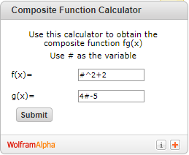
COMPOSITE FUNCTIONS
IN-CLASS PROBLEM 7
http://ihsankhairir.blogspot.com/2011/01/math-stuff-composite-function.html
ƒ(x)=x²+2
g(x)=4x-5
Calculate (ƒ ○ g)

Slide 49
COMPOSITE FUNCTIONS
IN-CLASS PROBLEM 7
Replace your “x” with “#”
Exponents use “^” notation

Slide 50
COMPOSITE FUNCTIONS
IN-CLASS PROBLEM 7
If you are doing (g ○ ƒ)
Put “g” on the f(x) line and
“ƒ” on g(x)

Slide 51
Composite Functions
This is the same as:
https://www.wolframalpha.com/widgets/gallery/view.jsp?id=d6128a5c44f82653361a48a60cbc47c2

Slide 52
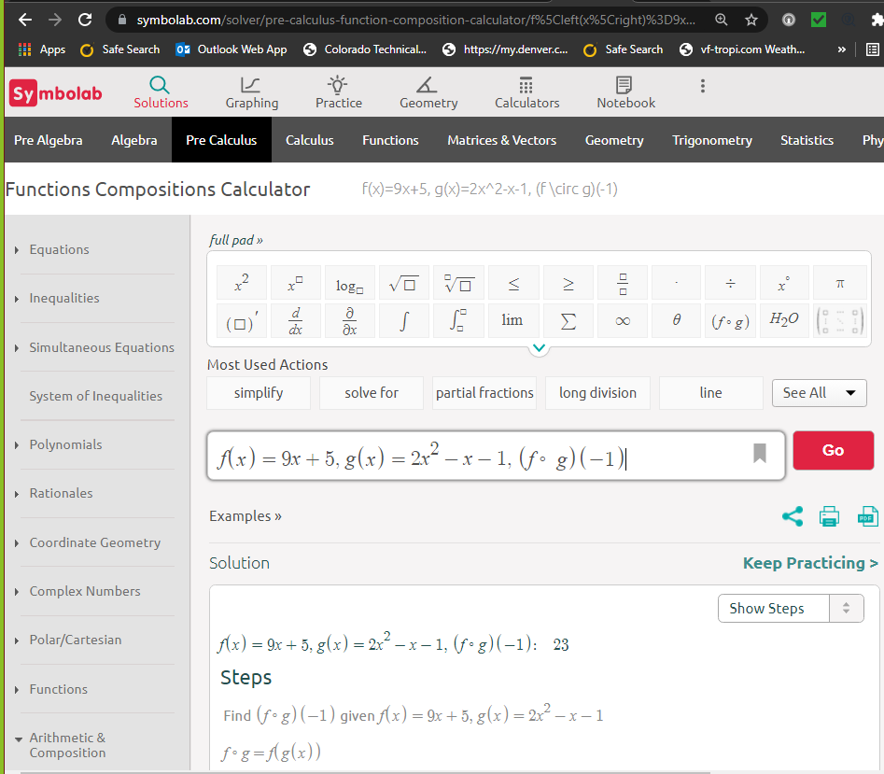
Best
solution:

Slide 53
Questions?
http://i.imgur.com/aliTlT3.jpg

Slide 54
Composite Functions
Remember, we said the “legal values” of a function were called:
the domain (for “x” values)
the range (for “y” values)

Slide 55
Composite Functions
Often the domain of the two functions being composited are both “the set of all real numbers”

Slide 56
Composite Functions
If the domain of ƒ and the domain of g are both the set of all real numbers (ℝ), then the domain of the composites
ƒ○g and g○ƒ are also the set of all real numbers (ℝ)

Slide 57
Questions?
http://i.imgur.com/aliTlT3.jpg

Slide 58
Composite Functions
Most of the calculations engineers and scientists do are actually composite functions!

Slide 59
Composite Functions
You do an experiment, get an answer…
Are you done?

Slide 60
Composite Functions
You do an experiment, get an answer…
Are you done?
Typically not…

Slide 61
Composite Functions
You do an experiment, get an answer…
Are you done?
Typically you will use the answer you got in this experiment to set up the next experiment

Slide 62
Composite Functions
The answer from the first experiment is the input to the next experiment…

Slide 63
Composite Functions
The answer from the first experiment is the input to the next experiment…
a composite function!

Slide 64
Questions?
http://i.imgur.com/aliTlT3.jpg

Slide 65
One-to-One Functions
A function is one-to-one if any two different inputs in the domain correspond to two different outputs in the range

Slide 66
One-to-One Functions
That is, if x₁ and x₂ are two different inputs of a function ƒ, then ƒ is one-to-one if
ƒ(x₁) ≠ ƒ(x₂)

Slide 67
One-to-One Functions
A function is not one-to-one if
two different inputs correspond
to the same output

Slide 68
ONE-TO-ONE FUNCTIONS
IN-CLASS PROBLEM 8
Identify: is it one-to-one?
STATE
POP (millions)
Indiana
N Carolina
Oklahoma
S Dakota
Washington
0.9
3.9
6.6
7.3
10.1
ANIMAL
LIFE EXP (years)
Cat
Dog
Duck
Goat
Pig
Rabbit
7
10
11

Slide 69
ONE-TO-ONE FUNCTIONS
IN-CLASS PROBLEM 8
Is it one-to-one?
yes
STATE
POP (millions)
Indiana
N Carolina
Oklahoma
S Dakota
Washington
0.9
3.9
6.6
7.3
10.1
ANIMAL
LIFE EXP (years)
Cat
Dog
Duck
Goat
Pig
Rabbit
7
10
11

Slide 70
ONE-TO-ONE FUNCTIONS
IN-CLASS PROBLEM 8
Is it one-to-one?
yes
no
STATE
POP (millions)
Indiana
N Carolina
Oklahoma
S Dakota
Washington
0.9
3.9
6.6
7.3
10.1
ANIMAL
LIFE EXP (years)
Cat
Dog
Duck
Goat
Pig
Rabbit
7
10
11

Slide 71
One-to-One Functions
How can you tell whether a function is one-to-one?

Slide 72
One-to-One Functions
Horizontal-Line Test
If every horizontal line intersects the graph of a function in at most one
point, then ƒ is one-to-one

Slide 73
One-to-One Functions
Like the Vertical Line Test for functions (except sideways)

Slide 74
ONE-TO-ONE FUNCTIONS
IN-CLASS PROBLEM 9
Identify: is it one-to-one?

Slide 75
ONE-TO-ONE FUNCTIONS
IN-CLASS PROBLEM 9
Is it one-to-one?
yes

Slide 76
ONE-TO-ONE FUNCTIONS
IN-CLASS PROBLEM 9
Is it one-to-one?
yes yes

Slide 77
ONE-TO-ONE FUNCTIONS
IN-CLASS PROBLEM 9
Is it one-to-one?
yes yes no

Slide 78
One-to-One Functions
Warning: in other disciplines, there is a special line called the 1:1 line (pronounced one-to-one)

Slide 79
One-to-One Functions
The 1:1 line is the line with a slope of 1 (where y=x)
y
4
3
2
1
x
- 4
-3
-2
-1
1
2
3
4
- 1
- 2
- 3
- 4
VFrench, 2020

Slide 80
One-to-One Functions
In Math we call this the
“identity line” or “line of equality”
y
4
3
2
1
x
- 4
-3
-2
-1
1
2
3
4
- 1
- 2
- 3
- 4
VFrench, 2020

Slide 81
Questions?
http://i.imgur.com/aliTlT3.jpg

Slide 82
Inverse Functions
Undo a function

Slide 83
Inverse Functions
Remember how addition “undoes” subtraction and multiplication “undoes” division and roots “undo” powers?

Slide 84
Inverse Functions
These were called “inverse” operations

Slide 85
Inverse Functions
A function ƒ(x)
has an inverse ƒ⁻¹ (x)

Slide 86
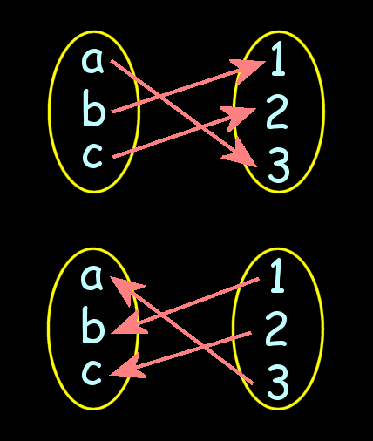
Inverse Functions
ƒ(x)
ƒ⁻¹ (x)

Slide 87
Inverse Functions
Formal (mathy) definition:
If ƒ ○ g = x for every x in the domain of g
and g ○ ƒ = x for every x in the domain of ƒ
Then the function g
is the inverse of ƒ

Slide 88
Inverse Functions
The domain of ƒ is equal to the range of ƒ⁻¹ and vice-versa

Slide 89
Inverse Functions
Calculating the Inverse
1) Replace "ƒ(x)" with "y"
2) Interchange "x" and "y"
3) Solve for "y"
4) Replace "y" in with ƒ⁻¹

Slide 90
INVERSE FUNCTIONS
IN-CLASS PROBLEM 10
ƒ(x) = 8x – 9
Calculate ƒ⁻¹ (x)

Slide 91
INVERSE FUNCTIONS
IN-CLASS PROBLEM 10
Calculate ƒ⁻¹ (x)
ƒ(x) = 8x – 9
y = 8x – 9

Slide 92
INVERSE FUNCTIONS
IN-CLASS PROBLEM 10
Calculate ƒ⁻¹ (x)
ƒ(x) = 8x – 9
y = 8x – 9
x = 8y – 9

Slide 93
INVERSE FUNCTIONS
IN-CLASS PROBLEM 10
Calculate ƒ⁻¹ (x)
ƒ(x) = 8x – 9
y = 8x – 9
x = 8y – 9
y = (x + 9)/8

Slide 94
INVERSE FUNCTIONS
IN-CLASS PROBLEM 10
Calculate ƒ⁻¹ (x)
ƒ(x) = 8x – 9
y = 8x – 9
x = 8y – 9
y = (x + 9)/8
ƒ⁻¹ (x) = (x + 9)/8

Slide 95
INVERSE FUNCTIONS
IN-CLASS PROBLEM 11
Calculate the inverse of the functions:
ƒ(x) = 9x
ƒ(x) = 9x + 5
ƒ(x) = 4x + 12

Slide 96
INVERSE FUNCTIONS
IN-CLASS PROBLEM 11
Calculate the inverse of the functions:
ƒ(x) = 9x ƒ⁻¹ (x) = x/9
ƒ(x) = 9x + 5 ƒ⁻¹ (x) =
ƒ(x) = 4x + 12

Slide 97
INVERSE FUNCTIONS
IN-CLASS PROBLEM 11
Calculate the inverse of the functions:
ƒ(x) = 9x ƒ⁻¹ (x) = x/9
ƒ(x) = 9x + 5 ƒ⁻¹ (x) = (x-5)/9
ƒ(x) = 4x + 12 ƒ⁻¹ (x) =

Slide 98
INVERSE FUNCTIONS
IN-CLASS PROBLEM 11
Calculate the inverse of the functions: ƒ(x) = 9x
ƒ⁻¹ (x) = x/9
ƒ(x) = 9x + 5
ƒ⁻¹ (x) = (x-5)/9
ƒ(x) = 4x + 12
ƒ⁻¹ (x) = (x-12)/4

Slide 99
Questions?
http://i.imgur.com/aliTlT3.jpg

Slide 100
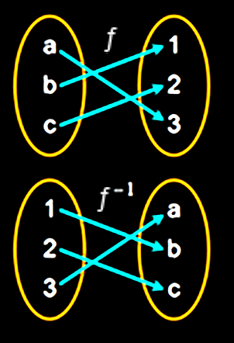
Inverse Functions
The domain of ƒ becomes the range of ƒ⁻¹ and vice-versa

Slide 101
INVERSE FUNCTIONS
IN-CLASS PROBLEM 12
Is {(2,5), (7,3)} the inverse of the function: {(5,2), (3,7)}?

Slide 102
INVERSE FUNCTIONS
IN-CLASS PROBLEM 12
Is {(2,5), (7,3)} the inverse of the function: {(5,2), (3,7)}? yes

Slide 103
INVERSE FUNCTIONS
IN-CLASS PROBLEM 12
Is {(3,8), (4,2)} the inverse of the function: {(8,3), (2,4)}?

Slide 104
INVERSE FUNCTIONS
IN-CLASS PROBLEM 12
Is {(3,8), (4,2)} the inverse of the function: {(8,3), (2,4)}? yes

Slide 105
INVERSE FUNCTIONS
IN-CLASS PROBLEM 13
Given the function:
ƒ(x) = {(7,–1),(0,5),(6,2),(–8,3)}
is the inverse also a function?

Slide 106
INVERSE FUNCTIONS
IN-CLASS PROBLEM 13
Given the function:
ƒ(x) = {(7,–1),(0,5),(6,2),(–8,3)}
is the inverse also a function? yes
Inverse: {(-1,7),(5,0),(2,6),)(3,-8)}
(a function)

Slide 107
INVERSE FUNCTIONS
IN-CLASS PROBLEM 13
Given the function:
ƒ(x) = {(6,8),(2,–4),(10,–2),(4,4)}
is the inverse also a function?

Slide 108
INVERSE FUNCTIONS
IN-CLASS PROBLEM 13
Given the function:
ƒ(x) = {(6,8),(2,–4),(10,–2),(4,4)}
is the inverse also a function? yes Inverse: {(8,6),(-4,2),(-2,10),(4,4)}

Slide 109
Questions?
http://i.imgur.com/aliTlT3.jpg

Slide 110
Inverse Functions
When a function ƒ(x) is
“ƒ○g-ed” with its inverse

Slide 111
INVERSE FUNCTIONS
IN-CLASS PROBLEM 14
Calculate (ƒ(x) ○ ƒ(x) ^{–1} ) =
Hint:

Slide 112
INVERSE FUNCTIONS
IN-CLASS PROBLEM 14
Calculate (ƒ(x) ○ ƒ(x) ^{–1} ) =
Remember, we had:
ƒ(x) = 8x-9 and ƒ(x)^{–1} = (x+9)/8
Now, ƒ○g:
= 8(x+9)/8) – 9

Slide 113
INVERSE FUNCTIONS
IN-CLASS PROBLEM 14
Calculate (ƒ(x) ○ ƒ(x) ^{–1} ) =
Remember, we had:
ƒ(x) = 8x-9 and ƒ(x)^{–1} = (x+9)/8
Now, ƒ○g:
= 8(x+9)/8) – 9
= x+9 – 9

Slide 114
INVERSE FUNCTIONS
IN-CLASS PROBLEM 14
Calculate (ƒ(x) ○ ƒ(x) ^{–1} ) =
Remember, we had:
ƒ(x) = 8x-9 and ƒ(x)^{–1} = (x+9)/8
Now, ƒ○g:
= 8(x+9)/8) – 9
= x+9 – 9
= x

Slide 115
Questions?
http://i.imgur.com/aliTlT3.jpg

Slide 116
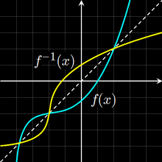
Inverse Functions
Because the domain of ƒ is equal to the range of ƒ⁻¹ and vice-versa, an inverse will
rotate a function:
Vfrench, 2010

Slide 117
Inverse Functions
The function is always rotated around the 1:1 y=x identity line
Vfrench, 2010

Slide 118
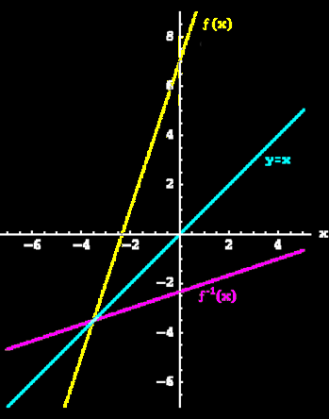
INVERSE FUNCTIONS
IN-CLASS PROBLEM 15
Select a point on the
graph
See if you can identify
the “undo point”
on the graph of
the inverse
13) Given the function : ƒ(x) = {(7,–1), (0,5), (6,2), (–8,3)}, is the inverse also a
function?
14) Given the function : ƒ(x) = {(6,8), (2,–4), (10,–2), (4,4)}, is the inverse also a
function?
Vfrench, 2010

Slide 119
Inverse Functions
Remember, to be a function it must pass a vertical line test

Slide 120
Inverse Functions
For a function to have an inverse that is also a function, the original function must also pass a horizontal line test

Slide 121
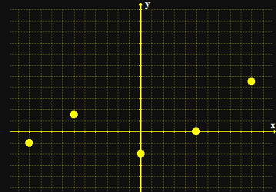
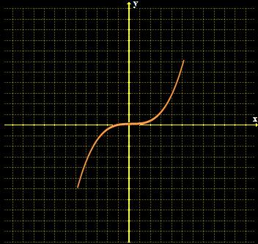
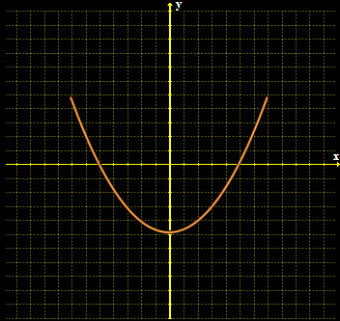
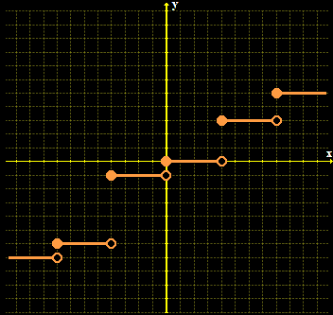
INVERSE FUNCTIONS
IN-CLASS PROBLEM 16
Identify: does it have an inverse that is a function?
Vfrench, 2010

Slide 122
INVERSE FUNCTIONS
IN-CLASS PROBLEM 16
Does it have an inverse that is a function?
no
Vfrench, 2010

Slide 123
INVERSE FUNCTIONS
IN-CLASS PROBLEM 16
Does it have an inverse that is a function?
no
yes
Vfrench, 2010

Slide 124
INVERSE FUNCTIONS
IN-CLASS PROBLEM 16
Does it have an inverse that is a function?
no
yes
maybe
Vfrench, 2010

Slide 125
INVERSE FUNCTIONS
IN-CLASS PROBLEM 16
Does it have an inverse that is a function?
no
yes
maybe
no
Vfrench, 2010

Slide 126
INVERSE FUNCTIONS
IN-CLASS PROBLEM 16
Does it have an inverse that is a function?
no
yes
maybe
no
no
Vfrench, 2010

Slide 127
INVERSE FUNCTIONS
IN-CLASS PROBLEM 16
wolframalpha.com
Calculate the inverse function: 4x+17
Calculate the inverse function: f(x)=x^2+2
inverse: x^3+5

Slide 128
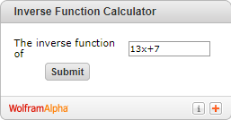
INVERSE FUNCTIONS
IN-CLASS PROBLEM 16
http://ihsankhairir.blogspot.com/2011/01/math-stuff-composite-function.html
Also has an “Inverse”

Slide 129
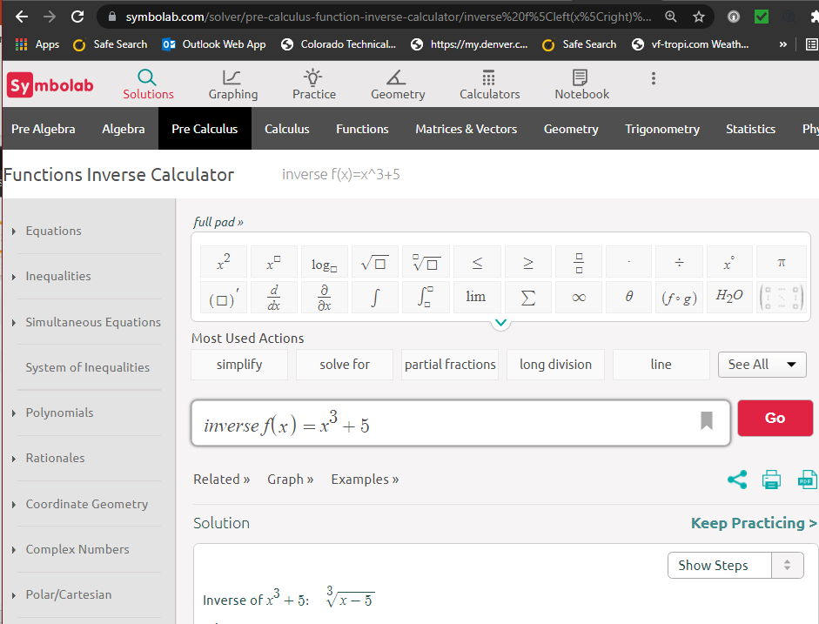

Slide 130
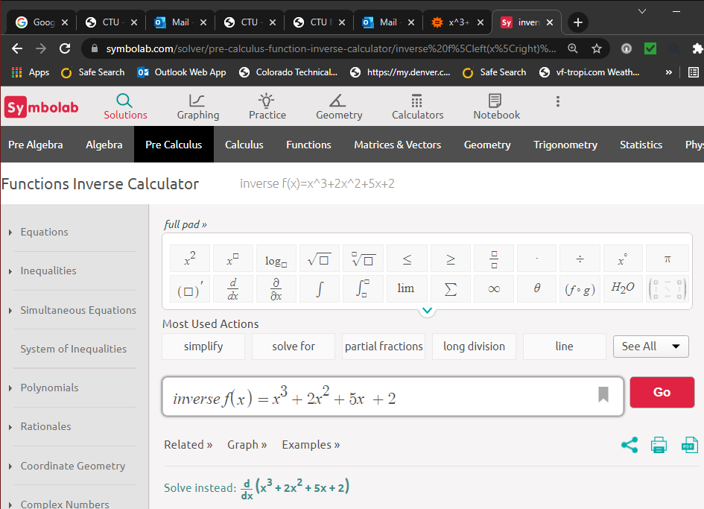
BUT…

Slide 131
Questions?
http://i.imgur.com/aliTlT3.jpg

Slide 132
Inverse Functions
A cubic function (the “maybe”)
ƒ(x) =ax³+ bx²+ cx + d,
all coefficients non-zero, x∈ℝ
in general, has no inverse because it is not a one-to-one function
Kimtee Goh, a mechanical engineer from UNIVERSITY OF MALAYA, MALAYSIA
https://www.quora.com/How-do-you-find-the-inverse-value-of-a-cubic-function

Slide 133
Inverse Functions
BUT cubic functions of the form:
(i) ƒ(x)=(ax+b)³+ c
(ii) ƒ(x)=a(x+b)³+ c
are invertible
Kimtee Goh, a mechanical engineer from UNIVERSITY OF MALAYA, MALAYSIA
https://www.quora.com/How-do-you-find-the-inverse-value-of-a-cubic-function

Slide 134
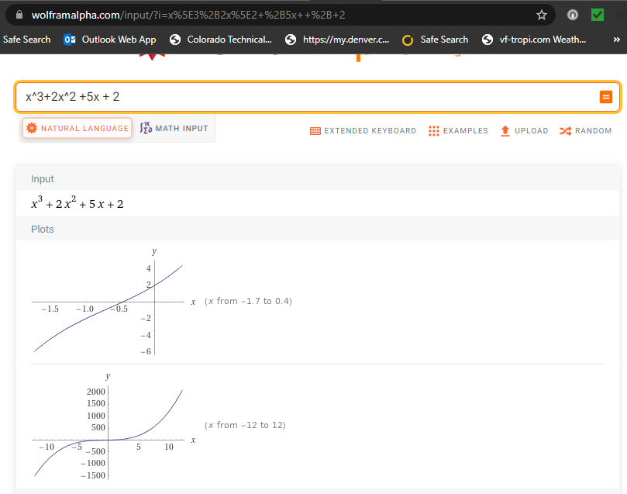
passes the horizontal line test
and the domain and range of its inverse is ℝ the domain and range of the original function

Slide 135
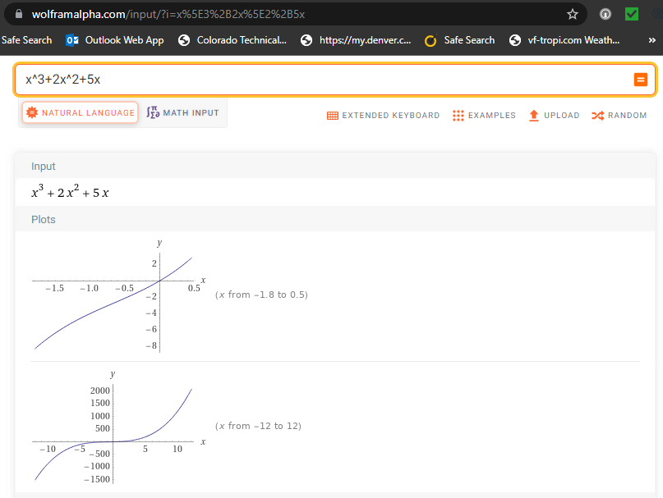
passes the horizontal line test
and the domain and range of its inverse is ℝ the domain and range of the original function

Slide 136
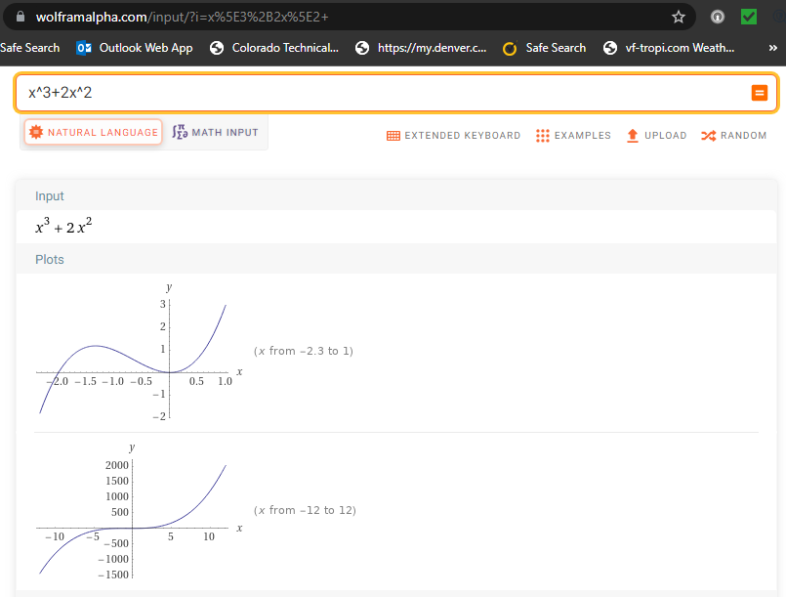
fails the horizontal line test

Slide 137
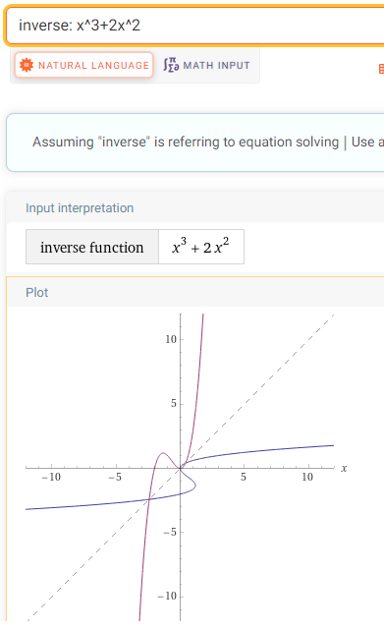

Slide 138
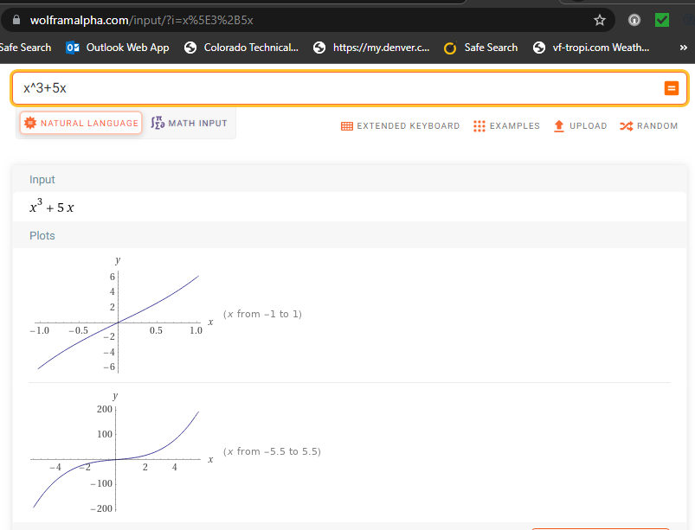
passes the horizontal line test
and the domain and range of its inverse is ℝ the domain and range of the original function

Slide 139
Inverse Functions
So, the trick seems to be:
if it’s got a “cx” term, it is invertible, otherwise probably not
Kimtee Goh, a mechanical engineer from UNIVERSITY OF MALAYA, MALAYSIA
https://www.quora.com/How-do-you-find-the-inverse-value-of-a-cubic-function

Slide 140
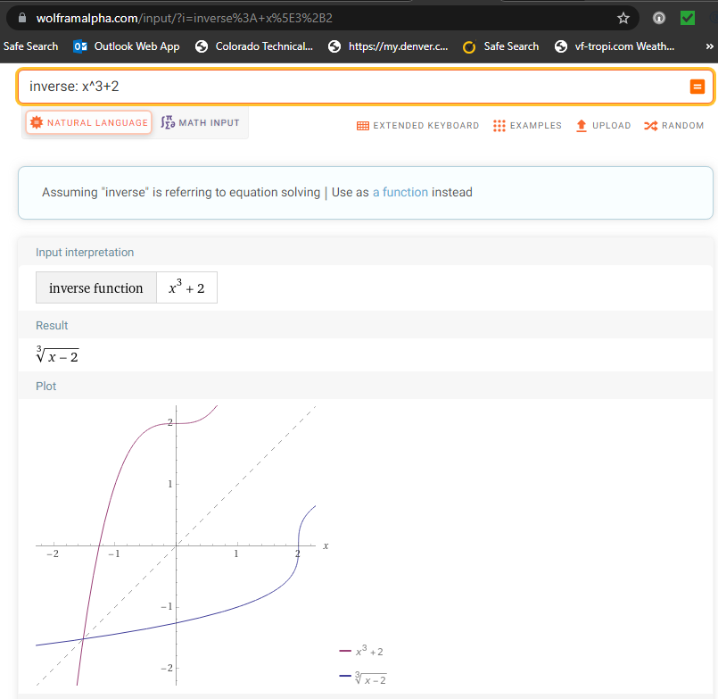
Still not sure…
Seems to be…

Slide 141
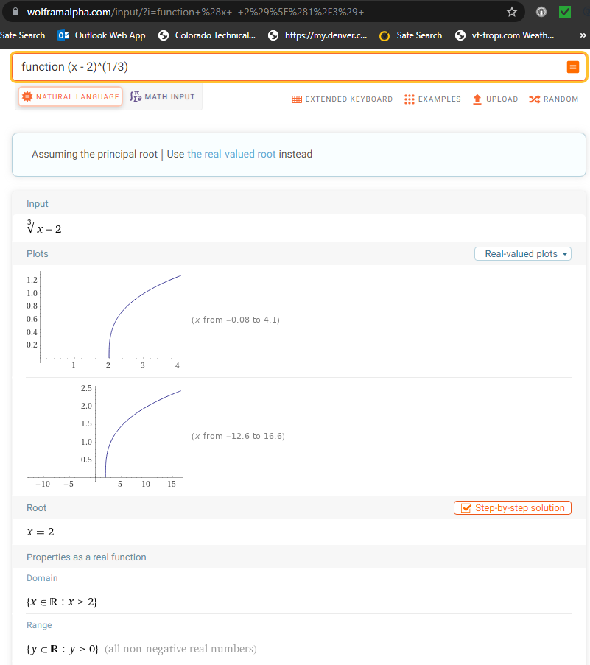
But, the domain and range of x^3+2 are both ℝ, so the domain and range of x^3+2 is NOT the range and domain of (x-2)^1/3
So IT’S NOT!

Slide 142
Questions?
http://i.imgur.com/aliTlT3.jpg

Slide 143
You Survived!
Today we studied:
Review of rational functions
Composite functions
One-to-one functions
Inverse functions
www.playbuzz.com

