Slide 1

Welcome to
Unit 5- Part 09
MATH116-Foundations for Calculus
https://media.istockphoto.com/vectors/green-blackboard-mathematical-with-thin-line-shapes-and-inscriptions-vector-id1084380192?k=6&m=1084380192&s=612x612&w=0&h=TcEOVpnUmyuswT4Pay
AL6lNiHU8SS8g33yOSg-jR5BE=

Slide 2
What’s Up?
Today we will be going over:
Review: Rational functions
New: Graphs of rational
functions
Asymptotes
Uses of rational equations

Slide 3
What’s Up?
Outcome 3) Graph rational functions and their transformations, identifying all intercepts and asymptotes

Slide 4

Review
http://995642590.r.lightningbase-cdn.com/wp-content/uploads/2010/12/looking-back-hrexaminer-v144-cover425px.jpg

Slide 5
Polynomial Graphs
We can solve the “which graph?” question without solving for any x values by using the zeros of multiplicity

Slide 6
Polynomial Graphs
Zero of Multiplicity
What is the exponent for the factor a particular zero comes from?

Slide 7
Polynomial Graphs
If r is a zero of even multiplicity:
Numerically – the sign of ƒ does
not change from one side to the
other side of r
Graphically: the graph of ƒ
touches the x-axis at r

Slide 8
Polynomial Graphs
If r is a zero of odd multiplicity:
Numerically – the sign of ƒ
changes from one side to the
other side of r
Graphically: the graph of ƒ
crosses the x-axis at r

Slide 9
Polynomial Graphs
How to identify the graph of a polynomial function:
  What is the degree?
  What is the y-intercept?
  What are the zeros?
  Check the zero of even/odd multiplicities
  The end behavior will be similar to the term with the largest degree

Slide 10
Polynomial Graphs
The bad (good?) news:
We live in the 21st century
We have ways to graph even
complicated functions easily
Use a graphing utility - the
amount of information that
can be obtained from
algebraic analysis is limited

Slide 11
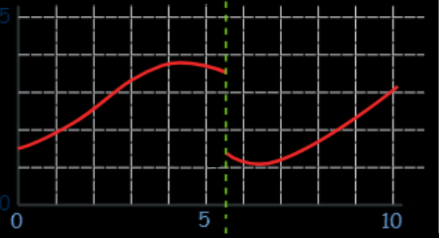
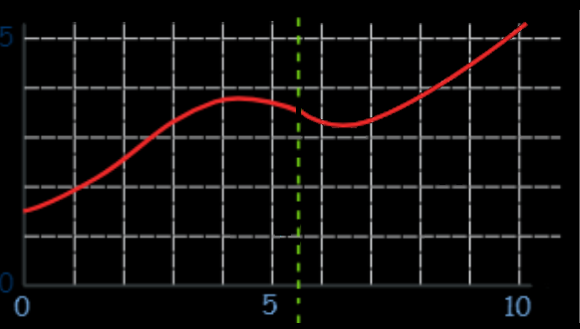
Continuity
The most important thing for calculus is that the functions must be smooth and continuous
No “cliffs”:
No “holes”:

Slide 12
Rational Equations
Have numerators and denominators in a function
Strategy: Get all denominators alike and cancel

Slide 13
Polynomial Division
Polynomial division:
long division of two polynomials
Synthetic division (the Remainder
Theorem):
can only be done for
denominators in the form
“x – c”

Slide 14

Questions?
http://i.imgur.com/aliTlT3.jpg

Slide 15
Rational Equation Graphs
Graphing rational equations can be tricky

Slide 16
Rational Equation Graphs
Finding the domain of a rational equation will determine where the function is continuous

Slide 17
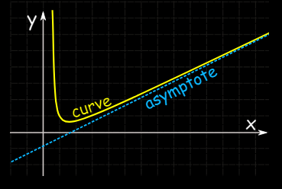
Rational Equation Graphs
Points of discontinuity may be a hole in the graph or an asymptote (a point the graph approaches)
hole

Slide 18
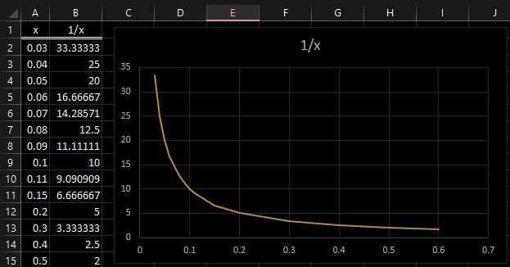
Rational Equation Graphs
The graph of y = 1/x:
x=0 is a vertical asymptote
VFrench, 2021

Slide 19
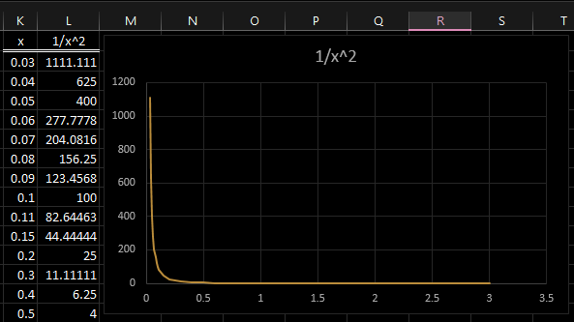
Rational Equation Graphs
The graph of 1/x²:
Even more so!
VFrench, 2021

Slide 20
Rational Equation Graphs
A vertical asymptote, when it occurs, describes the behavior of the graph when x is close to some number c
The graph of a rational function will never intersect a vertical asymptote

Slide 21
Rational Equation Graphs
The vertical asymptotes of a rational function are located at the real zeros of the denominator

Slide 22
RATIONAL EQUATION GRAPHS
IN-CLASS PROBLEM 1
Calculate any vertical asymptotes:
R(x) = 4x/(x-5)
R(x) = x/(x³-27)
R(x) = (x-3)/(x⁴+1)
R(x) = 5x²/(4+x)
R(x) = 5x³/(7+x)

Slide 23
RATIONAL EQUATION GRAPHS
IN-CLASS PROBLEM 1
Calculate any vertical asymptotes:
R(x) = 4x/(x-5) at x=5
R(x) = x/(x³-27)
R(x) = (x-3)/(x⁴+1)
R(x) = 5x²/(4+x)
R(x) = 5x³/(7+x)

Slide 24
RATIONAL EQUATION GRAPHS
IN-CLASS PROBLEM 1
Calculate any vertical asymptotes:
R(x) = 4x/(x-5) at x=5
R(x) = x/(x³-27) at x=3
R(x) = (x-3)/(x⁴+1)
R(x) = 5x²/(4+x)
R(x) = 5x³/(7+x)

Slide 25
RATIONAL EQUATION GRAPHS
IN-CLASS PROBLEM 1
Calculate any vertical asymptotes:
R(x) = 4x/(x-5) at x=5
R(x) = x/(x³-27) at x=3
R(x) = (x-3)/(x⁴+1) none
R(x) = 5x²/(4+x)
R(x) = 5x³/(7+x)

Slide 26
RATIONAL EQUATION GRAPHS
IN-CLASS PROBLEM 1
Calculate any vertical asymptotes:
R(x) = 4x/(x-5) at x=5
R(x) = x/(x³-27) at x=3
R(x) = (x-3)/(x⁴+1) none
R(x) = 5x²/(4+x) at x=-4
R(x) = 5x³/(7+x)

Slide 27
RATIONAL EQUATION GRAPHS
IN-CLASS PROBLEM 1
Calculate any vertical asymptotes:
R(x) = 4x/(x-5) at x=5
R(x) = x/(x³-27) at x=3
R(x) = (x-3)/(x⁴+1) none
R(x) = 5x²/(4+x) at x=-4
R(x) = 5x³/(7+x) at x=-7

Slide 28
Questions?
http://i.imgur.com/aliTlT3.jpg

Slide 29
Rational Equation Graphs
The graph of y = 1/x:
There is also a horizontal asymptote… what is it?
VFrench, 2021

Slide 30
Rational Equation Graphs
The graph of y = 1/x:
Yep! y=0 is a horizontal asymptote
VFrench, 2021

Slide 31
Rational Equation Graphs
A horizontal asymptote, when it occurs, describes the end behavior of the graph
The graph of a function may intersect a horizontal asymptote (!)

Slide 32
Rational Equation Graphs
Horizontal asymptotes will happen at the extreme values of x for the rational function
as x→∞ or x→-∞ (the end behavior)

Slide 33
Rational Equation Graphs
How to find horizontal asymptotes:
1) Is the degree of the numerator less than the degree of the denominator (proper)?
The graph will have the horizontal asymptote y=0 (the x-axis)

Slide 34
Rational Equation Graphs
How to find horizontal asymptotes:
2) Is the degree of the numerator the same as the degree of the denominator?
It has a horizontal asymptote:
coeff largest degree num “a”
coeff largest degree denom “b”

Slide 35
Rational Equation Graphs
How to find horizontal asymptotes:
3) Is the degree of the numerator larger than the degree of the denominator?
There is no horizontal asymptote

Slide 36
RATIONAL EQUATION GRAPHS
IN-CLASS PROBLEM 2
Calculate any horizontal asymptotes:
R(x) = 4x/(x-5)
R(x) = x/(x³-27)
R(x) = (x-3)/(x⁴+1)
R(x) = 5x²/(4+x)
R(x) = 5x³/(7+x)
Is the degree of the numerator less than the degree of the denominator (proper)?
horizontal asymptote y=0

Slide 37
RATIONAL EQUATION GRAPHS
IN-CLASS PROBLEM 2
Calculate any horizontal asymptotes:
R(x) = 4x/(x-5) degree1/degree1
R(x) = x/(x³-27) degree1/degree3
R(x) = (x-3)/(x⁴+1) degree1/degree4
R(x) = 5x²/(4+x) degree2/degree1
R(x) = 5x³/(7+x) degree3/degree1
Is the degree of the numerator less than the degree of the denominator (proper)?
horizontal asymptote y=0

Slide 38
RATIONAL EQUATION GRAPHS
IN-CLASS PROBLEM 2
Calculate any horizontal asymptotes:
R(x) = 4x/(x-5) degree1/degree1
R(x) = x/(x³-27) degree1/degree3
R(x) = (x-3)/(x⁴+1) degree1/degree4
R(x) = 5x²/(4+x) degree2/degree1
R(x) = 5x³/(7+x) degree3/degree1
Is the degree of the numerator less than the degree of the denominator (proper)?
horizontal asymptote y=0

Slide 39
RATIONAL EQUATION GRAPHS
IN-CLASS PROBLEM 2
Calculate any horizontal asymptotes:
R(x) = 4x/(x-5)
R(x) = x/(x³-27) at y=0
R(x) = (x-3)/(x⁴+1) at y=0
R(x) = 5x²/(4+x)
R(x) = 5x³/(7+x)
Is the degree of the numerator less than the degree of the denominator (proper)?
horizontal asymptote y=0

Slide 40
RATIONAL EQUATION GRAPHS
IN-CLASS PROBLEM 2
Calculate any horizontal asymptotes:
R(x) = 4x/(x-5) degree1/degree1
R(x) = x/(x³-27) at y=0
R(x) = (x-3)/(x⁴+1) at y=0
R(x) = 5x²/(4+x) degree2/degree1
R(x) = 5x³/(7+x) degree3/degree1
Is the degree of the numerator the same as the degree of the denominator?
horizontal asymptote: coeff largest degree num “a”/coeff largest degree denom “b”

Slide 41
RATIONAL EQUATION GRAPHS
IN-CLASS PROBLEM 2
Calculate any horizontal asymptotes:
R(x) = 4x/(x-5) degree1/degree1
R(x) = x/(x³-27) at y=0
R(x) = (x-3)/(x⁴+1) at y=0
R(x) = 5x²/(4+x) degree2/degree1
R(x) = 5x³/(7+x) degree3/degree1
Is the degree of the numerator the same as the degree of the denominator?
horizontal asymptote: coeff largest degree num “a”/coeff largest degree denom “b”

Slide 42
RATIONAL EQUATION GRAPHS
IN-CLASS PROBLEM 2
Calculate any horizontal asymptotes:
R(x) = 4x/(1x-5) at 4/1 or 4
R(x) = x/(x³-27) at y=0
R(x) = (x-3)/(x⁴+1) at y=0
R(x) = 5x²/(4+x)
R(x) = 5x³/(7+x)
Is the degree of the numerator the same as the degree of the denominator?
horizontal asymptote: coeff largest degree num/coeff largest degree denom

Slide 43
RATIONAL EQUATION GRAPHS
IN-CLASS PROBLEM 2
Calculate any horizontal asymptotes:
R(x) = 4x/(x-5) at 4
R(x) = x/(x³-27) at y=0
R(x) = (x-3)/(x⁴+1) at y=0
R(x) = 5x²/(4+x) degree2/degree1
R(x) = 5x³/(7+x) degree3/degree1
Is the degree of the numerator larger than the degree of the denominator?
There is no horizontal asymptote

Slide 44
RATIONAL EQUATION GRAPHS
IN-CLASS PROBLEM 2
Calculate any horizontal asymptotes:
R(x) = 4x/(x-5) at 4
R(x) = x/(x³-27) at y=0
R(x) = (x-3)/(x⁴+1) at y=0
R(x) = 5x²/(4+x) degree2/degree1
R(x) = 5x³/(7+x) degree3/degree1
Is the degree of the numerator larger than the degree of the denominator?
There is no horizontal asymptote

Slide 45
RATIONAL EQUATION GRAPHS
IN-CLASS PROBLEM 2
Calculate any horizontal asymptotes:
R(x) = 4x/(x-5) at 4
R(x) = x/(x³-27) at y=0
R(x) = (x-3)/(x⁴+1) at y=0
R(x) = 5x²/(4+x) none
R(x) = 5x³/(7+x) none
Is the degree of the numerator larger than the degree of the denominator?
There is no horizontal asymptote

Slide 46
Questions?
http://i.imgur.com/aliTlT3.jpg

Slide 47
Rational Equation Graphs
There is a third type of asymptote!
If, as x→∞ or as x→-∞, the value of a rational function approaches a linear expression ax+b, a≠0, then the line y=ax+b is an oblique asymptote of R

Slide 48
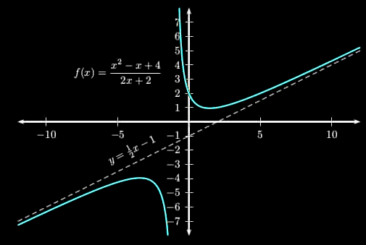
Rational Equation Graphs
Oblique asymptote
https://magoosh.com/hs/files/2017/01/oblique_asymptote_example.jpg

Slide 49
Rational Equation Graphs
An oblique asymptote, when it occurs, also describes the end behavior of the graph
The graph of a function may intersect an oblique asymptote

Slide 50
Rational Equation Graphs
So to find oblique asymptotes, we again need to find the end behavior of the rational function as x→∞ or as x→-∞

Slide 51
Rational Equation Graphs
How to find oblique asymptotes:
3) Is the degree of the numerator 1 larger than the degree of the denominator?
y = ax + b is an oblique asymptote
where “a” is the coefficient of the largest degree in the numerator and “b” is the coefficient of the largest degree in the denominator

Slide 52
Rational Equation Graphs
How to find oblique asymptotes:
4) Is the degree of the numerator 2 or more larger than the degree of the denominator?
There is no oblique asymptote
(or horizontal)

Slide 53
RATIONAL EQUATION GRAPHS
IN-CLASS PROBLEM 3
Calculate any oblique asymptotes:
R(x) = 4x/(x-5)
R(x) = x/(x³-27)
R(x) = (x-3)/(x⁴+1)
R(x) = 5x²/(4+x)
R(x) = 5x³/(7+x)
Is the degree of the numerator 1 larger than the degree of the denominator?
y = ax + b is an oblique asymptote

Slide 54
RATIONAL EQUATION GRAPHS
IN-CLASS PROBLEM 3
Calculate any oblique asymptotes:
R(x) = 4x/(x-5) degree1/degree1
R(x) = x/(x³-27) degree1/degree3
R(x) = (x-3)/(x⁴+1) degree1/degree4
R(x) = 5x²/(4+x) degree2/degree1
R(x) = 5x³/(7+x) degree3/degree1
Is the degree of the numerator 1 larger than the degree of the denominator?
y = ax + b is an oblique asymptote

Slide 55
RATIONAL EQUATION GRAPHS
IN-CLASS PROBLEM 3
Calculate any oblique asymptotes:
R(x) = 4x/(x-5) degree1/degree1
R(x) = x/(x³-27) degree1/degree3
R(x) = (x-3)/(x⁴+1) degree1/degree4
R(x) = 5x²/(4+x) degree2/degree1
R(x) = 5x³/(7+x) degree3/degree1
Is the degree of the numerator 1 larger than the degree of the denominator?
y = ax + b is an oblique asymptote

Slide 56
RATIONAL EQUATION GRAPHS
IN-CLASS PROBLEM 3
Calculate any oblique asymptotes:
R(x) = 4x/(x-5) none
R(x) = x/(x³-27) none
R(x) = (x-3)/(x⁴+1) none
R(x) = 5x²/(4+1x) at ax+b = 5x+1
R(x) = 5x³/(7+x) none
Is the degree of the numerator 1 larger than the degree of the denominator?
y = ax + b is an oblique asymptote

Slide 57
Questions?
http://i.imgur.com/aliTlT3.jpg

Slide 58
Rational Equation Graphs
You’ll be relieved to know Wolfram does these easily

Slide 59
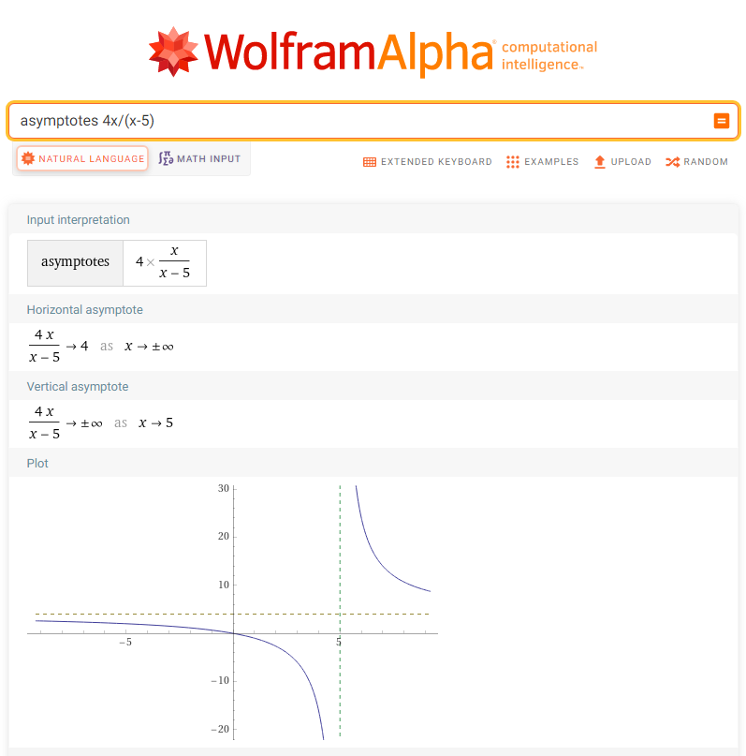

Slide 60
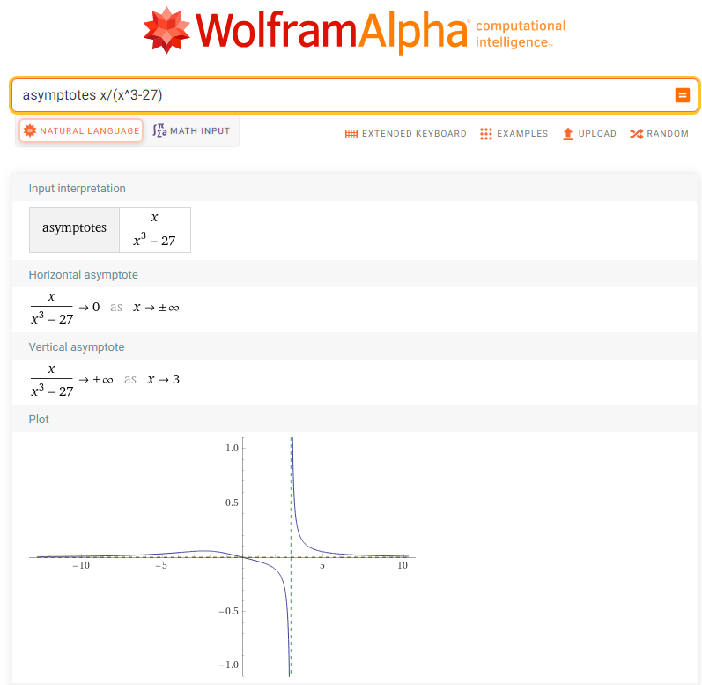

Slide 61
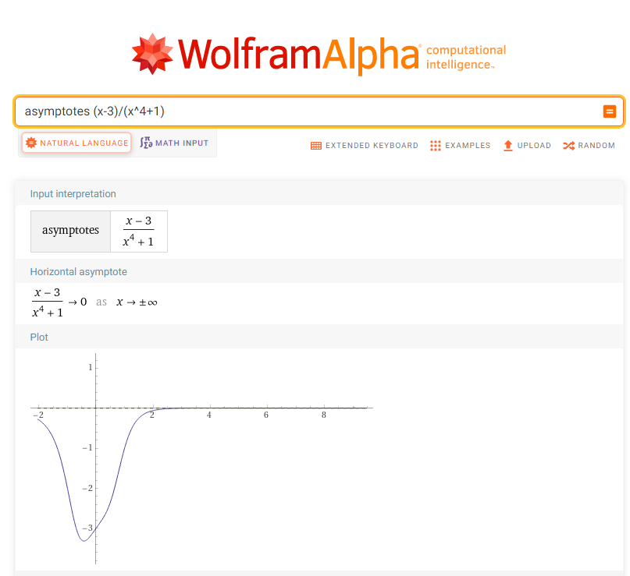

Slide 62
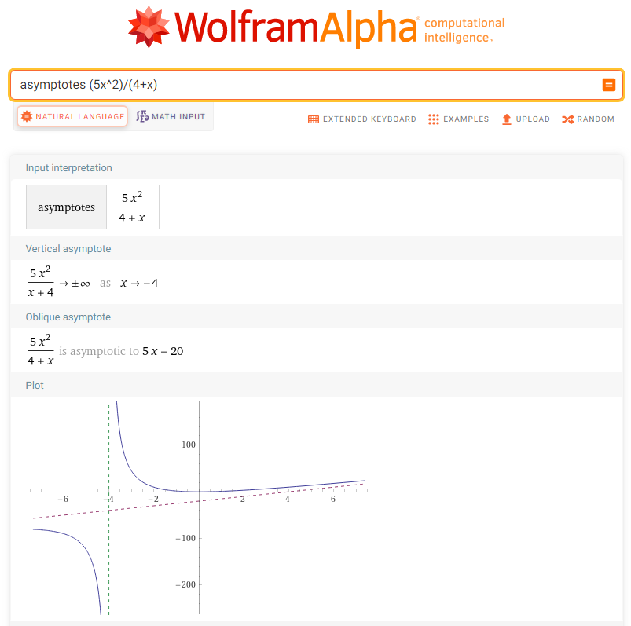

Slide 63
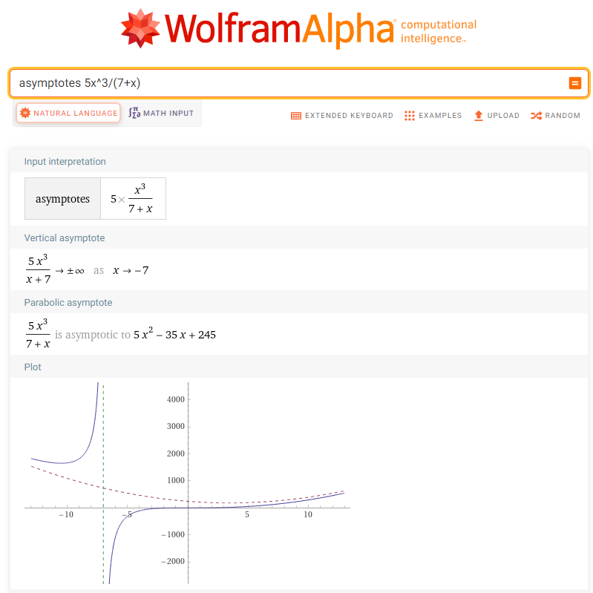
Wolfram even does a parabolic asymptote

Slide 64
Questions?
http://i.imgur.com/aliTlT3.jpg

Slide 65
Uses of Rational Equations
Rational equations are common in real-life problems (sorry!)

Slide 66
RATIONAL EQUATIONS
IN-CLASS PROBLEM 4
Reynolds Metal Company manufactures aluminum cans in the shape of a cylinder with a capacity of 500 cubic centimeters (½ liter)
The top and bottom of the can
are made of a special aluminum alloy that costs $0.05 per square centimeter
The sides of the can are made of material that costs $0.02 per square centimeter
(a) Express the cost of material for the can as a function of the radius r of the can
(b) Use a graphing utility to graph the function
(c) What value of r will result in the least cost?
(d) What is this least cost?

Slide 67
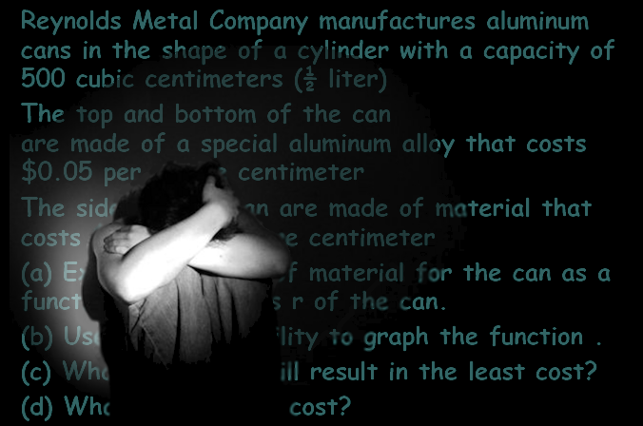
RATIONAL EQUATIONS
IN-CLASS PROBLEM 4

Slide 68
RATIONAL EQUATIONS
IN-CLASS PROBLEM 4
Don’t panic! Just look for the important stuff…

Slide 69
RATIONAL EQUATIONS
IN-CLASS PROBLEM 4
Reynolds Metal Company manufactures aluminum cans in the shape of a cylinder with a capacity of 500 cubic centimeters (½ liter)
The top and bottom of the can
are made of a special aluminum alloy that costs $0.05 per square centimeter
The sides of the can are made of material that costs $0.02 per square centimeter
(a) Express the cost of material for the can as a function of the radius r of the can
(b) Use a graphing utility to graph the function
(c) What value of r will result in the least cost?
(d) What is this least cost?

Slide 70
RATIONAL EQUATIONS
IN-CLASS PROBLEM 4
Cylinder capacity of 500 cubic centimeters
Top and bottom cost $0.05 per square centimeter
Sides cost $0.02 per square centimeter
(a) Express the cost of material for the can as a function of the radius r of the can
You’ll need a formula for the shape of the can

Slide 71
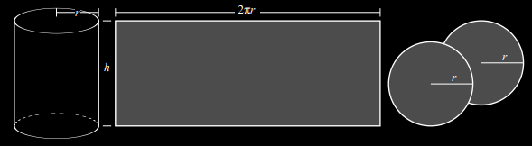
RATIONAL EQUATIONS
IN-CLASS PROBLEM 4
What will the surface area be?
VFrench 2020

Slide 72
RATIONAL EQUATIONS
IN-CLASS PROBLEM 4
The surface area:
A = 2 lids + 1 side
VFrench 2020

Slide 73
RATIONAL EQUATIONS
IN-CLASS PROBLEM 4
The surface area:
A = 2 lids + 1 side
= 2πr² + 2πrh
VFrench 2020

Slide 74
RATIONAL EQUATIONS
IN-CLASS PROBLEM 4
A = 2πr² + 2πrh
But how do we find r and h?
VFrench 2020

Slide 75
RATIONAL EQUATIONS
IN-CLASS PROBLEM 4
A = 2πr² + 2πrh
But how do we find r and h?
Well, the volume has to be
500cm³…
What’s the formula for the
volume of a cylinder?
VFrench 2020

Slide 76
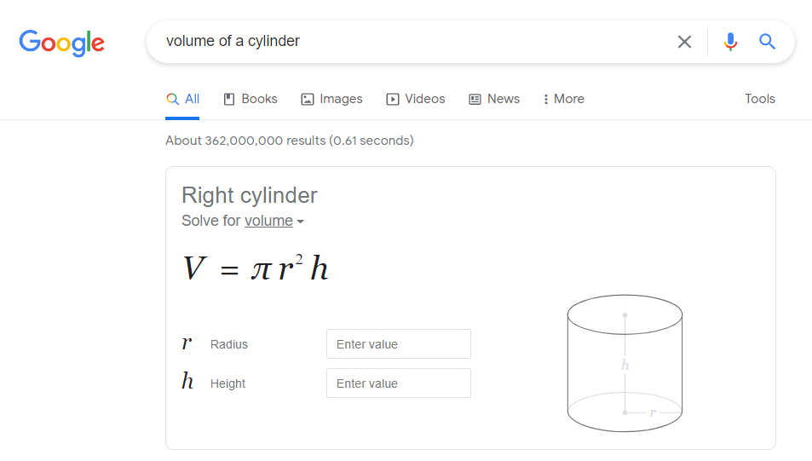
RATIONAL EQUATIONS
IN-CLASS PROBLEM 4
We live in a wonderful time…

Slide 77
RATIONAL EQUATIONS
IN-CLASS PROBLEM 4
A = 2πr² + 2πrh
But how do we find r and h?
Well, the volume has to be
500cm³…
V = 500 = πr²h
VFrench 2020

Slide 78
RATIONAL EQUATIONS
IN-CLASS PROBLEM 4
A = 2πr² + 2πrh
500 = πr²h
Hmm… two variables…
VFrench 2020

Slide 79
RATIONAL EQUATIONS
IN-CLASS PROBLEM 4
A = 2πr² + 2πrh
500 = πr²h
Hmm… two variables…
Pick one! (I pick the easy one):
h = 500/(πr²)
VFrench 2020

Slide 80
RATIONAL EQUATIONS
IN-CLASS PROBLEM 4
A = 2πr² + 2πrh
h = 500/(πr²)
Combine the two equations:
A = 2πr² + 2πr(500/(πr²))
VFrench 2020

Slide 81
RATIONAL EQUATIONS
IN-CLASS PROBLEM 4
A = 2πr² + 2πrh
h = 500/(πr²)
Simplify:
A = 2πr² + 2πr(500/(πr²))
= 2πr² + 2(500/r)
= 2πr² + 1000/r
Ah, now we have a rational equation!
VFrench 2020

Slide 82
RATIONAL EQUATIONS
IN-CLASS PROBLEM 4
Cylinder capacity of 500 cubic centimeters
Top and bottom cost $0.05 per square centimeter
Sides cost $0.02 per square centimeter
(a) Express the cost of material for the can as a function of the radius r of the can
A = 2πr² + 1000/r
Hmm… cost…

Slide 83
RATIONAL EQUATIONS
IN-CLASS PROBLEM 4
Cylinder capacity of 500 cubic centimeters
Top and bottom cost $0.05 per square centimeter
Sides cost $0.02 per square centimeter
(a) Express the cost of material for the can as a function of the radius r of the can
A = 2πr² + 1000/r
{
{
Top and
bottom
Sides

Slide 84
RATIONAL EQUATIONS
IN-CLASS PROBLEM 4
Cylinder capacity of 500 cubic centimeters
Top and bottom cost $0.05 per square centimeter
Sides cost $0.02 per square centimeter
(a) Express the cost of material for the can as a function of the radius r of the can
A = 2πr² + 1000/r
{
{
Top and
bottom
$0.05
Sides
$0.02

Slide 85
RATIONAL EQUATIONS
IN-CLASS PROBLEM 4
Cylinder capacity of 500 cubic centimeters
Top and bottom cost $0.05 per square centimeter
Sides cost $0.02 per square centimeter
(a) Express the cost of material for the can as a function of the radius r of the can
A = (0.05)2πr² + (0.02)1000/r
(b) Now for a graph…

Slide 86
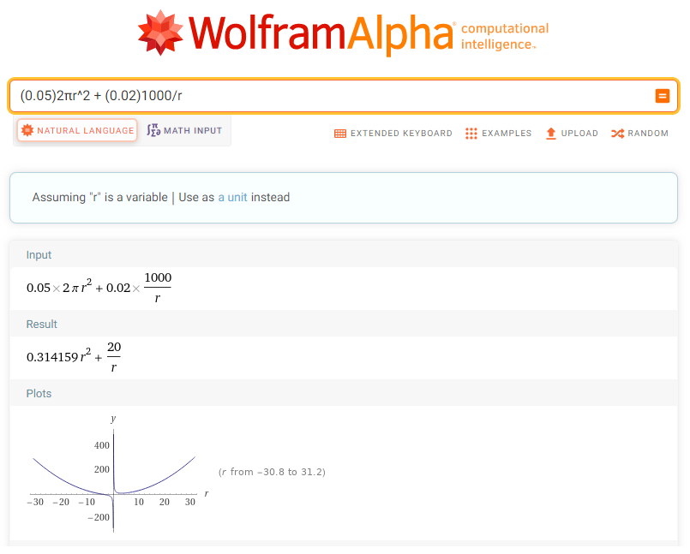
RATIONAL EQUATIONS
IN-CLASS PROBLEM 4
https://www.wolframalpha.com/input/?i=%280.05%292%CF%80r%5E2+%2B+%280.02%291000%2Fr+

Slide 87
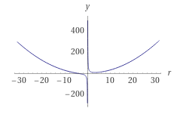
RATIONAL EQUATIONS
IN-CLASS PROBLEM 4
https://www.wolframalpha.com/input/?i=%280.05%292%CF%80r%5E2+%2B+%280.02%291000%2Fr+

Slide 88
RATIONAL EQUATIONS
IN-CLASS PROBLEM 4
Cylinder capacity of 500 cubic centimeters
Top and bottom cost $0.05 per square centimeter
Sides cost $0.02 per square centimeter
(a) Express the cost of material for the can as a function of the radius r of the can
A = (0.05)2πr² + (0.02)1000/r
(c) What value of r will result in the least cost?
(d) What is this least cost?
https://www.wolframalpha.com/input/?i=%280.05%292%CF%80r%5E2+%2B+%280.02%291000%2Fr+

Slide 89
RATIONAL EQUATIONS
IN-CLASS PROBLEM 4
Cylinder capacity of 500 cubic centimeters
Top and bottom cost $0.05 per square centimeter
Sides cost $0.02 per square centimeter
(a) Express the cost of material for the can as a function of the radius r of the can
A = (0.05)2πr² + (0.02)1000/r
(c) What value of r will result in the least cost?
(d) What is this least cost?
Here’s something’ sneaky…
https://www.wolframalpha.com/input/?i=%280.05%292%CF%80r%5E2+%2B+%280.02%291000%2Fr+

Slide 90
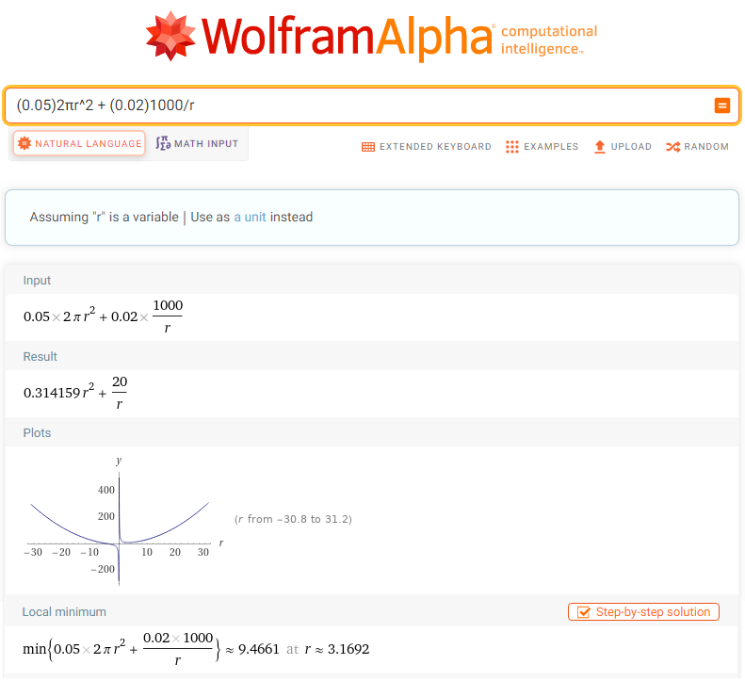

Slide 91
RATIONAL EQUATIONS
IN-CLASS PROBLEM 4
Cylinder capacity of 500 cubic centimeters
Top and bottom cost $0.05 per square centimeter
Sides cost $0.02 per square centimeter
(a) Express the cost of material for the can as a function of the radius r of the can
A = (0.05)2πr² + (0.02)1000/r
(c) What value of r will result in the least cost?
(d) What is this least cost?
So, the least cost is ≈ 0.0947 at r ≈ 3.17

Slide 92
RATIONAL EQUATIONS
IN-CLASS PROBLEM 4
Cylinder capacity of 500 cubic centimeters
Top and bottom cost $0.05 per square centimeter
Sides cost $0.02 per square centimeter
(a) Express the cost of material for the can as a function of the radius r of the can
A = (0.05)2πr² + (0.02)1000/r
(c) What value of r will result in the least cost?
(d) What is this least cost?
So, the least cost is ≈ 0.0947 WHATS?
at r ≈ 3.17 WHATS?

Slide 93
RATIONAL EQUATIONS
IN-CLASS PROBLEM 4
Cylinder capacity of 500 cubic centimeters
Top and bottom cost $0.05 per square centimeter
Sides cost $0.02 per square centimeter
(a) Express the cost of material for the can as a function of the radius r of the can
A = (0.05)2πr² + (0.02)1000/r
(c) What value of r will result in the least cost?
(d) What is this least cost?
So, the least cost is ≈ $0.0947
at r ≈ 3.17cm

Slide 94
Uses of Rational Equations
BTW – we’ll be learning an easy way to calculate the minimum in calculus class!

Slide 95
Questions?
http://i.imgur.com/aliTlT3.jpg

Slide 96
Uses of Rational Equations
We’ve seen that trajectory quadratic equations have been determined for different shot put angles

Slide 97
Uses of Rational Equations
Lots of other formulas commonly used in various professions have also been determined

Slide 98
Uses of Rational Equations
“Concentration over time” formulas have been determined for many drugs

Slide 99
RATIONAL EQUATIONS
IN-CLASS PROBLEM 5
micromole
The concentration “C” in µmol of a certain drug in a patient’s bloodstream “t” hours after injection is given by:
C(t) = t/(2t²+1)
Find the horizontal asymptote of C(t) whadda we need to know?

Slide 100
RATIONAL EQUATIONS
IN-CLASS PROBLEM 5
The concentration “C” in µmol of a certain drug in a patient’s bloodstream “t” hours after injection is given by:
C(t) = t/(2t²+1)
Find the horizontal asymptote of C(t) degree num/degree denom

Slide 101
RATIONAL EQUATIONS
IN-CLASS PROBLEM 5
The concentration “C” in µmol of a certain drug in a patient’s bloodstream “t” hours after injection is given by:
C(t) = t/(2t²+1)
Find the horizontal asymptote of C(t) degree1/degree2… so…
1) Is the degree of the numerator less than the degree of the denominator?
horizontal asymptote y=0
2) Is the degree of the numerator the same as the degree of the denominator?
horizontal asymptote: (coeff largest degree num “a”)/(coeff largest degree denom “b”
3) Is the degree of the numerator larger than the degree of the denominator?
no horizontal asymptote

Slide 102
RATIONAL EQUATIONS
IN-CLASS PROBLEM 5
The concentration “C” in µmol of a certain drug in a patient’s bloodstream “t” hours after injection is given by:
C(t) = t/(2t²+1)
Find the horizontal asymptote of C(t): degree1/degree2,
so the horizontal asymptote is:
y = 0
1) Is the degree of the numerator less than the degree of the denominator?
horizontal asymptote y=0

Slide 103
RATIONAL EQUATIONS
IN-CLASS PROBLEM 5
The concentration “C” in µmol of a certain drug in a patient’s bloodstream “t” hours after injection is given by:
C(t) = t/(2t²+1)
(b) Graph C(t)

Slide 104
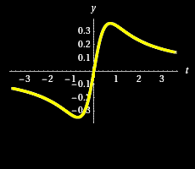
RATIONAL EQUATIONS
IN-CLASS PROBLEM 5
The concentration “C” in µmol of a certain drug in a patient’s bloodstream “t” hours after injection is given by:
C(t) = t/(2t²+1)
(b) Graph C(t)
Tell me about this
graph…
https://www.wolframalpha.com/input/?i=t%2F%282t%5E2%2B1%29

Slide 105
RATIONAL EQUATIONS
IN-CLASS PROBLEM 5
The concentration “C” in µmol of a certain drug in a patient’s bloodstream “t” hours after injection is given by:
C(t) = t/(2t²+1)
(c) Determine the time
at which the
concentration is
highest and what the
concentration is at that time
https://www.wolframalpha.com/input/?i=t%2F%282t%5E2%2B1%29

Slide 106
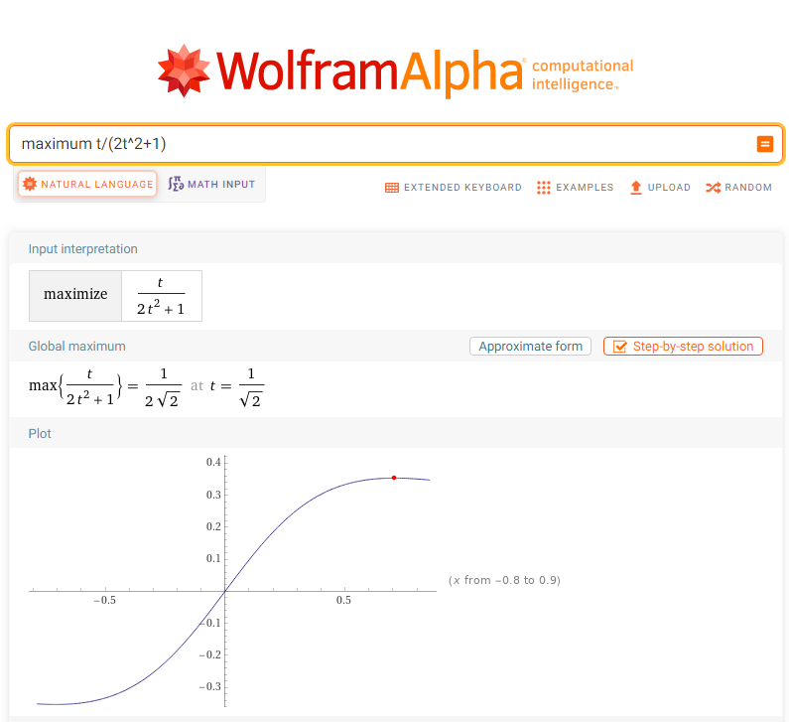
https://www.wolframalpha.com/input/?i=t%2F%282t%5E2%2B1%29

Slide 107
RATIONAL EQUATIONS
IN-CLASS PROBLEM 5
The concentration “C” in µmol of a certain drug in a patient’s bloodstream “t” hours after injection is given by:
C(t) = t/(2t²+1)
(c) So the maximum
concentration
≈ 0.354 whats? occurs
at ≈ 0.707 whats?
https://www.wolframalpha.com/input/?i=t%2F%282t%5E2%2B1%29

Slide 108
RATIONAL EQUATIONS
IN-CLASS PROBLEM 5
The concentration “C” in µmol of a certain drug in a patient’s bloodstream “t” hours after injection is given by:
C(t) = t/(2t²+1)
(c) So the maximum
concentration
≈ 0.354 µmol occurs
at ≈ 0.707 hours
https://www.wolframalpha.com/input/?i=t%2F%282t%5E2%2B1%29

Slide 109
RATIONAL EQUATIONS
IN-CLASS PROBLEM 6
There are two possible drugs a murder victim might have ingested
One has a concentration curve of:
C1(t) = t/(2t²+1)
The other has a concentration curve of: C2 = t/(t²+25)
Compare the two graphs

Slide 110
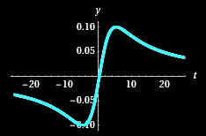
RATIONAL EQUATIONS
IN-CLASS PROBLEM 6
There are two possible drugs a murder victim might have ingested
C1(t)=t/(2t²+1) C2 = t/(t²+25)
Compare the two graphs

Slide 111
RATIONAL EQUATIONS
IN-CLASS PROBLEM 6
There are two possible drugs a murder victim might have ingested
C1(t)=t/(2t²+1) C2 = t/(t²+25)
If the concentration in the murder victims blood is 0.30, which is it?

Slide 112
RATIONAL EQUATIONS
IN-CLASS PROBLEM 6
There are two possible drugs a murder victim might have ingested
C1(t)=t/(2t²+1) C2 = t/(t²+25)
If the victim has been dead more than 10 hours and the concentration is 0.075, which is it?

Slide 113
Uses of Rational Equations
Again, we’ll be running into these in calculus class!

Slide 114
Questions?
http://i.imgur.com/aliTlT3.jpg

Slide 115

You Survived!
Today we studied:
Review of Rational Functions
Graphs of Rational Functions
Asymptotes
Uses of rational equations
www.playbuzz.com

