Slide 1
Welcome to
Unit 2- Part 04
MATH116-Foundations for Calculus
https://media.istockphoto.com/vectors/green-blackboard-mathematical-with-thin-line-shapes-and-inscriptions-vector-id1084380192?k=6&m=1084380192&s=612x612&w=0&h=TcEOVpnUmyuswT4Pay
AL6lNiHU8SS8g33yOSg-jR5BE=

Slide 2
What’s Up?
Today we will be going over:
Review of polynomial graphs
Complex numbers

Slide 3
What’s Up?
Outcome 2) Graph polynomial functions using the leading-term test, factoring, zeros and their multiplicities.

Slide 4
Review
http://995642590.r.lightningbase-cdn.com/wp-content/uploads/2010/12/looking-back-hrexaminer-v144-cover425px.jpg

Slide 5
Lines
To define a unique line, you need:
two points
or
a point and a slope

Slide 6
Lines
The standard form of the equation of a line involves a point and a slope:
y = mx + b
slope
y-intercept

Slide 7
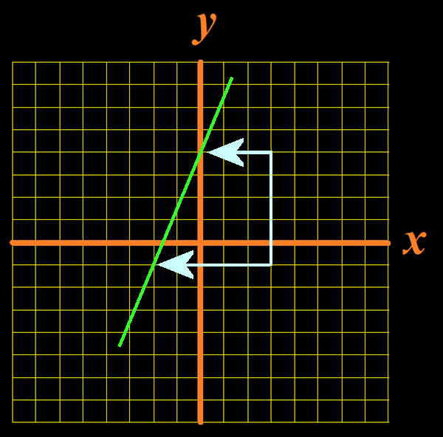
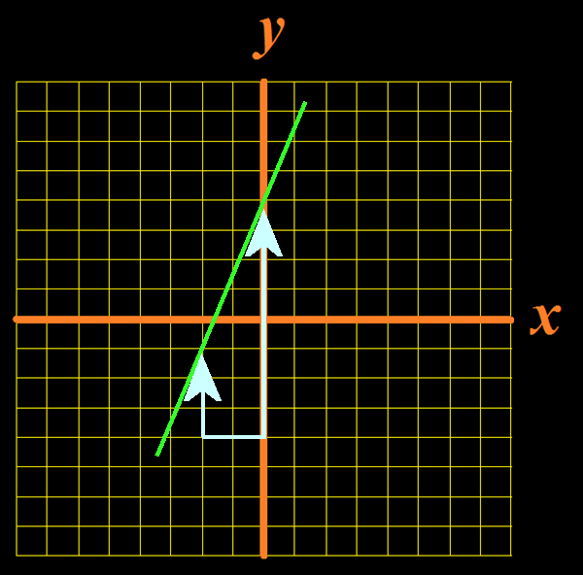
Lines
Slope of a line given a graph:
m =
rise run
rise
.
run
Vfrench, 2012

Slide 8
Lines
Slope of a line given two points:
(x₁,y₁) (x₂,y₂)
m =
y₁ – y₂
.
x₁ – x₂

Slide 9
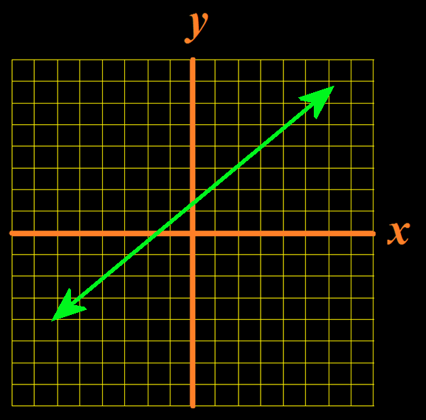
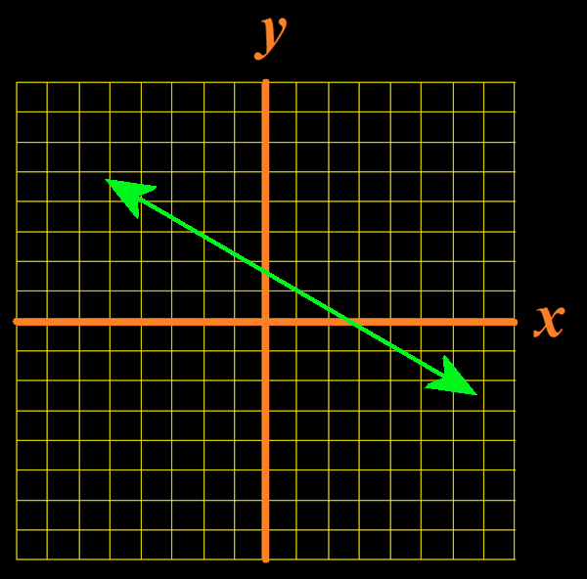
Lines
Positive slopes Negative slopes
move upward move downward
Vfrench, 2012

Slide 10
Lines
“b” is the y-intercept
where the “x” value is 0
where the graph crosses
the y-axis

Slide 11
Lines
“b” is the y-intercept
where the “x” value is 0
where the graph crosses
the y-axis
b = y – mx

Slide 12
Parabolas
The equation of a parabola is:
ax² + bx + c = y
“a” “b” and “c” determine the shape and location of the curve

Slide 13
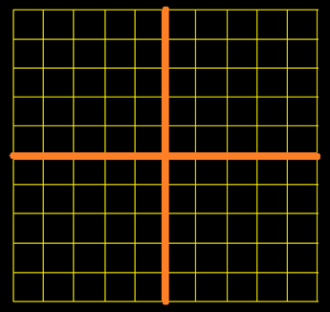
Parabolas
ax² + bx + c = y
If “a” is positive, the curve will be cup-shaped
8
6
4
2
0
-2
–4
-6
-8
-4 –3 –2 –1 0 1 2 3 4
Vfrench, 2020

Slide 14
Parabolas
ax² + bx + c = y
If “a” is negative, the curve will be hill-shaped
8
6
4
2
0
-2
–4
-6
-8
-4 –3 –2 –1 0 1 2 3 4
Vfrench, 2020

Slide 15
Parabolas
A positive “c” shifts the curve up
A negative shifts it down
y = x² + 7
y = x² - 7
10
5
0
–5
-10
10
5
0
–5
-10
-8 –6 –4 –2 0 2 4 6 8
-8 –6 –4 –2 0 2 4 6 8
Vfrench, 2020

Slide 16
Parabolas
Changing “b” will move the curve both vertically and horizontally
y = x² + 7x
y = x² - 7x
10
5
0
–5
-10
10
5
0
–5
-10
-8 –6 –4 –2 0 2 4 6 8
-8 –6 –4 –2 0 2 4 6 8
Vfrench, 2020

Slide 17
Questions?
http://i.imgur.com/aliTlT3.jpg

Slide 18
Complex Numbers
Remember how easy it is to factor a difference of two squares?
x² – 4 = (x – 2) (x + 2)

Slide 19
Complex Numbers
What is the factoring for:
x² + 4
Hmm… not so easy after all

Slide 20
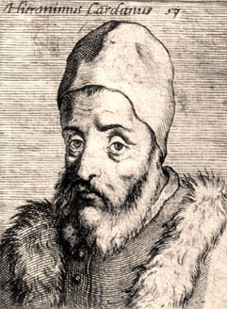
Complex Numbers
An Italian mathematician/astrologer named Girolamo Cardano
(1501-1576)
thought it should be!
https://www.daviddarling.info/encyclopedia/C/Cardano.html

Slide 21
Complex Numbers
Girolamo was illegitimate, and his mother tried to abort him
His father was a
famous lawyer who
was a friend of
Leonardo da Vinci
https://www.daviddarling.info/encyclopedia/C/Cardano.html

Slide 22
Complex Numbers
Cardano was the first mathematician to use negative
numbers systematically
in algebraic equations
https://www.daviddarling.info/encyclopedia/C/Cardano.html

Slide 23
Complex Numbers
He wanted to discover a solution to: x² + 4
that would be as easy
as for: x² - 4
https://www.daviddarling.info/encyclopedia/C/Cardano.html

Slide 24
Complex Numbers
In 1545, he decided the number he needed was:
$\sqrt{\text{−4}}$
https://www.daviddarling.info/encyclopedia/C/Cardano.html

Slide 25
Complex Numbers
?
x² + 4 = (x – $\sqrt{\text{−4}}$) (x + $\sqrt{\text{−4}}$)
https://www.daviddarling.info/encyclopedia/C/Cardano.html

Slide 26
Complex Numbers
?
x² + 4 = (x – $\sqrt{\text{−4}}$) (x + $\sqrt{\text{−4}}$)
= x² – $\sqrt{\text{−4}}$x + $\sqrt{\text{−4}}$ x - ($\sqrt{\text{−4}}$)²
?
https://www.daviddarling.info/encyclopedia/C/Cardano.html

Slide 27
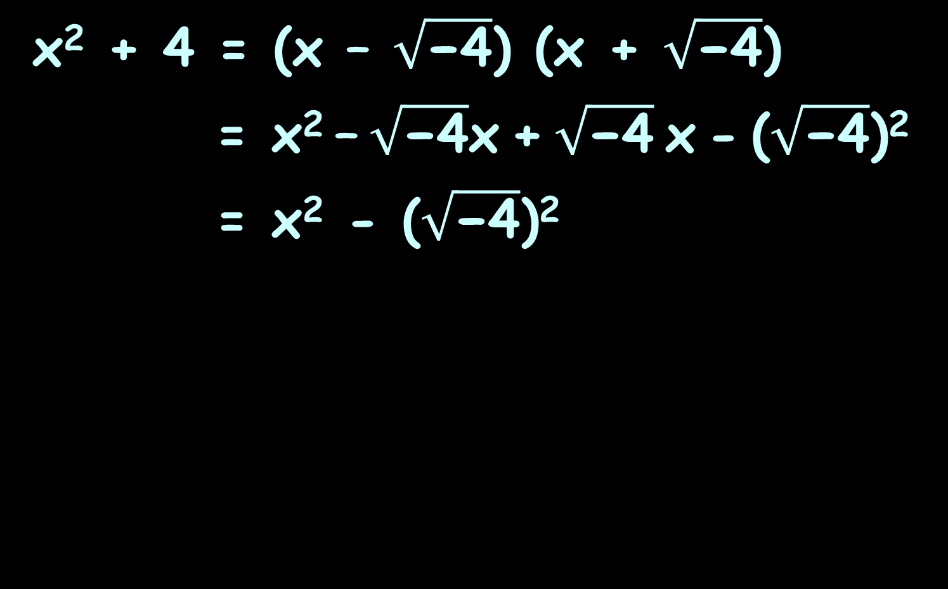
Complex Numbers
?
x² + 4 = (x – $\sqrt{\text{−4}}$) (x + $\sqrt{\text{−4}}$)
= x² – $\sqrt{\text{−4}}$x + $\sqrt{\text{−4}}$ x - ($\sqrt{\text{−4}}$)²
= x² - ($\sqrt{\text{−4}}$)²
?
?
https://www.daviddarling.info/encyclopedia/C/Cardano.html

Slide 28
Complex Numbers
?
x² + 4 = (x – $\sqrt{\text{−4}}$) (x + $\sqrt{\text{−4}}$)
= x² – $\sqrt{\text{−4}}$x + $\sqrt{\text{−4}}$ x - ($\sqrt{\text{−4}}$)²
= x² - ($\sqrt{\text{−4}}$)²
= x² – (-4)
?
?
?
https://www.daviddarling.info/encyclopedia/C/Cardano.html

Slide 29
Complex Numbers
?
x² + 4 = (x – $\sqrt{\text{−4}}$) (x + $\sqrt{\text{−4}}$)
= x² – $\sqrt{\text{−4}}$x + $\sqrt{\text{−4}}$ x - ($\sqrt{\text{−4}}$)²
= x² - ($\sqrt{\text{−4}}$)²
= x² – (-4)
= x² + 4
Yay!
?
?
?
https://www.daviddarling.info/encyclopedia/C/Cardano.html

Slide 30
Complex Numbers
Of course, Cardano realized that $\sqrt{\text{−4}}$ was “manifestly impossible”
https://www.daviddarling.info/encyclopedia/C/Cardano.html

Slide 31
Complex Numbers
But he didn’t let that slow him down!
He said:
“Nevertheless,
we will operate!”
https://www.daviddarling.info/encyclopedia/C/Cardano.html

Slide 32
Complex Numbers
Cardano called these roots of negative numbers “ghost numbers”
https://www.vox.com/2014/11/1/7138083/celebrate-the-spooky-weekend-with-this-ghost-playlist

Slide 33
Complex Numbers
These ghost numbers were actually a new kind of number called “complex numbers”

Slide 34
Complex Numbers
Cardano was also a famous physician
He was the first to describe typhoid fever

Slide 35
Complex Numbers
He was the first to say that deaf people actually had minds and should be educated just like hearing people

Slide 36
Complex Numbers
He was also a gambler and notoriously short of money
He made money by writing a book on how to cheat at gambling

Slide 37
Complex Numbers
He cut off the ears of one of his sons who had stolen money from him

Slide 38
Complex Numbers
In 1570, he was accused of heresy for casting the horoscope of Jesus

Slide 39
Complex Numbers
He was arrested and spent several months in prison

Slide 40
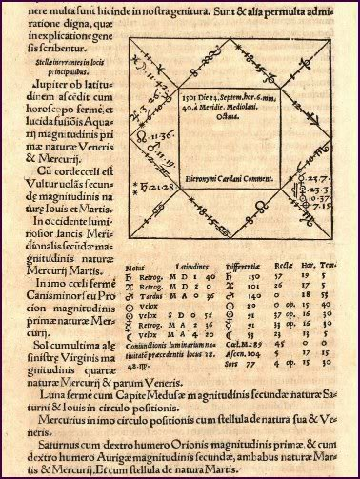
Complex Numbers
He also cast his own horoscope when he was 16
It said he would
die before he was
75

Slide 41
Complex Numbers
As he approached his 75th
birthday (still hale
and hearty), he
committed suicide
4 days before his
birthday to ensure
his prediction was
correct

Slide 42
Questions?
http://i.imgur.com/aliTlT3.jpg

Slide 43
Complex Numbers
Complex numbers include the "imaginary" unit:
i ≡ $\sqrt{\text{−}\text{1}}$

Slide 44
Complex Numbers
Complex numbers are written:
a + b i
real imaginary
part part

Slide 45
Complex Numbers
Every real number is a complex number in which the imaginary part equals zero:
17 = 17 + 0 i

Slide 46
Complex Numbers
Complex numbers are usually designated "z“
z = a + b i

Slide 47
Complex Numbers
Writing a complex number:
a + b i
Is called “standard form”

Slide 48
COMPLEX NUMBERS
IN-CLASS PROBLEM 1
The real part coefficient of
9 + 6i is:
The imaginary part coefficient of 9 + 6i is:

Slide 49
COMPLEX NUMBERS
IN-CLASS PROBLEM 1
The real part coefficient of
9 + 6i is: 9
The imaginary part coefficient of 9 + 6i is: 6

Slide 50
COMPLEX NUMBERS
IN-CLASS PROBLEM 2
The real part coefficient of
5 – 2i is:
The imaginary part coefficient of 5 – 2i is:

Slide 51
COMPLEX NUMBERS
IN-CLASS PROBLEM 2
The real part coefficient of
5 – 2i is: 5
The imaginary part coefficient of 5 – 2i is: -2

Slide 52
Questions?
http://i.imgur.com/aliTlT3.jpg

Slide 53
Complex Numbers
Arithmetic with complex numbers:
(a+bi) + (c+di) = (a+c) + (b+d)i
(a+bi) - (c+di) = (a-c) + (b-d)i

Slide 54
COMPLEX NUMBERS
IN-CLASS PROBLEM 3
(6 + 4i ) + (7 + 5i ) =

Slide 55
COMPLEX NUMBERS
IN-CLASS PROBLEM 3
(6 + 4i ) + (7 + 5i ) = 13 + 9i

Slide 56
COMPLEX NUMBERS
IN-CLASS PROBLEM 4
(–4 + 3i ) + (8 – 10i ) =

Slide 57
COMPLEX NUMBERS
IN-CLASS PROBLEM 4
(–4 + 3i ) + (8 – 10i ) = 4 - 7i

Slide 58
COMPLEX NUMBERS
IN-CLASS PROBLEM 5
(2 + i ) – (6 – 9i ) =

Slide 59
COMPLEX NUMBERS
IN-CLASS PROBLEM 5
(2 + i ) – (6 – 9i ) = (2+i ) -6 --9i

Slide 60
COMPLEX NUMBERS
IN-CLASS PROBLEM 5
(2 + i ) – (6 – 9i ) = (2+i ) -6 --9i = 2+i -6 +9i

Slide 61
COMPLEX NUMBERS
IN-CLASS PROBLEM 5
(2 + i ) – (6 – 9i ) = (2+i ) -6 --9i = 2+i -6 +9i
= -4 +10i

Slide 62
COMPLEX NUMBERS
IN-CLASS PROBLEM 6
(17 + 51i ) – (–19 – 88i ) =

Slide 63
COMPLEX NUMBERS
IN-CLASS PROBLEM 6
(17 + 51i ) – (–19 – 88i ) =
= 17+51i --19 --88i

Slide 64
COMPLEX NUMBERS
IN-CLASS PROBLEM 6
(17 + 51i ) – (–19 – 88i ) =
= 17+51i --19 --88i
= 17+51i +19 +88i

Slide 65
COMPLEX NUMBERS
IN-CLASS PROBLEM 6
(17 + 51i ) – (–19 – 88i ) =
= 17+51i --19 --88i
= 17+51i +19 +88i
= 36 + 139i

Slide 66
COMPLEX NUMBERS
IN-CLASS PROBLEM 7
$\sqrt{\text{−25}}$ + $\sqrt{\text{−}\text{81}}$ =

Slide 67
COMPLEX NUMBERS
IN-CLASS PROBLEM 7
$\sqrt{\text{−25}}$ + $\sqrt{\text{−}\text{81}}$ =
= $\sqrt{\text{−}\text{1 }\text{×} \text{25}}$ + $\sqrt{\text{−1} \text{×} \text{81}}$

Slide 68
COMPLEX NUMBERS
IN-CLASS PROBLEM 7
$\sqrt{\text{−25}}$ + $\sqrt{\text{−}\text{81}}$ =
= $\sqrt{\text{−}\text{1 }\text{×} \text{25}}$ + $\sqrt{\text{−1} \text{×} \text{81}}$
= $i$×$\sqrt{\text{25}}$ + $i \text{×} \sqrt{\text{81}}$

Slide 69
COMPLEX NUMBERS
IN-CLASS PROBLEM 7
$\sqrt{\text{−25}}$ + $\sqrt{\text{−}\text{81}}$ =
= $\sqrt{\text{−}\text{1 }\text{×} \text{25}}$ + $\sqrt{\text{−1} \text{×} \text{81}}$
= $i$×$\sqrt{\text{25}}$ + $i \text{×} \sqrt{\text{81}}$
= 5$i$ + 9$i$ = 14$i$

Slide 70
COMPLEX NUMBERS
IN-CLASS PROBLEM 8
(2 + $\sqrt{\text{−25}}$) – (7 + $\sqrt{\text{−}\text{49}}$)

Slide 71
COMPLEX NUMBERS
IN-CLASS PROBLEM 8
(2 + $\sqrt{\text{−25}}$) – (7 + $\sqrt{\text{−}\text{49}}$)
= (2 + $\sqrt{\text{−25}}$) – 7 - $\sqrt{\text{−49}}$)

Slide 72
COMPLEX NUMBERS
IN-CLASS PROBLEM 8
(2 + $\sqrt{\text{−25}}$) – (7 + $\sqrt{\text{−}\text{49}}$)
= (2 + $\sqrt{\text{−25}}$) – 7 - $\sqrt{\text{−49}}$)
= 2 + $\sqrt{\text{−}\text{1 }\text{×} \text{25}}$ -7 -$\sqrt{\text{−1} \text{×} \text{49}}$

Slide 73
COMPLEX NUMBERS
IN-CLASS PROBLEM 8
(2 + $\sqrt{\text{−25}}$) – (7 + $\sqrt{\text{−}\text{49}}$)
= (2 + $\sqrt{\text{−25}}$) – 7 - $\sqrt{\text{−49}}$)
= 2 + $\sqrt{\text{−}\text{1 }\text{×} \text{25}}$ -7 -$\sqrt{\text{−1} \text{×} \text{49}}$
= 2 + $i$×$\sqrt{\text{25}}$ -7 -$i \text{×} \sqrt{\text{49}}$

Slide 74
COMPLEX NUMBERS
IN-CLASS PROBLEM 8
(2 + $\sqrt{\text{−25}}$) – (7 + $\sqrt{\text{−}\text{49}}$)
= (2 + $\sqrt{\text{−25}}$) – 7 - $\sqrt{\text{−49}}$)
= 2 + $\sqrt{\text{−}\text{1 }\text{×} \text{25}}$ -7 -$\sqrt{\text{−1} \text{×} \text{49}}$
= 2 + $i \text{×} \sqrt{\text{25}}$ -7 -$i \text{×} \sqrt{\text{49}}$
= 2 + 5$i$ – 7 - 7$i$
= 2-7 + 5$i$-7$i$

Slide 75
COMPLEX NUMBERS
IN-CLASS PROBLEM 8
(2 + $\sqrt{\text{−25}}$) – (7 + $\sqrt{\text{−}\text{49}}$)
= (2 + $\sqrt{\text{−25}}$) – 7 - $\sqrt{\text{−49}}$)
= 2 + $\sqrt{\text{−}\text{1 }\text{×} \text{25}}$ -7 -$\sqrt{\text{−1} \text{×} \text{49}}$
= 2 + $i \text{×} \sqrt{\text{25}}$ -7 -$i \text{×} \sqrt{\text{49}}$
= 2 + 5$i$ – 7 - 7$i$
= 2-7 + 5$i$-7$i$
= -5 - 2$i$

Slide 76
Questions?
http://i.imgur.com/aliTlT3.jpg

Slide 77
Complex Numbers
Multiplying:
(a+bi) × (c+di) =
(a$\text{×}$c) + (a$\text{×}$d+b$\text{×}$c)i + (b$\text{×}$d)i²
But, what is i² ?

Slide 78
Complex Numbers
If i ≡ $\sqrt{\text{−1}}$
then i² = ($\sqrt{\text{−1}}$ )² = -1

Slide 79
Complex Numbers
So:
(a+bi) × (c+di) =
(a×c) + (a×d+b×c)i + (b×d)i²
= ac + (ad+bc)i + bd(-1)
= (ac-bd) + (ad+bc) i

Slide 80
Complex Numbers
Don’t leave any exponents of i in a formula!
http://scottsauls.com/wp-content/uploads/2015/06/Shame.jpg

Slide 81
In case you missed it…
Don’t leave any exponents of i in a formula!!!!!
http://scottsauls.com/wp-content/uploads/2015/06/Shame.jpg

Slide 82
Complex Numbers
complex conjugate:
(a + bi) × (a - bi) = a ² + b ²

Slide 83
Complex Numbers
What about:
$\sqrt{−\text{9}}$ × $\sqrt{−\text{36 }}$

Slide 84
Complex Numbers
What about:
$\sqrt{−\text{9}}$ × $\sqrt{−\text{36 }}$
You need to
take out the “i ” first
(If you don’t, you’ll get the wrong answer)

Slide 85
Complex Numbers
$\sqrt{−\text{9}}$ × $\sqrt{−\text{36 }}$ = 3i × 6i
= 18i²
= -18
If you don’t take out the “i ” first:
$\sqrt{−\text{9}}$ × $\sqrt{−\text{36 }}$ = $\sqrt{\text{324 }}$ = 18
(the wrong answer)

Slide 86
Complex Numbers
For a negative root, take out the “i ” first!
http://scottsauls.com/wp-content/uploads/2015/06/Shame.jpg

Slide 87
COMPLEX NUMBERS
IN-CLASS PROBLEM 9
6i × 4i =

Slide 88
COMPLEX NUMBERS
IN-CLASS PROBLEM 9
6i × 4i = 24i ²
are we done?

Slide 89
COMPLEX NUMBERS
IN-CLASS PROBLEM 9
6i × 4i = 24i ²
are we done?
No… i ² = -1… so…

Slide 90
COMPLEX NUMBERS
IN-CLASS PROBLEM 9
6i × 4i = 24i ²
= -24

Slide 91
COMPLEX NUMBERS
IN-CLASS PROBLEM 10
2i × 7i =

Slide 92
COMPLEX NUMBERS
IN-CLASS PROBLEM 10
2i × 7i = -14
Did you get it right?

Slide 93
COMPLEX NUMBERS
IN-CLASS PROBLEM 11
2i (7 + 3i ) =

Slide 94
COMPLEX NUMBERS
IN-CLASS PROBLEM 11
2i (7 + 3i ) =
Remember, this is an implied multiplication!

Slide 95
COMPLEX NUMBERS
IN-CLASS PROBLEM 11
2i (7 + 3i ) = 14i + 6i ²

Slide 96
COMPLEX NUMBERS
IN-CLASS PROBLEM 11
2i (7 + 3i ) = 14i + 6i ²
= -6 + 14i

Slide 97
COMPLEX NUMBERS
IN-CLASS PROBLEM 12
-4i (5 + 6i ) =

Slide 98
COMPLEX NUMBERS
IN-CLASS PROBLEM 12
-4i (5 + 6i ) = -20i - 24i ²

Slide 99
COMPLEX NUMBERS
IN-CLASS PROBLEM 12
-4i (5 + 6i ) = -20i - 24i ²
= 24 - 20i

Slide 100
COMPLEX NUMBERS
IN-CLASS PROBLEM 13
(5 – i )(5 + i )
First, build a box!

Slide 101
COMPLEX NUMBERS
IN-CLASS PROBLEM 13
(5 – i )(5 + i )
Include the terms of the multiplication:
 | 5 | -i
5
+i

Slide 102
COMPLEX NUMBERS
IN-CLASS PROBLEM 13
(5 – i )(5 + i )
Multiply the numbers on each box:
 | 5 | -i
5 | 25 | -5i
+i | 5i | -i ²

Slide 103
COMPLEX NUMBERS
IN-CLASS PROBLEM 13
(5 – i )(5 + i )
This is your answer!
(but not the final answer…)
 | 5 | -i
5 | 25 | -5i
+i | 5i | -i ²

Slide 104
COMPLEX NUMBERS
IN-CLASS PROBLEM 13
(5 – i )(5 + i )
The diagonals cancel:
 | 5 | -i
5 | 25 | -5i
+i | 5i | -i ²

Slide 105
COMPLEX NUMBERS
IN-CLASS PROBLEM 13
(5 – i )(5 + i )
…and you are left with
= 25 – i ²
 | 5 | -i
5 | 25 | -5i
+i | 5i | -i ²

Slide 106
COMPLEX NUMBERS
IN-CLASS PROBLEM 13
(5 – i )(5 + i )
…and you are left with
= 25 – i ²
= 25 --1
= 25 + 1
= 26
 | 5 | -i
5 | 25 | -5i
+i | 5i | -i ²

Slide 107
COMPLEX NUMBERS
IN-CLASS PROBLEM 14
(10 + $\sqrt{\text{−}\text{64}}$) (9 + $\sqrt{\text{−}\text{81}}$) =
Another implied multiplication

Slide 108
COMPLEX NUMBERS
IN-CLASS PROBLEM 14
(10 + $\sqrt{\text{−}\text{64}}$) (9 + $\sqrt{\text{−}\text{81}}$) =
Get rid of the square roots!

Slide 109
COMPLEX NUMBERS
IN-CLASS PROBLEM 14
(10 + $\sqrt{\text{−}\text{64}}$) (9 + $\sqrt{\text{−}\text{81}}$) =
= (10 + 8i ) (9 + 9i )
Now another box!

Slide 110
COMPLEX NUMBERS
IN-CLASS PROBLEM 14
(10 + $\sqrt{\text{−}\text{64}}$) (9 + $\sqrt{\text{−}\text{81}}$) =
= (10 + 8i ) (9 + 9i )
Now another box!
 | 10 | 8i
9
9i

Slide 111
COMPLEX NUMBERS
IN-CLASS PROBLEM 14
(10 + $\sqrt{\text{−}\text{64}}$) (9 + $\sqrt{\text{−}\text{81}}$) =
= (10 + 8i ) (9 + 9i )
Now another box!
 | 10 | 8i
9 | 90 | 72i
9i | 90i | 72i ²

Slide 112
COMPLEX NUMBERS
IN-CLASS PROBLEM 14
(10 + $\sqrt{\text{−}\text{64}}$) (9 + $\sqrt{\text{−}\text{81}}$) =
= (10 + 8i ) (9 + 9i )
This time the diagonals don’t cancel…
Sorry!
 | 10 | 8i
9 | 90 | 72i
9i | 90i | 72i ²

Slide 113
COMPLEX NUMBERS
IN-CLASS PROBLEM 14
(10 + $\sqrt{\text{−}\text{64}}$) (9 + $\sqrt{\text{−}\text{81}}$) =
= (10 + 8i ) (9 + 9i )
= 90 + 72i + 90i + 72i ²
 | 10 | 8i
9 | 90 | 72i
9i | 90i | 72i ²

Slide 114
COMPLEX NUMBERS
IN-CLASS PROBLEM 14
(10 + $\sqrt{\text{−}\text{64}}$) (9 + $\sqrt{\text{−}\text{81}}$) =
= (10 + 8i ) (9 + 9i )
= 90 + 72i + 90i + 72i ²
= 90 + 72i + 90i - 72
= 18 + 162i

Slide 115
COMPLEX NUMBERS
IN-CLASS PROBLEMS 15-18
These should be easy now!
15) (10i) ²
16) (–4i) ²
17) ($\sqrt{\text{−}\text{7}}$) ²
18) ($\sqrt{\text{−}\text{13}}$) ²

Slide 116
COMPLEX NUMBERS
IN-CLASS PROBLEMS 15-18
These should be easy now!
15) (10i) ² = -100
16) (–4i) ² =
17) ($\sqrt{\text{−}\text{7}}$) ²
18) ($\sqrt{\text{−}\text{13}}$) ²

Slide 117
COMPLEX NUMBERS
IN-CLASS PROBLEMS 15-18
These should be easy now!
15) (10i) ² = -100
16) (–4i) ² = -16
17) ($\sqrt{\text{−}\text{7}}$) ² =
18) ($\sqrt{\text{−}\text{13}}$) ²

Slide 118
COMPLEX NUMBERS
IN-CLASS PROBLEMS 15-18
These should be easy now!
15) (10i) ² = -100
16) (–4i) ² = -16
17) ($\sqrt{\text{−}\text{7}}$) ² = -7
18) ($\sqrt{\text{−}\text{13}}$) ² =

Slide 119
COMPLEX NUMBERS
IN-CLASS PROBLEMS 15-18
These should be easy now!
15) (10i) ² = -100
16) (–4i) ² = -16
17) ($\sqrt{\text{−}\text{7}}$) ² = -7
18) ($\sqrt{\text{−}\text{13}}$) ² = -13
Did you get them right?

Slide 120
Questions?
http://i.imgur.com/aliTlT3.jpg

Slide 121
You Survived!
Today we covered:
Review of Lines and
Quadratics (Parabolas)
Review of Complex Numbers
www.playbuzz.com

