Slide 1
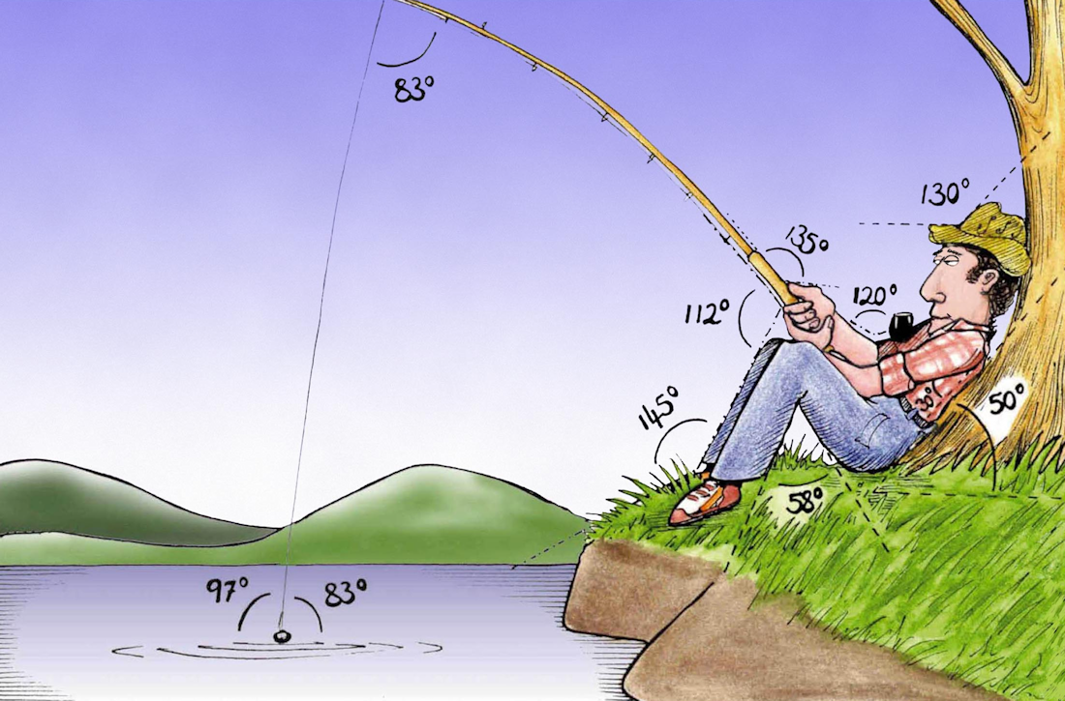
Welcome to
Week 3!
Analytic Trigonometry
http://www.lab-initio.com/images/fullsize/nz211.jpg

Slide 2
What’s Up?
Today we will be going over:
Review of trigonometric
functions
Graphs of trig functions
Radians
Arc length

Slide 3
What’s Up?
Obj 1) Apply the six trigonometric functions to solve problems using degree and radian measures, right triangles and unit circles
Obj 3) Graph sine and cosine functions
Obj 4) Apply trigonometric identities to simplify expressions and to solve equations

Slide 4
Review
www.hrexaminer.com

Slide 5
Trigonometry
This is called a “central angle”
.
VFrench, 2015

Slide 6
Trigonometry
The slope of the hypotenuse is: rise
run
hypotenuse
.
rise
θ
run
VFrench, 2015

Slide 7
Trigonometry
According to the Pythagorean Theorem, the length of the hypotenuse will be:
hyp² = rise² + run²
hypotenuse
.
rise
θ
run
VFrench, 2015

Slide 8
Trigonometry
In trigonometry, the terms “opposite” and “adjacent” are traditionally used for the “rise” and the “run”
hypotenuse
opposite
rise
.
θ
run
adjacent
VFrench, 2015

Slide 9
Trigonometry
sin(θ) = length of side opposite θ
length of hypotenuse
cos(θ) = length of side adjacent θ
length of hypotenuse
tan(θ) = length of side opposite θ
length of side adjacent θ

Slide 10
Trigonometry
cot(θ) = length of side adjacent θ
length of side opposite θ
sec(θ) = length of hypotenuse
length of side adjacent θ
csc(θ) = length of hypotenuse
length of side opposite θ

Slide 11
Questions?
lol-rofl.com

Slide 12
Graphs of Trig Functions
Periodic Functions – repeat a pattern over and over

Slide 13
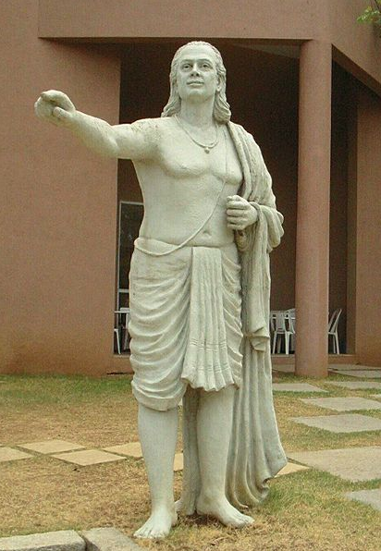
Graphs of Trig Functions
The sine function
was first described
by an Indian
mathematician
Aryabhata in the
5th century

Slide 14
Graphs of Trig Functions
Start with a 0º angle
What is the sin (rise)?
.
0º
VFrench, 2015

Slide 15
Graphs of Trig Functions
Start moving around the circle
What is the sin doing?
.
45º
VFrench, 2015

Slide 16
Graphs of Trig Functions
Finally you reach a 90º angle
What is the value of the sin?
.
90º
VFrench, 2015

Slide 17
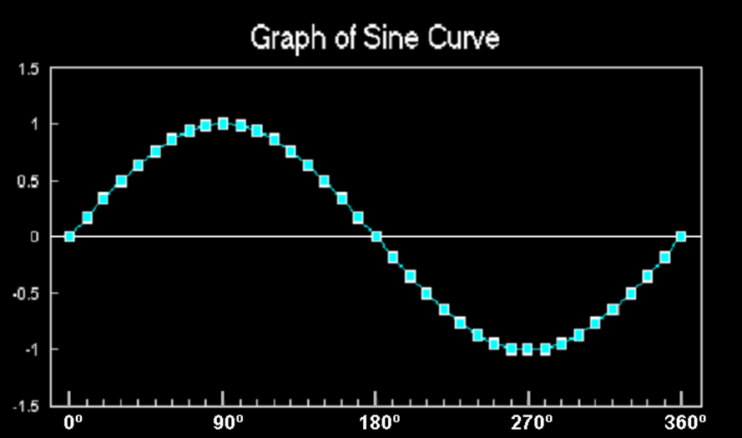
Graphs of Trig Functions
The graph of sin undulates back and forth
It has a value of 0 at 0°
VFrench, 2015

Slide 18
Graphs of Trig Functions
Go back to a 0º angle
What is the cos (run)?
.
0º
VFrench, 2015

Slide 19
Graphs of Trig Functions
Start moving around the circle
What is the cos doing?
.
45º
VFrench, 2015

Slide 20
Graphs of Trig Functions
Finally you reach a 90º angle
What is the value of the cos?
.
90º
VFrench, 2015

Slide 21
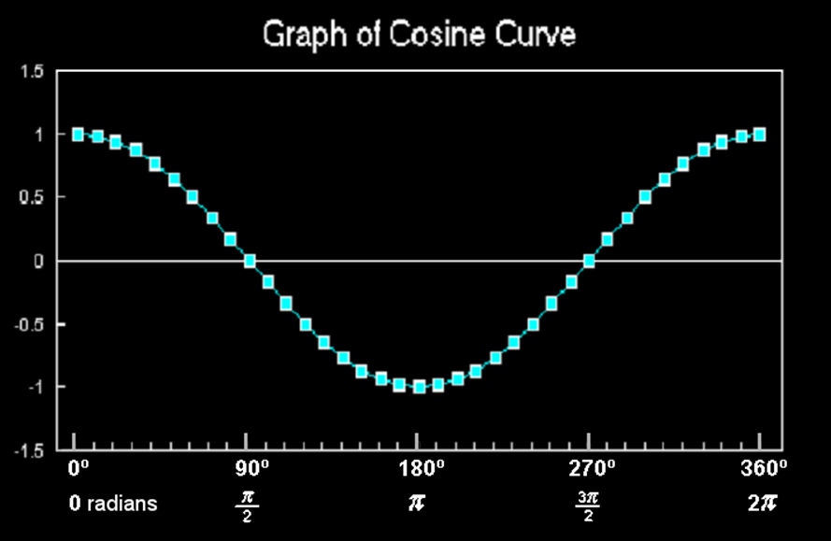
Graphs of Trig Functions
The graph of cos also undulates back and forth
It doesn’t have a value of 0 at 0°
VFrench, 2015

Slide 22
Graphs of Trig Functions
How to tell which is which?
What is it doing at x = 0?
If y = 0 at x = 0, it is a sin
If y = something else at x = 0, it is a cos

Slide 23
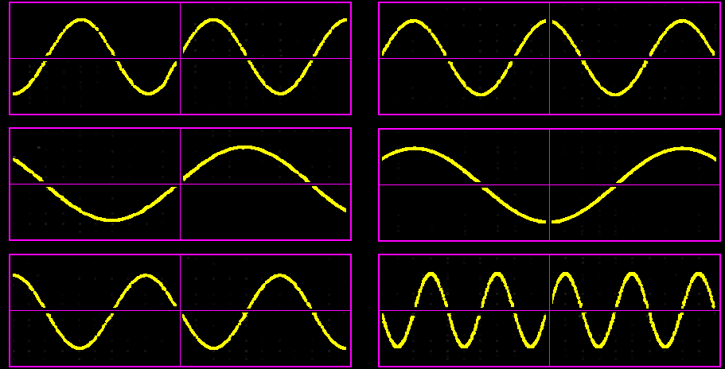
TRIG GRAPHS
IN-CLASS PROBLEM 1
Identify sines or cosines:
A
B
C
D
E
F
VFrench, 2015

Slide 24
Graphs of Trig Functions
Does it wiggle back and forth? It is a sin or cos
Does it look “weird”?
It’s not

Slide 25
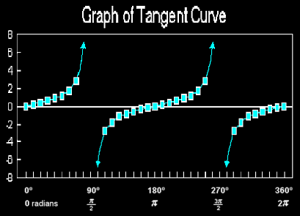
Graphs of Trig Functions
VFrench, 2015

Slide 26
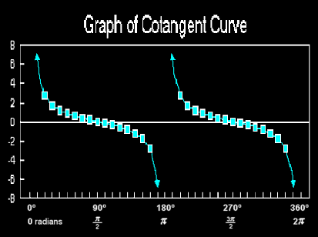
Graphs of Trig Functions
VFrench, 2015

Slide 27
Graphs of Trig Functions
How are these different from sin/cos?
What is the difference between them?
VFrench, 2015

Slide 28
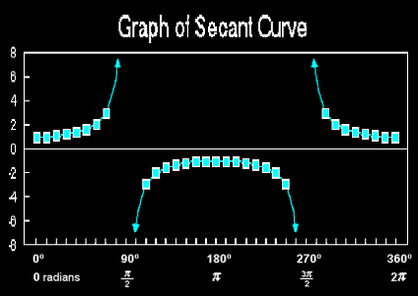
Graphs of Trig Functions
VFrench, 2015

Slide 29
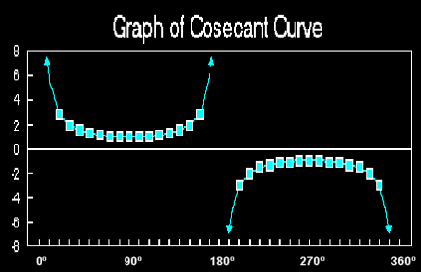
Graphs of Trig Functions
VFrench, 2015

Slide 30
Graphs of Trig Functions
How are these different from sin/cos? From tan/cot?
What is the difference between them?
VFrench, 2015

Slide 31
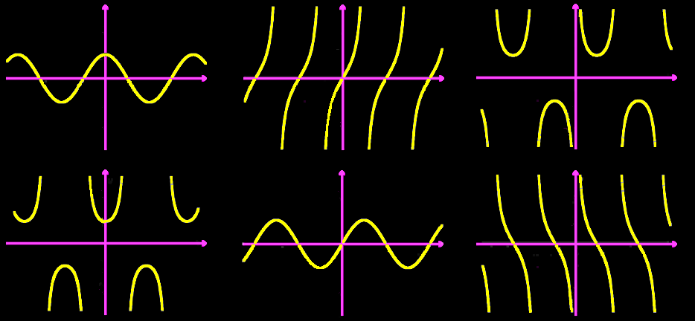
TRIG GRAPHS
IN-CLASS PROBLEM 2
Which trig function?
A
B
C
D
E
F
VFrench, 2015

Slide 32
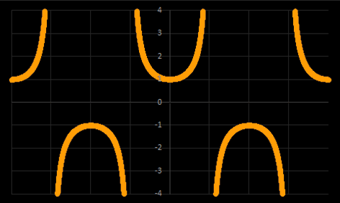
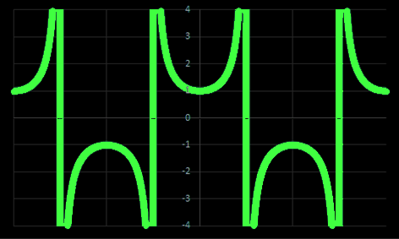
Graphs of Trig Functions
Secant
Secant with a graphing calculator
VFrench, 2015

Slide 33
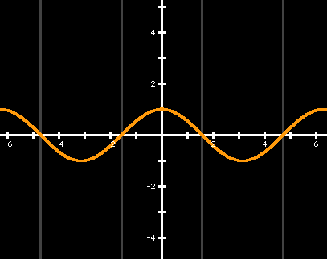
Graphs of Trig Functions
Something fun-
Start with a cosine:
VFrench, 2015

Slide 34
Graphs of Trig Functions
Remember, a secant is 1/cos
When cos=1, what is the secant?
VFrench, 2015

Slide 35
Graphs of Trig Functions
Remember, a secant is 1/cos
When cos=1, secant=1/1=1
VFrench, 2015

Slide 36
Graphs of Trig Functions
When cos=-1, what is the secant?
VFrench, 2015

Slide 37
Graphs of Trig Functions
When cos=-1, secant=1/-1=-1
VFrench, 2015

Slide 38
Graphs of Trig Functions
When cos=0, what is the secant?
VFrench, 2015

Slide 39
Graphs of Trig Functions
When cos=0, secant=1/0≡∞ or-∞
VFrench, 2015

Slide 40
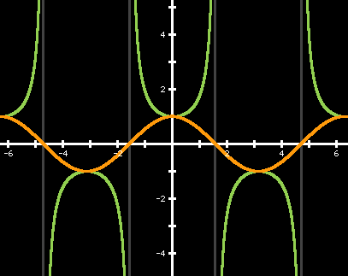
Graphs of Trig Functions
In fact, the graph IS the secant!
VFrench, 2015

Slide 41
Questions?
www.career.gatech.edu

Slide 42
Graphs of Trig Functions
How to recognize which function is which:
The shape, y-intercept, and asymptotes are critical

Slide 43
Graphs of Trig Functions
Does it wiggle back and forth? It is a sin or cos

Slide 44
Graphs of Trig Functions
Does it wiggle back and forth? It is a sin or cos
What is it doing at x=0?
If y=0 at x=0, it is a sin
If y=something else at x=0,
it is a cos

Slide 45
Graphs of Trig Functions
Does it look like a bunch of stretched-out S’s?
It is a tan or cot

Slide 46
Graphs of Trig Functions
Does it look like a bunch of stretched-out S’s?
It is a tan or cot
What is it doing at x=0?
If y=0 at x=0, it is a tan
If x=0 is an asymptote, it is a cot

Slide 47
Graphs of Trig Functions
Does it look like a bunch of U’s?
It is a sec or csc

Slide 48
Graphs of Trig Functions
Does it look like a bunch of U’s?
It is a sec or csc
What is it doing at x=0?
If y is the bottom of a U at
x=0, it is a sec
If x=0 is an asymptote, it is
a csc

Slide 49
Questions?
www.career.gatech.edu

Slide 50
Graphs of Trig Functions
Sines and cosines are useful because of the shape of their curves
Many natural phenomena undulate back and forth

Slide 51
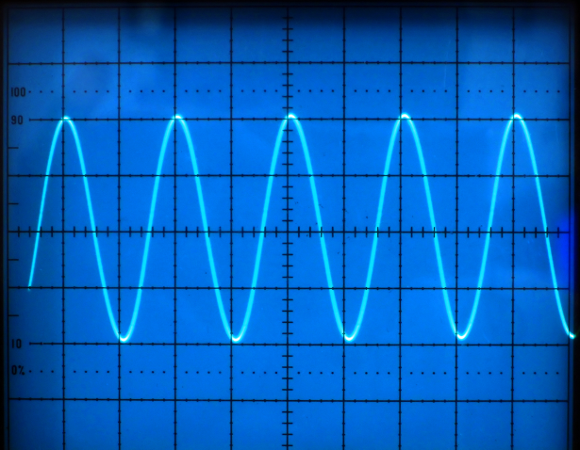
Graphs of Trig Functions
http://www.t4science.com/images/general/frequency.jpg

Slide 52
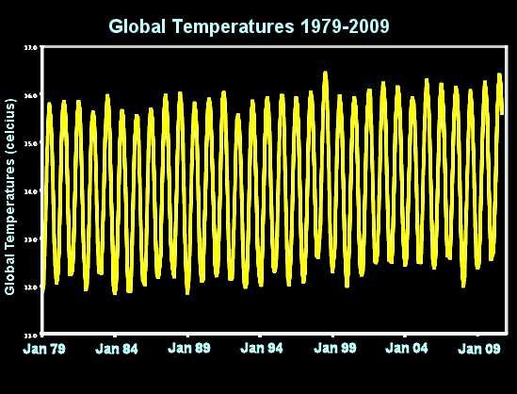
Graphs of Trig Functions
VFrench, 2012

Slide 53
Graphs of Trig Functions
A lot of mathematical models for real-world phenomena have a “sine” or “cosine” in them to include this cyclical pattern

Slide 54
Graphs of Trig Functions
A tangent isn’t important because it is a useful graph shape for mathematical modeling
A tangent is useful because it is a slope ($\frac{rise}{run}$)

Slide 55
Graphs of Trig Functions
The secant is used in calculus

Slide 56
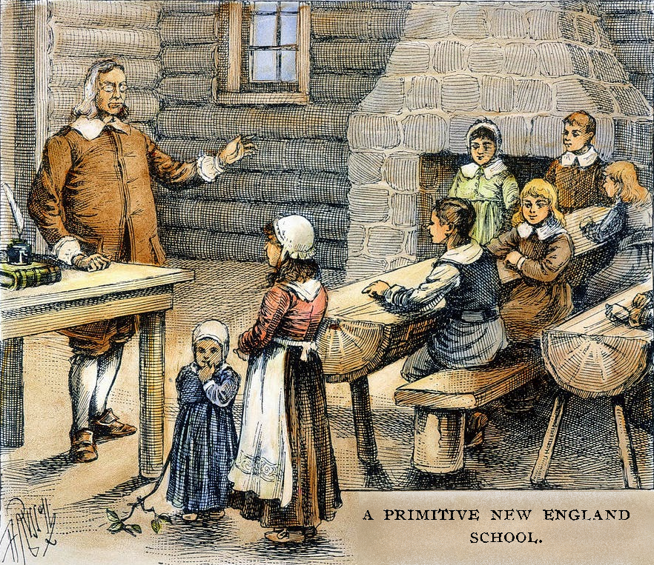
Trigonometry
US vs
Europe
bakerfamilytree.blogspot.com

Slide 57
Questions?
www.career.gatech.edu

Slide 58
Radians
You have probably always measured angles in degrees…

Slide 59
Radians
You have probably always measured angles in degrees…
Radians are another way of measuring angles used in CAD and by engineers (blame them…)

Slide 60
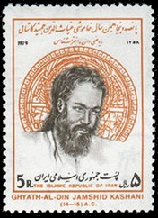
Radians
It was probably invented by an Arabic mathematician Jamshid al-Kashi in about 1400
http://jeff560.tripod.com/images/kashani.jpg

Slide 61
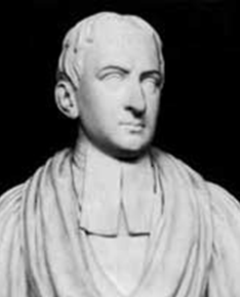
Radians
We can blame it on Roger Cotes a British mathematician and Newton’s proofreader who in 1714 introduced the idea to the English- speaking world
https://en.wikipedia.org/wiki/Roger_Cotes#/media/File:Roger_Cotes.png

Slide 62
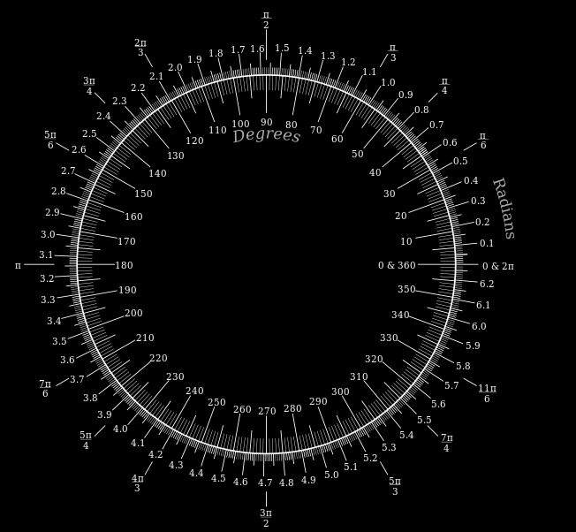
Radians
It uses the
fact that
the
circum-
ference
of a circle
is 2π r
https://mason.gmu.edu/~mmankus/Handson/polar.htm

Slide 63
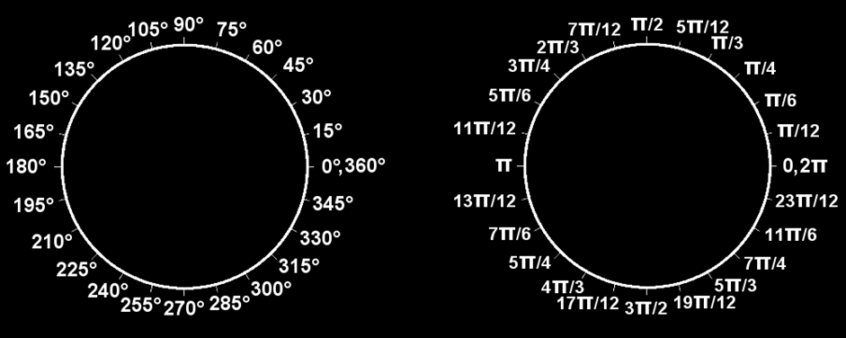
Radians
Suppose you have a unit circle where r = 1
VFrench, 2015

Slide 64
Radians
2πr = 2π
VFrench, 2015

Slide 65
Radians
All the way around the circle once (360º) is 2π (a length)
VFrench, 2015

Slide 66
Radians
To convert from degrees to radians, multiply the degrees by:
π radians
180°

Slide 67
RADIANS
IN-CLASS PROBLEM 3
Convert from degrees to radians:
0° 180°
45° 270°
90° 360°
330° 96°
77° 11°
π radians
180°

Slide 68
Radians
To convert from radians to degrees, multiply the radians by:
180° .
π radians

Slide 69
RADIANS
IN-CLASS PROBLEM 4
Convert from radians to degrees:
0 π/2
π 2π
3π/2 π/4
π/7 3π/13
10π/9 9π/10
180° .
π radians

Slide 70
Radians
Radians will often have a “π” to let you know you are dealing with radians

Slide 71
Radians
Radian measure on a calculator –
make sure you change
from “Deg” to “Rad”

Slide 72
RADIANS
IN-CLASS PROBLEM 5
Find the trig values:
sin(π/4) cos(π/4)
tan(π/4) sin(π/12)
cos(3π/5) tan(5π/7)

Slide 73
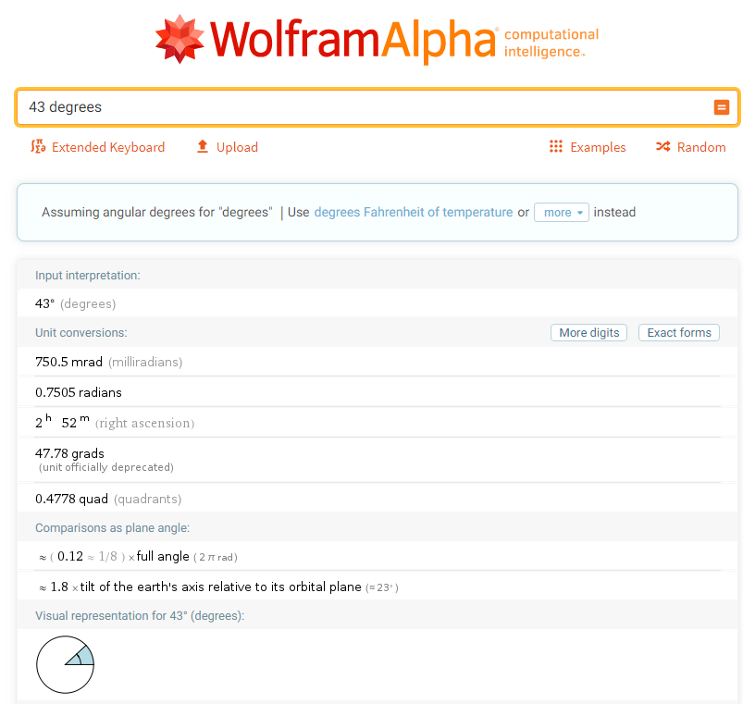

Slide 74
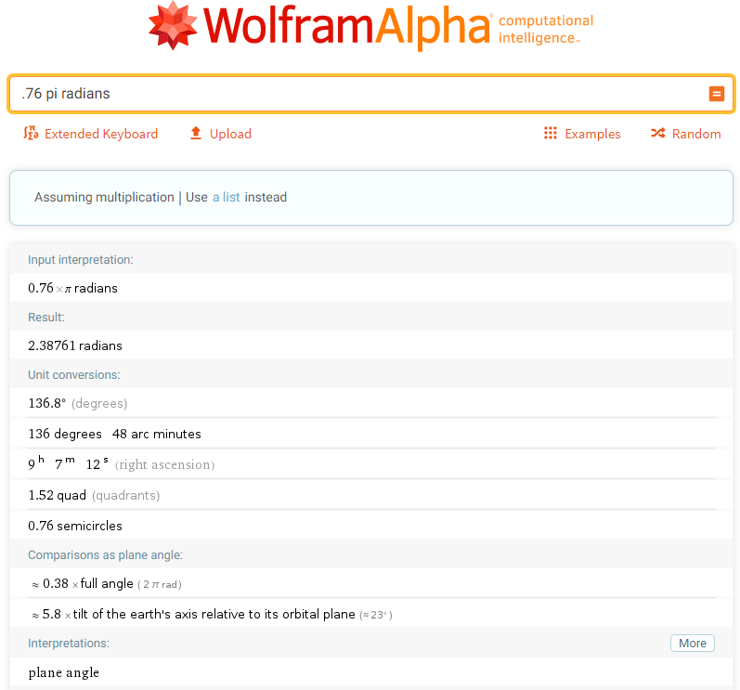

Slide 75
Questions?
www.career.gatech.edu

Slide 76
WHY Radians?
Frequency
The letter “f ” represents frequency in hertz
The Greek letter omega (ω)
represents frequency in
radians per second

Slide 77
WHY Radians?
Relationship between
hertz and radians:
ω = 2πf

Slide 78
WHY Radians?
Phase Angle
In most cases, we don't need to calculate the numerical phase relationship as such, we can simply describe it in terms of π

Slide 79
WHY Radians?
Simplicity
Use of radians simplifies the mathematical calculations

Slide 80
WHY Radians?
The factor 2π appears very often in calculations involving hertz
It is eliminated from those same calculations involving radians

Slide 81
WHY Radians?
By avoiding that factor throughout a circuit analysis or design process, we can reduce the chances of mathematical errors

Slide 82
WHY Radians?
Accuracy
Because π is a transcendental number, using its approximate value many times in your calculations can accumulate rounding errors and inaccurate results

Slide 83
WHY Radians?
By performing our calculations in radians rather than cycles or degrees, converting back and forth only at the very start and end of the procedure, we maintain greater precision in our computations and a more accurate final result

Slide 84
WHY Radians?
Discrete time-signal processing is done in radians only
(accept it and move on…)

Slide 85
WHEN Radians?
A “rule of thumb” (which is not really a rule and has lots of different cases):
Use radians for AC
Use degrees for DC

Slide 86
Questions?
www.career.gatech.edu

Slide 87
Arc Length
We have measures for triangles in circles
tan
sin
.
θ
cos
VFrench, 2015

Slide 88
Arc Length
… but sometimes we want to measure the circles
s
r
.
θ
VFrench, 2015

Slide 89
Arc Length
The length of the arc “s” (in radians) on the circle is:
s = r θ
where r is the
circle’s radius
and θ is
measured in
radians
s
r
.
θ
VFrench, 2015

Slide 90
Arc Length
The radian angle, θ, is:
θ = $\frac{\text{s}}{\text{r}}$ radians
where s is the
length of the
circle’s arc (in
radians) and
r is the circle’s
radius
s
r
.
θ
VFrench, 2015

Slide 91
Arc Length
Linear and angular speeds are used to describe motion on a circular path
s
r
.
θ
VFrench, 2015

Slide 92
Arc Length
The linear speed “ν ” is calculated in terms of the arc length:
ν = $\frac{\text{s}}{\text{t}}$
t = time in seconds
Note: ν (the Greek letter “nu”) is not the same as v

Slide 93
Arc Length
The angular velocity “ω ” is calculated in terms of angle θ
ω = $\frac{\text{θ}}{\text{t}}$
θ = angle measured in radians
t = time in seconds
Note: ω (the Greek letter “omega”) is not the same as w

Slide 94
Arc Length
Radians and angular velocity are terms that are commonly used in AC theory and measurement

Slide 95
Arc Length
AC is produced when a conductor rotates through a magnetic field

Slide 96
Arc Length
AC is produced when a conductor rotates through a magnetic field
This results in a waveform called a sine wave

Slide 97
Arc Length
As the conductor rotates around the circumference of a circle, it travels 360°
These degrees can be shown on the waveform

Slide 98
Arc Length
https://www.etcourse.com/relation-radians-and-angular-velocity-ac-circuits.html

Slide 99
Arc Length
Frequency (f) refers to the number of cycles or waveforms per second in units of hertz or Hz
f = 1/T

Slide 100
Arc Length
Angular velocity:
ω = 2π/T (radians/second)
Frequency: f = 1/T
Rewrite it as: T=1/f
ω = 2π/(1/f) = 2πf

Slide 101
Arc Length
You will encounter the term omega “ω” in a number of formulas as you study AC theory
ω will be equal to some number of radians per second

Slide 102
Questions?
www.career.gatech.edu

Slide 103
You Survived!
Don’t forget
your Homework
due next week!
Have a great rest
of the week!
www.playbuzz.com

