Slide 1
Air Pollution in Ulaanbaatar, Mongolia
By: Eric Chagnaadorj
Due: June 2, 2020
SCI201 Environmental Science

Slide 2
Research Question
What factor causes the most air pollution
in Ulaanbaatar, Mongolia?

Slide 3
Why is this an interesting topic?
I was born and raised in Ulaanbaatar
so this is a very personal topic to me.
I experienced this air pollution first hand.

Slide 4
Why is this an interesting topic?
I was also curious as to why
Ulaanbaatar wasn’t ranked in any list of
most air polluted cities, when UNICEF
agrees that it is way too polluted

Slide 5
Background Information

Slide 6
What is air pollution?
Air pollution is caused by solid and liquid particles and certain gases that are suspended in the air called aerosols (Williams, 2016)
Aerosols mixed with the ozone (a greenhouse gas) creates smog (ClimateKids, n.d.)

Slide 7
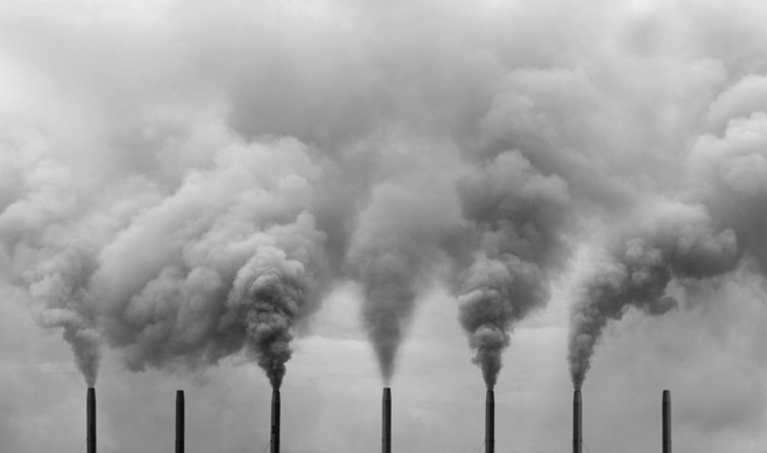
What is air pollution?
Fossil Fuel is used as a heat source but it also makes CO2 when it is burned (Denchack, 2020)
It makes most of the air pollution

Slide 8
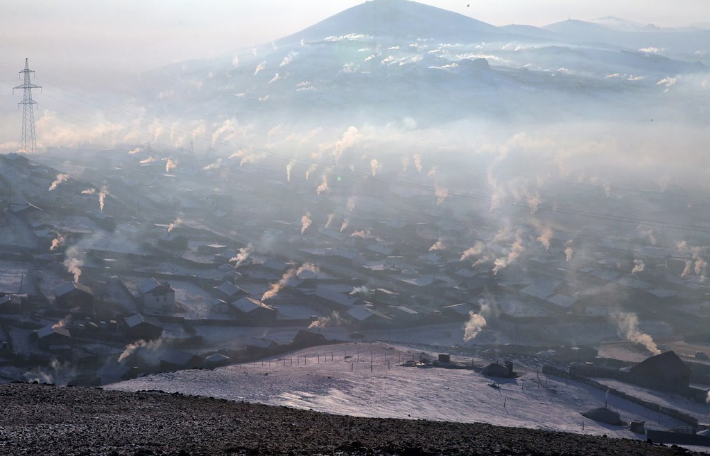
History
In the present time, Ulaanbaatar’s air pollution reach their peak in the winter at a daily average of PM2. 5 pollution levels reach 687 micrograms per cubic meter — 27 times the level WHO recommends as safe. (UNICEF, 2016)

Slide 9
History
Since switching from Socialism to Democracy in the 1990’s, Mongolians have started mining their coal for economic reasons, which lead to more household use of coal

Slide 10
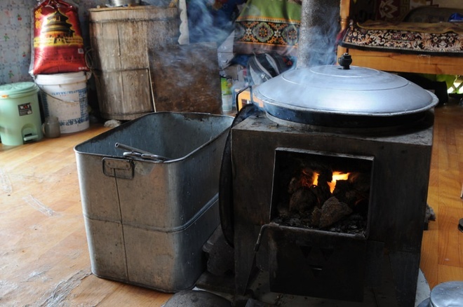
Results
In Ulaanbaatar, use of fossil fuel from factories, cars, and homes create most of the pollution
It can reach -30 F in the Winter, so people have to use fossil fuel to stay warm (Kwong, 2019)

Slide 11
Results
Government is starting to ban raw coal, which will be replaced by a more eco-friendly option (WHO, 2019)
However many people died from carbon monoxide poisoning which was made by the eco-friendly option (Bayartsogt, 2019)

Slide 12
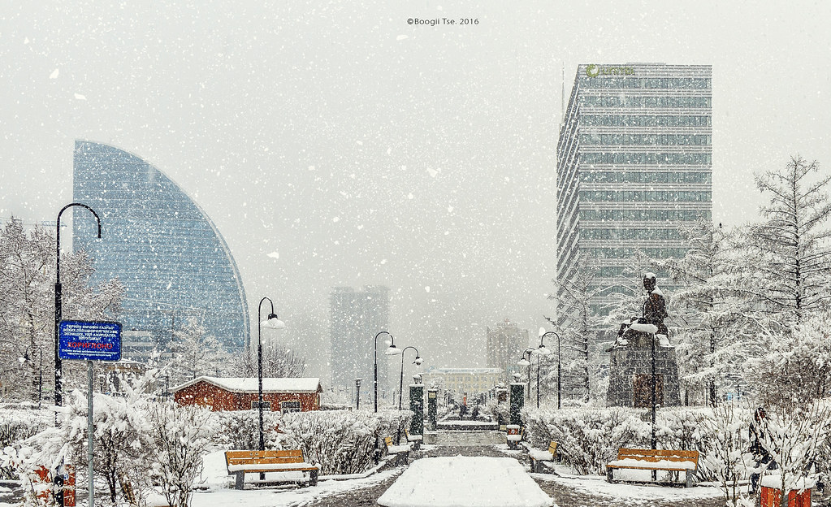
Summary
Air pollution is caused by toxins, contaminants, and other harmful products are introduced into an environment and stuck in the air
Ulaanbaatar’s most air pollutants come from the use of fossil fuel in homes, cars, and factories, which is further worsened in the cold weather

Slide 13
References
Bayartsogt, K. (2019, November 19). Mongolia's new 'cleaner' fuel linked to deaths, illness. Retrieved from https://phys.org/news/2019-11-mongolia-cleaner-fuel-linked-deaths.html
Photostream, B. (2016, May 15). Ulaanbaatar city. Mongolia. Winter Street Scene With Snow Falling. Retrieved from https://www.flickr.com/photos/124158150@N07/27016988245

Slide 14
References
Denchak, M. (2020, April 30). Fossil Fuels: The Dirty Facts. Retrieved June 2, 2020, from https://www.nrdc.org/stories/fossil-fuels-dirty-facts#:~:text=Burning Fossil Fuels,-Global warming pollution&text=Fossil fuels produce large quantities,and lead to climate change.

Slide 15
References
Environment & air pollution. (2016, December 7). Retrieved June 2, 2020, from https://www.unicef.org/mongolia/environment-air-pollution#:~:text=Ulaanbaatar – home to half of,level WHO recommends as safe.
French, V. (2020). SCI201 class lecture on Toxins in the Air. Personal Collection of V. French, Colorado Technical University, Aurora CO.

Slide 16
References
Purevdorj, K. (n.d.). Air Pollution in Ulaanbaatar, Mongolia, and the sustainable solutions. Retrieved from https://blog.mongolia-properties.com/air-pollution-in-mongolia-and-the-solutions
Network, S. and D., & News. (2016, October 12). Air Pollution Declines With Height: Study. Retrieved from https://www.asianscientist.com/2016/10/health/air-pollution-declines-height-black-carbon-aerosol-particulate-matter/

Slide 17
References
Mongolia-steppe-8. (2020, June 1). Retrieved from https://livingnomads.com/2016/02/mongolian-life/mongolia-steppe-8/
Williams, M. (2016, April 14). What causes air pollution? Retrieved June 2, 2020, from https://phys.org/news/2016-04-air-pollution.html

Slide 18
References
Kwong, E. (2019, July 30). Mongolia's Capital Banned Coal To Fix Its Pollution Problem. Will It Work? Retrieved June 2, 2020, from https://www.npr.org/2019/07/30/727688757/mongolias-capital-banned-coal-to-fix-its-pollution-problem-will-it-work#:~:text=Rapid population growth in Ulaanbaatar, Mongolia, coupled with a household,air pollution in the world.

Slide 19
References
What Causes Air Pollution? (n.d.). Retrieved June 2, 2020, from https://climatekids.nasa.gov/air-pollution/#:~:text=The Short Answer:,our air are called aerosols.
Air pollution in Mongolia. (2019, January 31). Retrieved June 2, 2020, from https://www.who.int/bulletin/volumes/97/2/19-020219/en/#:~:text=Starting in May, the government,importance to improving population health.

