Slide 1
Welcome to Wk05
MATH225 Applications of Discrete Mathematics and Statistics
http://media.dcnews.ro/image/201109/w670/statistics.jpg

Slide 2
Matrices
A matrix can be used as a shorthand way of writing a system of equations

Slide 3
Matrices
A matrix can be used as a shorthand way of writing a system of equations
This is not in your book…

Slide 4
Matrices
Called an augmented matrix:
Each row is an equation
Each column is the coefficient of a variable or a constant
A vertical bar separates coefficients on the left side from constants on the right

Slide 5
Matrices
For example:
3x + 7y – 4z = 10
2x + 5y + z = 9
x + 6z = 15

Slide 6
Matrices
3x + 7y – 4z = 10
2x + 5y + z = 9
x + 6z = 15 becomes:
x y z k
eq 1
eq 2
eq 3
┌-43 0 │ 8 ┐
│ 3 7 -4 │ 10│
│ 2 5 1 │ 9│
│ 1 0 6 │ 15│
└-43 0 8 ┘

Slide 7
Matrices
It is traditional to use “k” to designate the constant rather than “c”
(Don’t ask me why!)

Slide 8
Matrices
IN-CLASS PROBLEMS
What would be the matrix for the system of equations:
46x – 51y = 709
30x + 88y = -420

Slide 9
Matrices
IN-CLASS PROBLEMS
46x – 51y = 709
30x + 88y = -420
x y k
eq 1
eq 2
┌-43 0 │ 8 ┐
│ 46 -51 │ 709 │
│ 30 88 │ -420 │
└-43 0 │ 8 ┘

Slide 10
Matrices
IN-CLASS PROBLEMS
What would be the matrix for the system of equations:
x = 7y + 8
y = x – 3
Careful!

Slide 11
Matrices
IN-CLASS PROBLEMS
x = 7y + 8 x – 7y = 8
y = x – 3 -x + y = -3
x y k
eq 1
eq 2
┌-43 0 │ 8 ┐
│ 1 -7 │ 8 │
│ -1 1 │-3 │
└-43 0 │8 ┘

Slide 12
Matrices
IN-CLASS PROBLEMS
You can also recover the original equations from a matrix
What would be the equations for the matrix:
x y k
eq 1
eq 2
┌-43 0 │ 8 ┐
│ 10 4 │ 92│
│-43 0 │ 87│
└-43 0 │ 8 ┘

Slide 13
Matrices
IN-CLASS PROBLEMS
x y k
eq 1
eq 2
The equations would be:
10x + 4y = 92
-43x = 87
┌-43 0 │ 8 ┐
│ 10 4 │ 92│
│-43 0 │ 87│
└-43 0 │ 8 ┘

Slide 14
Matrices
The goal of a system of equations is to solve the system for values of the variables that work in all of the equations in the system

Slide 15
Matrices
Same thing with a matrix!

Slide 16
Matrices
IN-CLASS PROBLEMS
How would you solve:
x y z k
eq 1
eq 2
eq 3
┌-43 0 │ 8 ┐
│ 1 0 0 │ 10│
│ 0 1 0 │ 9│
│ 0 0 1 │ 15│
└-43 0 8 ┘

Slide 17
Matrices
IN-CLASS PROBLEMS
How would you solve:
x y z k
eq 1
eq 2
eq 3
x = 10, y = 9, z = 15
┌-43 0 │ 8 ┐
│ 1 0 0 │ 10│
│ 0 1 0 │ 9│
│ 0 0 1 │ 15│
└-43 0 8 ┘

Slide 18
Matrices
This pattern is easy to solve:
upper triangle
eq 1
eq 2
eq 3
lower triangle
┌-43 0 │ 8 ┐
│ 1 0 0 │ 10│
│ 0 1 0 │ 9│
│ 0 0 1 │ 15│
└-43 0 8 ┘

Slide 19
Matrices
IN-CLASS PROBLEMS
What if you had:
x y z k
eq 1
eq 2
eq 3
┌-43 0 │ 8 ┐
│ 1 1 2 │ 19│
│ 0 1 2 │ 13│
│ 0 0 1 │ 5│
└-43 0 8 ┘

Slide 20
Matrices
IN-CLASS PROBLEMS
Not quite as easy!
What value do you know?
x y z k
eq 1
eq 2
eq 3
┌-43 0 │ 8 ┐
│ 1 1 2 │ 19│
│ 0 1 2 │ 13│
│ 0 0 1 │ 5│
└-43 0 8 ┘

Slide 21
Matrices
IN-CLASS PROBLEMS
x y z k
eq 1
eq 2
eq 3 z = 5 !
┌-43 0 │ 8 ┐
│ 1 1 2 │ 19│
│ 0 1 2 │ 13│
│ 0 0 1 │ 5│
└-43 0 8 ┘

Slide 22
Matrices
IN-CLASS PROBLEMS
We’ll use the same techniques you used in solving systems of equations to solve for y and x
x y z k
┌ ┐
eq 1 │ 1 1 2 │ 19│
eq 2 │ 0 1 2 │ 13│
eq 3 │ 0 0 1 │ 5│
└ ┘

Slide 23
Matrices
Remember - each row in an augmented matrix represents an equation
So…anything that you can do to an equation can be done to the row of a matrix!

Slide 24
Matrices
Scalar multiplication:
3x + 7y = 15
2(3x + 7y) = 2(15)
You can multiply a row of an augmented matrix by a constant

Slide 25
Matrices
Scalar multiplication uses a special notation:
2R₁
This means multiply all of the elements in row 1 by the constant value 2

Slide 26
Matrices
Just like you can add two polynomial equations, you can also add two rows of an augmented matrix:
3x + 7y = 15
5x - 2y = 40
8x + 5y = 55

Slide 27
Matrices
You can multiply by a constant and add rows of a matrix at the same time

Slide 28
Matrices
3R1 + R2
means multiply the elements in row 1 by three, add it to the elements in row 2, and replace the elements in ROW 2 with the result

Slide 29
Matrices
IN-CLASS PROBLEMS
So… back to our problem:
x y z k
eq 1
eq 2
eq 3
┌-43 0 │ 8 ┐
│ 1 1 2 │ 19│
│ 0 1 2 │ 13│
│ 0 0 1 │ 5│
└-43 0 8 ┘

Slide 30
Matrices
IN-CLASS PROBLEMS
If you multiply row 3 by -2 and add it to row 2, you can solve for y easily!
x y z k
eq 1
eq 2
eq 3
┌-43 0 │ 8 ┐
│ 1 1 2 │ 19│
│ 0 1 2 │ 13│
│ 0 0 1 │ 5│
└-43 0 8 ┘

Slide 31
Matrices
IN-CLASS PROBLEMS
x y z k
eq 1 ┌ 1 1 2 │ 19┐
eq 1 │ 1 1 2 │ 19│
eq 2 │ 0 1 2 │ 13│
eq3∗-2 0 0 -2 -10
new eq2 0 1 0 3
eq 3 │ 0 0 1 │ 5│
└ ┘

Slide 32
Matrices
IN-CLASS PROBLEMS
x y z k
eq 1 ┌ 1 1 2 │ 19┐
eq 1 │ 1 1 2 │ 19│
eq 2 │ 0 1 0 │ 13│
eq 3 │ 0 0 1 │ 15│
eq 3 └ 0 0 1 │ 15┘

Slide 33
Matrices
IN-CLASS PROBLEMS
So now we know 2 values:
x y z k
eq 1 ┌ 1 1 2 │ 19┐
eq 1 │ 1 1 2 │ 19│
eq 2 │ 0 1 0 │ 13│y = 3
eq 3 │ 0 0 1 │ 15│z = 5
eq 3 └ 0 0 1 │ 15┘

Slide 34
Matrices
IN-CLASS PROBLEMS
Use the same strategy to solve for x!
x y z k
eq 1 ┌ 1 1 2 │ 19┐
eq 1 │ 1 1 2 │ 19│
eq 2 │ 0 1 0 │ 13│
eq 3 │ 0 0 1 │ 15│
eq 3 └ 0 0 1 │ 15┘

Slide 35
Matrices
IN-CLASS PROBLEMS
-R2 + R1:
x y z k
eq 1 ┌ 1 1 2 │ 19┐
eq 1 │ 1 1 2 │ 19│
+0 -1 +0 -3
1 0 2 16
eq 2 │ 0 1 0 │ 3│
eq 3 │ 0 0 1 │ 5│
└ ┘

Slide 36
Matrices
IN-CLASS PROBLEMS
Now what?
x y z k
eq 1 ┌ 1 1 2 │ 19┐
eq 1 │ 1 0 2 │ 16│
eq 2 │ 0 1 0 │ 13│
eq 3 │ 0 0 1 │ 15│
eq 3 └ 0 0 1 │ 15┘

Slide 37
Matrices
IN-CLASS PROBLEMS
-2R3 + R1:
x y z k
eq 1 ┌ 1 1 2 │ 19┐
eq 1 │ 1 0 2 │ 16│
+0 +0 -2 -5
1 0 0 11
eq 2 │ 0 1 0 │ 3│
eq 3 │ 0 0 1 │ 5│
└ ┘

Slide 38
Matrices
IN-CLASS PROBLEMS
Now what do we know?
x y z k
eq 1 ┌ 1 1 2 │ 19┐
eq 1 │ 1 0 0 │ 11│
eq 2 │ 0 1 0 │ 13│
eq 3 │ 0 0 1 │ 15│
eq 3 └ 0 0 1 │ 15┘

Slide 39
Matrices
IN-CLASS PROBLEMS
Now what do we know?
x y z k
eq 1 ┌ 1 1 2 │ 19┐
eq 1 │ 1 0 0 │ 11│ x = 11
eq 2 │ 0 1 0 │ 13│ y = 3
eq 3 │ 0 0 1 │ 15│ z = 5
eq 3 └ 0 0 1 │ 15┘

Slide 40
Matrices
So… if you have an upper and lower triangular matrix, the solution is obvious:
upper triangle
┌ ┐
eq 1 │ 1 0 0 │ 10│
eq 2 │ 0 1 0 │ 9│
eq 3 │ 0 0 1 │ 15│
└ ┘
lower triangle

Slide 41
Matrices
And… if you have only one zero triangle, it’s more work:
┌ ┐
eq 1 │ 1 1 2 │ 19│
eq 2 │ 0 1 0 │ 3│
eq 3 │ 0 0 1 │ 5│
└ ┘
lower triangular matrix

Slide 42
Matrices
The upper and lower triangular form is called the “Gauss-Jordan” solution, the lower triangular form is called the “Gauss” solution

Slide 43
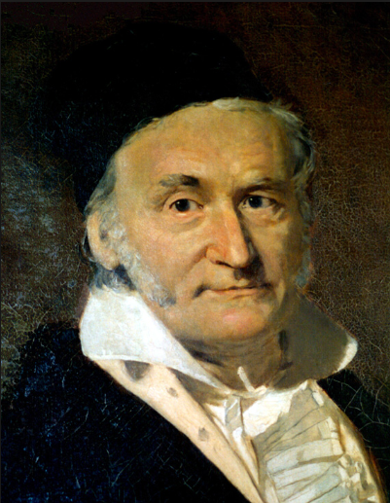
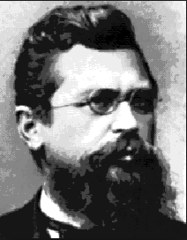
Matrices
Carl Friedrich Gauss Wilhelm Jordan

Slide 44
Matrices
Computers and calculators manipulate the matrix to achieve the Gauss-Jordan solution

Slide 45
Matrices
Computers and calculators do these processes using a strategy to reduce the matrix to the Gauss-Jordan “Easy-To-Solve” form

Slide 46
Questions?

Slide 47
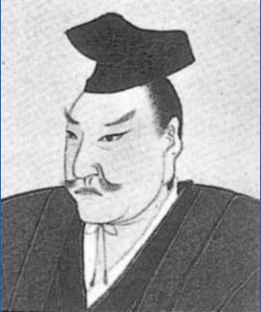
Matrices
The determinant was first introduced by the Japanese mathematician Seki in 1683

Slide 48
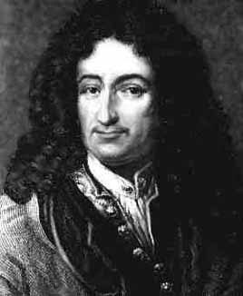
Matrices
Coincidentally, Gottfried Leibnitz also first published his concept of the determinant in 1683

Slide 49
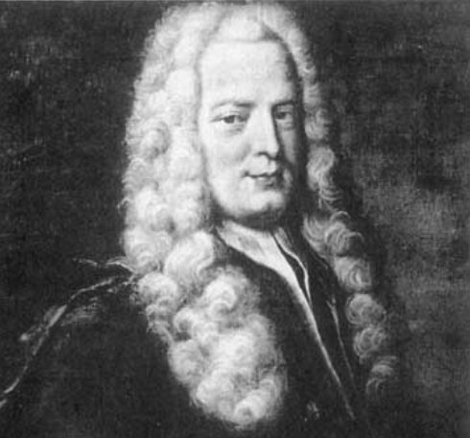
Matrices
Gabriel Cramer used determinants to solve small systems of equations

Slide 50
Matrices
The determinant of a matrix is used to solve small matrices

Slide 51
Matrices
It uses a symbol that looks like the absolute value of a matrix:
│ 10 4 │
│-43 0 │

Slide 52
Matrices
It uses a different element notation:
│ a1 b1 │
│ a2 b2 │

Slide 53
Matrices
The determinant is defined to be: a1∗b2 – a2∗b1
│ a1 b1 │
│ a2 b2 │

Slide 54
Matrices
The hardest part about it is remembering it’s Minus not Plus!

Slide 55
Matrices
IN-CLASS PROBLEMS
Find the determinant for the matrix: a1∗b2 – a2∗b1
│ 4 12 │
│ 7 9 │

Slide 56
Matrices
IN-CLASS PROBLEMS
Find the determinant for the matrix:
│ 4 12 │
│ 7 9 │
4∗9 – 7∗12 = 36 – 84 = -48

Slide 57
Matrices
IN-CLASS PROBLEMS
Find the determinant for the matrix: a1∗b2 – a2∗b1
│ 7 9 │
│ 2 4 │

Slide 58
Matrices
IN-CLASS PROBLEMS
Find the determinant for the matrix:
│ 7 9 │
│ 2 4 │
7∗4 – 2∗9 = 28 – 18 = 10

Slide 59
Matrices
Determinants are easy for small matrices, daunting for large ones

Slide 60
Matrices
For a 3x3 matrix:
┌ ┐
│ a1 b1 c1 │ k1│
│ a2 b2 c2 │ k2│
│ a3 b3 c3 │ k3│
└ ┘
the determinant is:
a₁b₂c₃+b₁c₂a₃+c₁a₂b₃
-a₃b₂c₁- b₃c₂a₁-c₃a₂b₁

Slide 61
Matrices

Slide 62
Matrices
So… you use determinants on SMALL matrices, not on large ones

Slide 63
Matrices
Notice you don’t use the “k” column of the augmented matrix
Use just the coefficients of
the variables from the original equations

Slide 64
Matrices
To solve the system of equations:
a₁x + b₁y = c₁
a₂ x + b₂ y = c₂
x = │ c1 b1 │ y = │ a1 c1 │
│ c2 b2 │ │ a2 c2 │
. . . .
│ a1 b1 │ │ a1 b1 │
│ a2 b2 │ │ a2 b2 │

Slide 65
Matrices
In terms of formulas:
x = (c1∗b2-c2∗b1)
(a1∗b2-a2∗b1)
y = (a1∗c2-a2∗c1)
(a1∗b2-a2∗b1)

Slide 66
Questions?

Slide 67
Algorithms
An algorithm is a series of instructions which if performed in order will solve a problem

Slide 68
Algorithms
It must be a sequence of unambiguous instructions

Slide 69
Algorithms
It must be a sequence of unambiguous instructions
(remember logic?)

Slide 70
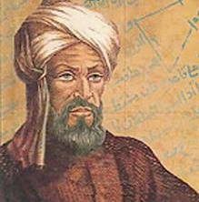
Algorithms
In 9th century Persia, the scientist, astronomer and mathematician Abdullah Muhammad bin Musa al- Khwarizmi, came up
with many standard algebraic calculation formulas
https://www.google.com/search?biw=1001&bih=825&tbm=isch&sa=1&q=al+khwarizmi&oq=al+kwa&gs_l=psy-ab.1.2.0i8i30k1l2j0i10i24k1j0i24k1l2j0i10i24k1l3j0i24k1j0i10i24k1.2302.7837.0.10616.6.6.0.0.0.0.113.651.0j6.6.0....0...1.1.64.psy-ab..0.6.648...0j0i67k1.0.JI94QCdrpUg#imgrc=YyylGTQAZMiX_M:

Slide 71
Algorithms
These were called “al Khwarizmis”
which morphed into “algorithms”

Slide 72
Algorithms
A flowchart is a pictorial representation of an algorithm

Slide 73
Algorithms
For an algorithm to be suitable for computer use, it must possess various properties:
Finiteness: The algorithm must terminate after a finite number of steps

Slide 74
Algorithms
IN-CLASS PROBLEMS
produce first digit of 1/7
while there are more digits of 1/7 do
produce next digit
https://www.macs.hw.ac.uk/~pjbk/pathways/cpp1/node32.html
Notes:
https://www.macs.hw.ac.uk/~pjbk/pathways/cpp1/node32.html

Slide 75
Algorithms
For an algorithm to be suitable for computer use, it must possess various properties:
Finiteness
Non-ambiguity: Each step must be precisely defined

Slide 76
Algorithms
Note: the book splits this one into two:
Unique initialization
Unique succession

Slide 77
Algorithms
For an algorithm to be suitable for computer use, it must possess various properties:
Finiteness
Non-ambiguity
Effectiveness: all the operations can actually be carried out, and in a finite time

Slide 78
Algorithms
Even if an algorithm satisfies the criteria, it may not be a practical way of solving a problem

Slide 79
Algorithms
While an algorithm may execute in a finite time, it is not much use if that finite time is so large as to make solution completely impractical

Slide 80
Algorithms
There is a lot of interest in finding ‘good' algorithms which generate correct solutions in a short time compared with other algorithms

Slide 81
Algorithms
In sorting 10,000 numbers into ascending order a ‘good' algorithm executing on a PC took less than a second while a ‘poor' algorithm took over 10 minutes

Slide 82
Questions?

Slide 83
Types of Algorithms
An algorithm can be recursive or nonrecursive

Slide 84
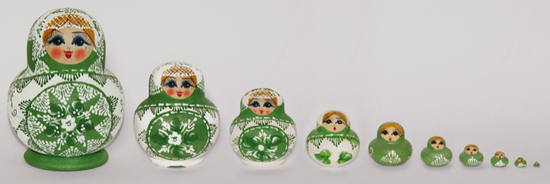
Types of Algorithms
Recursive algorithms are like Russian dolls

Slide 85
Types of Algorithms
One Russian doll has within it a smaller Russian doll, which has an even smaller Russian doll within it, all the way down to a tiny Russian doll that is too small to contain another

Slide 86
Types of Algorithms
Recursive algorithms solve problems by solving a smaller instance of the same problem, until the problem is so small that it can be solved directly

Slide 87
Types of Algorithms
A recursive implementation and an iterative implementation do the same exact job, but the way they do the job is different

Slide 88
Types of Algorithms
Recursion involves a function that calls itself
Iteration uses a counter to track through a structure or complete an operation n times

Slide 89
Types of Algorithms
Recursive algorithms are usually used in sequence operations

Slide 90
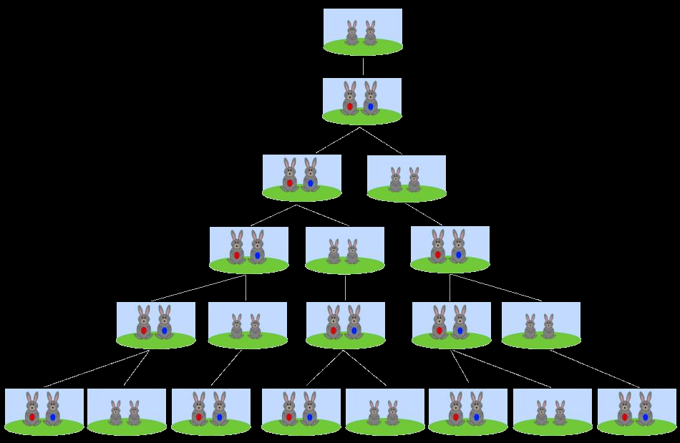
Types of Algorithms
Remember
Fibonacci?
http://www.abc.net.au/news/image/8217080-3x2-940x627.jpg

Slide 91
Types of Algorithms
How is the sequence defined? F(0) = 1 F(1) = 1 F(n) = F(n-1) + F(n-2)
http://planet.jboss.org/post/fibonacci_sequence_with_and_without_recursion

Slide 92
Types of Algorithms
The Fibonacci sequence can be implemented either using recursion or without
Jon Kartago Lamida
2013

Slide 93
With Recursion Without Recursion
int fibo(int in){ if(n <= 1){ return n }else{ return fibo(n-1) +
fibo(n-2); } }
int fibo(int n){ if(n <= 1){ return n; } int fibo = 1; int fiboPrev = 1; for(int i = 2; i < n; ++i){ int temp = fibo; fibo += fiboPrev; fiboPrev = temp; } return fibo; }
http://planet.jboss.org/post/fibonacci_sequence_with_and_without_recursion

Slide 94
Questions?

Slide 95
Big O
An algorithm is a well-defined procedure that allows a computer to solve a problem

Slide 96
Big O
All of the operations performed by a computer consist of algorithms

Slide 97
Big O
In computer programming, there are often a variety of algorithms to do a given calculation

Slide 98
Big O
In our computer programs we want to use algorithms that minimize the time (time complexity) and memory (space complexity) required to do calculations

Slide 99
Big O
Big O notation is used to classify algorithms according to how their running time or space requirements grow as the input size grows

Slide 100
Big O
Big O notation makes a limiting statement about long-term conditions as time goes on

Slide 101
Big O
Big O notation includes boundedness – limit or control

Slide 102
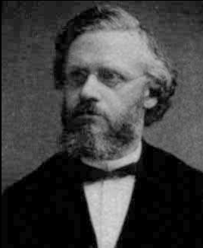
Big O
Big O concepts
first appeared in
Bachmann's
treatise on
number theory
(1894)
Paul Gustav
Heinrich Bachmann
(1837 – 1920)
https://en.wikipedia.org/wiki/Paul_Gustav_Heinrich_Bachmann#/media/File:Paul_Bachmann.jpg

Slide 103
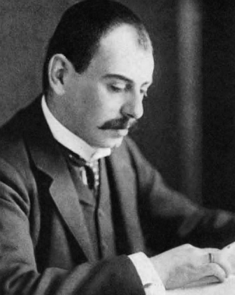
Big O
Landau came up
with modern O
notation (1909)
Edmund Georg
Hermann Landau
(1877 – 1938)
https://en.wikipedia.org/wiki/Edmund_Landau#/media/File:Edmund_Landau.jpg

Slide 104
Big O
“O” is used because the growth rate of a function is also referred to as order of the function

Slide 105
Big O
https://en.wikipedia.org/wiki/Big_O_notation#/media/File:Big-o-approx-logo.svg

Slide 106
Big O
Different functions with the same growth rate may be represented using the same O notation

Slide 107
Big O
Big O notation usually only provides an upper bound on the growth rate of the function

Slide 108
Big O
Big O specifically describes the worst-case scenario

Slide 109
Big O
O(1) describes an algorithm that will always execute in the same time (or space) regardless of the size of the input data set

Slide 110
Big O
IN-CLASS PROBLEMS
bool IsFirstElementNull(IList<string> elements)
{
return elements[0] == null;
}
https://rob-bell.net/2009/06/a-beginners-guide-to-big-o-notation/

Slide 111
Big O
O(n) describes an algorithm whose performance will grow linearly and in direct proportion to the size of the input data set

Slide 112
Big O
IN-CLASS PROBLEMS
bool ContainsValue(IList<string> elements, string value)
{
foreach (var element in elements)
{
if (element == value) return true;
}
return false;
}
https://rob-bell.net/2009/06/a-beginners-guide-to-big-o-notation/

Slide 113
Big O
The example demonstrates how Big O favors the worst-case performance scenario

Slide 114
Big O
The example demonstrates how Big O favors the worst-case performance scenario
A matching string could be found during any iteration of the for loop and the function would return early

Slide 115
Big O
Big O notation will always assume the upper limit where the algorithm will perform the maximum number of iterations

Slide 116
Big O
O(n²) represents an algorithm whose performance is directly proportional to the square of the size of the input data set

Slide 117
Big O
O(n²) is common with algorithms that involve nested iterations over the data set

Slide 118
Big O
O(n²) is common with algorithms that involve nested iterations over the data set
Deeper nested iterations will result in O(N³), O(N⁴) etc.

Slide 119
Big O
IN-CLASS PROBLEMS
bool ContainsDuplicates(IList<string> elements)
{
for (var outer = 0; outer < elements.Count; outer++)
{
for (var inner = 0; inner < elements.Count; inner++)
{
// Don't compare with self
if (outer == inner) continue;
if (elements[outer] == elements[inner]) return true;
}
}
return false;
}
https://rob-bell.net/2009/06/a-beginners-guide-to-big-o-notation/

Slide 120
Big O
O(2^{N}) denotes an algorithm whose growth doubles with each addition to the input data set

Slide 121
Big O
The growth curve of an O(2^{N}) function is exponential - starting off very shallow, then rising meteorically

Slide 122
Big O
An example of an O(2^{N}) function is the recursive calculation of Fibonacci numbers

Slide 123
Big O
IN-CLASS PROBLEMS
int Fibonacci(int number)
{
if (number <= 1) return number;
return Fibonacci(number - 2) + Fibonacci(number - 1);
}
https://rob-bell.net/2009/06/a-beginners-guide-to-big-o-notation/

Slide 124
Big O
The growth curve of an O(2^{N}) function is exponential - starting off very shallow, then rising meteorically. An example of an O(2^{N}) function is the recursive calculation of Fibonacci numbers

Slide 125
Big O
Ideally, an algorithm should run in linear time or better…

Slide 126
Big O
Ideally, an algorithm should run in linear time or better…
That means it should be O(n)

Slide 127
Big O
IN-CLASS PROBLEMS
Which runs slower:
O(1)
O(n)
O(n²)

Slide 128
Big O
IN-CLASS PROBLEMS
Which runs slower:
O(1)
O(n)
O(n²)
O(n²) will be slowest

Slide 129
Big O
IN-CLASS PROBLEMS
Which runs faster:
O(1)
O(n)
O(n²)

Slide 130
Big O
IN-CLASS PROBLEMS
Which runs slower:
O(1)
O(n)
O(n²)
O(0) will be fastest

Slide 131
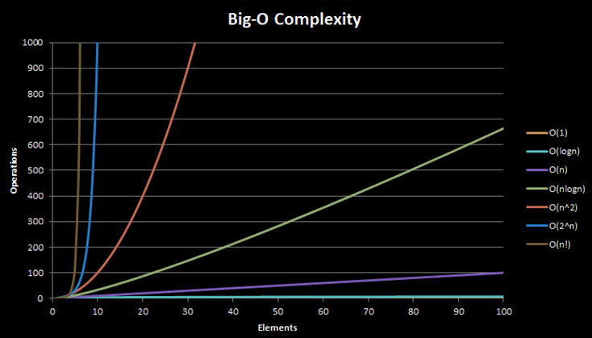
Big O
http://bigocheatsheet.com/

Slide 132
Note:
There is not just Big O…

Slide 133
Note:
There is not just Big O…
there is also little o
(yes, small “l”)
http://th07.deviantart.net/fs70/PRE/i/2012/297/6/a/scared_girl_caricature_portrait_by_jordylakiere-d5itcx5.jpg

Slide 134
Note:
There is not just Big O…
there is also little o
and omega Ω
http://th07.deviantart.net/fs70/PRE/i/2012/297/6/a/scared_girl_caricature_portrait_by_jordylakiere-d5itcx5.jpg

Slide 135
Note:
There is not just Big O…
there is also little o
and omega Ω
and Big Theta Θ
http://th07.deviantart.net/fs70/PRE/i/2012/297/6/a/scared_girl_caricature_portrait_by_jordylakiere-d5itcx5.jpg

Slide 136
Note:
There is not just Big O…
there is also little o
and omega Ω
and Big Theta Θ
and small omega ω
http://th07.deviantart.net/fs70/PRE/i/2012/297/6/a/scared_girl_caricature_portrait_by_jordylakiere-d5itcx5.jpg

Slide 137
Note:
I am assuming Intellipath will not require these…

Slide 138
Note:
I am assuming Intellipath will not require these…
I could be wrong…
(let me know!)

Slide 139
Questions?

Slide 140
Cost Analysis
The analysis of algorithms is the determination of the amount of time, storage and/or other resources necessary to execute them

Slide 141
Cost Analysis
You need a function that relates the length of an algorithm's input to the number of steps it takes (its time complexity) or the number of storage locations it uses (its space complexity)

Slide 142
Cost Analysis
An algorithm is said to be efficient when this function's values are small

Slide 143
Cost Analysis
Different inputs of the same length may cause the algorithm to have different behavior

Slide 144
Cost Analysis
The function describing performance is usually an upper bound on the actual performance

Slide 145
Cost Analysis
This is determined from the “worst case” inputs to the algorithm

Slide 146
Cost Analysis
Two cost models are generally used

Slide 147
Cost Analysis
The uniform cost model assigns a constant cost to every machine operation
(regardless of the size of the numbers)

Slide 148
Cost Analysis
The logarithmic cost model assigns a cost to every machine operation proportional to the number of bits involved

Slide 149
Cost Analysis
The logarithmic cost model is more cumbersome to use, so it's only employed when necessary

Slide 150
Questions?

Slide 151
Runtime
Using big O notation to determine the efficiency of an algorithm is called runtime analysis

Slide 152
Runtime
Runtime analysis estimates the increase in runtime of an algorithm as its input size (usually denoted as n) increases

Slide 153
Runtime
An algorithm is said to exhibit a growth rate on the order of a mathematical function if beyond a certain input size n, the function f (n) times a positive constant provides an upper bound or limit for the run-time of that algorithm

Slide 154
Runtime
In other words, for a given input size n greater than some n₀ and a constant c, the running time of that algorithm will never be larger than
c × f (n)

Slide 155
Runtime
This concept is frequently expressed using Big O notation

Slide 156
Runtime
For example, since the run-time of insertion sort grows quadratically as its input size increases, insertion sort can be said to be of order O(n²).

Slide 157
Runtime
Traditionally, empirical measurements were taken by observing a computer running an algorithm over a period of time

Slide 158
Runtime
Because runtime for algorithms is platform dependent, an empirical approach (watching it run in practice) may have problems

Slide 159
Runtime
Which algorithm looks better?
n (list size) | Computer A run-time (in nanoseconds) | Computer B run-time (in nanoseconds)
16 | 8 | 100,000
63 | 32 | 150,000
250 | 125 | 200,000
1,000 | 500 | 250,000

Slide 160
Runtime
Ah, but… how about now?
n (list size) | Computer A run-time (in nanoseconds) | Computer B run-time (in nanoseconds)
16 | 8 | 100,000
63 | 32 | 150,000
250 | 125 | 200,000
1,000 | 500 | 250,000
… | … | …
1,000,000 | 500,000 | 500,000
4,000,000 | 2,000,000 | 550,000
16,000,000 | 8,000,000 | 600,000

Slide 161
Runtime
Computer A, running the linear search program, exhibits a linear growth rate

Slide 162
Runtime
The program's run-time is directly proportional to its input size

Slide 163
Runtime
Doubling the input size doubles the run time, quadrupling the input size quadruples the run-time, and so forth

Slide 164
Runtime
On the other hand, Computer B, running the binary search program, exhibits a logarithmic growth rate

Slide 165
Runtime
Quadrupling the input size only increases the run time by a constant amount (in this example, 50,000 ns)

Slide 166
Runtime
Even though Computer A is ostensibly a faster machine, Computer B will inevitably surpass Computer A in run-time because it's running an algorithm with a much slower growth rate

Slide 167
Runtime
Runtime of common algorithms
Operation | Algorithm | Complexity
Addition | Schoolbook | O(n)
Subtraction | Schoolbook | O(n)
Multiplication | Schoolbook | O(n²)
 | Karatsuba | O(n^{1.585})
 | 3-way Toom-Cook | O(n^{1.465})
Division | Schoolbook | O(n²)
GCD | Euclidean | O(n²)
Polynomial Eval | Direct | O(n)
 | Horner’s | O(n)
https://en.wikipedia.org/wiki/Computational_complexity_of_mathematical_operations

Slide 168
Questions?

Slide 169
Big O for Matrices
How to compute big O for matric operations

Slide 170
Big O for Matrices
Adding two 2×2 matrices:
each element in the first
matrix is added to its counterpart in the second matrix

Slide 171
Big O for Matrices
Adding two 2×2 matrices:
for 2×2 matrices, this is 4
additions

Slide 172
Big O for Matrices
Adding two 2×2 matrices:
for 2×2 matrices, this is 4
additions
if the size of the matrix is
“n”, the number of
calculations is n²

Slide 173
Big O for Matrices
Adding two 2×2 matrices:
for 2×2 matrices, this is 4
additions
if the size of the matrix is
“n”, the number of
calculations is n²
so it’s O(n²)

Slide 174
Big O for Matrices
IN-CLASS PROBLEMS
What about subtraction?

Slide 175
Big O for Matrices
IN-CLASS PROBLEMS
What about subtraction?
O(n²) also

Slide 176
Big O for Matrices
Intellipath will ask you to compute the Big O
They mean how many calculations/steps are needed (worst case) to solve the problem

Slide 177
Big O for Matrices
For the addition of two 2×2 arrays, they would write it as:
O(4)

Slide 178
Big O for Matrices
IN-CLASS PROBLEMS
Will multiplying matrices take a longer or shorter time?

Slide 179
Big O for Matrices
IN-CLASS PROBLEMS
Will multiplying matrices take a longer or shorter time?
Usually lots longer…

Slide 180
Big O for Matrices
For a 2×2 matrix multiplication, there are how many calculations?
┌ 2 3 ┐
│ 1 2 │
│ 3 4 │
└ 2 3 ┘
┌ 2 3 ┐
│ 5 7 │
│ 6 8 │
└ 2 3 ┘
x
=
┌ 2 3 ┐
│1×5+2×6 1×7+2×8│
│3×5+4×6 3×7+4×8│
└ 2 3 ┘

Slide 181
Big O for Matrices
For a 2×2 matrix multiplication, there are how many calculations?
┌ 2 3 ┐
│ 1 2 │
│ 3 4 │
└ 2 3 ┘
┌ 2 3 ┐
│ 5 7 │
│ 6 8 │
└ 2 3 ┘
x
=
┌ 2 3 ┐
│1×5+2×6 1×7+2×8│
│3×5+4×6 3×7+4×8│
└ 2 3 ┘
1

Slide 182
Big O for Matrices
For a 2×2 matrix multiplication, there are how many calculations?
┌ 2 3 ┐
│ 1 2 │
│ 3 4 │
└ 2 3 ┘
┌ 2 3 ┐
│ 5 7 │
│ 6 8 │
└ 2 3 ┘
x
=
┌ 2 3 ┐
│1×5+2×6 1×7+2×8│
│3×5+4×6 3×7+4×8│
└ 2 3 ┘
1
2

Slide 183
Big O for Matrices
For a 2×2 matrix multiplication, there are how many calculations?
┌ 2 3 ┐
│ 1 2 │
│ 3 4 │
└ 2 3 ┘
┌ 2 3 ┐
│ 5 7 │
│ 6 8 │
└ 2 3 ┘
x
=
┌ 2 3 ┐
│1×5+2×6 1×7+2×8│
│3×5+4×6 3×7+4×8│
└ 2 3 ┘
1
2
3
4
5
6
7
8

Slide 184
Big O for Matrices
For a 2×2 matrix multiplication, there are how many calculations?
┌ 2 3 ┐
│ 1 2 │
│ 3 4 │
└ 2 3 ┘
┌ 2 3 ┐
│ 5 7 │
│ 6 8 │
└ 2 3 ┘
x
=
┌ 2 3 ┐
│1×5+2×6 1×7+2×8│
│3×5+4×6 3×7+4×8│
└ 2 3 ┘
1
2
3
4
9
5
6
7
8

Slide 185
Big O for Matrices
For a 2×2 matrix multiplication, there are how many calculations?
┌ 2 3 ┐
│ 1 2 │
│ 3 4 │
└ 2 3 ┘
┌ 2 3 ┐
│ 5 7 │
│ 6 8 │
└ 2 3 ┘
x
=
┌ 2 3 ┐
│1×5+2×6 1×7+2×8│
│3×5+4×6 3×7+4×8│
└ 2 3 ┘
1
2
3
4
9
10
5
11
6
7
12
8

Slide 186
Big O for Matrices
For a 2×2 matrix multiplication, there are 12 calculations!
┌ 2 3 ┐
│ 1 2 │
│ 3 4 │
└ 2 3 ┘
┌ 2 3 ┐
│ 5 7 │
│ 6 8 │
└ 2 3 ┘
x
=
┌ 2 3 ┐
│1×5+2×6 1×7+2×8│
│3×5+4×6 3×7+4×8│
└ 2 3 ┘
1
2
3
4
9
10
5
11
6
7
12
8

Slide 187
Big O for Matrices
How about a 3×3?
For the 2×2, there were 8
multiplications (2³), 2 for
each of the original 4 matrix
elements
(or n×n²)

Slide 188
Big O for Matrices
How about a 3×3?
For the 2×2, there were 8
multiplications (2³), 2 for
each of the original 4 matrix
elements
(or n×n²)
and 4 additions (2²)
(or (n-1)×n²)

Slide 189
Big O for Matrices
How about a 3×3?
For a 3×3, there are 27
multiplications (or 3×3²)
and 18 additions (or (3-1)×3²)

Slide 190
Big O for Matrices
In general, for an n×n matrix, there are n×n² multiplications and (n-1)×n² additions

Slide 191
Big O for Matrices
In general, for an n×n matrix, there are n×n² multiplications and (n-1)×n² additions or:
2n³ – n²

Slide 192
Big O for Matrices
IN-CLASS PROBLEMS
How many operations are in a 4×4 matrix multiplication?
Remember: 2n³ – n²

Slide 193
Big O for Matrices
IN-CLASS PROBLEMS
How many operations are in a 4×4 matrix multiplication?
112

Slide 194
Big O for Matrices
Ok, so there are a lot of calculations…
how do we figure out Big O?

Slide 195
Big O for Matrices
This is actually pretty complicated…

Slide 196
Big O for Matrices
Runtimes for matrix multiplication are polynomial

Slide 197
Big O for Matrices
Still, the overall runtime will be dominated by the highest power of n

Slide 198
Big O for Matrices
Since the number of calculations contained n³ terms,
Matrix multiplication will have a runtime of O(n³)

Slide 199
Big O for Matrices
BTW… O(n³) is incredibly slow

Slide 200
Big O for Matrices
BTW… O(n³) is incredibly slow
(remember, we want to be as close to O(n) as possible)

Slide 201
Big O for Matrices
Since the easiest matric calculation is addition/subtraction with O(n²)
this is the lower limit of runtime for matrix calculations

Slide 202
Big O for Matrices
It only goes up from there!
Operation | Algorithm | Complexity
Addition | Schoolbook | O(n)
Subtraction | Schoolbook | O(n)
Multiplication | 3-way Toom-Cook | O(n^{1.465})
Division | Schoolbook | O(n²)
Matrix Multiplication | Schoolbook | O(n³)
 | Strassen | O(n^{2.807})
 | CoppersmithWinograd | O(n^{2.376})
 | Optimized CW | O(n^{2.373})
Determinant | Division-free | O(n⁴)

Slide 203
Questions?

Slide 204
Searching Algorithms
A search algorithm retrieves information stored within some data structure or calculated in the search space of a problem domain

Slide 205
Searching Algorithms
Examples of searching algorithms include a Linked List, an Array data structure, and a Search tree

Slide 206
Searching Algorithms
Successful searching depends on:
The size of the data/speed of
the algorithm
How the data are structured
(tree vs array or list)

Slide 207
Sequential Search
A sequential search on an array (list)

Slide 208
Sequential Search
IN-CLASS PROBLEMS
Given the data:
8 4 5 2 0 9 1 7 3 6
What mental process would you go through to find 7?

Slide 209
Sequential Search
IN-CLASS PROBLEMS
Given the data:
8 4 5 2 0 9 1 7 3 6
That is a searching algorithm!
Was it something you could program?

Slide 210
Sequential Search
IN-CLASS PROBLEMS
Given the data:
8 4 5 2 0 9 1 7 3 6
What would be the big O for your algorithm?

Slide 211
Sequential Search
A sequential search is iterative

Slide 212
Sequential Search
A sequential search is iterative
If the first number is not 7,
you move on to the next
number

Slide 213
Sequential Search
A sequential search is iterative
If the first number is not 7,
you move on to the next
number
You continue this until the end
of the list

Slide 214
Sequential Search
IN-CLASS PROBLEMS
Suppose we want to find the number 3.8 in the list:
7.2 1.5 3.8 2.7
Sequential Search
http://python-textbok.readthedocs.io/en/1.0/Sorting_and_Searching_Algorithms.html

Slide 215
Sequential Search
IN-CLASS PROBLEMS
Suppose we want to find the number 3.8 in the list:
Start with the first element and perform a comparison to see if its value is the one we want
7.2 1.5 3.8 2.7
Sequential Search
http://python-textbok.readthedocs.io/en/1.0/Sorting_and_Searching_Algorithms.html

Slide 216
Sequential Search
IN-CLASS PROBLEMS
Suppose we want to find the number 3.8 in the list:
In this case, 1.5 is not equal to 3.8, so we move onto the next element
7.2 1.5 3.8 2.7
Sequential Search
http://python-textbok.readthedocs.io/en/1.0/Sorting_and_Searching_Algorithms.html

Slide 217
Sequential Search
IN-CLASS PROBLEMS
Suppose we want to find the number 3.8 in the list:
We perform another comparison, and see that 2.7 is also not equal to 3.8, so we move onto the next element:
7.2 1.5 3.8 2.7
Sequential Search
http://python-textbok.readthedocs.io/en/1.0/Sorting_and_Searching_Algorithms.html

Slide 218
Sequential Search
IN-CLASS PROBLEMS
Suppose we want to find the number 3.8 in the list:
We perform another comparison and determine that we have found the correct element
7.2 1.5 3.8 2.7
Sequential Search
http://python-textbok.readthedocs.io/en/1.0/Sorting_and_Searching_Algorithms.html

Slide 219
Sequential Search
IN-CLASS PROBLEMS
Suppose we want to find the number 3.8 in the list:
Now we can end the search and return the position of the element (index 2)
7.2 1.5 3.8 2.7
Sequential Search
http://python-textbok.readthedocs.io/en/1.0/Sorting_and_Searching_Algorithms.html

Slide 220
Sequential Search
We had to use a total of 3 comparisons when searching through this list of 4 elements

Slide 221
Sequential Search
How many comparisons we need to perform depends on the total length of the list, but also whether the element we are looking for is near the beginning or near the end of the list

Slide 222
Sequential Search
How many comparisons we need to perform depends on the total length of the list, but also whether the element we are looking for is near the beginning or near the end of the list
(luck)

Slide 223
Sequential Search
In the worst-case scenario, if our element is the last element of the list, we will have to search through the entire list to find it

Slide 224
Sequential Search
Some searching methods run faster than others

Slide 225
Sequential Search
Ordering the data can speed things up!

Slide 226
Sequential Search
IN-CLASS PROBLEMS
To find “7” in the numbers from 0 to 9, which will run faster:
sort from low to high numbers
sort from high to low numbers

Slide 227
Sequential Search
IN-CLASS PROBLEMS
To find “7” in the numbers from 0 to 9, which will run faster:
sort from low to high numbers
sort from high to low numbers

Slide 228
Sequential Search
But sorting takes time, too
You have to hope the time used in sorting is made up in the search

Slide 229
Sequential Search
Big O for searching algorithms:
you will have n entries

Slide 230
Sequential Search
Think of a list as a matrix that has been moved into an array

Slide 231
Sequential Search
So an n×n matrix would correspond to a list of n² items

Slide 232
Sequential Search
This is called a “vector space isomorphism”
http://1.bp.blogspot.com/-o6VoKoz9RRk/Uk1FfScUyeI/AAAAAAAAAno/eHm6IuPcfhA/s1600/scared+man.JPG

Slide 233
Sequential Search
While matrix operations are O(n²)
list operations like
searching would be
O($\sqrt{\text{n}\text{2}}$) or merely
O(n)
http://www.shutterstock.com/s/whew/search.html

Slide 234
Sequential Search
And O(n) is what we want!
(Linear time)

Slide 235
Sequential Search
But some searching algorithms can go even faster if the data are pre-ordered

Slide 236
Sequential Search
If the item you are searching for is the first item in the list, you’ll find it immediately! (O(0))

Slide 237
Sequential Search
This is the best–case scenario and unbeatable

Slide 238
Sequential Search
But… your item could also be the last in the list (O(n))

Slide 239
Sequential Search
And, remember, big O is the worst-case scenario

Slide 240
Sequential Search
And, remember, big O is the worst-case scenario
So our big O value is O(n)
(not O(n/2))

Slide 241
Questions?

Slide 242
Binary Search
Another type of searching algorithm is the binary search

Slide 243
Binary Search
This algorithm is very efficient

Slide 244
Binary Search
This algorithm is very efficient
Its worst-case runtime is better than sequential search

Slide 245
Binary Search
For a binary search, the list must be presorted in ascending or descending order

Slide 246
Binary Search
To run a binary search, find the middle of the list

Slide 247
Binary Search
To run a binary search, find the middle of the list
Check your middle
Throw out the half of the (ordered) data that won’t contain your value
Do it again until you find your number

Slide 248
Binary Search
This method is recursive
(remember, sequential searching was iterative)

Slide 249
Binary Search
IN-CLASS PROBLEMS
Suppose we want to find the number 3.8 in the list:
1.5 2.7 3.8 7.2 9.0 12.6 15.3
Binary Search
http://python-textbok.readthedocs.io/en/1.0/Sorting_and_Searching_Algorithms.html

Slide 250
Binary Search
IN-CLASS PROBLEMS
Suppose we want to find the number 3.8 in the list:
First we compare the element in the middle of the list to our value
1.5 2.7 3.8 7.2 9.0 12.6 15.3
Binary Search
http://python-textbok.readthedocs.io/en/1.0/Sorting_and_Searching_Algorithms.html

Slide 251
Binary Search
IN-CLASS PROBLEMS
Suppose we want to find the number 3.8 in the list:
7.2 is bigger than 3.8, so we need to check the first half of the list next
1.5 2.7 3.8 7.2 9.0 12.6 15.3
Binary Search
http://python-textbok.readthedocs.io/en/1.0/Sorting_and_Searching_Algorithms.html

Slide 252
Binary Search
IN-CLASS PROBLEMS
Suppose we want to find the number 3.8 in the list:
Now the first half of the list is our new list to search
1.5 2.7 3.8 7.2 9.0 12.6 15.3
Binary Search
http://python-textbok.readthedocs.io/en/1.0/Sorting_and_Searching_Algorithms.html

Slide 253
Binary Search
IN-CLASS PROBLEMS
Suppose we want to find the number 3.8 in the list:
We compare the element in the middle of this list to our value
1.5 2.7 3.8 7.2 9.0 12.6 15.3
Binary Search
http://python-textbok.readthedocs.io/en/1.0/Sorting_and_Searching_Algorithms.html

Slide 254
Binary Search
IN-CLASS PROBLEMS
Suppose we want to find the number 3.8 in the list:
2.7 is smaller than 3.8, so we need to search the second half of this sublist next
1.5 2.7 3.8 7.2 9.0 12.6 15.3
Binary Search
http://python-textbok.readthedocs.io/en/1.0/Sorting_and_Searching_Algorithms.html

Slide 255
Binary Search
IN-CLASS PROBLEMS
Suppose we want to find the number 3.8 in the list:
The second half of the last sub-list is just a single element, which is also the middle element
1.5 2.7 3.8 7.2 9.0 12.6 15.3
Binary Search
http://python-textbok.readthedocs.io/en/1.0/Sorting_and_Searching_Algorithms.html

Slide 256
Binary Search
IN-CLASS PROBLEMS
Suppose we want to find the number 3.8 in the list:
We compare this element to our value, and it is the element that we want
1.5 2.7 3.8 7.2 9.0 12.6 15.3
Binary Search
http://python-textbok.readthedocs.io/en/1.0/Sorting_and_Searching_Algorithms.html

Slide 257
Binary Search
IN-CLASS PROBLEMS
Suppose we want to find the number 3.8 in the list:
Now we can end the search and return the position of the element (index 2)
1.5 2.7 3.8 7.2 9.0 12.6 15.3
Binary Search
http://python-textbok.readthedocs.io/en/1.0/Sorting_and_Searching_Algorithms.html

Slide 258
Binary Search
We have performed 3 comparisons in total when searching this list of 7 items

Slide 259
Binary Search
The number of comparisons we need to perform scales with the size of the list, but much more slowly than for linear search

Slide 260
Binary Search
A binary search can be made iterative:

Slide 261
Binary Search
A binary search can be made iterative:
start with index limits in the search and adjust them on each iteration

Slide 262
Binary Search
A recursive method means you ultimately have less data to keep track of

Slide 263
Binary Search
Computing the runtime for a binary search is more tricky

Slide 264
Binary Search
Computing the runtime for a binary search is more tricky
The amount of work to be done at each step is determined by dividing by powers of 2

Slide 265
Binary Search
That is, on step 1 you are looking at n/2 data points

Slide 266
Binary Search
That is, on step 1 you are looking at n/2 data points
On step 2 you are looking at n/2/2 or n/2² numbers

Slide 267
Binary Search
That is, on step 1 you are looking at n/2 data points
On step 2 you are looking at n/2/2 or n/2² numbers
On step 3 you are looking at
n/2/2/2 or n/2³ numbers

Slide 268
Binary Search
Powers of two are an exponential function (n²)
One over powers of two are a logarithmic function (log₂)

Slide 269
Binary Search
A binary search has an average runtime of O(log₂ n)

Slide 270
Binary Search
A binary search has an average runtime of O(log₂ n)
Algorithms like this are said to run in logarithmic time

Slide 271
Binary Search
Note: because all logs in big O are base 2, computer scientists write it merely as O(log n)

Slide 272
Binary Search
All logarithms differ from each other by a constant only dependent on the bases involved
Because these factors are constants, they are irrelevant for the purposes of asymptotic analysis

Slide 273
Binary Search
As a rule of thumb “log n” for:
A mathematician or engineer means base 10
A computer scientist means base two

Slide 274
Binary Search
And… Intellipath writes it as:
O(Log2n)

Slide 275
Binary Search
A binary search runs faster than a sequential search BUT the data must be sorted

Slide 276
Binary Search
Sorting is minimally an additional O(n×log n) runtime

Slide 277
Questions?

Slide 278
Sorting Algorithms
The sorting of a list of values is a common computational task

Slide 279
Sorting Algorithms
The classic description of the task is:
Given a list of values and a function that compares two values, order the values in the list from smallest to largest

Slide 280
Sorting Algorithms
Types of sorting algorithms:
Bubble sort (in book)
Quicksort (in book)
Selection sort
Merge sort
Insertion sort
Heap sort

Slide 281
Sorting Algorithms
Sorts for specific types of values:
Counting sort - values belonging
to a small set of items
Bucket sort - maps each value
to one of a small set of items
Radix sort - values are
sequences of digits

Slide 282
Sorting Algorithms
Bubble sort - continuously steps through a list, swapping items until they appear in the correct order
O(n²)
Bubble sort

Slide 283
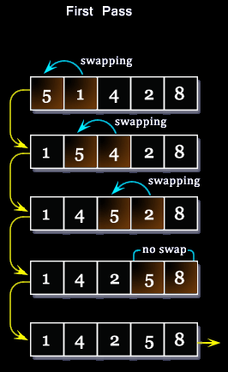
Sorting Algorithms
Bubble sort

Slide 284
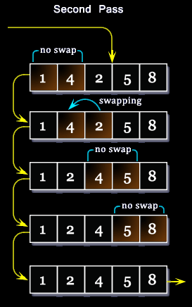
Sorting Algorithms
Bubble sort

Slide 285
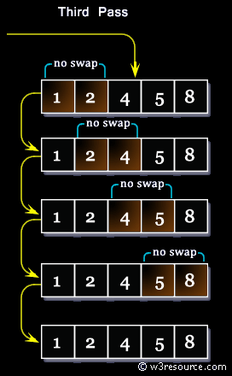
Sorting Algorithms
Bubble sort

Slide 286
Sorting Algorithms
The Quicksort algorithm is one of the fastest sorting algorithms for large data sets
Quicksort

Slide 287
Sorting Algorithms
Quicksort - first divides a large array into two smaller sub-arrays: above a pivot and below a pivot; it then recursively sorts the sub-arrays
O(n²)
Quicksort

Slide 288
Sorting Algorithms
Array of numbers:
Determine the pivot: 44
Quicksort
https://mgalalm.com/2014/11/08/data-structure-and-algorithm-quicksort-in-php/

Slide 289
Sorting Algorithms
Elements are sorted into less-than pivot values and greater- than pivot values
Quicksort
https://mgalalm.com/2014/11/08/data-structure-and-algorithm-quicksort-in-php/

Slide 290
Sorting Algorithms
Split arrays into subarrays on each side of the pivot value
New pivot values are
23 and 75
Quicksort
https://mgalalm.com/2014/11/08/data-structure-and-algorithm-quicksort-in-php/

Slide 291
Sorting Algorithms
Split the subarrays and sort on the pivot values
Left side:
Quicksort
https://mgalalm.com/2014/11/08/data-structure-and-algorithm-quicksort-in-php/

Slide 292
Sorting Algorithms
Split the subarrays and sort on the pivot values
Right side:
Quicksort
https://mgalalm.com/2014/11/08/data-structure-and-algorithm-quicksort-in-php/

Slide 293
Sorting Algorithms
Array after concentrating the right side to the left side
Quicksort
https://mgalalm.com/2014/11/08/data-structure-and-algorithm-quicksort-in-php/

Slide 294
Sorting Algorithms
Selection sort - repeatedly select the smallest remaining element and move it to the end of a growing sorted list
O(n²)
Selection Sort

Slide 295
Sorting Algorithms
Use the front of the list to hold the sorted items to avoid using extra storage space
Unsorted list:
7.2 3.8 1.5 2.7
Selection Sort
http://python-textbok.readthedocs.io/en/1.0/Sorting_and_Searching_Algorithms.html

Slide 296
Sorting Algorithms
First find the smallest element in the unsorted portion of the list
7.2 3.8 1.5 2.7
Selection Sort
http://python-textbok.readthedocs.io/en/1.0/Sorting_and_Searching_Algorithms.html

Slide 297
Sorting Algorithms
First you’ll need to find the smallest element in the unsorted portion of the list
7.2 3.8 1.5 2.7
Selection Sort
http://python-textbok.readthedocs.io/en/1.0/Sorting_and_Searching_Algorithms.html

Slide 298
Sorting Algorithms
Take the first element of the unsorted list as a candidate
7.2 3.8 1.5 2.7
Selection Sort
http://python-textbok.readthedocs.io/en/1.0/Sorting_and_Searching_Algorithms.html

Slide 299
Sorting Algorithms
Compare it to each of the following elements in turn
7.2 3.8 1.5 2.7
Selection Sort
http://python-textbok.readthedocs.io/en/1.0/Sorting_and_Searching_Algorithms.html

Slide 300
Sorting Algorithms
Flip any smaller element to the front of the line
3.8 7.2 1.5 2.7
Selection Sort
http://python-textbok.readthedocs.io/en/1.0/Sorting_and_Searching_Algorithms.html

Slide 301
Sorting Algorithms
Compare the new candidate to each of the remaining elements
3.8 7.2 1.5 2.7
Selection Sort
http://python-textbok.readthedocs.io/en/1.0/Sorting_and_Searching_Algorithms.html

Slide 302
Sorting Algorithms
Flip any smaller element to the front of the line
1.5 7.2 3.8 2.7
Selection Sort
http://python-textbok.readthedocs.io/en/1.0/Sorting_and_Searching_Algorithms.html

Slide 303
Sorting Algorithms
Compare the new candidate to each of the remaining elements
1.5 7.2 3.8 2.7
Selection Sort
http://python-textbok.readthedocs.io/en/1.0/Sorting_and_Searching_Algorithms.html

Slide 304
Sorting Algorithms
Flip any smaller element to the front of the line
1.5 7.2 3.8 2.7
Selection Sort
http://python-textbok.readthedocs.io/en/1.0/Sorting_and_Searching_Algorithms.html

Slide 305
Sorting Algorithms
This requires 3 comparisons and we find that element 1.5 at position 2 is smallest
1.5 7.2 3.8 2.7
Selection Sort
http://python-textbok.readthedocs.io/en/1.0/Sorting_and_Searching_Algorithms.html

Slide 306
Sorting Algorithms
Make the first element of our unordered list the start of our ordered list:
1.5 7.2 3.8 2.7
Selection Sort
http://python-textbok.readthedocs.io/en/1.0/Sorting_and_Searching_Algorithms.html

Slide 307
Sorting Algorithms
Repeat the previous steps for the unordered elements
Flip
1.5 7.2 3.8 2.7
Selection Sort
http://python-textbok.readthedocs.io/en/1.0/Sorting_and_Searching_Algorithms.html

Slide 308
Sorting Algorithms
Repeat the previous steps for the unordered elements
Flip
1.5 3.8 7.2 2.7
Selection Sort
http://python-textbok.readthedocs.io/en/1.0/Sorting_and_Searching_Algorithms.html

Slide 309
Sorting Algorithms
Now you have a new “smallest”
1.5 2.7 7.2 3.8
Selection Sort
http://python-textbok.readthedocs.io/en/1.0/Sorting_and_Searching_Algorithms.html

Slide 310
Sorting Algorithms
Consider it “sorted”
1.5 2.7 7.2 3.8
Selection Sort
http://python-textbok.readthedocs.io/en/1.0/Sorting_and_Searching_Algorithms.html

Slide 311
Sorting Algorithms
Repeat the previous steps for the unordered elements
Flip
1.5 2.7 7.2 3.8
Selection Sort
http://python-textbok.readthedocs.io/en/1.0/Sorting_and_Searching_Algorithms.html

Slide 312
Sorting Algorithms
Repeat the previous steps for the unordered elements
1.5 2.7 3.8 7.2
Selection Sort
http://python-textbok.readthedocs.io/en/1.0/Sorting_and_Searching_Algorithms.html

Slide 313
Sorting Algorithms
Repeat the previous steps for the unordered elements
1.5 2.7 3.8 7.2
Selection Sort
http://python-textbok.readthedocs.io/en/1.0/Sorting_and_Searching_Algorithms.html

Slide 314
Sorting Algorithms
The sorted elements:
1.5 2.7 3.8 7.2
Selection Sort
http://python-textbok.readthedocs.io/en/1.0/Sorting_and_Searching_Algorithms.html

Slide 315
Sorting Algorithms
The Selection sort algorithm as described here has two properties which are often desirable in sorting algorithms

Slide 316
Sorting Algorithms
The first is that the algorithm is “in-place”
This means that it uses essentially no extra storage beyond that required for the input (the unsorted list in this case)

Slide 317
Sorting Algorithms
The second is that the sorting algorithm is “stable”
This means that two elements which are equal retain their initial relative ordering

Slide 318
Sorting Algorithms
This becomes important if there is additional information attached to the values being sorted (for example, if we are sorting a list of people using a comparison function that compares their dates of birth)

Slide 319
Sorting Algorithms
Merge sort repeatedly merges sorted sub-sections of the list starting from sub-sections consisting of a single item each
O(Nlog₂N)

Slide 320
Sorting Algorithms
Merge sort repeatedly merges sorted sub-sections of the list starting from sub-sections consisting of a single item each
O(Nlog₂N)
(obviously the one used for the last slide under “Searching algorithms”)

Slide 321
Sorting Algorithms
Merge sort requires significantly fewer operations than selection sort

Slide 322
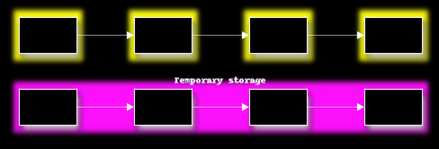
Sorting Algorithms
Start with the unsorted elements and some temporary storage the same size
7.2 3.8 1.5 2.7
Merge Sort
http://python-textbok.readthedocs.io/en/1.0/Sorting_and_Searching_Algorithms.html

Slide 323
Sorting Algorithms
First we will merge the two sections on the left into the temporary storage
7.2 3.8 1.5 2.7
7.2 3.8
Merge Sort
http://python-textbok.readthedocs.io/en/1.0/Sorting_and_Searching_Algorithms.html

Slide 324
Sorting Algorithms
Taking the smaller of the two elements and move it to the beginning of the merged list
7.2 3.8 1.5 2.7
3.8 7.2
Merge Sort
http://python-textbok.readthedocs.io/en/1.0/Sorting_and_Searching_Algorithms.html

Slide 325
Sorting Algorithms
Copy the merged list back into the portion of the list originally occupied by the subsections
3.8 7.2 1.5 2.7
3.8 7.2
Merge Sort
http://python-textbok.readthedocs.io/en/1.0/Sorting_and_Searching_Algorithms.html

Slide 326
Sorting Algorithms
Repeat the procedure to merge the second pair of sorted sub-sections:
3.8 7.2 1.5 2.7
1.5 2.7
Merge Sort
http://python-textbok.readthedocs.io/en/1.0/Sorting_and_Searching_Algorithms.html

Slide 327
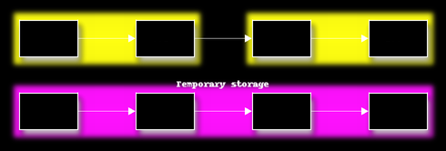
Sorting Algorithms
Repeat the procedure to merge the second pair of sorted sub-sections:
3.8 7.2 1.5 2.7
1.5 2.7
Merge Sort
http://python-textbok.readthedocs.io/en/1.0/Sorting_and_Searching_Algorithms.html

Slide 328
Sorting Algorithms
Having reached the end of the original list, return to the start of the list
3.8 7.2 1.5 2.7
1.5 2.7
Merge Sort
http://python-textbok.readthedocs.io/en/1.0/Sorting_and_Searching_Algorithms.html

Slide 329
Sorting Algorithms
Merge sorted sub-sections again
3.8 7.2 1.5 2.7
3.8 7.2 1.5 2.7
Merge Sort
http://python-textbok.readthedocs.io/en/1.0/Sorting_and_Searching_Algorithms.html

Slide 330
Sorting Algorithms
Repeat this until the entire list is a single sorted sub-section
1.5 2.7 3.8 7.2
1.5 2.7 3.8 7.2
Merge Sort
http://python-textbok.readthedocs.io/en/1.0/Sorting_and_Searching_Algorithms.html

Slide 331
Questions?

