Slide 1
Welcome to
MATH225 Applications of Discrete Mathematics and Statistics
http://media.dcnews.ro/image/201109/w670/statistics.jpg

Slide 2
Discrete Math?
http://ryanaweaver.com/files/2013/02/puzzled-look.jpg

Slide 3
Discrete Math?
There are two types of stuff in the universe:

Slide 4
Discrete Math?
There are two types of stuff in the universe:
discrete

Slide 5
Discrete Math?
There are two types of stuff in the universe:
discrete
continuous

Slide 6
Discrete Math?
Discrete stuff is distinct or separate

Slide 7
Discrete Math?
Not discreet (which means on the down low, under the radar)

Slide 8
Discrete Math?
There are two types of stuff in the universe:
discrete
continuous

Slide 9
Discrete Math?
Continuous stuff is, well, …

Slide 10
Discrete Math?
Continuous stuff is, well, …
continuous

Slide 11
Discrete Math?
Continuous stuff is, well, …
continuous
not distinct
not separate

Slide 12
Discrete Math?
Discrete stuff can often be counted

Slide 13
Discrete Math?
Discrete stuff can often be counted
Continuous stuff must be measured

Slide 14
Discrete Math?
Discrete stuff will be whole numbers
Continuous stuff can have fractions, decimals, etc.

Slide 15
Discrete Math?

Slide 16
DISCRETE MATH?
IN-CLASS PROBLEM
Which?
https://pixabay.com/p-1150021/?no_redirect

Slide 17
Discrete Math?
In reality “discrete math” is a hodgepodge of different types of mathematics that don’t fit into algebra or trig or calculus

Slide 18
Discrete Math?
These topics are frequently useful in IT

Slide 19
Questions?

Slide 20
Sets
Sets are collections of objects called “elements”

Slide 21
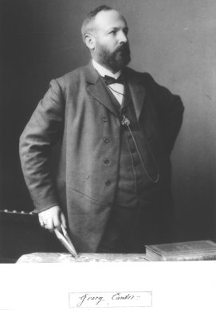
Sets
This branch of mathematics was
developed by Georg Cantor in a
paper published in
1874

Slide 22
Sets
It was HUGELY controversial in 1874!

Slide 23
Sets
Now it seems very normal

Slide 24
Sets
Sets allow mathematics to deal with things other than numbers

Slide 25
Sets
Sets allow us to use “mathy” ideas like “equality” for non-numeric stuff

Slide 26
Sets
Equal?
http://www.germes-online.com/direct/dbimage/50315828/Metallic_Rubber_Balls.jpg

Slide 27
Sets
It starts with the idea that an object can be either one of two states:
IN the set
or
OUT of the set

Slide 28
Sets
Elements in the set will all hold some characteristic in common with each other that no elements outside of the set share

Slide 29
Sets
IN-CLASS PROBLEMS
What elements are in the “red” set?

Slide 30
Sets
IN-CLASS PROBLEMS
What elements are not in the “red” set?

Slide 31
Sets
The cardinality of a set is the "number of distinct elements of the set"

Slide 32
Sets
For example, the set A = {2, 4, 6} contains 3 elements, and therefore A has a cardinality of 3

Slide 33
Sets
The set A = {1,1,1,2,2} and the set B = {1,2} both have cardinality of 2

Slide 34
Sets
IN-CLASS PROBLEMS
How many elements are in the “flowers” set?

Slide 35
Sets
IN-CLASS PROBLEMS
How many elements are in the “round” set?

Slide 36
Sets
IN-CLASS PROBLEMS
How many elements are in the “soccer balls” set?

Slide 37
Sets
IN-CLASS PROBLEMS
How many elements are in the “cars” set?

Slide 38
Sets
IN-CLASS PROBLEMS
How many elements are in the “yellow” set?

Slide 39
Sets
Equal sets have the exact same elements in them, even though they could be out of order

Slide 40
Sets
Equal sets have the exact same elements in them, even though they could be out of order
Symbolized by “=”

Slide 41
Sets
Equivalent sets have different elements but have the same number of elements

Slide 42
Sets
Equivalent sets have different elements but have the same number of elements
Symbolized by “~”

Slide 43
Sets
Because a set's cardinality is the number of elements in the set, if two sets have the same cardinality, they are equivalent!

Slide 44
Sets
IN-CLASS PROBLEMS
Are sets A and B equal?
Set B
Set A

Slide 45
Sets
IN-CLASS PROBLEMS
Are sets A and B equivalent?
Set B
Set A

Slide 46
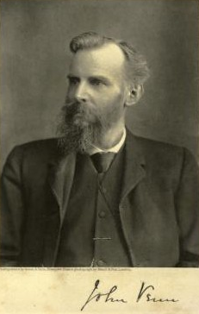
Sets
We show sets using overlapping circles called
“Venn diagrams”
invented by
John Venn in 1881

Slide 47
Sets
Each circle will represent a set
The circles will overlap to show
elements that fall into more
than one set

Slide 48
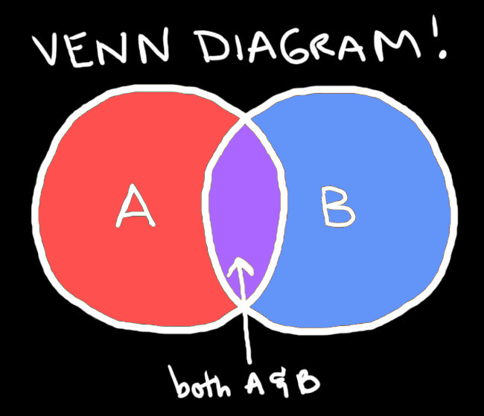
Sets

Slide 49
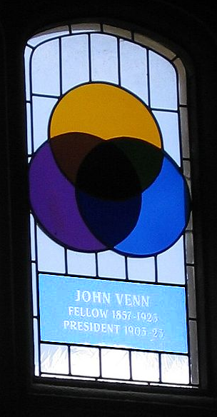
Sets
Stained glass window
at Gonville and Caius College, Cambridge, commemorating John Venn and the Venn diagram

Slide 50
Sets
IN-CLASS PROBLEMS
The class:
Alice, Ben, Carlos, Delphine
Set 1: Males in the class
Set 2: Females in the class
Who would be in set 1?
Who would be in set 2?
Is anybody in both sets?

Slide 51
Sets
IN-CLASS PROBLEMS
Put the sets into a Venn diagram:

Slide 52
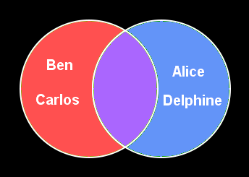
Sets
Set 1: Males Set 2: Females
Nobody in both groups

Slide 53
Sets
Set 1: Males Set 2: Females
∅

Slide 54
Sets
The empty set or the null set
Has no elements
Symbolized:
∅

Slide 55
Sets
We call non-overlapping sets “mutually exclusive”

Slide 56
Sets
Typically there are elements that fall into more than one set

Slide 57
Sets
Sets are often given in
“set roster notation”
Set 1 = {A,B,C,D}
Set 2 = {D,E,F}

Slide 58
Sets
IN-CLASS PROBLEMS
Write the sets in set roster
notation

Slide 59
Sets
IN-CLASS PROBLEMS
Write the sets in set roster
notation
Set 1 = {Ben, Carlos}
Set 2 = {Alice, Delphine}

Slide 61
Sets
A set is completely determined by what its elements are, not the order they are listed in
Elements may be listed more than once – it makes no difference

Slide 62
Sets
IN-CLASS PROBLEMS
Set 1 = {Ben, Carlos}
Set 2 = {Carlos, Ben}
Set 3 = {Ben, Carlos, Ben}
Are these sets equal?

Slide 63
Sets
IN-CLASS PROBLEMS
Set 1 = {Ben, Carlos}
Set 2 = {Carlos, Ben}
Set 3 = {Ben, Carlos, Ben}
All these sets are EQUAL!

Slide 64
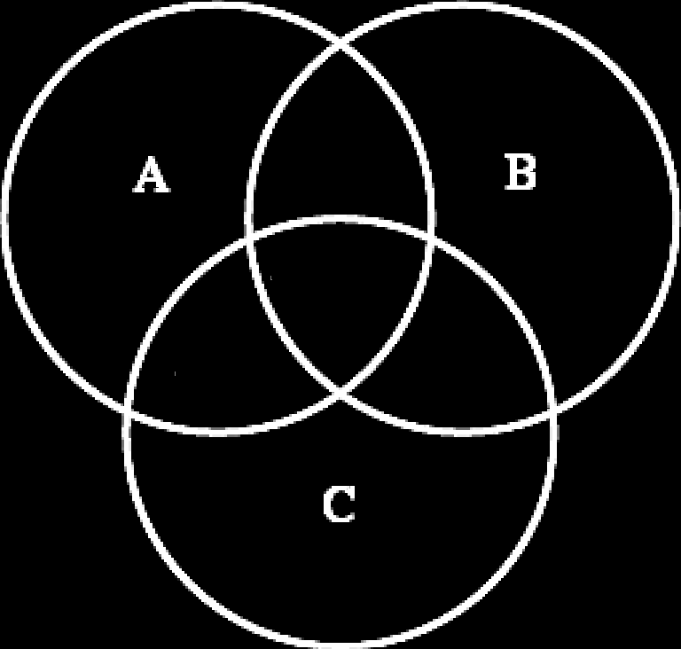
Sets
You can have more than two sets:

Slide 65
Sets
Suppose we had these elements:

Slide 66
Sets
Suppose we wanted to split the elements into the sets:
red, round, flowers

Slide 67
red round
flowers

Slide 68
red round
No
flowers non-red
round flowers

Slide 69
red round
flowers

Slide 70
Sets
The elements that fall into more than one set are called the “intersection” of those sets

Slide 71
Sets
The intersection is symbolized by:
∩

Slide 72
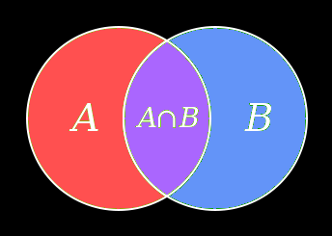
Sets

Slide 73
Sets
For more than two sets:

Slide 74
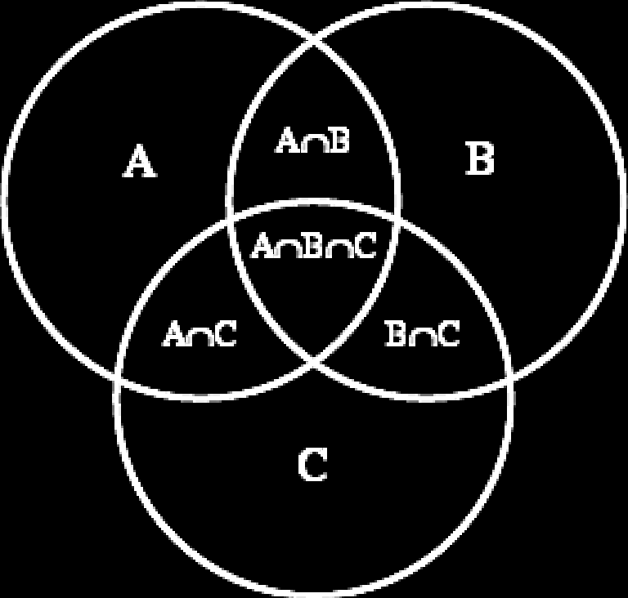
Sets
The intersections will be more complicated:

Slide 75
Sets
Intersection of two sets:
The element is in both set A and set B
A ∩ B

Slide 76
Sets
Find:
Red ∩ Round
(red and round)

Slide 77
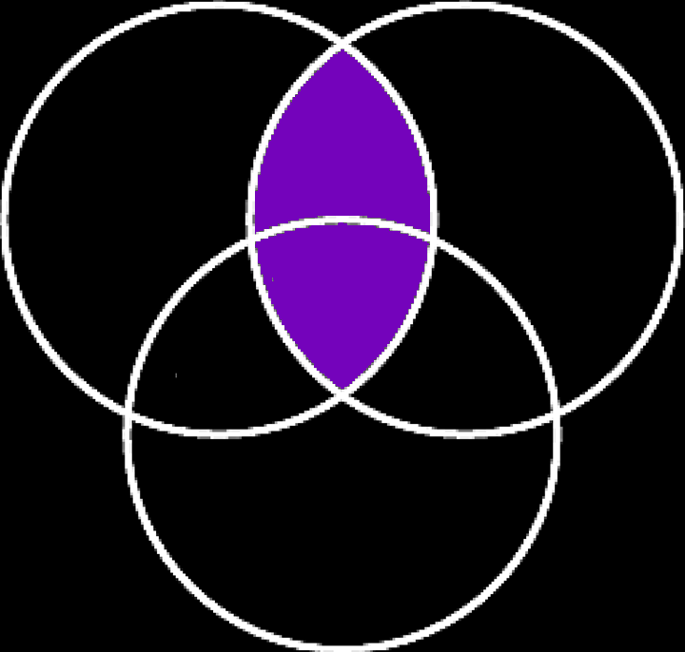
Sets
Red ∩ Round
(red and round)

Slide 78
Sets
Intersection of two sets:
The element is in both set A and set B
A ∩ B

Slide 79
Sets
Another symbol:
∪
means the “union” of two sets

Slide 80
Sets
Union of two sets:
The element is in either set A or set B
A ∪ B

Slide 81
Sets
Find:
Red ∪ Round
(red or round)

Slide 82
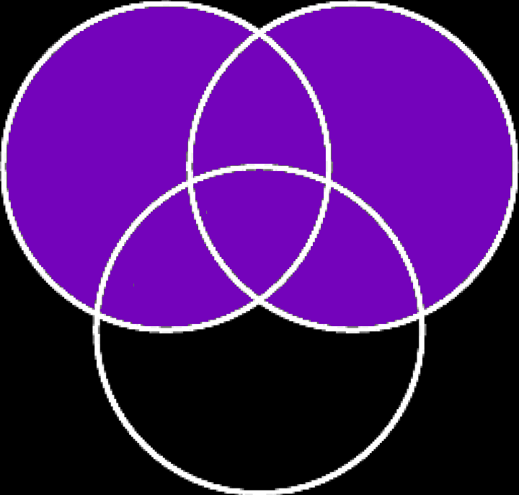
Sets
Find:
Red ∪ Round
(red or round)

Slide 83
Sets
IN-CLASS PROBLEMS
Let A = {1,2,3}
B = {3,1,2}
C = {1,1,2,3,3,3}
What are the elements of A, B
and C?
How are A, B, and C related?
How many elements are in A, B
and C?

Slide 84
Sets
IN-CLASS PROBLEMS
Is {0} = 0?

Slide 85
Sets
Nope!
{0} is a set
0 is the symbol representing
“zero”

Slide 86
Sets
IN-CLASS PROBLEMS
Is {0} = ∅ ?

Slide 87
Sets
Nope!
0 isn’t nothin’ !

Slide 88
Sets
IN-CLASS PROBLEMS
Shade in AUB Shade in A∩B Shade in A∩B∩C

Slide 89
Questions?

Slide 90
Set Builder Notation
If S is a set, x ∈ S means x is an element of S
If S is a set, x ∉ S means x is not an element of S

Slide 91
Set Builder Notation
Symbol | Set
R | Set of all real numbers
Z | Set of all integers
Q | Set of all rational numbers

Slide 92
Set Builder Notation
Symbol | Set
R⁺ | Set of all positive real numbers
Z⁻ | Set of all negative integers
Q^{nonneg} | Set of all nonnegative rational numbers
Addition of a superscript + or - or the letters nonneg indicates only the positive or negative or nonnegative elements are to be included

Slide 93
Set Builder Notation
Let S be a set
Let P(x) be a property that elements of S may have
Set builder notation:
{x ∈ S | P(x)}
the set of all
such that
elements x of set S
they have property p

Slide 94
Set Builder Notation
IN-CLASS PROBLEMS
Read each of these notations:
{x ∈ Z | -2 < x < 5}
{x ∈ Z⁺ | -2 < x < 5}
{x ∈ R | -2 < x < 5}

Slide 95
Set Builder Notation
IN-CLASS PROBLEMS
Describe each of the sets:
{x ∈ Z | -2 < x < 5}
{x ∈ Z⁺ | -2 < x < 5}
{x ∈ R | -2 < x < 5}

Slide 96
Set Builder Notation
IN-CLASS PROBLEMS
Describe each of the sets:
{x ∈ Z | -2 < x < 5}
{ -1, 0, 1, 2, 3, 4 }
{x ∈ Z⁺ | -2 < x < 5}
{x ∈ R | -2 < x < 5}

Slide 97
Set Builder Notation
IN-CLASS PROBLEMS
Describe each of the sets:
{x ∈ Z | -2 < x < 5}
{ -1, 0, 1, 2, 3, 4 }
{x ∈ Z⁺ | -2 < x < 5}
{ 1,2,3,4 }
{x ∈ R | -2 < x < 5}

Slide 98
Set Builder Notation
IN-CLASS PROBLEMS
Describe each of the sets:
{x ∈ Z | -2 < x < 5}
{ -1, 0, 1, 2, 3, 4 }
{x ∈ Z⁺ | -2 < x < 5}
{ 1,2,3,4 }
{x ∈ R | -2 < x < 5}

Slide 99
Questions?

Slide 100
Subsets
If A and B are sets,
A is a subset of B if and
only if every element of A
is also an element of B

Slide 101
Subsets
If A and B are sets,
A is a subset of B if and
only if every element of A
is also an element of B
Written: A ⊆ B

Slide 102
Subsets
A proper subset of a set A is a subset of A that is not equal to A
Written: A ⊂ B

Slide 103
Subsets
If B is a proper subset of A, then all elements of B are in A but A contains at least one element that is not in B

Slide 104
Subsets
For example, if A = {1,3,5} then B = {1,5} is a proper subset of A
but B = {3,5,1} is not

Slide 105
Subsets
For a set A not to be a subset
of a set B, there must be
at least one element of A
that is not an element of B

Slide 106
Subsets
For a set A not to be a subset
of a set B, there must be
at least one element of A
that is not an element of B
Written: A ⊄ B or A ⊄ B

Slide 107
Subsets
A ⊄ B
means there is at least one element that is in A but not in B

Slide 108
Subsets
IN-CLASS PROBLEMS
Let A = Z⁺
B = {n ∈ Z | 0 ≤ n ≤ 100}
C = {100,200,300,400,500}
Is B ⊆ A?

Slide 109
Subsets
IN-CLASS PROBLEMS
Let A = Z⁺
B = {n ∈ Z | 0 ≤ n ≤ 100}
C = {100,200,300,400,500}
Is B ⊆ A?
nope… zero is not a positive integer, so B ⊄ A

Slide 110
Subsets
IN-CLASS PROBLEMS
Let A = Z⁺
B = {n ∈ Z | 0 ≤ n ≤ 100}
C = {100,200,300,400,500}
Is C a proper subset of A?

Slide 111
Subsets
IN-CLASS PROBLEMS
Let A = Z⁺
B = {n ∈ Z | 0 ≤ n ≤ 100}
C = {100,200,300,400,500}
Is C a proper subset of A?
yep…

Slide 112
Subsets
IN-CLASS PROBLEMS
Let A = Z⁺
B = {n ∈ Z | 0 ≤ n ≤ 100}
C = {100,200,300,400,500}
Do C and B have at least one element in common?

Slide 113
Subsets
IN-CLASS PROBLEMS
Let A = Z⁺
B = {n ∈ Z | 0 ≤ n ≤ 100}
C = {100,200,300,400,500}
Do C and B have at least one element in common?
yep… 100 is in both B and C

Slide 114
Subsets
IN-CLASS PROBLEMS
Let A = Z⁺
B = {n ∈ Z | 0 ≤ n ≤ 100}
C = {100,200,300,400,500}
Is C ⊆ B?

Slide 115
Subsets
IN-CLASS PROBLEMS
Let A = Z⁺
B = {n ∈ Z | 0 ≤ n ≤ 100}
C = {100,200,300,400,500}
Is C ⊆ B?
nope… 200 is in C but not in B

Slide 116
Subsets
IN-CLASS PROBLEMS
Let A = Z⁺
B = {n ∈ Z | 0 ≤ n ≤ 100}
C = {100,200,300,400,500}
Is C ⊆ C?

Slide 117
Subsets
IN-CLASS PROBLEMS
Let A = Z⁺
B = {n ∈ Z | 0 ≤ n ≤ 100}
C = {100,200,300,400,500}
Is C ⊆ C?
yep… all sets are subsets of themselves

Slide 118
Subsets
For a set with “n” distinct elements, there are 2^{n} subsets

Slide 119
Subsets
IN-CLASS PROBLEMS
For the set {a,b,c}
how many subsets are there?

Slide 120
Subsets
IN-CLASS PROBLEMS
For the set {a,b,c}
how many subsets are there?
2³ = 8:
{a} {b} {c} {a,b} {a,c} {b,c} {a,b,c}
…what’s missing?

Slide 121
Subsets
IN-CLASS PROBLEMS
For the set {a,b,c}
how many subsets are there?
2³ = 8:
{a} {b} {c} {a,b} {a,c} {b,c} {a,b,c}
and Ø

Slide 122
Subsets
What is the difference between ⊆ and ∈ ?
What is the difference between
sets and elements of sets?

Slide 123
Subsets
IN-CLASS PROBLEMS
Which are true?
2 ∈ { 1,2,3 }
{2} ∈ { 1,2,3 }
2 ⊆ { 1,2,3 }
{2} ⊆ { 1,2,3 }
{2} ⊆ { {1},{2} }
{2} ∈ { {1},{2} }

Slide 124
Subsets
IN-CLASS PROBLEMS
Which are true?
2 ∈ { 1,2,3 } true
{2} ∈ { 1,2,3 }
2 ⊆ { 1,2,3 }
{2} ⊆ { 1,2,3 }
{2} ⊆ { {1},{2} }
{2} ∈ { {1},{2} }

Slide 125
Subsets
IN-CLASS PROBLEMS
Which are true?
2 ∈ { 1,2,3 } true
{2} ∈ { 1,2,3 } false
2 ⊆ { 1,2,3 }
{2} ⊆ { 1,2,3 }
{2} ⊆ { {1},{2} }
{2} ∈ { {1},{2} }

Slide 126
Subsets
IN-CLASS PROBLEMS
Which are true?
2 ∈ { 1,2,3 } true
{2} ∈ { 1,2,3 } false
2 ⊆ { 1,2,3 } false
{2} ⊆ { 1,2,3 }
{2} ⊆ { {1},{2} }
{2} ∈ { {1},{2} }

Slide 127
Subsets
IN-CLASS PROBLEMS
Which are true?
2 ∈ { 1,2,3 } true
{2} ∈ { 1,2,3 } false
2 ⊆ { 1,2,3 } false
{2} ⊆ { 1,2,3 } true
{2} ⊆ { {1},{2} }
{2} ∈ { {1},{2} }

Slide 128
Subsets
IN-CLASS PROBLEMS
Which are true?
2 ∈ { 1,2,3 } true
{2} ∈ { 1,2,3 } false
2 ⊆ { 1,2,3 } false
{2} ⊆ { 1,2,3 } true
{2} ⊆ { {1},{2} } false
{2} ∈ { {1},{2} }

Slide 129
Subsets
IN-CLASS PROBLEMS
Which are true?
2 ∈ { 1,2,3 } true
{2} ∈ { 1,2,3 } false
2 ⊆ { 1,2,3 } false
{2} ⊆ { 1,2,3 } true
{2} ⊆ { {1},{2} } false
{2} ∈ { {1},{2} } true

Slide 130
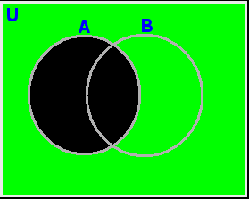
Subsets
When A is a subset of set U, the absolute complement of A is the set of elements in U not in A
Complement of set A in U

Slide 131
Subsets
When A is a subset of set U, the absolute complement of A is the set of elements in U not in A
Written: A^{c}

Slide 132
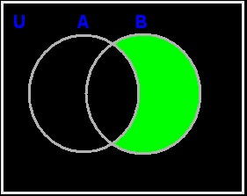
Subsets
The relative complement of A with respect to a set B is the set of elements in B but not in A
Relative complement of set A with respect to B

Slide 133
Subsets
The relative complement of A with respect to a set B is the set of elements in B but not in A
Written B ∖ A or B – A

Slide 134
Subsets
The relative complement is also called the “difference”
Difference B - A

Slide 135
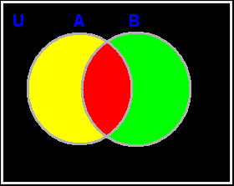
Subsets
IN-CLASS PROBLEMS
Which colors show the complement of B with respect to U?

Slide 136
Subsets
IN-CLASS PROBLEMS
Which colors show the complement of B with respect to U? black and yellow

Slide 137
Subsets
IN-CLASS PROBLEMS
Which colors show the difference of A - B?

Slide 138
Subsets
IN-CLASS PROBLEMS
Which colors show the difference of A - B? yellow

Slide 139
Questions?

Slide 140
De Morgan’s Laws
Not (A and B) is the same as:
Not A or Not B
Not (A or B) is the same as:
Not A and Not B

Slide 141
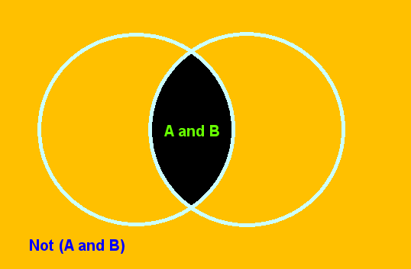
De Morgan’s Laws
Not (A and B)

Slide 142
De Morgan’s Laws
Not A Not B
or
Not A or Not B

Slide 143
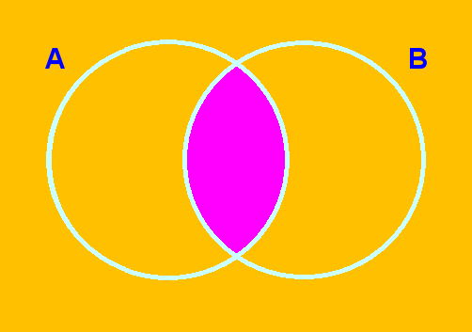
De Morgan’s Laws
Complement of an Intersection of Two Sets
A ∩ B
(A ∩ B) ^{c} = A^{c} ∪ B^{c}

Slide 144
De Morgan’s Laws
The complement of the intersection of sets A and B is equal to the union of A^{c} and B^{c}

Slide 145
De Morgan’s Laws
IN-CLASS PROBLEMS
A survey asked students whether or not they planned to go to the upcoming basketball game or the upcoming football game

Slide 146
De Morgan’s Laws
IN-CLASS PROBLEMS
200 total students were surveyed
158 students stated that they would miss at least one of the games (this includes the students that plan to miss both games)
How many students will miss at least one game?

Slide 147
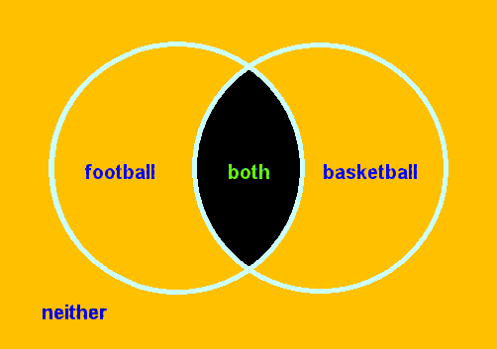
De Morgan’s Laws
IN-CLASS PROBLEMS

Slide 148
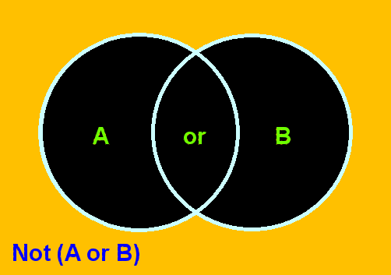
De Morgan’s Laws
Not (A or B)

Slide 149
De Morgan’s Laws
Not A Not B
and
Not A and Not B

Slide 150
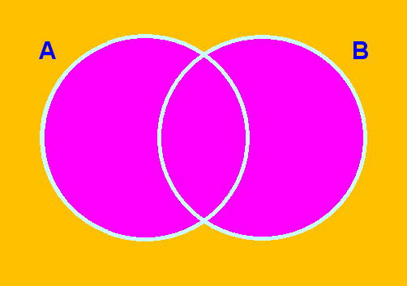
De Morgan’s Laws
Complement of a Union of Two Sets
A ∪ B
(A ∪ B) ^{c} = A^{c} ∩ B^{c}

Slide 151
De Morgan’s Laws
The complement of the union of sets A and B is equal to the intersection of A^{c} and B^{c}

Slide 152
De Morgan’s Laws
IN-CLASS PROBLEMS
A survey asked students whether or not they planned to go to the upcoming basketball game or the upcoming football game

Slide 153
De Morgan’s Laws
IN-CLASS PROBLEMS
200 total students were surveyed
158 students stated that they would miss at least one of the games (this includes the students that plan to miss both games)
How many students plan to attend neither game?

Slide 154
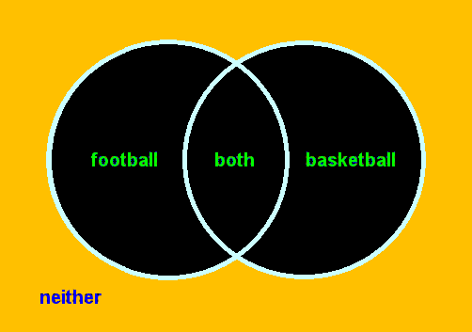
De Morgan’s Laws
IN-CLASS PROBLEMS

Slide 155
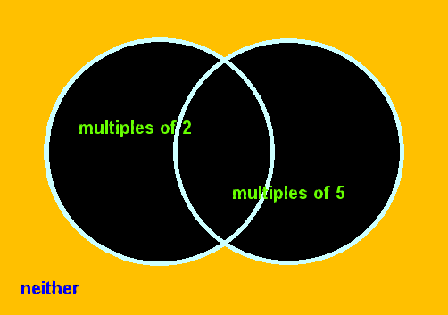
De Morgan’s Laws
IN-CLASS PROBLEMS
How many integers between 1 and 1000 (inclusive) are neither multiples of 2 nor multiples of 5?

Slide 156
De Morgan’s Laws
De Morgan's Laws can be generalized to any number of sets

Slide 157
Questions?

Slide 158
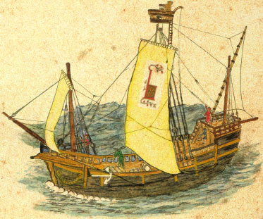
Longitude
Before Columbus, ships sailed as close as they could to shore
This ensured
they would not
be lost at sea

Slide 159
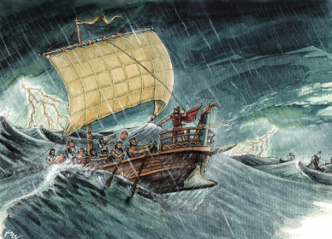
Longitude
Experienced Captains were critical – they could recognize more coastlines and be less likely to
get lost

Slide 160
Longitude
There were books of coastline drawings for areas a Captain might not have seen before

Slide 161
Longitude
A ship that was blown away from shore during a storm was in serious trouble

Slide 162
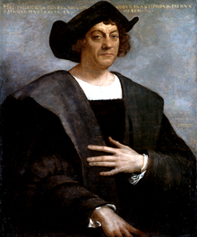
Longitude
When Columbus sailed the ocean blue he discovered a route that would be profitable for ships

Slide 163
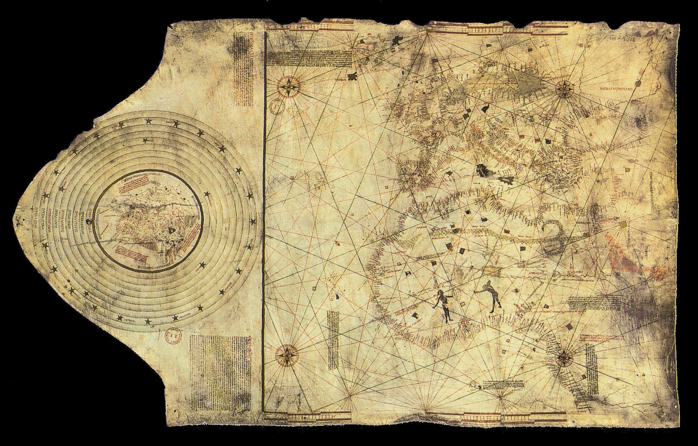
Longitude

Slide 164
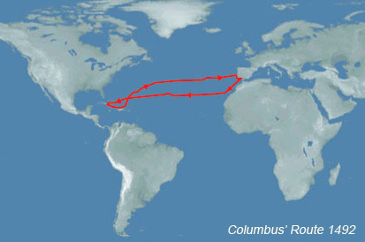
Longitude
But… you couldn’t go to America following a coastline…

Slide 165
Longitude
Navigators had to become brave enough to leave the coast
They also need a way to tell where
they were…

Slide 166
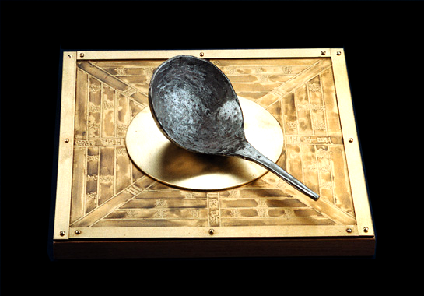
Longitude
Although the Chinese had had compasses for centuries, Europeans wouldn’t use them

Slide 167
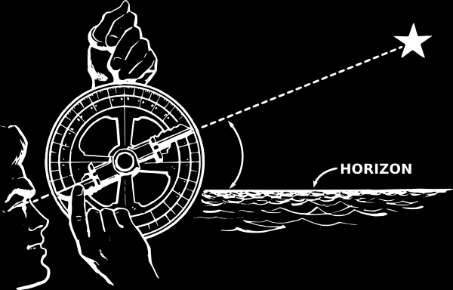
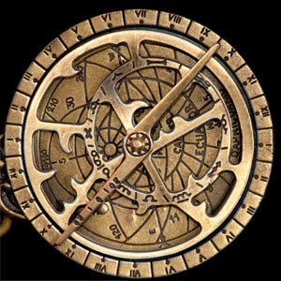
Longitude
They navigated by the North Star and the sun
This gave them their latitude

Slide 168
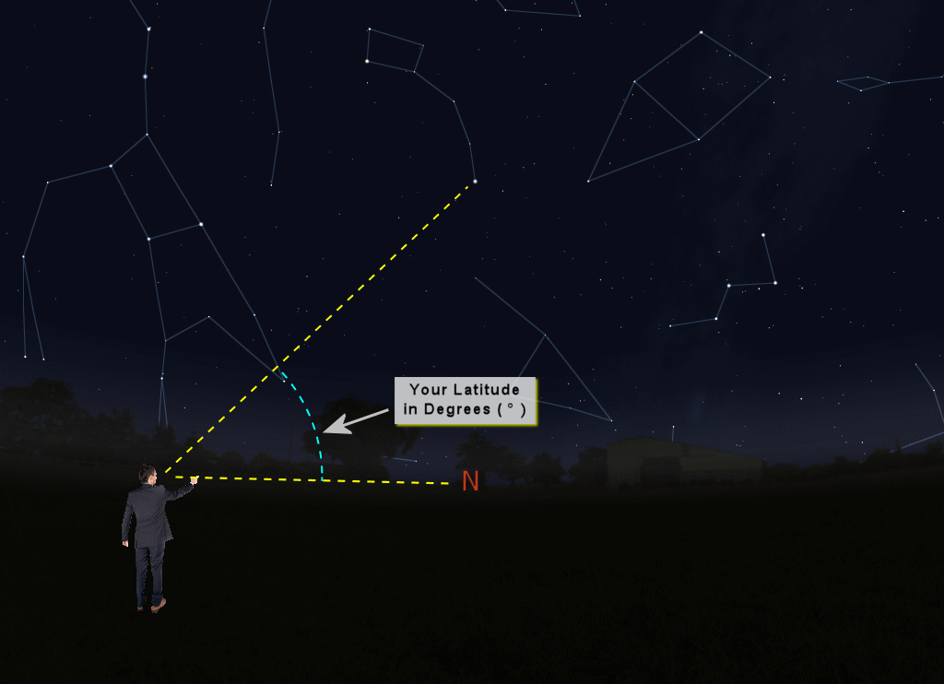

Slide 169
Longitude
But… it’s foggy a lot at sea -you often can’t see the North Star
The Sun had to be sighted at sunrise, noon or sunset

Slide 170
Longitude
When you were lucky and could find your latitude… you still had no way of finding your longitude!

Slide 171
Longitude
Captains would plot their (approximate) course on maps each day by making a line the (general) direction they thought were going and the (estimated) distance they thought they had gone

Slide 173
Longitude
It was possible to be off by quite a bit, particularly during storms

Slide 174
Longitude
Navigators knew they needed a way to determine not just how far north of
the equator
they were but
also how far
around the globe
they had travelled

Slide 175
Longitude
In 1502, a contest was announced: anyone who found a reliable method of determining the longitude at sea (to an accuracy of 69 miles) would get money and the honor of having the Prime Meridian go through their capital city

Slide 176
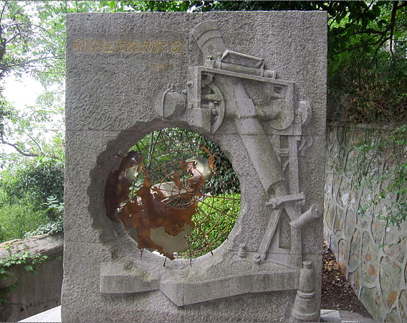
Longitude
(…of course, the Chinese had solved it years earlier… the Prime Meridian should go through
Beijing…)

Slide 177
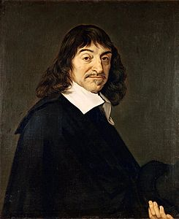
Longitude
One of the people who worked on the Problem of the Longitude was Rene Descartes

Slide 178
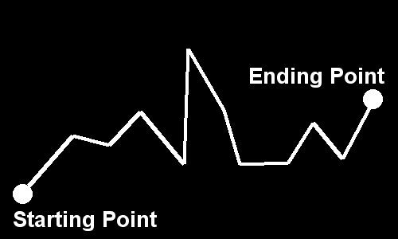
Longitude
He noted the way Captains plotted their course on maps:

Slide 179
Longitude
He thought that would be a good way to show changes in other data, too!

Slide 180
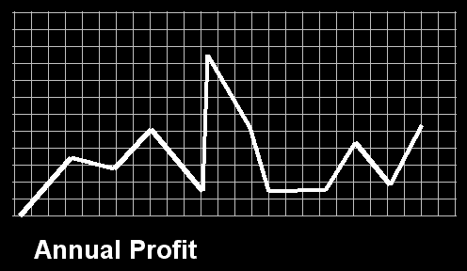
Longitude
He devised a gridded paper and a way to graph pairs of numbers on the grid

Slide 181
Longitude
In his honor, the grid is called the “Cartesian Coordinate System”

Slide 182
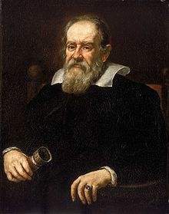
Longitude
Meanwhile…
Galileo was put under house arrest in 1633
All his friends were
under suspicion by
the Inquisition

Slide 183
Longitude
Descartes was a friend of Galileo…

Slide 184
Longitude
In late 1649, word came to Descartes that the Inquisitors were interested in him

Slide 185
Longitude
He fled to Stockholm, Sweden
He wrote a friend in early February 1660 that “it’s really cold here…”

Slide 186
Longitude
Descartes died February 11, 1650 in Stockholm, Sweden

Slide 187
Longitude
He didn’t solve the Problem of the Longitude…

Slide 188
Longitude
He didn’t solve the Problem of the Longitude…
But he did invent graph paper!

Slide 189
Longitude
And… that’s why the Prime Meridian doesn’t go through Paris!

Slide 190
Longitude
Back to the Problem of the Longitude…

Slide 191
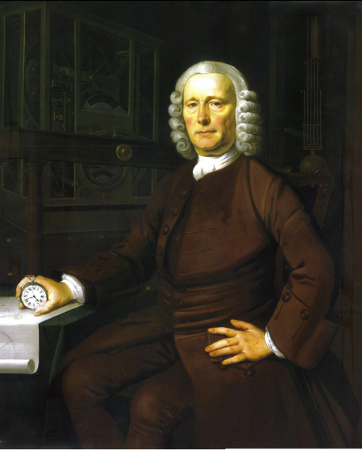
Longitude
John Harrison (1693–1776) was a self-educated English carpenter

Slide 192
Longitude
While everybody else was looking to science to solve the problem, Harrison looked to technology

Slide 193
Longitude
What’s the first thing they announce when your plane lands at an airport?

Slide 194
Longitude
Local time!

Slide 195
Longitude
That’s because not everyplace has sunrise at the same instant
The time lag
means “noon”
is later as you
move from east
to west

Slide 196
Longitude
Harrison decided a clock that would be accurate on board ship would allow the Captain
to determine how far
around the Earth
he had travelled

Slide 197
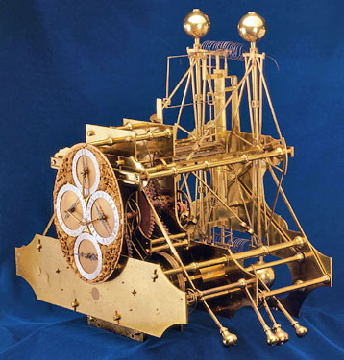
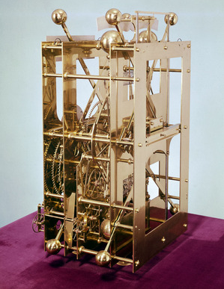
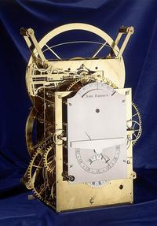
Longitude
From 1713-1758 he built pendulum clocks designed to counteract the movements of a ship at sea

Slide 198
Longitude
They were HUGE and didn’t work very well

Slide 199
Longitude
In 1758, Harrison decided a watch would be the solution
Watches weren’t very
accurate in 1758…

Slide 200
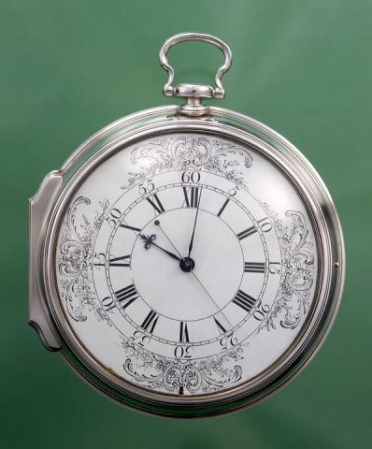
Longitude
Harrison created an accurate watch – the first chronometer

Slide 201
Longitude
In 1761, his son took the chronometer on a voyage to the West Indies
It was accurate to 1.2 miles

Slide 202
Longitude
Remember… the contest specified 69 miles…
AND
If you are within 1.2 miles of something at sea, you can SEE it!

Slide 203
Longitude
Ship Captains were ecstatic!

Slide 204
Longitude
The British Board of Longitude was not willing to believe an uneducated commoner could solve the Problem
They also wanted a more “scientific” solution

Slide 205
Longitude
They felt Harrison’s success was a fluke and demanded a retest

Slide 206
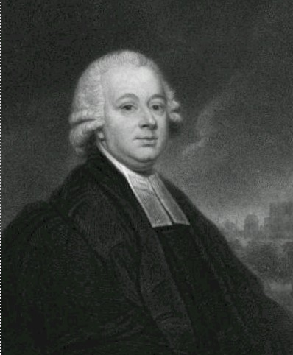
Longitude
The Reverend Dr. Nevil Maskelyne was not noble, but he WAS well-
educated and a
member of the
Royal Society

Slide 207
Longitude
He had a more scientific solution: the lunar distance
method

Slide 208
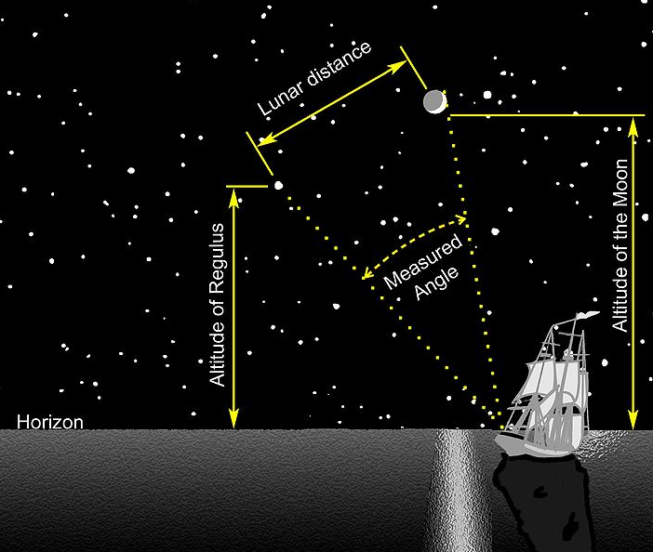

Slide 209
Longitude
It was accurate but hard to compute, and ship Captains hated it

Slide 210
Longitude
The Board demanded both Maskelyne and Harrison test their systems on a voyage to Barbados in 1763

Slide 211
Longitude
Harrison’s chronometer made the voyage with errors of 10 miles
Maskelyne’s system produced errors of 30 miles

Slide 212
Longitude
The Board still didn’t like it

Slide 213
Longitude
Then Maskelyne was appointed to the Board

Slide 214
Longitude
The Board demanded they be allowed to take apart Harrison’s watch to study it

Slide 215
Longitude
Amazingly, a negative report on Harrison’s chronometer was issued!

Slide 216
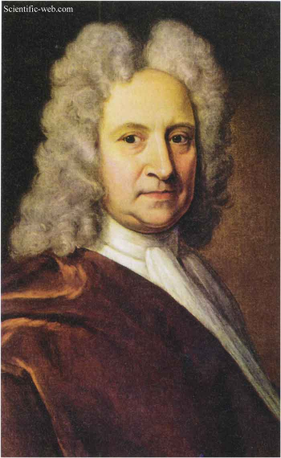
Longitude
Happily, Sir Edmond Halley was sympathetic to Harrison

Slide 217
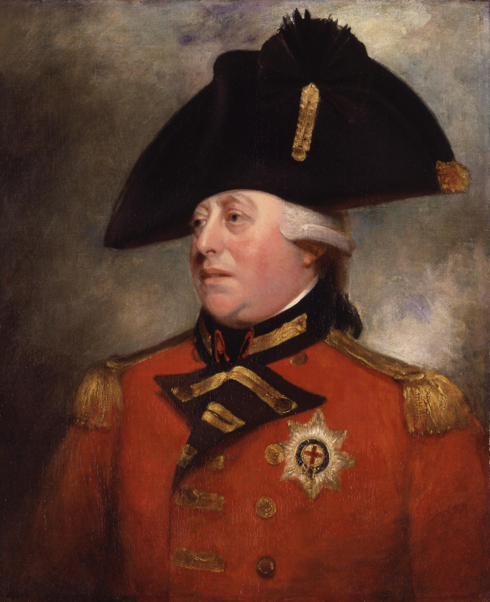
Longitude
He told King George III about his friend’s dilemma
The King was very
interested in science
and technology and
extremely annoyed
with the Board

Slide 218
Longitude
King George tested a second watch himself at the palace After ten weeks of daily observations he found
it to be accurate to
within one third of
one second per day

Slide 219
Longitude
King George then advised Harrison to petition Parliament for the full prize

Slide 220
Longitude
Finally in 1773, when he was 80 years old, Harrison received a monetary award from Parliament for his
achievements

Slide 221
Longitude
He never received the official award
(which was never
awarded to anyone)

Slide 222
Longitude
He was to survive for just three more years

Slide 223
Longitude
Because chronometers were expensive (and the Royal Navy was cheap) Captains were expected to use the lunar distance method into the 1800s
(they still hated it…)

Slide 224
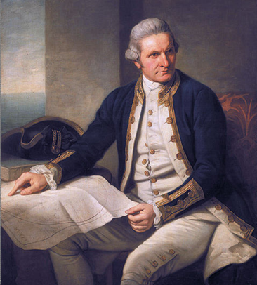
Longitude
Captains who could afford them (like Captain Cook) bought their own chronometers

Slide 225
Longitude
Since Maskelyne's observations and calculations were made at the Royal Greenwich Observatory, the Greenwich meridian was made the Prime Meridian by the Board

Slide 226
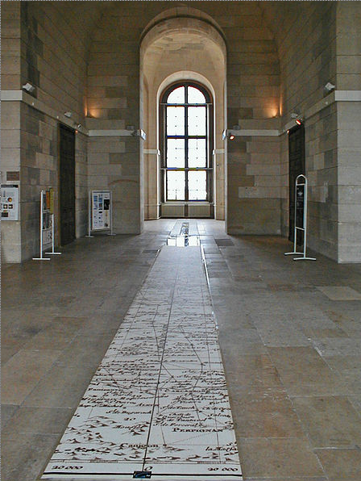
Longitude
France used the
Paris Meridian
until 1914

Slide 227
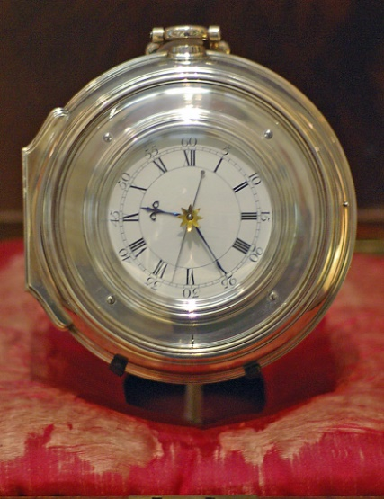
Longitude
Harrison’s clocks were restored in the 1930s and are working presently

Slide 228
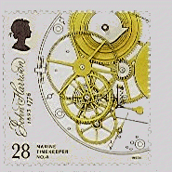
Longitude
John Harrison has a stamp
(Nevil Maskelyne doesn’t)

Slide 229
Ordered Pairs
Rene Descartes noted the way Captains plotted their course on maps:

Slide 230
Ordered Pairs
He thought that would be a good way to show changes in other data, too!

Slide 231
Ordered Pairs
He devised a gridded paper and a way to graph pairs of numbers on the grid

Slide 232
Ordered Pairs
Just like the ships’ captains needed a starting point for their charts, you need a starting point for graph paper

Slide 233
Ordered Pairs
The starting point on graph paper is called the “origin”

Slide 234
Ordered Pairs
Because the paper is 2-dimensional, we can graph two variables: x and y

Slide 235
Ordered Pairs
The variables or their values are represented using an “ordered pair”: (x,y)
“x” is always the first one
“y” is always the second one

Slide 236
Ordered Pairs
IN-CLASS PROBLEMS
(x,y)
(3,1)
What is x? What is y?
(14,-72)
What is x? What is y?
(π,80.9)
What is x? What is y?

Slide 237
Ordered Pairs
To graph (x,y) on the paper, x’s are plotted on a horizontal real number line (the x-axis) and y’s on a vertical one (the y-axis)
The origin is the (0,0) point where the two axes cross

Slide 238
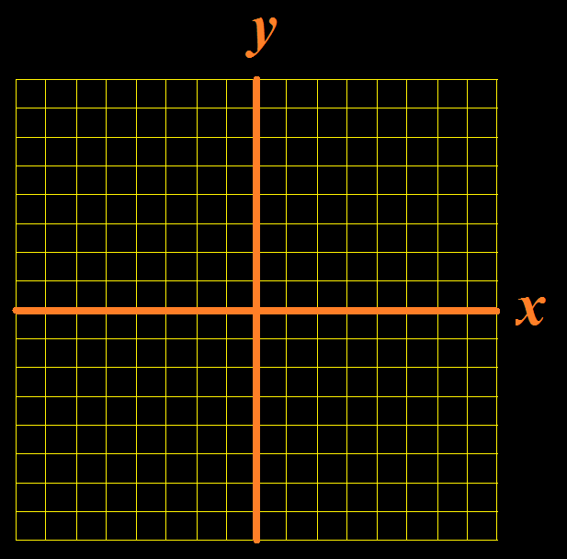
Ordered Pairs
y-axis
x-axis
(0,0)

Slide 239
Ordered Pairs
You also need units – make sure they are constant across an axis
(They can be different for each axis)

Slide 240
Ordered Pairs
7
6
5
4
3
2
1
0
-1
-2
-3
-4
-5
-6
-7
-7 -6 -5 -4 -3 -2 -1 0 1 2 3 4 5 6 7

Slide 241
Ordered Pairs
Graph the x value using the horizontal x-axis
Graph the y value using the vertical y-axis

Slide 242
Ordered Pairs
(4,2)
(-5,6)
(3,-5)
7
6
5
4
3
2
1
0
-1
-2
-3
-4
-5
-6
-7
*
*
-7 -6 -5 -4 -3 -2 -1 0 1 2 3 4 5 6 7
*

Slide 243
Ordered Pairs
Given elements a and b
(a,b) means an ordered pair
(a,b) = (c,d) if and only if
a = c and b = d

Slide 244
Ordered Pairs
IN-CLASS PROBLEMS
Is (1,2) = (2,1) ?
Is (3, 5/10) = ($\sqrt{\text{9}}$,.5) ?
What is the first element of (1,2)?

Slide 245
Cartesian Products
Given sets A and B, the Cartesian product of A and B is the set of all ordered pairs (a,b) where “a” is in A and “b” is in B

Slide 246
Cartesian Products
Given sets A and B, the Cartesian product of A and B is the set of all ordered pairs (a,b) where “a” is in A and “b” is in B
Written: A x B
(× vs x)

Slide 247
Cartesian Products
Symbolically:
A x B = {(a,b)| a∈A and b∈B}

Slide 248
Cartesian Products
A = {1,2}
B = {a,b}
A x B = {(1,a),(1,b),(2,a),(2,b)}

Slide 249
Cartesian Products
The number of elements in a Cartesian product will equal the product of the number of non-null elements in all the sets being crossed

Slide 250
Cartesian Products
IN-CLASS PROBLEMS
A = {1,2,3} B = {u,v}
How many elements are in AxB?

Slide 251
Cartesian Products
IN-CLASS PROBLEMS
A = {1,2,3} B = {u,v}
What is A x B?

Slide 252
Cartesian Products
IN-CLASS PROBLEMS
A = {1,2,3} B = {u,v}
What is A x B?
{(1,u),(2,u),(3,u),(1,v),(2,v),
(3,v)}

Slide 253
Cartesian Products
IN-CLASS PROBLEMS
A = {1,2,3} B = {u,v}
How many elements are in BxA?

Slide 254
Cartesian Products
IN-CLASS PROBLEMS
A = {1,2,3} B = {u,v}
What is B x A?

Slide 255
Cartesian Products
IN-CLASS PROBLEMS
A = {1,2,3} B = {u,v}
What is B x A?
{(u,1),(u,2),(u,3),(v,1),(v,2),
(v,3)}

Slide 256
Cartesian Products
IN-CLASS PROBLEMS
A = {1,2,3} B = {u,v}
How many elements are in BxB?

Slide 257
Cartesian Products
IN-CLASS PROBLEMS
A = {1,2,3} B = {u,v}
What is B x B?

Slide 258
Cartesian Products
IN-CLASS PROBLEMS
A = {1,2,3} B = {u,v}
What is B x B?
{(u,u),(u,v),(v,u),(v,v)}

Slide 259
Cartesian Products
IN-CLASS PROBLEMS
Describe R x R:

Slide 260
Cartesian Products
IN-CLASS PROBLEMS
Describe R x R:
Think of R as the real number line
R x R will be a horizontal “x” line and a vertical “y” line

Slide 261
Cartesian Products
IN-CLASS PROBLEMS
Describe R x R:
7
6
5
4
3
2
1
0
-1
-2
-3
-4
-5
-6
-7
-7 -6 -5 -4 -3 -2 -1 0 1 2 3 4 5 6 7

Slide 262
Questions?

