Slide 1
Statistics
Correlation
https://www.123rf.com/photo_6622261_statistics-and-analysis-of-data-as-background.html

Slide 2
Two Variables
So far we have used only one variable measured on each of our sample subjects
What if we had more than one?

Slide 3
Two Variables
Subject | Height | Weight
1 5’8’’ 170
2 5’3’’ 120
3 6’ 200
4 5’7’’ 250
5 6’2’’ 195

Slide 4
Two Variables
With two variables measured on each subject, the measurements are “paired” – linked to each other

Slide 5
Two Variables
If you calculate means or standard deviations for one variable then the other, the pairing is lost, and you
lose information
(a bad thing…)

Slide 6
Relationships
Using the pairing, you can determine if there is a
relationship
between the two variables

Slide 8
Relationships
The relationship can be seen by graphing the variables in a scatter graph
Our brains are programmed to see visual relationships

Slide 9
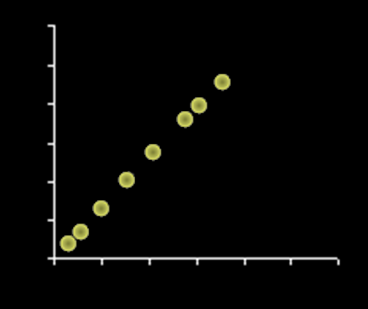
Correlation
There are all sorts of relationships, but we define a “correlation” to be a linear relationship

Slide 10
Correlation
a linear relationship between two variables (x,y)

Slide 11
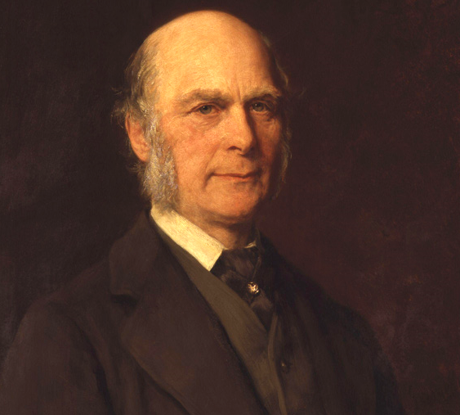
Correlation
Francis Galton

Slide 12
Correlation
Karl Pearson’s
Correlation
Coefficient:
r

Slide 13
Correlation
$$r=\frac{n\left(Σxy\right)−(Σx)(Σy)}{\sqrt{\left[n\left(Σx^{2}\right){−\left(Σx\right)}^{2}\right][n\left(Σy^{2}\right)−(Σ{x)}^{2}]}}$$

Slide 14
Correlation
$$r=\frac{n\left(Σxy\right)−(Σx)(Σy)}{\sqrt{\left[n\left(Σx^{2}\right){−\left(Σx\right)}^{2}\right][n\left(Σy^{2}\right)−(Σ{x)}^{2}]}}$$
EEK!
dreamstime.com

Slide 15
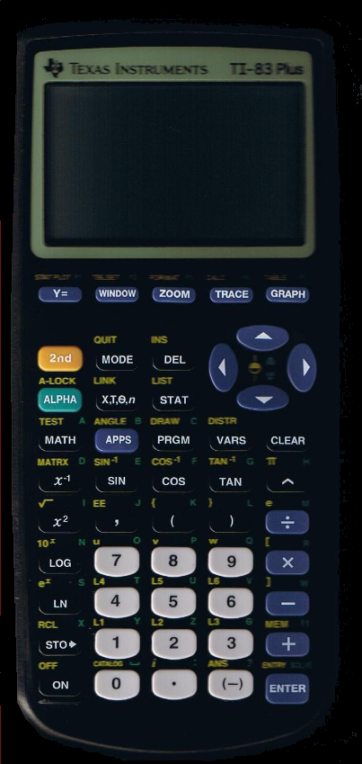
Correlation
There’s an easier way…
https://www.iupstore.com/sites/iupstore.com/files/imagecache/product_full/isbn_images/71HlMIzU63L.jpg
excel.gif
http://www.shutterstock.com/s/whew/search.html

Slide 16
Correlation
Correlation coefficient “r”:
Measures the strength of the linear relationship between two variables (x,y)

Slide 17
Correlation
Correlation coefficient “r”:
Measured by the closeness of the data to a straight line of “best fit”

Slide 18
Correlation
In real life, you practically never get all of your data points on the line of best fit
How close is close enough?

Slide 19
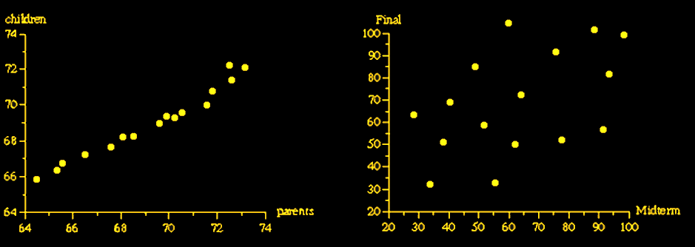
Correlation
Strong Weak
relationship relationship

Slide 20
Correlation
So… a correlation is actually a measure of

Slide 21
Correlation
So… a correlation is actually a measure of VARIABILITY!

Slide 22
Correlation
PROJECT QUESTION
Which has the strongest linear relationship?

Slide 23
Relationships
Can be positive…
https://images.sciencedaily.com/2015/05/150513135011_1_900x600.jpg

Slide 24
Relationships
http://cdn2.momjunction.com/wp-content/uploads/2016/01/Relationship-With-Kids-After-Divorce.jpg

Slide 25
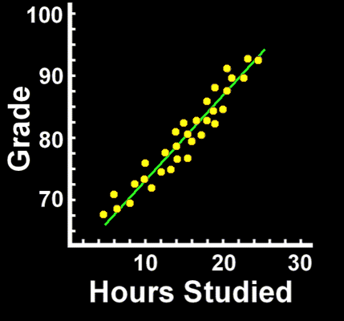
Correlation
Positive Correlation:
as one variable increases, the other also increases

Slide 26
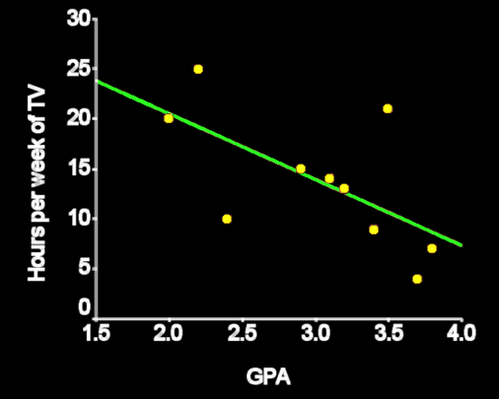
Correlation
Negative correlation:
as one variable increases, the other decreases

Slide 27
Correlation
Zero correlation:
no LINEAR relationship

Slide 28
Correlation
Zero correlation:
there may be a strong nonlinear relationship

Slide 29
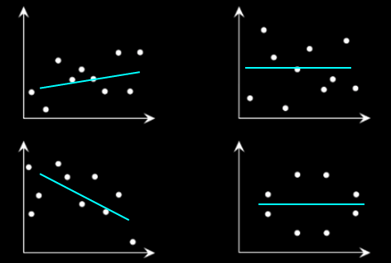
Correlation
A horizontal line fit is defined to be “zero correlation”
low correlation zero correlation

Slide 30
Correlation
Zero correlation:
If it is a horizontal line

Slide 31
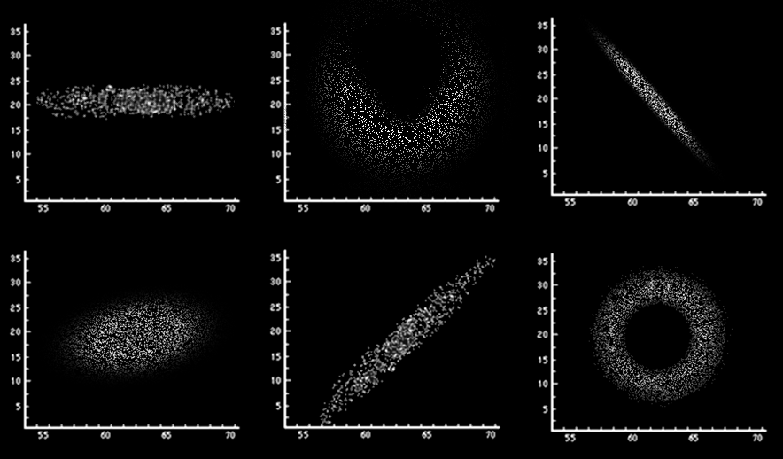
Correlation
PROJECT QUESTION
Positive, negative, or zero?

Slide 32
Correlation
Correlation coefficients range from -1.0 to +1.0
r=-1.0 r=-0.9 r=-0.5 r=0.0 r=0.5 r=0.9 r=1.0

Slide 33
Correlation
How would you interpret the relationship?
–1.0 perfect negative relationship
–0.7 strong negative relationship
–0.5 moderate negative relationship
–0.3 weak negative relationship
0.0 no linear relationship
+0.3 weak positive relationship
+0.5 moderate positive relationship
+0.7 strong positive relationship
+1.0 perfect positive relationship

Slide 34
Correlation
Correlation coefficients can’t be bigger than 1 or less than -1
-1 ≤ corr ≤ 1

Slide 35
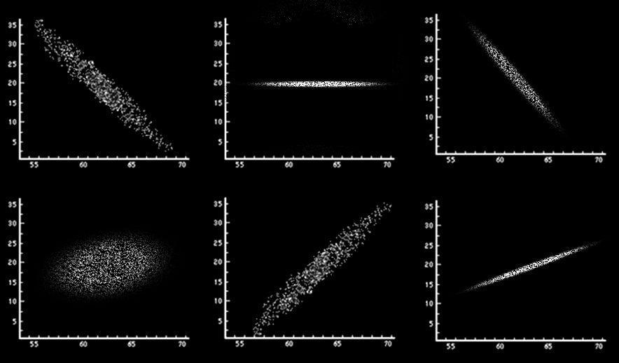
Correlation
PROJECT QUESTION
Which has the highest positive correlation? The highest negative correlation?

Slide 36
Greeky Stuff
The sample correlation coefficient is called “r”
The population coefficient is called “ρ ”
Pronounced “rho”

Slide 37
Correlation
If you square the correlation coefficient (R² or RSQ)
the coefficient tells how well the (x,y) values are “fitted” by the line of best fit

Slide 38
Correlation
R² tells you
in %
how well the trend line fits the data

Slide 39
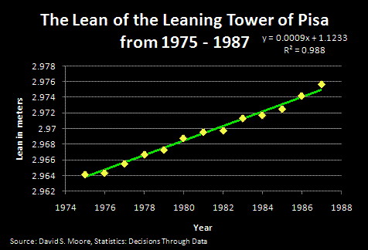
Correlation
PROJECT QUESTION
Is it a good fit?

Slide 40
Correlation
R² = 0.988 means 98.8% of the variability in the data is “explained” by the fit line

Slide 41
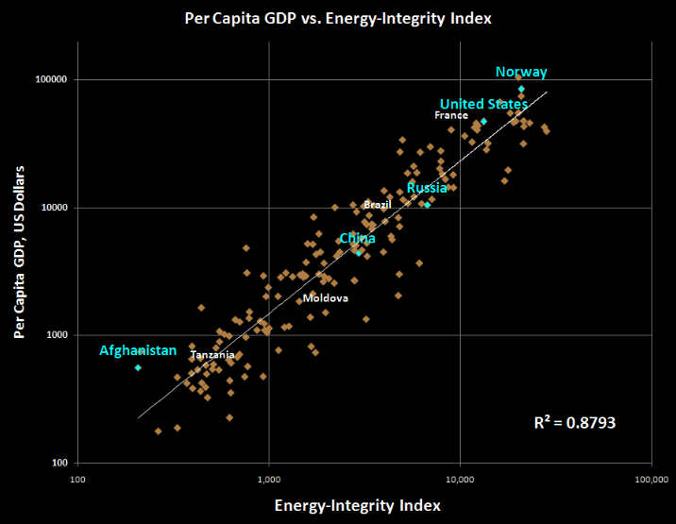
Correlation
PROJECT QUESTION
Is it a good fit?

Slide 42
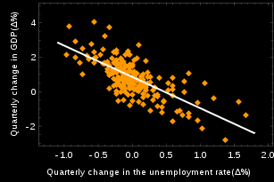
Correlation
PROJECT QUESTION
Is it a good fit?

Slide 43
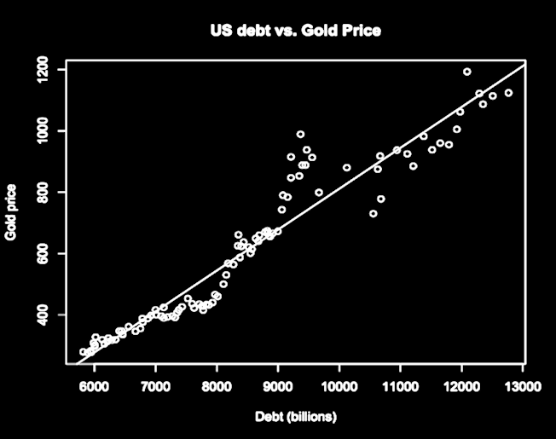
Correlation
PROJECT QUESTION
Is it a good fit?

Slide 44
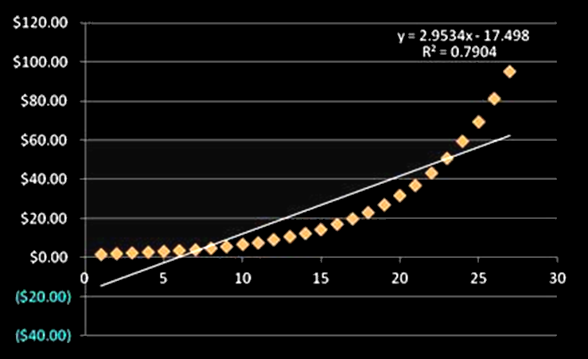
Correlation
PROJECT QUESTION
Is it a good fit?

Slide 45
Questions?

Slide 46
How to Lie with Statistics
Just because two variables have a high correlation coefficient doesn’t mean one causes the other

Slide 47
How to Lie with Statistics
They could both be caused by a third variable
Or… it could just be a coincidence

Slide 49
How to Lie with Statistics
Sleep studies

Slide 50
How to Lie with Statistics
How would you “prove” that getting a certain amount of sleep causes you to live longer?

Slide 51
Correlation vs Causation
Causation is hard to prove
In research, causation can only be shown by a carefully controlled experiment

Slide 52
Correlation vs Causation
So you can’t show causation by observation or by using a survey

Slide 53
Correlation vs Causation
The research must be carefully designed so that the suspected cause can be the only cause of the result

Slide 54
Correlation vs Causation
Just because a scientist speaks very persuasively about the results of their experiment does not mean he/she has proven causation

Slide 55
Correlation vs Causation
You have to be skeptical!

Slide 56
Correlation vs Causation
Spanish influenza video

Slide 57
CAUSATION
IN-CLASS PROBLEMS
Who “proved” causation?

Slide 58
Questions?

Slide 59
Causation
If you know that one variable DOES cause the other, put the variable that is the “causal” or “explanatory” variable on the horizontal “x” axis

Slide 60
Causation
The causal or explanatory or predictor variable is called the “independent” variable
Changing its value changes the value of the y variable

Slide 61
Causation
The variable affected by the causal variable (the response variable) is called the “dependent” variable
Its value depends on the value of x

Slide 62
CAUSATION
IN-CLASS PROBLEMS
Which graph has the correct placement for the causative variable?

Slide 63
Questions?

