Slide 1
Welcome to
Unit 4
Part 8!
MATH 207 Integral Calculus
http://en.wikipedia.org/wiki/Differential_equation#mediaviewer/File:Elmer-pump-heatequation.png

Slide 2
What’s Up?
Review:
Arc (Curve) Length
Surface Area
Growth Models
New stuff:
Diff Eq~!

Slide 3
What’s Up?
Outcome 1) Demonstrate a high level of proficiency in differentiation and integration for linear, polynomial, rational, trigonometric, inverse trigonometric, exponential and logarithmic function, including using the method of substitution, integration by parts and partial fraction decomposition
Outcome 7) Solve problems by identifying the requirements, making a sketch as appropriate

Slide 4

Review
http://995642590.r.lightningbase-cdn.com/wp-content/uploads/2010/12/looking-back-hrexaminer-v144-cover425px.jpg

Slide 5
Arc (Curve) Length
We want to determine the length of a continuous function
y=f(x) on the interval [a,b]

Slide 6
Arc (Curve) Length
To estimate the length of the curve, divide the interval up into equal subintervals each of width Δx
Δx
https://tutorial.math.lamar.edu/Classes/CalcII/ArcLength.aspx

Slide 7
Arc (Curve) Length
Approximate the curve by a series of straight lines connecting the points
Δx
https://tutorial.math.lamar.edu/Classes/CalcII/ArcLength.aspx

Slide 8
Arc (Curve) Length
The length of the curve can be
estimated by the sum of the lengths of the lines
Δx
https://tutorial.math.lamar.edu/Classes/CalcII/ArcLength.aspx

Slide 9

Arc (Curve) Length
The length of each line is: $\sqrt{\left({\text{x}}_{\text{i}}\text{−}{\text{x}}_{\text{i}\text{−1}}\right)\text{2}\text{+}\left({\text{y}}_{\text{i}}\text{−}{\text{y}}_{\text{i}\text{−1}}\right)\text{2}}$ =$\sqrt{\text{Δx}\text{2}\text{+}\text{Δ}\text{y}\text{2}}$
Δy
Δx
https://tutorial.math.lamar.edu/Classes/CalcII/ArcLength.aspx

Slide 10

Arc (Curve) Length
As Δx→0, the length of the curve becomes:
L = ∫ $\sqrt{\text{1+(}\text{dy}\text{/}\text{dx}\text{)^2}}$ dx
b
a
Δy
Δx
https://tutorial.math.lamar.edu/Classes/CalcII/ArcLength.aspx

Slide 11

Arc (Curve) Length
Note: this is often given the letter “S”
S = ∫ $\sqrt{\text{1+(}\text{dy}\text{/}\text{dx}\text{)^2}}$ dx
b
a
Δy
Δx
https://tutorial.math.lamar.edu/Classes/CalcII/ArcLength.aspx

Slide 12

Arc (Curve) Length
S = ∫ $\sqrt{\text{1+(}\text{dy}\text{/}\text{dx}\text{)^2}}$ dx
The "(1 + ...)" part of the formula guarantees we get at least the distance between x values, such as when f’(x) is zero
b
a

Slide 13
Surface Area
A surface of revolution is formed when a curve is rotated about a line

Slide 14
Surface Area
What if we wanted the surface area of this solid?
(Once again, the surface must be continuous)

Slide 15
Surface Area
We can derive a formula for the surface area much as we derived the formula for arc length

Slide 16
Surface Area
We’ll start by dividing the interval into equal subintervals of width Δx
Approximate the function in each subinterval with a straight line between the
interval endpoints
VFrench 2021

Slide 17
Surface Area
Rotate the approximations about the x-axis to get the solid of revolution
VFrench 2021

Slide 18
Surface Area
These rotated sections are called “frustums”
VFrench 2021

Slide 19
Surface Area
I call this the “lampshade method” (nobody else does…)
VFrench 2021

Slide 20
Surface Area
The surface area of a frustum is: A = 2πrL
where r=½(r₁+r₂)
r₁ = radius of right end
r₂ = radius of left end
and L is the length of the frustum

Slide 21
Surface Area
The surface area of a frustum over the interval will be the sum of teeny-tiny 0-length frustrum areas

Slide 22
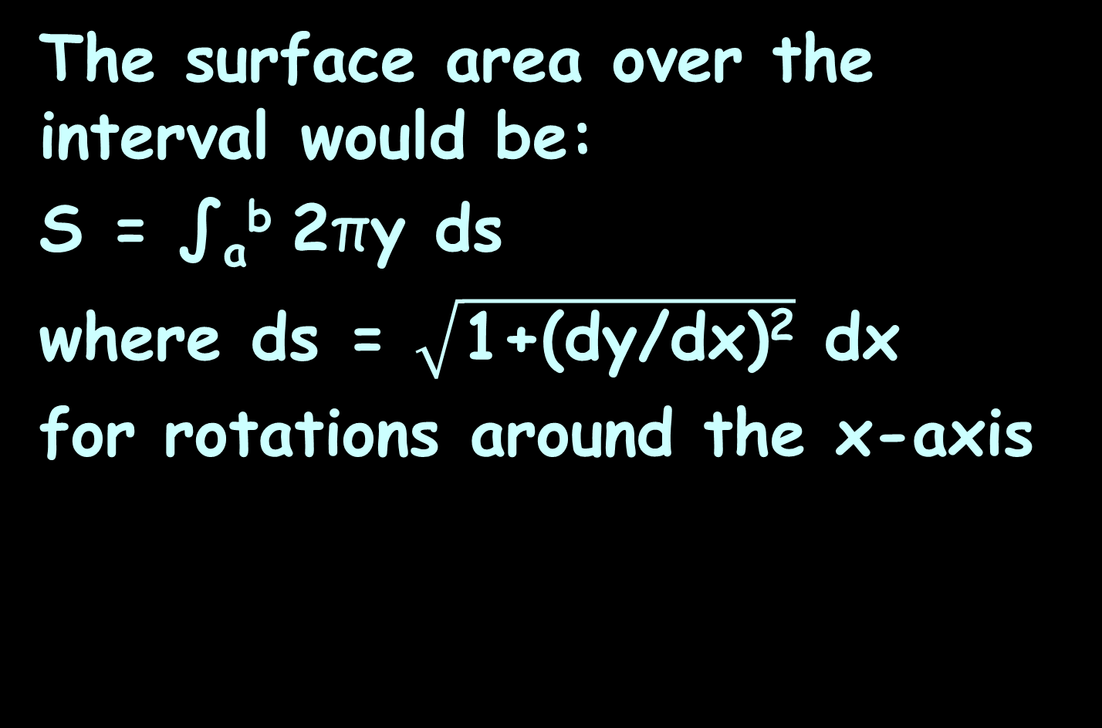
Surface Area
The surface area over the interval would be:
S = ∫_{a}^{b} 2πy ds
where ds = $\sqrt{\text{1+}\text{(}\text{dy}\text{/}\text{dx}\text{)}\text{2}}$ dx
for rotations around the x-axis

Slide 23

Surface Area
The surface area over the interval would be:
S = ∫_{c}^{d} 2πx ds
where ds = $\sqrt{\text{1+}\text{(}\text{dx}\text{/}\text{dy}\text{)}\text{2}}$ dy
for rotations around the y-axis

Slide 24
Growth Models
Exponential growth and decay models are often used in science and technology
In these models, quantities grow or decay at a rate proportional to their size

Slide 25
Growth Models
Populations that grow exponentially grow very rapidly as they get larger because there are more adults to produce offspring

Slide 26
Compound Interest
The formula:
A = P(1+r/n)^{nt}
Describes accumulated value (A) of a sum of money (P) after t years at an annual percentage interest rate r (decimal) compounded n times each year

Slide 27
Growth and Decay Models
Exponential growth and decay models often use the irrational number “e”
Mother nature likes irrationals like π and e
(students not so much…)

Slide 28
Growth and Decay Models
Population growth and radioactive decay are examples of models including e

Slide 29
Growth and Decay Models
The exponential growth or decay model is:
A = A₀e ^{kt}
A is the final amount
A₀ is the initial amount
t is the time (units will be given)

Slide 30
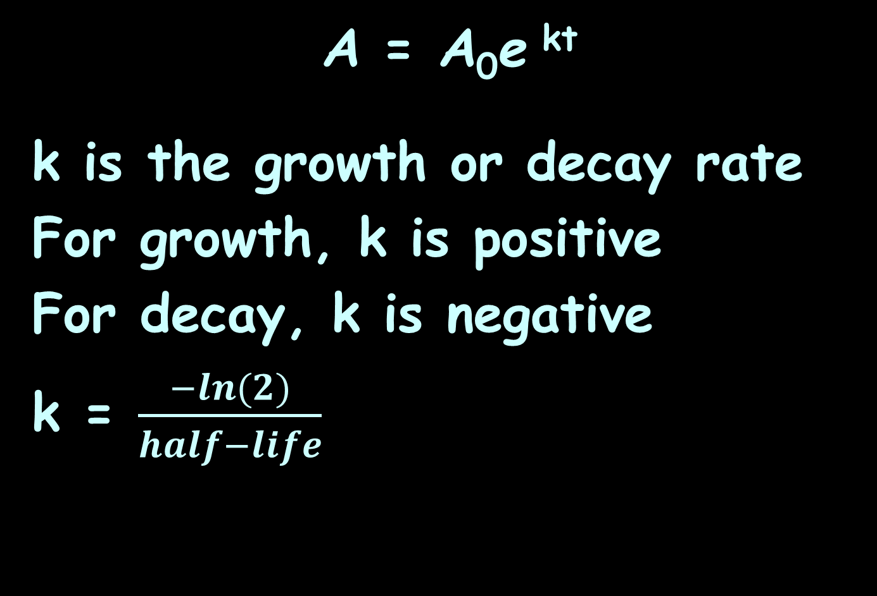
Growth and Decay Models
A = A₀e ^{kt}
k is the growth or decay rate
For growth, k is positive
For decay, k is negative
k = $\frac{−ln(2)}{half−life}$

Slide 31
Growth Models
All growth models (and ANY models that include a rate of change) are actually differential equations
(more about that today!)

Slide 32

Questions?
http://i.imgur.com/aliTlT3.jpg

Slide 33
Differential Equations
Differential equations (DE, DiffEq) are equations that include derivatives
(not integrals…)

Slide 34
Differential Equations
Differential equations are used to change calculus back into algebra

Slide 35
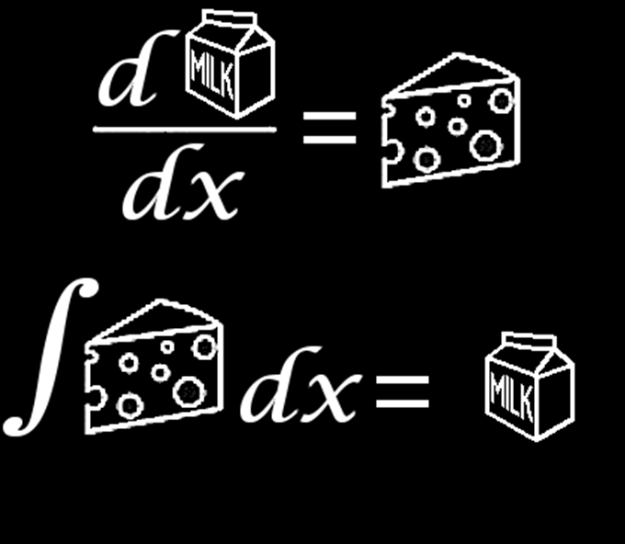
Differential Equations
Usually you integrate the DiffEq to recover the original equation
http://media-cache-ak0.pinimg.com/236x/a1/dd/15/a1dd150742773e9cb2b5ad2f1286cec4.jpg

Slide 36
Differential Equations
You will need to be given what are called "initial conditions" - values for the variables - to solve for the “C”s

Slide 37
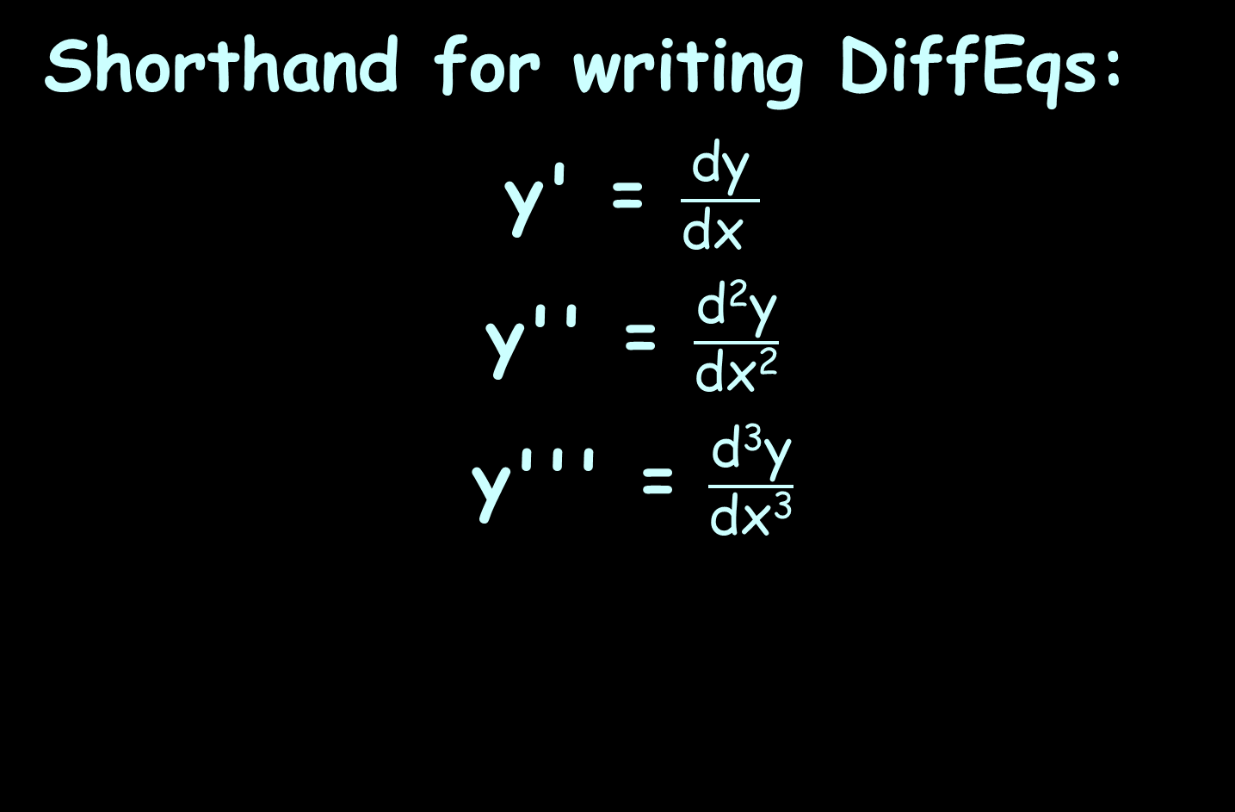
Differential Equations
Shorthand for writing DiffEqs:
y' = $\frac{\text{d}\text{y}}{\text{d}\text{x} }$
y'' = $\frac{\text{d}\text{2}\text{y}}{\text{d}\text{x}\text{2}}$
y''' = $\frac{\text{d}\text{3}\text{y}}{\text{d}\text{x}\text{3}}$

Slide 38
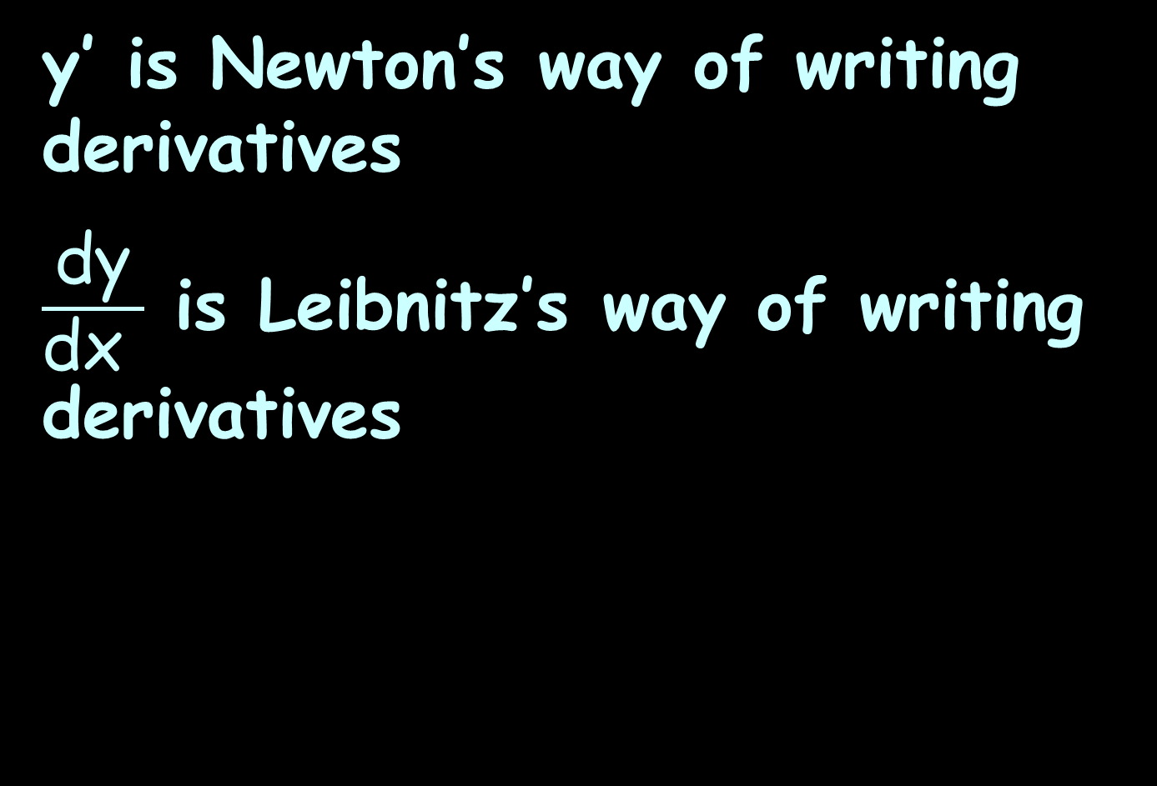
Differential Equations
y’ is Newton’s way of writing derivatives
$\frac{\text{d}\text{y}}{\text{d}\text{x} }$ is Leibnitz’s way of writing derivatives

Slide 39
Differential Equations
Usually we use Leibnitz’s notation because it provides more information and is more useful with the “algebra” of derivatives

Slide 40
Differential Equations
In DiffEq, however, because we are mostly looking at higher-level derivatives, we use Newton’s notation because Leibnitz’s looks really scary!

Slide 41

Differential Equations
y''''''''' = $\frac{\text{d}\text{9}\text{y}}{\text{d}\text{x}\text{9}}$

Slide 42
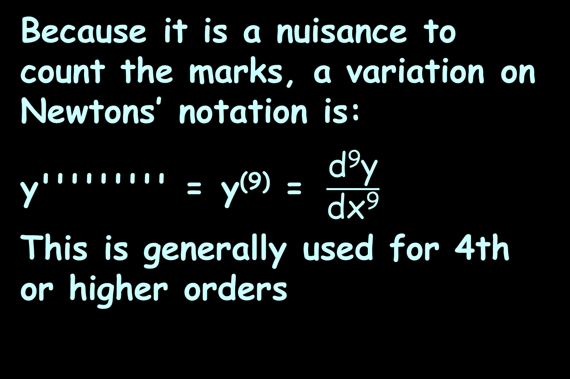
Differential Equations
Because it is a nuisance to count the marks, a variation on Newtons’ notation is:
y''''''''' = y⁽⁹⁾ = $\frac{\text{d}\text{9}\text{y}}{\text{d}\text{x}\text{9}}$
This is generally used for 4th or higher orders

Slide 43
Differential Equations
What they look like:
y'(t) = 3t² – 4t + 10, y(0) = 20

Slide 44
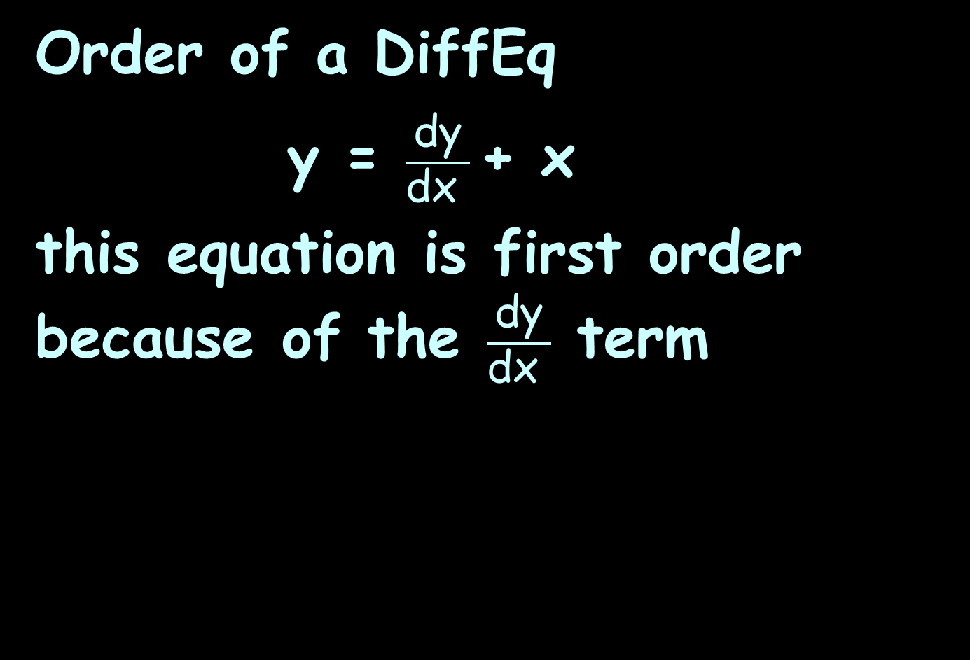
Differential Equations
Order of a DiffEq
y = $\frac{\text{dy}}{\text{dx} }$+ x
this equation is first order because of the $\frac{\text{dy}}{\text{dx} }$ term

Slide 45
Differential Equations
Order of a DiffEq
y″ - y′ - 12 y = 0
this equation is second order because of the y″ term

Slide 46
DiffEqs
Ex: The seawater DiffEq has 14 variables including temperature, tide, wave motion, salinity, depth, weather conditions, impurities, etc.
It contains a 14th derivative of the major variable
We say that the seawater DiffEq is 14th order

Slide 47
DIFFERENTIAL EQUATIONS
IN-CLASS PROBLEMS 1-5
What is the order?
y = y’’’ + 24y’’ – 6y + 42
y’’’’’’ = y’’’’’ – 7y’’
y’’ = 12y’’’
y – y’’’ + y’’ = 0
38y’’ – 96y' + 17y – 13 = 0

Slide 48
DIFFERENTIAL EQUATIONS
IN-CLASS PROBLEMS 1-5
What is the order?
y = y’’’ + 24y’’ – 6y + 42 3
y’’’’’’ = y’’’’’ – 7y’’
y’’ = 12y’’’
y – y’’’ + y’’ = 0
38y’’ – 96y' + 17y – 13 = 0

Slide 49
DIFFERENTIAL EQUATIONS
IN-CLASS PROBLEMS 1-5
What is the order?
y = y’’’ + 24y’’ – 6y + 42 3
y’’’’’’ = y’’’’’ – 7y’’ 6
y’’ = 12y’’’
y – y’’’ + y’’ = 0
38y’’ – 96y' + 17y – 13 = 0

Slide 50
DIFFERENTIAL EQUATIONS
IN-CLASS PROBLEMS 1-5
What is the order?
y = y’’’ + 24y’’ – 6y + 42 3
y’’’’’’ = y’’’’’ – 7y’’ 6
y’’ = 12y’’’ 3
y – y’’’ + y’’ = 0
38y’’ – 96y' + 17y – 13 = 0

Slide 51
DIFFERENTIAL EQUATIONS
IN-CLASS PROBLEMS 1-5
What is the order?
y = y’’’ + 24y’’ – 6y + 42 3
y’’’’’’ = y’’’’’ – 7y’’ 6
y’’ = 12y’’’ 3
y – y’’’ + y’’ = 0 3
38y’’ – 96y' + 17y – 13 = 0

Slide 52
DIFFERENTIAL EQUATIONS
IN-CLASS PROBLEMS 1-5
What is the order?
y = y’’’ + 24y’’ – 6y + 42 3
y’’’’’’ = y’’’’’ – 7y’’ 6
y’’ = 12y’’’ 3
y – y’’’ + y’’ = 0 3
38y’’ – 96y' + 17y – 13 = 0 2

Slide 53
Questions?
http://i.imgur.com/aliTlT3.jpg

Slide 54
Differential Equations
A differential equation can be used to describe any kind of a gradient

Slide 55
Differential Equations
They are used to describe systems that exhibit growth or decay, such as populations

Slide 56
Differential Equations
They are also used to describe a system that experiences an increase or decrease in energy, which may mean an increase or decrease in temperature, pressure, or in motion

Slide 57
Differential Equations
A first order system has one form of energy stored or released, and the equation will contain the first derivative only of the dependent variable

Slide 58
Differential Equations
A second-order equation is used in the science of radio communications

Slide 59
Differential Equations
1st and 2nd order systems solved in many science and engineering applications

Slide 60
DIFFERENTIAL EQUATIONS
IN-CLASS PROBLEM 6
y = y’’’ + 24y’’ – 6y + 42
y’’’’’’ = y’’’’’ – 7y’’
y’’ = 12y’’’
y – y’’’ + y’’ = 0
38y’’ – 96y' + 17y – 13 = 0
Which of these DiffEqs would be a likely model used in radio communications?

Slide 61
DIFFERENTIAL EQUATIONS
IN-CLASS PROBLEM 6
y = y’’’ + 24y’’ – 6y + 42
y’’’’’’ = y’’’’’ – 7y’’
y’’ = 12y’’’
y – y’’’ + y’’ = 0
38y’’ – 96y' + 17y – 13 = 0
Which of these DiffEqs would be a likely model used in radio communications?

Slide 62
Differential Equations
“The power brought to the capacitor is IV= CV dV/dt, and the energy change involved over a period of time is
∫CV dV/dt =(C/2)∫d(V²).
Since the integrand is a complete differential the energy expended depends on the difference in the square of the voltage only at the end and at the beginning of the time interval considered.”
http://www-personal.engin.umd.umich.edu/~fmeral/CIRCUITS/03*Unit%203/1%20Inductance
%20&%20Capacitance.pdf

Slide 63
Differential Equations
“A formal analysis proceeds in the same way as for a resistive circuit, except of course that one of the voltampere relations to be used is that for the capacitor.
A related consequence is that the equations obtained are differential not algebraic equations in general.”
http://www-personal.engin.umd.umich.edu/~fmeral/CIRCUITS/03*Unit%203/1%20Inductance
%20&%20Capacitance.pdf

Slide 64
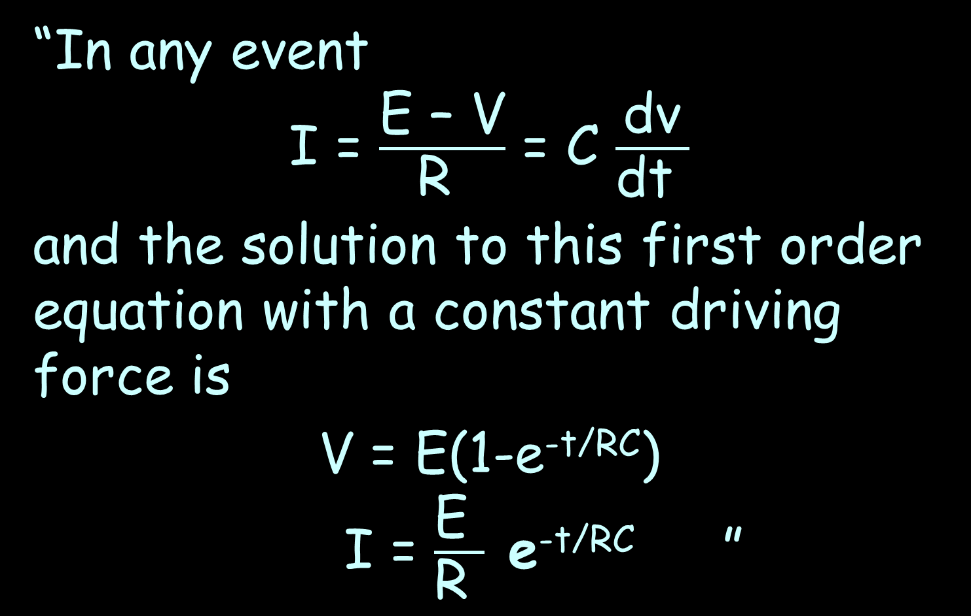
Differential Equations
“In any event
I = $\frac{\text{E}\text{ – }\text{V}}{\text{R} }$ = C $\frac{\text{dv}}{\text{dt} }$
and the solution to this first order equation with a constant driving force is
V = E(1-e^{-t/RC})
I = $\frac{\text{E} }{\text{R} }$ e^{-t/RC} ”
http://www-personal.engin.umd.umich.edu/~fmeral/CIRCUITS/03*Unit%203/1%20Inductance
%20&%20Capacitance.pdf

Slide 65
Questions?

Slide 66
Differential Equations
History: In 1671, Isaac Newton listed three kinds of differential equations:
those involving two derivatives and x,
those involving two derivatives and x and y,
and those involving more than two derivatives

Slide 67
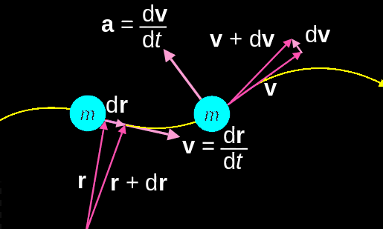
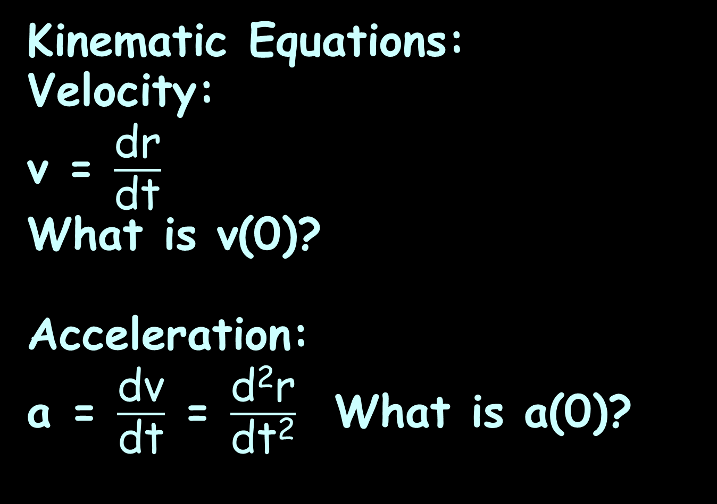
Differential Equations
Kinematic Equations:
Velocity:
v = $\frac{\text{d}\text{r}}{\text{dt}}$
What is v(0)?
Acceleration:
a = $\frac{\text{d}\text{v}}{\text{dt}}$ = $\frac{\text{d}\text{2}\text{r}}{\text{dt}\text{2}}$ What is a(0)?
http://en.wikipedia.org/wiki/Equations_of_motion#mediaviewer/File:Kinematics.svg

Slide 68
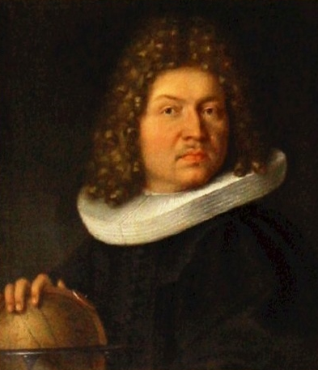
Differential Equations
Jacob Bernoulli solved the Bernoulli differential equation:
y'+ P(x)y = Q(x)y^{n}
in 1695
http://en.wikipedia.org/wiki/Jacob_Bernoulli#mediaviewer/File:Jakob_Bernoulli.jpg

Slide 69
Differential Equations
Bernoulli DiffEqs are nonlinear and have known exact solutions

Slide 70
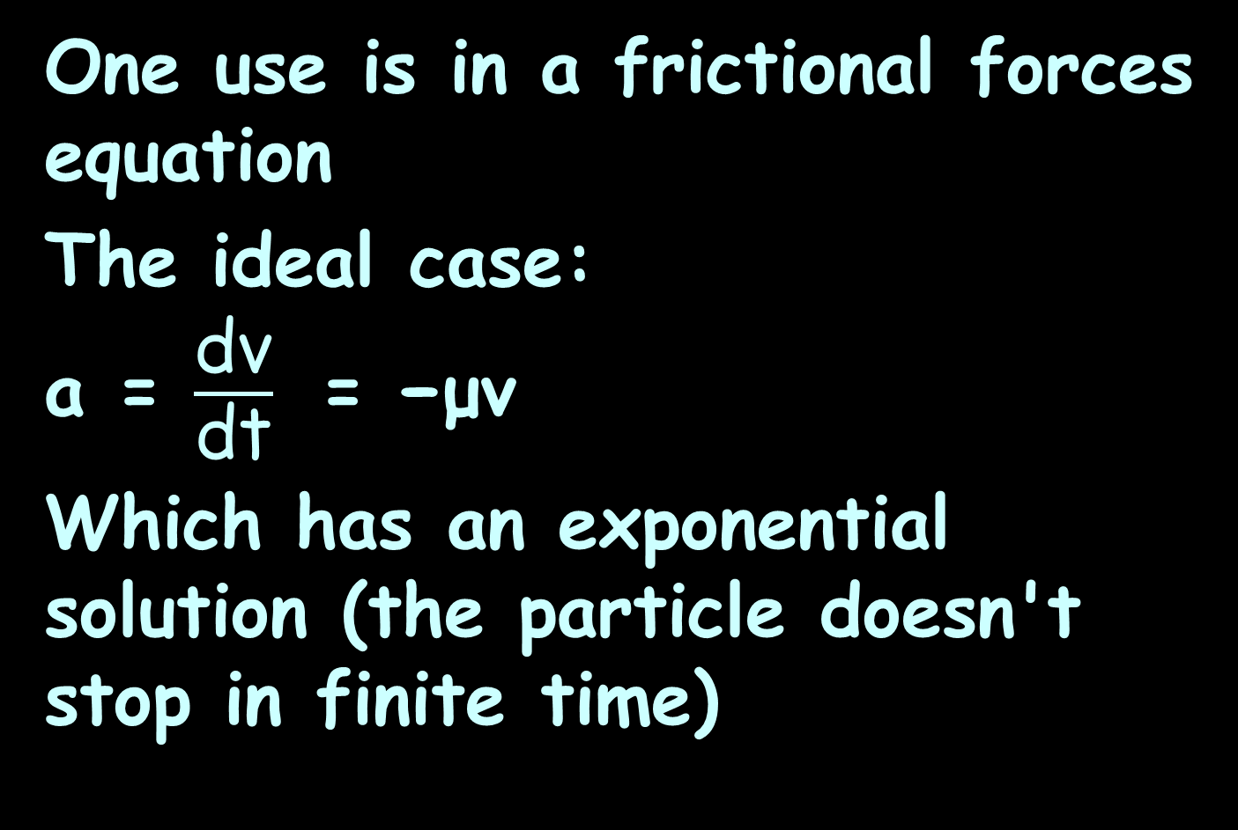
Differential Equations
One use is in a frictional forces equation
The ideal case:
a = $\frac{\text{dv}}{\text{dt}}$ = −μv
Which has an exponential solution (the particle doesn't stop in finite time)

Slide 71
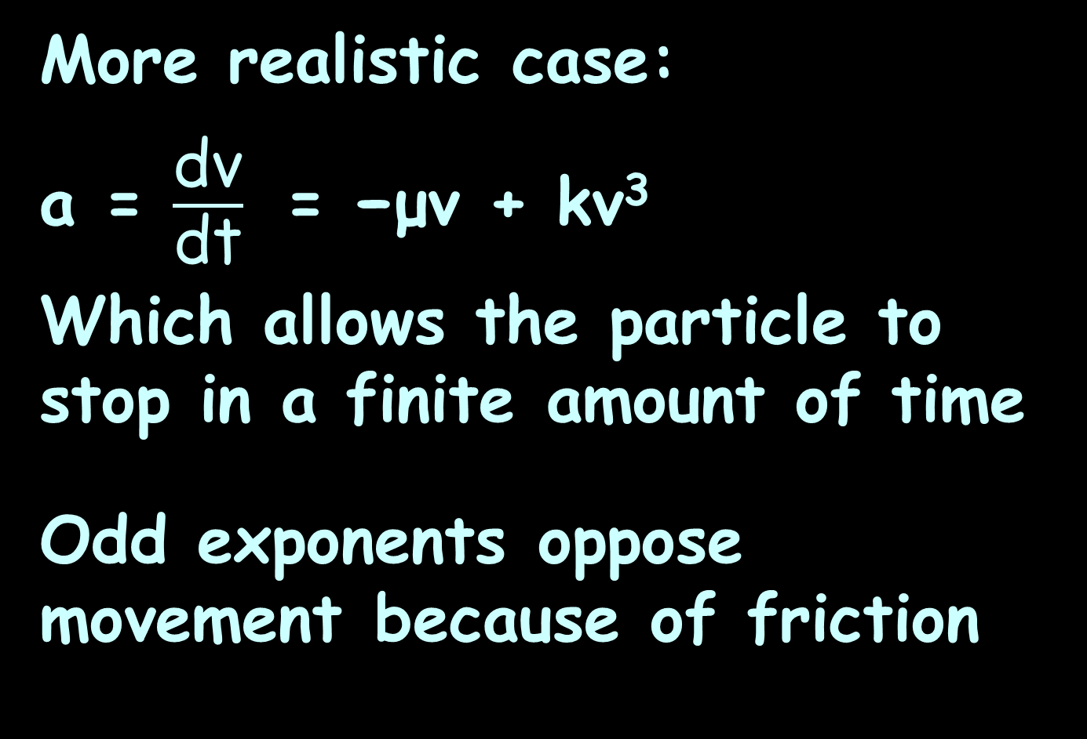
Differential Equations
More realistic case:
a = $\frac{\text{dv}}{\text{dt}}$ = −μv + kv³
Which allows the particle to stop in a finite amount of time
Odd exponents oppose movement because of friction

Slide 72
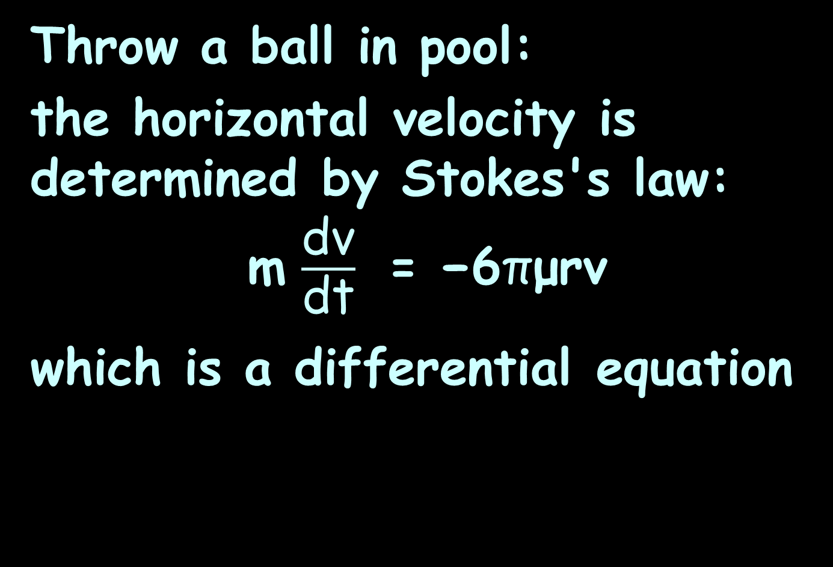
Differential Equations
Throw a ball in pool:
the horizontal velocity is determined by Stokes's law:
m $\frac{\text{dv}}{\text{dt}}$ = −6πμrv
which is a differential equation

Slide 73
Differential Equations
An equation describing the movement of a vibrating string such as that of a musical instrument is also a differential equation

Slide 74
Differential Equations
In 1746, d’Alembert discovered the one-dimensional wave equation which includes partial
derivatives (more
about those later…)
https://t1.gstatic.com/images?q=tbn:ANd9GcRVNoXg-hfwBZTeskz
PCASWtJ5W-GbYlZauWb_YzTmtGuYRy-7I4n-ZeB0f-Vl5

Slide 75
Differential Equations
Within ten years Euler discovered the three-dimensional wave equation which also includes partial derivatives
(more about
those later…)
https://www.geni.com/people/Johann-Albrecht-Euler/6000000006713164632

Slide 76
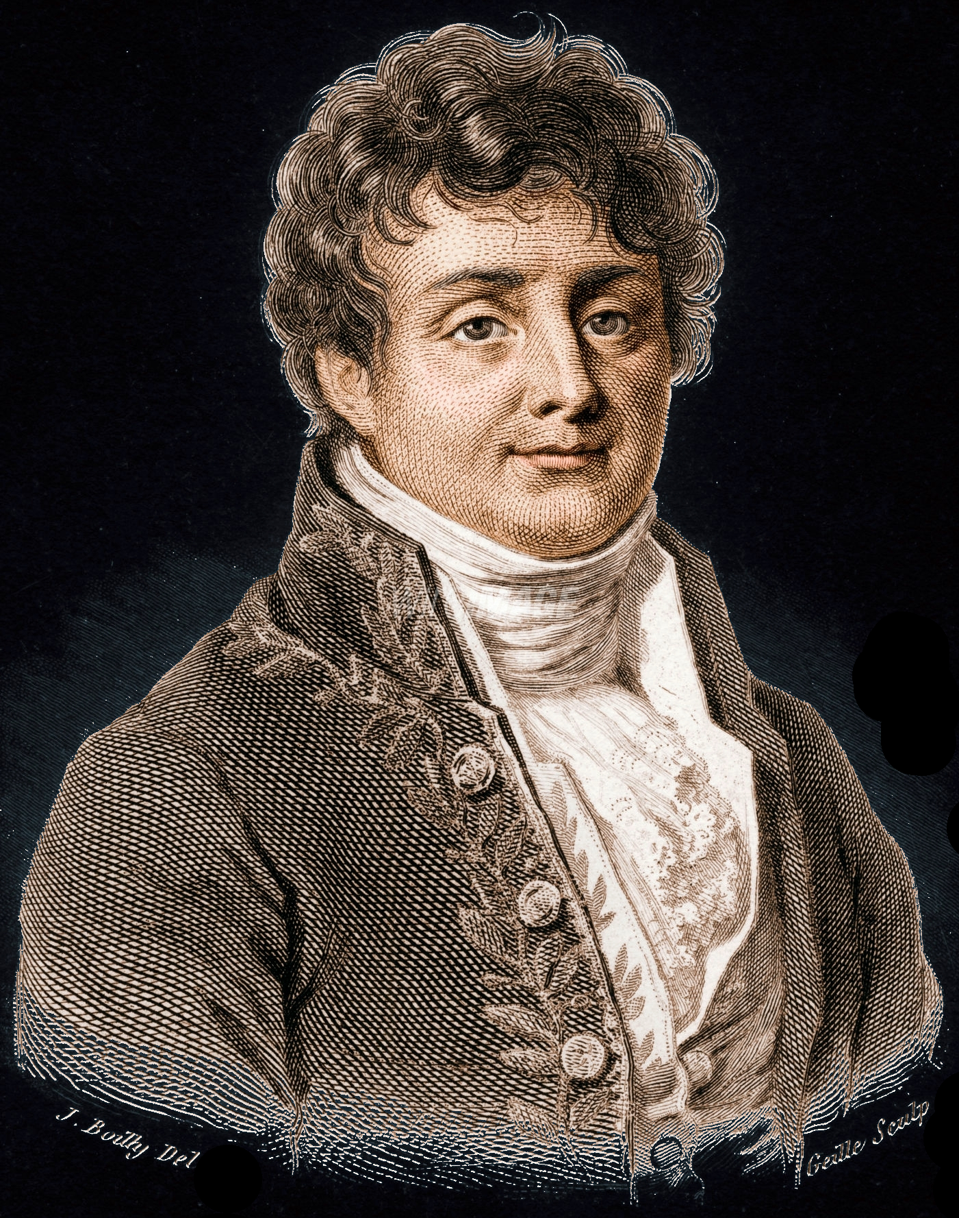
Differential Equations
Fourier published his heat equation for conductive diffusion of heat, a parabolic partial differential equation, which also includes partial derivatives (more about
those later…)
https://upload.wikimedia.org/wikipedia/commons/a/aa/Fourier2.jpg

Slide 77
DIFFERENTIAL EQUATIONS
IN-CLASS PROBLEM 7
The Criminal Code of Colorado specifies the legal limit for alcohol as 80 milligrams of ethyl alcohol per 100 milliliters of blood (.08%)

Slide 78
DIFFERENTIAL EQUATIONS
IN-CLASS PROBLEM 7
The concentration equation:
C_{t} = (C₀ e^{–Et})/1000
C_{t} = % alcohol/100 ml of blood
C₀ = initial concentration (ppm)
E = elimination rate constant
t = time in hours

Slide 79
DIFFERENTIAL EQUATIONS
IN-CLASS PROBLEM 7
It’s the “E” that makes this a differential equation
E = ln(Cmax/Cmin)/Δt
It is a rate of change
The cops generally use an “E” based on your weight

Slide 80
DIFFERENTIAL EQUATIONS
IN-CLASS PROBLEM 7
C_{t} = (C₀ e^{–Et})/1000
C_{t} = % alcohol/100 ml of blood
C₀ = 395 ppm
E = .4
Calculate the blood alcohol level after 2 hours

Slide 81
DIFFERENTIAL EQUATIONS
IN-CLASS PROBLEM 7
C_{t} = (C₀ e^{–Et})/1000
C_{t} = % alcohol/100 ml of blood
C₀ = 395 ppm
E = .4
Calculate the blood alcohol level after 2 hours
0.177 …whats?

Slide 82
DIFFERENTIAL EQUATIONS
IN-CLASS PROBLEM 7
C_{t} = (C₀ e^{–Et})/1000
C_{t} = % alcohol/100 ml of blood
C₀ = 395 ppm
E = .4
Calculate the blood alcohol level after 2 hours
0.177%
Is the person legally impaired?

Slide 83
DIFFERENTIAL EQUATIONS
IN-CLASS PROBLEM 7
C_{t} = (C₀ e^{–Et})/1000
C_{t} = % alcohol/100 ml of blood
C₀ = 395 ppm
E = .4
Calculate the blood alcohol level after 2 hours
0.177%
Is the person legally impaired?
yep

Slide 84
Questions?
http://i.imgur.com/aliTlT3.jpg

Slide 85
Differential Equations
Solving simple DiffEqs without a fancy calculator:
y‘(t) = 3t² – 4t + 10, y(0) = 20

Slide 86
DIFFERENTIAL EQUATIONS
IN-CLASS PROBLEM 8
y‘(t) = 3t² – 4t + 10, y(0) = 20
First take the integral of both sides of the DiffEq:
∫y‘(t)dt = ∫3t² – 4t + 10 dt

Slide 87
DIFFERENTIAL EQUATIONS
IN-CLASS PROBLEM 8
y‘(t) = 3t² – 4t + 10, y(0) = 20
First take the integral of both sides of the DiffEq:
∫y‘(t)dt = ∫3t² – 4t + 10 dt
y(t) = t³ - 2t² + 10t + C
Now plug in y(0)

Slide 88
DIFFERENTIAL EQUATIONS
IN-CLASS PROBLEM 8
y‘(t) = 3t² – 4t + 10, y(0) = 20
First take the integral of both sides of the DiffEq:
∫y‘(t)dt = ∫3t² – 4t + 10 dt
y(t) = t³ - 2t² + 10t + C
Now plug in y(0)
y(0) = 20 = (0)³-2(0)²+10(0)+C

Slide 89
DIFFERENTIAL EQUATIONS
IN-CLASS PROBLEM 8
So… C = 20

Slide 90
DIFFERENTIAL EQUATIONS
IN-CLASS PROBLEM 8
So… C = 20
And the original equation is:

Slide 91
DIFFERENTIAL EQUATIONS
IN-CLASS PROBLEM 8
So… C = 20
And the original equation is:
y(t) = t³ - 2t² + 10t + 20

Slide 92
Questions?
http://i.imgur.com/aliTlT3.jpg

Slide 93
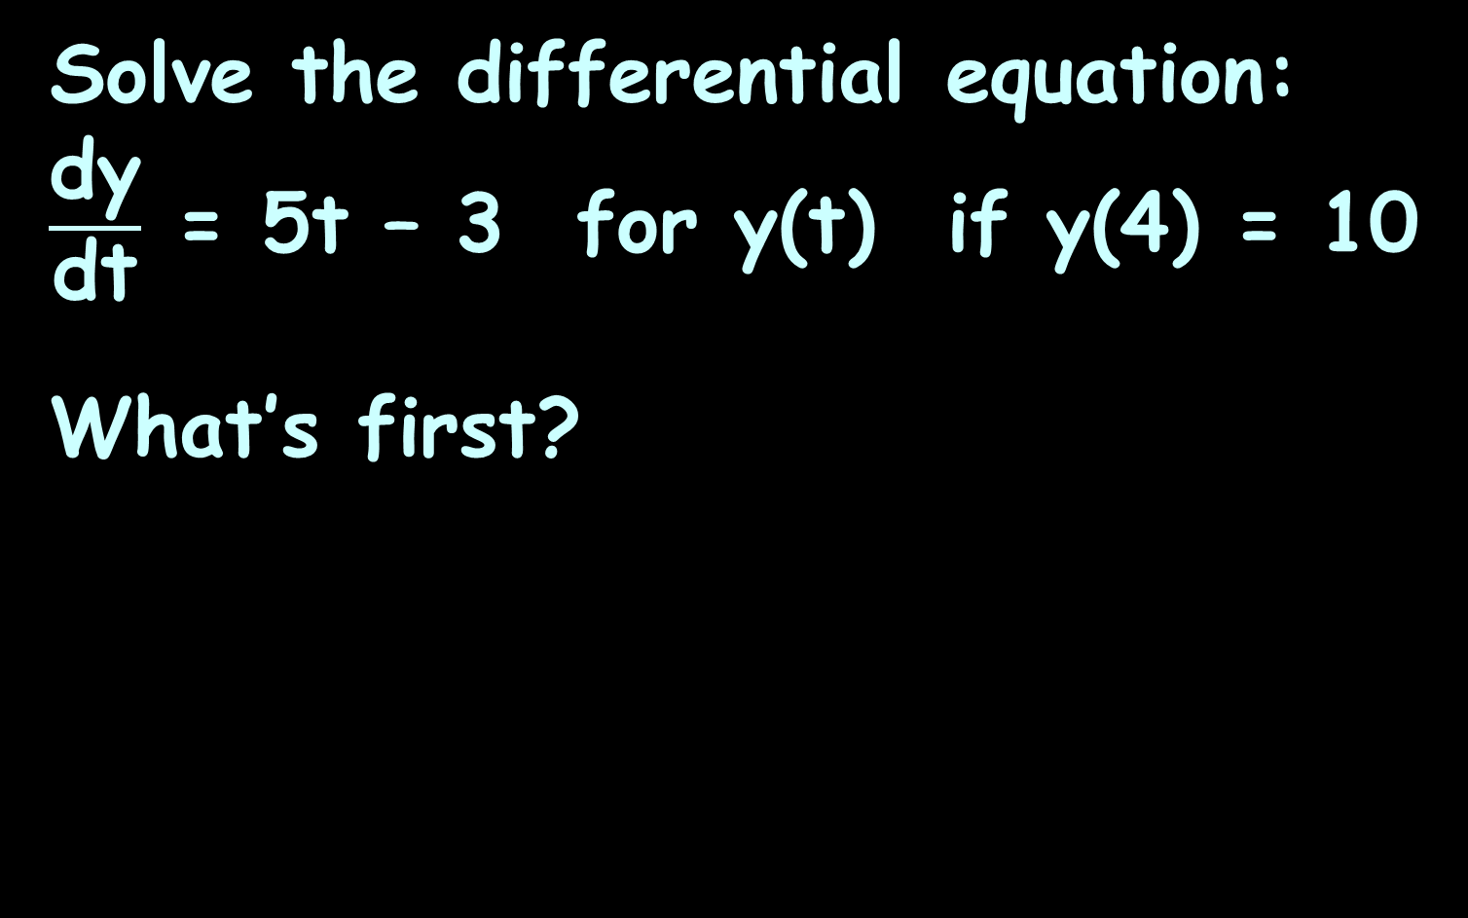
DIFFERENTIAL EQUATIONS
IN-CLASS PROBLEM 9
Solve the differential equation: $\frac{\text{dy}}{\text{dt}}$ = 5t – 3 for y(t) if y(4) = 10
What’s first?

Slide 94
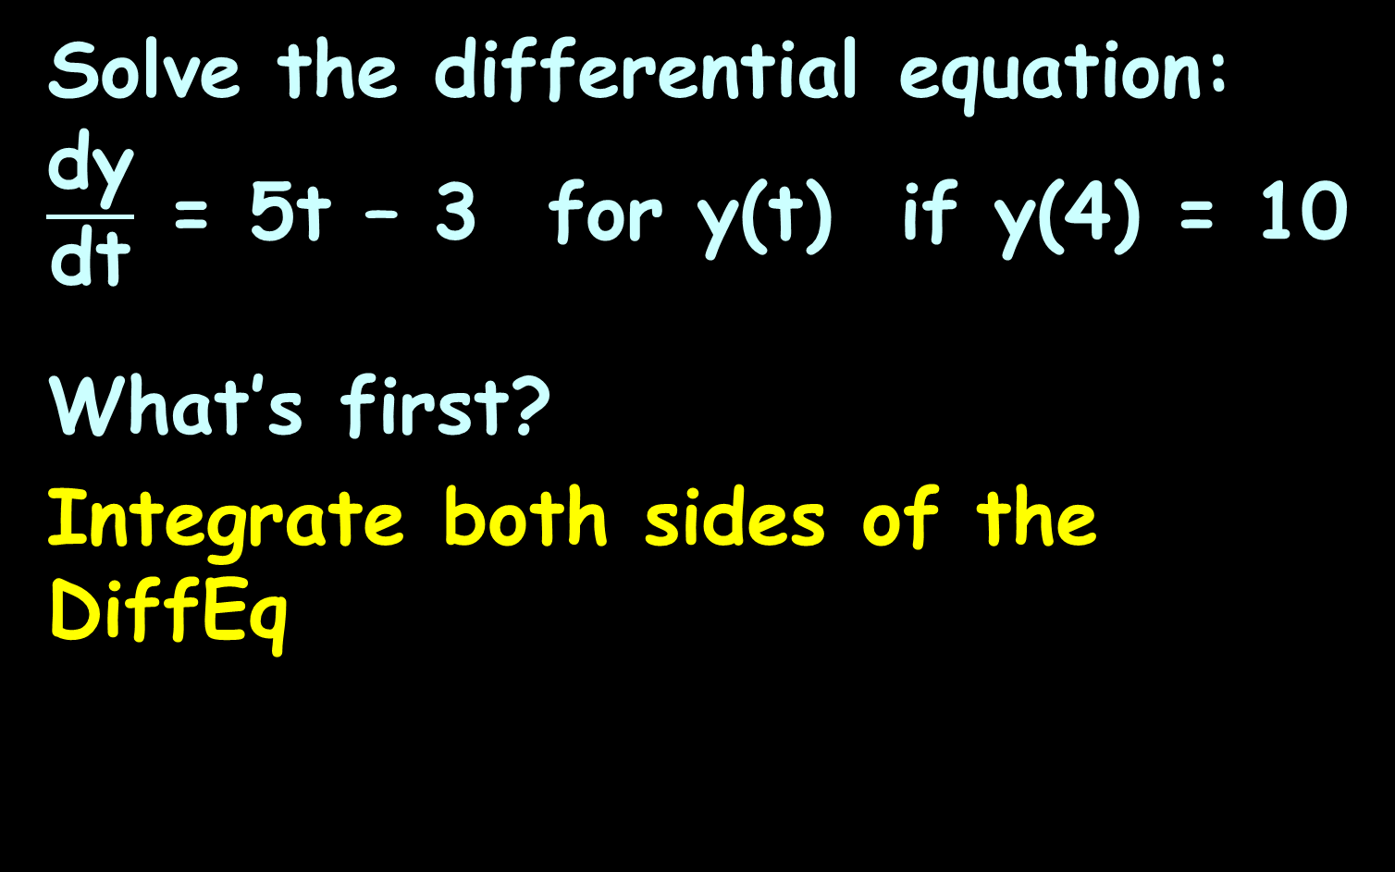
DIFFERENTIAL EQUATIONS
IN-CLASS PROBLEM 9
Solve the differential equation: $\frac{\text{dy}}{\text{dt}}$ = 5t – 3 for y(t) if y(4) = 10
What’s first?
Integrate both sides of the DiffEq

Slide 95
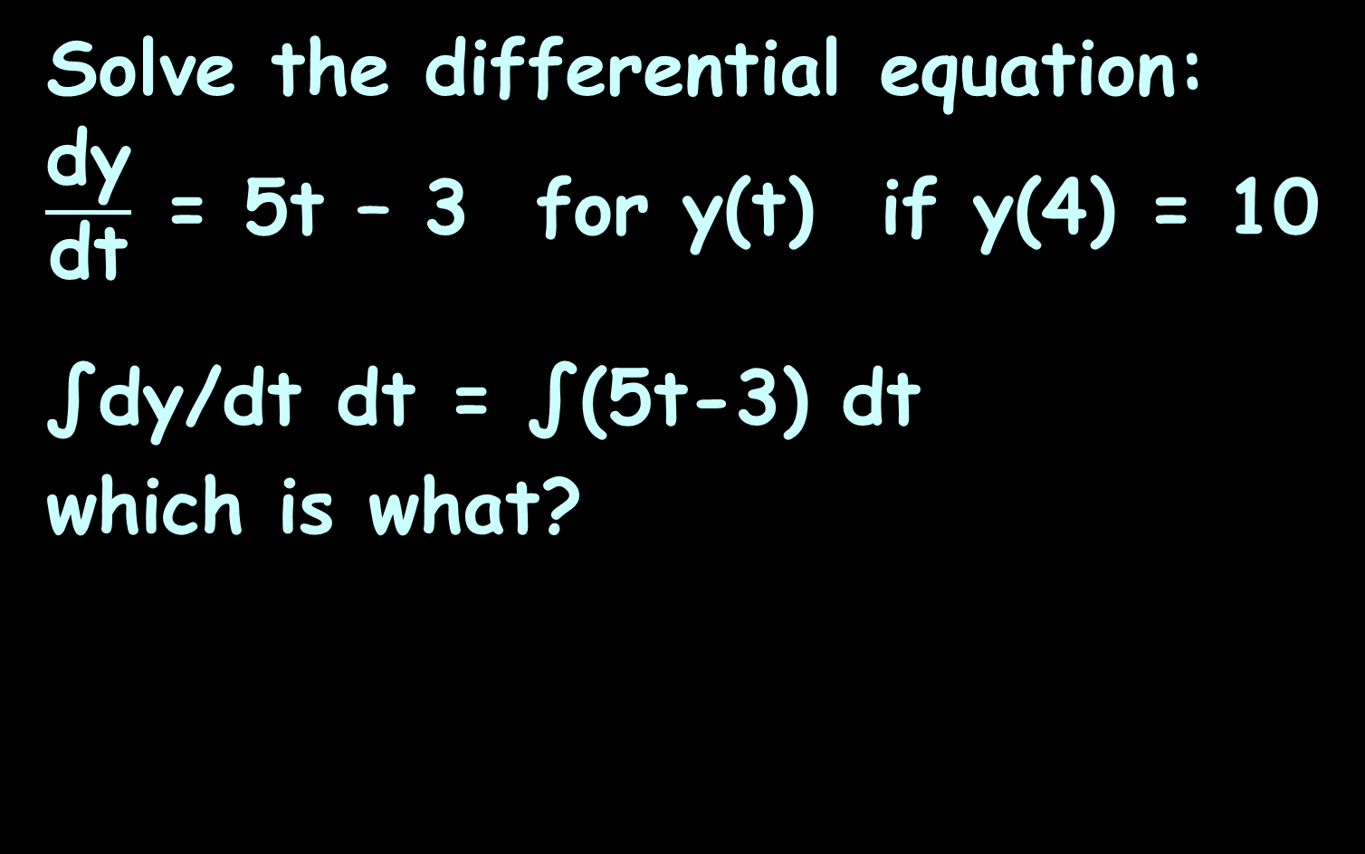
DIFFERENTIAL EQUATIONS
IN-CLASS PROBLEM 9
Solve the differential equation: $\frac{\text{dy}}{\text{dt}}$ = 5t – 3 for y(t) if y(4) = 10
∫dy/dt dt = ∫(5t-3) dt
which is what?

Slide 96
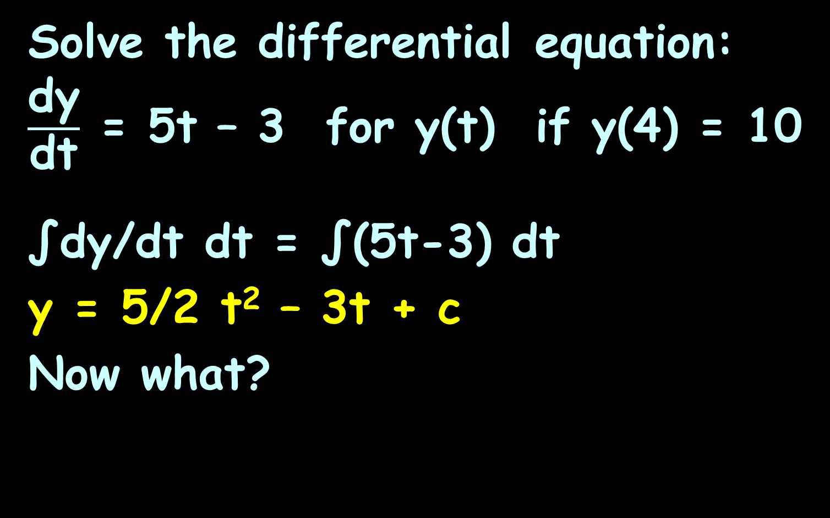
DIFFERENTIAL EQUATIONS
IN-CLASS PROBLEM 9
Solve the differential equation: $\frac{\text{dy}}{\text{dt}}$ = 5t – 3 for y(t) if y(4) = 10
∫dy/dt dt = ∫(5t-3) dt
y = 5/2 t² – 3t + c
Now what?

Slide 97
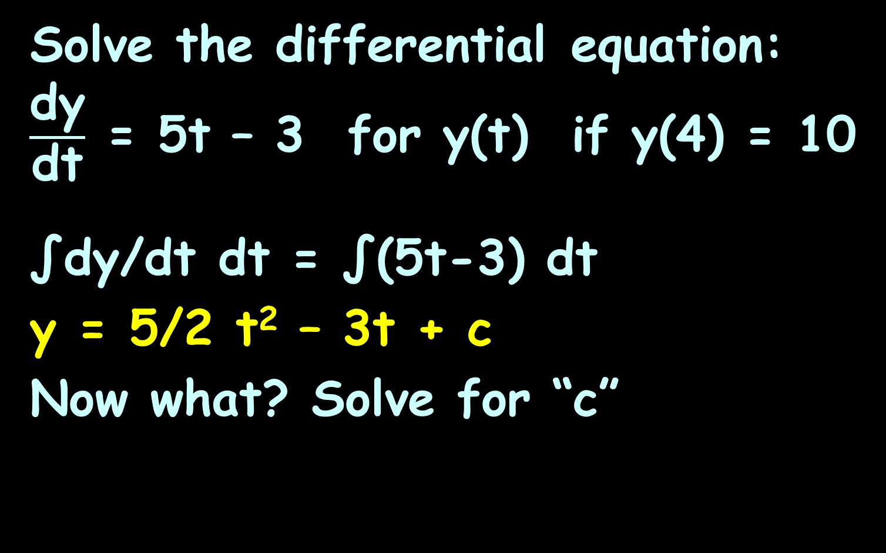
DIFFERENTIAL EQUATIONS
IN-CLASS PROBLEM 9
Solve the differential equation: $\frac{\text{dy}}{\text{dt}}$ = 5t – 3 for y(t) if y(4) = 10
∫dy/dt dt = ∫(5t-3) dt
y = 5/2 t² – 3t + c
Now what? Solve for “c”

Slide 98
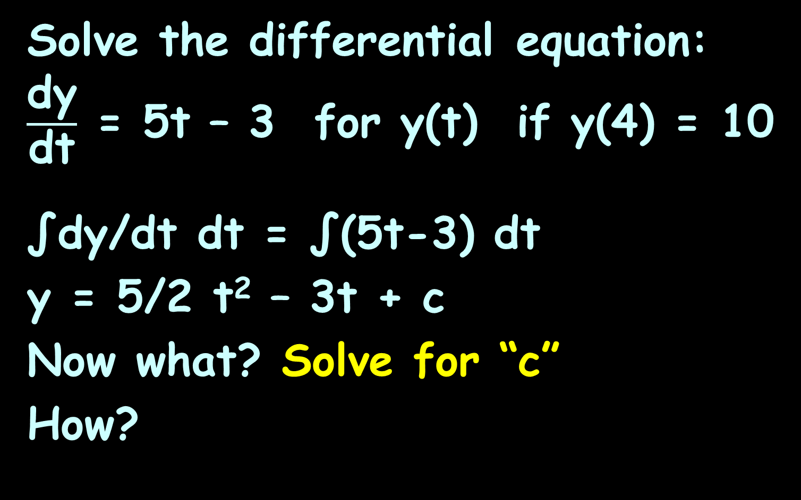
DIFFERENTIAL EQUATIONS
IN-CLASS PROBLEM 9
Solve the differential equation: $\frac{\text{dy}}{\text{dt}}$ = 5t – 3 for y(t) if y(4) = 10
∫dy/dt dt = ∫(5t-3) dt
y = 5/2 t² – 3t + c
Now what? Solve for “c”
How?

Slide 99

DIFFERENTIAL EQUATIONS
IN-CLASS PROBLEM 9
Solve the differential equation: $\frac{\text{dy}}{\text{dt}}$ = 5t – 3 for y(t) if y(4) = 10
y(t) = 5/2 t² – 3t + c
10 = 5/2 (4)² – 3(4) + c
Do it!

Slide 100
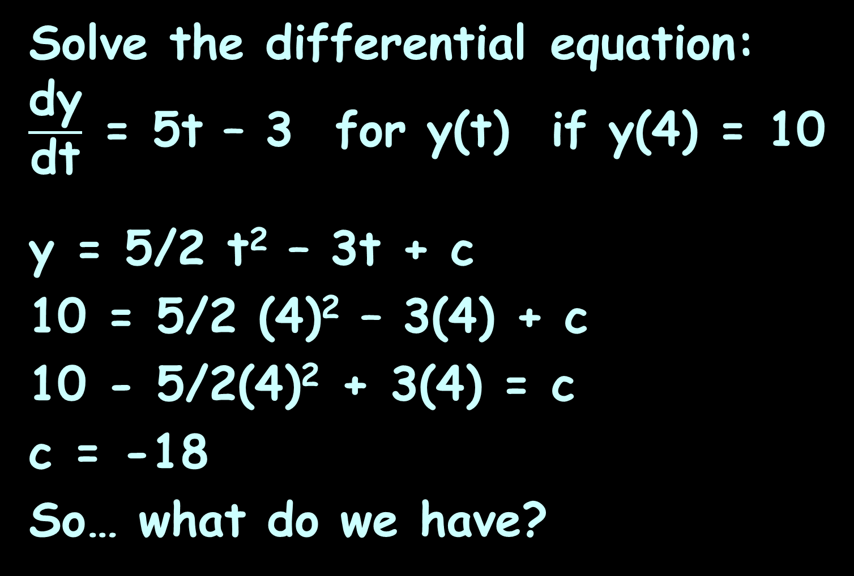
DIFFERENTIAL EQUATIONS
IN-CLASS PROBLEM 9
Solve the differential equation: $\frac{\text{dy}}{\text{dt}}$ = 5t – 3 for y(t) if y(4) = 10
y = 5/2 t² – 3t + c
10 = 5/2 (4)² – 3(4) + c
10 - 5/2(4)² + 3(4) = c
c = -18
So… what do we have?

Slide 101
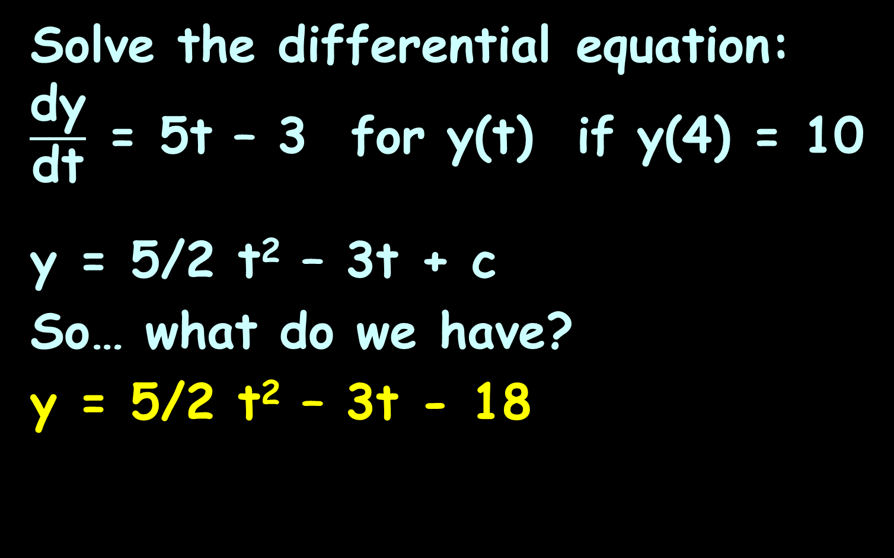
DIFFERENTIAL EQUATIONS
IN-CLASS PROBLEM 9
Solve the differential equation: $\frac{\text{dy}}{\text{dt}}$ = 5t – 3 for y(t) if y(4) = 10
y = 5/2 t² – 3t + c
So… what do we have?
y = 5/2 t² – 3t - 18

Slide 102
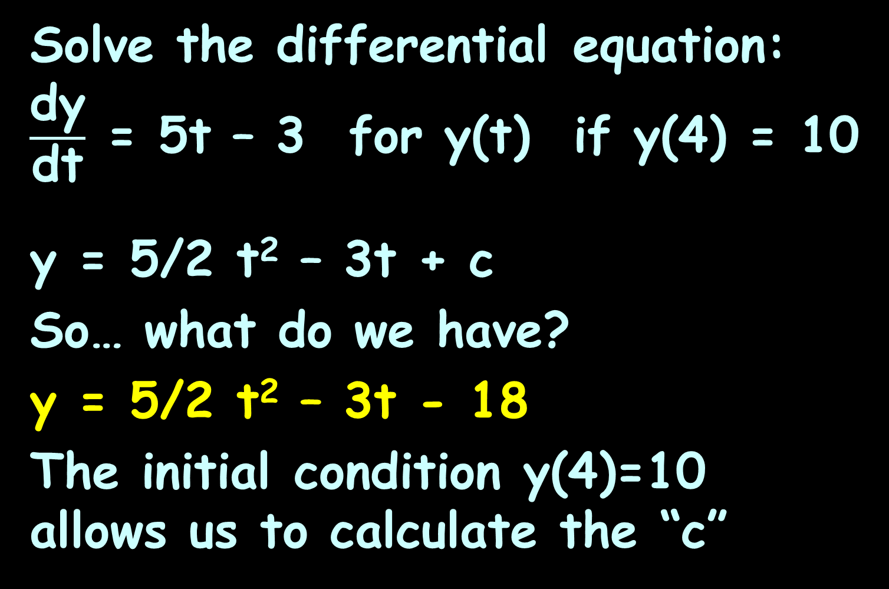
DIFFERENTIAL EQUATIONS
IN-CLASS PROBLEM 9
Solve the differential equation: $\frac{\text{dy}}{\text{dt}}$ = 5t – 3 for y(t) if y(4) = 10
y = 5/2 t² – 3t + c
So… what do we have?
y = 5/2 t² – 3t - 18
The initial condition y(4)=10 allows us to calculate the “c”

Slide 103
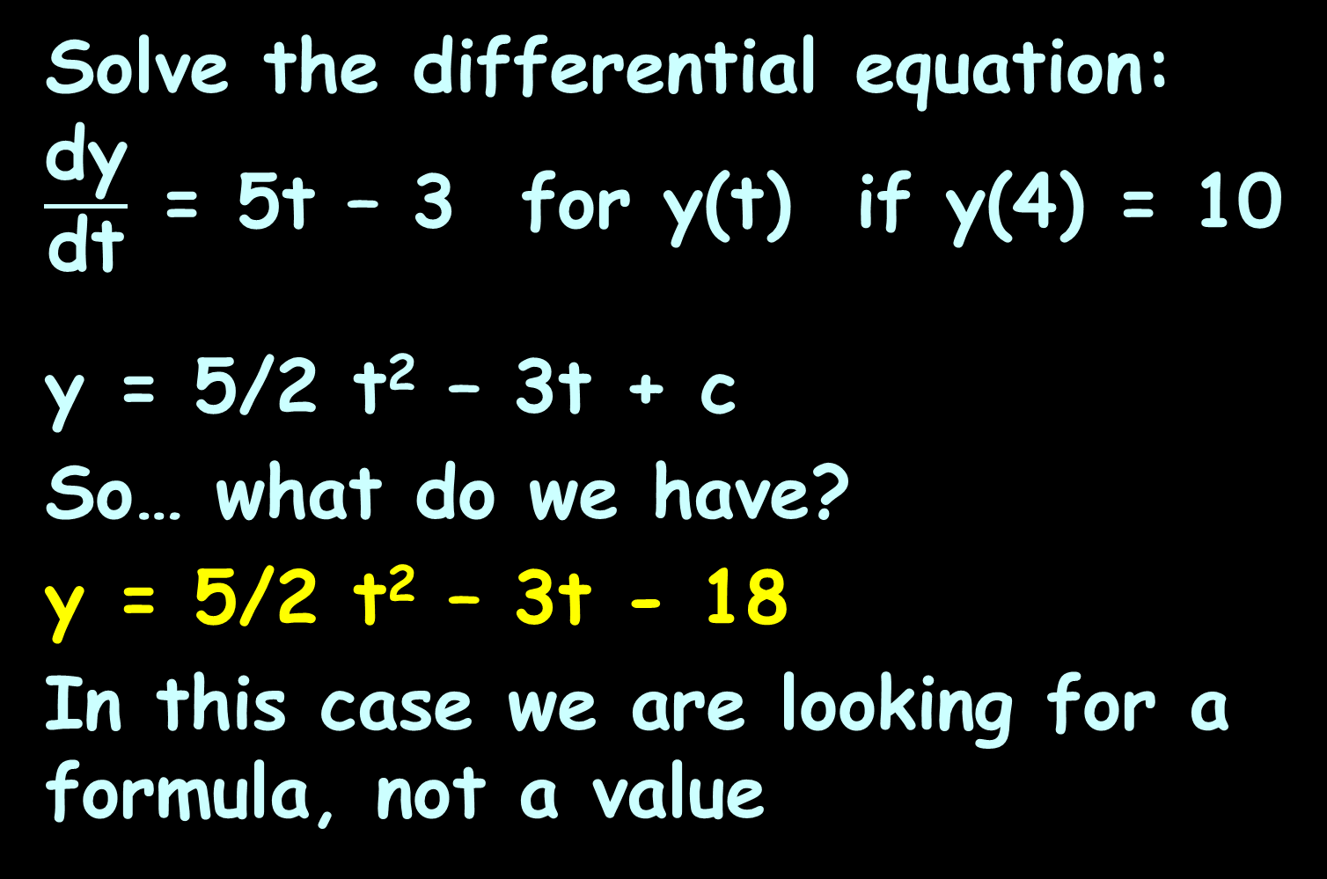
DIFFERENTIAL EQUATIONS
IN-CLASS PROBLEM 9
Solve the differential equation: $\frac{\text{dy}}{\text{dt}}$ = 5t – 3 for y(t) if y(4) = 10
y = 5/2 t² – 3t + c
So… what do we have?
y = 5/2 t² – 3t - 18
In this case we are looking for a formula, not a value

Slide 104
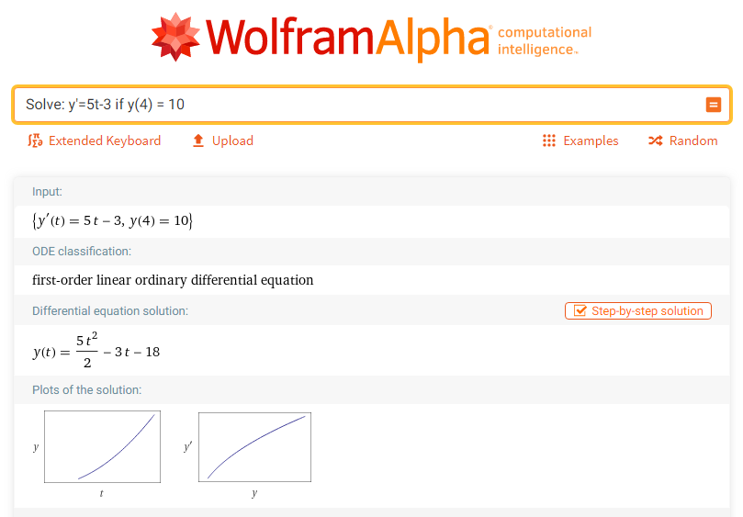

Slide 105
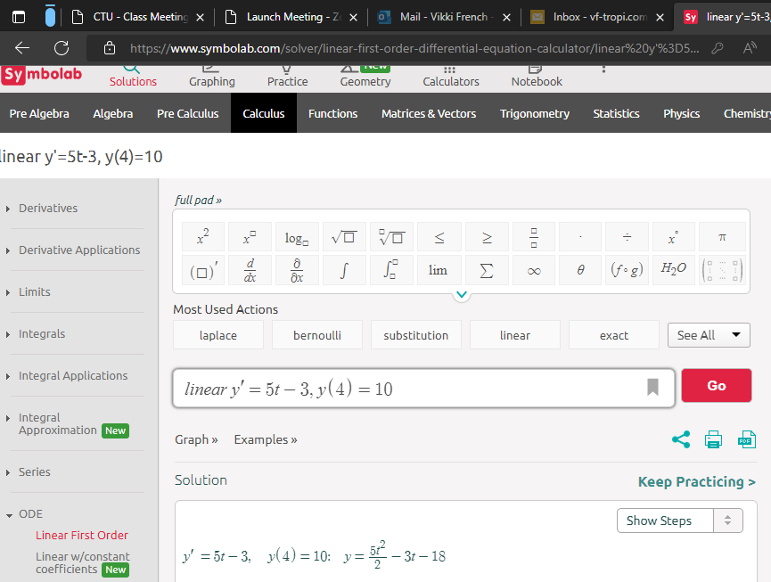

Slide 106
Differential Equations
TI89: deSolve(equation,indep,dep)
TI84: no

Slide 107
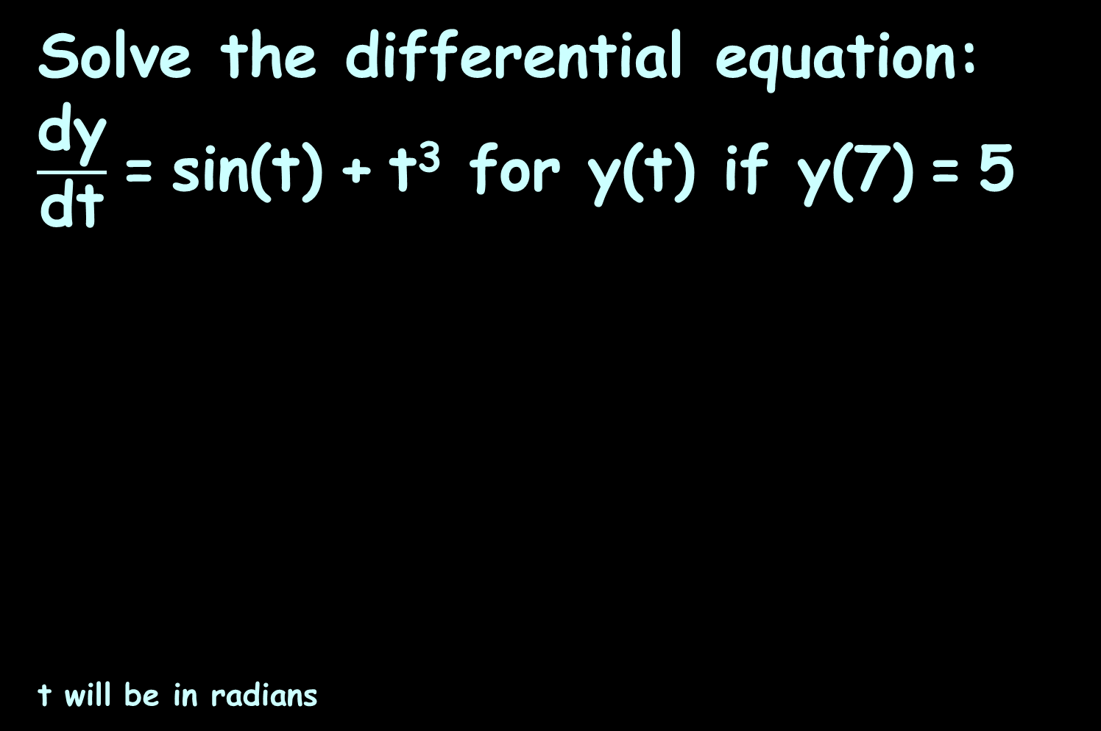
DIFFERENTIAL EQUATIONS
IN-CLASS PROBLEM 10
Solve the differential equation: $\frac{\text{dy}}{\text{dt}}$ = sin(t) + t³ for y(t) if y(7) = 5
t will be in radians

Slide 108
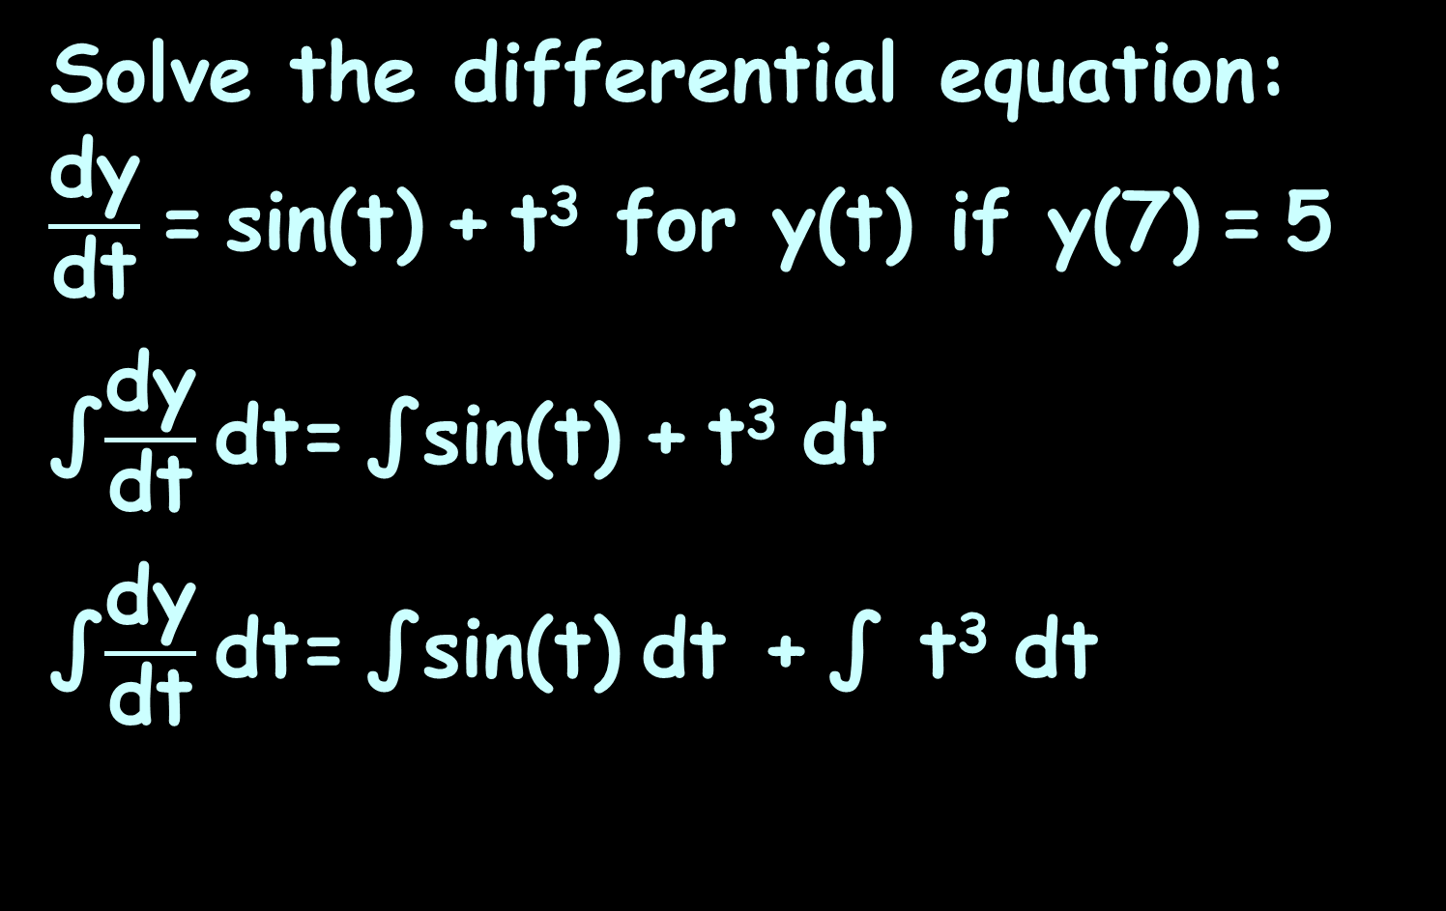
DIFFERENTIAL EQUATIONS
IN-CLASS PROBLEM 10
Solve the differential equation: $\frac{\text{dy}}{\text{dt}}$ = sin(t) + t³ for y(t) if y(7) = 5
∫$\frac{\text{dy}}{\text{dt}}$ dt= ∫sin(t) + t³ dt
∫$\frac{\text{dy}}{\text{dt}}$ dt= ∫sin(t) dt + ∫ t³ dt

Slide 109
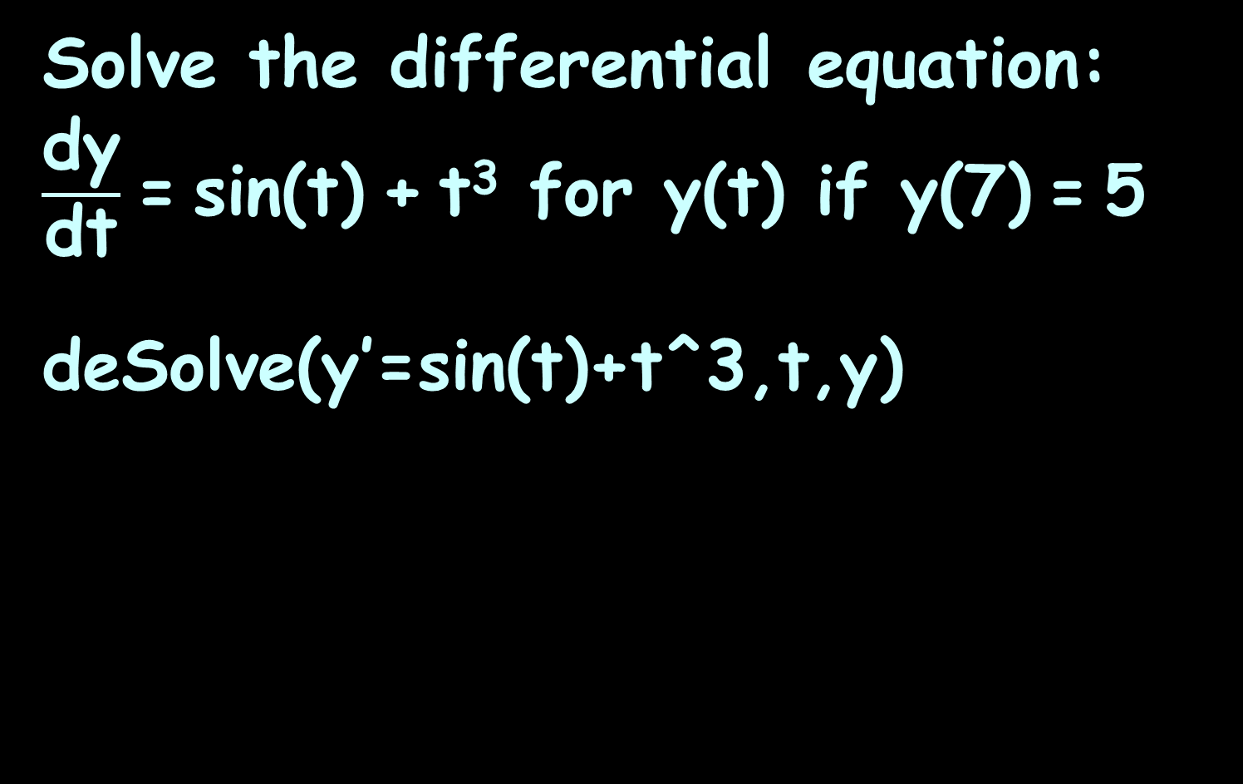
DIFFERENTIAL EQUATIONS
IN-CLASS PROBLEM 10
Solve the differential equation: $\frac{\text{dy}}{\text{dt}}$ = sin(t) + t³ for y(t) if y(7) = 5
deSolve(y’=sin(t)+t^3,t,y)

Slide 110
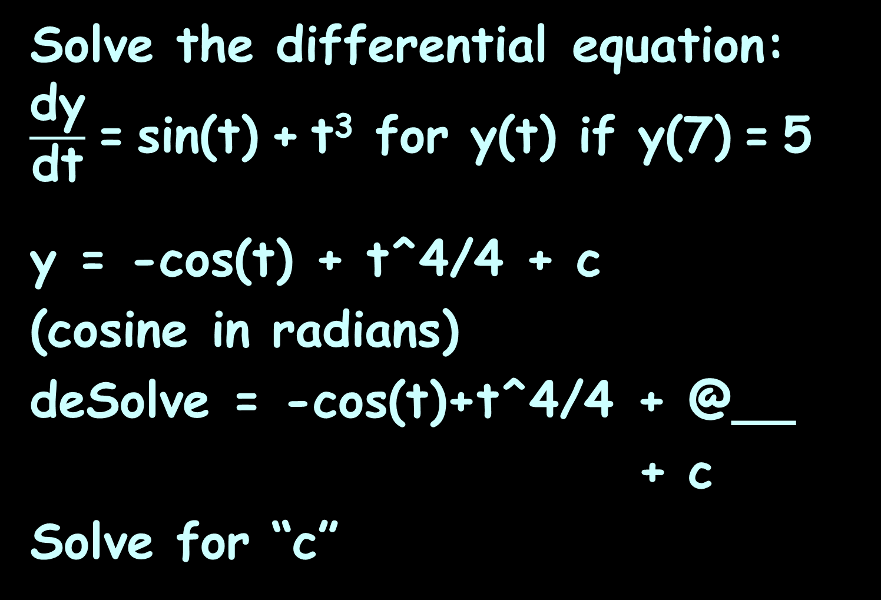
DIFFERENTIAL EQUATIONS
IN-CLASS PROBLEM 10
Solve the differential equation: $\frac{\text{dy}}{\text{dt}}$ = sin(t) + t³ for y(t) if y(7) = 5
y = -cos(t) + t^4/4 + c
(cosine in radians)
deSolve = -cos(t)+t^4/4 + @__
+ c
Solve for “c”

Slide 111
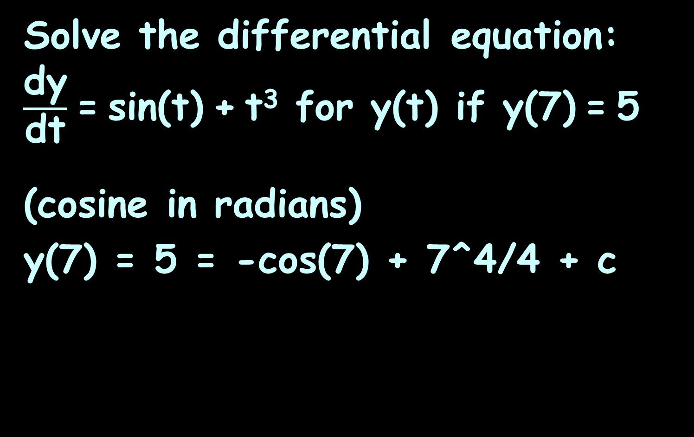
DIFFERENTIAL EQUATIONS
IN-CLASS PROBLEM 10
Solve the differential equation: $\frac{\text{dy}}{\text{dt}}$ = sin(t) + t³ for y(t) if y(7) = 5
(cosine in radians)
y(7) = 5 = -cos(7) + 7^4/4 + c

Slide 112
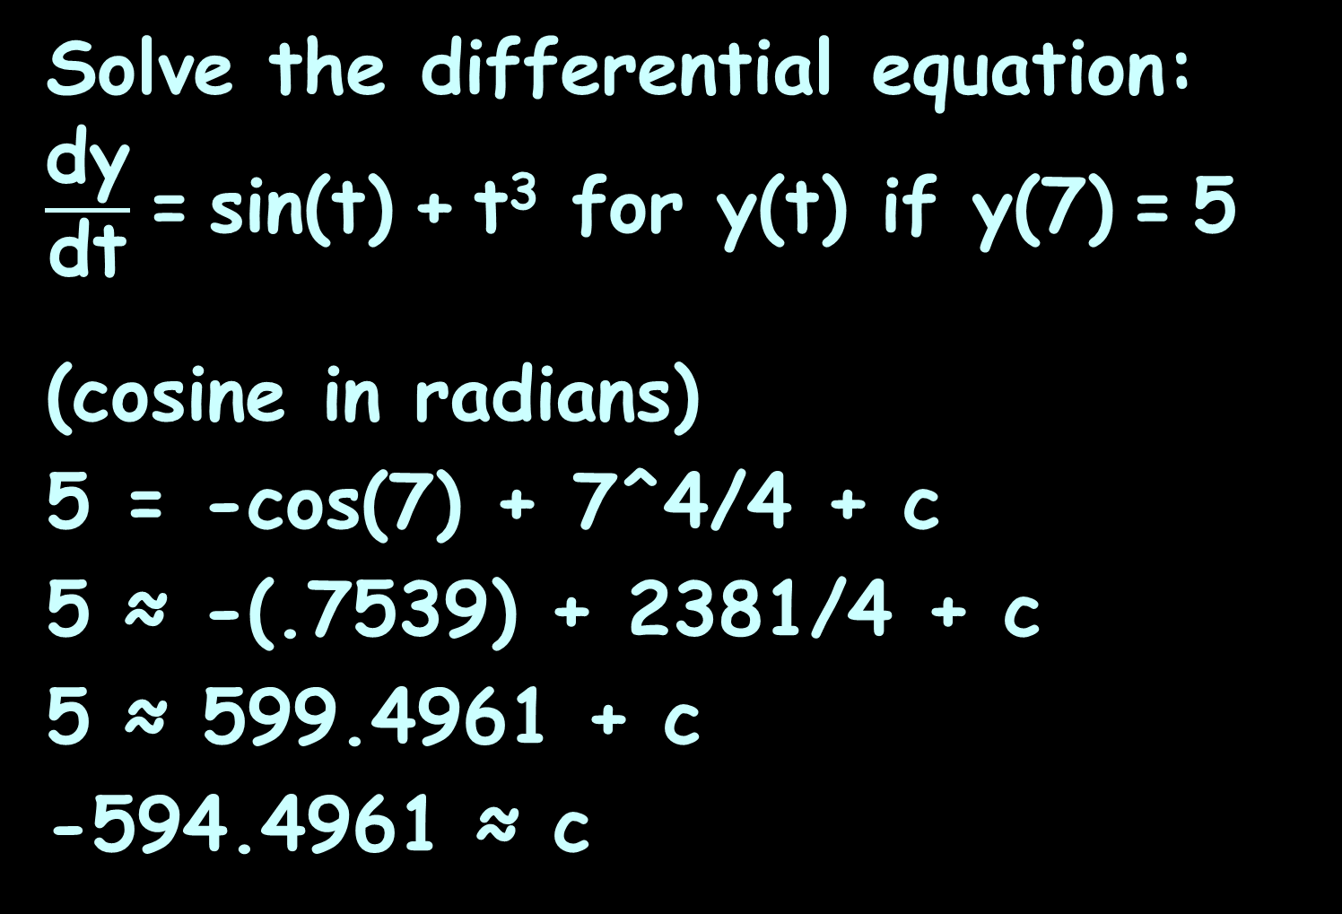
DIFFERENTIAL EQUATIONS
IN-CLASS PROBLEM 10
Solve the differential equation: $\frac{\text{dy}}{\text{dt}}$ = sin(t) + t³ for y(t) if y(7) = 5
(cosine in radians)
5 = -cos(7) + 7^4/4 + c
5 ≈ -(.7539) + 2381/4 + c
5 ≈ 599.4961 + c
-594.4961 ≈ c

Slide 113
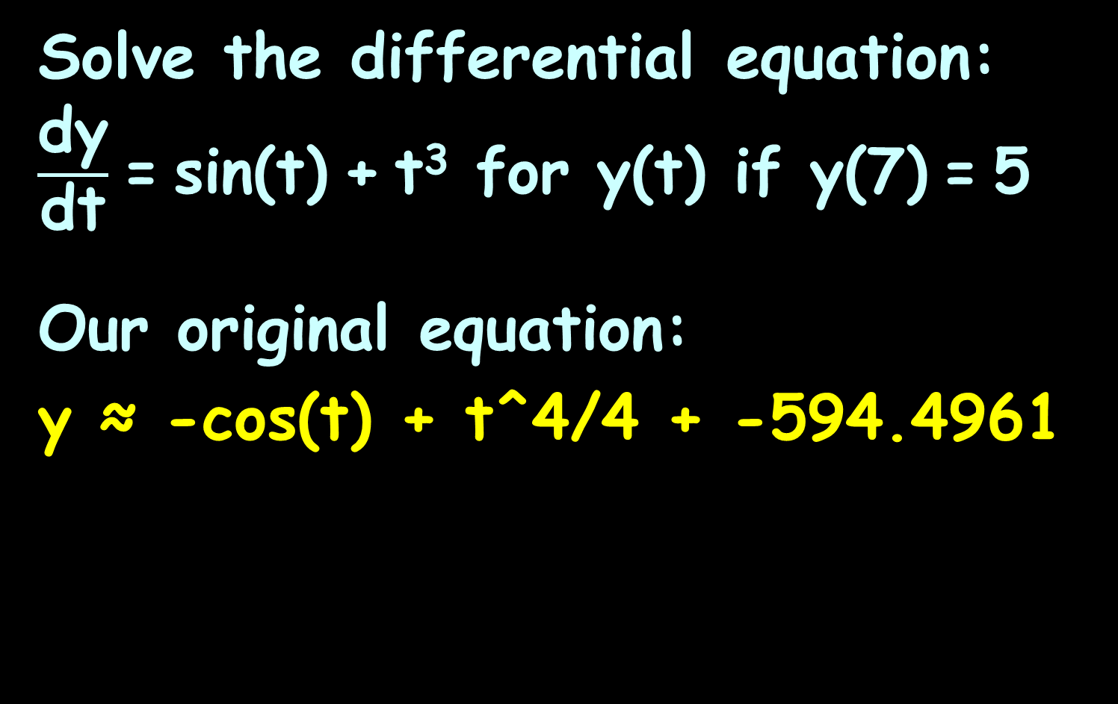
DIFFERENTIAL EQUATIONS
IN-CLASS PROBLEM 10
Solve the differential equation: $\frac{\text{dy}}{\text{dt}}$ = sin(t) + t³ for y(t) if y(7) = 5
Our original equation:
y ≈ -cos(t) + t^4/4 + -594.4961

Slide 114
Questions?
http://i.imgur.com/aliTlT3.jpg

Slide 115
Differential Equations
A second order system has two forms of energy stored or released, and the equation will contain the second derivative of the dependent variable

Slide 116
Differential Equations
How it works:
Original equation:
y = 5x² + 78x + 462
a second-degree equation because of the x²

Slide 117
Differential Equations
y = 5x² + 78x + 462
Take the derivative:
dy/dx = y' = 10x + 78
a first order DiffEq
but still a second degree equation
because it has an “x” still in it

Slide 118
Differential Equations
dy/dx = y' = 10x + 78
Take a second derivative:
d²y/dx² = y'' = 10
a second order DiffEq
a second degree equation will
have no variable left at this
step

Slide 119
DIFFERENTIAL EQUATIONS
IN-CLASS PROBLEM 11
Calculate the original equation for
y'' = 10
What do we do first?

Slide 120
DIFFERENTIAL EQUATIONS
IN-CLASS PROBLEM 11
Calculate the original equation for
y'' = 10
What do we do first?
Integrate both sides!

Slide 121
DIFFERENTIAL EQUATIONS
IN-CLASS PROBLEM 11
Calculate the original equation for
y'' = 10
∫y'' dx = ∫10 dx
∫d²y/dx² dx = ∫10 dx
Which is what?

Slide 122
DIFFERENTIAL EQUATIONS
IN-CLASS PROBLEM 11
Calculate the original equation for
y'' = 10
∫y'' dx = ∫10 dx
y' = 10x + c
Are we done?

Slide 123
DIFFERENTIAL EQUATIONS
IN-CLASS PROBLEM 11
Calculate the original equation for
y'' = 10
∫y'' dx = ∫10 dx
y' = 10x + c
Are we done? No…
We need to integrate again!
(A double integral!)

Slide 124
DIFFERENTIAL EQUATIONS
IN-CLASS PROBLEM 11
Calculate the original equation for
y'' = 10
∫y'' dx = ∫10 dx
y' = 10x + c
∫y' dx = ∫(10x + c) dx

Slide 125

DIFFERENTIAL EQUATIONS
IN-CLASS PROBLEM 11
Calculate the original equation for
y'' = 10
∫y'' dx = ∫10 dx
y' = 10x + c
∫y' dx = ∫(10x + c) dx
y = 10/2 x² + cx + c₂
y = 5x² + c₁x + c₂
Two constants?? Wow!!
http://th07.deviantart.net/fs70/PRE/i/2012/297/6/a/scared_girl_caricature_portrait_by_jordylakiere-d5itcx5.jpg

Slide 126
DIFFERENTIAL EQUATIONS
IN-CLASS PROBLEM 11
Calculate the original equation for
y'' = 10
We could also have written this:
∫∫y'' dxdx = ∫∫10 dxdx
y = 5x² + c₁x + c₂
_{More about that later…}

Slide 127
DIFFERENTIAL EQUATIONS
IN-CLASS PROBLEM 11
Calculate the original equation for
y'' = 10
∫∫y'' dxdx = ∫∫10 dxdx
y = 5x² + c₁x + c₂
Suppose we had initial condition:
y(0) = 462

Slide 128
DIFFERENTIAL EQUATIONS
IN-CLASS PROBLEM 11
Calculate the original equation for
y'' = 10
∫∫y'' dxdx = ∫∫10 dxdx
y = 5x² + c₁x + c₂
y(0) = 462:
462 = 5(0)² + c₁(0) + c₂
Which gives us c₂ = 462
Is that enough?

Slide 129
DIFFERENTIAL EQUATIONS
IN-CLASS PROBLEM 11
Calculate the original equation for
y'' = 10
∫∫y'' dxdx = ∫∫10 dxdx
y = 5x² + c₁x + c₂
y(0) = 462:
462 = 5(0)² + c₁(0) + c₂
Which gives us c₂ = 462
We need a point NOT at x=0!

Slide 130
DIFFERENTIAL EQUATIONS
IN-CLASS PROBLEM 11
Calculate the original equation for
y'' = 10
∫∫y'' dxdx = ∫∫10 dxdx
y = 5x² + c₁x + c₂
y = 5x² + c₁x + 462
Suppose we also know y(1) = 545
(a secondary condition)

Slide 131
DIFFERENTIAL EQUATIONS
IN-CLASS PROBLEM 11
Calculate the original equation for
y'' = 10
∫∫y'' dxdx = ∫∫10 dxdx
y = 5x² + c₁x + c₂
y = 5x² + c₁x + 462
Suppose we also know y(1) = 545
545 = 5(1)² + c₁(1) + 462

Slide 132
DIFFERENTIAL EQUATIONS
IN-CLASS PROBLEM 11
Calculate the original equation for
y'' = 10
∫∫y'' dxdx = ∫∫10 dxdx
y = 5x² + c₁x + c₂
y = 5x² + c₁x + 462
545 = 5(1)² + c₁(1) + 462
545 = 5 + c₁ + 462
c₁ = 545 – 5 – 462 = 78

Slide 133
DIFFERENTIAL EQUATIONS
IN-CLASS PROBLEM 11
Calculate the original equation for
y'' = 10
So, our original equation should have been:
y = 5x² + 78x + 462

Slide 134
DIFFERENTIAL EQUATIONS
IN-CLASS PROBLEM 11
Calculate the original equation for
y'' = 10
So, our original equation should have been:
y = 5x² + 78x + 462
(which it was…)

Slide 135
Questions?
http://i.imgur.com/aliTlT3.jpg

Slide 136
Differential Equations
What if your DiffEq has a “y” as well as a y’ and another variable in it?

Slide 137
Differential Equations
What if your DiffEq has a “y” as well as a y’ and another variable in it?
5v v’ = 10

Slide 138
Differential Equations
What if your DiffEq has a “y” as well as a y’ and another variable in it?
5v v’ = 10
or 5v dv/dt = 10
NOW WHAT?????

Slide 139
Differential Equations
Use algebra to get the v's on one side of the = sign and the
t's on the other:
5v dv/dt × dt = 10 × dt
5v dv = 10 dt
Ok… so…
http://en.wikipedia.org/wiki/Trigonometric_substitution

Slide 140
Differential Equations
5v dv = 10 dt
Now integrate both sides of the DiffEq:
∫5v dv = ∫10 dt

Slide 141
Differential Equations
5v dv = 10 dt
Now integrate both sides of the DiffEq:
∫5v dv = ∫10 dt
5v²/2 + C₁ = 10t + C₂

Slide 142
Differential Equations
5v dv = 10 dt
Now integrate both sides of the DiffEq:
∫5v dv = ∫10 dt
5v²/2 + C₁ = 10t + C₂
Algebra:
2(5v²/2 + C₁) = 2(10t + C₂)

Slide 143
Differential Equations
5v dv = 10 dt
2(5v²/2 + C₁) = 2(10t + C₂)
5v² + C₁ = 20t + C₂
More algebra:
5v² = 20t + K
v² = 4t + K

Slide 144
Differential Equations
5v dv = 10 dt
2(5v²/2 + C₁) = 2(10t + C₂)
5v² + C₁ = 20t + C₂
More algebra:
5v² = 20t + K
v² = 4t + K
Is this the original equation?

Slide 145
Differential Equations
5v dv = 10 dt
2(5v²/2 + C₁) = 2(10t + C₂)
5v² + C₁ = 20t + C₂
More algebra:
5v² = 20t + K
v² = 4t + K
Is this the original equation?
we need an initial condition

Slide 146
Differential Equations
5v dv = 10 dt
v² = 4t + K
Initial condition: v(t=0) = 3
v² = 4t + K
3² = 4(0) + K
K = 9
What is the original equation?

Slide 147
Differential Equations
5v dv = 10 dt
v² = 4t + K
Initial condition: v(t=0) = 3
K = 9
What is the original equation?
v² = 4t + 9

Slide 148
Differential Equations
Note for calculators:
You will have to use y’
rather than dy/dx and
y’’ instead of d²y/dx²
The ' symbol is blue 2nd =

Slide 149
Differential Equations
Note: You have to use the “∗”

Slide 150
Differential Equations
Your TI will solve 1st
and 2nd order DiffEqs
with deSolve
For higher-order DiffEqs
you will need to download
an app

Slide 151
Differential Equations
Note:
The TI app will call
each of the Cs as “@”
numbers, counting up
from the first one you
calculate

Slide 152
Questions?
http://i.imgur.com/aliTlT3.jpg

Slide 153
Differential Equations
Kirchhoff's voltage law says that the directed sum of the voltages around a circuit
must be zero

Slide 154

Differential Equations
This results in the following equation:
Ri + L$\frac{\text{di}}{\text{dt}}$ = V

Slide 155

DIFFERENTIAL EQUATION FOR A SERIES RL CIRCUIT
IN-CLASS PROBLEM 12
Ri + L$\frac{\text{di}}{\text{dt}}$ = V
Is this a differential equation?

Slide 156
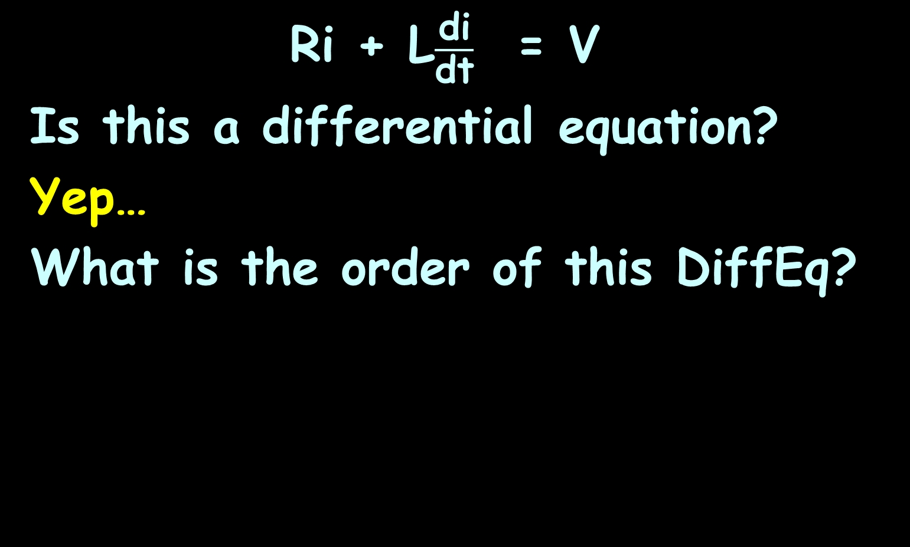
DIFFERENTIAL EQUATION FOR A SERIES RL CIRCUIT
IN-CLASS PROBLEM 12
Ri + L$\frac{\text{di}}{\text{dt}}$ = V
Is this a differential equation?
Yep…
What is the order of this DiffEq?

Slide 157
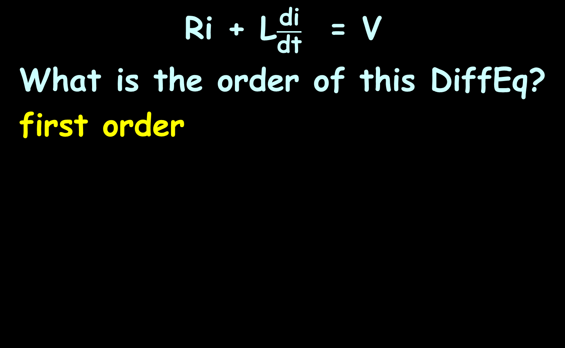
DIFFERENTIAL EQUATION FOR A SERIES RL CIRCUIT
IN-CLASS PROBLEM 12
Ri + L$\frac{\text{di}}{\text{dt}}$ = V
What is the order of this DiffEq?
first order

Slide 158
Questions?
http://i.imgur.com/aliTlT3.jpg

Slide 159
Summary
Today we studied:
Review of Surface Areas and
Growth models
DiffEq!

Slide 160

You Survived!

