Slide 1

Welcome to
Unit 9 ! .
MATH 205 Differential Calculus
https://www.smu.edu.sg/programmes/core-curriculum/course-structure/calculus

Slide 2
What’s Up?
New stuff:
Area Under a Curve and the
Fundamental Theorem of
Calculus
Area between two curves

Slide 3
What’s Up?
Outcome 5) Use basic integration techniques, including the method of substitution and the Fundamental Theorem of Calculus
Outcome 6) Use definite integrals to find areas under and between curves

Slide 4
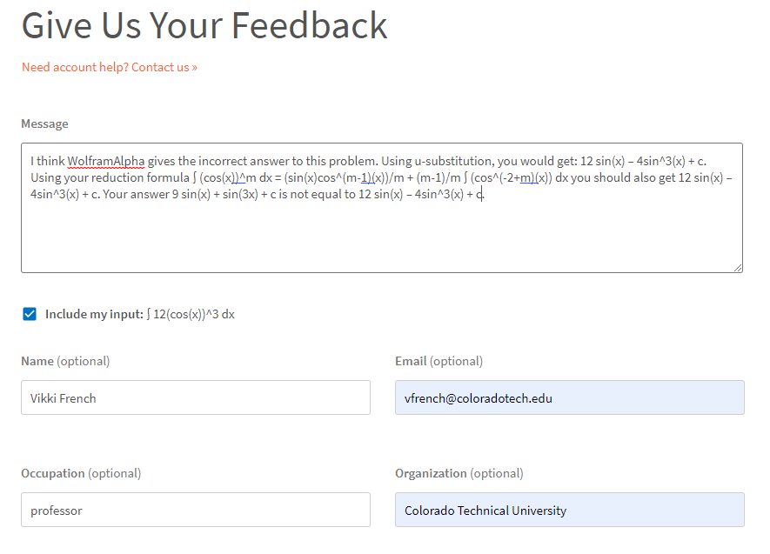
How about that 25)!

Slide 5
Area Under a Curve
We’ve been using integration as the inverse operation to undo differentiation

Slide 6
Area Under a Curve
We’ve been using integration as the inverse operation to undo differentiation
That’s important, but there’s an even more important use for integration

Slide 7
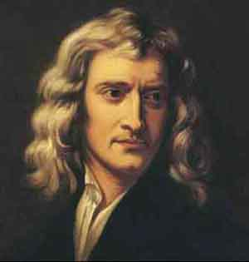
Area Under a Curve
Differentiation was invented by Newton to investigate the orbits of the planets
https://en.wikipedia.org/wiki/Isaac_Newton#/media/File:Sir_Isaac_Newton_(1643-1727).jpg
https://i.pinimg.com/originals/9a/de/89/9ade89ff4770e0390e40f6c168e80a26.png

Slide 8
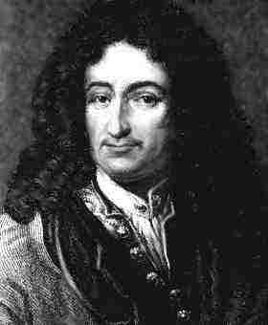
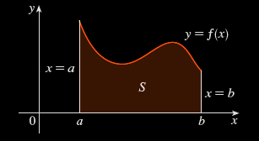
Area Under a Curve
Leibnitz was interested in solving the area problem: find the area of the region that lies under the curve
y = f(x) from a to b
https://coloradotech.vitalsource.com/#/books/9780357233375/cfi/6/28!/4/14@0:0
https://www.britannica.com/biography/Gottfried-Wilhelm-Leibniz

Slide 9
Area Under a Curve
What is an area?

Slide 10
Area Under a Curve
What is an area?
The area of a rectangle is: lw
l
w
VFrench 2020

Slide 11
Area Under a Curve
What is an area?
The area of a triangle is: ½bh
h
b
VFrench 2020

Slide 12
Area Under a Curve
What is an area?
An area is easy to find for regions with straight sides

Slide 13
Area Under a Curve
What is an area?
It isn't so easy to find the area of a region with curved sides

Slide 14
Area Under a Curve
For a curve, you can draw rectangles (which you CAN find the area for) to sort of fit the curve
http://archives.math.utk.edu/visual.calculus/4/midpoint.1/integral.html

Slide 15
Area Under a Curve
You can build
rectangles
above the
curve, below
the curve,
or going
through
midpoints
Kalkulus_Integral__cover.png

Slide 16
Area Under a Curve
You know the
true area under
the curve is a
number between
the sum of the
blue rectangles
and the sum of
the tan
rectangles
VFrench 2020

Slide 17
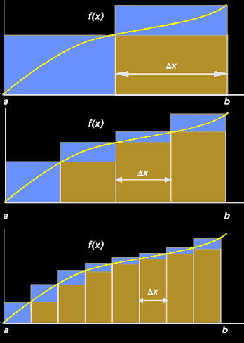
Area Under a Curve
As the rectangles
get narrower and
narrower (closer
and closer to
zero-width) the
area estimate
gets better
and better
VFrench 2020

Slide 18
Area Under a Curve
The true area is
going to be the
limit of the sum
of the blue or
tan rectangles (it
will converge)
VFrench 2020

Slide 19
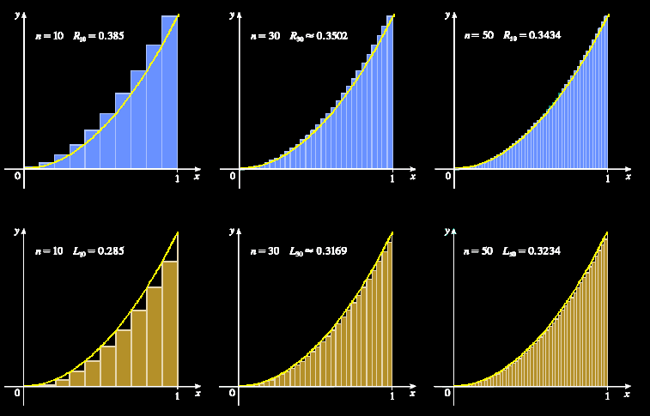
Area Under a Curve
https://coloradotech.vitalsource.com/#/books/9780357233375/cfi/6/28!/4/14@0:0

Slide 20
Area Under a Curve
This is what you are “adding up” that is the ∫um in integration – zillions of zero-width rectangles

Slide 21
Area Under a Curve
…and this is also why integral calculus is “nonsense”: you are adding up a whole bunch of zeros (areas of rectangles with zero width) to get something bigger than zero – the area under the curve

Slide 22
Area Under a Curve
…and this is also why integral calculus is “nonsense”: you are adding up a whole bunch of zeros (areas of rectangles with zero width) to get something bigger than zero – the area under the curve
Still, it works so well… let’s use it anyway!

Slide 23
Area Under a Curve
It’s also why this part of calculus is called “integration”: we are integrating all the slices together into a whole area

Slide 24
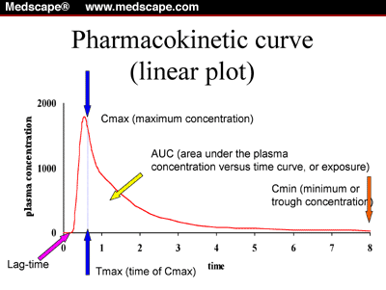
Area Under a Curve
Integration is used more than differentiation because a lot of people want to find areas under curves
(AUC means
“Area Under
Curve”)
cm.v17.fig1.gif

Slide 25
Area Under a Curve
Note: engineers use differentiation more than anybody else (physicists come close) and use differentiation more than integration

Slide 26

Questions?
http://i.imgur.com/aliTlT3.jpg

Slide 27
Area Under a Curve
This is the geometric interpretation of the integral (like tangent lines to the curve was the geometric interpretation of the derivative)

Slide 28
https://i2.wp.com/fractalkitty.com/wp-content/uploads/2019/07/untitled_artwork-10.jpg?fit=
2048%2C2048&ssl=1

Slide 29
Area Under a Curve
The height of each rectangle is the value of the function at some point “t” along the base of the rectangle
{
ƒ (t)
t
VFrench 2020

Slide 30
Area Under a Curve
The width of each rectangle is a constant Δt
Δt
{
t
VFrench 2020

Slide 31
Area Under a Curve
The area of each rectangle is area = height x width = ƒ(t)Δt
Δt
{
{
ƒ (t)
t
VFrench 2020

Slide 32
Area Under a Curve
The area under the curve between a and b (“n” rectangles) is approximately equal to the sum:
S_{n} = ƒ(t₁)Δt + ƒ(t₂)Δt +…+ ƒ(t_{n})Δt
Δt
{
{
ƒ (t)
a
t
b
VFrench 2020

Slide 33
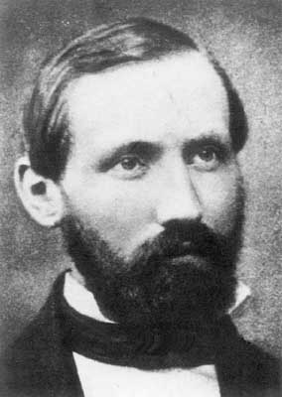
Area Under a Curve
S_{n} = ƒ(t₁)Δt + ƒ(t₂)Δt +…+ ƒ(t_{n})Δt
is called a “Riemann Sum”
Δt
{
{
ƒ (t)
Bernhard Riemann
a
t
b
https://www.usna.edu/Users/math/meh/riemann.html
VFrench 2020

Slide 34
Area Under a Curve
The smaller we choose the width Δx, the better the approximation for the area under the curve

Slide 35
Area Under a Curve
As Δx→0,
the number of terms n→∞
and the sum S_{n}→true area
under the curve:
S_{n} = A
lim
n→∞

Slide 36
Area Under a Curve
But, you wouldn’t want to actually do this to find the area under a curve

Slide 37
Area Under a Curve
But, you wouldn’t want to actually do this to find the area under a curve (it would take days to do even a simple problem)

Slide 38
Area Under a Curve
Instead, we use calculus:
A = ∫ƒ(b) dx - ∫ƒ(a) dx
Ending value
Starting value
VFrench 2020

Slide 39

AREA UNDER A CURVE
IN-CLASS PROBLEM 1
Find the area under the curve
y = x² from x=1 to x=2
4
3
2
1
A = ∫ƒ(b) dx - ∫ƒ(a) dx
-2
-1
0
1
2
Ending value
Starting value
VFrench 2022

Slide 40
AREA UNDER A CURVE
IN-CLASS PROBLEM 1
Find the area under the curve
y = x² from x=1 to x=2
What’s b?
4
3
2
1
A = ∫ƒ(b) dx - ∫ƒ(a) dx
-2
-1
0
1
2
Ending value
Starting value
VFrench 2022

Slide 41
AREA UNDER A CURVE
IN-CLASS PROBLEM 1
Find the area under the curve
y = x² from x=1 to x=2
What’s b? 2
What’s a?
4
3
2
1
A = ∫ƒ(b) dx - ∫ƒ(a) dx
-2
-1
0
1
2
Ending value
Starting value
VFrench 2022

Slide 42
AREA UNDER A CURVE
IN-CLASS PROBLEM 1
Find the area under the curve
y = x² from x=1 to x=2
What’s b? 2
What’s a? 1
What’s the formula?
A = ∫ƒ(b) dx - ∫ƒ(a) dx
Ending value
Starting value

Slide 43
AREA UNDER A CURVE
IN-CLASS PROBLEM 1
Find the area under the curve
y = x² from x=1 to x=2
What’s b? 2
What’s a? 1
What’s the formula?
A = ∫x² dx - ∫x² dx
First we do the integration
Where x = 2
Where x = 1
A = ∫ƒ(b) dx - ∫ƒ(a) dx

Slide 44
AREA UNDER A CURVE
IN-CLASS PROBLEM 1
Find the area under the curve
y = x² from x=1 to x=2
A = ∫x² dx - ∫x² dx
First we do the integration:
A = (x³/3 + c) – (x³/3 + c)
= (2³/3 + c) – (1³/3 + c)
= 8/3 + c – 1/3 – c = 7/3
Where x = 2
Where x = 1
Where x = 2
Where x = 1

Slide 45
AREA UNDER A CURVE
IN-CLASS PROBLEM 1
Find the area under the curve
y = x² from x=1 to x=2
A = ∫x² dx - ∫x² dx
First we do the integration:
A = (x³/3 + c) – (x³/3 + c)
= 8/3 + c – 1/3 – c = 7/3
Notice the c’s go away
Where x = 2
Where x = 1
Where x = 2
Where x = 1

Slide 46

Area Under a Curve
Each square is $\frac{\text{1}}{\text{3}}$ x $\frac{\text{1}}{\text{3}}$ with
area = $\frac{\text{1}}{\text{9}}$
How many squares?
4
3
2
1
-2
-1
0
1
2
VFrench 2022

Slide 47

Area Under a Curve
Each square is $\frac{\text{1}}{\text{3}}$ x $\frac{\text{1}}{\text{3}}$, area = $\frac{\text{1}}{\text{9}}$
How many squares? 16 full squares (16/9) and a bunch of bits (about 5)
All add up to 7/3 (21/9)
4
3
2
1
-2
-1
0
1
2
VFrench 2022

Slide 48
AREA UNDER A CURVE
IN-CLASS PROBLEM 1
Find the area under the curve
y = x² from x=1 to x=2
A = ∫x² dx - ∫x² dx
First we do the integration:
A = (x³/3 + c) – (x³/3 + c)
= 8/3 + c – 1/3 – c = 7/3
Where x = 2
Where x = 1
Where x = 2
Where x = 1

Slide 49
AREA UNDER A CURVE
IN-CLASS PROBLEM 1
Find the area under the curve
y = x² from x=1 to x=2
A = ∫x² dx - ∫x² dx
First we do the integration:
A = (x³/3 + c) – (x³/3 + c)
= 8/3 + c – 1/3 – c = 7/3
It’s now a definite integral!
Where x = 2
Where x = 1
Where x = 2
Where x = 1

Slide 50
Area Under a Curve
We write this symbolically as:
∫_{a}^{b} ƒ(x) dx
Where b is the upper limit and a the lower limit of the interval

Slide 51
Questions?
http://i.imgur.com/aliTlT3.jpg

Slide 52
Area Under a Curve
The Fundamental Theorem of Calculus says if ƒ(x) is continuous on the interval a≤x≤b
then ∫_{a}^{b} ƒ(x) dx = F(b) – F(a)
where F’(x) = ƒ(x)

Slide 53
Area Under a Curve
In other words, the technique for evaluating a definite integral is the same as finding the area under the curve

Slide 54
AREA UNDER A CURVE
IN-CLASS PROBLEM 2
Find the area under the curve
y = x³ from x=1 to x=3
What does our integral look like?
b
∫ ƒ(x) dx
a

Slide 55
AREA UNDER A CURVE
IN-CLASS PROBLEM 2
Find the area under the curve
y = x³ from x=1 to x=3
What does our integral look like? ∫_{a}^{b} ƒ(x) dx
What’s b?
b
∫ ƒ(x) dx
a

Slide 56
AREA UNDER A CURVE
IN-CLASS PROBLEM 2
Find the area under the curve
y = x³ from x=1 to x=3
What does our integral look like? ∫_{a}³ ƒ(x) dx
What’s b? 3
What’s a?
b
∫ ƒ(x) dx
a

Slide 57
AREA UNDER A CURVE
IN-CLASS PROBLEM 2
Find the area under the curve
y = x³ from x=1 to x=3
What does our integral look like? ∫₁³ ƒ(x) dx
What’s b? 3
What’s a? 1
What’s ƒ(x)?
b
∫ ƒ(x) dx
a

Slide 58
AREA UNDER A CURVE
IN-CLASS PROBLEM 2
Find the area under the curve
y = x³ from x=1 to x=3
What does our integral look like? ∫₁³ (x³) dx
What’s b? 3
What’s a? 1
What’s ƒ(x)? x³
What’s dx?

Slide 59
AREA UNDER A CURVE
IN-CLASS PROBLEM 2
Find the area under the curve
y = x³ from x=1 to x=3
What does our integral look like? ∫₁³ (x³) dx
What’s b? 3
What’s a? 1
What’s ƒ(x)? x³
What’s dx? dx (but it isn’t ALWAYS!)

Slide 60
AREA UNDER A CURVE
IN-CLASS PROBLEM 2
Find the area under the curve
y = x³ from x=1 to x=3
What does our integral look like? ∫₁³ (x³) dx
Now we can find the area!
(What do we do?)

Slide 61
AREA UNDER A CURVE
IN-CLASS PROBLEM 2
Find the area under the curve
y = x³ from x=1 to x=3
What does our integral look like? ∫₁³ (x³) dx
Now we can find the area!
(What do we do?) INTEGRATE!

Slide 62
AREA UNDER A CURVE
IN-CLASS PROBLEM 2
Find the area under the curve
y = x³ from x=1 to x=3
Area = ∫₁³ (x³) dx = x⁴/4 |₁³
Note: we don’t even bother with the “c”s for these!
new symbol

Slide 63
AREA UNDER A CURVE
IN-CLASS PROBLEM 2
Find the area under the curve
y = x³ from x=1 to x=3
Area = ∫₁³ (x³) dx = x⁴/4 |₁³
= 3⁴/4 - 1⁴/4 = 81/4 – 1/4
= 80/4 = 20

Slide 64
Questions?
http://i.imgur.com/aliTlT3.jpg

Slide 65
AREA UNDER A CURVE
IN-CLASS PROBLEM 3
Evaluate each definite integral:
∫₀¹ 5 dx

Slide 66
AREA UNDER A CURVE
IN-CLASS PROBLEM 3
Evaluate each definite integral:
∫₀¹ 5 dx = ∫₀¹ 5x⁰ dx = 5x |₀¹
= 5(1) – 5(0)

Slide 67
AREA UNDER A CURVE
IN-CLASS PROBLEM 3
Evaluate each definite integral:
∫₀¹ 5 dx = 5
∫₋₁¹ 5 dx =
https://www.wolframalpha.com/input/?i=definite+integral

Slide 68
AREA UNDER A CURVE
IN-CLASS PROBLEM 3
Evaluate each definite integral:
∫₀¹ 5 dx = 5
∫₋₁¹ 5 dx = 10
∫₀¹ 5x dx =
https://www.wolframalpha.com/input/?i=definite+integral

Slide 69
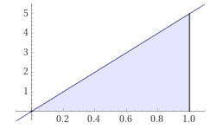
AREA UNDER A CURVE
IN-CLASS PROBLEM 3
Evaluate each definite integral:
∫₀¹ 5 dx = 5
∫₋₁¹ 5 dx = 10
∫₀¹ 5x dx = 2.5
∫₋₁¹ 5x dx =
= 5/2 x² |₀¹ = 2.5
=
https://www.wolframalpha.com/input/?i=definite+integral

Slide 70
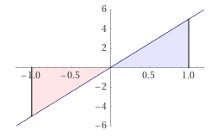
AREA UNDER A CURVE
IN-CLASS PROBLEM 3
Evaluate each definite integral:
∫₀¹ 5 dx = 5
∫₋₁¹ 5 dx = 10
∫₀¹ 5x dx = 2.5
∫₋₁¹ 5x dx = 0
https://www.wolframalpha.com/input/?i=definite+integral

Slide 71
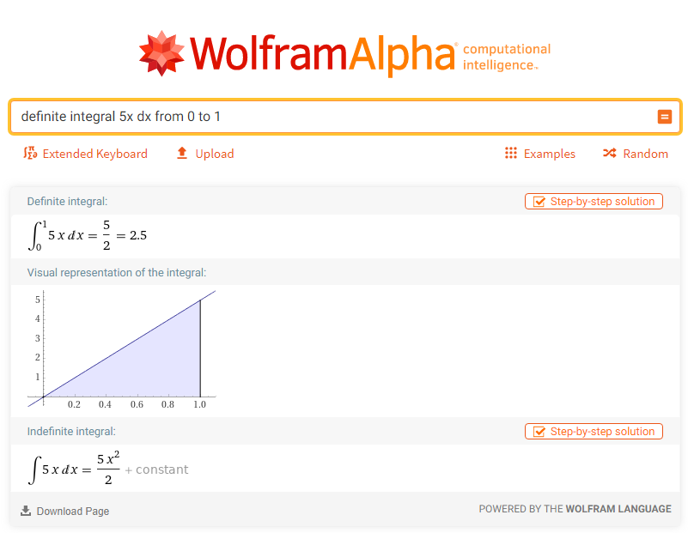

Slide 72
Area Under a Curve
Note: WolframAlpha does “area under a curve” as an absolute value and does NOT subtract the negative half from the positive half
(hence, their answers are wrong under the traditional rules)

Slide 73
Area Under a Curve
To get the right answer, use:
“definite integral” rather than “area under curve”

Slide 74
Questions?
http://i.imgur.com/aliTlT3.jpg

Slide 75
Area Under a Curve
You can have any function for your curve (even ones you can’t integrate)

Slide 76
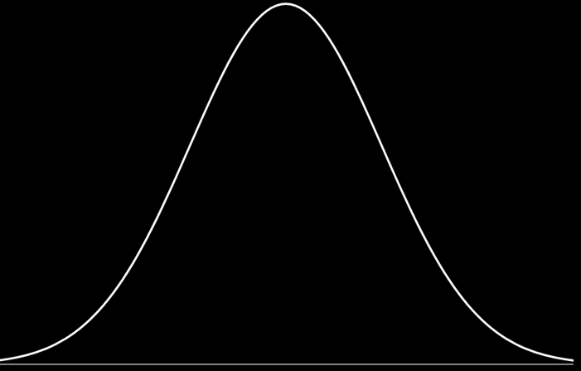
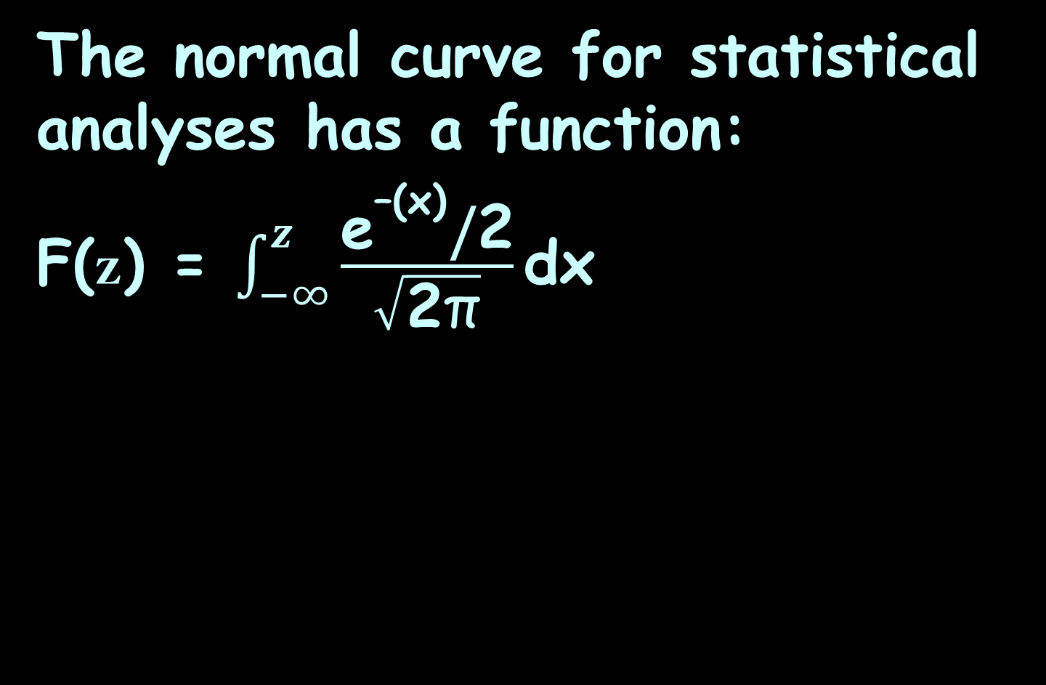
Area Under a Curve
The normal curve for statistical analyses has a function:
F(z) = $\int_{−∞}^{z}{\frac{{\text{e}}^{\text{–(}\text{x}\text{)}}\text{/}\text{2}}{\sqrt{\text{2}\text{π}}}\text{dx}}$
https://www.google.com/url?sa=i&url=http%3A%2F%2Fsciences.usca.edu%2Fbiology%2Fzelmer%2F305%2Fnorm%2F&psig=AOvVaw07wKhR9qMhfHqS4DcnjpYs&ust=1606637469634000&source=images&cd=vfe&ved=0CAIQjRxqFwoTCKiF4JXlpO0CFQAAAAAdAAAAABAD

Slide 77
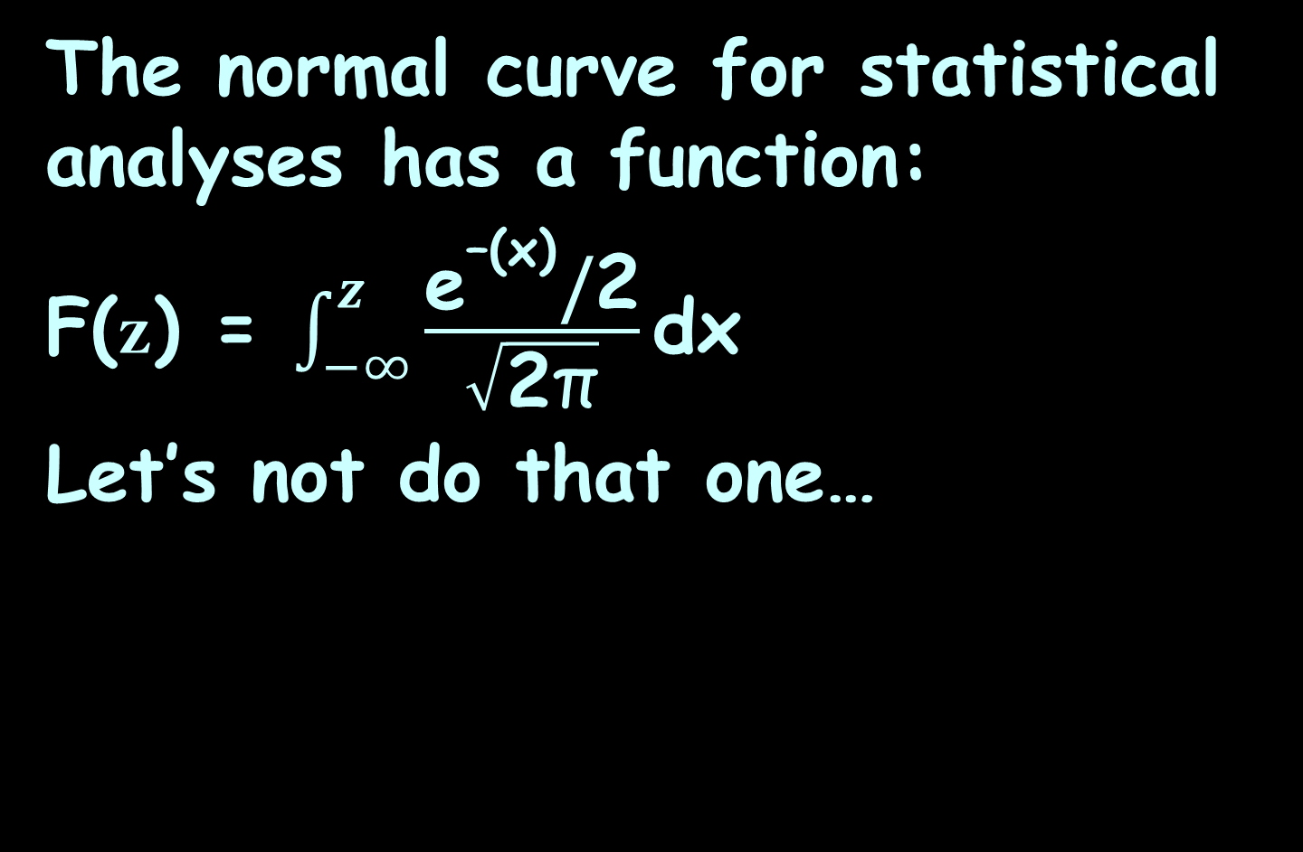
Area Under a Curve
The normal curve for statistical analyses has a function:
F(z) = $\int_{−∞}^{z}{\frac{{\text{e}}^{\text{–(}\text{x}\text{)}}\text{/}\text{2}}{\sqrt{\text{2}\text{π}}}\text{dx}}$
Let’s not do that one…
https://www.google.com/url?sa=i&url=http%3A%2F%2Fsciences.usca.edu%2Fbiology%2Fzelmer%2F305%2Fnorm%2F&psig=AOvVaw07wKhR9qMhfHqS4DcnjpYs&ust=1606637469634000&source=images&cd=vfe&ved=0CAIQjRxqFwoTCKiF4JXlpO0CFQAAAAAdAAAAABAD

Slide 78
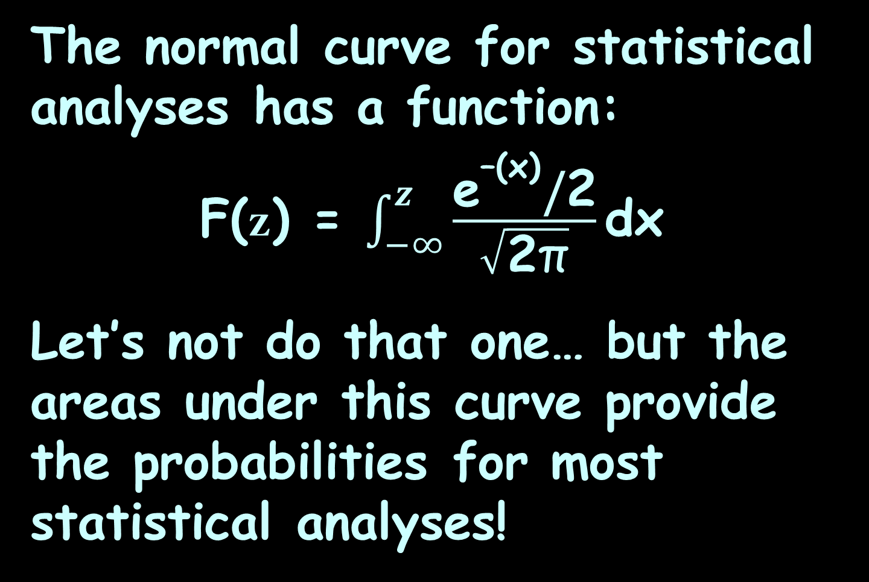
Area Under a Curve
The normal curve for statistical analyses has a function:
F(z) = $\int_{−∞}^{z}{\frac{{\text{e}}^{\text{–(}\text{x}\text{)}}\text{/}\text{2}}{\sqrt{\text{2}\text{π}}}\text{dx}}$
Let’s not do that one… but the areas under this curve provide the probabilities for most statistical analyses!

Slide 79
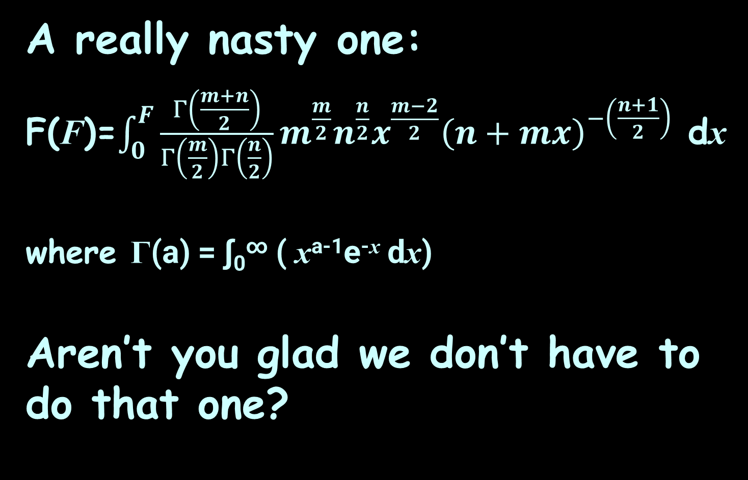
Area Under a Curve
A really nasty one:
F(F)=$\int_{0}^{F}{\frac{Γ\left(\frac{m+n}{2}\right)}{Γ\left(\frac{m}{2}\right)Γ\left(\frac{n}{2}\right)}}m^{\frac{m}{2}}n^{\frac{n}{2}}x^{\frac{m−2}{2}}{\left(n+mx\right)}^{−\left(\frac{n+1}{2}\right)}$ dx
where Γ(a) = ∫₀∞ ( x^{a-1}e^{-x} dx)
Aren’t you glad we don’t have to do that one?

Slide 80
Area Under a Curve
For more complicated integrals, there are some tricks!

Slide 81
AREA UNDER A CURVE
IN-CLASS PROBLEM 4
Find ∫₁⁰ x(x²+1)² dx
Note: the b and a don’t seem to be in order – that’s ok, too!

Slide 82
AREA UNDER A CURVE
IN-CLASS PROBLEM 4
Find ∫₁⁰ x(x²+1)² dx
Note: the b and a don’t seem to be in order – that’s ok, too!
It means we are adding from right to left and will get a negative area!

Slide 83
AREA UNDER A CURVE
IN-CLASS PROBLEM 4
Find ∫₁⁰ x(x²+1)² dx
Does it look like Reverse Chain Rule will work? (Is there a “u” and a “du”?)

Slide 84
AREA UNDER A CURVE
IN-CLASS PROBLEM 4
Find ∫₁⁰ x(x²+1)² dx
u = x²+1 du = 2x dx

Slide 85
AREA UNDER A CURVE
IN-CLASS PROBLEM 4
Find ∫₁⁰ x(x²+1)² dx
u = x²+1 du = 2x dx
Remember we can make this work by rewriting the original
as: ∫₁⁰ ½×2x(x²+1)² dx
or: ½∫₁⁰ u² du

Slide 86
AREA UNDER A CURVE
IN-CLASS PROBLEM 4
Find ∫₁⁰ x(x²+1)² dx
u = x²+1 du = 2x dx
½∫₁⁰ u² du
But… everything is in terms of “u” now EXCEPT the “b” and “a”

Slide 87
AREA UNDER A CURVE
IN-CLASS PROBLEM 4
Find ∫₁⁰ x(x²+1)² dx
u = x²+1 du = 2x dx
½∫_{x=1}^{x=0} u² du
Now, here’s a trick: rewrite the limits using the u, too!

Slide 88
AREA UNDER A CURVE
IN-CLASS PROBLEM 4
Find ∫₁⁰ x(x²+1)² dx
u = x²+1 du = 2x dx
½∫_{x=1}^{x=0} u² du
Now, here’s a trick: rewrite the limits using the u, too!
If x = 0, then u = 0²+1 = 1
and if x = 1, then u = 1²+1 = 2
½∫₂¹ u² du gee… that almost looks easy!

Slide 89
AREA UNDER A CURVE
IN-CLASS PROBLEM 4
Find ∫₁⁰ x(x²+1)² dx
u = x²+1 du = 2x dx
½∫₂¹ u² du = ½ (1/3 u³) |₂¹
= u³/6 |₂¹
= 1³/6 - 2³/6
= 1/6 – 8/6 = -7/6
Yes, there’s our negative area!

Slide 90
AREA UNDER A CURVE
IN-CLASS PROBLEM 4
Find ∫₁⁰ x(x²+1)² dx
u = x²+1 du = 2x dx
½∫₂¹ u² du = ½ (1/3 u³) |₂¹
= -7/6
Because we changed the limits to “u” values, we don’t have to change anything back to x’s at the end!

Slide 91
Area Under a Curve
And, we just proved another calculus theorem:
∫_{a}^{b} ƒ(x) dx = -∫_{b}ª ƒ(x) dx

Slide 92
Questions?
http://i.imgur.com/aliTlT3.jpg

Slide 93
AREA UNDER A CURVE
IN-CLASS PROBLEM 5
The rate of change of resistance with respect to temperature is given by:
dR/dT = 0.009T² + 0.02T – 0.7

Slide 94
AREA UNDER A CURVE
IN-CLASS PROBLEM 5
The rate of change of resistance with respect to temperature is given by:
dR/dT = 0.009T² + 0.02T – 0.7
A little algebra:
dR = (0.009T² + 0.02T – 0.7) dT
Kinda lookin’ like an integral…

Slide 95
AREA UNDER A CURVE
IN-CLASS PROBLEM 5
The rate of change of resistance with respect to temperature is given by:
dR/dT = 0.009T² + 0.02T – 0.7
A little algebra:
dR = (0.009T² + 0.02T – 0.7) dT
∫dR = ∫(0.009T² + 0.02T – 0.7) dT
These cancel

Slide 96
AREA UNDER A CURVE
IN-CLASS PROBLEM 5
The rate of change of resistance with respect to temperature is given by:
dR/dT = 0.009T² + 0.02T – 0.7
A little algebra:
dR = (0.009T² + 0.02T – 0.7) dT
R = ∫ (0.009T² + 0.02T – 0.7) dT

Slide 97
AREA UNDER A CURVE
IN-CLASS PROBLEM 5
The rate of change of resistance with respect to temperature is given by:
dR/dT = 0.009T² + 0.02T – 0.7
Suppose they ask:
Find the area under the curve between T=20°C and 25°C
What does the integral look like?

Slide 98
AREA UNDER A CURVE
IN-CLASS PROBLEM 5
The rate of change of resistance with respect to temperature is given by:
dR/dT = 0.009T² + 0.02T – 0.7
Find the area under the curve between T=20°C and 25°C
What does the integral look like?
∫₂₀²⁵ (0.009T² + 0.02T – 0.7) dT

Slide 99
AREA UNDER A CURVE
IN-CLASS PROBLEM 5
The rate of change of resistance with respect to temperature is given by:
dR/dT = 0.009T² + 0.02T – 0.7
Find the area under the curve between T=20°C and 25°C
∫₂₀²⁵ (0.009T² + 0.02T – 0.7) dT
Do it!

Slide 100
AREA UNDER A CURVE
IN-CLASS PROBLEM 5
The rate of change of resistance with respect to temperature is given by:
dR/dT = 0.009T² + 0.02T – 0.7
Find the area under the curve between T=20°C and 25°C
∫₂₀²⁵ (0.009T² + 0.02T – 0.7) dT
(0.009/3)T³+(0.02/2)T²-0.7T|₂₀²⁵

Slide 101
AREA UNDER A CURVE
IN-CLASS PROBLEM 5
∫₂₀²⁵ (0.009T² +0.02T – 0.7) dT
=(0.009/3)T³+(0.02/2)T²-0.7T |₂₀²⁵
= (0.003(25³)+0.01(25²)-0.7(25))
-(0.003(20³)+0.01(20²)-0.7(20))
≈ (46.9+6.25-17.5)-(24+4-14)
≈ 21.625
what are the units on this?

Slide 102
AREA UNDER A CURVE
IN-CLASS PROBLEM 5
∫₂₀²⁵ (0.009T² +0.02T – 0.7) dT
=(0.009/3)T³+(0.02/2)T²-0.7T |₂₀²⁵
= (0.003(25³)+0.01(25²)-0.7(25))
-(0.003(20³)+0.01(20²)-0.7(20))
≈ (46.9+6.25-17.5)-(24+4-14)
≈ 21.625
what are the units on this?
You would think it would be ohms/degree C… but…

Slide 103
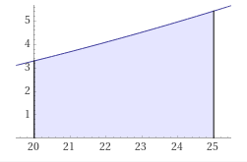
AREA UNDER A CURVE
IN-CLASS PROBLEM 5
The graph is ΔR/ΔT vs temp
ΔR/ΔT seems to be called “sensitivity” – it’s units would be ohms per degree C
The area will be
ΔR/ΔT x ΔT
So the units
should be ohms
ΔR/ΔT ohms/°C
Temperature °C
https://www.wolframalpha.com/input/?i=definite+integral+%280.009T%5E2+%2B0.02T+%E2%80%93+0.7%29+dT+from+20+to+25

Slide 104
AREA UNDER A CURVE
IN-CLASS PROBLEM 5
The rate of change of resistance with respect to temperature is given by:
dR/dT = 0.009T² + 0.02T – 0.7
A little algebra:
dR = (0.009T² + 0.02T – 0.7) dT
R = ∫ (0.009T² + 0.02T – 0.7) dT
≈ 21.625 ohms!

Slide 105
Area Under a Curve
The units of the area under the curve are the units of the Y axis times units of the x axis

Slide 106
Questions?
http://i.imgur.com/aliTlT3.jpg

Slide 107
The secret word for this unit is:
UNDER

Slide 108
Area Between Curves
The area under a curve is pretty easy if you know how to integrate the curve
https://www.math24.net/area-region-bounded-by-curves/

Slide 109
Area Between Curves
What if you wanted to know the area between two curves?
https://www.math24.net/area-region-bounded-by-curves/

Slide 110

Area Between Curves
That is easy, too!
(Believe it or not…)
rkitp/curriculum/v1n5/v1n5_wiki_how-t...
https://www.math24.net/area-region-bounded-by-curves/

Slide 111
Area Between Curves
Both curves have to be continuous over the interval
https://www.math24.net/area-region-bounded-by-curves/

Slide 112
Area Between Curves
It’s easier if one curve is always above or even with the other curve
https://www.math24.net/area-region-bounded-by-curves/

Slide 113
Area Between Curves
The area between the curves is:
- =
The area below the upper curve
The area below the lower curve
The area between the curves
https://www.math24.net/area-region-bounded-by-curves/

Slide 114
Area Between Curves
The area between the curves is:
- =
∫ ƒ(x) – g(x) dx
b
a
ƒ(x)
g(x)
The area below the upper curve
The area below the lower curve
The area between the curves
https://www.math24.net/area-region-bounded-by-curves/

Slide 115
Area Between Curves
Another way to look at it: what height is each rectangle in the Riemann sum?
https://www.math24.net/area-region-bounded-by-curves/

Slide 116
Area Between Curves
height = high value – low value
= ƒ(x) – g(x)
So the integral
will give
the area
∫ ƒ(x) – g(x) dx
b
a
https://www.math24.net/area-region-bounded-by-curves/

Slide 117
AREA BETWEEN CURVES
IN-CLASS PROBLEM 6
Find the area between the curves y = x² + 5 and y = x + 1 between x = 0 and x = 1
Which is the “top” curve?

Slide 118
AREA BETWEEN CURVES
IN-CLASS PROBLEM 6
Find the area between the curves y = x² + 5 and y = x + 1 between x = 0 and x = 1
Which is the “top” curve?
It doesn’t really
matter!
But x²+5 is higher
https://www.wolframalpha.com/input/?i=area+between+curves+y%3Dx%5E2%2B5+and+y%3Dx%2B1+interval+0%2C1

Slide 119
AREA BETWEEN CURVES
IN-CLASS PROBLEM 6
Find the area between the curves y = x² + 5 and y = x + 1 between x = 0 and x = 1
What is the integral?
What is a?
b
∫ ƒ(x) – g(x) dx
a

Slide 120
AREA BETWEEN CURVES
IN-CLASS PROBLEM 6
Find the area between the curves y = x² + 5 and y = x + 1 between x = 0 and x = 1
What is a? 0
What is b?
b
∫ ƒ(x) – g(x) dx
a

Slide 121
AREA BETWEEN CURVES
IN-CLASS PROBLEM 6
Find the area between the curves y = x² + 5 and y = x + 1 between x = 0 and x = 1
What is a? 0
What is b? 1
What is ƒ(x)?
b
∫ ƒ(x) – g(x) dx
a

Slide 122
AREA BETWEEN CURVES
IN-CLASS PROBLEM 6
Find the area between the curves y = x² + 5 and y = x + 1 between x = 0 and x = 1
What is a? 0
What is b? 1
What is ƒ(x)? x² + 5
What is g(x)?
b
∫ ƒ(x) – g(x) dx
a

Slide 123
AREA BETWEEN CURVES
IN-CLASS PROBLEM 6
Find the area between the curves y = x² + 5 and y = x + 1 between x = 0 and x = 1
What is a? 0
What is b? 1
What is ƒ(x)? x² + 5
What is g(x)? x + 1
What is the integral?
b
∫ ƒ(x) – g(x) dx
a

Slide 124
AREA BETWEEN CURVES
IN-CLASS PROBLEM 6
Find the area between the curves y = x² + 5 and y = x + 1 between x = 0 and x = 1
What is the integral?
Do it!
∫ (x² + 5) – (x+1) dx
1
0
b
∫ ƒ(x) – g(x) dx
a

Slide 125
AREA BETWEEN CURVES
IN-CLASS PROBLEM 6
Find the area between the curves y = x² + 5 and y = x + 1 between x = 0 and x = 1
=
= (x³/3+5x) – (x²/2+x)
∫ (x²+5) – (x+1) dx
1
0
|
|
1
1
0
0

Slide 126
AREA BETWEEN CURVES
IN-CLASS PROBLEM 6
Find the area between the curves y = x² + 5 and y = x + 1 between x = 0 and x = 1
=
= (x³/3+5x) – (x²/2+x)
= (((1³)/3+5(1))-((0³)/3+5(0)))
– ((1²/2+1)–(0²/2+0))
∫ (x²+5) – (x+1) dx
1
0
|
|
1
1
0
0

Slide 127
AREA BETWEEN CURVES
IN-CLASS PROBLEM 6
Find the area between the curves y = x² + 5 and y = x + 1 between x = 0 and x = 1
=
= (x³/3+5x) – (x²/2+x)
= (((1³)/3+5(1))-((0³)/3+5(0)))
– ((1²/2+1)–(0²/2+0))
= ((1/3+5)-(0+0))–((1/2+1)-(0+0))
∫ (x²+5) – (x+1) dx
1
0
|
|
1
1
0
0

Slide 128
AREA BETWEEN CURVES
IN-CLASS PROBLEM 6
Find the area between the curves y = x² + 5 and y = x + 1 between x = 0 and x = 1
=
= (x³/3+5x) – (x²/2+x)
= ((1/3+5)-(0+0))–((1/2+1)-(0+0))
= 16/3 – 3/2 = 32/6 – 9/6
= 23/6
∫ (x²+5) – (x+1) dx
1
0
|
|
1
1
0
0

Slide 129
AREA BETWEEN CURVES
IN-CLASS PROBLEM 6
Find the area between the curves y = x² + 5 and y = x + 1 between x = 0 and x = 1
= 23/6
∫ (x²+5) – (x+1) dx
1
0

Slide 130
Questions?
http://i.imgur.com/aliTlT3.jpg

Slide 131
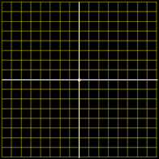
AREA BETWEEN CURVES
IN-CLASS PROBLEM 7a
Find the area between the curves on the interval 0,1
Each square
has an
area = ¼
4
3
2
1
-4
-3
0
-2
-1
0
1
2
3
4
-1
-2
-3
-4
VFrench 2020

Slide 132
AREA BETWEEN CURVES
IN-CLASS PROBLEM 7a
Find the area between the curves on the interval 0,1
Area = ½
How did you
do it?
4
3
2
1
-4
-3
0
-2
-1
0
1
2
3
4
-1
-2
-3
-4
VFrench 2020

Slide 133
AREA BETWEEN CURVES
IN-CLASS PROBLEM 7a
Find the area between the curves on the interval 0,1
Area = ½
How did you
do it?
Count the
squares
(1+½+½)* ¼
4
3
2
1
-4
-3
0
-2
-1
0
1
2
3
4
-1
Area
-2
-3
# of squares
-4
VFrench 2020

Slide 134
AREA BETWEEN CURVES
IN-CLASS PROBLEM 7b
Find the area between the curves on the interval -1,1
4
3
2
1
-4
-3
0
-2
-1
0
1
2
3
4
-1
-2
-3
-4
VFrench 2020

Slide 135
AREA BETWEEN CURVES
IN-CLASS PROBLEM 7b
Find the area between the curves on the interval -1,1
Area = 1
4
3
2
1
-4
-3
0
-2
-1
0
1
2
3
4
-1
-2
-3
-4
VFrench 2020

Slide 136

AREA BETWEEN CURVES
IN-CLASS PROBLEM 7b
Hold it! For the area under a curve, we had:
Evaluate
= 0
Why is this
different???
1
∫ 5x dx
-1
https://www.wolframalpha.com/
input/?i=definite+integral
http://www.testically.org/wp-content/uploads/2010/11/hmm.jpg

Slide 137
AREA BETWEEN CURVES
IN-CLASS PROBLEM 7b
Last class was about the area UNDER a curve
There was an
required location
(between the
curve and the
x-axis)
and direction (below the curve)
https://www.wolframalpha.com/input/?i=definite+integral

Slide 138
AREA BETWEEN CURVES
IN-CLASS PROBLEM 7b
This part is going the wrong direction, so it’s
negative
https://www.wolframalpha.com/input/?i=definite+integral

Slide 139
AREA BETWEEN CURVES
IN-CLASS PROBLEM 7b
The area between curves, though, doesn’t specify which curve is on top
You just
calculate the
area between
the two curves
Area = 1
4
3
2
1
-4
-3
0
-2
-1
0
1
2
3
4
-1
-2
-3
-4
VFrench 2020

Slide 140
AREA BETWEEN CURVES
IN-CLASS PROBLEM 7c
Find the area between the curves on the interval 1,2
4
3
2
1
-4
-3
0
-2
-1
0
1
2
3
4
-1
-2
-3
-4
VFrench 2020

Slide 141
AREA BETWEEN CURVES
IN-CLASS PROBLEM 7c
Find the area between the curves on the interval 1,2
Area = 6(¼)
= 1.5
4
3
2
1
-4
-3
0
-2
-1
0
1
2
3
4
-1
-2
-3
-4
VFrench 2020

Slide 142
AREA BETWEEN CURVES
IN-CLASS PROBLEM 7d
Find the area between the curves on the interval 0,1
4
3
2
1
-4
-3
0
-2
-1
0
1
2
3
4
-1
-2
-3
-4
VFrench 2020

Slide 143
AREA BETWEEN CURVES
IN-CLASS PROBLEM 7d
Find the area between the curves on the interval 0,1
Area = 4(¼)
= 1
4
3
2
1
-4
-3
0
-2
-1
0
1
2
3
4
-1
-2
-3
-4
VFrench 2020

Slide 144
Questions?
http://i.imgur.com/aliTlT3.jpg

Slide 145
Area Between Curves
Sometimes the question is about areas between the intersections of two curves

Slide 146
Area Between Curves
Sometimes the question is about areas between the intersections of two curves (they’re not telling you the interval…)

Slide 147
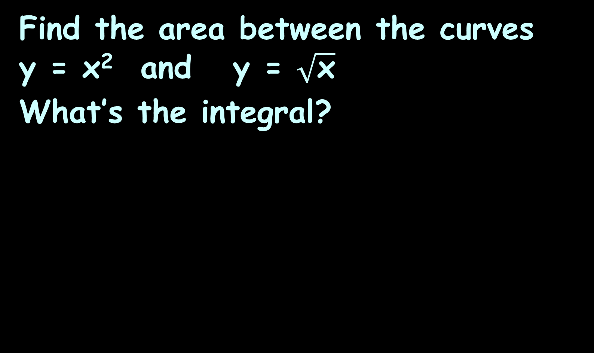
AREA BETWEEN CURVES
IN-CLASS PROBLEM 8
Find the area between the curves y = x² and y = $\sqrt{\text{x}}$
What’s the integral?
https://www.wolframalpha.com/input/?i=area+between+curves+y%3Dx%5E2+and+y%3Dsqrt%28x%29+

Slide 148
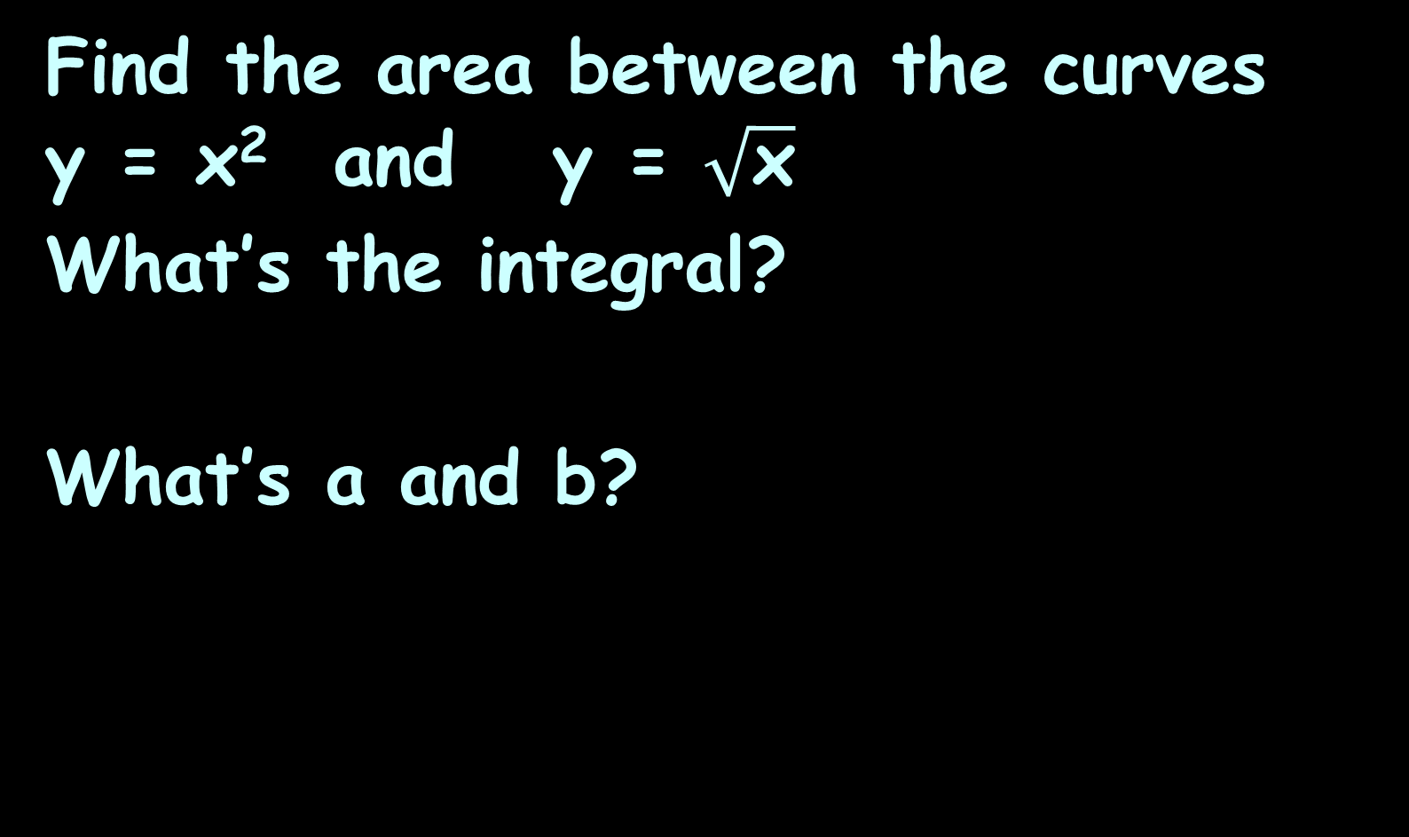
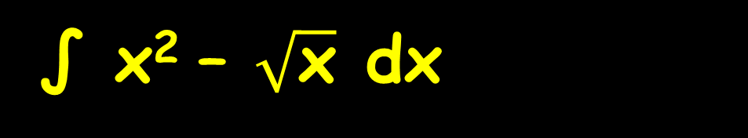
AREA BETWEEN CURVES
IN-CLASS PROBLEM 8
Find the area between the curves y = x² and y = $\sqrt{\text{x}}$
What’s the integral?
What’s a and b?
∫ x² – $\sqrt{\text{x}}$ dx
b
a
b
∫ ƒ(x) – g(x) dx
a
https://www.wolframalpha.com/input/?i=area+between+curves+y%3Dx%5E2+and+y%3Dsqrt%28x%29+

Slide 149
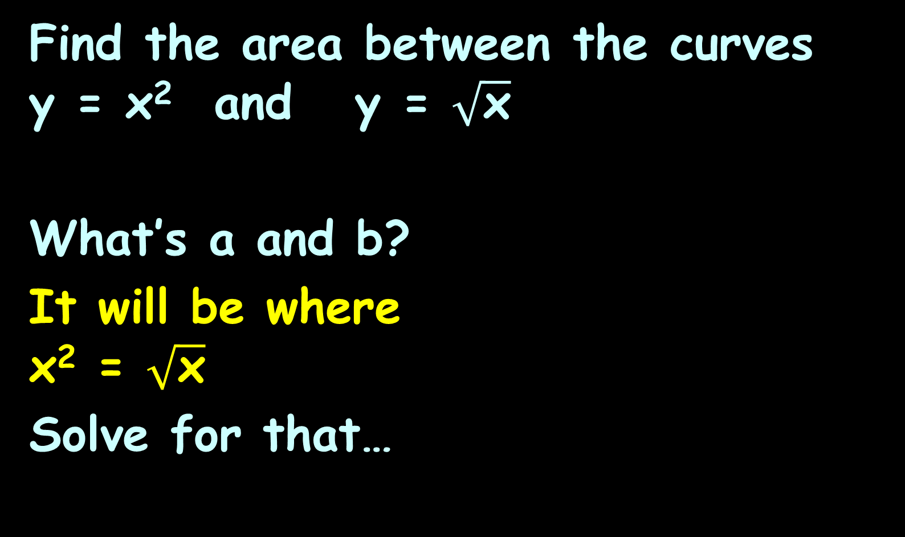
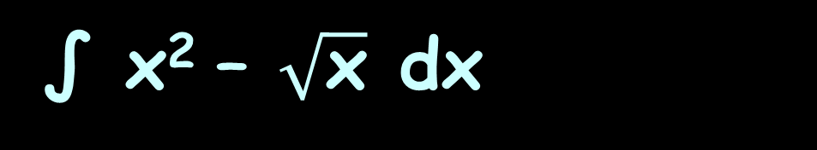
AREA BETWEEN CURVES
IN-CLASS PROBLEM 8
Find the area between the curves y = x² and y = $\sqrt{\text{x}}$
What’s a and b?
It will be where
x² = $\sqrt{\text{x}}$
Solve for that…
∫ x² – $\sqrt{\text{x}}$ dx
b
a
b
∫ ƒ(x) – g(x) dx
a
https://www.wolframalpha.com/input/?i=area+between+curves+y%3Dx%5E2+and+y%3Dsqrt%28x%29+

Slide 150

AREA BETWEEN CURVES
IN-CLASS PROBLEM 8
Find the area between the curves y = x² and y = $\sqrt{\text{x}}$
What’s a and b?
x² = $\sqrt{\text{x}}$
Happens where
x=0 and x=1
Which is a?
Which is b?
∫ x² – $\sqrt{\text{x}}$ dx
b
a
b
∫ ƒ(x) – g(x) dx
a
https://www.wolframalpha.com/input/?i=area+between+curves+y%3Dx%5E2+and+y%3Dsqrt%28x%29+

Slide 151
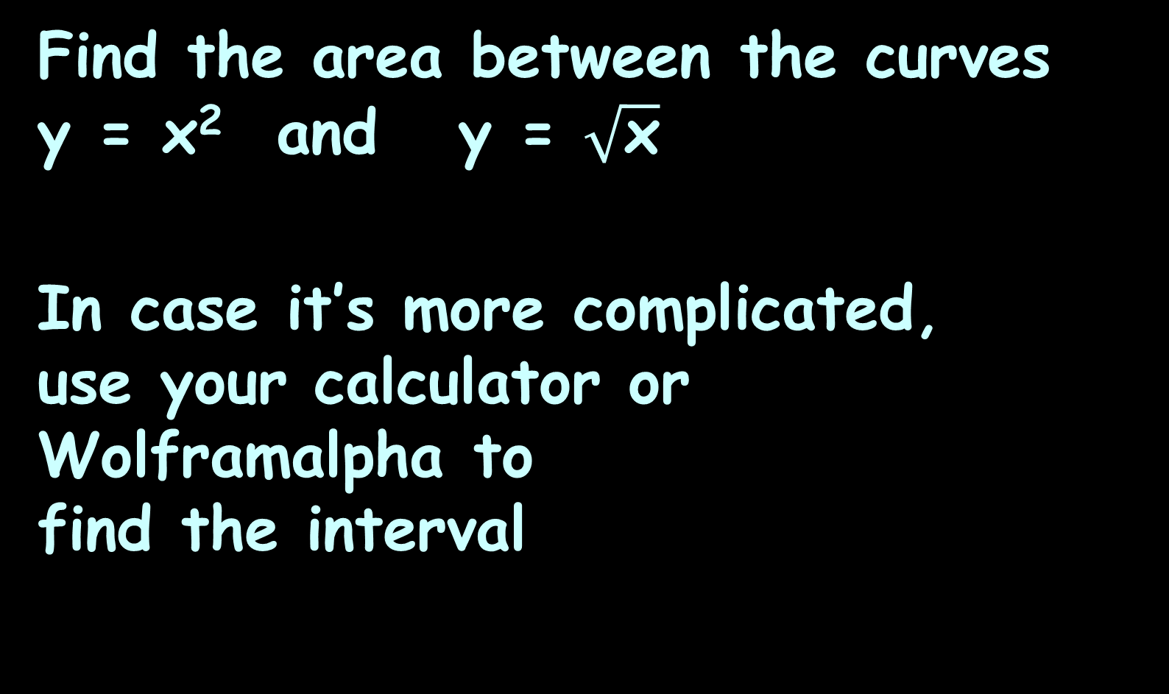
AREA BETWEEN CURVES
IN-CLASS PROBLEM 8
Find the area between the curves y = x² and y = $\sqrt{\text{x}}$
In case it’s more complicated,
use your calculator or Wolframalpha to
find the interval
∫ x² – $\sqrt{\text{x}}$ dx
1
0
b
∫ ƒ(x) – g(x) dx
a
https://www.wolframalpha.com/input/?i=area+between+curves+y%3Dx%5E2+and+y%3Dsqrt%28x%29+

Slide 152
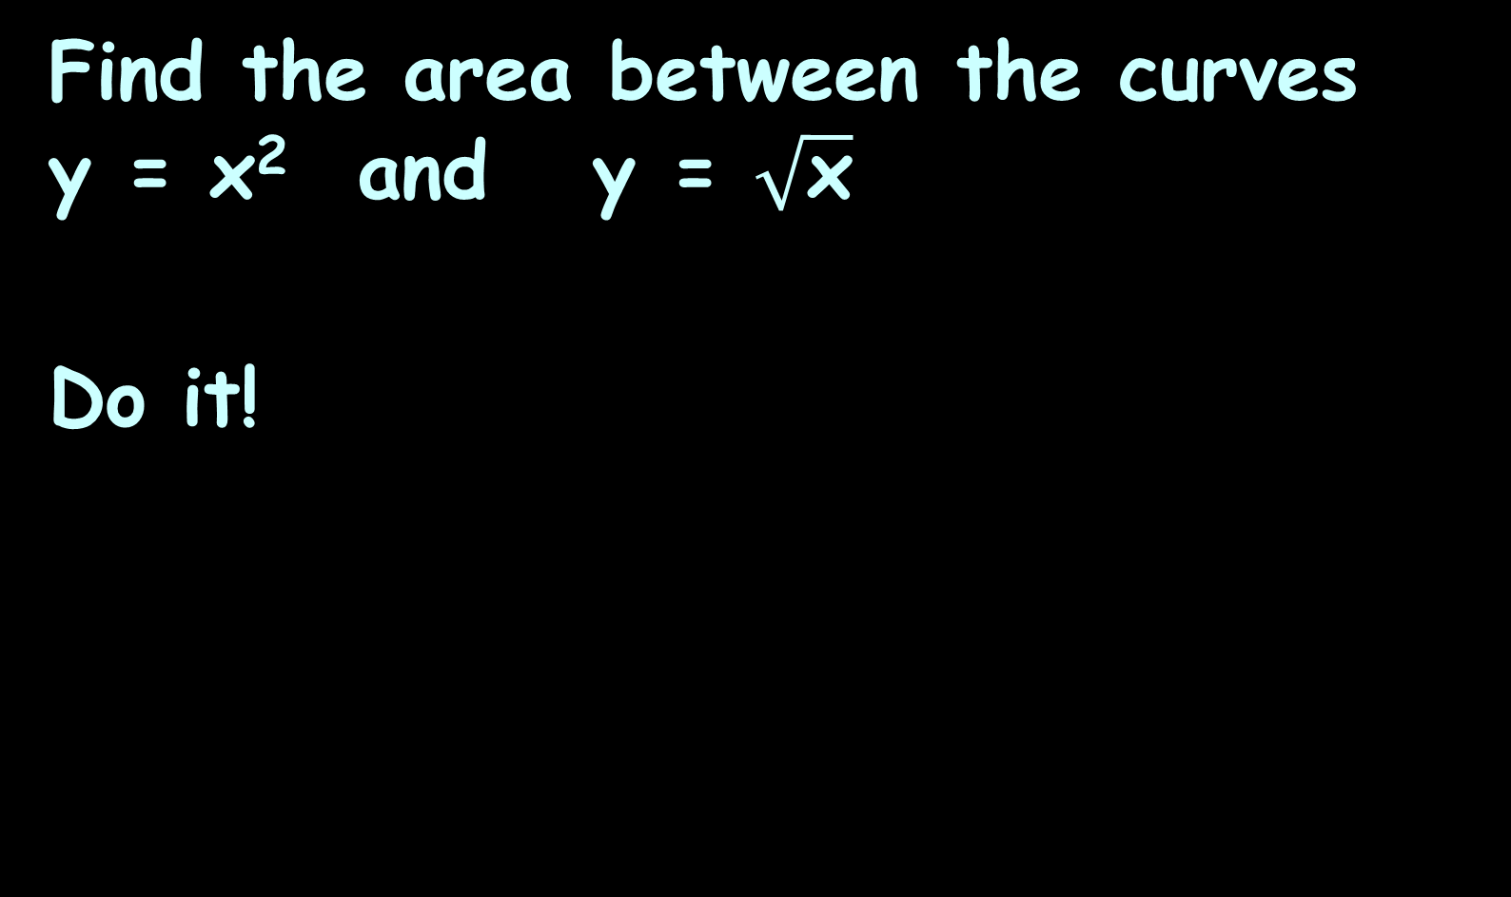
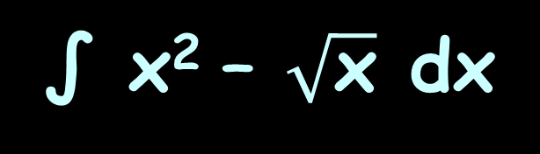
AREA BETWEEN CURVES
IN-CLASS PROBLEM 8
Find the area between the curves y = x² and y = $\sqrt{\text{x}}$
Do it!
∫ x² – $\sqrt{\text{x}}$ dx
1
0
https://www.wolframalpha.com/input/?i=area+between+curves+y%3Dx%5E2+and+y%3Dsqrt%28x%29+

Slide 153
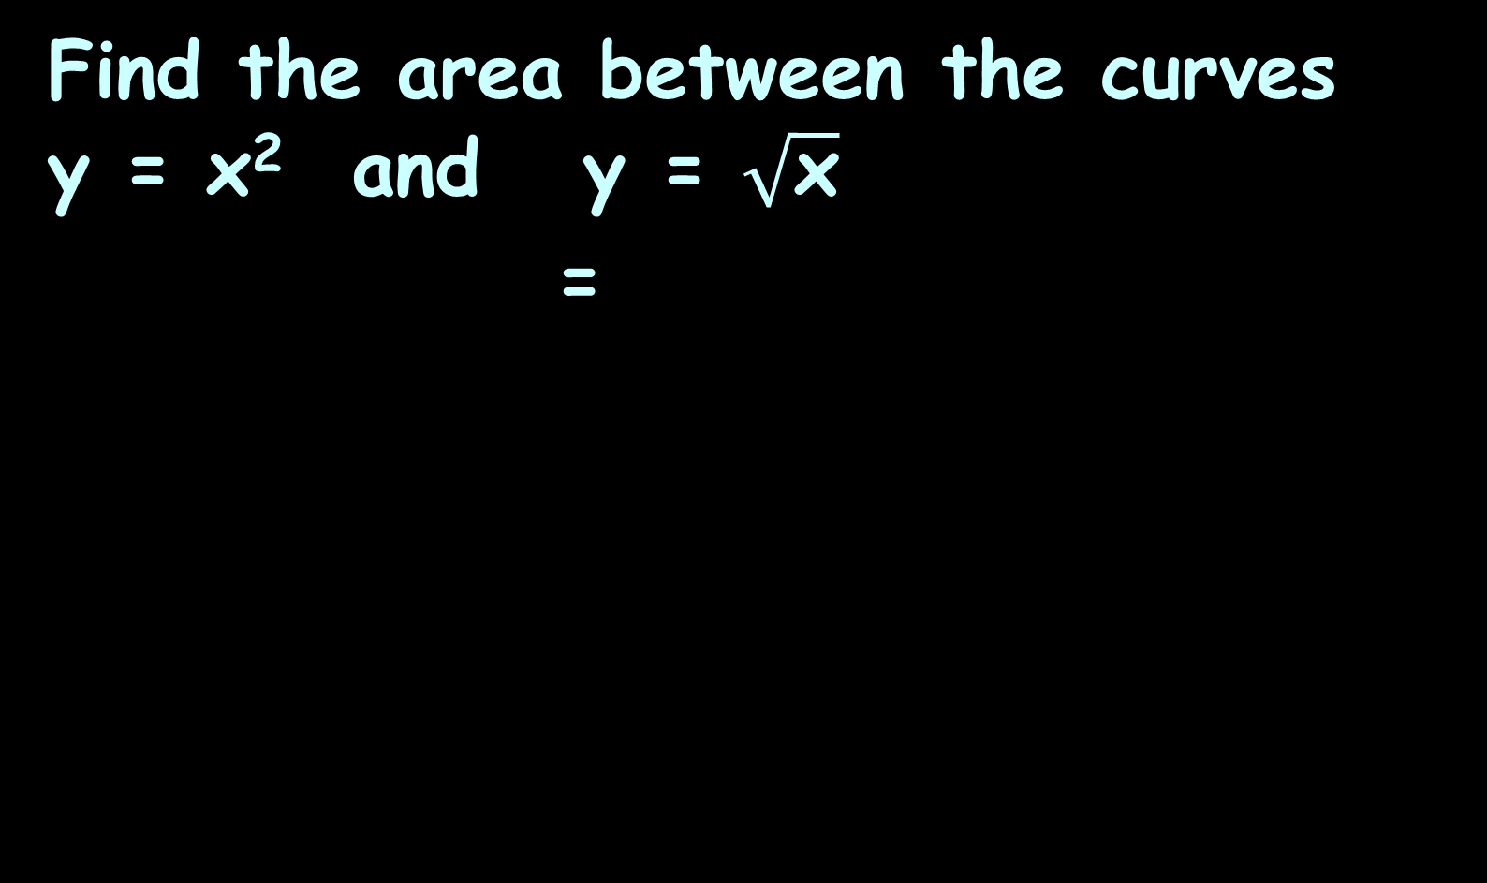
AREA BETWEEN CURVES
IN-CLASS PROBLEM 8
Find the area between the curves y = x² and y = $\sqrt{\text{x}}$
=
∫ x² – $\sqrt{\text{x}}$ dx
∫ x² – x^{½} dx
1
1
0
0
https://www.wolframalpha.com/input/?i=area+between+curves+y%3Dx%5E2+and+y%3Dsqrt%28x%29+

Slide 154
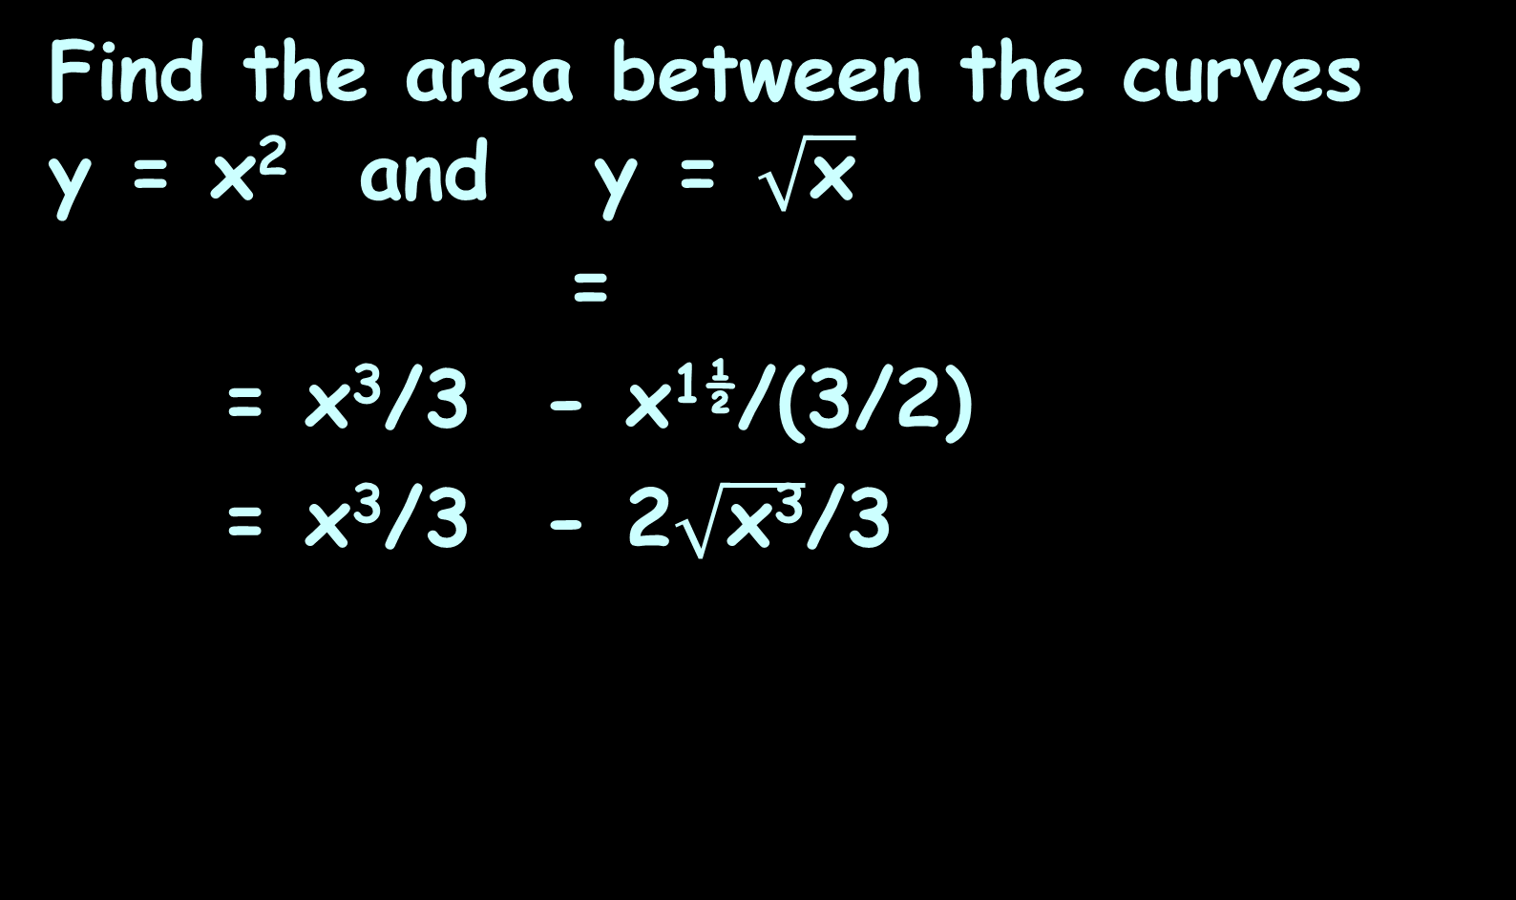
AREA BETWEEN CURVES
IN-CLASS PROBLEM 8
Find the area between the curves y = x² and y = $\sqrt{\text{x}}$
=
= x³/3 - x^{1½}/(3/2)
= x³/3 - 2$\sqrt{\text{x}\text{3}}$/3
∫ x² – $\sqrt{\text{x}}$ dx
∫ x² – x^{½} dx
1
1
0
0
|
1
|
1
0
0
|
1
|
1
0
0
https://www.wolframalpha.com/input/?i=area+between+curves+y%3Dx%5E2+and+y%3Dsqrt%28x%29+

Slide 155
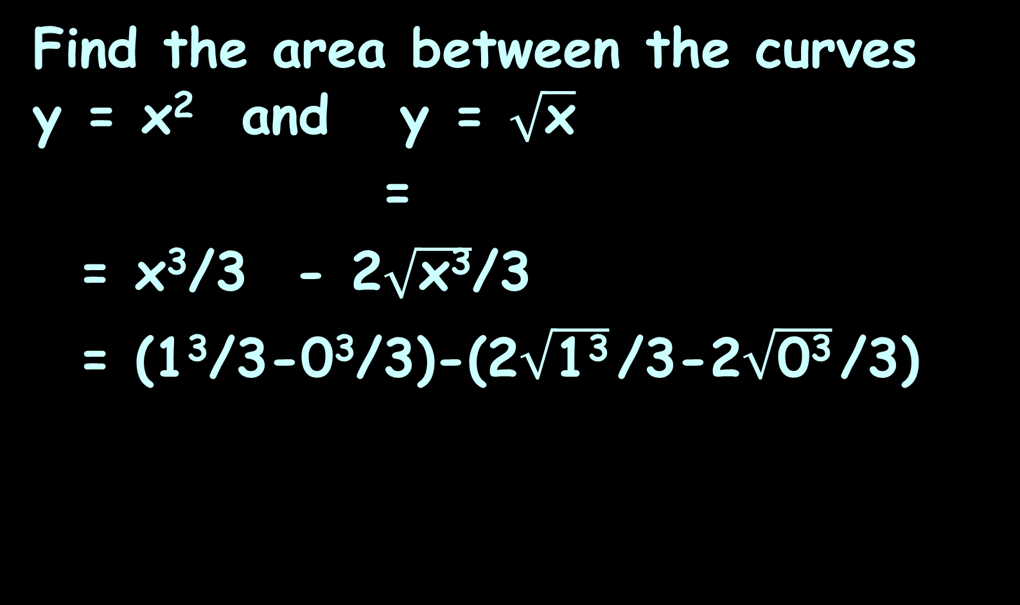
AREA BETWEEN CURVES
IN-CLASS PROBLEM 8
Find the area between the curves y = x² and y = $\sqrt{\text{x}}$
=
= x³/3 - 2$\sqrt{\text{x}\text{3}}$/3
= (1³/3-0³/3)-(2$\sqrt{\text{1}\text{3}}$/3-2$\sqrt{\text{0}\text{3}}$/3)
∫ x² – $\sqrt{\text{x}}$ dx
∫ x² – x^{½} dx
1
1
0
0
|
1
|
1
0
0
https://www.wolframalpha.com/input/?i=area+between+curves+y%3Dx%5E2+and+y%3Dsqrt%28x%29+

Slide 156
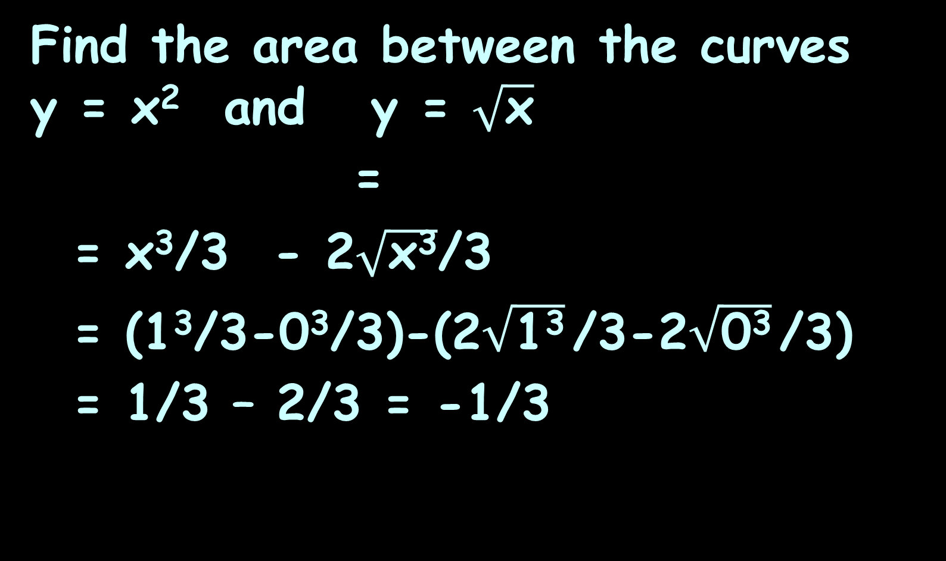
AREA BETWEEN CURVES
IN-CLASS PROBLEM 8
Find the area between the curves y = x² and y = $\sqrt{\text{x}}$
=
= x³/3 - 2$\sqrt{\text{x}\text{3}}$/3
= (1³/3-0³/3)-(2$\sqrt{\text{1}\text{3}}$/3-2$\sqrt{\text{0}\text{3}}$/3)
= 1/3 – 2/3 = -1/3
∫ x² – $\sqrt{\text{x}}$ dx
∫ x² – x^{½} dx
1
1
0
0
|
1
|
1
0
0
https://www.wolframalpha.com/input/?i=area+between+curves+y%3Dx%5E2+and+y%3Dsqrt%28x%29+

Slide 157
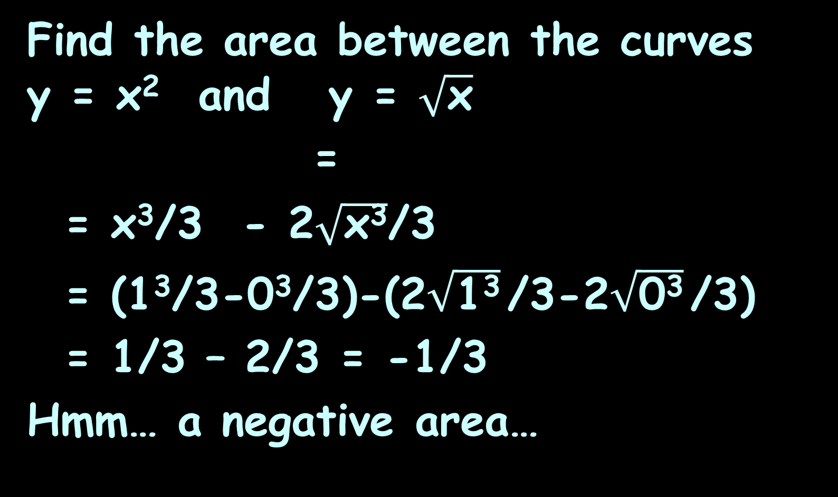
AREA BETWEEN CURVES
IN-CLASS PROBLEM 8
Find the area between the curves y = x² and y = $\sqrt{\text{x}}$
=
= x³/3 - 2$\sqrt{\text{x}\text{3}}$/3
= (1³/3-0³/3)-(2$\sqrt{\text{1}\text{3}}$/3-2$\sqrt{\text{0}\text{3}}$/3)
= 1/3 – 2/3 = -1/3
Hmm… a negative area…
∫ x² – $\sqrt{\text{x}}$ dx
∫ x² – x^{½} dx
1
1
0
0
|
1
|
1
0
0
https://www.wolframalpha.com/input/?i=area+between+curves+y%3Dx%5E2+and+y%3Dsqrt%28x%29+

Slide 158
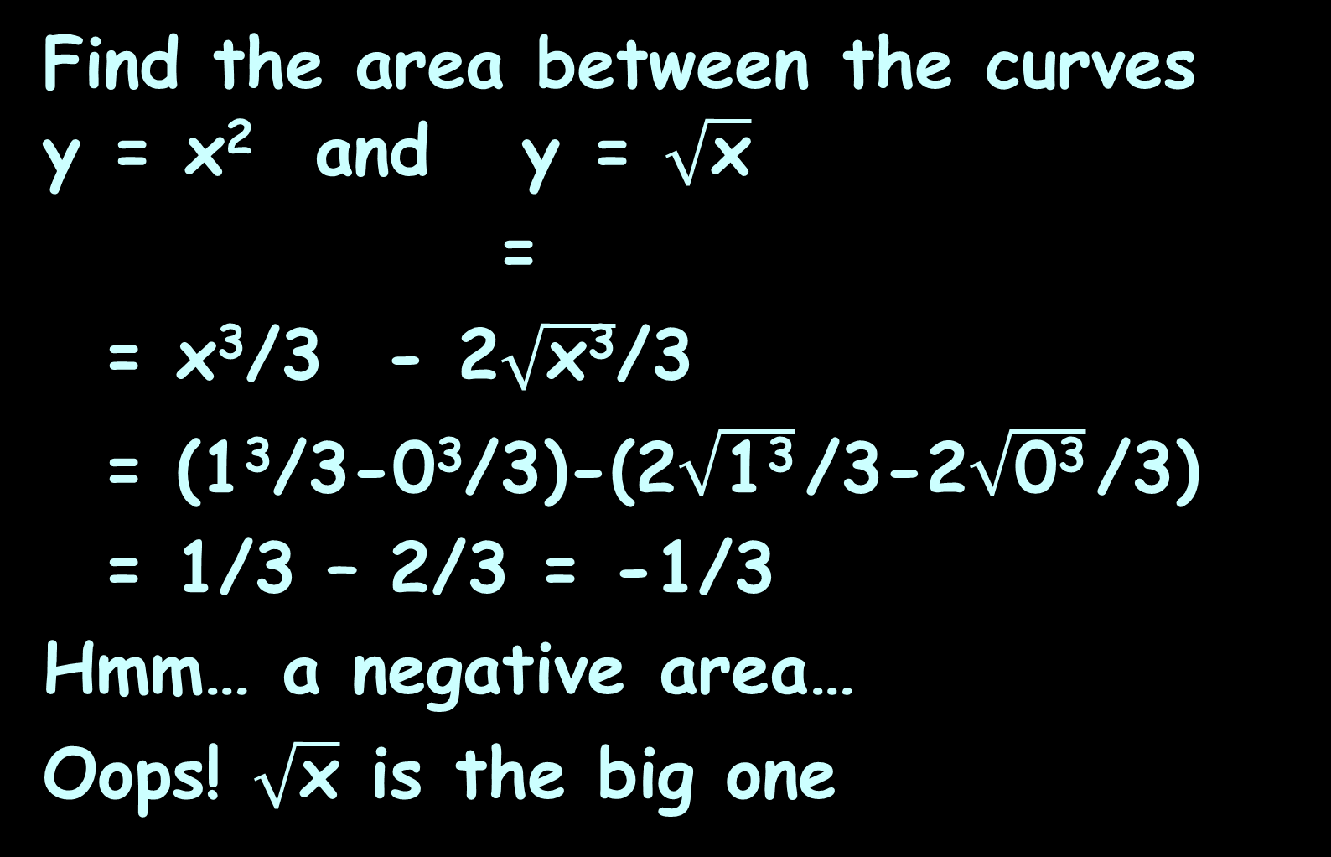
AREA BETWEEN CURVES
IN-CLASS PROBLEM 8
Find the area between the curves y = x² and y = $\sqrt{\text{x}}$
=
= x³/3 - 2$\sqrt{\text{x}\text{3}}$/3
= (1³/3-0³/3)-(2$\sqrt{\text{1}\text{3}}$/3-2$\sqrt{\text{0}\text{3}}$/3)
= 1/3 – 2/3 = -1/3
Hmm… a negative area…
Oops! $\sqrt{\text{x}}$ is the big one
∫ x² – $\sqrt{\text{x}}$ dx
∫ x² – x^{½} dx
1
1
0
0
|
1
|
1
0
0
https://www.wolframalpha.com/input/?i=area+between+curves+y%3Dx%5E2+and+y%3Dsqrt%28x%29+

Slide 159
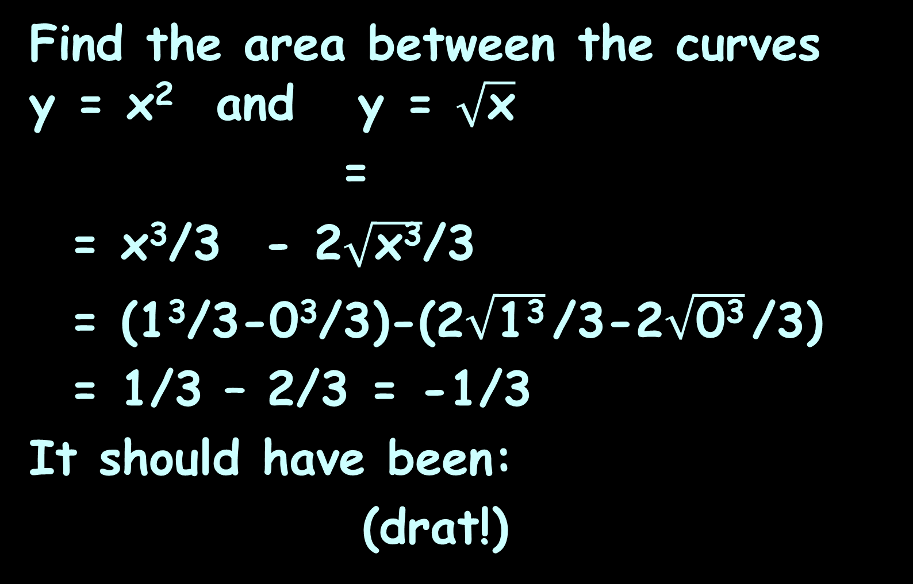
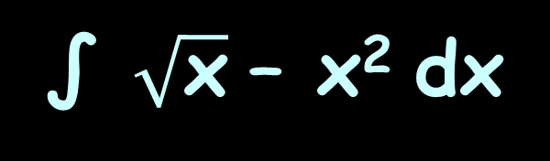
AREA BETWEEN CURVES
IN-CLASS PROBLEM 8
Find the area between the curves y = x² and y = $\sqrt{\text{x}}$
=
= x³/3 - 2$\sqrt{\text{x}\text{3}}$/3
= (1³/3-0³/3)-(2$\sqrt{\text{1}\text{3}}$/3-2$\sqrt{\text{0}\text{3}}$/3)
= 1/3 – 2/3 = -1/3
It should have been:
(drat!)
∫ x² – $\sqrt{\text{x}}$ dx
∫ x² – x^{½} dx
1
1
0
0
|
1
|
1
0
0
∫ $\sqrt{\text{x}}$ – x² dx
1
0
https://www.wolframalpha.com/input/?i=area+between+curves+y%3Dx%5E2+and+y%3Dsqrt%28x%29+

Slide 160
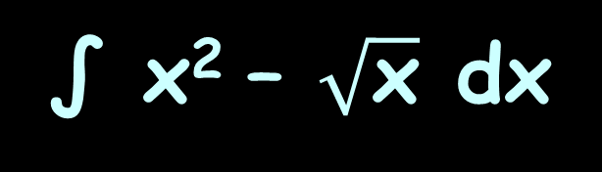

AREA BETWEEN CURVES
IN-CLASS PROBLEM 8
Good news!
= -
Using the Coefficient Rule:
=
All we have to do is multiply our (negative) answer by -1 to get the right (positive) answer
∫ $\sqrt{\text{x}}$ – x² dx
∫ x² – $\sqrt{\text{x}}$ dx
1
1
0
0
∫kƒ ’(x) dx
k∫ƒ ’(x) dx
https://www.wolframalpha.com/input/?i=area+between+curves+y%3Dx%5E2+and+y%3Dsqrt%28x%29+

Slide 161
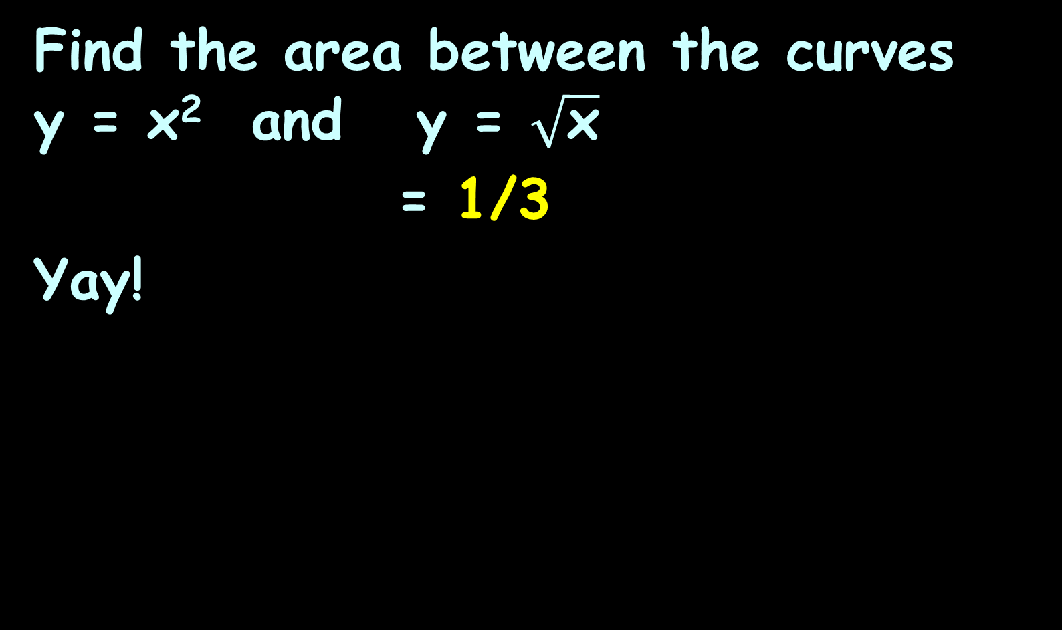
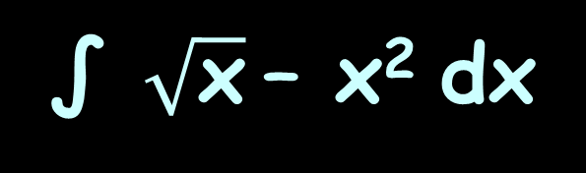
AREA BETWEEN CURVES
IN-CLASS PROBLEM 8
Find the area between the curves y = x² and y = $\sqrt{\text{x}}$
= 1/3
Yay!
∫ $\sqrt{\text{x}}$– x² dx
1
0
https://www.wolframalpha.com/input/?i=area+between+curves+y%3Dx%5E2+and+y%3Dsqrt%28x%29+

Slide 162
Area Between Curves
The Coefficient Rule
means you don’t really
have to know which curve is higher than
the other – if you get
a negative area (and
didn’t intend to) you
just make your answer
positive - No sweat!
http://www.vsexamprep.com/online-test.html

Slide 163
Area Between Curves
So if you have a question like:
Find the area between the curves y = 8 - x² and y = x + 2 between x = 0 and x = 1
And you don’t know which is the “top” curve - just pick one at random!
You can adjust your answer later

Slide 164
Questions?
http://i.imgur.com/aliTlT3.jpg

Slide 165
Area Between Curves
Sometimes the area between the curves crosses the axes
Does that make a difference?
Nope…

Slide 166
Area Between Curves
Sometimes the areas are complicated by overlapping curves

Slide 167
Area Between Curves
What would you have to do to calculate the area between these curves?
-
https://www.wolframalpha.com/input/?i=area+between+curves

Slide 168
Area Between Curves
What would you have to do to calculate the area between these curves?
Calculate piecewise
integral areas and
add them up!
-
https://www.wolframalpha.com/input/?i=area+between+curves

Slide 169
AREA BETWEEN CURVES
IN-CLASS PROBLEM 9
How many integrals would you need to find the area between the curves?
-
https://www.wolframalpha.com/input/?i=area+between+curves

Slide 170
AREA BETWEEN CURVES
IN-CLASS PROBLEM 9
How many integrals would you need to find the area between the curves? 2
-
https://www.wolframalpha.com/input/?i=area+between+curves

Slide 171
Area Between Curves
You can do this “sideways” too!
https://www.wolframalpha.com/input/?i=area+between+curves+x%3D-y%2B2++and+++x%3D4-y%5E2

Slide 172
Area Between Curves
When you do it sideways, write the formulas as x =
x=4-y²
x=4-y²
y=-x+2
x=-y+2
https://www.wolframalpha.com/input/?i=area+between+curves+x%3D-y%2B2++and+++x%3D4-y%5E2

Slide 173
Area Between Curves
The integral will be “dy” rather than “dx”
∫ (4-y²)-(-y+2) dy
2
-1
https://www.wolframalpha.com/input/?i=area+between+curves+x%3D-y%2B2++and+++x%3D4-y%5E2
https://www.wolframalpha.com/input/?i=area+between+curves+x%3D-y%2B2++and+++x%3D4-y%5E2

Slide 174
Area Between Curves
… and this is why they invented calculators and Wolframalpha…

Slide 175
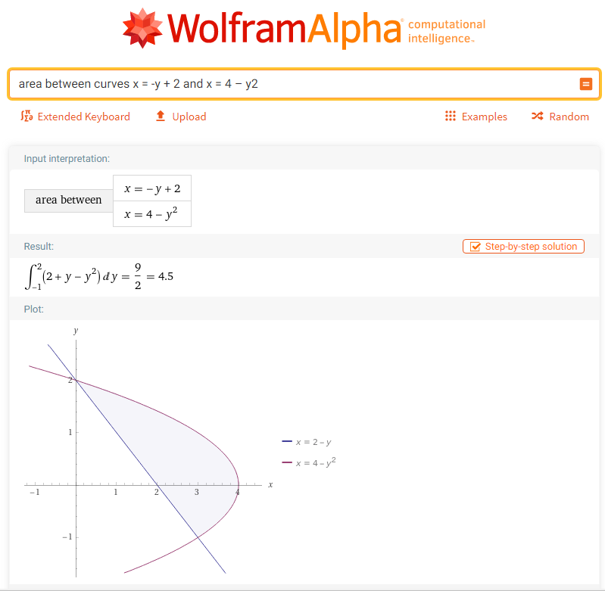

Slide 176
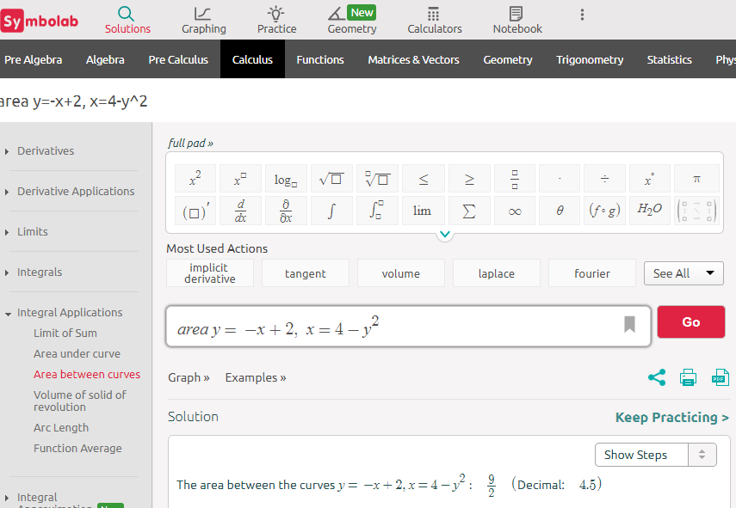

Slide 177
Questions?
http://i.imgur.com/aliTlT3.jpg

Slide 178

You Survived!
Today we covered:
Area under a curve and the Fundamental Theorem of Calculus
Area between
two curves
www.playbuzz.com

