Slide 1
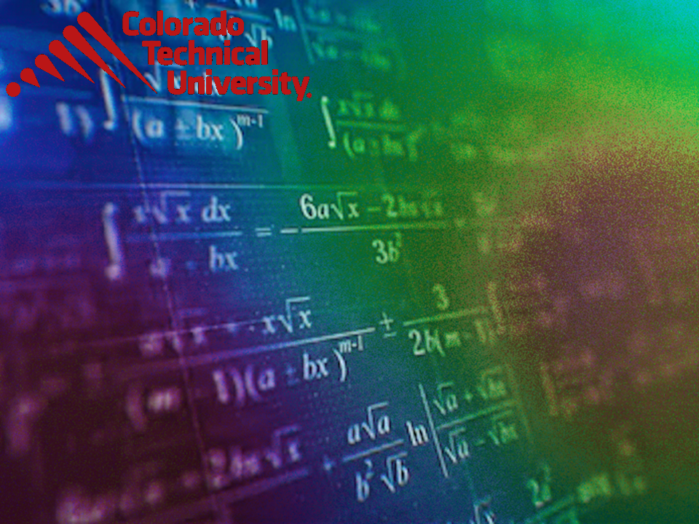
Welcome to
Unit 8! .
MATH 205 Differential Calculus
https://www.smu.edu.sg/programmes/core-curriculum/course-structure/calculus

Slide 2
What’s Up?
New stuff:
Antiderivatives and
integration
Reverse Chain Rule (u-
substitution)

Slide 3
What’s Up?
Outcome 5) Use basic integration techniques, including the method of substitution and the Fundamental Theorem of Calculus

Slide 4
Antidifferentiation
In mathematics we always want to be able to undo an operation

Slide 5
Antidifferentiation
Subtraction “undoes” addition
7 + 3 = 10
10 – 3 = 7
original
value
add
answer
answer
subtract
original
value

Slide 6
Antidifferentiation
What “undoes” subtraction?

Slide 7
Antidifferentiation
What “undoes” subtraction?
addition
What “undoes” multiplication?

Slide 8
Antidifferentiation
What “undoes” multiplication?
division
What “undoes” an exponent x²?

Slide 9

Antidifferentiation
What “undoes” an exponent x²?
a root $\sqrt{\text{x}}$
What “undoes” a sin(x)?

Slide 10
Antidifferentiation
What “undoes” a sin(x)?
an arcsin sin⁻¹(x)
What “undoes” a function ƒ(x)?

Slide 11
Antidifferentiation
What “undoes” a function ƒ(x)?
an inverse function ƒ⁻¹(x)

Slide 12
Antidifferentiation
We’ve just been taking derivatives dy/dx of various equations and expressions
So we need a way to undo this process, too!

Slide 13
Antidifferentiation
F(x) is an antiderivative of f(x) if F’(x) = f(x)

Slide 14
Antidifferentiation
F(x) is an antiderivative of f(x) if F’(x) = f(x)
We’re looking for an unknown function whose derivative is known (and the original function we want)

Slide 15
ANTIDIFFERENTIATION
IN-CLASS PROBLEM 1
Find a function with a derivative: 10x⁴

Slide 16
ANTIDIFFERENTIATION
IN-CLASS PROBLEM 1
Find a function with a derivative: dy/dx = 10x⁴

Slide 17
ANTIDIFFERENTIATION
IN-CLASS PROBLEM 1
Find a function with a derivative: dy/dx = 10x⁴
Well, how do we find the derivative of something in the form of kx^{n}?

Slide 18
ANTIDIFFERENTIATION
IN-CLASS PROBLEM 1
Find a function with a derivative: dy/dx = 10x⁴
Well, how do we find the derivative of something in the form of kx^{n}? nk x^{n-1}
So now we need to “undo” those steps

Slide 19
ANTIDIFFERENTIATION
IN-CLASS PROBLEM 1
Find a function with a derivative: dy/dx = 10x⁴
dy/dx kx^{n} = nk x^{n-1} = 10x⁴
So what would “n” be?
n-1

Slide 20
ANTIDIFFERENTIATION
IN-CLASS PROBLEM 1
Find a function with a derivative: dy/dx = 10x⁴
dy/dx kx^{n} = nk x^{n-1} = 10x⁴
So what would “n” be? 5
n-1

Slide 21
ANTIDIFFERENTIATION
IN-CLASS PROBLEM 1
Find a function with a derivative: dy/dx = 10x⁴
dy/dx kx^{n} = nk x^{n-1} = 10x⁴
Plug in 5

Slide 22
ANTIDIFFERENTIATION
IN-CLASS PROBLEM 1
Find a function with a derivative: dy/dx = 10x⁴
dy/dx kx⁵ = 5k x⁵⁻¹ = 10x⁴
So, what is “k”?

Slide 23
ANTIDIFFERENTIATION
IN-CLASS PROBLEM 1
Find a function with a derivative: dy/dx = 10x⁴
dy/dx kx⁵ = 5k x⁵⁻¹ = 10x⁴
So, what is “k”? 5k = 10
k = 2

Slide 24
ANTIDIFFERENTIATION
IN-CLASS PROBLEM 1
Find a function with a derivative: dy/dx = 10x⁴
dy/dx kx⁵ = 5k x⁵⁻¹ = 10x⁴
Plug in k = 2
So the original equation was…

Slide 25
ANTIDIFFERENTIATION
IN-CLASS PROBLEM 1
Find a function with a derivative: dy/dx = 10x⁴
dy/dx kx⁵ = 5k x⁵⁻¹ = 10x⁴
Plug in k = 2
So the original equation was 2x⁵

Slide 26
ANTIDIFFERENTIATION
IN-CLASS PROBLEM 1
Find a function with a derivative: dy/dx = 10x⁴
dy/dx 2x⁵ = 10x⁴

Slide 27

Questions?
http://i.imgur.com/aliTlT3.jpg

Slide 28
Antidifferentiation
dy/dx 2x⁵ = 10x⁴
But… is 2x⁵ the ONLY equation that has a derivative of 10x⁴?

Slide 29
Antidifferentiation
dy/dx 2x⁵ = 10x⁴
But… is 2x⁵ the ONLY equation that has a derivative of 10x⁴?
Remember, when we take the derivative of a constant, it is zero

Slide 30
Antidifferentiation
dy/dx 2x⁵ = 10x⁴
So dy/dx 2x⁵ + 1 = 10x⁴ also

Slide 31
Antidifferentiation
dy/dx 2x⁵ = 10x⁴
So dy/dx 2x⁵ + 1 = 10x⁴ also
So is dy/dx 2x⁵ + 276.38 = 10x⁴

Slide 32

Antidifferentiation
dy/dx 2x⁵ = 10x⁴
So dy/dx 2x⁵ + 1 = 10x⁴ also
So is dy/dx 2x⁵ + 276.38 = 10x⁴
How can we know
which one it
originally was?
https://henrytrocino.files.wordpress.com/2013/08/weeping-and-gnashing-of-teeth-300x236.jpg

Slide 33
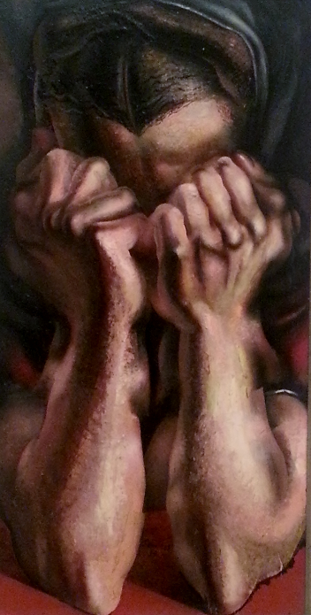
Antidifferentiation
dy/dx 2x⁵ = 10x⁴
So dy/dx 2x⁵ + 1 = 10x⁴ also
So is dy/dx 2x⁵ + 276.38 = 10x⁴
How can we know
which one it
originally was?
We can’t…
http://mommyneedscoffee.com/wp-content/uploads/2012/09/TheSob.jpg

Slide 34
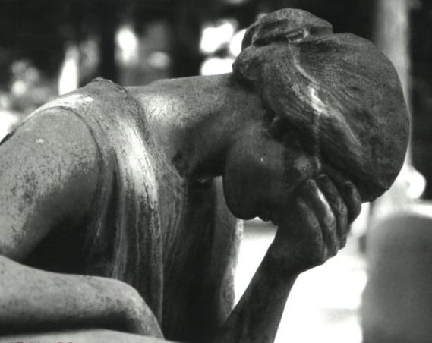
Antidifferentiation
There is no way to figure out what the original constant value was
http://notatthedinnertable.weebly.com/uploads/3/4/1/1/3411210/1794978.jpg

Slide 35
Antidifferentiation
Hence, these are called “indefinite integrals” because we can never be definite about what the original equation was

Slide 36

Antidifferentiation
Here’s what we do:
dy/dx 2x⁵ + c = 10x⁴
where “c” is the unknown constant we
can’t
reconstruct
http://dartoidsworld.net/wp-content/uploads/2015/02/so-what-pic.jpg

Slide 37
Antidifferentiation
Note: some people use “c”
Some use “C”
Some use “k”
Some use “K”
dy/dx 2x⁵ + c = 10x⁴
dy/dx 2x⁵ + C = 10x⁴
dy/dx 2x⁵ + k = 10x⁴
dy/dx 2x⁵ + K = 10x⁴

Slide 38
The way to succeed at antidifferentiation is to never forget to write “c”
VFrench 2020

Slide 39
ANTIDIFFERENTIATION
IN-CLASS PROBLEM 2
Find a function with a derivative: dy/dx = x² + 3x
Which derivative rule does this look like?

Slide 40
ANTIDIFFERENTIATION
IN-CLASS PROBLEM 2
Find a function with a derivative: dy/dx = x² + 3x
Which derivative rule does this look like? Addition Rule
So we want to undo the Addition Rule steps

Slide 41
ANTIDIFFERENTIATION
IN-CLASS PROBLEM 2
Find a function with a derivative: dy/dx = x² + 3x
What function would give a derivative of x² ?
{
first term

Slide 42
ANTIDIFFERENTIATION
IN-CLASS PROBLEM 2
Find a function with a derivative: dy/dx = x² + 3x
What function would give a derivative of x² ?
3 x ___ = 1
{
first term

Slide 43
ANTIDIFFERENTIATION
IN-CLASS PROBLEM 2
Find a function with a derivative: dy/dx = x² + 3x
What function would give a derivative of x² ? 1/3 x³ + c
(Did you get all the parts right?)
{
{
first term
second term

Slide 44
ANTIDIFFERENTIATION
IN-CLASS PROBLEM 2
Find a function with a derivative: dy/dx = x² + 3x
What function would give a derivative of x² ? 1/3 x³ + c
What function would give a derivative of 3x ?
{
{
first term
second term

Slide 45
ANTIDIFFERENTIATION
IN-CLASS PROBLEM 2
Find a function with a derivative: dy/dx = x² + 3x
What function would give a derivative of x² ? 1/3 x³ + c
What function would give a derivative of 3x ? 3/2 x² + c
{
{
first term
second term

Slide 46
ANTIDIFFERENTIATION
IN-CLASS PROBLEM 2
Find a function with a derivative: dy/dx = x² + 3x
What function would give a derivative of x² ? 1/3 x³ + c
What function would give a derivative of 3x ? 3/2 x² + c
Combine the two parts:
1/3 x³ + 3/2 x² + c
{
{
first term
second term

Slide 47
ANTIDIFFERENTIATION
IN-CLASS PROBLEM 2
Just to check… does
dy/dx 1/3 x³ + 3/2 x² + c = x² + 3x
?

Slide 48
ANTIDIFFERENTIATION
IN-CLASS PROBLEM 2
Just to check… does
dy/dx 1/3 x³ + 3/2 x² + c = x² + 3x
? It does…

Slide 49
Antidifferentiation
F(x) + c
can be viewed as a family of all curves whose derivatives for any given x are all equal to each other

Slide 50
Antidifferentiation
That means for any x value, the slopes of the curves are all equal

Slide 51
Questions?
http://i.imgur.com/aliTlT3.jpg

Slide 52
Antidifferentiation
So now we know how to do some simpler antidifferentiation (obviously something deriving from the Quotient Rule or the Chain Rule would be harder)

Slide 53
Antidifferentiation
But it’s a MATH class!
There’s always a symbol for everything!

Slide 54
Antidifferentiation
But it’s a MATH class!
There’s always a symbol for everything!
(And there is for antidifferentiation, too!)

Slide 55
Antidifferentiation
The symbol we use is: ∫
So ∫ 10x⁴ = 2x⁵ + c
But, we want to include which variable was being differentiated, so we write it as:
∫10x⁴ dx = 2x⁵ + c

Slide 56
Antidifferentiation
∫ (10x⁴) dx = 2x⁵ + c
is called “integral notation”
Could have been:
∫ (10y⁴) dy = 2y⁵ + c

Slide 57
Integration
The symbol for integration is:
∫
It is meant to represent a big, curvy “S”

Slide 58
Integration
That’s because dy/dx represents an infinitely-tiny difference (“d”, get it?)
While ∫ represents an infinitely-tiny sum (sum is the inverse of difference)

Slide 59
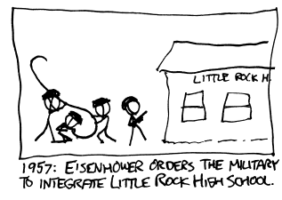

Slide 60
Integration
{
{
∫10x⁴ dx = 2x⁵ + c
integral sign
constant of integration
integrand
indefinite
integral
differential
variable of integration

Slide 61
Integration
{
{
∫10x⁴ dx = 2x⁵ + c
The integral is “indefinite” because we don’t know what “c” is
integral sign
constant of integration
integrand
indefinite
integral

Slide 62
Integration
When we solve the problem, we could say we are “antidifferentiating”
but usually we say we are “integrating”

Slide 63

INTEGRATION
IN-CLASS PROBLEM 3
How would you write:
dy/dx 1/3 x³ + 3/2 x² + c = x² + 3x
in integral notation?
Hint
$\int{\text{10}\text{x}\text{4}}$ dx = 2x⁵ + c

Slide 64
INTEGRATION
IN-CLASS PROBLEM 3
dy/dx 1/3 x³ + 3/2 x² + c = x² + 3x
Multiply both sides by “dx”
dy 1/3 x³ + 3/2 x² + c = (x²+3x) dx
Now put a ∫ in front of both sides
Hint
$\int{\text{10}\text{x}\text{4}}$ dx = 2x⁵ + c

Slide 65
INTEGRATION
IN-CLASS PROBLEM 3
dy/dx 1/3 x³ + 3/2 x² + c = x² + 3x
Multiply both sides by “dx”
∫dy 1/3 x³+3/2 x²+c = ∫(x²+3x)dx
Hint
$\int{\text{10}\text{x}\text{4}}$ dx = 2x⁵ + c

Slide 66
INTEGRATION
IN-CLASS PROBLEM 3
dy/dx 1/3 x³ + 3/2 x² + c = x² + 3x
Multiply both sides by “dx”
∫dy 1/3 x³+3/2 x²+c = ∫(x²+3x)dx
∫ is the “undo” of dy so they actually cancel each other out!
Hint
$\int{\text{10}\text{x}\text{4}}$ dx = 2x⁵ + c

Slide 67
INTEGRATION
IN-CLASS PROBLEM 3
How would you write:
dy/dx 1/3 x³ + 3/2 x² + c = x² + 3x
in integral notation?
∫(x² + 3x) dx = 1/3 x³ + 3/2 x² + c
Hint
$\int{\text{10}\text{x}\text{4}}$ dx = 2x⁵ + c

Slide 68
Questions?
http://i.imgur.com/aliTlT3.jpg

Slide 69

Integration
Ah, yes, and since it’s CALCULUS class, there are going to be a lot of rules…
https://www.campusreform.org/?ID=8934

Slide 70
Integration
But the rules are meant to make it easier to solve the integration problems

Slide 71
Integration
Back in differentiation, we had:
Rule #1: derivative of a constant:
d/dx c = 0
That’s (of course) what makes us have to stick a “+ c” at the end of all our integrals

Slide 72
Integration
Just like we had Rule 2 in differentiation:
Rule #2: derivative of a power function:
d/dx cx^{n} = cn × x ^{n-1}

Slide 73

Integration
We’ve already figured out the rule to “undo” a power function:
∫x^{n} dx = $\frac{\text{x}\text{n}\text{+1}}{\text{n}\text{+1 }}$ + c (n ≠ -1)
‘cause we don’t
want division
by zero

Slide 74
Integration
And we figured out how to undo derivatives of sums:
∫ (ƒ(x) + g(x)) dx =
∫(ƒ(x)) dx + ∫(g(x)) dx
Because the derivative of the sum of two functions equals the sum of their derivatives

Slide 75
Integration
Another helpful rule looks at how to handle a coefficient (which we were already doing):
∫ (k ƒ(x)) dx = k∫(ƒ(x)) dx
where k is a constant

Slide 76

INTEGRATION
IN-CLASS PROBLEMS 4
∫ dx = ?
∫ 5 dx = ?
∫ t³ dt = ?
∫ 10t⁴ dt = ?
Hint
$\int{\text{10}\text{x}\text{4}}$ dx = 2x⁵ + c
∫x² + 3x dx = 1/3 x³ + 3/2 x² + c

Slide 77
INTEGRATION
IN-CLASS PROBLEMS 4
∫ dx = ∫ 1 dx = ∫ 1x⁰ dx
∫ 5 dx = ?
∫ t³ dt = ?
∫ 10t⁴ dt = ?
Hint
$\int{\text{10}\text{x}\text{4}}$ dx = 2x⁵ + c
∫x² + 3x dx = 1/3 x³ + 3/2 x² + c

Slide 78
INTEGRATION
IN-CLASS PROBLEMS 4
∫ dx = x + c
∫ 5 dx = ?
∫ t³ dt = ?
∫ 10t⁴ dt = ?
Hint
$\int{\text{10}\text{x}\text{4}}$ dx = 2x⁵ + c
∫x² + 3x dx = 1/3 x³ + 3/2 x² + c

Slide 79
INTEGRATION
IN-CLASS PROBLEMS 4
∫ dx = x + c
∫ 5 dx = 5∫ dx
∫ t³ dt = ?
∫ 10t⁴ dt = ?
Hint
$\int{\text{10}\text{x}\text{4}}$ dx = 2x⁵ + c
∫x² + 3x dx = 1/3 x³ + 3/2 x² + c

Slide 80
INTEGRATION
IN-CLASS PROBLEMS 4
∫ dx = x + c
∫ 5 dx = 5x + c
∫ t³ dt = ?
∫ 10t⁴ dt = ?
Hint
$\int{\text{10}\text{x}\text{4}}$ dx = 2x⁵ + c
∫x² + 3x dx = 1/3 x³ + 3/2 x² + c

Slide 81
INTEGRATION
IN-CLASS PROBLEMS 4
∫ dx = x + c
∫ 5 dx = 5x + c
∫ t³ dt = ¼t⁴ + c
∫ 10t⁴ dt = ?
Hint
$\int{\text{10}\text{x}\text{4}}$ dx = 2x⁵ + c
∫x² + 3x dx = 1/3 x³ + 3/2 x² + c

Slide 82
INTEGRATION
IN-CLASS PROBLEMS 4
∫ dx = x + c
∫ 5 dx = 5x + c
∫ t³ dt = ¼t⁴ + c
∫ 10t⁴ dt = 2t⁵ + c
Hint
$\int{\text{10}\text{x}\text{4}}$ dx = 2x⁵ + c
∫x² + 3x dx = 1/3 x³ + 3/2 x² + c

Slide 83
Questions?
http://i.imgur.com/aliTlT3.jpg

Slide 84
Integration
While in math class we generally use the variable “x”, the real world rarely does!

Slide 85
Integration
We just did two problems “dt” which is very common in engineering

Slide 86
Integration
Just like derivatives, integrals can be dx or dt or versus any variable you like
Again, other variables not being “d-ed” will be treated as constants

Slide 87
INTEGRATION
IN-CLASS PROBLEM 5
Find y = ∫ (5w²p) dp

Slide 88
INTEGRATION
IN-CLASS PROBLEM 5
Find y = ∫ (5w²p) dp
What variable was this function differentiated with respect to?

Slide 89
INTEGRATION
IN-CLASS PROBLEM 5
Find y = ∫ (5w²p) dp
What variable was this function differentiated with respect to?
p
So what can be viewed as a constant?

Slide 90
INTEGRATION
IN-CLASS PROBLEM 5
Find y = ∫ (5w²p) dp
So what can be viewed as a constant? 5w²

Slide 91
INTEGRATION
IN-CLASS PROBLEM 5
Find y = ∫ (5w²p) dp
So what can be viewed as a constant? 5w²
Find y = ∫ (Kp) dp
So what is y?
5w²

Slide 92
INTEGRATION
IN-CLASS PROBLEM 5
Find y = ∫ (5w²p) dp
So what can be viewed as a constant? 5w²
Find y = ∫ (Kp) dp
So what is y? y = K/2 p²
is it?
5w²

Slide 93
INTEGRATION
IN-CLASS PROBLEM 5
Find y = ∫ (5w²p) dp
So what can be viewed as a constant? 5w²
Find y = ∫ (Kp) dp
So what is y? y = K/2 p² + c
= 5w²/2 p² + c
= 5w²p²/2 + c
= 5/2 w²p² + c
5w²

Slide 94
Integration
The integral with respect to one variable will not be the same as the integral with respect to another variable – so be careful with these!

Slide 95
INTEGRATION
IN-CLASS PROBLEM 5
Find y = ∫ (5w²p) dw

Slide 96
INTEGRATION
IN-CLASS PROBLEM 5
Find y = ∫ (5w²p) dw
What variable was this function differentiated with respect to?

Slide 97
INTEGRATION
IN-CLASS PROBLEM 5
Find y = ∫ (5w²p) dw
What variable was this function differentiated with respect to?
w
So what can be viewed as a constant?

Slide 98
INTEGRATION
IN-CLASS PROBLEM 5
Find y = ∫ (5w²p) dw
So what can be viewed as a constant? 5p

Slide 99
INTEGRATION
IN-CLASS PROBLEM 5
Find y = ∫ (5w²p) dw
So what can be viewed as a constant? 5p
Find y = ∫ (Kw²) dw
So what is y?
5p

Slide 100
INTEGRATION
IN-CLASS PROBLEM 5
Find y = ∫ (5w²p) dw
So what can be viewed as a constant? 5p
Find y = ∫ (Kw²) dw
So what is y? y = K/3 w³
is it?
5p

Slide 101
INTEGRATION
IN-CLASS PROBLEM 5
Find y = ∫ (5w²p) dw
So what can be viewed as a constant? 5p
Find y = ∫ (Kw²) dw
So what is y? y = K/3 w³ + c
= 5p/3 w³ + c
= 5pw³/3 + c
= 5/3 pw³ + c
5p

Slide 102
INTEGRATION
IN-CLASS PROBLEM 5
So y = ∫(5w²p) dw
= 5pw³/3 + c
But y = ∫(5w²p) dp
= 5w²p²/2 + c
So watch the differential variable!

Slide 103
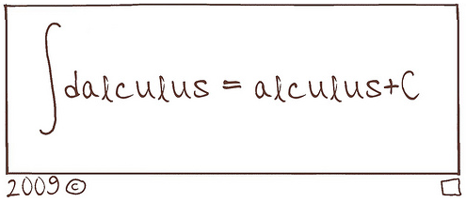
Antidifferentiation

Slide 104
Questions?
http://i.imgur.com/aliTlT3.jpg

Slide 105
Integration
If you are given a point the function goes though, you can actually find the missing “c” and have a definite value

Slide 106
INTEGRATION
IN-CLASS PROBLEM 6
The derivative of a function is known to be dy/dx = 24x³
and the function’s graph goes through the point x=1, y=11.
Find the function

Slide 107
INTEGRATION
IN-CLASS PROBLEM 6
The derivative of a function is known to be dy/dx = 24x³
and the function’s graph goes through the point x=1, y=11.
Find the function
What do we need to do first?

Slide 108
INTEGRATION
IN-CLASS PROBLEM 6
The derivative of a function is known to be dy/dx = 24x³
and the function’s graph goes through the point x=1, y=11.
Find the function
What do we need to do first?
∫ something dsomevariable =
What is the integral?

Slide 109
INTEGRATION
IN-CLASS PROBLEM 6
The derivative of a function is known to be dy/dx = 24x³
and the function’s graph goes through the point x=1, y=11.
Find the function
What is the integral?
∫ 24x³ dx =

Slide 110
INTEGRATION
IN-CLASS PROBLEM 6
The derivative of a function is known to be dy/dx = 24x³
and the function’s graph goes through the point x=1, y=11.
Find the function
What is the integral?
∫ 24x³ dx = 6x⁴ + c

Slide 111
INTEGRATION
IN-CLASS PROBLEM 6
The derivative of a function is known to be dy/dx = 24x³
and the function’s graph goes through the point x=1, y=11.
Find the function
What is the integral?
∫ 24x³ dx = 6x⁴ + c
Are we done?

Slide 112
INTEGRATION
IN-CLASS PROBLEM 6
The derivative of a function is known to be dy/dx = 24x³
and the function’s graph goes through the point x=1, y=11.
Find the function
y = 6x⁴ + c
Plug in x=1 and y=11

Slide 113
INTEGRATION
IN-CLASS PROBLEM 6
The derivative of a function is known to be dy/dx = 24x³
and the function’s graph goes through the point x=1, y=11.
Find the function
y = 6x⁴ + c
Plug in x=1 and y=11:
11 = 6(1⁴) + c so what is “c”?

Slide 114
INTEGRATION
IN-CLASS PROBLEM 6
The derivative of a function is known to be dy/dx = 24x³
and the function’s graph goes through the point x=1, y=11.
Find the function
y = 6x⁴ + c
Plug in x=1 and y=11:
11 = 6(1⁴) + c
c = 11 – 6 = 5

Slide 115
INTEGRATION
IN-CLASS PROBLEM 6
The derivative of a function is known to be dy/dx = 24x³
and the function’s graph goes through the point x=1, y=11.
Find the function
So what is the function?

Slide 116
INTEGRATION
IN-CLASS PROBLEM 6
The derivative of a function is known to be dy/dx = 24x³
and the function’s graph goes through the point x=1, y=11.
Find the function
So what is the function?
y = 6x⁴ + 5
A determinate (certain) function

Slide 117
Questions?
http://i.imgur.com/aliTlT3.jpg

Slide 118
The secret word for this unit is:
UNDO

Slide 119
Integration
We’ve done integrals of constants, sums and powers
Now, we need sort of a “Chain Rule” for integration

Slide 120
Integration
Suppose we wanted to find:
∫ 5(x³+4)⁴(3x²) dx
This doesn’t fit any of our rules so far

Slide 121
Integration
Suppose we wanted to find:
∫ 5(x³+4)⁴(3x²) dx
But… if you are alert and notice that 3x² is the derivative of x³
In fact, since it’s the derivative of x³+4 (even better!) you could do a “Chain Rule-like” thing and call x³+4 “u” and 3x²dx “du”

Slide 122
Integration
Suppose we wanted to find:
∫ 5(x³+4)⁴(3x²) dx
x³+4 = u 3x² dx = du
∫ (5u⁴) du

Slide 123

Integration
An integration rule that will help is:
∫ u^{n} du = $\frac{{\text{u}}^{\text{n}\text{+1}}}{\text{n}\text{+1}}$ + c

Slide 124
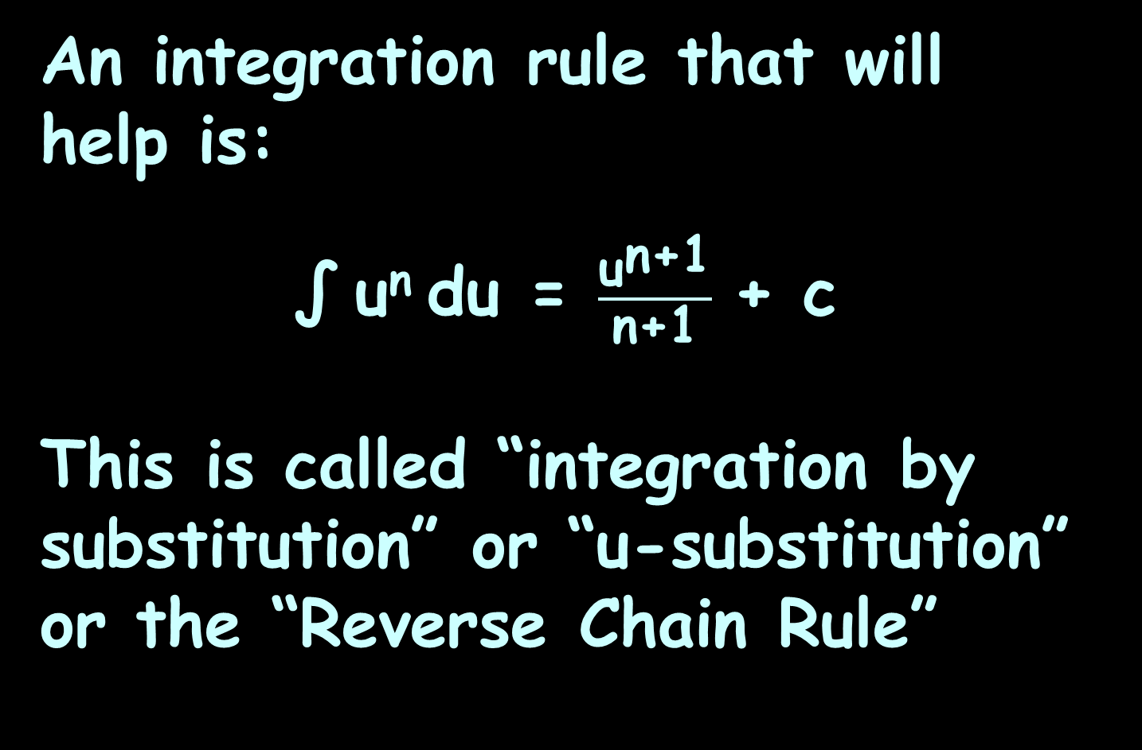
Reverse Chain Rule
An integration rule that will help is:
∫ u^{n} du = $\frac{{\text{u}}^{\text{n}\text{+1}}}{\text{n}\text{+1}}$ + c
This is called “integration by substitution” or “u-substitution” or the “Reverse Chain Rule”

Slide 125
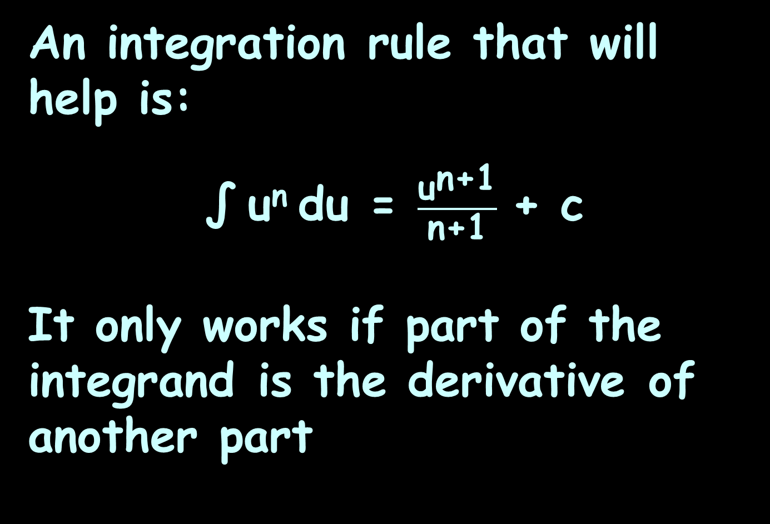
Reverse Chain Rule
An integration rule that will help is:
∫ u^{n} du = $\frac{{\text{u}}^{\text{n}\text{+1}}}{\text{n}\text{+1}}$ + c
It only works if part of the integrand is the derivative of another part

Slide 126
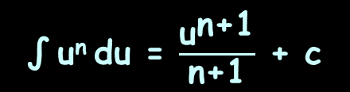
REVERSE CHAIN RULE
IN-CLASS PROBLEM 7
Find: ∫ 5(x³+4)⁴(3x²) dx
∫ u^{n} du = $\frac{{\text{u}}^{\text{n}\text{+1}}}{\text{n}\text{+1}}$ + c

Slide 127
REVERSE CHAIN RULE
IN-CLASS PROBLEM 7
Find: ∫ 5(x³+4)⁴(3x²) dx
Step 1: find a part of the integrand that is a derivative of another part
∫ u^{n} du = $\frac{{\text{u}}^{\text{n}\text{+1}}}{\text{n}\text{+1}}$ + c

Slide 128
REVERSE CHAIN RULE
IN-CLASS PROBLEM 7
Find: ∫ 5(x³+4)⁴(3x²) dx
Step 1: find a part of the integrand that is a derivative of another part
u = x³+4 du = 3x² dx
∫ u^{n} du = $\frac{{\text{u}}^{\text{n}\text{+1}}}{\text{n}\text{+1}}$ + c

Slide 129
REVERSE CHAIN RULE
IN-CLASS PROBLEM 7
Find: ∫ 5(x³+4)⁴(3x²) dx
Step 1: find a part of the integrand that is a derivative of another part
u = x³+4 du = 3x² dx
So, we actually have: ∫ 5u⁴ du
Use the exponent rule:
What’s “n”?
∫ u^{n} du = $\frac{{\text{u}}^{\text{n}\text{+1}}}{\text{n}\text{+1}}$ + c

Slide 130
REVERSE CHAIN RULE
IN-CLASS PROBLEM 7
Find: ∫ 5(x³+4)⁴(3x²) dx
Step 1: find a part of the integrand that is a derivative of another part
u = x³+4 du = 3x² dx
So, we actually have: ∫ 5u⁴ du
Use the exponent rule:
What’s “n”? 4
∫ u^{n} du = $\frac{{\text{u}}^{\text{n}\text{+1}}}{\text{n}\text{+1}}$ + c

Slide 131
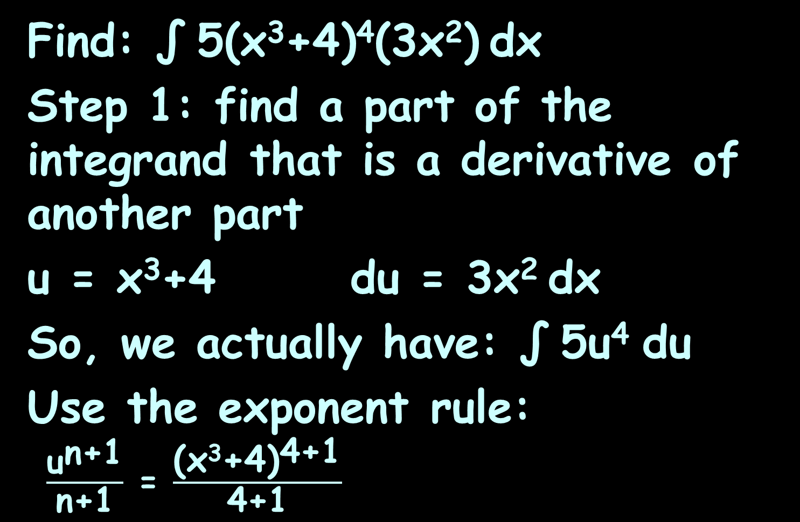
REVERSE CHAIN RULE
IN-CLASS PROBLEM 7
Find: ∫ 5(x³+4)⁴(3x²) dx
Step 1: find a part of the integrand that is a derivative of another part
u = x³+4 du = 3x² dx
So, we actually have: ∫ 5u⁴ du
Use the exponent rule:
$\frac{{\text{u}}^{\text{n}\text{+1}}}{\text{n}\text{+1}}$ = $\frac{{\text{(}\text{x}\text{3}\text{+4}\text{)}}^{\text{4}\text{+1}}}{\text{4}\text{+1}}$
∫ u^{n} du = $\frac{{\text{u}}^{\text{n}\text{+1}}}{\text{n}\text{+1}}$ + c

Slide 132
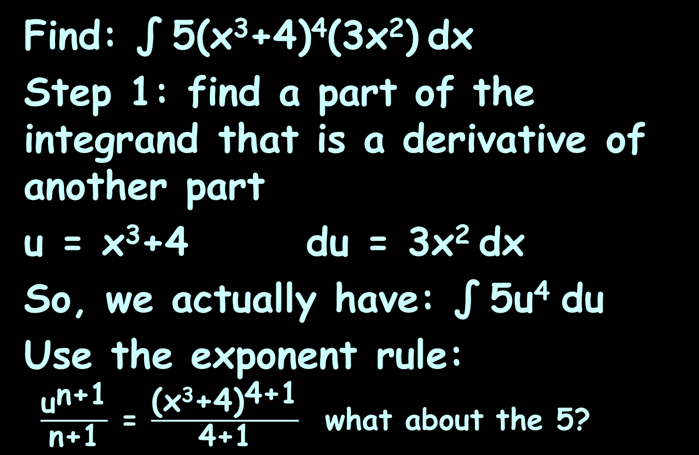
REVERSE CHAIN RULE
IN-CLASS PROBLEM 7
Find: ∫ 5(x³+4)⁴(3x²) dx
Step 1: find a part of the integrand that is a derivative of another part
u = x³+4 du = 3x² dx
So, we actually have: ∫ 5u⁴ du
Use the exponent rule:
$\frac{{\text{u}}^{\text{n}\text{+1}}}{\text{n}\text{+1}}$ = $\frac{{\text{(}\text{x}\text{3}\text{+4}\text{)}}^{\text{4}\text{+1}}}{\text{4}\text{+1}}$ what about the 5?

Slide 133
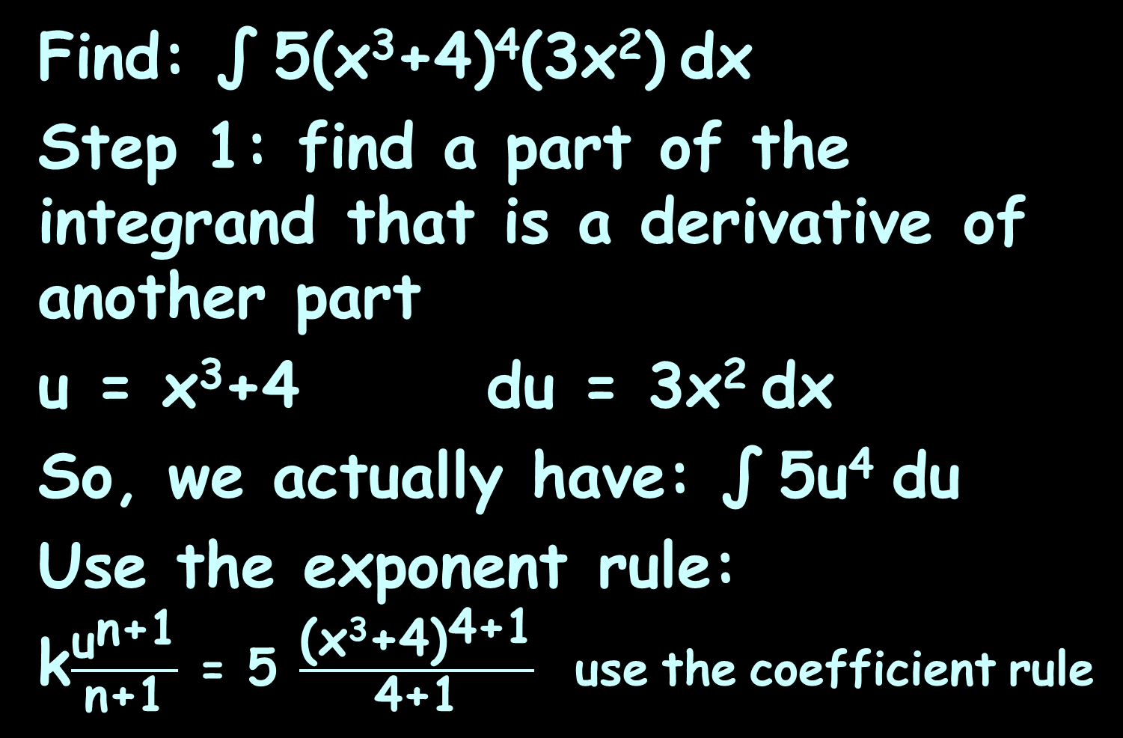
REVERSE CHAIN RULE
IN-CLASS PROBLEM 7
Find: ∫ 5(x³+4)⁴(3x²) dx
Step 1: find a part of the integrand that is a derivative of another part
u = x³+4 du = 3x² dx
So, we actually have: ∫ 5u⁴ du
Use the exponent rule:
k$\frac{{\text{u}}^{\text{n}\text{+1}}}{\text{n}\text{+1}}$ = 5 $\frac{{\text{(}\text{x}\text{3}\text{+4}\text{)}}^{\text{4}\text{+1}}}{\text{4}\text{+1}}$ use the coefficient rule

Slide 134
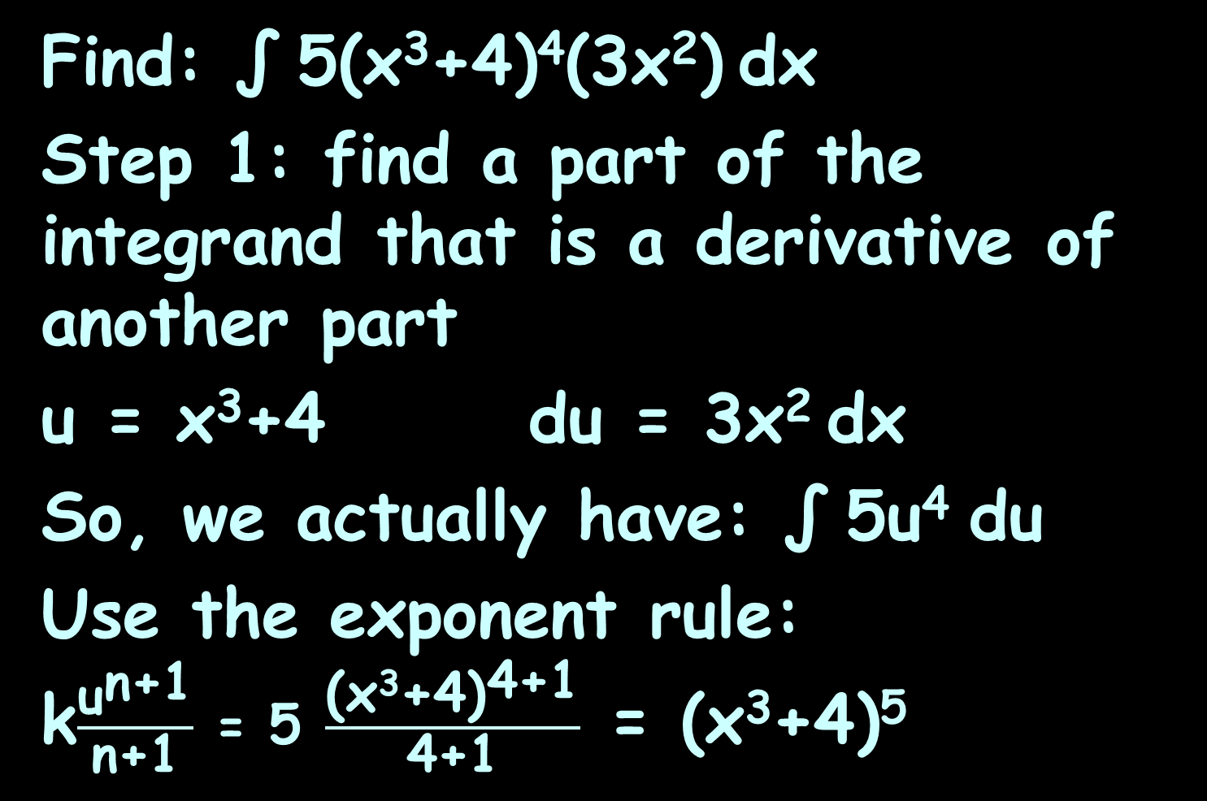
REVERSE CHAIN RULE
IN-CLASS PROBLEM 7
Find: ∫ 5(x³+4)⁴(3x²) dx
Step 1: find a part of the integrand that is a derivative of another part
u = x³+4 du = 3x² dx
So, we actually have: ∫ 5u⁴ du
Use the exponent rule:
k$\frac{{\text{u}}^{\text{n}\text{+1}}}{\text{n}\text{+1}}$ = 5 $\frac{{\text{(}\text{x}\text{3}\text{+4}\text{)}}^{\text{4}\text{+1}}}{\text{4}\text{+1}}$ = (x³+4)⁵
Are we done?

Slide 135
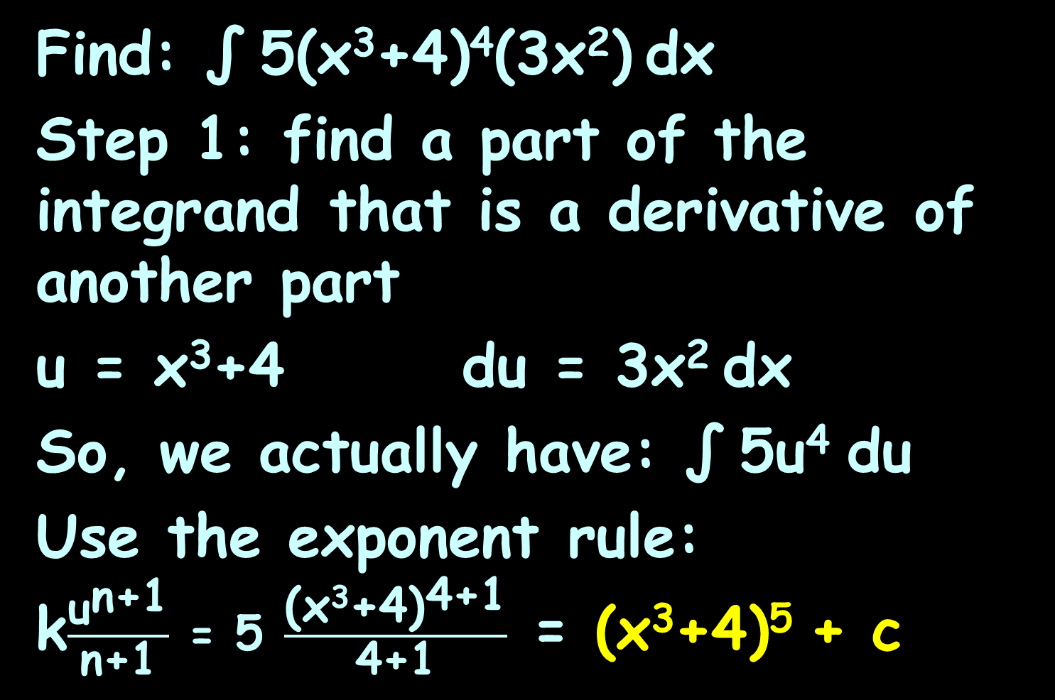
REVERSE CHAIN RULE
IN-CLASS PROBLEM 7
Find: ∫ 5(x³+4)⁴(3x²) dx
Step 1: find a part of the integrand that is a derivative of another part
u = x³+4 du = 3x² dx
So, we actually have: ∫ 5u⁴ du
Use the exponent rule:
k$\frac{{\text{u}}^{\text{n}\text{+1}}}{\text{n}\text{+1}}$ = 5 $\frac{{\text{(}\text{x}\text{3}\text{+4}\text{)}}^{\text{4}\text{+1}}}{\text{4}\text{+1}}$ = (x³+4)⁵ + c

Slide 136
Questions?
http://i.imgur.com/aliTlT3.jpg

Slide 137
Reverse Chain Rule
The Reverse Chain Rule works for a lot of integrals, but you have to be alert to detect the derivatives

Slide 138
REVERSE CHAIN RULE
IN-CLASS PROBLEM 8
Find: ∫ (x+1)³ dx
Are there any “du”s lurking in this problem?

Slide 139

REVERSE CHAIN RULE
IN-CLASS PROBLEM 8
Find: ∫ (x+1)³ dx
Are there any “du”s lurking in this problem?
u = x+1 du = 1 dx
So we’ve got: ∫ (u)³ du
What’s “n”?
∫ u^{n} du = $\frac{{\text{u}}^{\text{n}\text{+1}}}{\text{n}\text{+1}}$ + c

Slide 140
REVERSE CHAIN RULE
IN-CLASS PROBLEM 8
Find: ∫ (x+1)³ dx
Are there any “du”s lurking in this problem?
u = x+1 du = 1 dx
What’s “n”? 3
Find: ∫ (u)³ du = ?
∫ u^{n} du = $\frac{{\text{u}}^{\text{n}\text{+1}}}{\text{n}\text{+1}}$ + c

Slide 141
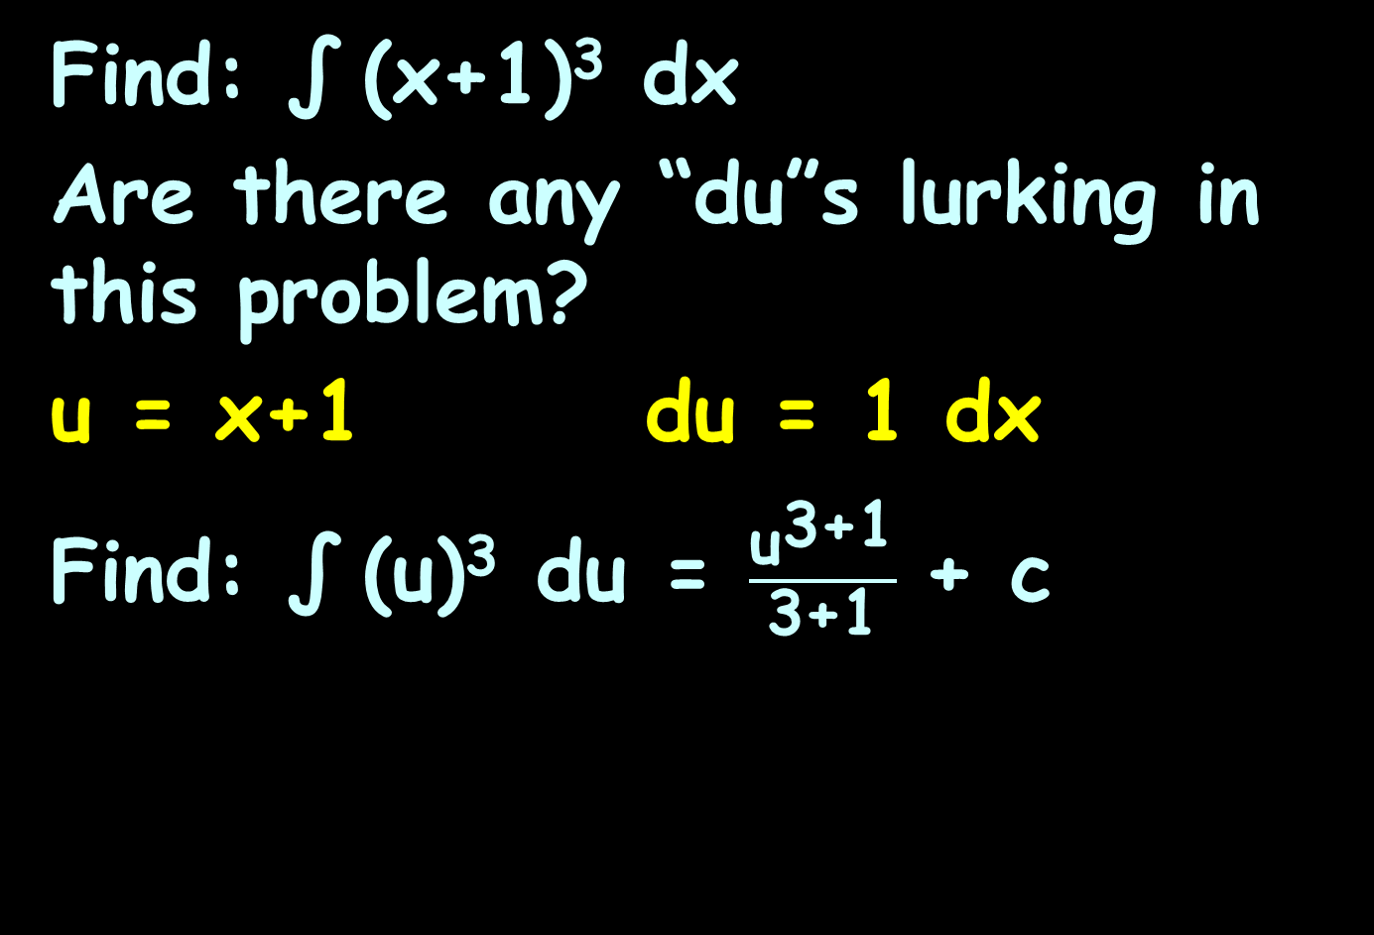
REVERSE CHAIN RULE
IN-CLASS PROBLEM 8
Find: ∫ (x+1)³ dx
Are there any “du”s lurking in this problem?
u = x+1 du = 1 dx
Find: ∫ (u)³ du = $\frac{{\text{u}}^{\text{3}\text{+1}}}{\text{3}\text{+1}}$ + c

Slide 142
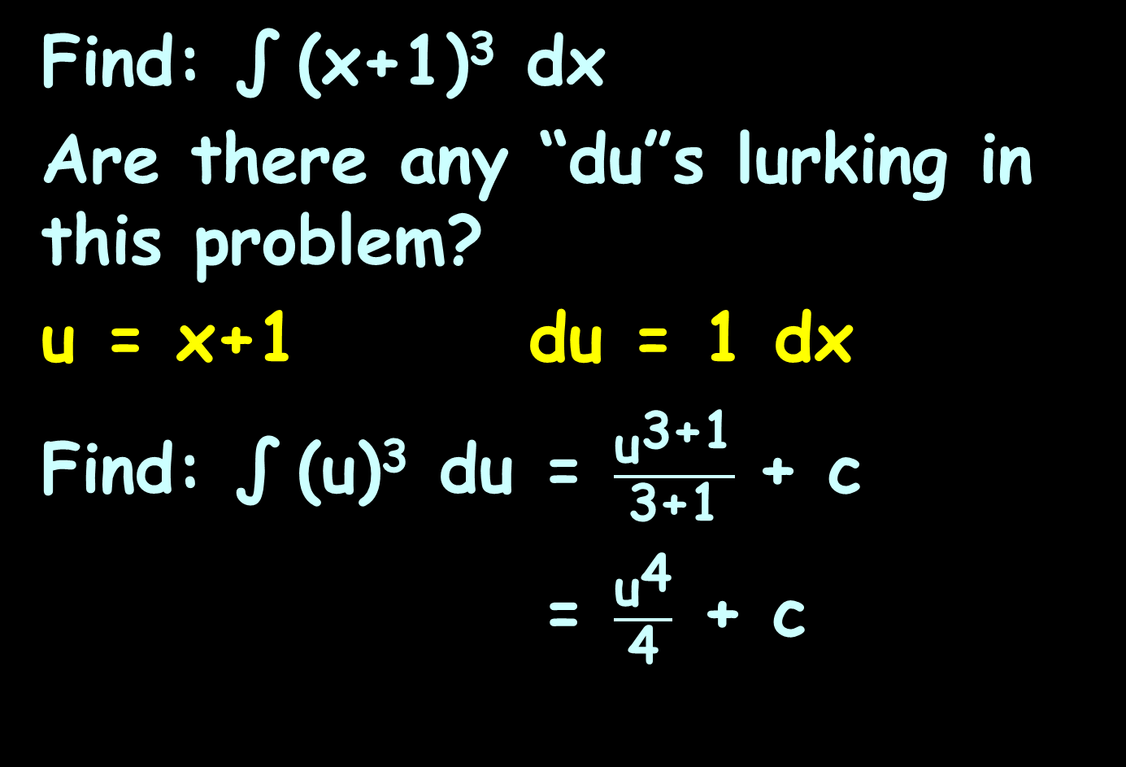
REVERSE CHAIN RULE
IN-CLASS PROBLEM 8
Find: ∫ (x+1)³ dx
Are there any “du”s lurking in this problem?
u = x+1 du = 1 dx
Find: ∫ (u)³ du = $\frac{{\text{u}}^{\text{3}\text{+1}}}{\text{3}\text{+1}}$ + c
= $\frac{{\text{u}}^{\text{4}}}{\text{4}}$ + c
Are we done?

Slide 143
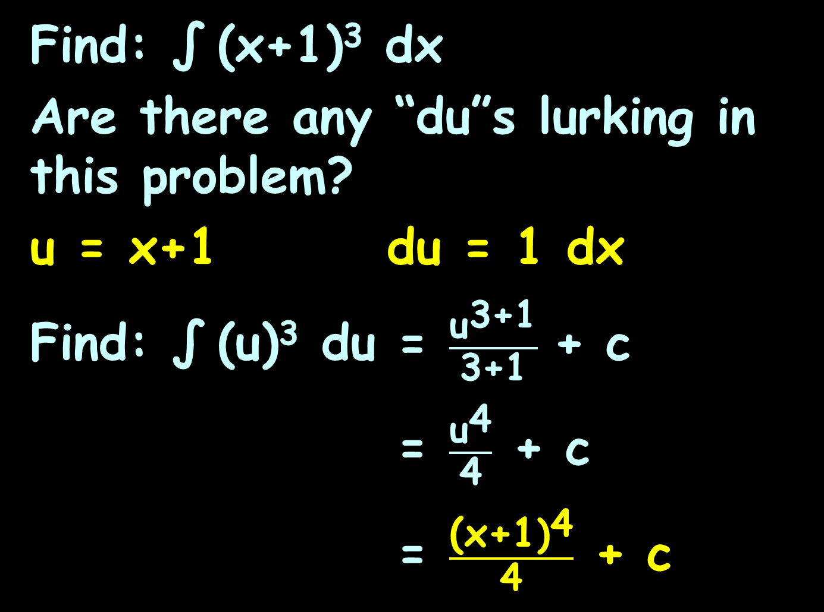
REVERSE CHAIN RULE
IN-CLASS PROBLEM 8
Find: ∫ (x+1)³ dx
Are there any “du”s lurking in this problem?
u = x+1 du = 1 dx
Find: ∫ (u)³ du = $\frac{{\text{u}}^{\text{3}\text{+1}}}{\text{3}\text{+1}}$ + c
= $\frac{{\text{u}}^{\text{4}}}{\text{4}}$ + c
= $\frac{{\text{(}\text{x}\text{+1}\text{)}}^{\text{4}}}{\text{4}}$ + c

Slide 144
Questions?
http://i.imgur.com/aliTlT3.jpg

Slide 145
Reverse Chain Rule
The Reverse Chain Rule works for transcendentals, too

Slide 146
REVERSE CHAIN RULE
IN-CLASS PROBLEM 9
Find: ∫ 2x cos(x²) dx
Are there any “du”s lurking in this problem?

Slide 147
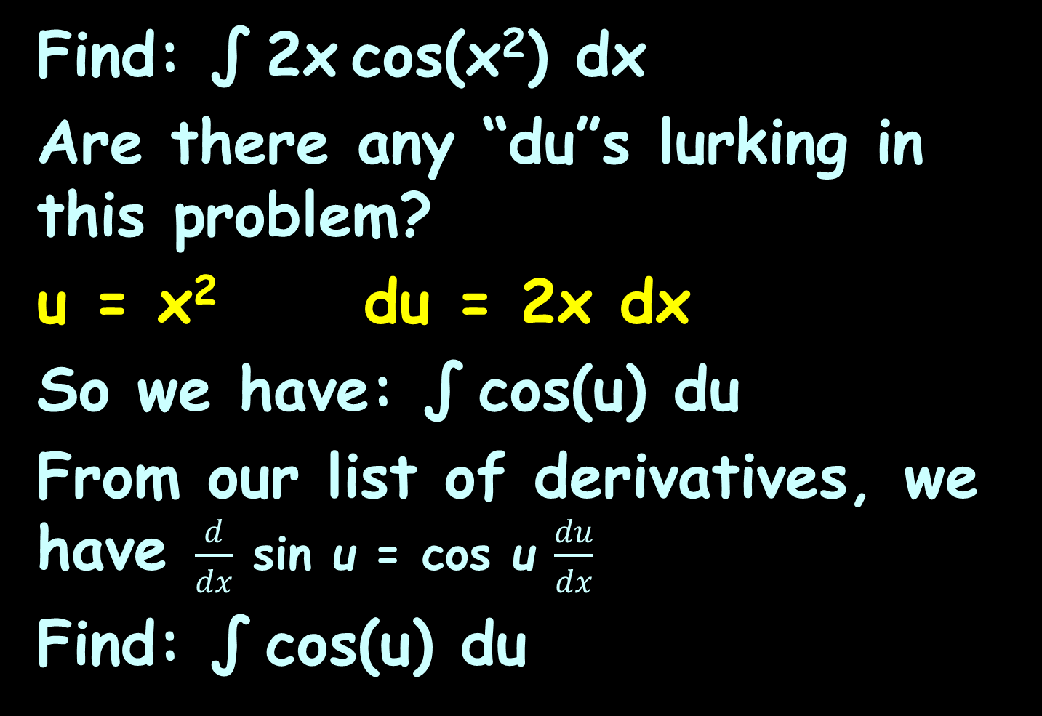
REVERSE CHAIN RULE
IN-CLASS PROBLEM 9
Find: ∫ 2x cos(x²) dx
Are there any “du”s lurking in this problem?
u = x² du = 2x dx
So we have: ∫ cos(u) du
From our list of derivatives, we have $\frac{d}{dx}$ sin u = cos u $\frac{du}{dx}$
Find: ∫ cos(u) du

Slide 148
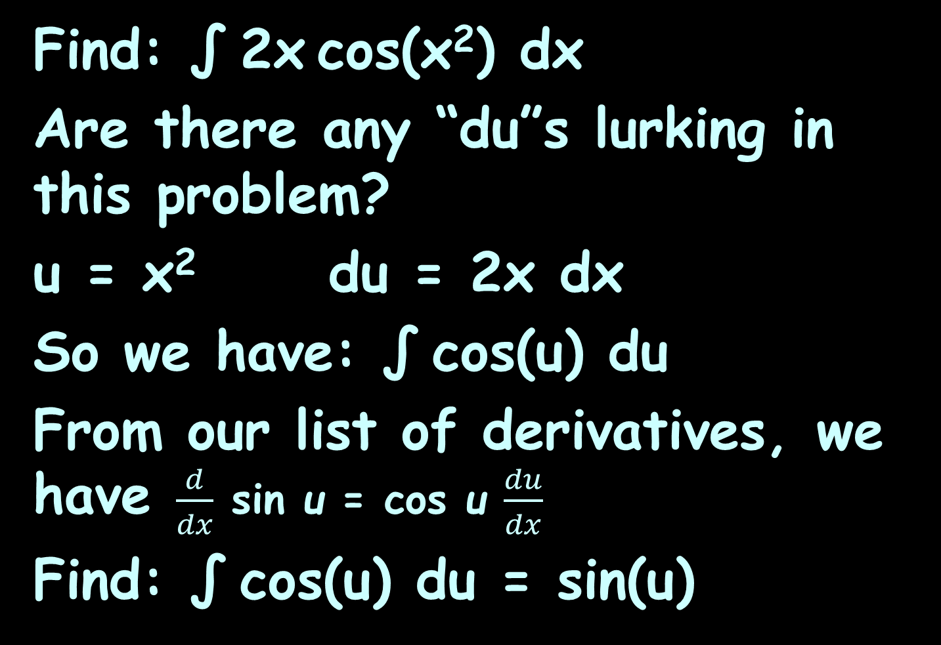
REVERSE CHAIN RULE
IN-CLASS PROBLEM 9
Find: ∫ 2x cos(x²) dx
Are there any “du”s lurking in this problem?
u = x² du = 2x dx
So we have: ∫ cos(u) du
From our list of derivatives, we have $\frac{d}{dx}$ sin u = cos u $\frac{du}{dx}$
Find: ∫ cos(u) du = sin(u)
Are we done?

Slide 149
REVERSE CHAIN RULE
IN-CLASS PROBLEM 9
Find: ∫ 2x cos(x²) dx
Are there any “du”s lurking in this problem?
u = x² du = 2x dx
So we have: ∫ cos(u) du
From our list of derivatives, we Find: ∫ cos(u) du = sin(u) + c
Are we done?

Slide 150
REVERSE CHAIN RULE
IN-CLASS PROBLEM 9
Find: ∫ 2x cos(x²) dx
Are there any “du”s lurking in this problem?
u = x² du = 2x dx
So we have: ∫ cos(u) du
Find: ∫ cos(u) du = sin(u) + c
Find: ∫ 2x cos(x²) dx = sin(x²) + c

Slide 151
Reverse Chain Rule
This is a very powerful tool for doing integration
But you have to be alert and know your derivatives
Look for exponents
Include stray constants if you can

Slide 152
Reverse Chain Rule
There is a list of derivatives at the end of your IP

Slide 153
Questions?
http://i.imgur.com/aliTlT3.jpg

Slide 154
Reverse Chain Rule
Sometimes we are just SO CLOSE to having the right derivative…

Slide 155
Reverse Chain Rule
Sometimes we are just SO CLOSE to having the right derivative…
Sometimes we can fudge to make it so!

Slide 156
REVERSE CHAIN RULE
IN-CLASS PROBLEM 10
Find: ∫ (5x+2)⁷ dx

Slide 157
REVERSE CHAIN RULE
IN-CLASS PROBLEM 10
Find: ∫ (5x+2)⁷ dx
If it was: ∫ 5(5x+2)⁷ dx it would fit the rule!

Slide 158
REVERSE CHAIN RULE
IN-CLASS PROBLEM 10
Find: ∫ (5x+2)⁷ dx
If it was: ∫ 5(5x+2)⁷ dx it would fit the rule!
Let’s make it do that!

Slide 159
REVERSE CHAIN RULE
IN-CLASS PROBLEM 10
Find: ∫ (5x+2)⁷ dx
If it was: ∫ 5(5x+2)⁷ dx it would fit the rule!
Let’s make it do that!
Find: 1/5 ∫ 5(5x+2)⁷ dx
(same problem, now much easier!)

Slide 160
REVERSE CHAIN RULE
IN-CLASS PROBLEM 10
Find: ∫ (5x+2)⁷ dx
Find: 1/5 ∫ 5(5x+2)⁷ dx
What’s the u and du?

Slide 161
REVERSE CHAIN RULE
IN-CLASS PROBLEM 10
Find: ∫ (5x+2)⁷ dx
Find: 1/5 ∫ 5(5x+2)⁷ dx
What’s the u and du?
u = 5x+2 du = 5 dx
Now we have:

Slide 162
REVERSE CHAIN RULE
IN-CLASS PROBLEM 10
Find: ∫ (5x+2)⁷ dx
Find: 1/5 ∫ 5(5x+2)⁷ dx
What’s the u and du?
u = 5x+2 du = 5 dx
Now we have: 1/5 ∫ u⁷ du
What’s “n?
∫ u^{n} du = $\frac{{\text{u}}^{\text{n}\text{+1}}}{\text{n}\text{+1}}$ + c

Slide 163
REVERSE CHAIN RULE
IN-CLASS PROBLEM 10
Find: ∫ (5x+2)⁷ dx
Find: 1/5 ∫ 5(5x+2)⁷ dx
What’s the u and du?
u = 5x+2 du = 5 dx
Now we have: 1/5 ∫ u⁷ du
What’s “n? 7
1/5 ∫u⁷du =
∫ u^{n} du = $\frac{{\text{u}}^{\text{n}\text{+1}}}{\text{n}\text{+1}}$ + c

Slide 164
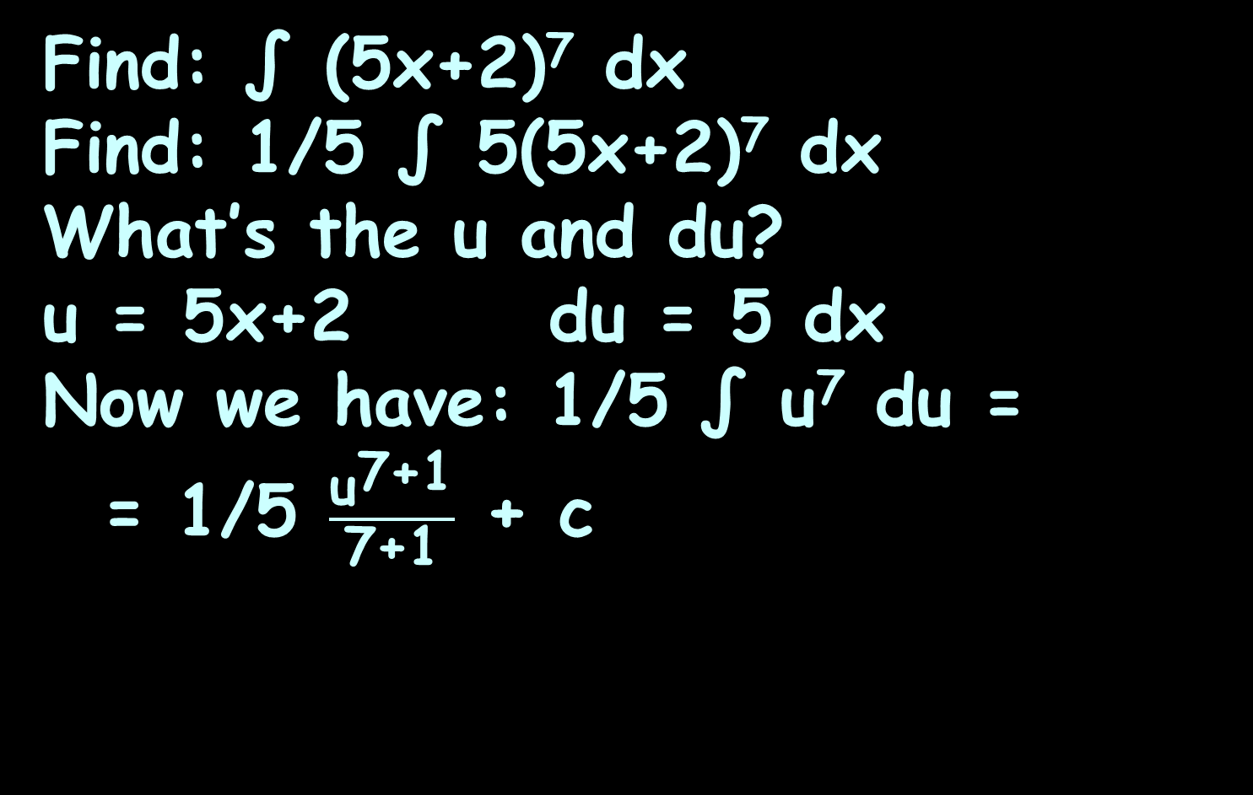
REVERSE CHAIN RULE
IN-CLASS PROBLEM 10
Find: ∫ (5x+2)⁷ dx
Find: 1/5 ∫ 5(5x+2)⁷ dx
What’s the u and du?
u = 5x+2 du = 5 dx
Now we have: 1/5 ∫ u⁷ du =
= 1/5 $\frac{{\text{u}}^{\text{7}\text{+1}}}{\text{7}\text{+1}}$ + c
Are we done?

Slide 165
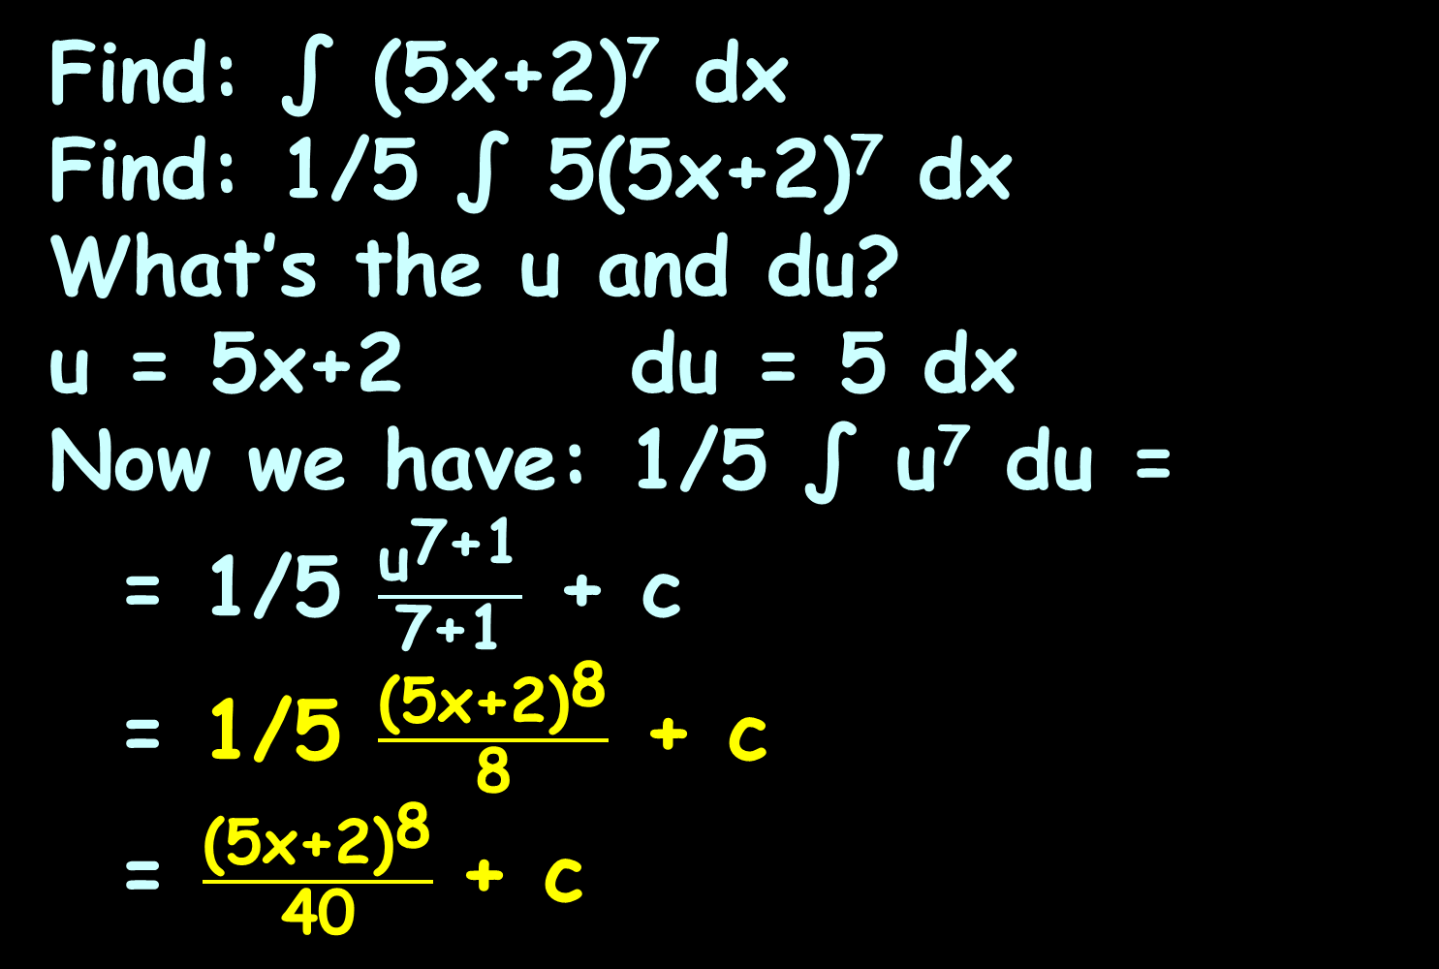
REVERSE CHAIN RULE
IN-CLASS PROBLEM 10
Find: ∫ (5x+2)⁷ dx
Find: 1/5 ∫ 5(5x+2)⁷ dx
What’s the u and du?
u = 5x+2 du = 5 dx
Now we have: 1/5 ∫ u⁷ du =
= 1/5 $\frac{{\text{u}}^{\text{7}\text{+1}}}{\text{7}\text{+1}}$ + c
= 1/5 $\frac{{\text{(5}\text{x}\text{+2)}}^{\text{8}}}{\text{8}}$ + c
= $\frac{{\text{(5}\text{x}\text{+2)}}^{\text{8}}}{\text{40}}$ + c

Slide 166
Questions?
http://i.imgur.com/aliTlT3.jpg

Slide 167

You Survived!
Today we covered:
Antiderivatives and
integration
Reverse Chain Rule
www.playbuzz.com

