Slide 1

Welcome to
Unit 1 Part 2!
MATH 205 Differential Calculus
https://www.smu.edu.sg/programmes/core-curriculum/course-structure/calculus

Slide 2
What’s Up?
Review: Increments, Rate of
Change, Limits
New stuff: functions, evaluating functions, domain and range,
interpreting functions, types
of functions

Slide 3
What’s Up?
Outcome 2) Use algebra and limits to examine the properties and graphs of functions
Outcome 7) Solve problems by identifying the requirements, making a sketch as appropriate, and using calculus techniques to model the problem, calculating the final answer and verifying the solution

Slide 4

Review
http://995642590.r.lightningbase-cdn.com/wp-content/uploads/2010/12/looking-back-hrexaminer-v144-cover425px.jpg

Slide 5

CALCULUS
is the mathematics of CHANGE
541711_329185230530409_2035452876_n.jpg

Slide 6
New Symbol
∆ means “change”
∆x means the change in x
∆y means the change in y

Slide 7
Another Way to Write It
“d” also means change
dx means the change in x
dy means the change in y

Slide 8
∆ Increments
An increment Δ is the final value minus the initial value:
Δx (the change in x) = x_{final} - x_{initial}
Δy (the change in y) = y_{final} - y_{initial}

Slide 9
Rate of Change
The ratio of two increments will be a rate of change

Slide 10
Rate of Change
∆ location (distance you went)
d_{final} – d_{initial}
∆ time (time it took)
t_{final} – t_{initial}
∆location / ∆time is the rate of change of your distance vs change in time “mph”

Slide 11
Average Speed
mph an average value over the entire journey

Slide 12
Instantaneous Speed
At any instant in time, your speed would be a bit different from the average
This is called your “instantaneous speed”

Slide 13
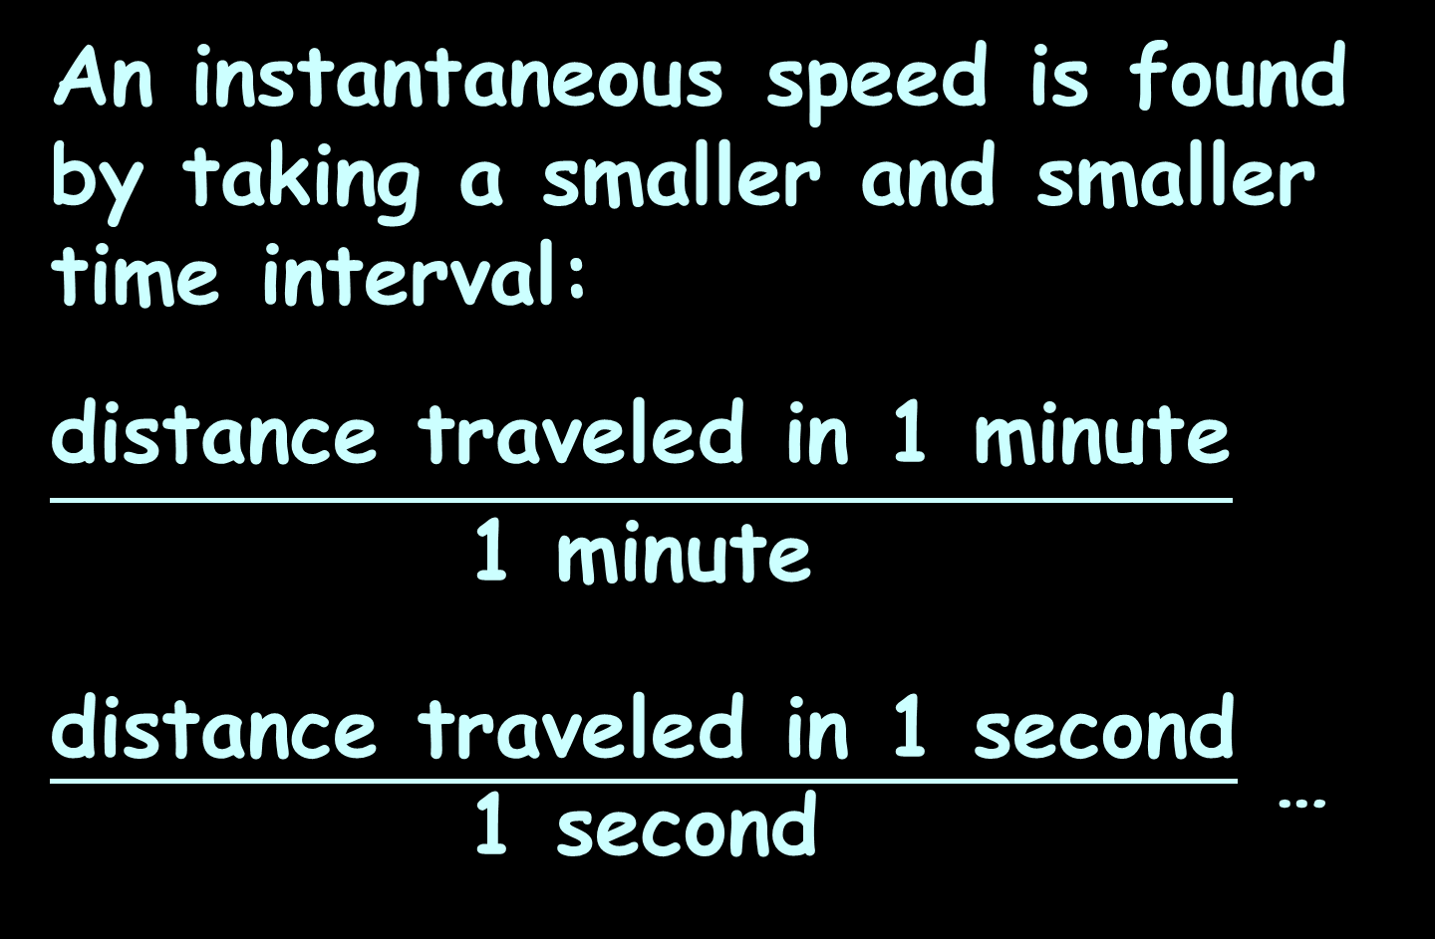
Instantaneous Speed
An instantaneous speed is found by taking a smaller and smaller time interval:
$$\frac{\text{distance} \text{traveled} \text{in}\text{ 1 }\text{minute}}{\text{1 }\text{minute}}$$
$\frac{\text{distance} \text{traveled} \text{in}\text{ 1 }\text{second}}{\text{1 }\text{second}}$ …

Slide 14
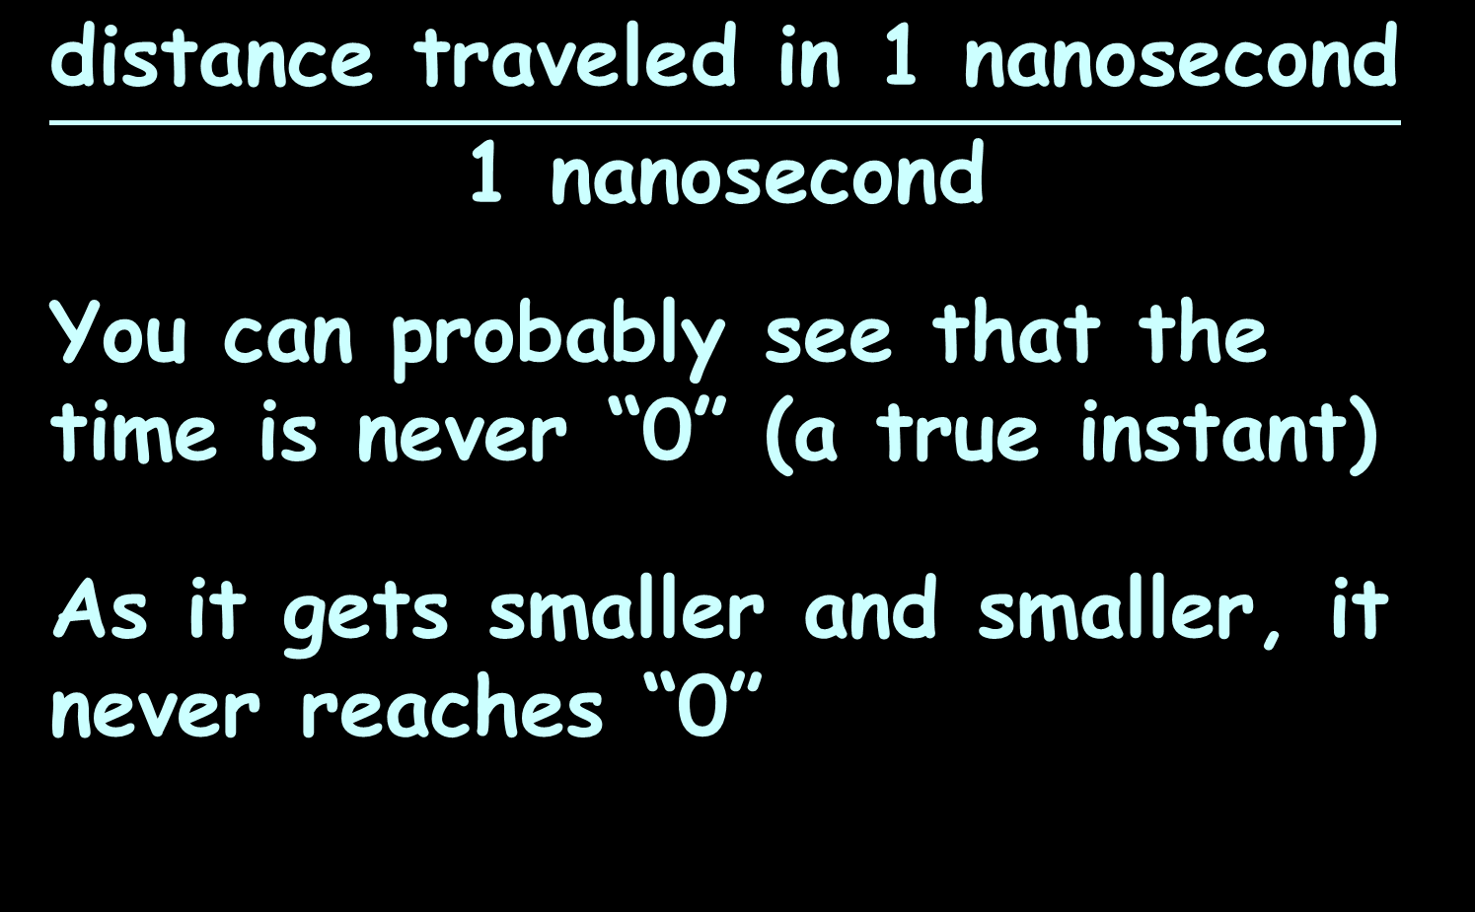
Instantaneous Speed
$$\frac{\text{distance} \text{traveled} \text{in}\text{ 1 }\text{nano}\text{second}}{\text{1 }\text{nano}\text{second}}$$
You can probably see that the time is never “0” (a true instant)
As it gets smaller and smaller, it never reaches “0”

Slide 15
Instantaneous Speed
This is the basis for the first subject we study in calculus:
limits
As we get closer and closer to the thing we want to know, are we zeroing in on a single value or not?

Slide 16
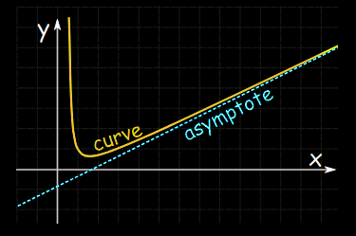
Limits
Asymptotes get closer and closer to a value, but never actually get there
https://www.mathsisfun.com/algebra/asymptote.html

Slide 17
Limits
This concept of getting closer and closer to a value or a location on a graph is called
calculating a “limit”

Slide 18
Limits
We write this as:
lim = 64
change in time →0
or
lim = 64
∆time →0
or
lim = 64
∆t →0
or
lim(∆t → 0) = 64

Slide 19

Questions?
http://i.imgur.com/aliTlT3.jpg

Slide 20
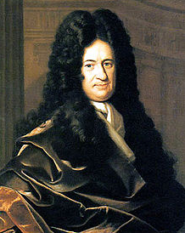
Functions
The term, "function" was coined by Gottfried Wilhelm Leibniz in 1673
https://en.wikipedia.org/wiki/Gottfried_Wilhelm_Leibniz#/media/File:Christoph_Bernhard_Francke_-_Bildnis_des_Philosophen_Leibniz_(ca._1695).jpg

Slide 21
Functions
Leibnitz observed that in many real-world processes there are inputs and outputs

Slide 22
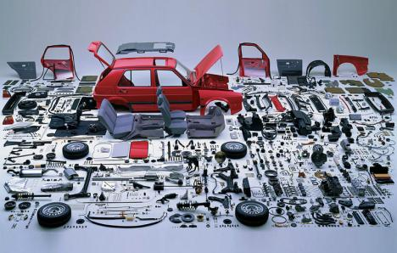
Functions
In a factory, the inputs are the components
https://3.bp.blogspot.com/-DEIw6og908M/VuLU19CgaII/AAAAAAAACgg/
IcW5UTOy7MY4O9ZdcCeqPyV_NI63Ou-6Q/s1600/Screen%2BShot%2B2016-03-07%2Bat%2B11.23.54%2BAM.png

Slide 23
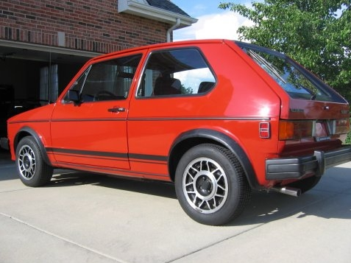
Functions
The output is the final product
https://i89.photobucket.com/albums/k230/echassin/GTI008.jpg

Slide 24
Functions
In formulas, some variables are “input” variables
The thing you are calculating with the formula is the “output”

Slide 25
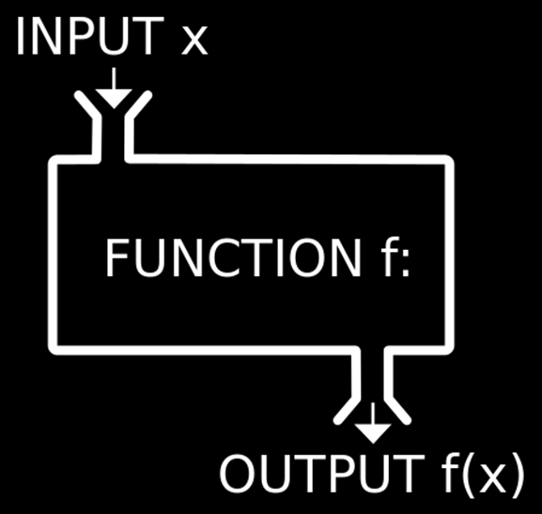
Functions
https://1.bp.blogspot.com/-YEqWLoN5V88/Wblu4NWyg4I/AAAAAAAAefY/G01iSXT2zn4L-W2-S-BETZHwvwHc_X1WQCLcBGAs/w530-h298-p/php-inbuilt-functions.jpg

Slide 26
FUNCTIONS
IN-CLASS PROBLEM 1
In the formula:
A = πr²
What is the input variable?

Slide 27
FUNCTIONS
IN-CLASS PROBLEM 1
In the formula:
A = πr²
What is the input variable?
“r”
What is the output variable?

Slide 28
FUNCTIONS
IN-CLASS PROBLEM 1
In the formula:
A = πr²
What is the input variable?
“r”
What is the output variable?
“A”

Slide 29
Functions
A = πr²
The size of “r” the radius completely determines A the area of the circle

Slide 30
Functions
The input variable is ALWAYS put on the x-axis (horizontal axis)
No reason – it’s a TRADITION!

Slide 31
FUNCTIONS
IN-CLASS PROBLEM 1
Which variable goes on the horizontal axis in A = πr²?

Slide 32
FUNCTIONS
IN-CLASS PROBLEM 1
Which variable goes on the horizontal axis in A = πr²?
r

Slide 33
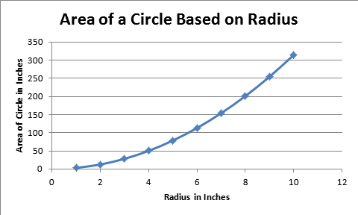
Functions
A graph that tells the whole story!
2
Vfrench 2008

Slide 34
Functions
What the output turns out to be depends on what the input is
The output is frequently called the “dependent” variable

Slide 35
Functions
The input is called the “independent” variable because it’s value comes from an outside (sometimes uncontrollable) source

Slide 36
Questions?
http://i.imgur.com/aliTlT3.jpg

Slide 37
Functions
When you have a certain input, you want to be able to forecast exactly what the output will be
https://3.bp.blogspot.com/-DEIw6og908M/VuLU19CgaII/AAAAAAAACgg/IcW5UTOy7MY4O9ZdcCeqPyV_NI63Ou-6Q/s1600/Screen%2BShot%2B2016-03-07%2Bat%2B11.23.54%2BAM.png
https://i89.photobucket.com/albums/k230/echassin/GTI008.jpg

Slide 38
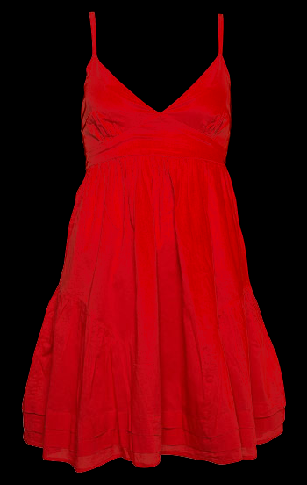
Functions
You don’t want several possible outputs
https://3.bp.blogspot.com/-DEIw6og908M/VuLU19CgaII/AAAAAAAACgg/IcW5UTOy7MY4O9ZdcCeqPyV_NI63Ou-6Q/s1600/Screen%2BShot%2B2016-03-07%2Bat%2B11.23.54%2BAM.png
https://i89.photobucket.com/albums/k230/echassin/GTI008.jpg

Slide 39
Functions
A special type of mathematical formula was designed for input-outputs: functions

Slide 40
Functions
For a formula to be a function, every x can have only one y

Slide 41
Functions
Example:
The set: {(1,3)(2,4)(7,25)}
is a function because:
every x-value (1,2,7) has only one y-value:
1→3
2→4
7→25

Slide 42
FUNCTIONS
IN-CLASS PROBLEM 2
Is this set of points a function?
{(0,-2)(5,0)(13,4.2)(8.1,6)}

Slide 43
FUNCTIONS
IN-CLASS PROBLEM 2
Is this set of points a function?
{(0,-2)(5,0)(13,4.2)(8.1,6)}
YES! Because every x-value has only one y-value:
0 → -2
5 → 0
13 → 4.2
8.1 → 6

Slide 44
FUNCTIONS
IN-CLASS PROBLEM 2
Is this set of points a function?
{(0,-2)(5,0)(0,4.2)(8.1,6)}

Slide 45
FUNCTIONS
IN-CLASS PROBLEM 2
Is this set of points a function?
{(0,-2)(5,0)(0,4.2)(8.1,6)}
NO! Because when x = 0, the y-value could be -2 or 4.2:
0 → -2 or 4.2
5 → 0
8.1 → 6

Slide 46
Questions?
http://i.imgur.com/aliTlT3.jpg

Slide 47
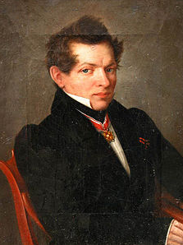
Functions
Nikolai Lobachevsky gave the modern "formal" definition of a function as a relation in which every first element has a unique second element
(1830-ish)
https://en.wikipedia.org/wiki/Nikolai_Lobachevsky#/media/File:Lobachevsky.jpg

Slide 48
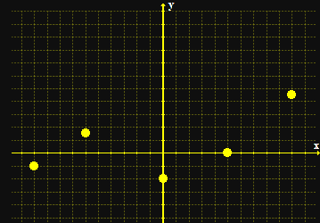
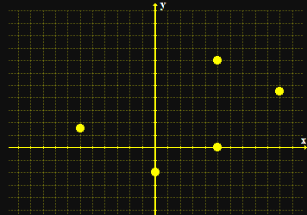
Functions
When you graph a function, only one of the points fall on a vertical line
a function not a function
Vfrench 2008

Slide 49
Functions
To test whether a formula is a function, you graph it and do the “vertical line test”
If it passes the VLT, it is a function

Slide 50
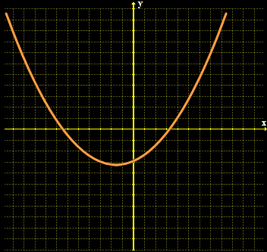
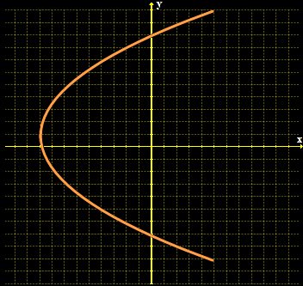
FUNCTIONS
IN-CLASS PROBLEM 2
Is it a function?
?
Vfrench 2008

Slide 51
FUNCTIONS
IN-CLASS PROBLEM 2
Is it a function?
yes
?
Vfrench 2008

Slide 52
FUNCTIONS
IN-CLASS PROBLEM 2
Is it a function?
yes
no
Vfrench 2008

Slide 53
FUNCTIONS
IN-CLASS PROBLEM 2
Is it a function?
{(2,1), (4,5), (8,4), (1,0)}
{(0,8), (9,6), (6,6), (9,0)}
{(7,7), (7,8), (8,8), (9,8)}
VFrench 2015

Slide 54
FUNCTIONS
IN-CLASS PROBLEM 2
Is it a function?
{(2,1), (4,5), (8,4), (1,0)} yes
{(0,8), (9,6), (6,6), (9,0)}
{(7,7), (7,8), (8,8), (9,8)}
VFrench 2015

Slide 55
FUNCTIONS
IN-CLASS PROBLEM 2
Is it a function?
{(2,1), (4,5), (8,4), (1,0)} yes
{(0,8), (9,6), (6,6), (9,0)} no
{(7,7), (7,8), (8,8), (9,8)}
VFrench 2015

Slide 56
FUNCTIONS
IN-CLASS PROBLEM 2
Is it a function?
{(2,1), (4,5), (8,4), (1,0)} yes
{(0,8), (9,6), (6,6), (9,0)} no
{(7,7), (7,8), (8,8), (9,8)} no
VFrench 2015

Slide 57
FUNCTIONS
IN-CLASS PROBLEM 2
Is it a function?
{(2,1), (4,5), (8,4), (1,0)} yes
{(0,8), (9,6), (6,6), (9,0)} no
{(7,7), (7,8), (8,8), (9,8)} no
yes
VFrench 2015

Slide 58
FUNCTIONS
IN-CLASS PROBLEM 2
Is it a function?
{(2,1), (4,5), (8,4), (1,0)} yes
{(0,8), (9,6), (6,6), (9,0)} no
{(7,7), (7,8), (8,8), (9,8)} no
yes
yes
VFrench 2015

Slide 59
FUNCTIONS
IN-CLASS PROBLEM 2
Is it a function?
{(2,1), (4,5), (8,4), (1,0)} yes
{(0,8), (9,6), (6,6), (9,0)} no
{(7,7), (7,8), (8,8), (9,8)} no
yes
yes
no
VFrench 2015

Slide 60
Questions?
http://i.imgur.com/aliTlT3.jpg

Slide 61
Functions
Naturally, there is a special symbol for functions
Where you used to write
y = 8x + 13
A function is written:
ƒ(x) = 8x + 13
read as: “f of x”

Slide 62
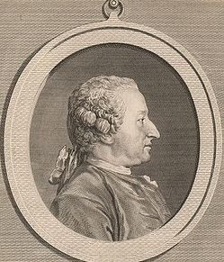
Functions
Alexis Claude Clairaut introduced the familiar notation "ƒ(x)" in 1734
https://en.wikipedia.org/wiki/Alexis_Clairaut#/media/File:Alexis_Clairault.jpg

Slide 63
Functions
ƒ(x) shows that the formula uses “x” as the input and the output depends on it
y = ƒ(x)

Slide 64
Functions
When you evaluate a function, you need to substitute the given value for x in the formula

Slide 65
Functions
ƒ(3) means “evaluate the function for x=3”

Slide 66
Evaluating Functions
The Order of Operations to get the right answer is:
P parentheses
E exponents
M multiplication
D division
A addition
S subtraction
>
Done at the same
time left to right
>
Done at the same
time left to right

Slide 67
FUNCTIONS
IN-CLASS PROBLEM 3
ƒ(x) = 8x + 13
Calculate ƒ(2) =
Calculate ƒ(-1)
Calculate ƒ(1)

Slide 68
FUNCTIONS
IN-CLASS PROBLEM 3
ƒ(x) = 8x + 13
Calculate ƒ(2) = 29
Calculate ƒ(-1) =
Calculate ƒ(1)

Slide 69
FUNCTIONS
IN-CLASS PROBLEM 3
ƒ(x) = 8x + 13
Calculate ƒ(2) = 29
Calculate ƒ(-1) = 5
Calculate ƒ(1) =

Slide 70
FUNCTIONS
IN-CLASS PROBLEM 3
ƒ(x) = 8x + 13
Calculate ƒ(2) = 29
Calculate ƒ(-1) = 5
Calculate ƒ(1) = 21

Slide 71
Questions?
http://i.imgur.com/aliTlT3.jpg

Slide 72
Functions
The “legal” values for a function are called:
Domain - the xs
Range - the ys
(aid to memory: x comes before y; d comes before r)

Slide 73
FUNCTIONS
IN-CLASS PROBLEM 4
What is the domain for this function:
{(0,-2)(5,0)(13,4.2)(8.1,6)}

Slide 74
FUNCTIONS
IN-CLASS PROBLEM 4
What is the domain for this function:
{(0,-2)(5,0)(13,4.2)(8.1,6)}
Domain = 0,5,13,8.1

Slide 75
FUNCTIONS
IN-CLASS PROBLEM 4
What is the range for this function:
{(0,-2)(5,0)(13,4.2)(8.1,6)}

Slide 76
FUNCTIONS
IN-CLASS PROBLEM 4
What is the range for this function:
{(0,-2)(5,0)(13,4.2)(8.1,6)}
Range = -2,0,4.2,6

Slide 77
Questions?
http://i.imgur.com/aliTlT3.jpg

Slide 78
Polynomials
“poly” means “many”
“nomials” means “names” (variables)

Slide 79
Polynomials
Polynomials – algebraic formulas with only non-negative integer exponents

Slide 80
Polynomials
Contain many variables:
7x² + 4x - 2.5x³y + 41y³ = 723.6

Slide 81
Polynomials
Parts of a polynomial:
Terms are separated by
+ - or = signs

Slide 82
Polynomials
Each “term” is separated by a “+” “-” or “=”:
7x² + 4x - 2.5x³y + 41y³ = 723.6
term1
term2
term3
term4
term5

Slide 83
Polynomials
The number multiplying a variable term is called a coefficient

Slide 84
Polynomials
The number that is not multiplying any variable term is called a constant

Slide 85
Polynomials
The number multiplying each term is called the “coefficient”:
7x² + 4x - 2.5x³y + 41y³ = 723.6
coeff
term1
coeff
term2
coeff
term3
coeff
term4
constant

Slide 86
Polynomials
Degree of a polynomial
Sum the exponents in each
term
The largest sum is the
degree of the polynomial

Slide 87
Polynomials
The largest exponent determines the “degree” of the polynomial:
7x² + 4x - 2.5x³y + 41y³ = 723.6
expon
term1
=2
expon
term2
=1
add
expon
term3
=4
expon
term4
=3
constant
exponent is 0
(x⁰=1)

Slide 88
Polynomials
So the degree of this polynomial is “4”:
7x² + 4x - 2.5x³y + 41y³ = 723.6
expon
term1
=2
expon
term2
=1
add
expon
term3
=4
expon
term4
=3
constant
exponent is 0
(x⁰=1)

Slide 89
Questions?
http://i.imgur.com/aliTlT3.jpg

Slide 90
Functions
Interpreting functions – what do they mean?

Slide 91
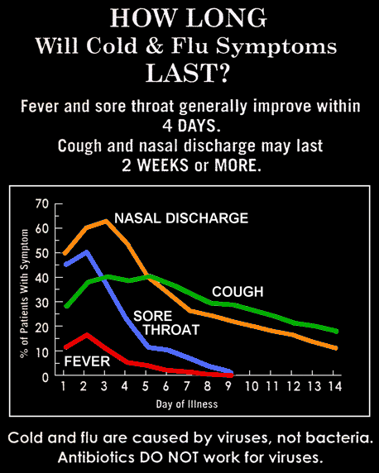
FUNCTIONS
IN-CLASS PROBLEM 5
Is each line the graph of a function? Why or why not?
2011

Slide 92
FUNCTIONS
IN-CLASS PROBLEM 5
What are the major "change" points for each line
2011

Slide 93
FUNCTIONS
IN-CLASS PROBLEM 5
Calculate ƒ(5) for each line
2011

Slide 94
FUNCTIONS
IN-CLASS PROBLEM 5
Calculate x at
ƒ(x) = 20 for each line
2011

Slide 95
Questions?
http://i.imgur.com/aliTlT3.jpg

Slide 96
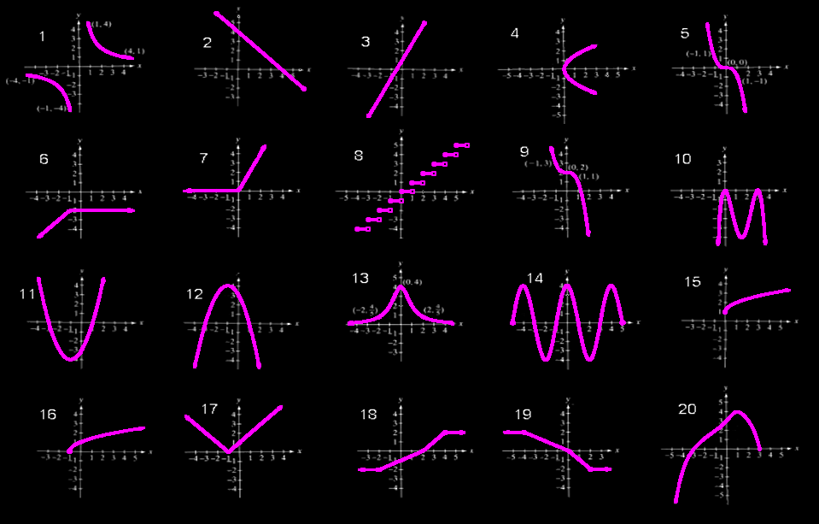
FUNCTIONS
IN-CLASS PROBLEM 6
Identify which are functions?
Vfrench 2008

Slide 97
FUNCTIONS
IN-CLASS PROBLEM 6
Identify which are functions?
function
function
function
function
function
function
function
function
function
function
function
function
function
function
function
function
function
function
function
Vfrench 2008

Slide 98
Functions
Increasing functions
Decreasing functions
Constant functions
relative maximums and minimums

Slide 99
FUNCTIONS
IN-CLASS PROBLEM 6
Identify which are increasing across the domain?
Which are decreasing? Which are constant?
Vfrench 2008

Slide 100
FUNCTIONS
IN-CLASS PROBLEM 6
Identify which are increasing across the domain?
Which are decreasing? Which are constant?
increasing
increasing
increasing
increasing
increasing
increasing
increasing
increasing
Vfrench 2008
increasing

Slide 101
FUNCTIONS
IN-CLASS PROBLEM 6
Identify which are increasing across the domain?
Which are decreasing? Which are constant?
decreasing
decreasing
decreasing
decreasing
Vfrench 2008

Slide 102
FUNCTIONS
IN-CLASS PROBLEM 6
Identify which are increasing across the domain?
Which are decreasing? Which are constant?
constant
constant
constant
constant
constant
probably constant
Vfrench 2008

Slide 103
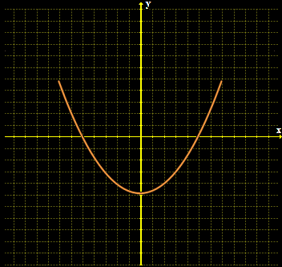
Functions
Even functions are symmetric with respect to the y-axis
ƒ(x) = ƒ(–x)
Vfrench 2008

Slide 104
Functions
Even functions written as equations have only even exponents of the variable
ƒ(x) = 3x⁴ - 15x² + 45

Slide 105
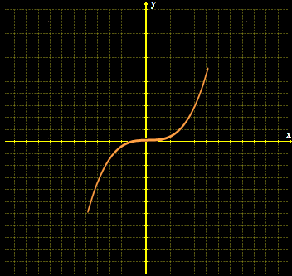
Functions
Odd functions are symmetric with respect to the origin
ƒ(-x) = –ƒ(x)
Vfrench 2008

Slide 106
Functions
Odd functions written as equations have only odd exponents of the variable
ƒ(x) = 3x⁵ - 15x³ + 45x

Slide 107
FUNCTIONS
IN-CLASS PROBLEM 6
Identify which are even? Which are odd?
Vfrench 2008

Slide 108
FUNCTIONS
IN-CLASS PROBLEM 6
Identify which are even? Which are odd?
Odd
Odd
Even
Even
Vfrench 2008

Slide 109
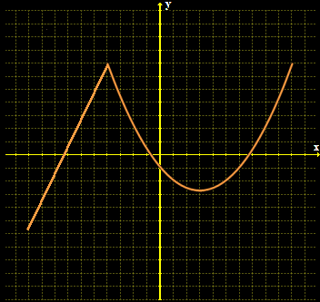
Functions
Types of functions:
piecewise functions - defined by two or more
equations
Vfrench 2008

Slide 110
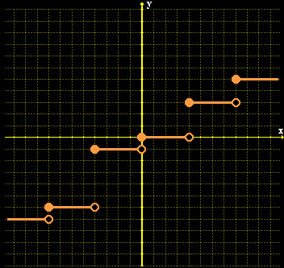
Functions
Step functions: function values graphically form discontinuous steps
Vfrench 2008

Slide 111
FUNCTIONS
IN-CLASS PROBLEM 6
Identify which are piecewise? Which are step functions?
Vfrench 2008

Slide 112
FUNCTIONS
IN-CLASS PROBLEM 6
Identify which are piecewise? Which are step functions?
could be
piecewise
(if you didn’t know the formula)
Step
Piecewise
Piecewise
Piecewise
Piecewise
Piecewise
could be piecewise
Piecewise
Vfrench 2008

Slide 113
Questions?
http://i.imgur.com/aliTlT3.jpg

Slide 114
Summary
Today we studied:
Review of Increments, Rate of
Change, Limits
Functions, mathematical models

Slide 115

You Survived!
www.playbuzz.com

