Slide 1
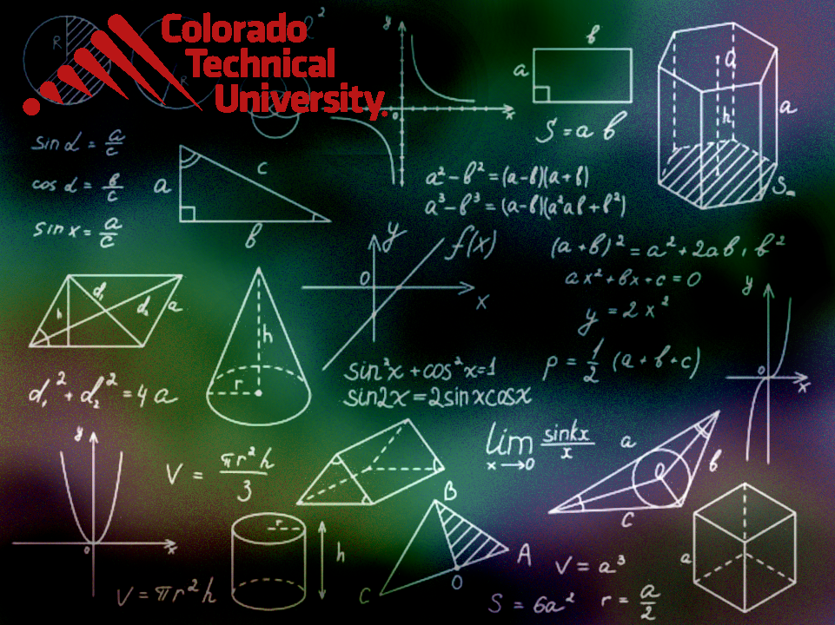
Welcome to
Unit 4- Part 08
MATH116-Foundations for Calculus
https://media.istockphoto.com/vectors/green-blackboard-mathematical-with-thin-line-shapes-and-inscriptions-vector-id1084380192?k=6&m=1084380192&s=612x612&w=0&h=TcEOVpnUmyuswT4Pay
AL6lNiHU8SS8g33yOSg-jR5BE=

Slide 2
What’s Up?
Today we will be going over:
Review: Zeros
New: Rational Functions
Polynomial and Rational
Inequalities

Slide 3
What’s Up?
Outcome 1) Analyze polynomials and find polynomial functions with specified zeros using polynomial division, the Remainder and Factor Theorems, and Conjugate Zeroes Theorem
Outcome 2) Graph polynomial functions using the leading-term test, factoring, zeros and their multiplicities
Outcome 3) Graph rational functions and their transformations, identifying all intercepts and asymptotes
Outcome 4) Solve equations, inequalities and applied problems involving rational functions

Slide 4

Review
http://995642590.r.lightningbase-cdn.com/wp-content/uploads/2010/12/looking-back-hrexaminer-v144-cover425px.jpg

Slide 5
Polynomial Graphs
A monomial function contains only a single variable
A power function is a monomial in which the variable is raised to a power:
ƒ(x) = cx^{k}

Slide 6
Polynomial Graphs
Because graphs (in this universe, anyway!) are 2 dimensional, we often concentrate on monomials

Slide 7
Polynomial Graphs
Before graphing calculators and home computers it was very difficult to get the graph of a function
Several techniques were developed to estimate what a graph would look like without actually graphing it

Slide 8
Polynomial Graphs
Zeros (where y=0) and the y-intercept (where x=0) were used

Slide 9
Polynomial Graphs
1st degree graphs go in one direction with no turning points
2nd degree graphs go in 2 directions with one turning point
3rd degree graphs go in 3 directions with 2 turning points

Slide 10
Polynomial Graphs
End behavior of a graph is what is going on when values of x are large (positive or negative)
It can be used to determine which quadrant the end values of a curve should lie in

Slide 11
Polynomial Graphs
The end behavior of a polynomial function resembles that of its leading term
(the biggest exponent swamps the rest)

Slide 12
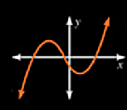
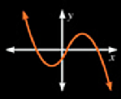
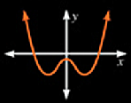
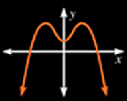
Polynomial Graphs
There are 4 types of end behavior:
ƒ→∞ as x→∞ ƒ→-∞ as x→-∞ | ƒ→-∞ as x→∞ ƒ→∞ as x→-∞
ƒ→∞ as x→∞ ƒ→∞ as x→-∞ | ƒ→-∞ as x→∞ ƒ→-∞ as x→-∞
https://mrloiselsclassroom.weebly.com/uploads/9/0/4/4/9044748/honors_algebra_2_-_graphing_polynomial_functions.pdf

Slide 13
Polynomial Graphs
How to identify the graph of a polynomial function

Slide 14
Polynomial Graphs
What is the degree?
What is the y-intercept?
What are the zeros?
Check the zero of even/odd
multiplicities
The end behavior will be similar
to the term with the
largest degree

Slide 15
Polynomial Graphs
How to analyze the graph of a polynomial function

Slide 16
Polynomial Graphs
Step 1: Determine the end behavior of the function

Slide 17
Polynomial Graphs
Step 2: Find the x- and y-intercepts of the graph

Slide 18
Polynomial Graphs
Step 3: Determine the zeros of the function and their multiplicity
Use this information to determine whether the graph touches or crosses the x-axis at each x-intercept

Slide 19
Polynomial Graphs
Step 4: Determine the maximum number of turning points on the graph of the function

Slide 20
Polynomial Graphs
Step 5: Use the information in Steps 1-4 to draw a complete graph of the function.
To help establish the y-axis scale, find additional points on the graph on each side of any x-intercept

Slide 21
Polynomial Graphs
For polynomial functions that have noninteger coefficients and for polynomials that are not easily factored, use a graphing utility
This is because the amount of information that can be obtained from algebraic analysis is limited

Slide 22

Questions?
http://i.imgur.com/aliTlT3.jpg

Slide 23
Polynomial Graphs
If (x-r)^{m} is a factor of a polynomial ƒ and (x-r)^{m+1} is not a factor of ƒ, then r is called a zero of multiplicity m of ƒ

Slide 24

Polynomial Graphs
If (x-r)^{m} is a factor of a polynomial ƒ and (x-r)^{m+1} is not a factor of ƒ, then r is called a zero of multiplicity m of ƒ
http://ahungryrunner.files.wordpress.com/2013/07/confused-baby.png

Slide 25
Polynomial Graphs
What they are trying to say is “what is the exponent for the factor a particular zero comes from?”

Slide 26
POLYNOMIAL GRAPHS
IN-CLASS PROBLEM 1
ƒ(x) = (x+1)²(x-2)
zeros: x = -1,2
Identify what is the zero of multiplicity for -1?

Slide 27
POLYNOMIAL GRAPHS
IN-CLASS PROBLEM 1
ƒ(x) = (x+1)²(x-2)
zeros: x = -1,2
Identify what is the zero of multiplicity for -1? 2
Identify what is the zero of multiplicity for 2?

Slide 28
POLYNOMIAL GRAPHS
IN-CLASS PROBLEM 1
ƒ(x) = (x+1)²(x-2)
zeros: x = -1,2
Identify what is the zero of multiplicity for -1? 2
Identify what is the zero of multiplicity for 2? 1

Slide 29
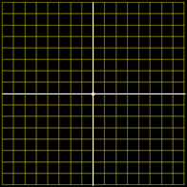
POLYNOMIAL GRAPHS
IN-CLASS PROBLEM 1
ƒ(x) = (x+1)²(x-2)
How can we decide?
4
4
3
3
2
2
1
1
-4
-3
0
0
-2
-1
0
1
2
3
4
-4
-3
-2
-1
0
1
2
3
4
-1
-1
-2
-2
-3
-3
-4
-4

Slide 30
Polynomial Graphs
We can also solve the “which graph?” question without solving for any x values by using the zeros of multiplicity

Slide 31
Polynomial Graphs
ƒ(x) = (x+1)²(x-2)
Remember, we had:
zeros: x = -1,2
zero of multiplicity for -1: 2
zero of multiplicity for 2: 1
even
odd

Slide 32
Polynomial Graphs
If r is a zero of even multiplicity:
Numerically – the sign of ƒ does
not change from one side to the
other side of r
Graphically: the graph of ƒ
touches the x-axis at r

Slide 33
Polynomial Graphs
If r is a zero of odd multiplicity:
Numerically – the sign of ƒ
changes from one side to the
other side of r
Graphically: the graph of ƒ
crosses the x-axis at r

Slide 34
Polynomial Graphs
ƒ(x) = (x+1)²(x-2)
Remember, we had:
zeros: x = -1,2
zero of multiplicity for -1: 2
so the graph will touch at x = -1
zero of multiplicity for 2: 1
so the graph will cross at x = 2
even
odd

Slide 35
Questions?
http://i.imgur.com/aliTlT3.jpg

Slide 36
Polynomial Graphs
How to identify the graph of a polynomial function

Slide 37
Polynomial Graphs
What is the degree?
What is the y-intercept?
What are the zeros?
Check the zero of even/odd
multiplicities
The end behavior will be similar
to the term with the
largest degree

Slide 38
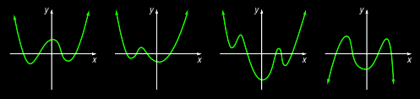
POLYNOMIAL GRAPHS
IN-CLASS PROBLEM 2
Identify which could be the graph of ƒ(x) = x⁴ + 5x³ + 5x² - 5x – 6:
What is the degree?
https://www.bellevernonarea.net/site/handlers/filedownload.ashx?moduleinstanceid=7637&dataid=10310&FileName=precalculusbook.pdf

Slide 39
POLYNOMIAL GRAPHS
IN-CLASS PROBLEM 2
Identify which could be the graph of ƒ(x) = x⁴ + 5x³ + 5x² - 5x – 6:
What is the degree? 4
So how many directions?
https://www.bellevernonarea.net/site/handlers/filedownload.ashx?moduleinstanceid=7637&dataid=10310&FileName=precalculusbook.pdf

Slide 40
POLYNOMIAL GRAPHS
IN-CLASS PROBLEM 2
Identify which could be the graph of ƒ(x) = x⁴ + 5x³ + 5x² - 5x – 6:
What is the degree? 4
So how many directions? 4
Does that eliminate any of them?
https://www.bellevernonarea.net/site/handlers/filedownload.ashx?moduleinstanceid=7637&dataid=10310&FileName=precalculusbook.pdf

Slide 41
POLYNOMIAL GRAPHS
IN-CLASS PROBLEM 2
Identify which could be the graph of ƒ(x) = x⁴ + 5x³ + 5x² - 5x – 6:
What is the degree? 4
So how many directions? 4
Does that eliminate any of them?
https://www.bellevernonarea.net/site/handlers/filedownload.ashx?moduleinstanceid=7637&dataid=10310&FileName=precalculusbook.pdf

Slide 42
POLYNOMIAL GRAPHS
IN-CLASS PROBLEM 2
Identify which could be the graph of ƒ(x) = x⁴ + 5x³ + 5x² - 5x – 6:
What is the y-intercept?
https://www.bellevernonarea.net/site/handlers/filedownload.ashx?moduleinstanceid=7637&dataid=10310&FileName=precalculusbook.pdf

Slide 43
POLYNOMIAL GRAPHS
IN-CLASS PROBLEM 2
Identify which could be the graph of ƒ(x) = x⁴ + 5x³ + 5x² - 5x – 6:
What is the y-intercept?
ƒ(0) = 0⁴ + 5(0)³ + 5(0)² – 5(0) – 6
= -6
https://www.bellevernonarea.net/site/handlers/filedownload.ashx?moduleinstanceid=7637&dataid=10310&FileName=precalculusbook.pdf

Slide 44
POLYNOMIAL GRAPHS
IN-CLASS PROBLEM 2
Identify which could be the graph of ƒ(x) = x⁴ + 5x³ + 5x² - 5x – 6:
What is the y-intercept? -6
Does that eliminate any of them?
https://www.bellevernonarea.net/site/handlers/filedownload.ashx?moduleinstanceid=7637&dataid=10310&FileName=precalculusbook.pdf

Slide 45
POLYNOMIAL GRAPHS
IN-CLASS PROBLEM 2
Identify which could be the graph of ƒ(x) = x⁴ + 5x³ + 5x² - 5x – 6:
What is the y-intercept? -6
Does that eliminate any of them?
https://www.bellevernonarea.net/site/handlers/filedownload.ashx?moduleinstanceid=7637&dataid=10310&FileName=precalculusbook.pdf

Slide 46
POLYNOMIAL GRAPHS
IN-CLASS PROBLEM 2
Identify which could be the graph of ƒ(x) = x⁴ + 5x³ + 5x² - 5x – 6:
Can we find the zeros?
Not without WolframAlpha!
https://www.bellevernonarea.net/site/handlers/filedownload.ashx?moduleinstanceid=7637&dataid=10310&FileName=precalculusbook.pdf

Slide 47
POLYNOMIAL GRAPHS
IN-CLASS PROBLEM 2
Identify which could be the graph of ƒ(x) = x⁴ + 5x³ + 5x² - 5x – 6:
What about the end behavior?
https://www.bellevernonarea.net/site/handlers/filedownload.ashx?moduleinstanceid=7637&dataid=10310&FileName=precalculusbook.pdf

Slide 48
POLYNOMIAL GRAPHS
IN-CLASS PROBLEM 2
Identify which could be the graph of ƒ(x) = x⁴ + 5x³ + 5x² - 5x – 6:
What about the end behavior?
As x→∞ ƒ→x⁴
https://www.bellevernonarea.net/site/handlers/filedownload.ashx?moduleinstanceid=7637&dataid=10310&FileName=precalculusbook.pdf

Slide 49
POLYNOMIAL GRAPHS
IN-CLASS PROBLEM 2
Identify which could be the graph of ƒ(x) = x⁴ + 5x³ + 5x² - 5x – 6:
What about the end behavior?
As x→∞ ƒ→x⁴ which is positive…
https://www.bellevernonarea.net/site/handlers/filedownload.ashx?moduleinstanceid=7637&dataid=10310&FileName=precalculusbook.pdf

Slide 50
POLYNOMIAL GRAPHS
IN-CLASS PROBLEM 2
Identify which could be the graph of ƒ(x) = x⁴ + 5x³ + 5x² - 5x – 6:
What about the end behavior?
As x→∞ ƒ→x⁴ which is positive…
Does that eliminate any of them?
https://www.bellevernonarea.net/site/handlers/filedownload.ashx?moduleinstanceid=7637&dataid=10310&FileName=precalculusbook.pdf

Slide 51
POLYNOMIAL GRAPHS
IN-CLASS PROBLEM 2
Identify which could be the graph of ƒ(x) = x⁴ + 5x³ + 5x² - 5x – 6:
What about the end behavior?
As x→∞ ƒ→x⁴ which is positive…
Does that eliminate any of them?
https://www.bellevernonarea.net/site/handlers/filedownload.ashx?moduleinstanceid=7637&dataid=10310&FileName=precalculusbook.pdf

Slide 52
POLYNOMIAL GRAPHS
IN-CLASS PROBLEM 2
Identify which could be the graph of ƒ(x) = x⁴ + 5x³ + 5x² - 5x – 6:
Tah-dah! It’s that one!
https://www.bellevernonarea.net/site/handlers/filedownload.ashx?moduleinstanceid=7637&dataid=10310&FileName=precalculusbook.pdf

Slide 53
Questions?
http://i.imgur.com/aliTlT3.jpg

Slide 54
Polynomial Graphs
How to analyze the graph of a polynomial function

Slide 55
Polynomial Graphs
Step 1: Determine the end behavior of the function

Slide 56
Polynomial Graphs
Step 2: Find the x- and y-intercepts of the graph

Slide 57
Polynomial Graphs
Step 3: Determine the zeros of the function and their multiplicity
Use this information to determine whether the graph touches or crosses the x-axis at each x-intercept

Slide 58
Polynomial Graphs
Step 4: Determine the maximum number of turning points on the graph of the function

Slide 59
Polynomial Graphs
Step 5: Use the information in Steps 1-4 to draw a complete graph of the function.
To help establish the y-axis scale, find additional points on the graph on each side of any x-intercept

Slide 60
Polynomial Graphs
The bad (good?) news:
We live in the 21st century
We have ways to graph even
complicated functions easily
Use a graphing utility - the
amount of information that
can be obtained from
algebraic analysis is limited

Slide 61
Questions?
http://i.imgur.com/aliTlT3.jpg

Slide 62
Continuity
The most important thing for calculus is that the functions must be smooth and continuous

Slide 63
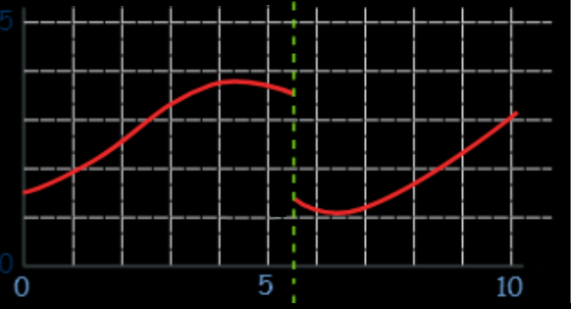
Continuity
No “cliffs”:

Slide 64
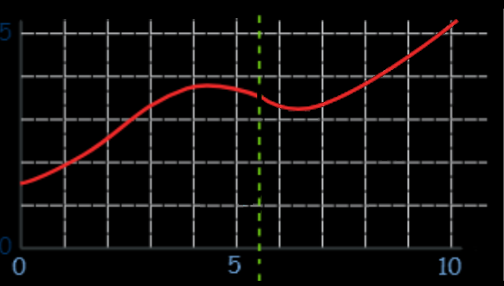
Continuity
No “holes”:

Slide 65
Continuity
This “continuity” of functions will be a prime requirement for calculus

Slide 66
Continuity
Discontinuities happen:
At steps in step functions (like switching on a circuit)
At places where there is no
defined answer (like division by zero)

Slide 67
CONTINUITY
IN-CLASS PROBLEM 3
Where might this function’s graph be discontinuous?
y = x/(x+1)
y = 54/(x²-1)
y = (7+x)/(x-7)
y = 18/(|x|-1)

Slide 68
CONTINUITY
IN-CLASS PROBLEM 3
Where might this function’s graph be discontinuous?
y = x/(x+1) at x=-1
y = 54/(x²-1)
y = (7+x)/(x-7)
y = 18/(|x|-1)

Slide 69
CONTINUITY
IN-CLASS PROBLEM 3
Where might this function’s graph be discontinuous?
y = x/(x+1) at x=-1
y = 54/(x²-1) at x=1
y = (7+x)/(x-7)
y = 18/(|x|-1)

Slide 70
CONTINUITY
IN-CLASS PROBLEM 3
Where might this function’s graph be discontinuous?
y = x/(x+1) at x=-1
y = 54/(x²-1) at x=1
y = (7+x)/(x-7) at x=7
y = 18/(|x|-1)

Slide 71
CONTINUITY
IN-CLASS PROBLEM 3
Where might this function’s graph be discontinuous?
y = x/(x+1) at x=-1
y = 54/(x²-1) at x=1
y = (7+x)/(x-7) at x=7
y = 18/(|x|-1) at x=1 or -1

Slide 72
Continuity
Notice that all of these functions are ratios – what we call rational equations
have special problems because we don’t want division by zero

Slide 73
Continuity
Rational equations have special problems because we don’t want division by zero

Slide 74
Continuity
Finding the domain of a rational equation will determine where the function is continuous

Slide 75
Questions?
http://i.imgur.com/aliTlT3.jpg

Slide 76
Rational Equations
Are NOT equations which do not think they are Napoleon…
https://pbs.twimg.com/media/DLtFmu-X0AEjRI7.jpg

Slide 77
Rational Equations
Have numerators and denominators in a function

Slide 78
Rational Equations
Have numerators and denominators in a function
(Which we generally hate…)

Slide 79
Rational Equations
Strategy: Get all denominators alike and cancel

Slide 80
RATIONAL EQUATIONS
IN-CLASS PROBLEM 4
Solve: x/3 + x/7 = 4

Slide 81
RATIONAL EQUATIONS
IN-CLASS PROBLEM 4
Solve: x/3 + x/7 = 4
Get all the denominators alike:
x×7/3×7 + x×3/7×3 = 4×7×3/7×3
Now what?

Slide 82
RATIONAL EQUATIONS
IN-CLASS PROBLEM 4
Solve: x/3 + x/7 = 4
Cancel the denominators
(which are all the same…)
x×7 + x×3 = 4×7×3
Now what?

Slide 83
RATIONAL EQUATIONS
IN-CLASS PROBLEM 4
Solve: x/3 + x/7 = 4
(Algebra)
x×7 + x×3 = 4×7×3
7x + 3x = 84
10x = 84
x = 84/10 = 8.4

Slide 84
Rational Equations
If there are xs or a function of x in the denominator – same strategy!

Slide 85
Questions?
http://i.imgur.com/aliTlT3.jpg

Slide 86
Polynomial Division
What if we had the quotient of two polynomial expressions?
x³ – 12x² – 42
.
x – 3

Slide 87
Polynomial Division
Polynomial division:
long division of two polynomials

Slide 88
Polynomial Division
Or:
synthetic division

Slide 89
Polynomial Division
Video

Slide 90
POLYNOMIAL DIVISION
IN-CLASS PROBLEM 5
x³ – 12x² – 42
.
x – 3

Slide 91
POLYNOMIAL DIVISION
IN-CLASS PROBLEM 5
x²
.
x – 3 ) x³ – 12x² – 42
x³ – 3x²
0 -9x²

Slide 92
POLYNOMIAL DIVISION
IN-CLASS PROBLEM 5
x² – 9x
.
x – 3 ) x³ – 12x² – 42
x³ – 3x²
-9x² – 42
-9x² – 27x
- 27x - 42

Slide 93
POLYNOMIAL DIVISION
IN-CLASS PROBLEM 5
x² – 9x - 27
.
x – 3 ) x³ – 12x² – 42
x³ – 3x²
-9x² – 42
-9x² – 27x
- 27x – 42
- 27x – 81
- 123

Slide 94
POLYNOMIAL DIVISION
IN-CLASS PROBLEM 5
- 123 is the remainder
It is still to be divided by (x-3)

Slide 95
POLYNOMIAL DIVISION
IN-CLASS PROBLEM 5
So the answer to
x³ – 12x² – 42
.
x – 3
is: x² – 9x – 27 R:–123/(x-3)

Slide 96
Questions?
http://i.imgur.com/aliTlT3.jpg

Slide 97
Polynomial Division
Polynomial division can be done (with pain…) for any polynomial denominator, no matter how complicated:
6x³ – 2x² + 5x – 1
.
x² + 3x + 2

Slide 98
Synthetic Division
Synthetic division:
Is easier, but can only be done for denominators: x – c
where c is a constant (it can be positive or negative)

Slide 99
Synthetic Division
Notice that we’re using “c” from a denominator “x – c”
A negative “c” becomes positive
A positive “c” becomes negative

Slide 100
Synthetic Division
Can we use synthetic division?
x³ – 12x² – 42
.
x – 3

Slide 101
Synthetic Division
What is “c"?
x³ – 12x² – 42
.
x – 3

Slide 102
Synthetic Division
What is “c"?
x³ – 12x² – 42
.
x – 3

Slide 103
SYNTHETIC DIVISION
IN-CLASS PROBLEM 6
Write the coefficients of the polynomial numerator in a frame:
x³ x² x k
| 1 – 12 0 – 42
| .
(the zero is for the unseen 0x)

Slide 104
SYNTHETIC DIVISION
IN-CLASS PROBLEM 6
Write “c” outside the frame:
x³ x² x k
| 1 – 12 0 – 42
3 | .
Remember it’s “x-c”,
so for x-3
“c” is 3

Slide 105
SYNTHETIC DIVISION
IN-CLASS PROBLEM 6
Drop the first coefficient after the bar to the third row:
x³ x² x k
| 1 – 12 0 – 42
3 | .
1

Slide 106
SYNTHETIC DIVISION
IN-CLASS PROBLEM 6
Multiply the dropped number by the number before the bar, and place it in the next column:
x³ x² x k
| 1 – 12 0 – 42
3 | 3 .
1

Slide 107
SYNTHETIC DIVISION
IN-CLASS PROBLEM 6
Add the numbers in the second column:
x³ x² x k
| 1 – 12 0 – 42
3 | 3 .
1 -9

Slide 108
SYNTHETIC DIVISION
IN-CLASS PROBLEM 6
Repeat the previous steps:
x³ x² x k
| 1 – 12 0 – 42
3 | 3 -27 .
1 -9 -27

Slide 109
SYNTHETIC DIVISION
IN-CLASS PROBLEM 6
Repeat the previous steps:
x³ x² x k
| 1 – 12 0 – 42
3 | 3 -27 - 81.
1 -9 -27 -123

Slide 110
SYNTHETIC DIVISION
IN-CLASS PROBLEM 6
Mark the last number with a vertical line:
x³ x² x k
| 1 – 12 0 – 42
3 | 3 -27 - 81.
1 -9 -27 | -123

Slide 111
SYNTHETIC DIVISION
IN-CLASS PROBLEM 6
Use the third line as the coefficients in the answer:
x³ x² x k
| 1 – 12 0 – 42
3 | 3 -27 - 81.
1 -9 -27 | -123
-123 is the remainder

Slide 112
SYNTHETIC DIVISION
IN-CLASS PROBLEM 6
x³ x² x k
| 1 – 12 0 – 42
3 | 3 -27 - 81.
1 -9 -27 | -123
Becomes:
1x² – 9x – 27 R:–123/(x-3)
The same answer we got from polynomial division!

Slide 113
Questions?
http://i.imgur.com/aliTlT3.jpg

Slide 114
Remainder Theorem
You can use synthetic division to find ƒ(x)
It will be the remainder (hence the name “Remainder Theorem")

Slide 115
Remainder Theorem
To find ƒ(c), use synthetic division with "c" as the "c" in synthetic division

Slide 116
Remainder Theorem
Find the remainder from:
x³ – 12x² – 42
.
x – 3

Slide 117
Remainder Theorem
Find the remainder from:
x³ – 12x² – 42
.
x – 3
Just calculate ƒ(3)

Slide 118
Remainder Theorem
(3)³-12(3)²-42 = 27-12(9)-42
= 27-108-42
= -123
(which is the remainder we got before!)

Slide 119
REMAINDER THEOREM
IN-CLASS PROBLEM 7
Find the remainder from
we don't need to divide by (x – 2)
Just calculate ƒ(2)
2x² – 5x – 1
x – 2

Slide 120
REMAINDER THEOREM
IN-CLASS PROBLEM 7
2(2)²-5(2)-1 = 2×4-5×2-1
= ?

Slide 121
REMAINDER THEOREM
IN-CLASS PROBLEM 7
2(2)²-5(2)-1 = 2×4-5×2-1
= 8-10-1
= -3

Slide 122
Questions?
http://i.imgur.com/aliTlT3.jpg

Slide 123

You Survived!
Today we studied:
Review of Zeros
Rational Functions
www.playbuzz.com

