Slide 1
Welcome to
Unit 1- Part 02
MATH116-Foundations for Calculus
https://media.istockphoto.com/vectors/green-blackboard-mathematical-with-thin-line-shapes-and-inscriptions-vector-id1084380192?k=6&m=1084380192&s=612x612&w=0&h=TcEOVpnUmyuswT4Pay
AL6lNiHU8SS8g33yOSg-jR5BE=

Slide 2
What’s Up?
Today we will be going over:
Review: Mathematical
modeling
New: Review of Functions

Slide 3
What’s Up?
Outcome 12) Solve a problem by identifying the given data, making a sketch as appropriate, using trigonometric tools to model the problem, and calculating the final answer.

Slide 4
Review
http://995642590.r.lightningbase-cdn.com/wp-content/uploads/2010/12/looking-back-hrexaminer-v144-cover425px.jpg

Slide 5
Mathematical Models
Mathematical formulas are everywhere in science, engineering, and business
These models use letters to designate variables in the formulas - often the first letter in the real-world item in the formula

Slide 6
Mathematical Models
Mathematical models are “functions” – for every set of number you plug into the model, you will get only ONE possible (right) numerical answer

Slide 7
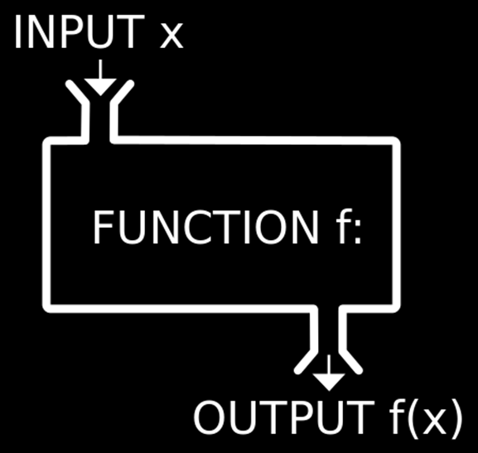
Mathematical Models
In formulas, some variables are “input” variables
The thing you are
calculating with the
formula is the
“output”
https://1.bp.blogspot.com/-YEqWLoN5V88/Wblu4NWyg4I/AAAAAAAAefY/G01iSXT2zn4L-W2-S-BETZHwvwHc_X1WQCLcBGAs/w530-h298-p/php-inbuilt-functions.jpg

Slide 8
Mathematical Models
The input variable is ALWAYS put on the x-axis (horizontal axis)
No reason – it’s a TRADITION!

Slide 9
Mathematical Models
What the output turns out to be depends on what the input is
The output is frequently called the “dependent” variable

Slide 10
Mathematical Models
The input is called the “independent” variable because it’s value comes from an outside (sometimes uncontrollable) source

Slide 11
Mathematical Models
A special type of mathematical formula was designed for input-outputs: functions
For a formula to be a function, every x can have only one y: when you have a certain input, you can calculate exactly what the output will be

Slide 12
Mathematical Models
The purpose of the model is to understand the phenomenon and often to make predictions about future behavior (forecasts)

Slide 13
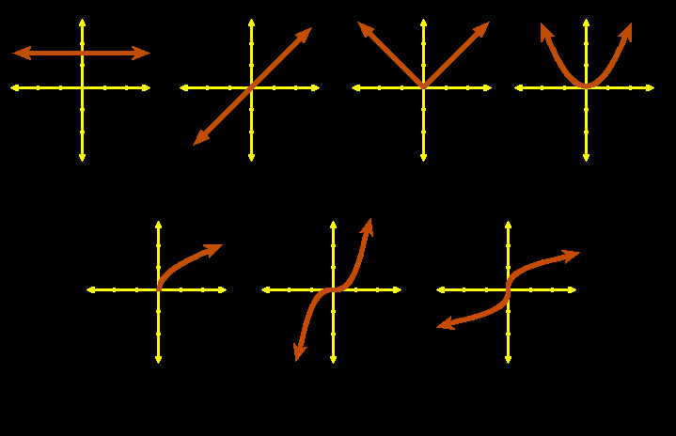
Mathematical Models
Graphs of common algebraic functions:
constant identity abs value quadratic
square root cubic cube root
VFrench, 2010

Slide 14
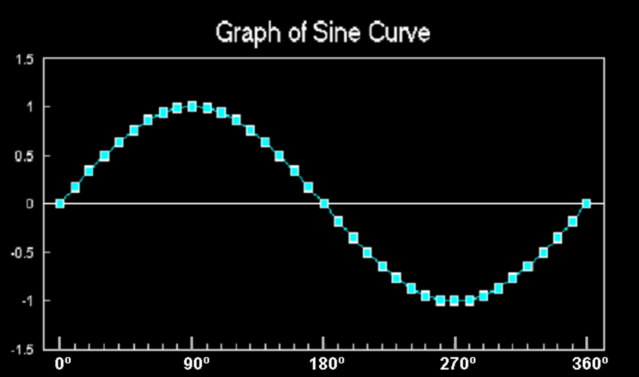
Mathematical Modeling
Trig functions (especially sine and cosine) are used to model cyclical phenomena
VFrench, 2015

Slide 15
Mathematical Modeling
Because data RARELY fits the known functions exactly, we have to transform the functions to fit the data

Slide 16
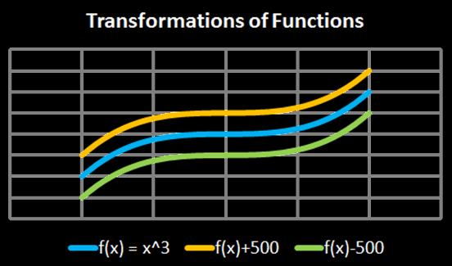
Transforming Functions
vertical shifts:
ƒ(x) + c plus shifts up
ƒ(x) - c minus shifts down
Vfrench, 2010

Slide 17
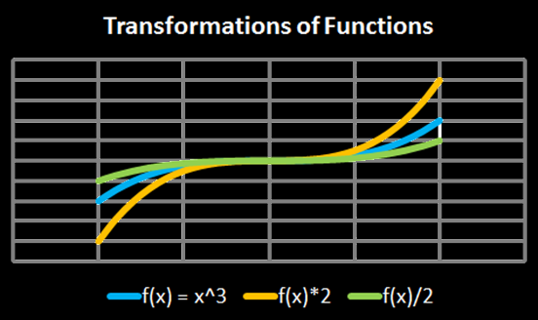
Transforming Functions
vertical stretch:
ƒ(x) × c stretches
ƒ(x) ÷ c squashes
Vfrench, 2010

Slide 18
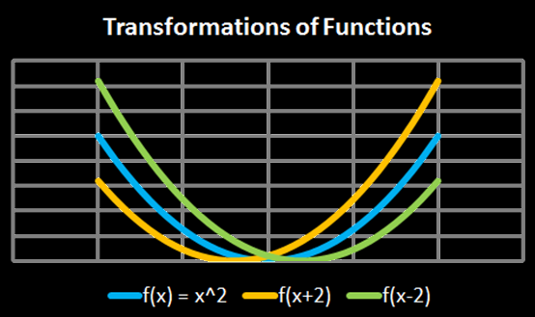
Transforming Functions
horizontal shifts:
ƒ(x + c) shifts left
ƒ(x - c) shifts right
Vfrench, 2010

Slide 19
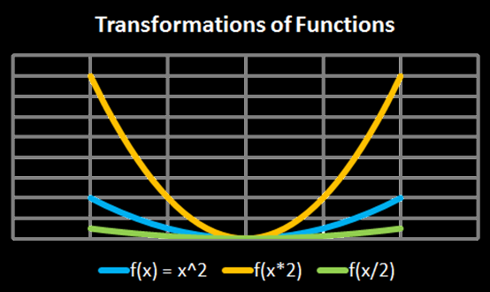
Transforming Functions
horizontal shifts:
ƒ(x × c) squashes
ƒ(x ÷ c) stretches
Vfrench, 2010

Slide 20
Transforming Functions
Any operations done to the function outside of the parentheses affects the “y” values
These operations lead to an intuitive result

Slide 21
Transforming Functions
Any operations done to the function inside the parentheses affects the “x” values
These operations lead to a counterintuitive result

Slide 22
Questions?
http://i.imgur.com/aliTlT3.jpg

Slide 23
Functions
For a formula to be a function, every x can have only one y

Slide 24
Functions
Example:
The set: {(1,3)(2,4)(7,25)}
is a function because:
every x-value (1,2,7) has only one y-value:
1→3
2→4
7→25

Slide 25
FUNCTIONS
IN-CLASS PROBLEM 1
Is this set of points a function?
{(1,-1)(4,1)(10,3.6)(1.2,4)}

Slide 26
FUNCTIONS
IN-CLASS PROBLEM 1
Is this set of points a function?
{(1,-1)(4,1)(10,3.6)(1.2,4)}
YES! Because every x-value has only one y-value:
1 → -1
4 → 1
10 → 3.6
1.2 → 4

Slide 27
FUNCTIONS
IN-CLASS PROBLEM 1
Is this set of points a function?
{(1,-1)(4,1)(1,3.6)(1.2,4)}

Slide 28
FUNCTIONS
IN-CLASS PROBLEM 1
Is this set of points a function?
{(1,-1)(4,1)(1,3.6)(1.2,4)}
NO! Because when x = 1, the y-value could be -1 or 3.6:
1 → -1 or 3.6
4 → 1
1.2 → 4

Slide 29
Questions?
http://i.imgur.com/aliTlT3.jpg

Slide 30
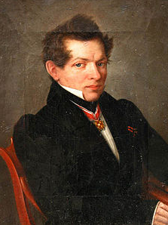
Functions
Nikolai Lobachevsky gave the modern "formal" definition of a function as a relation in which every first element has a unique second element
(1830-ish)
https://en.wikipedia.org/wiki/Nikolai_Lobachevsky#/media/File:Lobachevsky.jpg

Slide 31
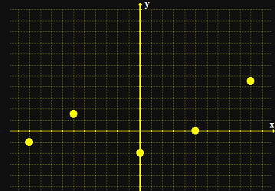
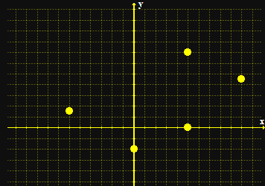
Functions
When you graph a function, none of the points fall on a vertical line
a function not a function
Vfrench 2008

Slide 32
Functions
To test whether a formula is a function, you graph it and do the “vertical line test”
If it passes the VLT, it is a function

Slide 33
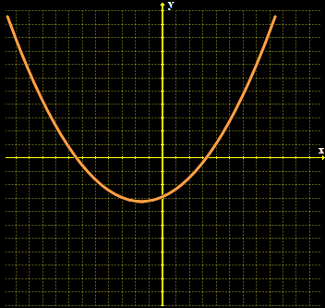
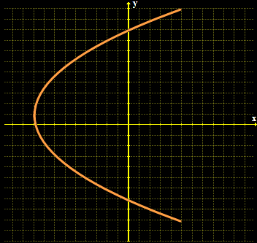
FUNCTIONS
IN-CLASS PROBLEM 6
Is it a function?
?
Vfrench 2008

Slide 34
FUNCTIONS
IN-CLASS PROBLEM 6
Is it a function?
yes
?
Vfrench 2008

Slide 35
FUNCTIONS
IN-CLASS PROBLEM 6
Is it a function?
yes
no
Vfrench 2008

Slide 36
Questions?
http://i.imgur.com/aliTlT3.jpg

Slide 37
Functions
Naturally, there is a special symbol for functions
Where you used to write
y = 6x + 11
A function is written:
ƒ(x) = 6x + 11
read as: “f of x”

Slide 38
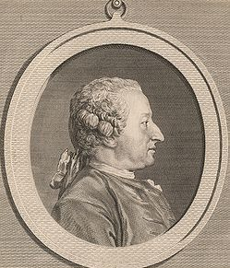
Functions
Alexis Claude Clairaut introduced the familiar notation "ƒ(x)" in 1734
https://en.wikipedia.org/wiki/Alexis_Clairaut#/media/File:Alexis_Clairault.jpg

Slide 39
Functions
ƒ(x) shows that the formula uses “x” as the input and the output depends on it

Slide 40
Functions
When you evaluate a function, you need to substitute the given value for x in the formula

Slide 41
Functions
ƒ(3) means “evaluate the function for x=3”

Slide 42
Evaluating Polynomials
The Order of Operations to get the right answer is:
P parentheses
E exponents
M multiplication
D division
A addition
S subtraction
>
Done at the same
time left to right
>
Done at the same
time left to right

Slide 43
FUNCTIONS
IN-CLASS PROBLEM 3
ƒ(x) = 6x + 11
Calculate ƒ(2) =
Calculate ƒ(-1)
Calculate ƒ(1)

Slide 44
FUNCTIONS
IN-CLASS PROBLEM 3
ƒ(x) = 6x + 11
Calculate ƒ(2) = 23
Calculate ƒ(-1) =
Calculate ƒ(1)

Slide 45
FUNCTIONS
IN-CLASS PROBLEM 3
ƒ(x) = 6x + 11
Calculate ƒ(2) = 23
Calculate ƒ(-1) = 5
Calculate ƒ(1) =

Slide 46
FUNCTIONS
IN-CLASS PROBLEM 3
ƒ(x) = 6x + 11
Calculate ƒ(2) = 23
Calculate ƒ(-1) = 5
Calculate ƒ(1) = 17

Slide 47
Questions?
http://i.imgur.com/aliTlT3.jpg

Slide 48
Functions
The “legal” values for a function are called:
Domain - the xs
Range - the ys
(aid to memory: x comes before y; d comes before r)

Slide 49
FUNCTIONS
IN-CLASS PROBLEM 4
What is the domain for this function:
{(1,-1)(4,1)(10,3.6)(1.2,4)}

Slide 50
FUNCTIONS
IN-CLASS PROBLEM 4
What is the domain for this function:
{(1,-1)(4,1)(10,3.6)(1.2,4)}
Domain = 1,4,10,1.2

Slide 51
FUNCTIONS
IN-CLASS PROBLEM 4
What is the range for this function:
{(1,-1)(4,1)(10,3.6)(1.2,4)}

Slide 52
FUNCTIONS
IN-CLASS PROBLEM 4
What is the range for this function:
{(1,-1)(4,1)(10,3.6)(1.2,4)}
Range = -1,1,3.6,4

Slide 53
Questions?
http://i.imgur.com/aliTlT3.jpg

Slide 54
Functions
Interpreting functions – what do they mean?

Slide 55
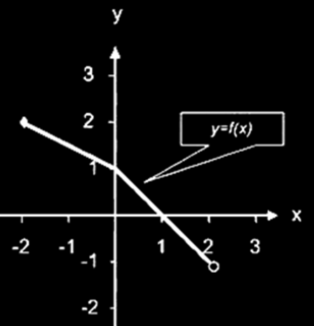
FUNCTIONS
IN-CLASS PROBLEM 5
Why is this a function?
Vfrench 2008

Slide 56
FUNCTIONS
IN-CLASS PROBLEM 5
Estimate ƒ(–2)
Vfrench 2008

Slide 57
FUNCTIONS
IN-CLASS PROBLEM 5
What is the domain of ƒ?
Vfrench 2008

Slide 58
FUNCTIONS
IN-CLASS PROBLEM 5
What is the domain of ƒ?
-2 ≤ x < 2
Vfrench 2008

Slide 59
FUNCTIONS
IN-CLASS PROBLEM 5
What is the range of ƒ?
Vfrench 2008

Slide 60
FUNCTIONS
IN-CLASS PROBLEM 5
What is the range of ƒ?
-1 < y ≤ 2
Vfrench 2008

Slide 61
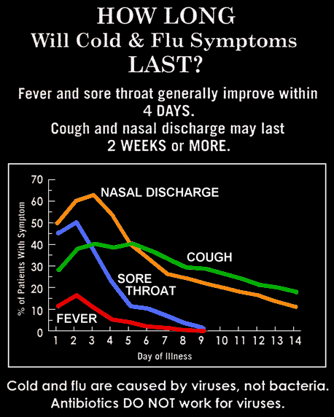
FUNCTIONS
IN-CLASS PROBLEM 6
Is each line the graph of a function? Why or why not?
2011

Slide 62
FUNCTIONS
IN-CLASS PROBLEM 6
What are the major "change" points for each line
2011

Slide 63
FUNCTIONS
IN-CLASS PROBLEM 6
Calculate ƒ(5) for each line
2011

Slide 64
FUNCTIONS
IN-CLASS PROBLEM 6
Calculate x at
ƒ(x) = 20 for each line
2011

Slide 65
Questions?
http://i.imgur.com/aliTlT3.jpg

Slide 66
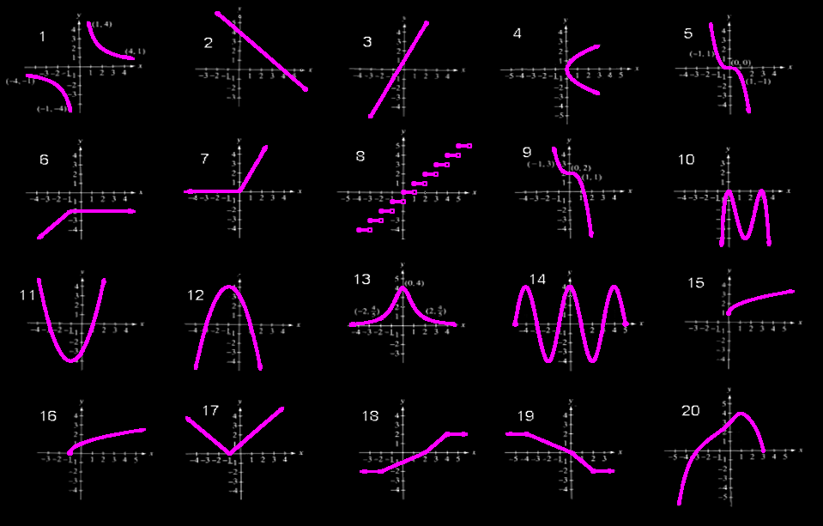
FUNCTIONS
IN-CLASS PROBLEM 7
Identify which are functions?
Vfrench 2008

Slide 67
FUNCTIONS
IN-CLASS PROBLEM 7
Identify which are functions?
function
function
function
function
function
function
function
function
function
function
function
function
function
function
function
function
function
Vfrench 2008
function
function

Slide 68
Functions
Increasing functions
Decreasing functions
Constant functions
relative maximums and minimums

Slide 69
FUNCTIONS
IN-CLASS PROBLEM 7
Identify which are increasing across the domain?
Which are decreasing? Which are constant?
Vfrench 2008

Slide 70
FUNCTIONS
IN-CLASS PROBLEM 7
Identify which are increasing across the domain?
Which are decreasing? Which are constant?
increasing
increasing
increasing
increasing
increasing
increasing
increasing
increasing
Vfrench 2008
increasing

Slide 71
FUNCTIONS
IN-CLASS PROBLEM 7
Identify which are increasing across the domain?
Which are decreasing? Which are constant?
decreasing
decreasing
decreasing
decreasing
Vfrench 2008

Slide 72
FUNCTIONS
IN-CLASS PROBLEM 7
Identify which are increasing across the domain?
Which are decreasing? Which are constant?
constant
constant
constant
constant
constant
probably constant
Vfrench 2008

Slide 73
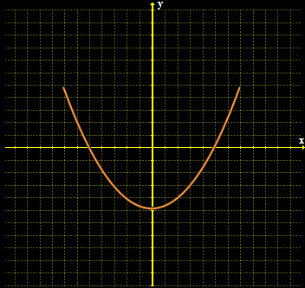
Functions
Even functions are symmetric with respect to the y-axis
ƒ(x) = ƒ(–x)
Vfrench 2008

Slide 74
Functions
Even functions written as equations have only even exponents of the variable
ƒ(x) = 3x⁴ - 15x² + 45

Slide 75
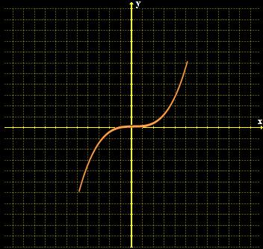
Functions
Odd functions are symmetric with respect to the origin
ƒ(-x) = –ƒ(x)
Vfrench 2008

Slide 76
Functions
Odd functions written as equations have only odd exponents of the variable
ƒ(x) = 3x⁵ - 15x³ + 45x

Slide 77
FUNCTIONS
IN-CLASS PROBLEM 7
Identify which are even? Which are odd?
Vfrench 2008

Slide 78
FUNCTIONS
IN-CLASS PROBLEM 7
Identify which are even? Which are odd?
Odd
Odd
Even
Even
Vfrench 2008

Slide 79
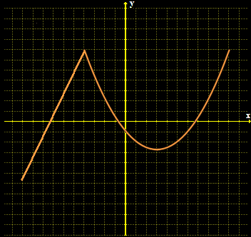
Functions
Types of functions:
piecewise functions - defined by two or more
equations
Vfrench 2008

Slide 80
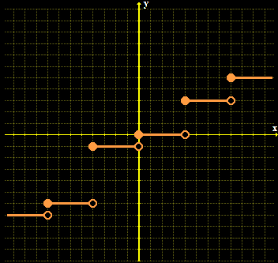
Functions
Step functions: function values graphically form discontinuous steps
Vfrench 2008

Slide 81
FUNCTIONS
IN-CLASS PROBLEM 7
Identify which are piecewise? Which are step functions?
Vfrench 2008

Slide 82
FUNCTIONS
IN-CLASS PROBLEM 7
Identify which are piecewise? Which are step functions?
could be
piecewise
(if you didn’t know the formula)
Step
Piecewise
Piecewise
Piecewise
Piecewise
Piecewise
could be piecewise
Piecewise
Vfrench 2008

Slide 83
Questions?
http://i.imgur.com/aliTlT3.jpg

Slide 84
Combining Functions
( ƒ + g)(x) = ƒ(x) + g (x)
( ƒ - g)(x) = ƒ(x) – g (x)
( ƒ×g)(x) = ƒ(x) × g (x)
( ƒ/ g)(x) = ƒ(x) / g (x)
when g (x) ≠ 0

Slide 85
COMBINING FUNCTIONS
IN-CLASS PROBLEM 8
ƒ(x) = 5x + 6
g (x) = 2x – 1
Develop ƒ + g =
Develop ƒ – g
Develop ƒ × g
Develop ƒ/g

Slide 86
COMBINING FUNCTIONS
IN-CLASS PROBLEM 8
ƒ(x) = 5x + 6
g (x) = 2x – 1
Develop ƒ + g = 7x + 5
Develop ƒ – g =
Develop ƒ × g
Develop ƒ/g

Slide 87
COMBINING FUNCTIONS
IN-CLASS PROBLEM 8
ƒ(x) = 5x + 6 5x + 6
g (x) = 2x – 1 -2x -- 1
Develop ƒ + g = 7x + 5
Develop ƒ – g = 3x + 7
Develop ƒ × g =
Develop ƒ/g

Slide 88
COMBINING FUNCTIONS
IN-CLASS PROBLEM 8
ƒ(x) = 5x + 6
g (x) = 2x – 1
Develop ƒ + g = 7x + 5
Develop ƒ – g = 3x + 7
Develop ƒ × g = 10x²+7x-6
Develop ƒ/g =

Slide 89
COMBINING FUNCTIONS
IN-CLASS PROBLEM 8
ƒ(x) = 5x + 6
g (x) = 2x – 1
Develop ƒ + g = 7x + 5
Develop ƒ – g = 3x + 7
Develop ƒ × g = 10x²+7x-6
Develop ƒ/g = (5x+6)/(2x–1)

Slide 90
COMBINING FUNCTIONS
IN-CLASS PROBLEM 9
ƒ(x) = 8x + 4
g (x) = 13x + 7
Develop ƒ + g =
Develop ƒ – g
Develop ƒ × g
Develop ƒ/g

Slide 91
COMBINING FUNCTIONS
IN-CLASS PROBLEM 9
ƒ(x) = 8x + 4
g (x) = 13x + 7
Develop ƒ + g = 21x + 11
Develop ƒ – g =
Develop ƒ × g
Develop ƒ/g

Slide 92
COMBINING FUNCTIONS
IN-CLASS PROBLEM 9
ƒ(x) = 8x + 4
g (x) = 13x + 7
Develop ƒ + g = 21x + 11
Develop ƒ – g = -5x - 3
Develop ƒ × g =
Develop ƒ/g

Slide 93
COMBINING FUNCTIONS
IN-CLASS PROBLEM 9
ƒ(x) = 8x + 4
g (x) = 13x + 7
Develop ƒ + g = 21x + 11
Develop ƒ – g = -5x - 3
Develop ƒ × g = 104x²+108x+28
Develop ƒ/g =

Slide 94
COMBINING FUNCTIONS
IN-CLASS PROBLEM 9
ƒ(x) = 8x + 4
g (x) = 13x + 7
Develop ƒ + g = 21x + 11
Develop ƒ – g = -5x - 3
Develop ƒ × g = 104x²+108x+28
Develop ƒ/g = (8x+4)/(13x+7)

Slide 95
COMBINING FUNCTIONS
IN-CLASS PROBLEM 10
ƒ(x) = 9x + 5
g (x) = 2x ² – x – 1
Develop ƒ + g =
Develop ƒ – g
Develop ƒ × g
Develop ƒ/g

Slide 96
COMBINING FUNCTIONS
IN-CLASS PROBLEM 10
ƒ(x) = 9x + 5
g (x) = 2x ² – x – 1
Develop ƒ + g = 2x²+8x+4
Develop ƒ – g =
Develop ƒ × g
Develop ƒ/g

Slide 97
COMBINING FUNCTIONS
IN-CLASS PROBLEM 10
ƒ(x) = 9x + 5
g (x) = 2x ² – x – 1
Develop ƒ + g = 2x²+8x+4
Develop ƒ – g = -2x²+10x+6
Develop ƒ × g =
Develop ƒ/g

Slide 98
COMBINING FUNCTIONS
IN-CLASS PROBLEM 10
ƒ(x) = 9x + 5
g (x) = 2x ² – x – 1
Develop ƒ + g = 2x²+8x+4
Develop ƒ – g = -2x²+10x+6
Develop ƒ × g = 18x³+x²-14x-5
Develop ƒ/g =

Slide 99
COMBINING FUNCTIONS
IN-CLASS PROBLEM 10
ƒ(x) = 9x + 5
g (x) = 2x ² – x – 1
Develop ƒ + g = 2x²+8x+4
Develop ƒ – g = -2x²+10x+6
Develop ƒ × g = 18x³+x²-14x-5
Develop ƒ/g = (9x+5)/(2x ²–x–1)

Slide 100
Questions?
http://i.imgur.com/aliTlT3.jpg

Slide 101
You Survived!
Today we studied:
Review of Mathematical
Modeling
Functions
www.playbuzz.com

