Slide 1
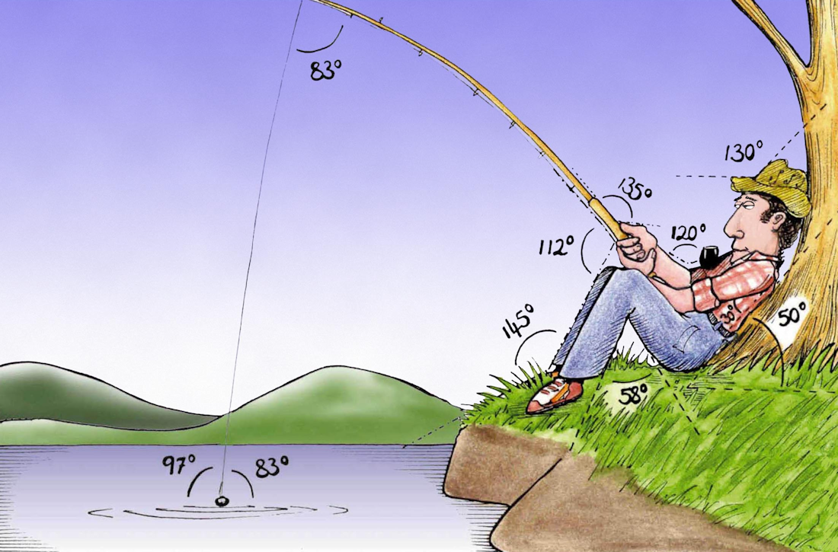
Welcome to
Week 7!
Analytic Trigonometry
http://www.lab-initio.com/images/fullsize/nz211.jpg

Slide 2
What’s Up?
Today we will be going over:
Review of Law of Sines and
Cosines
Complex numbers
Phasor arithmetic

Slide 3
What’s Up?
Obj 6) Perform computations with complex numbers including the operations of powers and roots, both by "hand" and with technology.

Slide 4
Review
http://995642590.r.lightningbase-cdn.com/wp-content/uploads/2010/12/looking-back-hrexaminer-v144-cover425px.jpg

Slide 5
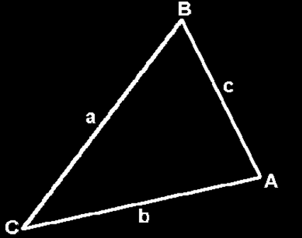
Oblique Triangles
If you have measurements of some of the sides and some of the angles, it is usually
possible to figure
out all of the
measurements
of a triangle

Slide 6
Law of Sines
$\frac{\text{a}}{\text{sin}\text{(}\text{A}\text{)}}$ = $\frac{\text{b}}{\text{sin}\text{(}\text{B}\text{)}}$ = $\frac{\text{c}}{\text{sin}\text{(}\text{C}\text{)}}$
or
$\frac{\text{sin}\text{(}\text{A}\text{)}}{\text{a}}$ = $\frac{\text{sin}\text{(}\text{B}\text{)}}{\text{b}}$= $\frac{\text{sin}\text{(}\text{C}\text{)}}{\text{c}}$

Slide 7
Law of Sines
To calculate using the Law of Sines you need a “big” and a “little”:
A and a or
B and b or
C and c

Slide 8
Law of Cosines
a² = b² +c² - 2bc cosA or
b² = a² +c² - 2ac cosB or
c² = a² +b² - 2ab cosC

Slide 9
Law of Cosines
You use Law of Cosines when you don’t have a big and a little of the same letter

Slide 10
How Many Triangles
Rules for oblique triangles can be used to find out whether a certain set of measurements describes a real triangle or not

Slide 11
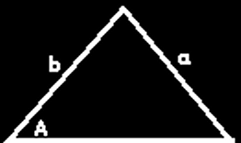
How Many Triangles
Sometimes the measurements describe a triangle that is unique:

Slide 12
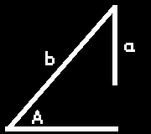
How Many Triangles
Sometimes the measurements
cannot possibly describe a real triangle:

Slide 13
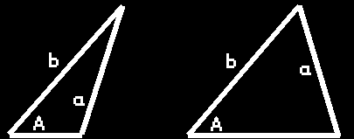
How Many Triangles
Sometimes the measurements
describe two possible triangles:
This is called the “ambiguous case”

Slide 14
Questions?
lol-rofl.com

Slide 15
Complex Numbers
Remember how easy it is to factor a difference of two squares?
x² – 4 = (x – 2) (x + 2)

Slide 16
Complex Numbers
What is the factoring for:
x² + 4
Hmm… not so easy after all

Slide 17
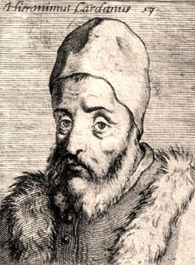
Complex Numbers
An Italian mathematician/astrologer named Girolamo Cardano
(1501-1576)
thought it should be!
https://www.daviddarling.info/encyclopedia/C/Cardano.html

Slide 18
Complex Numbers
Girolamo was illegitimate, and his mother tried to abort him
His father was a
famous lawyer who
was a friend of
Leonardo da Vinci
https://www.daviddarling.info/encyclopedia/C/Cardano.html

Slide 19
Complex Numbers
Cardano was the first mathematician to use negative
numbers systematically
in algebraic equations
https://www.daviddarling.info/encyclopedia/C/Cardano.html

Slide 20
Complex Numbers
He wanted to discover a solution to: x² + 4
that would be as easy
as for: x² - 4
https://www.daviddarling.info/encyclopedia/C/Cardano.html

Slide 21
Complex Numbers
In 1545, he decided the number he needed was:
$\sqrt{\text{−4}}$
https://www.daviddarling.info/encyclopedia/C/Cardano.html

Slide 22
Complex Numbers
?
x² + 4 = (x – $\sqrt{\text{−4}}$) (x + $\sqrt{\text{−4}}$)
https://www.daviddarling.info/encyclopedia/C/Cardano.html

Slide 23
Complex Numbers
?
x² + 4 = (x – $\sqrt{\text{−4}}$) (x + $\sqrt{\text{−4}}$)
= x² – $\sqrt{\text{−4}}$x + $\sqrt{\text{−4}}$ x - ($\sqrt{\text{−4}}$)²
?
https://www.daviddarling.info/encyclopedia/C/Cardano.html

Slide 24
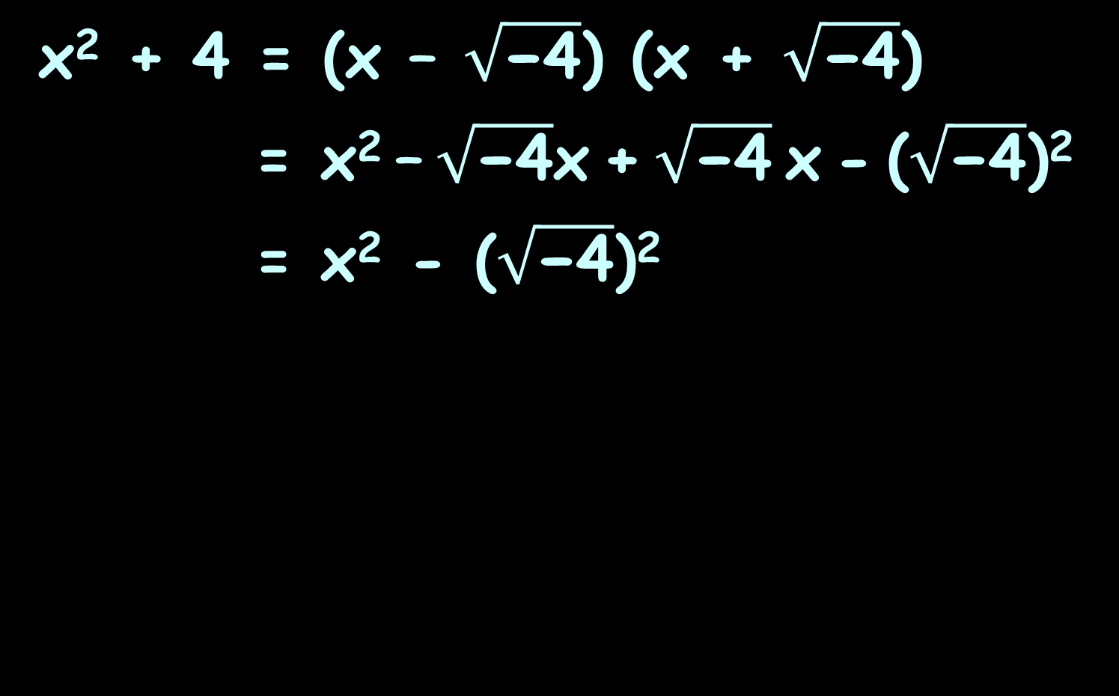
Complex Numbers
?
x² + 4 = (x – $\sqrt{\text{−4}}$) (x + $\sqrt{\text{−4}}$)
= x² – $\sqrt{\text{−4}}$x + $\sqrt{\text{−4}}$ x - ($\sqrt{\text{−4}}$)²
= x² - ($\sqrt{\text{−4}}$)²
?
?
https://www.daviddarling.info/encyclopedia/C/Cardano.html

Slide 25
Complex Numbers
?
x² + 4 = (x – $\sqrt{\text{−4}}$) (x + $\sqrt{\text{−4}}$)
= x² – $\sqrt{\text{−4}}$x + $\sqrt{\text{−4}}$ x - ($\sqrt{\text{−4}}$)²
= x² - ($\sqrt{\text{−4}}$)²
= x² – (-4)
?
?
?
https://www.daviddarling.info/encyclopedia/C/Cardano.html

Slide 26
Complex Numbers
?
x² + 4 = (x – $\sqrt{\text{−4}}$) (x + $\sqrt{\text{−4}}$)
= x² – $\sqrt{\text{−4}}$x + $\sqrt{\text{−4}}$ x - ($\sqrt{\text{−4}}$)²
= x² - ($\sqrt{\text{−4}}$)²
= x² – (-4)
= x² + 4
Yay!
?
?
?
https://www.daviddarling.info/encyclopedia/C/Cardano.html

Slide 27
Complex Numbers
Of course, Cardano realized that $\sqrt{\text{−4}}$ was “manifestly impossible”
https://www.daviddarling.info/encyclopedia/C/Cardano.html

Slide 28
Complex Numbers
But he didn’t let that slow him down!
He said:
“Nevertheless,
we will operate!”
https://www.daviddarling.info/encyclopedia/C/Cardano.html

Slide 29
Complex Numbers
Cardano called these roots of negative numbers “ghost numbers”
https://www.vox.com/2014/11/1/7138083/celebrate-the-spooky-weekend-with-this-ghost-playlist

Slide 30
Complex Numbers
These ghost numbers were actually a new kind of number called “complex numbers”

Slide 31
Complex Numbers
Cardano was also a famous physician
He was the first to describe typhoid fever

Slide 32
Complex Numbers
He was the first to say that deaf people actually had minds and should be educated just like hearing people

Slide 33
Complex Numbers
He was also a gambler and notoriously short of money
He made money by writing a book on how to cheat at gambling

Slide 34
Complex Numbers
He cut off the ears of one of his sons who had stolen money from him

Slide 35
Complex Numbers
In 1570, he was accused of heresy for casting the horoscope of Jesus

Slide 36
Complex Numbers
He was arrested and spent several months in prison

Slide 37
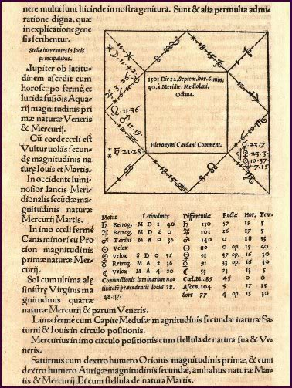
Complex Numbers
He also cast his own horoscope when he was 16
It said he would
die before he was
75

Slide 38
Complex Numbers
As he approached his 75th
birthday (still hale
and hearty), he
committed suicide
4 days before his
birthday to ensure
his prediction was
correct

Slide 39
Questions?
http://i.imgur.com/aliTlT3.jpg

Slide 40
Complex Numbers
Complex numbers include the "imaginary" unit:
i ≡ $\sqrt{\text{−}\text{1}}$

Slide 41
Complex Numbers
Complex numbers are written:
a + b i
real imaginary
part part

Slide 42
Complex Numbers
Every real number is a complex number in which the imaginary part equals zero:
17 = 17 + 0 i

Slide 43
Complex Numbers
Complex numbers are usually designated "z“
z = a + b i

Slide 44
Complex Numbers
Writing a complex number:
a + b i
Is called “standard form”

Slide 45
COMPLEX NUMBERS
IN-CLASS PROBLEM 1
The real part coefficient of
9 + 6i is:
The imaginary part coefficient of 9 + 6i is:

Slide 46
COMPLEX NUMBERS
IN-CLASS PROBLEM 1
The real part coefficient of
9 + 6i is: 9
The imaginary part coefficient of 9 + 6i is: 6

Slide 47
COMPLEX NUMBERS
IN-CLASS PROBLEM 2
The real part coefficient of
5 – 2i is:
The imaginary part coefficient of 5 – 2i is:

Slide 48
COMPLEX NUMBERS
IN-CLASS PROBLEM 2
The real part coefficient of
5 – 2i is: 5
The imaginary part coefficient of 5 – 2i is: -2

Slide 49
Questions?
http://i.imgur.com/aliTlT3.jpg

Slide 50
Complex Numbers
Arithmetic with complex numbers:
(a+bi) + (c+di) = (a+c) + (b+d)i
(a+bi) - (c+di) = (a-c) + (b-d)i

Slide 51
COMPLEX NUMBERS
IN-CLASS PROBLEM 3
(6 + 4i ) + (7 + 5i ) =

Slide 52
COMPLEX NUMBERS
IN-CLASS PROBLEM 3
(6 + 4i ) + (7 + 5i ) = 13 + 9i

Slide 53
COMPLEX NUMBERS
IN-CLASS PROBLEM 4
(–4 + 3i ) + (8 – 10i ) =

Slide 54
COMPLEX NUMBERS
IN-CLASS PROBLEM 4
(–4 + 3i ) + (8 – 10i ) = 4 - 7i

Slide 55
COMPLEX NUMBERS
IN-CLASS PROBLEM 5
(2 + i ) – (6 – 9i ) =

Slide 56
COMPLEX NUMBERS
IN-CLASS PROBLEM 5
(2 + i ) – (6 – 9i ) = (2+i ) -6 --9i

Slide 57
COMPLEX NUMBERS
IN-CLASS PROBLEM 5
(2 + i ) – (6 – 9i ) = (2+i ) -6 --9i = 2+i -6 +9i

Slide 58
COMPLEX NUMBERS
IN-CLASS PROBLEM 5
(2 + i ) – (6 – 9i ) = (2+i ) -6 --9i = 2+i -6 +9i
= -4 +10i

Slide 59
COMPLEX NUMBERS
IN-CLASS PROBLEM 6
(17 + 51i ) – (–19 – 88i ) =

Slide 60
COMPLEX NUMBERS
IN-CLASS PROBLEM 6
(17 + 51i ) – (–19 – 88i ) =
= 17+51i --19 --88i

Slide 61
COMPLEX NUMBERS
IN-CLASS PROBLEM 6
(17 + 51i ) – (–19 – 88i ) =
= 17+51i --19 --88i
= 17+51i +19 +88i

Slide 62
COMPLEX NUMBERS
IN-CLASS PROBLEM 6
(17 + 51i ) – (–19 – 88i ) =
= 17+51i --19 --88i
= 17+51i +19 +88i
= 36 + 139i

Slide 63
COMPLEX NUMBERS
IN-CLASS PROBLEM 7
$\sqrt{\text{−25}}$ + $\sqrt{\text{−}\text{81}}$ =

Slide 64
COMPLEX NUMBERS
IN-CLASS PROBLEM 7
$\sqrt{\text{−25}}$ + $\sqrt{\text{−}\text{81}}$ =
= $\sqrt{\text{−}\text{1 }\text{×} \text{25}}$ + $\sqrt{\text{−1} \text{×} \text{81}}$

Slide 65
COMPLEX NUMBERS
IN-CLASS PROBLEM 7
$\sqrt{\text{−25}}$ + $\sqrt{\text{−}\text{81}}$ =
= $\sqrt{\text{−}\text{1 }\text{×} \text{25}}$ + $\sqrt{\text{−1} \text{×} \text{81}}$
= $i$×$\sqrt{\text{25}}$ + $i \text{×} \sqrt{\text{81}}$

Slide 66
COMPLEX NUMBERS
IN-CLASS PROBLEM 7
$\sqrt{\text{−25}}$ + $\sqrt{\text{−}\text{81}}$ =
= $\sqrt{\text{−}\text{1 }\text{×} \text{25}}$ + $\sqrt{\text{−1} \text{×} \text{81}}$
= $i$×$\sqrt{\text{25}}$ + $i \text{×} \sqrt{\text{81}}$
= 5$i$ + 9$i$ = 14$i$

Slide 67
COMPLEX NUMBERS
IN-CLASS PROBLEM 8
(2 + $\sqrt{\text{−25}}$) – (7 + $\sqrt{\text{−}\text{49}}$)

Slide 68
COMPLEX NUMBERS
IN-CLASS PROBLEM 8
(2 + $\sqrt{\text{−25}}$) – (7 + $\sqrt{\text{−}\text{49}}$)
= (2 + $\sqrt{\text{−25}}$) – 7 - $\sqrt{\text{−49}}$)

Slide 69
COMPLEX NUMBERS
IN-CLASS PROBLEM 8
(2 + $\sqrt{\text{−25}}$) – (7 + $\sqrt{\text{−}\text{49}}$)
= (2 + $\sqrt{\text{−25}}$) – 7 - $\sqrt{\text{−49}}$)
= 2 + $\sqrt{\text{−}\text{1 }\text{×} \text{25}}$ -7 -$\sqrt{\text{−1} \text{×} \text{49}}$

Slide 70
COMPLEX NUMBERS
IN-CLASS PROBLEM 8
(2 + $\sqrt{\text{−25}}$) – (7 + $\sqrt{\text{−}\text{49}}$)
= (2 + $\sqrt{\text{−25}}$) – 7 - $\sqrt{\text{−49}}$)
= 2 + $\sqrt{\text{−}\text{1 }\text{×} \text{25}}$ -7 -$\sqrt{\text{−1} \text{×} \text{49}}$
= 2 + $i$×$\sqrt{\text{25}}$ -7 -$i \text{×} \sqrt{\text{49}}$

Slide 71
COMPLEX NUMBERS
IN-CLASS PROBLEM 8
(2 + $\sqrt{\text{−25}}$) – (7 + $\sqrt{\text{−}\text{49}}$)
= (2 + $\sqrt{\text{−25}}$) – 7 - $\sqrt{\text{−49}}$)
= 2 + $\sqrt{\text{−}\text{1 }\text{×} \text{25}}$ -7 -$\sqrt{\text{−1} \text{×} \text{49}}$
= 2 + $i$×$\sqrt{\text{25}}$ -7 -$i \text{×} \sqrt{\text{49}}$
= 2 + 5$i$ – 7 - 7$i$
= 2-7 + 5$i$-7$i$

Slide 72
COMPLEX NUMBERS
IN-CLASS PROBLEM 8
(2 + $\sqrt{\text{−25}}$) – (7 + $\sqrt{\text{−}\text{49}}$)
= (2 + $\sqrt{\text{−25}}$) – 7 - $\sqrt{\text{−49}}$)
= 2 + $\sqrt{\text{−}\text{1 }\text{×} \text{25}}$ -7 -$\sqrt{\text{−1} \text{×} \text{49}}$
= 2 + $i$×$\sqrt{\text{25}}$ -7 -$i \text{×} \sqrt{\text{49}}$
= 2 + 5$i$ – 7 - 7$i$
= 2-7 + 5$i$-7$i$
= -5 - 2$i$

Slide 73
Questions?
http://i.imgur.com/aliTlT3.jpg

Slide 74
Complex Numbers
Multiplying:
(a+bi) × (c+di) =
(a×c) + (a×d+b×c)i + (b×d)i²
But, what is i² ?

Slide 75
Complex Numbers
If i ≡ $\sqrt{\text{−1}}$
then i² = ($\sqrt{\text{−1}}$ )² = -1

Slide 76
Complex Numbers
So:
(a+bi) × (c+di) =
(a×c) + (a×d+b×c)i + (b×d)i²
= ac + (ad+bc)i + bd(-1)
= (ac-bd) + (ad+bc) i

Slide 77
Complex Numbers
Don’t leave any exponents of i in a formula
http://scottsauls.com/wp-content/uploads/2015/06/Shame.jpg

Slide 78
Complex Numbers
complex conjugate:
(a + bi) × (a - bi) = a ² + b ²

Slide 79
Complex Numbers
What about:
$\sqrt{−\text{9}}$ × $\sqrt{−\text{36 }}$

Slide 80
Complex Numbers
What about:
$\sqrt{−\text{9}}$ × $\sqrt{−\text{36 }}$
You need to
take out the “i ” first
(If you don’t, you’ll get the wrong answer)

Slide 81
Complex Numbers
$\sqrt{−\text{9}}$ × $\sqrt{−\text{36 }}$ = 3i × 6i
= 18i²
= -18
If you don’t take out the “i ” first:
$\sqrt{−\text{9}}$ × $\sqrt{−\text{36 }}$ = $\sqrt{\text{324 }}$ = 18
(the wrong answer)

Slide 82
COMPLEX NUMBERS
IN-CLASS PROBLEM 9
6i × 4i =

Slide 83
COMPLEX NUMBERS
IN-CLASS PROBLEM 9
6i × 4i = 24i ²
are we done?

Slide 84
COMPLEX NUMBERS
IN-CLASS PROBLEM 9
6i × 4i = 24i ²
are we done?
No… i ² = -1… so…

Slide 85
COMPLEX NUMBERS
IN-CLASS PROBLEM 9
6i × 4i = 24i ²
= -24

Slide 86
COMPLEX NUMBERS
IN-CLASS PROBLEM 10
2i × 7i =

Slide 87
COMPLEX NUMBERS
IN-CLASS PROBLEM 10
2i × 7i = -14
Did you get it right?

Slide 88
COMPLEX NUMBERS
IN-CLASS PROBLEM 11
2i (7 + 3i ) =

Slide 89
COMPLEX NUMBERS
IN-CLASS PROBLEM 11
2i (7 + 3i ) =
Remember, this is an implied multiplication!

Slide 90
COMPLEX NUMBERS
IN-CLASS PROBLEM 11
2i (7 + 3i ) = 14i + 6i ²

Slide 91
COMPLEX NUMBERS
IN-CLASS PROBLEM 11
2i (7 + 3i ) = 14i + 6i ²
= -6 + 14i

Slide 92
COMPLEX NUMBERS
IN-CLASS PROBLEM 12
-4i (5 + 6i ) =

Slide 93
COMPLEX NUMBERS
IN-CLASS PROBLEM 12
-4i (5 + 6i ) = -20i - 24i ²

Slide 94
COMPLEX NUMBERS
IN-CLASS PROBLEM 12
-4i (5 + 6i ) = -20i - 24i ²
= 24 - 20i

Slide 95
COMPLEX NUMBERS
IN-CLASS PROBLEM 13
(5 – i )(5 + i )
First, build a box!

Slide 96
COMPLEX NUMBERS
IN-CLASS PROBLEM 13
(5 – i )(5 + i )
Include the terms of the multiplication:
 | 5 | -i
5
+i

Slide 97
COMPLEX NUMBERS
IN-CLASS PROBLEM 13
(5 – i )(5 + i )
Multiply the numbers on each box:
 | 5 | -i
5 | 25 | -5i
+i | 5i | -i ²

Slide 98
COMPLEX NUMBERS
IN-CLASS PROBLEM 13
(5 – i )(5 + i )
This is your answer!
(but not the final answer…)
 | 5 | -i
5 | 25 | -5i
+i | 5i | -i ²

Slide 99
COMPLEX NUMBERS
IN-CLASS PROBLEM 13
(5 – i )(5 + i )
The diagonals cancel:
 | 5 | -i
5 | 25 | -5i
+i | 5i | -i ²

Slide 100
COMPLEX NUMBERS
IN-CLASS PROBLEM 13
(5 – i )(5 + i )
…and you are left with
= 25 – i ²
 | 5 | -i
5 | 25 | -5i
+i | 5i | -i ²

Slide 101
COMPLEX NUMBERS
IN-CLASS PROBLEM 13
(5 – i )(5 + i )
…and you are left with
= 25 – i ²
= 25 --1
= 25 + 1
= 26
 | 5 | -i
5 | 25 | -5i
+i | 5i | -i ²

Slide 102
COMPLEX NUMBERS
IN-CLASS PROBLEM 14
(10 + $\sqrt{\text{−}\text{64}}$) (9 + $\sqrt{\text{−}\text{81}}$) =
Another implied multiplication

Slide 103
COMPLEX NUMBERS
IN-CLASS PROBLEM 14
(10 + $\sqrt{\text{−}\text{64}}$) (9 + $\sqrt{\text{−}\text{81}}$) =
Get rid of the square roots!

Slide 104
COMPLEX NUMBERS
IN-CLASS PROBLEM 14
(10 + $\sqrt{\text{−}\text{64}}$) (9 + $\sqrt{\text{−}\text{81}}$) =
= (10 + 8i ) (9 + 9i )
Now another box!

Slide 105
COMPLEX NUMBERS
IN-CLASS PROBLEM 14
(10 + $\sqrt{\text{−}\text{64}}$) (9 + $\sqrt{\text{−}\text{81}}$) =
= (10 + 8i ) (9 + 9i )
Now another box!
 | 10 | 8i
9
9i

Slide 106
COMPLEX NUMBERS
IN-CLASS PROBLEM 14
(10 + $\sqrt{\text{−}\text{64}}$) (9 + $\sqrt{\text{−}\text{81}}$) =
= (10 + 8i ) (9 + 9i )
Now another box!
 | 10 | 8i
9 | 90 | 72i
9i | 90i | 72i ²

Slide 107
COMPLEX NUMBERS
IN-CLASS PROBLEM 14
(10 + $\sqrt{\text{−}\text{64}}$) (9 + $\sqrt{\text{−}\text{81}}$) =
= (10 + 8i ) (9 + 9i )
This time the diagonals don’t cancel…
Sorry!
 | 10 | 8i
9 | 90 | 72i
9i | 90i | 72i ²

Slide 108
COMPLEX NUMBERS
IN-CLASS PROBLEM 14
(10 + $\sqrt{\text{−}\text{64}}$) (9 + $\sqrt{\text{−}\text{81}}$) =
= (10 + 8i ) (9 + 9i )
= 90 + 72i + 90i + 72i ²
 | 10 | 8i
9 | 90 | 72i
9i | 90i | 72i ²

Slide 109
COMPLEX NUMBERS
IN-CLASS PROBLEM 14
(10 + $\sqrt{\text{−}\text{64}}$) (9 + $\sqrt{\text{−}\text{81}}$) =
= (10 + 8i ) (9 + 9i )
= 90 + 72i + 90i + 72i ²
= 90 + 72i + 90i - 72
= 18 + 162i

Slide 110
COMPLEX NUMBERS
IN-CLASS PROBLEMS 15-18
These should be easy now!
15) (10i) ²
16) (–4i) ²
17) ($\sqrt{\text{−}\text{7}}$) ²
18) ($\sqrt{\text{−}\text{13}}$) ²

Slide 111
COMPLEX NUMBERS
IN-CLASS PROBLEMS 15-18
These should be easy now!
15) (10i) ² = -100
16) (–4i) ² = -16
17) ($\sqrt{\text{−}\text{7}}$) ² = -7
18) ($\sqrt{\text{−}\text{13}}$) ² = -13
Did you get them right?

Slide 112
Questions?
http://i.imgur.com/aliTlT3.jpg

Slide 113
Complex Numbers
Exponents of i create what is called the “complex plane”
i = $\sqrt{\text{−1}}$
i ² = ($\sqrt{\text{−1}}$ )² = -1
i ³ = i ² ∗ i = -i
i ⁴ = i ² ∗ i ² = 1
i ⁵ = i ⁴ ∗ i = i

Slide 114
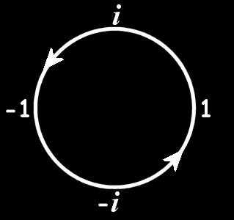
Complex Numbers
The complex plane is cyclical:
Vfrench 2010

Slide 115
Complex Numbers
Because of this, complex numbers are often used in formulas to model cyclical events

Slide 116
Complex Numbers
Also, i changes instantaneously, so it is used to model events that switch from one state to another abruptly

Slide 117
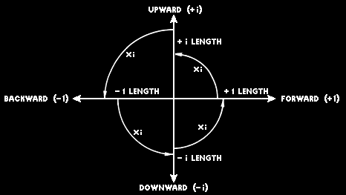
Complex Numbers
Vfrench 2010

Slide 118
Complex Graphing
We can graph complex numbers by using the horizontal x-axis for the real part and the vertical y-axis for the imaginary part

Slide 119
Complex Graphing
3 + 4i would be graphed:
i
4
3
2
1
0
x
-4
-3
-2
-1
0
1
2
3
4
-1
-2
-3
-4

Slide 120
Complex Graphing
In electrical engineering, this way of graphing complex numbers is called an Argand Diagram
https://www.electronics-tutorials.ws/accircuits/complex-numbers.html

Slide 121
Questions?
http://i.imgur.com/aliTlT3.jpg

Slide 122
Complex Numbers
Complex numbers play an important role in real-world formulas modeling things that switch abruptly

Slide 123
Complex Numbers
In control theory, systems are often transformed from the time domain to the frequency domain
The system's poles and zeros are then analyzed using complex numbers

Slide 124
Complex Numbers
In fluid dynamics, potential flow in two dimensions can be described using complex numbers

Slide 125
Complex Numbers
In quantum mechanics, spacetime uses an imaginary variable for time and a real variable for space

Slide 126
Complex Numbers
In AC electrical circuits, resistors, capacitors, and inductors can be combined in a single complex number called the impedance (in ohms, Ω):
Z = R + j·X
R is the resistance (a real number)
X is the reactance (imaginary)
https://mathbitsnotebook.com/Algebra2/ComplexNumbers/CPElectricityPractice.html

Slide 127
Complex Numbers
Z = R + j·X
These are generally written:
Z = (17 + j·1.5)Ω
https://mathbitsnotebook.com/Algebra2/ComplexNumbers/CPElectricityPractice.html

Slide 128
Complex Numbers
Note: It is the practice in electrical engineering to represent the imaginary unit, i, by the letter "j", to avoid confusion with the symbol for electric current which is I

Slide 129
Phasor Arithmetic
A common situation in electrical networks is the existence of many sine-shaped waves all with the same frequency but with different amplitudes and phases

Slide 130
Phasor Arithmetic
They are represented by a real multiplier for frequency and time and a complex multiplier for amplitude (phasor)

Slide 131
Phasor Arithmetic
They are represented by a real multiplier for frequency and time and a complex multiplier for amplitude (phasor)
Combining these phasors is called phasor arithmetic

Slide 132
Phasor Arithmetic
If two impedances are connected in series, the equivalent impedance is obtained by addition:
Z_{e}= Z₁ + Z₂
https://mathbitsnotebook.com/Algebra2/ComplexNumbers/CPElectricityPractice.html

Slide 133
PHASOR ARITHMETIC
IN-CLASS PROBLEM 19
Suppose you had impedances:
Z = 10 + j·1.5
Z = 15 + j·2.0
Find the equivalent impedance when they are connected in series
https://mathbitsnotebook.com/Algebra2/ComplexNumbers/CPElectricityPractice.html

Slide 134
PHASOR ARITHMETIC
IN-CLASS PROBLEM 19
Suppose you had impedances:
Z = 10 + j·1.5
Z = 15 + j·2.0
Find the equivalent impedance when they are connected in series
Z_{e} = (25 + j·3.5)Ω
https://mathbitsnotebook.com/Algebra2/ComplexNumbers/CPElectricityPractice.html

Slide 135
Phasor Arithmetic
Complex numbers are used in AC electronics to describe the current in an electric circuit
https://mathbitsnotebook.com/Algebra2/ComplexNumbers/CPElectricityPractice.html

Slide 136
Phasor Arithmetic
Ohm's law relates the current in a circuit I in amperes, the voltage of a circuit V in volts and the resistance of the circuit R in ohms by the formula:
V = I R
https://mathbitsnotebook.com/Algebra2/ComplexNumbers/CPElectricityPractice.html

Slide 137
PHASOR ARITHMETIC
IN-CLASS PROBLEM 20
V = I R
Find V, the voltage of a circuit, if I = (7 + j·6) amperes and
R = (12 + j·3) ohms
https://mathbitsnotebook.com/Algebra2/ComplexNumbers/CPElectricityPractice.html

Slide 138
PHASOR ARITHMETIC
IN-CLASS PROBLEM 20
V = I R
Find V, the voltage of a circuit, if I = (7 + j·6) amperes and
R = (12 + j·3) ohms
(66 + j·93)v
https://mathbitsnotebook.com/Algebra2/ComplexNumbers/CPElectricityPractice.html

Slide 139
Questions?
www.career.gatech.edu

Slide 140
You Survived!
Don’t forget
your Homework
due next week!
Have a great rest
of the week!
www.playbuzz.com

