Slide 1
Hazardous Substances
05-31-2019
Environmental Science and Sustainability (SCI201)
Joshua Davey

Slide 2
Terminal Learning Objectives
What makes waste hazardous?
How to properly dispose of Hazardous Substances?
If and what hazardous materials are recyclable?
How is nuclear waste Classified?

Slide 3
The Questions
What are the types of hazardous substance and waste?

Slide 4
Points of interest
I chose this topic because as a society we tend not to pay a lot of attention to what materials or substances we use in our daily life. The adage “out of sight out of mind” is representative of our society’s state of mind when it comes to the disposal of hazardous materials and nuclear waste. Thus we bury it, and some even joke about launching trash and these volatile materials into space.

Slide 5
points of interest
Disposing of Evidence
Out of Sight out of mind
What your future holds
https://www.cnn.com/2012/04/26/us/la-trash-puente-landfill/index.html

Slide 6
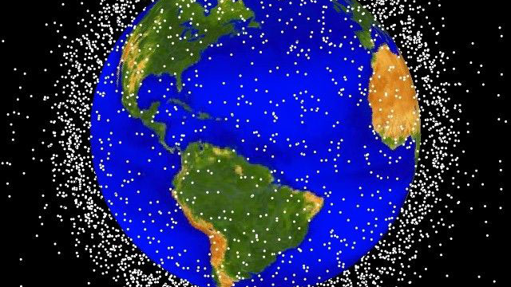
https://www.nasa.gov/mission_pages/station/news/orbital_debris.html

Slide 7
Hazardous Substances Basic Characteristics
There are four basic groups that a hazardous material can be characterized by. The first being corrosive, if the material erodes or deteriorates its environment it is consider corrosive.

Slide 8
Hazardous Substances Basic Characteristics
Next is ignitability, this one is pretty self explanatory, but what determines the ignitability. Ignitability has been defined by the EPA as “liquids with flash points below 60 °C, non-liquids that cause fire through specific conditions, ignitable compressed gases and oxidizers.”

Slide 9
Hazardous Substances Basic Characteristics
Reactivity is the next characteristic of a hazardous substance. A substance has a reactivity characteristic if it is dangerous under normal conditions meaning reacts with water, emits toxic fumes, it may even be explosive in nature when exposed to heat or again even under normal conditions.

Slide 10
Hazardous Substances Basic Characteristics
Toxicity is the last characteristic and is one of the more complex, it is basically determined by the amount of a chemical or a substance that it would take to cause significant harm to the environment or an organism.

Slide 11
Hazardous Substances Basic Characteristics
Corrosivity
Class 8 highly volatile
Aqueous pH ≥ 2
Solid pH ≤ 12.5
Ignitability
Oxidizers
Liquids
Gases
Reactivity
Not so normal
Highly Dangerous
Toxicity
Arsenic
Lead
Mercury
Image: http://www.dmp.wa.gov.au/Safety/Guidance-about-hazardous-6930.aspx

Slide 12
Disposing of Hazardous Substances
RCRA
NEAR YOU
Resource Conservation and Recovery Act
Storage
Disposal
Permitting
https://www.colorado.gov/pacific/cdphe/hazardous-waste-management-sites-and-facilities

Slide 13
Hazmat Recycling
Recyclables
EPA Biennial Report
Bio Waste
Solvents
Heavy metals
Any thing that is used, reused, reclaimed
2017 Colorado recycled 4,961 tons of solvents
Only 1 recycler

Slide 14
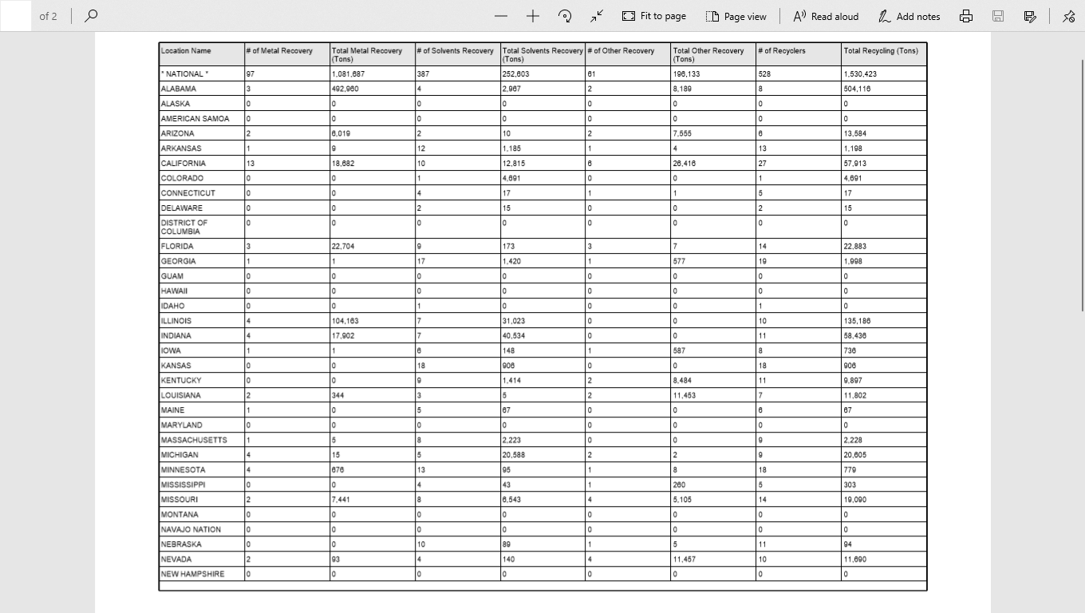

Slide 15
Nuclear Waste
3 Classifications
A
96% LLW
B
4% - 96% ILW
C
4% HLW
https://www.shutterstock.com/search/toxic+symbol

Slide 16
Disposal
LLW
At or near surface vault
ILW
At or near surface vault
Open retrievable Geological Repository
HLW
Sealed or open Geological Repository
https://www.shutterstock.com/search/toxic+symbol

Slide 17
Summary
What makes waste hazardous
4 characteristics
How to properly dispose of Hazardous Substances
https://www.colorado.gov/pacific/cdphe/hazardous-waste-management-sites-and-facilities
If and what hazardous materials are recyclable
Used, Reused, and reclaimed.
How is nuclear waste Classified
A, B, and C

Slide 18
Questions?

Slide 19
References
2017 Biennial Report Summary Results for National. (2018, March). Retrieved May 25, 2019, from https://rcrapublic.epa.gov/rcrainfoweb/action/modules/br/summary/view
French, V. (2019). SCI201 class lecture on REcycling. Personal Collection of V. French, Colorado Technical University, Aurora CO.
Government of Western Australia. (2019) Retrieved from http://www.dmp.wa.gov.au/
Safety/Guidance-about-hazardous-6930.aspx
Hackett, D. P. (1989). Assessment of the Basel Convention on the Control of Transboundary Movements of Hazardous Wastes and Their Disposal. Am. UJ Int'l L. & Pol'y, 5, 291.
Learn the Basics of Hazardous Waste. (2019, April 26). Retrieved from https://www.epa.gov/hw/learn-basics-hazardous-waste#hwid
NASA. (2019). Retrieved from https://www.nasa.gov/mission_pages/station/news/
orbital_debris.html

Slide 20
References
(n.d.). Retrieved from https://www.chemsafetypro.com/Topics/GHS/
GHS_Classification_Criteria_for_Skin_Corrosion_and_Irritation.html
Shutterstock. (2019). Retrieved from https://www.shutterstock.com/search/toxic+symbol
Sittig, M. (1981). Handbook of toxic and hazardous chemicals.
State of Colorado. (2019). Retrieved from https://www.colorado.gov/pacific/cdphe/hazardous-waste-management-sites-and-facilities
Zeitz, P., Orr, M. F., & Kaye, W. E. (2002). Public health consequences of mercury spills: Hazardous Substances Emergency Events Surveillance system, 1993-1998. Environmental health perspectives, 110(2), 129-132.

