Slide 1
Welcome to Wk10
MATH225 Applications of Discrete Mathematics and Statistics
http://media.dcnews.ro/image/201109/w670/statistics.jpg

Slide 2
Probability
Previously we studied probability for things with outcomes like:
H T
1 2 3 4 5 6
Win Lose

Slide 3
Probability
These were all “discrete” outcomes

Slide 4
Probability
Now we will look at probabilities for things with an infinite number of outcomes that can be considered continuous

Slide 5
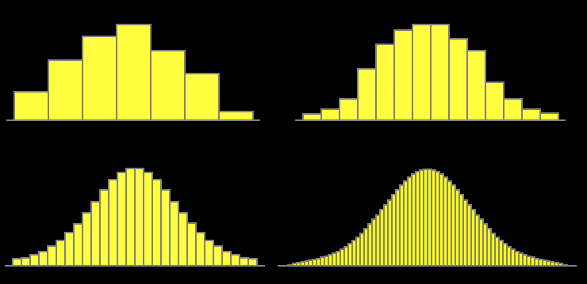
Probability
You can think of smooth quantitative data graphs as a series of skinnier and skinnier bars

Slide 6
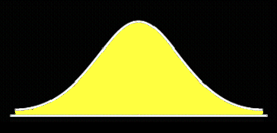
Probability
When the width of the bars reach “zero” the graph is perfectly smooth

Slide 7
Probability
SO, a smooth quantitative (continuous) graph can be thought of as a bar chart where the bars have width zero

Slide 8
Probability
The probability for a continuous graph is the area of its bar:
height x width

Slide 9
Probability
But…
the width of the bars on a continuous graph are zero, so
P = Bar Area = height x zero
All the probabilities are
P = 0 !

Slide 10
Probability
Yep.
It’s true.
The probability of any specific value on a continuous graph is:
ZERO

Slide 11
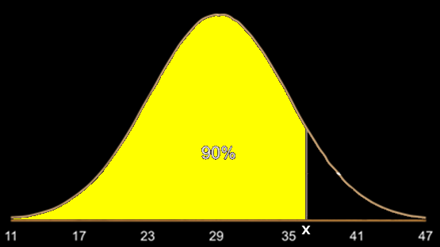
Probability
So…
Instead of a specific value, for continuous graphs we find the probability of a range of values – an
area under
the curve

Slide 12
Probability
Because this would require yucky calculus to find the probabilities, commonly-used
continuous graphs are included in Excel
Yay!

Slide 13
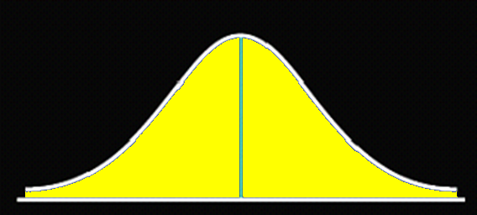
Normal Probability
The most popular continuous graph in statistics is the
NORMAL DISTRIBUTION

Slide 14
Normal Probability
Two descriptive statistics completely define the shape of a normal distribution:
Mean µ
Standard deviation σ

Slide 15
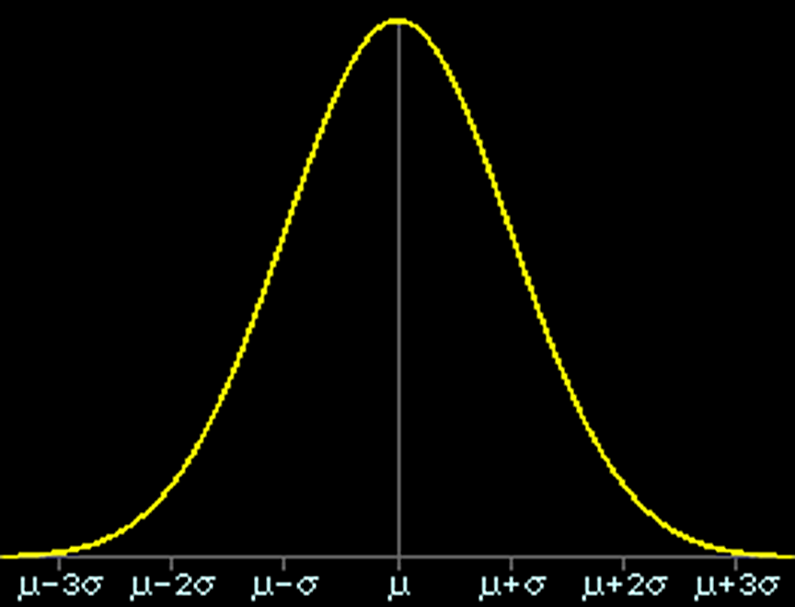

Slide 16
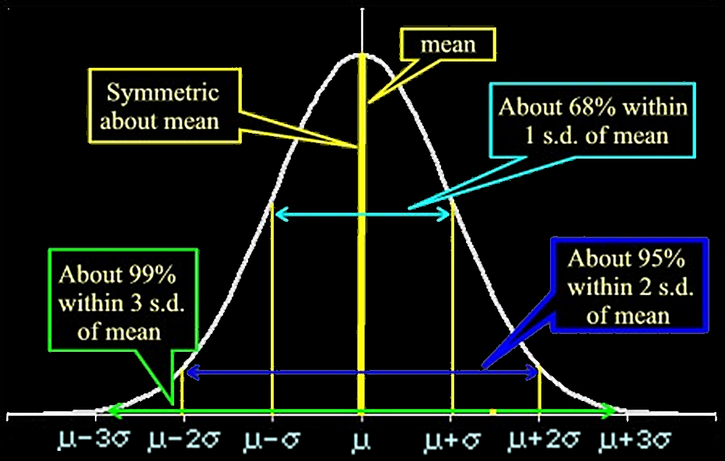

Slide 17
Normal Probability
Suppose we have a normal distribution, µ = 12 σ = 2

Slide 18
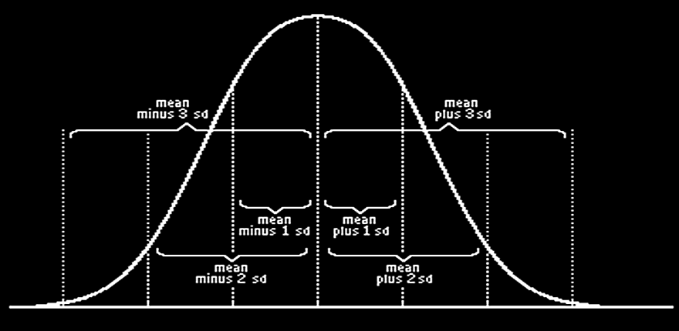
Normal Probability
If µ = 12
12

Slide 19
Normal Probability
If µ = 12 σ = 2
6 8 10 12 14 16 18

Slide 20
Normal Probability
PROJECT QUESTION
Suppose we have a normal distribution, µ = 10
?

Slide 21
Normal Probability
PROJECT QUESTION
Suppose we have a normal distribution, µ = 10 σ = 5
? ? ? ? ? ? ?

Slide 22
Normal Probability
Suppose we have a normal distribution, µ = 10 σ = 5
-5 0 5 10 15 20 25

Slide 23
Questions?

Slide 24
Normal Probability
The standard normal distribution has a mean µ = 0 and a standard deviation σ = 1

Slide 25
Normal Probability
PROJECT QUESTION
For the standard normal distribution, µ = 0 σ = 1
? ? ? ? ? ? ?

Slide 26
Normal Probability
PROJECT QUESTION
For the standard normal distribution, µ = 0 σ = 1
-3 -2 -1 0 1 2 3

Slide 27
Normal Probability
The standard normal is also called “z”

Slide 28
Normal Probability
We can change any normally-distributed variable into a
standard normal
One with:
mean = 0
standard deviation = 1

Slide 29
Normal Probability
To calculate a “z-score”:
Take your value x
Subtract the mean µ
Divide by the standard
deviation σ

Slide 30
Normal Probability
z = (x - µ)/σ

Slide 31
Normal Probability
IN-CLASS PROBLEMS
Suppose we have a normal distribution, µ = 10 σ = 2
z = (x - µ)/σ = (x-10)/2
Calculate the z values for
x = 9, 10, 15

Slide 32
Normal Probability
IN-CLASS PROBLEMS
z = (x - µ)/σ = (x-10)/2
x .
9 z = (9-10)/2 = -1/2

Slide 33
Normal Probability
IN-CLASS PROBLEMS
z = (x - µ)/σ = (x-10)/2
x .
9 z = (9-10)/2 = -1/2
10 z = (10-10)/2 = 0

Slide 34
Normal Probability
IN-CLASS PROBLEMS
z = (x - µ)/σ = (x-10)/2
x .
9 z = (9-10)/2 = -1/2
10 z = (10-10)/2 = 0
15 z = (15-10)/2 = 5/2

Slide 35
Normal Probability
-3 -2 -1 0 1 2 3
| |
-1/2 5/2

Slide 36
Normal Probability
But…
What about the probabilities??

Slide 37
Normal Probability
We use the properties of the normal distribution to calculate the probabilities

Slide 38
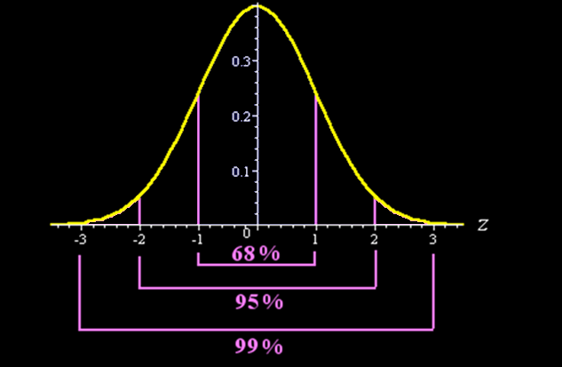
Normal Probability
IN-CLASS PROBLEMS
What is the probability of getting a z-score value between
-1 and 1
-2 and 2
-3 and 3

Slide 39
Normal Probability
You also use symmetry to calculate probabilities

Slide 40
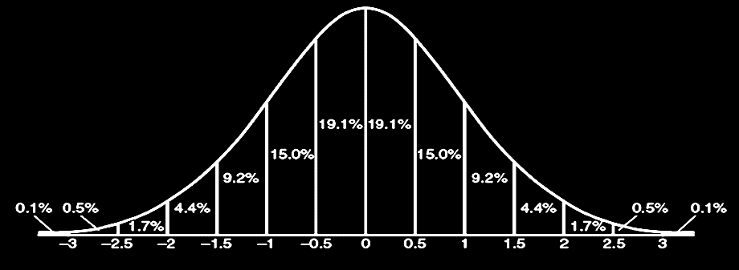
Normal Probability
IN-CLASS PROBLEMS
What is the probability of getting a z-score value between
-1 & 0 -2 & 0 -3 & 0
Percentage
of the curve
z-score

Slide 41
Normal Probability
IN-CLASS PROBLEMS
What is the probability of getting a z-score value between
-1 & 2.5 -0.5 & 3 -2.5 & -1.5
Percentage
of the curve
z-score

Slide 42
Normal Probability
Note: these are not exact – more accurate values can be found using Excel
Percentage
of the curve
z-score

Slide 43
Questions?

Slide 44
Excel Probability
Normal probability values in Excel are given as cumulative values (the probability of getting an x or z value less than or equal to the value you want)

Slide 45
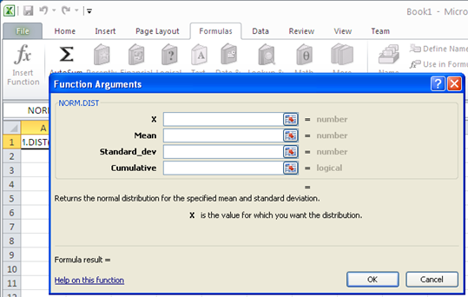
Excel Probability
Use the function: NORM.DIST

Slide 46
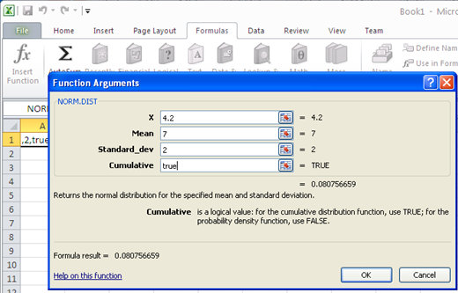
Excel Probability

Slide 47
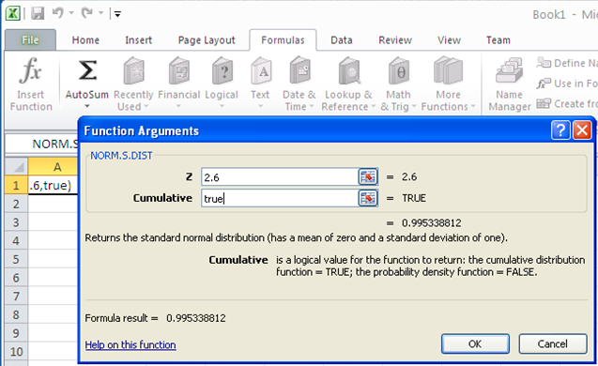
Excel Probability
For a z prob, use: NORM.S.DIST

Slide 48
Excel Probability
Excel gives you the cumulative probability – the probability of getting a value UP to your x value:
P (x ≤ your value)

Slide 49
Excel Probability
How do you calculate other probabilities using the cumulative probability Excel gives you?

Slide 50
Normal Probability
IN-CLASS PROBLEMS
If the area under the entire curve is 100%, how much of the graph lies above “x”?

Slide 51
Excel Probability
P(x ≥ b) = 1 - P(x ≤ b)
or = 100% - P(x ≤ b)
or = 100% - 90% = 10%

Slide 52
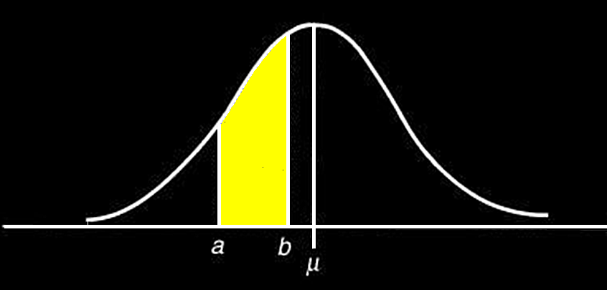
Excel Probability
What about probabilities between two “x” values?

Slide 53
Excel Probability
P(a ≤ x ≤ b)
equals
P(x ≤ b) – P(x ≤ a)
minus

Slide 54
Normal Probability
IN-CLASS PROBLEMS
Calculate the probabilities when µ = 0 σ = 1:
P(-1 ≤ x ≤ 2)
P(1 ≤ x ≤ 3)
P(-2 ≤ x ≤ 1)

Slide 55
Normal Probability
IN-CLASS PROBLEMS
P(-1 ≤ x ≤ 2) = 34%+34%+13.5%
= 81.5%

Slide 56
Normal Probability
IN-CLASS PROBLEMS
P(-1 ≤ x ≤ 2) = 81.5%
P(1 ≤ x ≤ 3) = 13.5%+2%
= 15.5%

Slide 57
Normal Probability
IN-CLASS PROBLEMS
P(-1 ≤ x ≤ 2) = 81.5%
P(1 ≤ x ≤ 3) = 15.5%
P(-3 ≤ x ≤ 1) =
= 2%+13.5%+34%+34%
= 83.5%

Slide 58
Questions?

Slide 59
Non-normal Distributions
Some distributions are not normal …

Slide 60
Non-normal Distributions
Kurtosis - how tall or flat your curve is compared to a normal curve

Slide 61
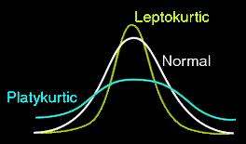
Non-normal Distributions
Curves taller than a normal curve are called “Leptokurtic”
Curves that are flatter than a normal curve are
called
”Platykurtic”

Slide 62
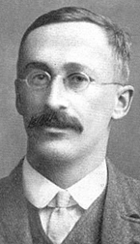
Non-normal Distributions
Platykurtic Leptokurtic
W.S. Gosset 1908

Slide 63
Sampling Distributions
PROJECT QUESTION
Which is platykurtic?
Which is leptokurtic?

Slide 64
Non-normal Distributions
Skewness – the data are “bunched” to one side vs a normal curve

Slide 65
Non-normal Distributions
Scores that are "bunched" at the right or high end of the scale are said to have a “negative skew”

Slide 66
Non-normal Distributions
In a “positive skew”, scores are bunched near the left or low end of a scale

Slide 67
Non-normal Distributions
Note: this is exactly the opposite of how most people use the terms!

Slide 68
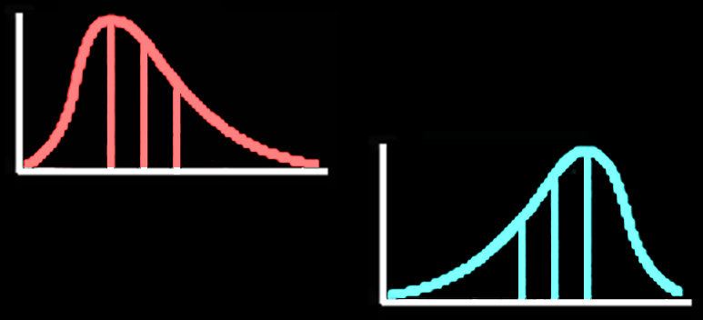
Sampling Distributions
PROJECT QUESTION
Which is positively skewed?
Which is negatively skewed?

Slide 69
Normal Distributions
We use normal distributions a lot in statistics because lots of things have graphs this shape!
heights
weights
IQ test scores
bull’s eyes

Slide 70
Normal Distributions
Also, even data which are not normally distributed
have averages which DO have normal distributions

Slide 71
Normal Distributions
If you take a gazillion samples and find the means for each of the gazillion samples
You would have a new population:
the gazillion means

Slide 72
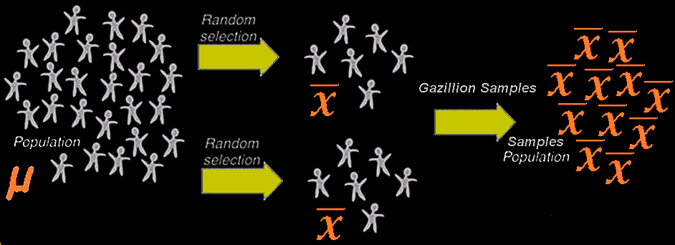
Normal Distributions

Slide 73
Normal Distributions
If you plotted the frequency of the gazillion mean values, it is called a
SAMPLING DISTRIBUTION

Slide 74
Sampling Distributions
The shape of the plot of the gazillion sample means would have a normal-ish distribution
NO MATTER WHAT THE ORIGINAL DATA LOOKED LIKE

Slide 75
Sampling Distributions
But … the shape of the distribution of your gazillion means changes with the size “n” of the samples you took

Slide 76
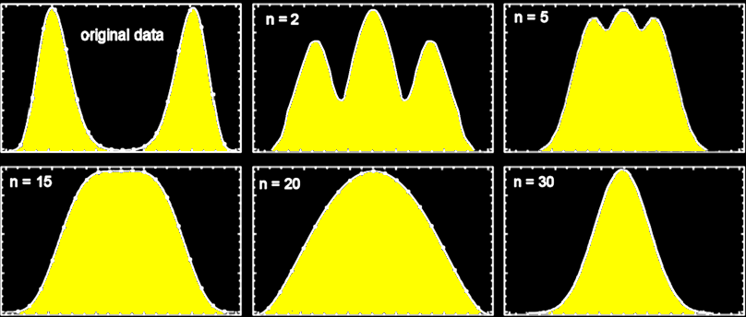
Sampling Distributions
Graphs of a gazillion means for
different n values

Slide 77
Sampling Distributions
As “n” increases, the distributions of the means become closer and closer
to normal

Slide 78
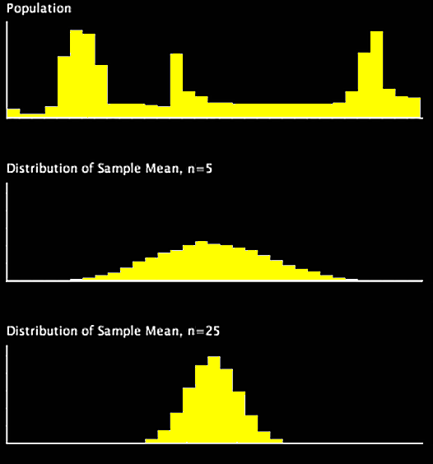
Sampling Distributions
This also
works for
discrete data

Slide 79
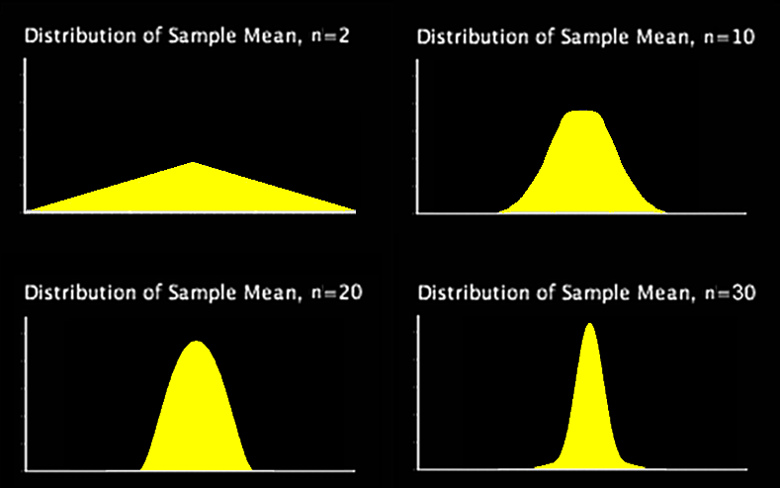
Sampling Distributions
as “n” increases,
variability (spread) also decreases

Slide 80
Sampling Distributions
We usually say the sample mean will be normally distributed if n is ≥ 20or30
(the “good-enuff” value)

Slide 81
Sampling Distributions
The statistical principle that allows us to conclude that sample means have a normal distribution if the sample size is 20 or more is called the
Central Limit Theorem

Slide 82
Sampling Distributions
If you can assume the distribution of the sample means is normal, you can use the normal distribution probabilities for making probability statements about µ

Slide 83
Sampling Distributions
Sample means from platykurtic, leptokurtic, and bimodal distributions become “normal enough” when your sample size n is 20 or more

Slide 84
Sampling Distributions
Means from samples of skewed populations do not become “normal enough” very easily
You sometimes need a
mega-huge
sample size to “normalize” a badly skewed distribution

Slide 85
Sampling Distributions
A wild outlier might indicate a badly skewed distribution

Slide 86
Sampling Distributions
PROJECT QUESTION
From which of these would you expect the distribution of the sample means to be normal?
Original population normal
Samples taken of size 10
Sample taken of size 50
Highly skewed population

Slide 87
Questions?

Slide 88
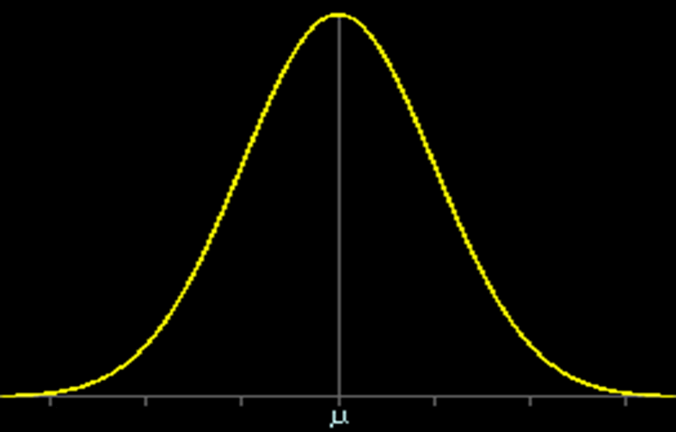
Graphs of $\overline{x}$
Graph of $\overline{x}$ values

Slide 89
Graphs of $\overline{x}$
Averages (measures of central tendency) show where the data tend to pile up
Graph of $\overline{x}$ values

Slide 90
Graphs of $\overline{x}$
The place where $\overline{x}$ tends to pile up is at μ
Graph of $\overline{x}$ values

Slide 91
Graphs of $\overline{x}$
So, the most likely value for $\overline{x}$ is μ
Graph of $\overline{x}$ values

Slide 92
Graphs of $\overline{x}$
As you move away from μ on the graph, $\overline{x}$ is less likely to have these values
Graph of $\overline{x}$ values

Slide 93
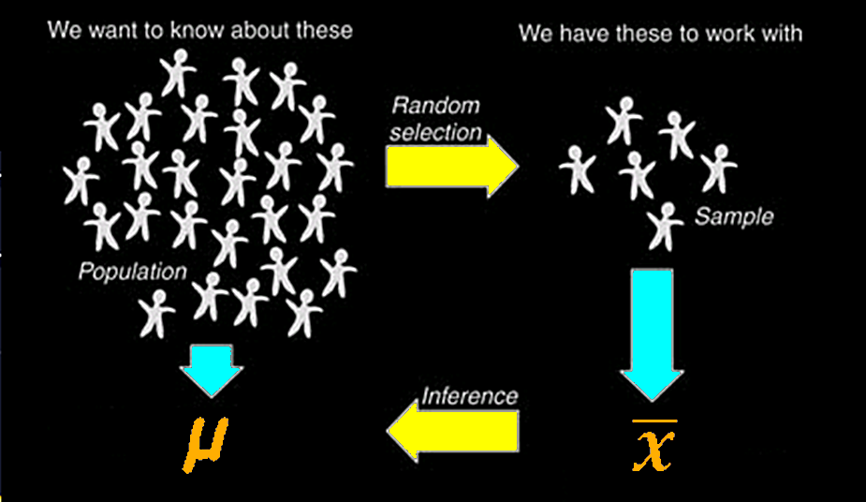
Estimation

Slide 94
Estimation
PROJECT QUESTION
Population Sample
mean mean
μ $\overline{x}$
What is the best estimate
we have for the unknown
population mean µ ?

Slide 95
Estimation
PROJECT QUESTION
$\overline{x}$
is the best estimate
we have for the unknown
population mean µ

Slide 96
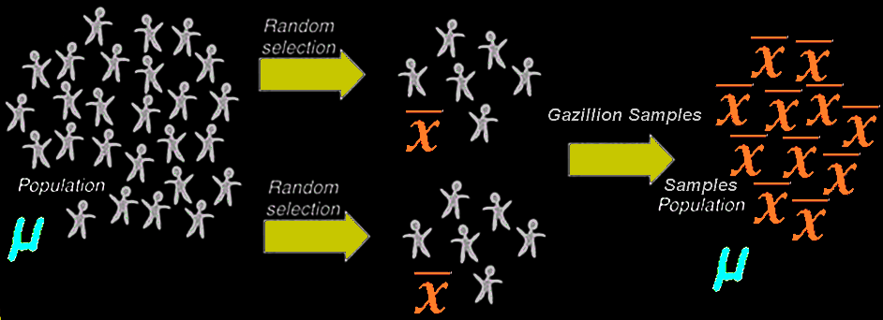
Estimation
The mean of all of the
gazillion $\overline{x}$ values
will be µ

Slide 97
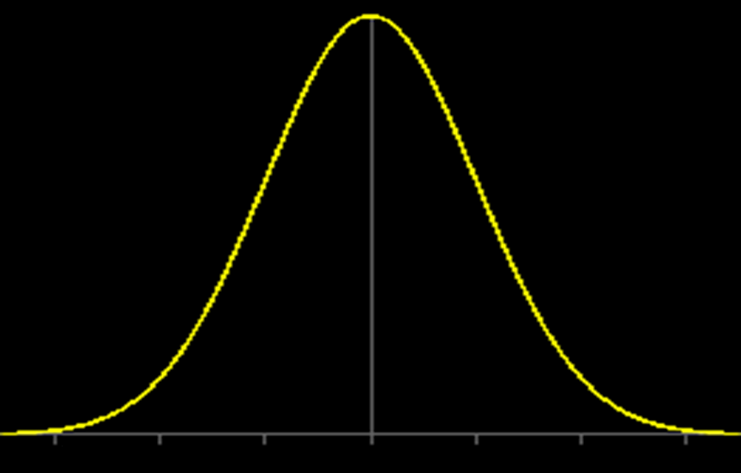
Estimation
PROJECT QUESTION
Graph of likely values for µ:
?

Slide 98
Estimation
PROJECT QUESTION
Graph of likely values for µ:
$\overline{x}$

Slide 99
Estimation
We will use the sample mean $\overline{x}$ to estimate the unknown population mean µ

Slide 100
Estimation
Using the sample mean $\overline{x}$ to estimate the unknown population mean µ is called “making inferences”

Slide 101
Estimation
The sample standard deviation “s” is the best estimate we have for the unknown population standard deviation “σ”

Slide 102
Estimation
Using s to estimate σ
is also
an inference

Slide 103
Estimation
You would think, since we use $\overline{x}$ to estimate µ and s to estimate σ that the graph of $\overline{x}$ would be:
$\overline{x}$-3s $\overline{x}$-2s $\overline{x}$-s $\overline{x}$ $\overline{x}$+s $\overline{x}$+2s $\overline{x}$+3s

Slide 104
Estimation
It’s not…

Slide 105
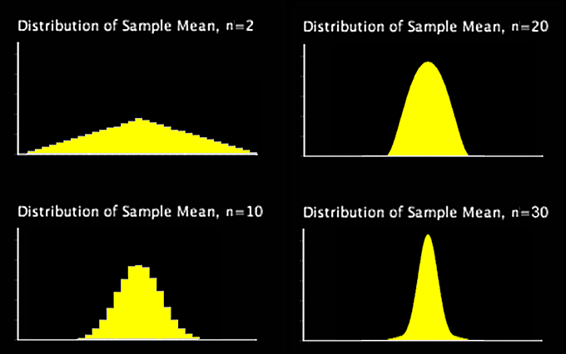
Estimation
Remember, as “n” increases,
the variability decreases:

Slide 106
Estimation
While s is a good estimate for the original population standard deviation σ, s IS NOT the measure of variability in the new population of $\overline{x}$s

Slide 107
Estimation
It needs to be decreased to take sample size into account!

Slide 108
Estimation
We use:
s/$\sqrt{\text{n}}$
for the measure of variability in the new population of $\overline{x}$s

Slide 109
Estimation
The standard deviation
of the $\overline{x}$s: s/$\sqrt{\text{n}}$
is called the “standard error”
abbreviated “se”

Slide 110
Estimation
BTW: you now know ALL of the items on the Descriptive Statistics list in Excel

Slide 111
Estimation
So our curve is:
$\overline{x}$-3se $\overline{x}$-2se $\overline{x}$-se $\overline{x}$ $\overline{x}$+se $\overline{x}$+2se $\overline{x}$+3se

Slide 112
Estimation
PROJECT QUESTION
Suppose we have a population of $\overline{x}$s from samples of size 49
The mean of the $\overline{x}$s is 150
The standard deviation is 56
Can we assume the population of $\overline{x}$s forms a normal distribution?

Slide 113
Estimation
PROJECT QUESTION
Suppose we have a population of $\overline{x}$s from samples of size 49
The mean of the $\overline{x}$s is 150
The standard deviation is 56
Because the sample size 49 is above the usual “good-enuff” value of 20or30, unless the original distribution is very skewed, it will be normal

Slide 114
Estimation
PROJECT QUESTION
Suppose we have a population of $\overline{x}$s from samples of size 49
The mean of the $\overline{x}$s is 150
The standard deviation is 56
What is our best estimate of the original population mean?

Slide 115
Estimation
PROJECT QUESTION
Suppose we have a population of $\overline{x}$s from samples of size 49
The mean of the $\overline{x}$s is 150
The standard deviation is 56
What is our best estimate of the original population mean?
150

Slide 116
Estimation
PROJECT QUESTION
Suppose we have a population of $\overline{x}$s from samples of size 49
The mean of the $\overline{x}$s is 150
The standard deviation is 56
What is our best estimate of the original population standard deviation?

Slide 117
Estimation
PROJECT QUESTION
Suppose we have a population of $\overline{x}$s from samples of size 49
The mean of the $\overline{x}$s is 150
The standard deviation is 56
What is our best estimate of the original population standard deviation?
56

Slide 118
Estimation
PROJECT QUESTION
Suppose we have a population of $\overline{x}$s from samples of size 49
The mean of the $\overline{x}$s is 150
The standard deviation is 56
What is our estimate of the standard error?

Slide 119
Estimation
PROJECT QUESTION
Suppose we have a population of $\overline{x}$s from samples of size 49
The mean of the $\overline{x}$s is 150
The standard deviation is 56
What is our estimate of the standard error?
56/$\sqrt{\text{49}}$ = 56/7 = 8

Slide 120
Estimation
PROJECT QUESTION
Suppose we have a population of $\overline{x}$s from samples of size 49
The mean of the $\overline{x}$s is 150
The standard deviation is 56
What will be the normal curve for the $\overline{x}$s

Slide 121
Estimation
PROJECT QUESTION
Our curve is:
126 134 142 150 158 166 174

Slide 122
Questions?

Slide 123
Inferences About μ
Although our normal curve graphs the $\overline{x}$s, we will use it to make inferences about what value μ actually has

Slide 124
Inferences About μ
About 95% of the possible values for μ will be within 2 SE of $\overline{x}$

Slide 125
Confidence Intervals
This allows us to create a “confidence interval” for values of μ

Slide 126
Confidence Intervals
Confidence interval formula:
$\overline{x}$ - 2s/$\sqrt{\text{n}}$ ≤ μ ≤ $\overline{x}$ + 2s/$\sqrt{\text{n}}$
or
$\overline{x}$ - 2se ≤ μ ≤ $\overline{x}$ + 2se
With a confidence level of 95%

Slide 127
Confidence Intervals
The “2” in the equations is called the “critical value”

Slide 128
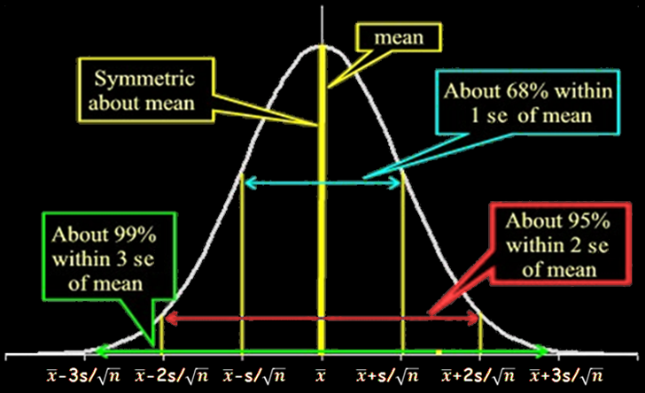
Confidence Intervals
It comes from the normal curve, which gives us the 95%

Slide 129
Confidence Intervals
2s/$\sqrt{\text{n}}$ or 2se is called the
“margin of error”

Slide 130
Confidence Intervals
PROJECT QUESTION
What if we wanted a confidence level of 99%

Slide 131
Confidence Intervals
PROJECT QUESTION
What if we wanted a confidence level of 99%
We’d use a value
of “3”
rather
than 2

Slide 132
Confidence Intervals
For most scientific purposes, 95% is “good-enuff”
In the law, 98% is required for a criminal case
In medicine, 99% is required

Slide 133
Confidence Intervals
For a 95% confidence interval, 95% of the values of μ will be within 2se of $\overline{x}$

Slide 134
Confidence Intervals
If we use the confidence interval to estimate a likely range for true values of μ, we will be right 95% of the time

Slide 135
Confidence Intervals
For a 95% confidence interval, we will be
WRONG
5% of the time

Slide 136
Confidence Intervals
PROJECT QUESTION
For a 99% confidence interval, how much of the time will we be wrong?

Slide 137
Confidence Intervals
PROJECT QUESTION
For a 99% confidence interval, how much of the time will we be wrong?
we will be wrong 1% of the time

Slide 138
Confidence Intervals
The percent of time we are willing to be wrong is called
“α”
(“alpha”)
or “the α-level”

Slide 139
Confidence Intervals
Everyday use of confidence intervals:
You will frequently hear that a poll has a candidate ahead by 10 points with a margin of error of 3 points

Slide 140
Confidence Intervals
This means:
10-3 ≤ true difference ≤ 10+3
Or, the true difference is
between 7 and 13 points
(with 95% likelihood)

Slide 141
Confidence Intervals
PROJECT QUESTION
Find a 95% confidence interval for μ given: $\overline{x}$ = 7
s = 5
n = 25
Can we assume normality?

Slide 142
Confidence Intervals
PROJECT QUESTION
Find a 95% confidence interval for μ given: $\overline{x}$ = 7
s = 5
n = 25
Can we assume normality?
yes, because n>20

Slide 143
Confidence Intervals
PROJECT QUESTION
Find a 95% confidence interval for μ given: $\overline{x}$ = 7
s = 5
n = 25
What is the α-level?

Slide 144
Confidence Intervals
PROJECT QUESTION
Find a 95% confidence interval for μ given: $\overline{x}$ = 7
s = 5
n = 25
What is the α-level?
5%

Slide 145
Confidence Intervals
PROJECT QUESTION
Find a 95% confidence interval for μ given: $\overline{x}$ = 7
s = 5
n = 25
What is the critical value?

Slide 146
Confidence Intervals
PROJECT QUESTION
Find a 95% confidence interval for μ given: $\overline{x}$ = 7
s = 5
n = 25
What is the critical value?
2, because we want a 95%
confidence interval

Slide 147
Confidence Intervals
PROJECT QUESTION
Find a 95% confidence interval for μ given: $\overline{x}$ = 7
s = 5
n = 25
What is the standard error?

Slide 148
Confidence Intervals
PROJECT QUESTION
Find a 95% confidence interval for μ given: $\overline{x}$ = 7
s = 5
n = 25
What is the standard error?
s/$\sqrt{\text{n}}$ = 5/$\sqrt{\text{25}}$ = 5/5 = 1

Slide 149
Confidence Intervals
PROJECT QUESTION
Find a 95% confidence interval for μ given: $\overline{x}$ = 7
s = 5
n = 25
What is the margin of error?

Slide 150
Confidence Intervals
PROJECT QUESTION
Find a 95% confidence interval for μ given: $\overline{x}$ = 7
s = 5
n = 25
What is the margin of error? 2se = 2(1) = 2

Slide 151
Confidence Intervals
PROJECT QUESTION
Find a 95% confidence interval for μ given: $\overline{x}$ = 7
s = 5
n = 25
What is the confidence interval?

Slide 152
Confidence Intervals
PROJECT QUESTION
Find a 95% confidence interval for μ given: $\overline{x}$ = 7
s = 5
n = 25
What is the confidence interval?
$\overline{x}$ - 2s/$\sqrt{\text{n}}$ ≤ μ ≤ $\overline{x}$ + 2s/$\sqrt{\text{n}}$
7 – 2 ≤ μ ≤ 7 + 2
5 ≤ μ ≤ 9 with 95% confidence

Slide 153
Confidence Intervals
PROJECT QUESTION
Interpreting confidence intervals:
If the 95% confidence interval is:
5 ≤ µ ≤ 9
Is it likely that µ = 10?

Slide 154
Confidence Intervals
PROJECT QUESTION
No, because it’s outside of the interval
That would only happen 5% of the time

Slide 155
Confidence Intervals
PROJECT QUESTION
Find the 95% confidence interval for μ given: $\overline{x}$ = 53
s = 14
n = 49

Slide 156
Confidence Intervals
PROJECT QUESTION
Find the 95% confidence interval for μ given: $\overline{x}$ = 53
s = 14
n = 49
49 ≤ µ ≤ 57

Slide 157
Confidence Intervals
PROJECT QUESTION
Can you say with 95% confidence that µ ≠ 55?

Slide 158
Confidence Intervals
PROJECT QUESTION
Can you say with 95% confidence that µ ≠ 55?
Nope… it’s in the interval
It IS a likely value for µ

Slide 159
Confidence Intervals
PROJECT QUESTION
Find the 95% confidence interval for μ given: $\overline{x}$ = 481
s = 154
n = 121

Slide 160
Confidence Intervals
PROJECT QUESTION
Find the 95% confidence interval for μ given: $\overline{x}$ = 481
s = 154
n = 121
453 ≤ µ ≤ 509

Slide 161
Confidence Intervals
PROJECT QUESTION
Can you say with 95% confidence that µ might be 450?

Slide 162
Confidence Intervals
PROJECT QUESTION
Can you say with 95% confidence that µ might be 450?
µ is unlikely to be 450 – that value is outside of the confidence interval and would only happen 5% of the time

Slide 163
Confidence Intervals
What if you have a sample size smaller than 20???

Slide 164
Confidence Intervals
What if you have a sample size smaller than 20???
You must use a different (bigger) critical value
W.S. Gosset 1908

Slide 165
Confidence Intervals
You will have a smaller interval
if you have a larger value
for n

Slide 166
Confidence Intervals
So you want to take the LARGEST sample you can

Slide 167
Confidence Intervals
This is called the
“LAW OF LARGE NUMBERS”

Slide 168
Confidence Intervals
LAW OF LARGE NUMBERS
The larger your sample size, the better your estimate

Slide 169
Questions?

Slide 170
Two Variables
So far we have used only one variable measured on each of our sample subjects
What if we had more than one?

Slide 171
Two Variables
Subject | Height | Weight
1 5’8’’ 170
2 5’3’’ 120
3 6’ 200
4 5’7’’ 250
5 6’2’’ 195

Slide 172
Two Variables
With two variables measured on each subject, the measurements are “paired” – linked to each other

Slide 173
Two Variables
If you calculate means or standard deviations for one variable then the other, the pairing is lost, and you
lose information
(a bad thing…)

Slide 174
Relationships
Using the pairing, you can determine if there is a
relationship
between the two variables

Slide 176
Relationships
The relationship can be seen by graphing the variables in a scatter graph
Our brains are programmed to see visual relationships

Slide 177
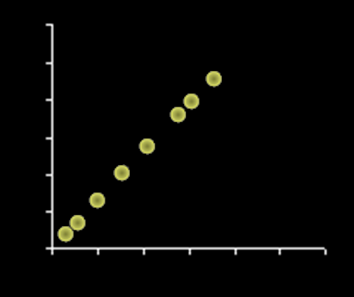
Correlation
There are all sorts of relationships, but we define a “correlation” to be a linear relationship

Slide 178
Correlation
a linear relationship between two variables (x,y)

Slide 179
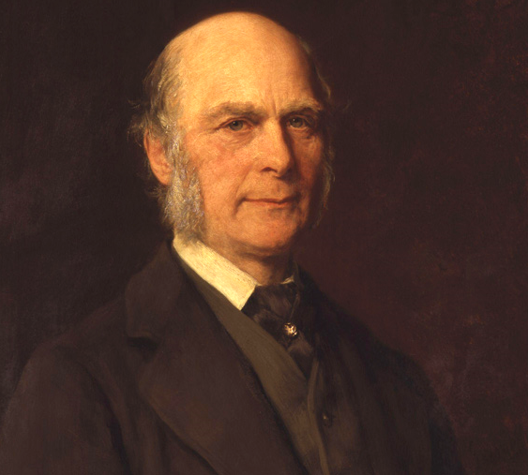
Correlation
Francis Galton

Slide 180
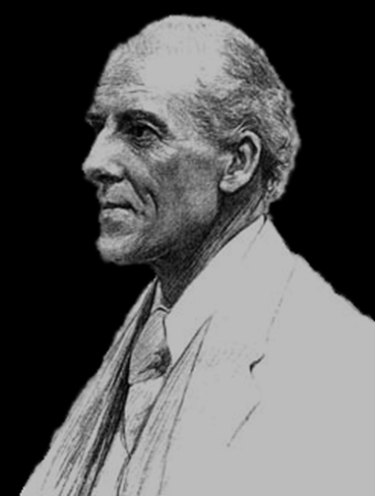
Correlation
Karl Pearson’s
Correlation
Coefficient:
r

Slide 181
Correlation
Correlation coefficient “r”:
Measures the strength of the linear relationship between two variables (x,y)

Slide 182
Correlation
Correlation coefficient “r”:
Measured by the closeness of the data to a straight line of “best fit”

Slide 183
Correlation
In real life, you practically never get all of your data points on the line of best fit
How close is close enough?

Slide 184
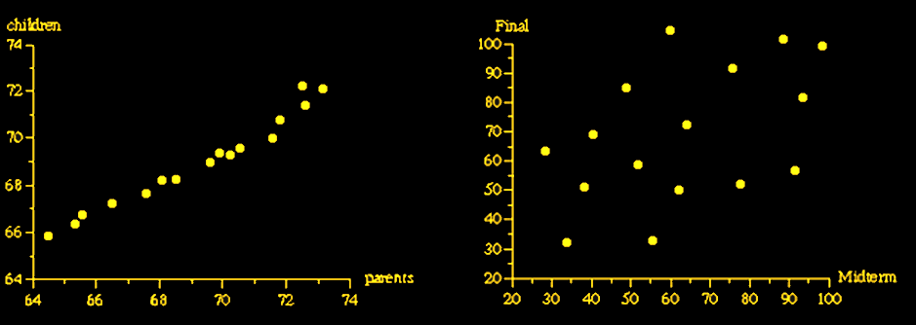
Correlation
Strong Weak
relationship relationship

Slide 185
Correlation
So… a correlation is actually a measure of

Slide 186
Correlation
So… a correlation is actually a measure of VARIABILITY!

Slide 187
Correlation
PROJECT QUESTION
Which has the strongest linear relationship?

Slide 188
Relationships
Can be positive…
https://images.sciencedaily.com/2015/05/150513135011_1_900x600.jpg

Slide 189
Relationships
http://cdn2.momjunction.com/wp-content/uploads/2016/01/Relationship-With-Kids-After-Divorce.jpg

Slide 190
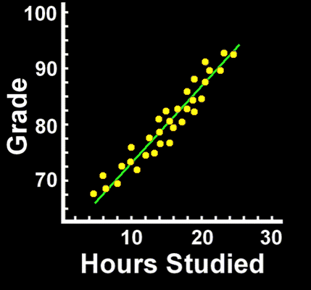
Correlation
Positive Correlation:
as one variable increases, the other also increases

Slide 191
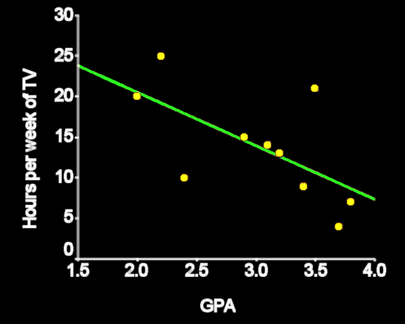
Correlation
Negative correlation:
as one variable increases, the other decreases

Slide 192
Correlation
Zero correlation:
no LINEAR relationship

Slide 193
Correlation
Zero correlation:
there may be a strong nonlinear relationship

Slide 194
Correlation
Zero correlation:
If it is a horizontal line

Slide 195
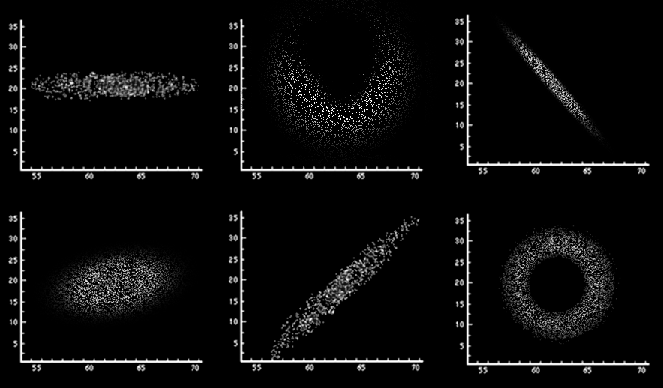
Correlation
PROJECT QUESTION
Positive, negative, or zero?

Slide 196
Correlation
Correlation coefficients range from -1.0 to +1.0
r=-1.0 r=-0.9 r=-0.5 r=0.0 r=0.5 r=0.9 r=1.0

Slide 197
Correlation
Correlation coefficients can’t be bigger than 1 or less than -1
-1 ≤ corr ≤ 1

Slide 198
Greeky Stuff
The sample correlation coefficient is called “r”
The population coefficient is called “ρ ”
Pronounced “rho”

Slide 199
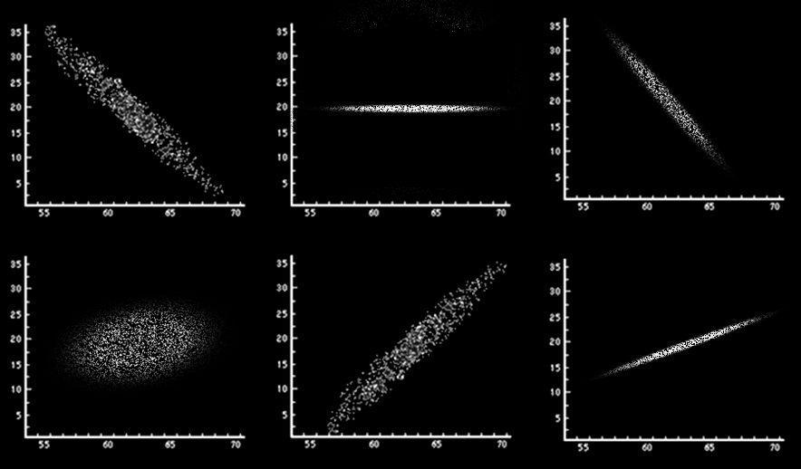
Correlation
PROJECT QUESTION
Which has the highest positive correlation? The highest negative correlation?

Slide 200
Correlation
If you square the correlation coefficient (R² or RSQ)
the coefficient tells how well the (x,y) values are “fitted” by the line of best fit

Slide 201
Correlation
R² tells you
in %
how well the trend line fits the data

Slide 202
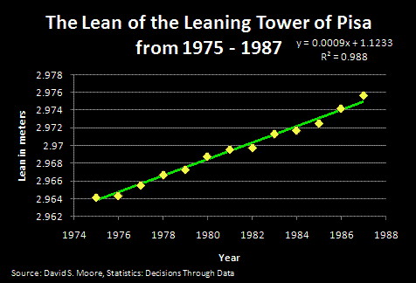
Correlation
PROJECT QUESTION
Is it a good fit?

Slide 203
Correlation
R² = 0.988 means 98.8% of the variability in the data is “explained” by the fit line

Slide 204
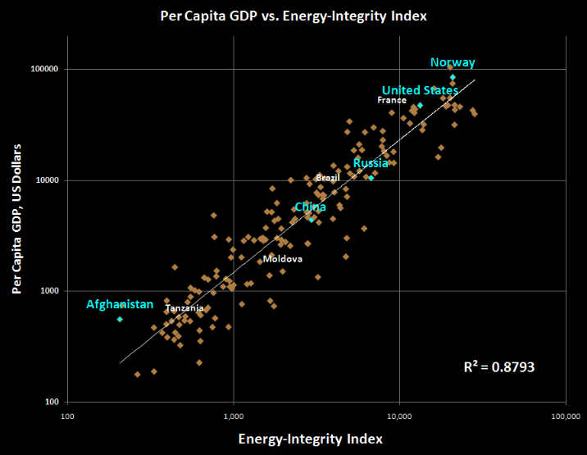
Correlation
PROJECT QUESTION
Is it a good fit?

Slide 205
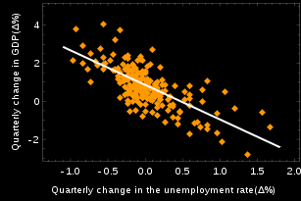
Correlation
PROJECT QUESTION
Is it a good fit?

Slide 206
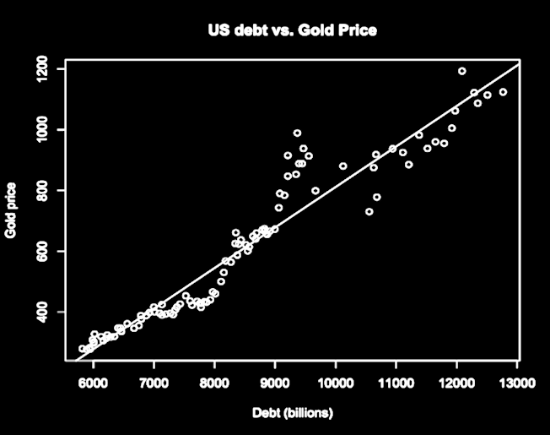
Correlation
PROJECT QUESTION
Is it a good fit?

Slide 207
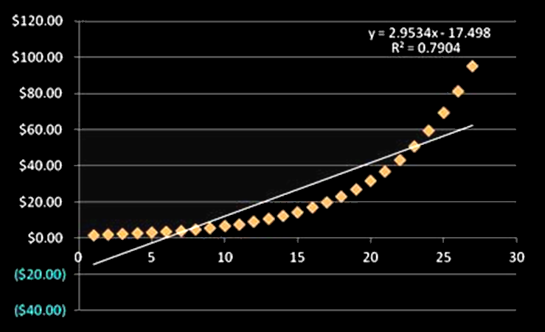
Correlation
PROJECT QUESTION
Is it a good fit?

Slide 208
Questions?

Slide 209
How to Lie with Statistics #5
Just because two variables have a high correlation coefficient doesn’t mean one causes the other

Slide 210
How to Lie with Statistics #5
They could both be caused by a third variable
Or… it could just be a coincidence

Slide 212
How to Lie with Statistics
Sleep studies

Slide 213
How to Lie with Statistics
How would you “prove” that getting a certain amount of sleep causes you to live longer?

Slide 214
Correlation vs Causation
Causation is hard to prove
In research, causation can only be shown by a carefully controlled experiment

Slide 215
Correlation vs Causation
So you can’t show causation by observation or by using a survey

Slide 216
Correlation vs Causation
The research must be carefully designed so that the suspected cause can be the only cause of the result

Slide 217
Correlation vs Causation
Just because a scientist speaks very persuasively about the results of their experiment does not mean he/she has proven causation

Slide 218
Correlation vs Causation
You have to be skeptical!

Slide 219
Correlation vs Causation
Spanish influenza video

Slide 220
CAUSATION
IN-CLASS PROBLEMS
Who “proved” causation?

Slide 221
Questions?

Slide 222
Causation
If you know that one variable DOES cause the other, put the variable that is the “causal” or “explanatory” variable on the horizontal “x” axis

Slide 223
Causation
The causal or explanatory or predictor variable is called the “independent” variable
Changing its value changes the value of the y variable

Slide 224
Causation
The variable affected by the causal variable (the response variable) is called the “dependent” variable
Its value depends on the value of x

Slide 225
CAUSATION
IN-CLASS PROBLEMS
Which graph has the correct placement for the causative variable?

Slide 226
Questions?

Slide 227
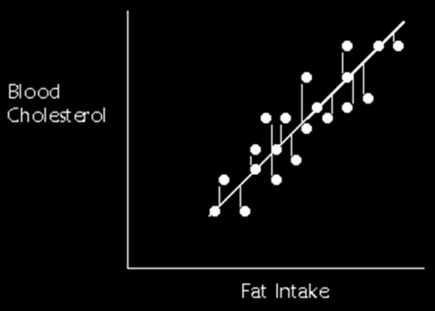
Line of Best Fit
The “line of best fit” is created by minimizing the total
distance of
all the
points to
the line
(deviations)

Slide 228
Regression
The line of best fit is called the “regression” line

Slide 229
Regression
Because it is a line, it has an equation:
y = b + mx
m = slope
b = y-intercept

Slide 230
Regression
The slope “m” and the correlation coefficient “r” will both have the same sign

Slide 231
Regression
R² tells how closely the regression line “fits” the data –
“goodness of fit”

Slide 232
Regression
As you can imagine, the calculations for correlation and
the regression
line are scary

Slide 233
Regression
Hooray for Excel!

Slide 234
Regression
Francis Galton

Slide 235
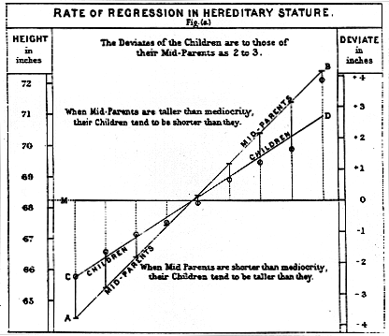

Slide 236
Questions?

Slide 237
Regression in Excel
Data/Data Analysis/Regression
Enter “y” first
Copy the first two coefficients
in the bottom table
Trend line is:
=Coeff*Data+Intercept
Make a graph
Change the trend dots into a line

Slide 238
Forecasting
On the Forecasting tab of the spreadsheet is data for the Olympic men’s high jump
What if we want to forecast the 2020 value?

Slide 239
Forecasting
Highlight all of the data including labels from “Year” to “Forecast” and down through 2020 (where your forecast will be…)

Slide 240
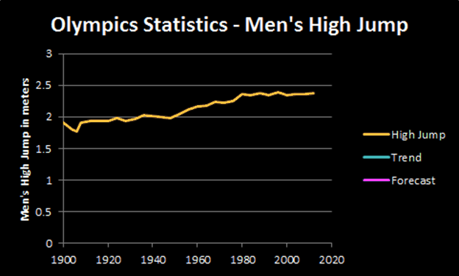
Forecasting
Graph using the Scatter Chart “Scatter with Straight Lines”

Slide 241
Forecasting
We want to make a forecast, so we need a formula!
It kinda looks like a line, so let’s try Regression!

Slide 242
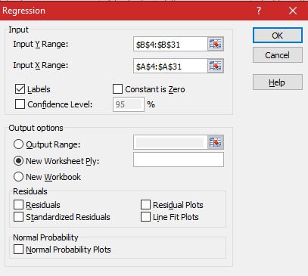
Forecasting
Our independent variable “x” is
“Year”
Enter this
with label
BUT ONLY
DOWN
TO 2016

Slide 243
Forecasting
Our dependent
variable “y” is
“High Jump”

Slide 244
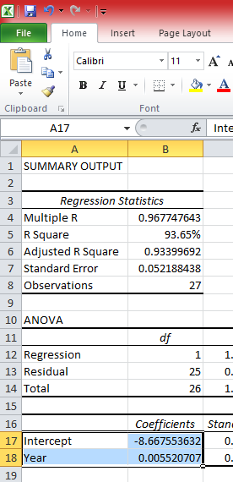
Forecasting
Regression outputs:

Slide 245
Forecasting
Create the “trend” line in the data table

Slide 246
Forecasting
Drag the last value
(2020) over to the
forecast column

Slide 247
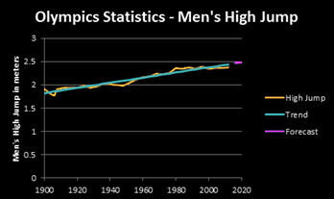
Forecasting

Slide 248
Questions?

