Slide 1
Annual US Death Forecast
By: Chad Clyburn
Math301 - Data driven statistics
Dr. Vikki French

Slide 2
What is the question?
What are the forecasted annual US deaths for 1999 - 2009?
Why I chose this topic
Population growth
Advances in medicine
Data
CDC
https://www.cdc.gov/nchs/data/dvs/lead1900_98.pdf

Slide 3
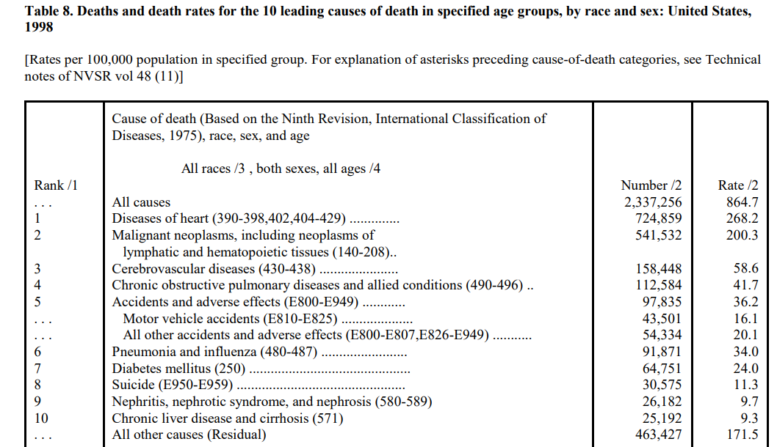
Original Data
(National Vital Statistics System, 2015)

Slide 4
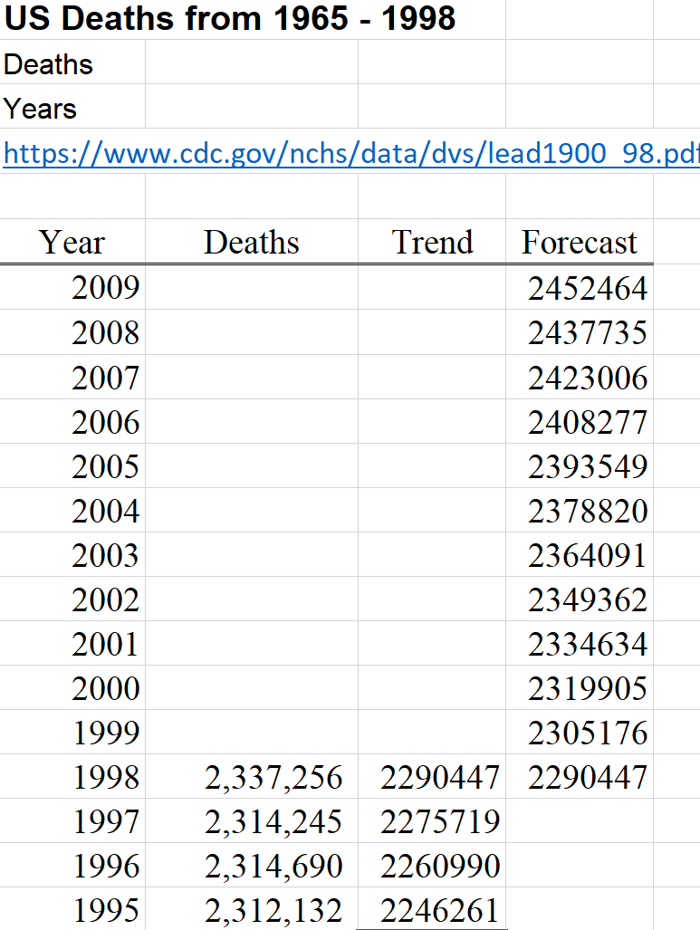
My Data
(Pixabay, 2019)
(Clyburn, 2019)

Slide 5
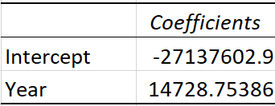
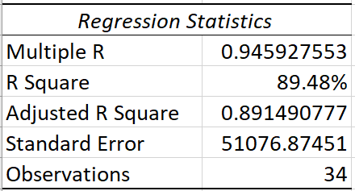
Analysis
(Clyburn, 2019)
Time series analysis
Regression
y = b + mx
Coefficients
(Clyburn, 2019)

Slide 6
WHY forecasting?
Forecasting
Projection based off historical data
Provides and an accurate forecast for the years in question
It is a great tool to have
(Tenzo, 2017)

Slide 7
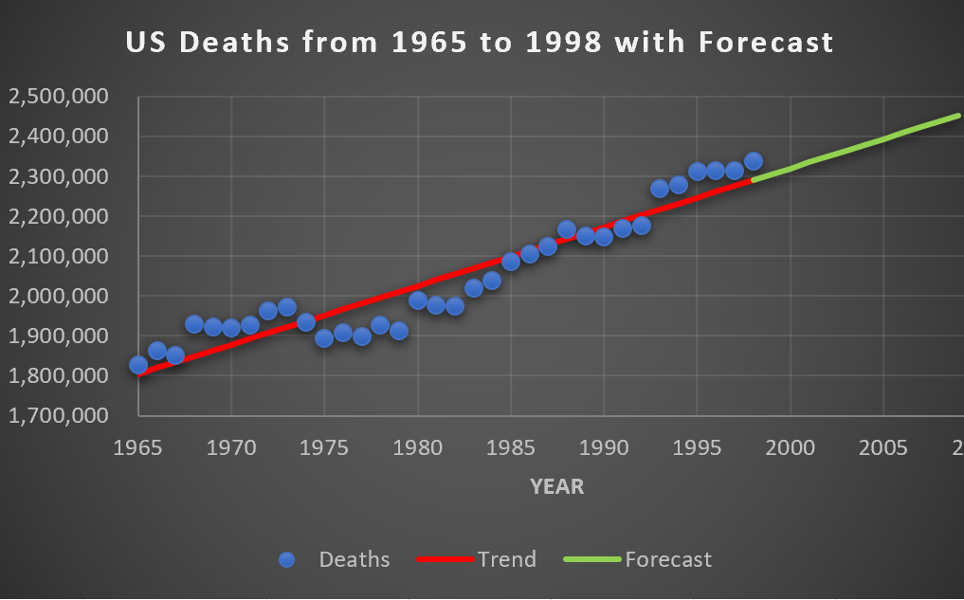
Results
(Clyburn, 2019)

Slide 8
Conclusion
Summary
The annual death rates in the US will continue to rise
Rate of increase as in line with historical data
Why?
The forecast slope is in line with the data
The forecast begins in the same area as the data
(ProEssayWriter, n.d.)

Slide 9
References
French, V. (2019). MATH301 class lecture on Time Series Forecasting. Personal Collection of V. French, Colorado Technical University, Aurora CO.
National Vital Statistics System. (November 6, 2015). Historical Data, 1900- 1998. Center for Disease Control and Prevention. Retrieved from: https://www.cdc.gov/nchs/data/dvs/lead1900_98.pdf
National Vital Statistics System. (November 6, 2015). Historical Data, Population. Center for Disease Control and Prevention. Retrieved from: https://www.cdc.gov/nchs/nvss/mortality/historical_population.htm
Pixabay. (2019). Statistics. Pixabay.com. Retrieved from: https://pixabay.com/illustrations/website-statistics-business-3483020/
ProEssayWriter. (n.d.) How to write a strong conclusion based on the outstanding essay conclusion examples. Retrieved from: https://pro-essay- writer.com/blog/essay-conclusion-examples
Tenzo. (October 9, 2017). Forecasting methodology and process for restaurants.
Medium.com. Retrieved from: https://medium.com/@tenzoinc/forecasting-methodology-and-process- for-restaurants-66dc7325744f

